Slide 1
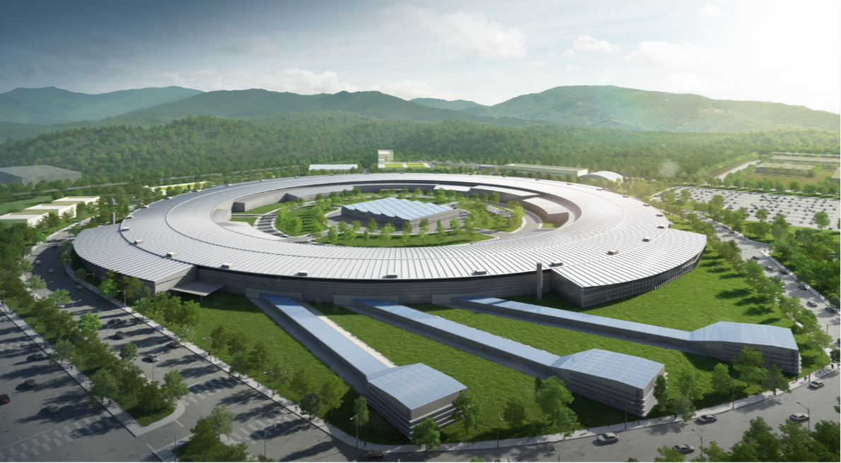

20250310 Group Meeting
20250310 Group Meeting
Minseo Jeong
10, Mar 2025

Slide 2
20250310 Group Meeting
Outline
Experimental Progress
Source Code for Optimization of UED Machine Parameters
- Multi-objective Bayesian Optimization
2

Slide 3
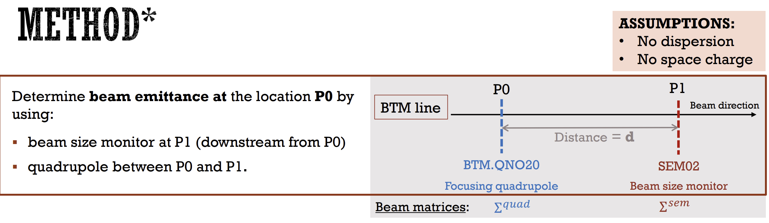
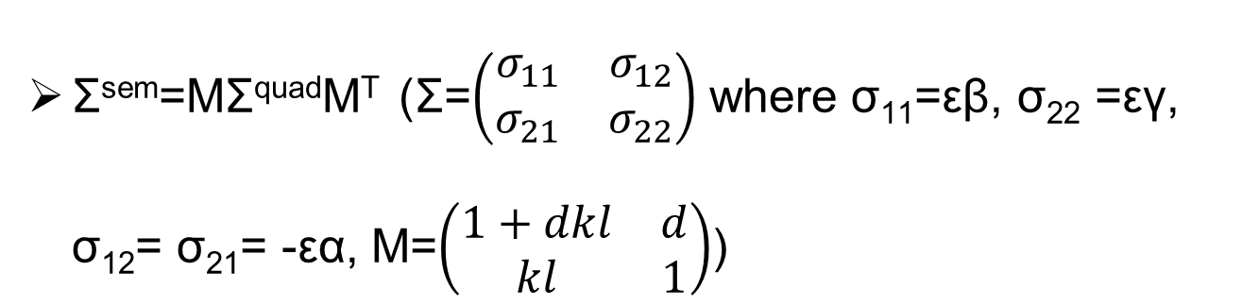
20250310 Group Meeting
Experiment Progress
Measurement of emittance by CCD camera(C9100-13) and quadrupole
Σ^{sem}=MΣ^{quad}M^{T} (Σ=$\left(\begin{matrix}σ_{11} & σ_{12} \\ σ_{21} & σ_{22}\end{matrix}\right)$ where σ₁₁=εβ, σ₂₂ =εγ, σ₁₂= σ₂₁= -εα, M=$\left(\begin{matrix}1+dkl & d \\ kl & 1\end{matrix}\right)$)
Parameter | Value
Quadrupole length | 0.090m
Drift | 2.325m
3

Slide 4
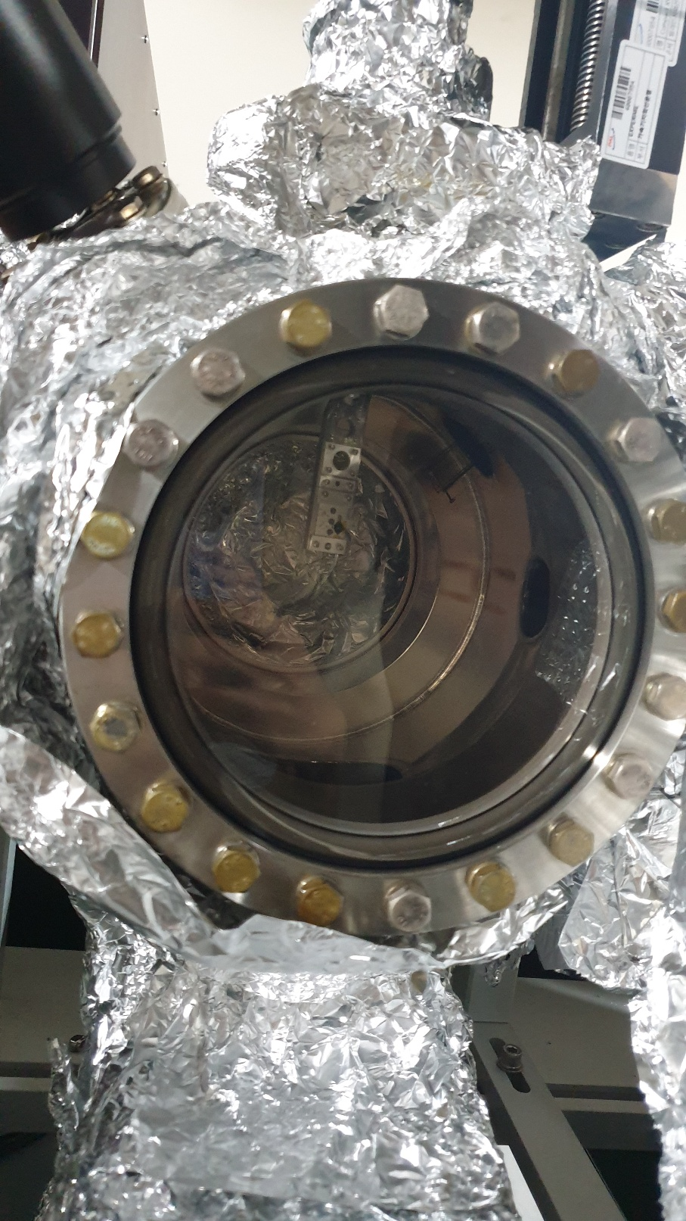
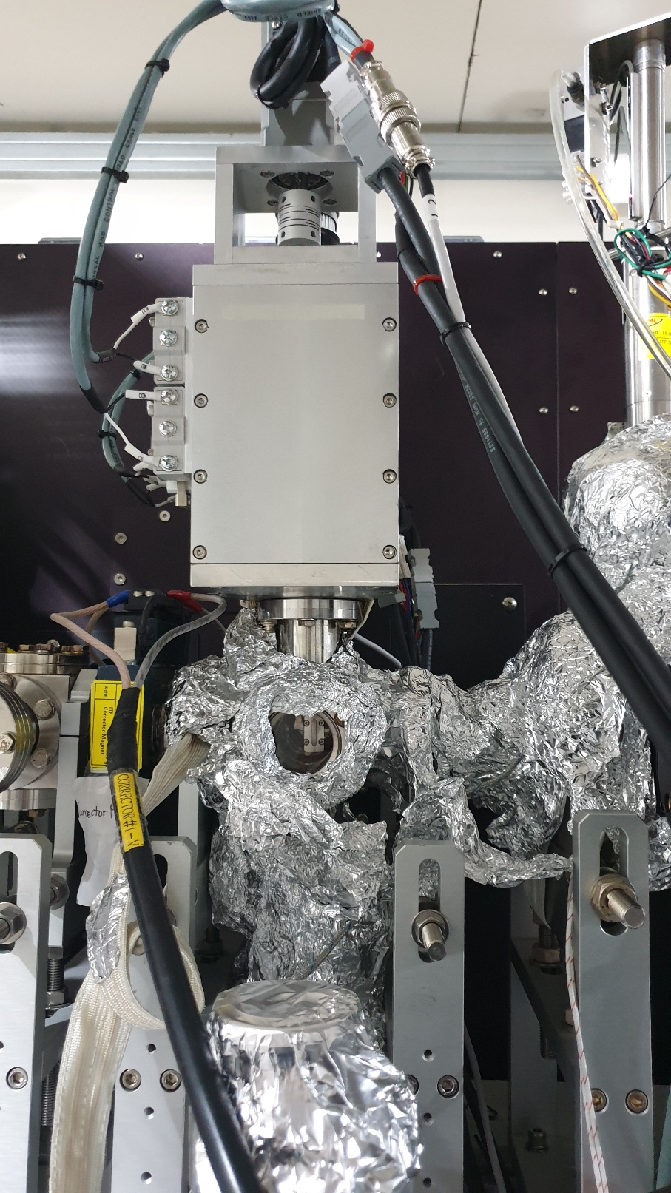
20250310 Group Meeting
Experiment Progress
4

Slide 5
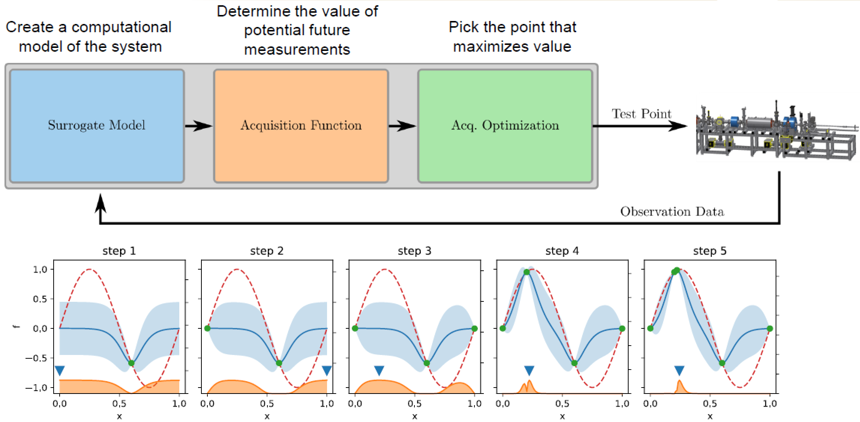
20250310 Group Meeting
Multi-objective Bayesian Optimization
5
Notes:
HV: size of the portion of the objective space that is dominated by the PF

Slide 6
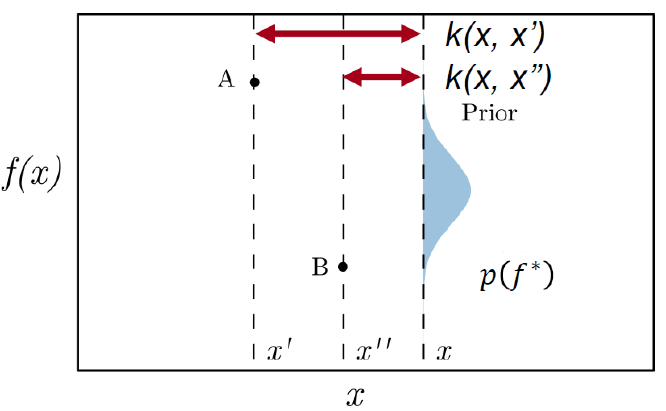
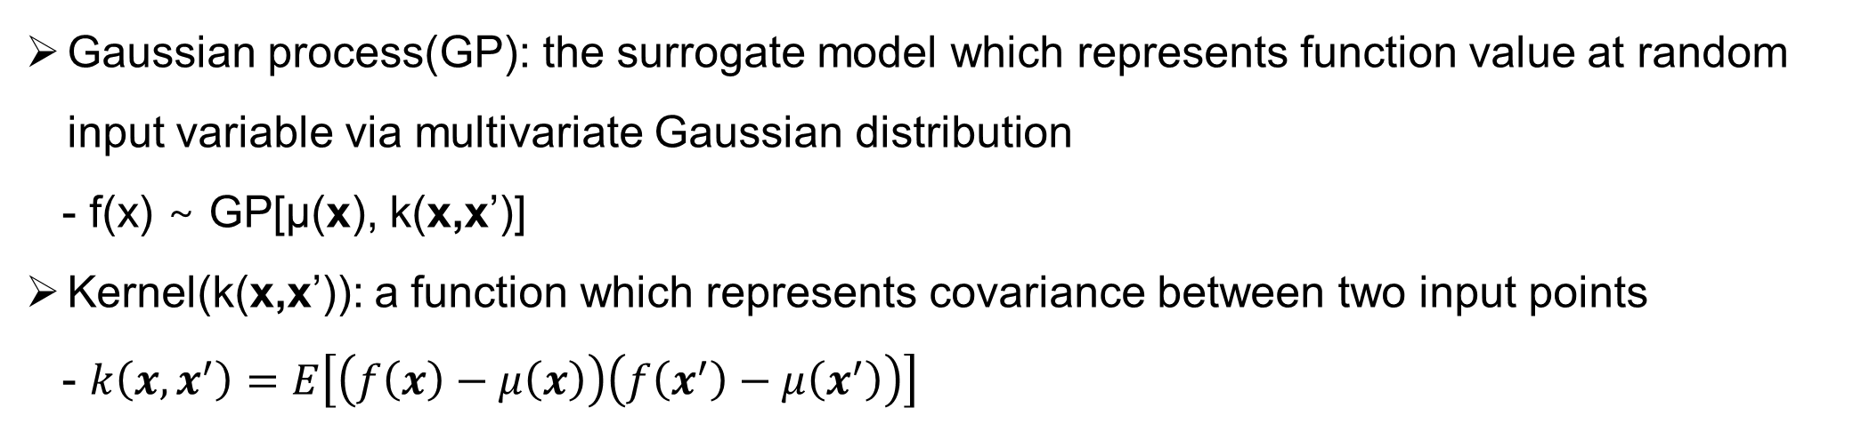
20250310 Group Meeting
Multi-objective Bayesian Optimization
Gaussian process(GP): the surrogate model which represents function value at random input variable via multivariate Gaussian distribution
- f(x) ∼ GP[μ(x), k(x,x’)]
Kernel(k(x,x’)): a function which represents covariance between two input points
- $k\left(x,x^{′}\right)=E\left[\left(f\left(x\right)−μ\left(x\right)\right)\left(f\left(x^{′}\right)−μ\left(x^{′}\right)\right)\right]$
6

Slide 7
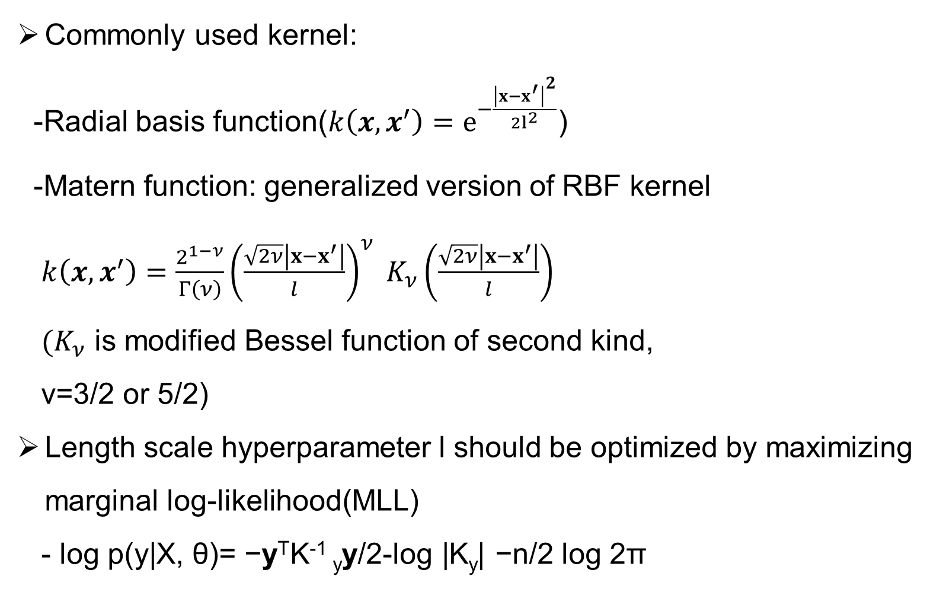
20250310 Group Meeting
Multi-objective Bayesian Optimization
Commonly used kernel:
-Radial basis function($k\left(x,x^{′}\right)=e^{−\frac{{\left|x−x^{′}\right|}^{2}}{2l^{2}}}$)
-Matern function: generalized version of RBF kernel
$k\left(x,x^{′}\right)=\frac{2^{1−ν}}{Γ\left(ν\right)}{\left(\frac{\sqrt{2ν}\left|x−x^{′}\right|}{l}\right)}^{ν} K_{ν}\left(\frac{\sqrt{2ν}\left|x−x^{′}\right|}{l}\right)$
$(K_{ν}$ is modified Bessel function of second kind,
ν=3/2 or 5/2)
Length scale hyperparameter l should be optimized by maximizing marginal log-likelihood(MLL)
- log p(y|X, θ)= −y^{T}K⁻¹ _{y}y/2-log |K_{y}| −n/2 log 2π
R. Roussel et al. Phys. Rev. Accel. Beams 27. (2024).
7
Notes:
θ is the set of GP model hyperparameters
The first term is the data fit term which is maximized when model predictions accurately predict experimental data.
The second term describes model complexity and is maximized given the simplest model,
The final term is a normalization constant based on the number of training points in the dataset.

Slide 8
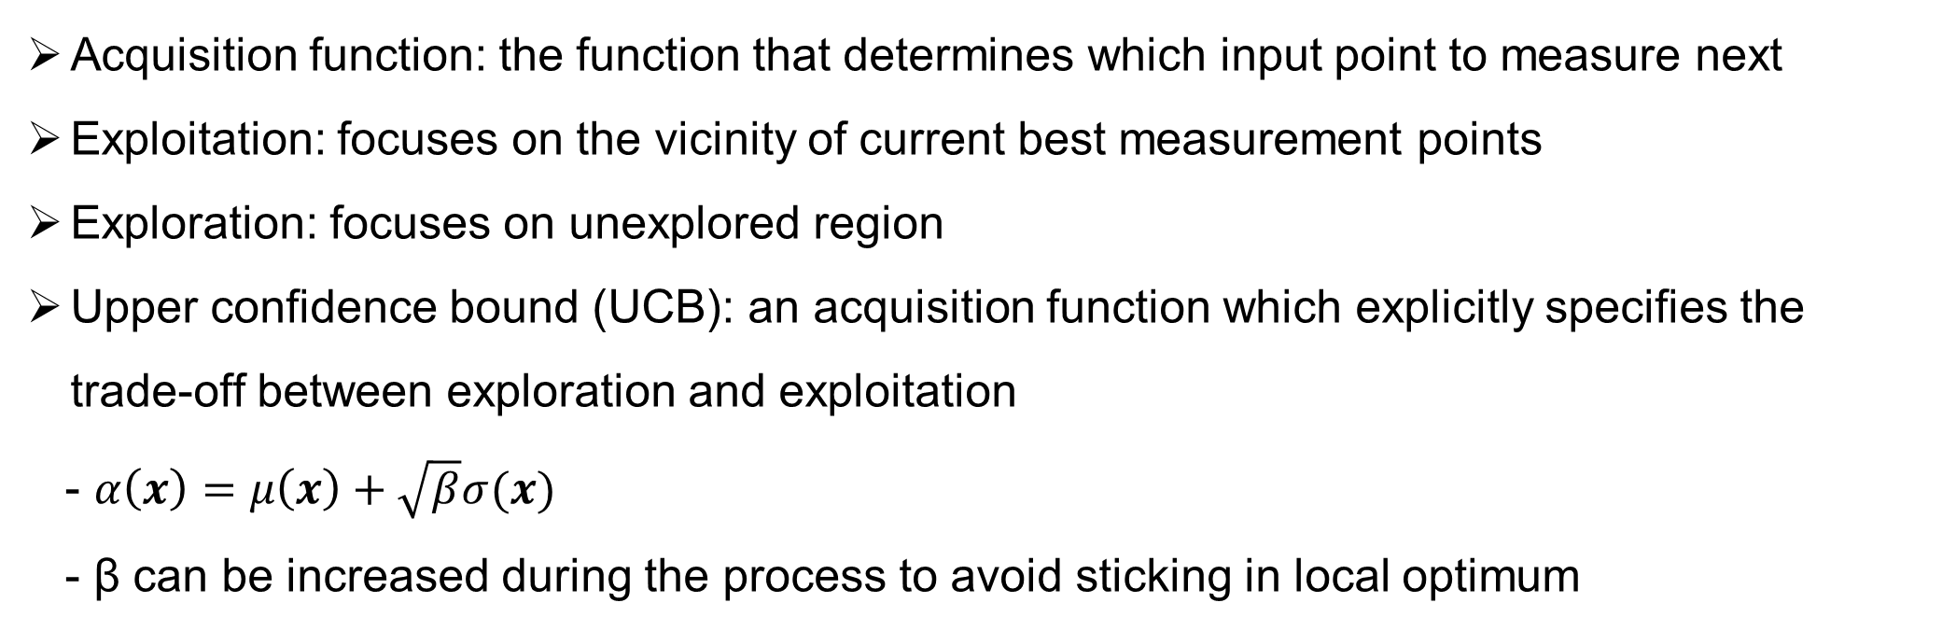
20250310 Group Meeting
Multi-objective Bayesian Optimization
Acquisition function: the function that determines which input point to measure next
Exploitation: focuses on the vicinity of current best measurement points
Exploration: focuses on unexplored region
Upper confidence bound (UCB): an acquisition function which explicitly specifies the trade-off between exploration and exploitation
- $α\left(x\right)=μ\left(x\right)+\sqrt{β}σ(x)$
- β can be increased during the process to avoid sticking in local optimum
8

Slide 9
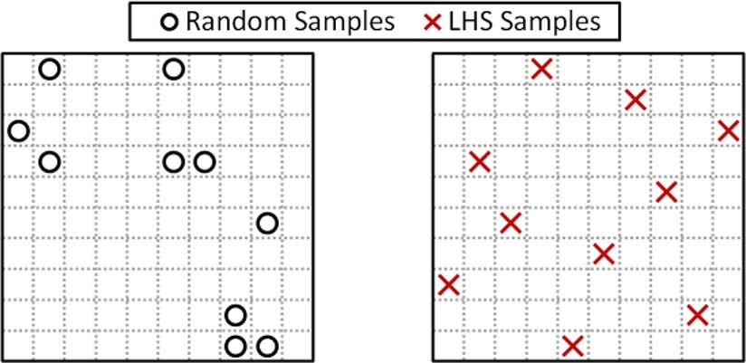
20250310 Group Meeting
Optimization of UED Machine Parameters
Input points for initial sample dataset will be generated by Latin hypercube sampling(LHS) method
Input parameter: Strength of solenoids, bunch charge, RF gun phase, source beam size
Objective parameter: Beam size, bunch length, normalized emittance, energy spread, q-resolution
R. Preece and J. V. Milanović, IEEE Transactions on Power Systems, vol. 31, no. 2. (2016)
9

Slide 10
20250310 Group Meeting
Optimization of UED Machine Parameters
Automatic General Particle Tracer(GPT) simulation will be conducted by python LUME-GPT module
Number of macroparticles is reduced from 50k to 10k
Parameter | Range
Charge | [50fC, 100fC]
Source beam size | [20μm, 100μm]
RF gun phase | [-70°, -40°]
Solenoid 1 strength | [0.144T, 0.18T]
Solenoid 2 strength | [0.07664T, 0.0958T]
10

Slide 11
20250310 Group Meeting
Optimization of UED Machine Parameters
Cavity frequency | 2.856GHz
Gun gradient | 82.84MV/m(max)
Solenoid 1 position | 0.196m
Solenoid 2 position | 1.26m
Aperture position | 0.55m
Aperture diameter | 100μm
Sample position | 1.75m
11

Slide 12
20250310 Group Meeting
Optimization of UED Machine Parameters
Programming will be based on PyTorch and Xopt library
Surrogate model: Gaussian process
Kernel: Matern function with v=5/2
Initial sample point: 20
Acquisition function: Upper confidence bound hypervolume improvement(UCB-HVI)
- β can be changed for optimization
Number of iteration: 100~500
12

Slide 13
20250310 Group Meeting
Current Progress
Coding for generation of initial sample dataset(in progress)
Coding for MOBO algorithm(in progress)
13

Slide 14
20250310 Group Meeting
Future Plan
Completing MOBO algorithm for optimization
Changing some variables in algorithm
(e.g. β, period of optimizing length-scale hyperparameter)
Measurement of hypervolume after rerunning same optimization for several times
Comparing hypervolume with other ML methods (e.g. grid search, MOGA)
14

Slide 15
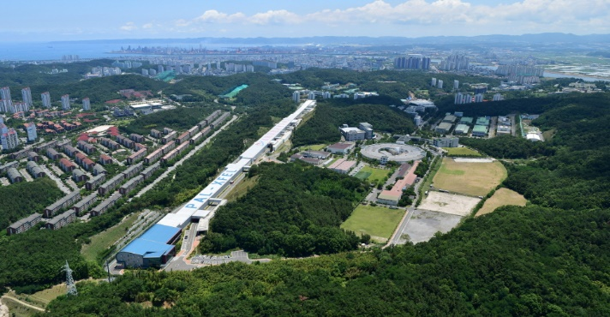


20250310 Group Meeting
Thank you!

Slide 16
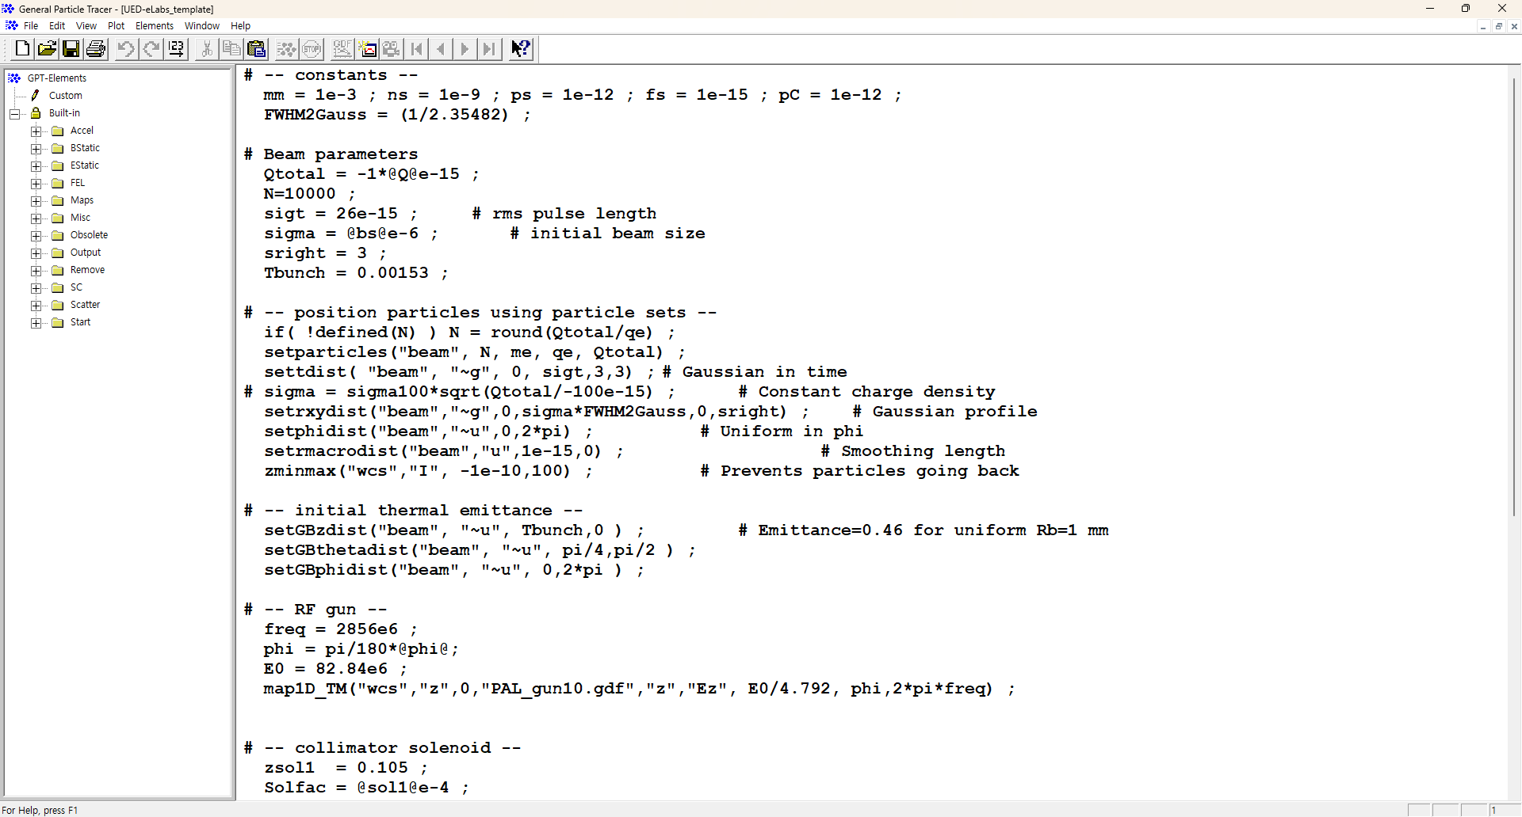
20250310 Group Meeting
GPT Simulation Code
-PAL-eLabs UED Facility Setup
16

Slide 17
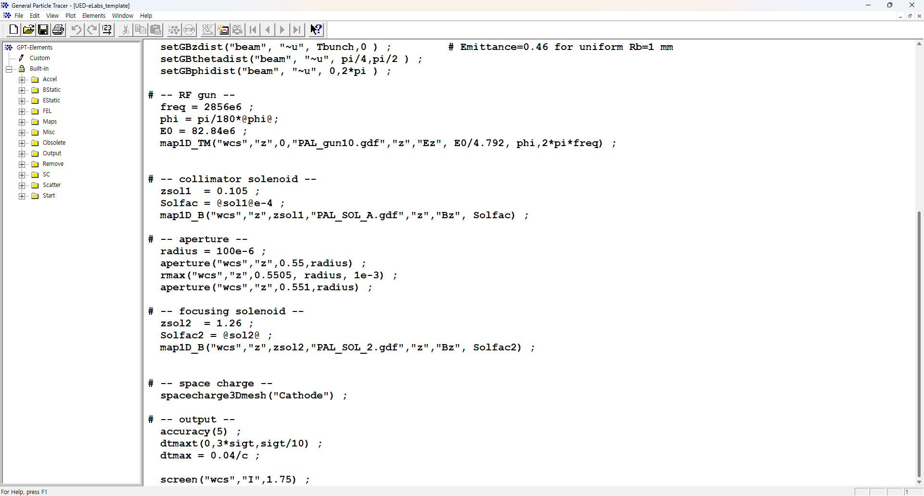
20250310 Group Meeting
GPT Simulation Code
-PAL-eLabs UED Facility Setup
17

