Slide 1
Active Harmonic Cavity Problems
2025-02-24, Pohang, South Korea
Young Min Park
Division of Advanced Nuclear Engineering (DANE), POSTECH

Slide 2
Index
Centroid Shift Problem
  Simulation setup
  Transient effect
  Simulation
HHC with uniform filling pattern
  Problems
Uneven filling pattern
  Analytic solution
  vs Simulation
2

Slide 3
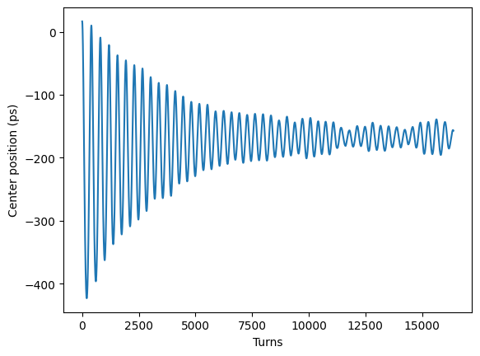
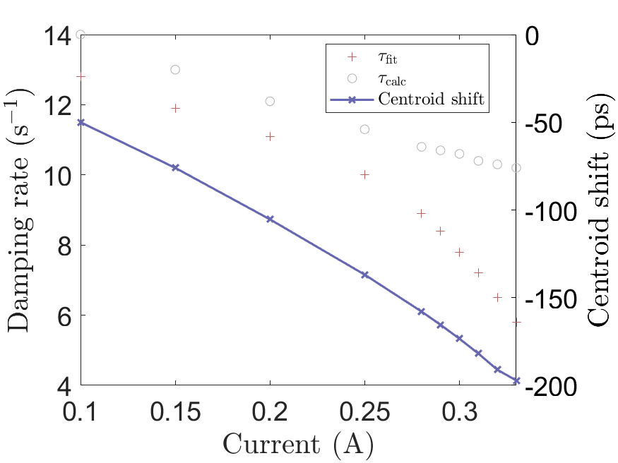
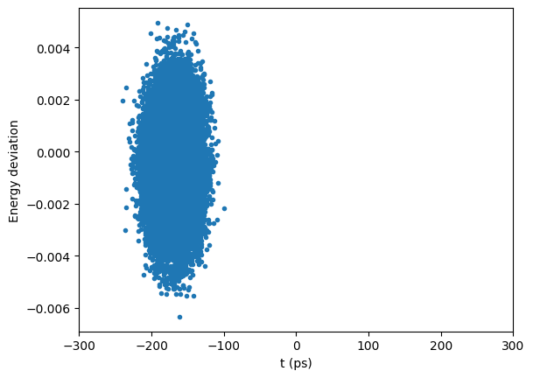
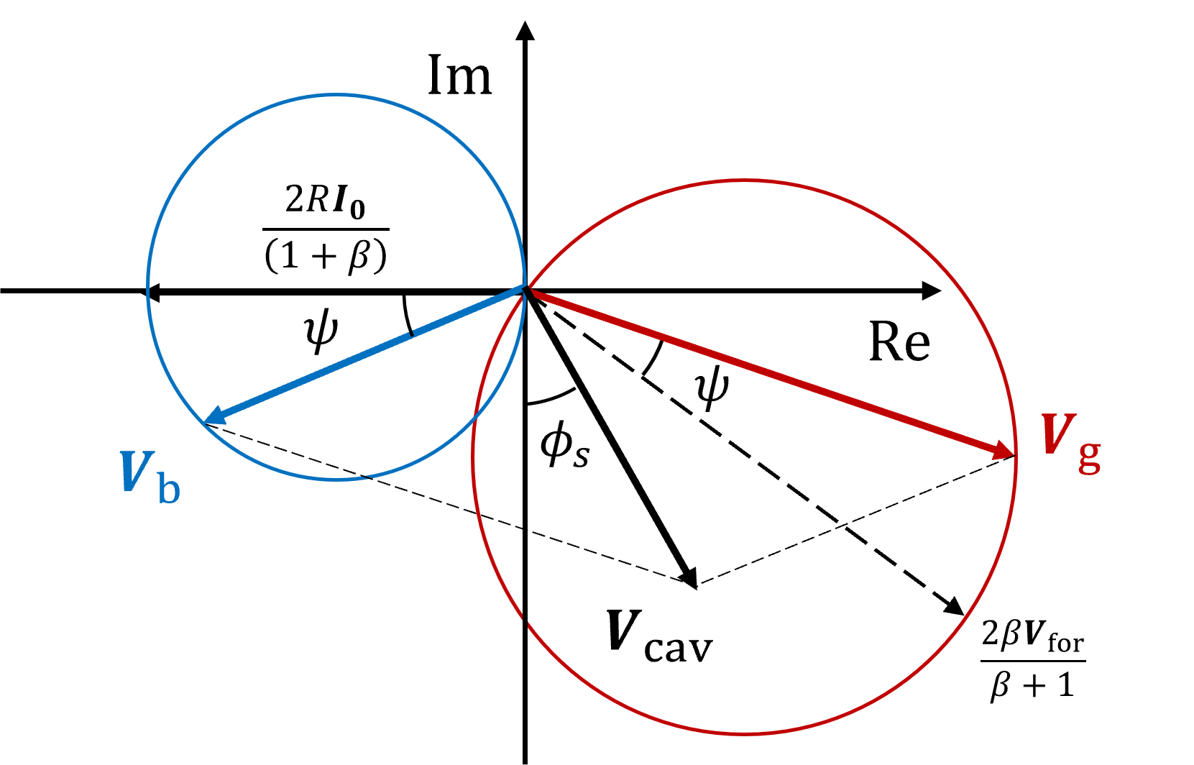
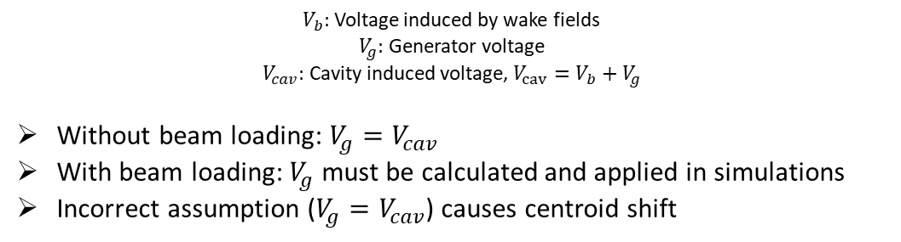
Problem
Simulation setup
w/o HHC, Wake on, $I=0.3A$, 1 Macroparticles
?
Centroid Shift
?
Centroid Shift
Beam loss occurs
$V_{b}:$ Voltage induced by wake fields
$V_{g}:$ Generator voltage
$V_{cav}:$ Cavity induced voltage, $V_{cav}=V_{b}+V_{g}$
Without beam loading: $V_{g}=V_{cav}$
With beam loading: $V_{g}$ must be calculated and applied in simulations
Incorrect assumption ($V_{g}=V_{cav}$) causes centroid shift
3

Slide 4
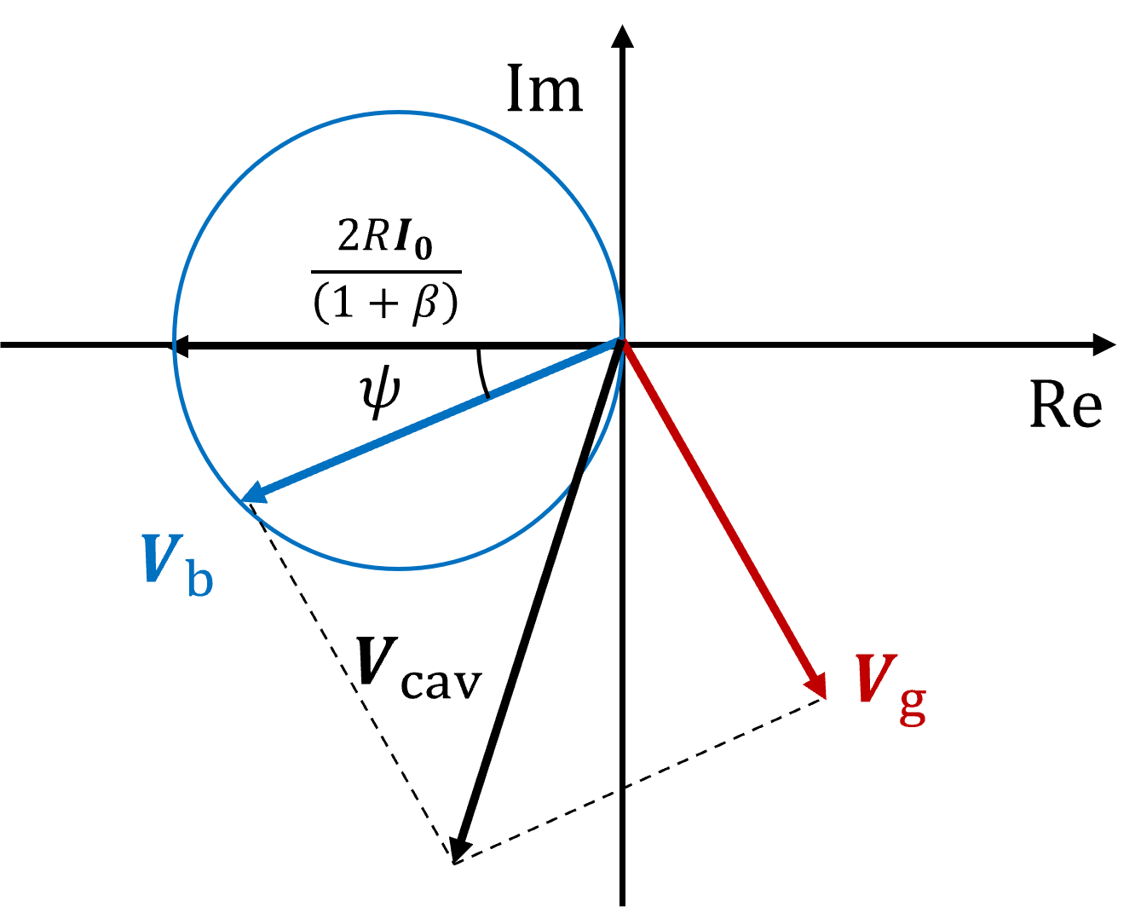
Problem
Simulation setup
w/o HHC, Wake on, $I=0.3A$, 1 Macroparticles
?
Centroid Shift
?
Centroid Shift
Beam loss occurs
$V_{b}:$ Voltage induced by wake fields
$V_{g}:$ Generator voltage
$V_{cav}:$ Cavity induced voltage, $V_{cav}=V_{b}+V_{g}$
Without beam loading: $V_{g}=V_{cav}$
With beam loading: $V_{g}$ must be calculated and applied in simulations
Incorrect assumption ($V_{g}=V_{cav}$) causes centroid shift
4

Slide 5
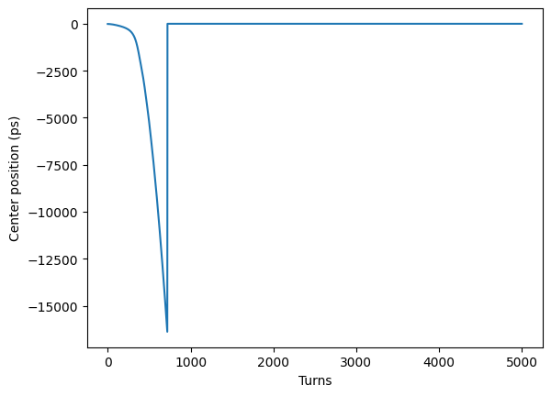
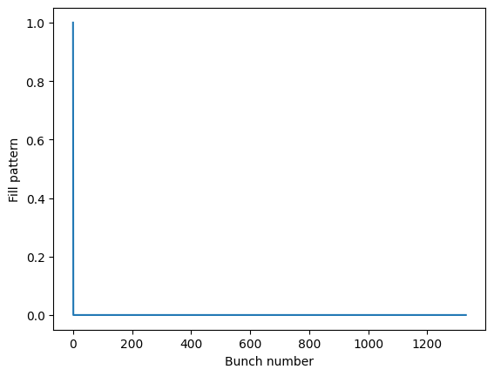
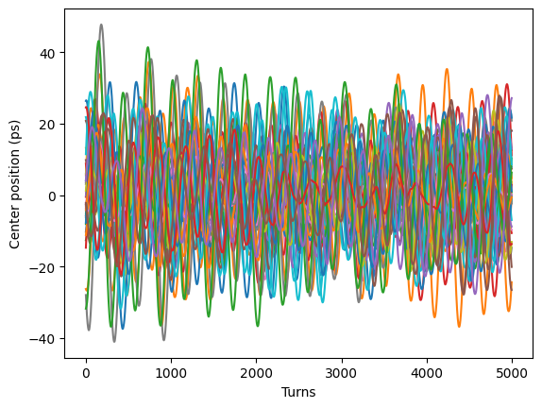
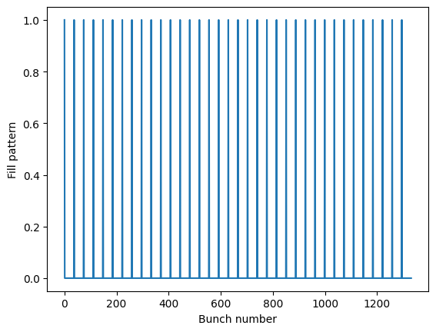

Problem
Transient effect
Single bunch (1 bunch)
SB cases: Beam becomes unstable and disappears.
$$I=0.3A$$
Multi-bunch (36 bunches)
MB cases: Beam oscillates around zero.
5

Slide 6
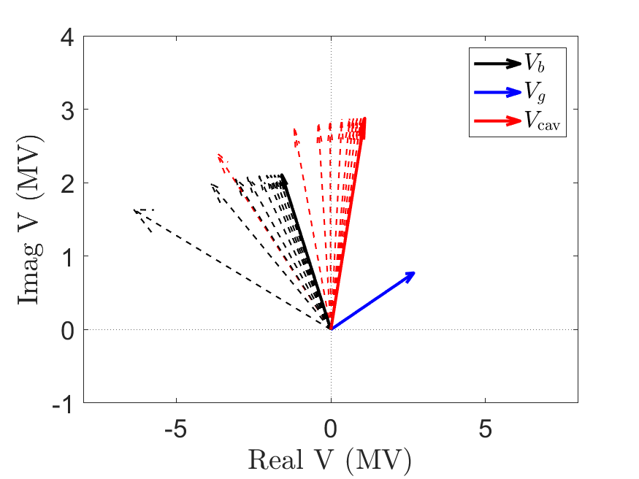
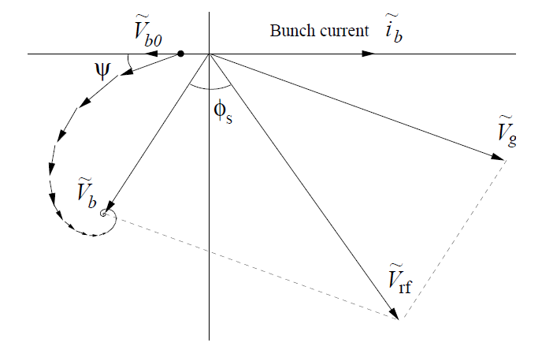


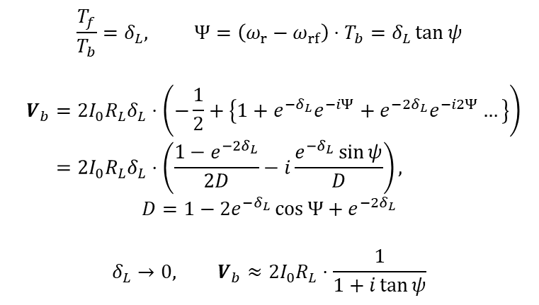
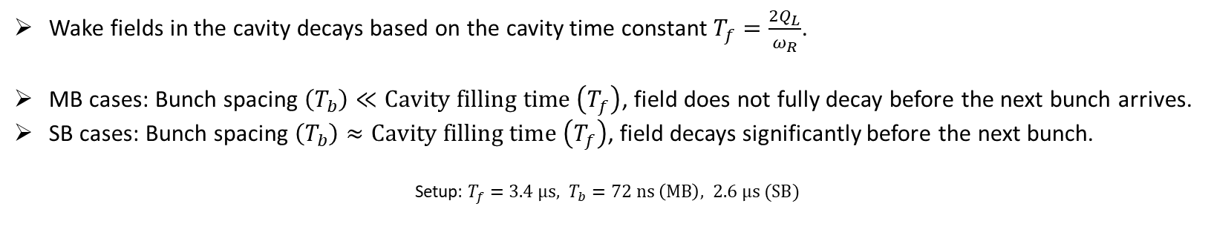
Problem
Transient effect
Wake fields in the cavity decays based on the cavity time constant $T_{f}=\frac{2Q_{L}}{ω_{R}}$.
MB cases: Bunch spacing $\left(T_{b}\right)≪Cavity filling time \left(T_{f}\right)$, field does not fully decay before the next bunch arrives.
SB cases: Bunch spacing $\left(T_{b}\right)≈Cavity filling time \left(T_{f}\right)$, field decays significantly before the next bunch.
Setup: $T_{f}=3.4 μs, T_{b}=72 ns \left(MB\right), 2.6 μs (SB)$
$$\frac{T_{f}}{T_{b}}=δ_{L}, Ψ=\left(ω_{r}−ω_{rf}\right)⋅T_{b}=δ_{L}\tan{ψ}$$
$$V_{b}=2I_{0}R_{L}δ_{L}⋅\left(−\frac{1}{2}+\left\{1+e^{−δ_{L}}e^{−iΨ}+e^{−{2δ}_{L}}e^{−i2Ψ}…\right\}\right)=2I_{0}R_{L}δ_{L}⋅\left(\frac{1−e^{−2δ_{L}}}{2D}−i\frac{e^{−δ_{L}}\sin{ψ}}{D}\right),$$
$$D=1−2e^{−δ_{L}}\cos{Ψ}+e^{−2δ_{L}}$$
$$δ_{L}→0, V_{b}≈2I_{0}R_{L}⋅\frac{1}{1+i\tan{ψ}}$$
$$V_{cav}\left(N=1332\right)$$
$$V_{cav}\left(N=1\right)$$
6

Slide 7
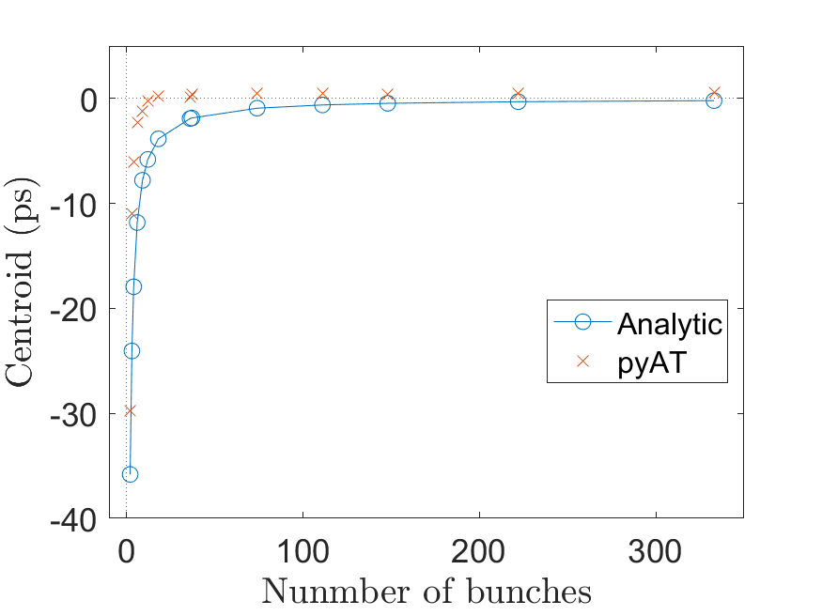
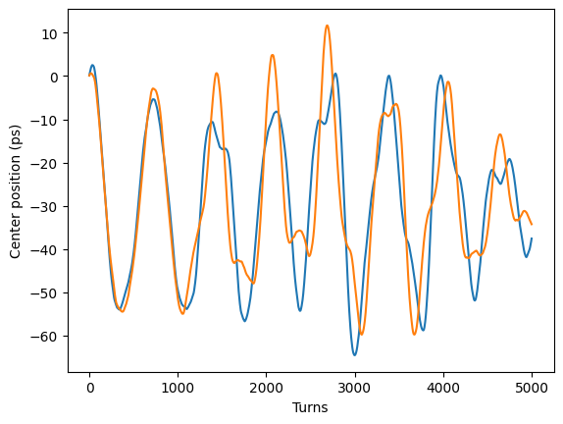
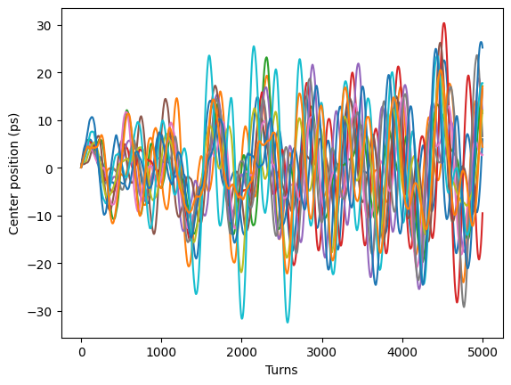
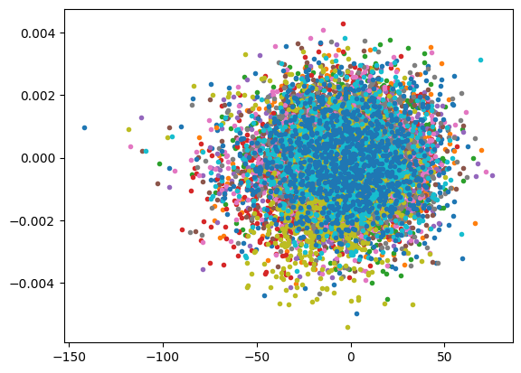
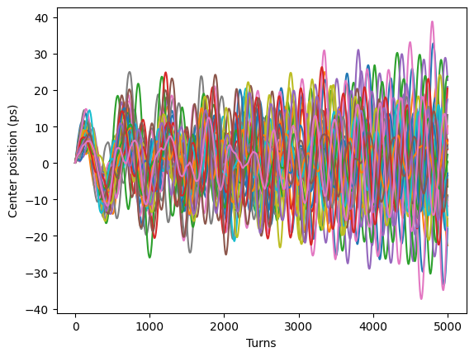
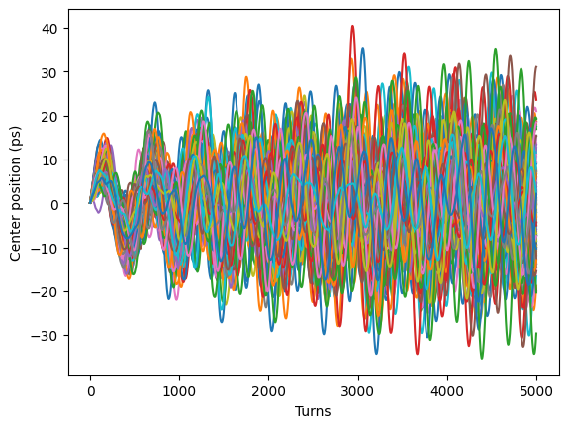
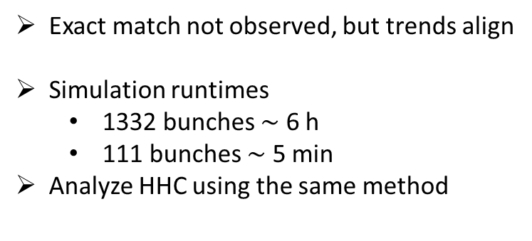

Problem
Simulation
$$I=0.3A$$
Multi-bunch (2 bunches)
Multi-bunch (12 bunches)
Multi-bunch (37 bunches)
Multi-bunch (111 bunches)
Exact match not observed, but trends align
Simulation runtimes
  1332 bunches $\sim$ 6 h
  111 bunches $\sim$ 5 min
Analyze HHC using the same method
7

Slide 8
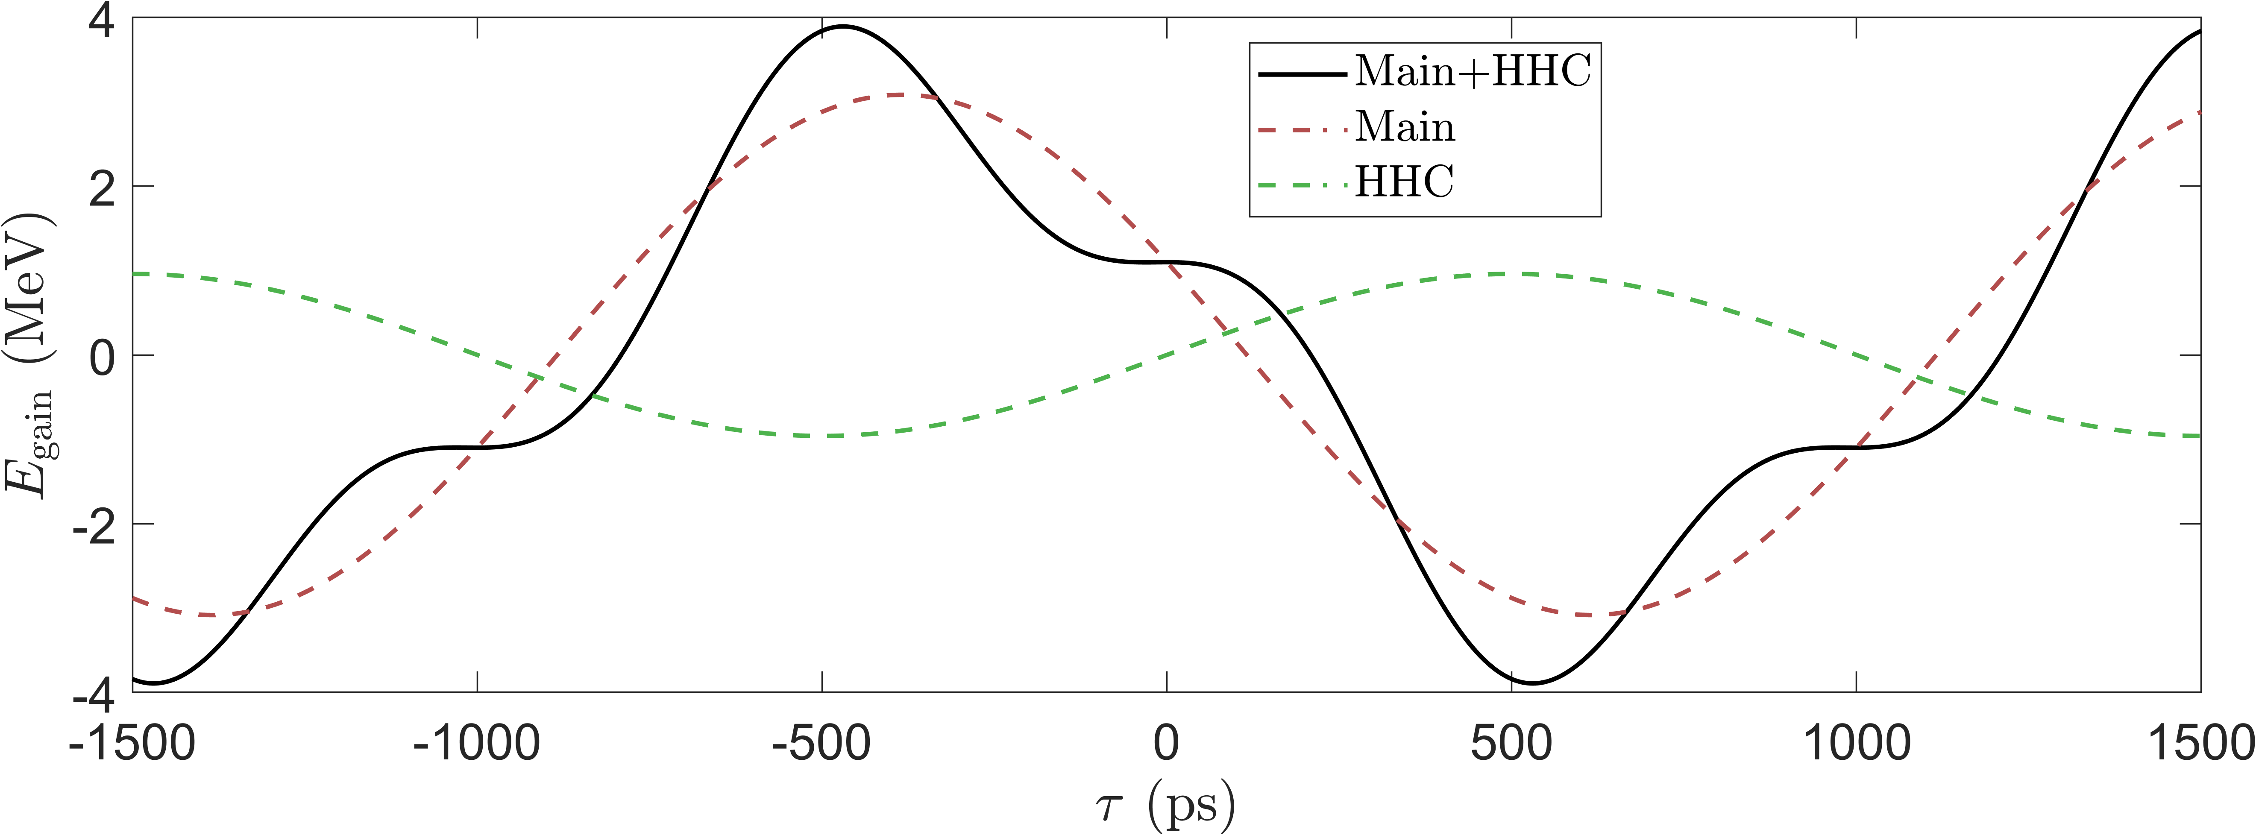
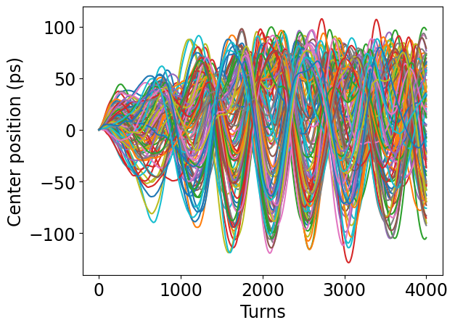
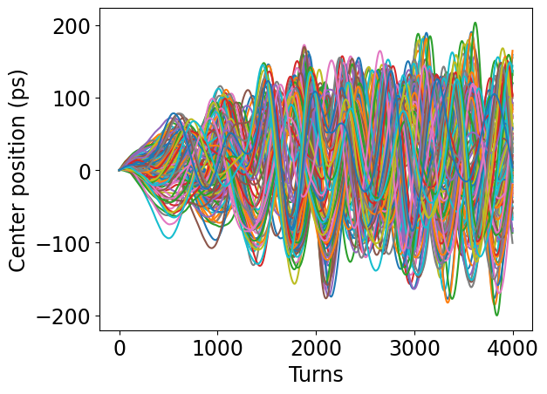
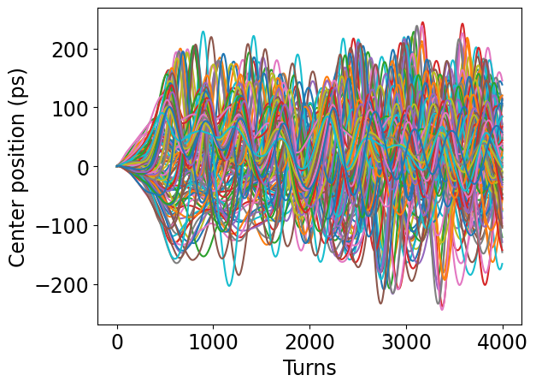
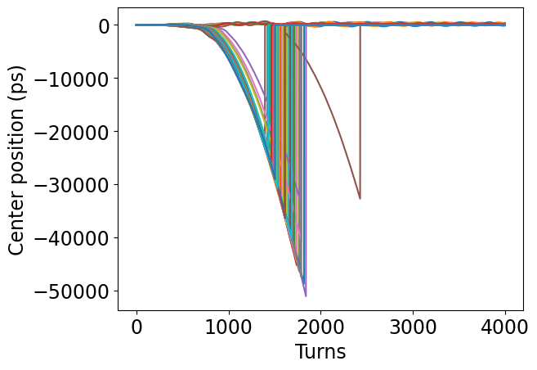
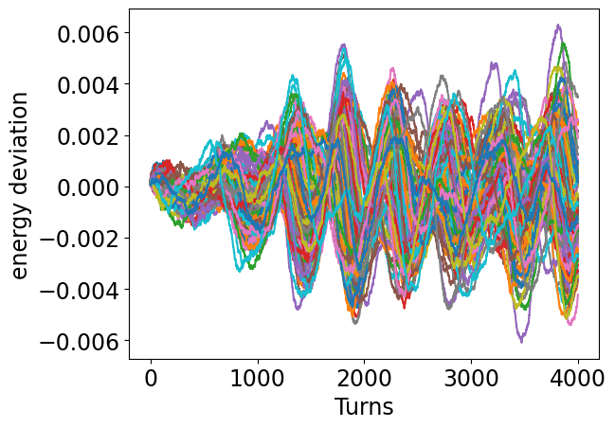
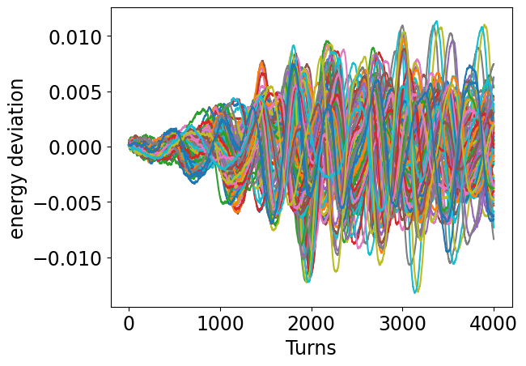
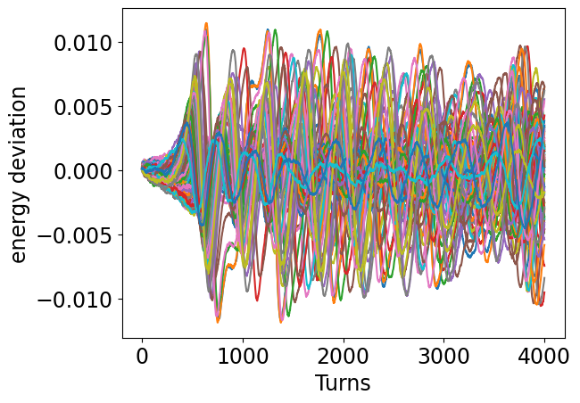
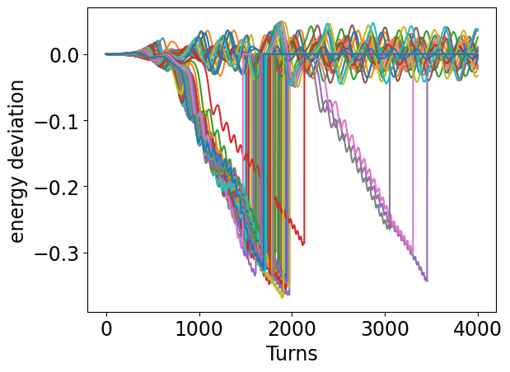






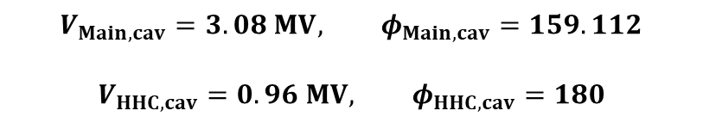

HHC with uniform filling pattern
Problem 2
$$V_{Main,cav}=3.08 MV, φ_{Main,cav}=159.112$$
$$V_{HHC,cav}=0.96 MV, φ_{HHC,cav}=180$$
$$σ_{δ}=0.15 \%$$
$$σ_{δ}=0.30 \%$$
$$σ_{δ}=0.31 \%$$
$$I=0.05 A$$
$$I=0.1 A$$
$$I=0.15 A$$
$$I=0.2 A$$
8

Slide 9
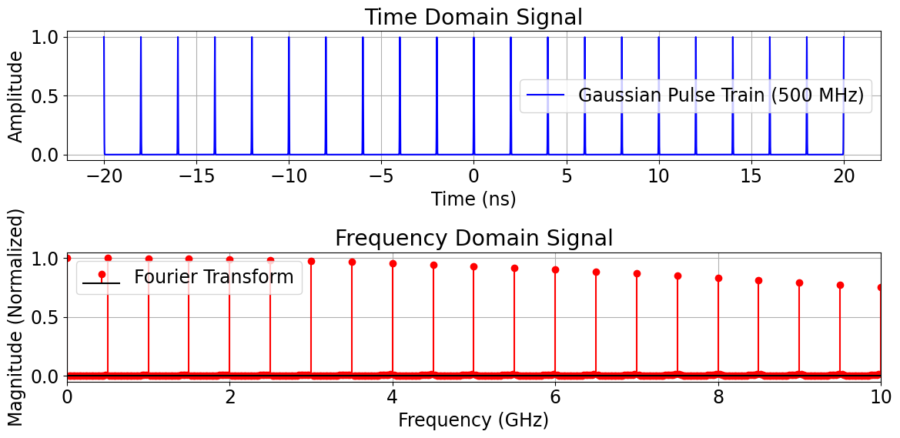

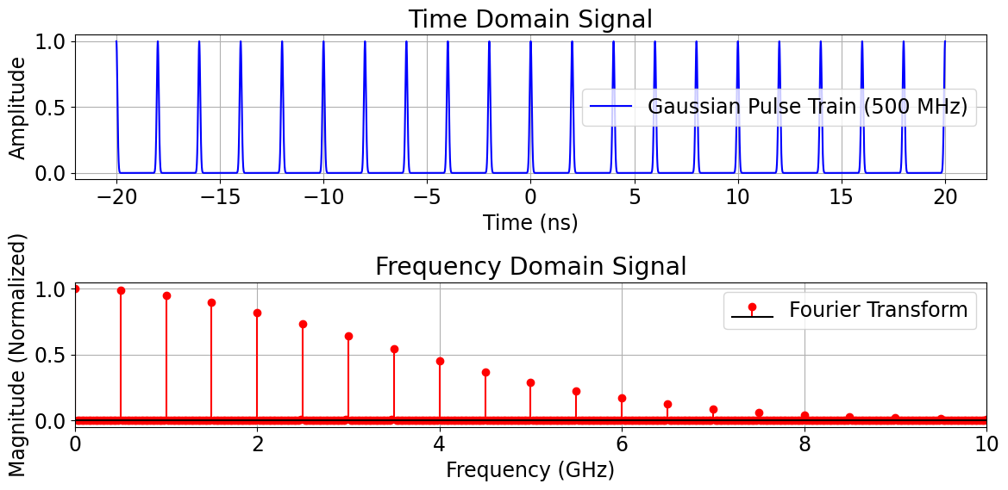






HHC with uniform filling pattern
Multi-particles
$F=\frac{{\left|ρ\left(ω\right)\right|}_{ω=ω_{RF}}}{{\left|ρ\left(ω\right)\right|}_{ω=0}}$, Bunch form factor
$$V_{b}=2IR_{L}F$$
$$F≈1$$
$$15 ps$$
For the long bunch, bunch form factor must be considered.
Determine form factor based on the expected bunch distribution
$$F<1$$
$$50 ps$$
9

Slide 10







Uneven filling pattern
Analytic solution
$$N_{gap}$$
Bunch number $=n$
$$…$$
$$…$$
$$…$$
Bunch train
$$B_{n2}$$
$$B_{n1}$$
$$B_{n1}=\frac{1}{2}2I_{0}R_{L}δ_{L}+2I_{0}R_{L}δ_{L}\left(e^{−\left(δ_{L}−jψ\right)}+e^{\left.−{2\left(δ\right.}_{L}−jψ\right)}…e^{−n\left(δ_{L}−jψ\right)}\right)=2I_{0}R_{L}δ_{L}⋅\left(\frac{1−e^{−\left(n+1\right)\left(δ_{L}−jψ\right)}}{1−e^{−\left(δ_{L}−jψ\right)}}−\frac{1}{2}\right)$$
$$B_{n2}=2I_{0}R_{L}δ_{L}⋅e^{−\left(N_{gap}+n+1\right)\left(δ_{L}−jψ\right)}⋅\left(1+e^{−\left(δ_{L}−jψ\right)}+e^{\left.−{2\left(δ\right.}_{L}−jψ\right)}…e^{−\left(h−N_{gap}−n−2\right)\left(δ_{L}−jψ\right)}\right)=2I_{0}R_{L}δ_{L}⋅e^{−\left(N_{gap}+n+1\right)\left(δ_{L}−jψ\right)}⋅\frac{e^{−\left(h−N_{gap}−n−1\right)\left(δ_{L}−jψ\right)}}{1−e^{−\left(δ_{L}−jψ\right)}}$$
$$V_{bn}=\left(B_{n1}+B_{n2}\right)⋅\left(1+e^{−h\left(δ_{L}+iψ\right)}+e^{−2h\left(δ_{L}+iψ\right)}…\right)=\left(B_{n1}+B_{n2}\right)⋅\left(\frac{1−e^{−2hδ_{L}}}{2\left(1−2e^{−hδ_{L}}\cos{Ψ}+e^{−2hδ_{L}}\right)}−i\frac{e^{−hδ_{L}}\sin{ψ}}{1−2e^{−hδ_{L}}\cos{Ψ}+e^{−2hδ_{L}}}\right)$$
By calculate the beam loading voltage for 1 turn, the steady-state beam loading voltage can also be determined.
This method could potentially extend to semi-analytic calculations for general filling patterns, such as
  Multiple gaps within a bunch train
  Varying currents for each bunch
10

Slide 11
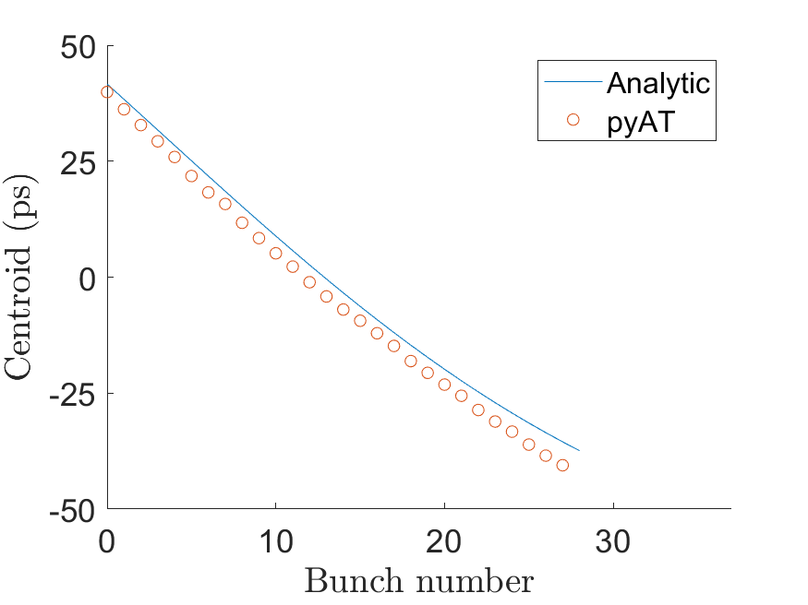
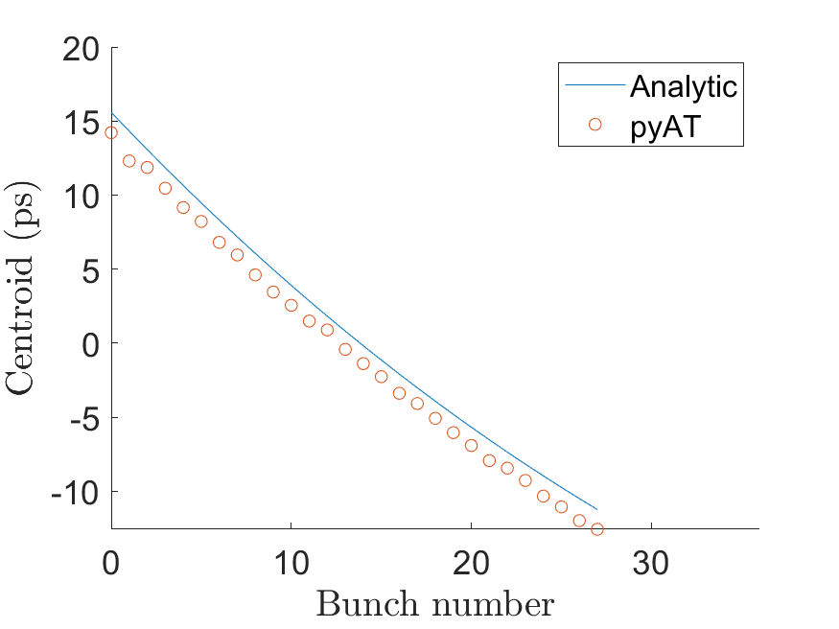
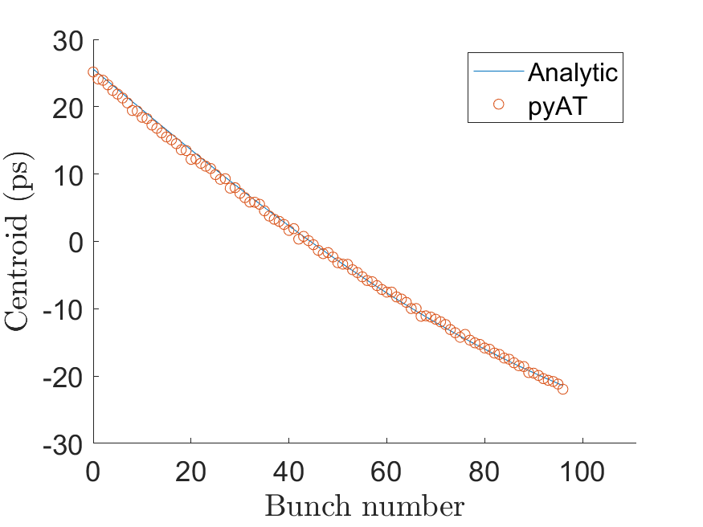
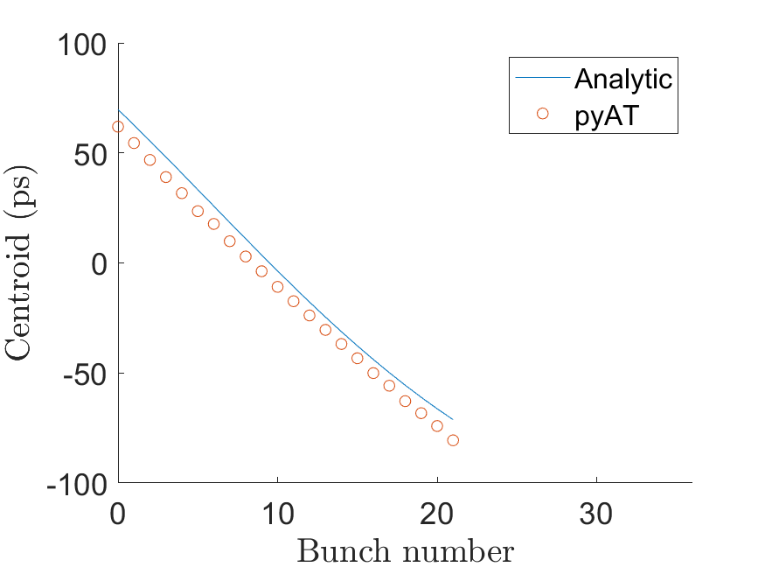
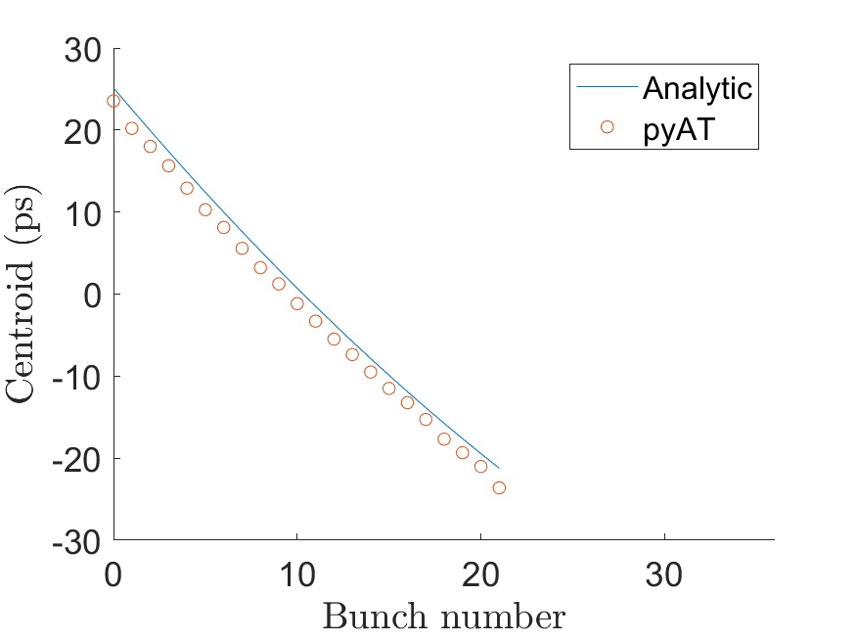
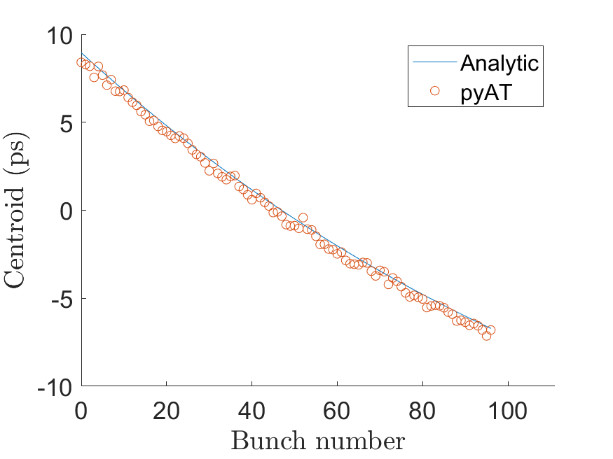
Uneven filling pattern
vs Simulation
$$36 bunches, 8 gaps, I=0.3 A$$
$$36 bunches, 8 gaps, I=0.1 A$$
$$111 bunches, 8 gaps, I=0.3 A$$
$$36 bunches, 14 gaps, I=0.3 A$$
$$36 bunches, 14 gaps, I=0.1 A$$
$$111 bunches, 14 gaps, I=0.3 A$$
11

Slide 12
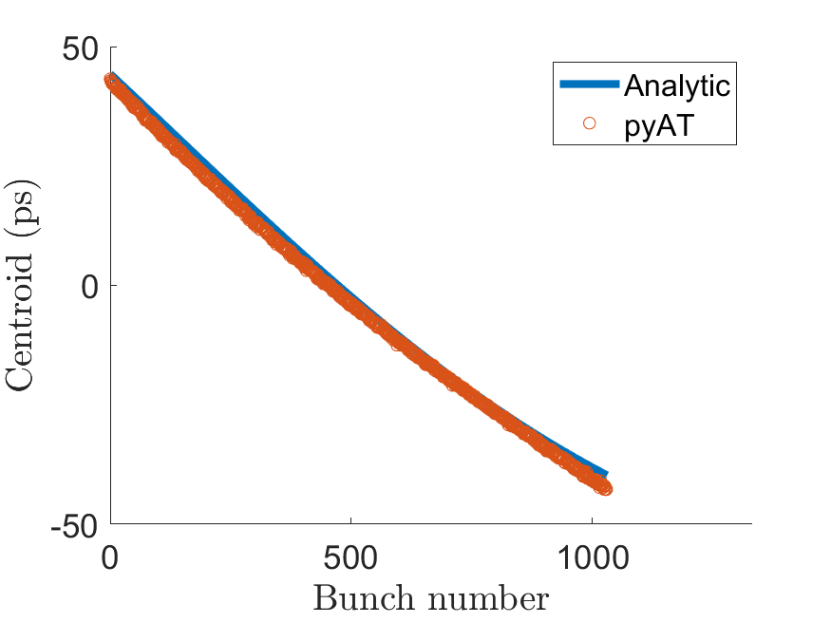
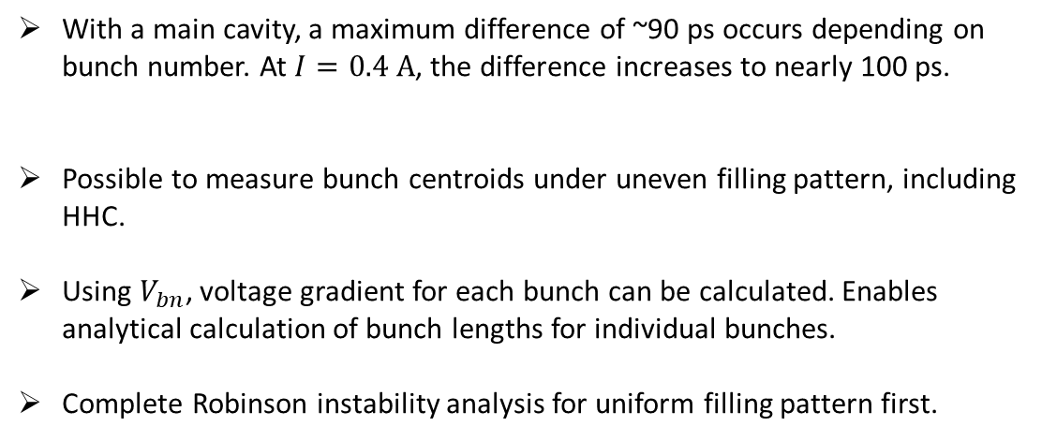
Uneven filling pattern
vs Simulation
With a main cavity, a maximum difference of ~90 ps occurs depending on bunch number. At $I=0.4 A$, the difference increases to nearly 100 ps.
Possible to measure bunch centroids under uneven filling pattern, including HHC.
Using $V_{bn}$, voltage gradient for each bunch can be calculated. Enables analytical calculation of bunch lengths for individual bunches.
Complete Robinson instability analysis for uniform filling pattern first.
$$1332 bunches, 300 gaps, I=0.3 A$$
12

Slide 13
Thank you for your attention!
13

