Slide 1
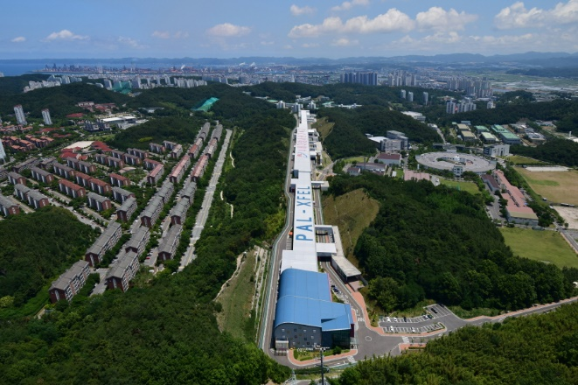
Collective effects in a diffraction-limited storage ring
Collective effects in a diffraction-limited storage ring-cont’d
Jimin Seok
4GSR Beam Dynamics Group
Pohang Accelerator Laboratory, POSTECH
2025.01.24

Slide 2
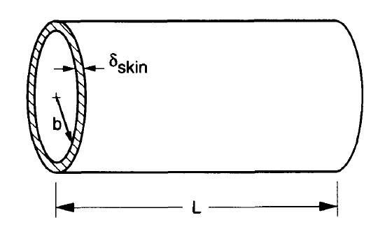
Collective effects in a diffraction-limited storage ring
Resistive wall impedance in DLSR
Resistive wall (RW) impedance is one of main source of single and multi bunch instability
Small vacuum chamber radius brought significant increasement of RW impedance -> Due to small magnet bore radius
Material resistivity
Chamber radius
Above equations are impedance for circular cross section, there is method to calculate non-circular and coated chamber impedances
Some chambers are made of dielectric materials (such as ceramic) with metallic coating
Those kind of chambers frequently has a heating issue. We can calculate heating from longitudinal impedance.

Slide 3
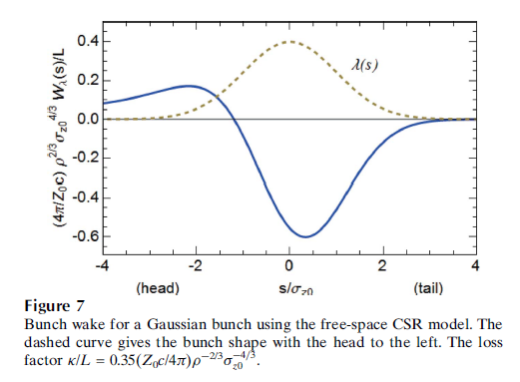
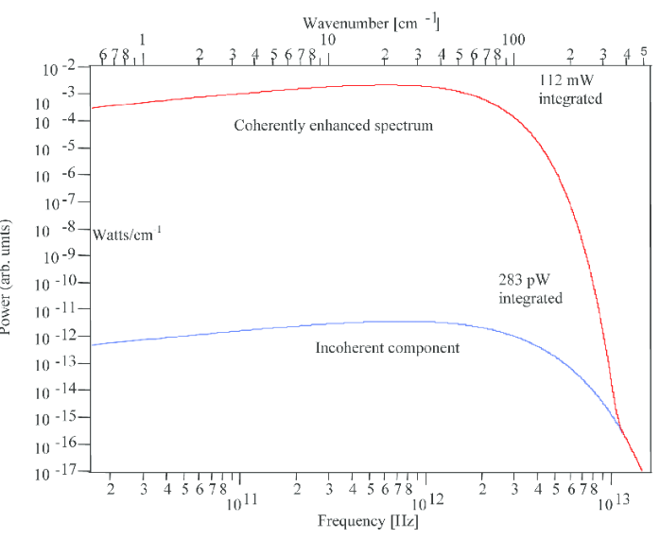
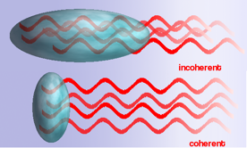
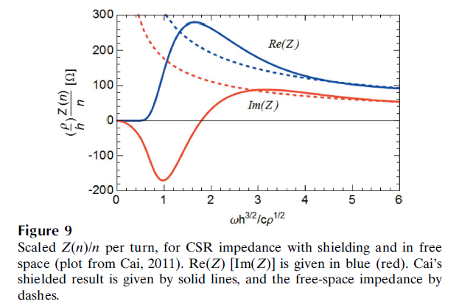
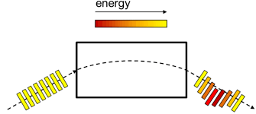
Collective effects in a diffraction-limited storage ring
Coherent synchrotron radiation
Coherent synchrotron radiation (CSR) induced by bending sources
Comparing with other impedance sources, beam gain the energy at head and lose it at the middle.

Slide 4
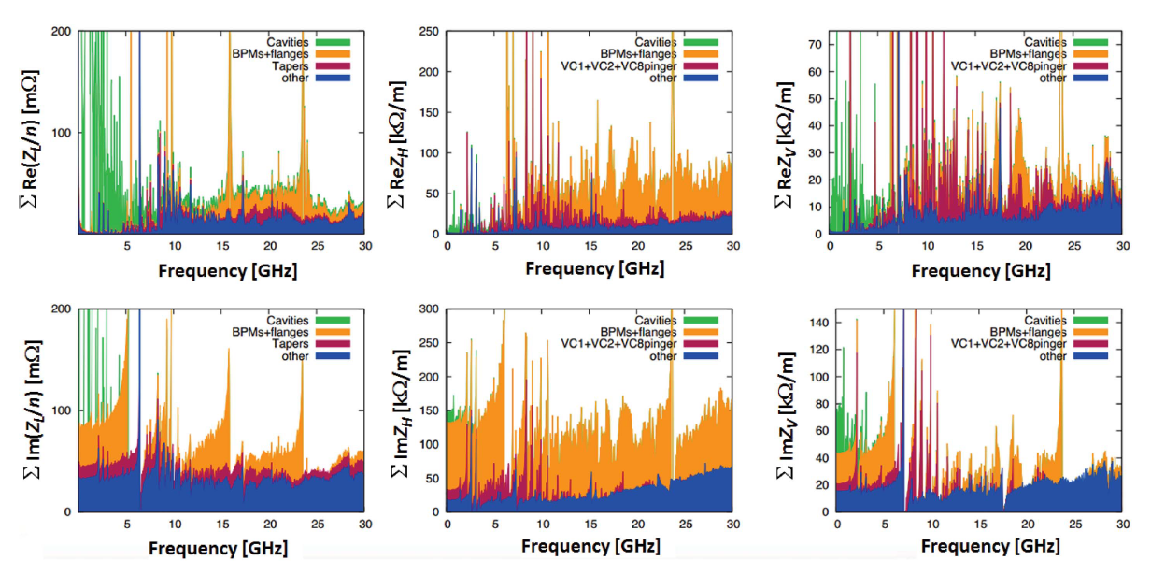
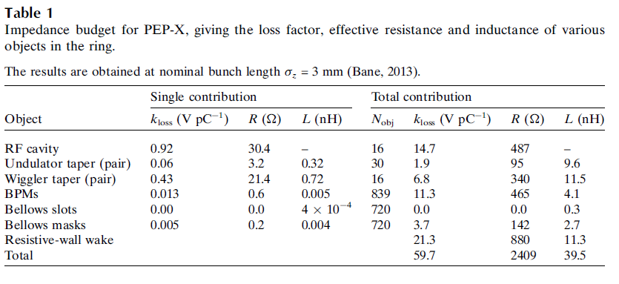
Collective effects in a diffraction-limited storage ring
Impedance budget for PEP-X
From impedance budget, we can roughly estimate the ring instability status and perform tracking simulations

Slide 5
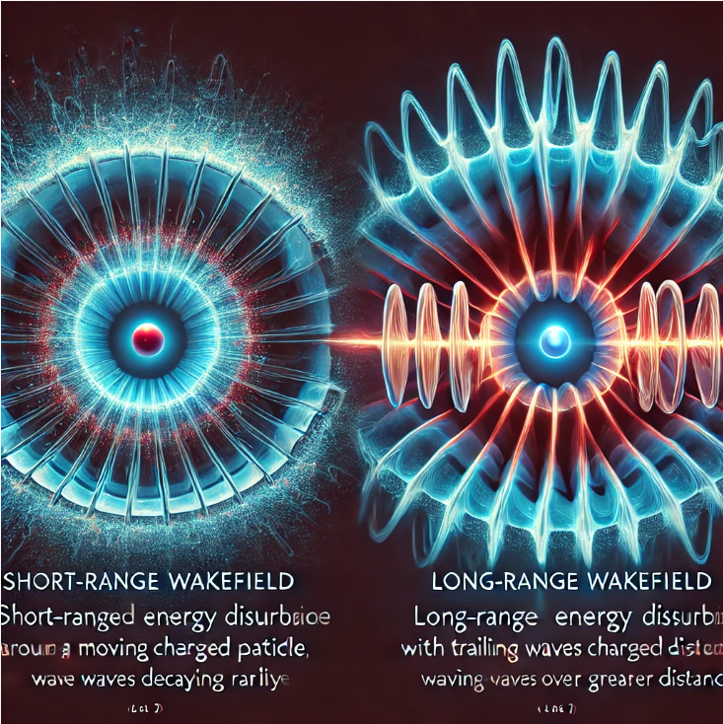
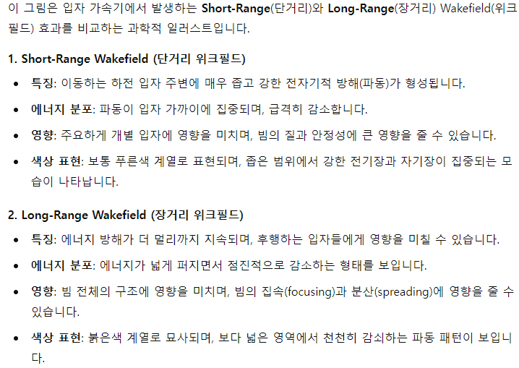
Collective effects in a diffraction-limited storage ring
Beam instabilities in DLSR
Main source of instabilities
Single bunch instability: Short range wakefield
Multi-bunch instability: Long range wakfield
Short range wakefield = broadband impedance
Long range wakefield = narrow band impedance

Slide 6
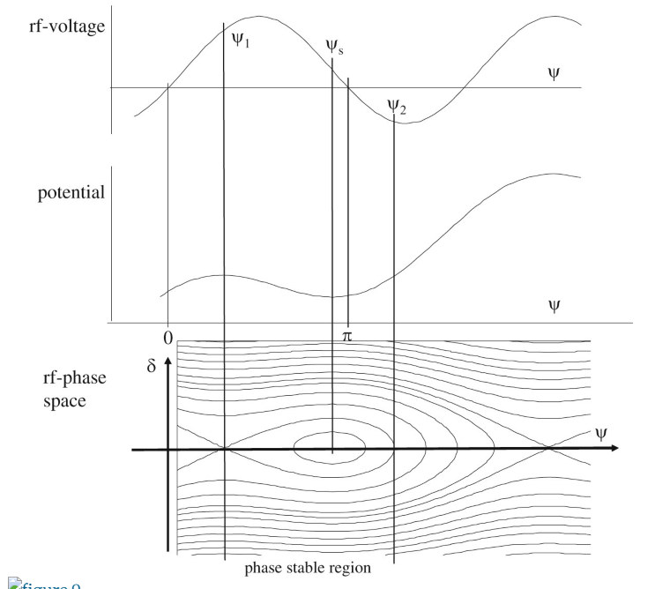
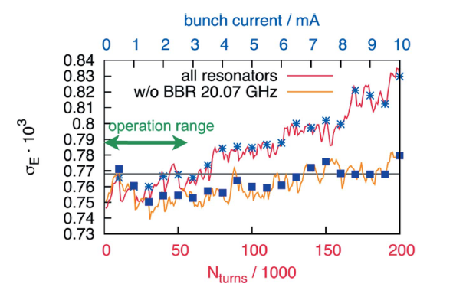
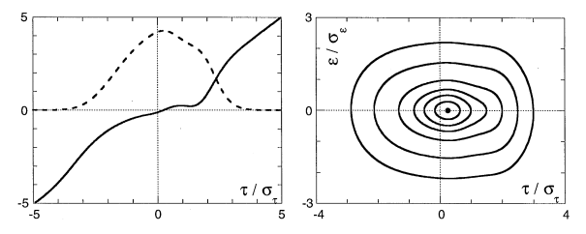
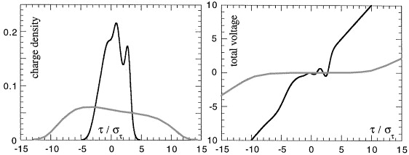
Collective effects in a diffraction-limited storage ring
Normal condition separatrix
Beam instabilities in DLSR
Single bunch instabilities
Potential well distortion
Haissinski euqation
Only bunch lengthening, irrelevant to energy spread
Microwave instability: increase energy spread
Boussard criterion
PWD
MWI

Slide 7
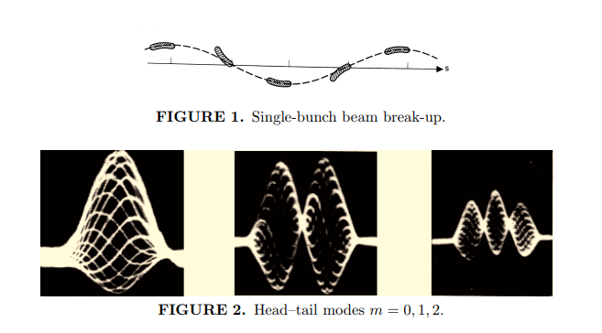
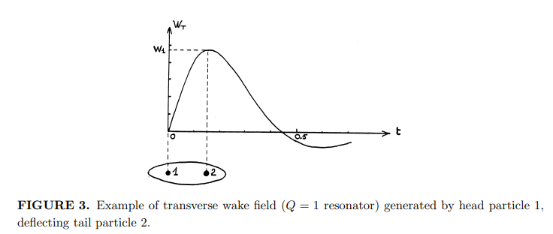
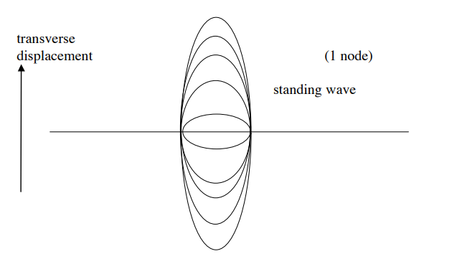
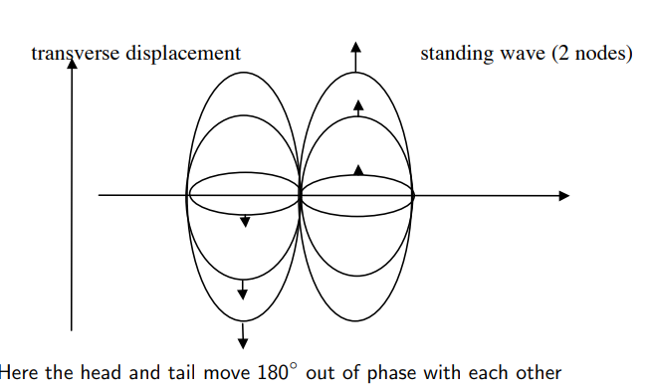
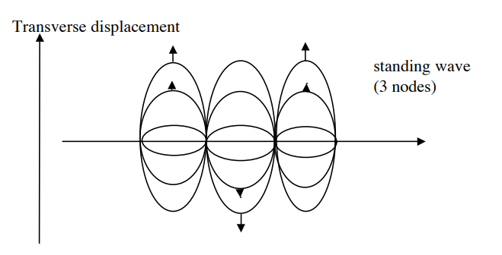
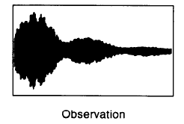
Collective effects in a diffraction-limited storage ring
Similar principle with beam break up (BBU)
Beam instabilities in DLSR
Single bunch instabilities
Head-tail instability and Transverse mode coupling instability
Mode 0
Mode 1
Mode 2
Mode coupling
Beam current

Slide 8
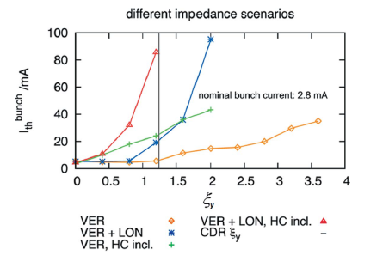
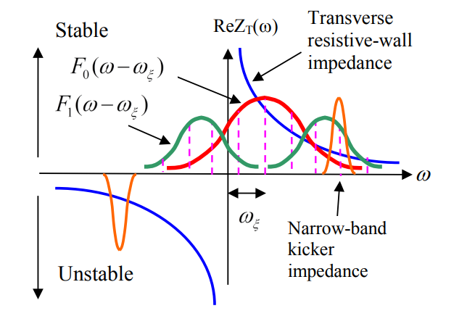
Collective effects in a diffraction-limited storage ring
Beam instabilities in DLSR
Single bunch instabilities
Head-tail instability and Transverse mode coupling instability

Slide 9
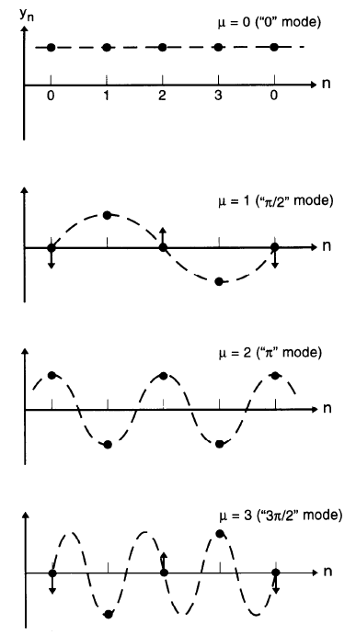
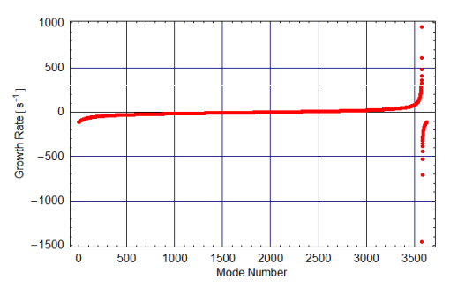
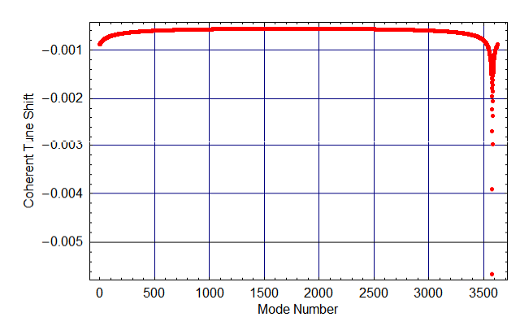
Collective effects in a diffraction-limited storage ring
Beam instabilities in DLSR
Multi bunch instability
Resistive wall (RW) instability: main source of transverse coupled-bunch instability
Starting from simple harmonic oscillator
Wakefield effect
Achieved equation

Slide 10
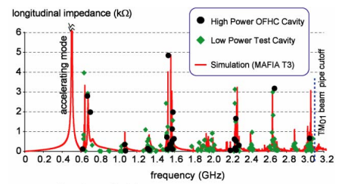
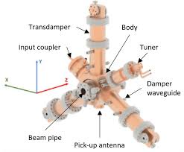
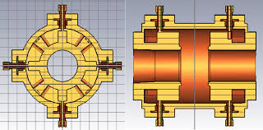
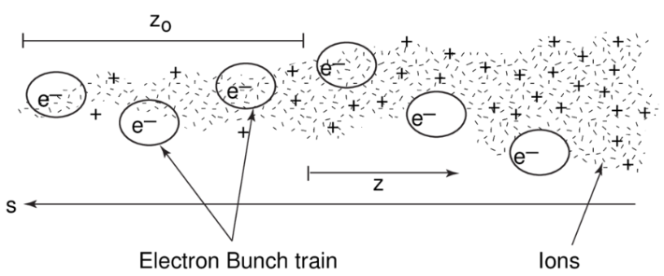
Collective effects in a diffraction-limited storage ring
Beam instabilities in DLSR
Multi bunch instability
HOM-induced coupled-bunch instability
Main source: RF cavity
Solutions: HOM damped RF cavity, Longitudinal feedback
Cavity longitudinal impedance
HOM damped RF cavity
Longitudinal feedback kicker
Ion instability
Interactions of an electron beam with ionized residual gases in a storage ring generally induce transverse center-of-mass oscillations of the former, effectively increasing the transverse electron beam dimensions possibly by several factors.
Depending on ion species, vacuum pressure, and beam intensity, the growth rate of instability changes.
Solution: Ion clearing gap, High vacuum pressure (like NEG coating) and feedback system.

Slide 11
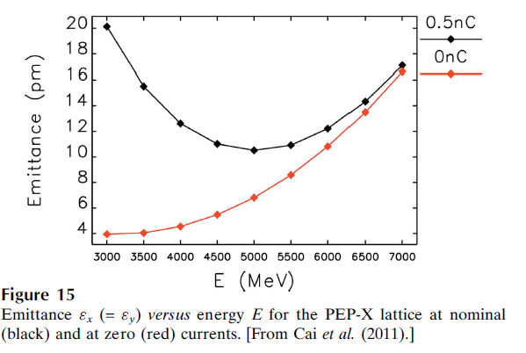
Collective effects in a diffraction-limited storage ring
IBS and Touscheck scattering
IBS will limit the emittances that can be achieved and the Touschek effect sets the beam lifetime.
Intra-beam scattering (IBS)
multiple Coulomb scattering that in electron machines leads to an increase in all bunch dimensions and in energy spread
subscript 0 indicating a nominal zero current value

Slide 12
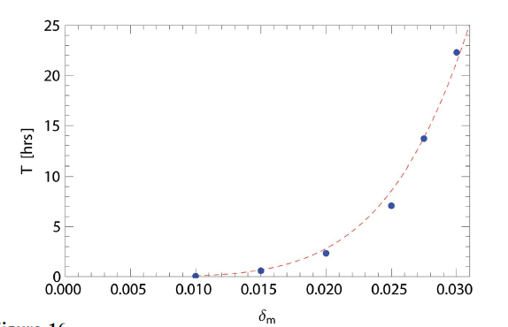
Collective effects in a diffraction-limited storage ring
IBS and Touscheck scattering
IBS will limit the emittances that can be achieved and the Touschek effect sets the beam lifetime.
Touscheck scattering
Touschek effect concerns large single Coulomb scattering events where energy transfer from transverse to longitudinal leads to immediate particle loss.
Momentum acceptance
(i) the Touschek effect is strongest where the beam size is small and
(ii) the effect becomes weak again for very small emittances.
The Touschek lifetime depends on the momentum acceptance of a ring

Slide 13
Collective effects in a diffraction-limited storage ring
Cure of beam instabilities
Chromaticity shifting
The chromaticity shifting should be effective in stabilizing a single bunch against TMCI or HT instability, as well as multibunch beam against RW instability.
However, at the cost of damping a head-tail mode the shift may excite higher-order modes that were previously stable.
A larger positive chromaticity generally signifies stronger sextupoles, thus increasing the nolinearity of the machine optics, and reducing the dynamic acceptance.
Bunch-by-bunch feedback
For collective instabilities associating dipolar motions, whether transverse or longitudinal, bunch-by-bunch feedback appears to be a highly efficient method of stabilizing the beam with today’s advanced technology in digital signal processing.
Transverse feedback stabilizes beam gainst both RW and ions simultaneously in the high current multibunch operation.
In single bunch, the TMCI threshold is increased by nearly a factor of three with the maximum stripline power available
Bunch lengthening with harmonic cavity
Flatten RF voltage using fundamental and third harmonic cavities -> Increase bunch length and Touschek lifetime.
In addition to bunch lengthening, the flattened potential also induces synchrotron tune spread which in turn helps stabilizing the beam against collective instability.

Slide 14
Collective effects in a diffraction-limited storage ring
The end

