Slide 1


JKPS 250117
Breaking 50 Femtosecond Resolution Barrier in MeV Ultrafast Electron Diffraction
with a Double Bend Achromat Compressor
Minseo Jeong
17, Jan 2025

Slide 2
JKPS 250117
Index
Background
Introduction
Experiment setting
Result
Demonstration of pump-probe experiment
2

Slide 3
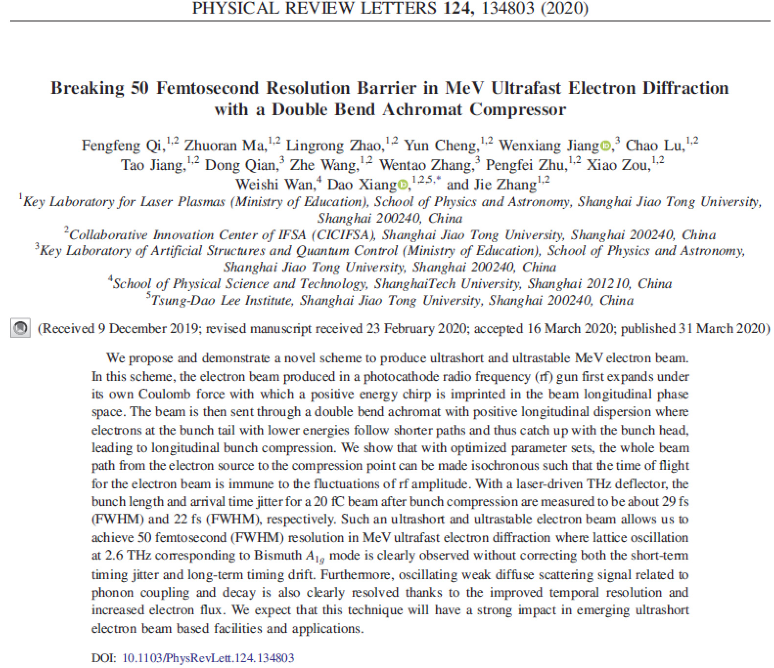
JKPS 250117
Background
3

Slide 4
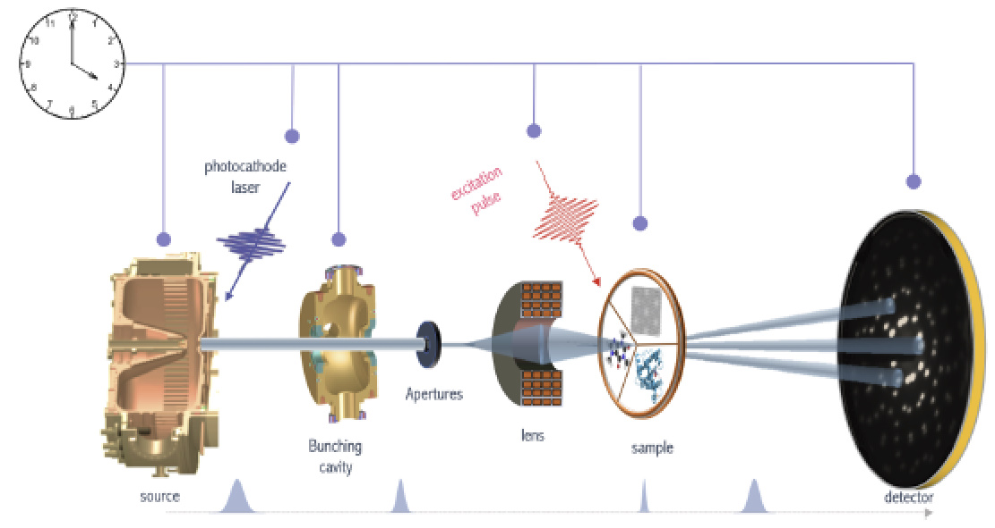
JKPS 250117
Background
Ultrafast electron diffraction(UED): Imaging technique based on electron diffraction caused by ultrafast electron
D. Filippetto et al. Rev. Mod. Phys. (2022).
4

Slide 5
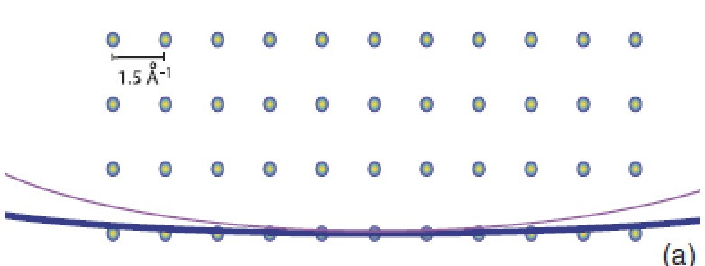
JKPS 250117
Background
Comparison with X-ray diffraction
- Larger momentum resolution
- Higher(10⁴~10⁶) cross section
→Applicable to 2D matter, liquid, and gas samples
- Less(10⁻³) radiation damage per scattering event
- Controllable by EM lenses
5

Slide 6
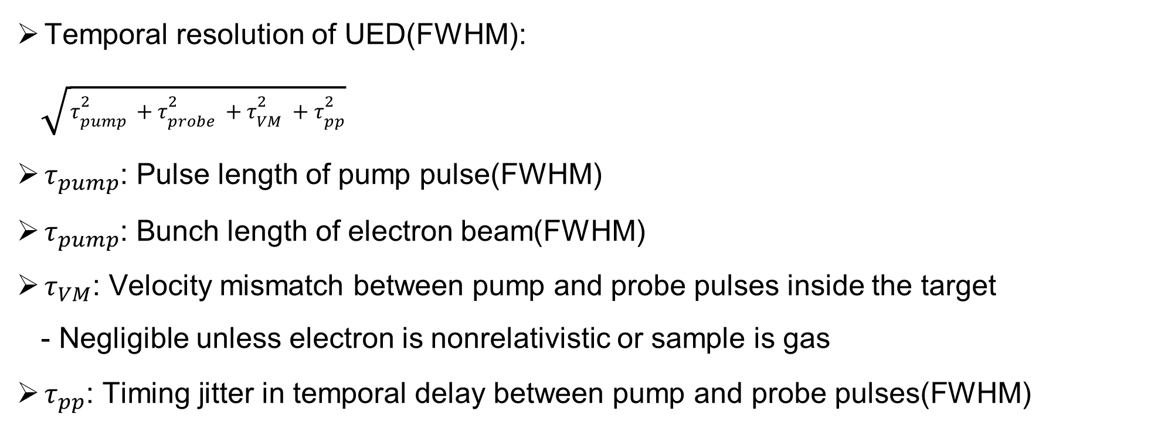
JKPS 250117
Introduction
Temporal resolution of UED(FWHM):
$\sqrt{τ_{pump}^{2}+τ_{probe}^{2}+τ_{VM}^{2}+τ_{pp}^{2}}$
$τ_{pump}$: Pulse length of pump pulse(FWHM)
$τ_{pump}$: Bunch length of electron beam(FWHM)
$τ_{VM}$: Velocity mismatch between pump and probe pulses inside the target
- Negligible unless electron is nonrelativistic or sample is gas
$τ_{pp}$: Timing jitter in temporal delay between pump and probe pulses(FWHM)
6
Notes:
If the same laser system is used to both generate photoelectrons and excite the sample, we then
have τΔpp =τΔeTOF , where τΔeTOF is the electron time of flight (TOF)

Slide 7
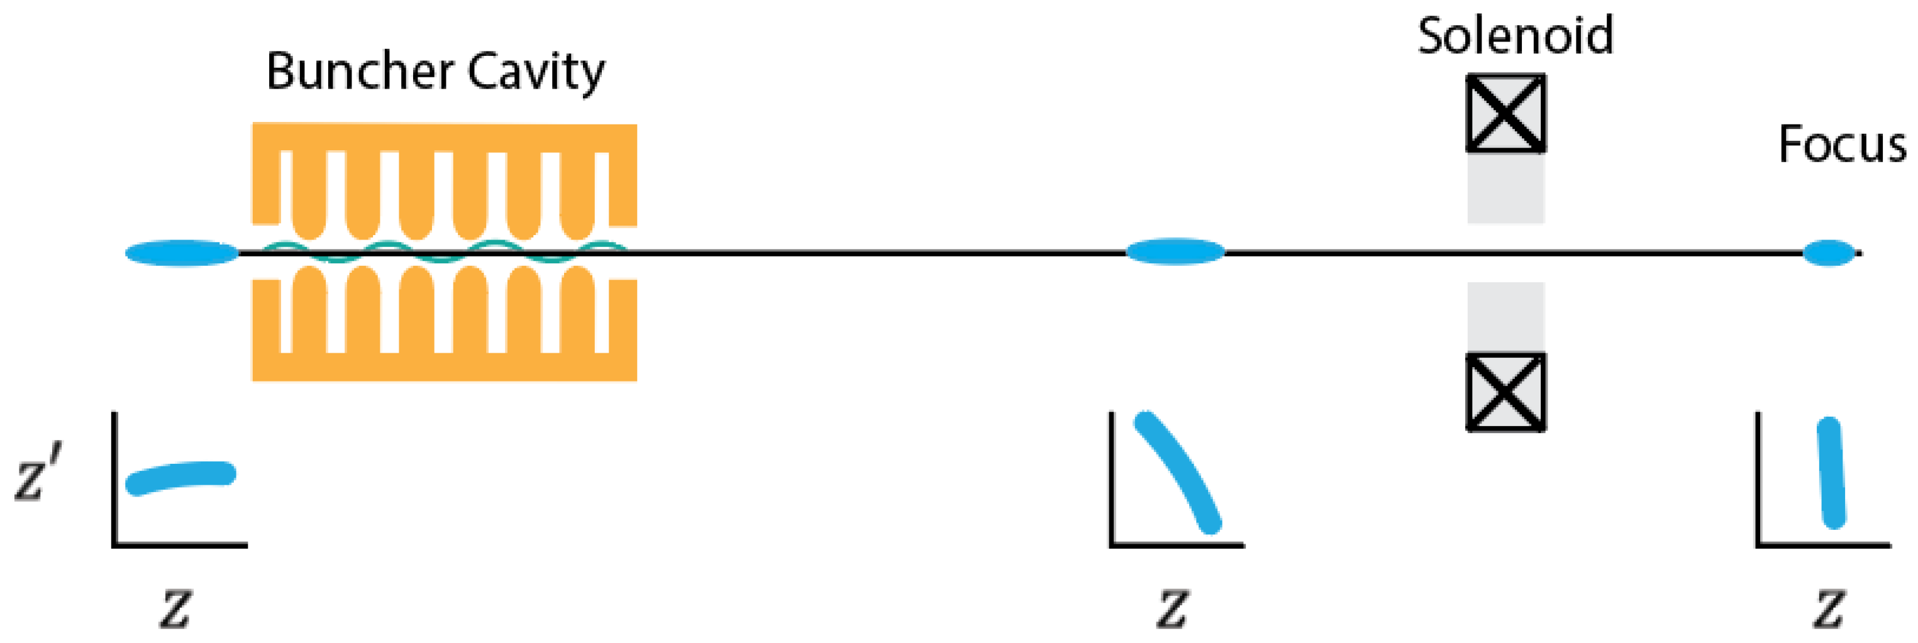
JKPS 250117
Introduction
RF buncher
- Compresses electron bunch to sub-10fs
- High timing jitter due to RF phase jitter
P. Denham and P. Musumeci. Instruments. (2023)
7
Notes:
Velocity bunching: a difference in longitudinal momentum translates into a difference in longitudinal velocities,
energy chirp->tail have a higher energy->tail catches up

Slide 8
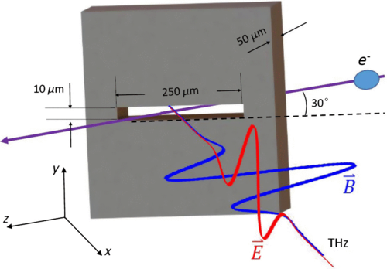
JKPS 250117
Introduction
THz-based time stamping
- Records beam parameters(e.g. energy) and timing jitter in high accuracy (~1.5fs)
- Feasible to correct timing jitter
- Applicable only to low repetition rate (due to the detector response time) and single shot
L. Zhao. et al. Phys. Rev. X (2018)
8
Notes:
The electron beam gets a time-dependent angular kick from the THz pulse when it passes through the slit
The terahertz pulse and the electrons interact in a narrow slit, ->deflects the electron beam.
By correlating these deflections with the terahertz pulses, we can measure and sort the beam arrival time on a shot-by-shot basis
timing jitter Δt is linearly correlated with the beam energy jitter
Accuracy: 12fs(FWHM) for real-time time stamping(beam energy stability 때문에 정확성이 낮아짐)

Slide 9
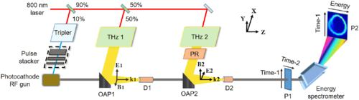
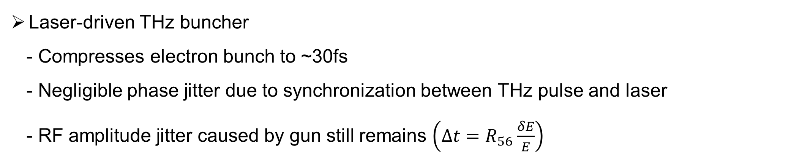
JKPS 250117
Introduction
Laser-driven THz buncher
- Compresses electron bunch to ~30fs
- Negligible phase jitter due to synchronization between THz pulse and laser
- RF amplitude jitter caused by gun still remains $\left(∆t=R_{56}\frac{δE}{E}\right)$
L. Zhao. et al. Phys. Rev. Lett. (2020)
9
Notes:
D1, D2: dielectric tube
THz 1은 vertical, 2는 horizontal

Slide 10
JKPS 250117
Experiment Setup
Compression of pulse and reduction of jitter via double bend achromat(DBA), which consists of two bending magnets and three quadrupoles
Gun : 2.4 cell RF (2.856GHz) gun
Electron beam energy : 3MeV
UV laser pulse length : ~100fs (FWHM)
UV laser transverse size : ∼200μm (FWHM)
the bending angles of the two dipole magnets : ±60° respectively
The effective length of the bending magnet : ~28cm
The beam trajectory offset before and after the DBA : 70cm
Initial bunch charge : 200fC
F. Qi. et al. Phys. Rev. Lett. (2020)
10

Slide 11
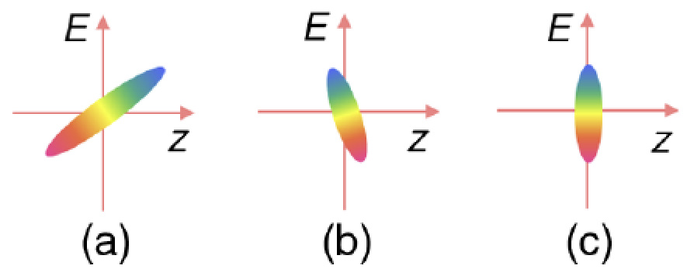
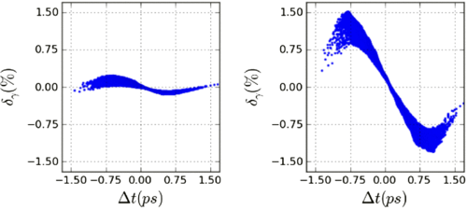
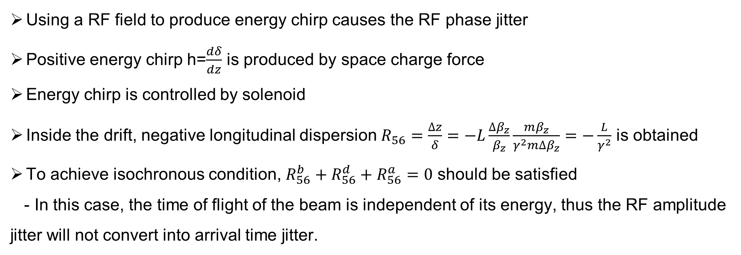
JKPS 250117
Experiment Setup
Using a RF field to produce energy chirp causes the RF phase jitter
Positive energy chirp h=$\frac{dδ}{dz}$ is produced by space charge force
Energy chirp is controlled by solenoid
Inside the drift, negative longitudinal dispersion $R_{56}=\frac{∆z}{δ}=−L\frac{∆β_{z}}{β_{z}}\frac{mβ_{z}}{γ^{2}m∆β_{z}}=−\frac{L}{γ^{2}}$ is obtained
To achieve isochronous condition, $R_{56}^{b}+R_{56}^{d}+R_{56}^{a}=0$ should be satisfied
- In this case, the time of flight of the beam is independent of its energy, thus the RF amplitude jitter will not convert into arrival time jitter.
A. He. et al. Phys. Rev. ST Accel. Beams (2015)
11
Notes:
charge repulsion force 때문에 the bunch head gets energy while the bunch tail loses energy
(a): bunch head moving faster than the bunch tail

Slide 12
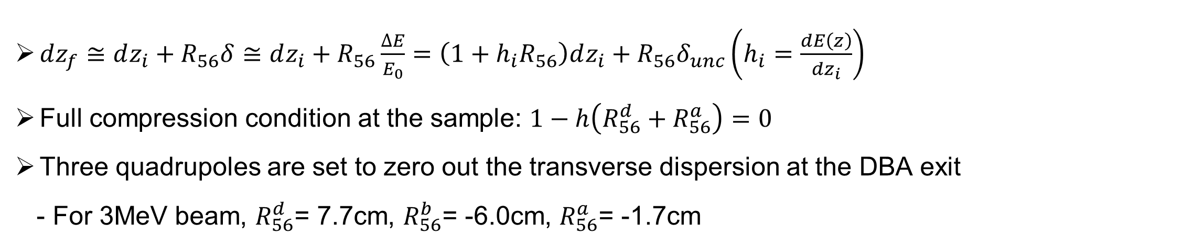
JKPS 250117
Experiment Setup
$dz_{f}≅dz_{i}+R_{56}δ≅dz_{i}+R_{56}\frac{∆E}{E_{0}}=\left(1+h_{i}R_{56}\right)dz_{i}+R_{56}δ_{unc}\left(h_{i}=\frac{dE\left(z\right)}{dz_{i}}\right)$
Full compression condition at the sample: $1−h\left(R_{56}^{d}+R_{56}^{a}\right)=0$
Three quadrupoles are set to zero out the transverse dispersion at the DBA exit
- For 3MeV beam, $R_{56}^{d}$= 7.7cm, $R_{56}^{b}$= -6.0cm, $R_{56}^{a}$= -1.7cm
12
Notes:
Linear approximation
R56: dispersion in dispersive section(R56b)

Slide 13
JKPS 250117
Experiment Setup
Performance of the system is subject to the spread of the initial energy chirp and higher-order effects in the transport line
Collimator eliminates spread of energy chirp
A slit is placed inside the DBA to remove the electrons at bunch head and tail where the energy chirp is dominated by nonlinear curvature
13
Notes:
High order effect의 예: second order longitudinal dispersion
Collimator: transverse offset이 큰 전자들을 제거 ->emittance, beam size 조절, energy chirp의 spread 제거
200fC->20fC

Slide 14
JKPS 250117
Experiment Setup
THz streaking was used to measure arrival time of beam
-single-cycle THz pulse produced by the 800 nm laser in a LiNbO₃ crystal is focused to a 100μm circular hole
Dynamic range: ~250fs
Fluctuation of the beam centroid divergence: 18μrad
Accuracy of THz streaking: 4fs(FWHM)
14
Notes:
Detector: phosphor screen
Zero-crossing point에서 minimized impact of THz power fluctuation, angular change is approximately linear.
Dynamic range: where the time is linearly correlated with the deflection
Accuracy는 fluctuation of the beam centroid divergence가 낮을 수록 좋아짐

Slide 15
JKPS 250117
Result
Since the longitudinal dispersion depends on beam energy, the arrival time at the sample is immune to RF amplitude fluctuation only for a specific beam energy
- When the beam energy is lower, DBA undercompensates the longitudinal
dispersion of the drifts and thus the whole beam line has negative longitudinal dispersion such that higher energy electrons have shorter time of flight.
- When the beam energy is higher, DBA overcompensates the longitudinal dispersion of the drifts and as a result higher energy electrons have longer time of flight
The slight nonlinear dependence of the beam arrival time on beam energy is due to second order longitudinal dispersion of the DBA
Red: 2.8MeV
Black: 3.0MeV
Blue: 3.2MeV
15

Slide 16
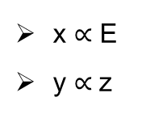
JKPS 250117
Result
x $∝$ E
y $∝$z
Bunch length: ~100fs(FWHM)
Bunch length: ~50fs(FWHM)
16
Notes:
electron bunch length is longer than the dynamic range(~250fs) of THz deflector

Slide 17
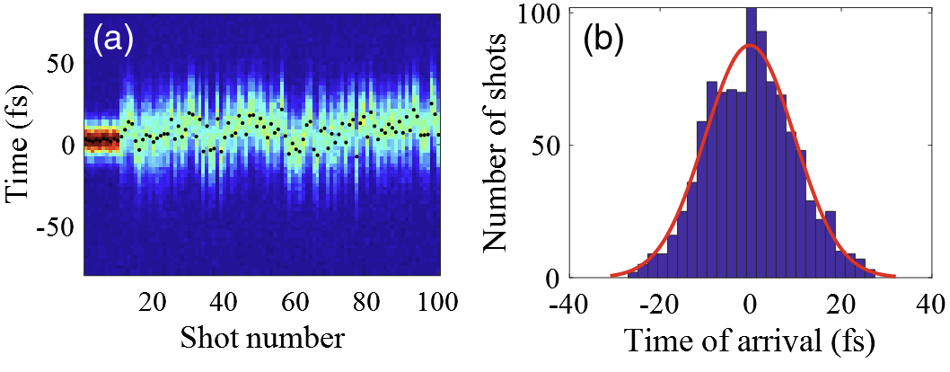
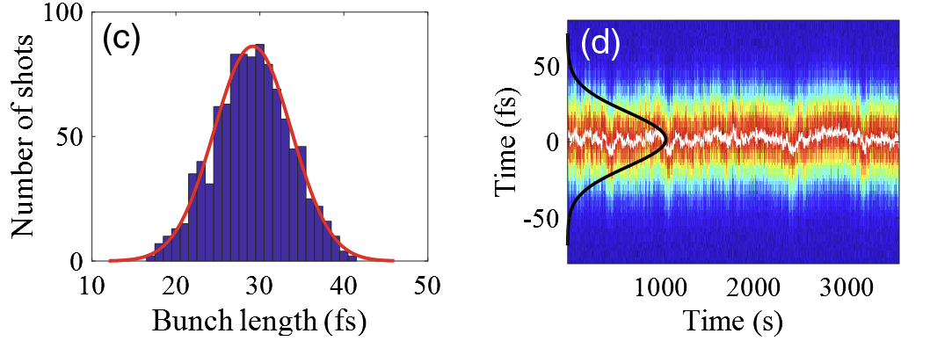
JKPS 250117
Result
Electron bunch length after full compression: 29fs(FWHM)
Timing jitter before DBA/ at the sample: 200fs/22fs(FWHM)
Residual timing jitter is caused by the RF phase jitter from RF gun
Convolution of bunch length and timing jitter: ~40fs(FWHM)
- If laser pulse length is ~25fs, then 50fs resolution can be achieved
17
Notes:
(d): long-term stability of the bunch length and timing jitter
High order long. dispersion can be compensated by sextupole

Slide 18
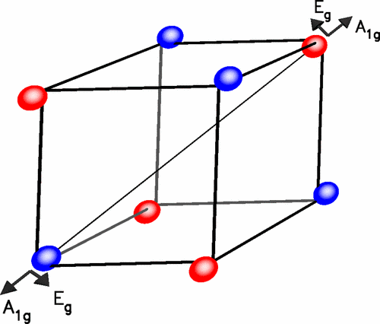
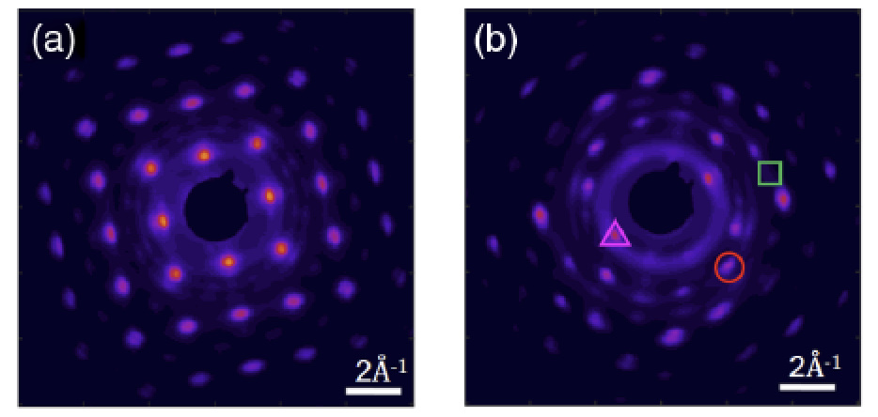
JKPS 250117
Demonstration of pump-probe experiment
A_{1g} phonon dynamics of bismuth was used to demonstrate pump-probe experiment
800nm laser with fluence 2.4mJ/cm² was used as pump
E. Zijlstra. et al. Phys. Rev. B. (2006)
18
Notes:
Bismuth: monoclinic, strong electron-phonon coupling due to its Peierls distorted structure
->large-amplitude phonon motion 연구에 많이 사용됨
photoexcitation->sudden change in the lattice potential->A1g mode oscillation

Slide 19
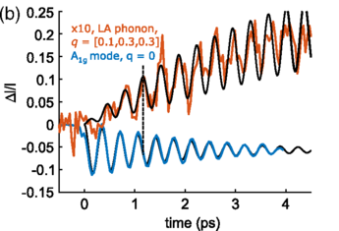
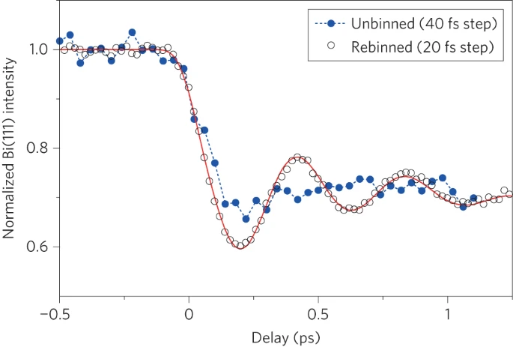
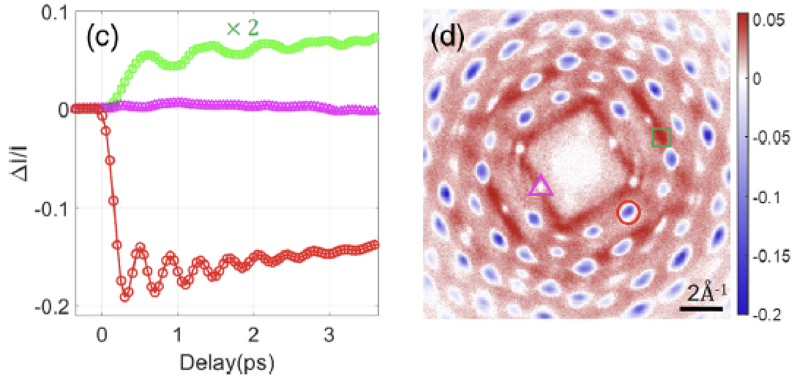
JKPS 250117
Demonstration of pump-probe experiment
Measured oscillation frequency of A_{1g} mode : ~2.6 THz
(Previous result by X-ray diffraction: 2.4~2.8THz)
Measured oscillation frequency of anharmonic decay of A_{1g} phonon: ~1.3THz
M. Harmand. et al. Nat. Photonics. (2013)
S. Teitelbaum. et al. Phys. Rev. Lett. (2018)
19
Notes:
Anharmonic: A1g phonon이 wavevector의 부호가 반대인 2개의 phonon으로 붕괴하여 생성
-resonance condition은 A1g freq의 절반

Slide 20
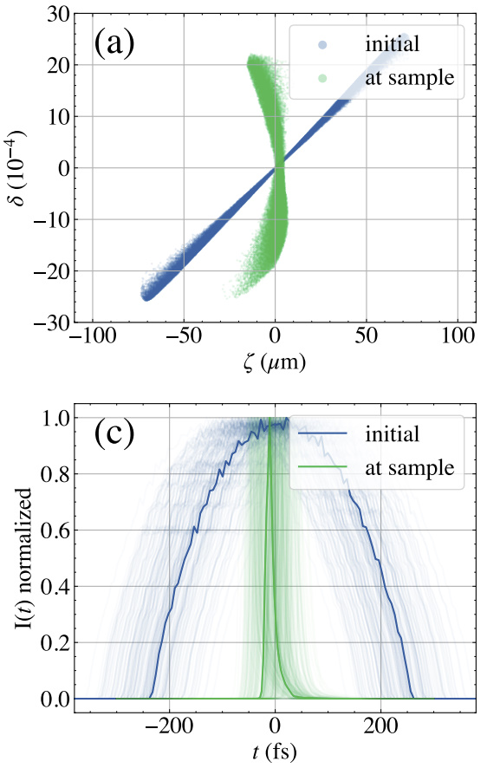
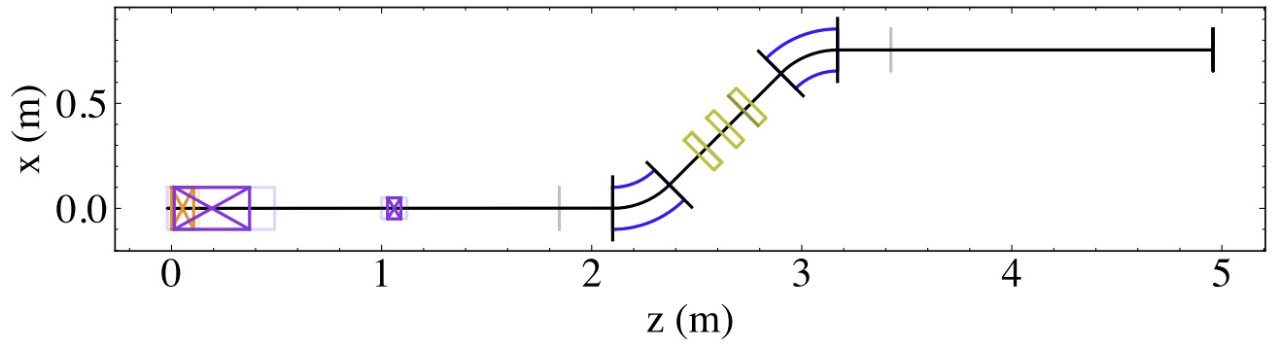
JKPS 250117
GPT Simulation(SLAC)
Beam energy | 4.2MeV
Charge | 100fC
Bunch length (rms, before compressor) | 112fs
Temporal jitter (rms, before compressor) | 36fs
x,y emittance (before compressor) | 26.8nm, 26.8nm
Bunch length (rms, after compressor) | 11.6fs
Temporal jitter (rms, after compressor) | 21fs
x,y emittance (after compressor) | 29.3nm, 27.7nm
ζ:relative longitudinal position within the bunch
T. Xu and J. England. arXiv:2408.00936v2. (2024)
20

Slide 21
JKPS 250117
Summary
In this paper, double bend achromat(DBA) was used to electron beam compression and removal of temporal jitter
As a result, electron bunch length and timing jitter was reduced to 29fs(FWHM), 22fs(FWHM) respectively
Limitation
- Immune to RF amplitude fluctuation is applicable only for a specific beam energy
- Remaining of RF phase jitter
21

Slide 22
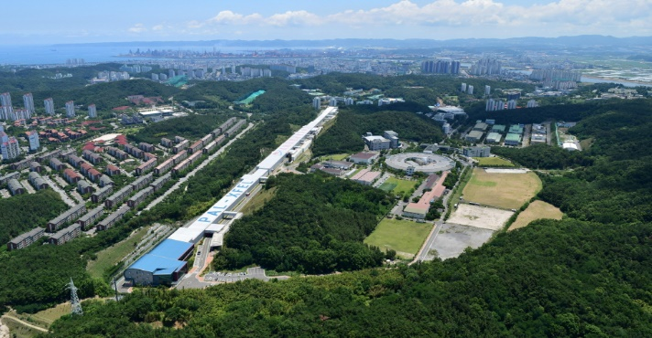


JKPS 250117
Thank you!

