Slide 1
Active Harmonic Cavity Analysis
2025-01-17, Pohang, South Korea
Young Min Park
Division of Advanced Nuclear Engineering (DANE), POSTECH

Slide 2
Index
Previous work
Active harmonic cavity
  Overview
  Without beam loading
  With beam loading
4GSR analysis
  Main cavity
  HHC
Simulation result
Conclusion
2

Slide 3
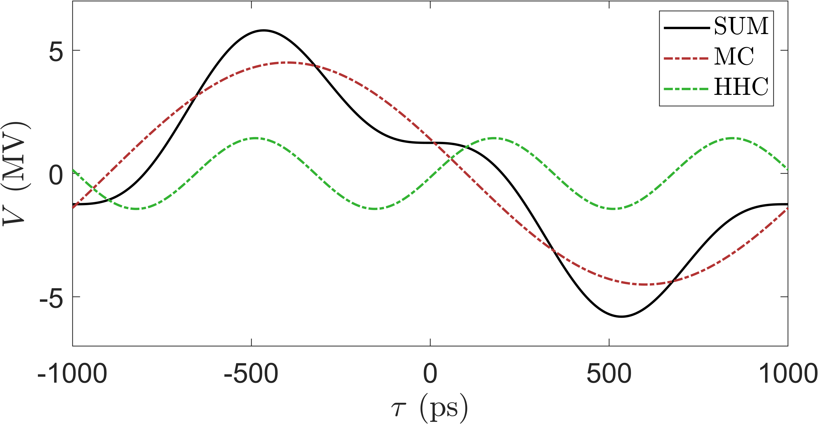
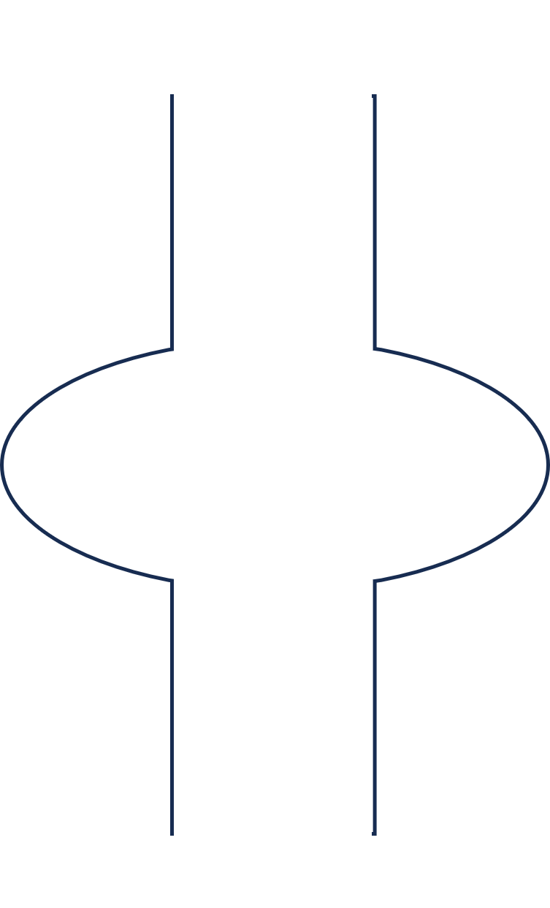



Previous work
Bunch lengthening
Beam loses energy due to bending or insertion devices, and the lost energy is replenished through the RF cavity.
Flattening the voltage slope at the energy replenishment location can increase the bunch length.
The well-known method for flattening the voltage slope is using a Higher Harmonic Cavity with the harmonics of the Main cavity.
Previous work focused only on bunch lengthening using passive cavities, but since the 4GSR uses active cavities for bunch lengthening, a study on the physics of active cavities was conducted.
N
Radiation loss $=U_{0}$
S
Main cavity
Undulator
3/23

Slide 4
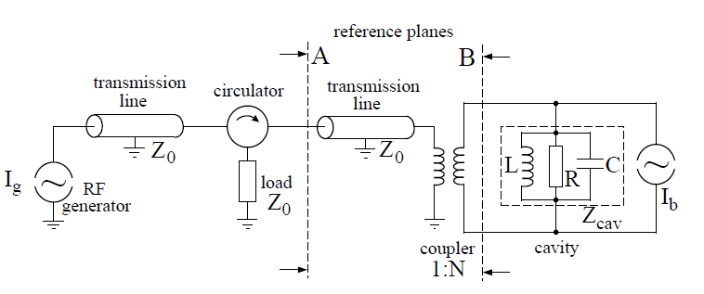
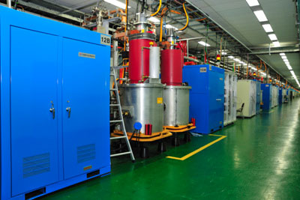
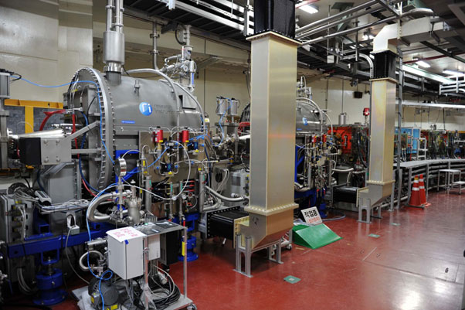
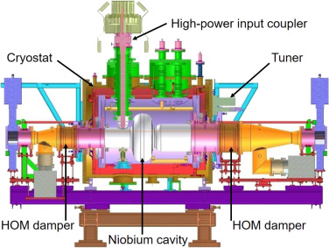
Active Harmonic Cavity
Active cavity
Overview
Passive cavity
Power generator
Waveguide
Coupler&Cavity
Waveguide
Cryostat
Klystron
Modulator
Waveguide
4/23

Slide 5
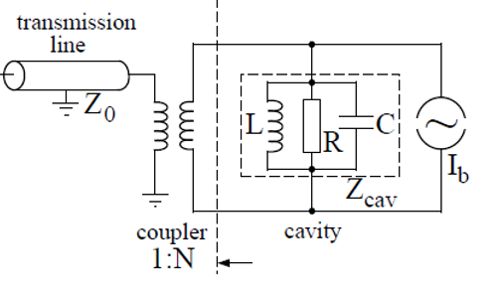


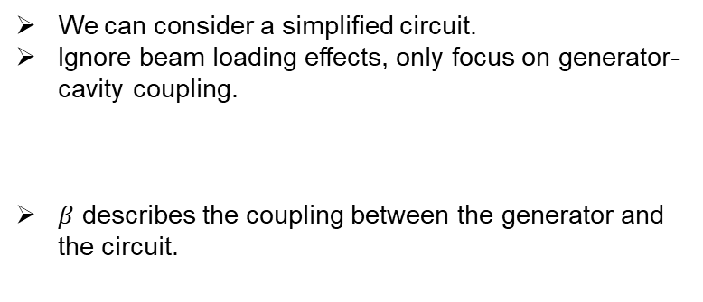

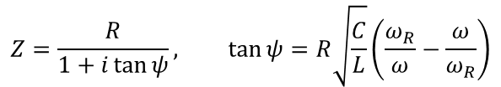










Active Harmonic Cavity
Without Beam Loading
We can consider a simplified circuit.
Ignore beam loading effects, only focus on generator-cavity coupling.
$β$ describes the coupling between the generator and the circuit.
$$V_{ref}$$
$$V_{for}$$
$$V_{cav}$$
$$β=\frac{R}{N^{2}Z_{0}}$$
$$β=\left\{\begin{matrix}<1 & →under coupling \\ =1 & →critical coupling \\ >1 & →over coupling\end{matrix}\right.$$
$$Im$$
Impedance of cavity
Real axis is in-phase voltage seen by beam.
$$Z=\frac{R}{1+i\tan{ψ}}, \tan{ψ}=R\sqrt{\frac{C}{L}}\left(\frac{ω_{R}}{ω}−\frac{ω}{ω_{R}}\right)$$
$$Re$$
$$V_{cav}$$
$$ψ$$
$$V_{for}$$
$$V_{ref}$$
$$V_{cav}=\frac{2βV_{for}}{β+1}⋅\cos{ψ}e^{iψ}$$
$$β→1, P_{ref}=\frac{{\left|V_{ref}\right|}^{2}}{2N^{2}Z_{0}} is minimized$$
5/23

Slide 6



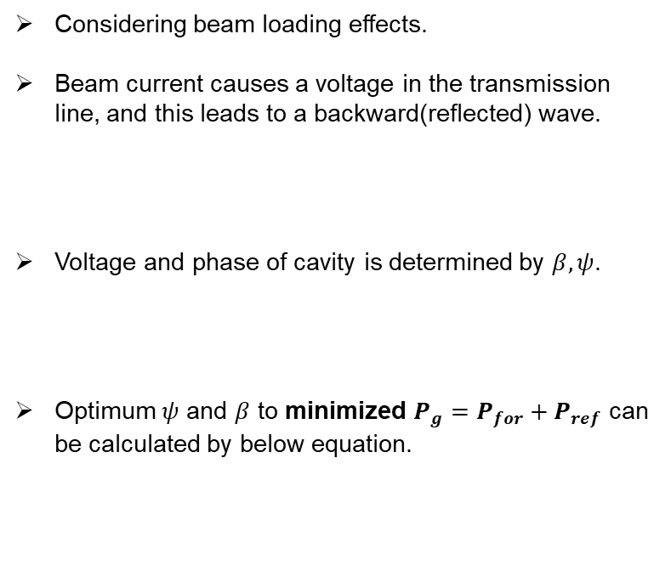














Active Harmonic Cavity
With Beam Loading
Considering beam loading effects.
Beam current causes a voltage in the transmission line, and this leads to a backward(reflected) wave.
Voltage and phase of cavity is determined by $β, ψ$.
Optimum $ψ$ and $β$ to minimized $P_{g}=P_{for}+P_{ref}$ can be calculated by below equation.
$$V_{ref}$$
$$V_{for}$$
$$V_{cav}$$
$$V_{b}$$
$$V_{b}=\frac{2RI_{0}}{\left(1+β\right)}\cos{ψ}⋅e^{iψ}$$
$$V=V_{cav}\sin{φ_{s}}=Re \left(V_{cav}\right)$$
$$Im$$
$$\frac{2RI_{0}}{\left(1+β\right)}$$
$$ψ$$
$$Re$$
$$\tan\left(ψ_{opt}\right)=\frac{2RI_{0}}{\left(β+1\right)V_{cav}}\cos{φ_{s}}$$
$$ψ$$
$$P_{ref}→0$$
$$φ_{s}$$
$$V_{g}$$
$$V_{b}$$
$$β_{opt}=1+\frac{2RI_{0}}{V_{cav}}\sin{φ_{s}}$$
$$minimized P_{for}$$
$$V_{cav}$$
$$\frac{2βV_{for}}{β+1}$$
6/23

Slide 7
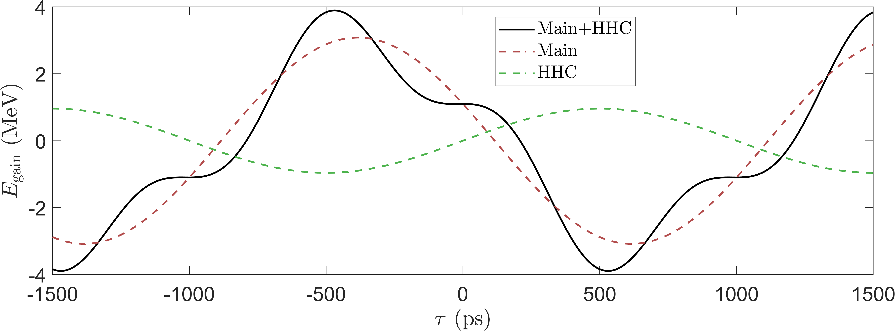
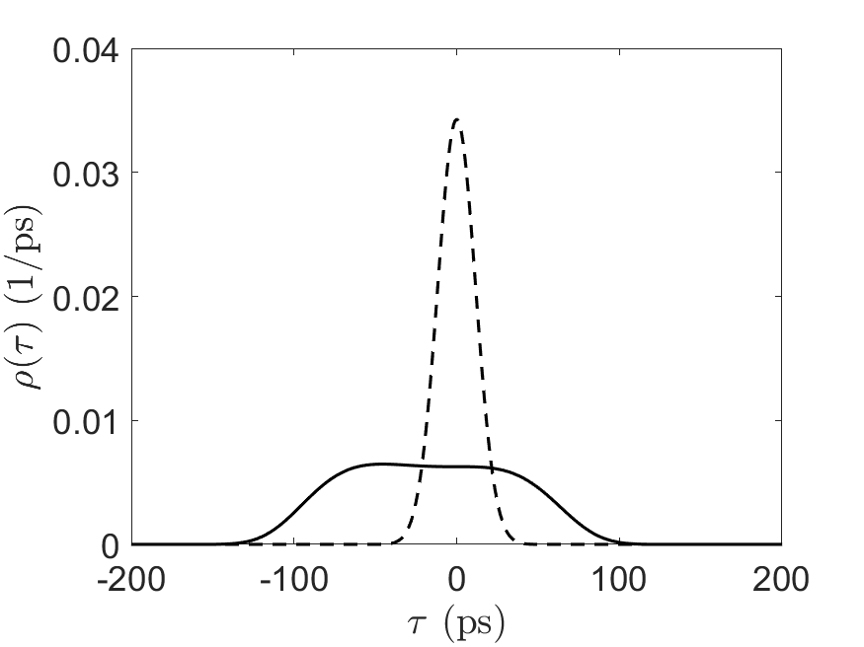
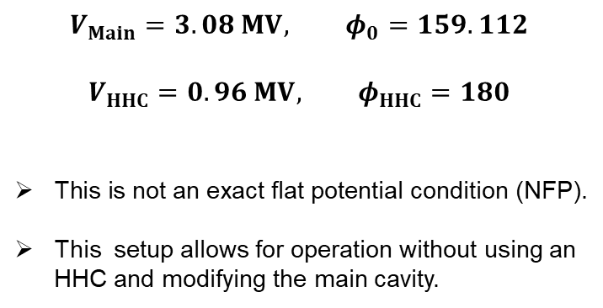
4GSR bunch lengthening
Ring parameter
$$V_{Main}=3.08 MV, φ_{0}=159.112$$
$$V_{HHC}=0.96 MV, φ_{HHC}=180$$
This is not an exact flat potential condition (NFP).
This setup allows for operation without using an HHC and modifying the main cavity.
$$σ_{τ}=11.6369 ps →σ_{τ}=49.3984 ps$$
7

Slide 8
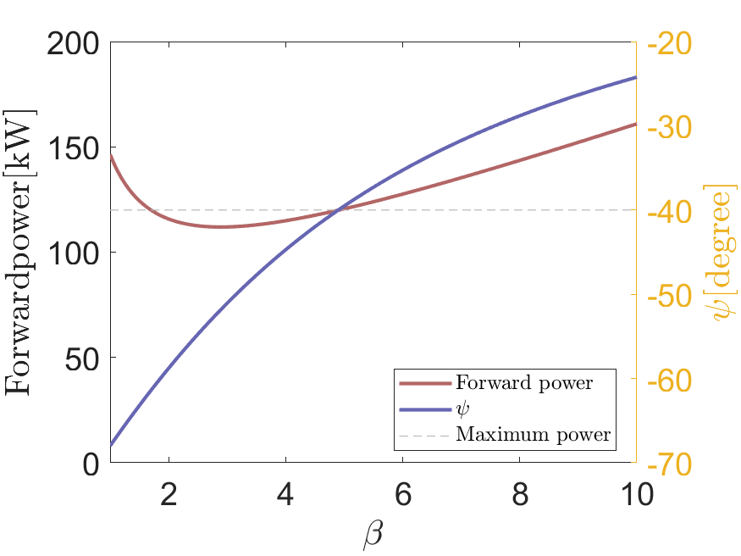
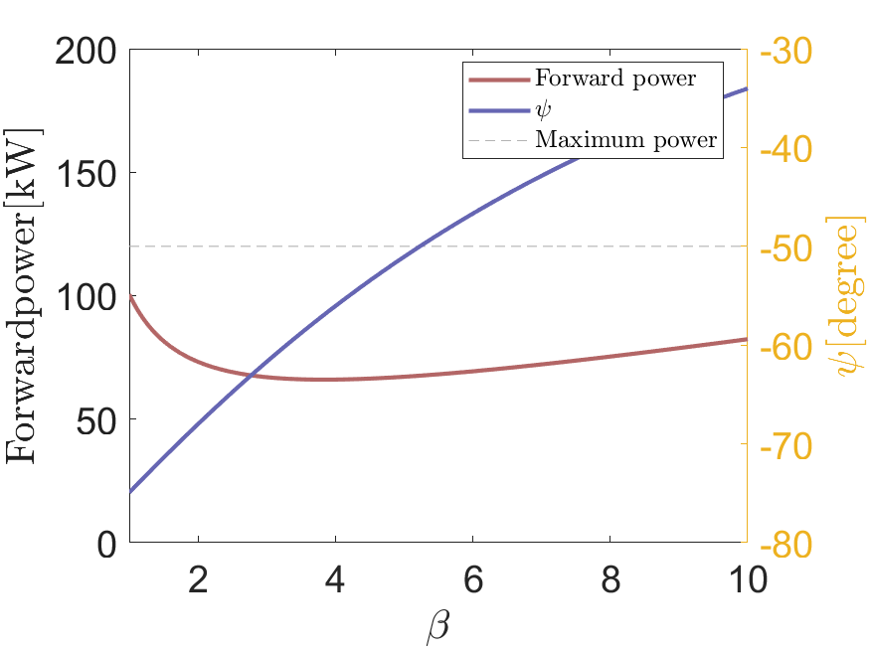
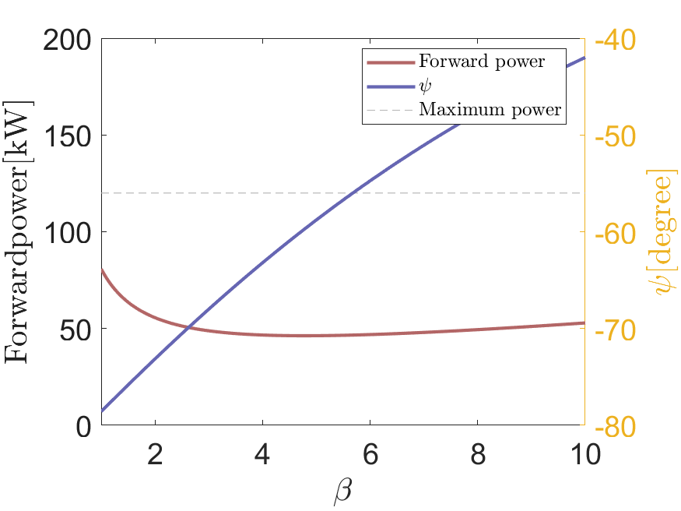


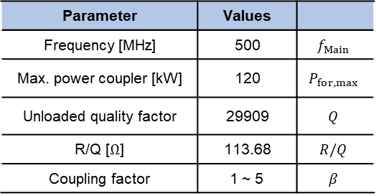
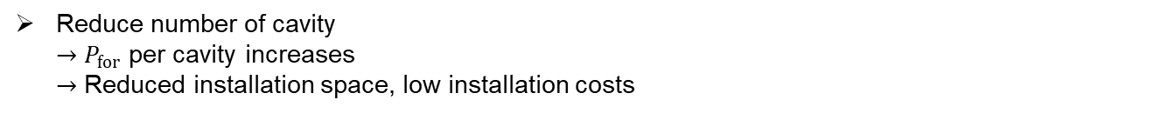

4GSR main cavity
Ring parameter
BESSY-II/ EU-HOM damped cavity
Cavity parameter
Parameter | Values
Frequency [MHz] | 500 | $$f_{Main}$$
Max. power coupler [kW] | 120 | $$P_{for,max}$$
Unloaded quality factor | 29909 | $$Q$$
R/Q [$Ω$] | 113.68 | $$R/Q$$
Coupling factor | 1 ~ 5 | $$β$$
$$N_{cav}=6$$
$$N_{cav}=9$$
$$N_{cav}=12$$
$$V_{cav}=3.08 MV, φ_{s}=159.112$$
Reduce number of cavity
$→$ $P_{for}$ per cavity increases
$→$ Reduced installation space, low installation costs
8

Slide 9
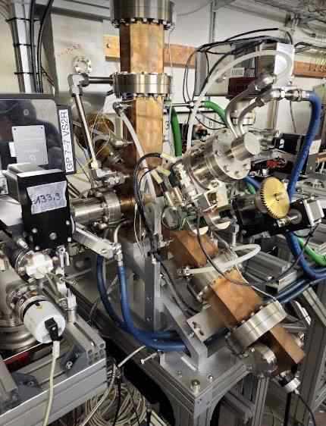
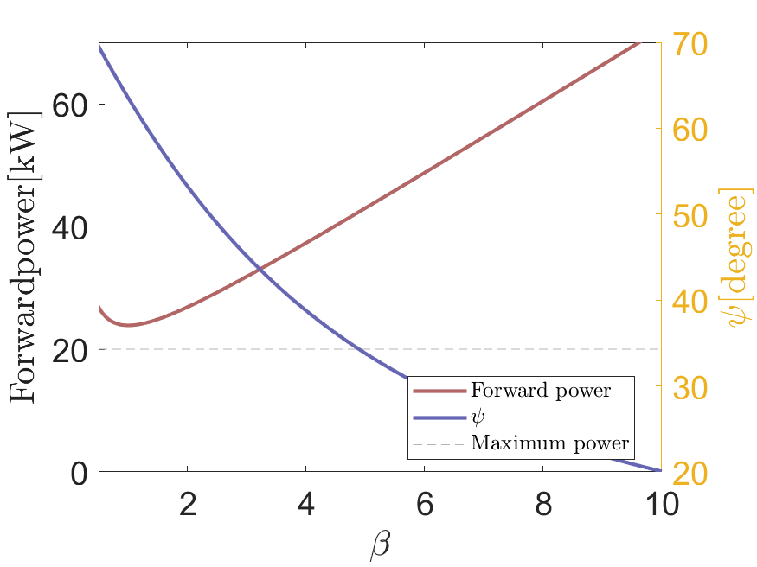
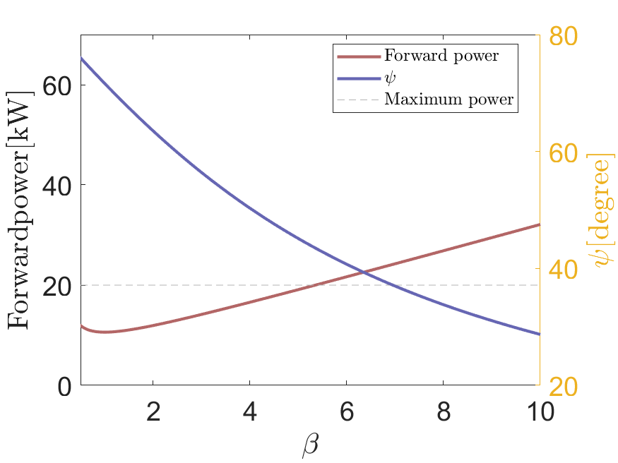
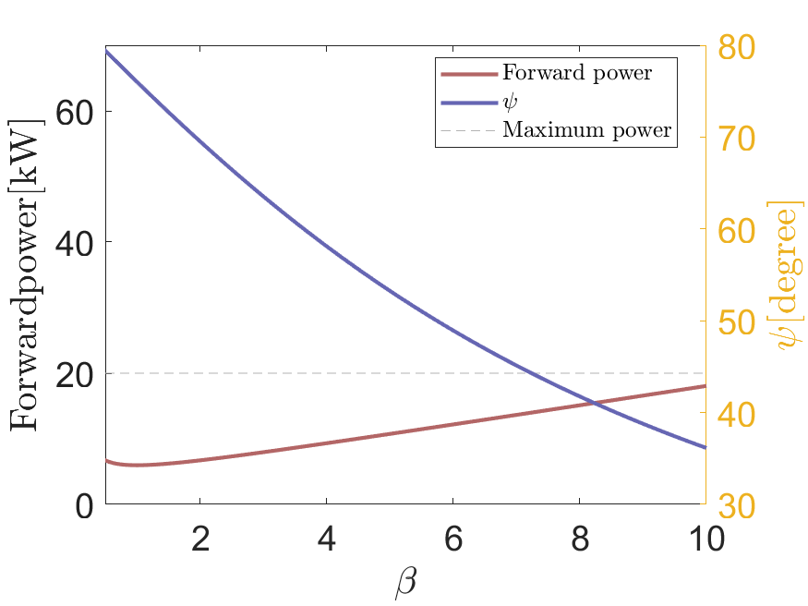


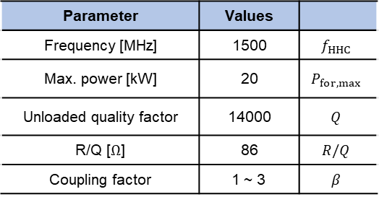

4GSR harmonic cavity
Ring parameter
ALBA 3rd Harmonic cavity
Cavity parameter
Parameter | Values
Frequency [MHz] | 1500 | $$f_{HHC}$$
Max. power [kW] | 20 | $$P_{for,max}$$
Unloaded quality factor | 14000 | $$Q$$
R/Q [$Ω$] | 86 | $$R/Q$$
Coupling factor | 1 ~ 3 | $$β$$
$$N_{cav}=4$$
$$N_{cav}=6$$
$$N_{cav}=8$$
$N_{Main,cav}→12, N_{HHC,cav}→8$
$β_{Main}→4.58, β_{HHC}→1$
$Δf_{Main}→−82.8 kHz,Δf_{HHC}→143.44 kHz$
$$V_{cav}=0.96 MV, φ_{s}=180$$
9

Slide 10
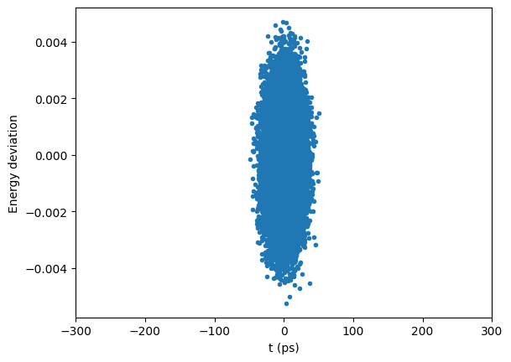
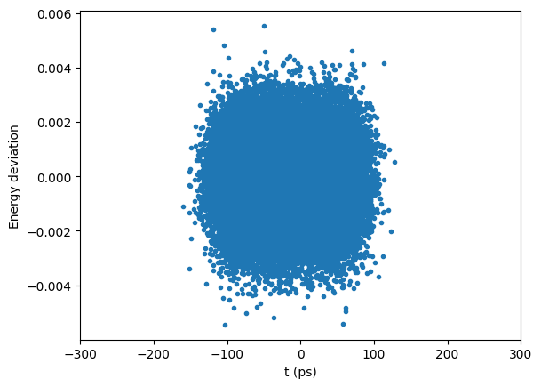
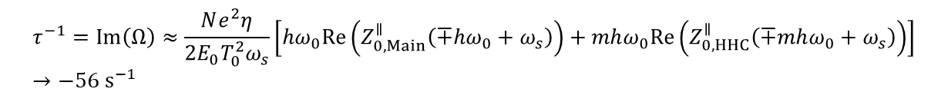


Simulation result
Ring parameter
By using pyAT(python Accelerator Toolbox)
Setting : 1 Bunch, 50000 Macroparticles
Can achieve a 4 times increase in bunch lengthening.
However, Severe instability observed when wake is included, deviating from analytical results.
Simulations conducted with only the main cavity for further investigation.
W/o Wake
HHC off
HHC on
$$12 ps$$
$$50 ps$$
$$τ^{−1}=Im\left(Ω\right)≈\frac{Ne^{2}η}{2E_{0}T_{0}^{2}ω_{s}}\left[hω_{0}Re\left(Z_{0,Main}^{∥}\left(∓hω_{0}+ω_{s}\right)\right)+mhω_{0}Re\left(Z_{0,HHC}^{∥}\left(∓mhω_{0}+ω_{s}\right)\right)\right] \\ →−56 s^{−1}$$
10

Slide 11
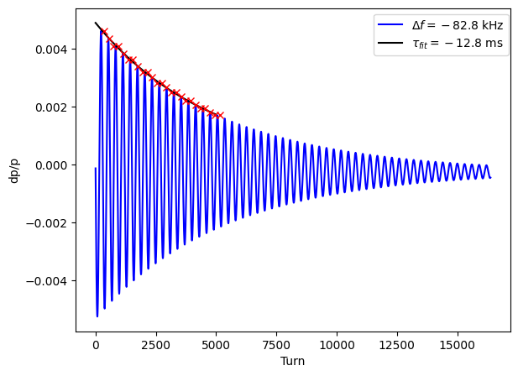
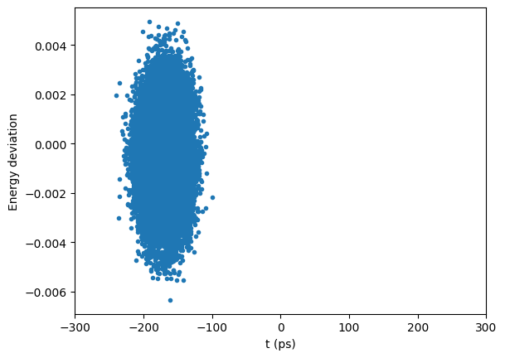
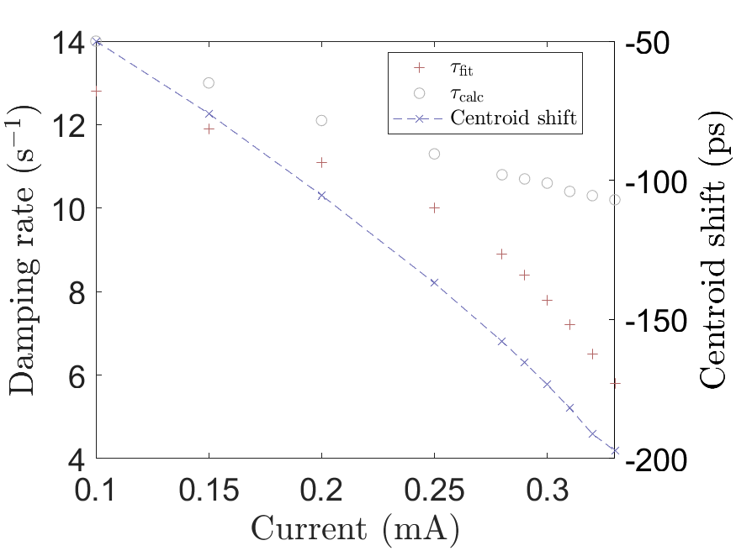
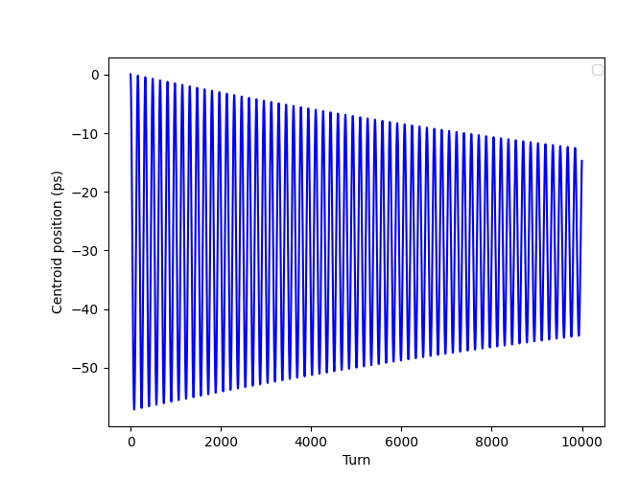
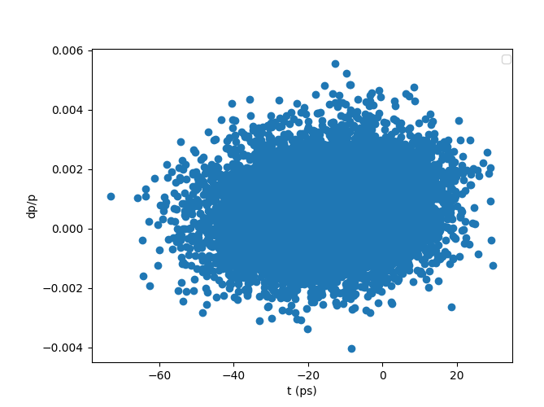



Simulation result
Ring parameter
Problems
w/o HHC, Wake on, $I=0.3A$
?
Centroid Shift
$$τ_{calc}=−10.6 ms$$
Suspected that beam loss occurred due to the centroid shift crossing the bucket separatrix.
Need to investigate the cause of the centroid shift observed in the simulation.
Head-tail? Robinson?
In the example file of ESRF, the centroid shift is also observed.
High single bunch current suspected as the cause.
Beam loss occurs $(I=0.3A)$
11

Slide 12
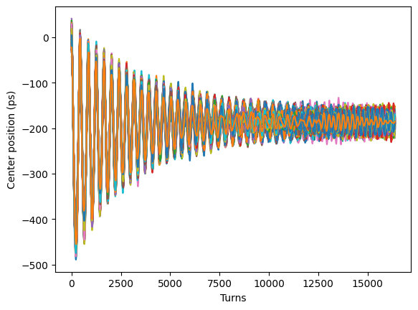
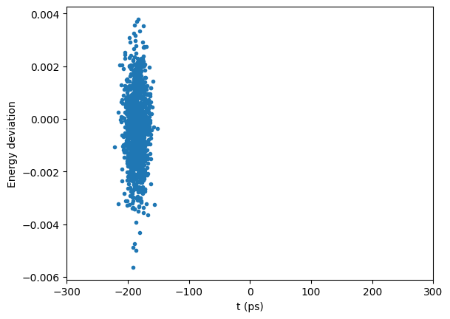
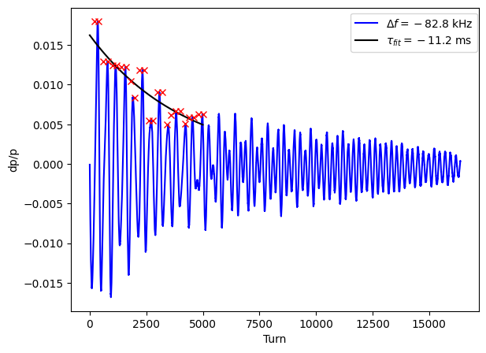
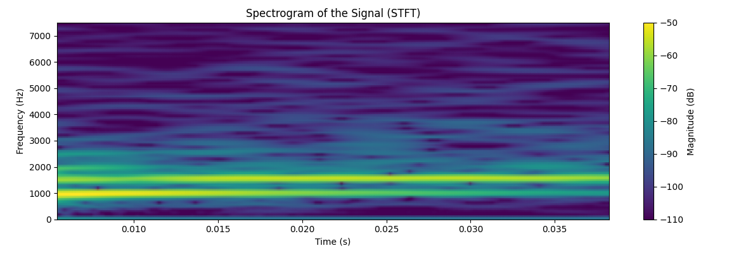

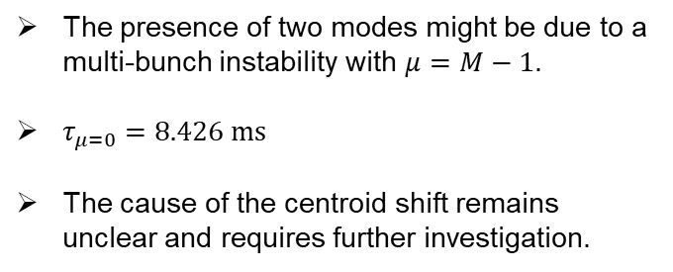

Simulation result
Ring parameter
Multi-bunch Simulation
w/o HHC, Wake on, $I=0.4A$, 1332 Bunches(1332 Macroparticles)
?
Centroid Shift
Observed a centroid shift of a similar scale to the single bunch case.
The calculated damping time is 9.4 ms, while the fitted value is 11.2 ms.
Signs of instability in other modes are observed, suggesting that analysis using STFT would provide more accurate insights.
The presence of two modes might be due to a multi-bunch instability with $μ=M−1$.
$τ_{μ=0}=8.426 ms$
The cause of the centroid shift remains unclear and requires further investigation.
$$μ=h−1$$
$$μ=0$$
12

Slide 13
Conclusion
Conducted a study on the conditions for steady state operation with an active cavity.
Identified the conditions for both the 4GSR main cavity and the HHC cavity.
Performed tracking simulations using pyAT and compared the results with analytical predictions
Problems
  A beam loss occurred at the location where Robinson instability does not take place due to centroid shift.
Research plan:
  Insert Harmonic cavities and wake fields and reran the simulation.
  Remove 300 bunch to makes gaps and observe transient effects.
  Optimized parameters of the main cavity and HHC cavity according to the Robinson instability analysis.
13/23

Slide 14
Thank you for your attention!
14/23

