Slide 1
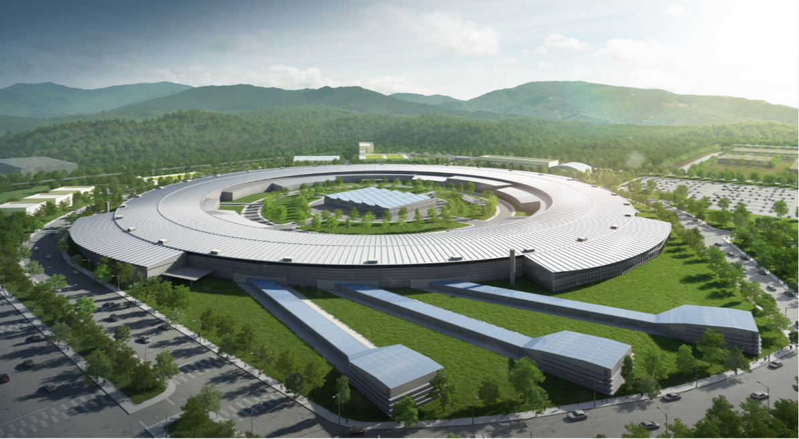

20250110 Group Meeting
20250110 Group Meeting
Minseo Jeong
10, Jan 2025

Slide 2
20250110 Group Meeting
Outline
Laser System of PAL-eLabs
Experiment Progress
GPT Simulation Code
2

Slide 3
20250110 Group Meeting
Laser System of PAL-eLabs
Photogun laser: Used to generate electron bunches by photoelectron effect
Pump laser: Used in pump-probe spectroscopy (scheme used to measure ultrafast phenomena)
3

Slide 4
20250110 Group Meeting
Laser System of PAL-eLabs
CPA
Oscillator
Stretcher
Amplifier
Compressor
THG/FHG
Photo-
cathode
Vacuum pipe
Spatial/
temporal shaping
4

Slide 5
20250110 Group Meeting
Laser System of PAL-eLabs
Material | Ti-Sapphire laser(800nm)
Pulse energy | 7mJ(IR) / >500μJ(UV)
Oscillator repetition rate | 79.333MHz
Pulse repetition rate | 120Hz
Spot size | 100μm(FWHM, variable)
Pulse duration | ~150fs
Wavelength on the photocathode | 266nm
5

Slide 6
20250110 Group Meeting
Ultrafast Electron Diffraction(UED)
Pump-probe imaging technique based on optical pump-probe spectroscopy and electron diffraction caused by ultrafast electron
D. Filippetto et al. Rev. Mod. Phys. (2022).
6

Slide 7
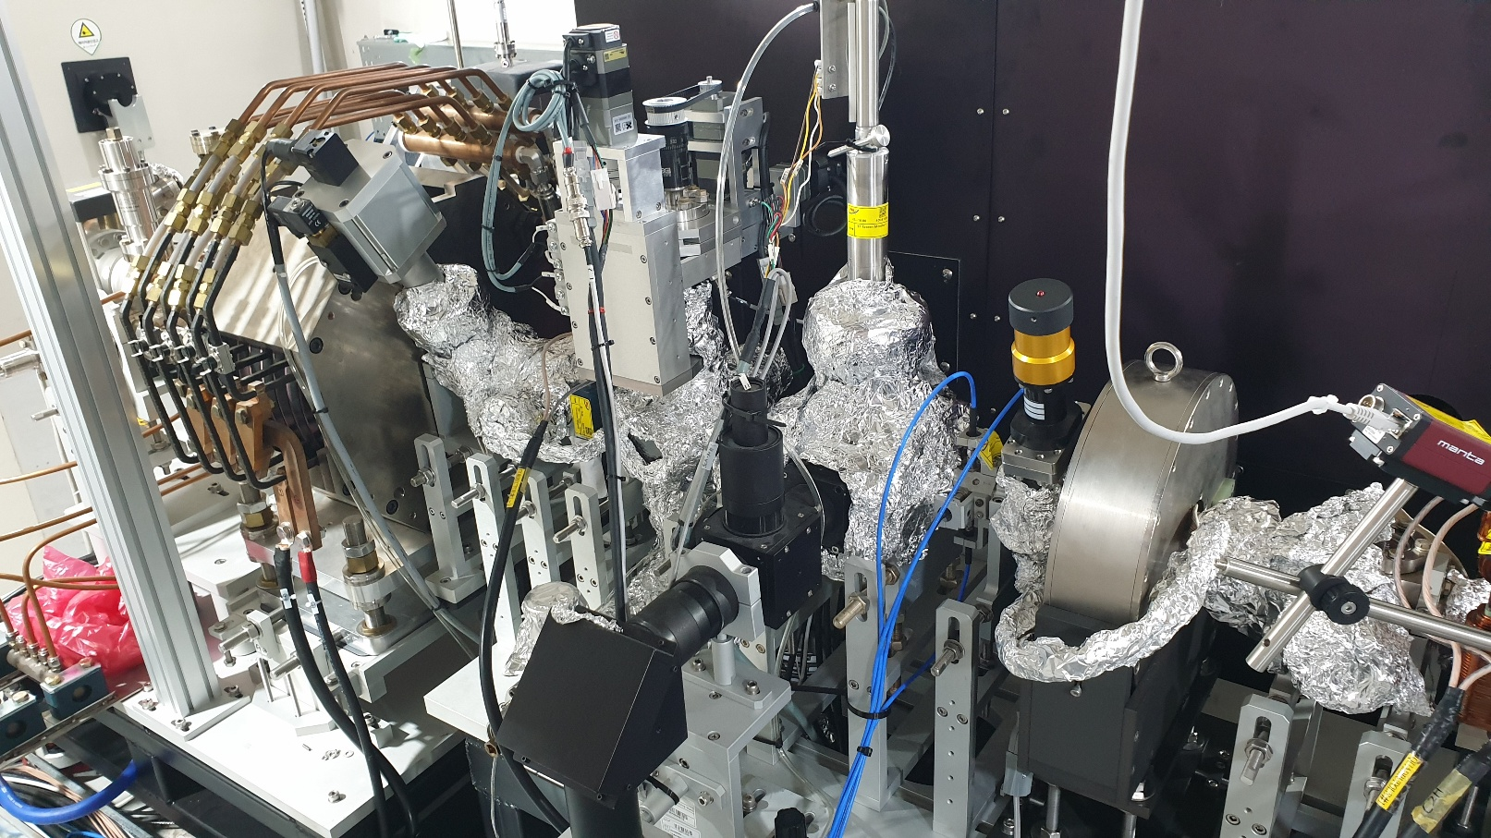
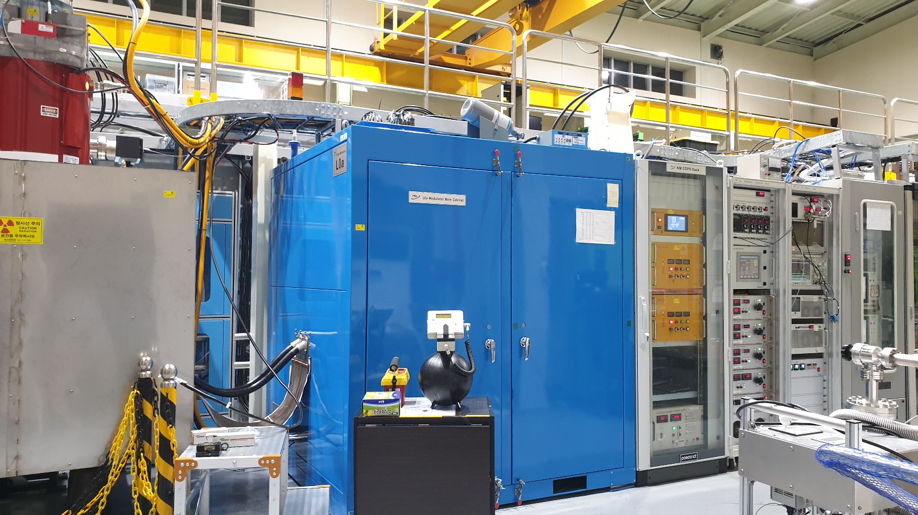
20250110 Group Meeting
Experiment Progress
7

Slide 8
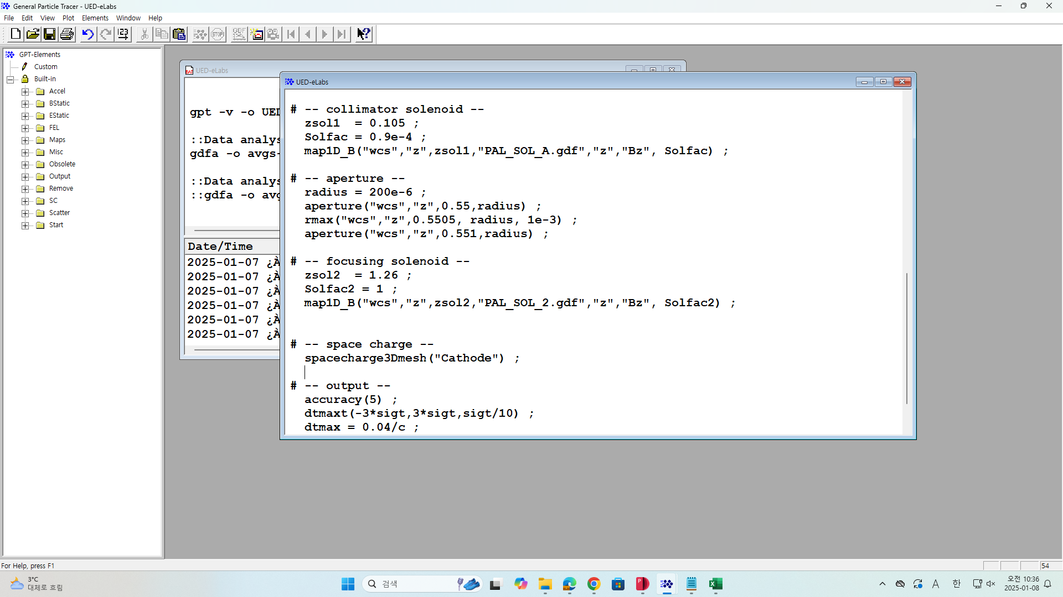
20250110 Group Meeting
GPT Simulation Code
General Particle Tracer(GPT): Beam simulation code which tracks charged particles in electromagnetic field
8

Slide 9
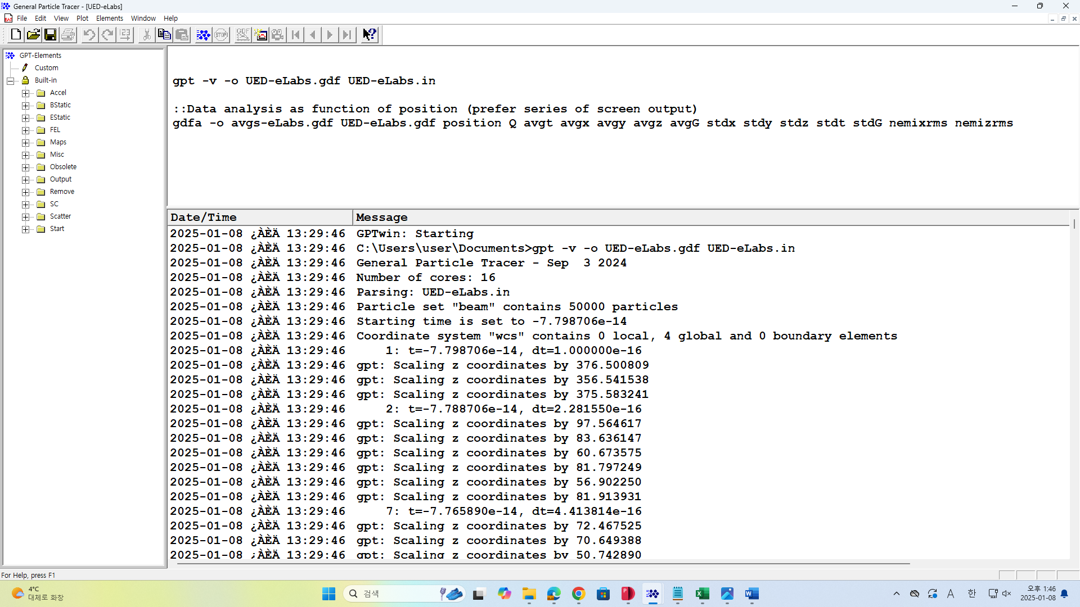
20250110 Group Meeting
GPT Simulation Code
Batch file: A file that contains instructions to run GPT
9

Slide 10
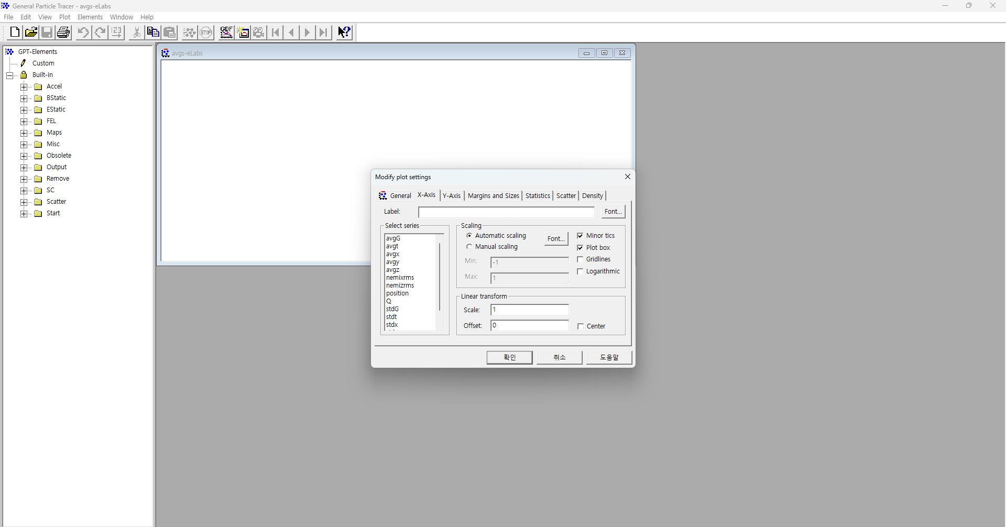
20250110 Group Meeting
GPT Simulation Code
Plotting Graph
10

Slide 11
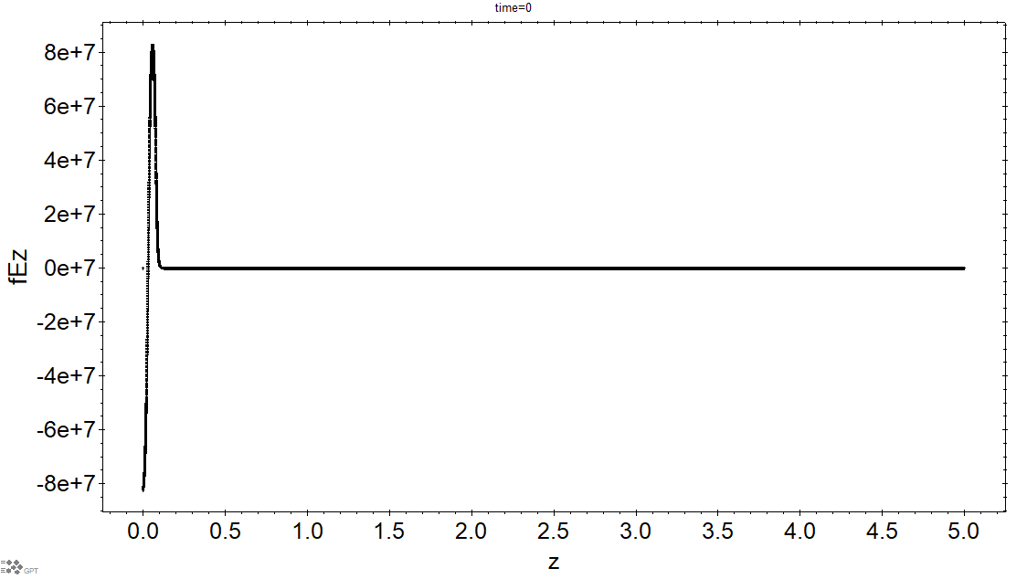
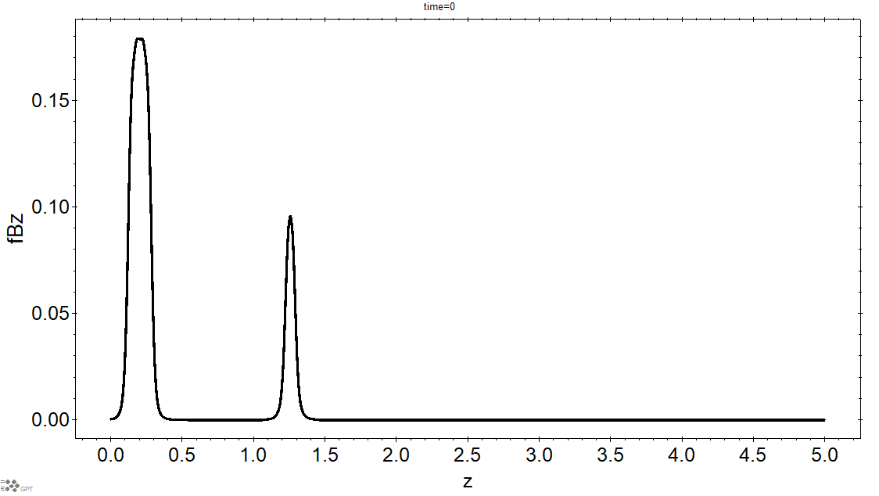
20250110 Group Meeting
GPT Simulation Code
Plotting field profile: By positioning a line of on-axis particles using setstartline at t=0
11

Slide 12
20250110 Group Meeting
GPT Simulation Code
Bunch charge | 75fC
Initial pulse length | 26fs(rms)
Beam size | 100μm(FWHM)
11

Slide 13
20250110 Group Meeting
GPT Simulation Code
Cavity frequency | 2.856GHz
Gun gradient | 82.84MV/m(max)
UV pump pulse duration | ~150fs
Solenoid 1 position | 0.196m
Solenoid 1 strength | 0.180T(max)
Solenoid 2 position | 1.26m
Solenoid 2 strength | 0.0959T(max)
Aperture position | 0.55m
Aperture diameter | 400μm
Detector position | 5.00m
11

Slide 14
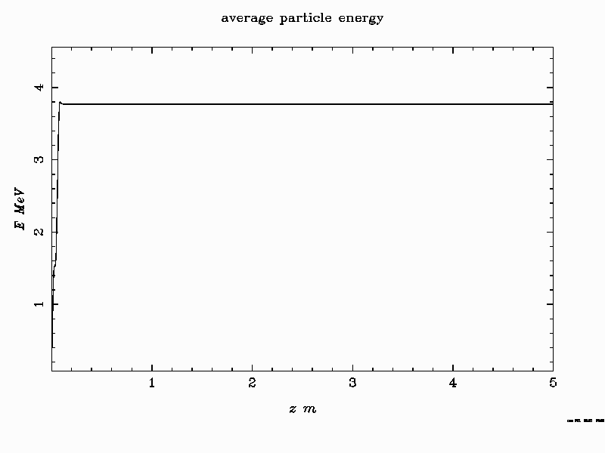
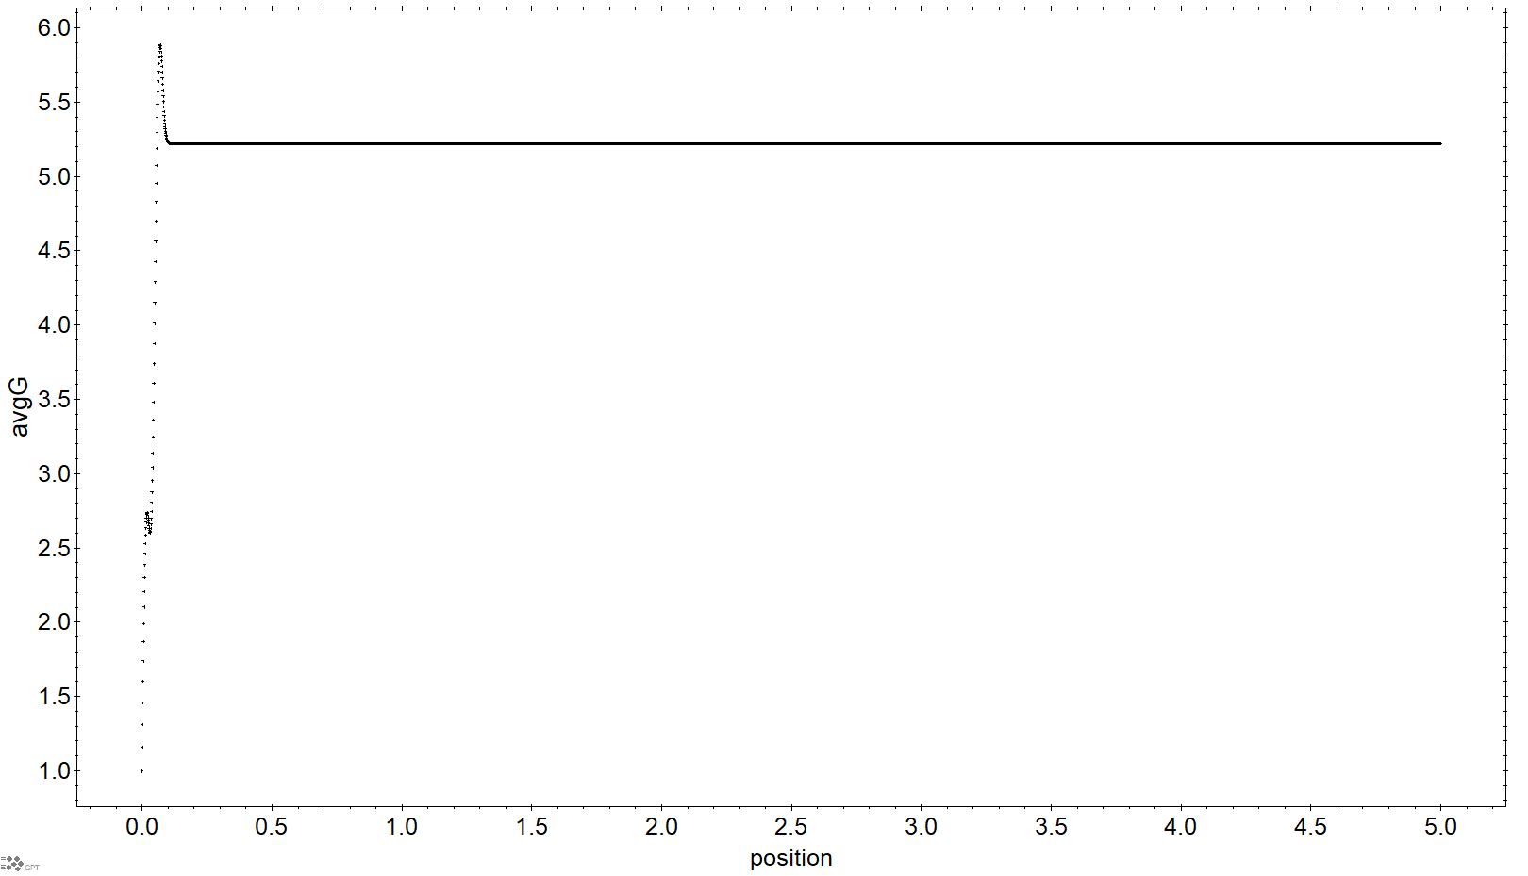
20250110 Group Meeting
GPT Simulation Code
Plot of energy of electron beam
12

Slide 15
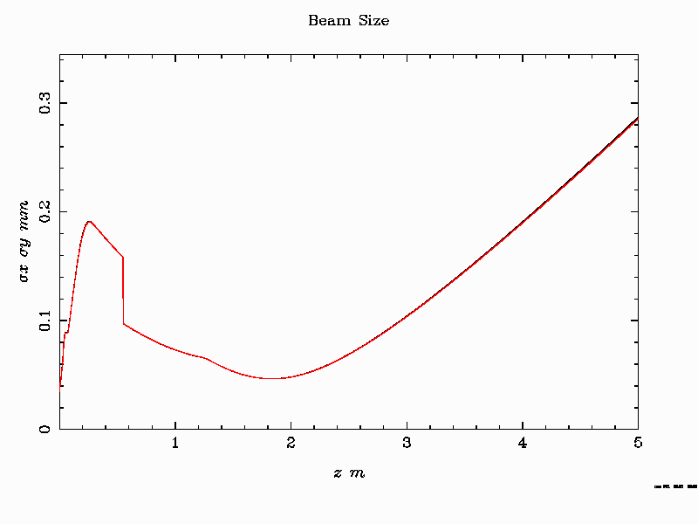
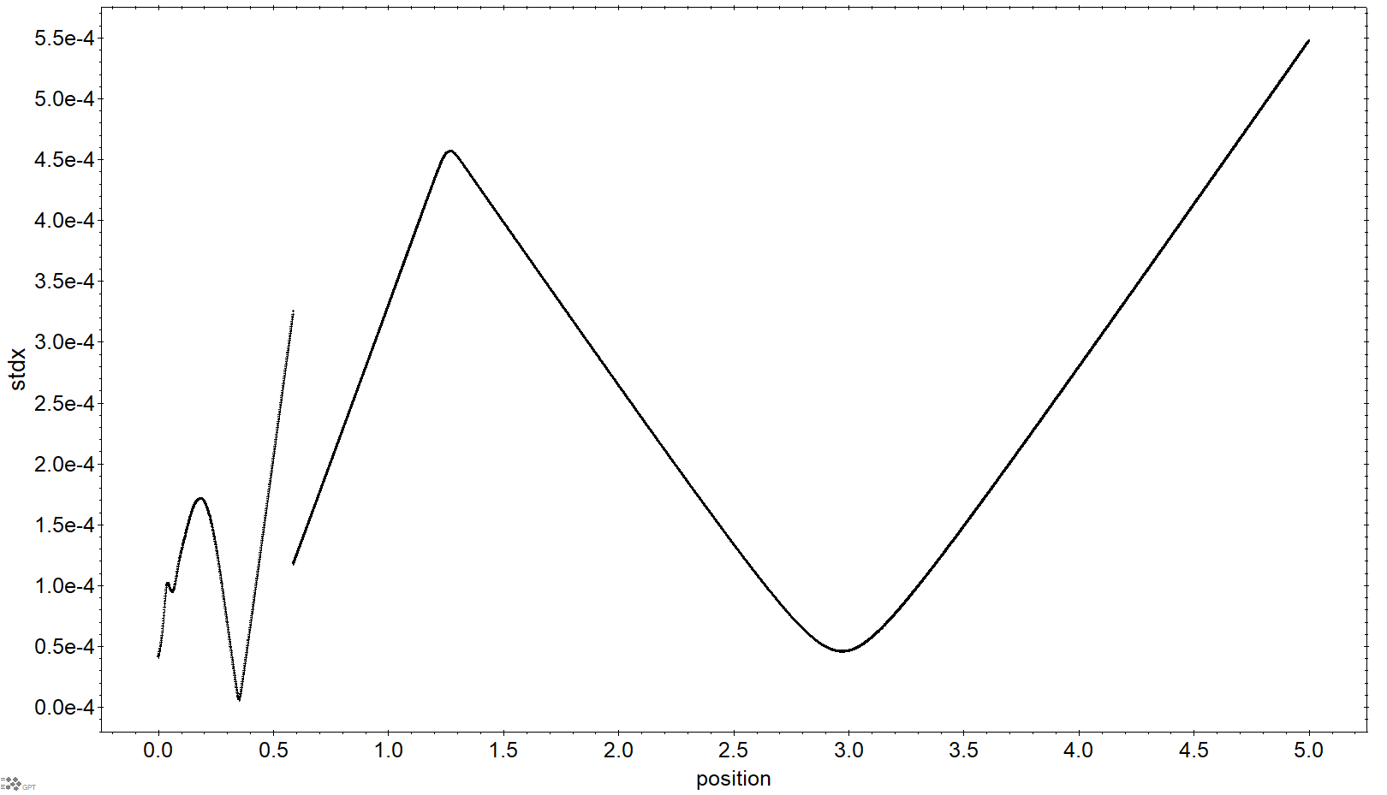
20250110 Group Meeting
GPT Simulation Code
Plot of beam size(rms)
13

Slide 16
20250110 Group Meeting
GPT Simulation Code
Field plot by ASTRA
14

Slide 17
20250110 Group Meeting
GPT Simulation Code
Changing the phase to φ=2°
15

Slide 18
20250110 Group Meeting
GPT Simulation Code
Changing the phase to φ=-2°
16

Slide 19
20250110 Group Meeting
GPT Simulation Code
Plot of emittance of electron bunch
17

Slide 20
20250110 Group Meeting
Future Plan
Generating multiple dataset for training of ML
Coding the source code for ML
Participating in UED experiment
18

Slide 21
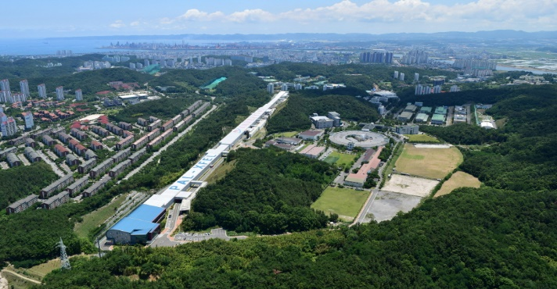


20250110 Group Meeting
Thank you!

Slide 22
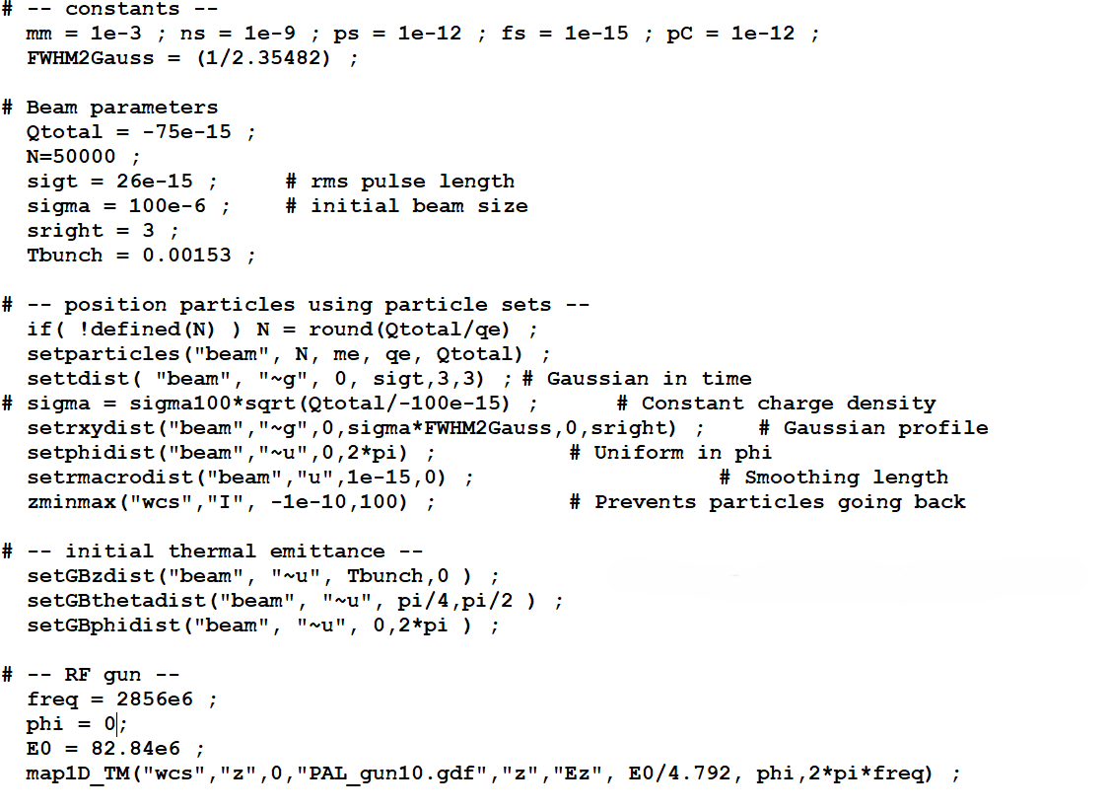
20250110 Group Meeting
GPT Simulation Code
-PAL-eLabs UED Facility Setup
20

Slide 23
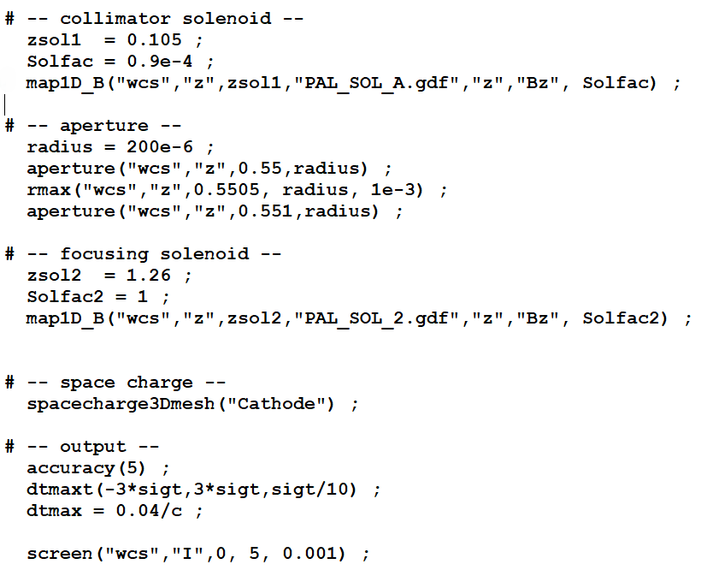
20250110 Group Meeting
GPT Simulation Code
-PAL-eLabs UED Facility Setup
21

