Slide 1
Progress of deflecting cavity and status of eLABs
25. 01. 10
Geunwoo Kim

Slide 2
Outline
Current Status of eLABS Facility
Transverse deflecting cavity design study
CST and ASTRA Simulation
Next Steps

Slide 3
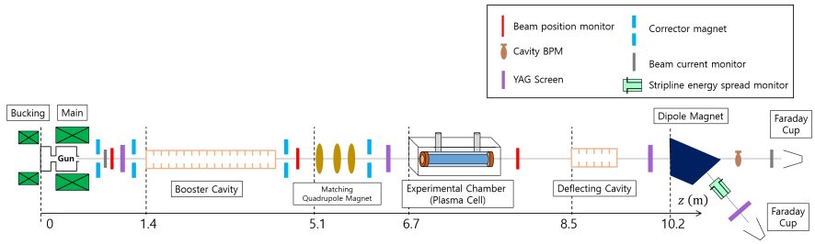
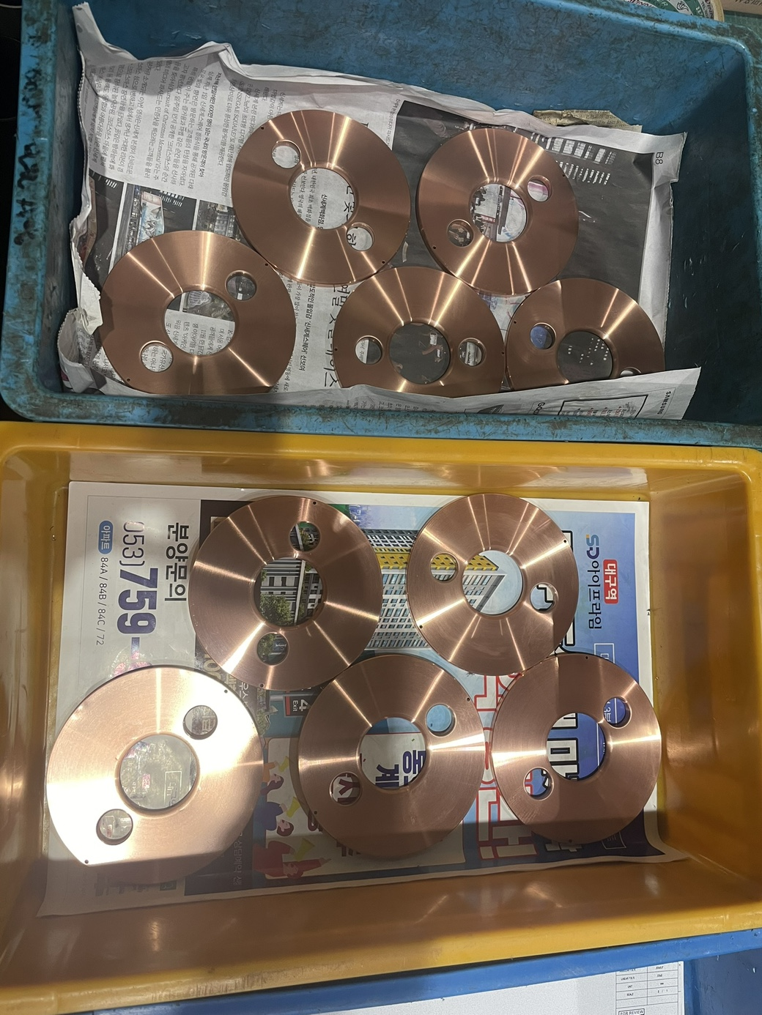
Current status of elabs facility.
Previous: RF was turned on, and Dr. Min worked on the laser setup.
Current: Due to ongoing repairs, progress is delayed. Tests will proceed whenever time allows.
Operation Plan: : If all systems stabilize, more tests may be possible during the XFEL maintenance in Feb.
+) Deflecting cavity manufacturing status: Disk, cylinder, coupler
3

Slide 4
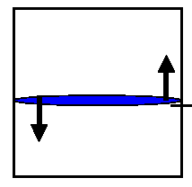
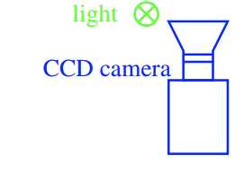
Review
Brief concepts of Transverse Deflecting Cavity (TDC)
Screen
RF
deflecting
cavity
Beam
E₀
x’
① Design and tunning
Force
② Theory
Force
Computer
(Data processing)
4

Slide 5
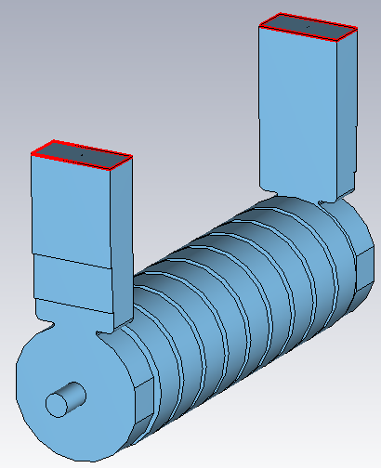
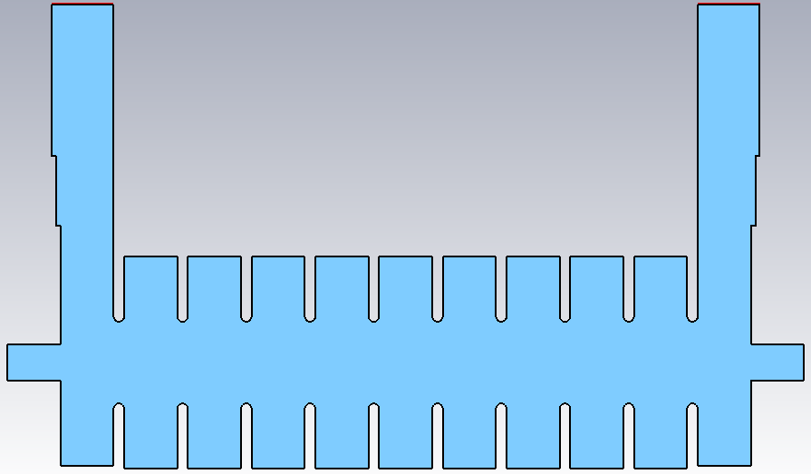
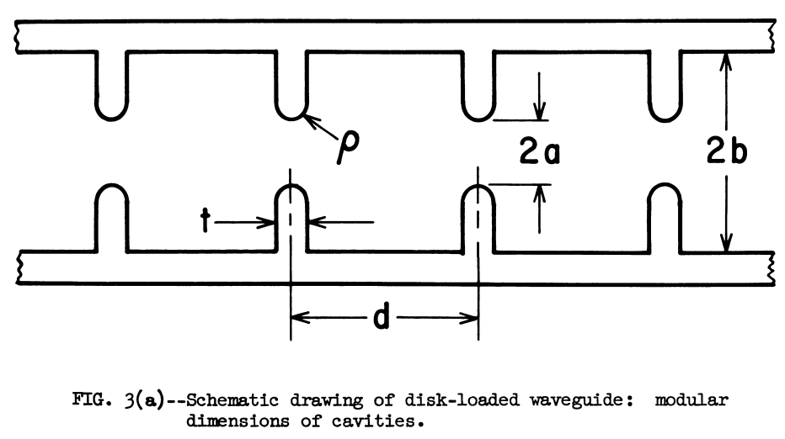
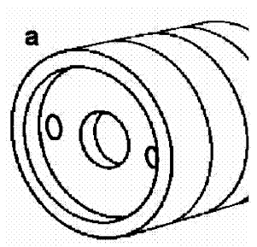

Primarily priority for design TDC
Force
Power efficiency
  High r⊥ ($V=I ∙Z$)
  High Quality factor Q
  Low group velocity v_{g}
Manufacturing costs
  Not to challenge for its manufacture
Force
RF system
(Power generation)
Transmission
Deflecting cavity
Load
RF Input
RF Output
Field formation
y
<Simple flowchart of TDC>
z
5

Slide 6
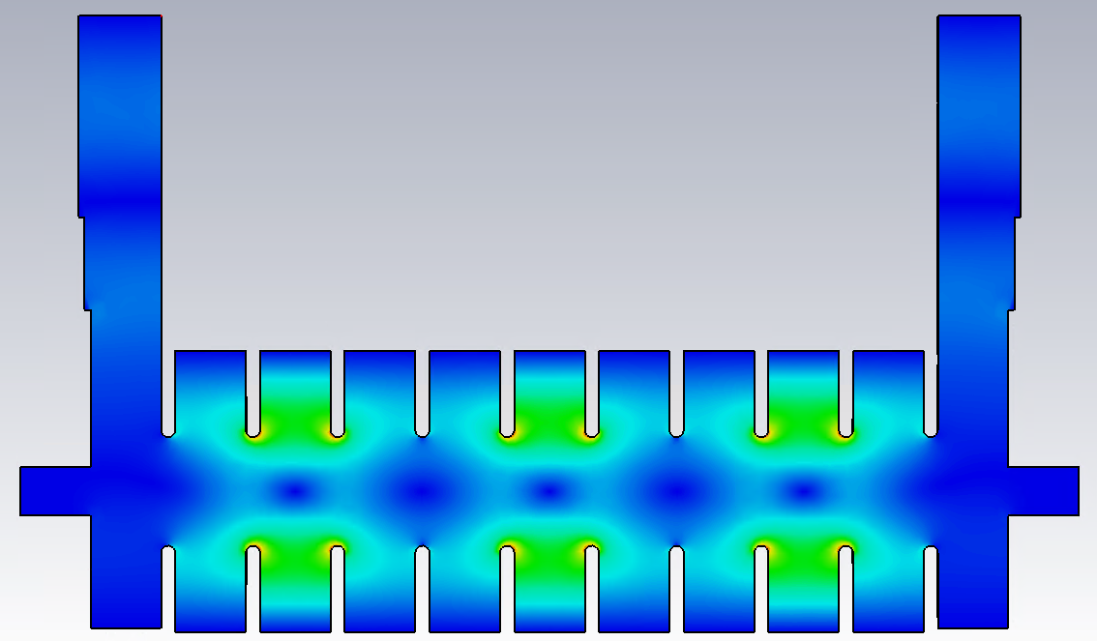
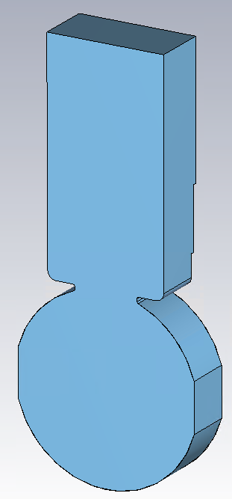
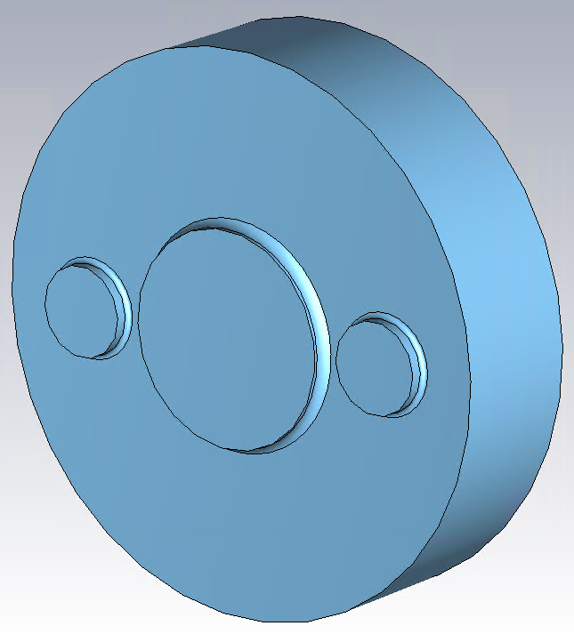

Designed TDC feature
<E-field distribution>
Main feature of elabs TDC
HEM₁₁ field mode (TE₁₁ + TM₁₁ mode)
  Can get high deflecting voltage V_{T}.
  Higher r⊥ compared to TM₁₁ mode.
Disk-loaded structure (a.k.a slow-wave structure)
  Need to suppress $v_{p}$ less than $c$ by disk.
  2π/3 operation mode (ΔΦ = 2π for 3 cells) operation
  Higher r⊥ than the other mode.
Travelling-wave and mode suppressors.
2/3π mode operation
Coupler cell
Power
efficiency
y
Coupler cell
Active cells
z
Manufacturing costs
6

Slide 7
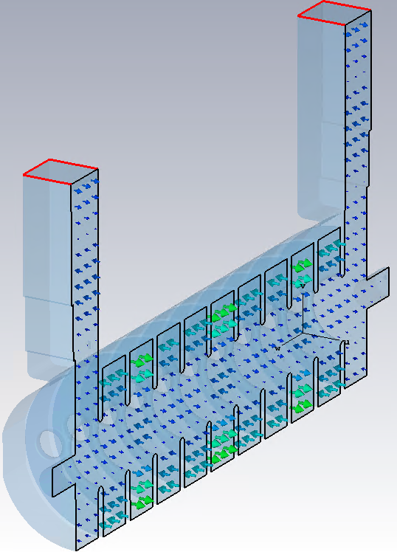
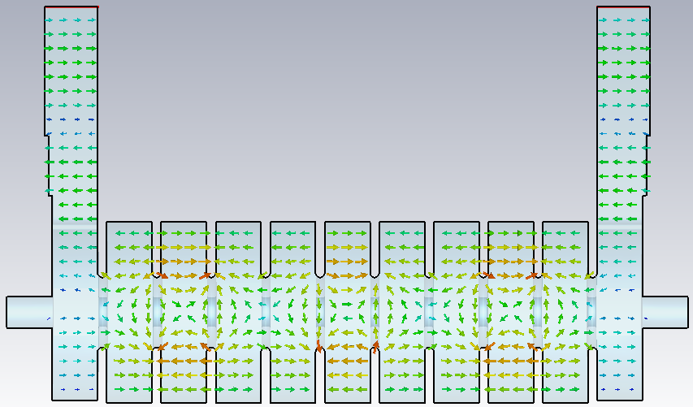
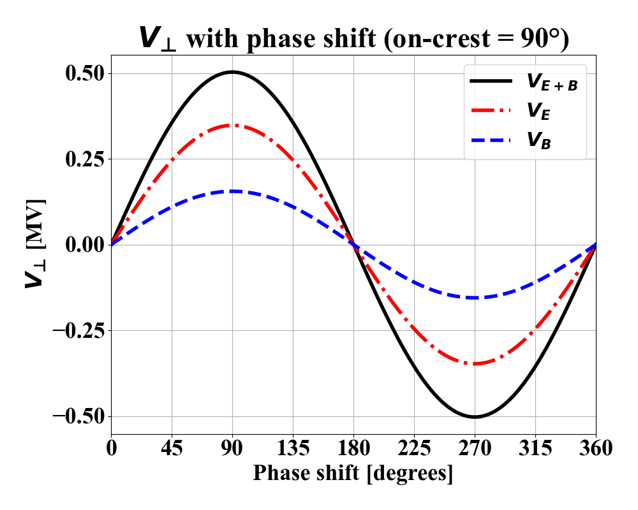
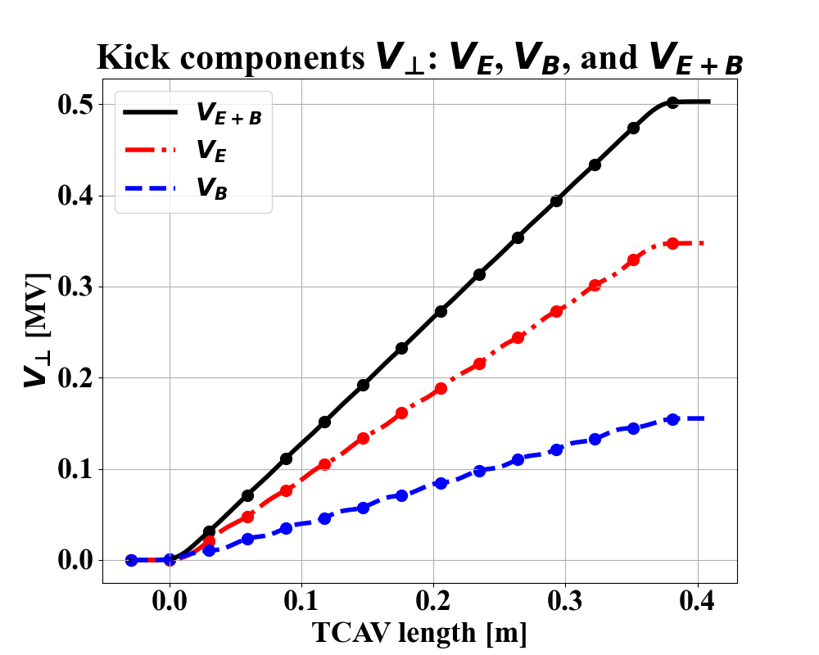
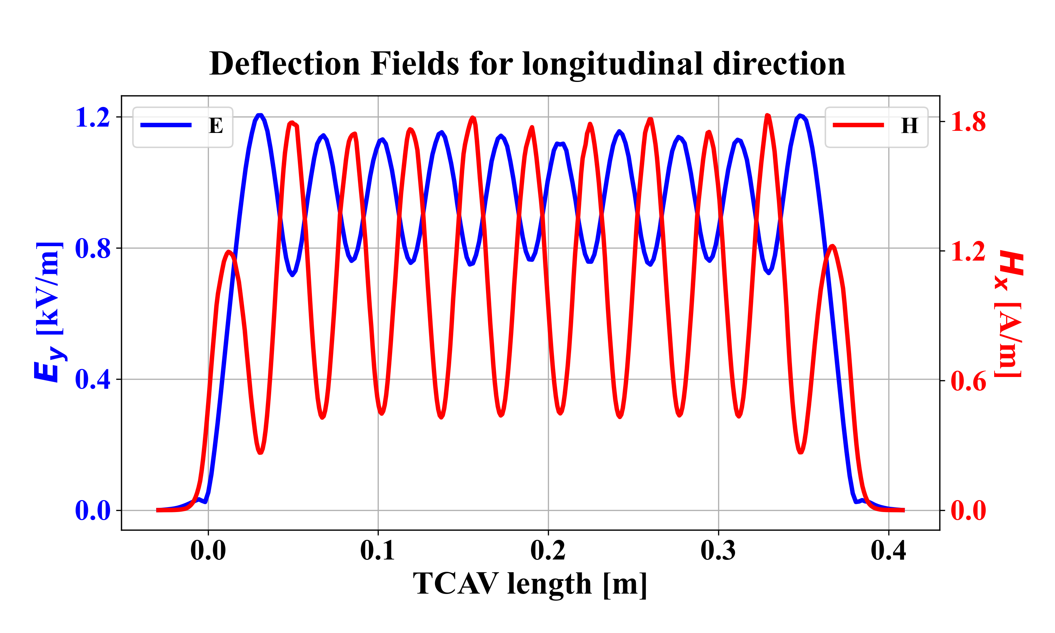
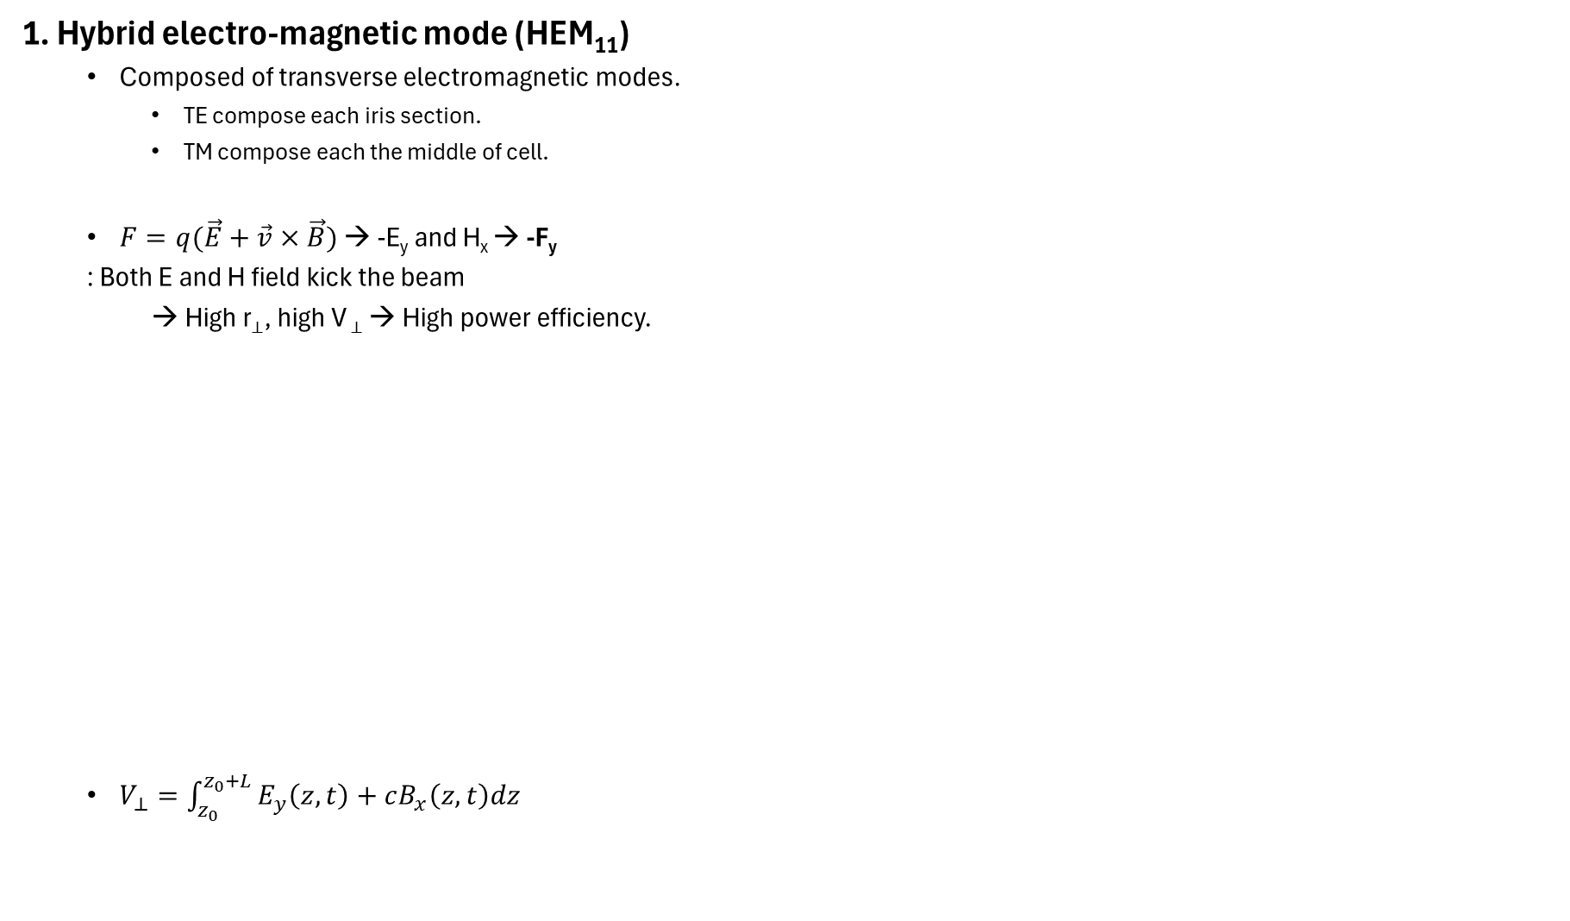
Designed TDC feature
<E-field distribution>
<H-field distribution>
2/3π operation mode
ΔΦ = 4π
1. Hybrid electro-magnetic mode (HEM₁₁)
  Composed of transverse electromagnetic modes.
    TE compose each iris section.
    TM compose each the middle of cell.
  $F=q(\vec{E}+\vec{v}×\vec{B})$ → -E_{y} and H_{x} → -F_{y}
  : Both E and H field kick the beam
  → High r⊥, high V ⊥ → High power efficiency.
  $V_{⊥}=\int_{z_{0}}^{z_{0}+L}{E_{y}\left(z,t\right)+cB_{x}\left(z,t\right)dz}$
Beam
Beam
y
z
7

Slide 8
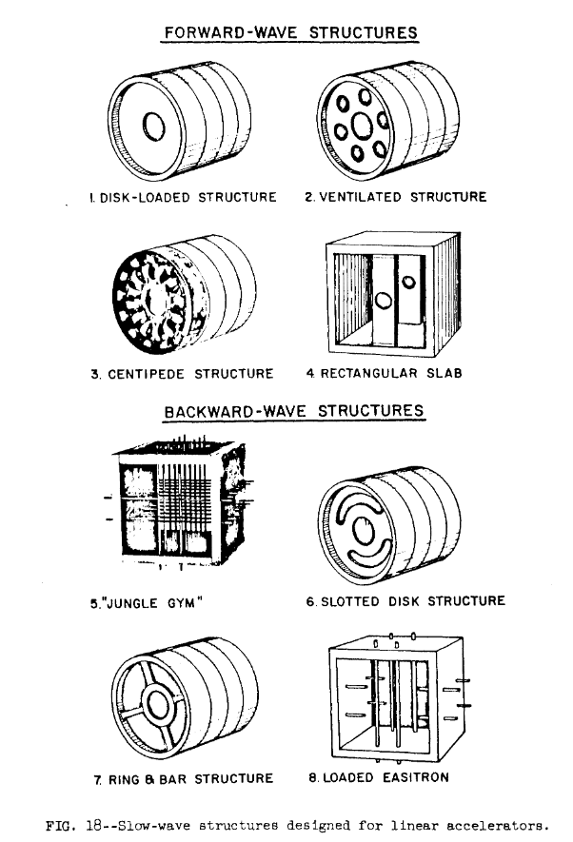
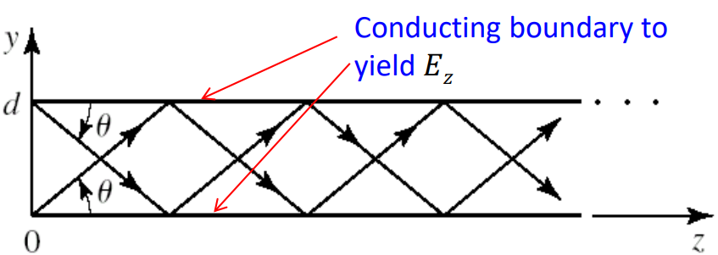
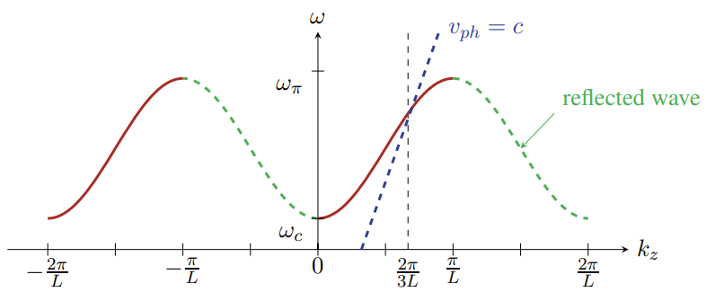
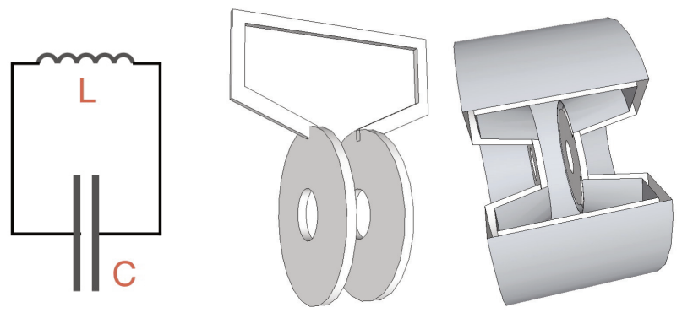

Designed TDC feature
2. Disk-loaded structure
Why we choose disk-loaded structure?
  First, $v_{p}>c$ in uniform cavity
  Slow-wave structure is needed.
    $v_{p}=\frac{ω}{k}∝\frac{1}{\sqrt{LC}}$
  Some structure have higher r⊥, but too high v_{g} or hard to manufacture.
8

Slide 9
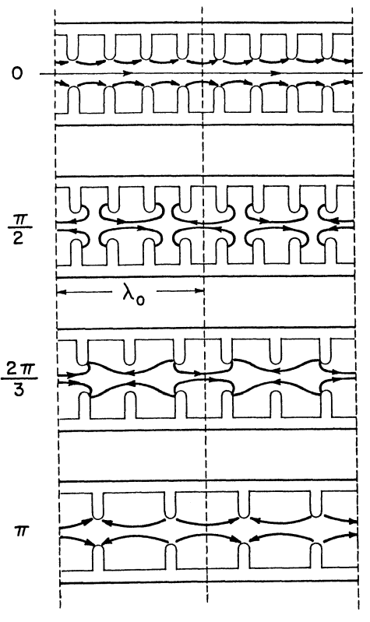
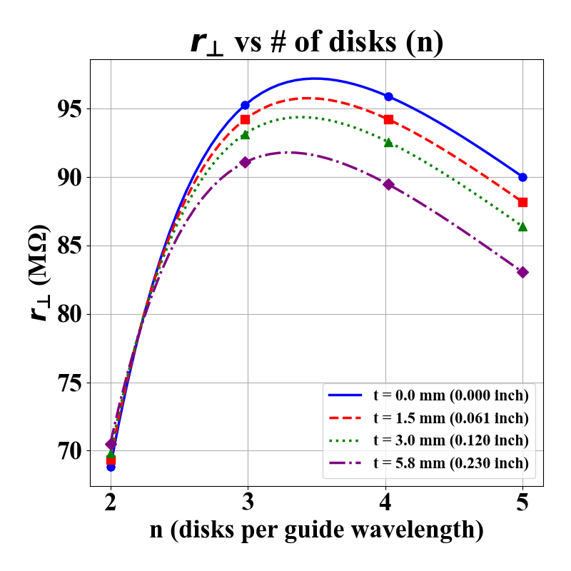
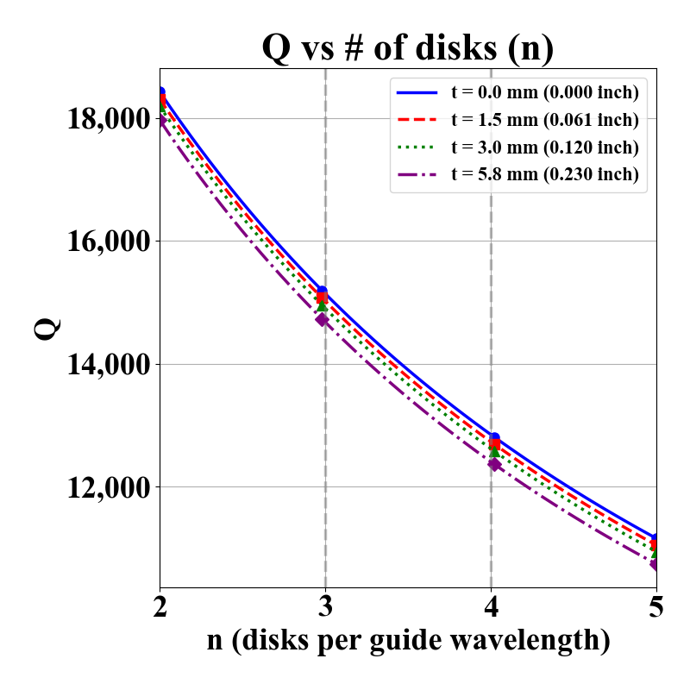
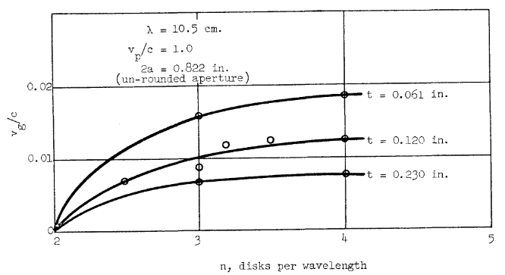

Designed TDC feature
Why 2π/3 mode operation was selected? (Efficiency of the structure)
  Fewer disks required than π/2 mode.
    Not only cheaper manufacturing cost but also higher r⊥ .
  Quality factor Q = $\frac{Stored energy}{Energy lost per cycle}$
  Thick disk → low v_{g} → Enhanced power efficiency.
RF system
(Power generation)
Transmission
Deflecting cavity
Load
9

Slide 10
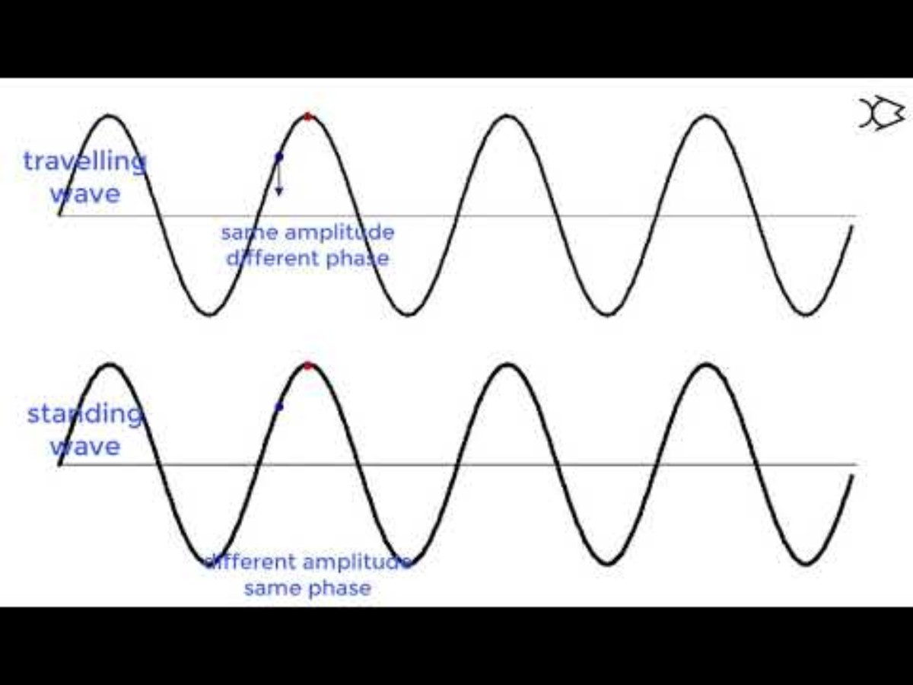
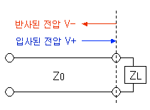
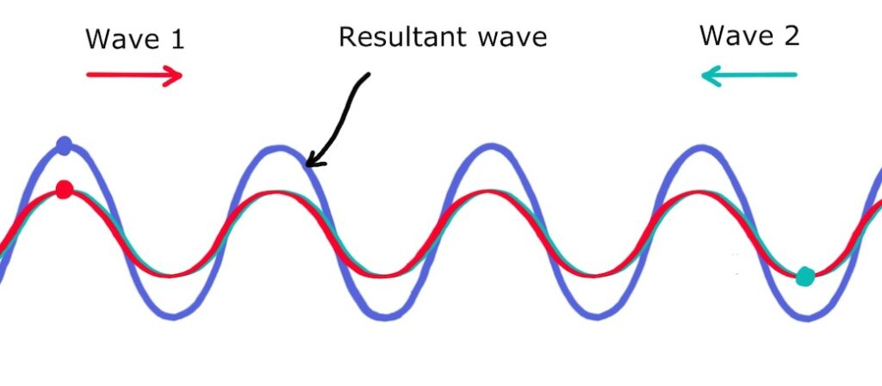

Designed TDC feature
3. Travelling-wave and mode suppressors.
Standing vs Travelling wave
  In standing wave, only half power assist deflection components.
  Need a few μm waiting time to develop fields in cavity.
    $\frac{Z}{Z_{0}}=\frac{1−e^{−\frac{ωt}{2Q_{L}}}}{1+e^{−\frac{ωt}{2Q_{L}}}}$
    $Γ=\frac{V_{−}}{V_{+}}=\frac{Z_{L}−Z_{0}}{Z_{L}+Z_{0}}$
    → May damage RF system.
  In opposite case, all the above problems are not a concern.
RF system
(Power generation)
Transmission
Deflecting cavity
<Principal of standing and travelling wave>
RF system
(Power generation)
Transmission
Deflecting cavity
Load
10

Slide 11
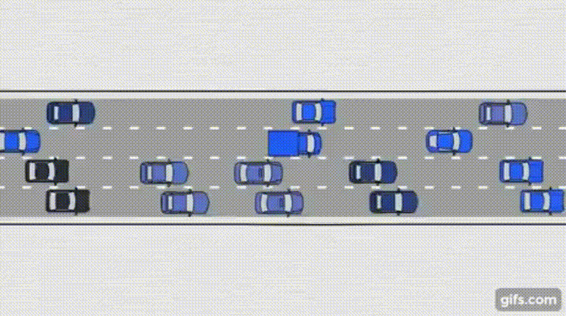
Designed TDC feature
3. Travelling-wave and mode suppressors.
Backward travelling wave
  High Quality factor Q (Low field loss).
  Easy to contorl phase variation.
RF Input
RF Output
v_{g}
v_{p}
Field formation
Beam
y
<Backward travelling-wave example>
<Simple flowchart of TDC>
z
11

Slide 12
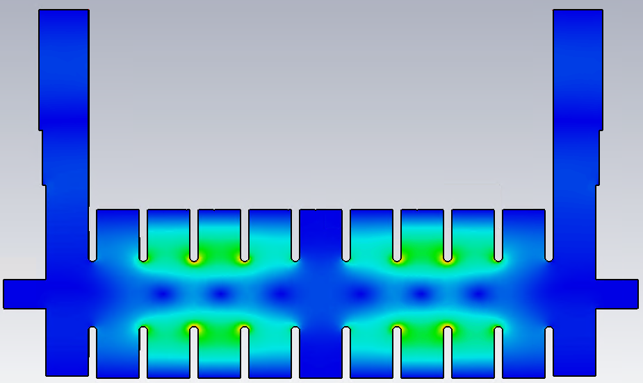
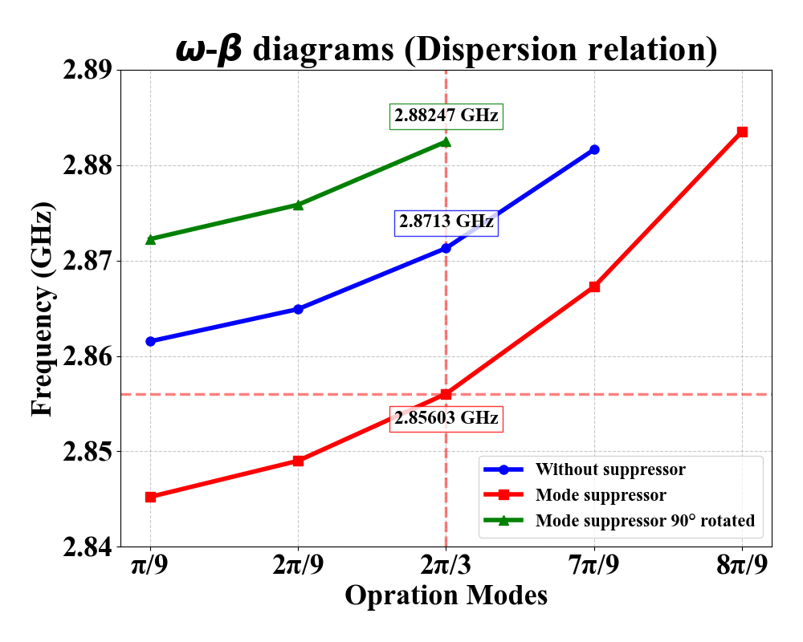
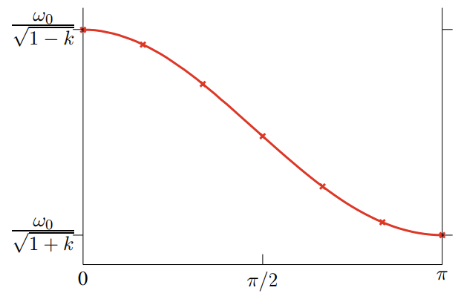
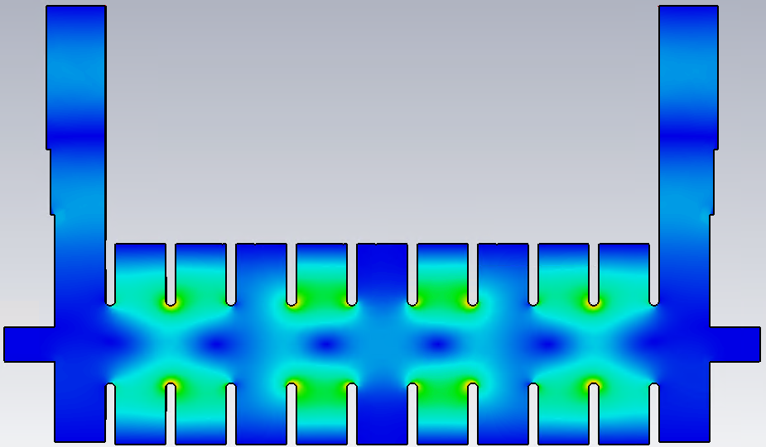
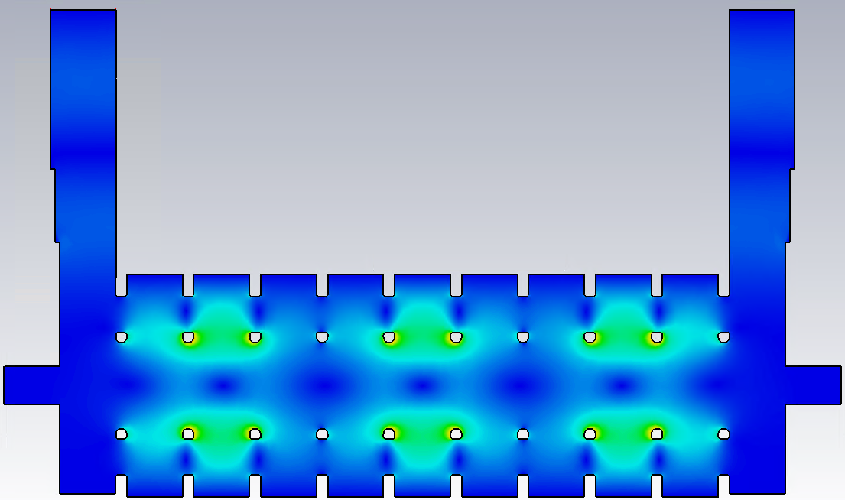
Designed TDC feature
2π/9 mode @ 2.849 GHz
Mode suppressors (Mode isolators)
  Damping unwanted operation mode like HOM dampers in RF cavity.
2π/3 mode @ 2.85603 GHz
Mode suppressors
7π/9 mode @ 2.86725 GHz
2π/3 mode @ 2.88247 GHz
Maybe due to B.C.
12

Slide 13
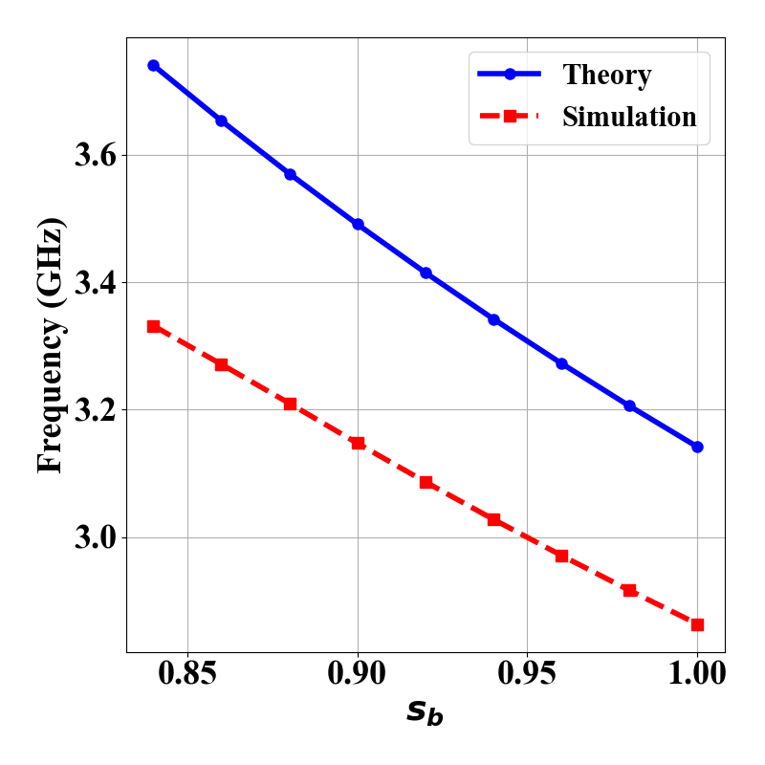
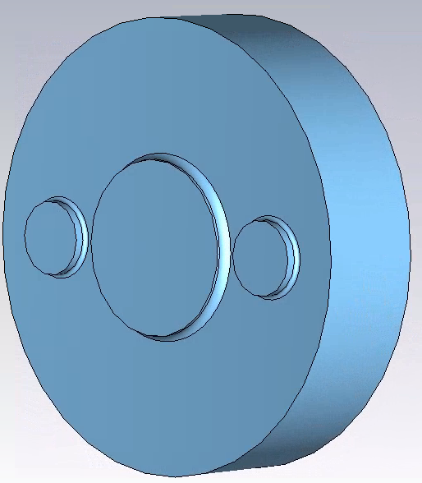
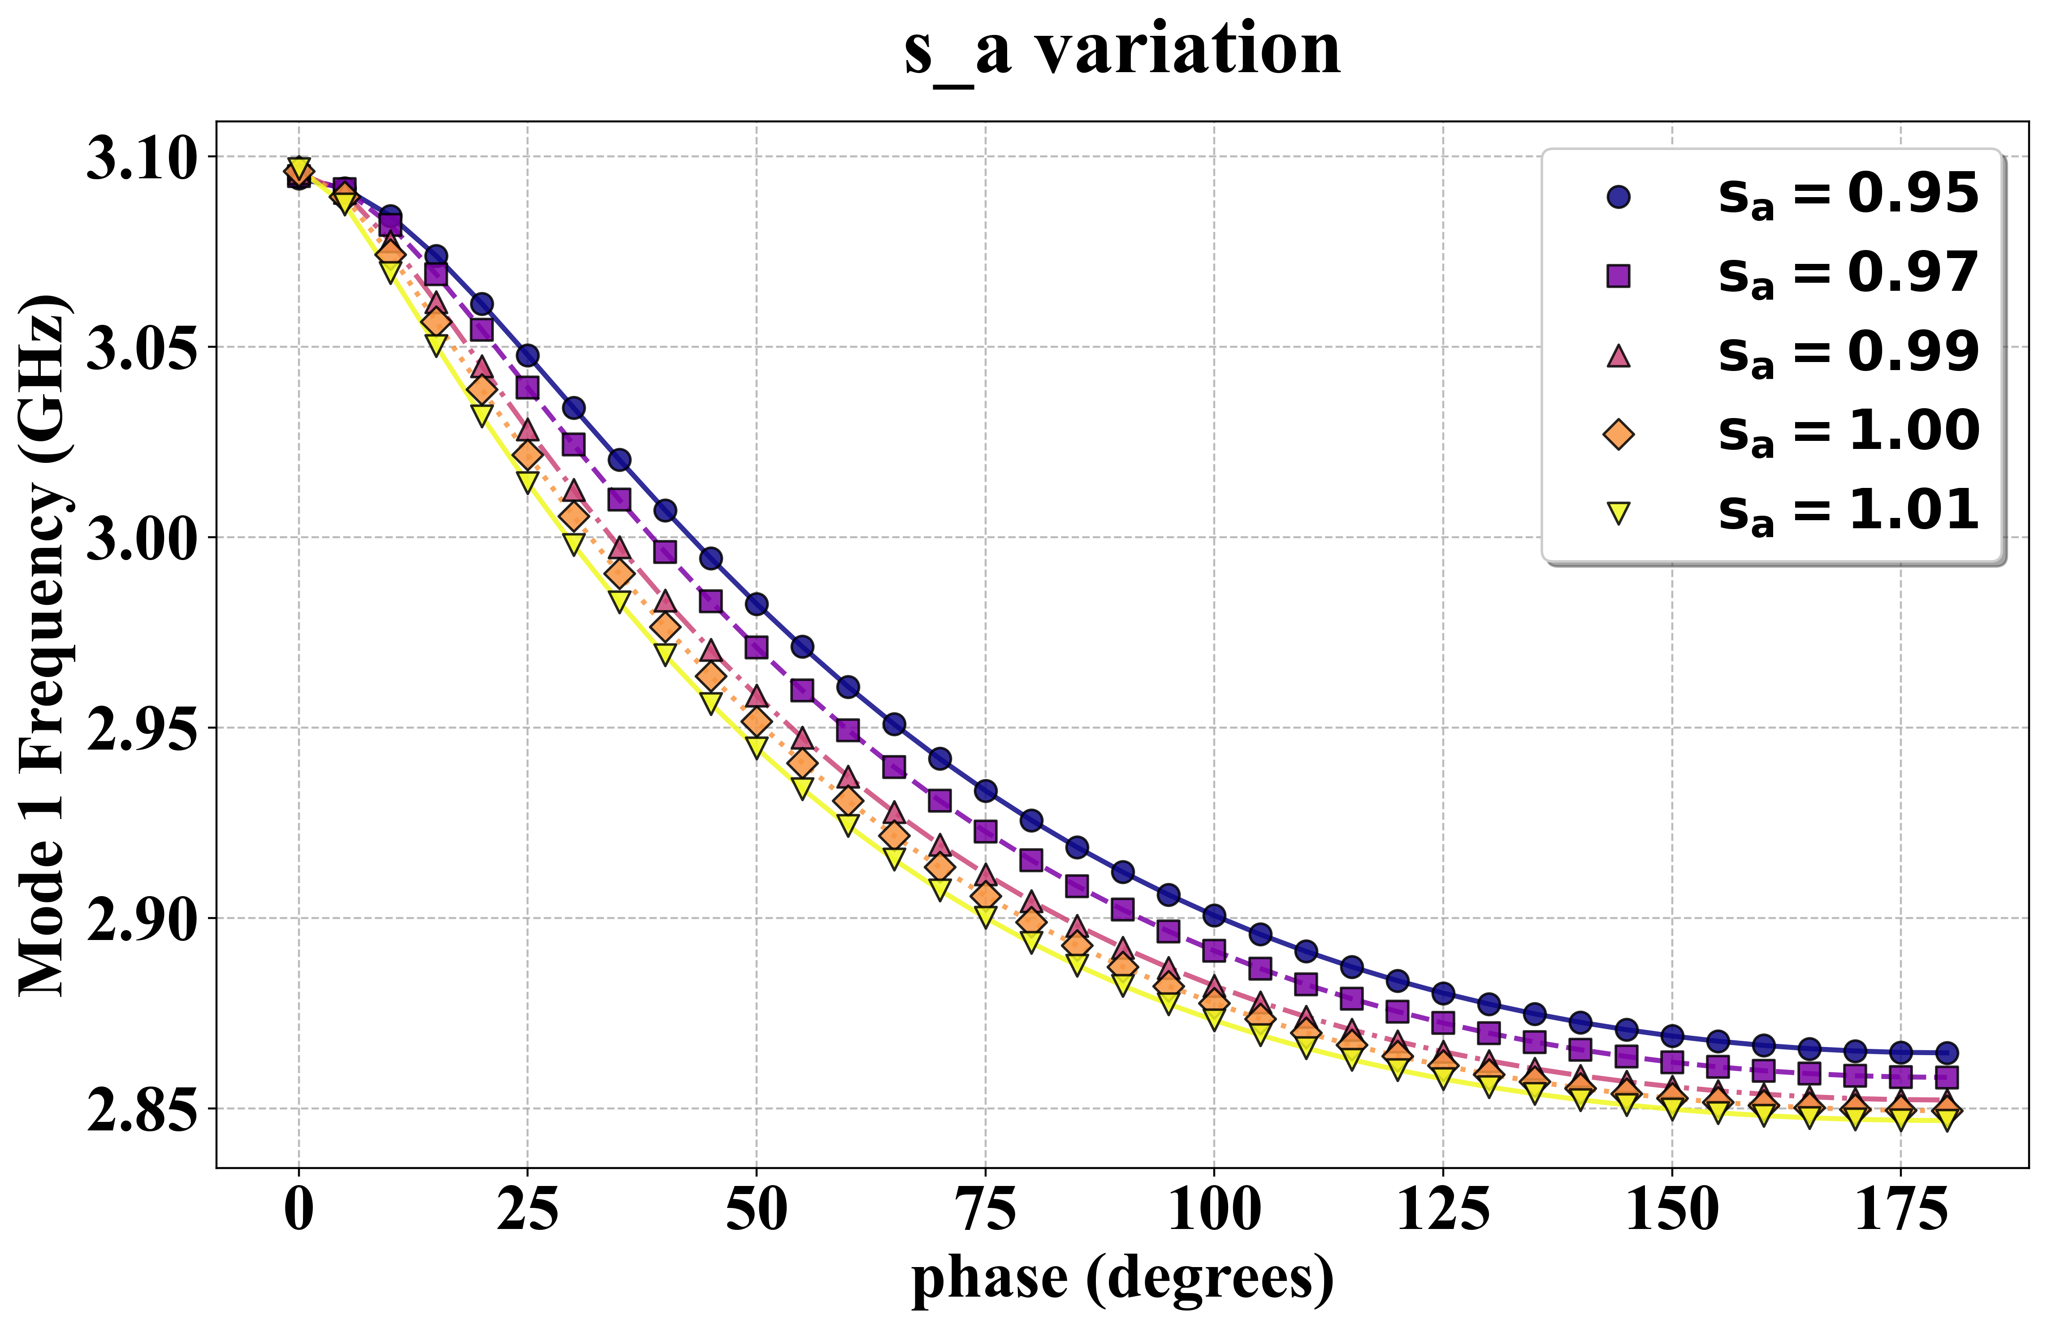
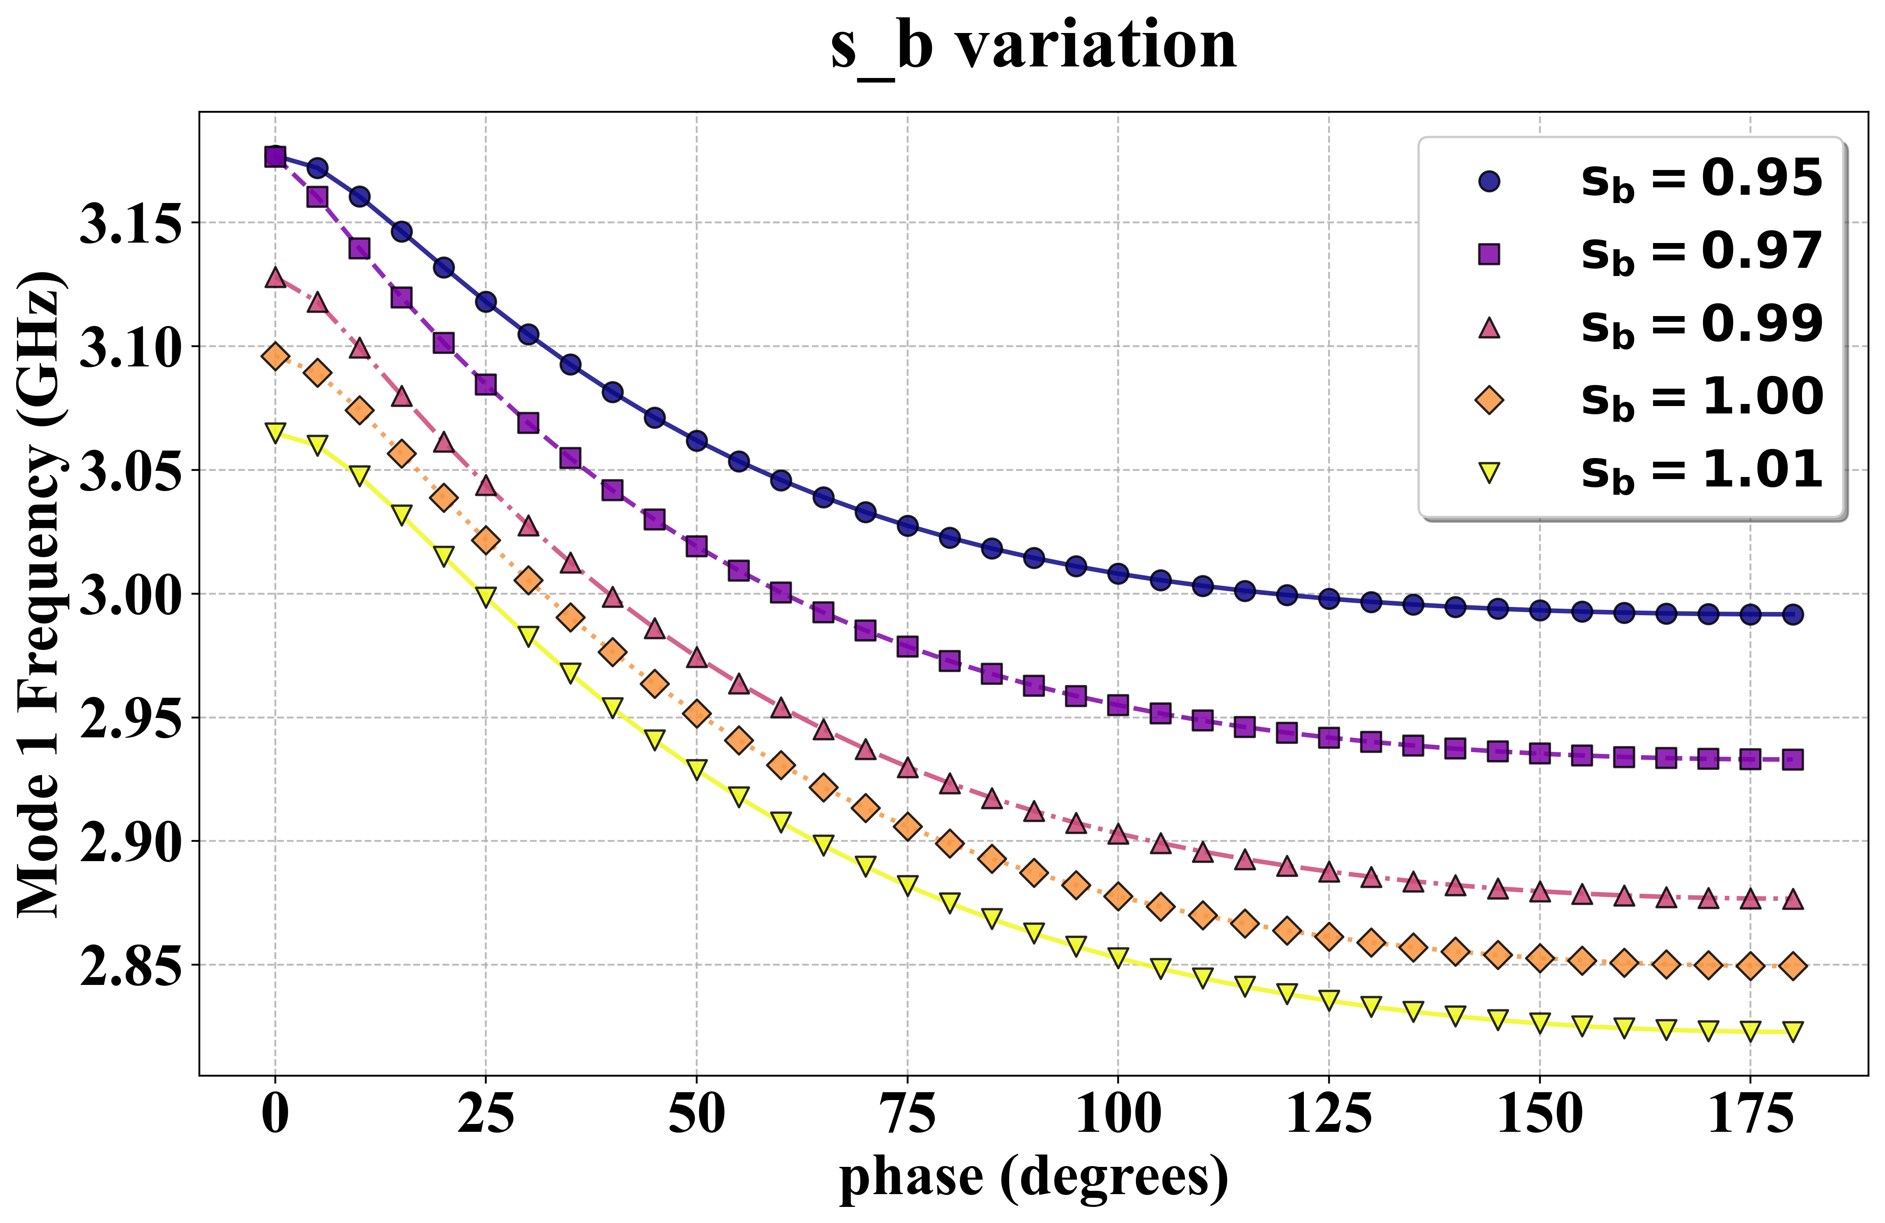

CST simulation of TDC
Single cell
  $ω_{110}=\frac{1}{\sqrt{με}}∙\frac{x_{11}}{b}$ for cylindrical waveguide.
Dispersion relation
t/2
2a
2b
p
d
c
Variables | Mean Δf/Δs [MHz/mm] | STD [MHz/mm]
s_{b} | -2.665 | 0.080
s_{a} | -0.386 | 0.002
s_{mode} | -0.048 | 0.005
s_{d} | 0.039 | 0.014
s_{c} | 0.095 | 0.012
s_{t} | 0.025 | 0.003
13

Slide 14
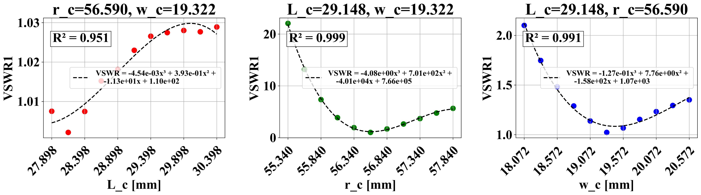

Analysis of TDC
RF system
(Power generation)
Transmission
Deflecting cavity
Load
Coupler cell
  Reflection coefficient $Γ=\frac{V_{−}}{V_{+}}=\frac{Z_{L}−Z_{0}}{Z_{L}+Z_{0}}$
  VSWR (Reflection value) < 1.05 or 1.1
  → Next, field flatness study…
~1.02
~1.02
w_{c}
r_{c}
L_{c}
Variable in Kyhl’s tuning
14

Slide 15
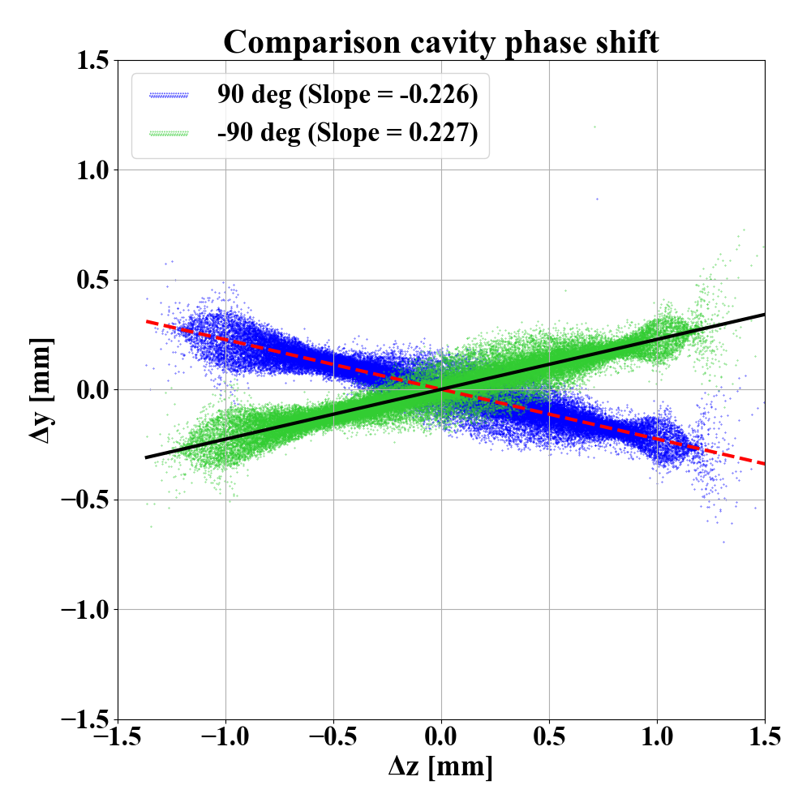
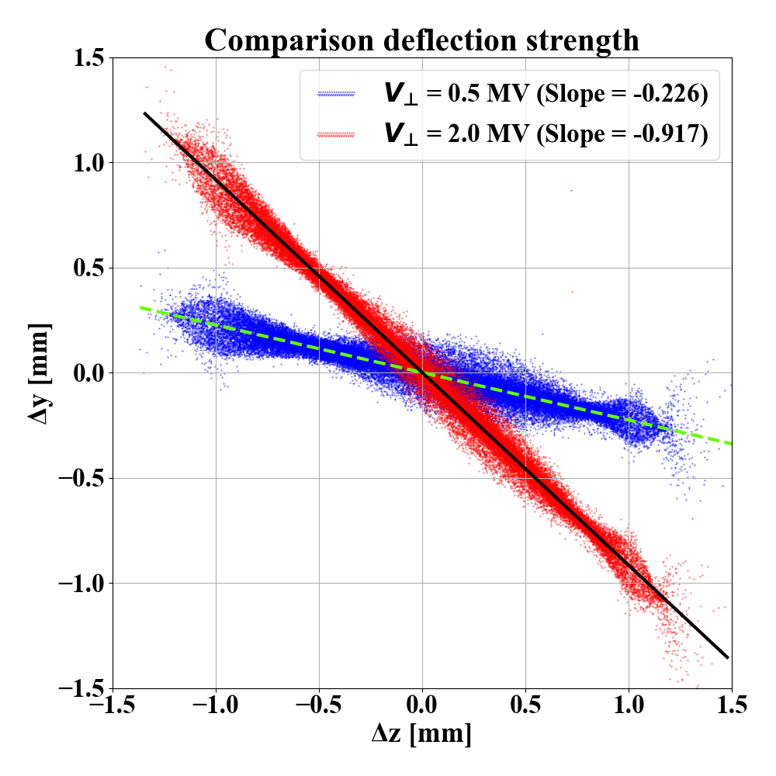
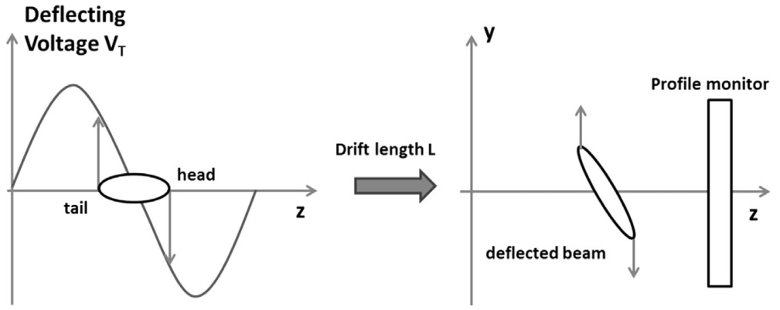
ASTRA simulation status
Φ_{TCAV} | Slope | offset
90 deg | -0.226 | -6.70
-90 deg | 0.227 | 6.70
V⊥ | Slope | offset
0.5 MV | -0.226 | -6.70
2.0 MV | -0.917 | -26.92
In an ideal situation, no offset exists.
15

Slide 16
Summary
TDC design study done.
CST and ASTRA simulation conducted.
Next steps
  elabs: under maintenance
  Field flatness optimization pending (CST)
  ASTRA phase matching
16

Slide 17
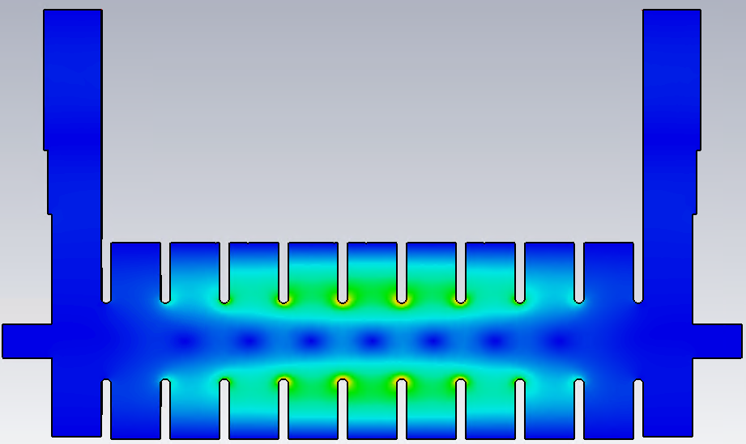








Appendix A
Mode damper
π/9 mode @ 2.84522 GHz
Without damper
Mode damper 90deg rotated
π/9 mode @ 2.86153 GHz
π/9 mode @ 2.87225 GHz
2π/9 mode @ 2.849 GHz
2π/9 mode @ 2.86491 GHz
2π/9 mode @ 2.87585 GHz
2π/3 mode @ 2.85603 GHz
2π/3 mode @ 2.8713 GHz
2π/3 mode @ 2.88247 GHz
7π/9 mode @ 2.86725 GHz
7π/9 mode @ 2.88164 GHz
8π/9 mode @ 2.88353 GHz
17

Slide 18


Appendix B

