Slide 1
Research Plan
Jan. 03. 2025
송우진

Slide 2
Time table
1. Photon beam profile monitor (ionization profile monitor)
25.01
25.02
25.05
4GSR 장비 심의 및 발주.
Internal review meeting for
장비 심의 on Jan. 8th.
PAL-XFEL XIBPM upgrade and test at SX beamline
Equipment fabrication
Complete fabrication
Vacuum test
PLS-II BL-6C test
Chamber fabrication will take 2–3 months, while there are no deadline issues for other components.
Complete the draft of the design paper
or include the content of the XFEL experiment.

Slide 3
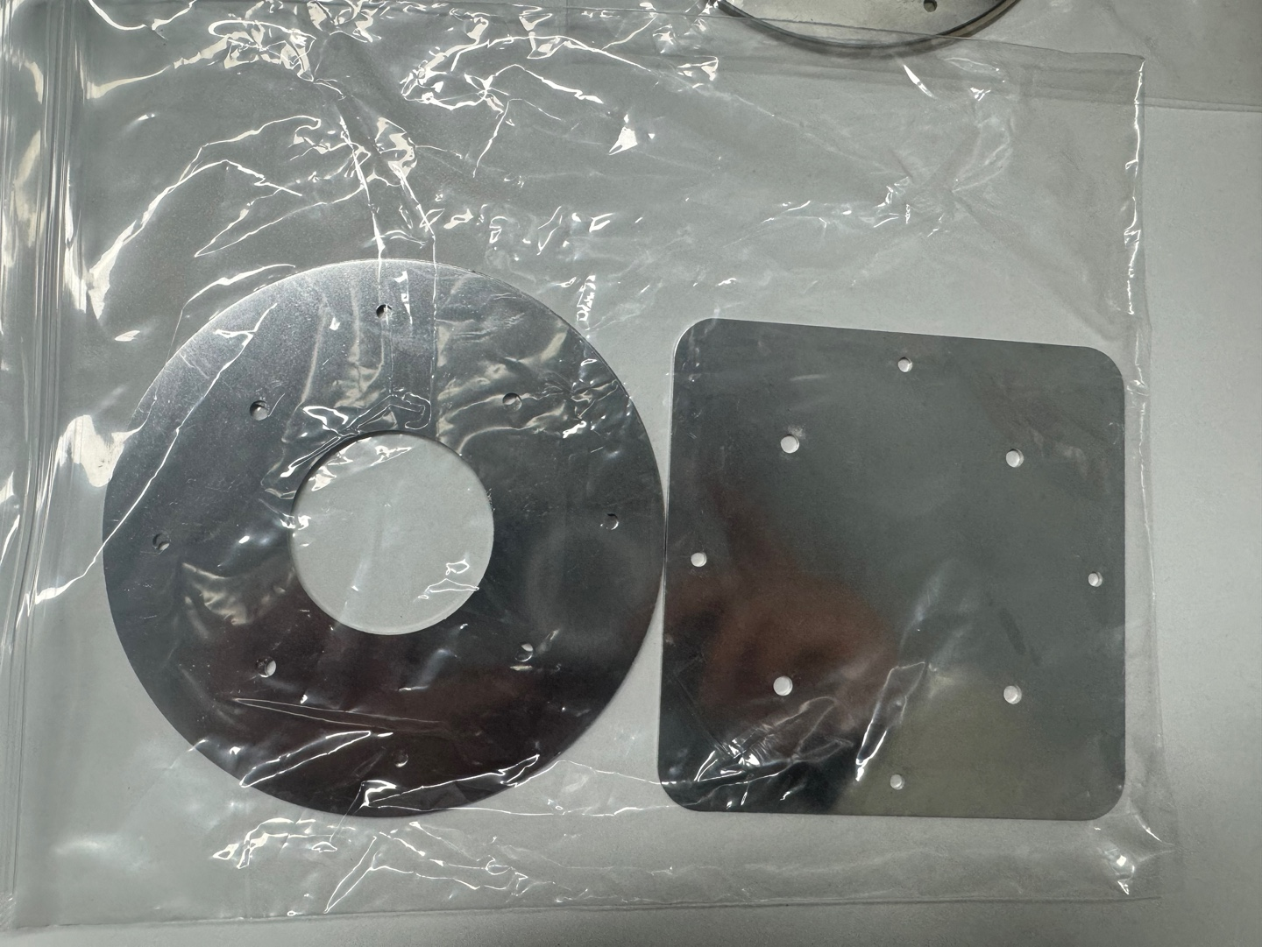
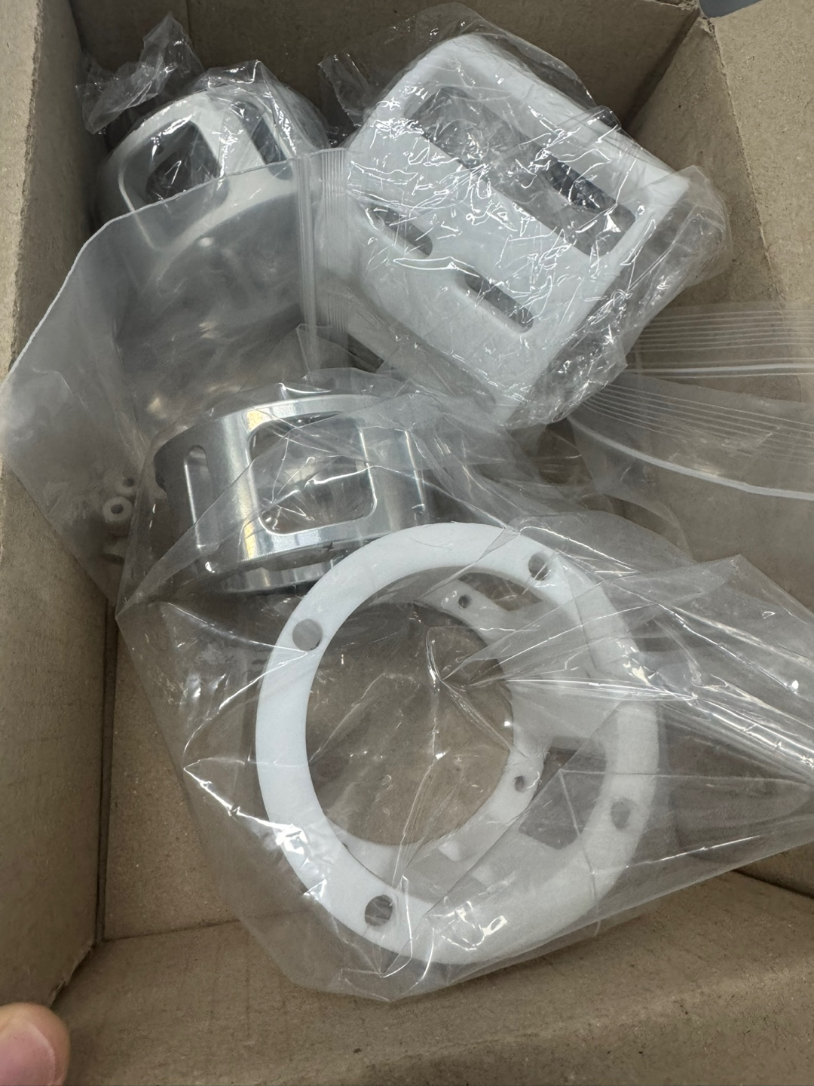
Time table
1. Photon beam profile monitor (ionization profile monitor)
XIBPM upgrade test plan
Jan. 06. – XIBPM upgrade, replacement of internal structures.
Jan. 08. – Discuss plans for measuring profile.
Jan. 13. – Vertical displacement measurement @ pink-beam
Jan. 14-17. – Chamber rotation and flange re-assemble
Jan. 20. – Horizontal displacement measurement @ pink- & mono-beam
(Plan) After Horizontal Experiment
Target – Profile measurement test, Calibration method validation.
Method – Extremely high magnification to measure profile
(XFEL beam size is ~50 um, current design resolution ~ 100 um)
→ Measurable range simulation in progress (to be discussed on 8th)

Slide 4
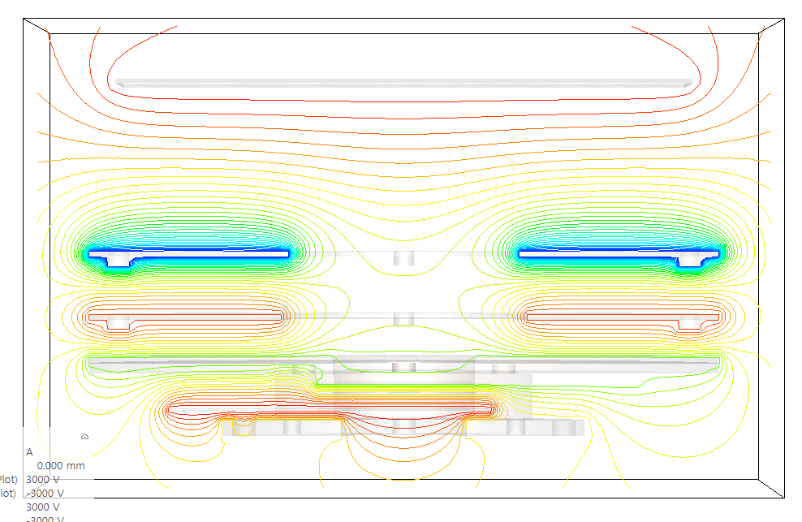
PAL-XFEL photon beam profile measurement
Magnification = x2.90
Repeller
Rep <-> E2 Diff. ↑-> large gradient
E2
E1
Shield
MCP V↑ -> gradient ↑

Slide 5

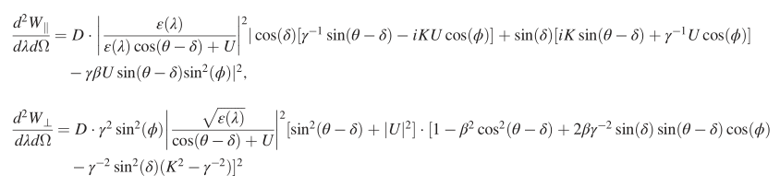

Time table
2. Cherenkov diffraction radiation based (electron) beam diagnostics
Background
Beam profile monitor
Beam position monitor
Bunch length
THz Source
Conceptual Design
Classical Cherenkov radiation
Radiation spectrum
Emission angle
Polarization, Diffraction
Beam profile (size)
Impact parameter
Beam position
Form factor, Coherence
Bunch length (sub-pico)
Coherent THz source
Camera, Optics
BPM electronics
R/O electronics
Photodiode
Spectrometer

Slide 6
Time table
2. Cherenkov diffraction radiation based (electron) beam diagnostics
Beam profile monitor
Bunch length measurement
Before installation
Radiator design and manufacture
Set-up
Data acquisition system
Alignment test
Future plan
Installation
Alignment at e-Labs
Experiment
Radiator fabrication
Securing test facilities
Calculation of the target range
Detector (Spectrometer or power meter)
Experiment (1st test at IBS)

Slide 7
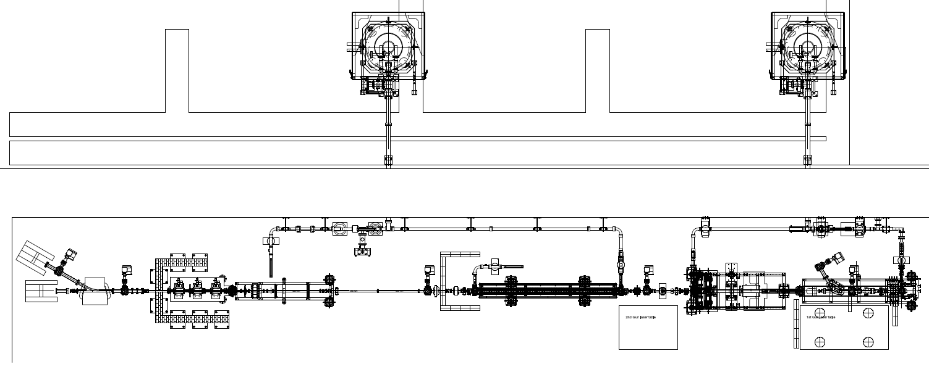
Configuration of e-Labs
Advanced compact accelerator exp.
UED exp.
S3
S1
S2
BAM
ACC
ICT
GUN-II
GUN-I
BPM test stand
diagnostics
Optical table
GUN-II Section
(200 pC, 70 MeV, 10 Hz)
GUN-I Section
(200 pC, 6 MeV, 10 Hz)

Slide 8
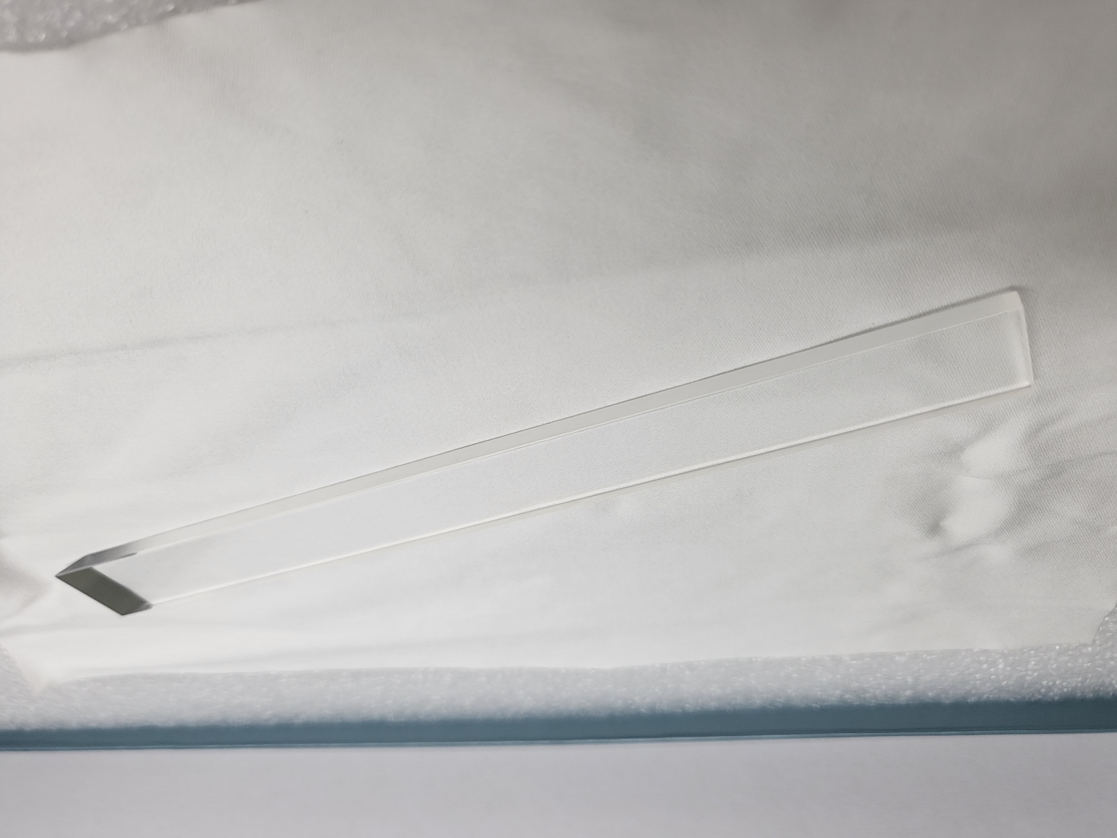
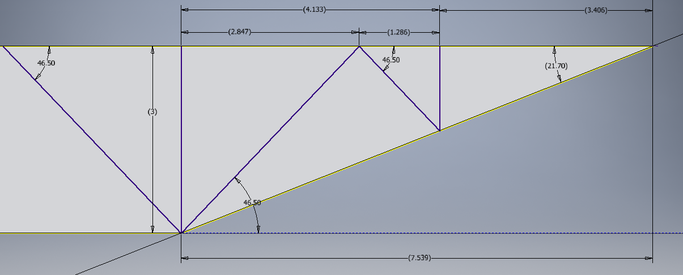
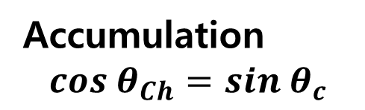
Radiator design
Accumulation
$$cos θ_{Ch}=sin θ_{c}$$
Al Coating

Slide 9
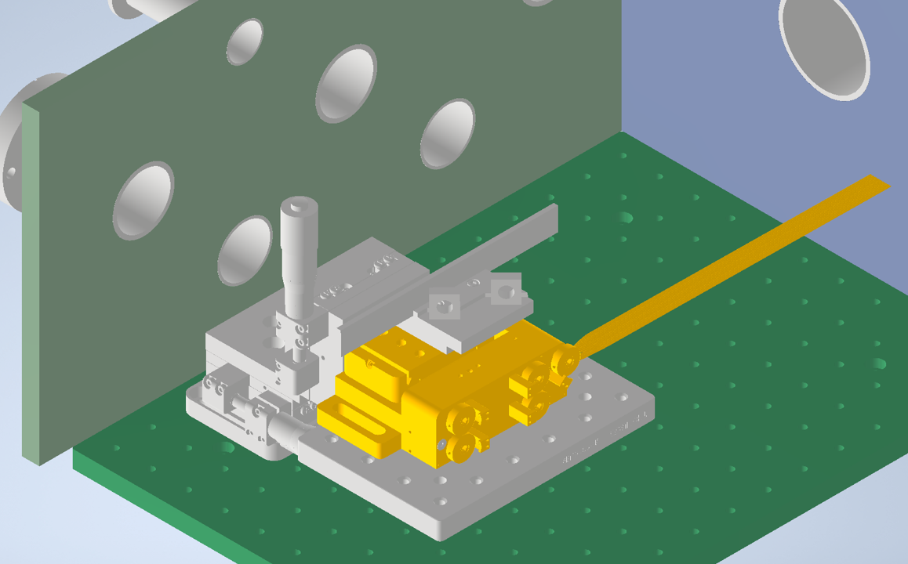
Set-up
7-axis stage
1축 linear motor
(Impact factor)
1축 manual (Hight)
5축 motor (Alignment)
Electron beam
ChDR

Slide 10
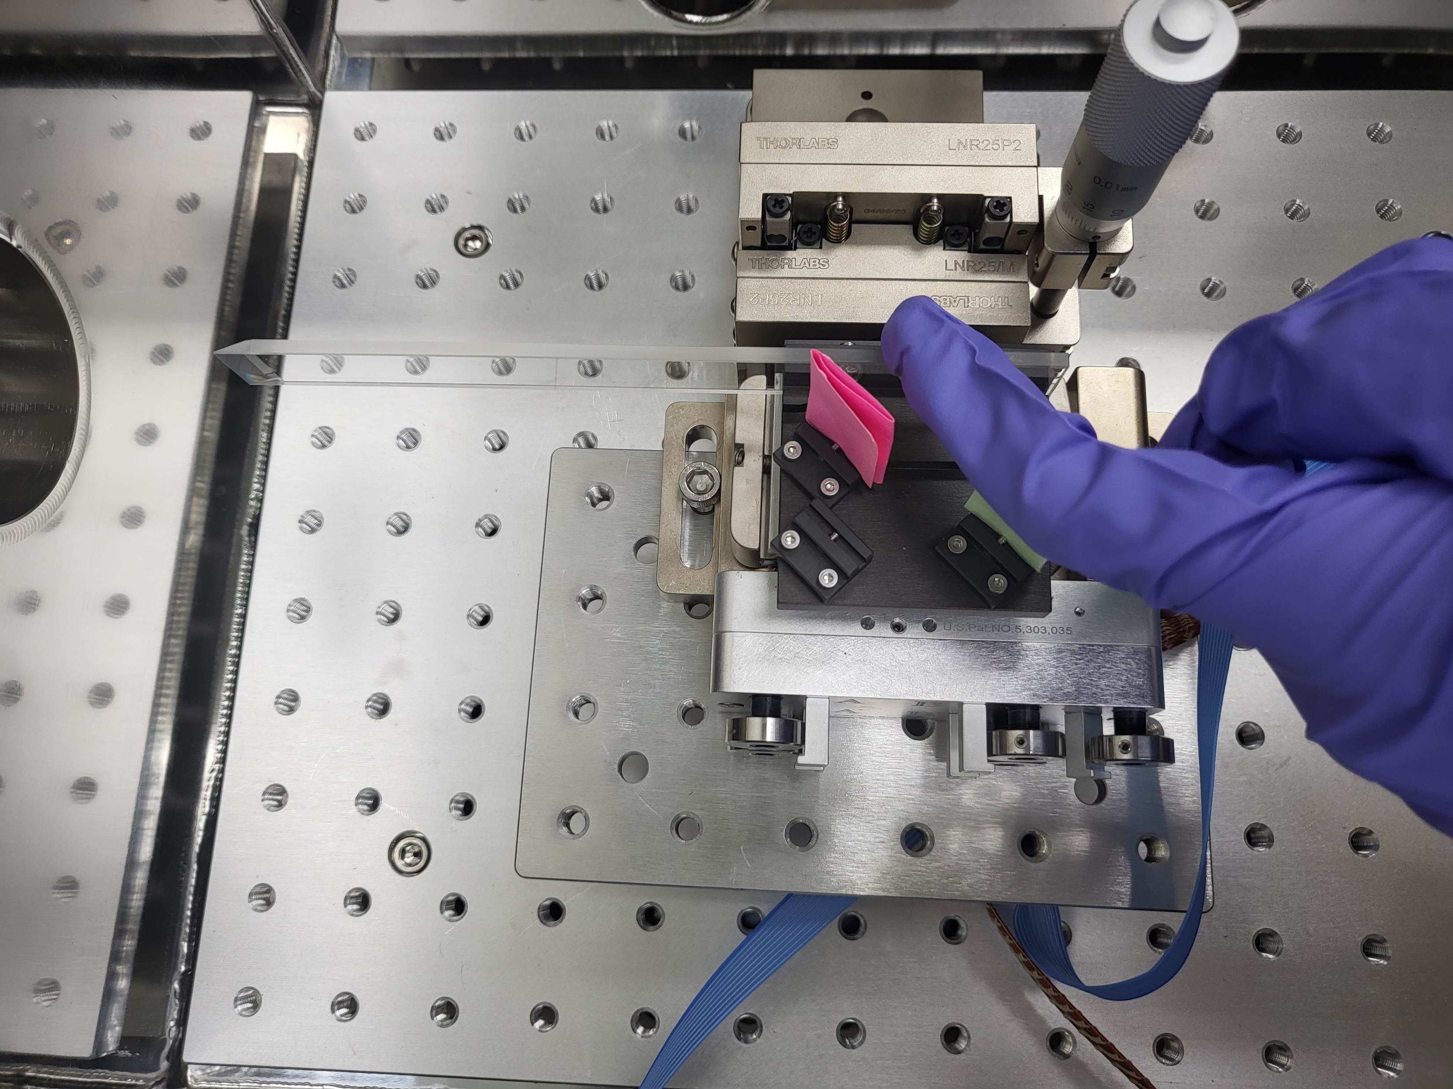
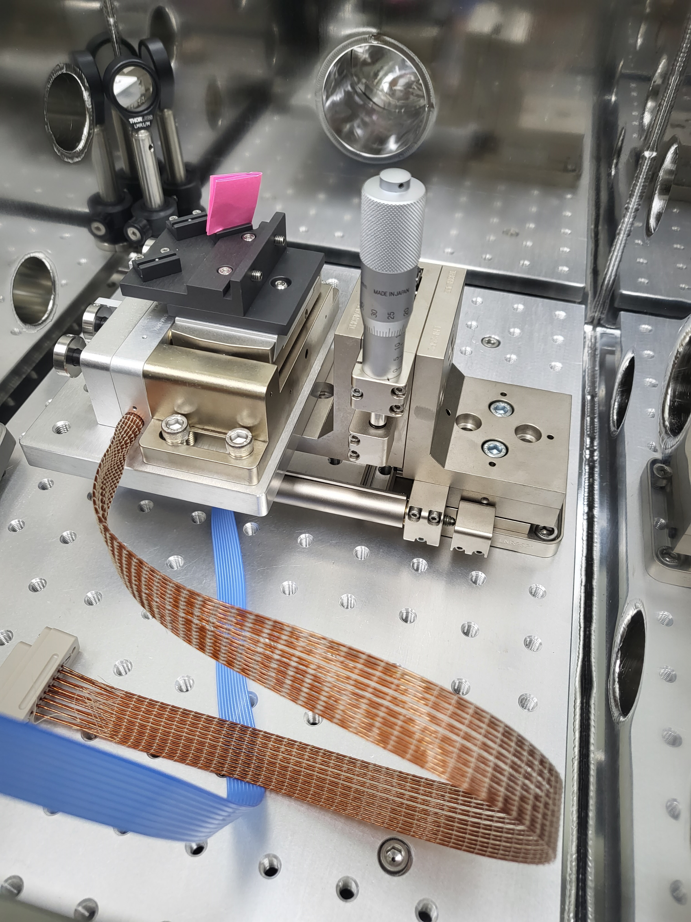
Set-up
Electron beam
ChDR

Slide 11
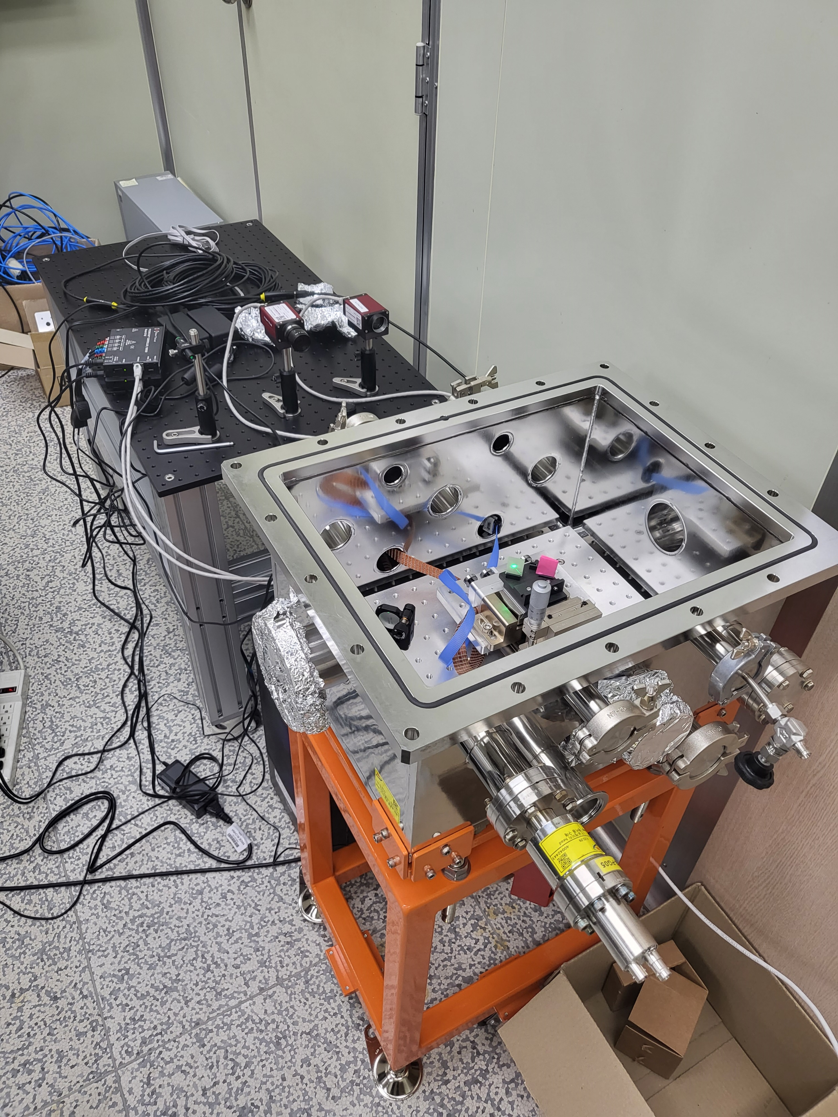
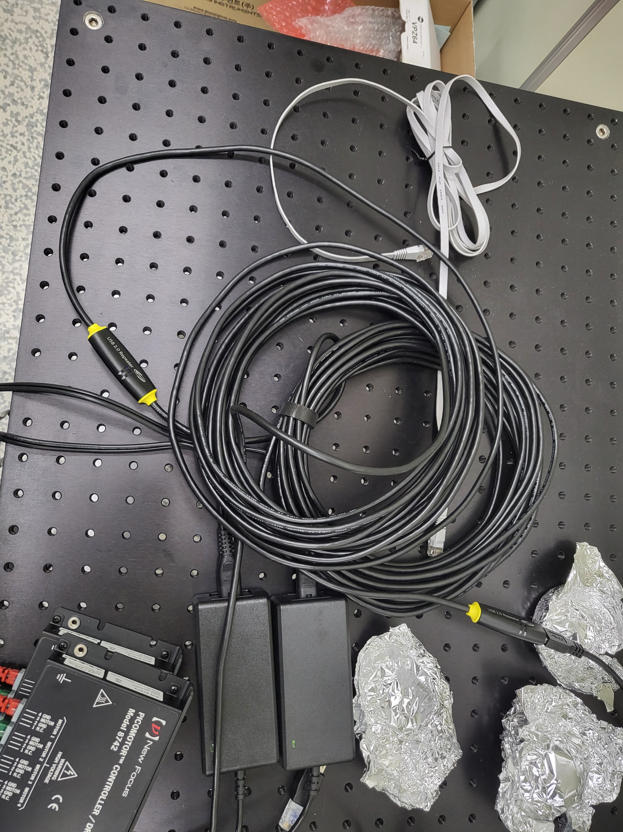
Data acquisition system
USB, Serial
LAN
5-axis motor
1-axis motor
Tunnel (Optical table)
Chamber
Tunnel
(Optical table)
5축 controller
5-axis controller
Camera
Camera
Chamber
LAN hub
1-axis controller
20m USB extension
Gallery (PC)
Gallery
Main PC
Control room
Control PC

Slide 12
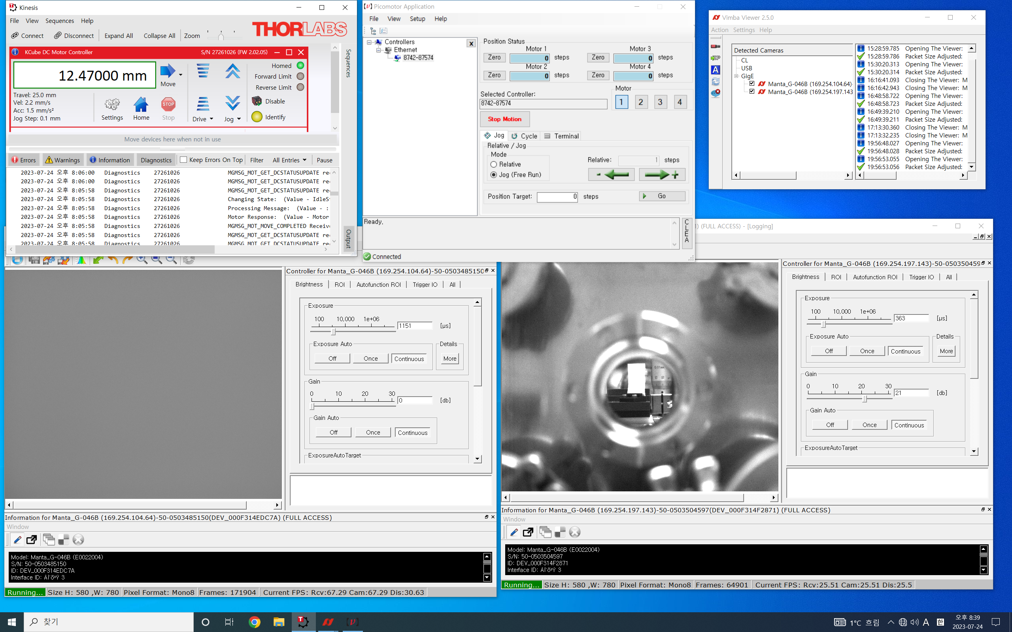
Data acquisition system
1-axis motor controller
5-axis motor controller
Camera 1 (ChDR)
Camera 2 (YAG)

Slide 13
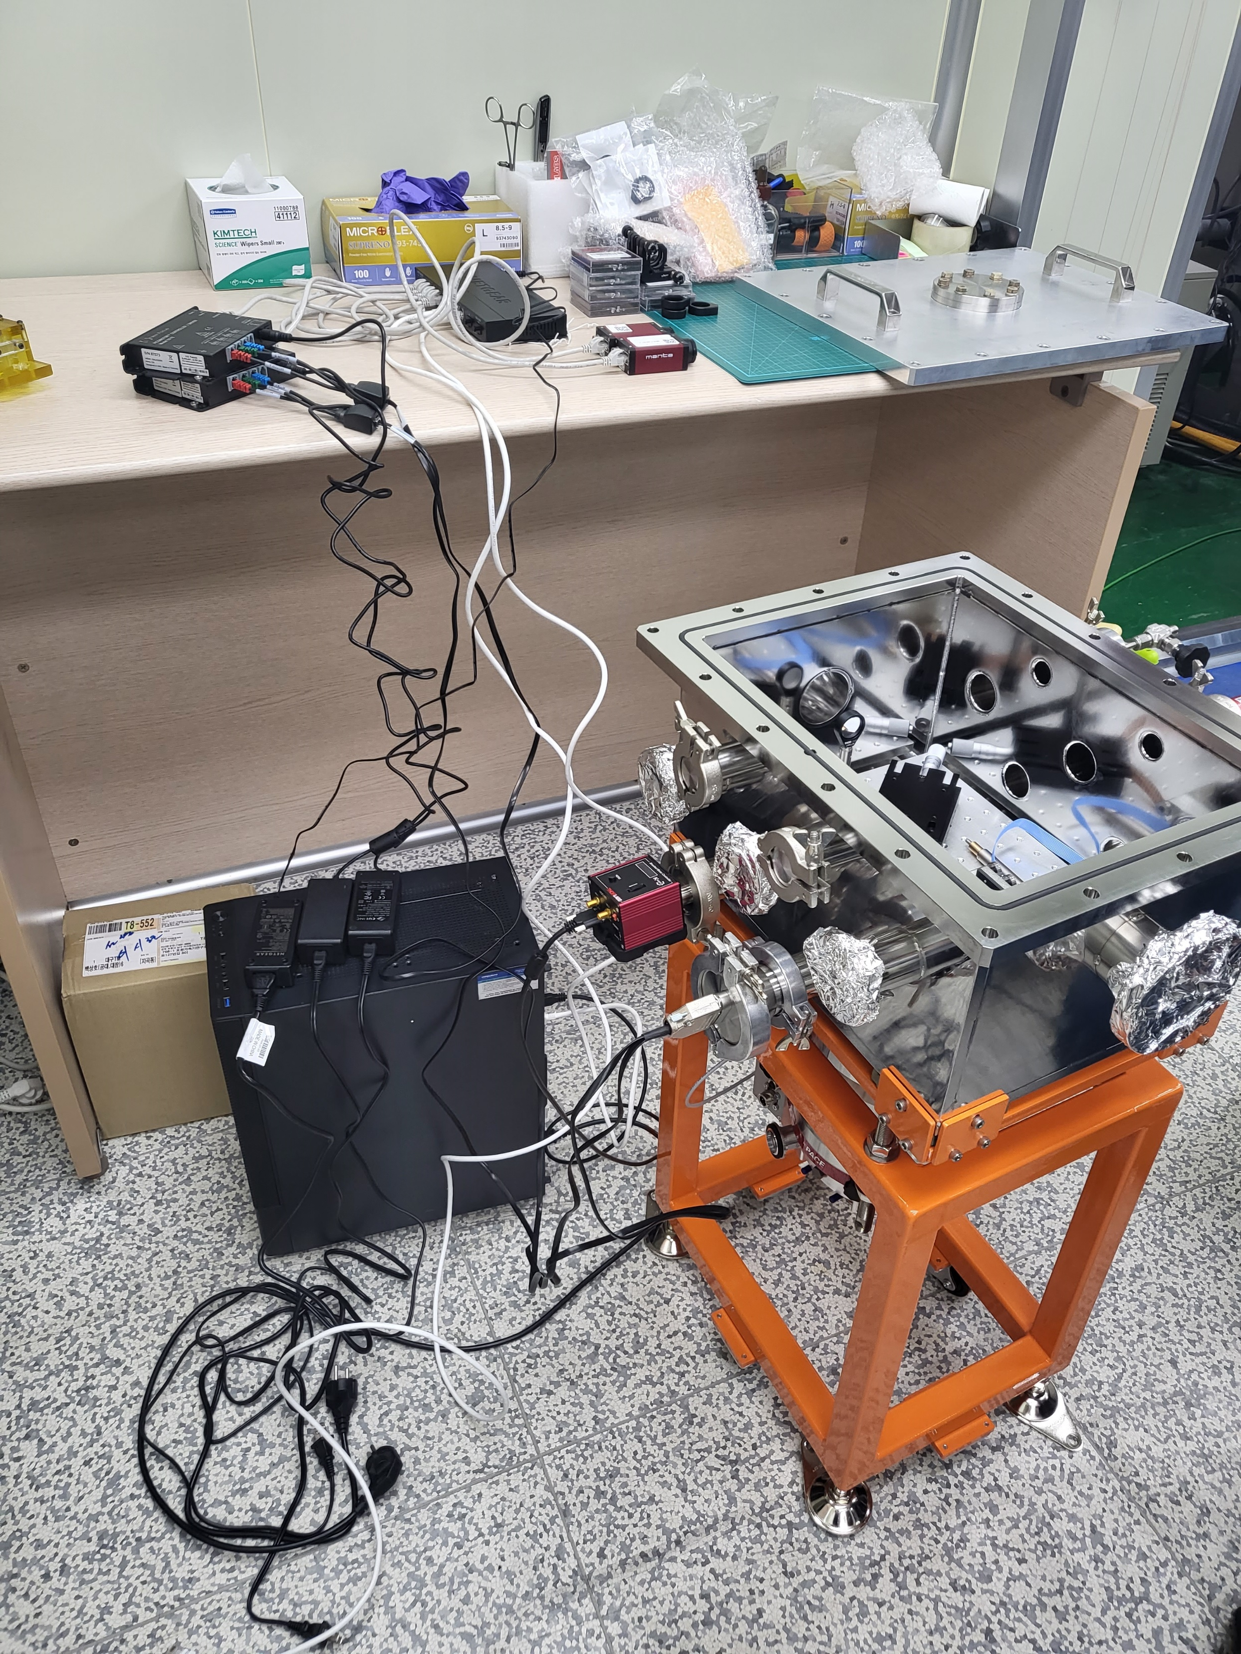
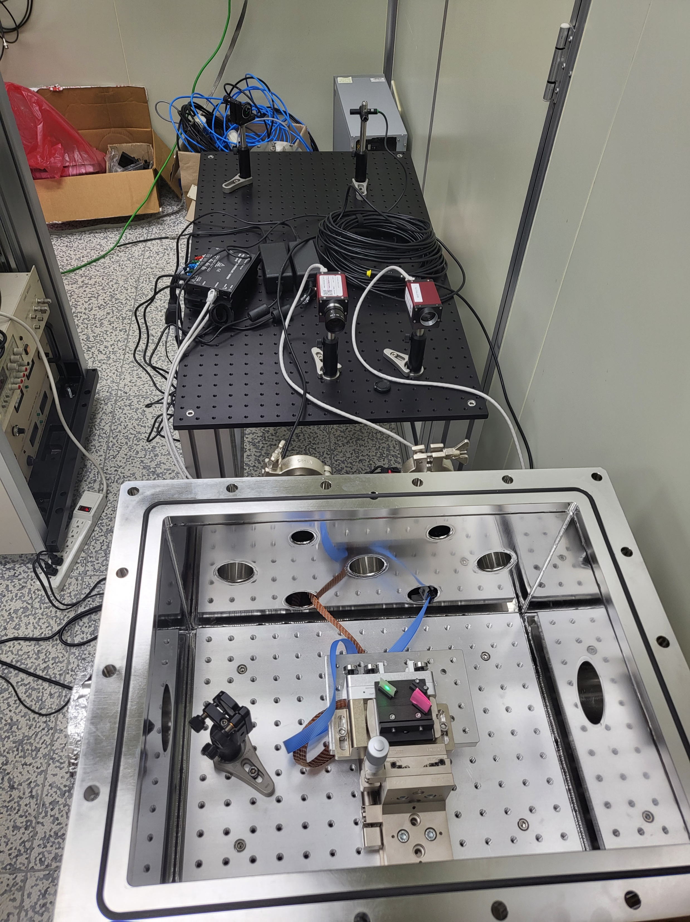
DAQ test
Alignment test

Slide 14
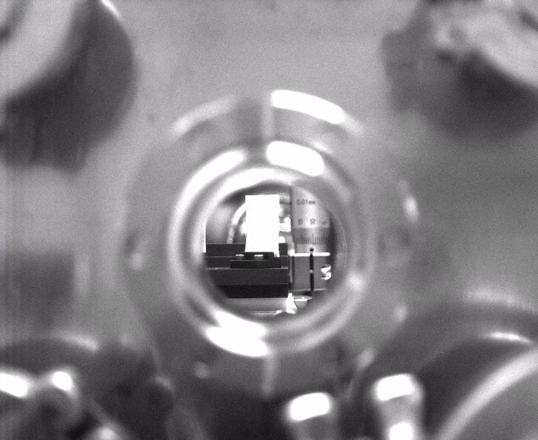
Alignment test
Positioning the camera to fit
the ChDR total reflection path
SCM2
SCM1
Alignment based on initial beam path (SCM1-2)
9.53 mm
Radiator
Cor1
Cor2
12.47 mm
YAG
Laser
(ChDR)
Laser
(e-beam)
Adjust the position to cover two views with one camera
Camera
Camera
+lens f~30mm

Slide 15
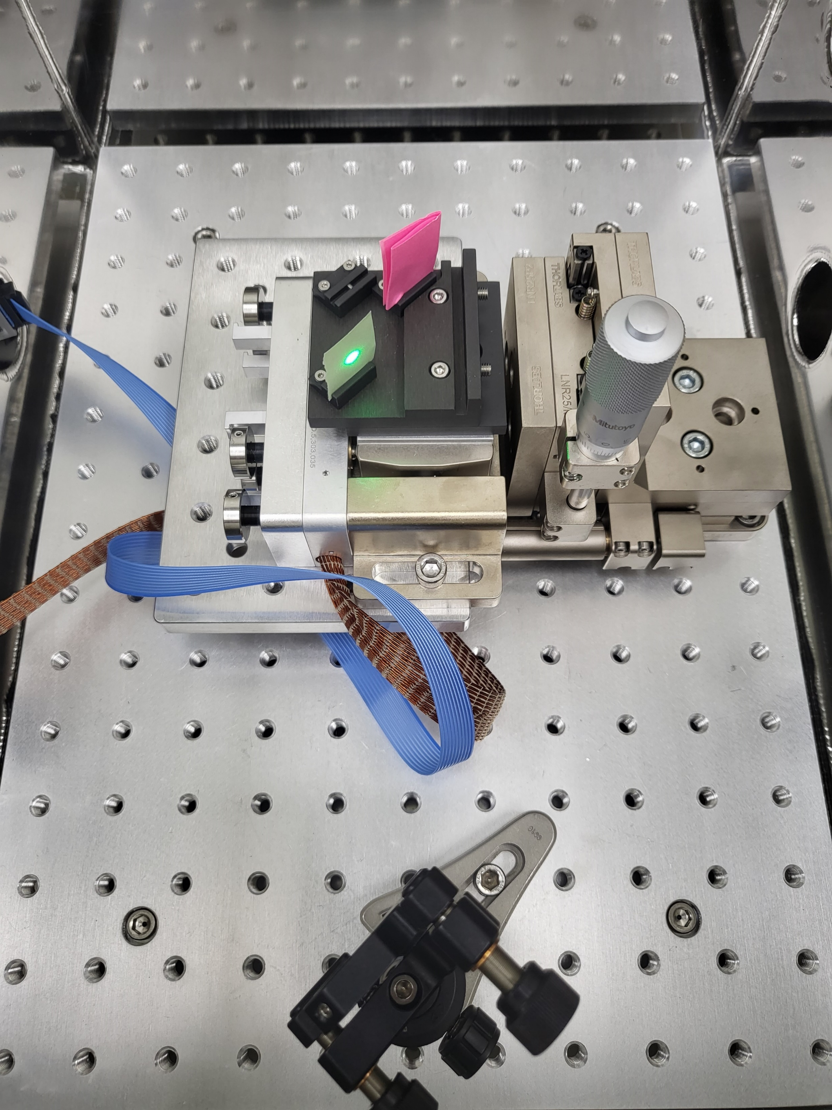
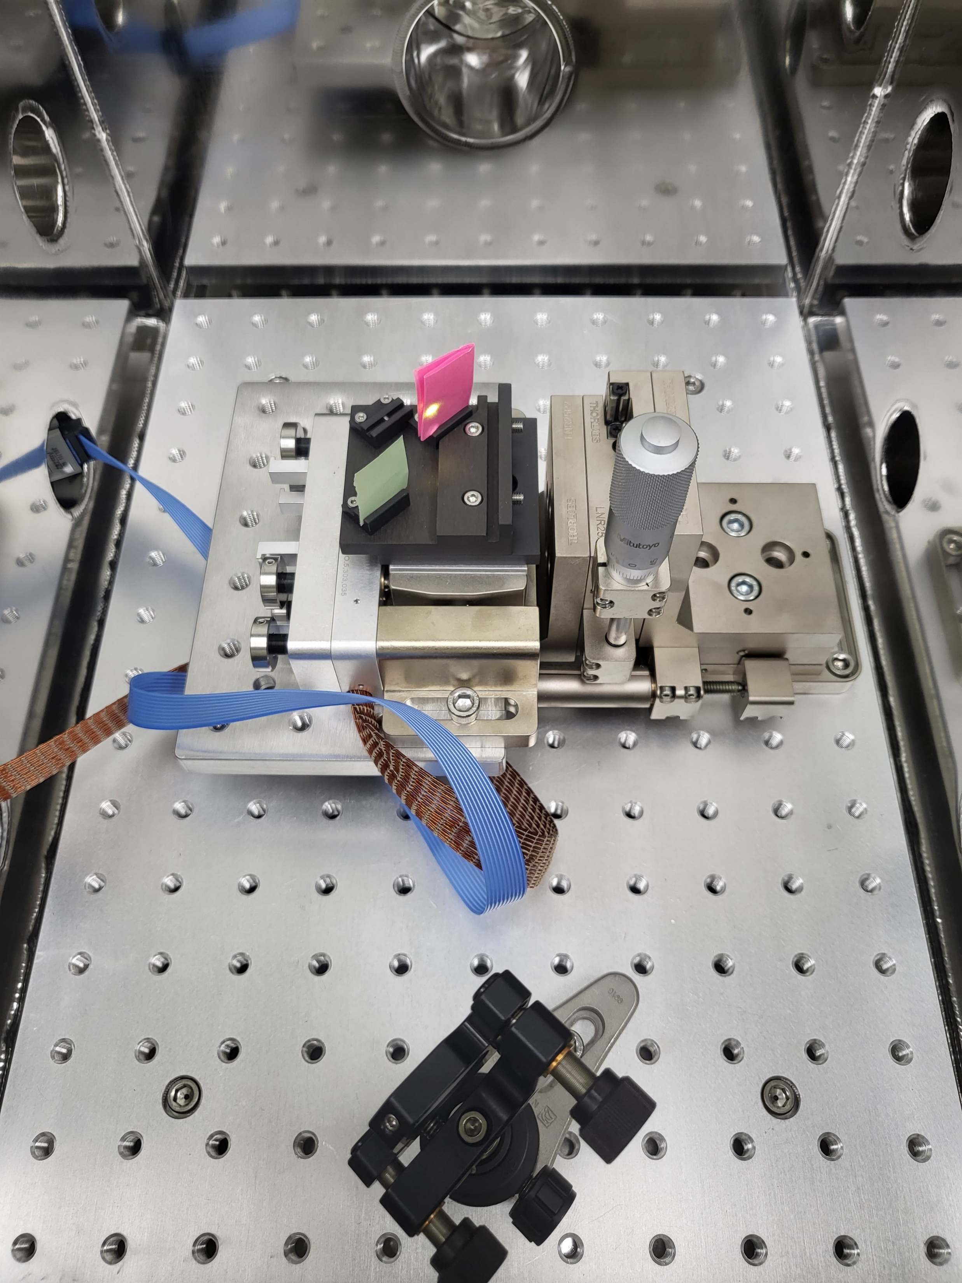
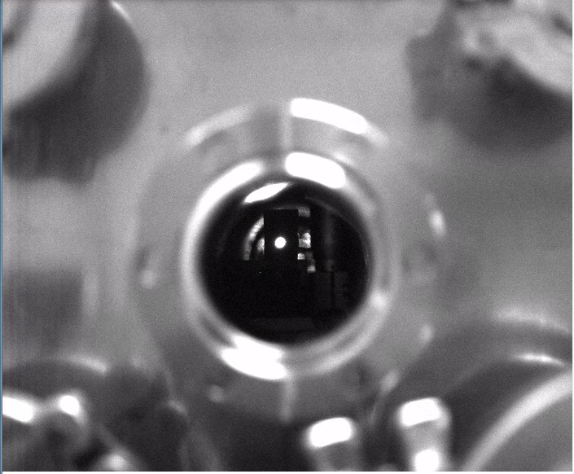
Alignment test
Positioning the camera to fit
the ChDR total reflection path
SCM2
SCM1
Alignment based on initial beam path (SCM1-2)
9.53 mm
Radiator
Cor1
Cor2
12.47 mm
YAG
Laser
(ChDR)
Laser
(e-beam)
Adjust the position to cover two views with one camera
Camera
Camera
+lens f~30mm

Slide 16
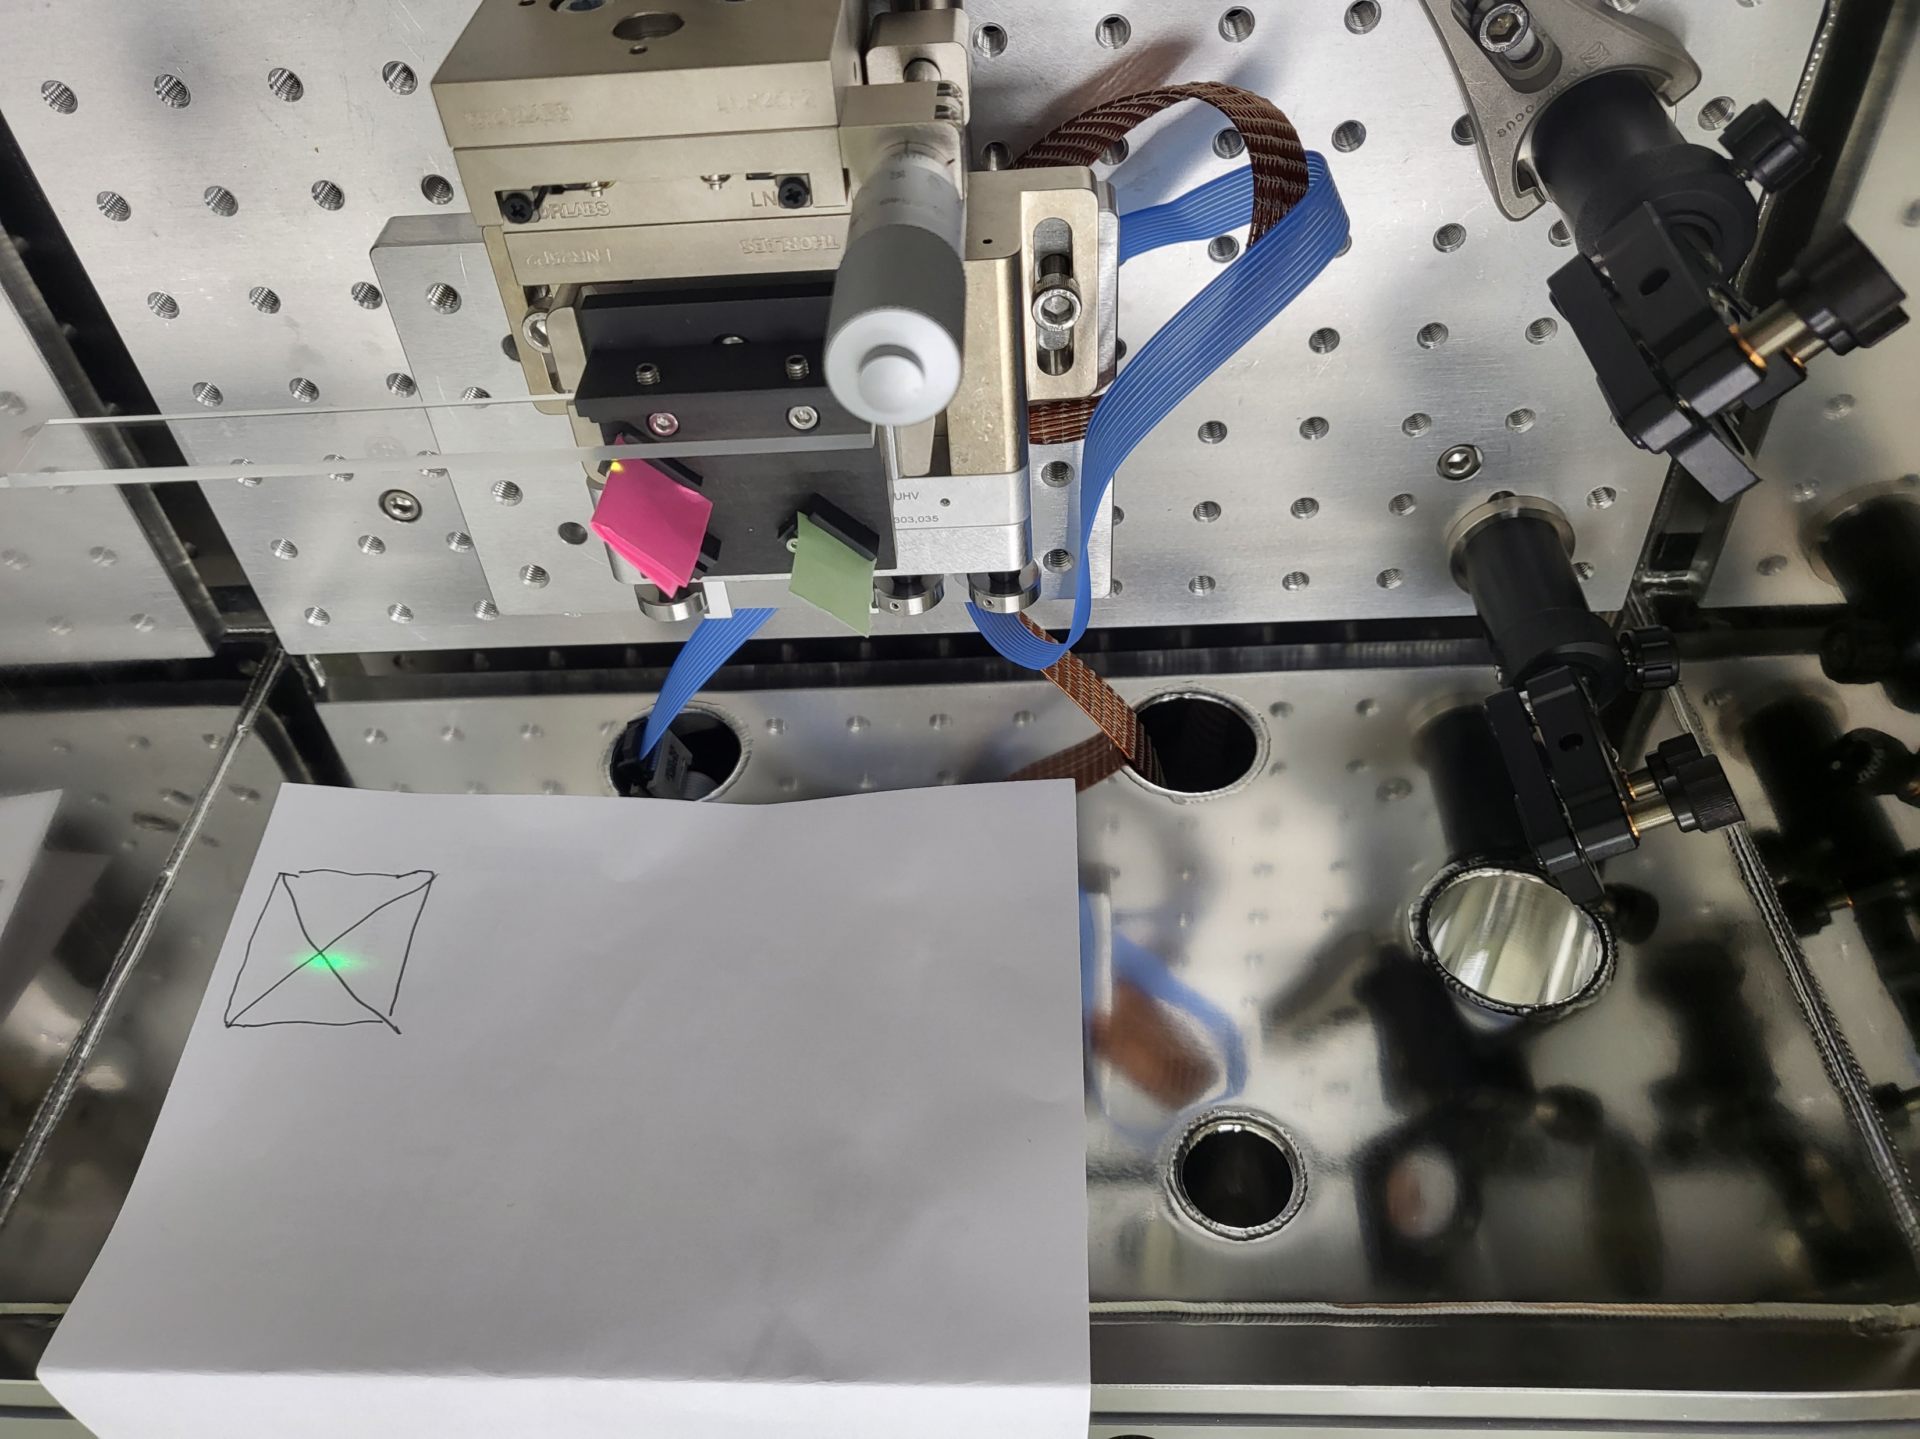
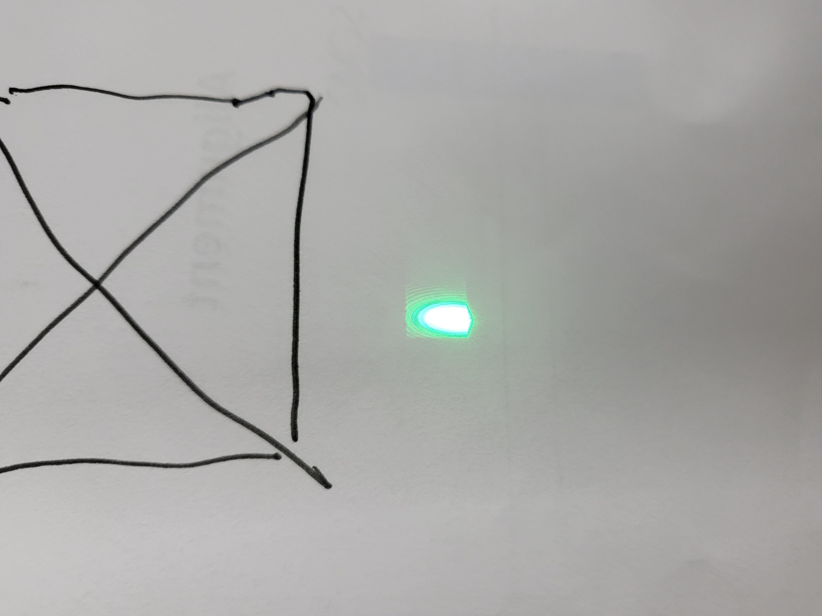
Alignment test
SCM2
SCM1
12.47 mm
Cor1
Cor2
Laser
(ChDR)
Laser
(e-beam)
Lens
MVL35M23 (35mm)
MVL7000 (Zoom 18-108)
Camera
Camera
+lens

Slide 17
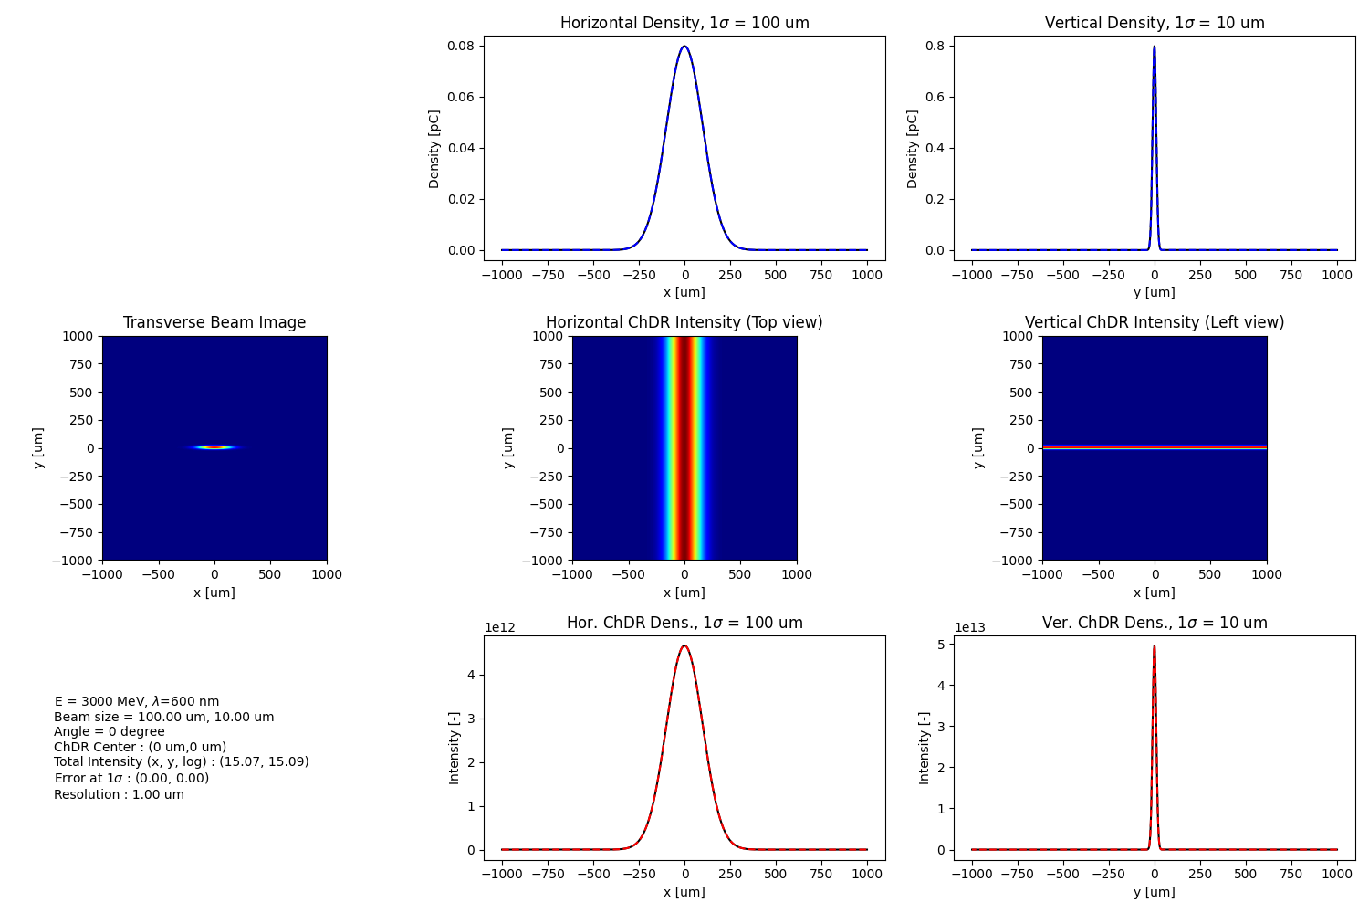
Expected results
Horizontal profile
Vertical profile
3 GeV 600 nm 0’

Slide 18
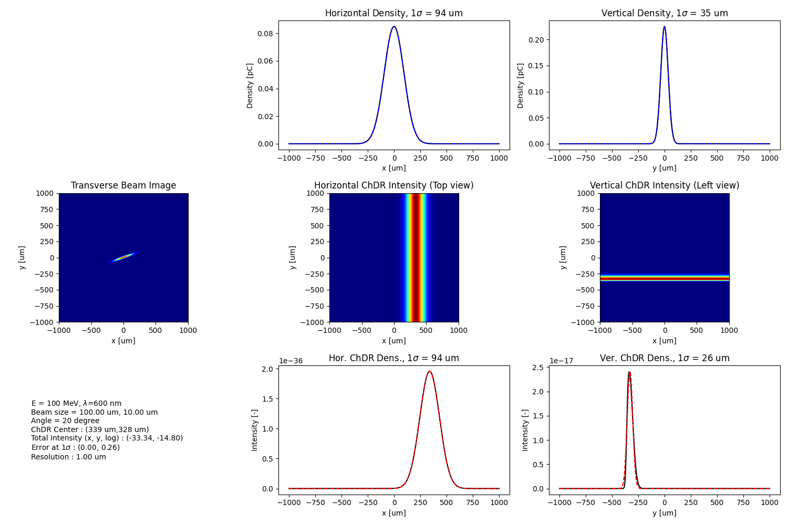
100 MeV 600 nm 20’

Slide 19
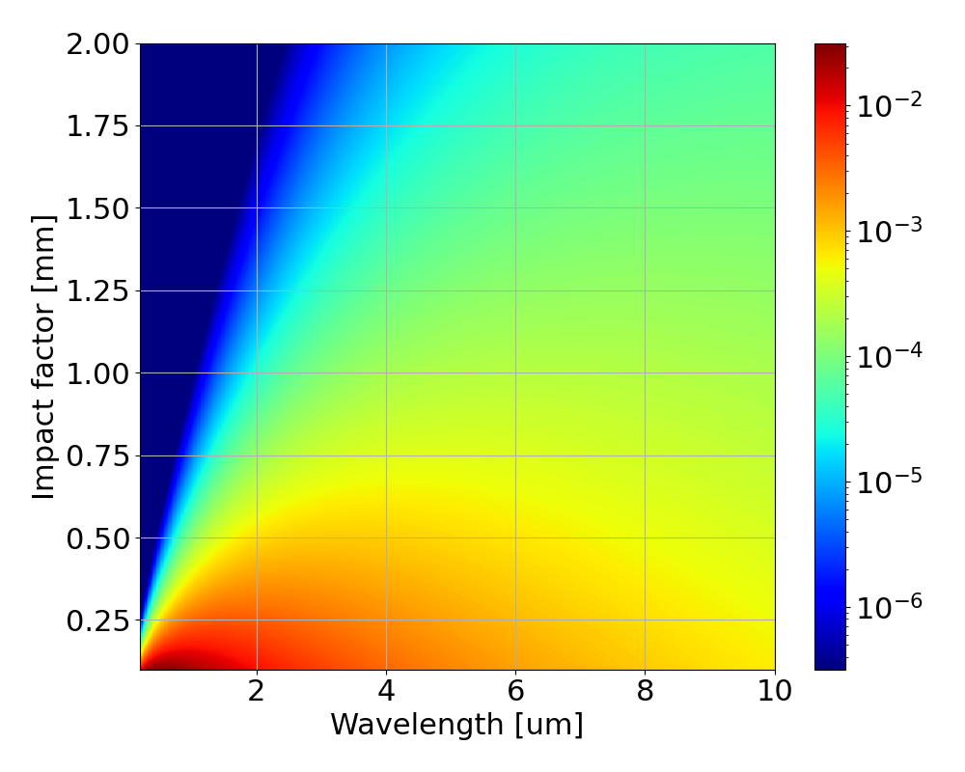
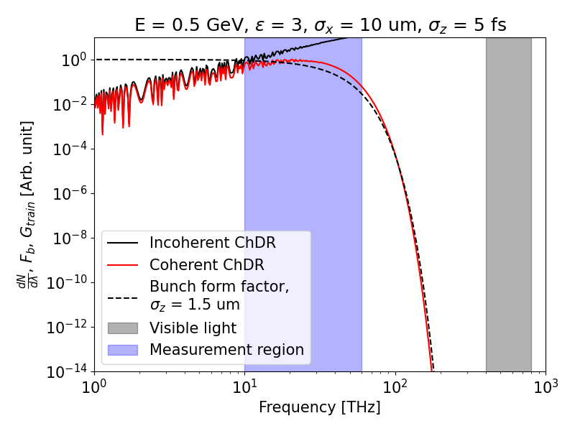
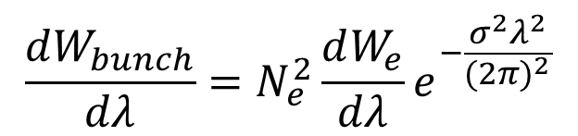
Bunch length measurement
What we already know
(Incoherent / Single particle ChDR)
$$\frac{dW_{bunch}}{dλ}=N_{e}^{2}\frac{dW_{e}}{dλ}e^{−\frac{σ^{2}λ^{2}}{{(2π)}^{2}}}$$
What we Measure
(Coherent ChDR)
What we want to know
(Bunch length)
IBS 150 TW Laser, LWFA experiment
Expected e-beam parameters:
500 MeV, 1~5 fs(0.3~1.5 um), 10 pc

Slide 20
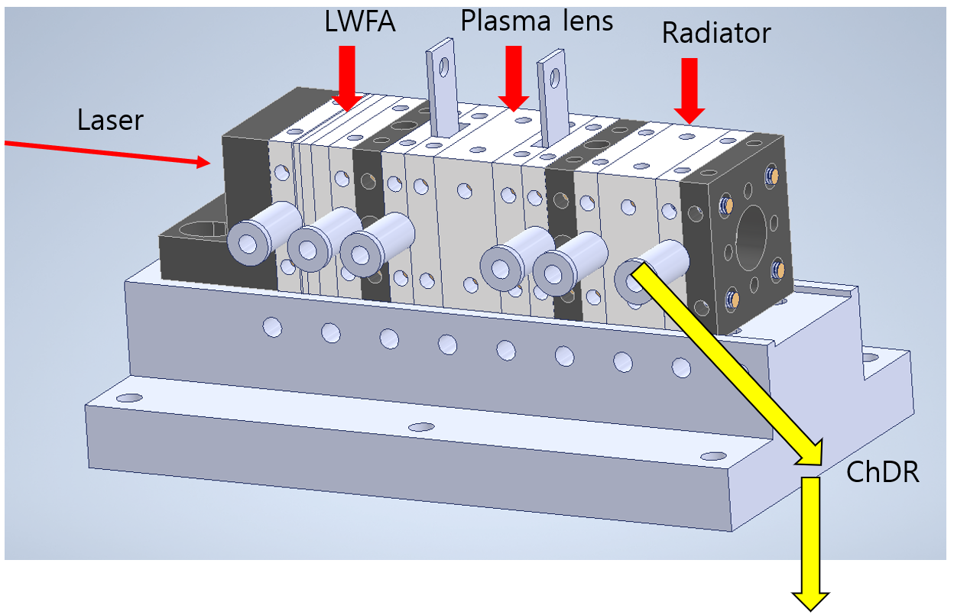
Radiator (with capillary) design
Spectrometer

Slide 21
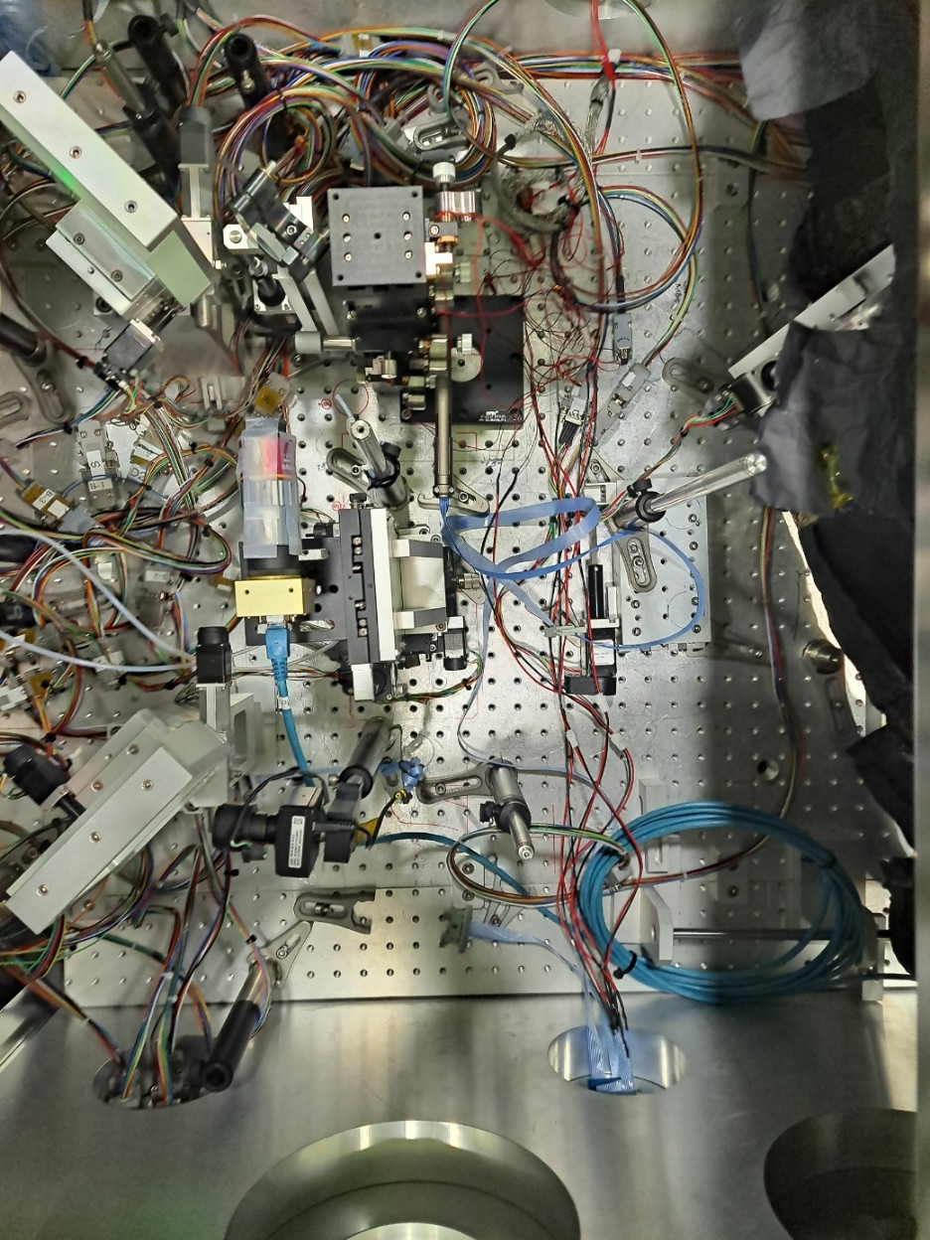
Experimental set-up
LWFA Experiment with IBS 150 TW Laser
The goal was to measure the length of the electron beam. (500 MeV, a few fs, 10 pC)
Measuring ChDR coming off the edge of a capillary.
Beam transported using a 3’ Au mirror.
Outside the chamber, only passes through the filter and directly into the detector.
Capillary
Laser
ChDR
ChDR
Capillary
Detector
ChDR
Au Mirror
Au Mirror
ChDR
Filtered signal
ChDR
Window
ChDR
THz filter
Window

Slide 22
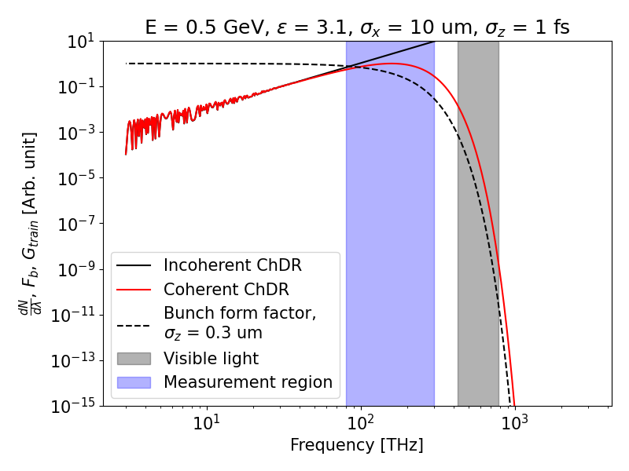
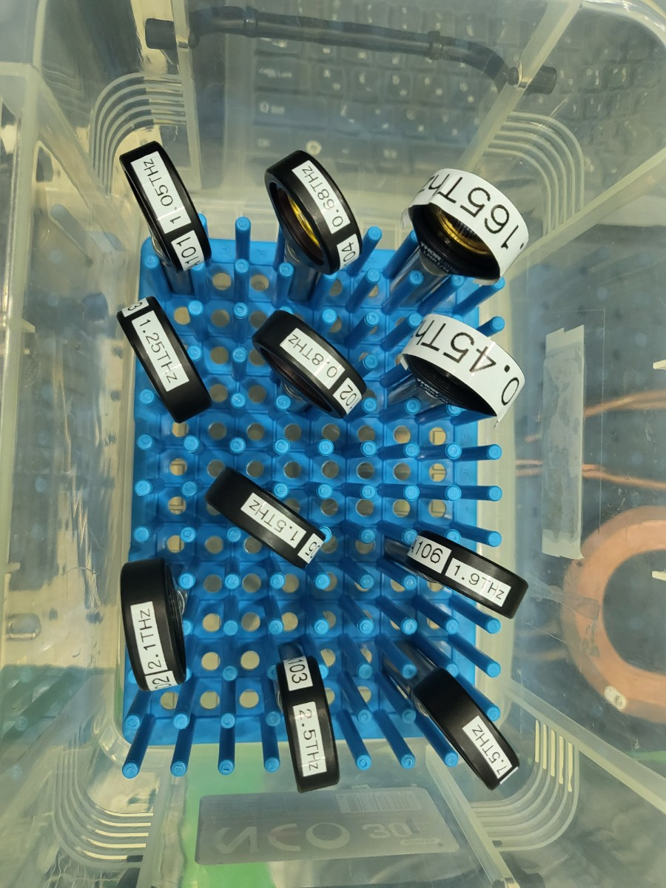
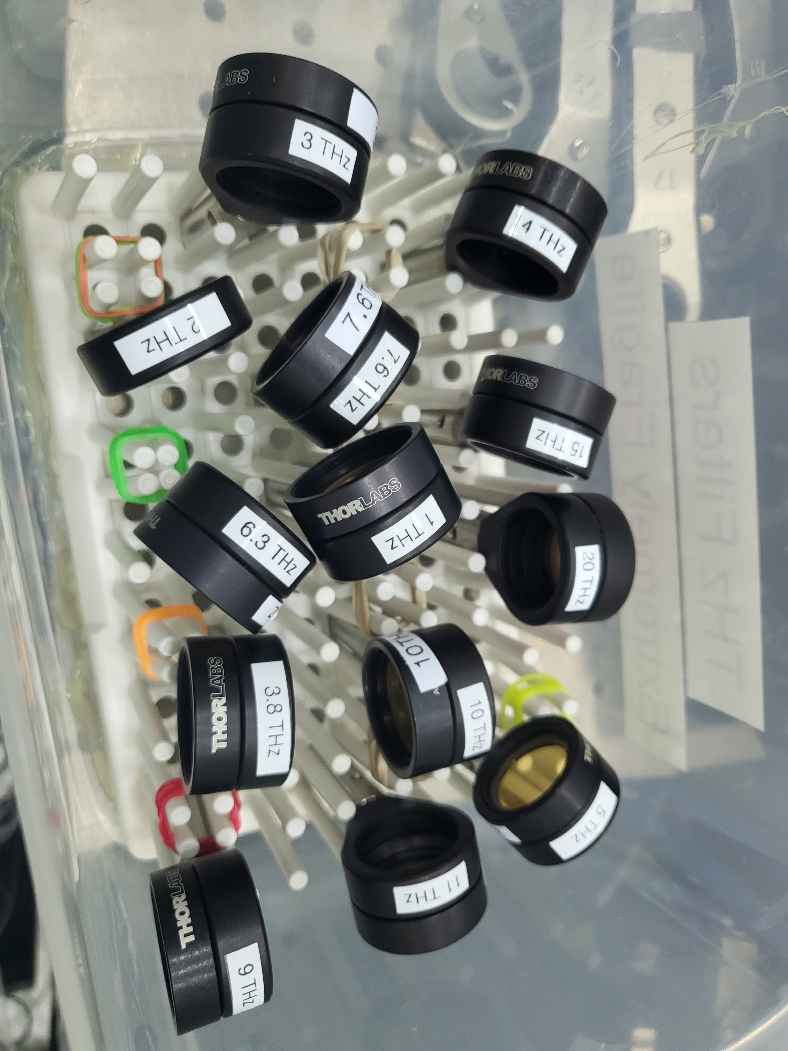
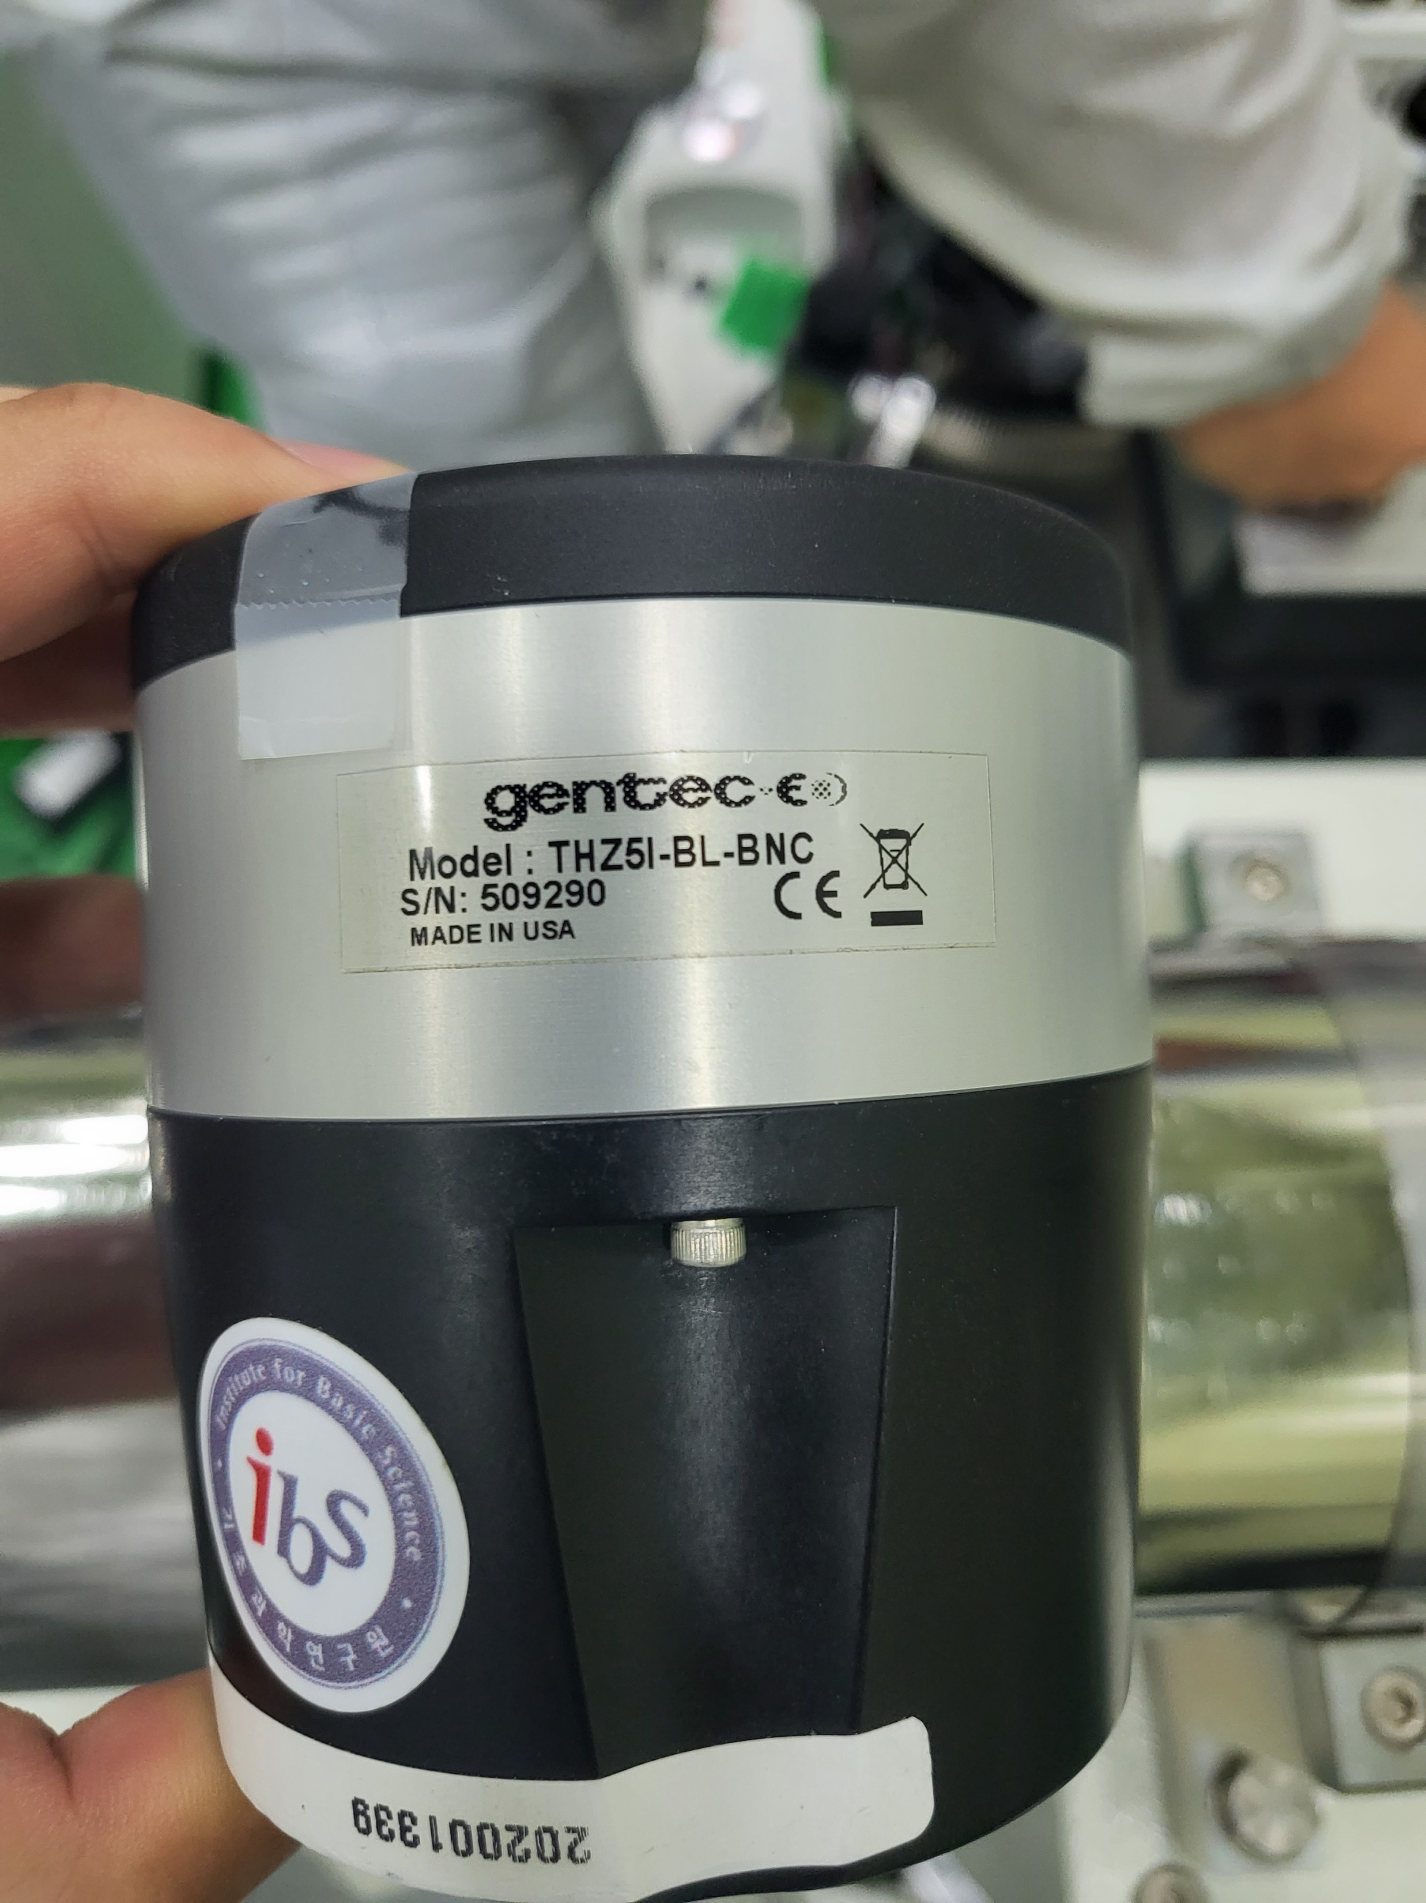
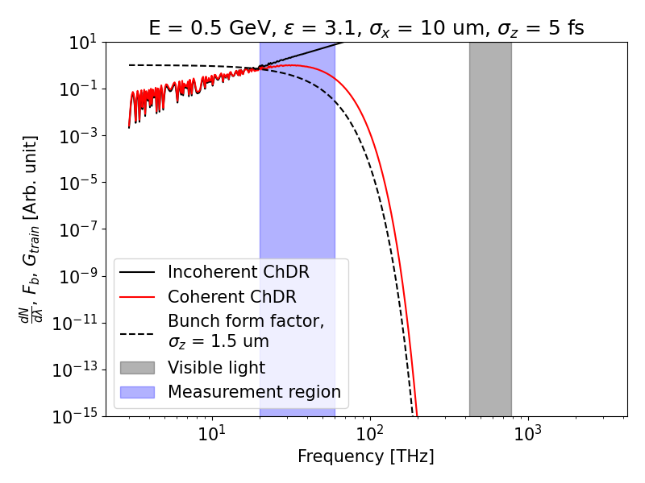
Experimental set-up
THz detector
(power meter, 0.1~30 THz)
THz filter
Measurement Target: Regions where the trends of Incoherent ChDR and Coherent ChDR differ.
  As the bunch length increases, differences appear at lower frequencies.(1 fs → ~80 THz, 5 fs → ~ 20 THz)
Measurement Plan: Use filters up to 20 THz and replace 5 filters sequentially from the highest frequency.
  Record beam energy and, if possible, beam size for each measurement.

Slide 23
Conclusion
Electron Beam Profile Monitor
The current profile monitor is disassembled for cleaning.
Reassembly is planned in the tunnel before the scheduled installation at e-Labs.
After e-Labs installation:
  Perform laser-based alignment (2-axis).
  Follow with beam-based alignment (5-axis).
Significant time is expected to be required for alignment before actual ChDR measurements.
Bunch Length Measurement
The first experiment using the IBS 150 TW laser failed.
Aiming to find a facility capable of sub-pico bunch length experiments and reattempt using the same method.

Slide 24
Appendix
- Theoretical Background on ChDR

Slide 25
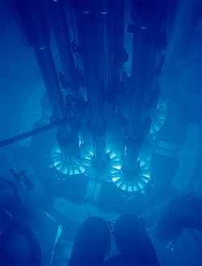
Cherenkov Radiation
- Cherenkov(or Vavilov-Cherenkov) radiation is electromagnetic radiation emitted when charged particle moves faster than the light.
- The radiation is named after the Soviet scientist Pavel Cherenkov who was the first to detect it experimentally under the supervision of Sergey Vavilov at the Lebedev Institute in 1934.
- A theory of this effect was developed in 1938 within the framework of Einstein’s special relativity theory by Igor Tamm and Ilya Frank.

Slide 26
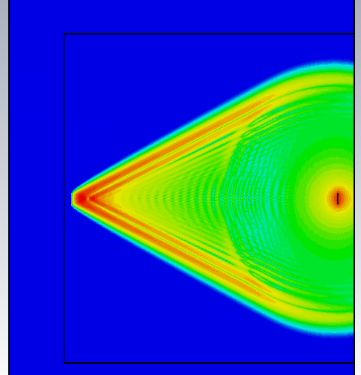
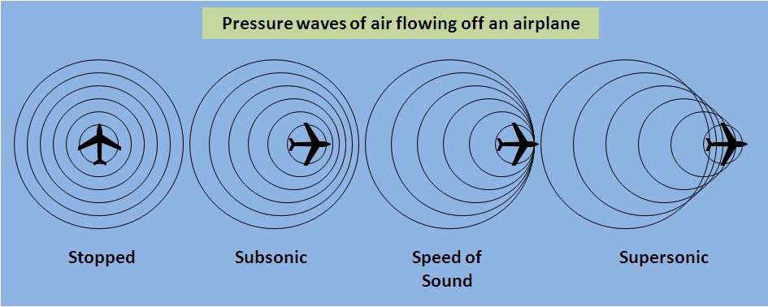

Classical Cherenkov Radiation
Vacuum
Particle speed : $βc$
Light speed (in medium) : $\frac{c}{n}$
Emission angle : $\cos{θ}=\frac{1}{nβ}$
Glass
Beam

Slide 27

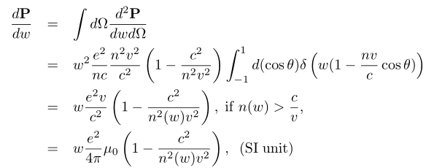
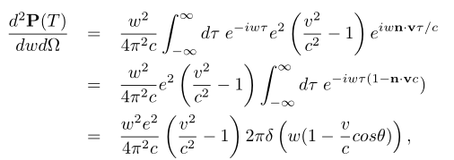


Classical Cherenkov Radiation
Charged particle moving with constant velocity and the charge and current densities
Frank-Tamm formula (1937)
Power spectrum at
T(avg time=1/2*(t+t’))
: no radiation
: EM radiation emitted

Slide 28
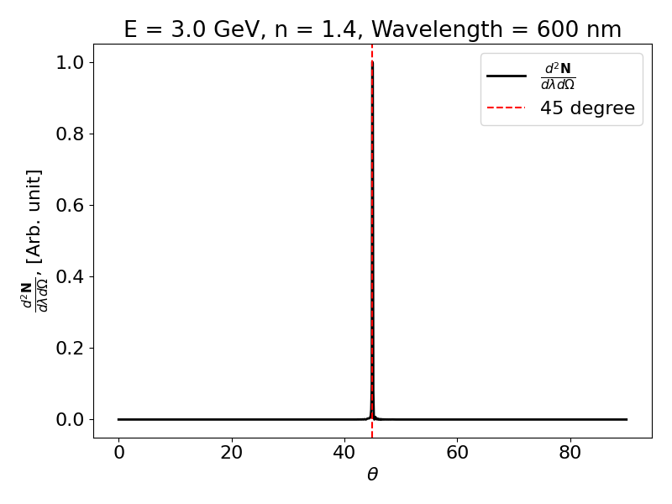
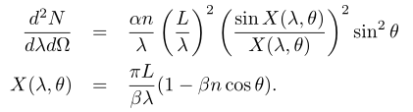
Classical Cherenkov Radiation
The number of photons emitted
per unit length per solid angle
Cherenkov angle θ
ε=2 → Cherenkov angle θ = 45°

Slide 29
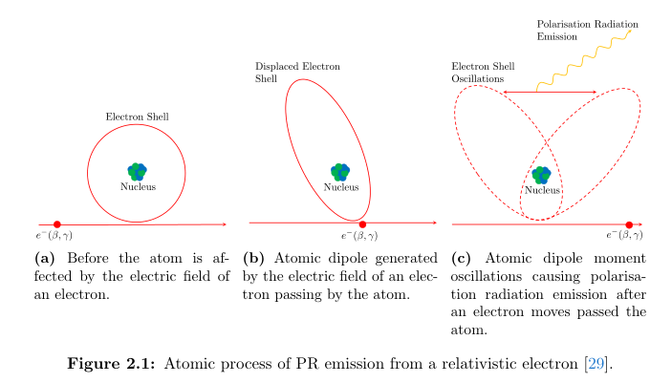
Polarization radiation

Slide 30
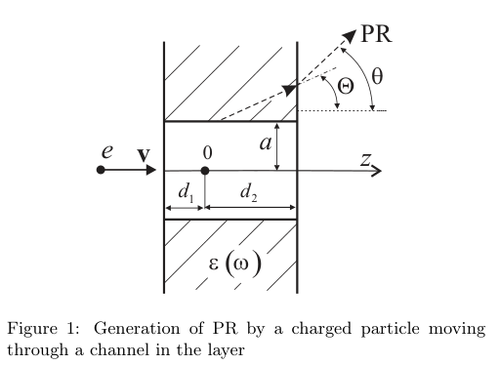



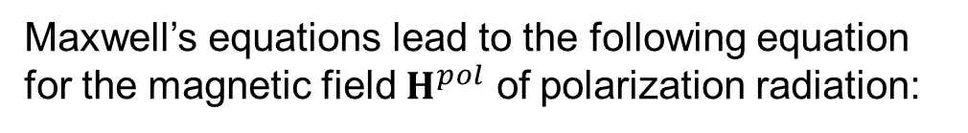
Cherenkov Diffraction Radiation
The radiation field is a solution to the vacuum macroscopic Maxwell equation with the polarization current.
Substance
Maxwell’s equations lead to the following equation for the magnetic field $H^{pol}$ of polarization radiation:
The spectral-angular density of polarized radiation can be determined from the relation

Slide 31
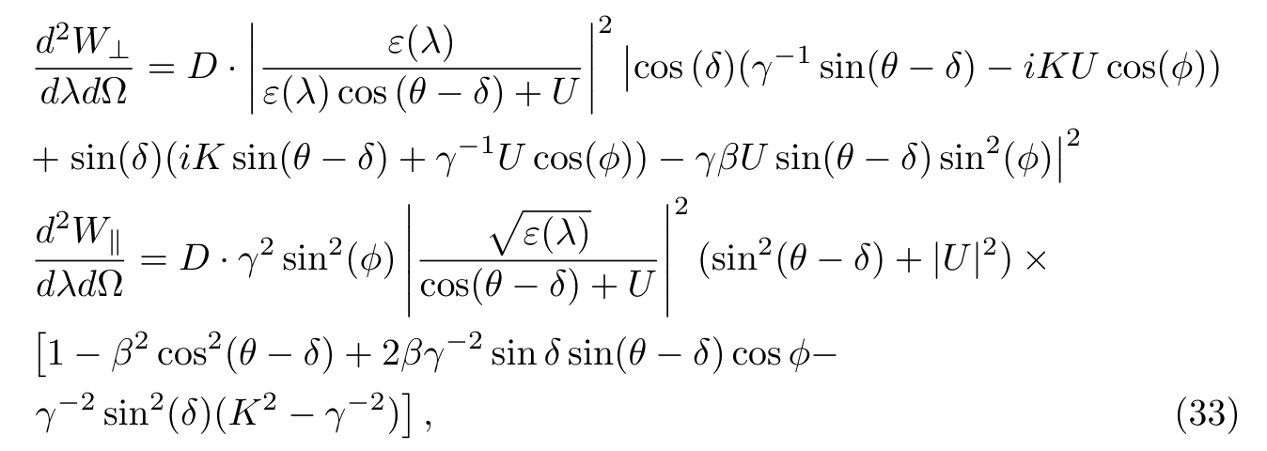
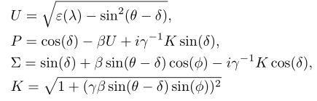
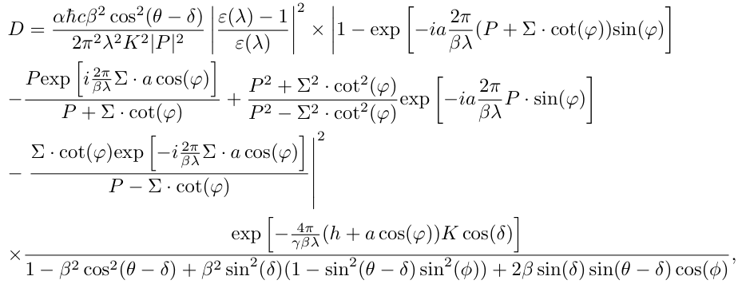
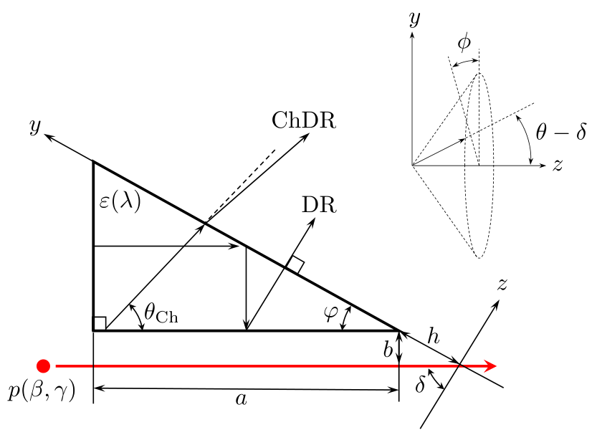
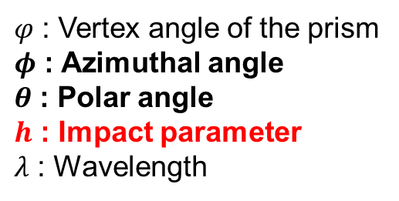
Cherenkov Diffraction Radiation
$φ$ : Vertex angle of the prism
$φ$ : Azimuthal angle
$θ$ : Polar angle
$h$ : Impact parameter
$λ$ : Wavelength

Slide 32


Cherenkov Diffraction Radiation
Intensity of ChDR vs h and λ
Intensity of ChDR vs h and λ

Slide 33

Beam profile monitor
Extremely small divergence of ChDR
Radiator
y
~mrad
z

