Slide 1
Steady-State Microbunching in a Storage Ring for Generating Coherent Radiation
2024-12-20, Pohang, South Korea
Young Min Park
Division of Advanced Nuclear Engineering (DANE), POSTECH
JKPS meeting, (2024.12.20)

Slide 2
Index
Introduction
SSMB Theory
  SSMB Mechanism
  Dual Modulation Analysis
  Long Wavelength Beating
Application of SSMB
  Simulation Method
  Radiation source
Drawback
Conclusion
2

Slide 3
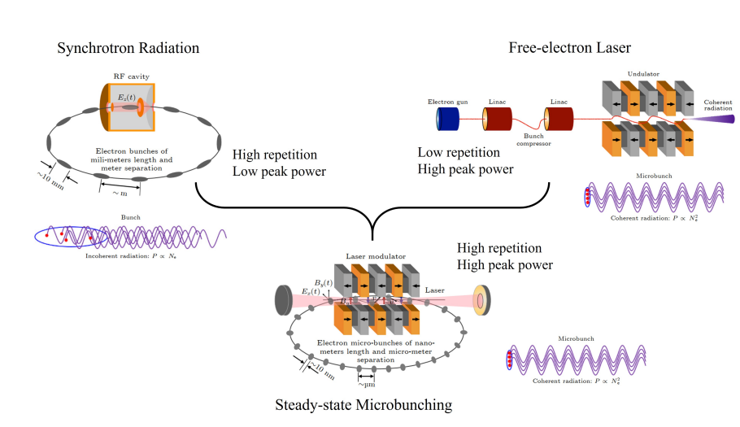
Introduction
Combined the two approaches. The new approach would invoke a storage ring for high repetition rate and a microbunched beam for high peak power.
3

Slide 4
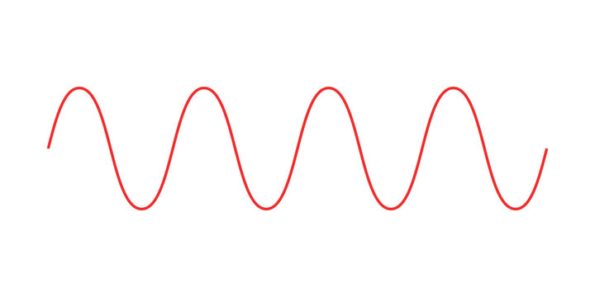






SSMB Mechanism
Modulation
Low energy gain
$$V$$
High energy gain
$$δ$$
$$δ$$
After modulation
$$z$$
$$z$$
$$z$$
In a storage ring, modulation refers to variations in the energy or density of the particle beam along its longitudinal profile. These modulations can be induced by RF fields, undulator with lasers, or other interactions.
4

Slide 5
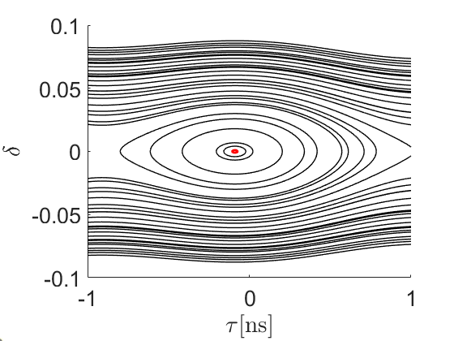
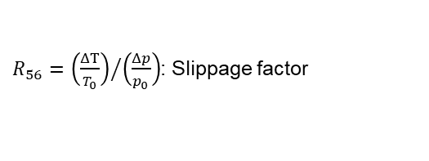
SSMB Mechanism
RF-bucket
$$ℋ\left(τ,δ\right)=\frac{1}{2}R_{56}δ^{2}+eV\left[\cos\left(ω_{rf}τ+φ_{s}\right)−\cos{φ_{s}}+\sin{φ_{s}}τ\right]$$
$R_{56}={\left(\frac{ΔT}{T_{0}}\right)}/{\left(\frac{Δp}{p_{0}}\right)}$: Slippage factor
RF-bucket
An RF-bucket refers to the region in the longitudinal phase space where particles can remain stable.
Particles within the bucket oscillate stably, while particles outside the bucket move to another bucket.
A fixed point is defined as a point in the particle's phase space where its position does not change with each turn.
5

Slide 6
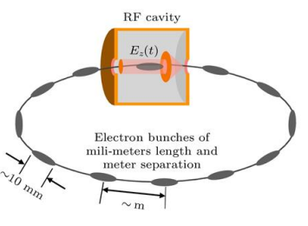
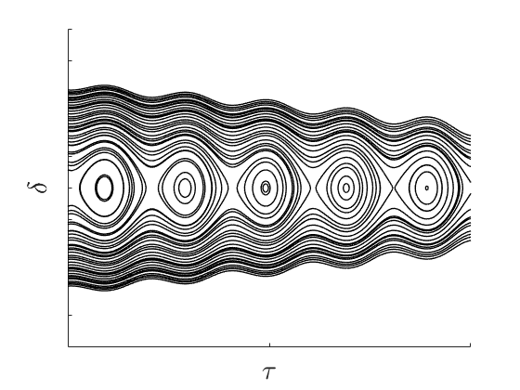
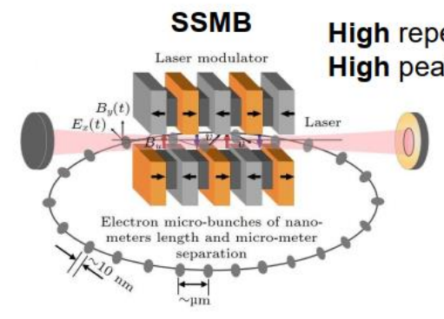
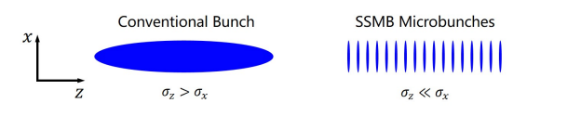

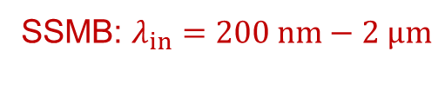
SSMB Mechanism
Key difference between Storage Ring and SSMB is Modulation method
Storage ring
Storage ring: $λ_{in}=0.6 m\left(PLS−II\right)≈\sim m$
SSMB
SSMB: $λ_{in}=200 nm−2 μm$
6

Slide 7
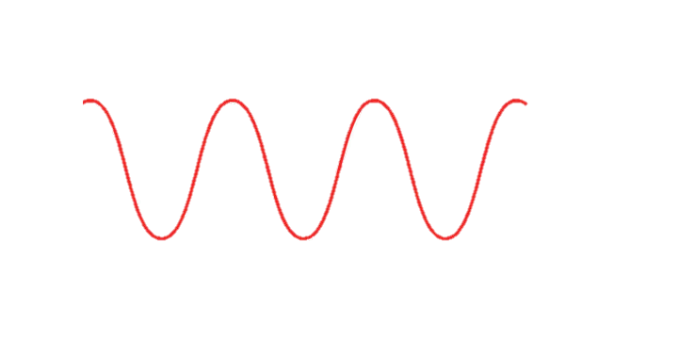














SSMB Mechanism
$$δ$$
$$δ$$
$$λ_{in}$$
$$λ_{in}$$
$$λ_{in}$$
$$λ_{in}$$
$$λ_{in}$$
$$λ_{in}$$
$$Δp=\frac{λ_{in}}{R_{56}C}p_{0}$$
After One turn
$$z$$
$$z$$
$$Δp=−\frac{λ_{in}}{R_{56}C}p_{0}$$
$$z=−λ_{in}$$
$$z=λ_{in}$$
7

Slide 8



SSMB Mechanism
$$δ$$
$$δ$$
$$Δp=2\frac{λ_{in}}{R_{56}C}p_{0}$$
$$λ_{in}$$
$$λ_{in}$$
$$λ_{in}$$
$$λ_{in}$$
$$λ_{in}$$
$$λ_{in}$$
After One turn
$$z$$
$$z$$
$$Δp=−\frac{λ_{in}}{R_{56}C}p_{0}$$
$$z=−2λ_{in}$$
$$z=λ_{in}$$
8

Slide 9
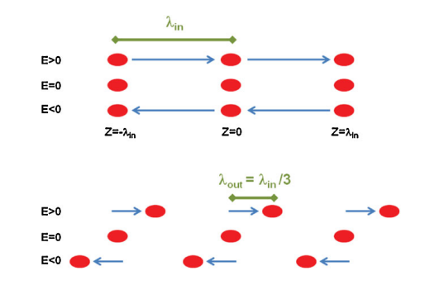
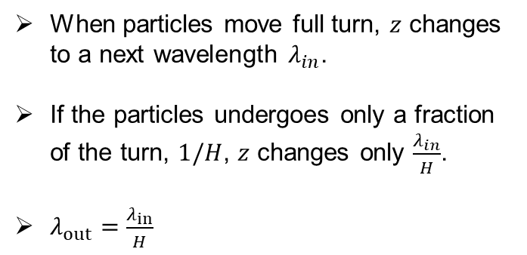
SSMB Mechanism
When particles move full turn, $z$ changes to a next wavelength $λ_{in}$.
If the particles undergoes only a fraction of the turn, $1/H$, $z$ changes only $\frac{λ_{in}}{H}$.
$λ_{out}=\frac{λ_{in}}{H}$
9

Slide 10
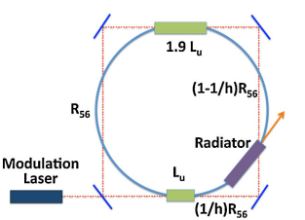
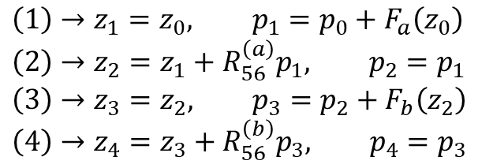




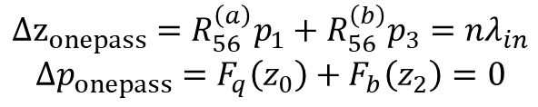
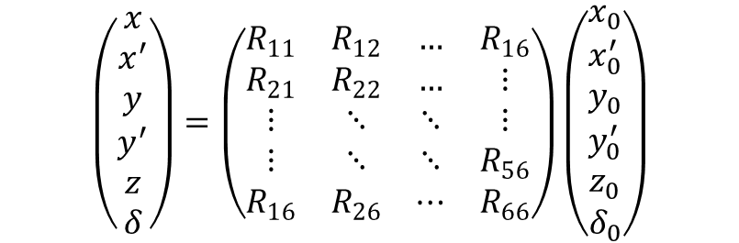
Dual Modulation Analysis
$$\left(1\right)→z_{1}=z_{0}, p_{1}=p_{0}+F_{a}\left(z_{0}\right) \\ \left(2\right)→z_{2}=z_{1}+R_{56}^{\left(a\right)}p_{1}, p_{2}=p_{1} \\ \left(3\right)→z_{3}=z_{2}, p_{3}=p_{2}+F_{b}\left(z_{2}\right) \\ \left(4\right)→z_{4}=z_{3}+R_{56}^{\left(b\right)}p_{3}, p_{4}=p_{3}$$
$$\left(3\right)$$
$$\left(\begin{matrix}x \\ x^{′} \\ y \\ y^{′} \\ z \\ δ\end{matrix}\right)=\left(\begin{matrix}R_{11} & R_{12} & … & R_{16} \\ R_{21} & R_{22} & … & ⋮ \\ ⋮ & ⋱ & ⋱ & ⋮ \\ ⋮ & ⋱ & ⋱ & R_{56} \\ R_{16} & R_{26} & ⋯ & R_{66}\end{matrix}\right)\left(\begin{matrix}x_{0} \\ x_{0}^{′} \\ y_{0} \\ y_{0}^{′} \\ z_{0} \\ δ_{0}\end{matrix}\right)$$
$$\left(4\right)$$
$$\left(2\right)$$
$$\left(1\right)$$
$$F_{a,b}\left(z\right)=V_{a,b}\sin\left(kz\right)$$
$$Δz_{onepass}=R_{56}^{\left(a\right)}p_{1}+R_{56}^{\left(b\right)}p_{3}=nλ_{in}$$
$$Δp_{onepass}=F_{q}\left(z_{0}\right)+F_{b}\left(z_{2}\right)=0$$
Single turn fixed point
10

Slide 11


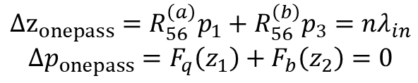
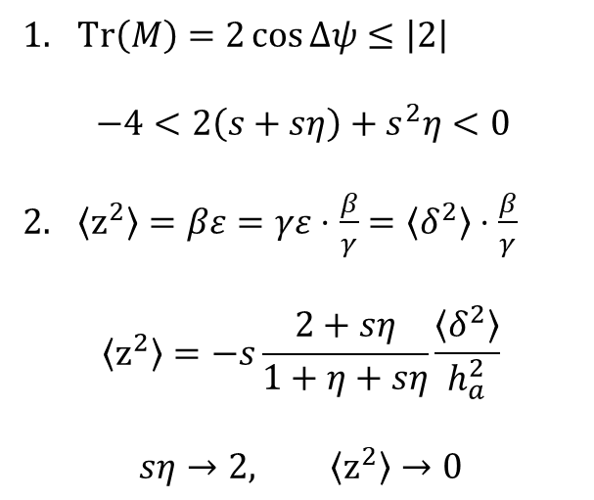
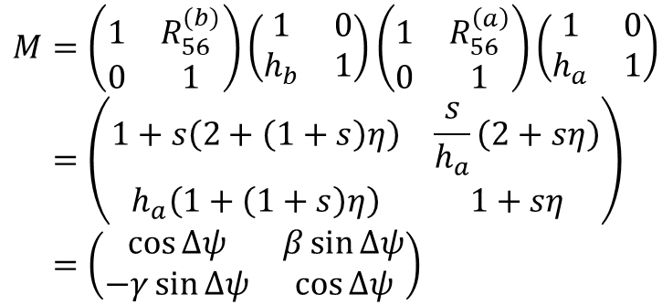

Dual Modulation Analysis
$$Δz_{onepass}=R_{56}^{\left(a\right)}p_{1}+R_{56}^{\left(b\right)}p_{3}=nλ_{in}$$
$$Δp_{onepass}=F_{q}\left(z_{1}\right)+F_{b}\left(z_{2}\right)=0$$
$$F_{q}\left(z_{0}\right)=F_{q}\left(z_{2}\right)=0$$
$$R_{56}^{\left(a\right)}=R_{56}^{\left(b\right)}=\frac{nλ_{in}}{2}$$
One turn map
Stability and Shortening condition
$$M=\left(\begin{matrix}1 & R_{56}^{(b)} \\ 0 & 1\end{matrix}\right)\left(\begin{matrix}1 & 0 \\ h_{b} & 1\end{matrix}\right)\left(\begin{matrix}1 & R_{56}^{\left(a\right)} \\ 0 & 1\end{matrix}\right)\left(\begin{matrix}1 & 0 \\ h_{a} & 1\end{matrix}\right)=\left(\begin{matrix}1+s\left(2+\left(1+s\right)η\right) & \frac{s}{h_{a}}\left(2+sη\right) \\ h_{a}\left(1+\left(1+s\right)η\right) & 1+sη\end{matrix}\right)=\left(\begin{matrix}\cos{Δψ} & β\sin{Δψ} \\ −γ\sin{Δψ} & \cos{Δψ}\end{matrix}\right)$$
$Tr\left(M\right)=2\cos{Δψ}≤\left|2\right|$
  $$−4<2\left(s+sη\right)+s^{2}η<0$$
$\left\langle z^{2}\right\rangle =βε=γε⋅\frac{β}{γ}=\left\langle δ^{2}\right\rangle ⋅\frac{β}{γ}$
$$\left\langle z^{2}\right\rangle =−s\frac{2+sη}{1+η+sη}\frac{\left\langle δ^{2}\right\rangle }{h_{a}^{2}}$$
$$sη→2, \left\langle z^{2}\right\rangle →0$$
$$h_{a,b}=\frac{V_{a,b}}{k}, R_{56}^{\left(a\right)}=R_{56}^{\left(b\right)}=\frac{s}{h_{a}}, η=\frac{h_{b}}{h_{a}}$$
11

Slide 12








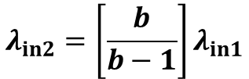

Long Wavelength Beating
$$λ_{in2}=\left[\frac{b}{b−1}\right]λ_{in1}$$
$$δ$$
$$λ_{in}$$
$$λ_{in}$$
$$λ_{in}$$
$$λ_{in}$$
$$λ_{in}$$
$$λ_{in}$$
$$z$$
$$λ_{in1}$$
Only the point where the phases overlap constructively survives, and the fixed points are distributed according to the beat wavelength.
$$λ_{out}=bλ_{in}$$
12

Slide 13
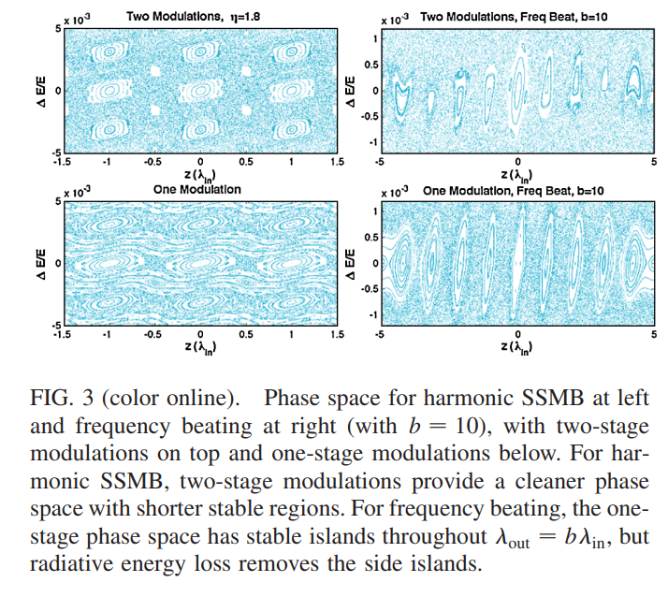
SSMB Phase Space
13

Slide 14
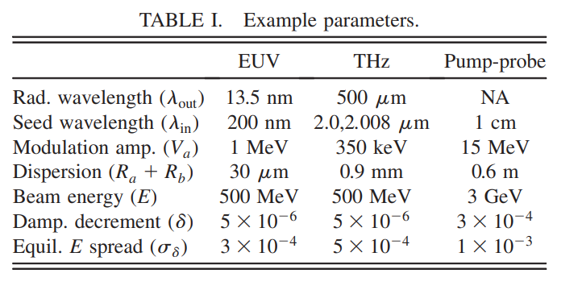

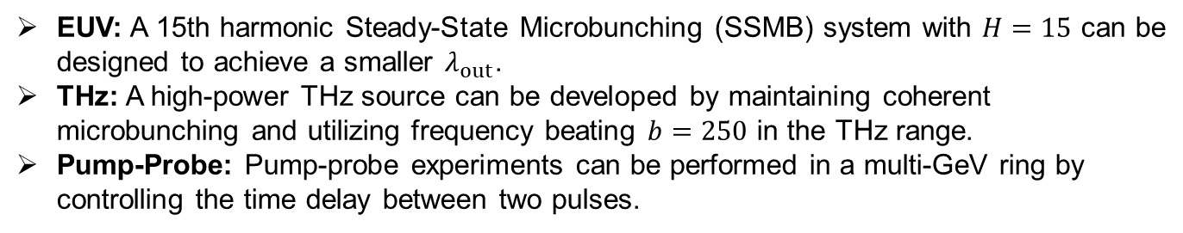

Radiation Source
$$H=15$$
$$b=250$$
EUV: A 15th harmonic Steady-State Microbunching (SSMB) system with $H=15$ can be designed to achieve a smaller $λ_{out}$​.
THz: A high-power THz source can be developed by maintaining coherent microbunching and utilizing frequency beating $b=250$ in the THz range.
Pump-Probe: Pump-probe experiments can be performed in a multi-GeV ring by controlling the time delay between two pulses.
14

Slide 15
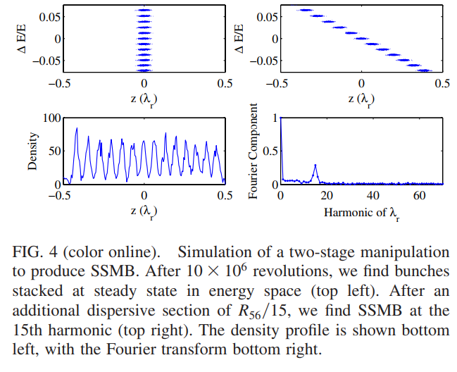

Simulation Method
They use 4D tracking simulation ($x,x^{′},z,p$)
$$Δp_{n+1} =Δp_{n}⋅\left(1−2\frac{T_{0}}{τ_{s}}\right)+\frac{e}{c}⋅V_{modulator}−\frac{δ}{c}$$
$$Δz_{n+1}=Δz_{n}+R_{56}\frac{Δp}{p_{0}}+T_{566}{\left(\frac{Δp}{p_{0}}\right)}^{2}+R_{51}x+R_{52}x^{′}$$
15

Slide 16
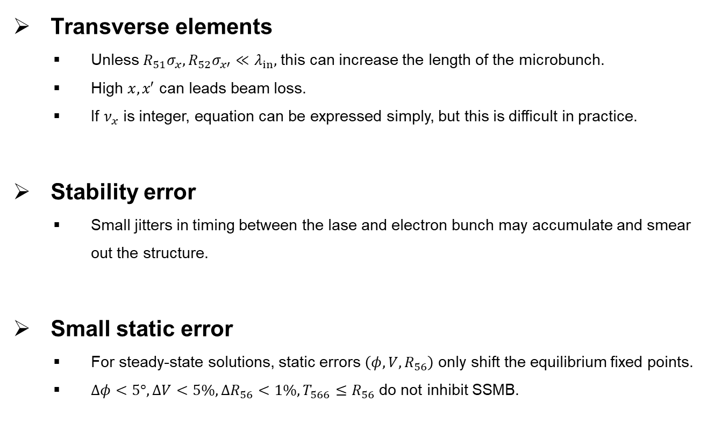
Drawback
Transverse elements
  Unless $R_{51}σ_{x}, R_{52}σ_{x′}≪λ_{in},$this can increase the length of the microbunch.
  High $x, x′$ can leads beam loss.
  If $ν_{x}$ is integer, equation can be expressed simply, but this is difficult in practice.
Stability error
  Small jitters in timing between the lase and electron bunch may accumulate and smear out the structure.
Small static error
  For steady-state solutions, static errors $\left(φ, V, R_{56}\right)$ only shift the equilibrium fixed points.
  $Δφ<5°, ΔV<5\%, ΔR_{56}<1\%, T_{566}≤R_{56}$ do not inhibit SSMB.
16

Slide 17
Conclusion
This paper present a mechanism for producing SSMB in a storage ring.
The combination of dispersion and modulation regions produces fixed points (and thus SSMB) at harmonics or multiples of the modulation wavelength.
SSMB can serve as many radiation sources such as EUV, THz, and Pump-Probe.
The future plan is to resolve technical issues and conduct research on the proof of principle.
17

Slide 18
Thank you for your attention!
18/23

