Slide 1
Research Progress
Dec. 06. 2024
송우진

Slide 2
Summary of GPBPM Development
1. Background Study
5. Resolution
Expected signal strength
  Photon-gas interaction
  Spectral photon flux
  Event number estimation
Transverse spread
  Space charge effect
  Thermal energy
Systematic error
  Resolution estimation
  Experimental results
2. Conceptual Design
3. Detailed Design
4. Experiment
Experimental plan
  Experimental goal and contents
  Preliminary preparations
  Detailed experimental procedure
Fabrication
Test
  Apr.-May.

Slide 3
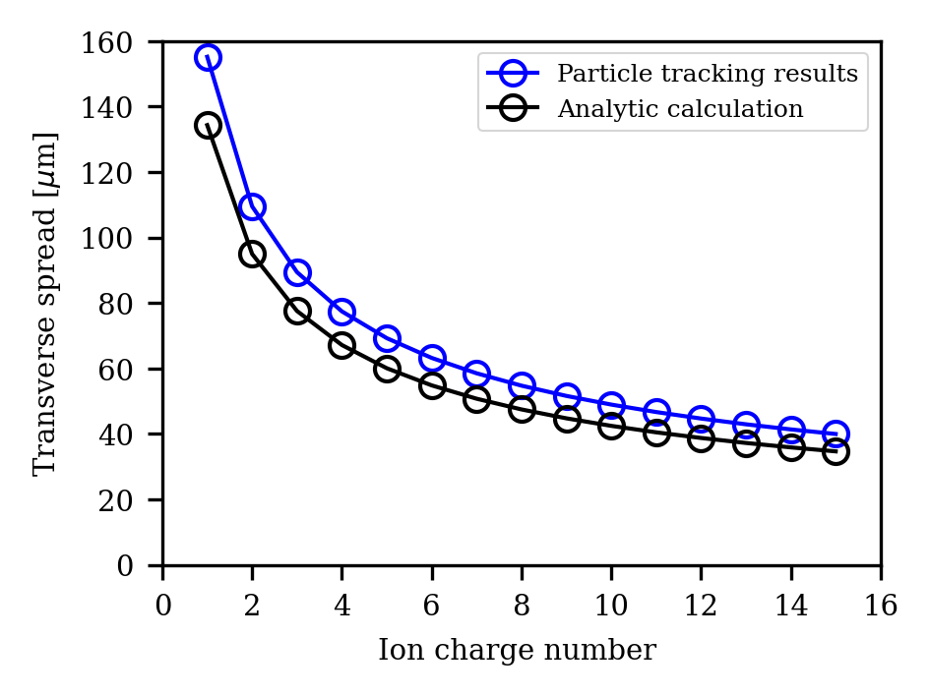
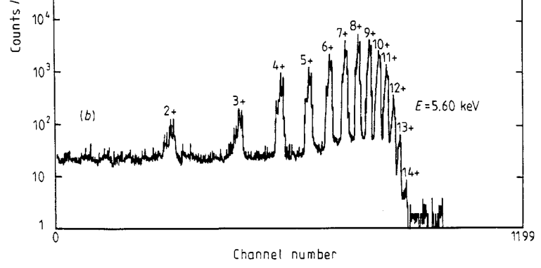
Transverse spread simulation
The transverse spread due to thermal energy was calculated using both an analytical method and tracking simulation.
However, additional calculations were needed to account for the results due to different charge states caused by multiple photoelectric effects.

Slide 4
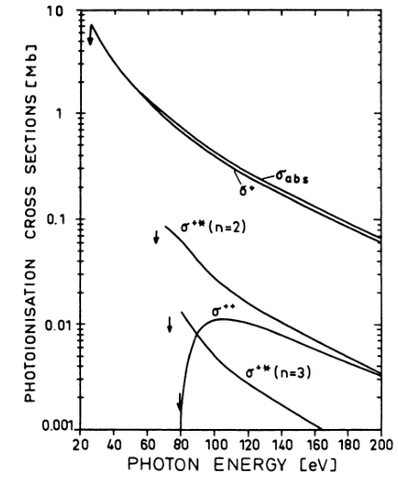
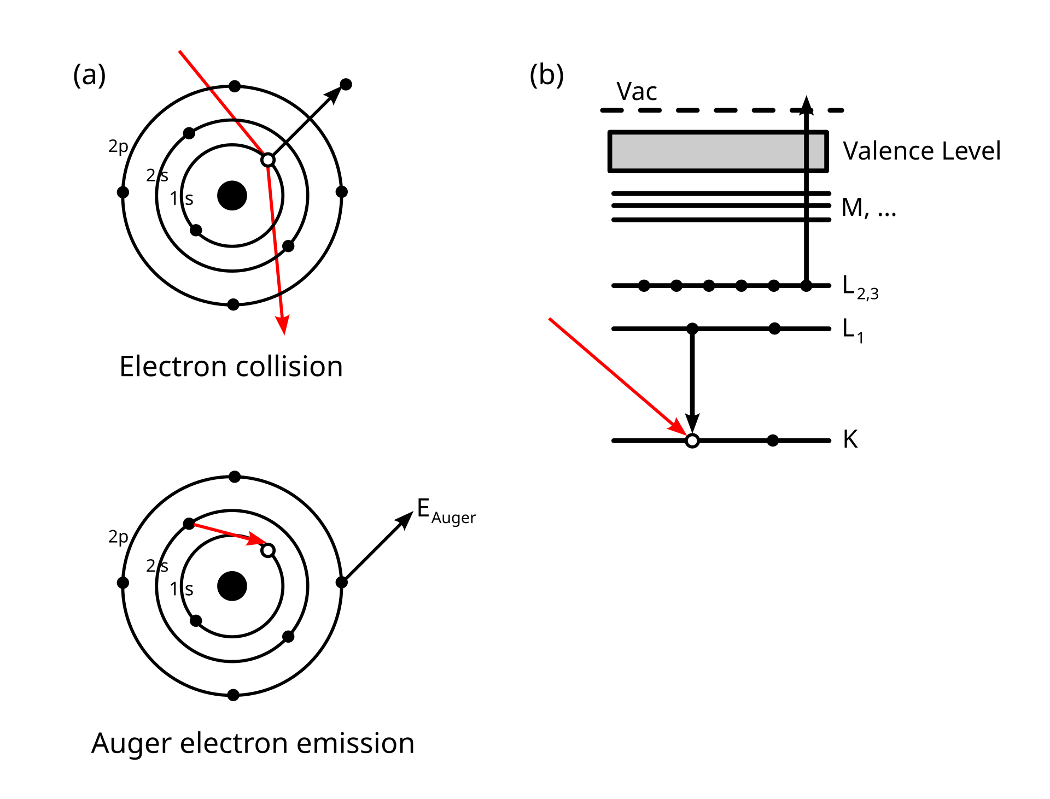
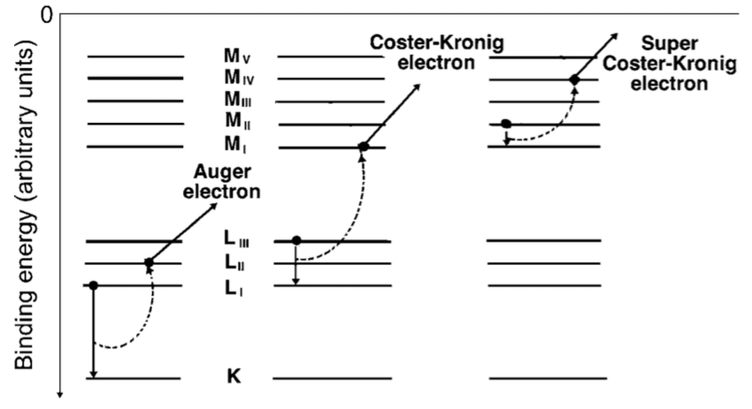
Multiple Photo-Ionization (MPI)
Two or more outermost electron can be simultaneously ejected by a single-photon collision → Direct photoionization
Inner-shell electron ionization or excitation
→ Filling vacancy
→ Auger effect and Coster-Kroning transition (L1 → L2,3)
Auger effect
Coster-Kroning transition

Slide 5
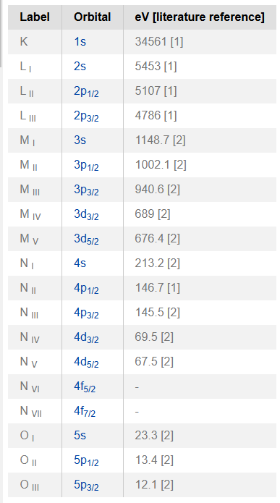
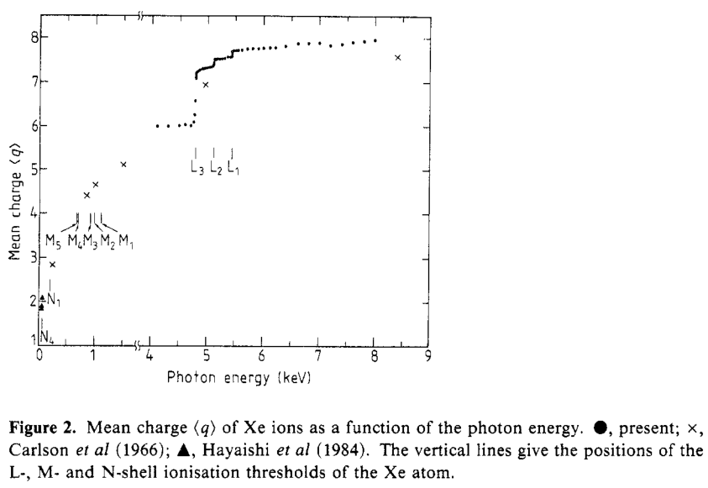
Multiple Photoionization
If the MPI cross-section above the fundamental mode (2.7 keV) of 4GSR-IVU20 is known, it would be possible to calculate the charge state of photo-ions created by the white beam.

Slide 6
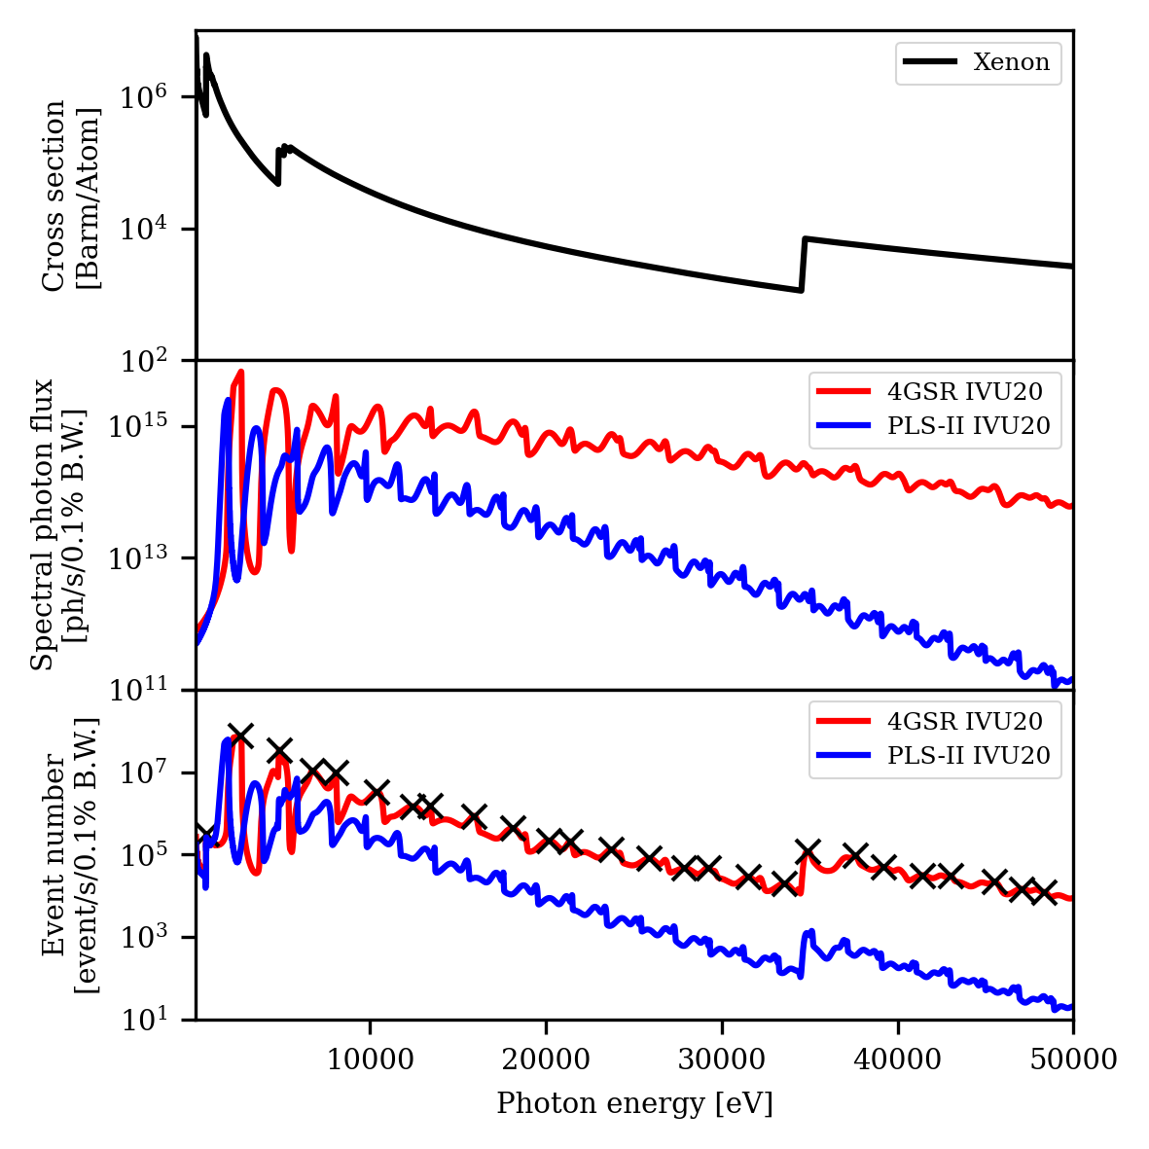
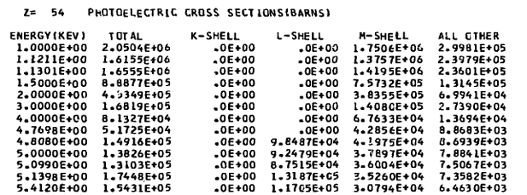
MPI simulation
Calculated at photon energies where events occur most often.
(2.6, 4.8, 6.7, 8.0 keV → slightly different from harmonics)
L1=5.453 keV
L2=5.107 keV
L3=4.786 keV
Total cross-section data is the sum of all values up to MPI.
Except for fundamental mode, all L-shell process.

Slide 7
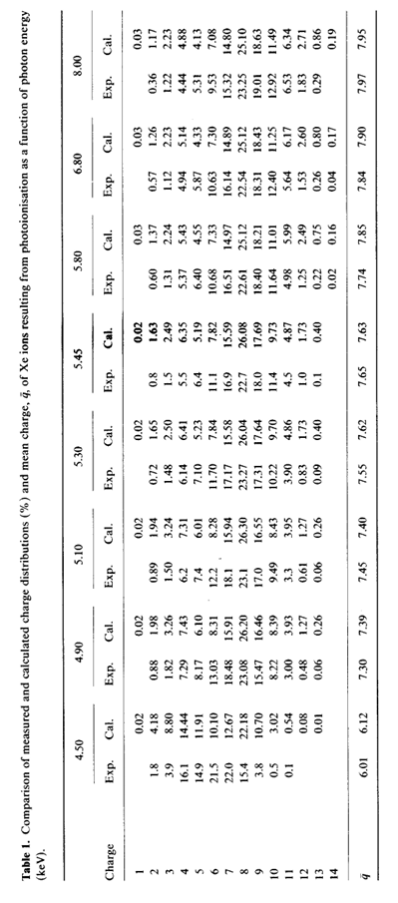
MPI simulation

Slide 8




MPI simulation
Total transverse spread (σ) =
$$STD\left(\sum_{E=2.6 keV}^{100 keV}{σ_{E}N_{E}\left(\sum_{q=1}^{14}{X_{q}P_{q, λ}}\right)}\right)$$
$σ$ is photoionization total cross-section,
$E$ is photon energy,
$N$ is spectral photon flux,
$X_{q}$ is transverse spread due to thermal energy at given charge q and
$p_{q,λ}$ is charge distribution at $λ (\sum_{q=1}^{14}{p_{q}}=1)$
$$σ$$
$$N$$
$$E$$

Slide 9
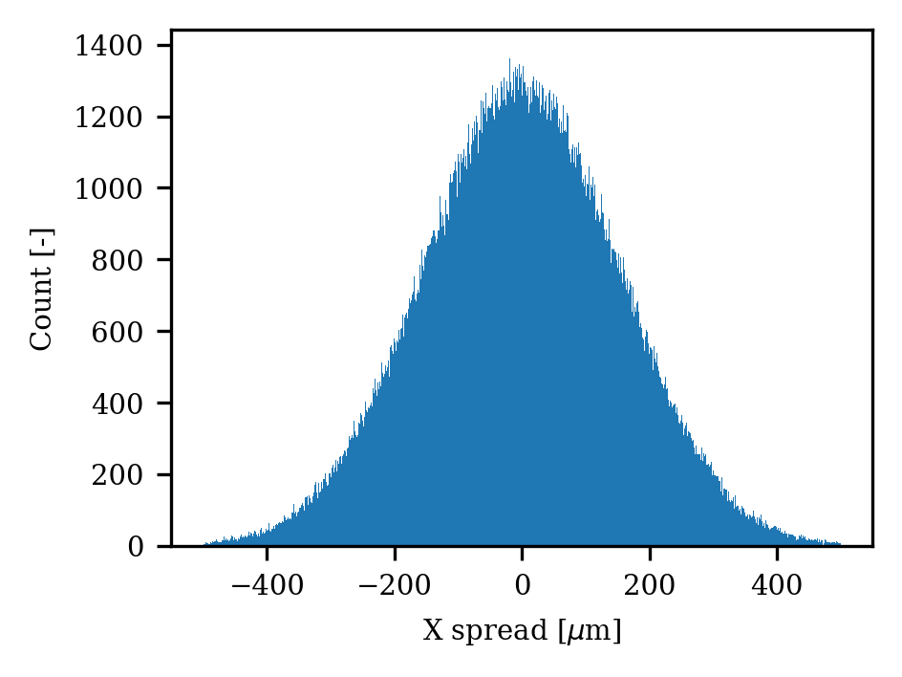
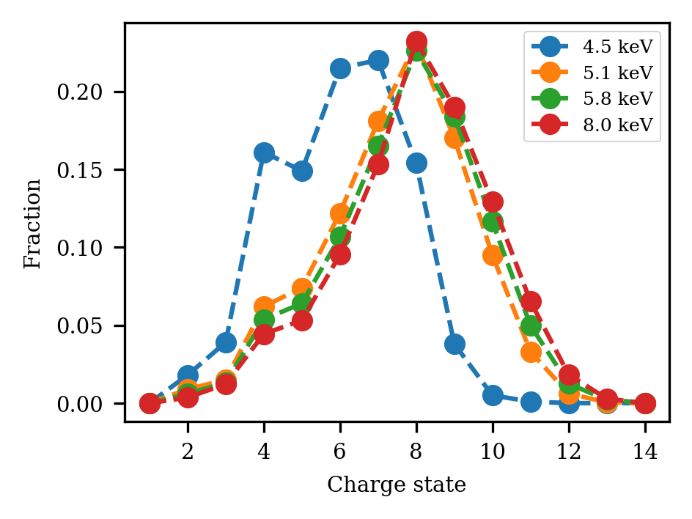
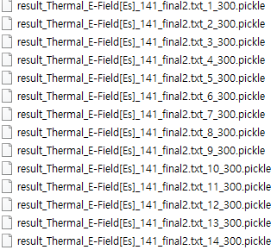




MPI simulation
Total transverse spread (σ) =
$$STD\left(\sum_{E=2.6 keV}^{100 keV}{σ_{E}N_{E}\left(\sum_{q=1}^{14}{X_{q}P_{q, λ}}\right)}\right)$$
$X_{q}$ is transverse spread due to thermal energy at given charge q and
$p_{q,λ}$ is charge distribution at $λ (\sum_{q=1}^{14}{p_{q}}=1)$
$X_{q}$
$X_{+1}$
$$p_{q,λ}$$

Slide 10
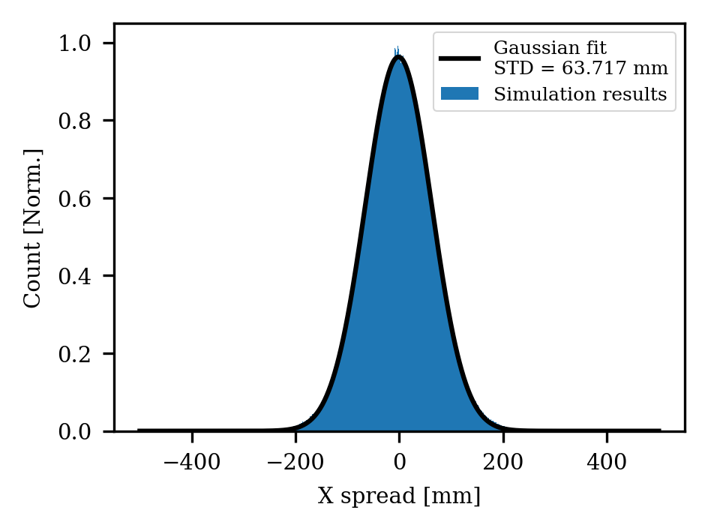
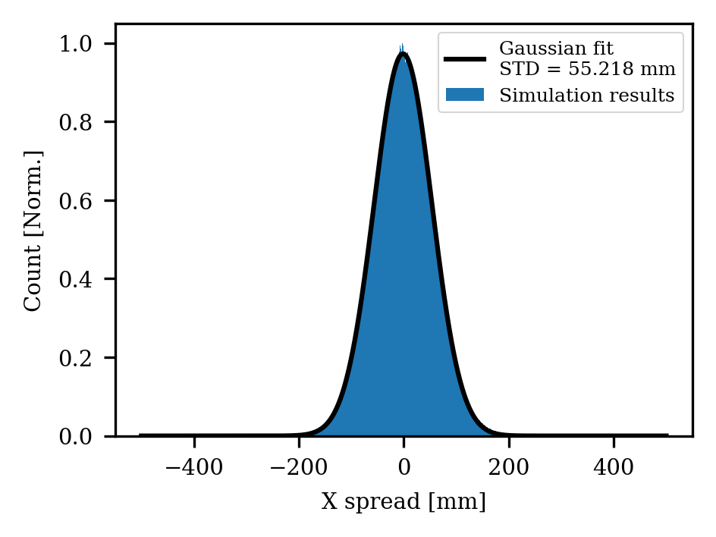
MPI simulation results
4.5 keV photon beam
PSF = 64 um (~+6)
8.0 keV photon beam
PSF = 55 um (~+8)
4.5 keV
8 keV

Slide 11
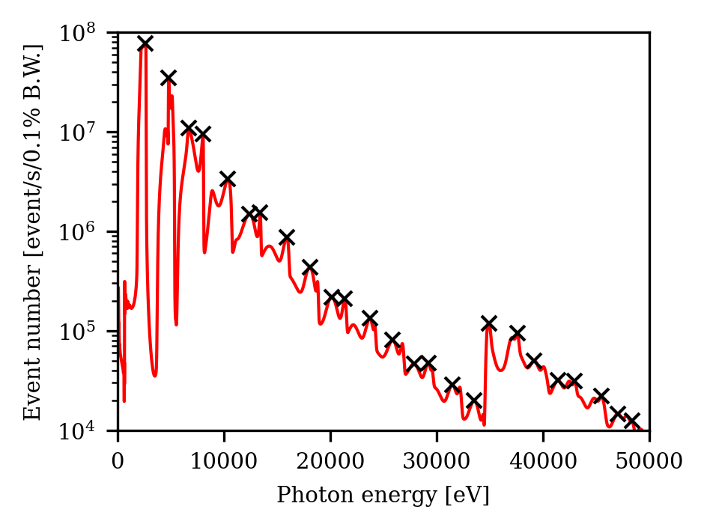

MPI simulation results
Consider the beam spectrum of the 4GSR-IVU20
PSF = 55 um

Slide 12
MPI summary
The expected thermal spread at each photon energy is equal to the expected average charge spread.
The data in this simulation is up to 8 keV, and higher energies are expected to saturate or increase to an average of +8.
Therefore, the most conservative thermal spread is 55 um for both 4GSR and PLS-II.

Slide 13
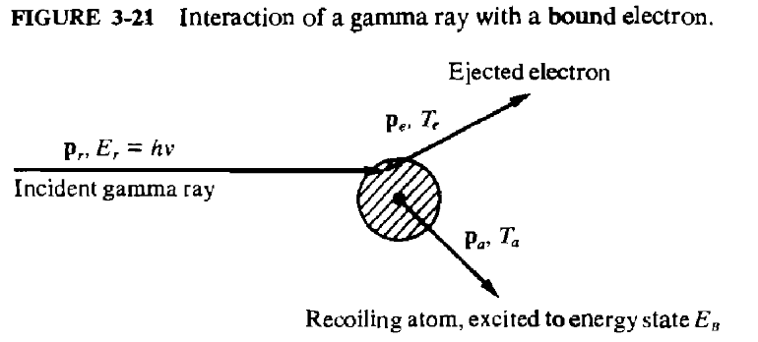
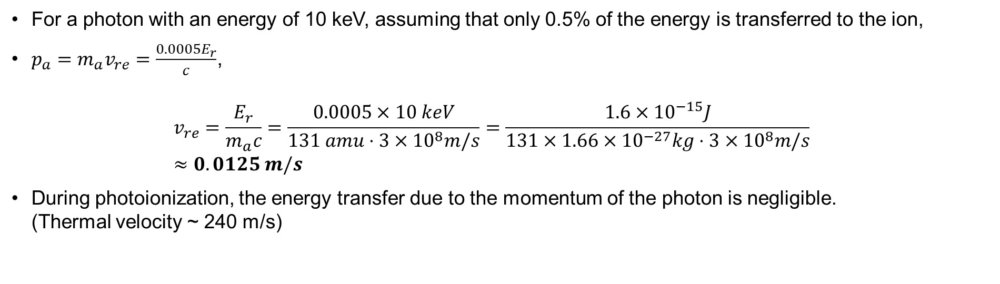
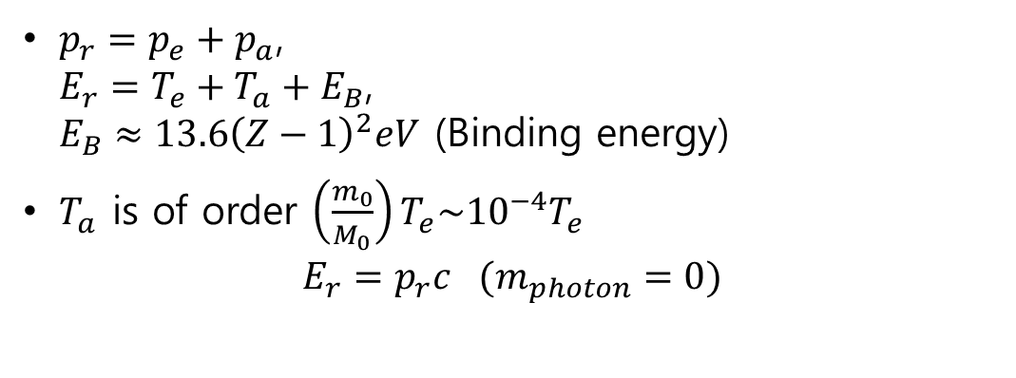
Momentum transfer
$p_{r}=p_{e}+p_{a}$,
$E_{r}=T_{e}+T_{a}+E_{B}$,
$E_{B}≈13.6{\left(Z−1\right)}^{2}eV$ (Binding energy)
$T_{a}$ is of order $\left(\frac{m_{0}}{M_{0}}\right)T_{e}\sim 10^{−4}T_{e}$
$E_{r}=p_{r}c (m_{photon}=0)$
For a photon with an energy of 10 keV, assuming that only 0.5% of the energy is transferred to the ion,
$p_{a}=m_{a}v_{re}=\frac{0.0005E_{r}}{c}$,
$v_{re}=\frac{E_{r}}{m_{a}c}=\frac{0.0005×10 keV}{131 amu⋅3×{10}^{8}m/s}=\frac{{1.6×10}^{−15}J}{131×1.66×{10}^{−27}kg⋅3×{10}^{8}m/s}$
$≈0.0125 m/s$
During photoionization, the energy transfer due to the momentum of the photon is negligible.
(Thermal velocity ~ 240 m/s)

Slide 14
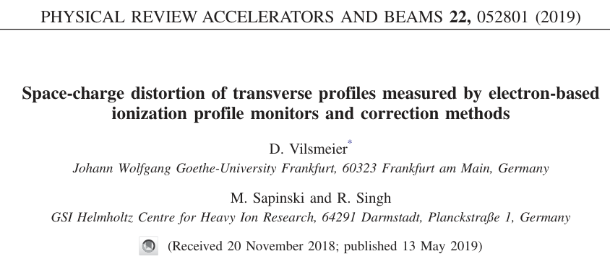
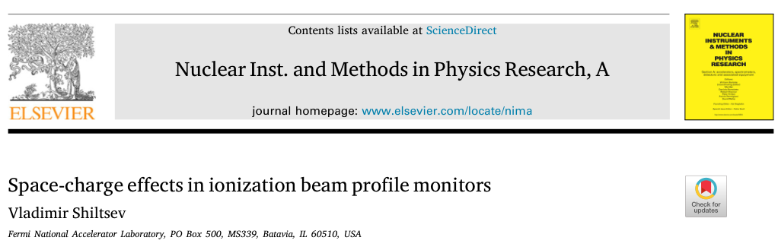
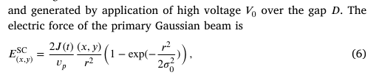

Source of space charge effect
Space charge is induced by the field of the primary beam (main beam).
For a photon beam without charge, there is no reason to consider this phenomenon.

Slide 15
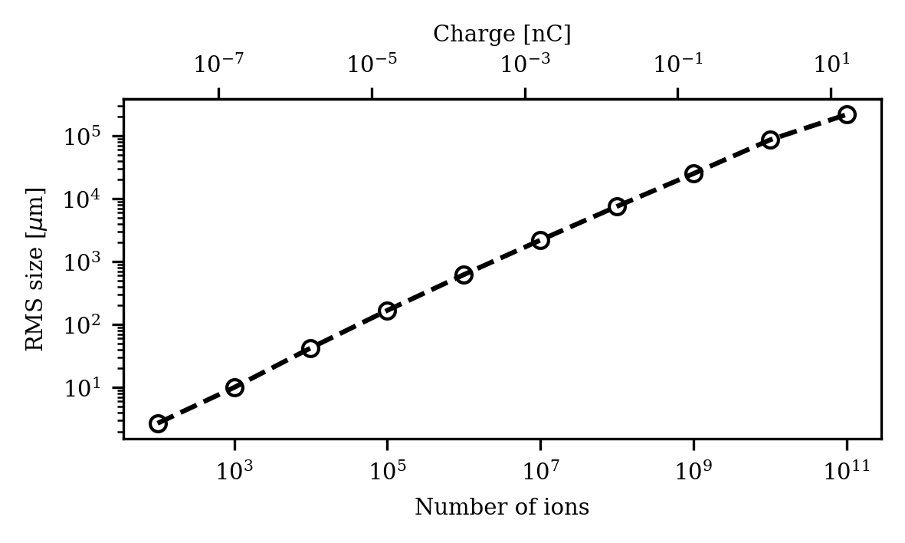
Cross check with Astra (Including SC)
Species : Proton
Bunch length : 6 mm (20 ps)
Initial beam size : 1 um
White beam

Slide 16
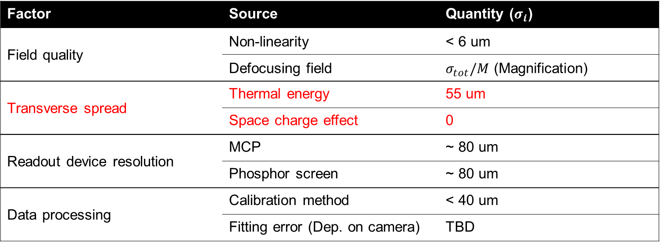
Summary
Calculate the expected charge state with multiple photoelectric effects and calculate the transverse spread accordingly.
Momentum transfer and space charge do not affect the transverse spread.
The resolution of the readout device will be clearly found and finalized in the paper.
Factor | Source | Quantity ($σ_{i}$)
Field quality | Non-linearity | < 6 um
 | Defocusing field | $σ_{tot}/M$ (Magnification)
Transverse spread | Thermal energy | 55 um
 | Space charge effect | 0
Readout device resolution | MCP | ~ 80 um
 | Phosphor screen | ~ 80 um
Data processing | Calibration method | < 40 um
 | Fitting error (Dep. on camera) | TBD

