Slide 1
20241122 Group Meeting
Minseo Jeong

Slide 2
Ultrafast Electron Diffraction
Ultrafast electron diffraction(UED): Pump-probe imaging technique based on optical pump-probe spectroscopy and electron diffraction caused by ultrafast electron
D. Filippetto et al. Rev. Mod. Phys. (2022).

Slide 3
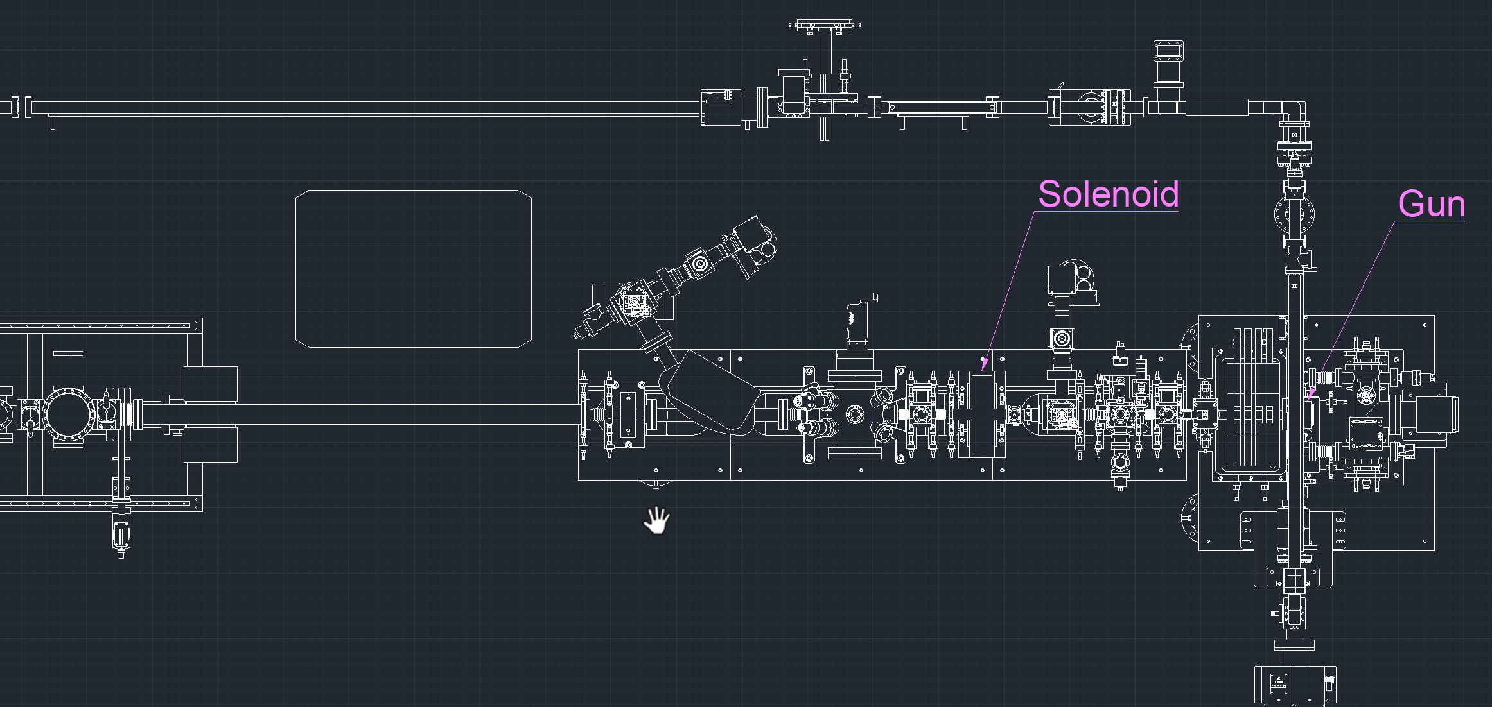
UED in PAL-eLabs

Slide 4
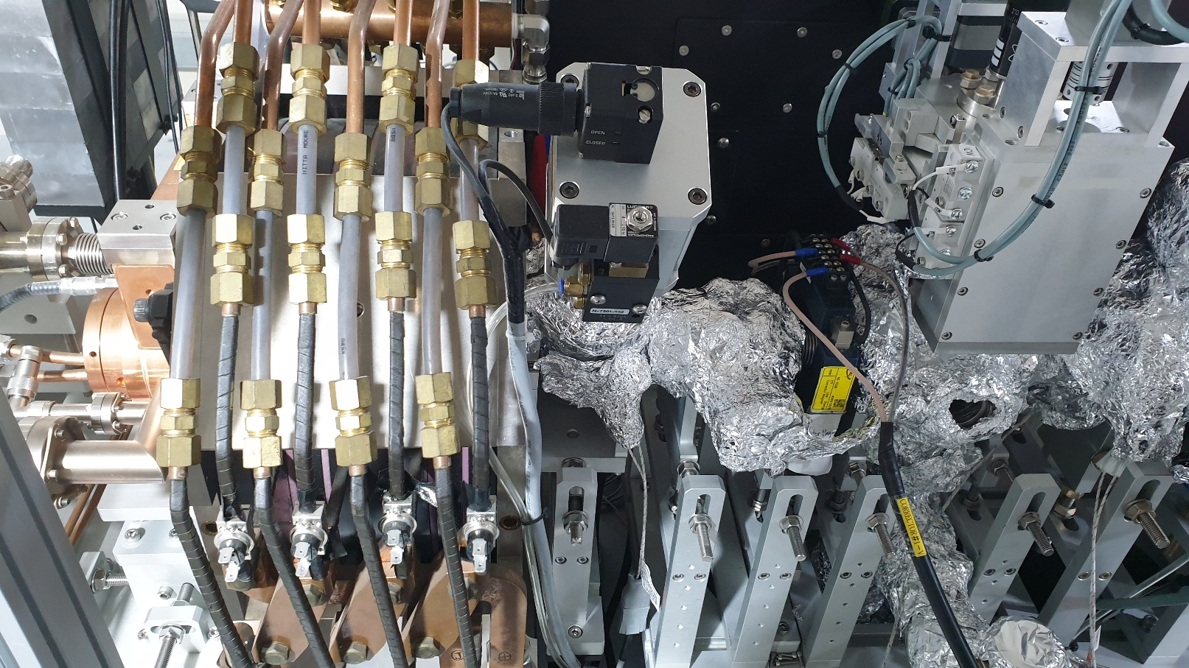
UED in PAL-eLabs

Slide 5
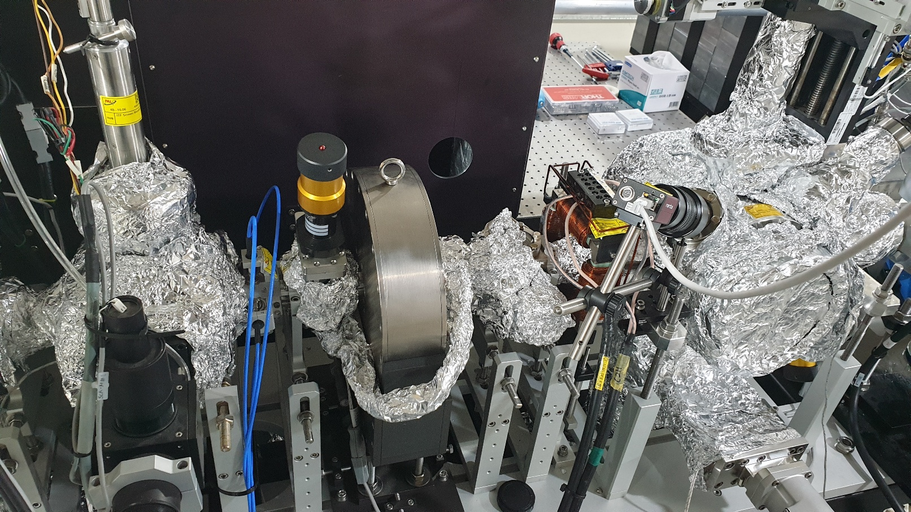
UED in PAL-eLabs

Slide 6
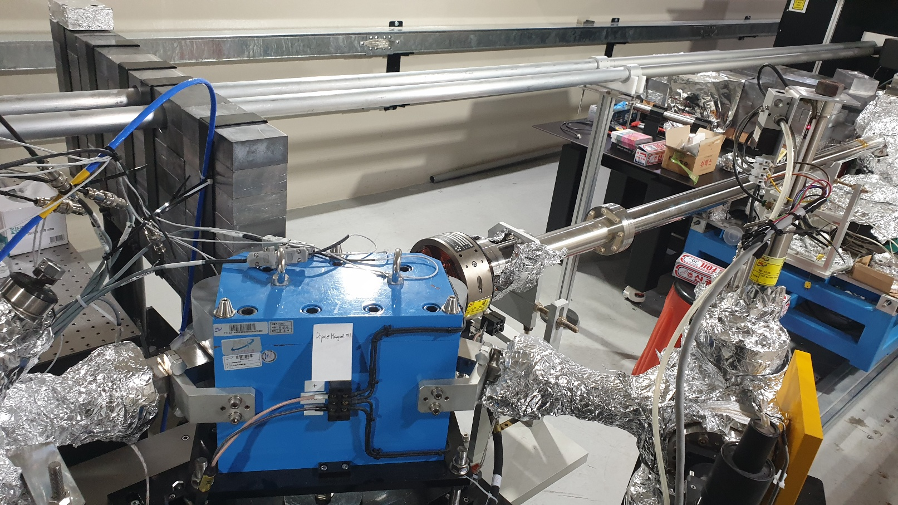
UED in PAL-eLabs

Slide 7
UED in PAL-eLabs
Cavity frequency | 2.856GHz
Gun gradient | 82.84MV/m(max)
RF phase stability | 5×10⁻² deg
RF amplitude stability | 5×10⁻⁴
IR pump pulse duration | ~150fs
Solenoid 1 position | 0.196m
Solenoid 1 strength | 0.180T(max)
Solenoid 2 position | 1.20m
Solenoid 2 strength | 0.0437T(max)
Aperture position | 0.55m
Aperture diameter | 100~500μm
Sample chamber position | 1.70m
Detector position | 5.00m

Slide 8
UED in PAL-eLabs
Bunch charge | <1pC
Beam emittance | 0.5μm
Beam energy | ~4MeV
Beam size | 15~30μm
Energy spread | <2*10⁻³
Repetition rate | 10Hz

Slide 9
Research Plan
- Optimization of PAL-eLabs UED
Main goal: Optimization and real-time diagnostics of electron beam parameters(spatial/energy jitter, angular divergence, energy spread)
-Generation of simulation dataset for ML
-Training process
-Application of ML to experimental data
-Real-time diagnostics of electron beam parameters

Slide 10
UED Simulation
Gun-to-sample simulation will be conducted by GPT code
Sample-to-detector simulation with single crystal will be conducted by electron diffraction pattern(EDP) code
Bragg diffraction images will be used as dataset
-Prediction of beam parameters by BD peak position and width
Since size of data is large(256×256), neural network(NN) is required to machine learning

Slide 11
Convolution Neural Network
Convolution neural network: A deep learning model designed for processing structured grid data
Effective for pattern recognition, capability of retaining spatial data of image
For Bragg diffraction image, LeNet-like CNN is a proper option

Slide 12
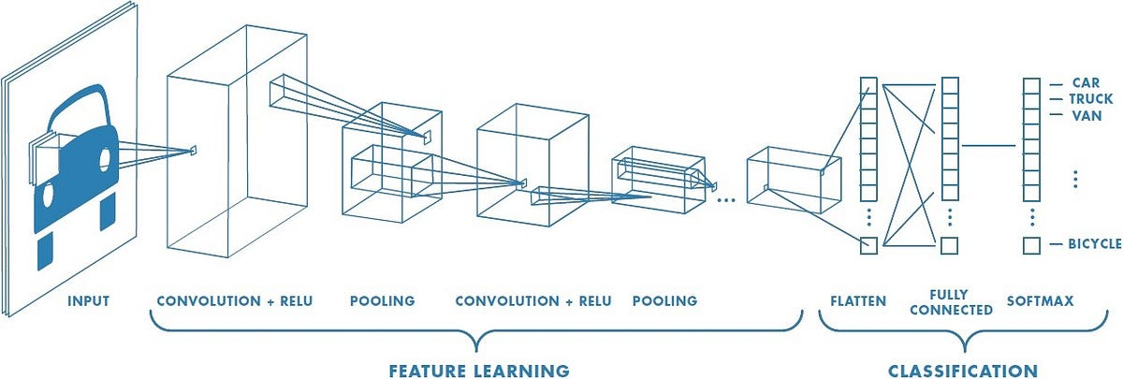
Convolution Neural Network

Slide 13
Convolution Neural Network
5 | 2 | 6
4 | 3 | 4
3 | 9 | 2
 | 5
-1 | 0 | 1
2 | 1 | 2
1 | -2 | 0
Filter

Slide 14
Convolution Neural Network
CNN requires huge amounts of data for training and quickly over-fit on small data
Applying multi-objective Bayesian optimization(MOBO) can be a solution

Slide 15
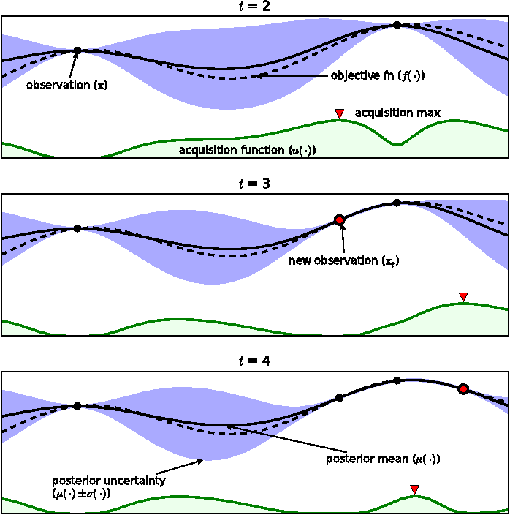
Bayesian Optimization
Brochu, Eric, Vlad M. Cora and Nando de Freitas. ArXiv abs/1012.2599 (2010).

Slide 16
Multi-objective Bayesian Optimization
Gaussian process will be used as surrogate model
Expected hypervolume improvement(EHVI) will be used as an acquisition function

Slide 17
Future Plan
Completing GPT input file
GPT&EDP simulation
Coding source code for ML

