Slide 1
Selective electron beam sensing through coherent Cherenkov diffraction radiation
Nov. 22, 2024
Woojin Song

Slide 2
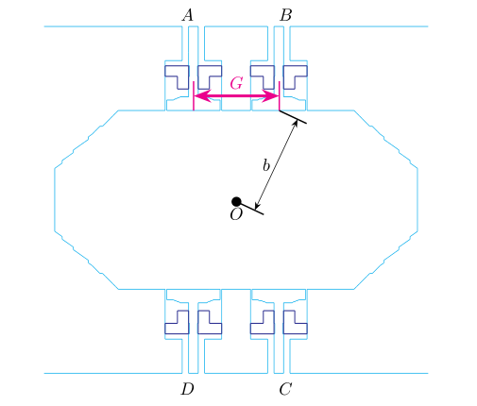
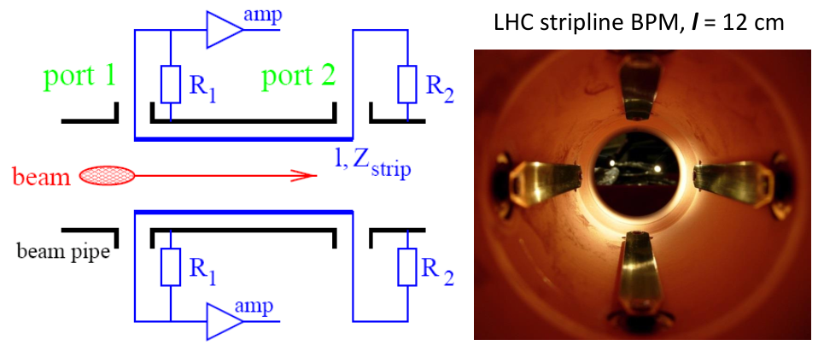
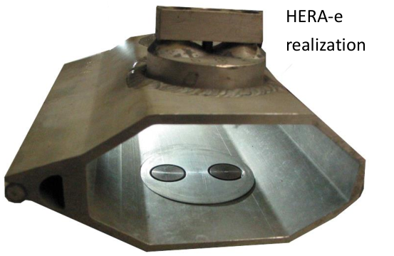
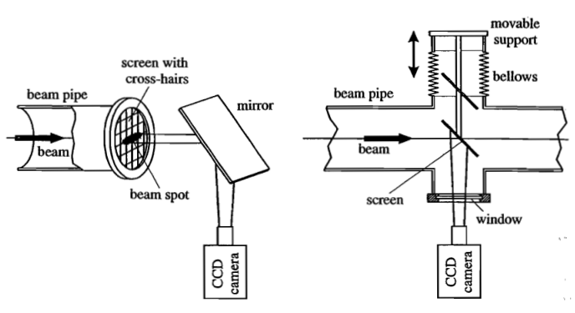
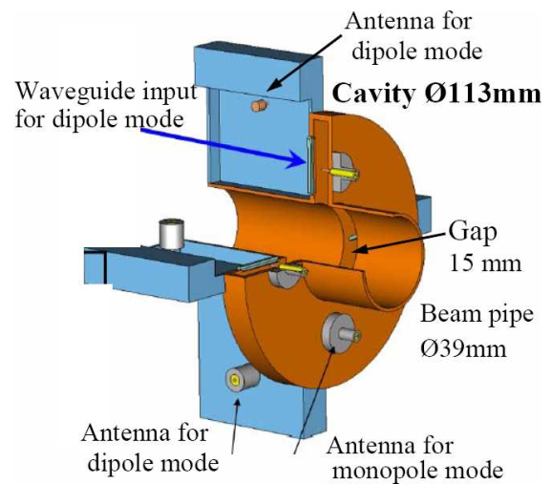
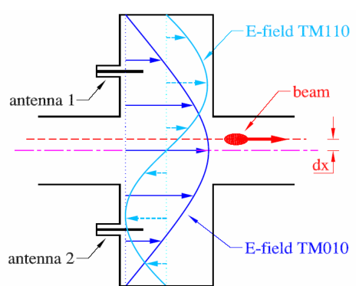
Beam Position Monitor (BPM)
Strip line BPM
Button BPM
Fluorescent screen
Cavity BPM

Slide 3
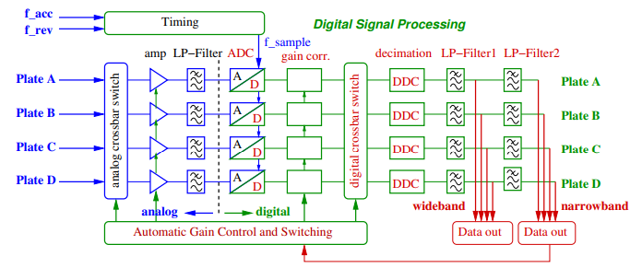
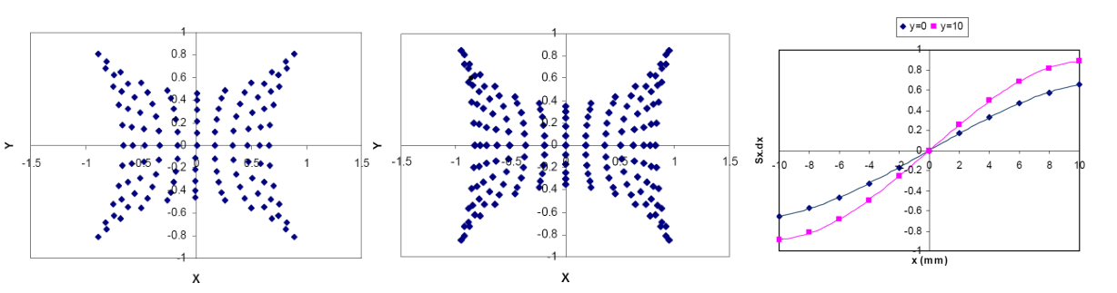
Beam Position Monitor (BPM)
BPM electronics
Thermal noise reduction
TbT feedback
Calibration

Slide 4
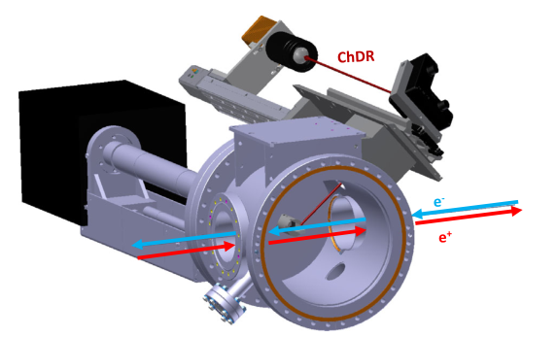
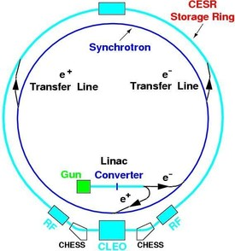
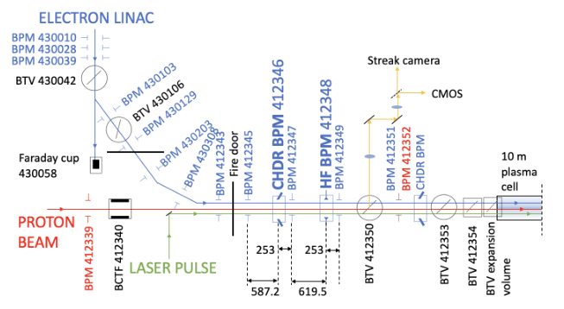
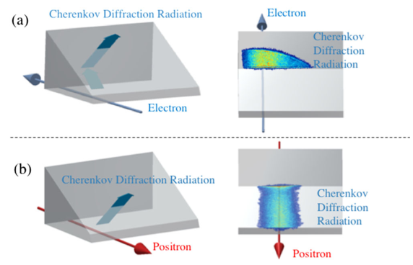
Cherenkov Diffraction Radiation BPM (ChDR BPM)
Why is a new approach to BPM necessary despite the existence of conventional methods?
1. Two copropagating beams are indistinguishable.
Cornell electron storage ring (CESR)
Advanced WAKEfield Experiment (AWAKE)

Slide 5
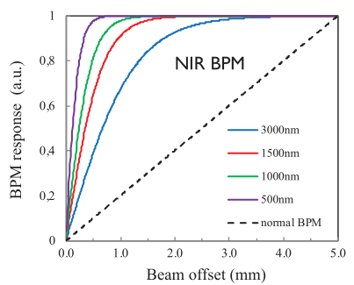
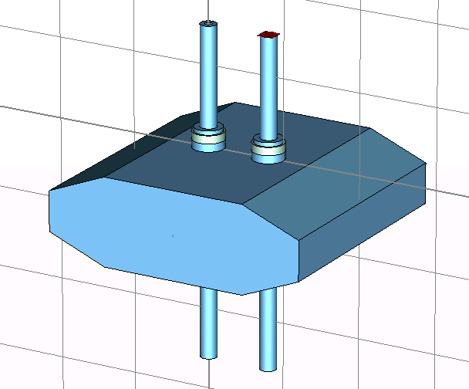
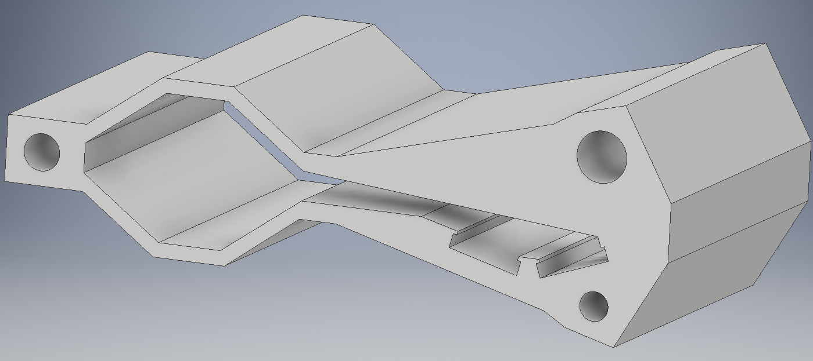
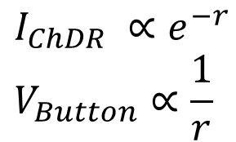
Cherenkov Diffraction Radiation BPM (ChDR BPM)
2. Higher response → Leads to better resolution
3. Small aperture → Suitable for small chambers, no heat generation issues.
$$I_{ChDR} ∝e^{−r} \\ V_{Button}∝\frac{1}{r}$$
3GSR BPM (PLS-II)
4GSR Vacuum Chamber
Φ8mm
8.7mm
30mm
66mm

Slide 6
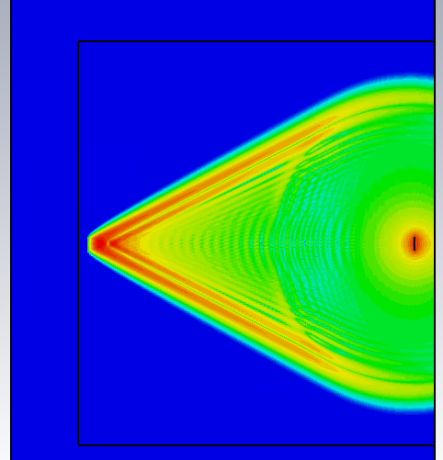
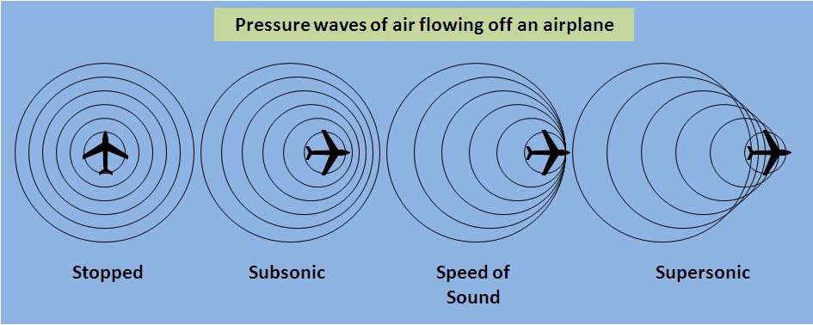

Classical Cherenkov Radiation
Particle speed : $βc$
Light speed (in medium) : $\frac{c}{n}$
Emission angle : $\cos{θ}=\frac{1}{nβ}$
Vacuum
Glass
Beam

Slide 7
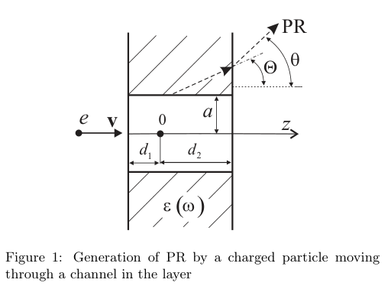




Cherenkov Diffraction Radiation
The radiation field is a solution to the vacuum macroscopic Maxwell equation with the polarization current.
Substance
Maxwell’s equations lead to the following equation for the magnetic field $H^{pol}$ of polarization radiation:
The spectral-angular density of polarized radiation can be determined from the relation

Slide 8
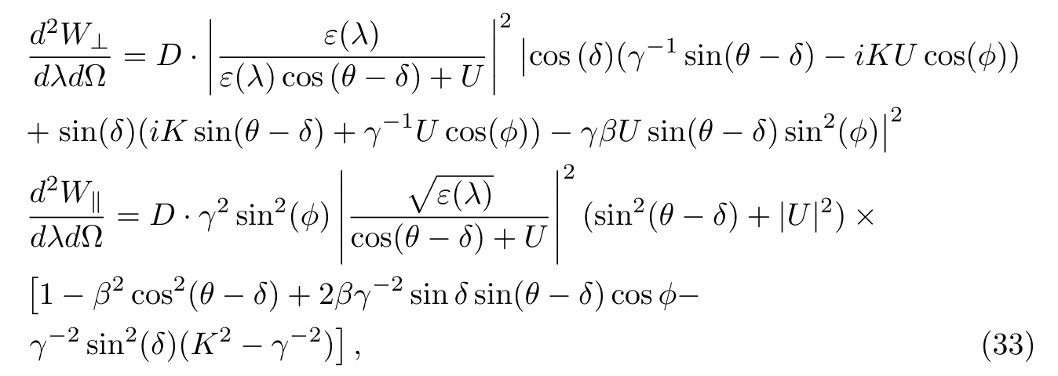
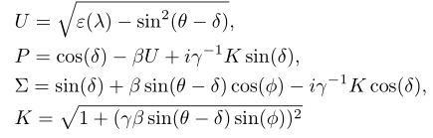
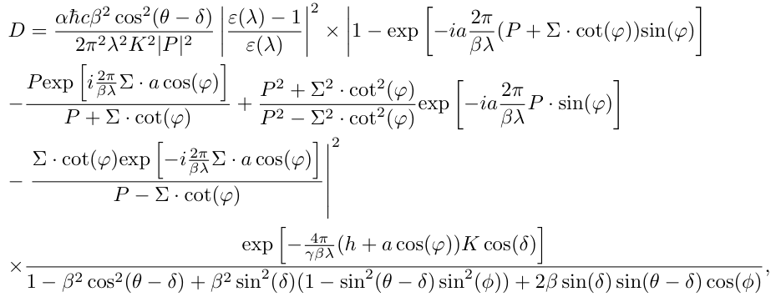
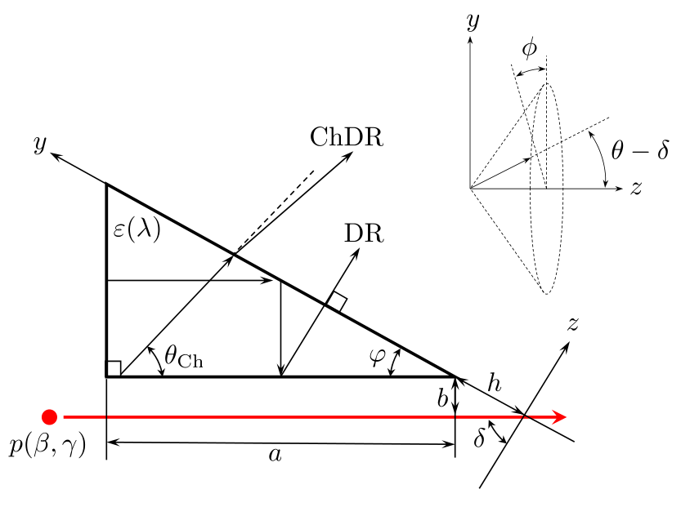
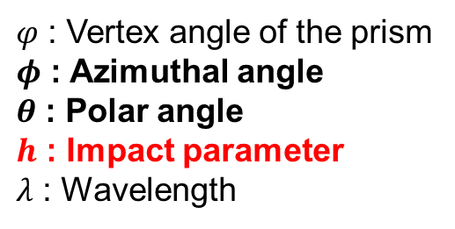
Cherenkov Diffraction Radiation
$φ$ : Vertex angle of the prism
$φ$ : Azimuthal angle
$θ$ : Polar angle
$h$ : Impact parameter
$λ$ : Wavelength

Slide 9
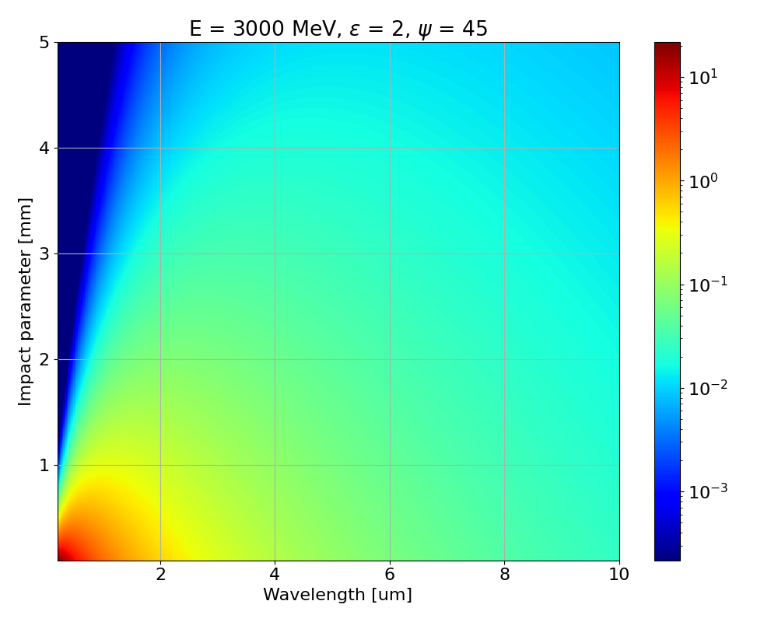
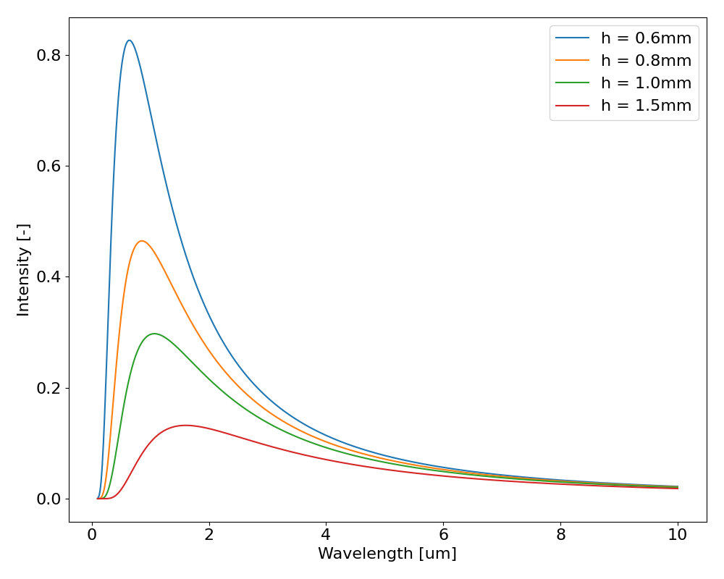
Cherenkov Diffraction Radiation
Intensity of ChDR vs h and λ

Slide 10
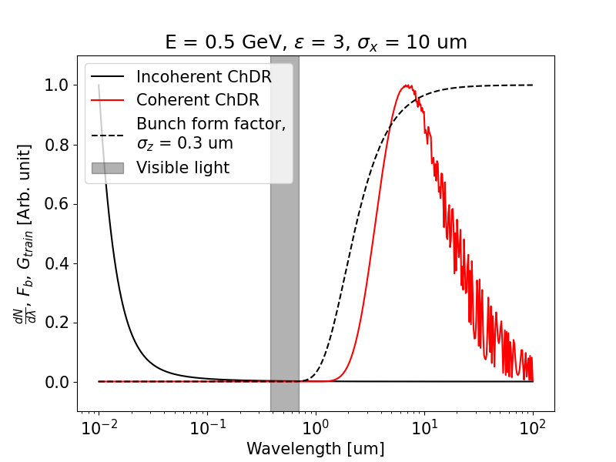


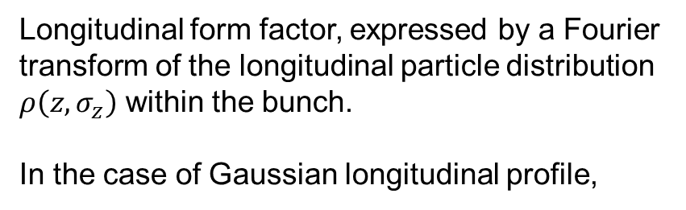
Coherent Cherenkov Diffraction Radiation
Emission from all the particles in the bunch
Longitudinal form factor, expressed by a Fourier transform of the longitudinal particle distribution $ρ\left(z, σ_{z}\right)$ within the bunch.
In the case of Gaussian longitudinal profile,

Slide 11
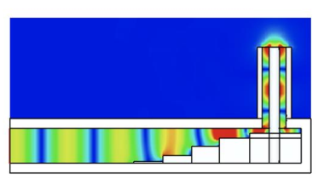
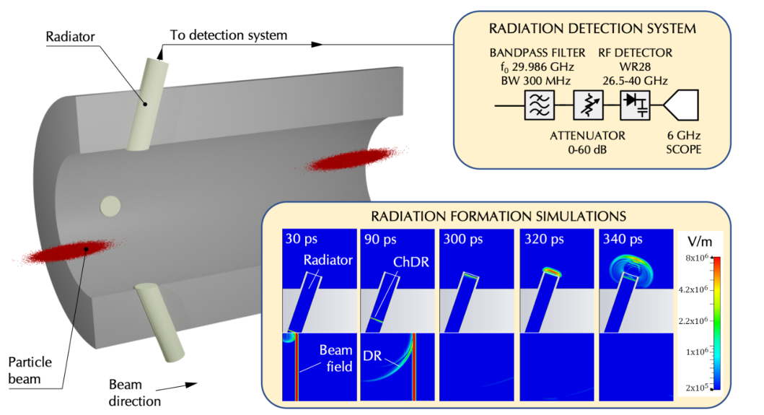
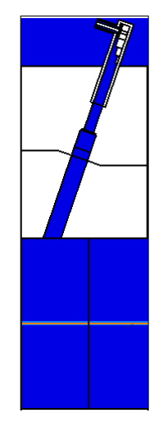
Radiator
WR28 waveguide (TE10) 1.5 m
Alumina
Ф 60 mm

Slide 12
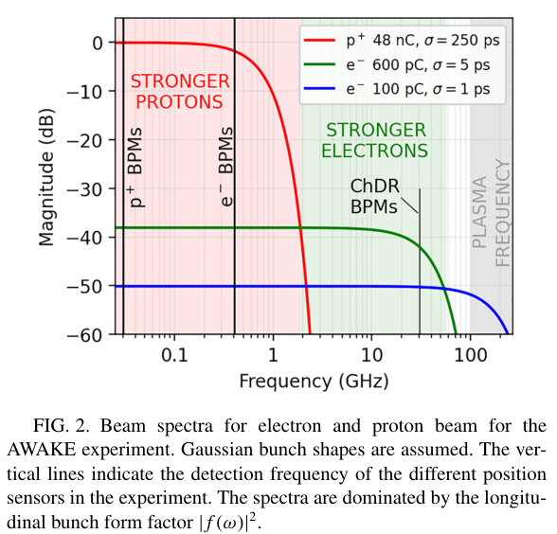
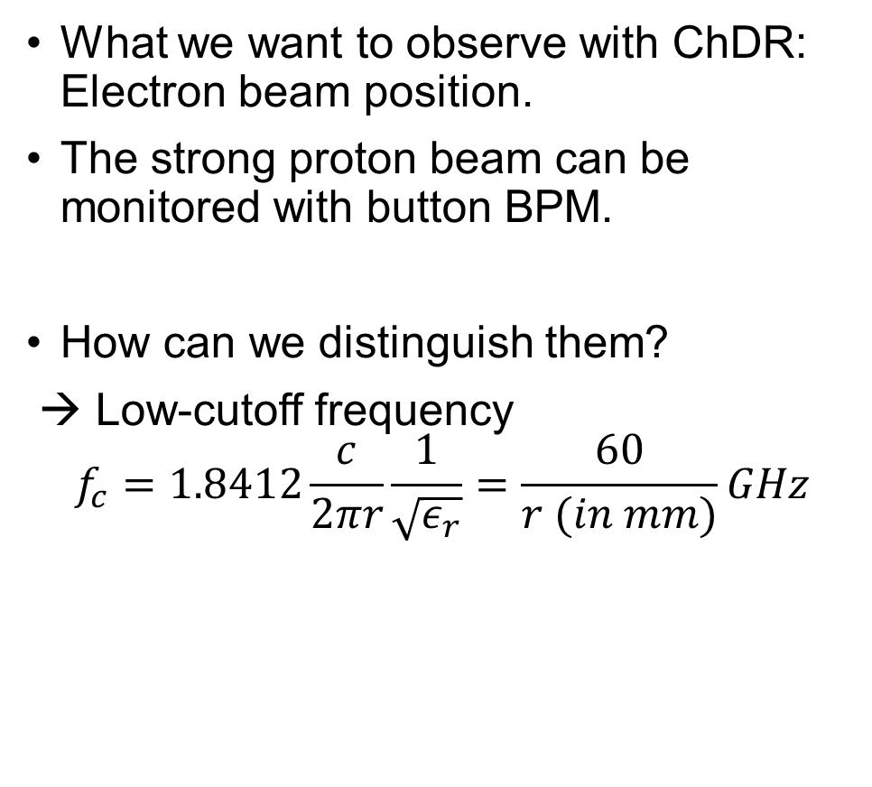
Radiator Optimization
What we want to observe with ChDR: Electron beam position.
The strong proton beam can be monitored with button BPM.
How can we distinguish them?
→ Low-cutoff frequency
$$f_{c}=1.8412\frac{c}{2πr}\frac{1}{\sqrt{ε_{r}}}=\frac{60}{r (in mm)}GHz$$

Slide 13
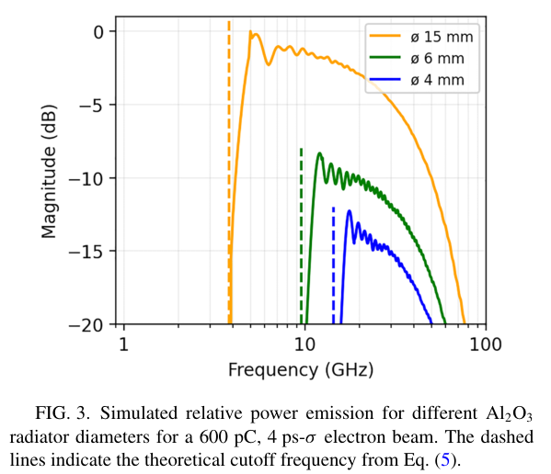
Radiator Optimization
6 mm radiator (9.6 GHz cut)
1. 30 GHz electron beam signal measure
2. Avoid Radiation from proton blow 1 GHz

Slide 14
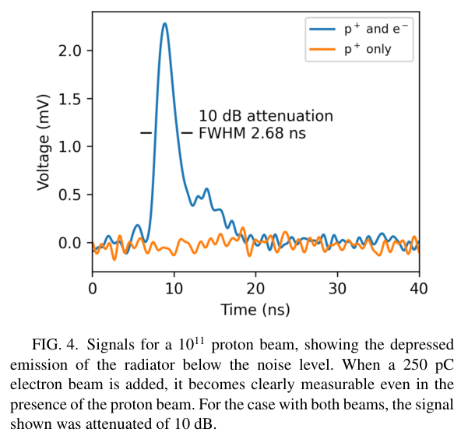
Results
Experiment conducted at AWAKE.
Signal from a single radiator.
No signal observed when the proton beam is present.
→ Successfully separated the electron beam.

Slide 15
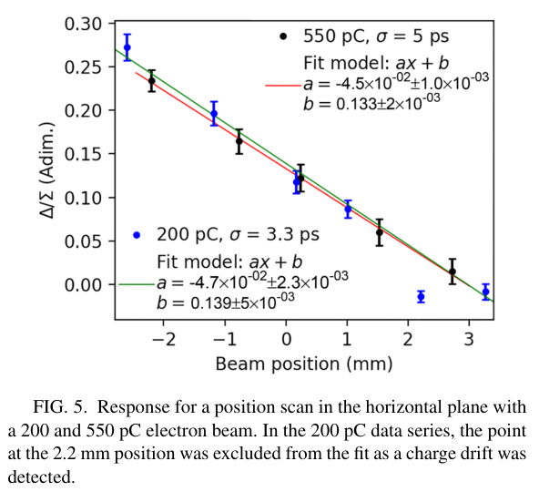
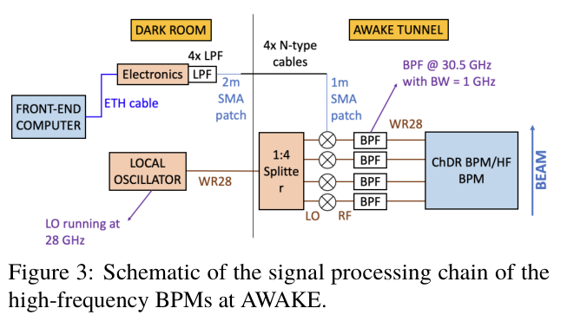
Results
The position is calculated using Difference Over Sum (DOS).
Measurements were taken within a 5 mm range, and the response matched well with the simulation results.

Slide 16
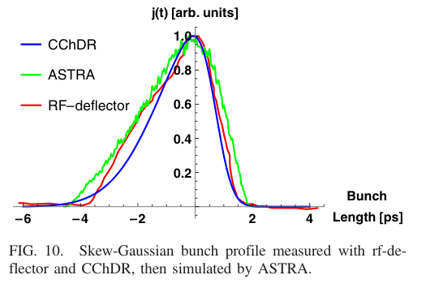
Discussion
With coherent ChDR, it's possible to measure various beam parameters beyond just the position.
Ex) Bunch length measurement - Short bunch, high energy
→ It is advantageous for FEL and P(L)WFA applications.

Slide 17
Summary
Proposed new diagnostic technology:
The non-invasive approach using ChDR can detect beam positions even in areas that are challenging to access with existing technologies.
Various application possibilities:
Advantageous for analyzing beam characteristics in high-energy and ultra-short pulse accelerators.
Adaptability to plasma environments:
Less affected by noise in plasma, making it applicable in future plasma-based accelerators.

Slide 18
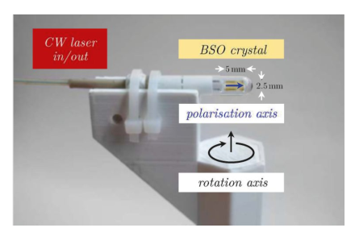
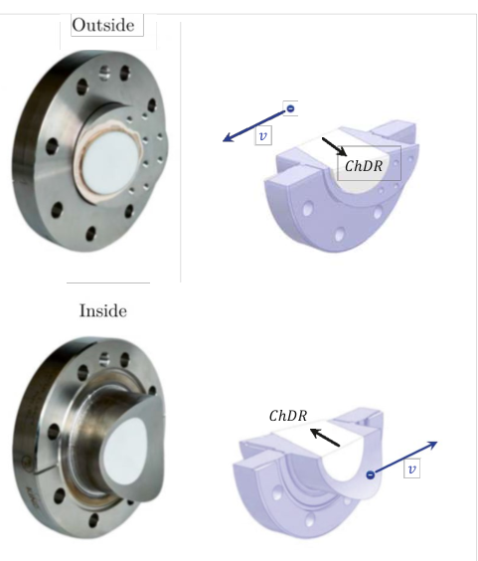
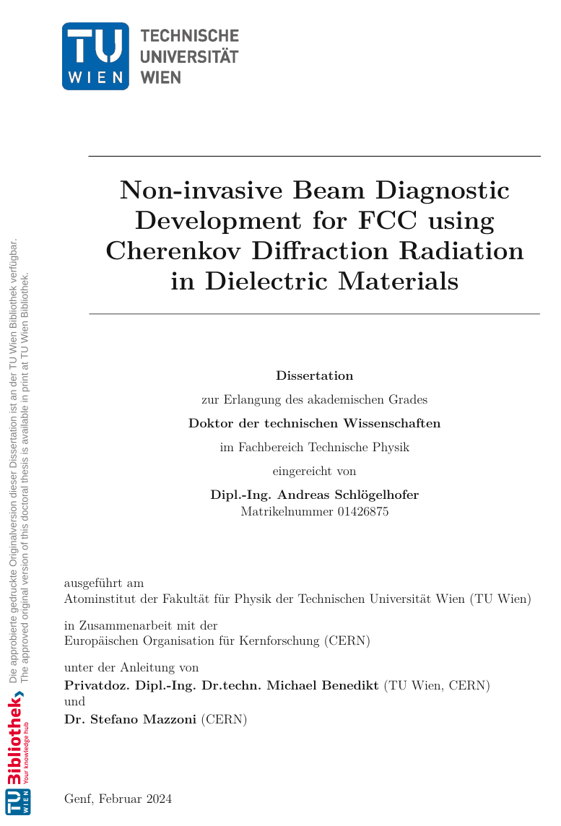
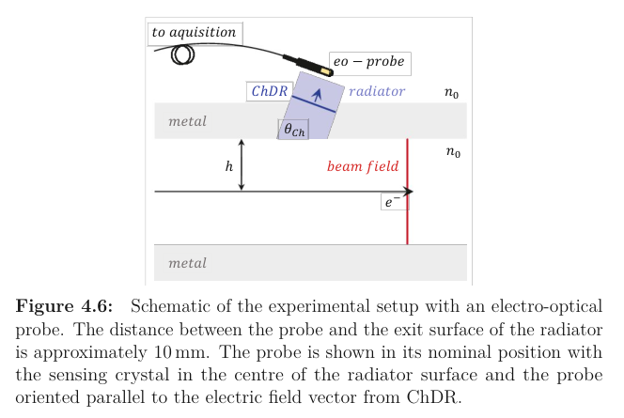
Outlook

