Slide 1
Comparison same bunch and fresh bunch
self-seeding at PAL
MyungHoon Cho,
Chang-Kyu Sung, Chi Hyun Shim, Gyujin Kim, Yeong Jin Suh, Donghyun Na,
Haeryong Yang, Kook-Jin Moon, Seongyeol Kim, Hoon Heo
2025-10-16

Slide 2
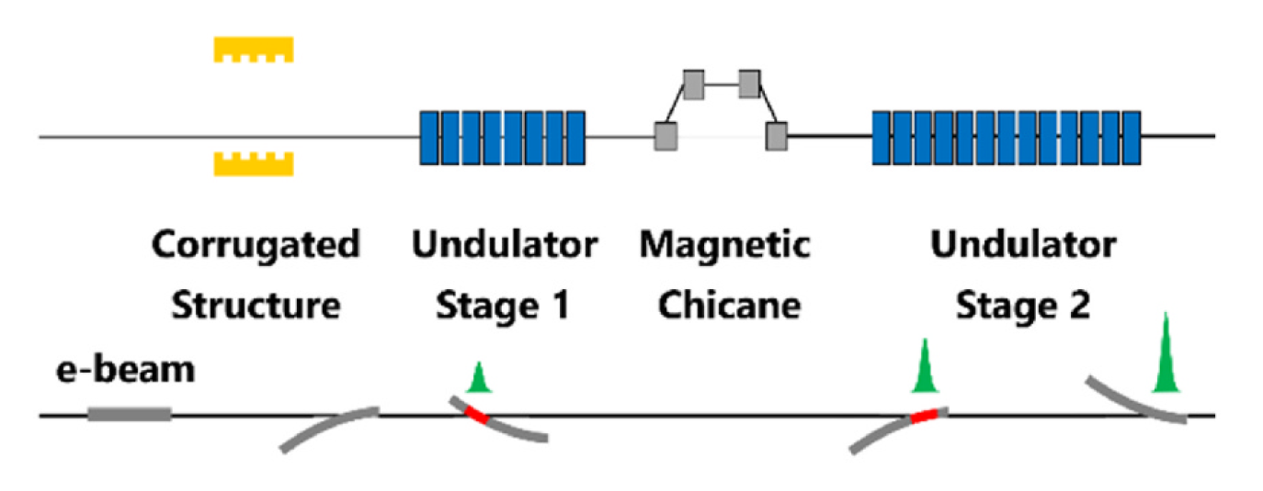
Fresh Slice and Self-Seeding Scheme
Combining self-seeding and fresh slice schemes
Transverse deflection using a corrugated plate (dechirper).
Forward Bragg Diffraction for self-seeding.
self-seeding crystal

Slide 3
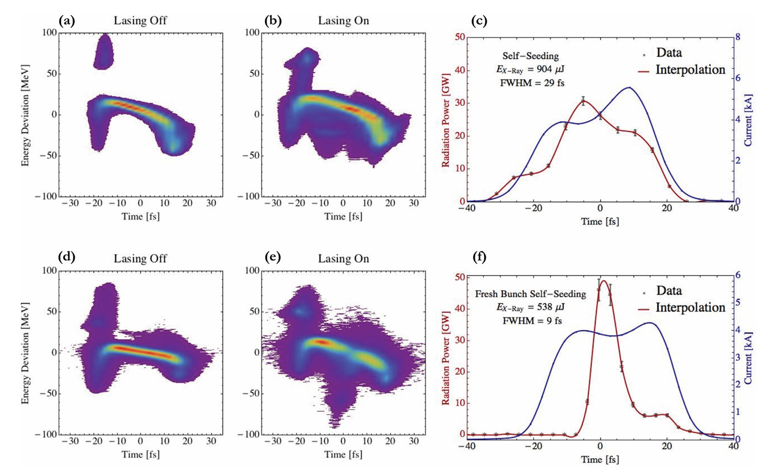
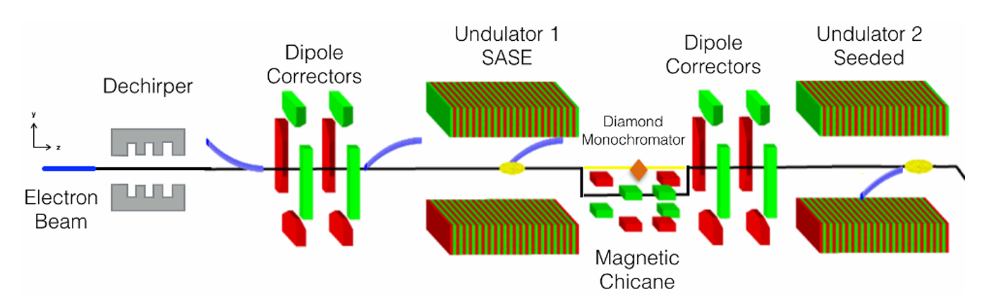
Fresh Slice and Self-Seeding Scheme
LCLS already demonstrated the fresh slice self-seeding.
Shorten FEL duration was measured by X-TCAV.
Proceedings of NAPAC, TUB3CO03 (2016)
APPLIED PHYSICS LETTERS 110, 154101 (2017)

Slide 4
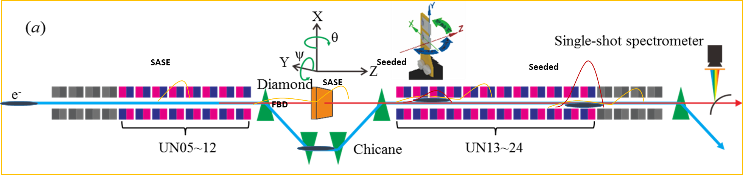
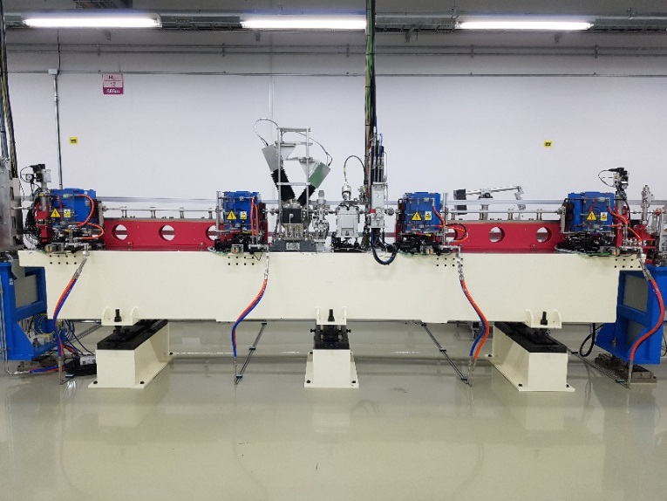
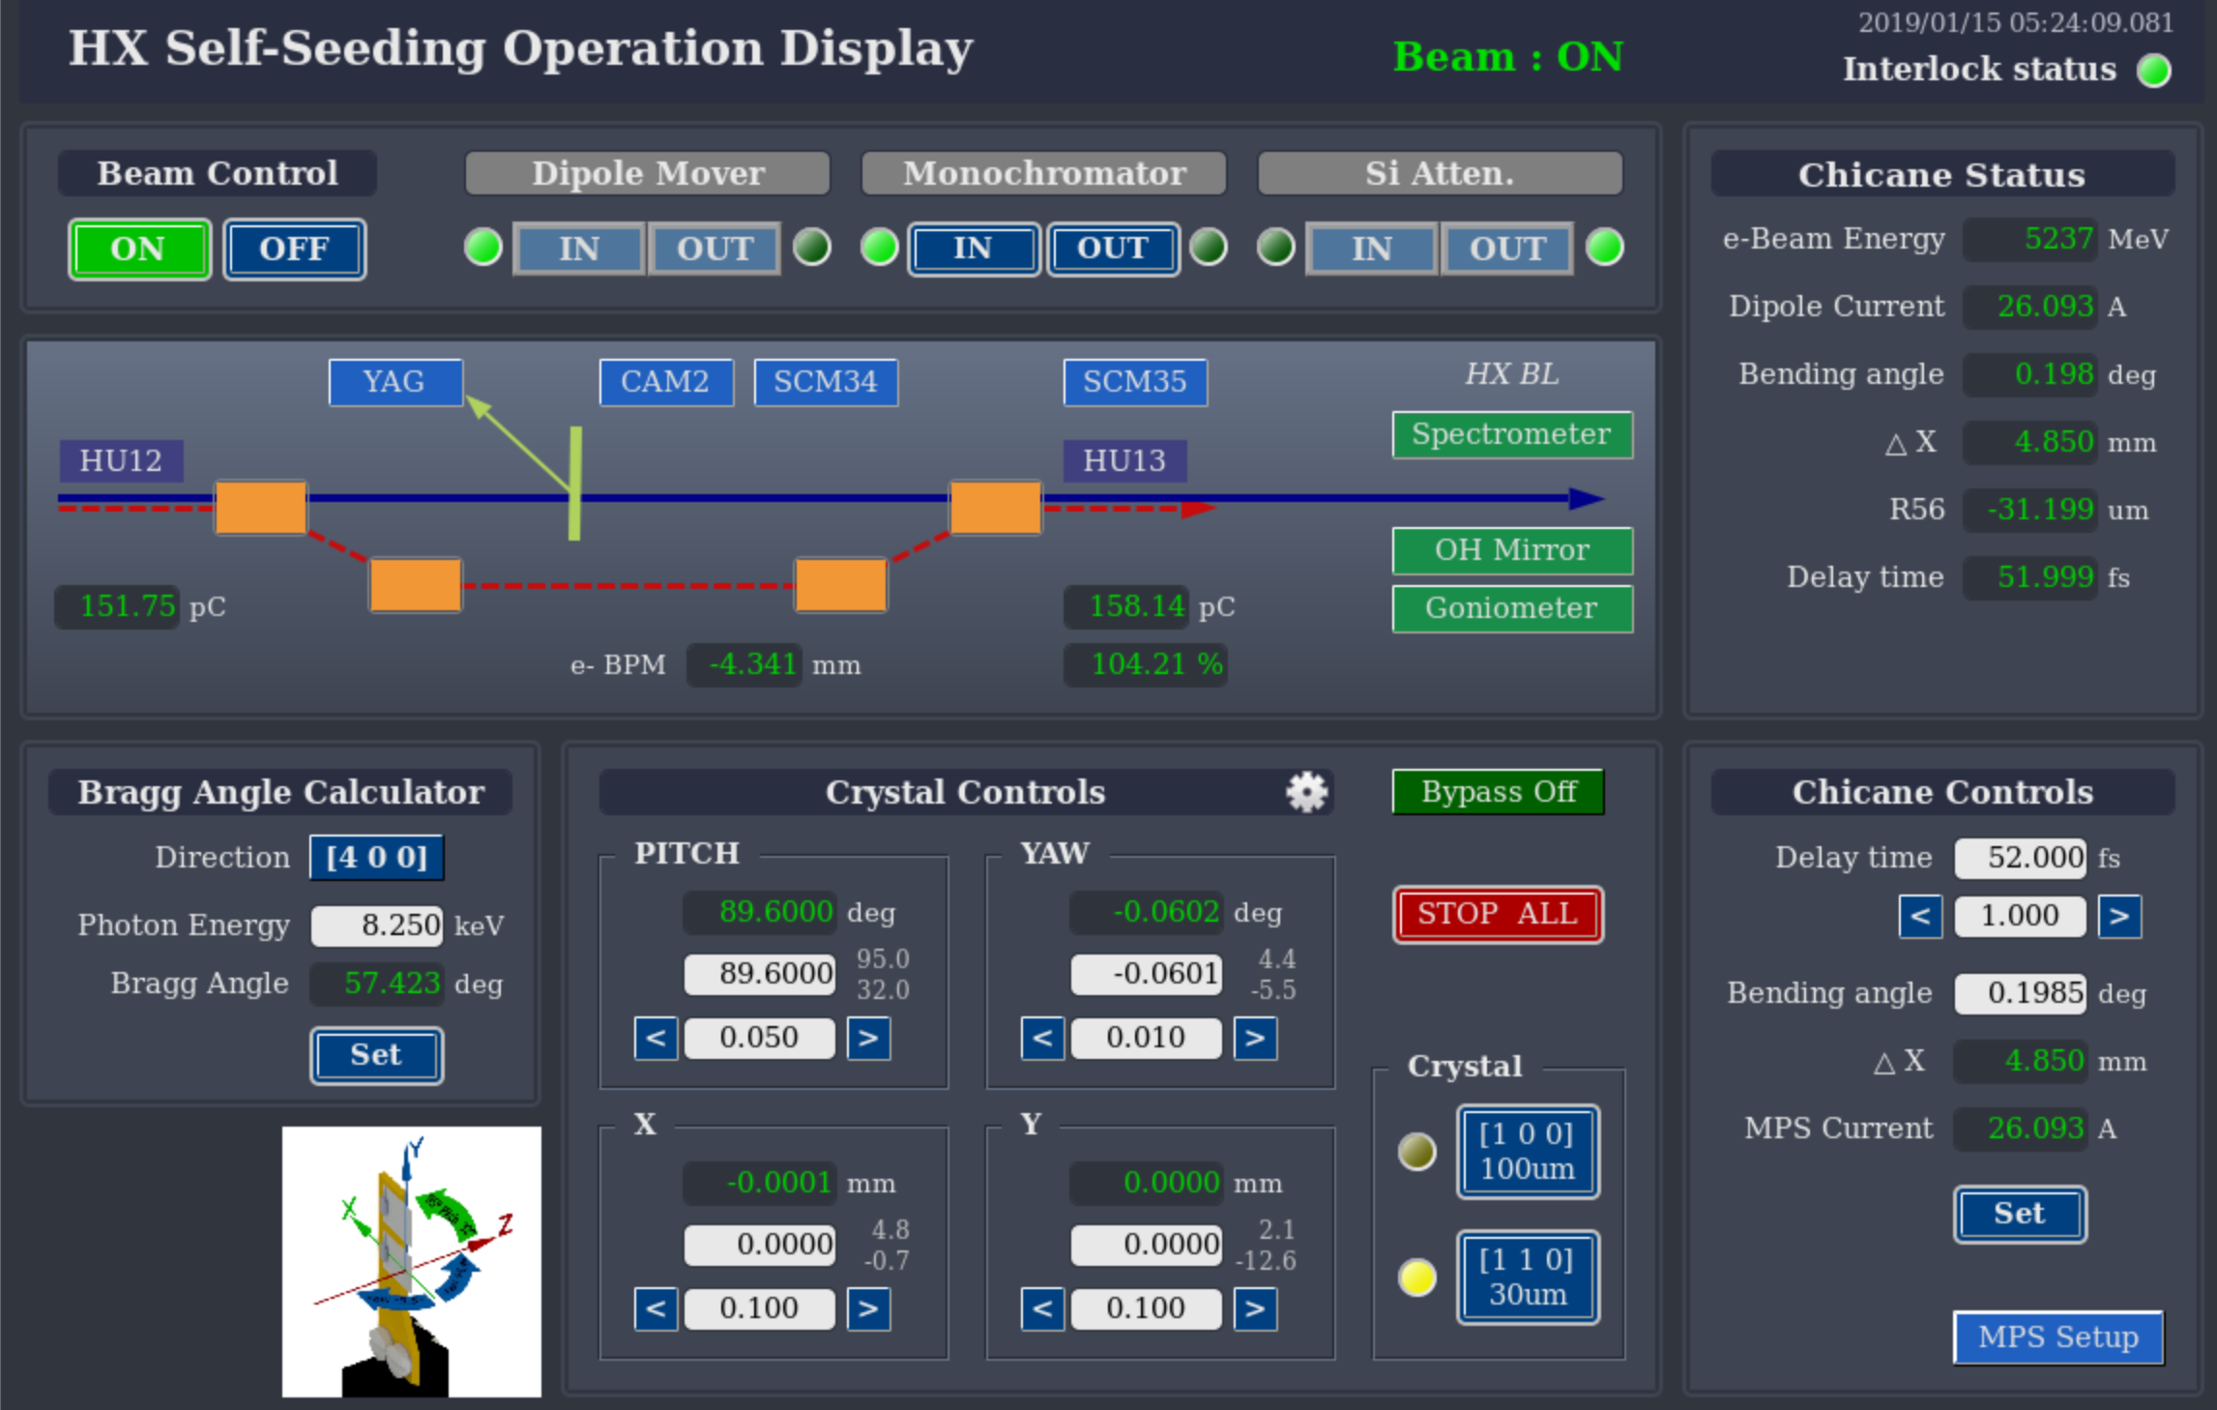
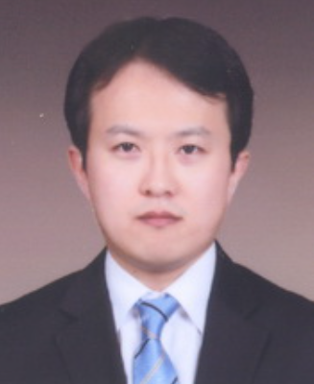
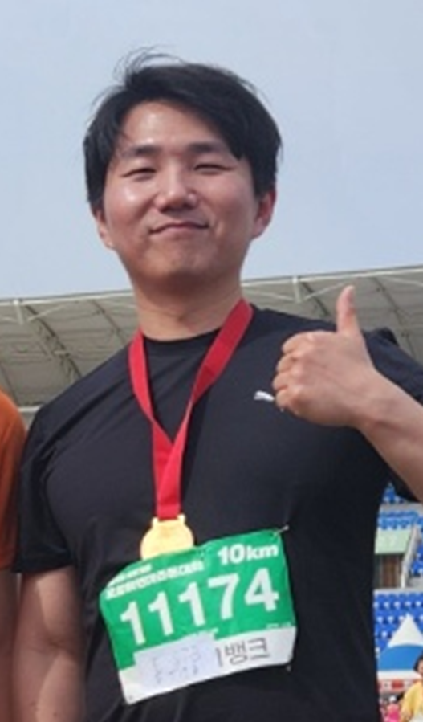
Hard X-ray Self-Seeding at PAL
Since installed the self-Seeding monochromator in 2018, many efforts are dedicated to operate in stable and to generate high intensity.
4 X 5 mm size Diamond crystals
100 μm [100] orientation
30 μm [110] orientation
Gyujin Kim
Control
Sunghoon Kwon
Laser Heater
Picture of self-seeding section

Slide 5
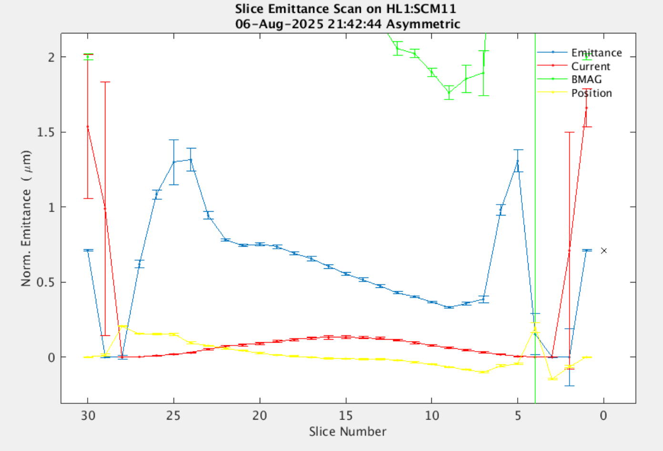
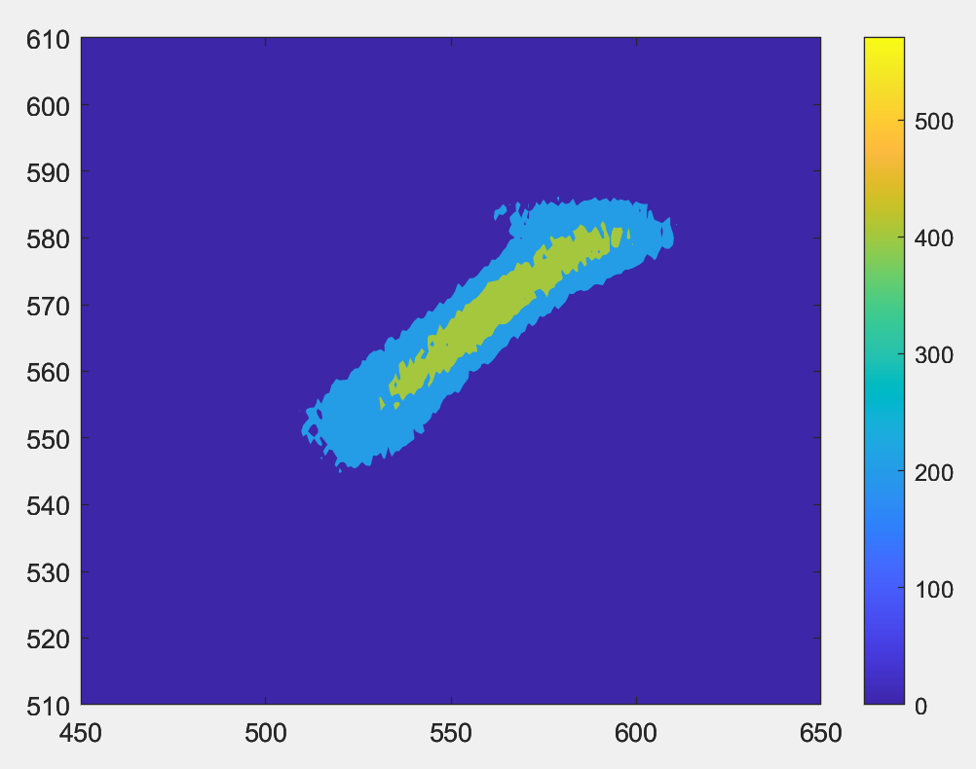
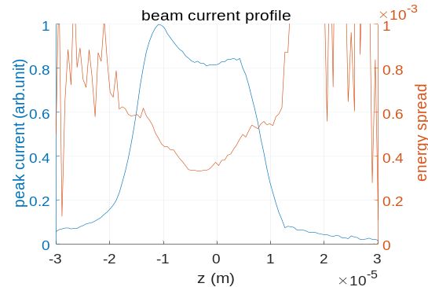
Hard X-ray Self-Seeding at PAL
Some features of PAL-XFEL.
Mechanical collimator at BC1 (operational up to 60 Hz)
- eliminating head and tail horn of the electron beam.
- unwanted head part (high emittance and high current) can be eliminated.
- it help to make a flat current profile and low energy chirp.
Electron beam matching at acceleration and undulators
Efficient laser heater
- required laser heater energy :
6 uJ for SASE
> 40 uJ for SS
Slice emittance at L1
tail
lasing part
head
time
energy

Slide 6
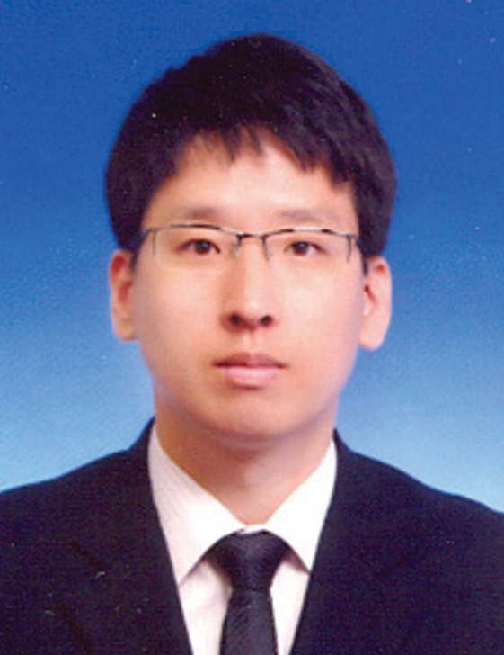
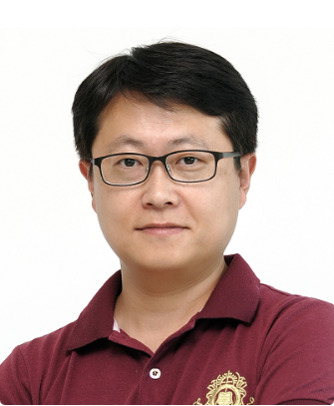
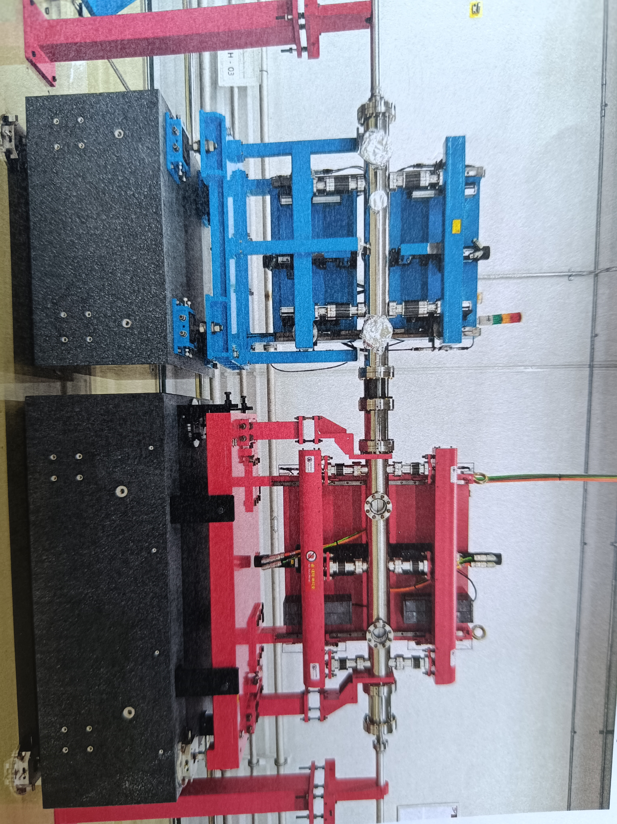
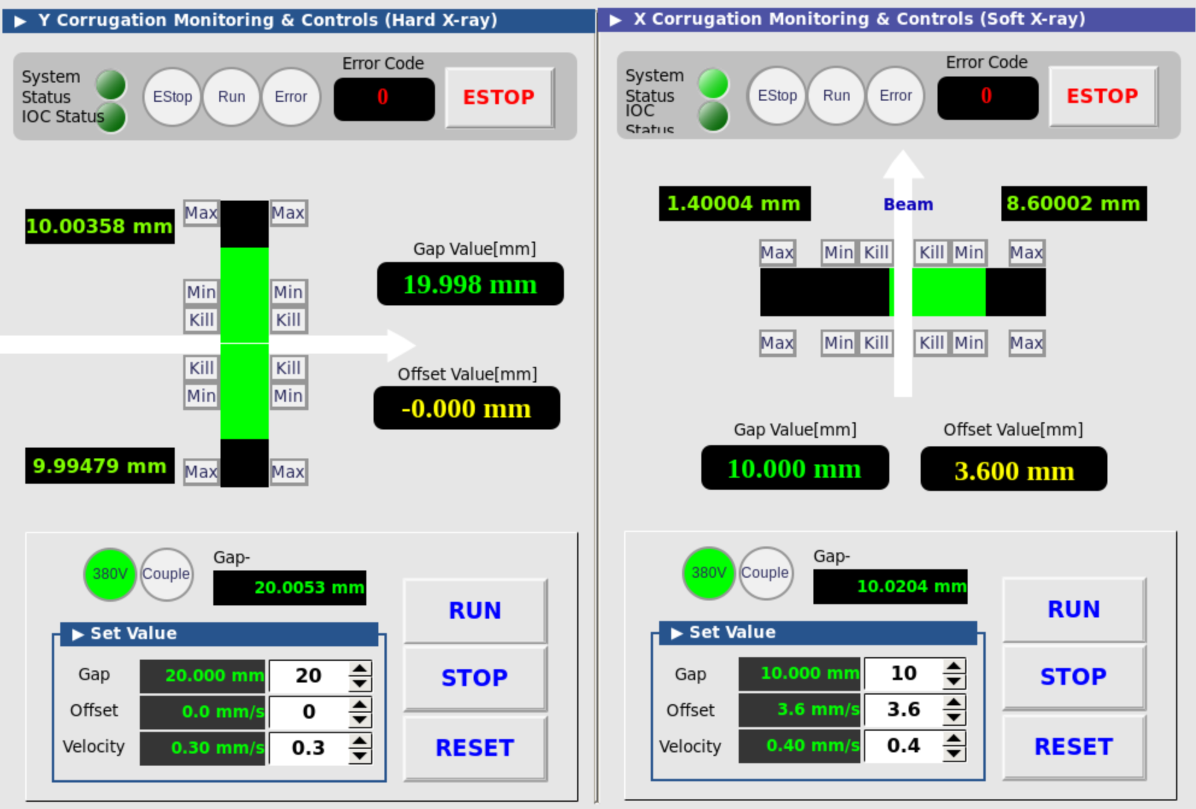
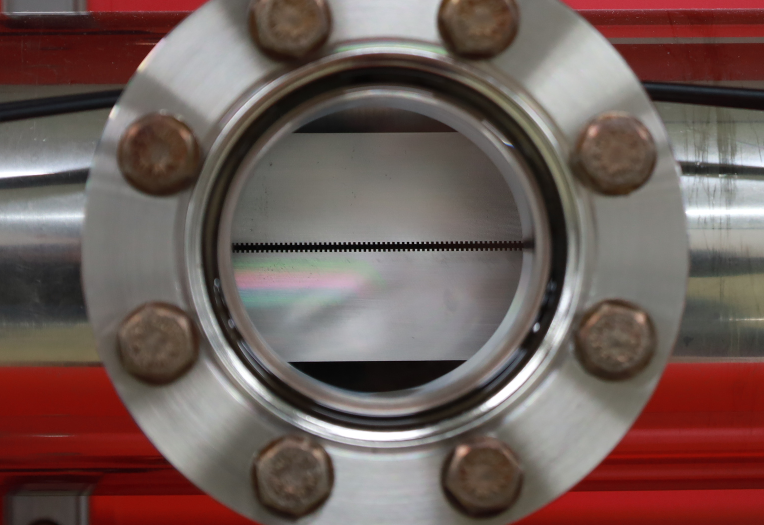









Dechirper Structure
Parameter | Value
h | 500 µm
p | 500 µm
t | 250 µm
a | variable
b | variable
length | 1 m
Positioned before undulators.
- Two flat and corrugated plates (dechirper)
$$p$$
$$y$$
$$z$$
$$h$$
$$t$$
$$s$$
$$b$$
Donghyun Na
Install, Vacuum
Yeong Jin Suh
Install, Vacuum
$$\left(z_{0},y_{0}\right)$$
$$a→∞$$

Slide 7
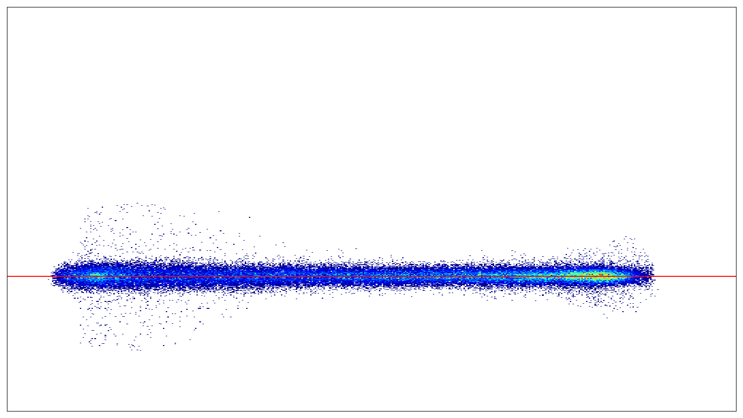
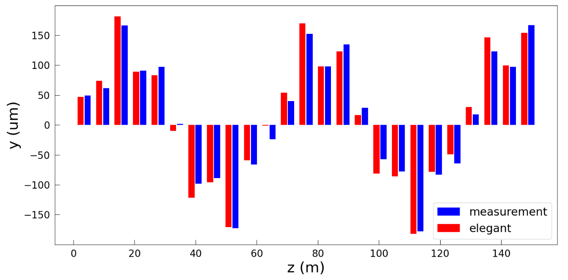
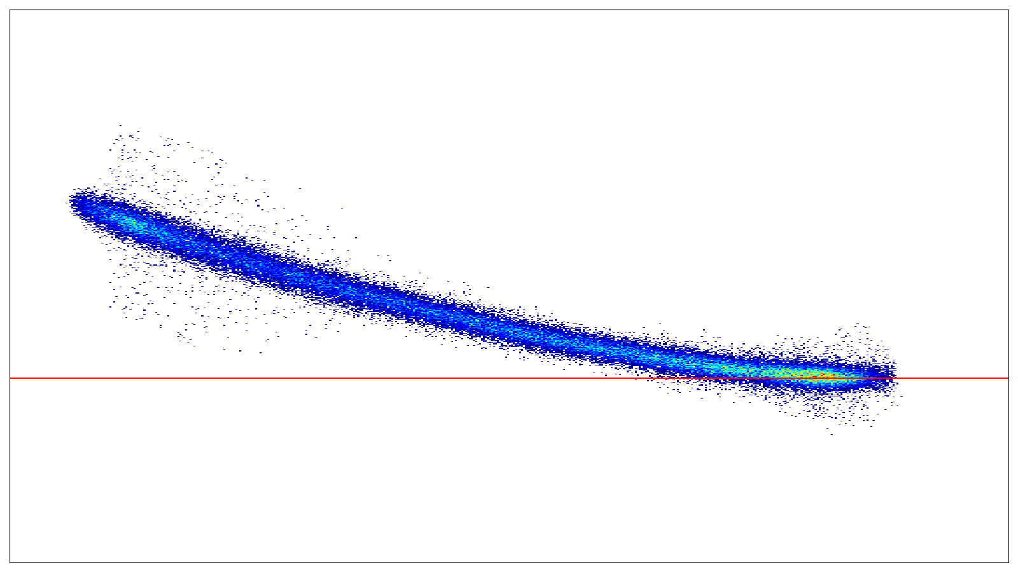
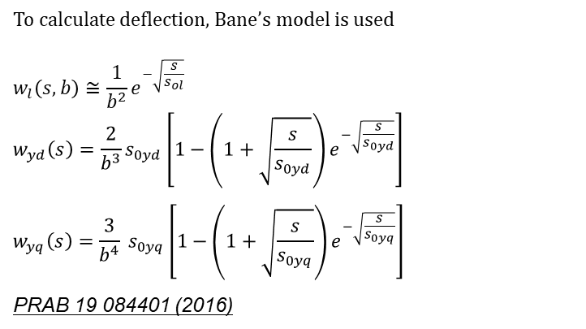
Electron Beam Deflection
To calculate deflection, Bane’s model is used
$$w_{l}\left(s,b\right)≅\frac{1}{b^{2}}e^{−\sqrt{\frac{s}{s_{ol}}}}$$
$$w_{yd}\left(s\right)=\frac{2}{b^{3}}s_{0yd}\left[1−\left(1+\sqrt{\frac{s}{s_{0yd}}}\right)e^{−\sqrt{\frac{s}{s_{0yd}}}}\right]$$
$$w_{yq}\left(s\right)=\frac{3}{b^{4}} s_{0yq}\left[1−\left(1+\sqrt{\frac{s}{s_{0yq}}}\right)e^{−\sqrt{\frac{s}{s_{0yq}}}}\right]$$
PRAB 19 084401 (2016)
To confirm deflection, we compared electron beam position after the dechirper.
Numerical model of deflection and tracking simulation has well agreement with BPM measurement.
→ Good Dechirper alignment
Elegant Simulation at just after dechirper
Parameters
- b=450 um
- beam energy = 4.2 GeV
Particle distribution by simulation (elegant)
DECH OFF
Beam position measurement after performing dechirper
Undulator on-axis line (lasing)
DECH ON
y
Tail
Head

Slide 8
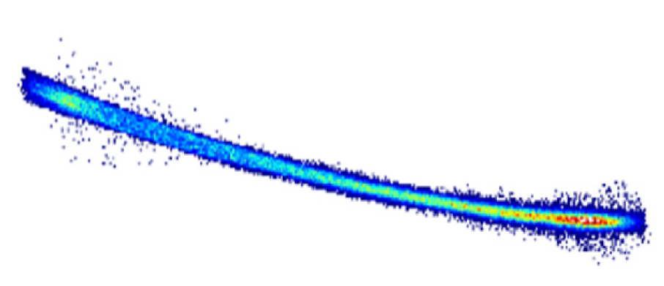
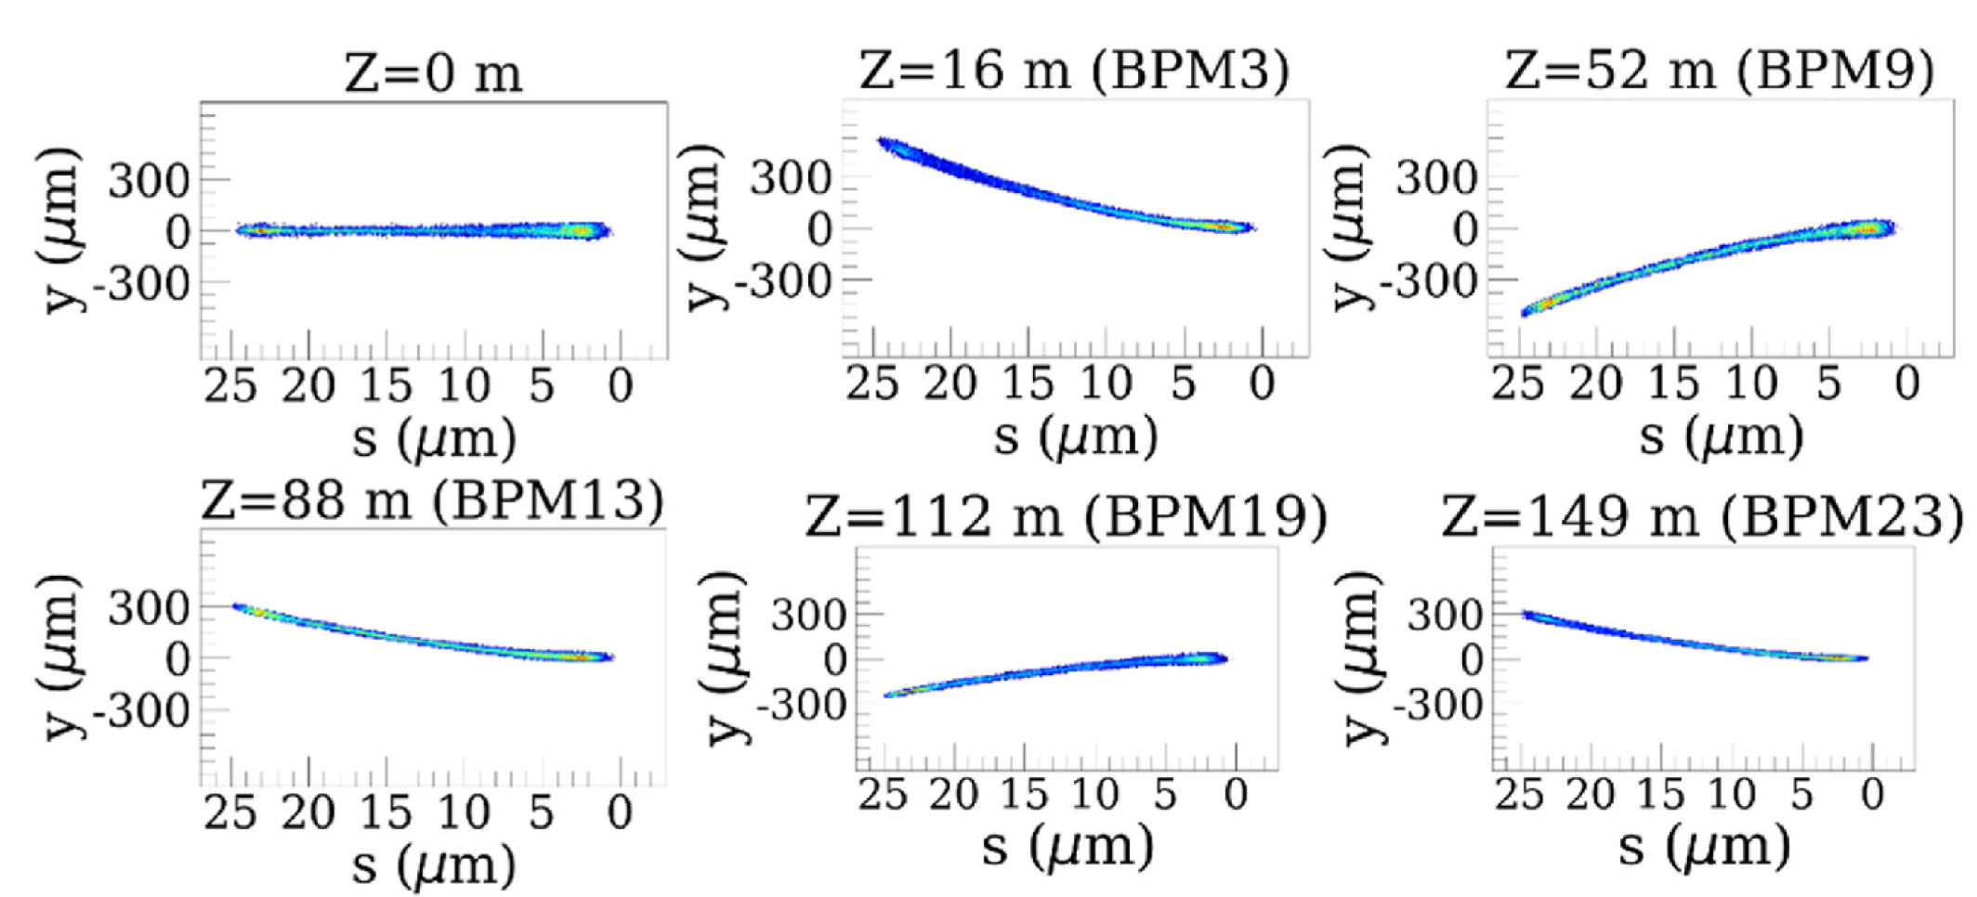
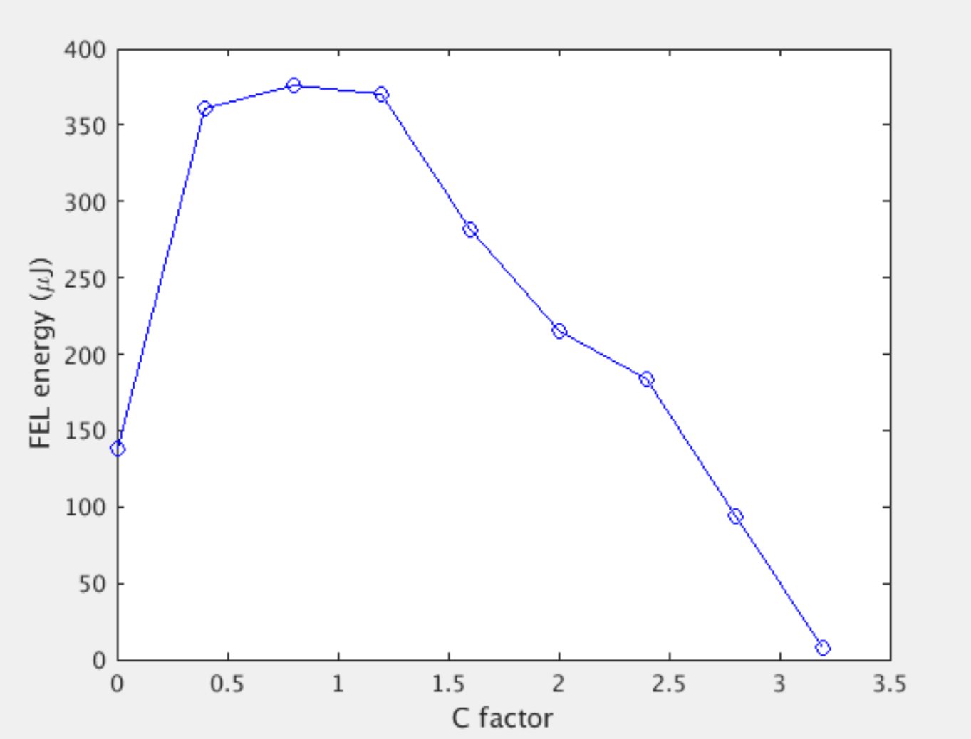




Alignment of the local Electron Beam
Using vertical deflection, specific slice section should be aligned at the undulator axis.
C factor parameter is used.
The center of mass (COM) or value of BPM will be a target of position feedback.
$$y_{2}=Cy_{1} , C≥0$$
$$C=2$$
$$C=1$$
$$C=0$$
C factor scan (FEL intensity)
$$y_{1}$$

Slide 9
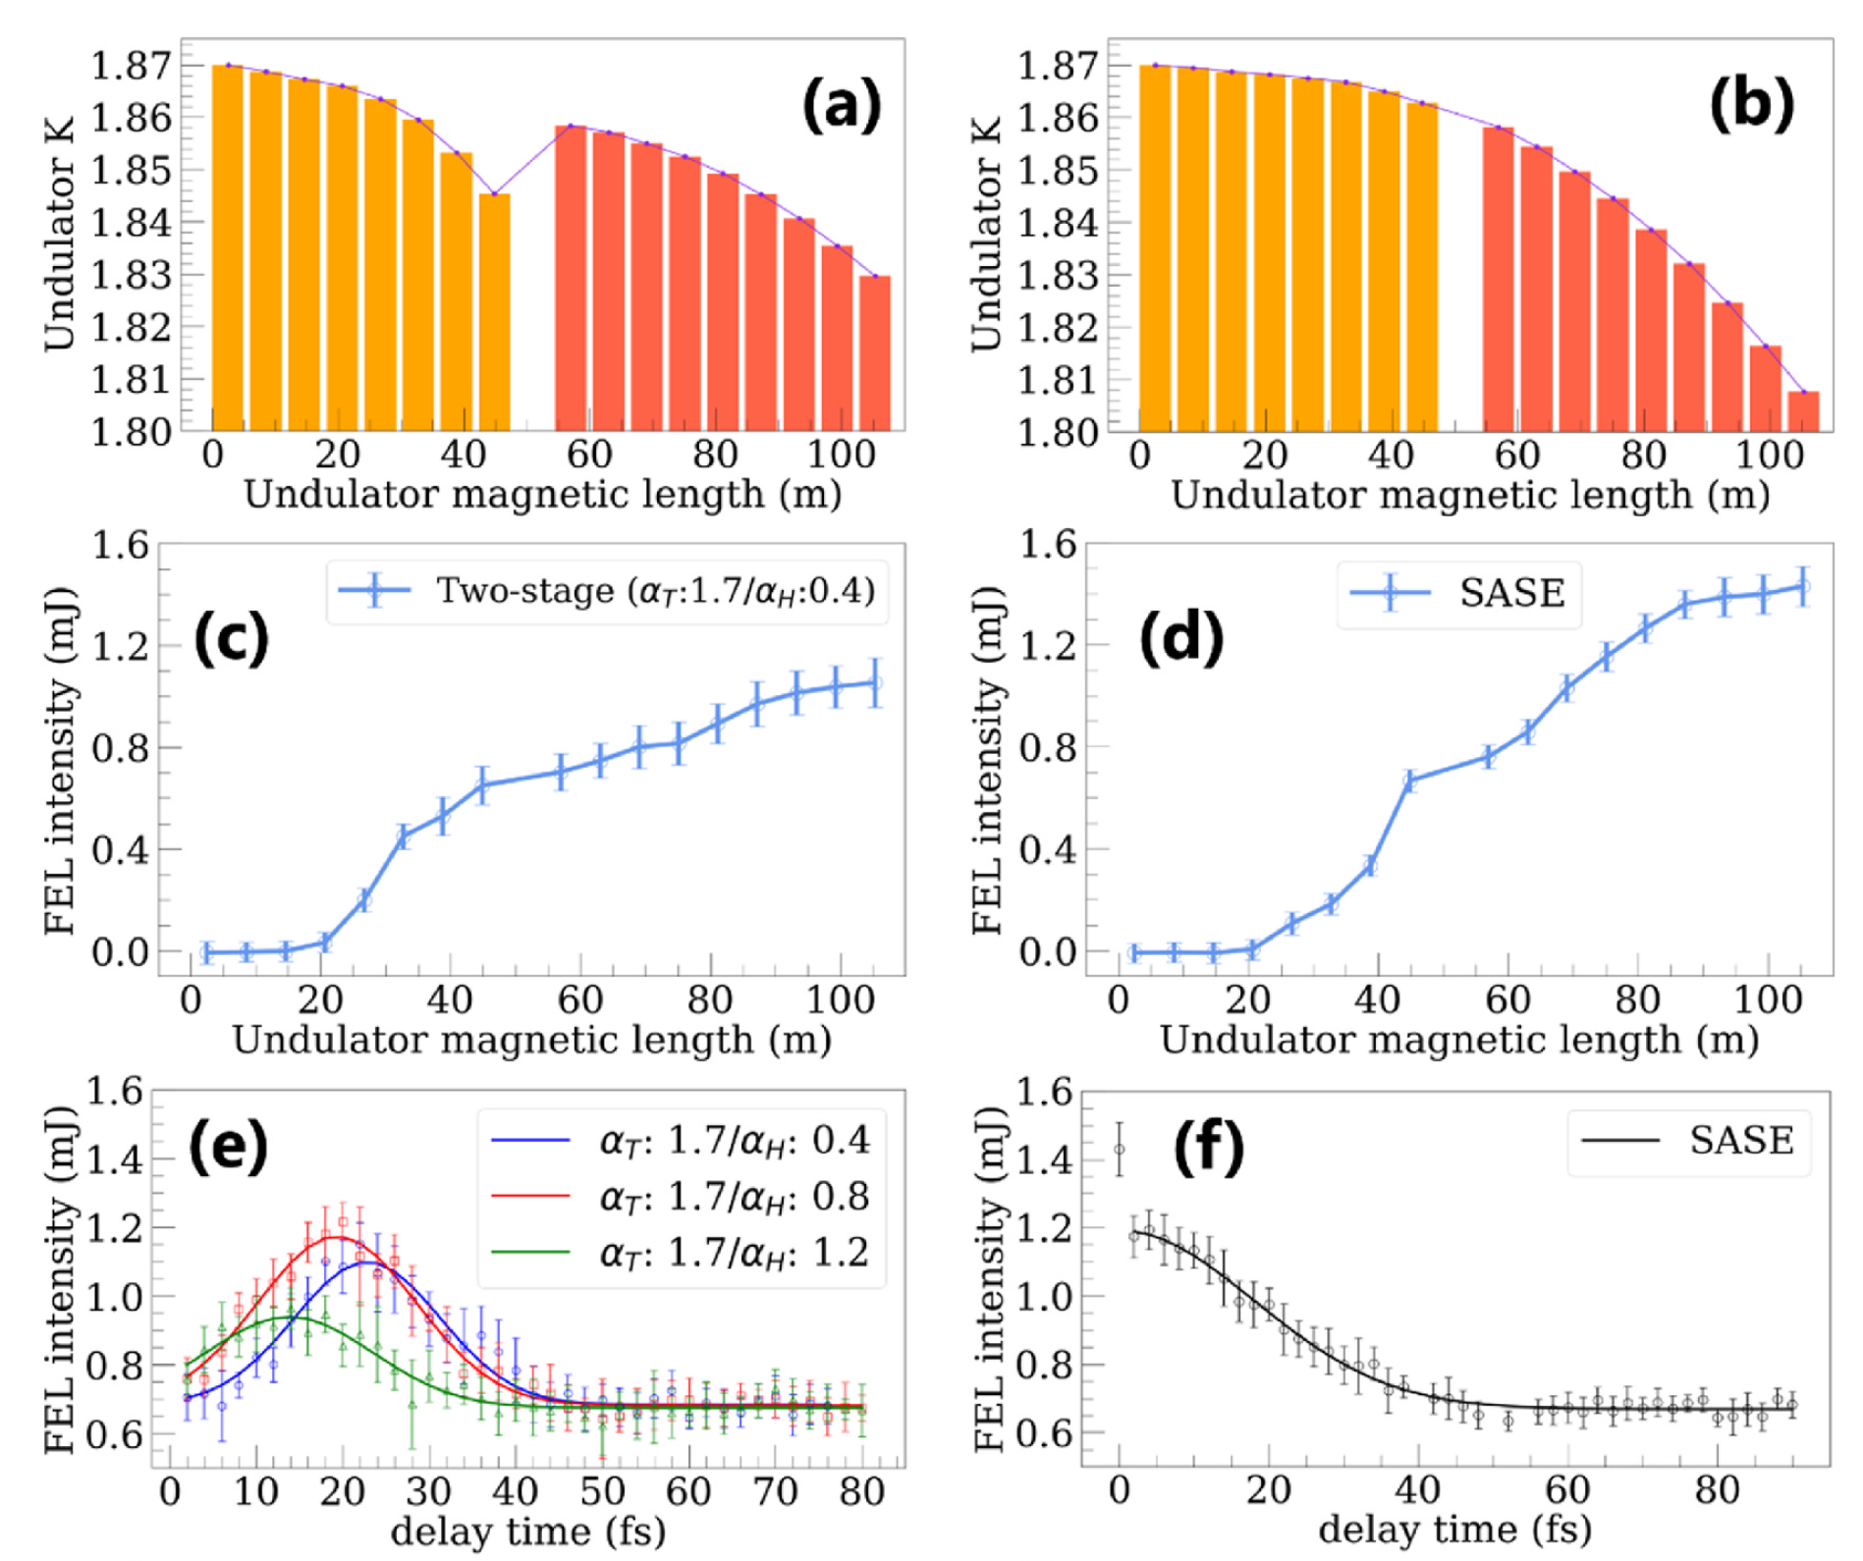
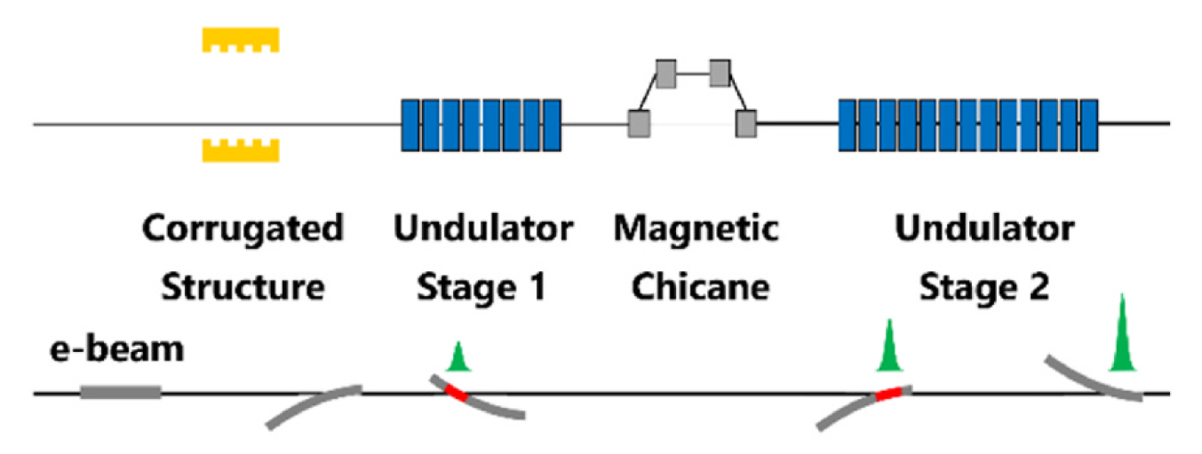
Fresh Slice FEL
Overlapping the seed and e-beam head slice is done by the Chicane at the Self-Seeding section.
→ Resulting FEL durations is shorten.
NIMA 1076 170458 (2025)
Fresh slice (2.47 keV)
SASE (2.47 keV)
8 units
13 units
overlap
➔ Chicane scan shows FEL duration.
18.05 fs (RMS)
9.19 fs (RMS)

Slide 10
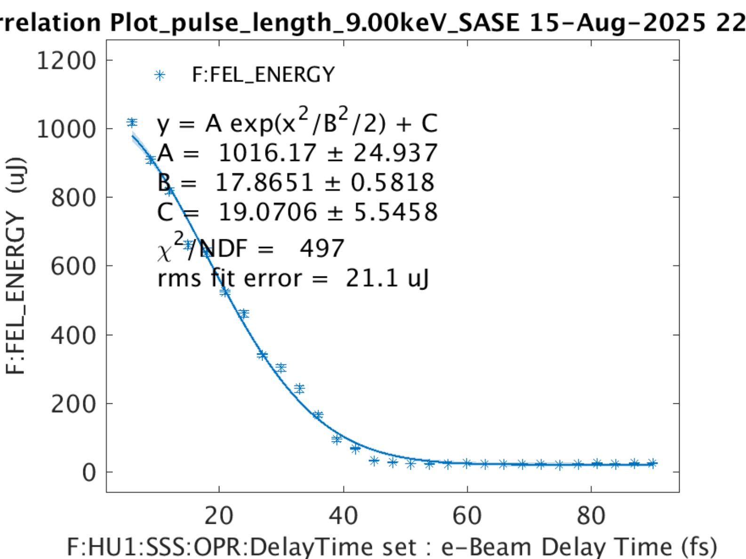
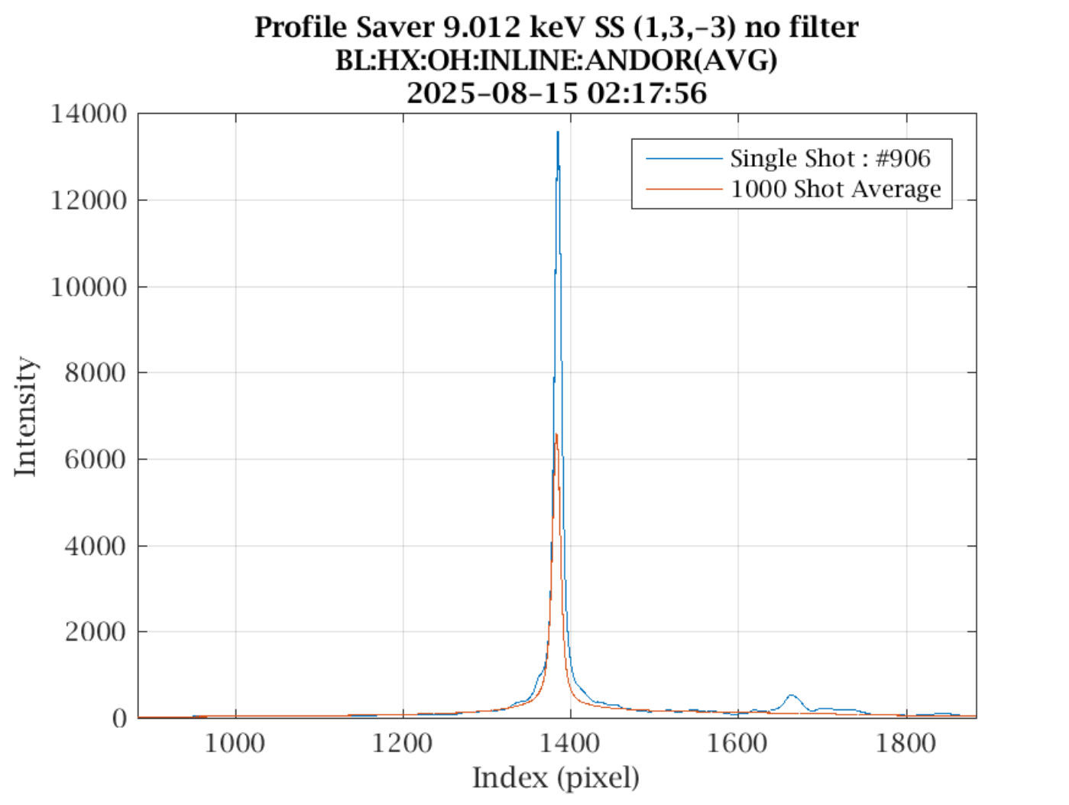
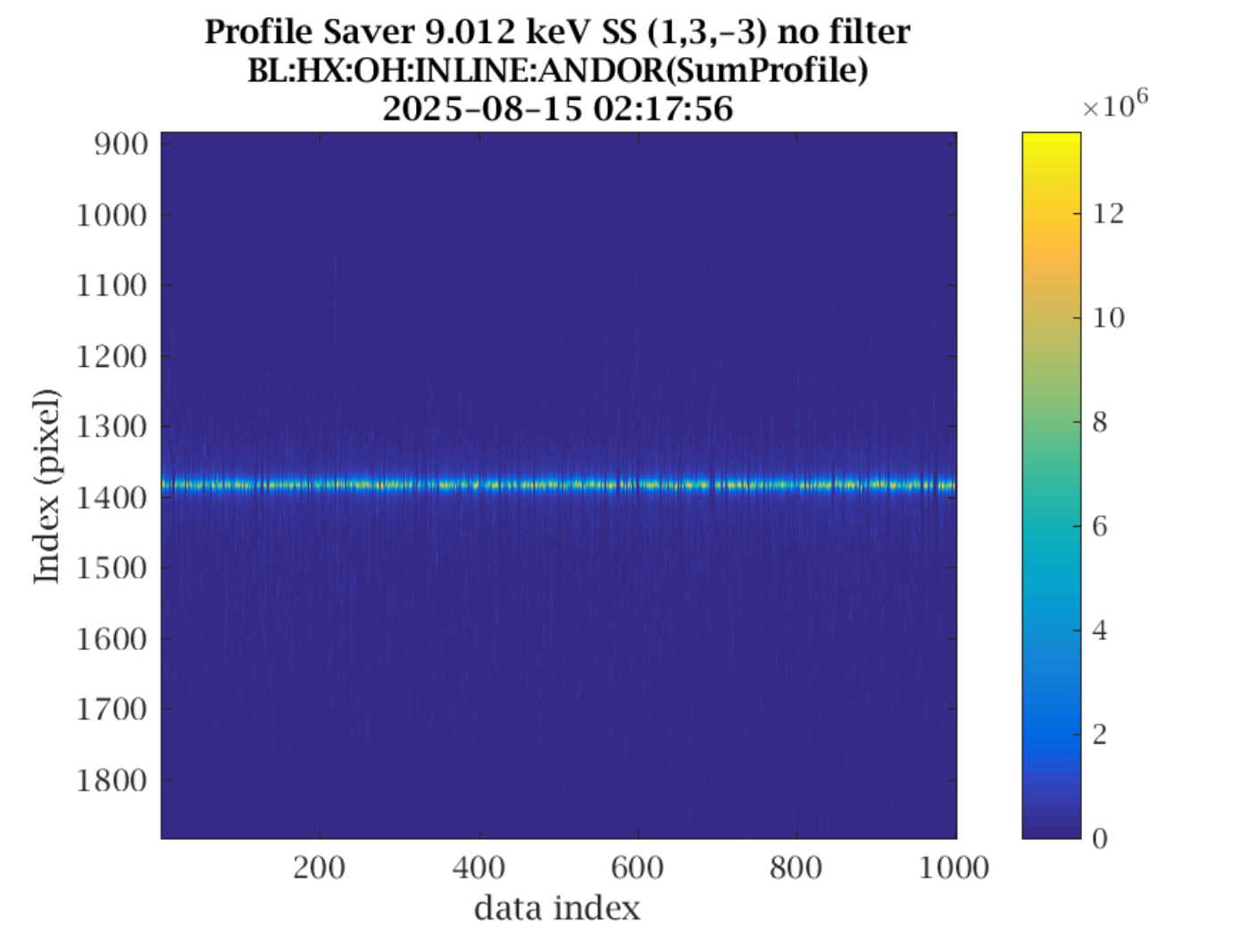

Self-seeding FEL
Hard X-ray Self-Seeding is possible at $≥5 keV$ with 100 $μ$m crystal, $≥3.5keV$ with 30 $μ$m crystal.
We tested with 100 $μ$m crystal at $9 keV$.
We assume FEL beam duration 29.74 fs at SS.
SASE FEL beam duration : 29.74 fs
Self-seeding intensity : 759 $μJ$

Slide 11
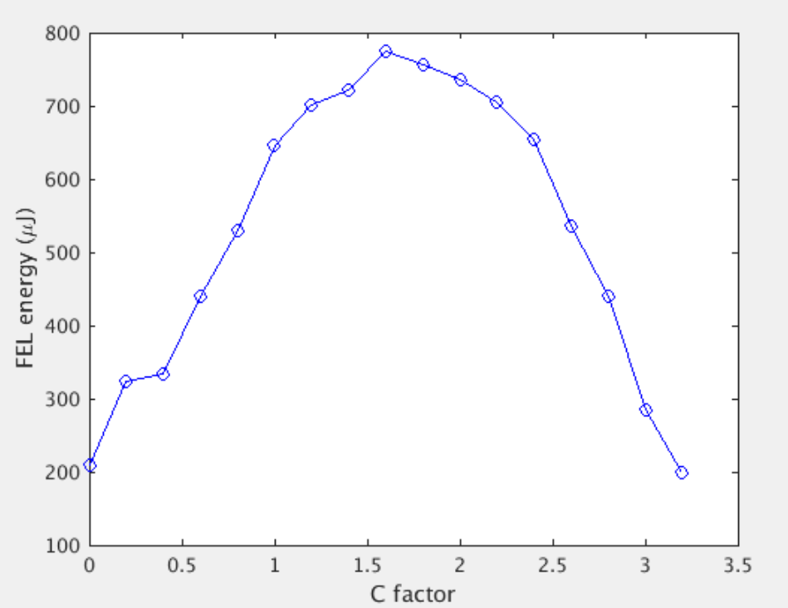
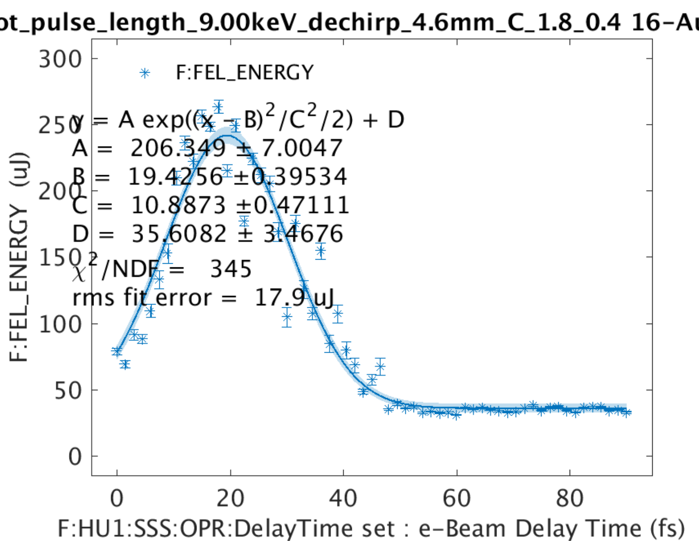
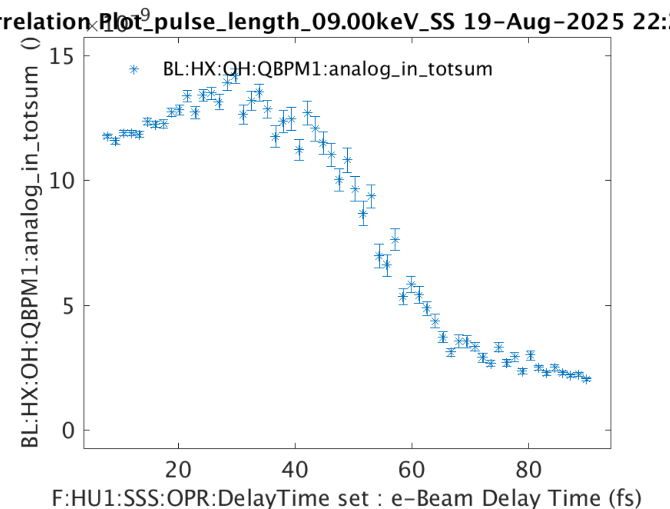


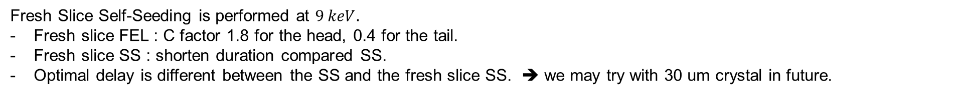

Fresh Slice Self-seeding FEL
Fresh Slice Self-Seeding is performed at $9 keV.$
Fresh slice FEL : C factor 1.8 for the head, 0.4 for the tail.
Fresh slice SS : shorten duration compared SS.
Optimal delay is different between the SS and the fresh slice SS. ➔ we may try with 30 um crystal in future.
C factor scan at 9 keV
Fresh slice SS FEL duration : 18.1 fs
SS FEL duration : 29.7 fs
head
Delay scan at SS FEL
tail
$$C=2$$
$$C=1$$
$$C=0$$

Slide 12
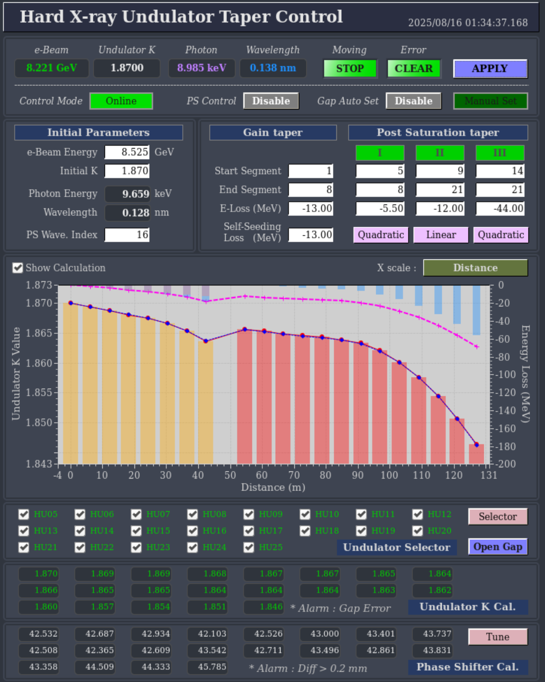
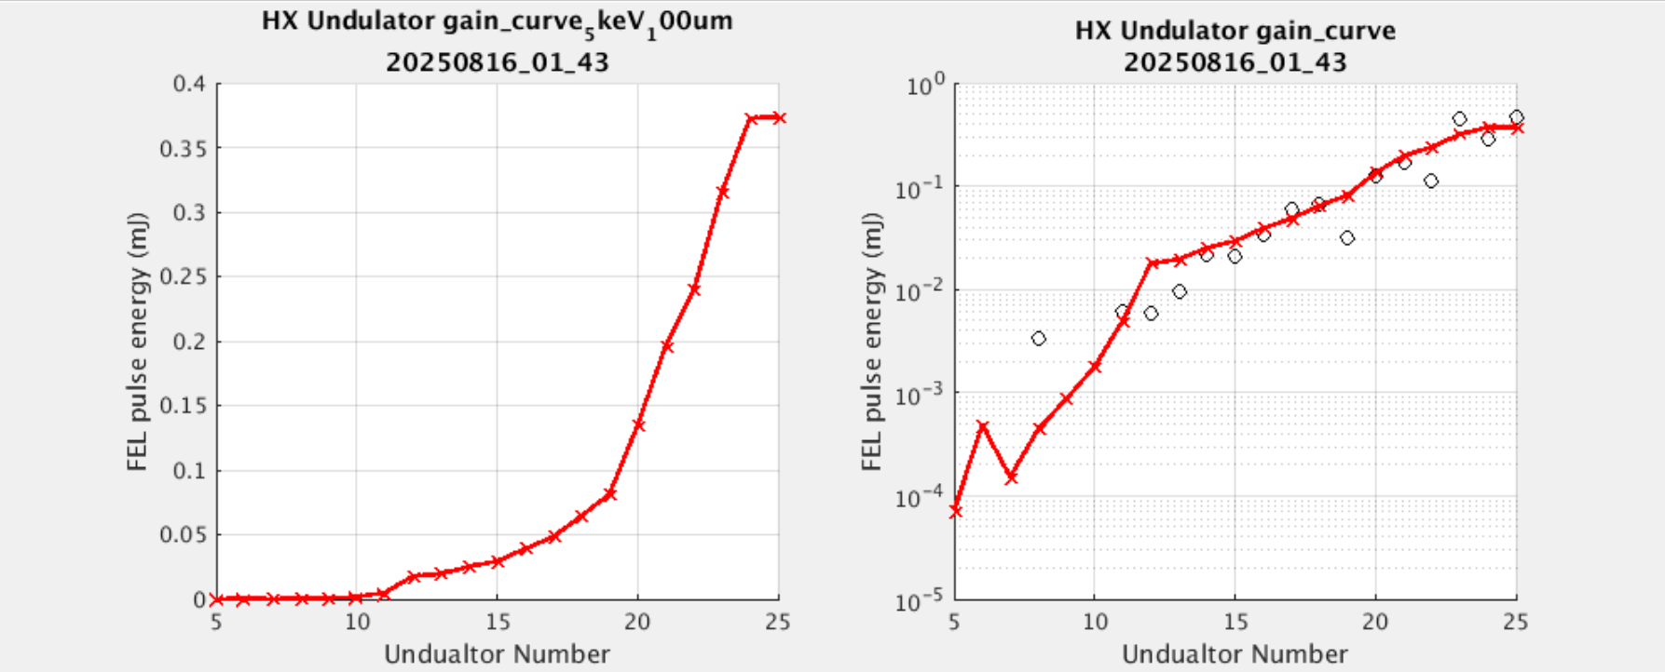
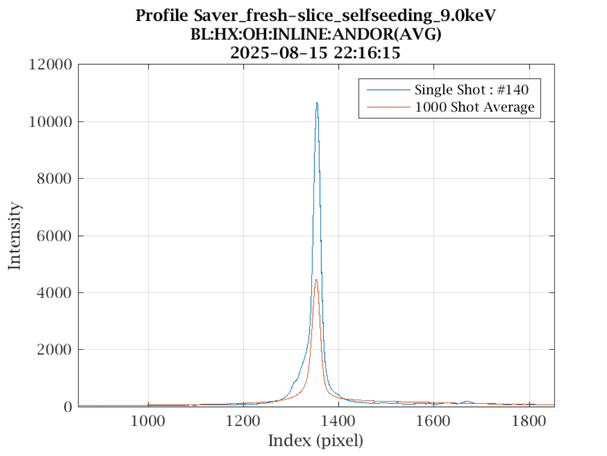

Fresh Slice Self-seeding FEL
2 stage undulator taper.
Intensity : 355 $μJ$
1ST
2ND
1ST
2ND

Slide 13
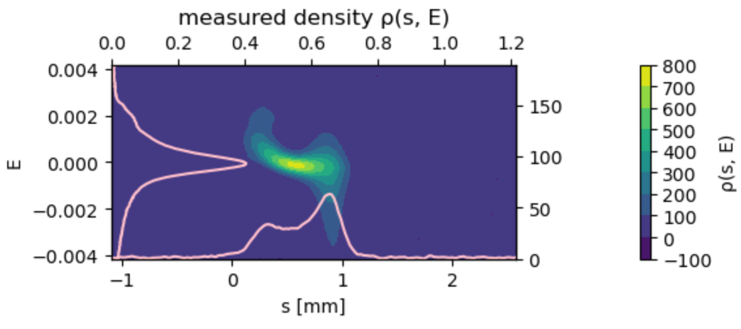
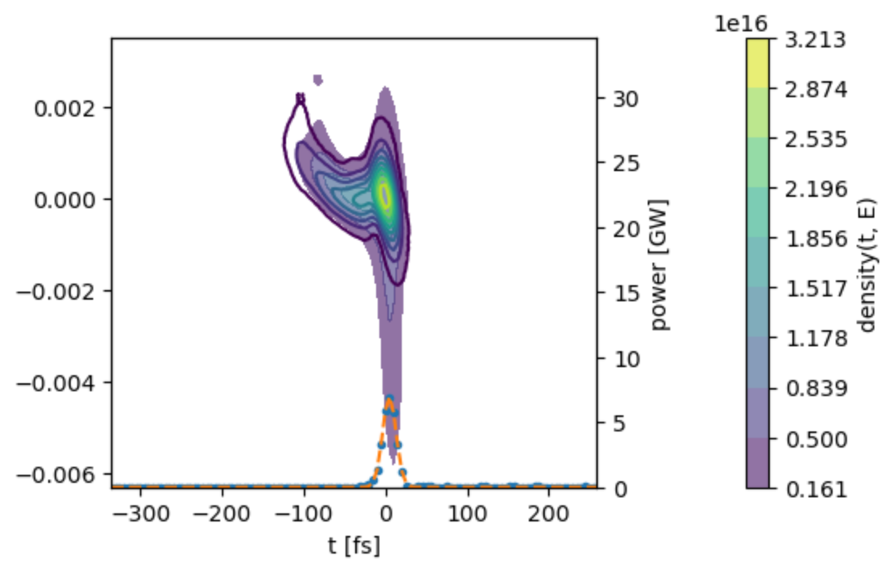
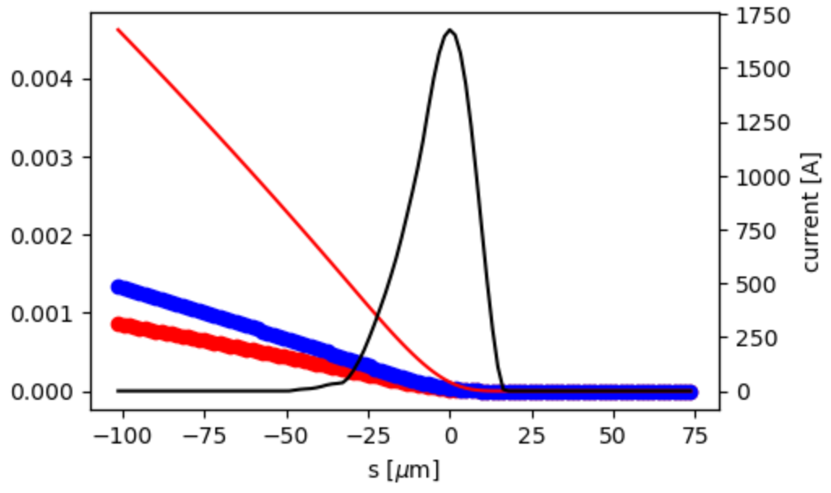
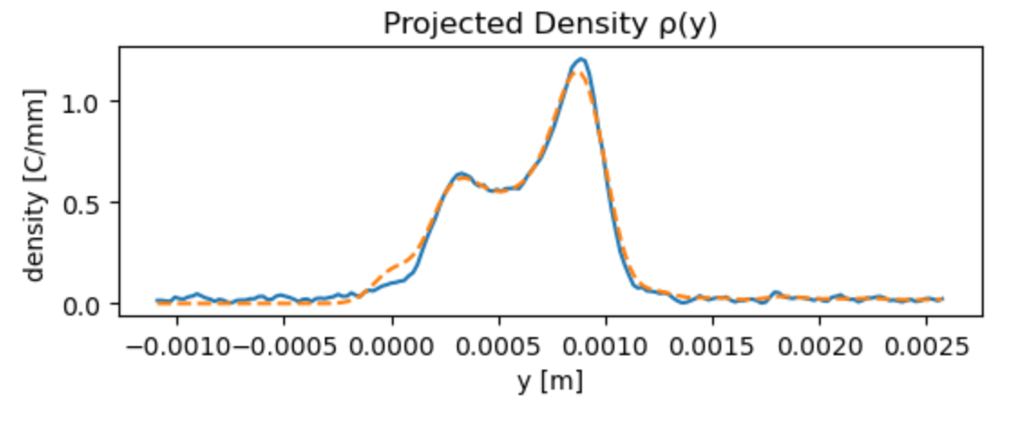
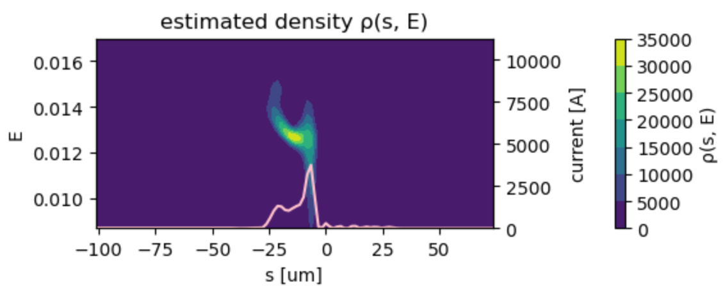
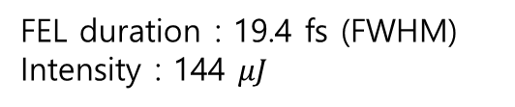
Electron Beam Phase Space Measurement
PAL-XFEL try to measure a phase space of e-beam using the dechiper.
Below is an example of the soft x-ray beam line measurement at the dump screen.
For hard X-ray, the dechirper plate should be rotated to 90 deg.
numerical analysis
deconvolution method
FEL duration : 19.4 fs (FWHM)
Intensity : 144 $μJ$

Slide 14
Summary
1. Fresh slice self-seeding was successfully demonstrated at 9 keV.
2. Flat top current profile is good to predict the gap between the electron beam and the dechirper plate.
3. The deflection C factor was used to control a targeted local part of electron beam.
4. The obtained fresh slice SS duration was 18 fs, which was 60 % of SS duration 30 fs.
The averaged power is still 78% of SS power.
➔ we need further activity to increase a peak power.

Slide 15
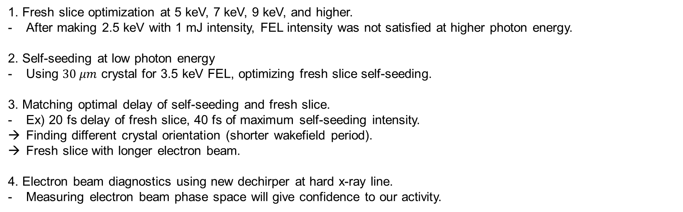
Future work
1. Fresh slice optimization at 5 keV, 7 keV, 9 keV, and higher.
After making 2.5 keV with 1 mJ intensity, FEL intensity was not satisfied at higher photon energy.
2. Self-seeding at low photon energy
Using $30 μm$ crystal for 3.5 keV FEL, optimizing fresh slice self-seeding.
3. Matching optimal delay of self-seeding and fresh slice.
Ex) 20 fs delay of fresh slice, 40 fs of maximum self-seeding intensity.
Finding different crystal orientation (shorter wakefield period).
Fresh slice with longer electron beam.
4. Electron beam diagnostics using new dechirper at hard x-ray line.
Measuring electron beam phase space will give confidence to our activity.

