Slide 1
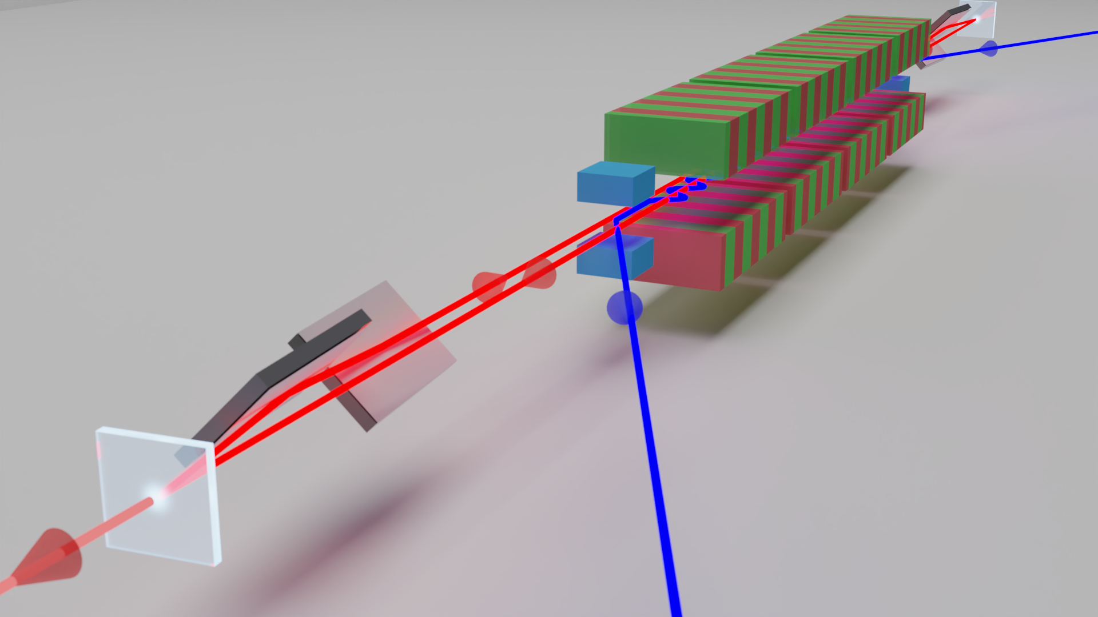


First Lasing of A Cavity based XFEL .
1st Hard X-ray Self-seeded FEL workshop, PAL-XFEL, Pohang
Patrick Rauer on behalf of
the CBXFEL@EuXFEL team

Slide 2
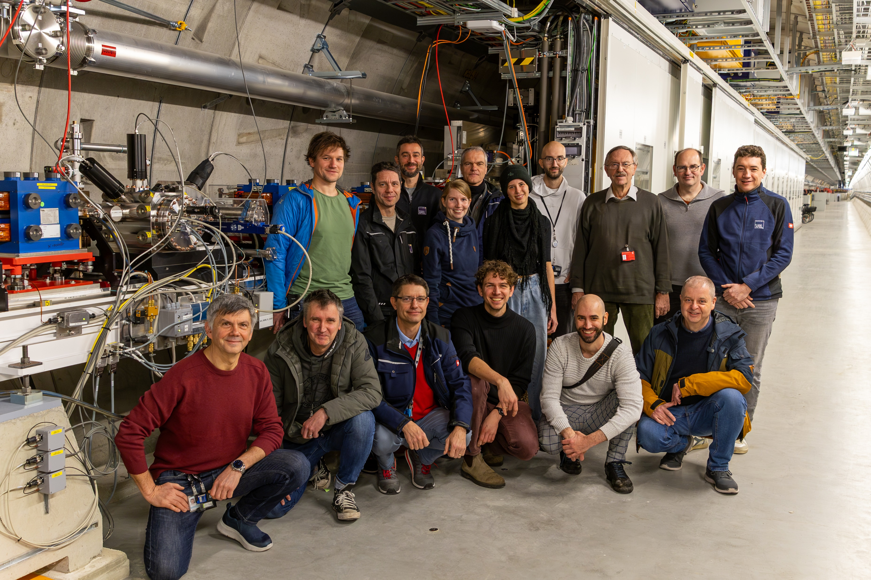
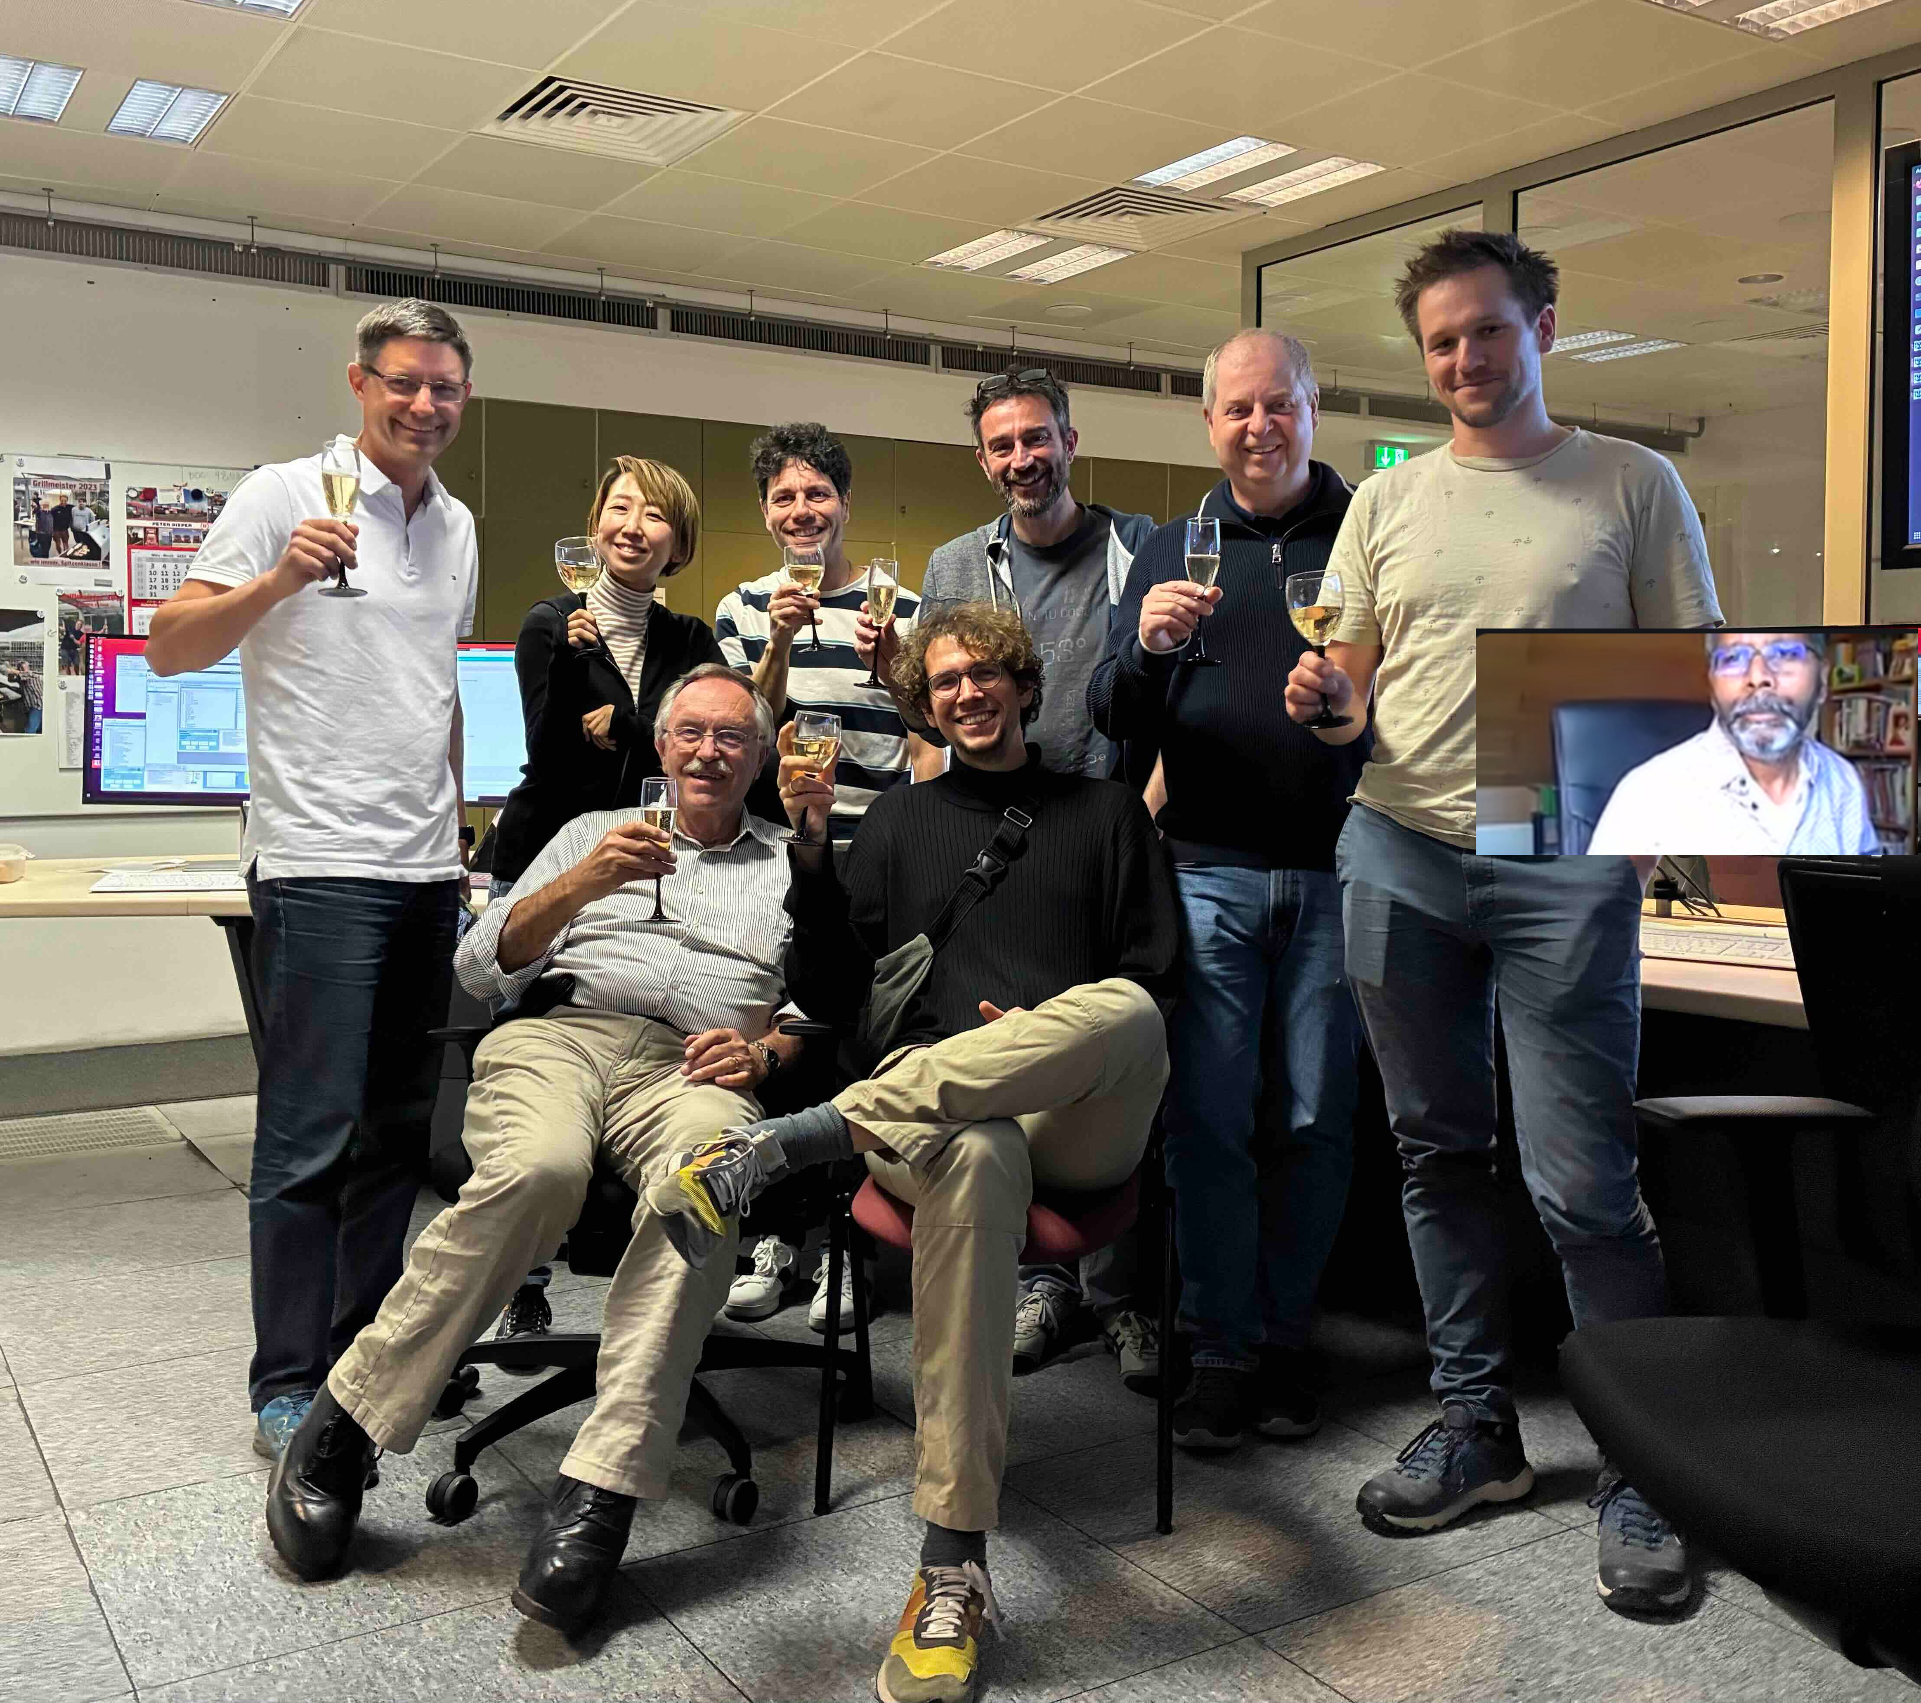
The CBXFEL @EuXFEL Team

Slide 3



The CBXFEL @EuXFEL Team
Immo Bahns Sara Casalbuoni Massimiliano Di Felice Martin Dommach Bertram Friedrich Jan Grünert Wolfgang Freund Ivars Kapic | Suren Karabekyan Andreas Koch Daniele La Civita Liubov Samoylova Harald Sinn Maurizio Vannoni Allesandro Silenzi Jia Liu Naresh Kujala
Winfried Decking
Dirk Lipka
Patrick Rauer
Matthias Scholz
Marc Guetg
Daniel Thoden
Frank Mayet
Torsten Wohlenberg
Lukas Müller
Jörg Roßbach

Slide 4
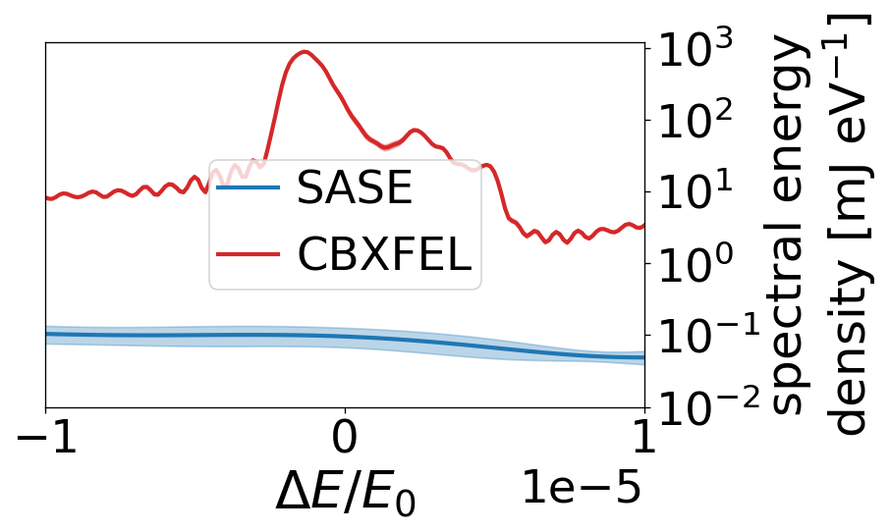
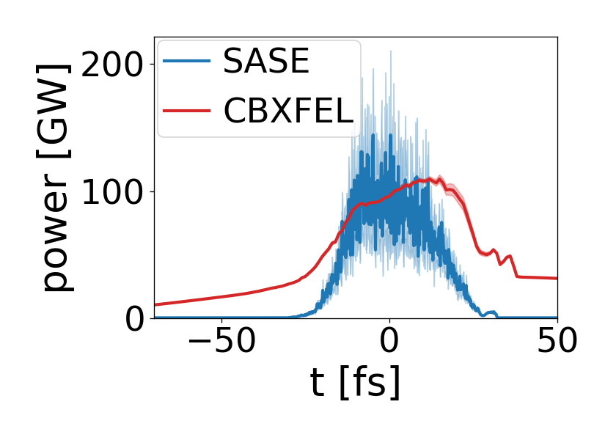
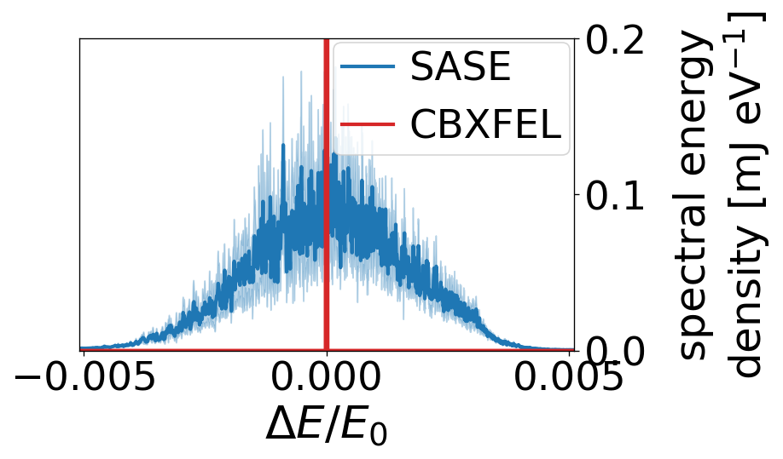

Cavity Based X-ray FELs
SASE vs. CBXFEL
CBXFEL
  Small Bandwidth
  Very high peak spectral density
  ~full pulse coherence (3D)
  Nearly transform limited
Possible use cases
  Time resolved Inelastic (Hard) X-ray Scattering (IXS + RIXS)
  Nuclear Resonance Spectroscopy
  High peak power applications
  Moving closer to optical lasers —> Development potential (X-ray frequency comb etc.)

Slide 5
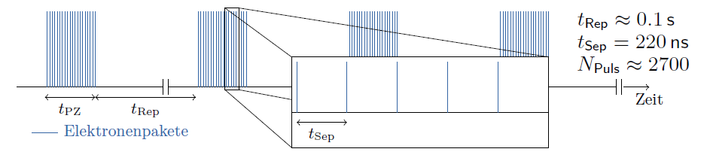
Cavity Based X-ray FELs
The Challenge of Electron-Photon Matching
Burst Mode:
No Steady State
Longitudinal matching: Matching between electron bunch repetition and photon pulse round trip time
  Normal conducting linac: 100 Hz repetition rate ↔ >1E6m optical path length (orbital XFELO?)
  EuXFEL/LCLS-II/Shine: electron bunch repetition rate ~0.1 - 4.5 MHz↔ 66-2800 m optical path length
Transverse matching between electron bunches and photon pulses after at each repetition
  µm -scale electron and photon pulses ← Tens of nrad angular resolution for 100m optical path length

Slide 6
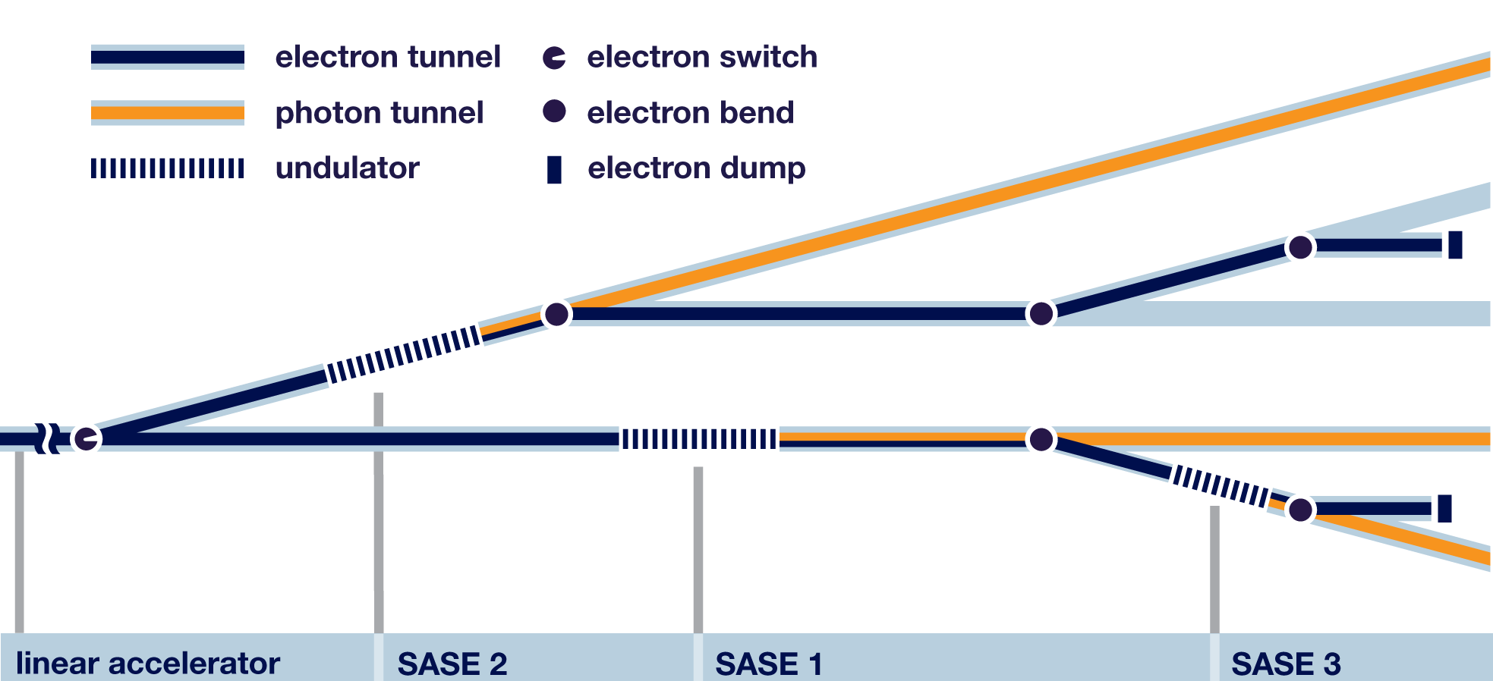
A CBXFEL Demonstrator for the European XFEL
Proof-of-concept experiment at the end of SASE1 tunnel

Slide 7

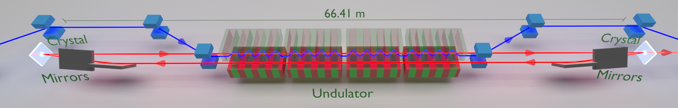
A CBXFEL Demonstrator for the European XFEL
Accelerator
High repetition rate (2.2 MHz)
High energy (14 GeV)
Long. and trans. ultra stable (6 fs, 1 µm)
Radiators
Last 4 SASE Undulators
Aligned to 10 µm
Lasing of a Cavity Based X-ray Source
Patrick Rauer, Immo Bahns, …, Harald Sinn (submitted)
Diagnostics
Spectrometer
Gas Monitor
Diode
Imagers
37 cm
X-Ray Cavity
For demo experiment as simple as possible
Crystal in backscattering geometry (no wavelength tunability ← 7keV)
Mirrors for guidance and focusing
Retro-reflector to reduce sensitivity to angular errors (nrad tolerance)
Return Beam in same vacuum pipe as SASE/electron beam
Length matched to 2.2 MHz and adjustable with sub-µm precision – while keeping nrad angular reproducibility!

Slide 8
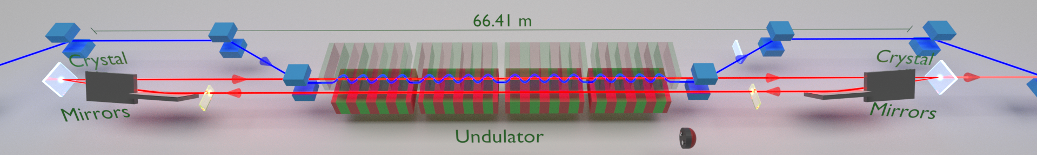
A CBXFEL Demonstrator for the European XFEL
Experimental Realization: Alignment using YAG:Ce
YAG:Ce
YAG:Ce
Step by step tracking through individual components using pre-defined positions on screen.
Transverse scanning of KB apertures to maximize transmission

Slide 9
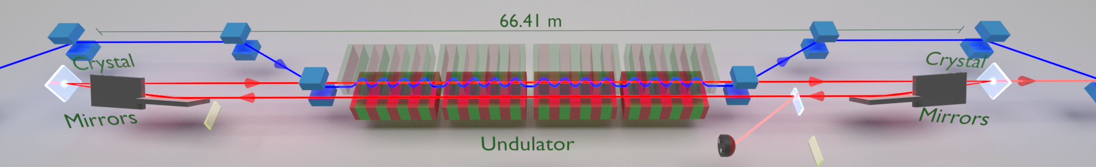
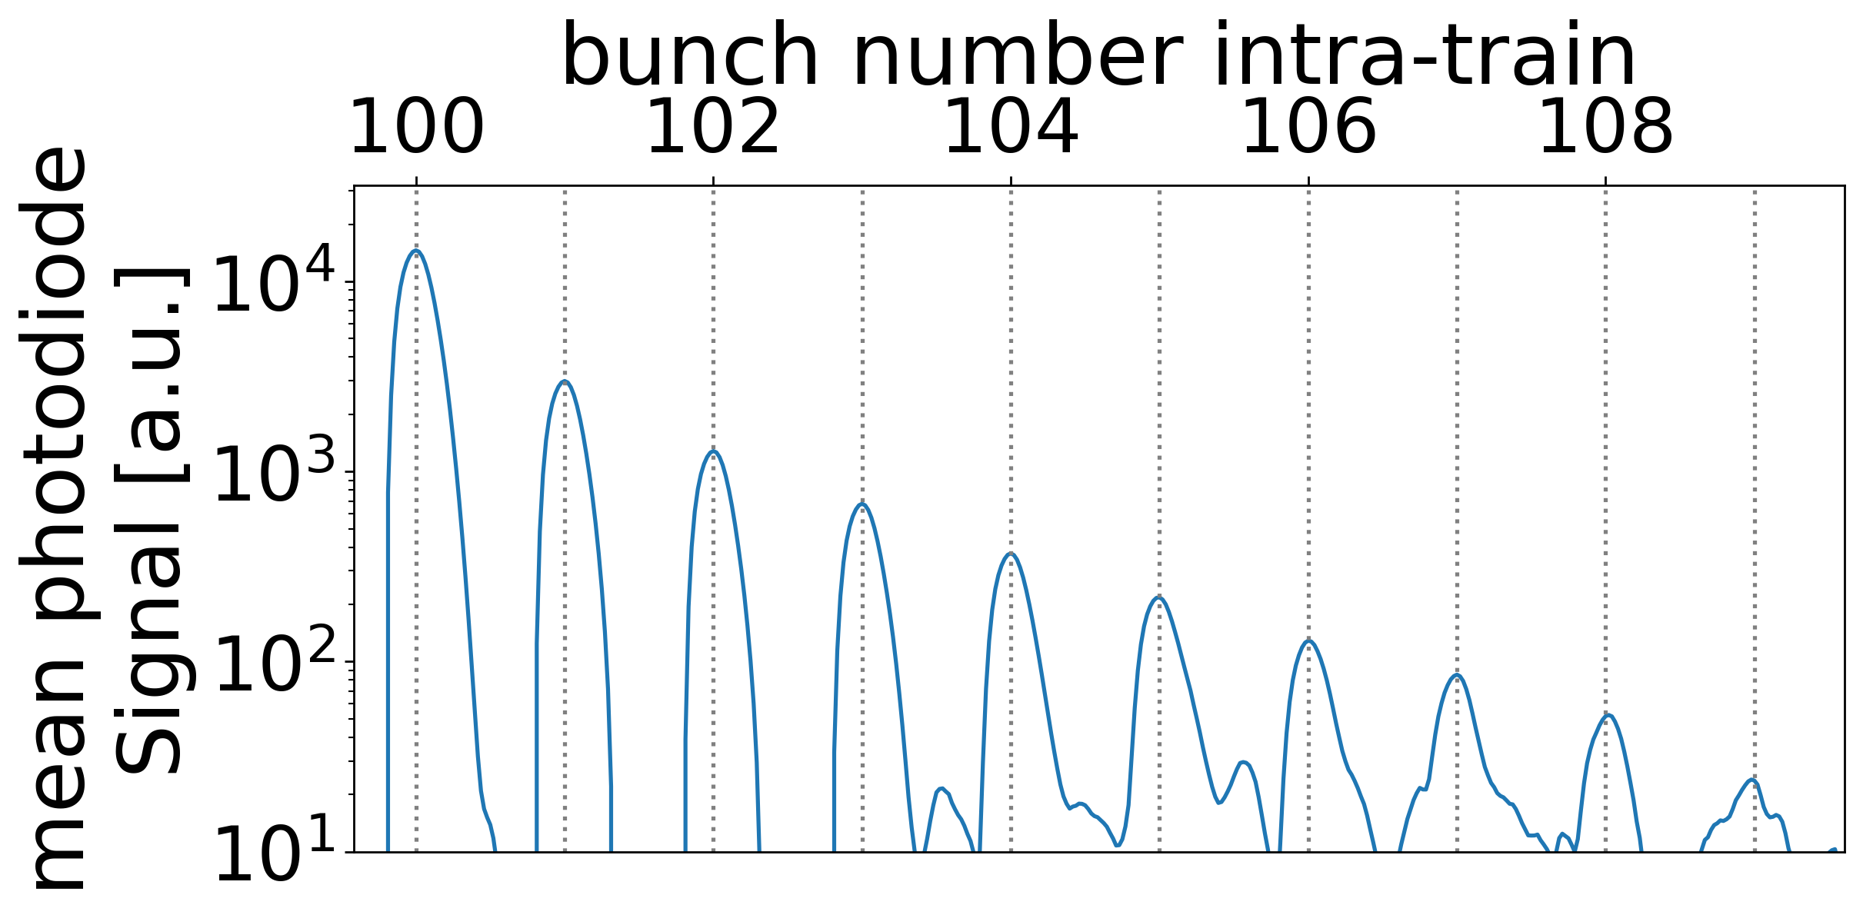
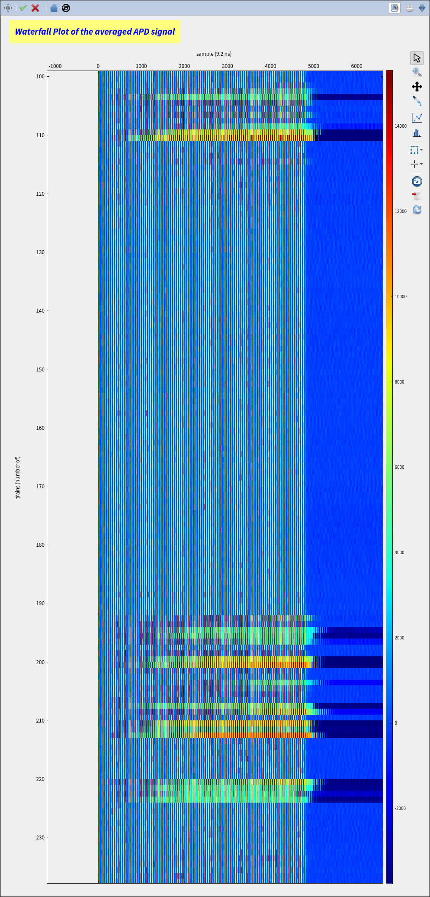
A CBXFEL Demonstrator for the European XFEL
Experimental Realization: Alignment using Intra-Cavity Photodiode
Grating
Photodiode
100 bunches going through cavity |→ ring down (6 cycles after opt.)
Final alignment by maximizing cavity effiency (cold-cavity ringdown):
∆Θ~100 nrad
time
consecutive bursts
Cavity Reflectivity ~ 75%

Slide 10
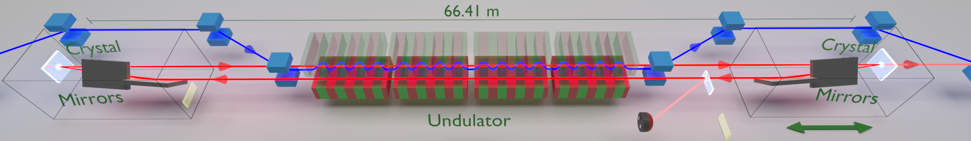
A CBXFEL Demonstrator for the European XFEL
Experimental Realization: Matching Cavity Length
100 bunches going through cavity |→ ring down (6 cycles)
time
consecutive bursts
tuning of cavity length
Saturation of
Diode

Slide 11
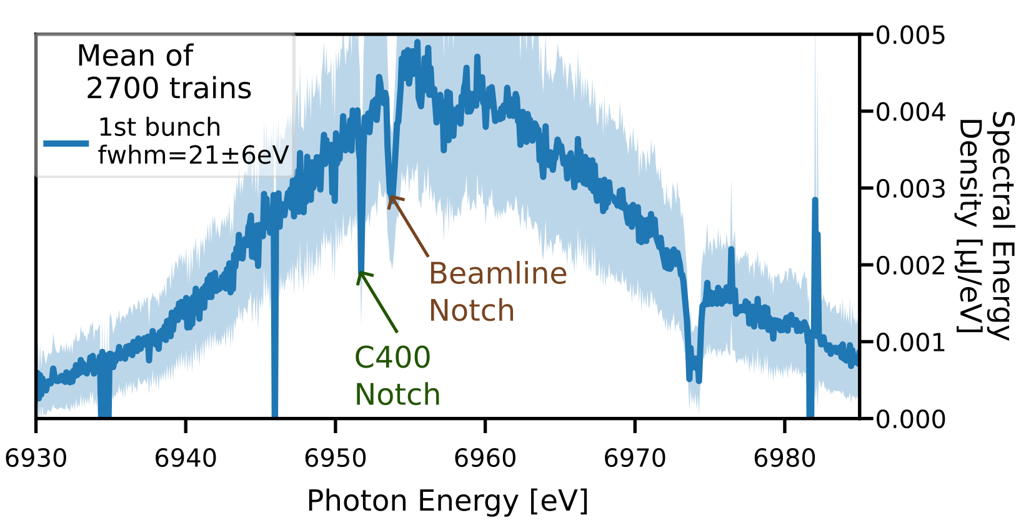
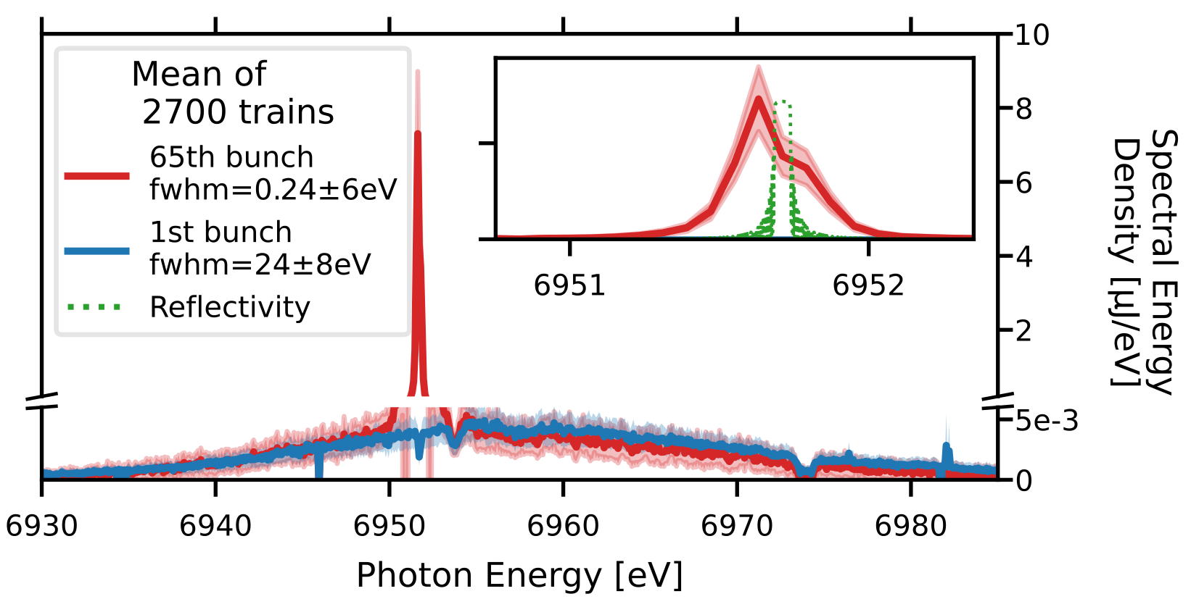
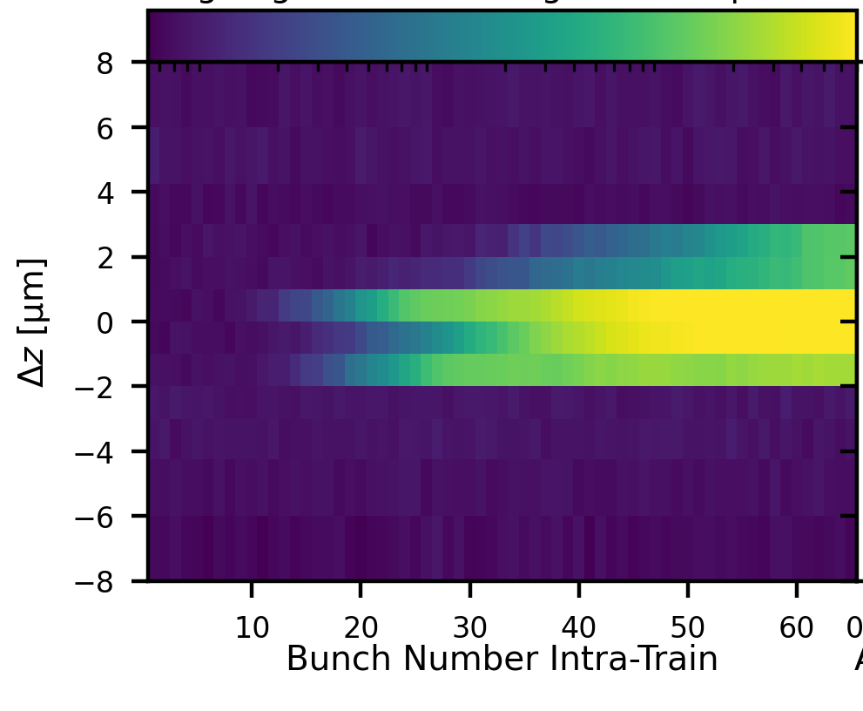
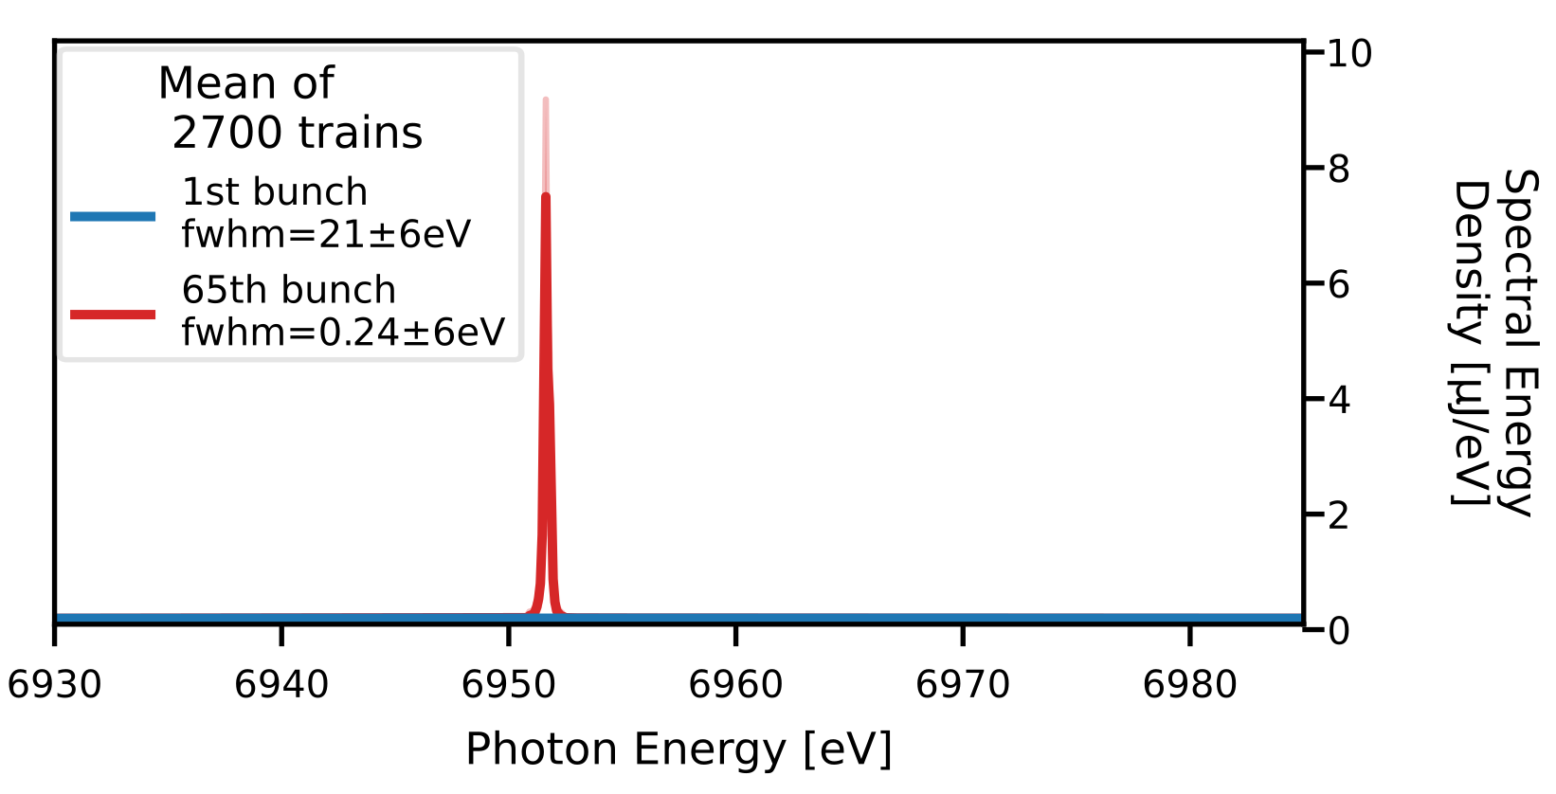
A CBXFEL Demonstrator for the European XFEL
Experimental Realization: Spectrum
Spectrometer

Slide 12
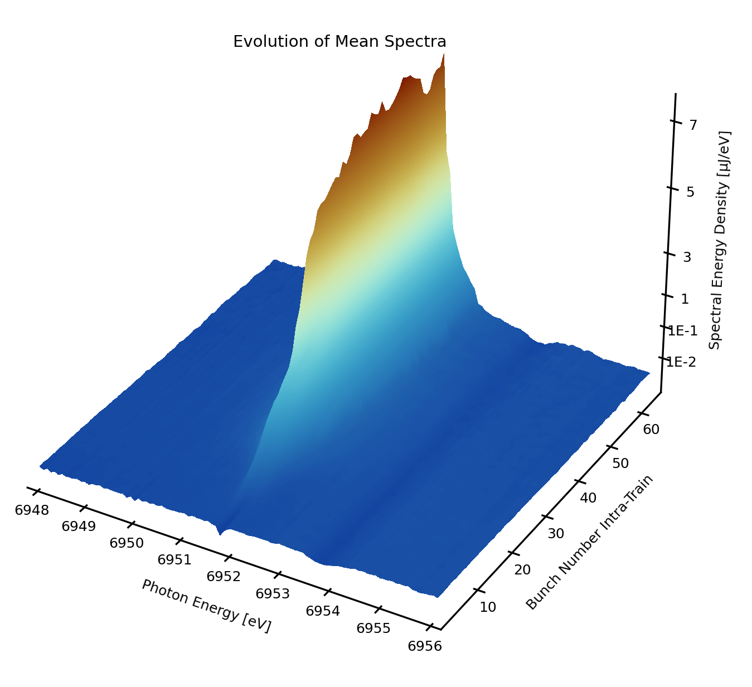
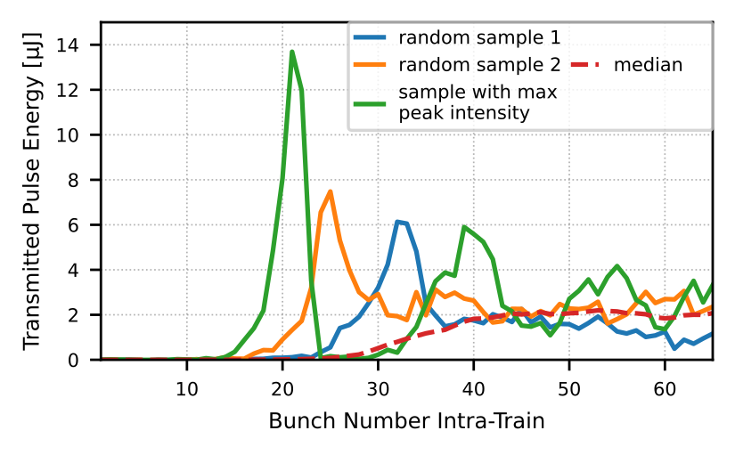
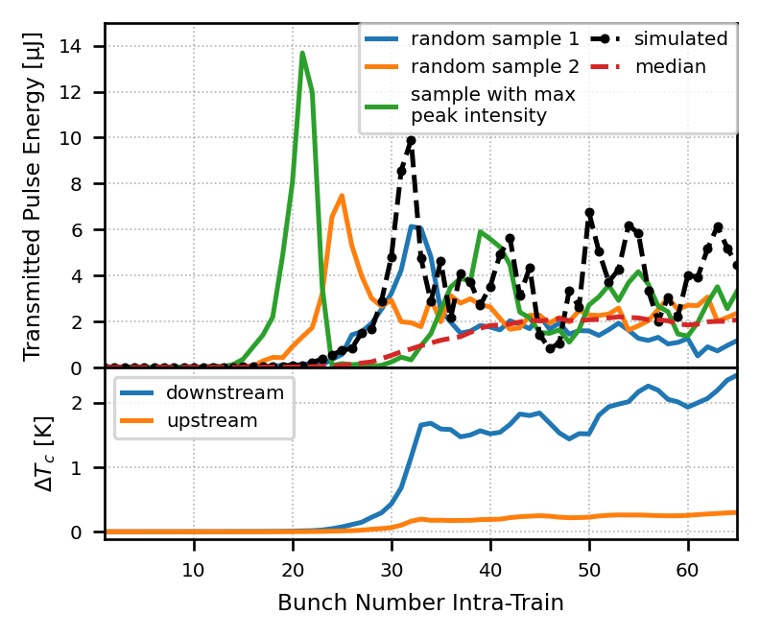
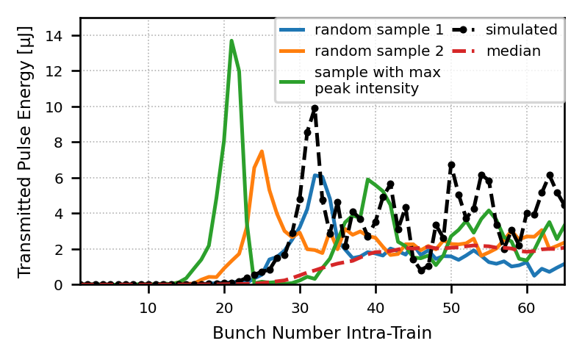
A CBXFEL Demonstrator for the European XFEL
Experimental Realization: Alignment using Intra-Cavity Photodiode
Heat load limits output power

Slide 13
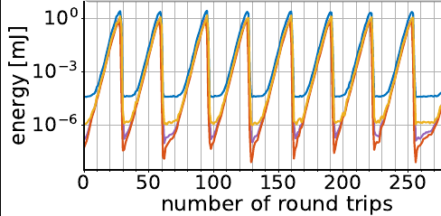
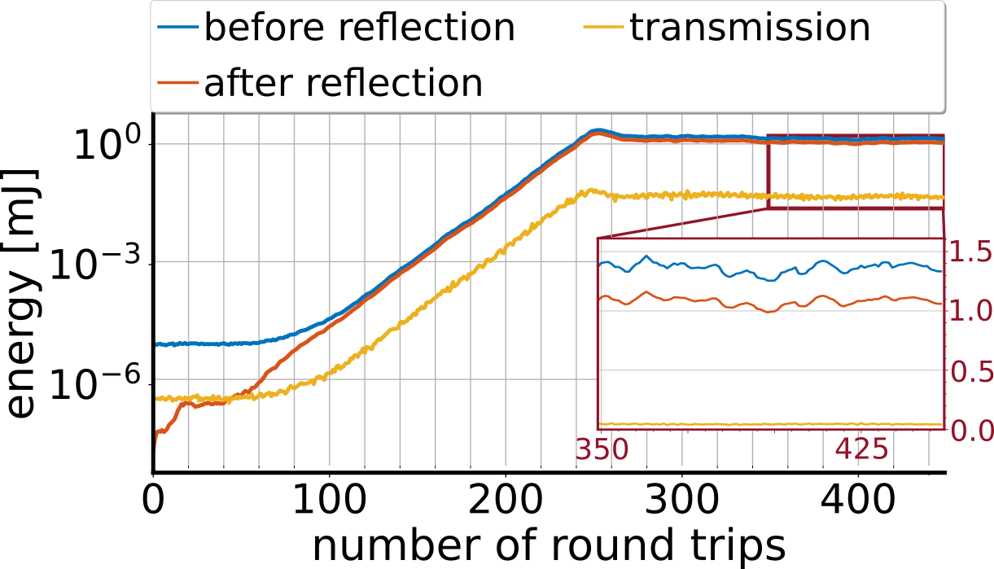


A CBXFEL Demonstrator for the European XFEL
What’s Next?
Reproduce results (should be faster, as we have the longitudinal distance and a proven method)
Better characterize the radiation: Time domain measurement, wavefront characterization, ...
„Cryogenic“ Cooling (~70K)
77K with high gain: 1mJ transmitted
77K with low gain: 100µJ but stable

Slide 14
Thank You!

Slide 15
Backup

Slide 16
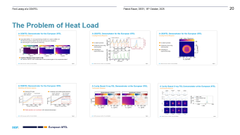
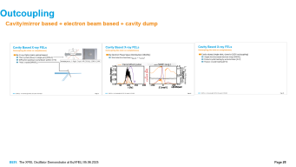
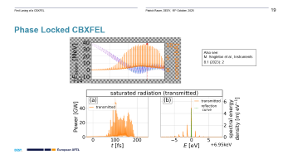
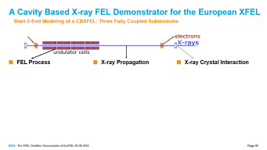
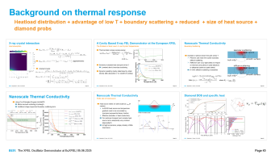
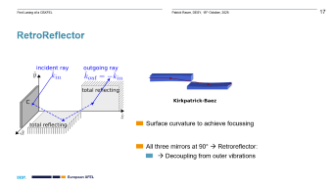
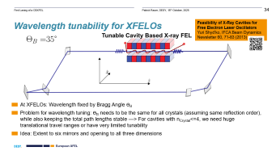
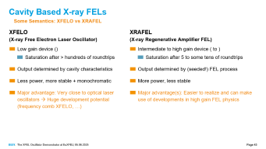




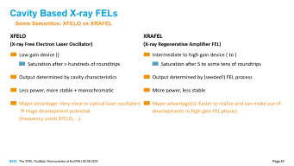

Slide 17
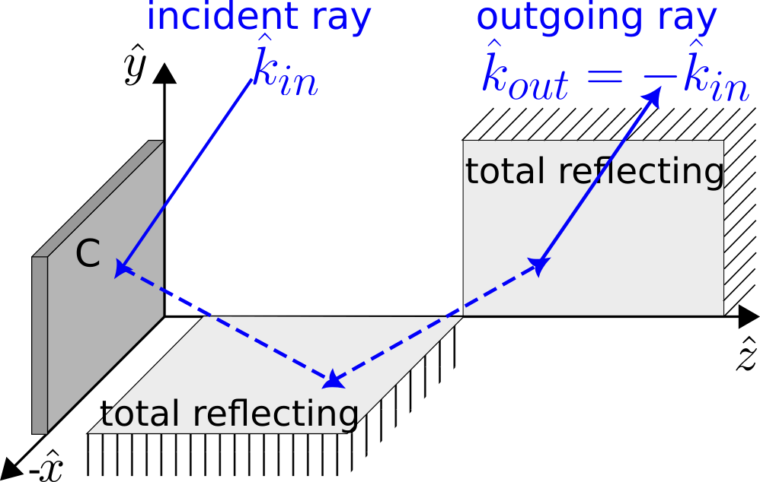
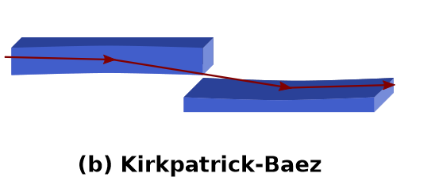
RetroReflector
Surface curvature to achieve focussing
All three mirrors at 90° → Retroreflector:
  → Decoupling from outer vibrations

Slide 18
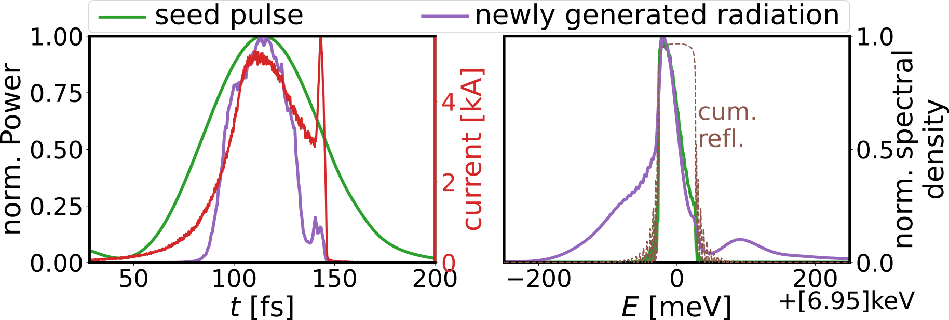
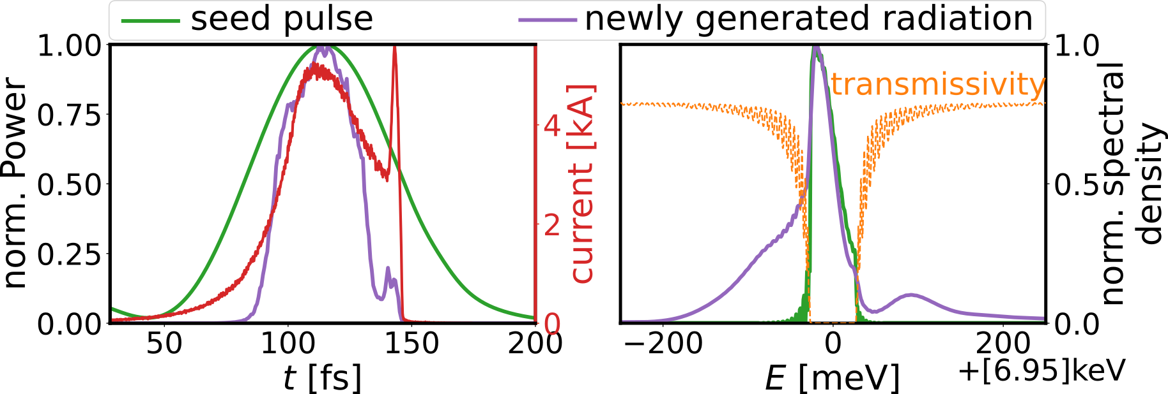
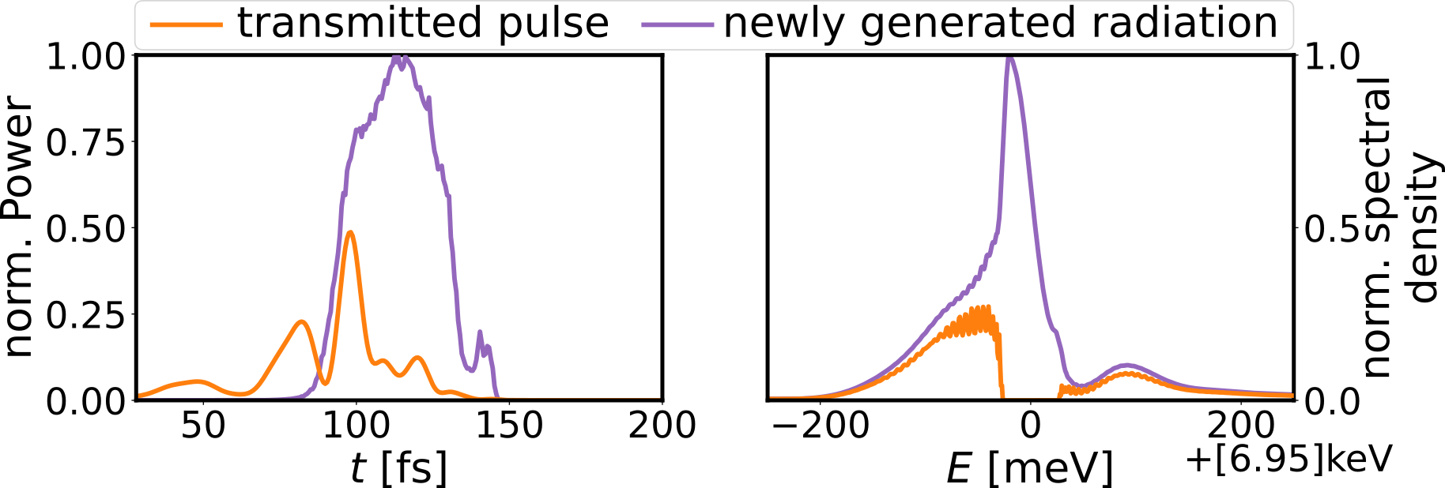
Outcoupling
Using “short” (10fs) electron bunches
  Regular operation mode of EUXFEL

Slide 19
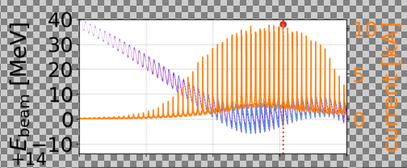
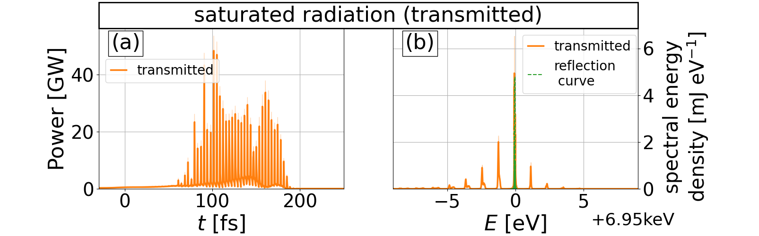
Phase Locked CBXFEL
Also see:
M. Singleton et al., Instruments 8.1 (2023): 2

Slide 20
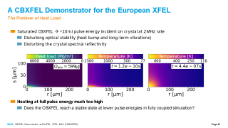
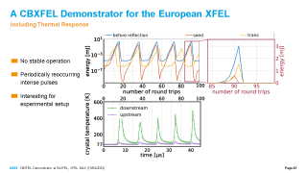
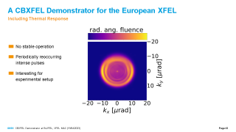
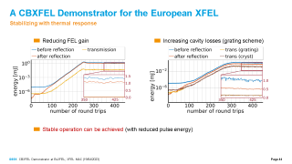
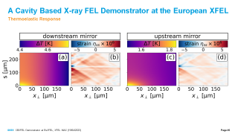
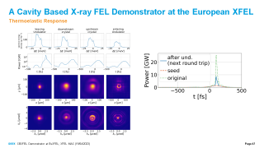
The Problem of Heat Load
The Problem of Heat Load

Slide 21
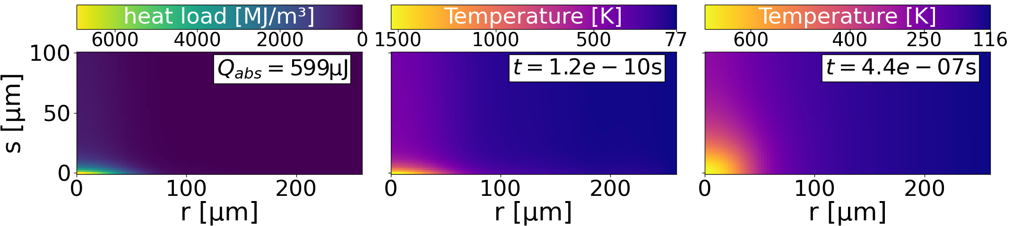
The Problem of Heat Load
Saturated CBXFEL → ~10 mJ pulse energy incident on crystal at 2 MHz rate
  Disturbing optical stability (heat bump and long-term vibrations)
  Disturbing the crystal spectral reflectivity
mJ pulse
Heating at full pulse energy much too high
  Does the CBXFEL reach a stable state at lower pulse energies in fully coupled simulation?

Slide 22
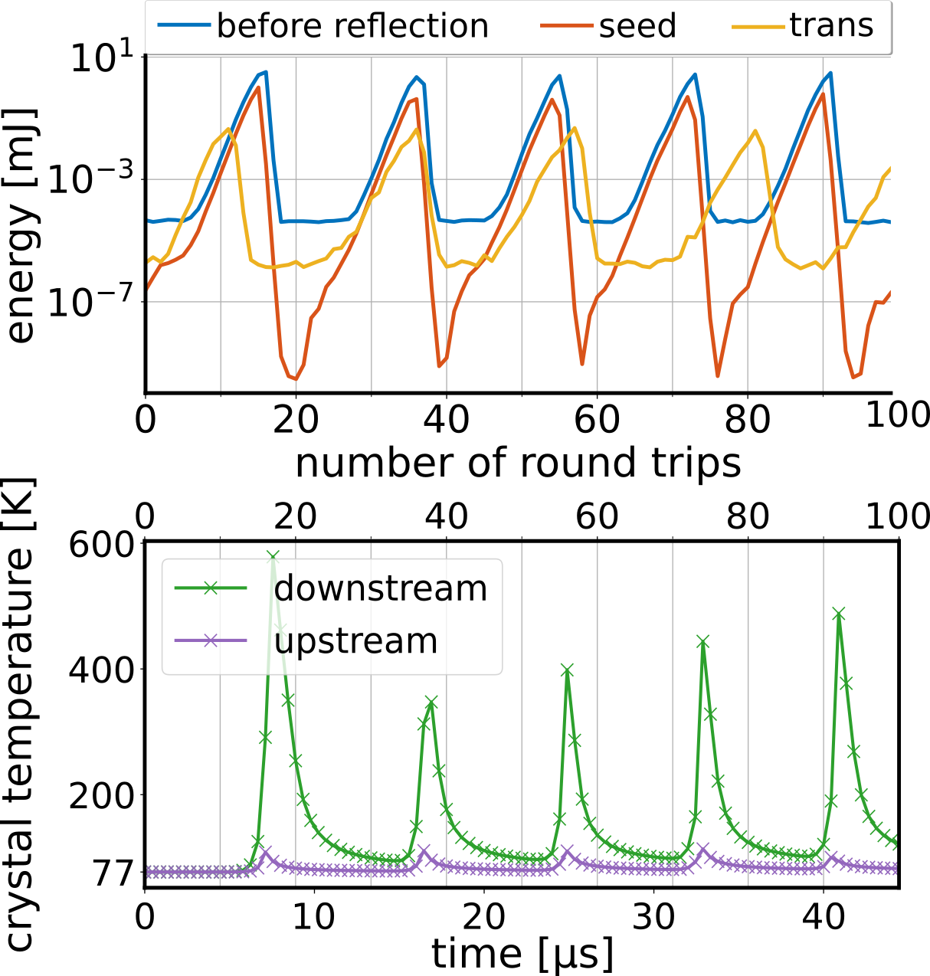
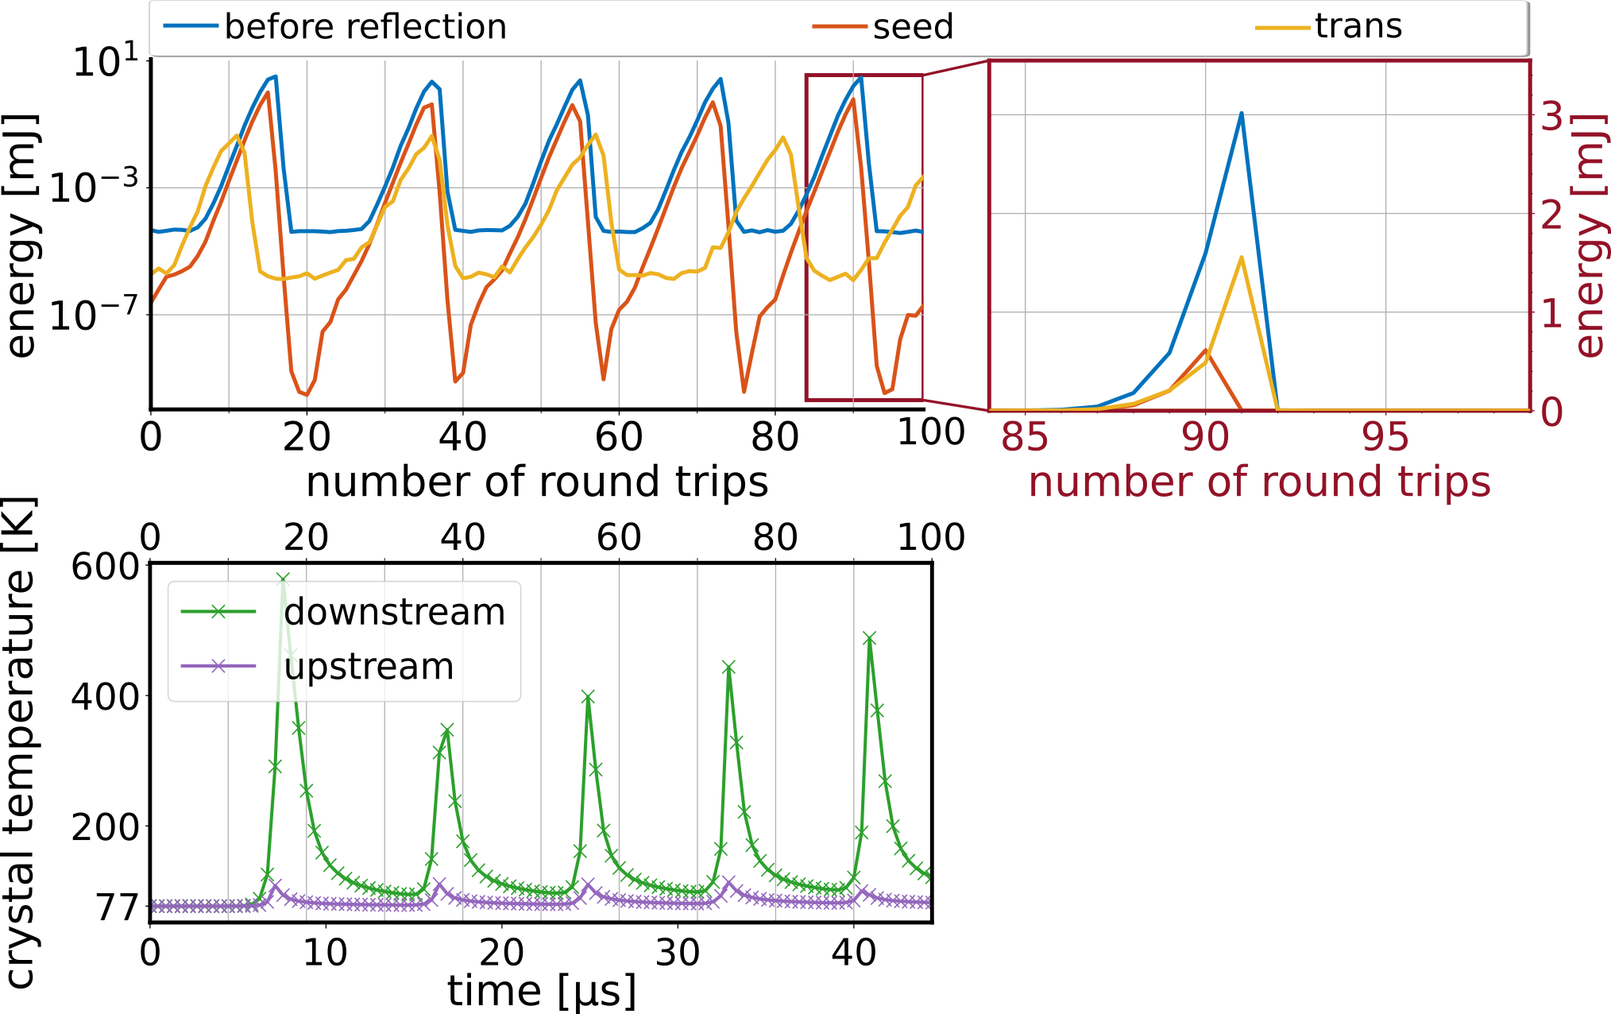
Thermal Response
No stable operation
Periodically reoccurring intense pulses
Interesting for experimental setup

Slide 23
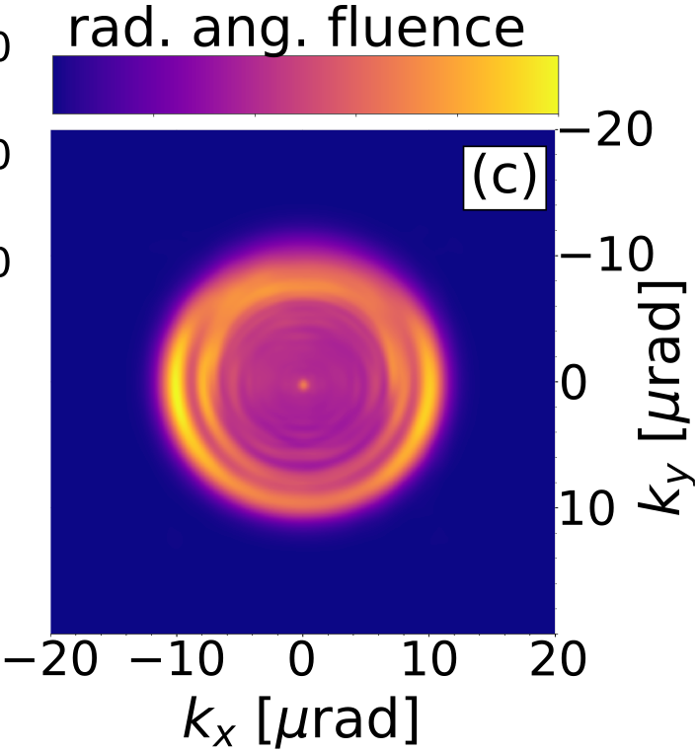
Thermal Response
No stable operation
Periodically reoccurring intense pulses
Interesting for experimental setup

Slide 24

Thermal Response
Reducing FEL gain
Increasing cavity losses (grating scheme)
Simulation results
Transmitted (grating)
Sat. pulse energy | 0.16(1) mJ
Spectral Q density | ~30 µJ/THz
Brilliance | 1.9(2)*10³³
Transmitted (cryst)
Sat. pulse energy | 0.15(2) mJ
Spectral Q density | ~4 µJ/THz
Brilliance | 1.7(4)*10³³
SASE
Sat. pulse energy | ~3 mJ
Spectral Q density | ~0.5 µJ/THz
Brilliance | ~5*10³³
Stable operation can be achieved (with reduced pulse energy)

Slide 25

Thermal Response with Thermoelasticity
Thermoelastic Response

Slide 26

Thermal Response (with thermoelasticity)

Slide 27


Thermal Response with Thermoelasticity

Slide 28



Outcoupling
Cavity/mirror based + electron beam based + cavity dump

Slide 29



Cavity Based X-ray FELs
Outcoupling (No claim on completeness)
By X-ray Optics (akin optical lasers)
  Thin crystals (down to single µm!) [XFELO]
  Diffractive grating | crystal beam splitter [X+X]
  “Holy” crystal [XRAFEL]
Kolodiej et al., J. Appl. Cryst. 49 (2016), 1240–1244

Slide 30


Cavity Based X-ray FELs
Outcoupling (No claim on completeness)
By Electron Phase Space Distribution [XRAFEL]
  Short electron bunches ()

Slide 31


Cavity Based X-ray FELs
Outcoupling (No claim on completeness)
By Electron Phase Space Distribution [XRAFEL]
  Short electron bunches ()
  Use chirped (frequency-shift)/compressed electron beam (increased bandwidth)
Tang et al., PRAB 25 (2022), 08070

Slide 32



Cavity Based X-ray FELs
Outcoupling (No claim on completeness)
By Electron Phase Space Distribution [XRAFEL]
  Short electron bunches ()
  Use chirped/compressed electron beam
  Use microbunch rotation + afterburner
Margraf et al., Proc. of IPAC2020, WEVIR03

Slide 33
Cavity Based X-ray FELs
Outcoupling (No claim on completeness)
Cavity dump (single shot, close to 100% outcoupling)
  Single shot increased electron chirp [XRAFEL]
  Pulsed crystal heating by external laser [X+X]
  Passive crystal heating [X+X]

Slide 34


Wavelength tunability for XFELOs
Yuri Shyd‘ko, Feasibility of X-Ray Cavities for Free Electron Laser Oscillators, ICFA Beam Dynamics Newsletter, vol. 60, 2013.
Feasibility of X-Ray Cavities for Free Electron Laser Oscillators
Yuri Shyd’ko, IFCA Beam Dynamics Newsletter 60, 71-83 (2013)
  At XFELOs: Wavelength fixed by Bragg Angle Ɵ_{B}
  Problem for wavelength tuning: Ɵ_{B} needs to be the same for all crystals (assuming same reflection order), while also keeping the total path lengths stable —> For cavities with n_{Crystal}<=4, we need huge translational travel ranges or have very limited tunability
  Idea: Extent to six mirrors and opening to all three dimensions
Notes:
Ich versichere, dass ich die
Disputation selbstständig ohne die Unterstützung Dritter absolviere und keine unerlaubten
Hilfsmittel verwende. Mir ist bewusst dass, sollte während der Disputation ein
Täuschungsversuch festgestellt werden, die Prüfung sofort abgebrochen und als „nicht
bestanden“ bewertet wird.“

Slide 35



Wavelength tunability for XFELOs
  Six Mirror cavity:
  Crystals C1(')/C3(') in x-z plane, with fixed spaxing H_{x} in x, but same z and y
  Crystal C2(') with tunable offsets H_{y} in y and H_{z} in z and fixed offset H_{x}/2 in x
  Same angle Ɵ_{B} for all crystals if (${R_{x;y}}^{C_{i}}$= rotation around x;y-axis of crystal C_{i}):
  ${R_{x}}^{C_{1;3}}=\tan^{−1}\left(\frac{2\cos{Θ_{B} }}{\sqrt{4\sin^{2}{Θ_{B}}−1}}\right)$, ${R_{x}}^{C_{2}}={−sin}^{−1}\left(\frac{\cos{2Θ_{B} }}{sinΘ_{B}}\right)$, ${R_{y}}^{C_{1}}=\cos^{−1}\left(−0.5\sqrt{4−\frac{1}{\tan^{2}{Θ_{B}}}}\right)$,${{ R}_{y}}^{C_{3}}{{ =−R}_{y}}^{C_{1}}$,${{ R}_{y}}^{C_{2}}=0$
Notes:
Ich versichere, dass ich die
Disputation selbstständig ohne die Unterstützung Dritter absolviere und keine unerlaubten
Hilfsmittel verwende. Mir ist bewusst dass, sollte während der Disputation ein
Täuschungsversuch festgestellt werden, die Prüfung sofort abgebrochen und als „nicht
bestanden“ bewertet wird.“

Slide 36


Wavelength tunability for XFELOs
  Six Mirror cavity:
  When changing Ɵ_{B}, offset H_{y} in y and H_{z} in z for crystal C2 and C2' need to be changed. Also, in order to keep the total cavity length L_{C}, the z-position of all downstream Crystals C₁₋₃ need to be changed by ΔL:
  $H_{y}=H_{x}\sqrt{4\sin^{2}{Θ_{B}}−1}$, $H_{z}=H_{x}\frac{\cos{{2Θ}_{B}}}{\cos{Θ_{B} }}$, $ΔL=−2H_{x}/\cos{Θ_{B} }$
  All offsets scale proportional with H_{x}: The smaller the H_{x}, the smaller the necessary range in other offsets
Notes:
Ich versichere, dass ich die
Disputation selbstständig ohne die Unterstützung Dritter absolviere und keine unerlaubten
Hilfsmittel verwende. Mir ist bewusst dass, sollte während der Disputation ein
Täuschungsversuch festgestellt werden, die Prüfung sofort abgebrochen und als „nicht
bestanden“ bewertet wird.“

Slide 37


Wavelength tunability for XFELOs
  Import note: The angle for ${R_{y}}^{C_{3}}=−{R_{y}}^{C_{1}}$
Notes:
Ich versichere, dass ich die
Disputation selbstständig ohne die Unterstützung Dritter absolviere und keine unerlaubten
Hilfsmittel verwende. Mir ist bewusst dass, sollte während der Disputation ein
Täuschungsversuch festgestellt werden, die Prüfung sofort abgebrochen und als „nicht
bestanden“ bewertet wird.“

Slide 38

CBXFEL – fixed wavelength
If tunability too mechanically demanding
Fixed photon energies [eV] |  | Reflection order
 |  | C<400> | C<111> | C<333> | C<444>
Cavity geometry | 4 mirrors${ (Θ}_{B}=45$°) | 8950 | 4250 | 12770 | 17000
 | 3 mirrors ${ (Θ}_{B}=60$°) | 8027. | 3467 | 10428 | 13900
 | 2 mirrors ${ (Θ}_{B}=90$°) | 6952 | 3010 | 9030 | 12040
 | 6 mirrors ${ (35°<Θ}_{B}=75$°) | 7200-12100 | 3100-5250 | 9350-15745 | 12470-21000

Slide 39

A Cavity Based X-ray FEL Demonstrator for the European XFEL
Start-2-End Modeling of a CBXFEL: Three Fully Coupled Submodules
FEL Process
X-ray Propagation
X-ray Crystal Interaction

Slide 40


A Cavity Based X-ray FEL Demonstrator for the European XFEL
Start-2-End Modeling of a CBXFEL: Four Submodules
Electron Dynamics
  Based on Start-2-End Simulations by I. Zagarodnov et al.
FEL Process
X-ray Propagation
X-ray Crystal Interaction
Simulation parameters
Electron Energy | 16 GeV
Bunch Charge | 250 pC
FODO | 32 m
Igor Zagorodnov et al., Accelerator beam dynamics at the European X-ray Free Electron Laser, PRAB (2019)

Slide 41
A Cavity Based X-ray FEL Demonstrator for the European XFEL
Start-2-End Modeling of a CBXFEL: Three Fully Coupled Submodules (+1)
FEL Process
  Using Genesis-1.3 (V4)
    Well known and benchmarked
    Parallelized and fast
    Many tunable parameters and adjustable errors
X-ray Propagation
  Self-written parallel X-ray Cavity Propagator (pXCP)
    Based on Fourier Optics
    Very fast on (Maxwell) Cluster
    Very versatile (adjustable optics and error sources)
X-ray Crystal Interaction
  X-ray reflection based on (two beam) dynamic diffraction
  Crystal thermal response using COMSOL Multiphysics®

Slide 42
Numerical Framework
Benchmark
Genesis-1.3
  Good agreement with analytic approximation (M.Xie)
pXCP
  Square Beam
  Gaussian Beam approximation
  Ocelot
  Transverse gaussian resonator modes
X-ray diffraction
  Strained crystal with V.A. Bushuev
Thermal Response
  Room temperature analytic response

Slide 43
Cavity Based X-ray FELs
Some Semantics: XFELO vs XRAFEL
XFELO
(X-ray Free Electron Laser Oscillator)
XRAFEL
(X-ray Regenerative Amplifier FEL)
Low gain device ()
  Saturation after > hundreds of roundtrips
Output determined by cavity characteristics
Less power, more stable + monochromatic
Major advantage: Very close to optical laser oscillators → Huge development potential
(frequency comb XFELO, …)
Intermediate to high gain device ( to )
  Saturation after 5 to some tens of roundtrips
Output determined by (seeded!) FEL process
More power, less stable
Major advantage(s): Easier to realize and can make use of developments in high gain FEL physics

Slide 44


X-ray Diffraction
nBeam diffraction

Slide 45






Background on thermal response
Heatload distribution + advantage of low T + boundary scattering + reduced + size of heat source + diamond probs

Slide 46

X-ray crystal interaction
Heat absorption
(approximation)
strained crystal:

Slide 47



A Cavity Based X-ray FEL Demonstrator at the European XFEL
The Problem of Heat Load → Low Crystal Temperatures
Thermal strain versus excess energy:
Severely increased heat transport at low
  Lowered due to boundary scattering
Dynamic elasticity mostly determined by strain directly after absorption (~no benefit of cooling)
small

Slide 48

Nanoscale Thermal Conductivity
Boundary Scattering
Increase of phonon mean free path at low T
  Phonons can reach the crystal boundary without scattering
  Reflection can occur specularly (no impact on thermal conductivity in radial direction) or diffusively (same as point defect)
  A 100% diffusive scattering is assumed

Slide 49
Nanoscale Thermal Conductivity
Using First-Principles Program ALMABTE
  Mode resolved scattering time/length
  Additional shape dependent boundary scattering term

Slide 50

Nanoscale Thermal Conductivity
Using First-Principles Program ALMABTE
  Mode resolved scattering time/length
  Additional shape dependent boundary scattering term

