Slide 1
Coherence Control and Limitations with High-Brightness SASE
Talk presented by Philipp Dijkstal and prepared by Eduard Prat
1st Hard X-ray Self-seeding Workshop
15 October 2025, PAL, Pohang (Korea)

Slide 2
Contents
Introduction
High-brightness SASE
Results at SwissFEL
HB-SASE simulations
Experimental demonstration of HB-SASE (and MC-SASE)
Bonus: mode-locked SASE and fresh-slice multi-stage amplification
Conclusion

Slide 3
Introduction
Many experiments benefit from a high longitudinal coherence and low bandwidth
Ways to improve the longitudinal coherence of SASE-XFELs
(Filter the signal at the user station with monochromator (MC) → significant power loss)
Start the FEL process with a seed:
Seed power needs to be higher than shot noise power (~kW)
Seed can be an external laser (external seeding) or a monochromatized SASE radiation (self-seeding)
Increase the SASE cooperation length
Use delays: reduce bandwidth with high-brightness SASE (HB-SASE) or produce frequency combs with mode-coupled (ML) or mode-locked (ML) SASE. THIS TALK!
Use subharmonic lasing
Short pulses with a single spike (fully coherent but bandwidth not improved)
XFEL oscillator

Slide 4
Contents
Introduction
High-brightness SASE
Results at SwissFEL
HB-SASE simulations
Experimental demonstration of HB-SASE (and MC-SASE)
Bonus: mode-locked SASE and fresh-slice multi-stage amplification
Conclusion

Slide 5
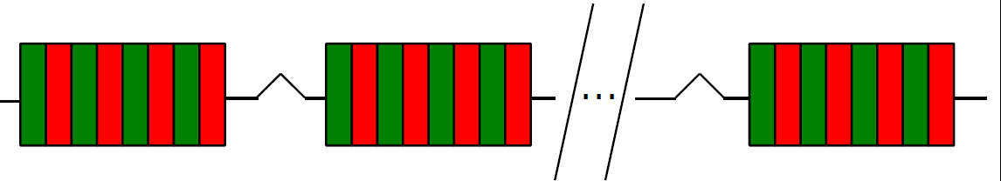
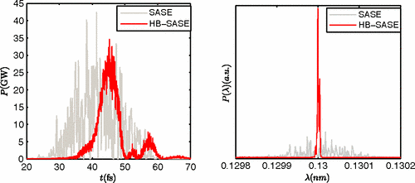
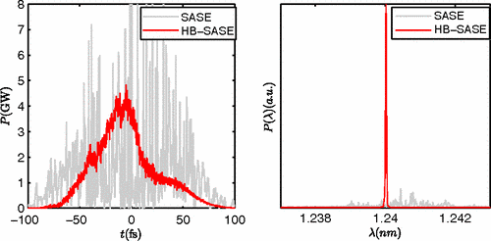
High-brightness (HB) SASE
[B. W. J. McNeil et al, PRL 110, 134802 (2013)]
Enhance coherence length due to delay of magnetic chicanes placed between every two undulator modules
Delay
FEL interaction
Field
Bunching
etc
It can achieve close to Fourier-limited pulses with BW reduced by two orders of magnitude
It works for any repetition rate and wavelength
Compact (only one stage)
Does not require external laser or monochromator
Requires isochronous chicanes (for best performance) and short undulator modules (module length must be shorter or comparable to gain length)
Electron beam energy jitter translates to photon energy jitter (but not to intensity jitter), as in normal operation
Simulations (McNeil et al)
5
PSI Center for Accelerator Science and Engineering
15 Oct 2025

Slide 6
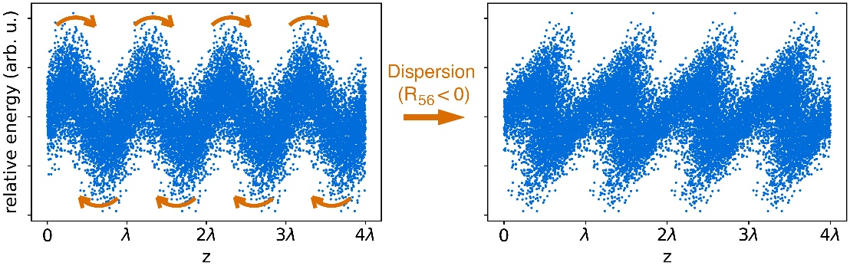

HB-SASE with dispersive chicanes
R56 is about twice the delay in a dispersive chicane
In original delay sequence (increase delays) → overbunching
Better to invert sequence (reduced delays) → avoids overbunching and reduces saturation length thanks to optical klystron (OK) effect
Energy spread needs to be small to avoid Landau damping
Coherence / BW improvement limited to a factor of 10
OK effect schematic
$$R_{56}^{∗}=\frac{λ}{2πσ_{δ}}$$
Delay
FEL interaction
Field
etc
Bunching
6
PSI Center for Accelerator Science and Engineering
15 Oct 2025

Slide 7
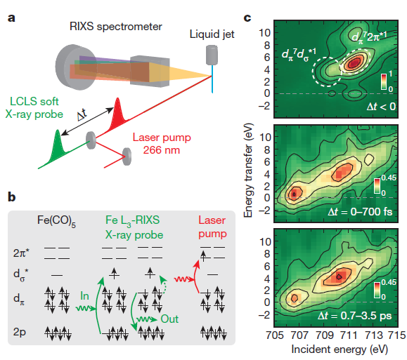
Possible applications
Time-resolved RIXS example
Similar to self-seeding: well-defined spectrum (no need for monochromators).
Potentially helpful to applications requiring a large number of photons at a certain frequency.
Examples: diffraction, frequency domain spectroscopy such as resonant inelastic X-ray scattering (RIXS).
Ph. Wernet, et al. Nature 520, 78-81 (2015).

Slide 8
Chicanes isochronicity
Simulation studies for X-ray FELs show that a deviation from non-isochronicity by <<10% of the R56 of a standard dispersive chicane does not affect the results. [B. W. J. McNeil et al, PRL 110, 134802 (2013)]
Challenge: how to make compact (quasi) isochronous chicanes?
Proposal: [N. Thompson, FEL19, THP033]
2 options for quasi-isochronous chicanes (4 and 3 quads)
Up to 2.5 um delay (for 6 GeV e- beam energy)
Length: 3-4 meters (with Halbach quads with ~400 T/m)
Quadrupole field does not depend on delay
2nd order dispersion similar as dispersive chicane
Transverse focusing not included yet (expect to increase length to ~5 m or more)
Compact isochronous chicanes with the flexibility needed for HB-SASE have technical challenges which difficult their practical implementation

Slide 9
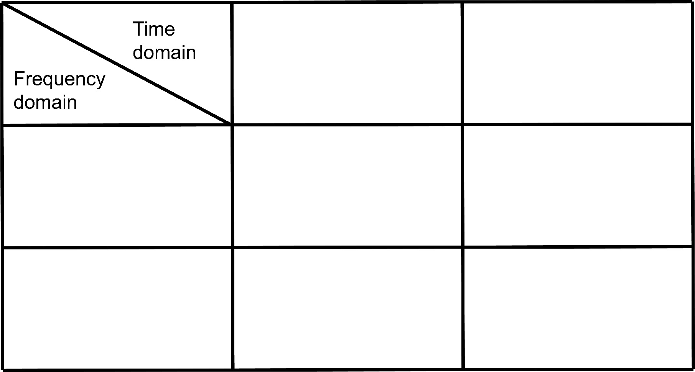
Chicanes enable mode-coupled and mode-locked SASE
Uncontrolled
Controlled, via seed laser
Standard (self-amplified spontaneous emission) SASE: FEL process starts from beam intrinsic noise.
External seeding: periodic beam energy (or density) modulation regulates the output.
Chicanes in between undulator modules: improves longitudinal coherence by delaying the electrons.
Uncontrolled
Standard SASE
(SASE)
Enhanced SASE
(ESASE)*
Controlled, via chicanes
Mode-coupled SASE
(MC-SASE)**
Mode-locked SASE
(ML-SASE)**
*A. A. Zholents, Phys. Rev. ST Accel. Beams, 8:040701 (2005).
**N. R. Thompson and B. W. J. McNeil, Phys. Rev. Lett., 100:203901 (2008).

Slide 10
Chicanes enable fresh-slice multi-stage amplification schemes
A short FEL pulse can be shifted/delayed to fresh electrons for “superradiant” amplification
How to provide fresh electrons: by shaping the electron beam, e.g., uneven current spike separation or tilted beam
Tilted beam: the fresh bunch slices are derived from a realignment of a tilted beam
Delay + Alignment
Betatron
oscillation
First demonstrated at LCLS with tilted beam and 3 stages of amplification [A Lutman et al, PRL 120, 264801, 2018] (few hundreds of µJ and few fs at ~600 eV)

Slide 11
Contents
Introduction
High-brightness SASE
Results at SwissFEL
HB-SASE simulations
Experimental demonstration of HB-SASE (and MC-SASE)
Bonus: mode-locked SASE and fresh-slice multi-stage amplification
Conclusion

Slide 12
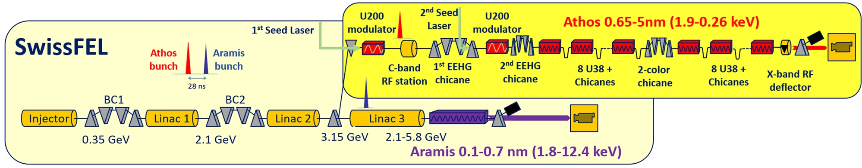
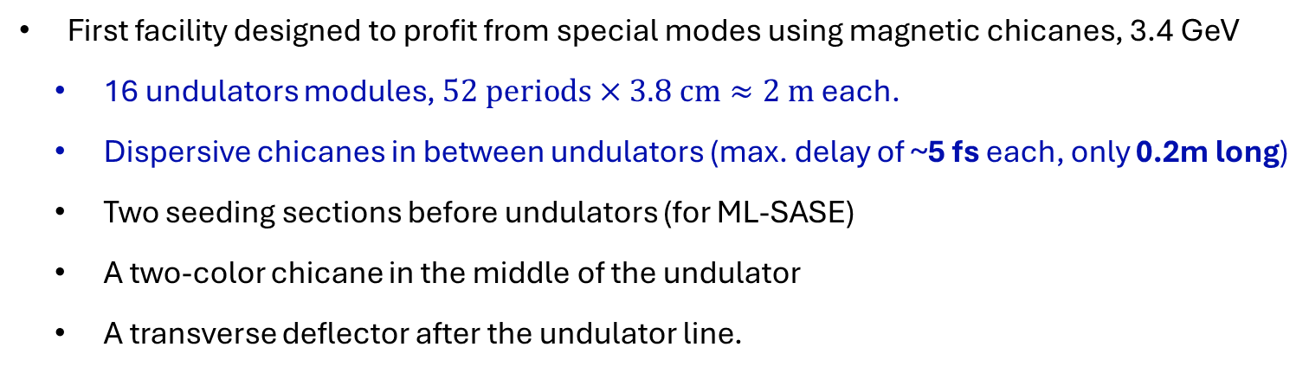
Athos, the soft X-ray beamline of SwissFEL
First facility designed to profit from special modes using magnetic chicanes, 3.4 GeV
16 undulators modules, $52 periods×3.8 cm≈2 m$ each.
Dispersive chicanes in between undulators (max. delay of ~5 fs each, only 0.2m long)
Two seeding sections before undulators (for ML-SASE)
A two-color chicane in the middle of the undulator
A transverse deflector after the undulator line.
Demonstration for MC-SASE and HB-SASE done simultaneously (same setup, just different chicane delays)

Slide 13
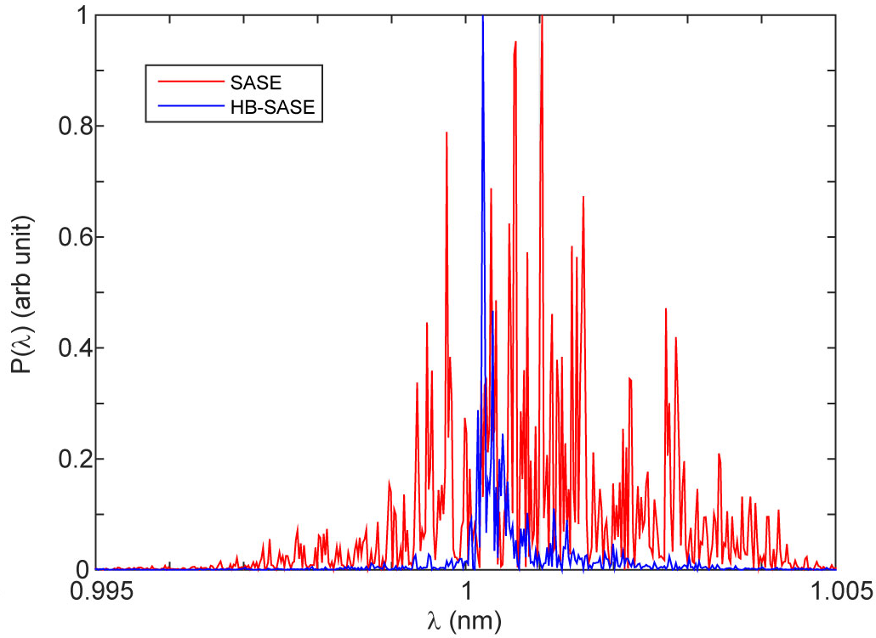
Athos simulations: module length dependence
Simulation results (average over 10 seeds)
Simulations for 1 nm
E- beam: 200 pC, 2kA, 3 GeV, 350 keV, 300 nm emittance
Planar undulator configuration, beta-function as low as possible for each case
Module lengths (L): 1, 1.5, 2, 3 and 4 m
Per each case we simulated different delay/R₅₆ configurations
Module length | FWHM Bandwidth x10⁻⁴
L=1m | 1.6±1.5
L=1.5m | 2.1±1.2
L=2m | 2.4±1.5
L=3m | 7.0±4.2
L=4m | 16.0±6.9
L=2m (SASE) | 19.4±10.3
Single shot spectrum for L=1.5 m
Results: For L≤ 2 m the bandwidth gets reduced by about an order of magnitude
Final decision (also based on other modes and costs): L=2m
[E. Prat et al, JSR 23, 861 (2016)]
13
PSI Center for Accelerator Science and Engineering
15 Oct 2025

Slide 14
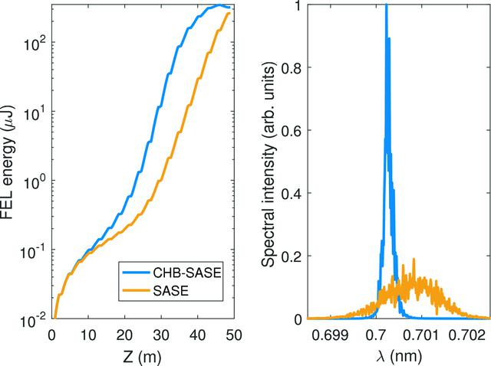
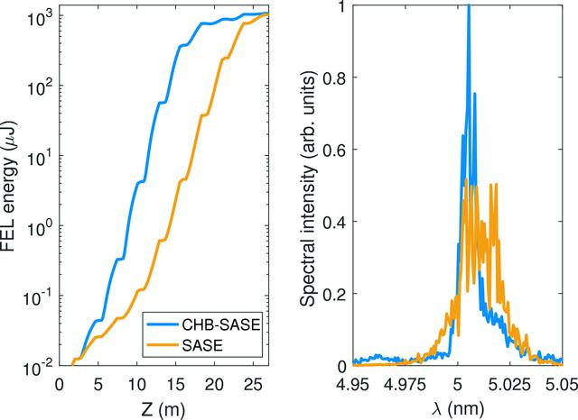
Athos simulations: different wavelengths
E- beam: 200 pC, 2kA, 3.4 GeV, 500 keV, 400 nm emittance
Planar undulator configuration, beta-function = 10 m
Results:
BW improved by a factor of ~10 (0.7 and 1 nm), ~5 (3 nm) and ~3 (5 nm)
(Worse performance at long wavelengths due to better FEL gain)
Saturation length improved by 20% (0.7 and 1 nm) and 25 % (3 and 5 nm)
 | SASE | CHB-SASE
0.7 nm (~1.8 keV)
BW | 16.9 × 10⁻⁴ | 1.9 × 10⁻⁴
Lsat (m) | 47.3 | 39.3
1 nm (~1.2 keV)
BW | 21.0 × 10⁻⁴ | 2.3 × 10⁻⁴
Lsat (m) | 36.4 | 28.1
3 nm (~410 eV)
BW | 34.9 × 10⁻⁴ | 6.4 × 10⁻⁴
Lsat (m) | 26.3 | 19.1
5 nm (~250 eV)
BW | 37.0 × 10⁻⁴ | 13.5 × 10⁻⁴
Lsat (m) | 23.0 | 17.2
Gain curve and average spectral profile at saturation for 0.7 and 5 nm
[E. Prat and S. Reiche, JSR 26, 1085 (2019)]
14
CHB-SASE: compact HB-SASE
PSI Center for Accelerator Science and Engineering
15 Oct 2025

Slide 15

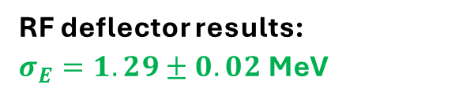
Experimental demonstration in Athos: difficulties
e- beam quality generally too good in standard operation (helical undulators, slice emittance ~200nm, β-function 5 m) → gain length is too short
Large intrinsic energy spread >1 MeV for ~3 kA
$$σ_{E,m}^{2}=σ_{E}^{2}+σ_{E,T}^{2}=σ_{E}^{2}+{(ekVσ_{T})}^{2}$$
RF deflector results:
$σ_{E}=1.29±0.02$MeV
Optical klystron gives $1.2±0.1$MeV
[E. Prat et al, PRAB 27, 030701, 2024]

Slide 16
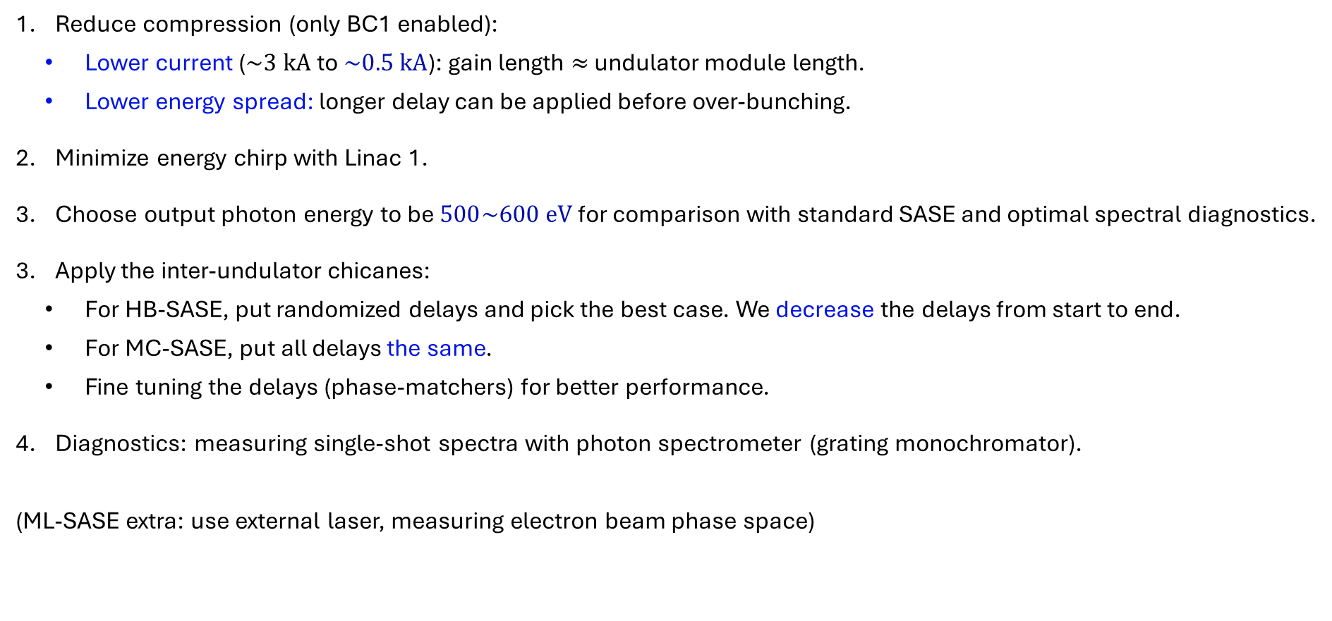
Experimental demonstration in Athos: setup
Reduce compression (only BC1 enabled):
Lower current ($\sim 3 kA$ to $\sim 0.5 kA$): gain length $≈$ undulator module length.
Lower energy spread: longer delay can be applied before over-bunching.
Minimize energy chirp with Linac 1.
Choose output photon energy to be $500\sim 600 eV$ for comparison with standard SASE and optimal spectral diagnostics.
Apply the inter-undulator chicanes:
For HB-SASE, put randomized delays and pick the best case. We decrease the delays from start to end.
For MC-SASE, put all delays the same.
Fine tuning the delays (phase-matchers) for better performance.
Diagnostics: measuring single-shot spectra with photon spectrometer (grating monochromator).
(ML-SASE extra: use external laser, measuring electron beam phase space)

Slide 17
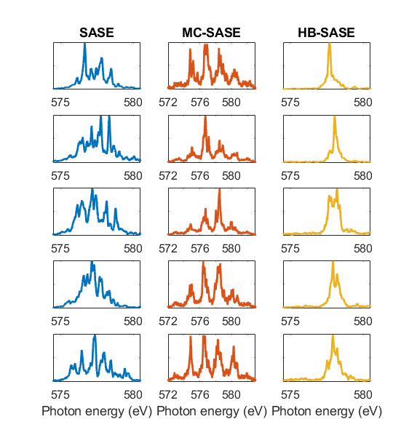
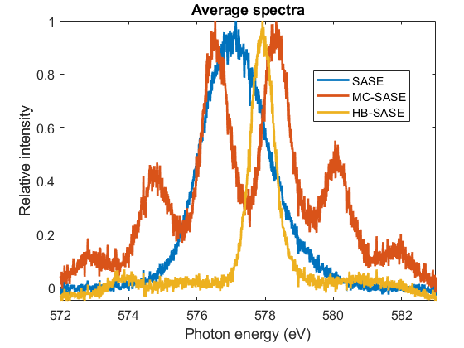
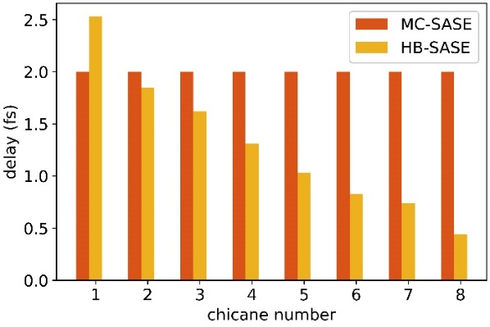
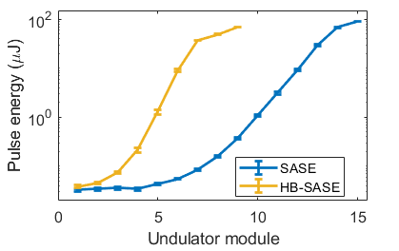
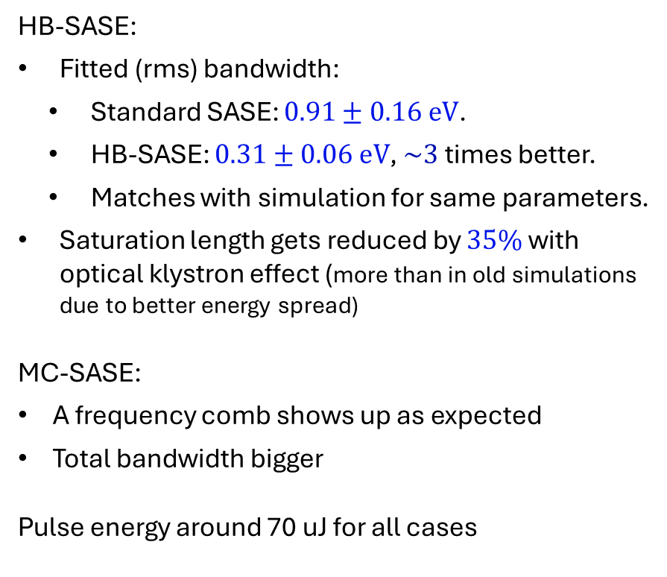
Experimental demonstration in Athos: results
HB-SASE:
Fitted (rms) bandwidth:
Standard SASE: $0.91±0.16 eV$.
HB-SASE: $0.31±0.06 eV$, $\sim 3$ times better.
Matches with simulation for same parameters.
Saturation length gets reduced by $35\%$ with optical klystron effect (more than in old simulations due to better energy spread)
MC-SASE:
A frequency comb shows up as expected
Total bandwidth bigger
Pulse energy around 70 uJ for all cases
Measured spectra
Applied delays
Gain curve
[E. Prat et al., Phys. Rev. Lett., 133, 205001, 2024]

Slide 18
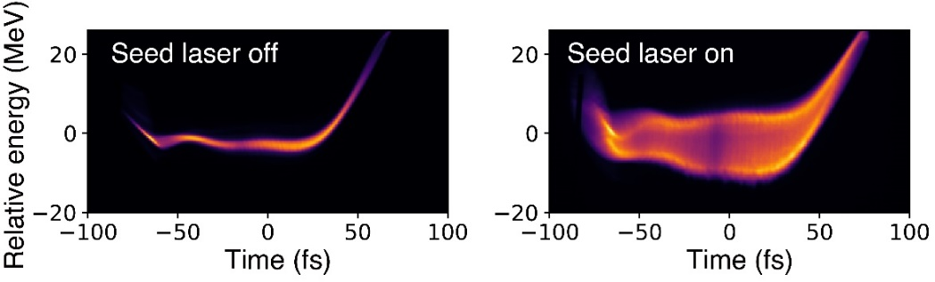
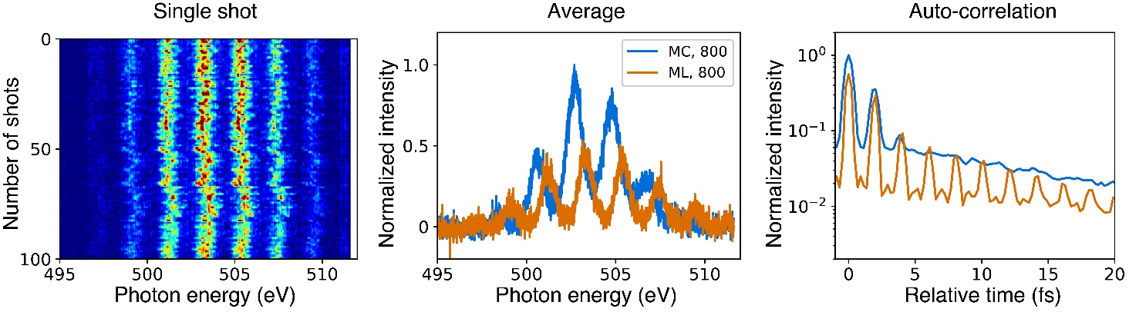
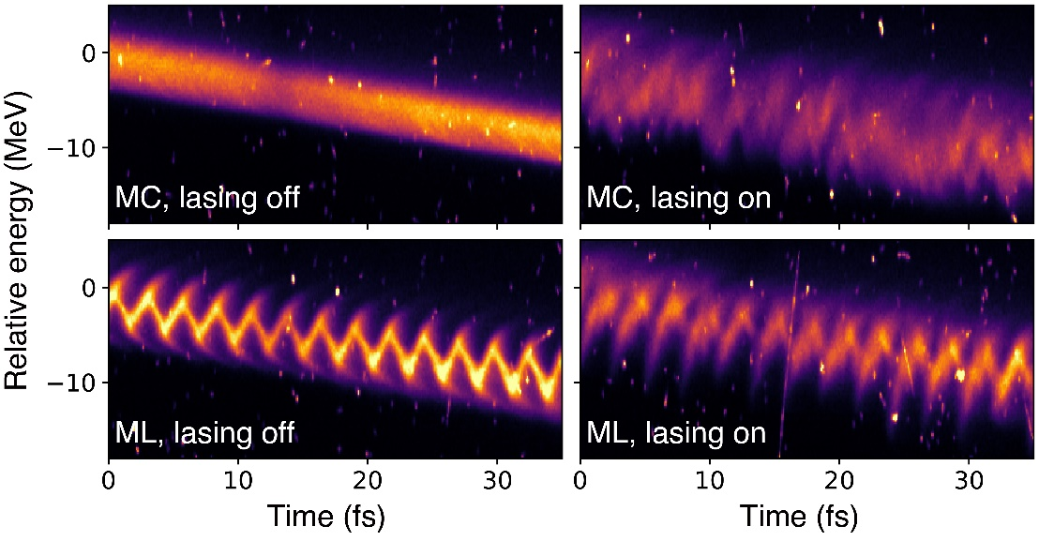
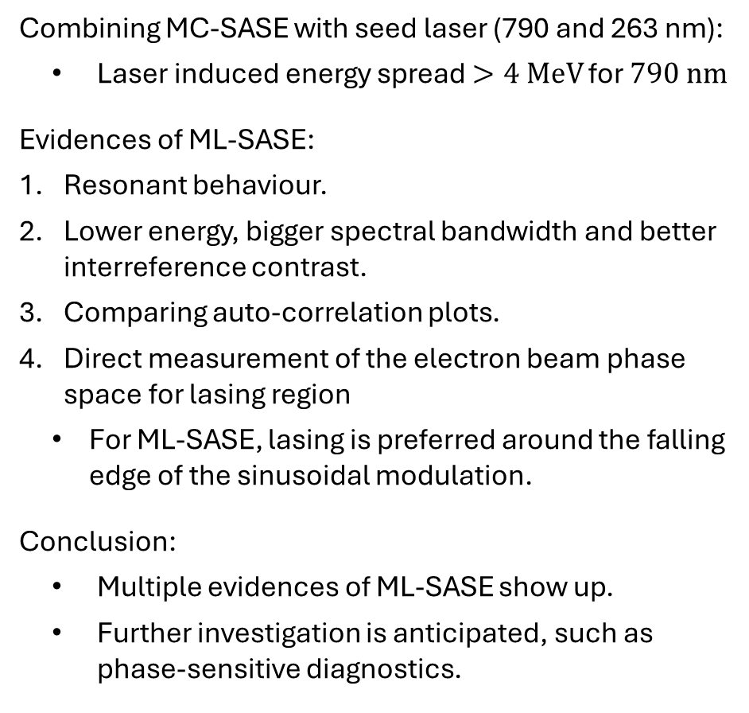
Bonus: demonstration of ML-SASE
Phase space for 800 nm seed laser
Combining MC-SASE with seed laser (790 and 263 nm):
Laser induced energy spread $>4 MeV$ for $790 nm$
Evidences of ML-SASE:
Resonant behaviour.
Lower energy, bigger spectral bandwidth and better interreference contrast.
Comparing auto-correlation plots.
Direct measurement of the electron beam phase space for lasing region
For ML-SASE, lasing is preferred around the falling edge of the sinusoidal modulation.
Conclusion:
Multiple evidences of ML-SASE show up.
Further investigation is anticipated, such as phase-sensitive diagnostics.
Spectral analysis
High-resolution phase space measurements

Slide 19
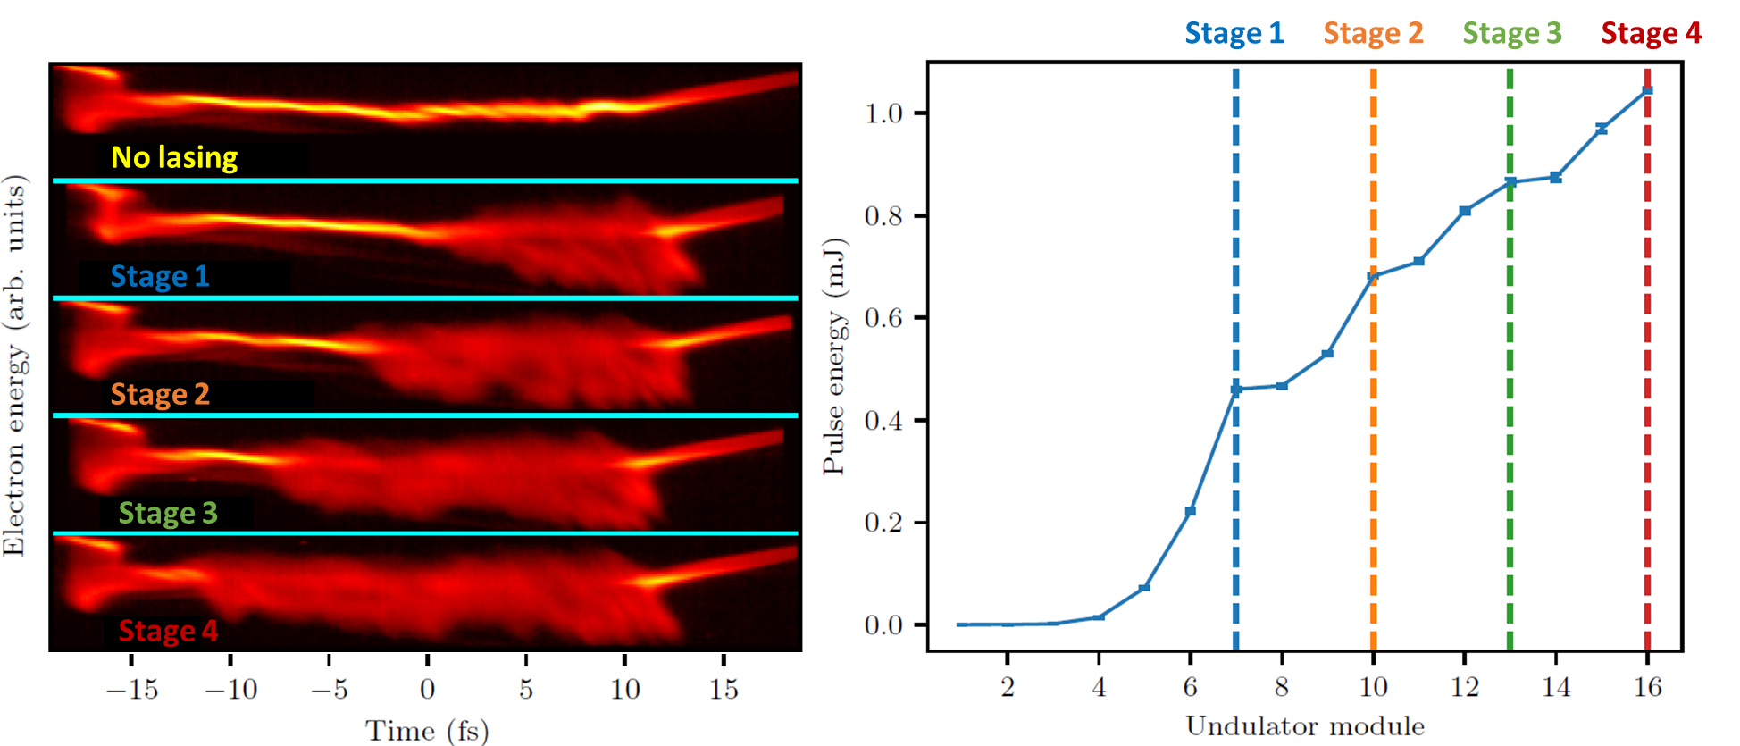
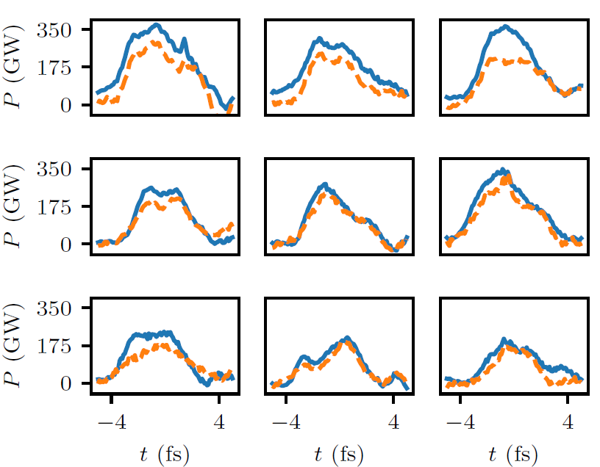
Bonus: demonstration of multi-stage amplification scheme
520 eV (shown here) : 4 stages, 1.05 mJ, 2-3 fs rms
1 keV: 3 stages, 0.84 mJ, ~2 fs rms
[G. Wang et al, PRL 132, 035002 (2024)]
Time-resolved measurements
FEL Pulse Energy along Undulator
FEL Pulse Reconstruction

Slide 20
Contents
Introduction
High-brightness SASE
Results at SwissFEL
HB-SASE simulations
Experimental demonstration of HB-SASE (and MC-SASE)
Bonus: mode-locked SASE and fresh-slice multi-stage amplification
Conclusion

Slide 21
Conclusion
HB-SASE pros :
Works for any repetition rate and wavelength
Compact (only one section) and cost efficient
Does not require any laser (external seeding) or MC (self seeding)
Potentially as good as self seeding (with isochronous chicanes)
Shared hardware with MC/ML-SASE and multi-stage amplification
Reduction of saturation length via OK for dispersive chicanes
HB-SASE limitations:
Requires isochronous chicanes
Bandwidth improvement limited to about a factor of 10 for standard dispersive chicanes
Requires small energy spread
Requires short modules
Demonstration at Athos:
Limited by energy spread and beam quality
BW improved a factor of 3
Outlook:
Compact isochronous chicanes
e- beams with low energy spread
Other ideas:
Use HB-SASE in first section of self-seeding?
Combine MC/ML-SASE concepts with self-seeding?

Slide 22
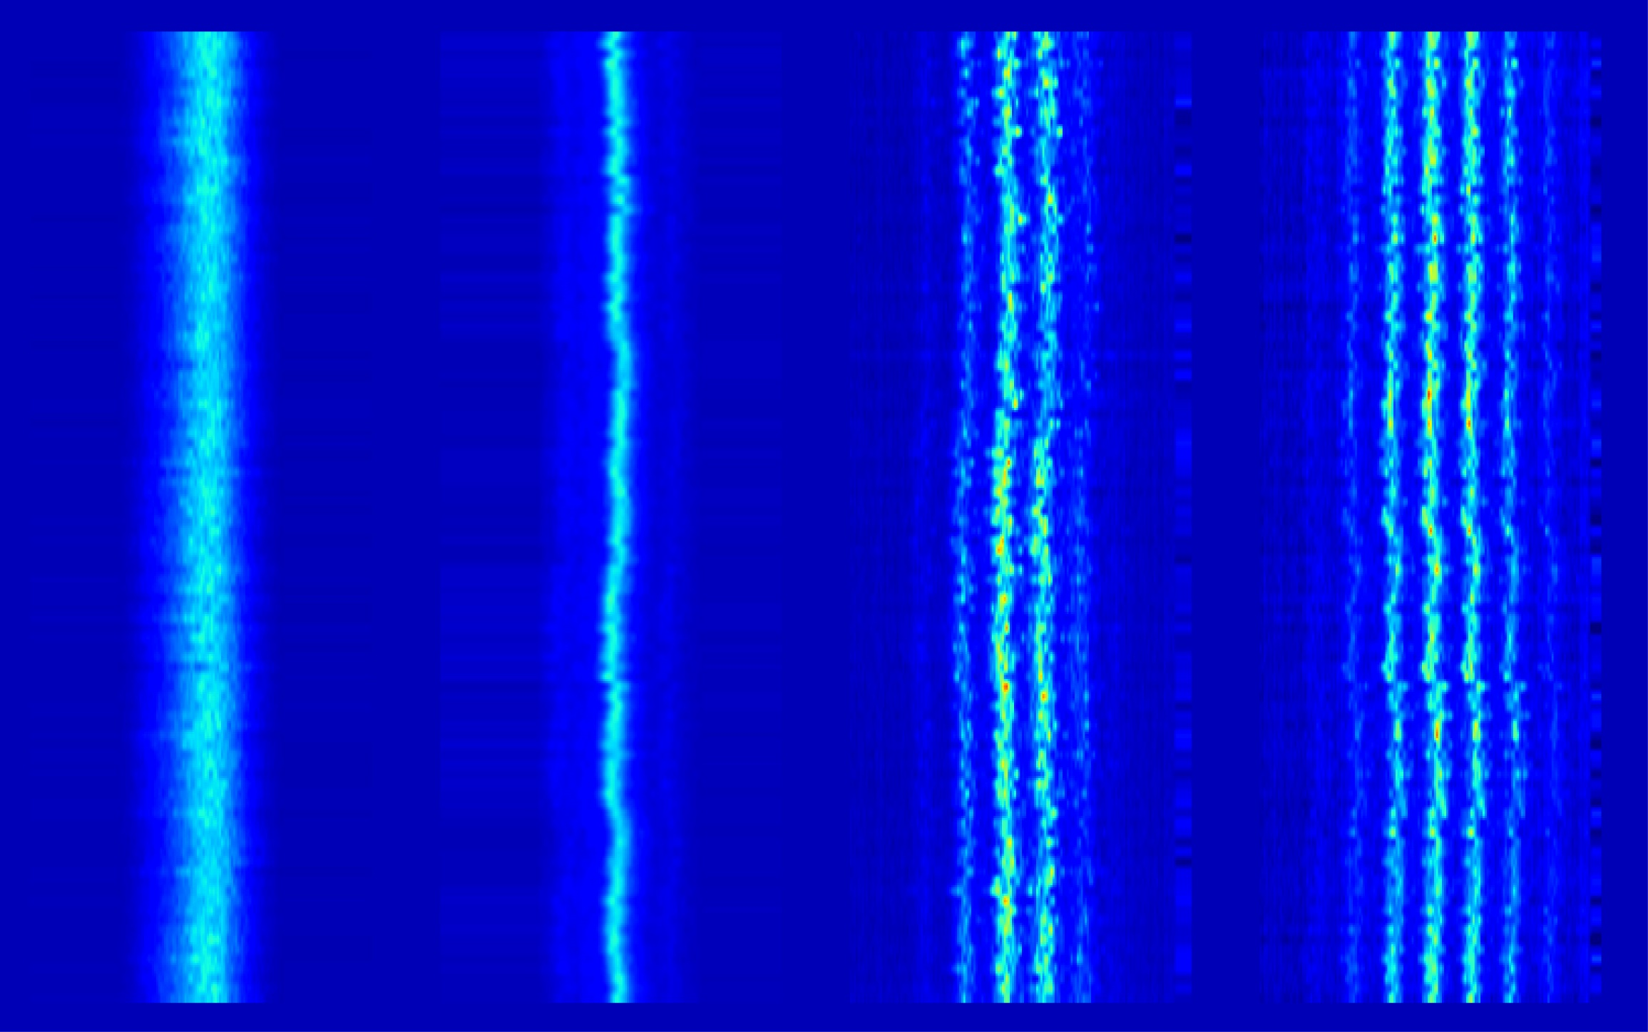

Thanks for your attention!
Special thanks to Wenxiang Hu and Sven Reiche
Thanks to all technical groups involved in the operation of SwissFEL
SASE
HB-SASE
MC-SASE
ML-SASE

