Slide 1
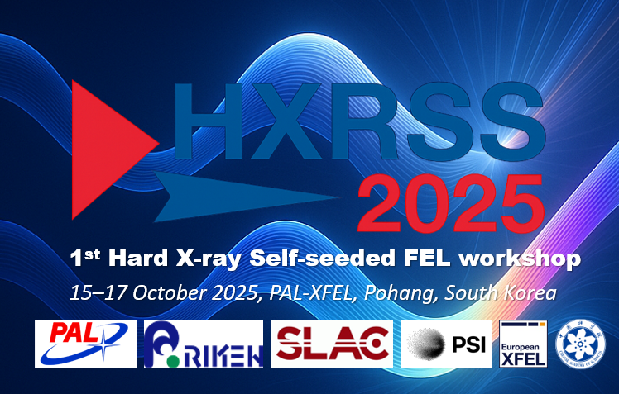
A warm welcome

Slide 2
Introduction to the workshop
Heung-Sik Kang
PAL-XFEL
Gianluca Geloni
European XFEL

Slide 3
Why a workshop on self-seeding?
HXRSS: the only scheme providing Users with high-brightness (an order of magnitude higher than SASE) and narrow-bandwidth (down to a fraction of eV) hard X-rays
Four facilities, LCLS-I, SACLA, PAL-XFEL, and European XFEL, use a self-seeded scheme for narrow-band scientific applications.
At upcoming CW XFEL facilities, like SHINE and LCLS-II, self-seeding is considered for advancing the scientific case.
…with a relatively simple addition to existing SASE setups

Slide 4
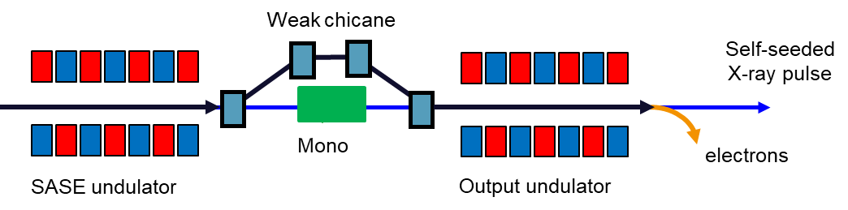
Reminder of the principle (1)
Conceptually, a particular mode of operation of an FEL amplifier
Initial noise density
modulation of e-beam
Density-modulated
electron beam
Initial density modulation
of electron beam
In SASE → start up from shot noise
Initial energy modulation
of electron beam
Amplifier
Energy-modulated
electron beam
Amplifier
Amplifier
In HXRSS → start up from an initial, narrow BW radiation pulse
Initial radiation pulse
at the target λ
Initial radiation pulse
at the target λ
FEL radiation pulse

Slide 5
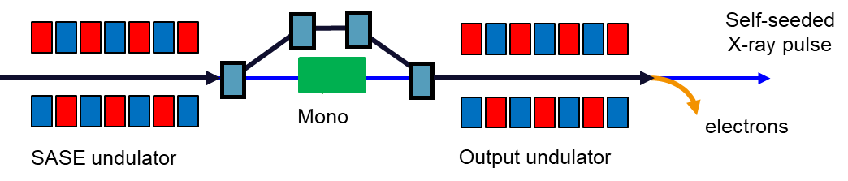
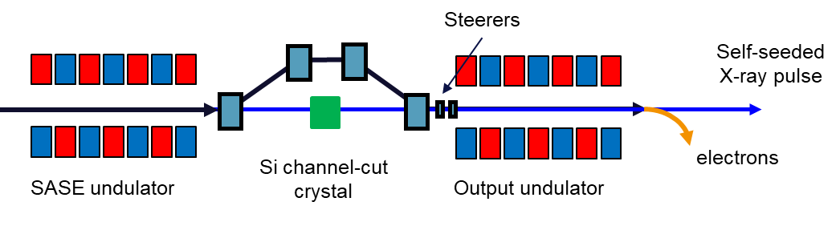
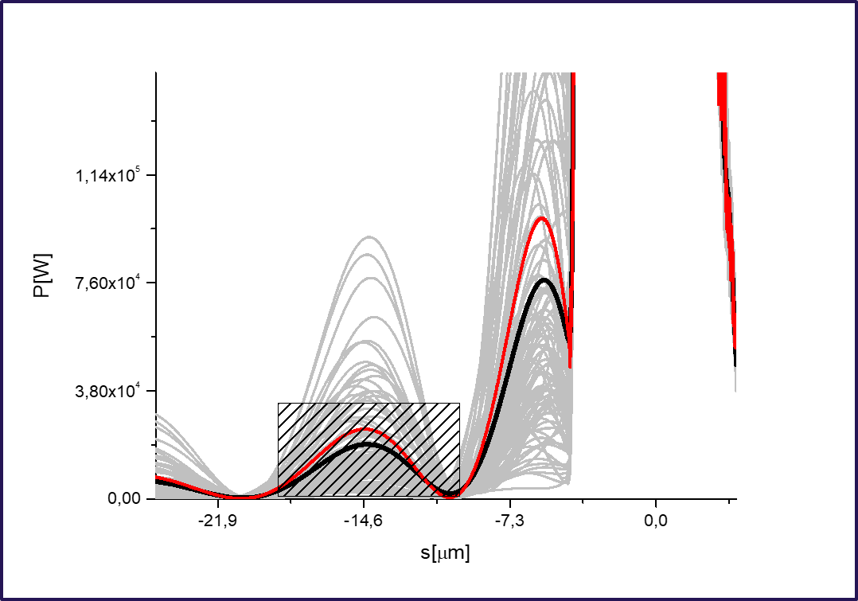
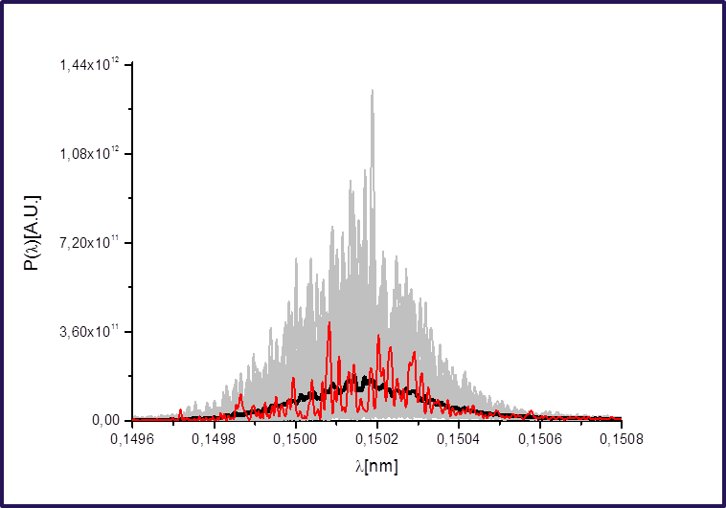
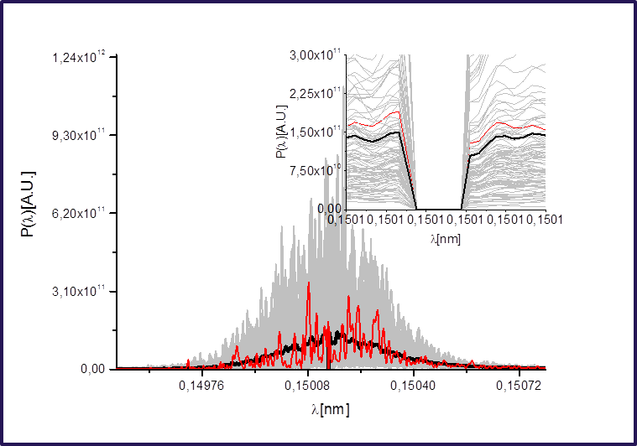
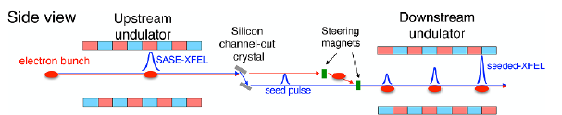
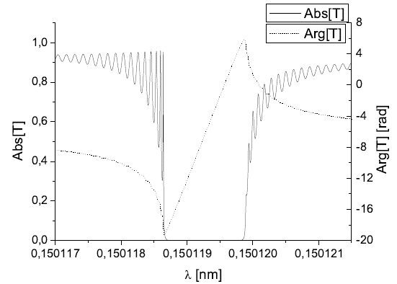
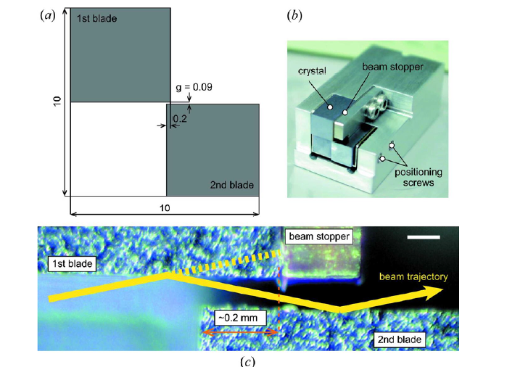
Reminder of the principle (2): single-crystal monochromator
Synchrotron Radiation News, 38:2, 17-22, DOI: 10.1080/08940886.2025.2472609
Single-crystal monochromator
LCLS (I and II), PAL-XFEL, European XFEL, SHINE
Channel-cut monochromator
SACLA, SHINE

Slide 6
Technique is mature enough for a summary
Topics to be discussed:
- experiments (cool things we can do with it)
- current performance (or expected performance from facilities that will install it)
developments/schemes (transmission/reflection, single/double chicane, harmonics, phase locking)
Workshop goals:
1. Review the state of the art of HXRSS around the world
2. Discuss possible novel developments of the method and of the science case around it
3. Consider possible international collaborations to facilitate these developments

Slide 7
Chairs and Discussions
Space for discussions is allocated after each session.
Only a few “burning questions” after each talk
…and we have a special format for Session Chairing and Discussions:
-Each Session is chaired by the first speaker
-After each session, we will have a Panel Discussion with all Speakers, moderated by Chairs

Slide 8
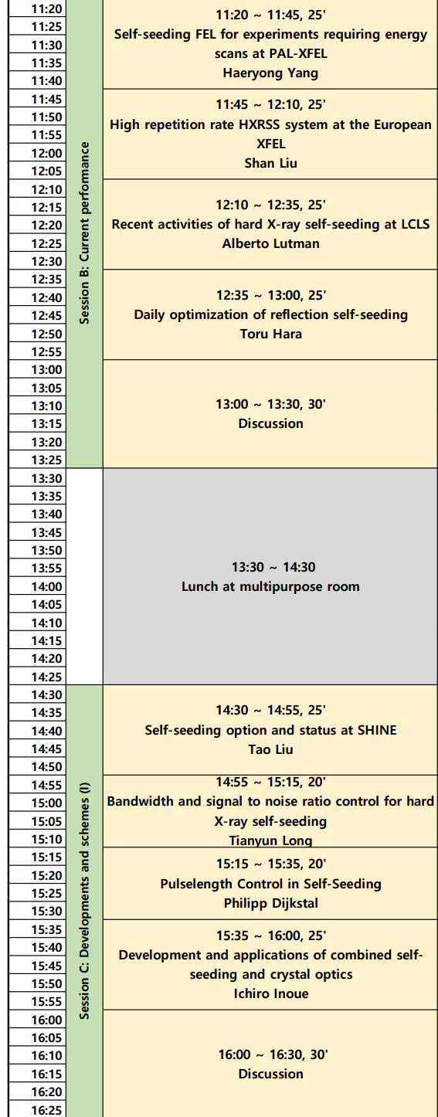
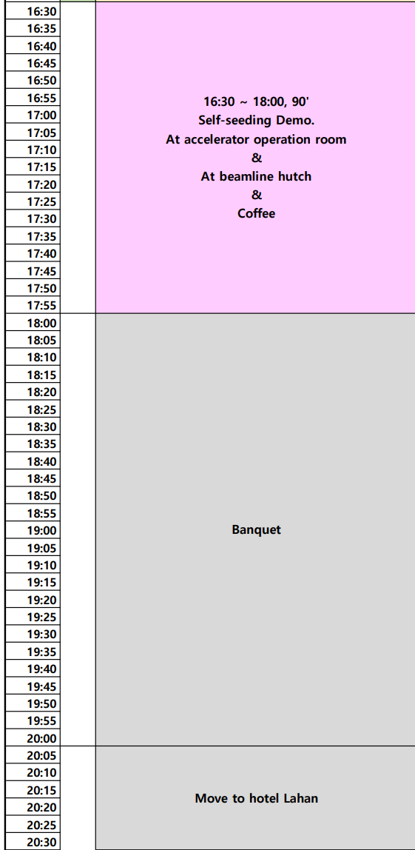
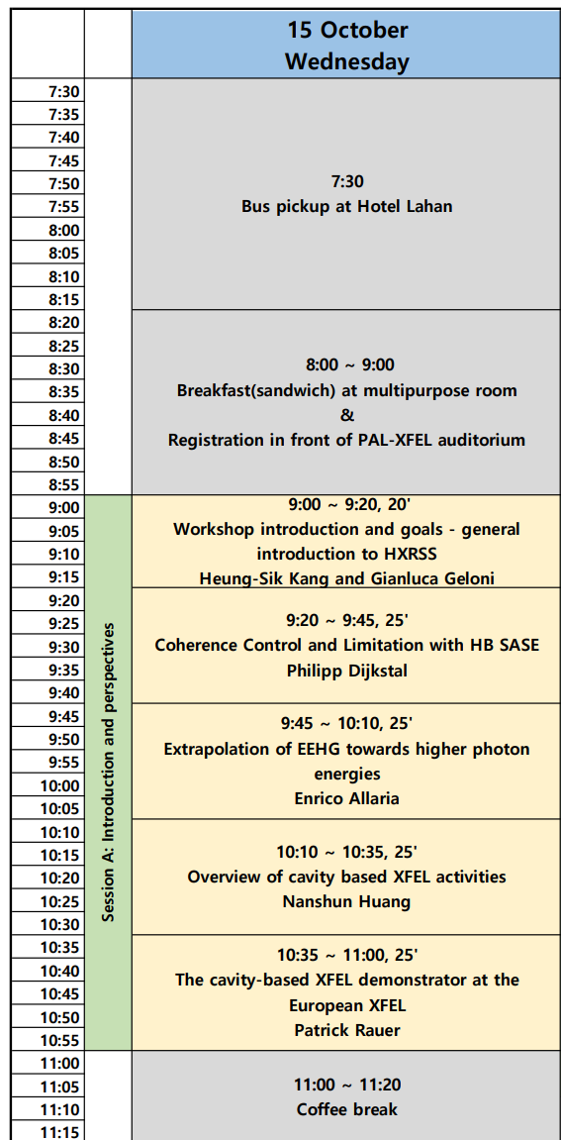
Workshop program (I)
Review: what can we offer to Users today with self-seeding?
Chair: Haeryong Yang
Introduction and Perspectives
Alternative and novel techniques.
Chair: Philipp Dijkstal
Developments: what may we be offering to Users tomorrow?
Chair: Tao Liu

Slide 9
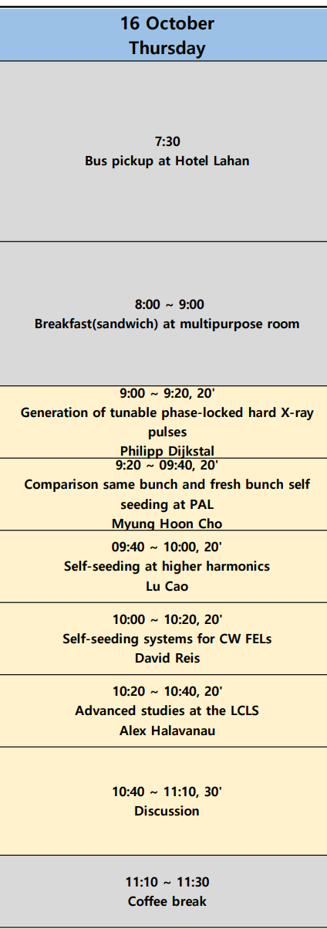
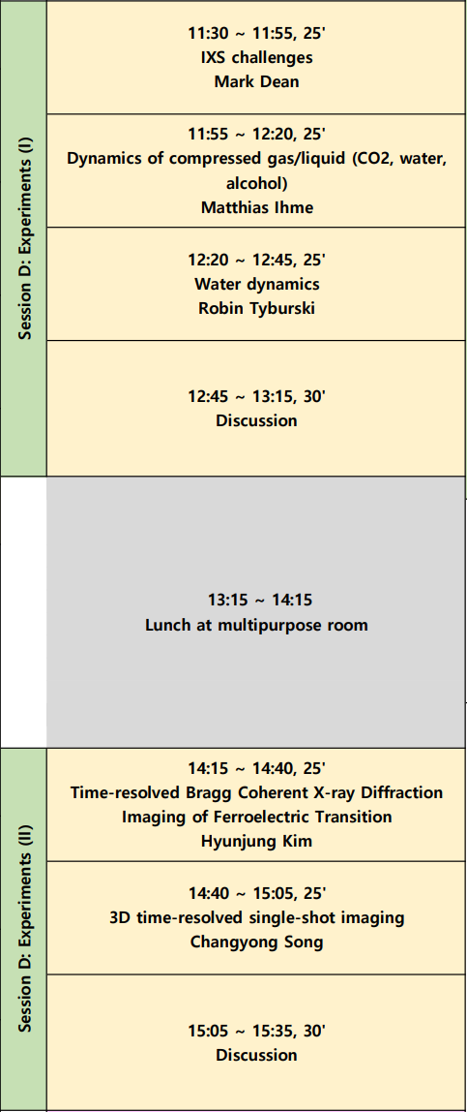
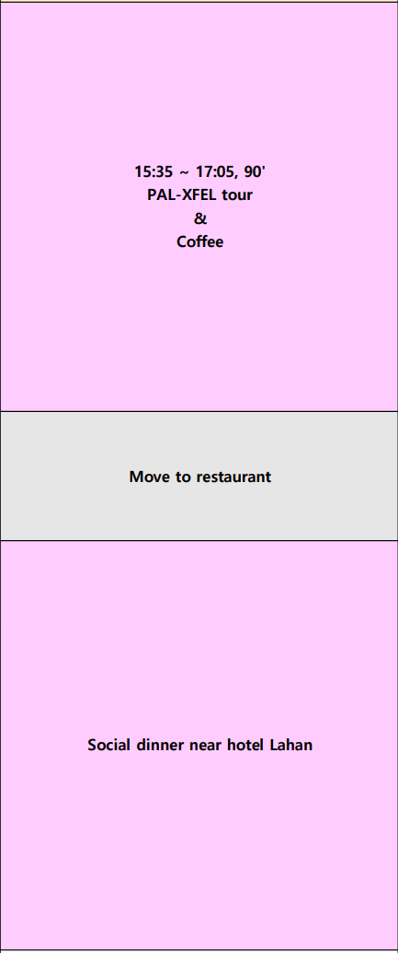
Workshop program (II)
Experiments:
What Users did, and what would they like to have?
Chair: Mark Dean
Developments: what may we be offering to Users tomorrow?
Chair: Philipp Dijkstal
Experiments:
What Users did, and what would they like to have?
Chair: Hyunjung Kim

Slide 10
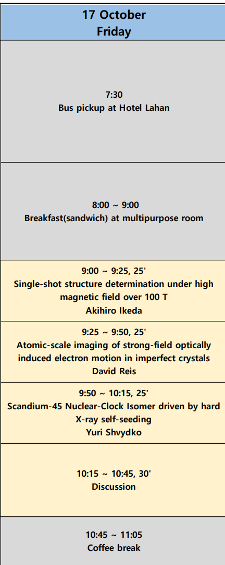
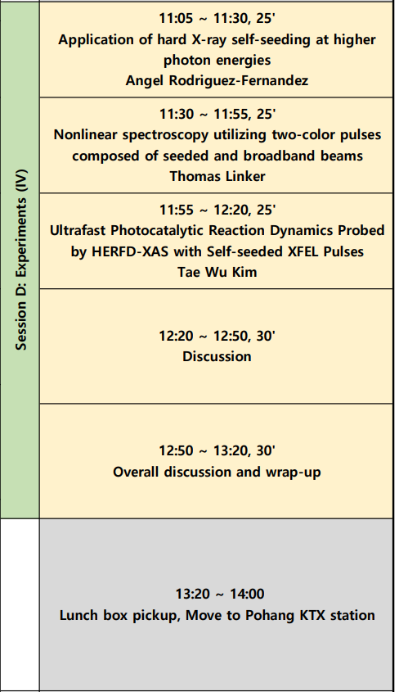
Workshop program (III)
Experiments:
What Users did, and what would they like to have?
Chair: Angel Rodriguez-Fernandez
Moderators:
Heung-Sik Kang
Gianluca Geloni
Experiments:
What Users did, and what would they like to have?
Chair: Akihiro Ikeda

Slide 11
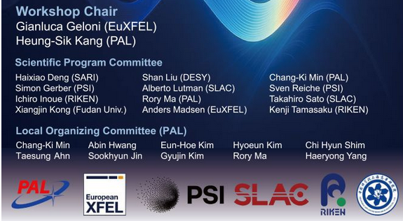
We wish you a fruitful and interesting workshop!
Workshop goals:
1. Review the state of the art of HXRSS around the world
2. Discuss possible novel developments of the method and of the science case around it
3. Consider possible international collaborations to facilitate these developments
With special thanks to Chang-Ki Min
For the great work done!

Slide 12
With in mind our goals, we wish a fruitful and interesting workshop!
Workshop goals:
1. Review the state of the art of HXRSS around the world
2. Discuss possible novel developments of the method and of the science case around it
3. Consider possible international collaborations to facilitate these developments

Slide 13
Collaboration for PAL-XFEL Self-seeding
December 10, 2013 Kwang-Je Kim’s advised the collaboration with ANL on self-seeding project for the PAL XFEL project
Jan. 2014 Task force team organized at PAL-XFEL
Sept. 23 ~ 24, 2014 Collaboration meeting for developing a self-seeding system for PAL-XFEL
Yuri Shavydko (ANL), Deming Shu (ANL), Vladimir Blank (TISNCM), Kwang-Je Kim (ANL)
October 31, 2014 An Argonne Work for Others Project and Collaboration with Pohang Accelerator Laboratory
May 28 ~ 31, 2018 PAL-XFEL HX-self-seeding commissioning with Franz-Josef Decker (SLAC), Deming Shu (ANL),
Svitozar Serkez (Euro-XFEL), and Yuri Shvydko (ANL)
Oct. 1 ~ 7, 2018 self-seeding test with Henrik Loos
Nov. 17 ~ 20, 2018 self-seeding test with Alberto Lutman (SLAC), Zhirong Huang (SLAC)
July 11, 2019 self-seeding test with Gianluca Gelnoni(Euro-XFEL), Alexander Malyzhenkov (PSI)
Mar. & Aug. 2024 self-seeding experiment with Philipp Dijkstal (PSI), Wenxiang Hu (PSI), Gabriel Aeppli (PSI))
Many thanks to those who contributed to the PAL-XFEL self-seeding project !!

Slide 14
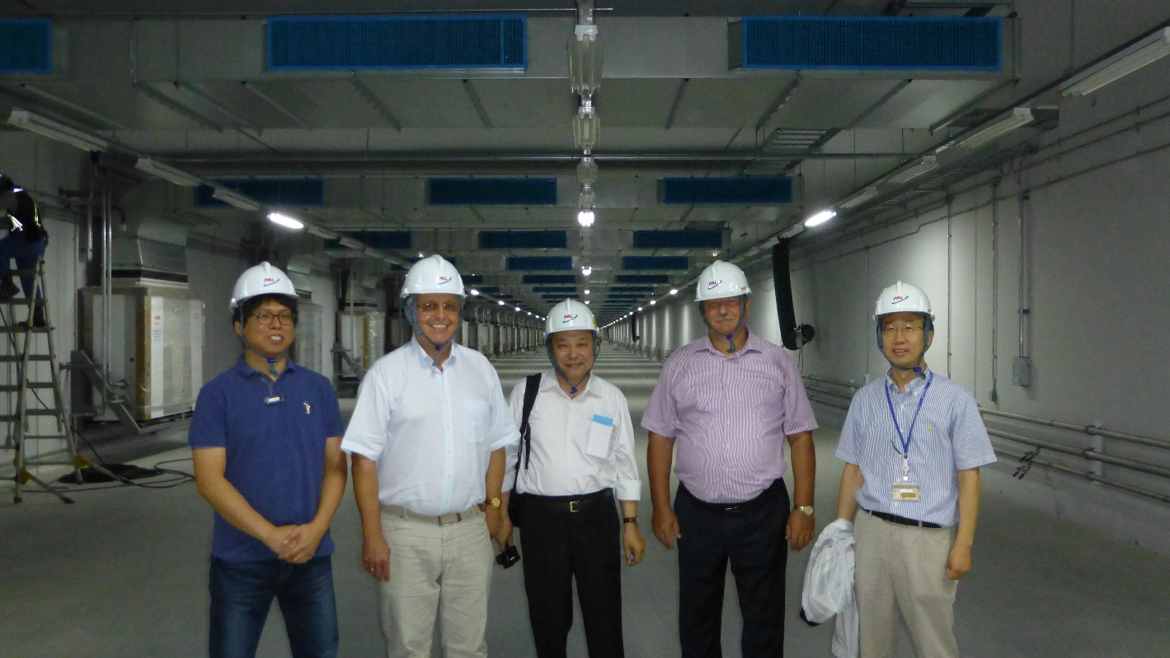
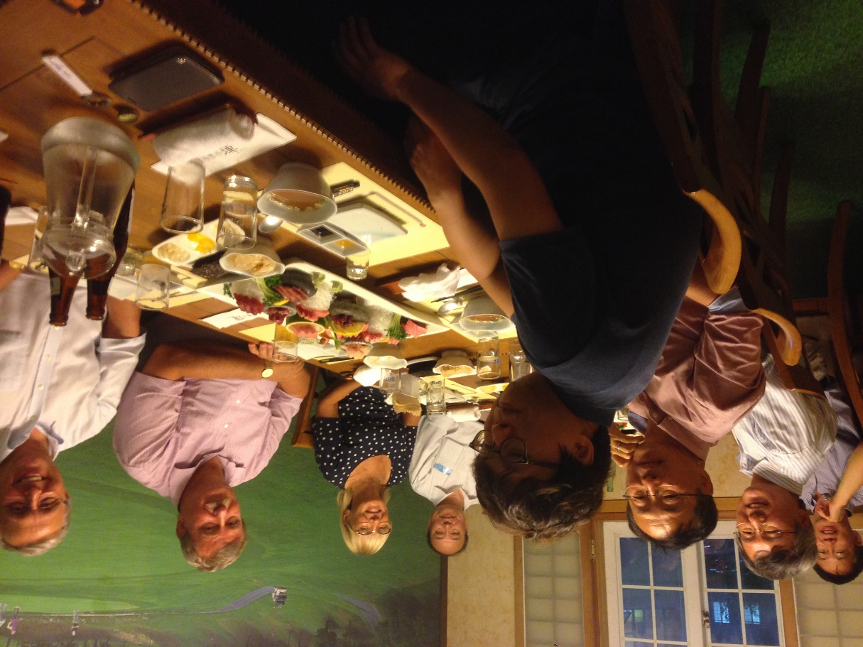
Sept. 23~24, 2014

Slide 15
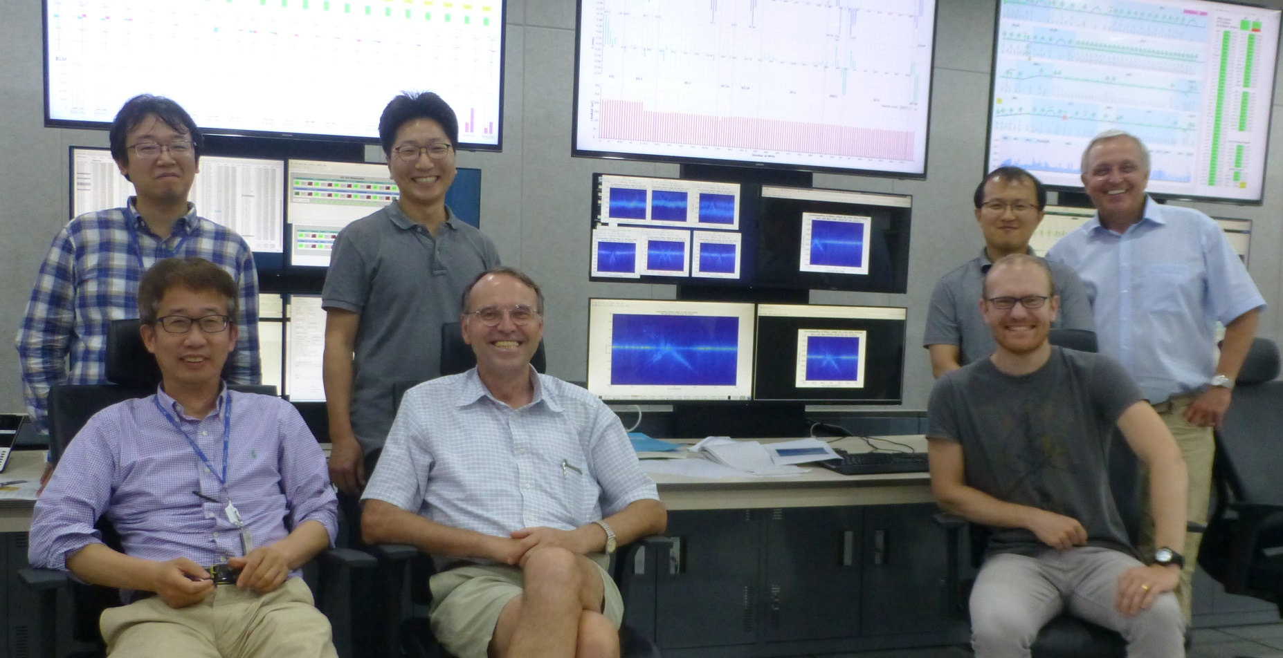
Self-Seeding Test (May 30, 2018)

Slide 16
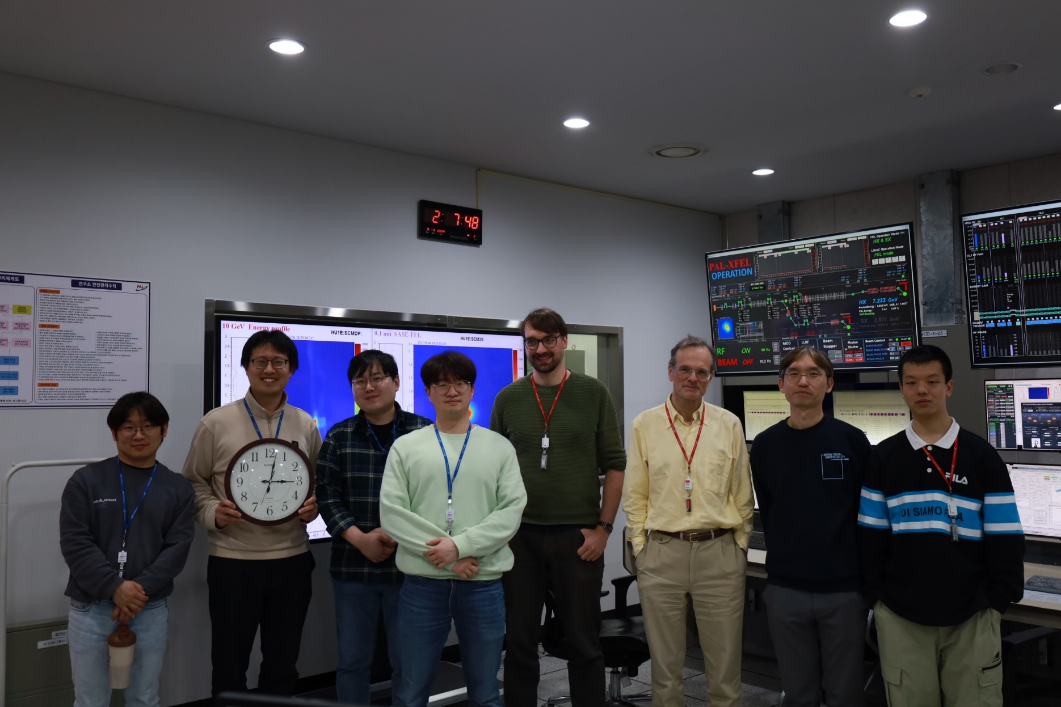
Collaborative R&D with PSI (March & August 2024)
Philipp Dijkstal (PSI)
Chi Hyun Shim
Myung-Hoon Cho
Gabriel Aeppli (PSI)
Kook-Jin Moon
Wenxiang Hu (PSI)
Seongyeol Kim
Chang-kyu Sung
XFEL Accelerator Control Team PAL-XFEL
Notes:
Before I conclude I would like to introduce my team.

Slide 17
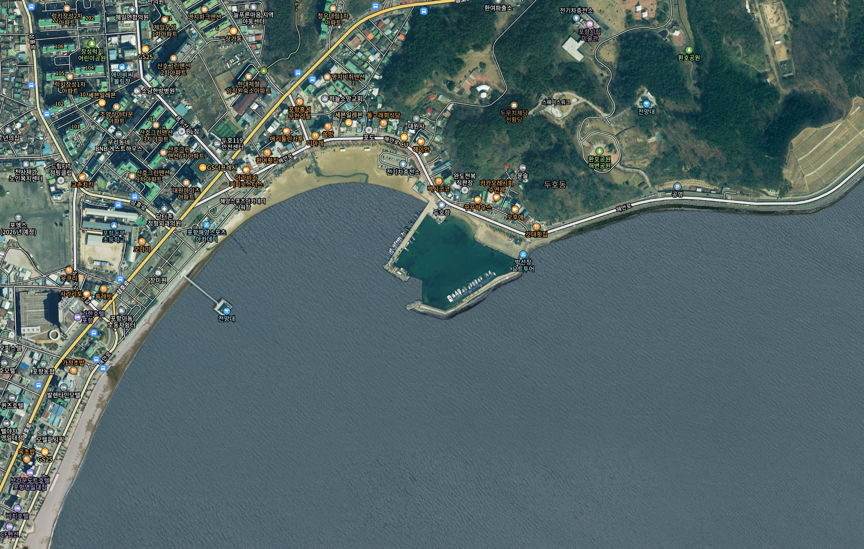
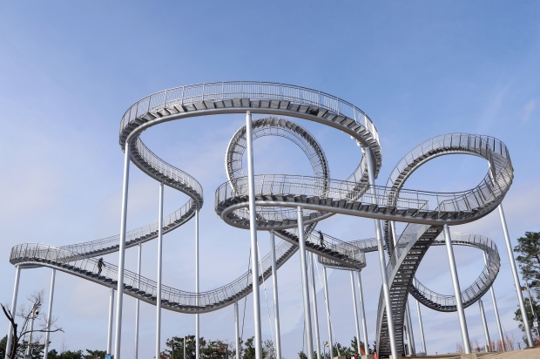
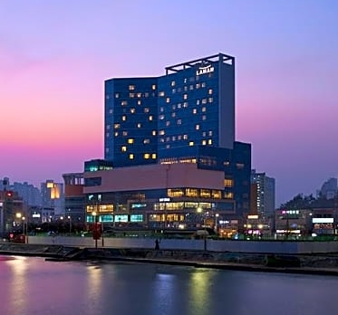
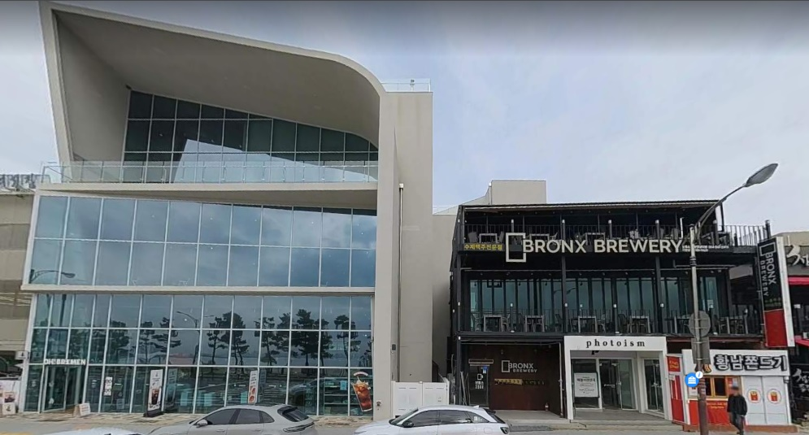

Skywalk
Hotel Lahan
Café : Oh! Bremen
Observatory
Bronx Brewery

