Slide 1
Research Progress
Nov. 01. 2024
송우진

Slide 2
Summary of GPBPM Development
2. Conceptual Design
4GSR-GPBPM
  Electrode structure design
  Target 1: 1:1 mapping field
    Electrode modification
    Simulation results for several parameters (applied electrode voltage, inner diameter, position)
  Target 2: Achieving linearity
    Shield plate modification
    Repeller size, electrode outer diameter change
Calibration
  Issue
  Calibration method
  Case study
    Gaussian distribution (W/O beam pipe)
    Part of Gaussian (W/ beam pipe)
    Mixture of Gaussian distribution
    Distribution with flat-top
  Calibration error estimation
  Calibration beam size – slit (iris) size
    Calibration map based on calibration beam size
    Error analysis due to calibration beam size
1. Background Study
Review
  Beam induced fluorescence monitor
  Ionization profile monitor
  Gas-jet type IPM
  IPM for photon beam monitoring
PAL-XFEL XIBPM
XIBPM upgrade
  1:1 mapping field design
  Shield plate

Slide 3
Summary of GPBPM Development
3. Detailed Design
5. Resolution
Magnification modification
  Target magnification
  Result
Determination of main parameters
Manufacturing drawing
Expected signal strength
  Photon-gas interaction
  Spectral photon flux
  Event number estimation
Transverse spread
  Space charge effect
  Thermal energy
Systematic error
  Resolution estimation
  Experimental results
4. Experiment
Experimental plan
  Experimental goal and contents
  Preliminary preparations
  Detailed experimental procedure
Fabrication
Test
  12/16-19 PLS-II BL-6C

Slide 4
Experimental Plan
Main goal:
- Evaluate the beam profile and position measurement performance of the PBPM
Contents
  Gas pressure optimization (minimum injection)
    TMP – Exp. condition, independent system / Ion pump – Beamline, connected system
  Beam size and position variation: 0.1 ~ 6 mm, Ф 12 mm
  (*Microscope FOV: 4.16 mm (H) @ 4x, 8.3 mm (H) @ 2x)
  (Optional) Beam energy: mono beam (10 ~ 40 keV)
  (Optional) Photon flux variation

Slide 5
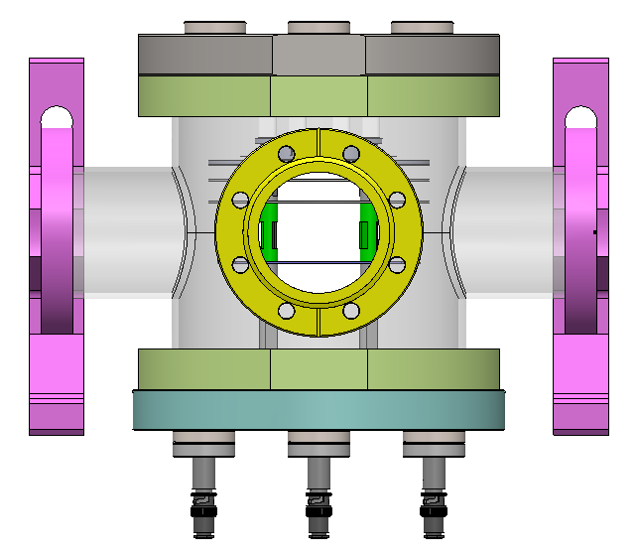
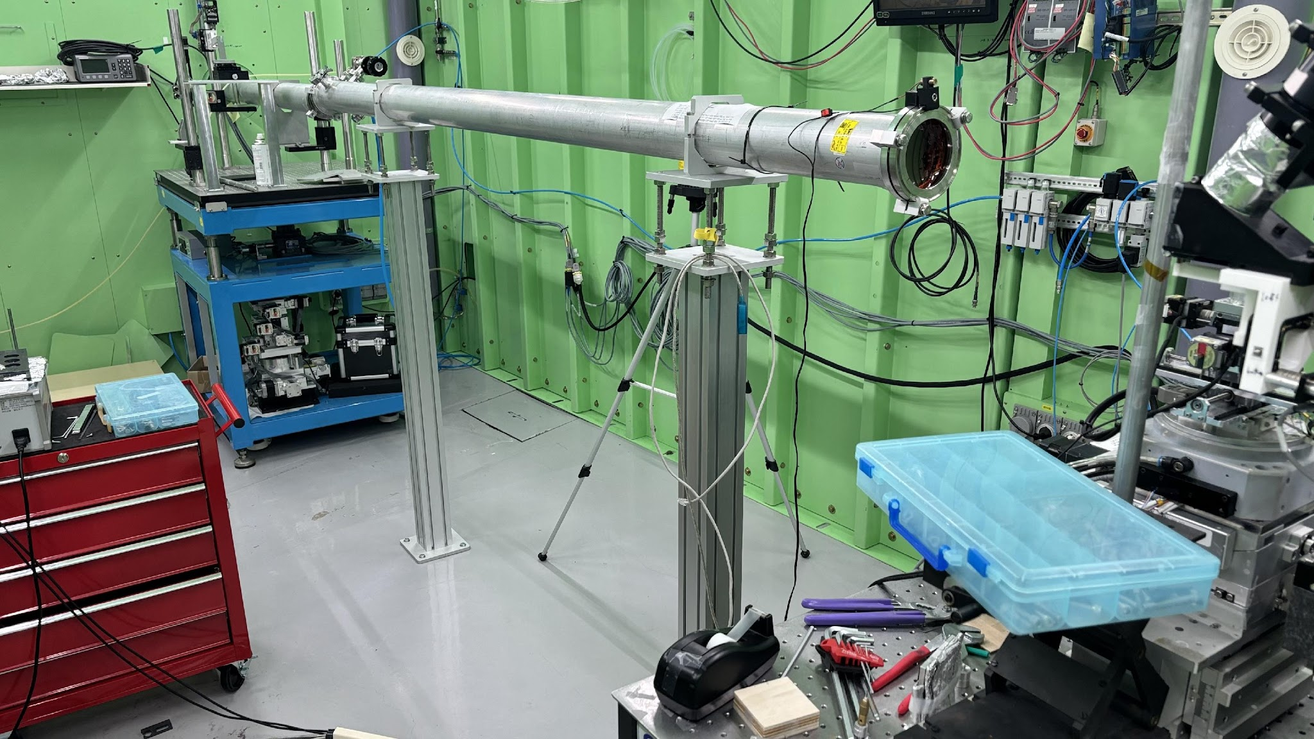
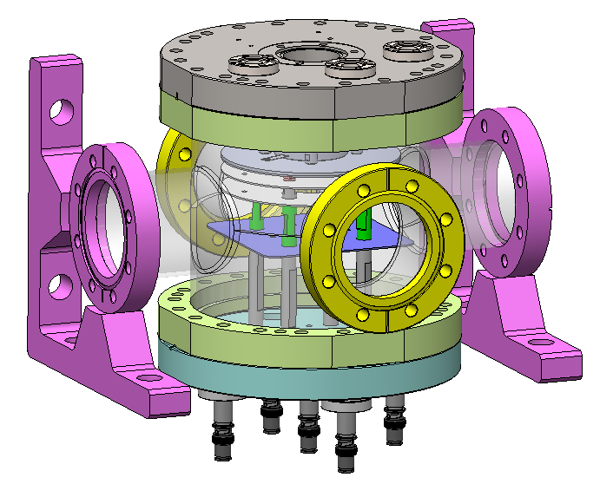
Layout of PLS-II BL-6C
sCMOS Camera
Pco.Edge 5.5
Hamamatsu Fusion
2x, 5x, 10x, 20x, 40x
36m
Slit
LMM
Multi-Pole Wigger
E_{c} = 12 keV
Normal source size
: 500 um x 30um
Total power : 10kW
Double Multilayer
Monochromator
Ru/C, 4.0 nm
: 10 – 20 keV
W/B4C, 2.6 nm
: 20 – 55 keV
DCM 1
Si (220)
: 30 – 50 keV
DCM 2
Si (111)
: 12 – 33 keV
Sample stage
Air bearing rotation stage

Slide 6
Preliminary preparations
Chamber manufacturing and vacuum test
DAQ (Camera) interface
Gas injection test
BL-6C white beam ray-tracing
(Optional) Confirm applicability of motorized stage → Replace with beam adjustment
(Optional) Cooperation with Survey/Alignment team
→ Ray-tracing (Beam based alignment)
Procedure
Completion of the chamber → Preliminary test (Gas, Pumping, Beam tuning, etc.)
→ White beam ray-tracing → Installing in BL-6C
→ PBPM and beam alignment
→ Experiment: 12/16 (Mon) to 12/19 (Thu)

Slide 7
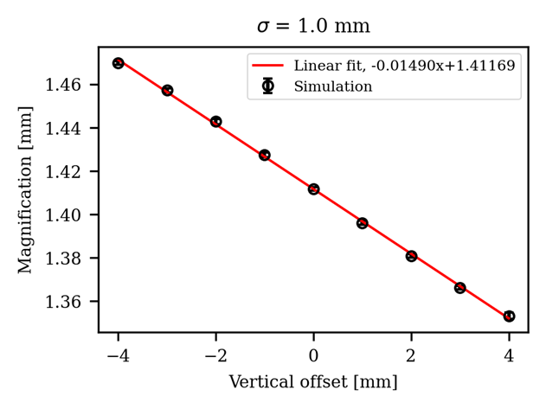
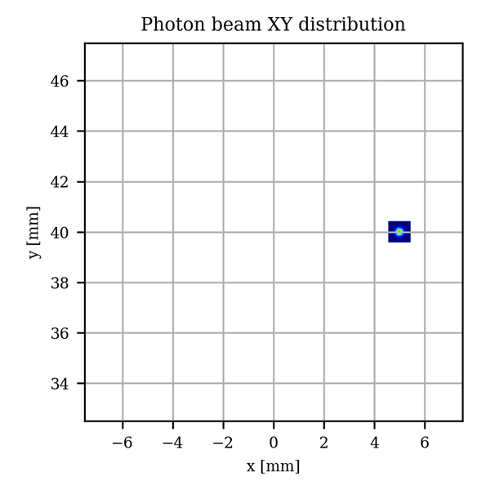
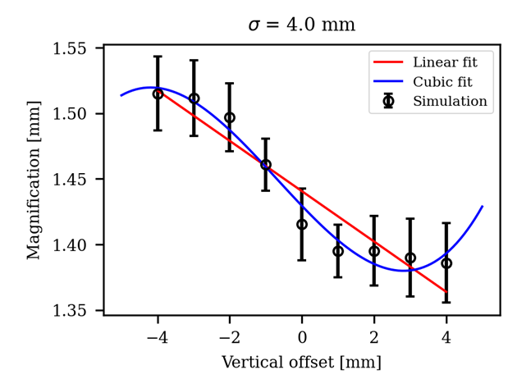
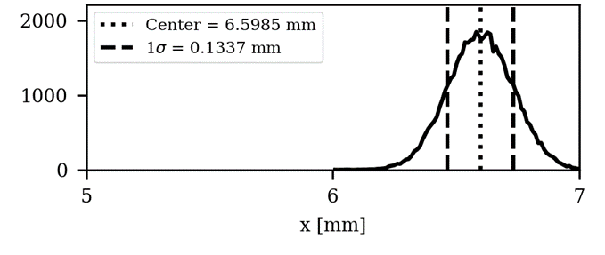
Detailed experimental procedure
Gas pressure optimization
  Measure signal intensity and PSF according to gas species (Xe, Res. gas) and pressure.
  Electrical control of gas pressure (MFC) is required? (Stability, automation of the measurement process).
Beam size and position measurement
  Measure performance of beam size (profile) and position monitoring.
  Verify magnification correction method (Calibration method).
  Measure point spread function.
PSF measurement
Position
Beam size
0.1 ~ 6 mm
Window (Φ12 mm)

Slide 8
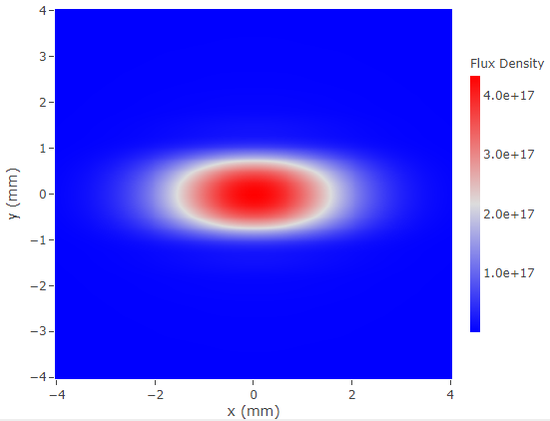
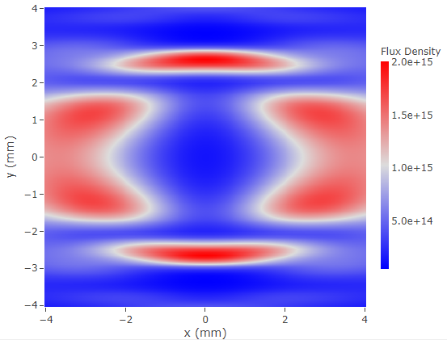
Detailed experimental procedure
3. (Optional) Beam energy: Mono energetic beam profile measurement.
4. (Optional) Photon flux: Test signal intensity changes proportional to beam intensity.
→ Verify the applicability of the beam intensity monitor.
1st harmonic
(1955 eV)
20 keV

Slide 9
Resolution estimation
Expected signal strength
  Photon-gas interaction
  Spectral photon flux
  Event number estimation
Transverse spread
  Space charge effect
  Thermal energy
Systematic error
  Resolution estimation
  Experimental results

Slide 10
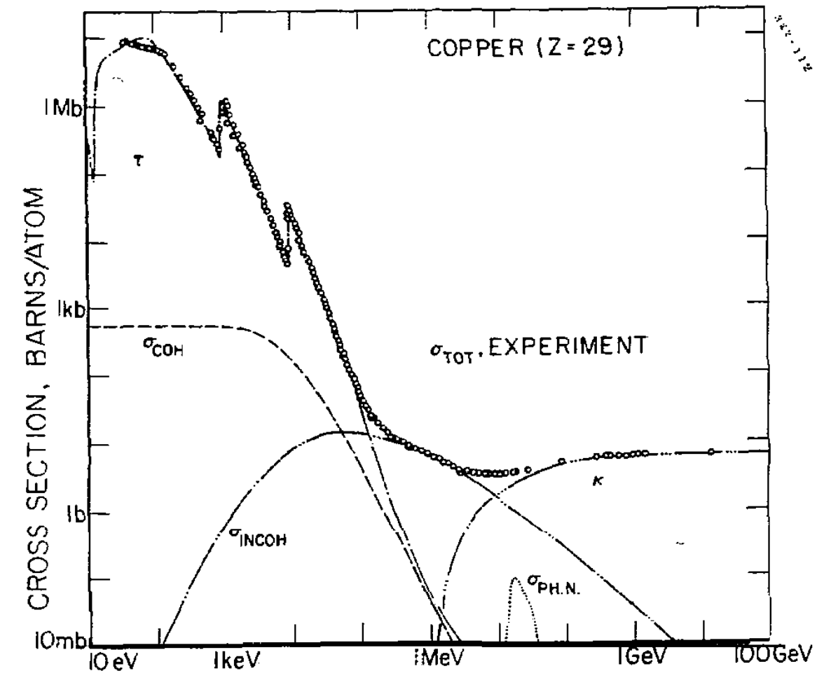
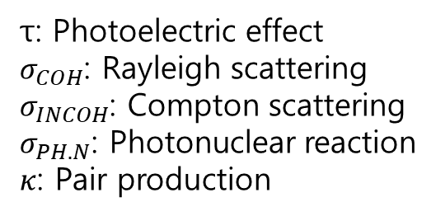
Photon-gas interaction
Up to approximately 100 keV photon energy, the photoelectric effect is predominantly governing.
Beyond 100 keV, Compton scattering and pair production become dominant, but these are outside the region of interest.
τ: Photoelectric effect
$σ_{COH}$: Rayleigh scattering
$σ_{INCOH}$: Compton scattering
$σ_{PH.N}$: Photonuclear reaction
$κ$: Pair production

Slide 11
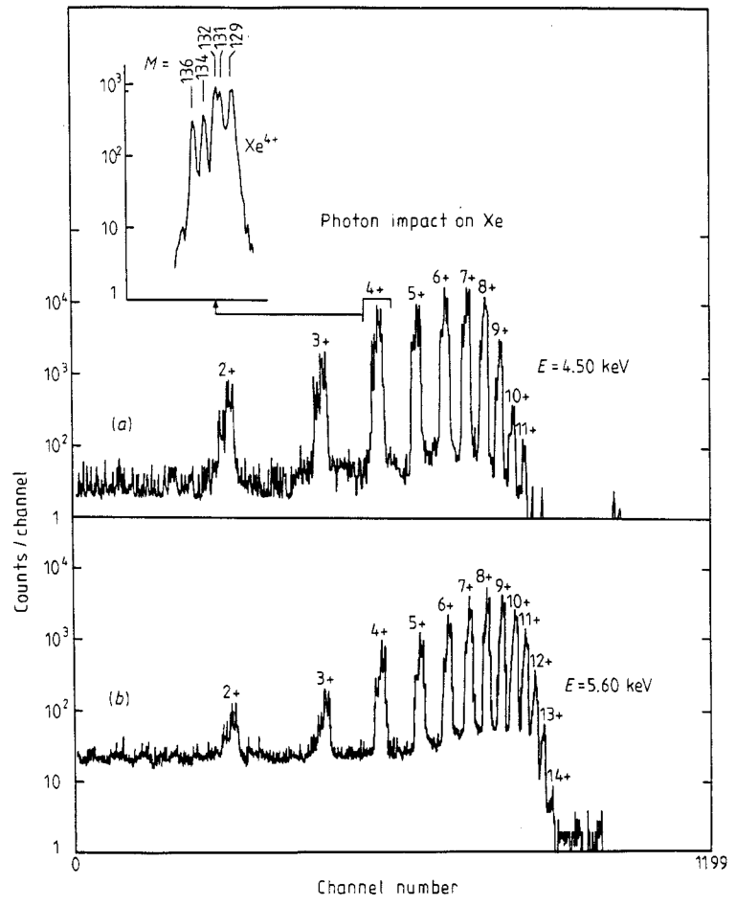
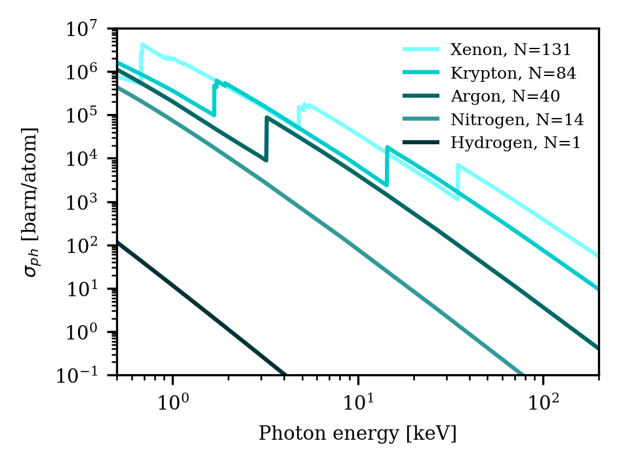
Photoionization cross-section
Charge state spectrum of Xe in collision
with 4.5 and 5.6 keV photons
Single photoionization cross-section

Slide 12
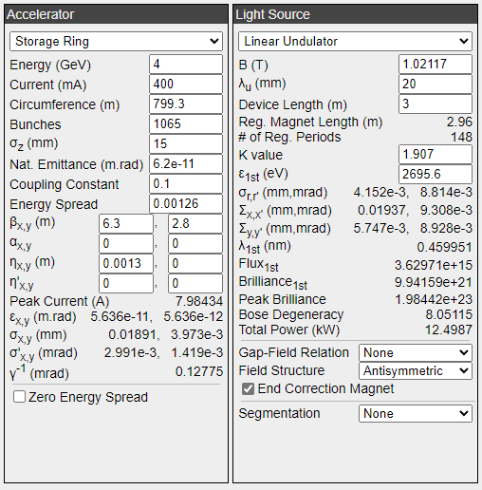
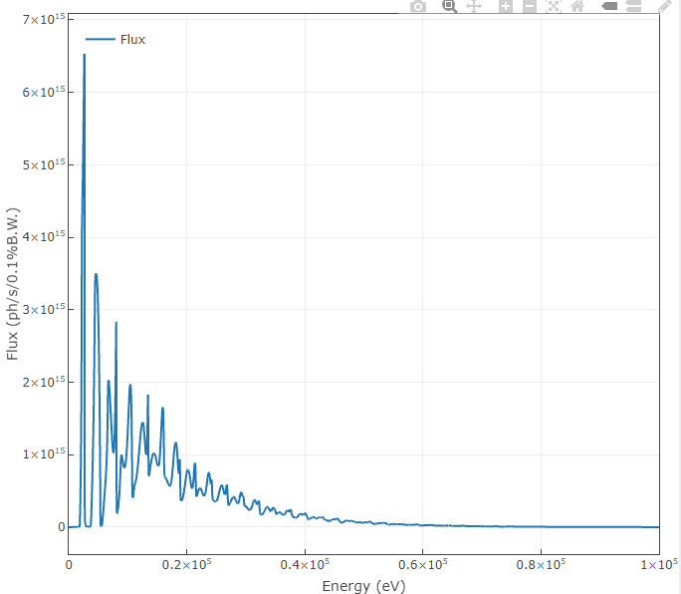
Spectral photon flux - Spectra
4GSR IVU20 (8 mm x 8 mm @ 40m, W/O diffraction)

Slide 13
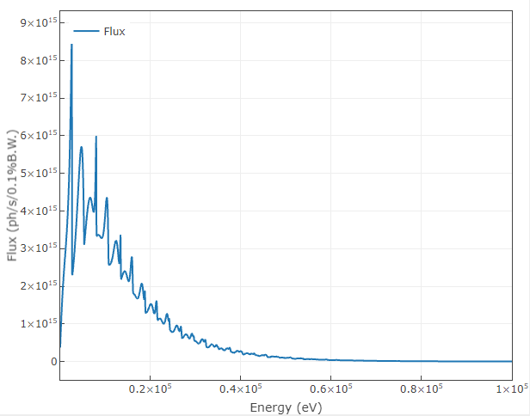
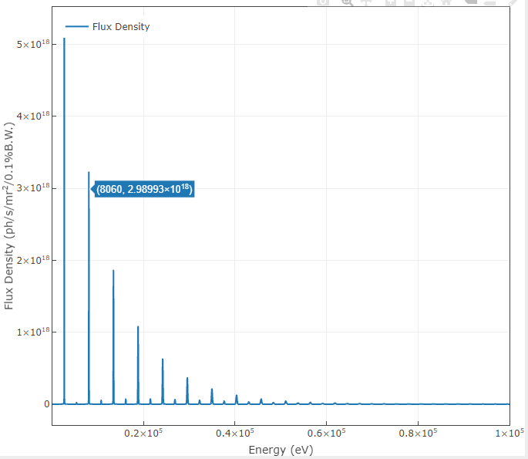
Spectral photon flux - Spectra
4GSR IVU20 (8 mm x 8 mm @ 40m, W/O diffraction)
Total flux (4 pi)
including off-axis radiation
On-axis flux density

Slide 14
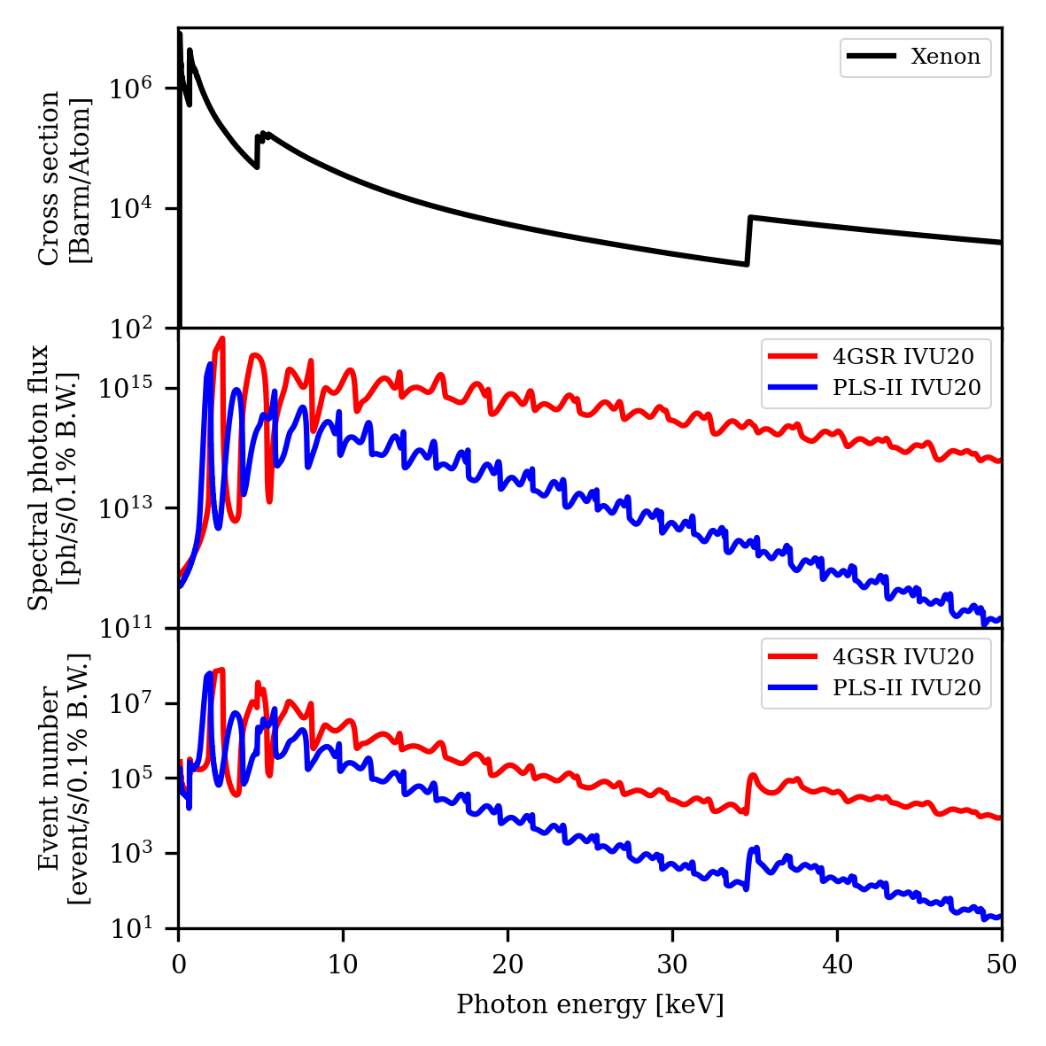
Event number estimation
Number of interaction
= Cross section *
Spectral photon flux *
Gas density (1e-6 Torr)
 | PLS-II IVU20 | 4GSR IVU20
Total event (0.1~50 keV) | 3.00e+9 | 7.91e+9
@ 10 keV (0.1% B.W.) | 1.85e+5 | 2.50e+6
@ 30 keV (0.1% B.W) | 5.09e+2 | 2.59e+4

Slide 15
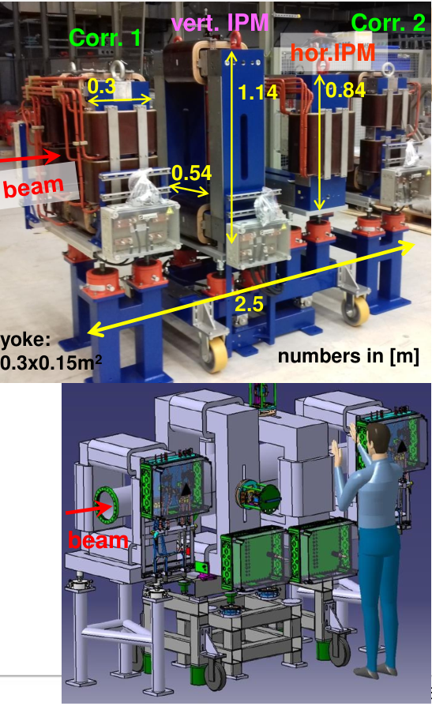
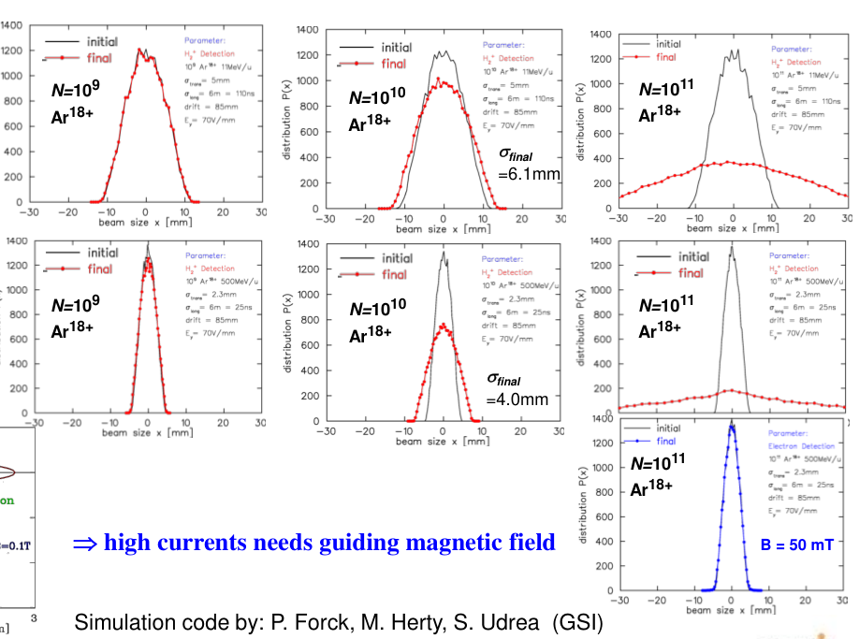
Space charge effect

Slide 16
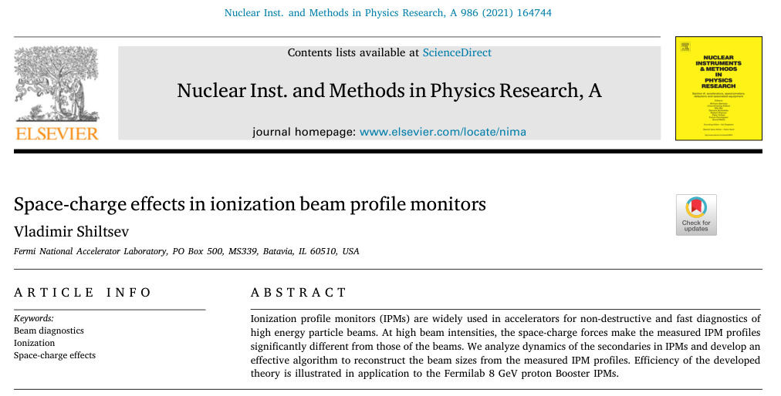
Space charge effect
The space charge model for IPM has been calculated experimentally, but the beam size analyzed in this paper provides a more accurate calculation.

Slide 17


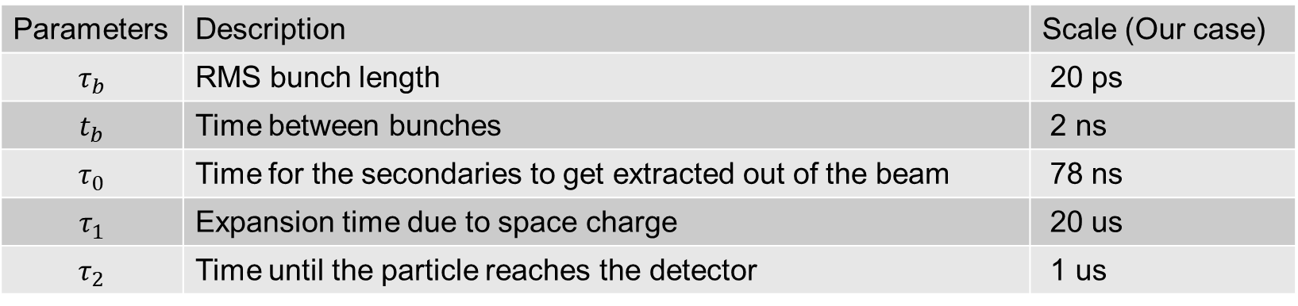





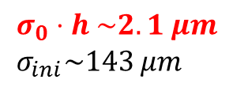
Space charge effect
Beam
$$τ_{0}$$
$$τ_{b}$$
$$t_{b}$$
$$τ_{2}$$
Measurement beam size $σ_{m}$ is calculated by initial beam size $σ_{0}=3 mm$,
1. $τ_{b}≪t_{b}≤τ_{0}≪\left(τ_{1},τ_{2}\right)$
$σ_{m}^{2}=σ_{0}^{2}⋅h^{2}+σ_{ini}^{2}≈σ_{0}^{2}{\left[1+\frac{2U_{SC}}{E_{ext}σ_{0}}\left(\frac{Γ\left(\frac{1}{4}\right)}{3}\sqrt{\frac{d}{σ_{0}}}−\frac{\sqrt{π}}{2}\right)\right]}^{2}+$ $\frac{4ε_{i}d}{ZeE_{ext}}$,
2. $τ_{b}≪τ_{0},τ_{1}, τ_{2}≪t_{b}$
$σ_{m}^{2}=σ_{0}^{2}+κN_{p}+\frac{4κ^{2}N_{p}^{2}}{3σ_{0}^{2}}\ln{\frac{4}{3}}$,
where
$$N_{p}=1e10$$
Detector
$$σ_{0}⋅h \sim 2.1 μm \\ σ_{ini}\sim 143 μm$$
$$σ_{m}−σ_{0} \sim 3.1 μm$$
Parameters | Description | Scale (Our case)
$$τ_{b}$$ | RMS bunch length | 20 ps
$$t_{b}$$ | Time between bunches | 2 ns
$$τ_{0}$$ | Time for the secondaries to get extracted out of the beam | 78 ns
$$τ_{1}$$ | Expansion time due to space charge | 20 us
$$τ_{2}$$ | Time until the particle reaches the detector | 1 us

Slide 18
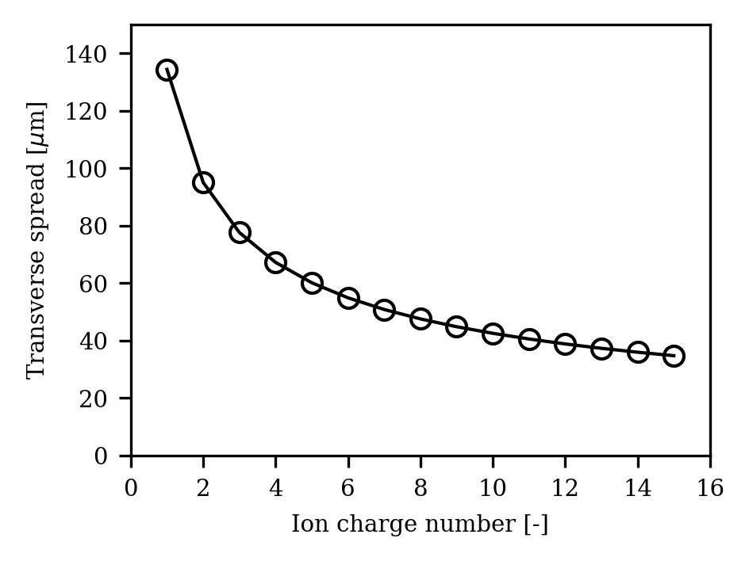
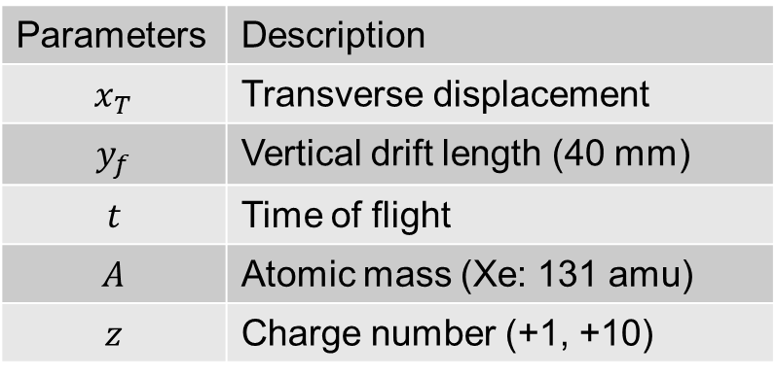

Transverse spread due to thermionic energy
$F_{y}=zeE_{y}=ma_{y}$ (Assuming the $E_{y}$ is constant)
$t\sim \sqrt{\frac{A}{z}{10}^{−14}} \left[s\right]\sim [μs]$
$v_{T}=\sqrt{\frac{3k_{B}T}{m_{Xe}}}=238 m/s$ Thermal velocity
$v_{Tx}=137 m/s$
$x_{T}=tv_{Tx}=\sqrt{\frac{2my_{f}}{zeE}\frac{3k_{B}T}{m}}$ → Independent of gas type
$x_{T, +1}=143.8 μm$ , RMS
$x_{T,+10}=45.5 μm$ , RMS
Parameters | Description
$$x_{T}$$ | Transverse displacement
$$y_{f}$$ | Vertical drift length (40 mm)
$$t$$ | Time of flight
$$A$$ | Atomic mass (Xe: 131 amu)
$$z$$ | Charge number (+1, +10)
Defocusing field

Slide 19
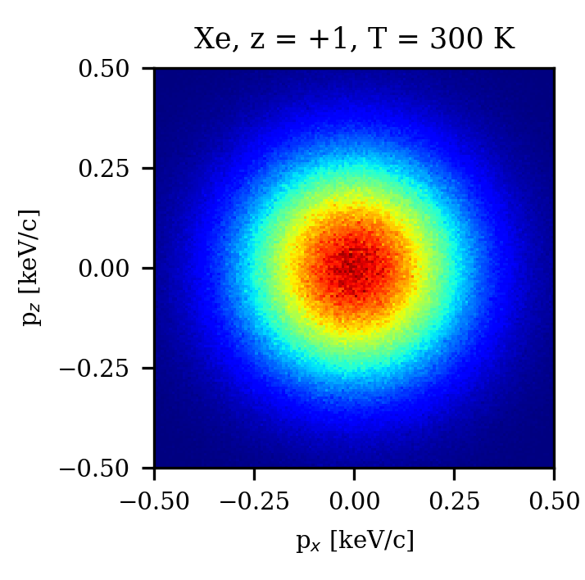
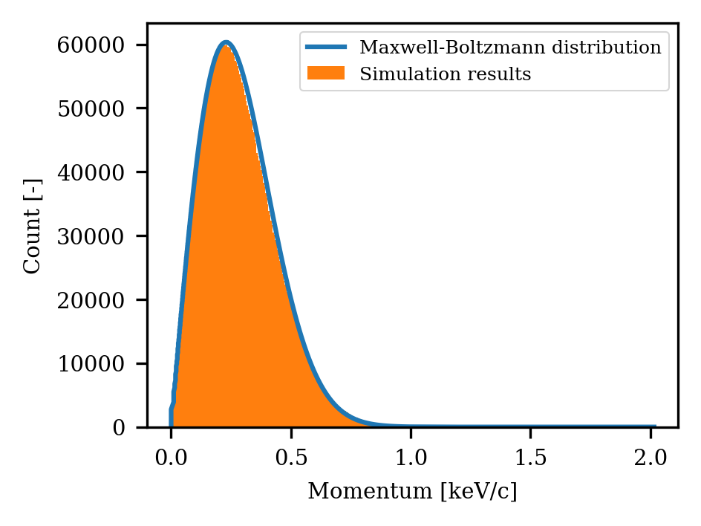
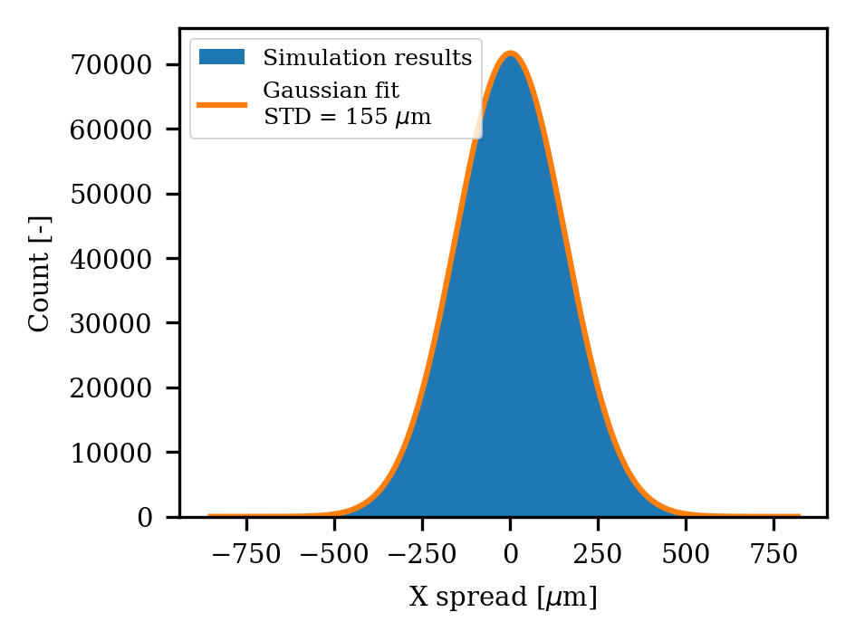
Transverse spread simulation
Calculate the transverse spread numerically using a particle tracking code.
(Space charge effect is not considered)

Slide 20
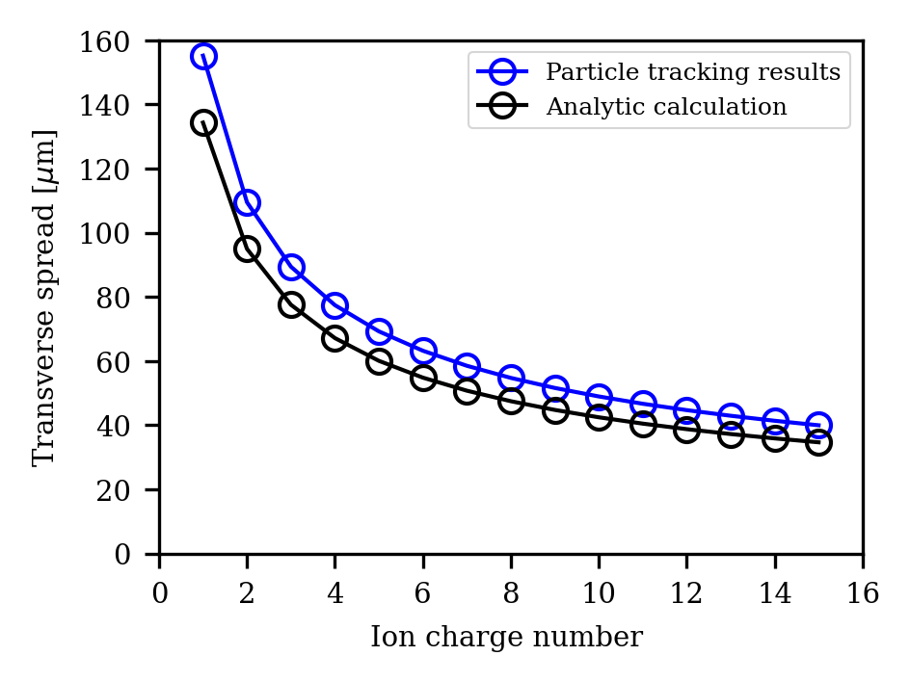
Transverse spread simulation
Transverse spread due to thermal energy
- 155 um (for +1), 49 um (for +10)
The tracking results show a 15% greater broadening compared to analytic calculations.
In the tracking simulation, the actual (defocusing) field is implemented.
→ Particles with transverse momentum are accelerated in the transverse direction the moment they deviate from the center.

Slide 21
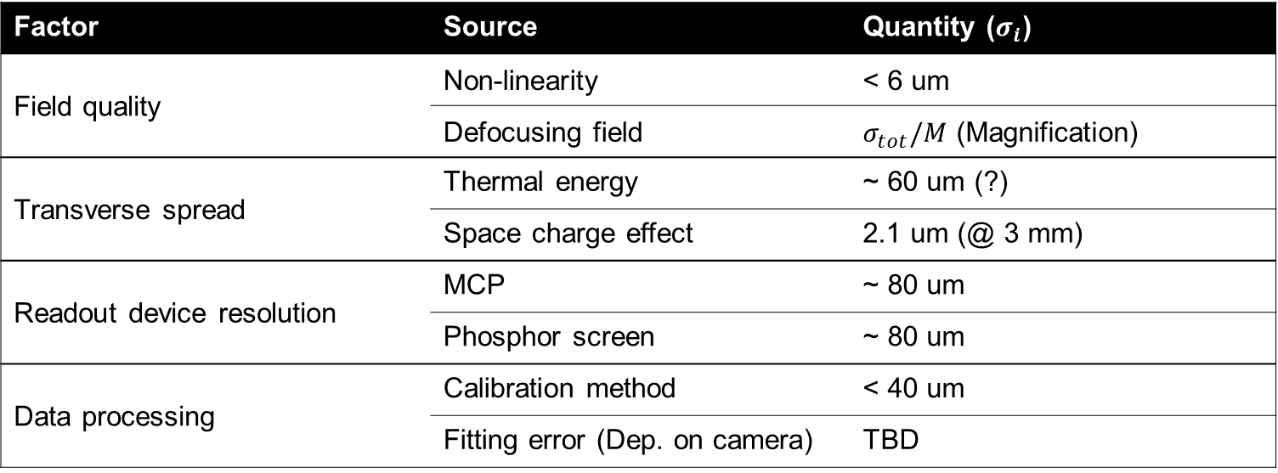

Summary
An experiment plan for the ionization profile monitor has been established.
While waiting for its fabrication, aim to calculate the resolution of the IPM.
Resolution of device $σ_{tot}=\sqrt{{\sum_{i}^{n}{σ_{i}}}^{2}}/M\sim 100 μm$
Factor | Source | Quantity ($σ_{i}$)
Field quality | Non-linearity | < 6 um
 | Defocusing field | $σ_{tot}/M$ (Magnification)
Transverse spread | Thermal energy | ~ 60 um (?)
 | Space charge effect | 2.1 um (@ 3 mm)
Readout device resolution | MCP | ~ 80 um
 | Phosphor screen | ~ 80 um
Data processing | Calibration method | < 40 um
 | Fitting error (Dep. on camera) | TBD

Slide 23

Alignment using ray-tracing
Horizontal monitor
1 mm
…
1.1 mm
1.05
1.05
monitor
Horizontal center
Vertical monitor
monitor
Vertical center

