Slide 1
Optimization of Ultrafast Electron Diffraction Facility
Minseo Jeong

Slide 2
Index
Introduction of ultrafast electron diffraction
Review of UED papers
Plans for application to eLabs UED

Slide 3
Ultrafast Electron Diffraction
Ultrafast electron diffraction(UED): Pump-probe imaging technique based on optical pump-probe spectroscopy and electron diffraction caused by ultrafast electron
D. Filippetto et al. “Ultrafast electron diffraction: Visualizing dynamic states of matter” Rev. Mod. Phys. 94, 045004 (2022).

Slide 4
Ultrafast Electron Diffraction

Slide 5
MeV Ultrafast Electron Diffraction
Using MeV electron can reduce space charge effect
High scattering cross section
Since wavelength of MeV electron is pm range, MeV UED provides high momentum resolution

Slide 6
ML and UED Optimization
ML can be used to optimize UED machine and electron beam
Ability to provide a good condition for machine startup
Capability of real-time diagnosis and tuning of beam

Slide 7
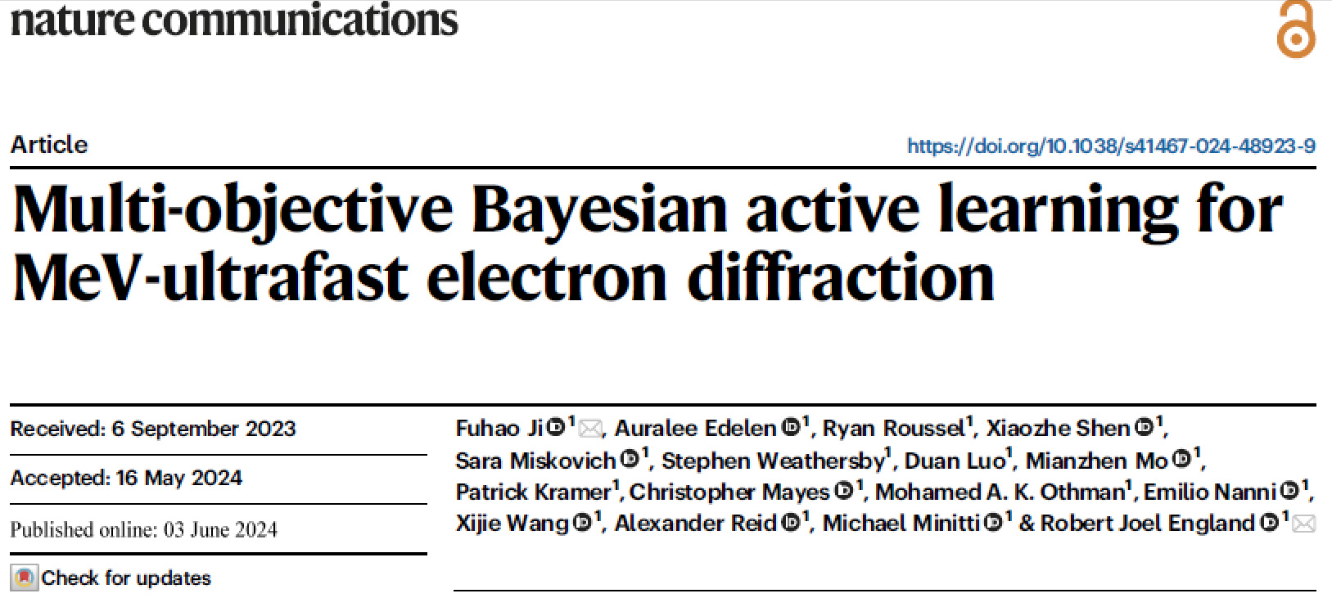
Review of UED Papers (1)

Slide 8
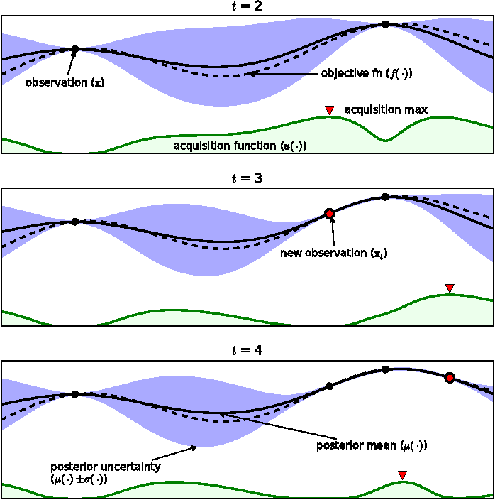
Review of UED Papers (1)
- Bayesian Optimization
Brochu, Eric, Vlad M. Cora and Nando de Freitas. “A Tutorial on Bayesian Optimization of Expensive Cost Functions, with Application to Active User Modeling and Hierarchical Reinforcement Learning.” ArXiv abs/1012.2599 (2010).

Slide 9
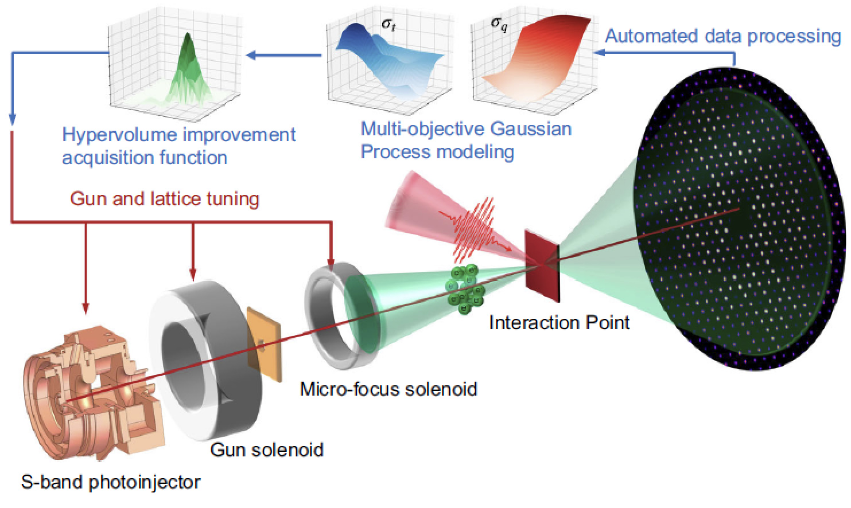
Review of UED Papers (1)
Multi-Objective Bayesian Optimization (MOBO) scheme with Gaussian processes was used for online beam tuning

Slide 10
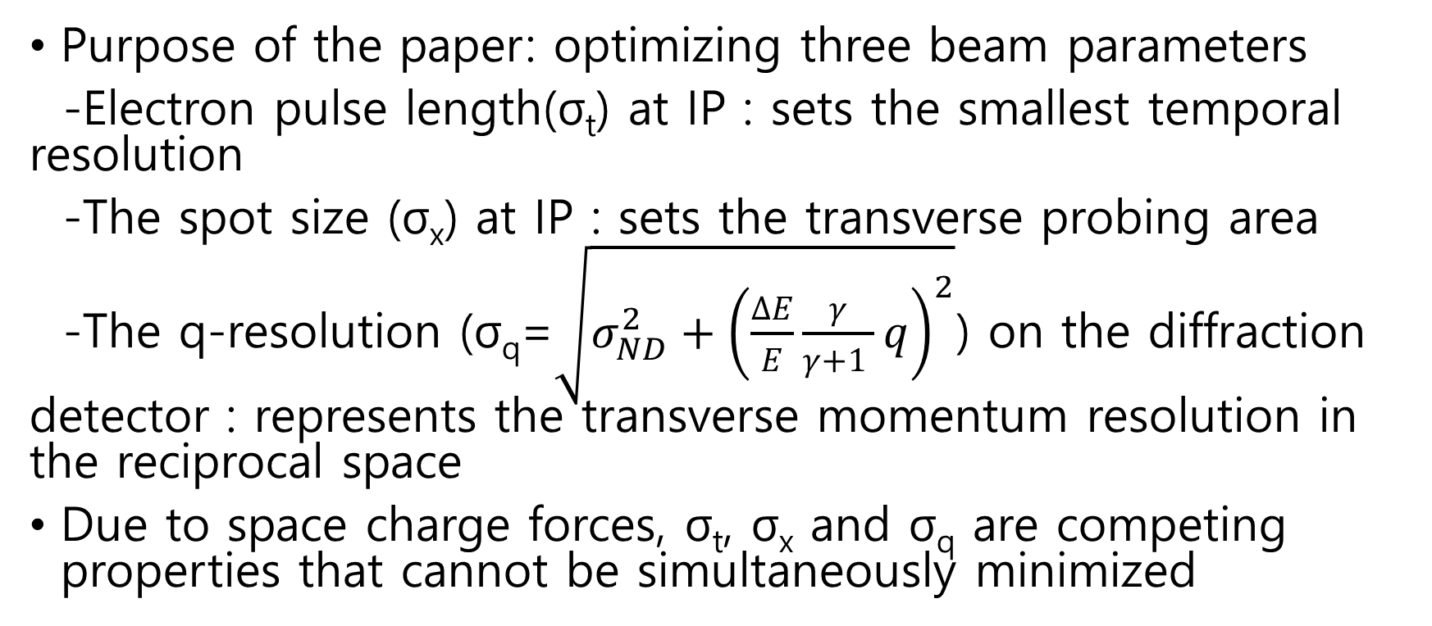
Review of UED Papers (1)
Purpose of the paper: optimizing three beam parameters
-Electron pulse length(σ_{t}) at IP : sets the smallest temporal resolution
-The spot size (σ_{x}) at IP : sets the transverse probing area
-The q-resolution (σ_{q}=$\sqrt{σ_{ND}^{2}+{\left(\frac{∆E}{E}\frac{γ}{γ+1 }q\right)}^{2}}$) on the diffraction detector : represents the transverse momentum resolution in the reciprocal space
Due to space charge forces, σ_{t}, σ_{x} and σ_{q} are competing properties that cannot be simultaneously minimized

Slide 11
Review of UED Papers (1)
Input parameters for optimization of σ_{t} and σ_{q} : Gun phase, strength of solenoids
The Expected Hypervolume Improvement (EHVI) acquisition function was used to calculate the optimal next observation point
Parameter | Range/Unit
Gun phase | [35,60] degree
Gun solenoid strength | [0.11, 0.17] T
Micro-focus solenoid strength | [0.15, 0.30] T

Slide 12
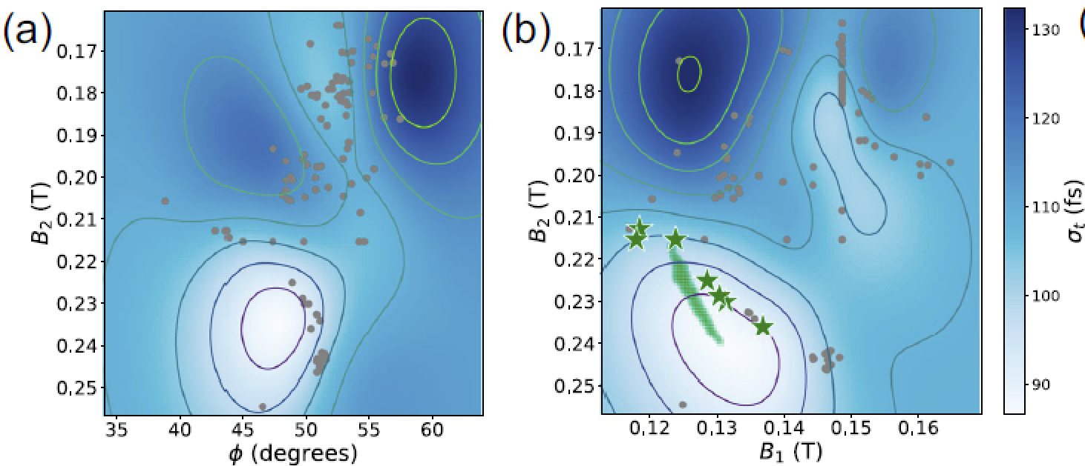
Review of UED Papers (1)

Slide 13
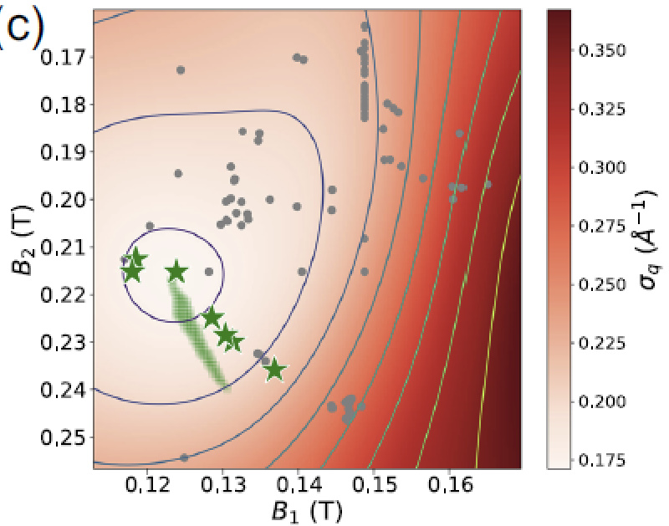
Review of UED Papers (1)

Slide 14
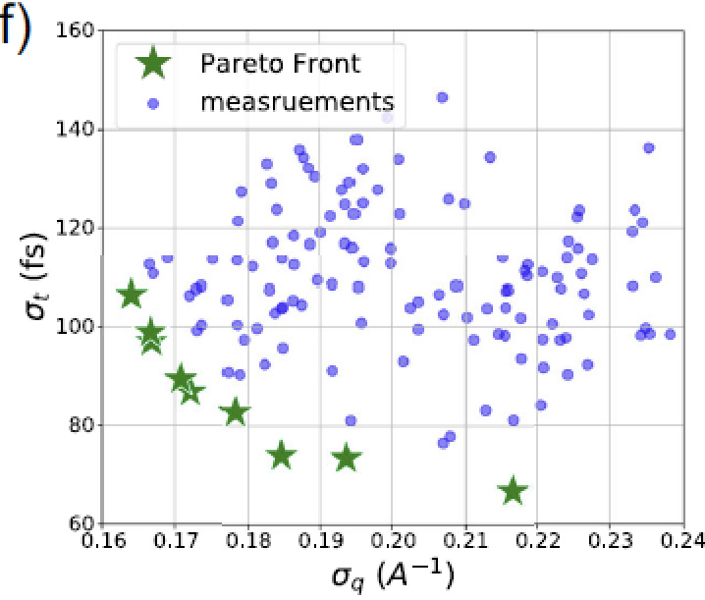
Review of UED Papers (1)

Slide 15
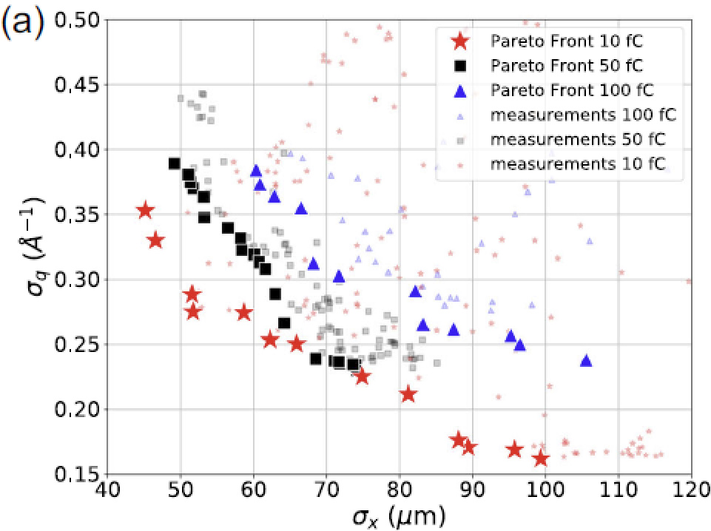
Review of UED Papers (1)
Input parameters for optimization of σ_{x} and σ_{q} : charge of bunches, strength of solenoids

Slide 16
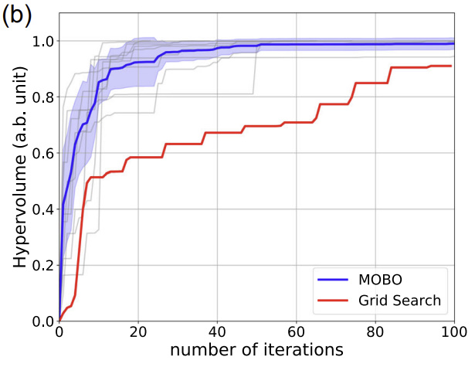
Review of UED Papers (1)

Slide 17
Review of UED Papers (1)
Challenge of MOBO: the rapidly increasing computational cost when the number of data points becomes large
-Introducing Neural Network (NN) surrogate models as the prior mean to improve the BO efficiency can be a solution

Slide 18
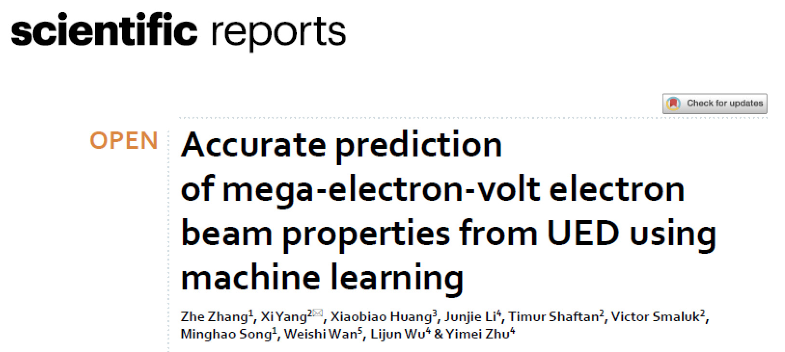
Review of UED Papers (2)

Slide 19
Review of UED Papers (2) - Introduction
Challenges of UED: Large energy spread and shot-to-shot spatial-pointing and energy jitters of the photocathode-based electron source
The real-time nondestructive measurements of the energy spread and angular divergence is required to optimize electron bunch
Diagnostics based on Bragg diffraction was developed

Slide 20
Review of UED Papers (2) - Introduction
Frequently overloads the data stream and demands more complex numerical algorithms for the data analysis due to background noise and instrument instability
→Applying the BD diagnostic in real time is currently impossible for every electron pulse
→In this paper, ML was introduced to overcome the limit

Slide 21
Review of UED Papers (2) - Simulation
GPT code was used to track transverse bunch
Electron diffraction pattern(EDP) code was used to compute electron diffraction for single crystal
Since EDP is based on the Bloch wave method, macroparticle concept was introduced for transition from GPT to EDP

Slide 22
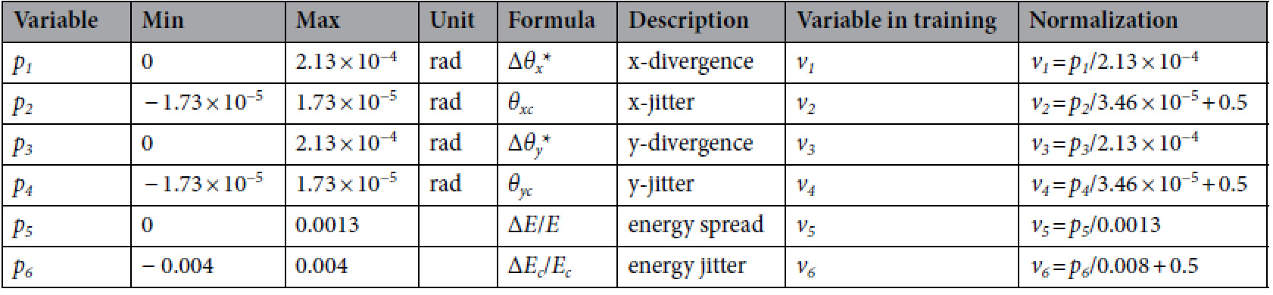
Review of UED Papers (2) - Simulation
Experimental setup of the UED facility at the BNL ATF was used to determine the ranges of variables

Slide 23
Review of UED Papers (2) - Simulation
Dataset(BD pattern images, 256×256) was generated by GPT and EDP code
Typically, the existing data are divided into three subsets: the training set, the validation set, the test set
-The training and validation sets are used to fit the model and to prevent the model from overfitting
-test set is used to check the accuracy of the trained model
Since dimension of data is high, LeNet-style convolution neural network based ML was chosen

Slide 24
Review of UED Papers (2) - Simulation
Zhang, Z., Yang, X., Huang, X. et al. ”Accurate prediction of mega-electron-volt electron beam properties from UED using machine learning.” Sci Rep 11, 13890 (2021).

Slide 25
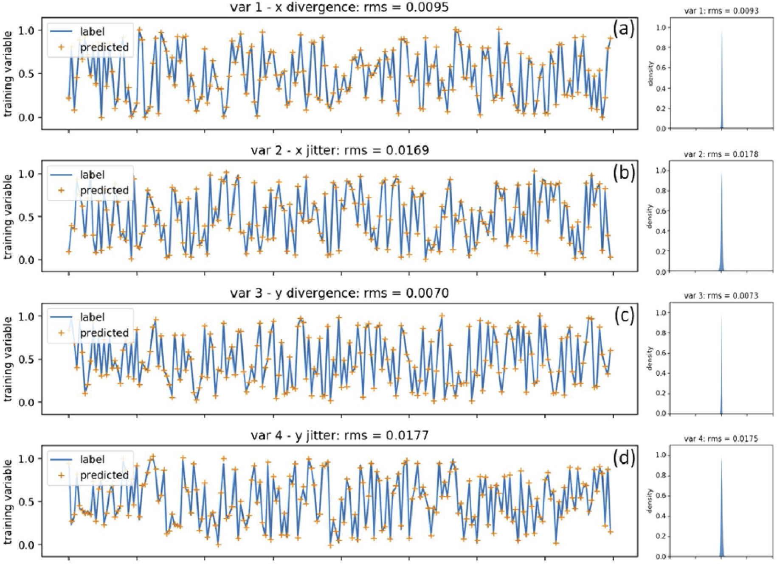
Review of UED Papers (2) - Simulation

Slide 26
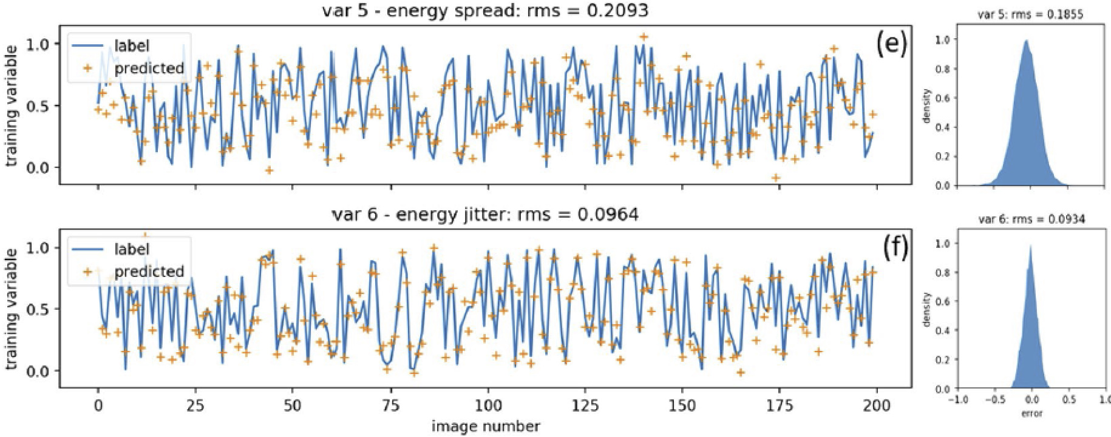
Review of UED Papers (2) - Simulation

Slide 27
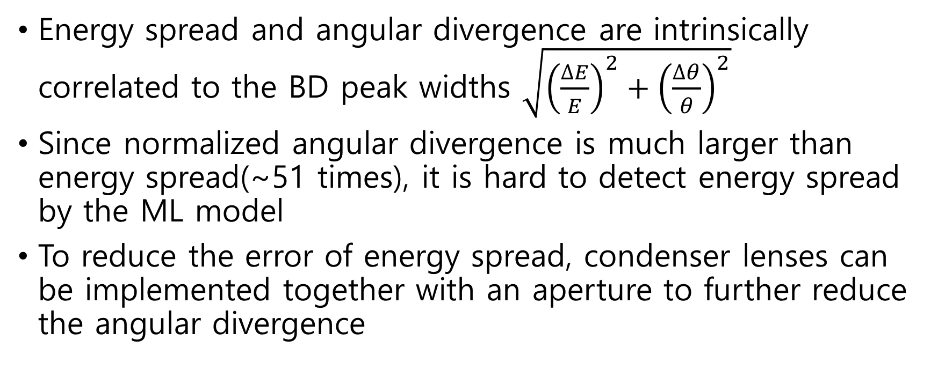
Review of UED Papers (2) - Simulation
Energy spread and angular divergence are intrinsically correlated to the BD peak widths $\sqrt{{\left(\frac{∆E}{E}\right)}^{2}+{\left(\frac{∆θ}{θ}\right)}^{2}}$
Since normalized angular divergence is much larger than energy spread(~51 times), it is hard to detect energy spread by the ML model
To reduce the error of energy spread, condenser lenses can be implemented together with an aperture to further reduce the angular divergence

Slide 28
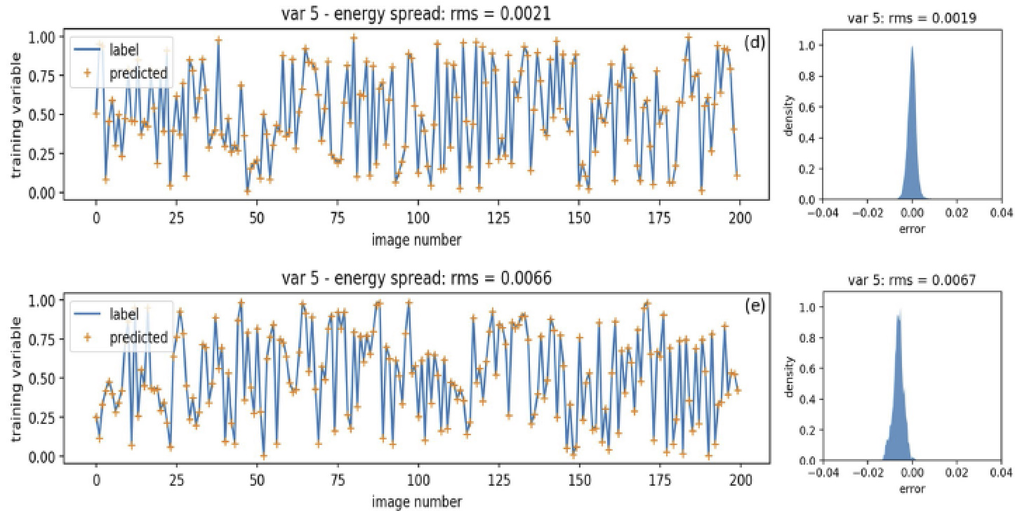
Review of UED Papers (2) - Simulation

Slide 29
Review of UED Papers (2) - Experiment
Since it is hard to achieve 10⁻⁴ precision with respect to the fitted peak width, it is impossible to predict divergence and energy spread with high fidelity
Due to condition of UED facility at the BNL ATF, differentiating the peak broadening due to the energy spread and angular divergence is not available
→Only spatial and energy jitter was used for training

Slide 30
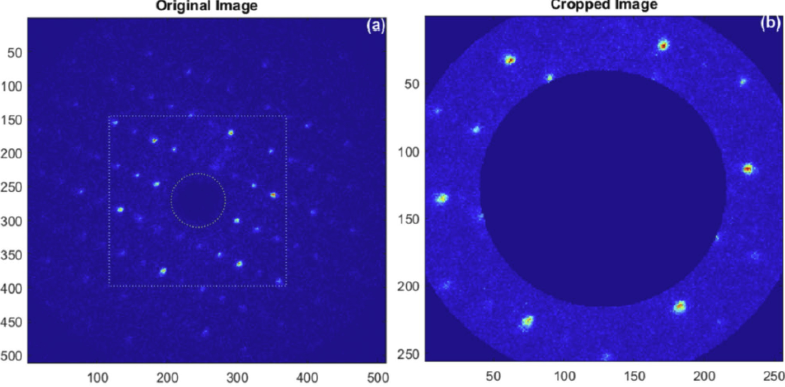
Review of UED Papers (2) - Experiment

Slide 31
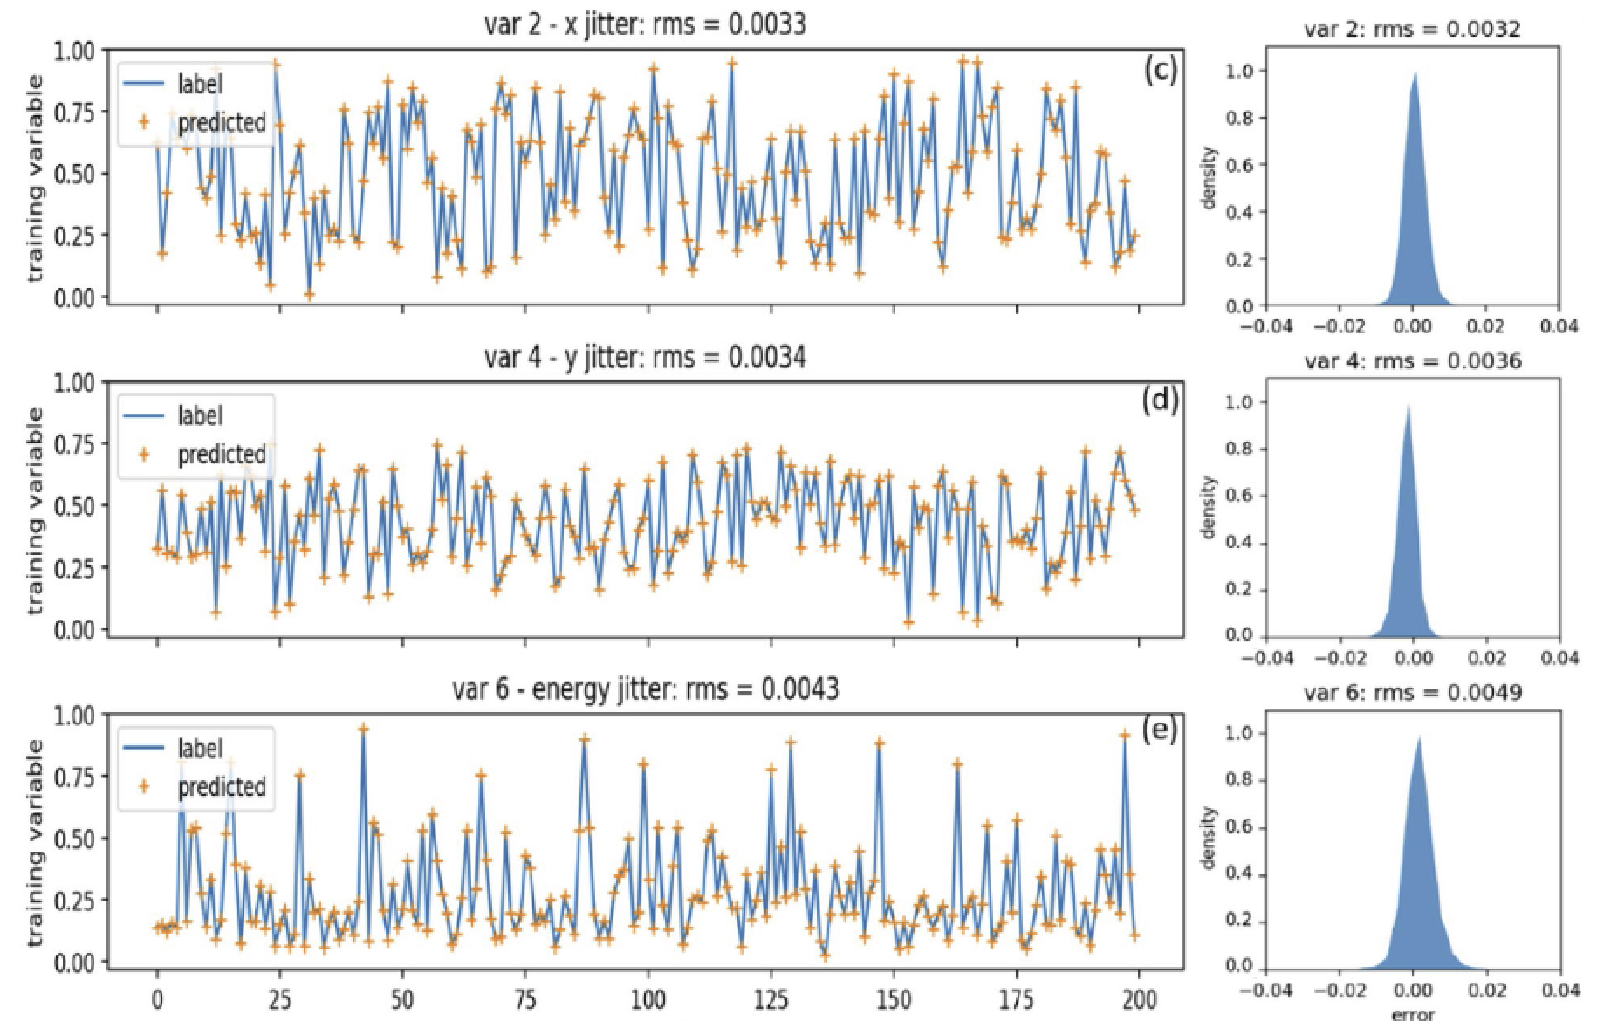
Review of UED Papers (2) - Experiment

Slide 32
Review of UED Papers (2) - Experiment

Slide 33
Review of UED Papers (2) - PCT
To reduce training time, polar coordinate transformation(PCT) was implemented
By PCT, training time was reduced by 40%, with cost of prediction accuracy

Slide 34
Review of UED Papers (2) - PCT

Slide 35
Review of UED Papers (2) - PCT

Slide 36
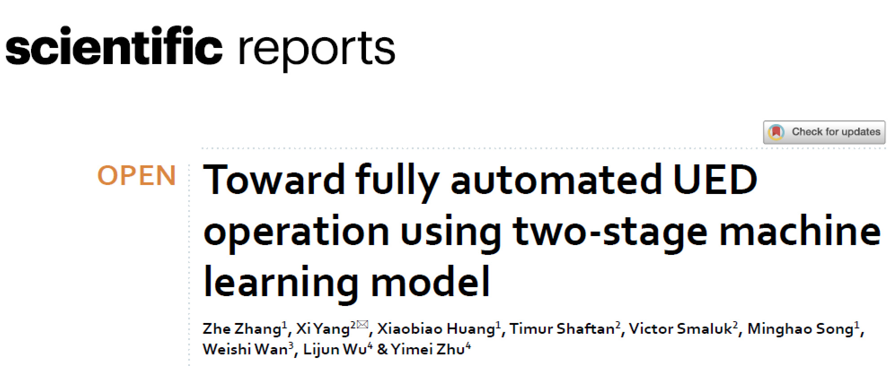
Review of UED Papers (3)

Slide 37
Review of UED Papers (3)
Zhang, Z., Yang, X., Huang, X. et al. Toward fully automated UED operation using two-stage machine learning model. Sci Rep 12, 4240 (2022).

Slide 38
Review of UED Papers (3) - GTS
GPT simulations from the gun to the sample were used to provide training datasets
Criteria for choosing machine parameters for training:
- Parameters determining the electron beam dynamics
- Correlation with the output of the simulation
- Necessity in determining the electron beam properties at the sample
- Fluctuant, needed to be constantly tuned during an experiment.

Slide 39
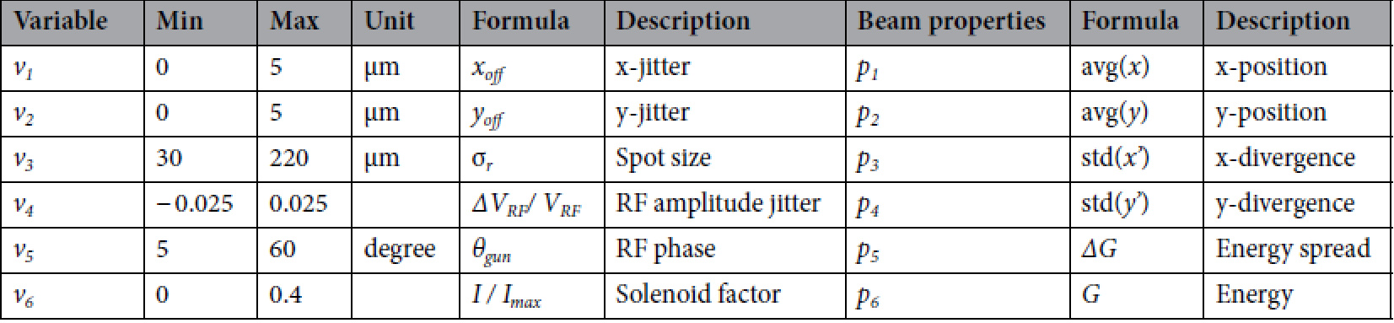
Review of UED Papers (3) - GTS

Slide 40
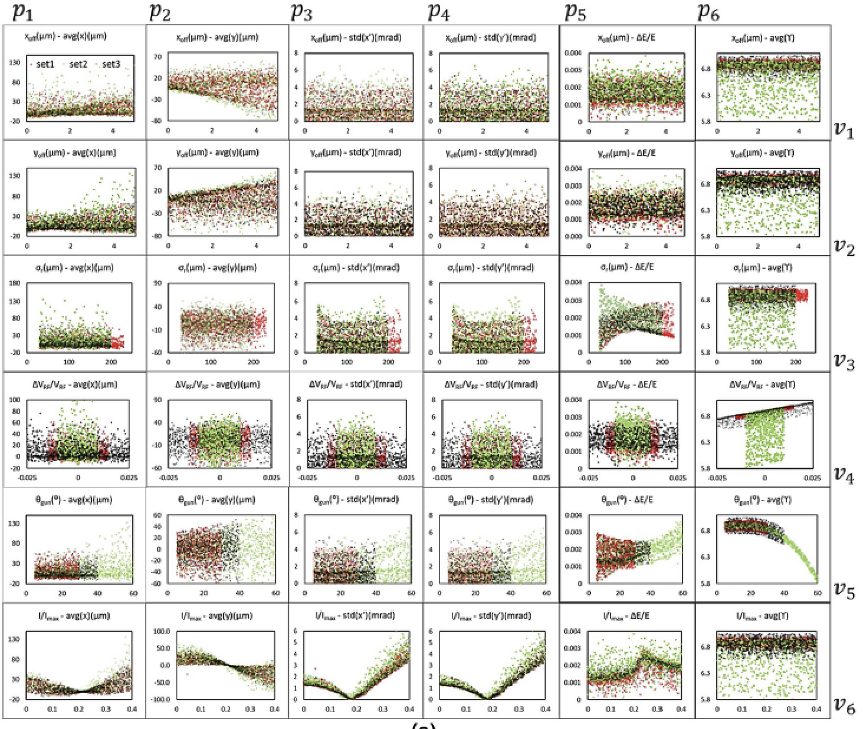
Review of UED Papers (3) - GTS

Slide 41
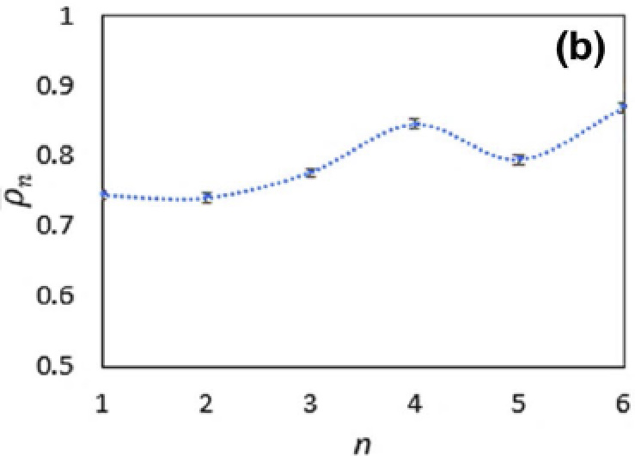

Review of UED Papers (3) - GTS
Mean correlation ${\overline{ρ}}_{n}=\sum_{j=1}^{6}{\frac{ρ_{n,j}}{6}}, ρ_{n,j}=\frac{\sum_{i=1}^{M}{v_{n}^{\left(i\right)}∙p_{n}^{\left(i\right)}}}{\sqrt{\sum_{i=1}^{M}{v_{n}^{\left(i\right)2}}∙\sum_{i=1}^{M}{p_{n}^{\left(i\right)2}}}}$

Slide 42
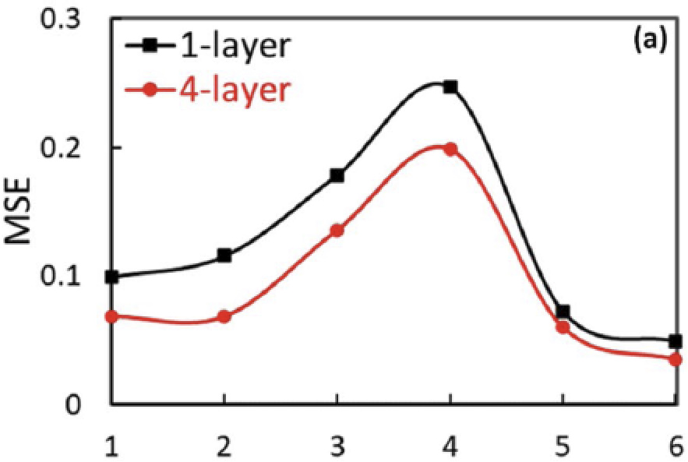
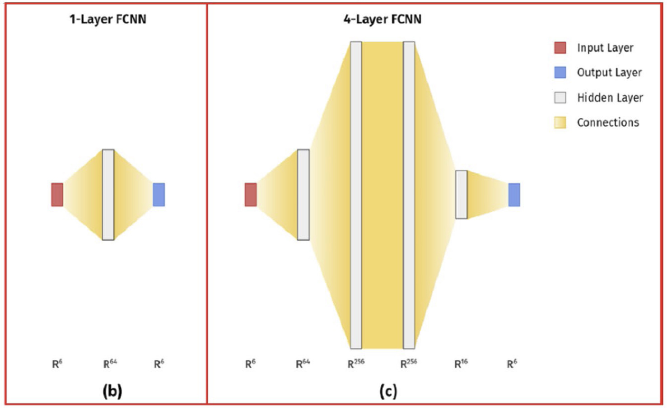
Review of UED Papers (3) - GTS

Slide 43
Review of UED Papers (3) - GTS
Since v₃(spot size), v₄(RF jitter), v₅(RF phase) are machine parameters with significant impact on the space charge effect, these parameters are varied in GPT simulations to generate three different training datasets for comparison

Slide 44
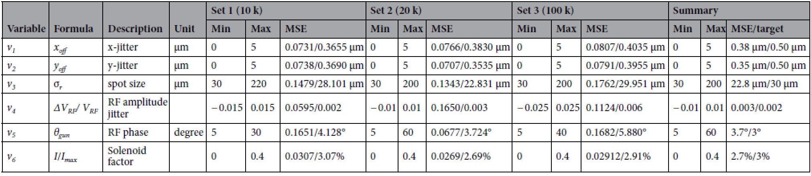
Review of UED Papers (3) - GTS

Slide 45
Review of UED Papers (3) - GTS

Slide 46
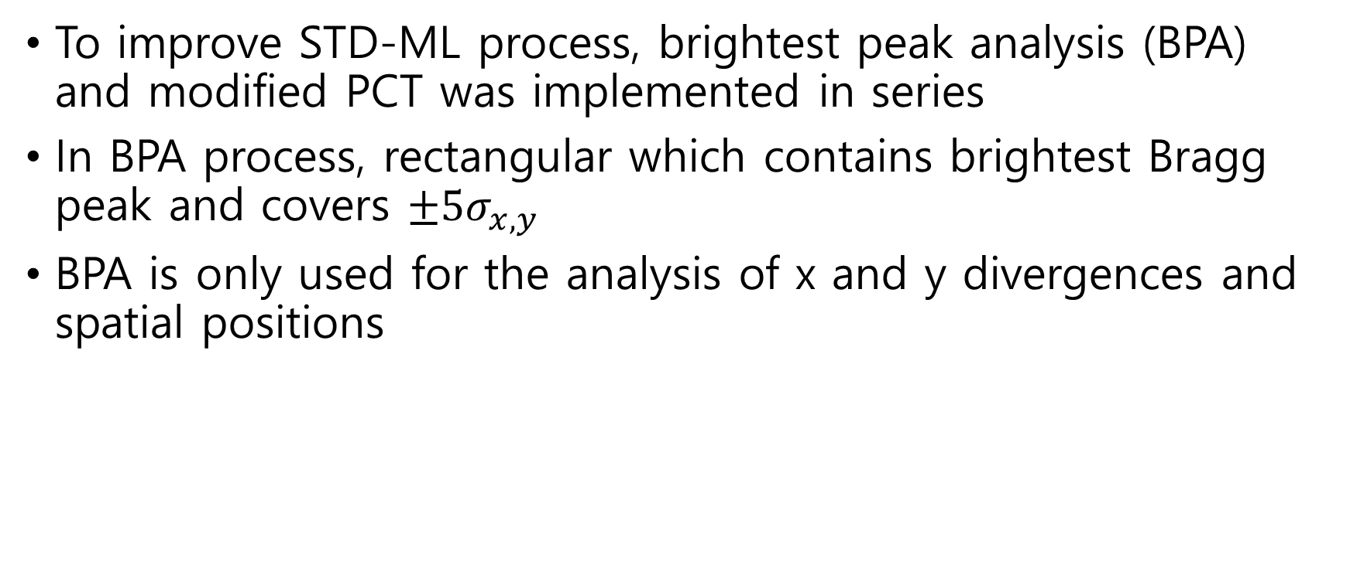
Review of UED Papers (3) - STD
To improve STD-ML process, brightest peak analysis (BPA) and modified PCT was implemented in series
In BPA process, rectangular which contains brightest Bragg peak and covers $±5σ_{x,y}$
BPA is only used for the analysis of x and y divergences and spatial positions

Slide 47
Review of UED Papers (3) - STD

Slide 48
Review of UED Papers (3) – STD(PCT)
Obtain x and y position jitters for each BD pattern by BPA
Remove x and y position jitters from each BD pattern
Apply modified PCT to BD patterns which sets the center of BD pattern as an origin point of PCT
Train an ML model with the PCT-BD patterns as the input, which only predicts the energy spread and the energy

Slide 49
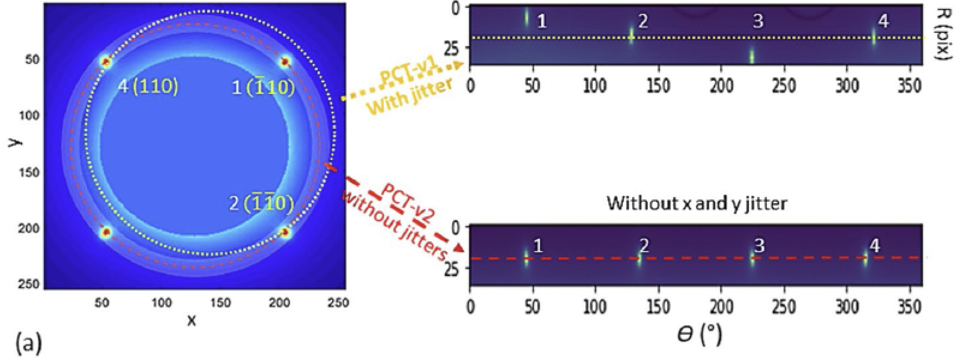
Review of UED Papers (3) - STD

Slide 50
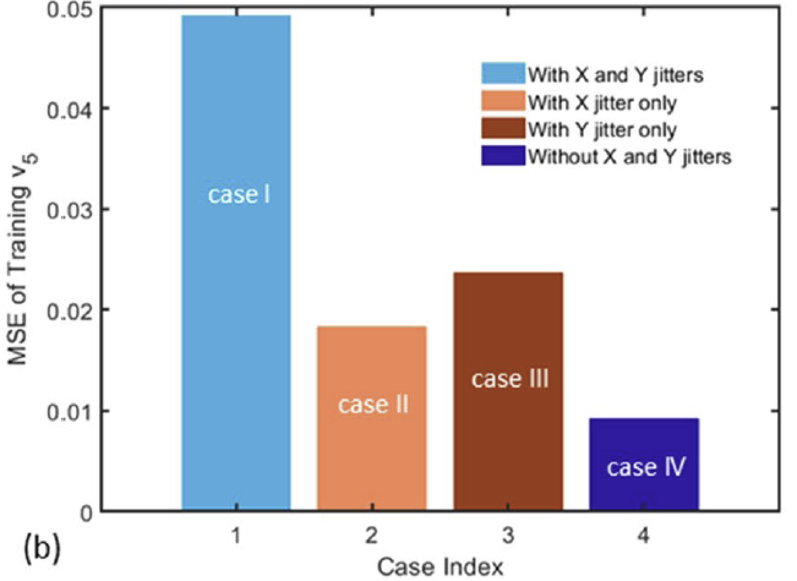
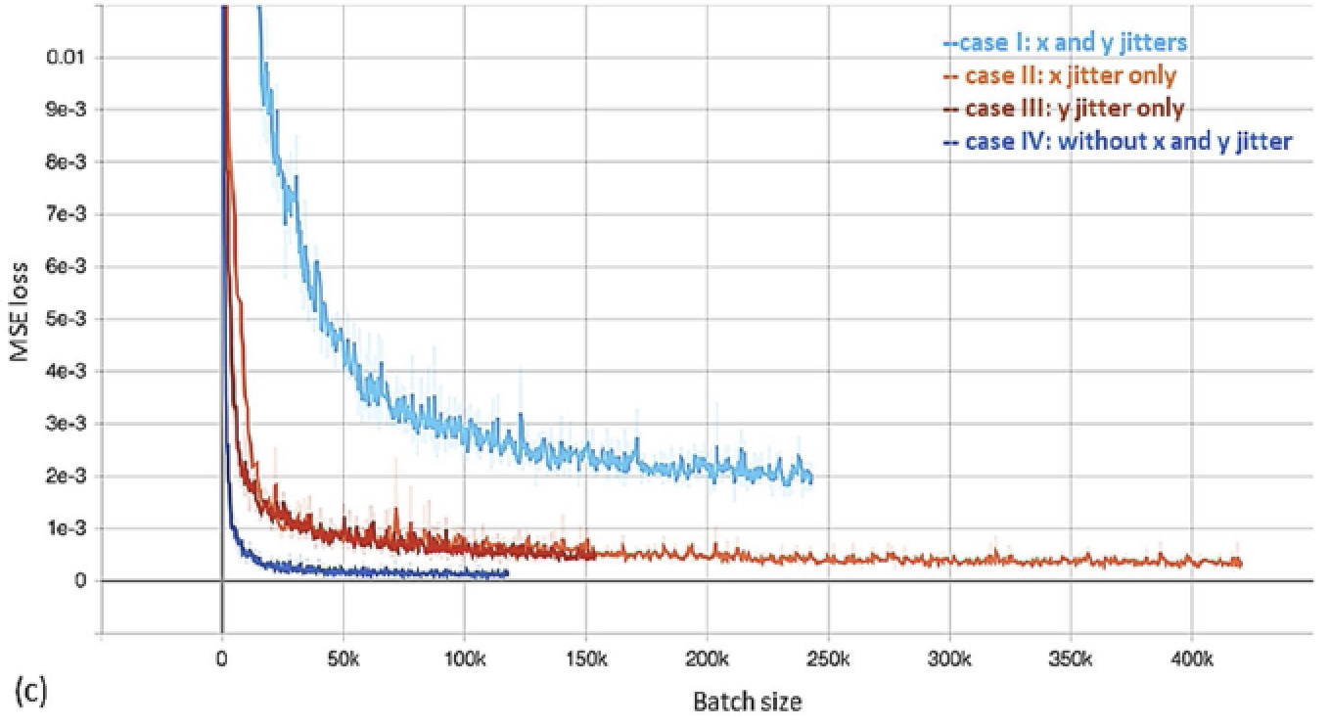
Review of UED Papers (3) - STD

Slide 51
Future Plans - Optimization of eLabs UED Machine
Main goal: Optimization of machine parameters (and electron beam parameters if possible)
Beam alignment
Implementation of MOBO-based machine learning
Introduction of NN surrogate models
Application for optimization of other machine parameters
(e.g. spatial jitter, RF amplifier jitter)

Slide 52
Future Plans - Optimization of eLabs UED Machine
Beam simulation code(GPT/ASTRA)
Data analysis code(Python/Matlab)

