Slide 1


Machine Learning and Accelerator
K. M. Nam¹
¹Division of Advanced Nuclear Engineering, Pohang University of Science and Technology (POSTECH)

Slide 2
Outline
1. Machine Learning Basic
- Learning
- Each Type of Machine Learning
- FEL Simulation Result
2. Application to MOGA (Unsupervised Learning)
- MOGA and Machine Learning
- Machine Learning Layout
- Optimization Result
3. Virtual Diagnostics (Supervised Learning)
- Introduction
- Prediction using Simulation (FACET-II)
- Prediction using Experiment (LCLS)

Slide 3
1. Machine Learning Basic

Slide 4
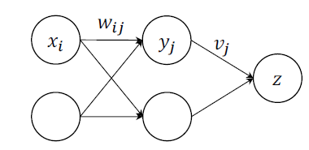

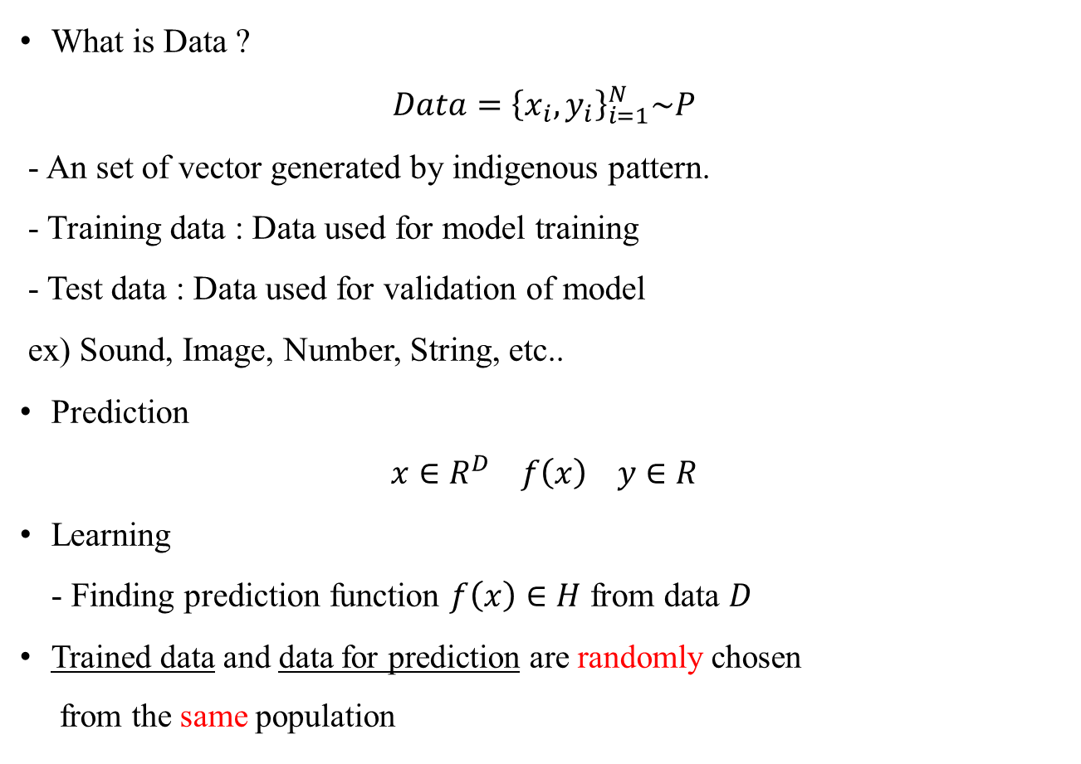
Learning
What is Data ?
$Data={\left\{x_{i},y_{i}\right\}}_{i=1}^{N}\sim P$
- An set of vector generated by indigenous pattern.
- Training data : Data used for model training
- Test data : Data used for validation of model
ex) Sound, Image, Number, String, etc..
Prediction
$x∈R^{D} f\left(x\right) y∈R$
Learning
- Finding prediction function $f\left(x\right)∈H$ from data $D$
Trained data and data for prediction are randomly chosen
from the same population
What is “Learning”?
- E:experience (data)
- T:tasks (output)
- P:performance measure (Target function)
In Neural network
- Finding $w_{ij}, v_{j}$ minimizing error

Slide 5
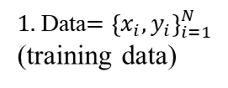
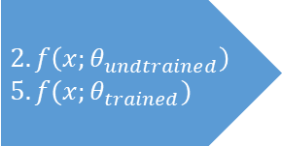
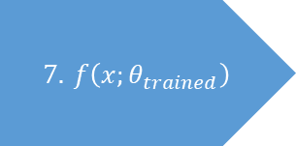
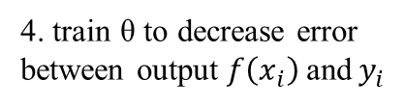
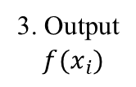
Supervised Learning
Learning from examples (training data) and classifying an unseen data
Supervised Learning
Input Output Pairs available
Make prediction for unknown input based on experience from given example
Untrained Predictor
Trained Predictor
$1.$ Data$={\left\{x_{i},y_{i}\right\}}_{i=1}^{N}$
(training data)
$$2. f\left(x;θ_{undtrained}\right) \\ 5. f(x;θ_{trained})$$
$$7. f\left(x;θ_{trained}\right)$$
3. Output
$$f(x_{i})$$
6. Unlabeled Data x
8. Label (6)
4. train θ to decrease error
between output $f\left(x_{i}\right)$and$y_{i}$
Repeat this process to
minimize error
Regression, Classification etc…
[Based on the assumption of regularity]

Slide 6
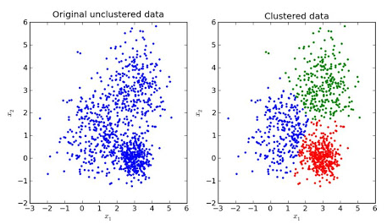
Unsupervised Learning
Type of machine learning that looks for previously undetected patterns in a data set with no pre-existing labels and clusters data into several pieces
Unsupervised Learning
Only input data is given
Learn structures and patterns
Clustering, Anomaly detection etc..

Slide 7
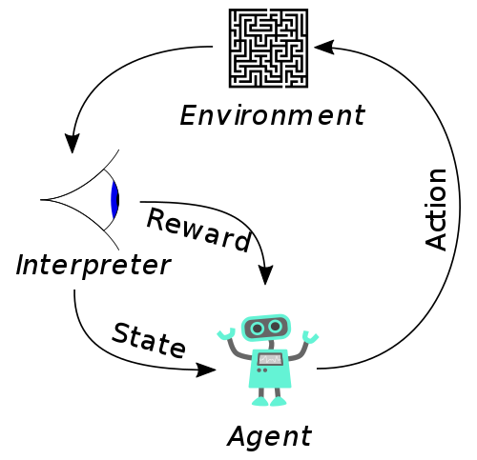
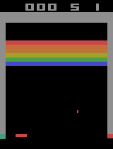
Reinforcement Learning
Machine learning concerned with how software agents ought to take actions in an environment in order to maximize the notion of cumulative reward.
Reinforcement Learning
No training Data
Interact with an environment
Trying to learn optimal sequences of decisions
AlphaGo, Automatic Driving..
Environment : Ball position, Block position, Bar position…
Reward : Score

Slide 8
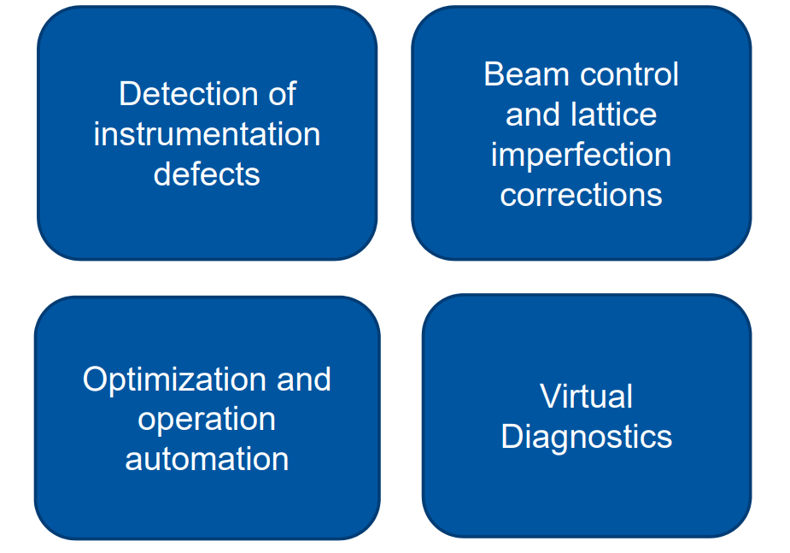
Potential of ML for Accelerator
Application of Machine Learning to Beam Diagnostics 39th FEL Conference, Hamburg Elena Fol

Slide 9
2. Application to MOGA (Unsupervised Learning)

Slide 10
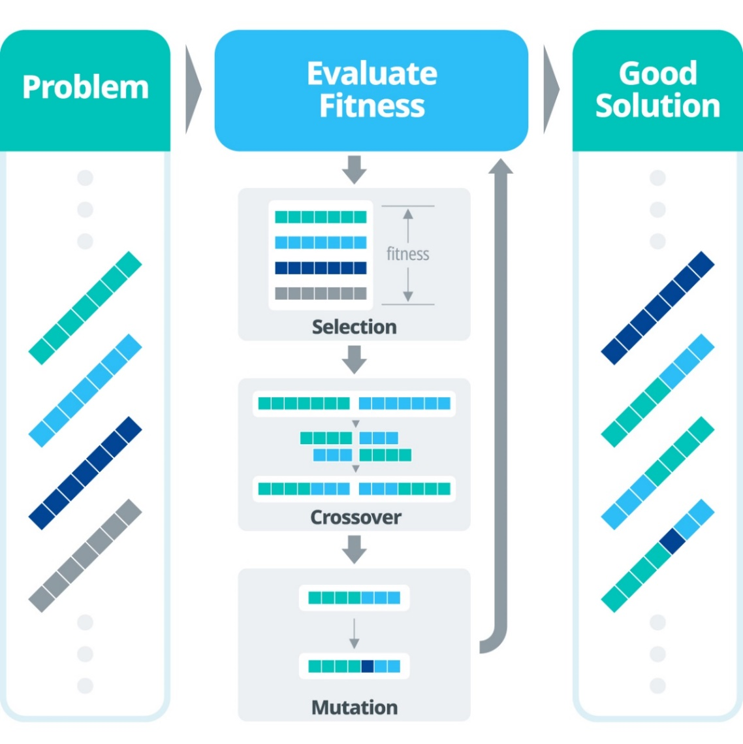
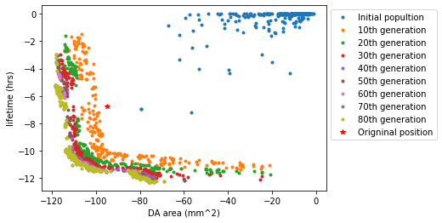
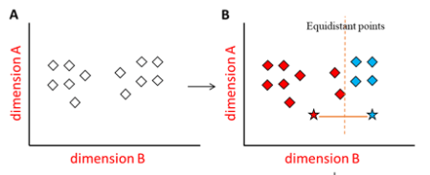
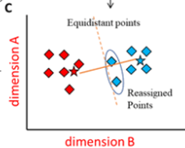
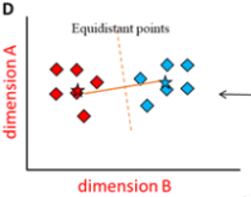
MOGA and Unsupervised Learning
Multi-Objective Genetic Algorithm (MOGA)
MOGA in Accelerator
Good
Bad
Elite
K-Mean Method

Slide 11
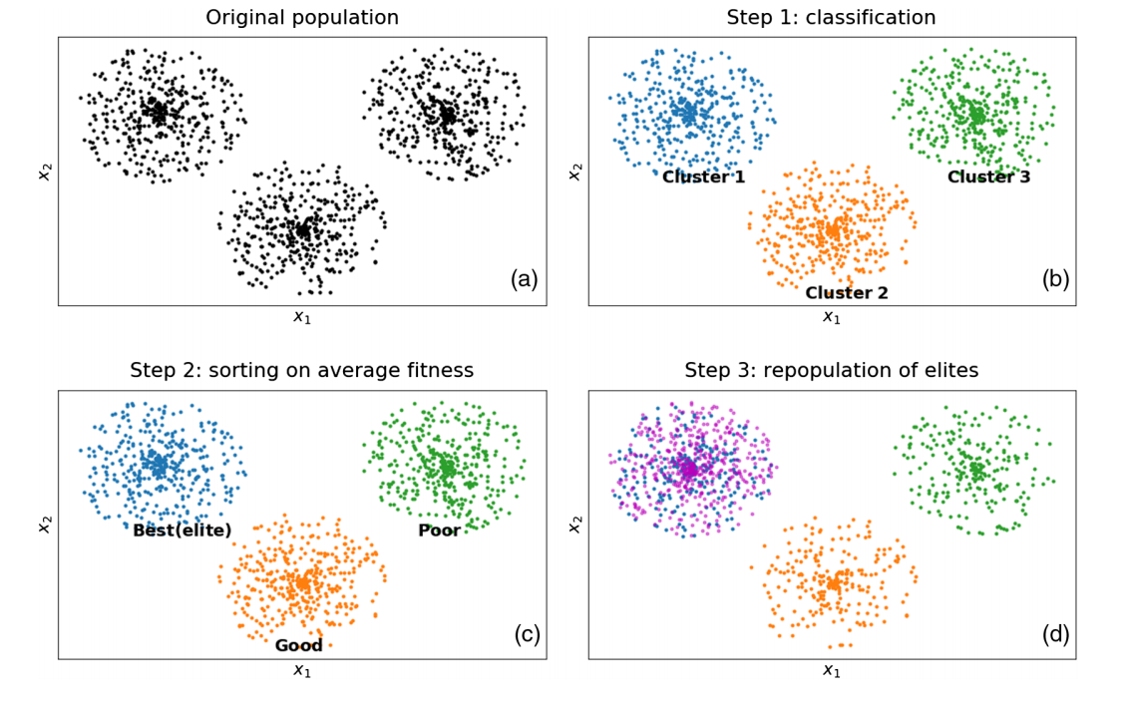
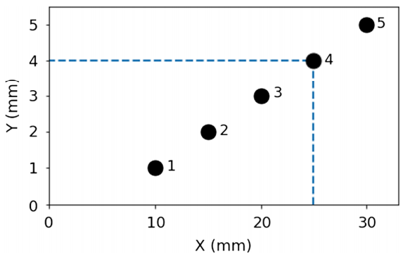
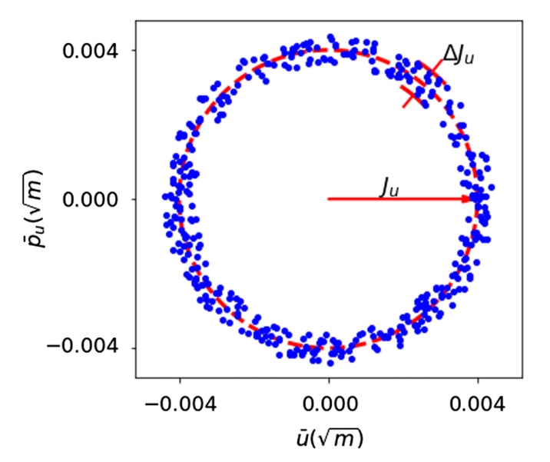
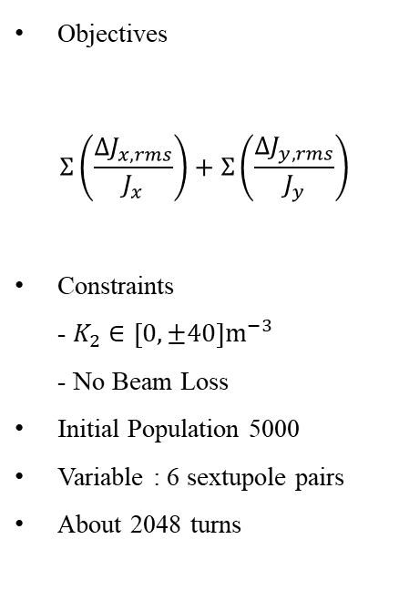
Application to MOGA (NSLS-II)
Objectives
$$Σ\left(\frac{ΔJ_{x,rms}}{J_{x}}\right)+Σ\left(\frac{ΔJ_{y,rms}}{J_{y}}\right)$$
Constraints
- $K_{2}∈\left[0,±40\right]m^{−3}$
- No Beam Loss
Initial Population 5000
Variable : 6 sextupole pairs
About 2048 turns
Initial condition
(a) Initial population distribution with two free variables.
(b) Candidates clustered via K-means.
(c) Clusters labeled “Best (elite),” “Good,” and “Poor” based on average fitness.
(d) Competitive candidates (magenta) added to “Best (elite),” lowering densities in other clusters.

Slide 12
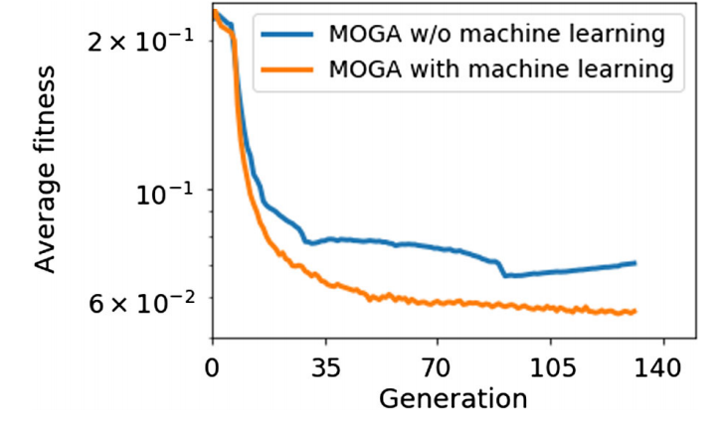
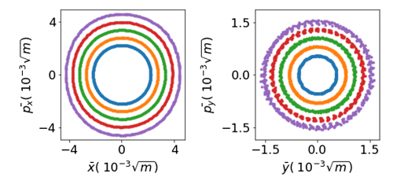
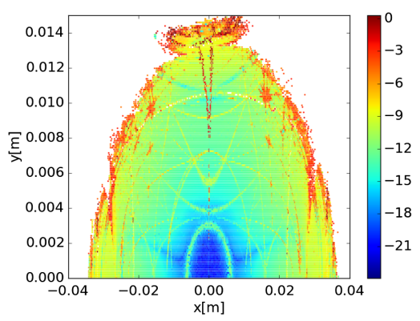
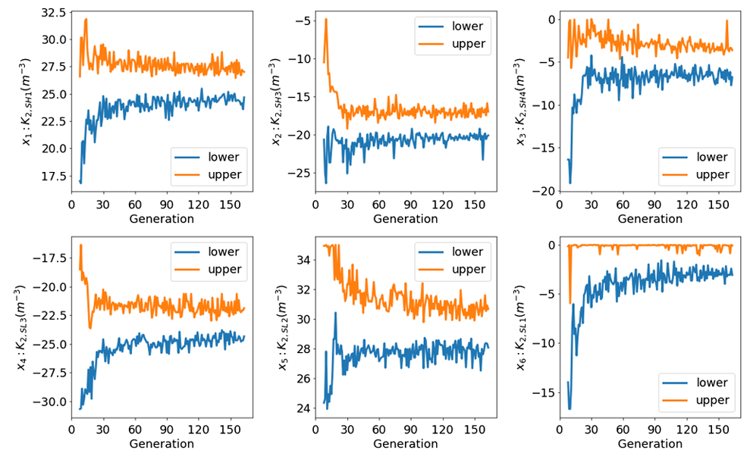
Optimization Result
Fitness
Trajectory
Dynamic Aperture (1 Case)
Low speed for one generation, but it needs small number of generation.
It shows lower average fitness, it can improve time consumption problem and performance.
It can be used to design lattice or other complex optimization.
Sextupole Distribution

Slide 13
3. Virtual Diagnostics (Supervised Learning)

Slide 14
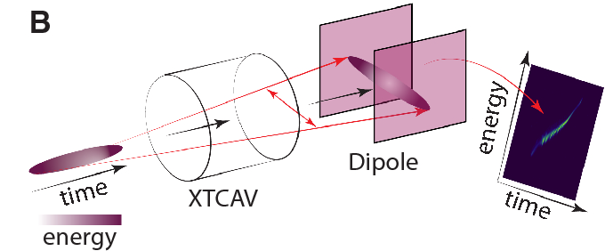
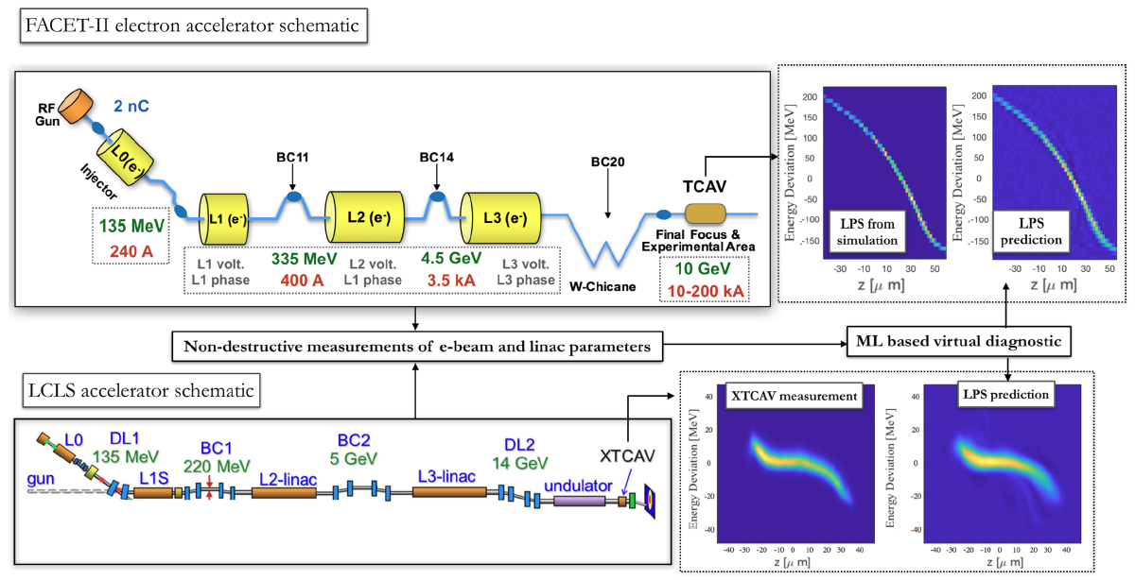
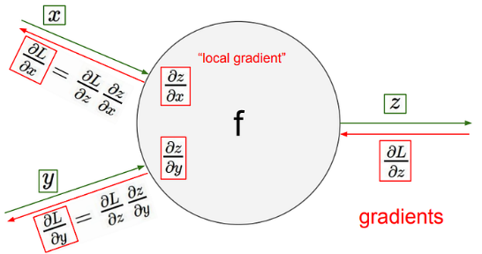
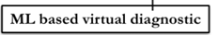
Introduction
Alexander Scheinker, Scientific Reports, 2024
High-intensity beams damage interceptive diagnostics.
Destructive diagnostics can't be used during experiments.
Traditional tools can't measure very short pulses effectively.
Beam quality is compromised without real-time monitoring.
C. Emma et al., PRAB, 2018

Slide 15
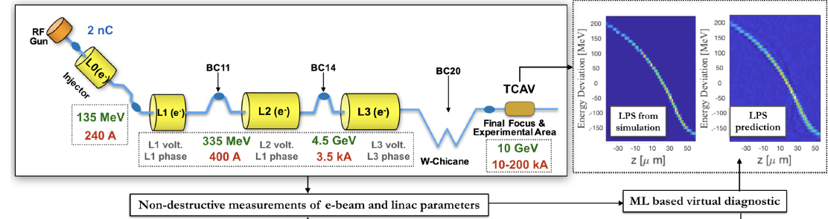
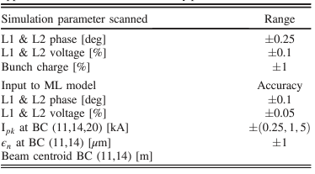
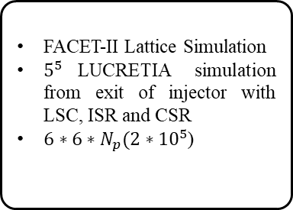
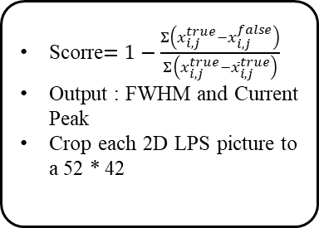
Training Process (FACET-II)
1. Data Extraction
2. Training
3. Prediction
FACET-II Lattice Simulation
$5^{5}$LUCRETIA simulation from exit of injector with LSC, ISR and CSR
$6∗6∗N_{p}(2∗{10}^{5}$)
Input : RF phase, voltage, Current peak, emittance and Beam centroid,
Three hidden layer (200,100,50)- neuron fully connected feed-forward NN with a relu
Scorre$=1−\frac{Σ\left(x_{i,j}^{true}−x_{i,j}^{false}\right)}{Σ\left(x_{i,j}^{true}−{\overline{x}}_{i,j}^{true}\right)}$
Output : FWHM and Current Peak
Crop each 2D LPS picture to a 52 * 42

Slide 16
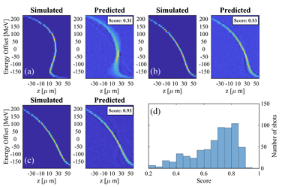
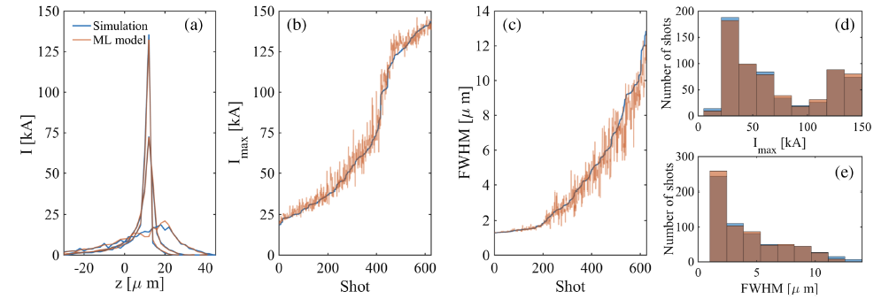
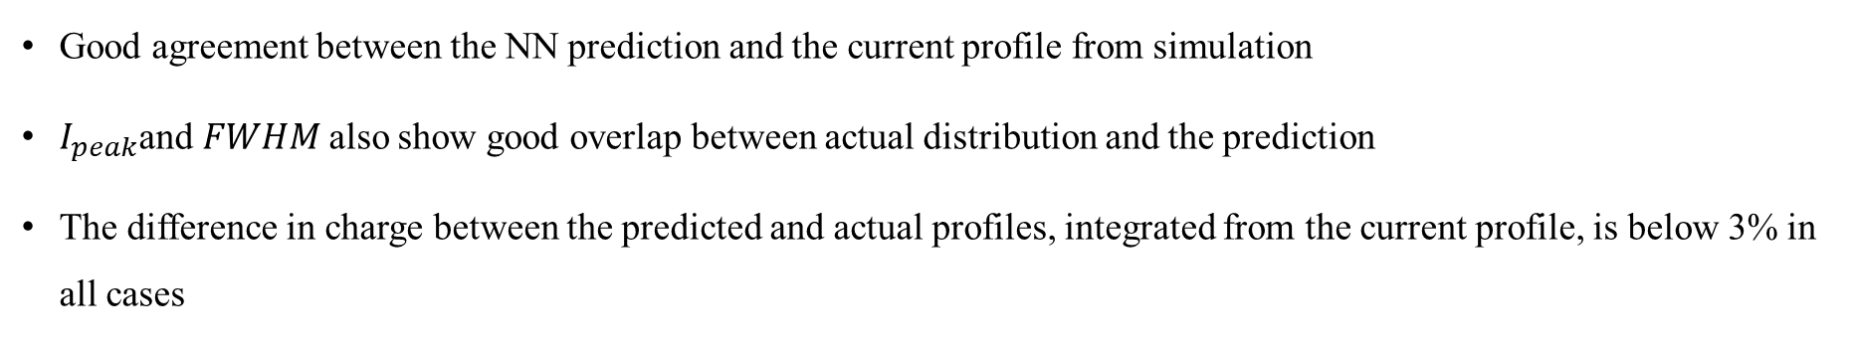
Prediction Result (Simulation)
Good agreement between the NN prediction and the current profile from simulation
$I_{peak}$and $FWHM$also show good overlap between actual distribution and the prediction
The difference in charge between the predicted and actual profiles, integrated from the current profile, is below 3% in all cases

Slide 17
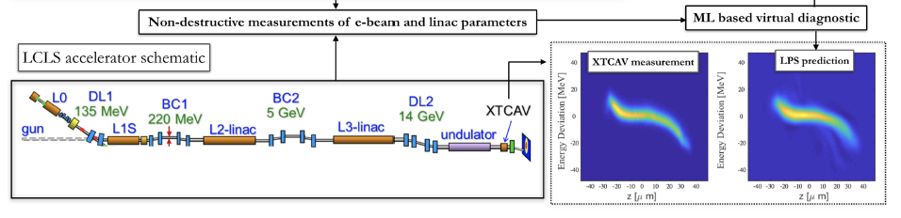
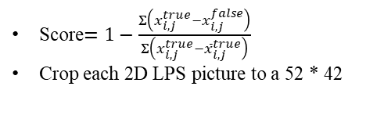
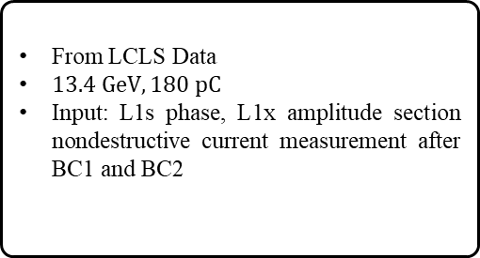
LCLS Prediction
1. Data Extraction
2. Training
3. Prediction
From LCLS Data
$13.4 GeV, 180 pC$
Input: L1s phase, L1x amplitude section nondestructive current measurement after BC1 and BC2
Input : RF phase, voltage, Current peak, emittance and Beam centroid,
Three hidden layer (200,100,50) - neuron fully connected feed-forward NN with a relu
Score$=1−\frac{Σ\left(x_{i,j}^{true}−x_{i,j}^{false}\right)}{Σ\left(x_{i,j}^{true}−{\overline{x}}_{i,j}^{true}\right)}$
Crop each 2D LPS picture to a 52 * 42

Slide 18
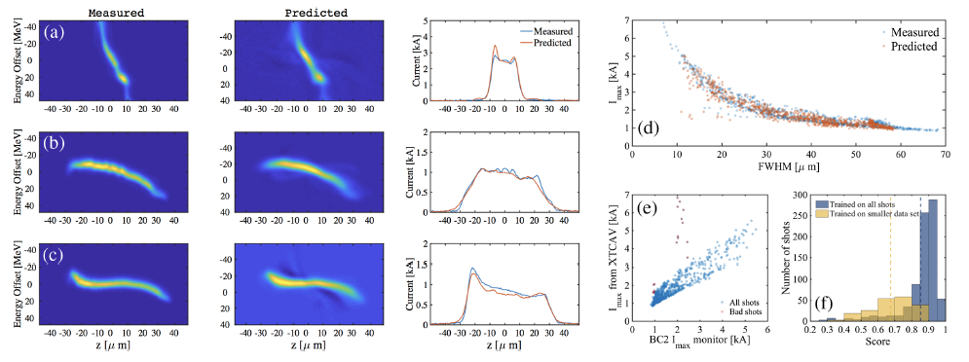
LCLS LPS Prediction
At high peak current (I > 4 kA) over nominal setting, model fails.
The low accuracy is correlated to the large discrepancy between measurement of BC2 and XTCAV

Slide 19
Summary
Machine Learning: Method of performance improvement by using data
This work shows chance for enhancing optimization efficiency in dynamic aperture, offering a powerful approach for complex accelerator design.
It demonstrates the potential of machine learning for nondestructive real-time monitoring of particle accelerator phase space

Slide 20
Thank you

