Slide 1


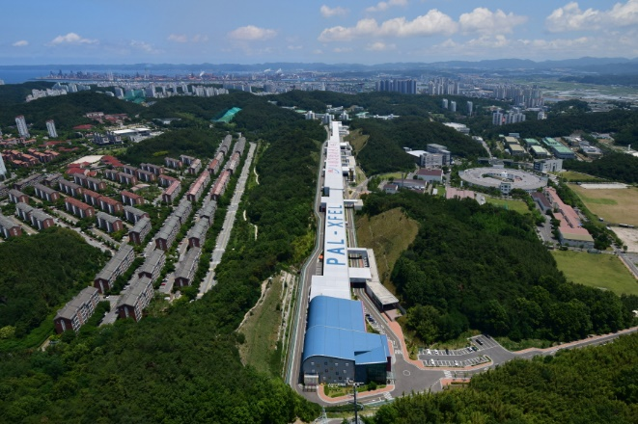

Journal Klub for Pohang Scientists (aka JKPS)
Journal Klub for Pohang Scientists (aka JKPS)
Jimin Seok
4GSR Beam Dynamics Group
Pohang Accelerator Laboratory, POSTECH
2024.10.18

Slide 2
Journal Klub for Pohang Scientists (aka JKPS)
Aim of journal club
According to ChatGPT, the aim of a journal club is
"The aim of a journal club is to critically analyze and discuss academic papers. Through this, participants can keep up with the latest research trends, evaluate research methodologies and results, and enhance their knowledge and research skills. A journal club also promotes academic discussions, helping participants to share opinions and develop critical thinking skills.“
This club meets regularly every Friday at 4 p.m.
The location is here, and if it change in the future, I will notify you.
Every week, a club member will present a selected paper. The paper should be announced a week in advance.
The presentation time is ~30 min.
If you avoid the scheduled presentation, there will be a significant penalty.
Additionally, if you come unprepared, be ready to face serious consequences.
Official language of the club is English.

Slide 3
Journal Klub for Pohang Scientists (aka JKPS)
Aim of journal club
Next week, let’s have each member present their current research (~15 min)
I occasionally plan to invite speakers from PAL or other facilities
If you don’t want to remain in this club, please feel free to leave today.

Slide 4

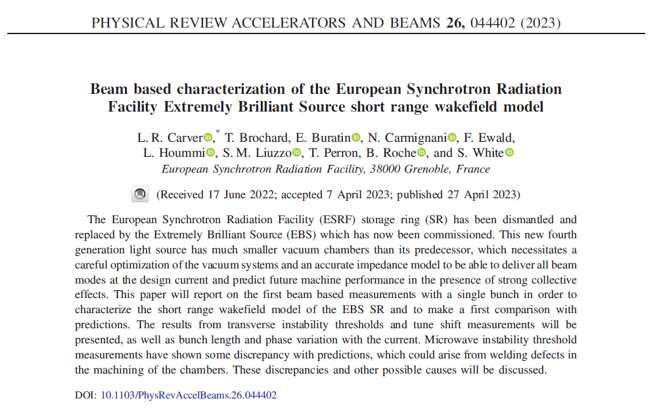
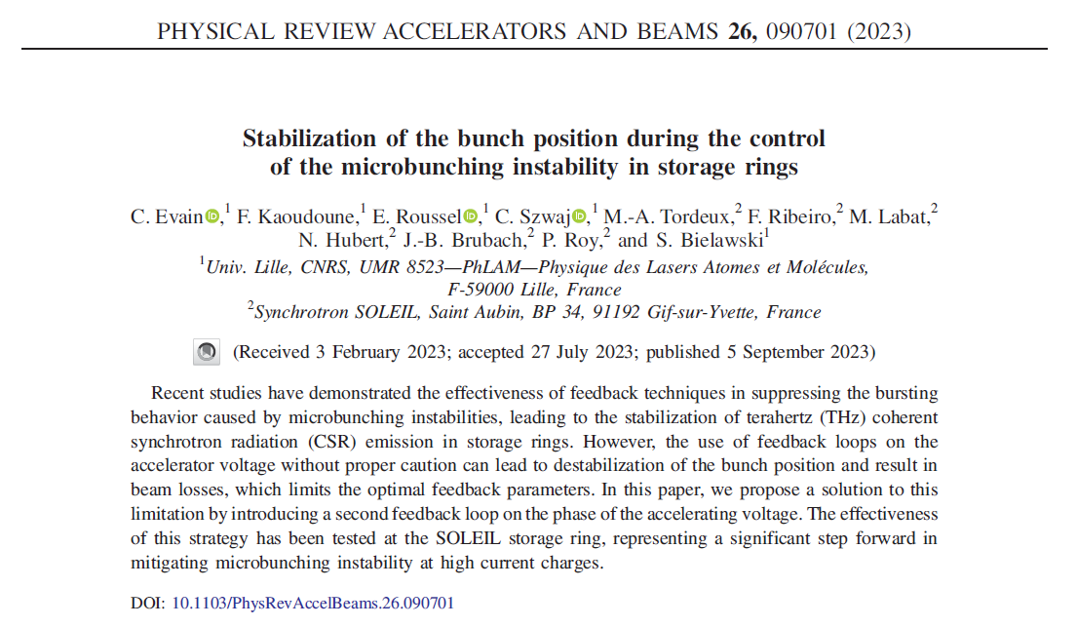
Journal Klub for Pohang Scientists (aka JKPS)
Select paper
Select the latest paper in your field or area of interest

Slide 5
Journal Klub for Pohang Scientists (aka JKPS)
Purpose: Analyze single bunch instability in ESRF-EBS
Structure:
Introduce ESRF-EBS
Impedance calculation results for instability study
Theoretical and numerical single bunch instability estimations
Experimental result and comparison with simulations
Explain the discrepancies
Conclusions
Analyze the paper:
Characteristics of ESRF-EBS comparing other 4GSR facilities
  Main parameters, operation mode, and remarkable things
For impedance calculation what they focused in simulations or components modeling.
  Characteristics of GdifidL and CST
  Why they use that simulation setting
  Why they developed zero gap flange gasket
How they performed the tracking simulations.
  Characteristic of PyAT comparing with AT, ELEGANT, etc…
  Their simulations models
How they performed the experiment.
  Experimental setup
  Device information
  How they analyze their experiment results
Read and analyze the paper

Slide 6
Journal Klub for Pohang Scientists (aka JKPS)
How to present?
Why I select this paper
  -First experimental paper in 4GSR instability
Topic, main subject
  -Single bunch instability in 4GSR
Structure
  -Intro + Simulation + Experimental results + comparison + conclusion
Paper analyze results
Discussion
  -If I’m an author of this paper I will do ~
  -Thing what you want to discuss with other members

