Slide 1
Robinson Instability in PHC
(Passive Harmonic Cavity)
20232308 Youngmin Park
2024-10-18

Slide 2
Index
Robinson Instability with Multiple Bunch
HHC in Storage Ring
  PNHC Simulation
  PSHC Simulation
Cavity Mode(D-mode) in PSHC Case

Slide 3
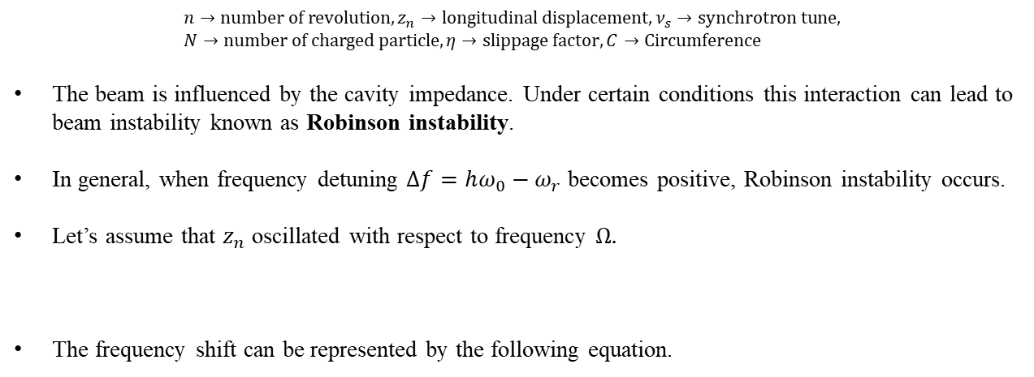


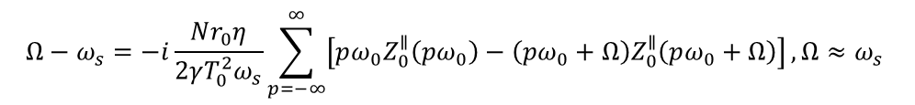
Robinson Instability with Multiple Bunch
Robinson Instability
$$\frac{d^{2}z_{n}}{dn^{2}}+{\left(2πν_{s}\right)}^{2}z_{n}=\frac{Nr_{0}ηC}{γ}\sum_{k=−∞}^{n}{W_{0}′(kC−nC+z_{n}−z_{k})}$$
$$n→number of revolution, z_{n}→longitudinal displacement, ν_{s}→synchrotron tune, \\ N→number of charged particle, η→slippage factor, C→Circumference$$
The beam is influenced by the cavity impedance. Under certain conditions this interaction can lead to beam instability known as Robinson instability.
In general, when frequency detuning $Δf=hω_{0}−ω_{r}$ becomes positive, Robinson instability occurs.
Let’s assume that $z_{n}$ oscillated with respect to frequency $Ω.$
The frequency shift can be represented by the following equation.
$$z_{n}→e^{−inΩT_{0}}$$
$$Ω−ω_{s}=−i\frac{Nr_{0}η}{2γT_{0}^{2}ω_{s}}\sum_{p=−∞}^{∞}{\left[pω_{0}Z_{0}^{∥}\left(pω_{0}\right)−\left(pω_{0}+Ω\right)Z_{0}^{∥}\left(pω_{0}+Ω\right)\right]},Ω≈ω_{s}$$
$$Z_{0}^{∥}\left(ω\right)=\frac{R_{s}}{1+iQ\left(\frac{ω_{r}}{ω}−\frac{ω}{ω_{r}}\right)}$$

Slide 4
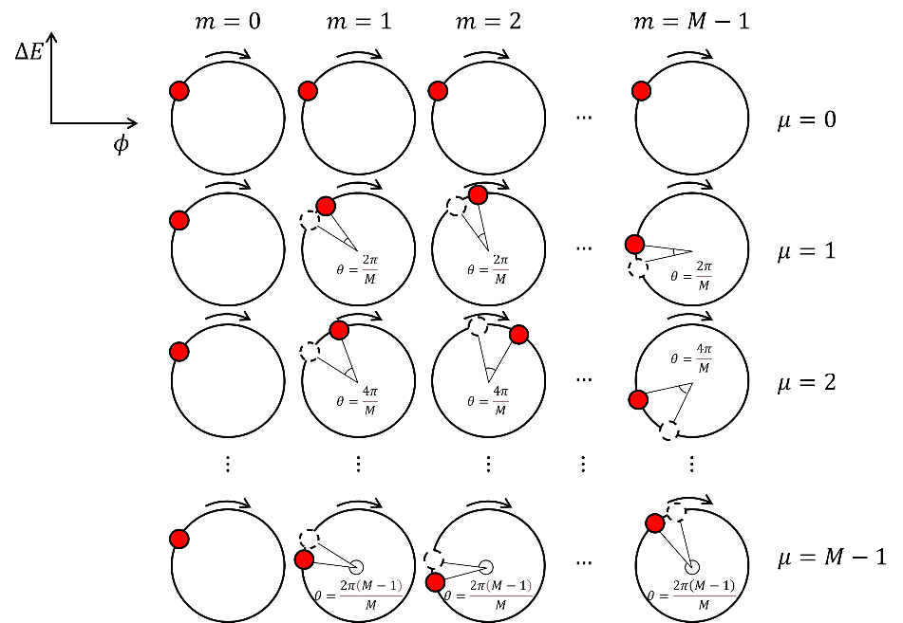

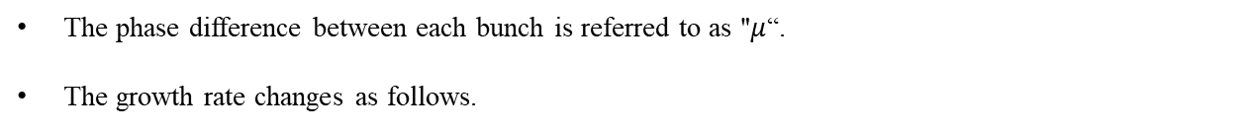
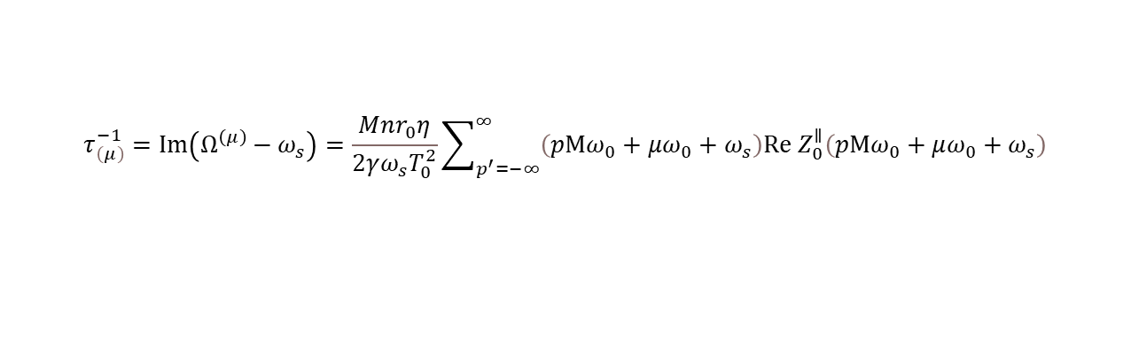
Robinson Instability with Multiple Bunch
Robinson Instability with Multiple Bunch
$${\tilde{z}}_{j}^{\left(μ\right)}∝e^{\frac{i2πμj}{M}}$$
$$z_{j,n}={\tilde{z}}_{j}e^{−i\left(n−\frac{j}{M}\right)ΩT_{0}}$$
The phase difference between each bunch is referred to as "$μ$“.
The growth rate changes as follows.
$$τ_{\left(μ\right)}^{−1}=Im\left(Ω^{\left(μ\right)}−ω_{s}\right)=\frac{Mnr_{0}η}{2γω_{s}T_{0}^{2}}\sum_{p^{′}=−∞}^{∞}{\left(pMω_{0}+μω_{0}+ω_{s}\right)Re Z_{0}^{∥}\left(pMω_{0}+μω_{0}+ω_{s}\right)}$$

Slide 5
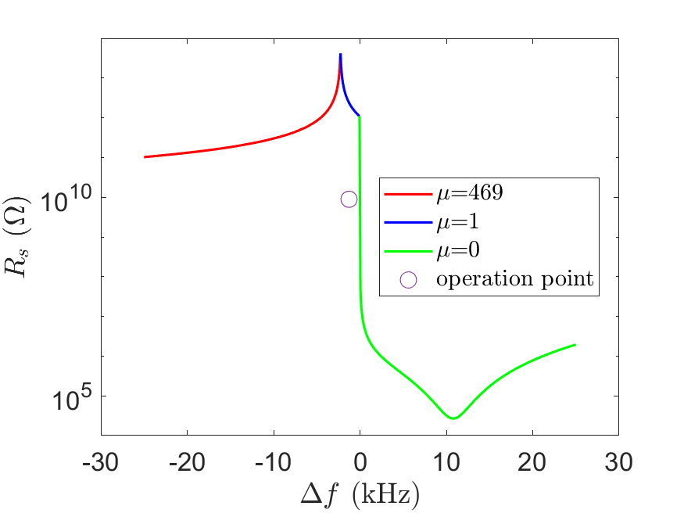
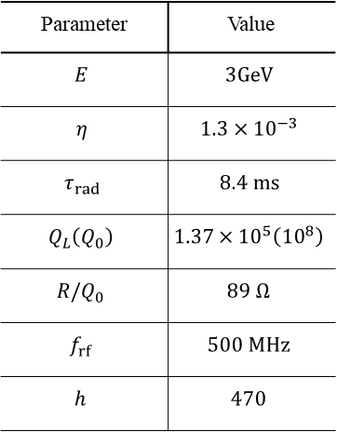
Robinson Instability with Multiple Bunch
Threshold Shunt Impedance
If $τ_{\left(μ\right)}^{−1}$ is greater than the longitudinal damping time($τ_{rad}$), instability occurs.
In the PLS-II parameters, the threshold shunt impedance for each detune frequency is:
Unstable
Parameter | Value
$$E$$ | $$3GeV$$
$$η$$ | $$1.3×{10}^{−3}$$
$$τ_{rad}$$ | $$8.4 ms$$
$$Q_{L}\left(Q_{0}\right)$$ | $$1.37×{10}^{5}\left({10}^{8}\right)$$
$$R/Q_{0}$$ | $$89 Ω$$
$$f_{rf}$$ | $$500 MHz$$
$$h$$ | $$470$$
Stable

Slide 6
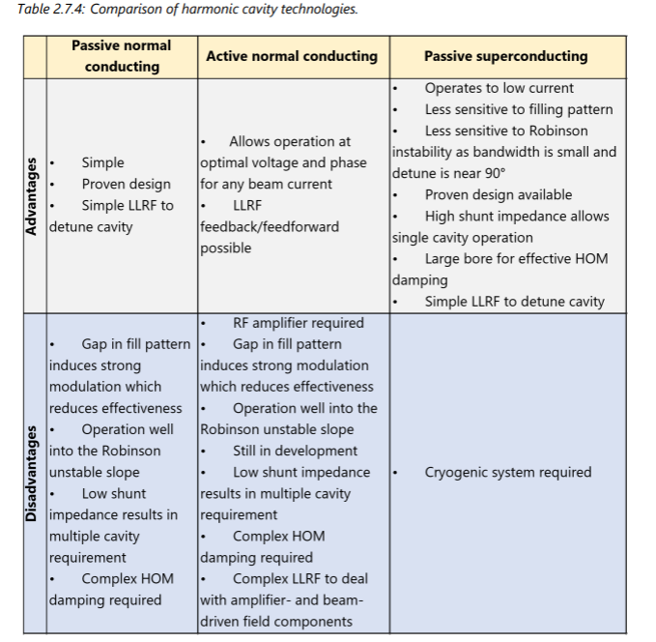
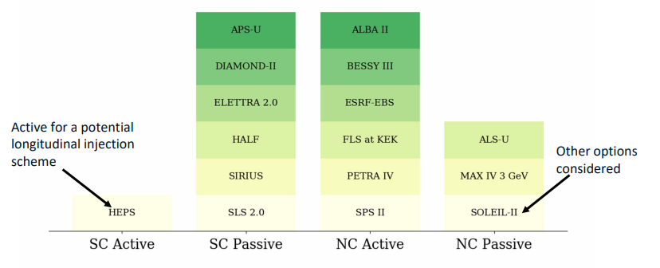
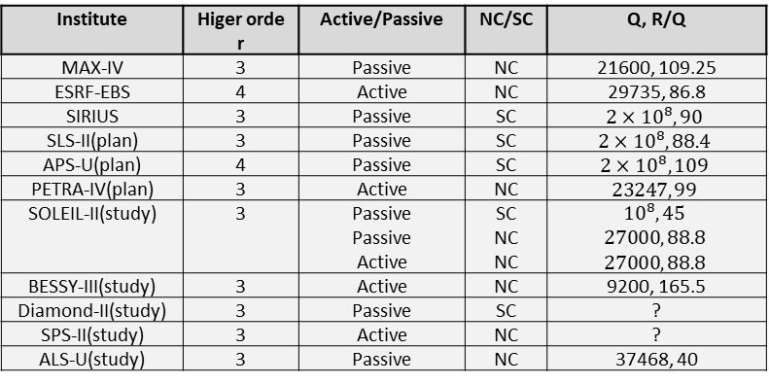
HHC in Storage Ring
Institute | Higer order | Active/Passive | NC/SC | Q, R/Q
MAX-IV | 3 | Passive | NC | 21600, 109.25
ESRF-EBS | 4 | Active | NC | 29735, 86.8
SIRIUS | 3 | Passive | SC | $$2×{10}^{8}, 90$$
SLS-II(plan) | 3 | Passive | SC | $$2×{10}^{8},88.4$$
APS-U(plan) | 4 | Passive | SC | $$2×{10}^{8}, 109$$
PETRA-IV(plan) | 3 | Active | NC | $$23247, 99$$
SOLEIL-II(study) | 3 | Passive Passive Active | SC NC NC | $${10}^{8},45$$ $$27000, 88.8$$ $$27000, 88.8$$
BESSY-III(study) | 3 | Active | NC | 9200, 165.5
Diamond-II(study) | 3 | Passive | SC | ?
SPS-II(study) | 3 | Active | NC | ?
ALS-U(study) | 3 | Passive | NC | 37468, 40
HHC
[1]
[2]
[1] R.P. Walker et al., “Diamond-II technical design report”, Diamond Light Source Ltd, (2022).
[2] Francis Cullinan., “Review of Harmonic Cavities in Fourth-Generation Storage Rings”,FLS2023,Luzern,(2023).

Slide 7


HHC in Storage Ring
PHC
The voltage induced by PHC is follows:
The equations for the double RF system are expressed as follows:
Once the cavity is manufactured, the only adjustable parameters are $ψ$ and $φ_{1}$.
Introducing $ξ$, the ratio of the harmonic force to the main cavity.
$$V\left(τ\right)=−2R_{s}I_{avg}\cos{ψ_{3}}\cos\left(3hω_{0}τ+ψ_{m}\right), \tan{ψ_{3}}≈\frac{2Q_{3}Δω}{3ω_{rf}}$$
$$V\left(τ\right)=V_{1}\sin\left(hω_{0}τ+φ_{1}\right)−2R_{s}I_{avg}\cos{ψ_{3}}\sin\left(3hω_{0}τ+ψ_{3}+\frac{π}{2}\right)−\frac{U_{0}}{e}$$
$$ξ=−\frac{6R_{s}I_{avg}\cos{ψ_{3}}\sin{ψ_{3}}}{V_{1}\cos{φ_{1}}}$$
$$V\left(0\right)=V_{1}\left(\sin{φ_{1}}−\frac{ξ\cos{φ_{1}}}{3\tan{ψ_{3}}}\right)−\frac{U_{0}}{e}=0$$
$$V′\left(0\right)=3hω_{0}V_{1}\cos{φ_{1}}\left(1−ξ\right)$$
$$V^{′′}\left(0\right)=−9h^{2}{ω_{0}}^{2}V_{1}\left(\sin{φ_{1}+ξ\frac{3\cos{φ_{1}}}{\tan{ψ_{3}}}}\right)$$

Slide 8
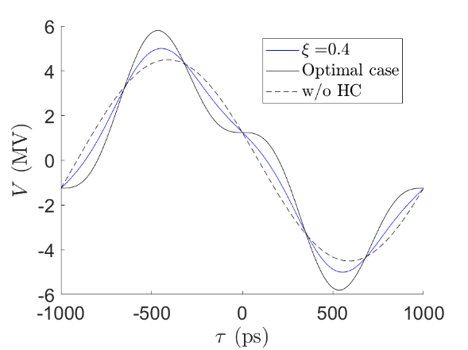
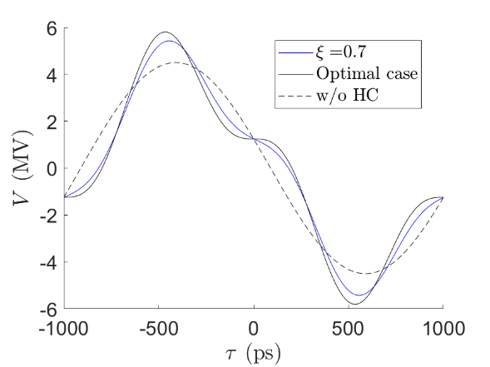
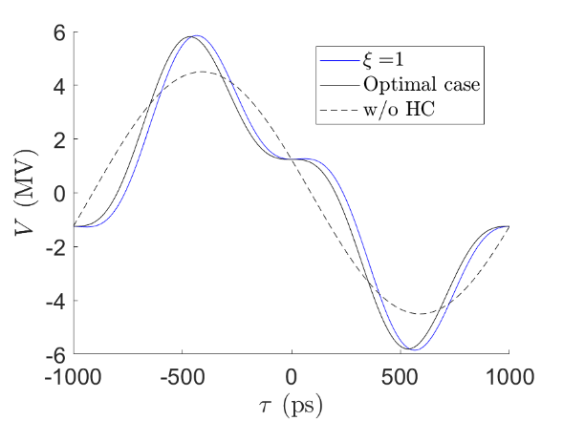


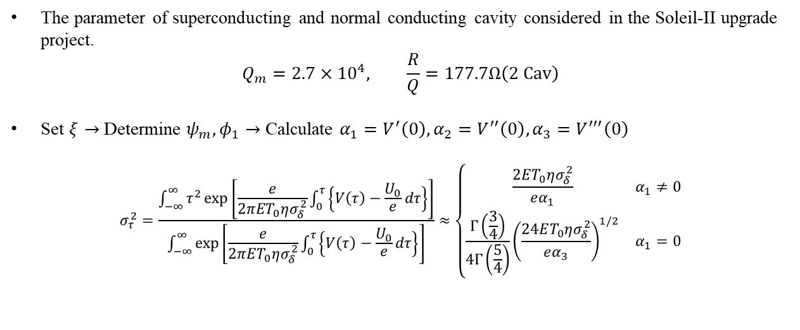
HHC in Storage Ring
PNHC
The parameter of superconducting and normal conducting cavity considered in the Soleil-II upgrade project.
$$Q_{m}=2.7×{10}^{4}, \frac{R}{Q}=177.7Ω\left(2 Cav\right)$$
Set $ξ→$ Determine $ψ_{m},φ_{1}→$ Calculate $α_{1}=V^{′}\left(0\right), α_{2}=V^{′′}\left(0\right),α_{3}=V^{′′′}\left(0\right)$
$$σ_{τ}^{2}=\frac{\int_{−∞}^{∞}{τ^{2}\exp\left[\frac{e}{2πET_{0}ησ_{δ}^{2}}\int_{0}^{τ}{\left\{V\left(τ\right)−\frac{U_{0}}{e}dτ\right\}}\right]}}{\int_{−∞}^{∞}{\exp\left[\frac{e}{2πET_{0}ησ_{δ}^{2}}\int_{0}^{τ}{\left\{V\left(τ\right)−\frac{U_{0}}{e}dτ\right\}}\right]}}≈\left\{\begin{matrix}\frac{2ET_{0}ησ_{δ}^{2}}{eα_{1}} & α_{1}≠0 \\ \frac{Γ\left(\frac{3}{4}\right)}{4Γ\left(\frac{5}{4}\right)}{\left(\frac{24ET_{0}ησ_{δ}^{2}}{eα_{3}}\right)}^{1/2} & α_{1}=0\end{matrix}\right.$$
$$Δf=181.88 kHz, σ_{τ}=19 ps$$
$$Δf=100.20 kHz,σ_{τ}=28 ps$$
$$Δf=66.07 kHz,σ_{τ}=64 ps$$

Slide 9
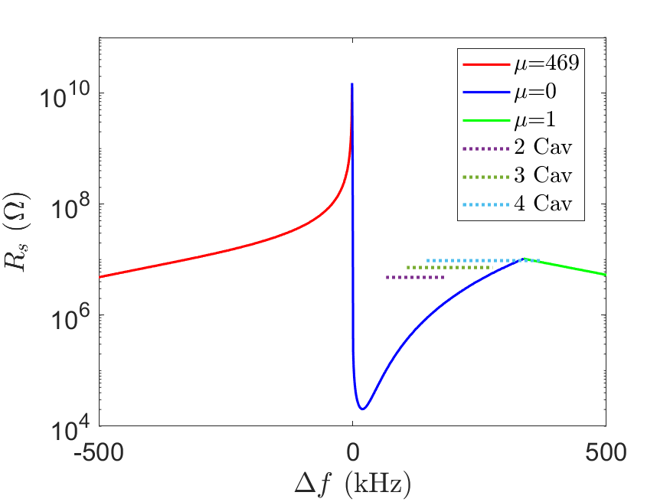

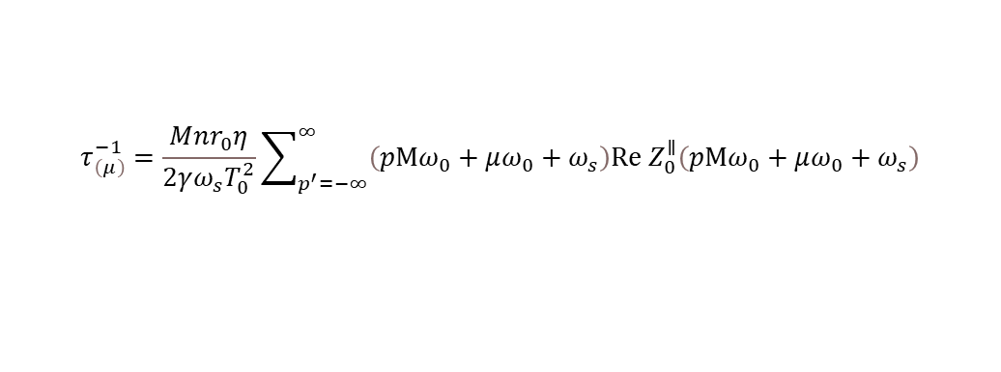

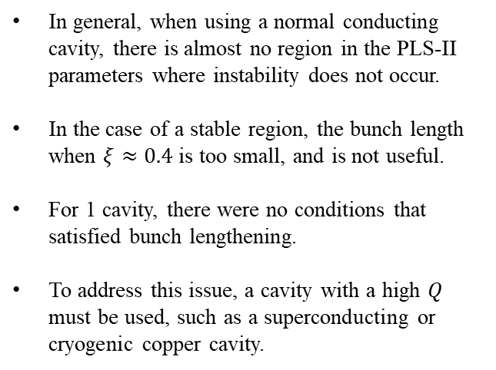
HHC in Storage Ring
PNHC and Threshold Shunt Impedance
$$τ_{\left(μ\right)}^{−1}=\frac{Mnr_{0}η}{2γω_{s}T_{0}^{2}}\sum_{p^{′}=−∞}^{∞}{\left(pMω_{0}+μω_{0}+ω_{s}\right)Re Z_{0}^{∥}\left(pMω_{0}+μω_{0}+ω_{s}\right)}$$
In general, when using a normal conducting cavity, there is almost no region in the PLS-II parameters where instability does not occur.
In the case of a stable region, the bunch length when $ξ≈0.4$ is too small, and is not useful.
For 1 cavity, there were no conditions that satisfied bunch lengthening.
To address this issue, a cavity with a high 𝑄 must be used, such as a superconducting or cryogenic copper cavity.
Unstable
$$ξ=1$$
$$ξ=0.44$$
Stable
Stable, but not useful
Instability region
$$R_{s}=2.4 MΩ, Q_{m}=2.7×{10}^{4}$$

Slide 10
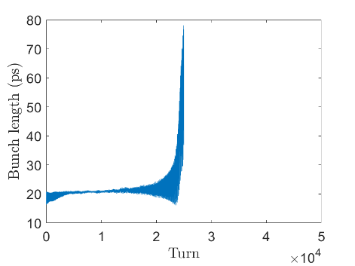
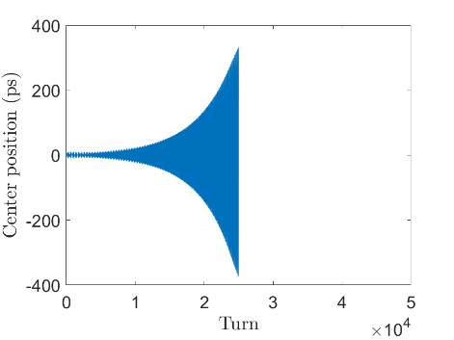
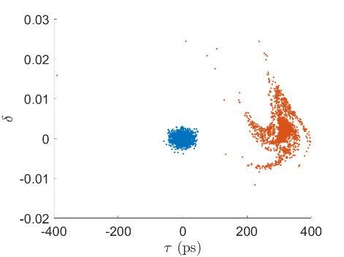
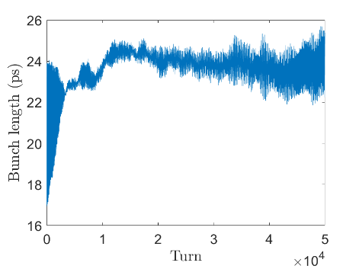
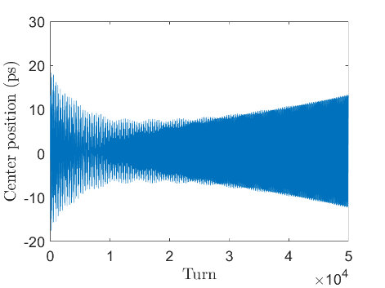
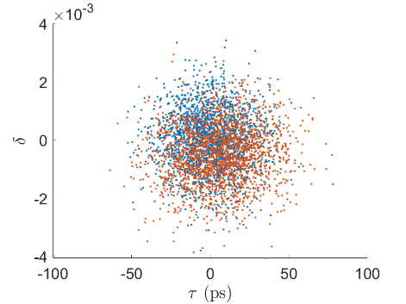
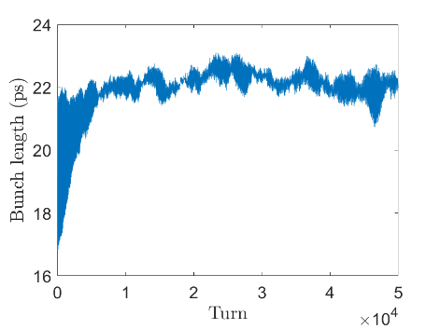
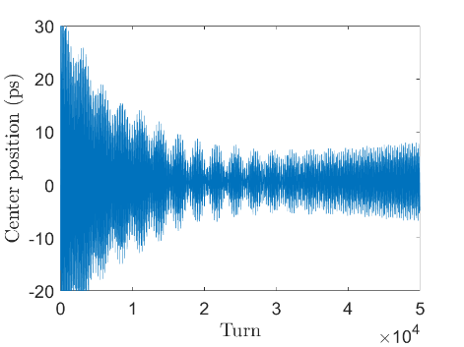
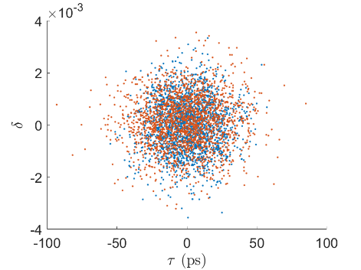



HHC in Storage Ring
PNHC Simulation
2 Cav, $Δf=66.07 kHz$
3 Cav, $Δf=275.81 kHz$
4 Cav, $Δf=335.3 kHz$

Slide 11
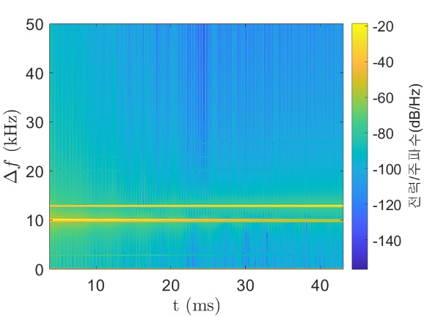
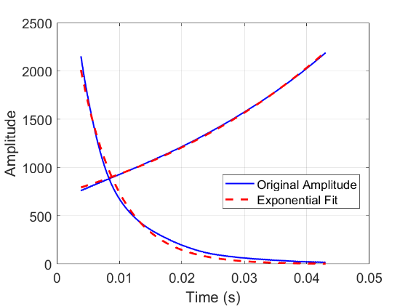
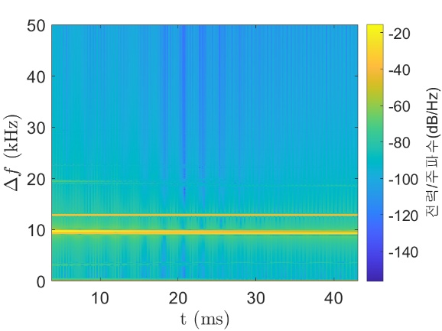
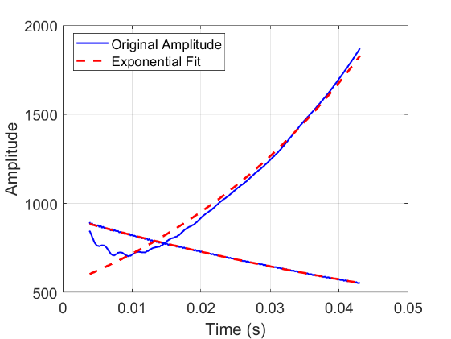
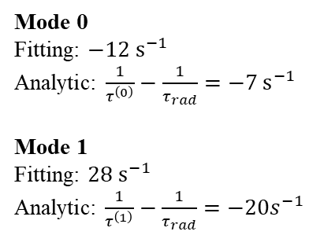

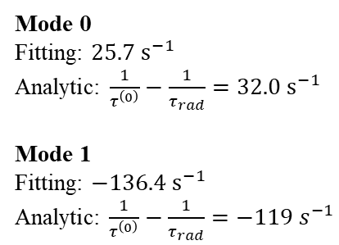







HHC in Storage Ring
Analysis
3 Cav, $Δf=275.81 kHz$
Mode 0
Fitting: $25.7 s^{−1}$
Analytic: $\frac{1}{τ^{\left(0\right)}}−\frac{1}{τ_{rad}}=32.0 s^{−1}$
Mode 1
Fitting: $−136.4 s^{−1}$
Analytic: $\frac{1}{τ^{\left(0\right)}}−\frac{1}{τ_{rad}}=−119 s^{−1}$
$$Ω^{\left(0\right)}$$
$$Ω^{\left(0\right)}$$
$$Ω^{\left(1\right)}$$
$$Ω^{\left(1\right)}$$
4 Cav, $Δf=335.3 kHz$
Mode 0
Fitting: $−12 s^{−1}$
Analytic: $\frac{1}{τ^{\left(0\right)}}−\frac{1}{τ_{rad}}=−7 s^{−1}$
Mode 1
Fitting: $28 s^{−1}$
Analytic: $\frac{1}{τ^{\left(1\right)}}−\frac{1}{τ_{rad}}=−20s^{−1}$
$$Ω^{\left(0\right)}$$
$$Ω^{\left(1\right)}$$
$$Ω^{\left(0\right)}$$
$$Ω^{\left(1\right)}$$

Slide 12
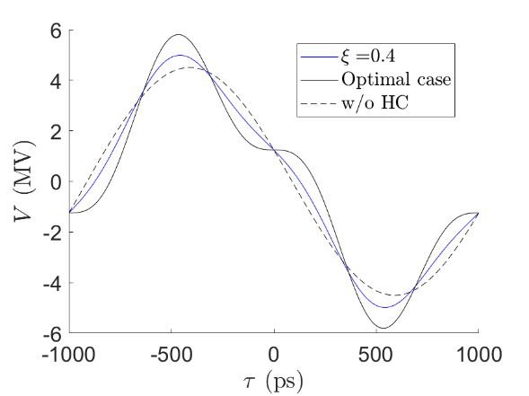
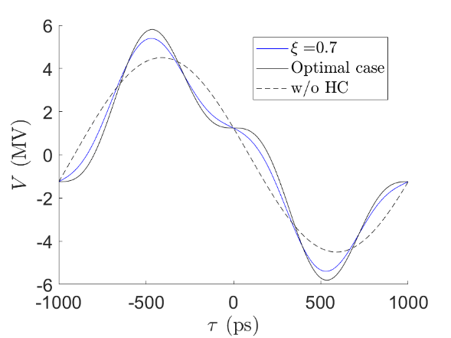
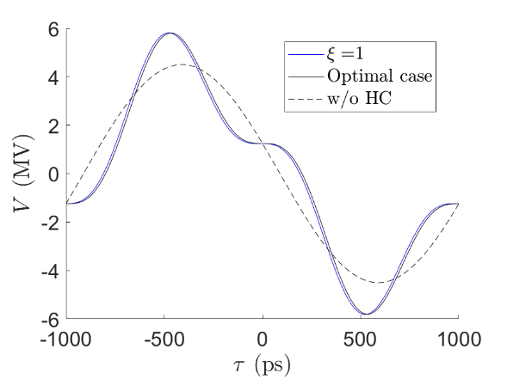



HHC in Storage Ring
PSHC
The parameter of superconducting and normal conducting cavity considered in the Soleil-II upgrade project.
$$Q_{m}={10}^{8}, \frac{R}{Q}=45 Ω\left(1 Cav\right)$$
$φ_{1}$ and $α_{2}$ maintains a constant value because $\tan{ψ_{3}}≈∞$.
Set $ξ→$ Determine $ψ_{m},φ_{1}→$ Calculate $α_{1}=V^{′}\left(0\right),α_{3}=V^{′′′}\left(0\right)$
$$φ_{1}=\sin^{−1}\left(\frac{U_{0}}{eV_{1}}+\frac{ξ\cos{φ_{1}}}{3\tan{ψ_{3}}}\right)≈\sin^{−1}\left(\frac{U_{0}}{eV_{1}}\right), α_{2}=−9h^{2}{ω_{0}}^{2}V_{1}\left(\sin{φ_{1}+ξ\frac{3\cos{φ_{1}}}{\tan{ψ_{3}}}}\right)≈−9h^{2}ω_{0}^{2}V_{1}\sin{φ_{1}}$$
$$Δf=46.81 kHz, σ_{τ}=19 ps$$
$$Δf=26.75 kHz,σ_{τ}=28 ps$$
$$Δf=11.70 kHz,σ_{τ}=64 ps$$

Slide 13
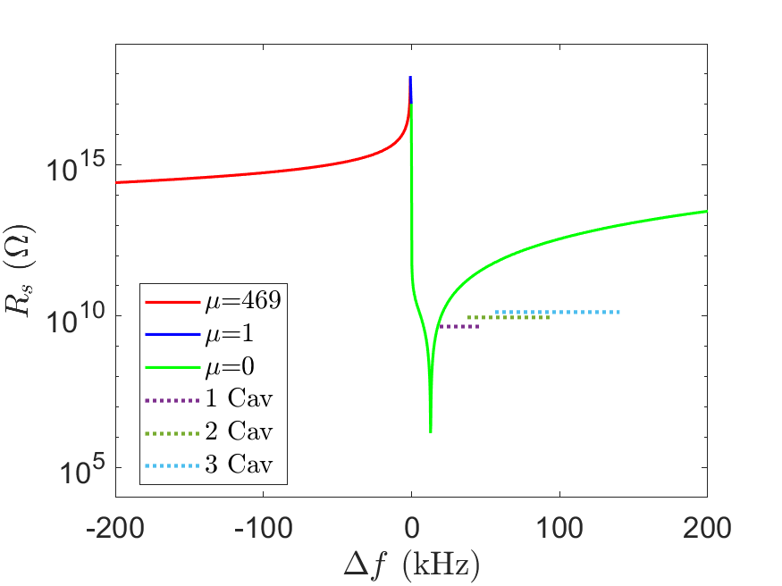
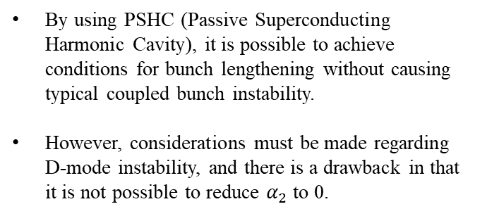
HHC in Storage Ring
PSHC
By using PSHC (Passive Superconducting Harmonic Cavity), it is possible to achieve conditions for bunch lengthening without causing typical coupled bunch instability.
However, considerations must be made regarding D-mode instability, and there is a drawback in that it is not possible to reduce $α_{2}$ to 0.
Unstable
Stable
Stable
$$R_{s}=4.5 GΩ, Q_{m}={10}^{8}$$

Slide 14
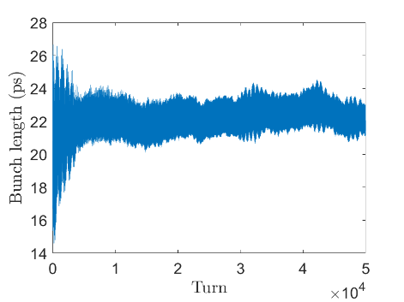
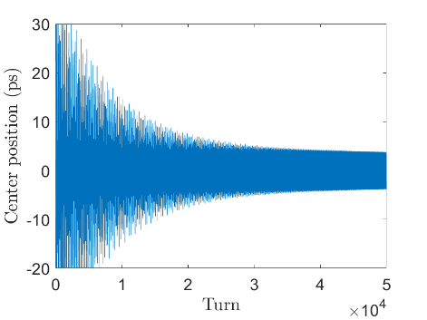
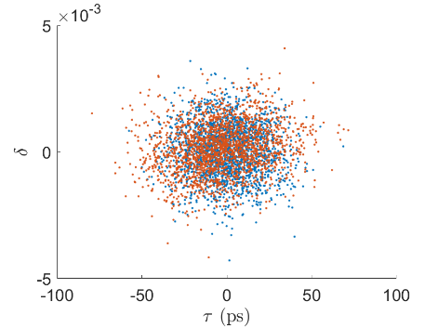
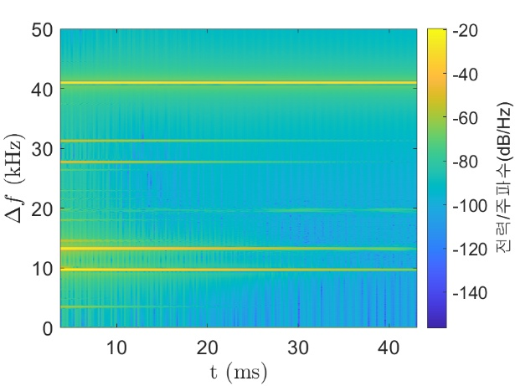
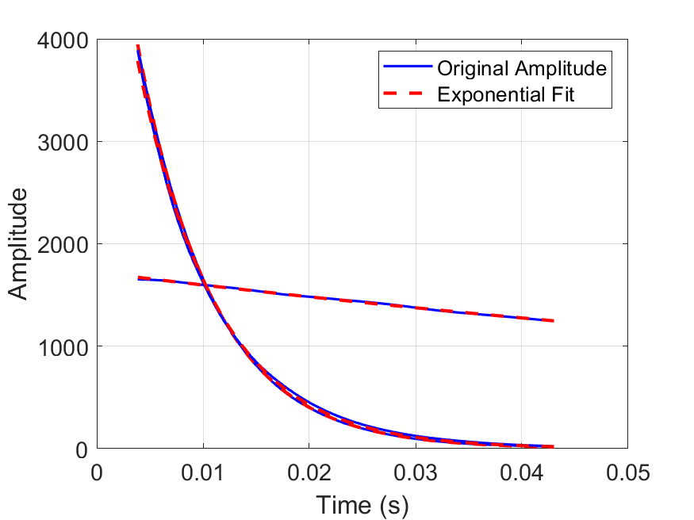





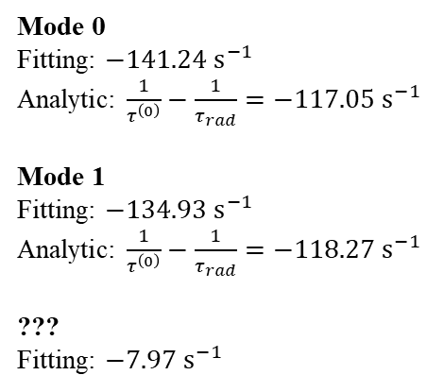

HHC Simulation and Result
PSHC Case
1 Cav, $Δf=42 kHz$
$$???$$
Mode 0
Fitting: $−141.24 s^{−1}$
Analytic: $\frac{1}{τ^{\left(0\right)}}−\frac{1}{τ_{rad}}=−117.05 s^{−1}$
Mode 1
Fitting: $−134.93 s^{−1}$
Analytic: $\frac{1}{τ^{\left(0\right)}}−\frac{1}{τ_{rad}}=−118.27 s^{−1}$
???
Fitting: $−7.97 s^{−1}$
$$Ω^{\left(0\right)}$$
???
$$Ω^{\left(0\right)}$$
$$Ω^{\left(1\right)}$$
$$Ω^{\left(1\right)}$$

Slide 15
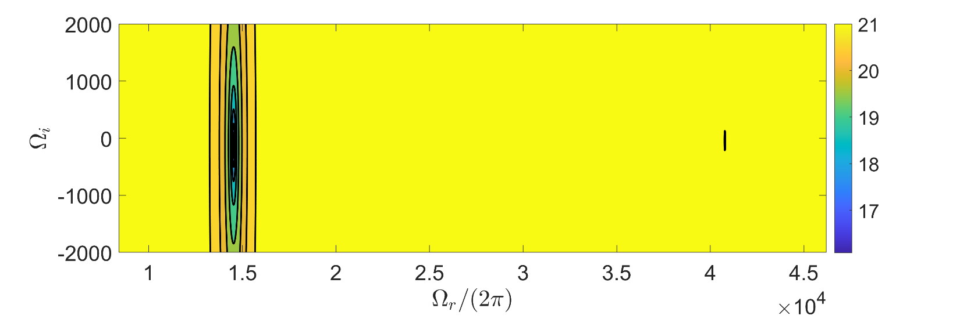
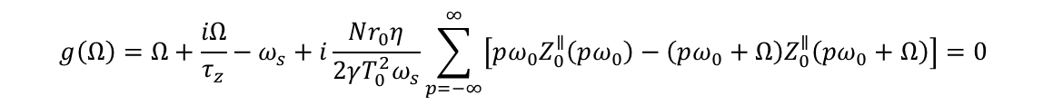
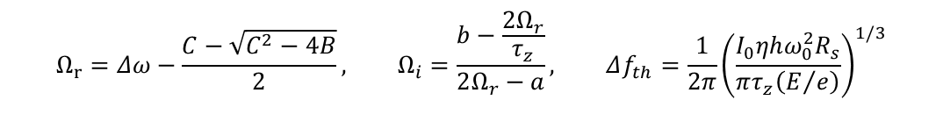
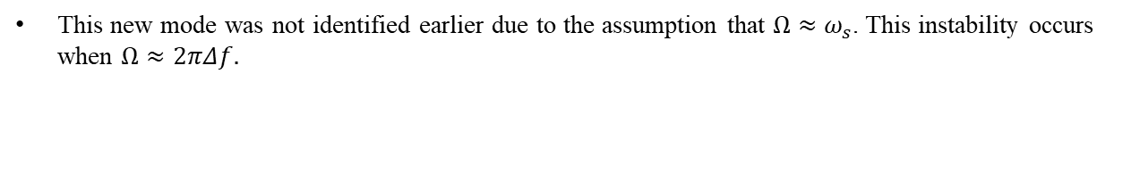


Cavity Mode(D-mode) in PSHC Case
D-mode Instability
This new mode was not identified earlier due to the assumption that $Ω≈ω_{s}$. This instability occurs when $Ω≈2πΔf.$
$$g\left(Ω\right)=Ω+\frac{iΩ}{τ_{z}}−ω_{s}+i\frac{Nr_{0}η}{2γT_{0}^{2}ω_{s}}\sum_{p=−∞}^{∞}{\left[pω_{0}Z_{0}^{∥}\left(pω_{0}\right)−\left(pω_{0}+Ω\right)Z_{0}^{∥}\left(pω_{0}+Ω\right)\right]}=0$$
$$\log_{10}{abs\left(g\left(Ω\right)\right)}$$
$$Ω_{r}=Δω−\frac{C−\sqrt{C^{2}−4B}}{2}, Ω_{i}=\frac{b−\frac{2Ω_{r}}{τ_{z}}}{2Ω_{r}−a}, Δf_{th}=\frac{1}{2π}{\left(\frac{I_{0}ηhω_{0}^{2}R_{s}}{πτ_{z}\left(E/e\right)}\right)}^{1/3}$$
$$B=\frac{h^{2}ω_{0}^{3}I_{0}ηR_{s}}{8πQ\left(E/e\right)Δω}, C=\frac{1}{2}\left(Δω−\frac{ω_{s}^{2}}{Δω}−\frac{B}{Δω} \right)$$
$$a=\frac{h^{2}ω_{0}^{3}R_{s}}{4Qπ\left(E/e\right){\left(Δω−Ω_{r}\right)}^{2}}, b=\frac{h^{3}ω_{0}^{4}R_{s}}{8Q^{2}π\left(E/e\right){\left(Δω−Ω_{r}\right)}^{2}}$$

Slide 16
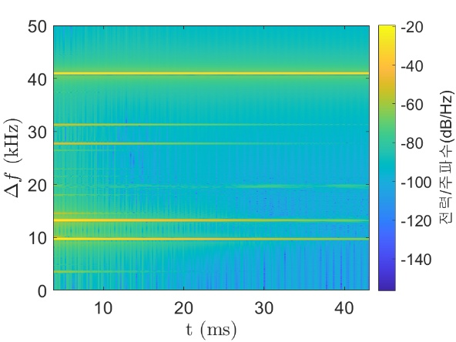







Cavity Mode(D-mode) in PSHC Case
Calculation: $Ω_{r}=41.01 kHz, Ω_{i}=−43.2 s^{−1}, Δf_{th}=19.8 kHz$
Simulation: $Ω_{r}=40.98 kHz, Ω_{i}=−43.2s^{−1}, Δf_{th}=40 kHz$
Problem
There is a discrepancy between the calculations and simulations.
1 Cav, $Δf=42 kHz$
2 Cav, $Δf=57 kHz$
3 Cav, $Δf=80 kHz$
 | $$Ω_{r}\left(C/S\right)$$ | $$Ω_{i}\left(C/S\right)$$ | $$Δf_{th}\left(C/S\right)$$
1Cav, $Δf=42 kHz$ | $$\left({41.01}/{40.98}\right) kHz$$ | $$\left({−43.2}/{−7.98}\right) s^{−1}$$ | $$\left({19.8}/{40}\right) kHz$$
2Cav, $Δf=42 kHz$ | $$\left({55.98}/{55.96}\right) kHz$$ | $$\left({−43.2}/{19}\right) s^{−1}$$ | $$\left({25}/{57}\right) kHz$$
3Cav, $Δf=42 kHz$ | $$\left({79.25}/{79.20}\right) kHz$$ | $$\left({−45.7}/7\right) s^{−1}$$ | $$\left({28}/{80}\right) kHz$$

Slide 17



Appendix A.
Simulation Method
$$ΔE_{n+1}=ΔE_{n}⋅\left(1−2\frac{T_{0}}{τ_{s}}\right)+e⋅\left(V_{g}+V_{b}\right)−U_{0}−2\frac{σ_{E}}{E}E_{0}\sqrt{\frac{T_{0}}{τ_{s}}}R$$
$$Δz_{n+1}=Δz_{n}+ηc⋅\frac{T_{0}}{E_{0}}ΔE_{n+1}$$
$$ΔE:Energy difference, Δz:position difference, τ_{s}:damping time, T_{0}:revolution period, U_{0}:radiation loss,$$
$$\frac{σ_{E}}{E}:norminal RMS energy spread, R:random number\left(avg 0, RMS 1\right), η:slippage factor$$
$$V_{g}=V_{1}⋅\sin\left(ω_{rf}t_{m}+φ_{1}\right), {\tilde{V}}_{b,i}={\tilde{V}}_{b,i−1}⋅\exp\left(imω_{rf}Δt−\frac{mω_{rf}Δt}{2Q_{m}}\right)−\frac{R_{s}}{Q_{m}}mω_{rf}⋅q, V_{b,i}=Re\left({\tilde{V}}_{b,i}\right)$$
The voltage from the main cavity is assumed to be a sin wave. The voltage induced by passive harmonic cavity is determined by the wake field.
$$W_{0}^{′}\left(t\right)=\left\{\begin{matrix}0 & if t<0 \\ \frac{R_{s}}{Q_{m}}\frac{mω_{rf}}{2} & if t=0 \\ \frac{R_{s}}{Q_{m}}mω_{rf}e^{−\frac{mω_{rf}}{2Q_{m}}t}\cos\left(mω_{rf}t\right) & if t>0\end{matrix}\right.$$

