Slide 1


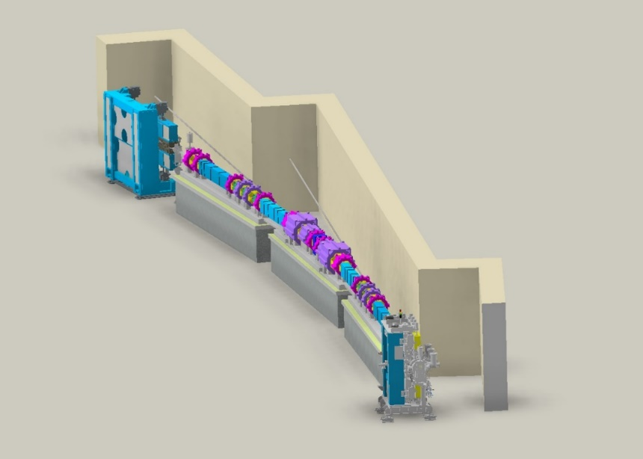

Beam physics group meeting
Design of the Korea-4GSR booster lattice
Junha Kim
OCT 10th, 2024

Slide 2
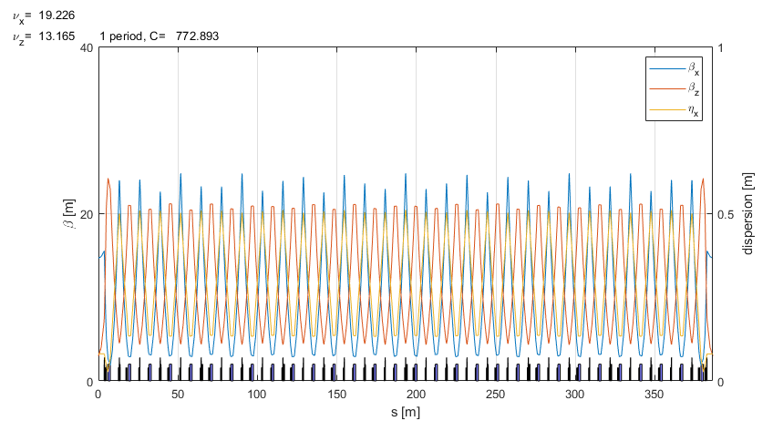
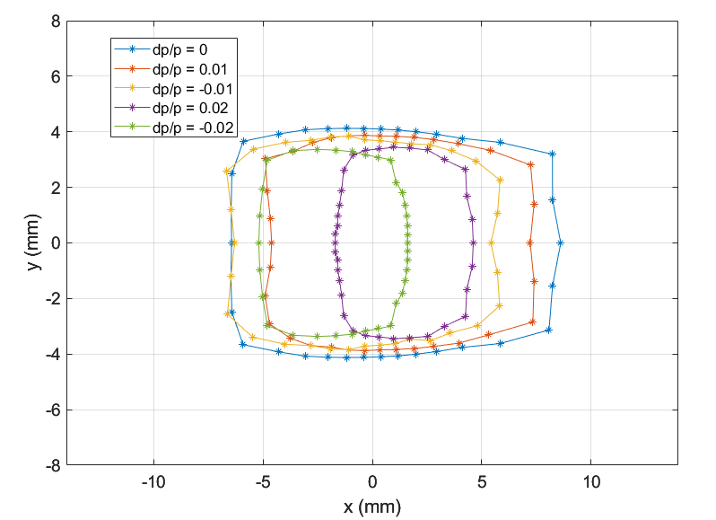
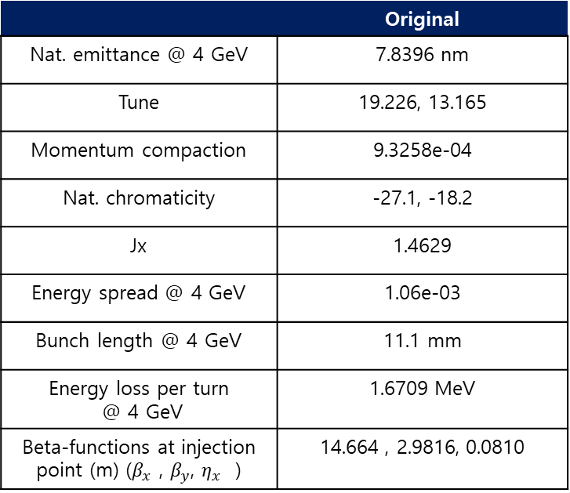
Booster design consideration
BR shares same tunnel wall with SR
BR also has racetrack shape
56 FODO unit cells + 4 racetrack matching cells
Distance from SR orbit to BR orbit is (almost) constant for any longitudinal position
Large dynamic aperture
Original booster lattice
 | Original
Nat. emittance @ 4 GeV | 7.8396 nm
Tune | 19.226, 13.165
Momentum compaction | 9.3258e-04
Nat. chromaticity | -27.1, -18.2
Jx | 1.4629
Energy spread @ 4 GeV | 1.06e-03
Bunch length @ 4 GeV | 11.1 mm
Energy loss per turn @ 4 GeV | 1.6709 MeV
Beta-functions at injection point (m) ($β_{x}$ , $β_{y}$, $η_{x}$ ) | 14.664 , 2.9816, 0.0810

Slide 3
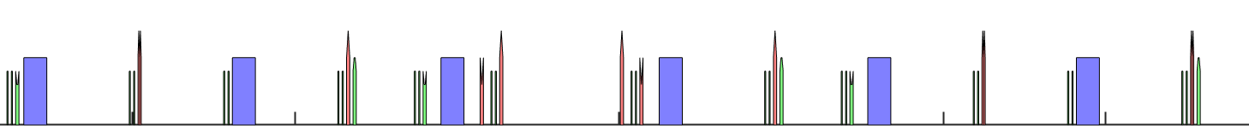
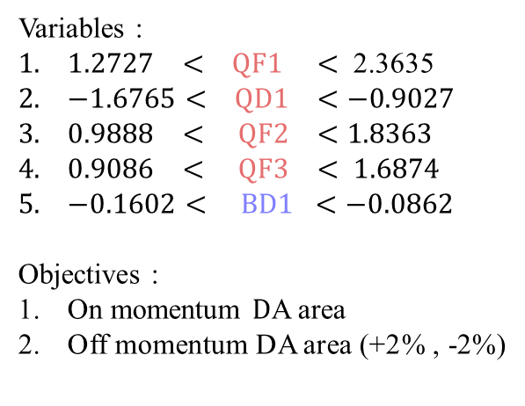
Variables of MOGA simulations
The total number of variables is 5.
There are quadrupoles and bending magnet in the Booster lattice. The upper limit is set 30% higher than the original strength, while the lower limit is -30% of the original strength.
In the case of a bending magnet, the quadrupole field can be adjusted by altering the shape of the pole tip instead of adjusting the current. We have two types of bending magnets (BD1, BD2). The quadrupole field of each bending magnet is appropriate to its respective bending angle.
Variables :
$1.2727 < QF1 <$ 2.3635
$−1.6765< QD1 <−0.9027$
$0.9888 < QF2 <1.8363$
$0.9086 < QF3 < 1.6874$
$−0.1602< BD1 <−0.0862$
Objectives :
On momentum $D$A area
Off momentum DA area (+2% , -2%)
Middle of straight section
QF3
QF2
QF1
QF1
QF2
QF3
QF3
BD2
BD2
BD1
BD1
BD2
BD2
QD1
QD1

Slide 4
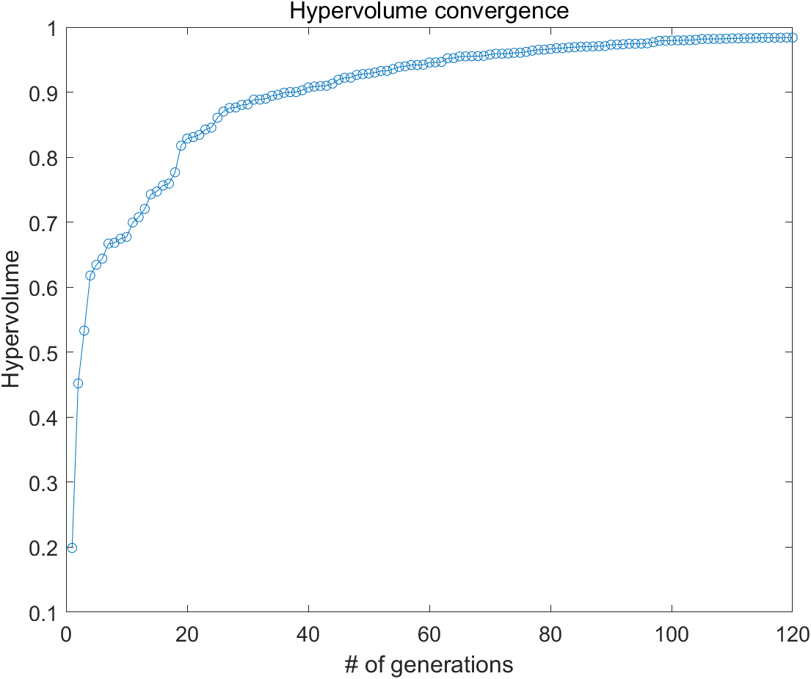
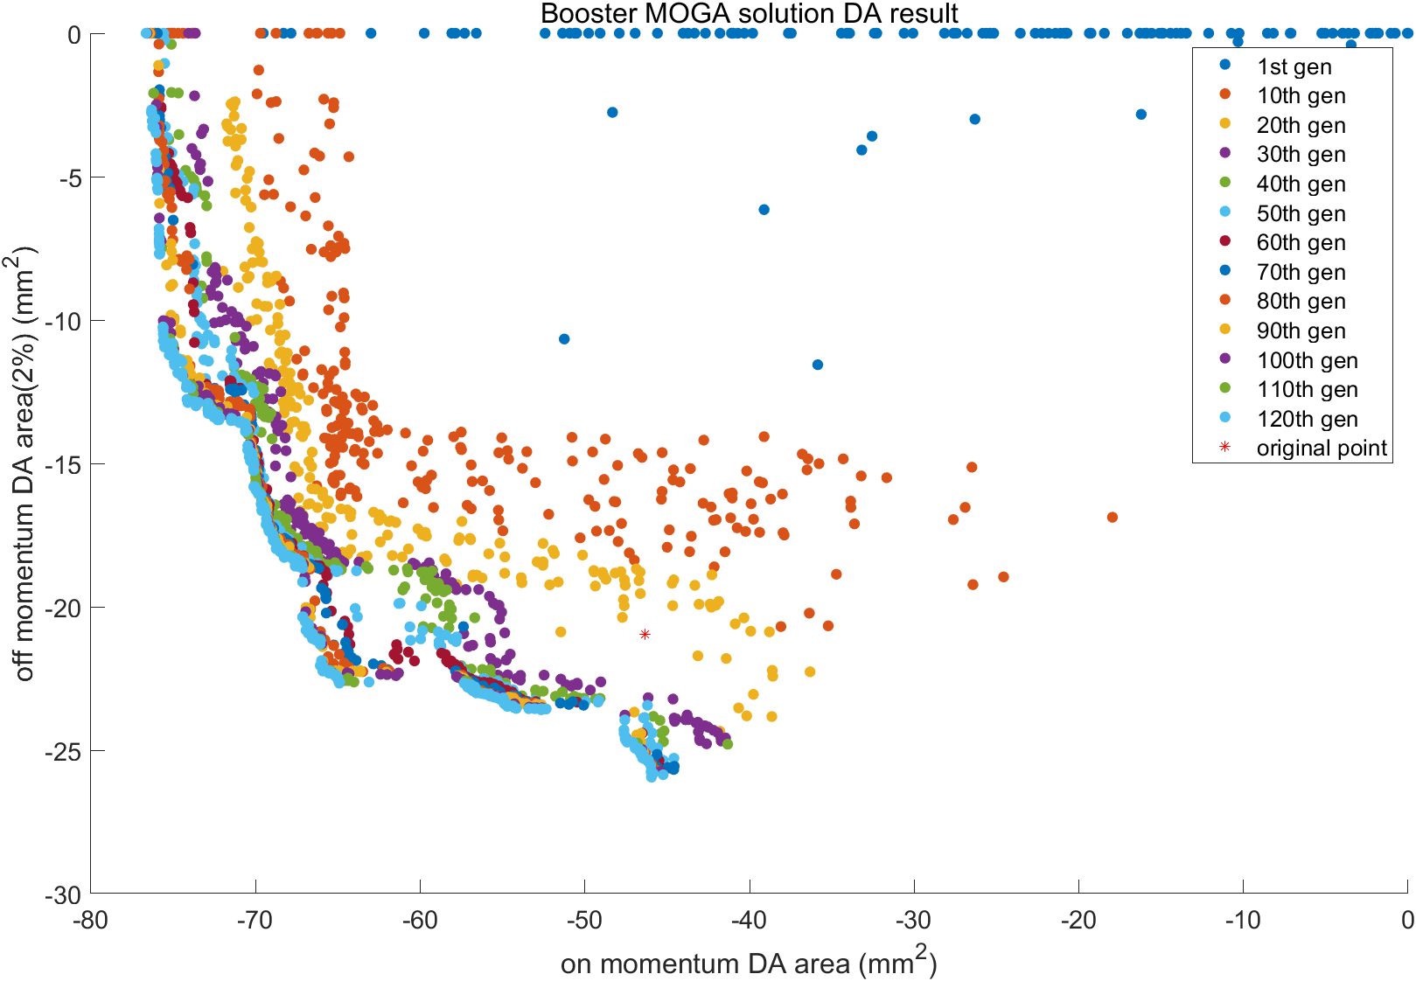
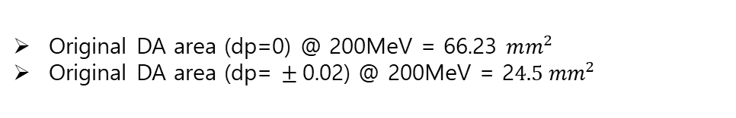
Booster MOGA simulation result
Lattice : gen_Booster_v4_cand1_20240411
The population size = 256
Used CPU number = 256
Total generations = 120
Number of variables = 5
(Quad in straight section + Quad in unit cells+Bending)
70% original strength < x < 130% original strength
Number of objectives = 2
(On momentum DA area, Off momentum DA area(2%))
Original DA area (dp=0) @ 200MeV = 66.23 $mm^{2}$
Original DA area (dp= $±$0.02) @ 200MeV = 2$4.5 mm^{2}$

Slide 5
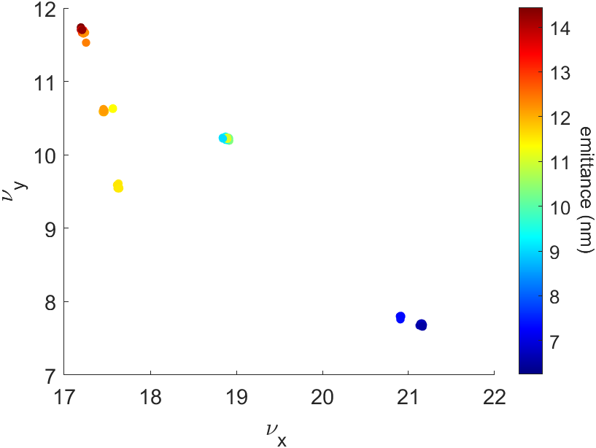
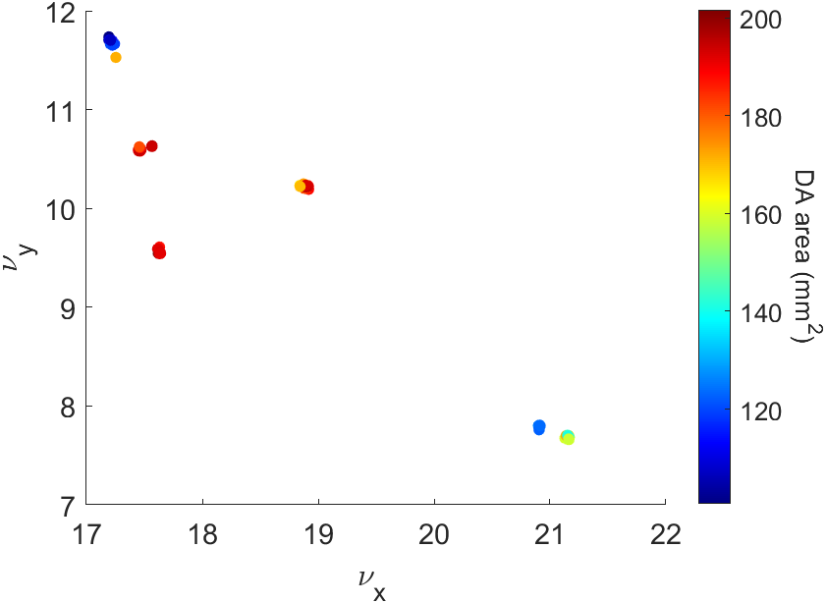
Booster MOGA simulation result (Final generation)
These three figures show the natural emittance and the sum of the On/Off momentum DA area across 256 populations in tune space of the 120th generation.
We can observe six clusters of the 256 populations. Each cluster's populations share similar lattice characteristics.
The populations within the blue box have the largest DA area, while those in the red box have the second-largest DA area.

Slide 6
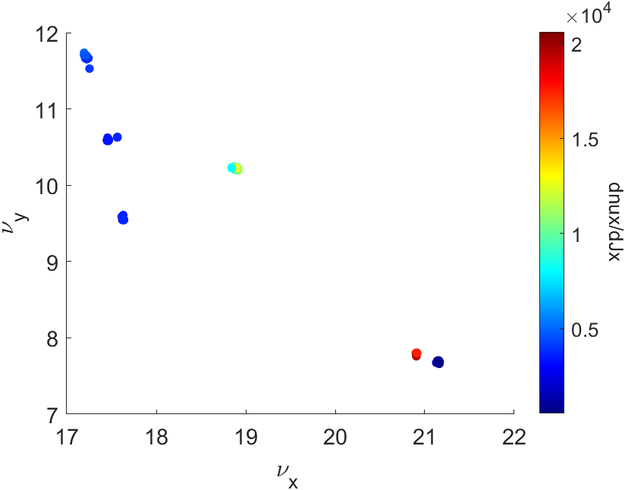
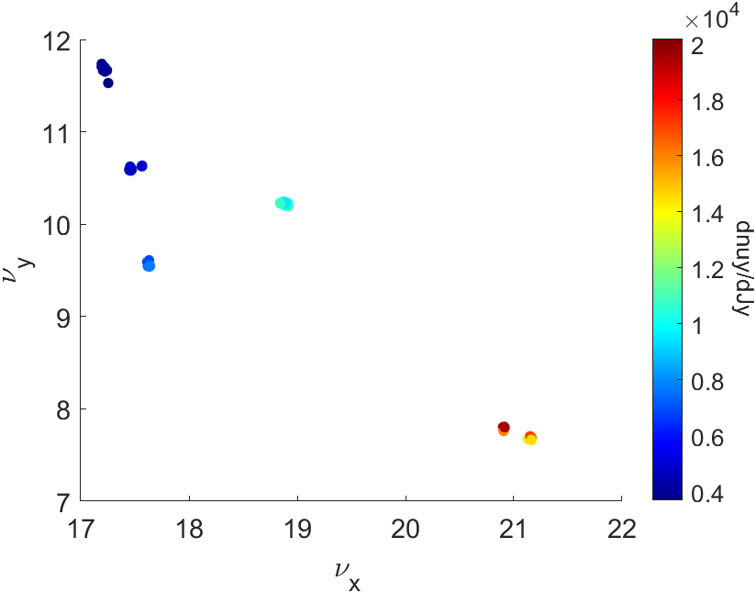
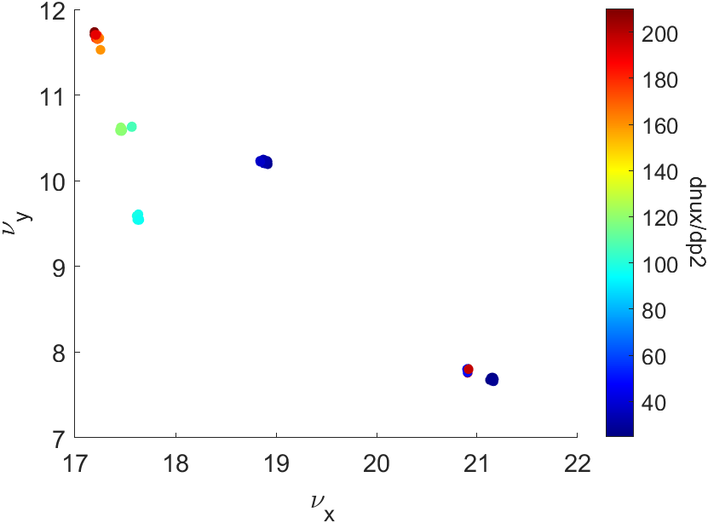
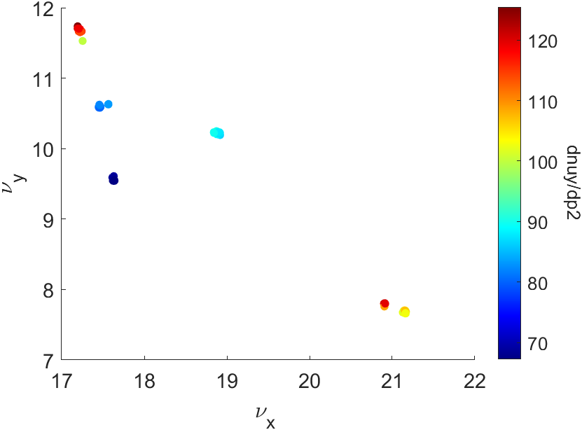
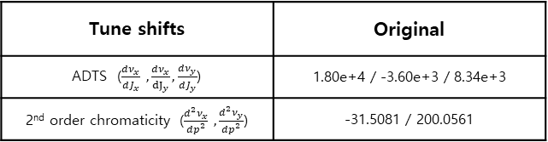
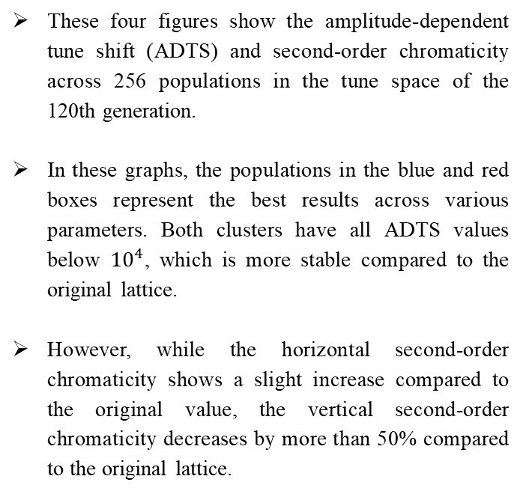
Booster MOGA simulation result(Final generation)
These four figures show the amplitude-dependent tune shift (ADTS) and second-order chromaticity across 256 populations in the tune space of the 120th generation.
In these graphs, the populations in the blue and red boxes represent the best results across various parameters. Both clusters have all ADTS values below ${10}^{4}$, which is more stable compared to the original lattice.
However, while the horizontal second-order chromaticity shows a slight increase compared to the original value, the vertical second-order chromaticity decreases by more than 50% compared to the original lattice.
Tune shifts | Original
ADTS ($\frac{dν_{x}}{dJ_{x}} ,\frac{dν_{x}}{{dJ}_{y}},\frac{dν_{y}}{dJ_{y}}$) | 1.80e+4 / -3.60e+3 / 8.34e+3
2nd order chromaticity ($\frac{d^{2}ν_{x}}{dp^{2}} ,\frac{d^{2}ν_{y}}{dp^{2}}$) | -31.5081 / 200.0561

Slide 7
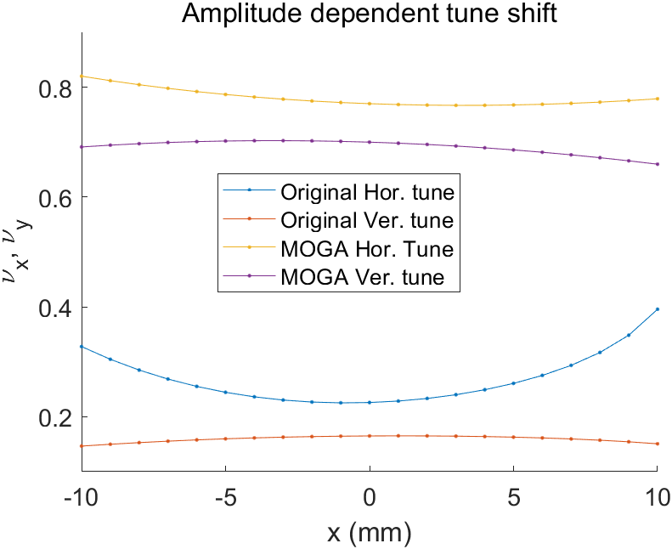
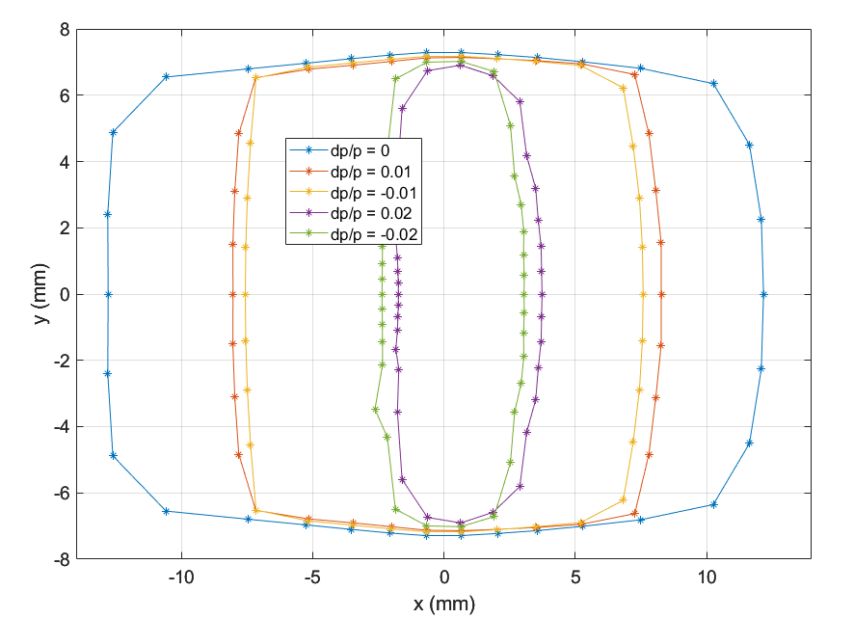
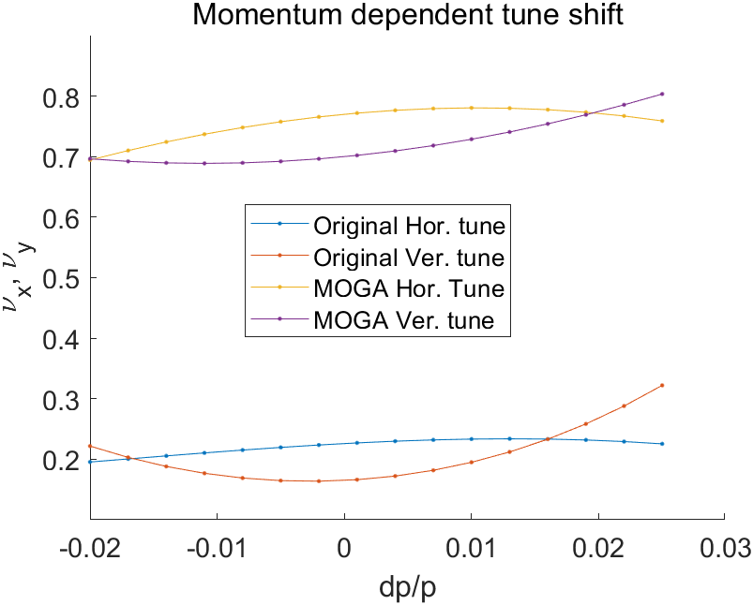
Booster optics update

Slide 8
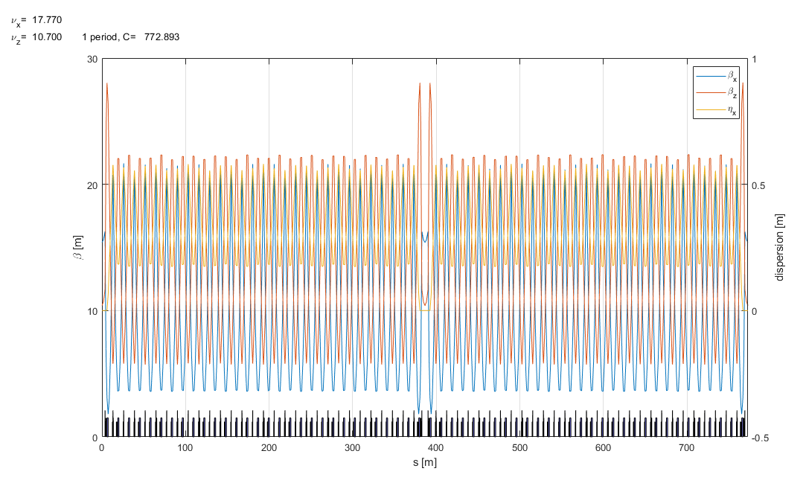
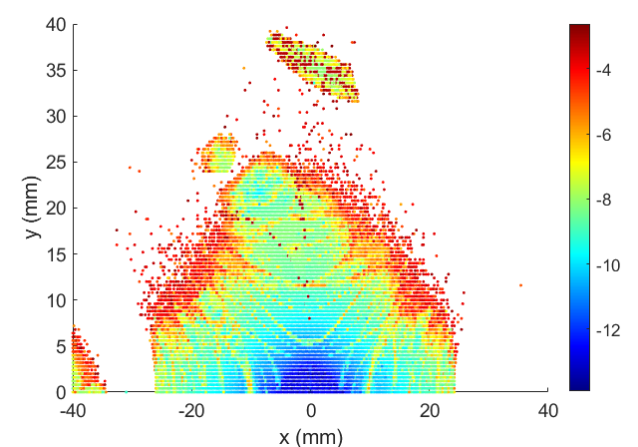
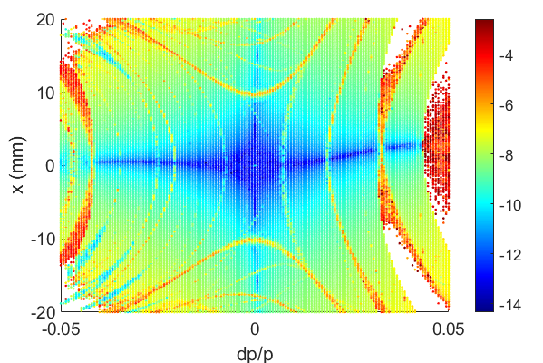
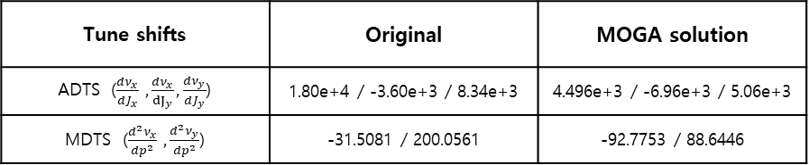
Booster optics update
Frequency map analysis
(w/o aperture)
New parameters
Hor. Tune = 17.770
Ver. Tune = 10.700
Hor. Emitt = 10.89nm @ 4GeV
Twiss function at Injection point
Hor. Beta = 15. 403
Ver. Beta = 10.397
Dispersion = 0.0
Nat. Chrom = (-22.2238, -15.3008)
Tune shifts | Original | MOGA solution
ADTS ($\frac{dν_{x}}{dJ_{x}} ,\frac{dν_{x}}{{dJ}_{y}},\frac{dν_{y}}{dJ_{y}}$) | 1.80e+4 / -3.60e+3 / 8.34e+3 | 4.496e+3 / -6.96e+3 / 5.06e+3
MDTS ($\frac{d^{2}ν_{x}}{dp^{2}} ,\frac{d^{2}ν_{y}}{dp^{2}}$) | -31.5081 / 200.0561 | -92.7753 / 88.6446

Slide 9
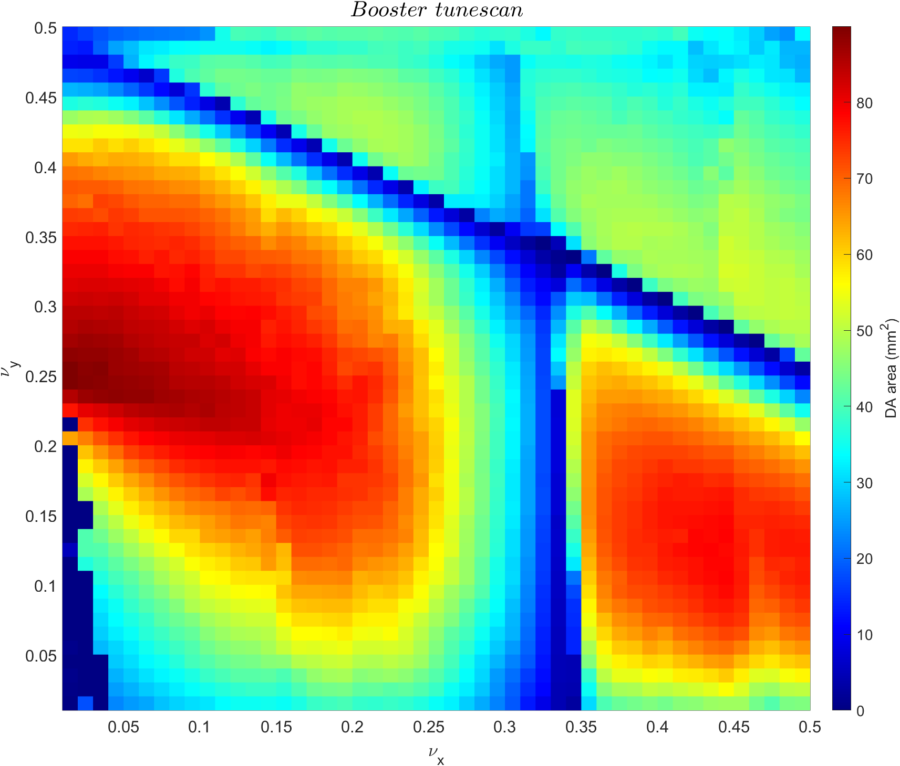
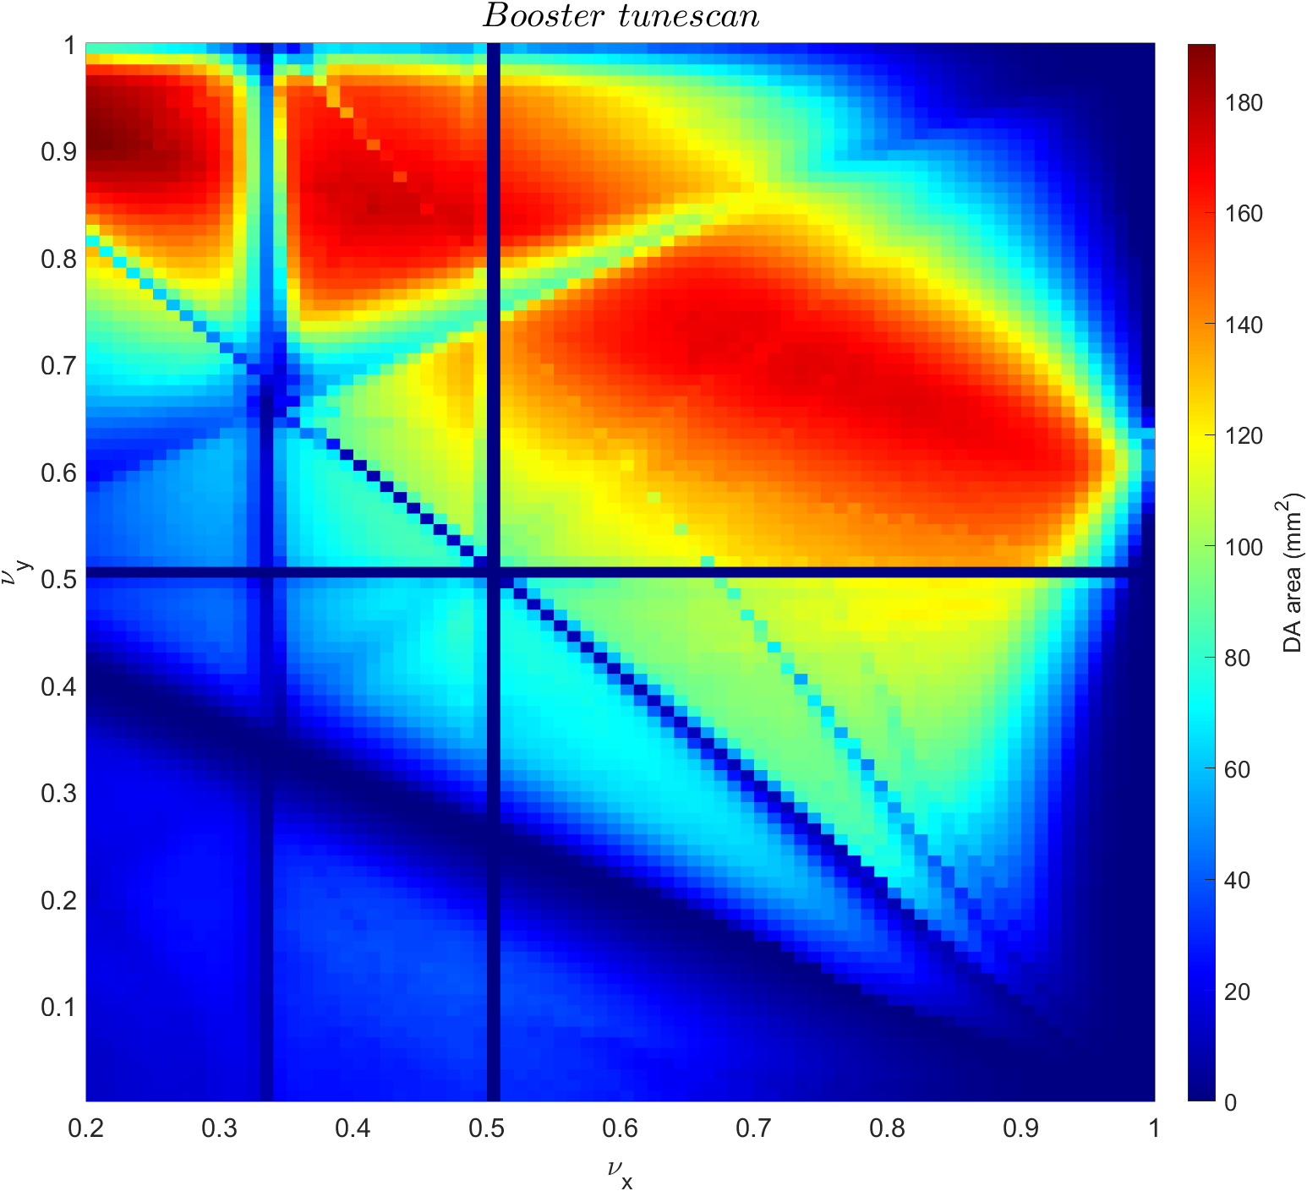
Booster tune scan result
0 < nux < 0.5
0 < nuy < 0.5
Original Booster
0.2 < nux < 1.0
0.0 < nuy < 1.0
Booster optics update

Slide 10
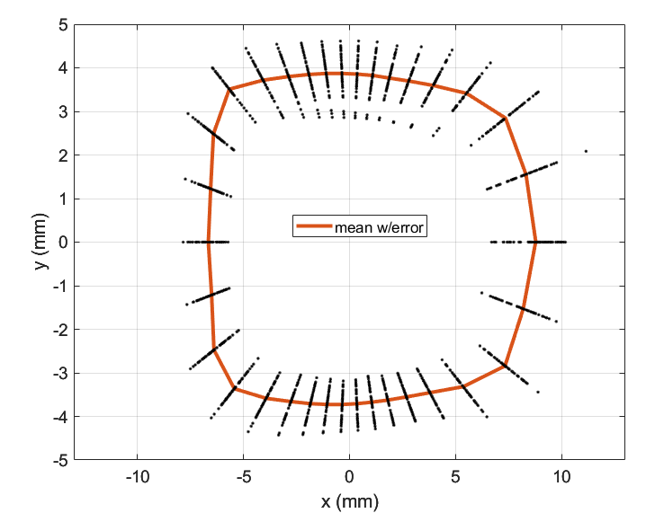
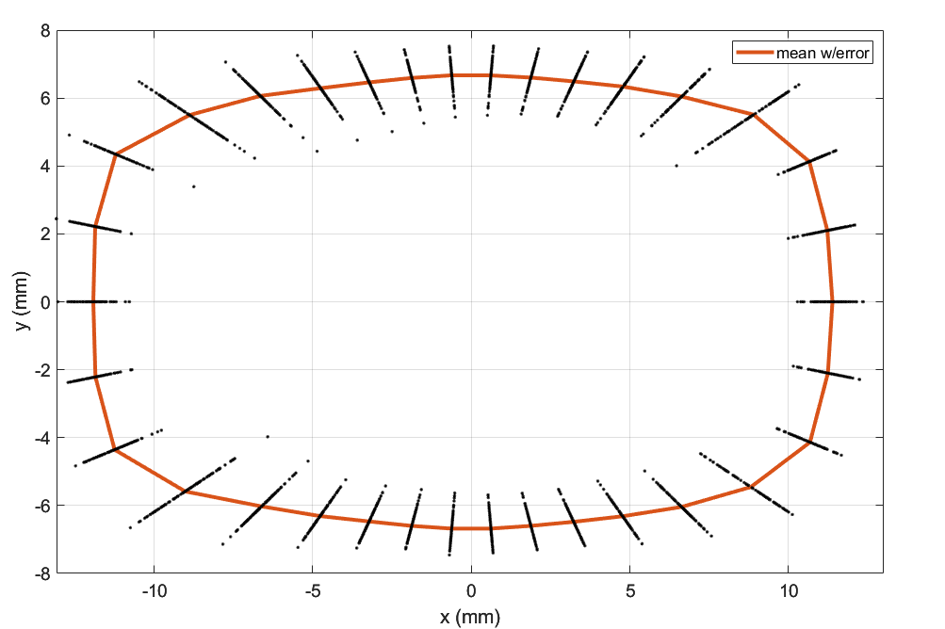


DA w/ magnet alignment error & magnet strength error
DA w/o error
Booster update
Original booster
DA w/ magnet alignment error & magnet strength error
Original booster
Booster update
$\frac{dp}{p}$ = 0
$\frac{dp}{p}$ = 0

Slide 11
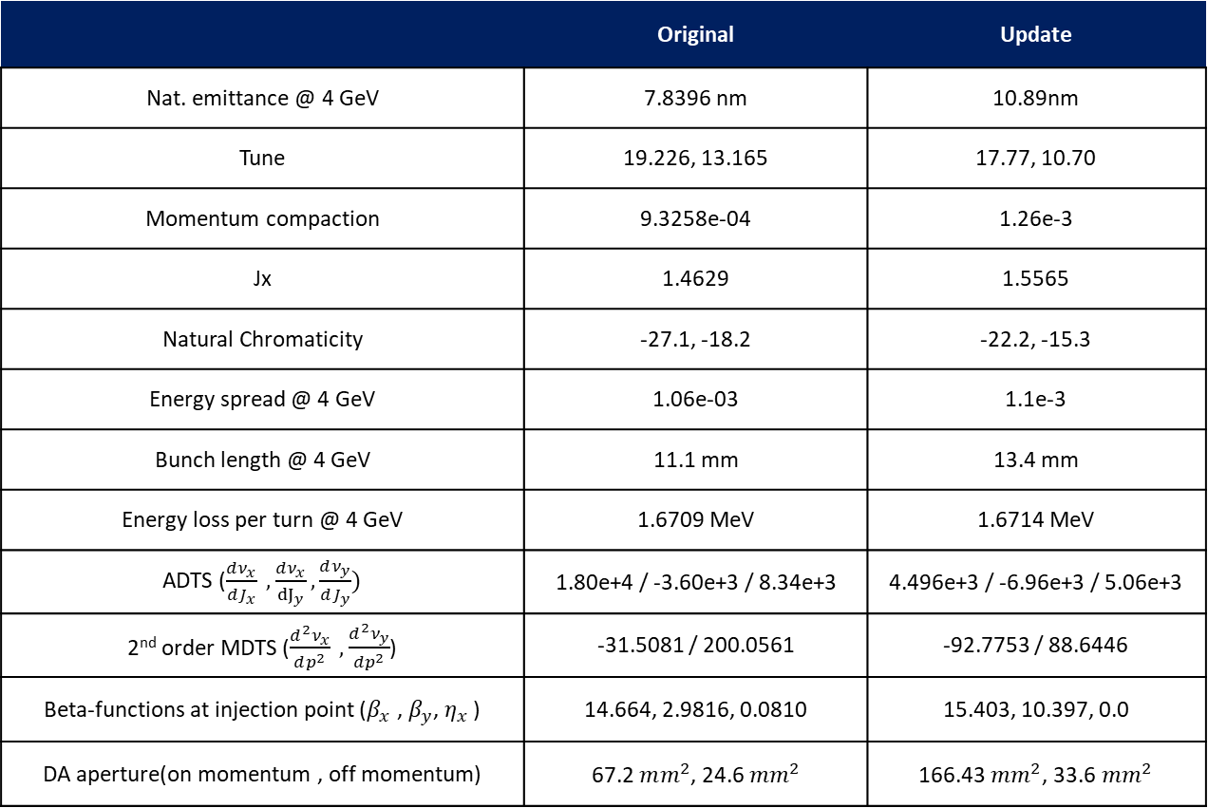
Comparison of parameters
Booster ring parameter
 | Original | Update
Nat. emittance @ 4 GeV | 7.8396 nm | 10.89nm
Tune | 19.226, 13.165 | 17.77, 10.70
Momentum compaction | 9.3258e-04 | 1.26e-3
Jx | 1.4629 | 1.5565
Natural Chromaticity | -27.1, -18.2 | -22.2, -15.3
Energy spread @ 4 GeV | 1.06e-03 | 1.1e-3
Bunch length @ 4 GeV | 11.1 mm | 13.4 mm
Energy loss per turn @ 4 GeV | 1.6709 MeV | 1.6714 MeV
ADTS ($\frac{dν_{x}}{dJ_{x}} ,\frac{dν_{x}}{{dJ}_{y}},\frac{dν_{y}}{dJ_{y}})$ | 1.80e+4 / -3.60e+3 / 8.34e+3 | 4.496e+3 / -6.96e+3 / 5.06e+3
2nd order MDTS ($\frac{d^{2}ν_{x}}{dp^{2}} ,\frac{d^{2}ν_{y}}{dp^{2}}$) | -31.5081 / 200.0561 | -92.7753 / 88.6446
Beta-functions at injection point ($β_{x}$ , $β_{y}$, $η_{x}$ ) | 14.664, 2.9816, 0.0810 | 15.403, 10.397, 0.0
DA aperture(on momentum , off momentum) | 67.2 $mm^{2}$, 24.6 $mm^{2}$ | 166.43 $mm^{2}$, 33.6$mm^{2}$

Slide 12
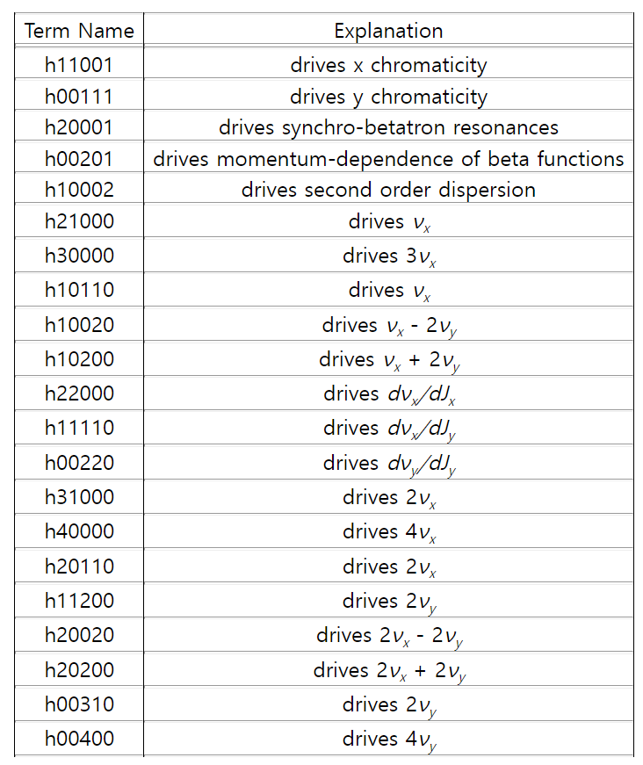
Comparison of one-turn resonance driving terms
 | Orignal | Update | Ratio (update/original)
h11001 | 4.631 | 7.211 | 1.557
h00111 | 9.171 | 11.836 | 1.291
h10100 | 0.000 | 0.000
h10010 | 0.000 | 0.000
h21000 | 5.862 | 7.709 | 1.315
h30000 | 15.965 | 0.972 | 0.061
h10110 | 9.377 | 10.075 | 1.074
h10020 | 3.278 | 3.290 | 1.004
h10200 | 10.824 | 3.482 | 0.322
h20001 | 0.358 | 2.285 | 6.377
h00201 | 0.744 | 0.676 | 0.910
h10002 | 0.090 | 0.298 | 3.317
h22000 | 12822.751 | 3337.164 | 0.260
h11110 | 5464.975 | 11148.126 | 2.040
h00220 | 6637.550 | 3890.082 | 0.586
h31000 | 1271.205 | 93.878 | 0.074
h40000 | 300.149 | 19.461 | 0.065
h20110 | 765.204 | 157.827 | 0.206
h11200 | 615.354 | 141.216 | 0.229
h20020 | 421.407 | 99.437 | 0.236
h20200 | 425.162 | 122.164 | 0.287
h00310 | 359.866 | 74.248 | 0.206
h00400 | 108.448 | 24.771 | 0.228
https://ops.aps.anl.gov/manuals/elegant_latest/elegantsu82.html#x90-890007.71

Slide 13
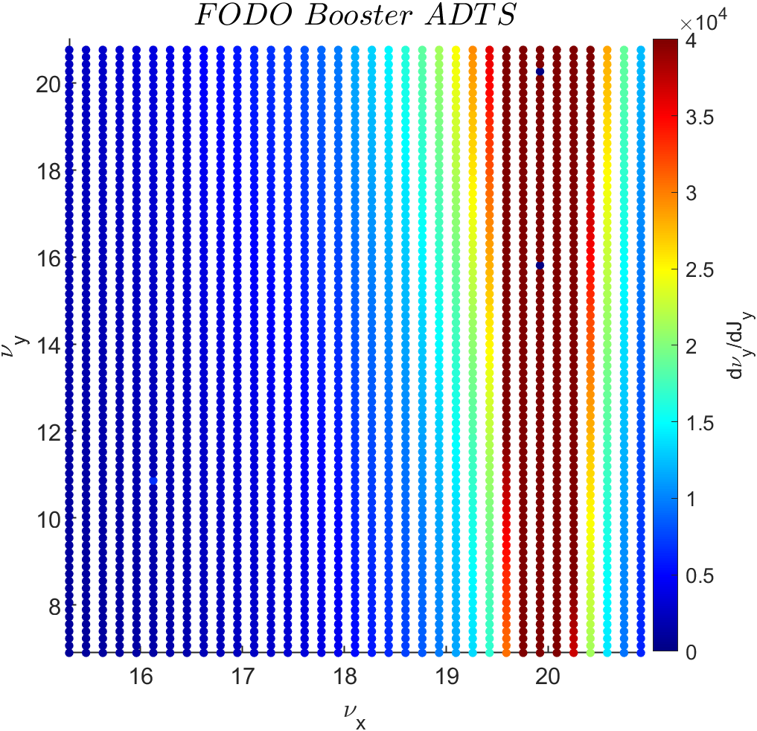
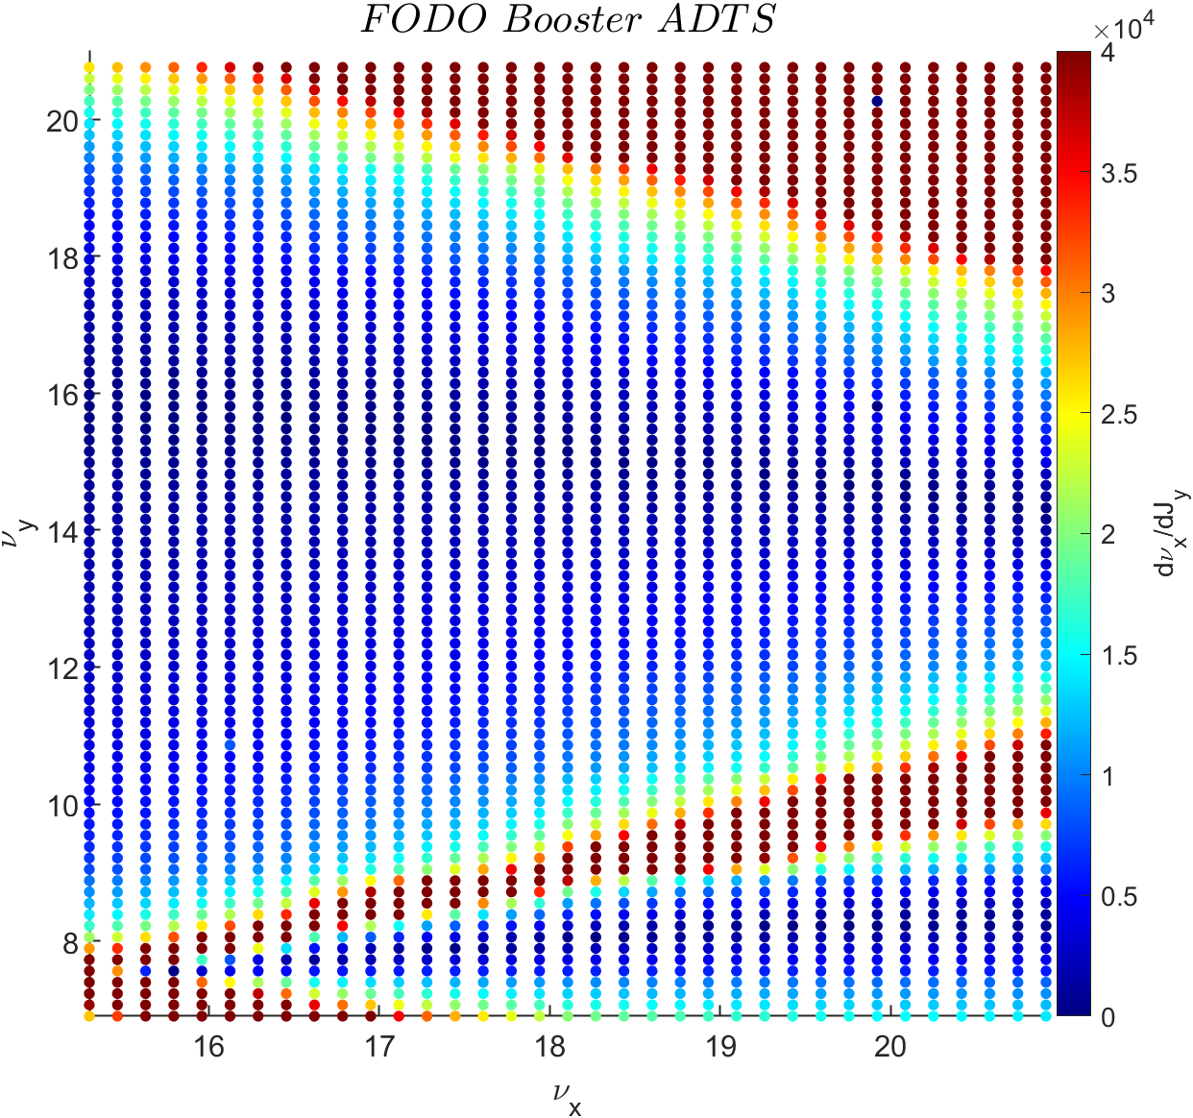
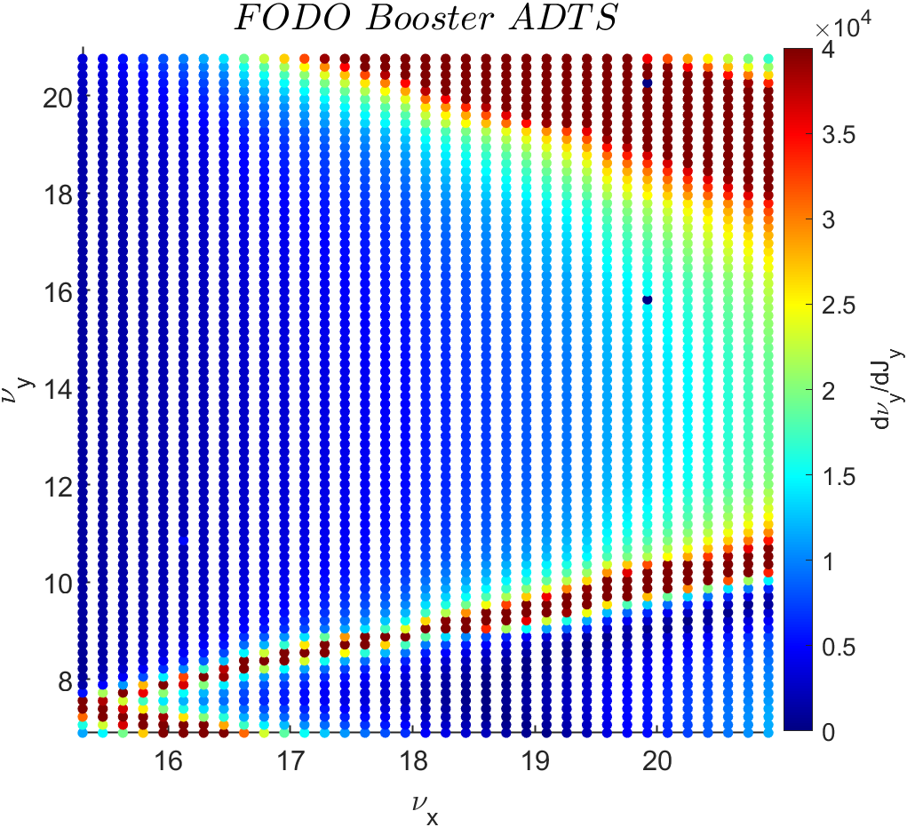
Beam physics group meeting
Detuning parameter of FODO Booster lattice along tune difference

Slide 14
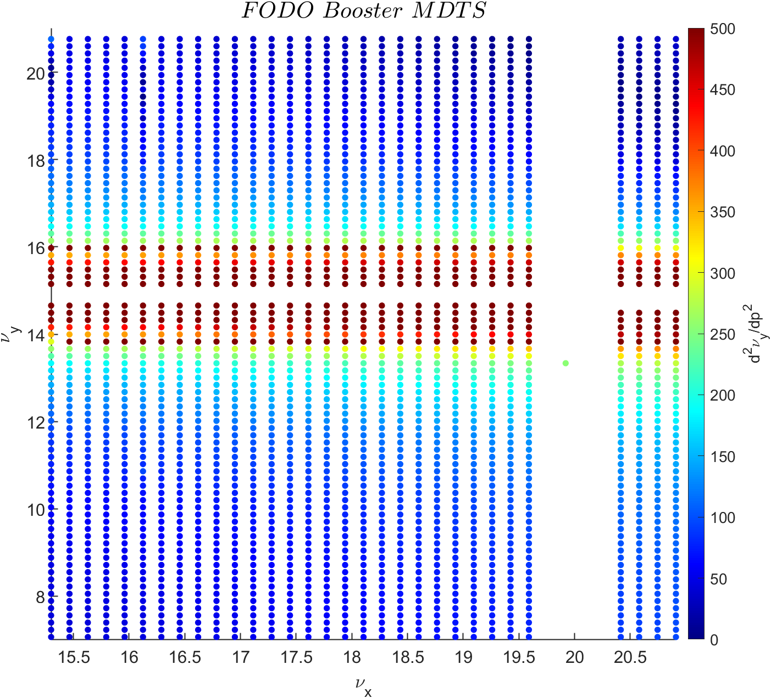
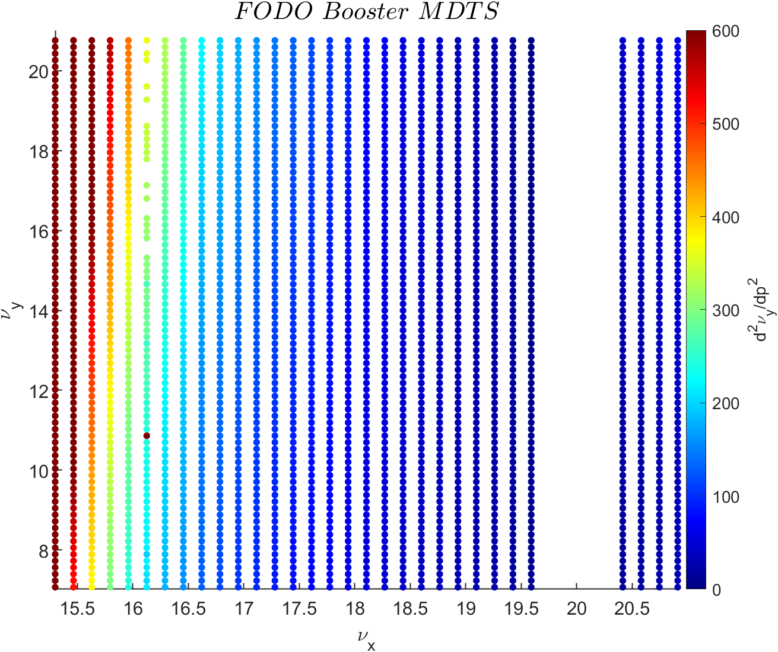
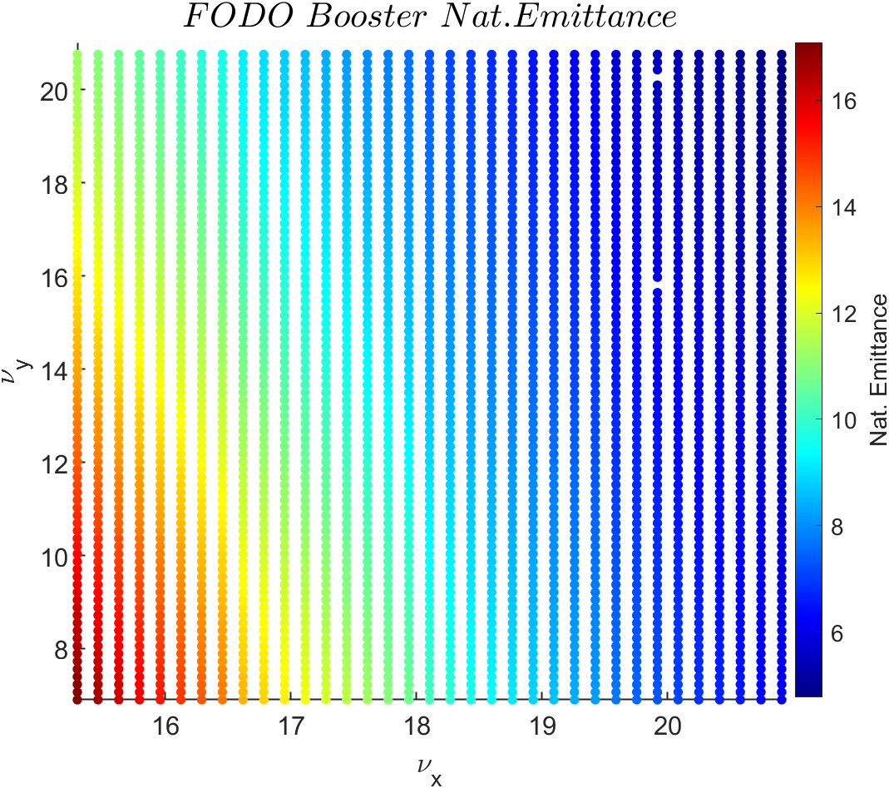
Beam physics group meeting
Detuning parameter of FODO Booster lattice along tune difference

Slide 15
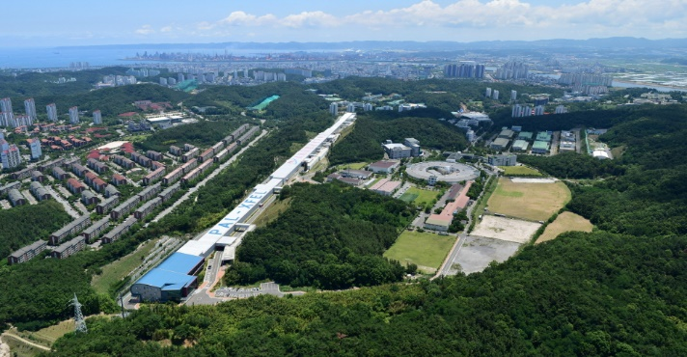
4GSR weekly meeting
Thank you!

Slide 16
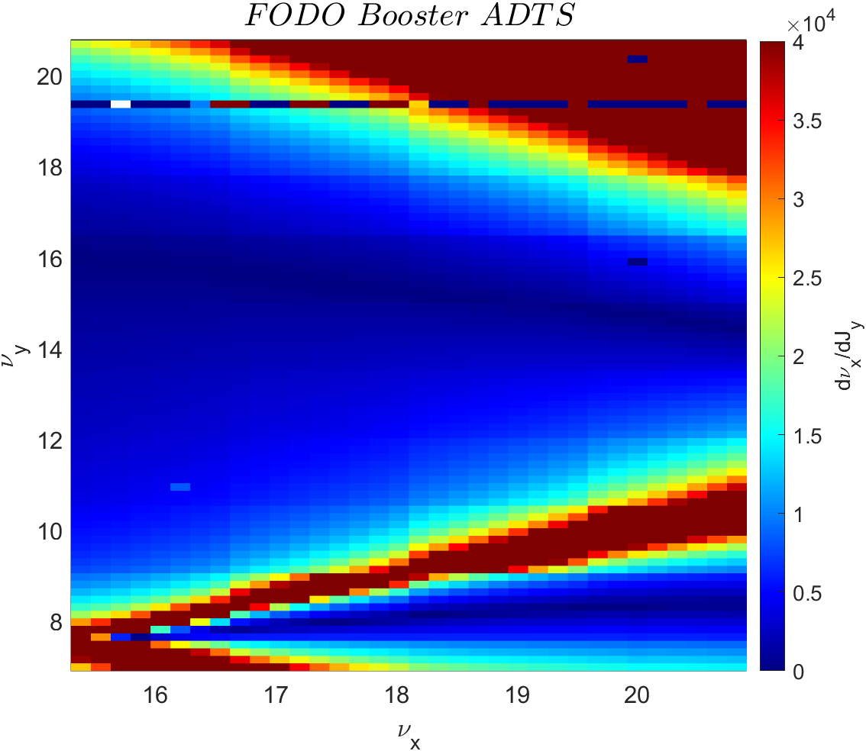
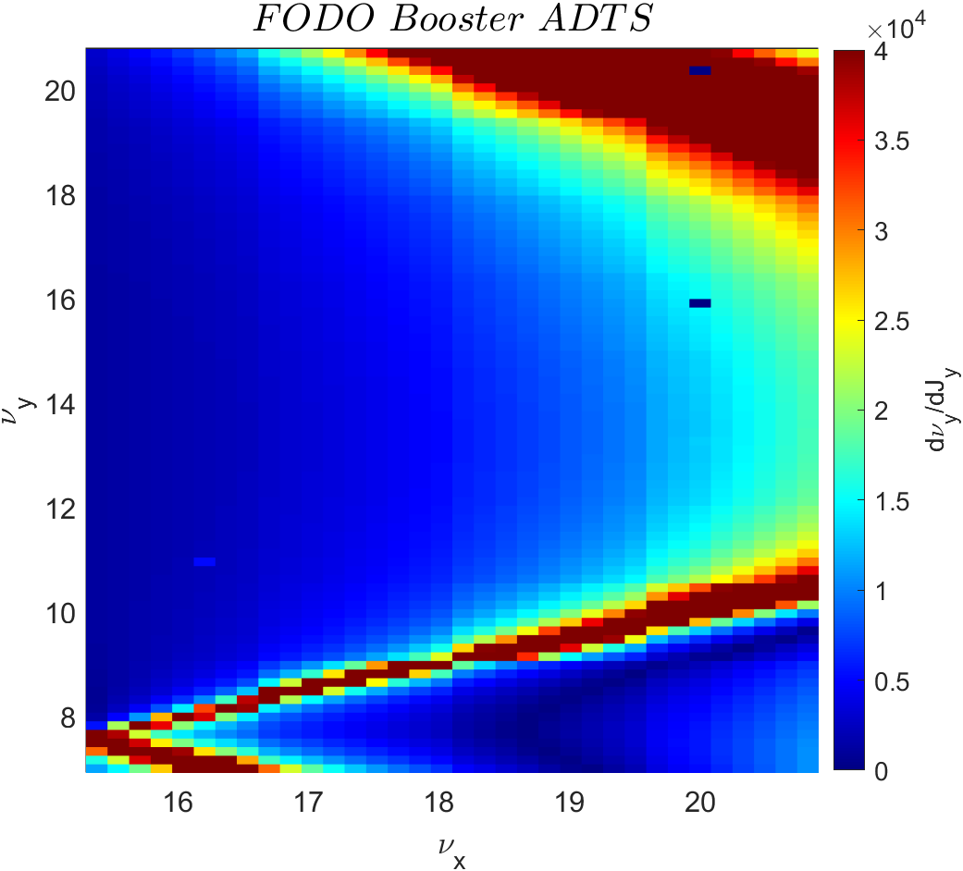
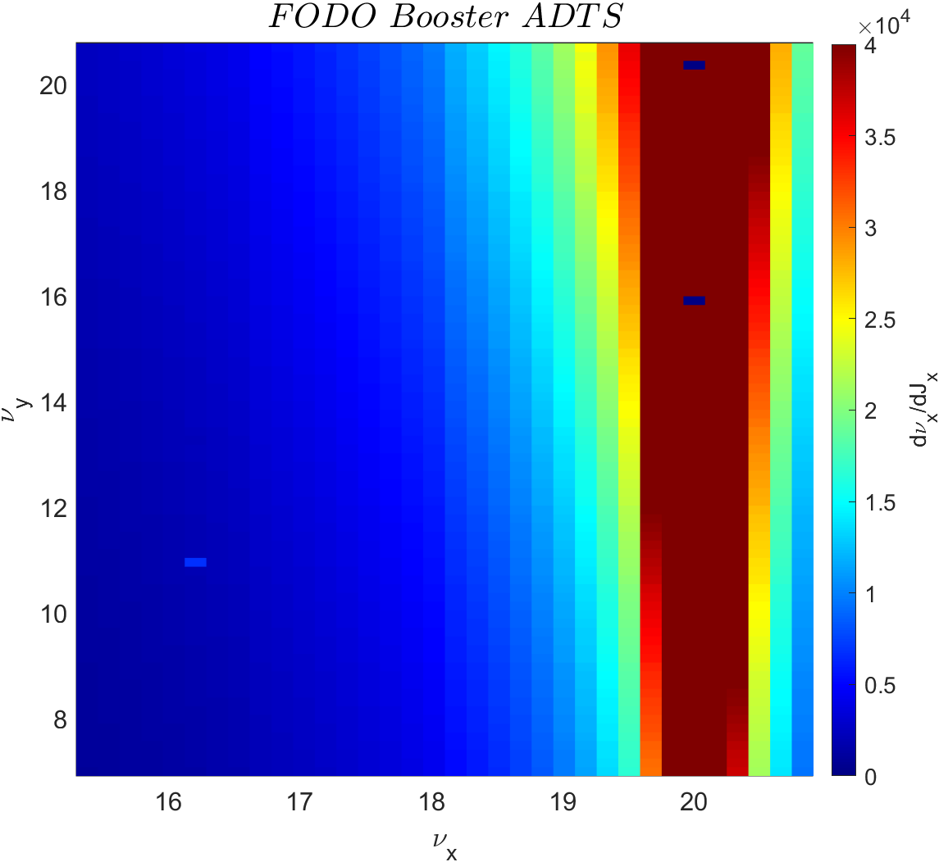

Slide 17
Beam physics group meeting
Booster MOGA simulation result(Final generation)

Slide 18
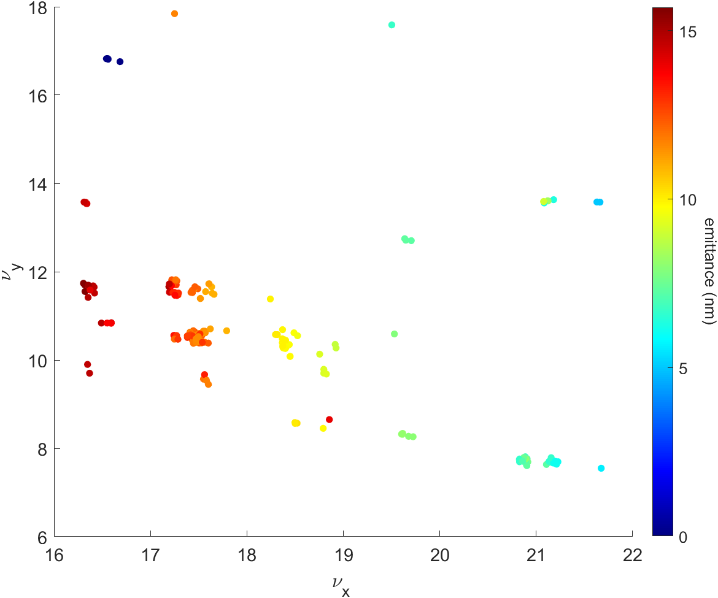
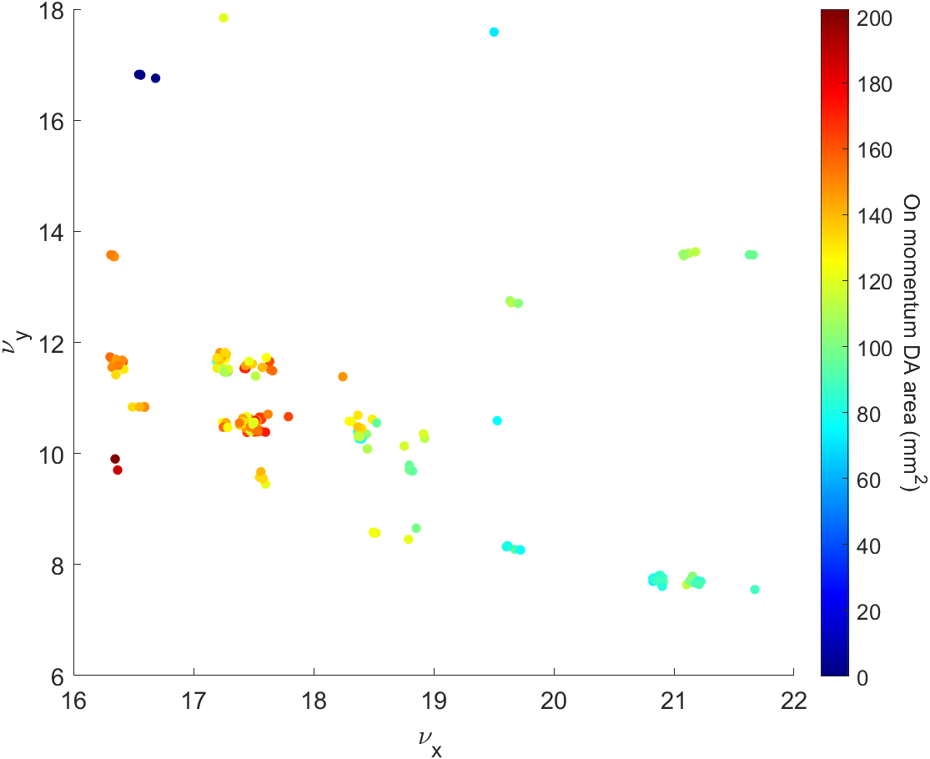
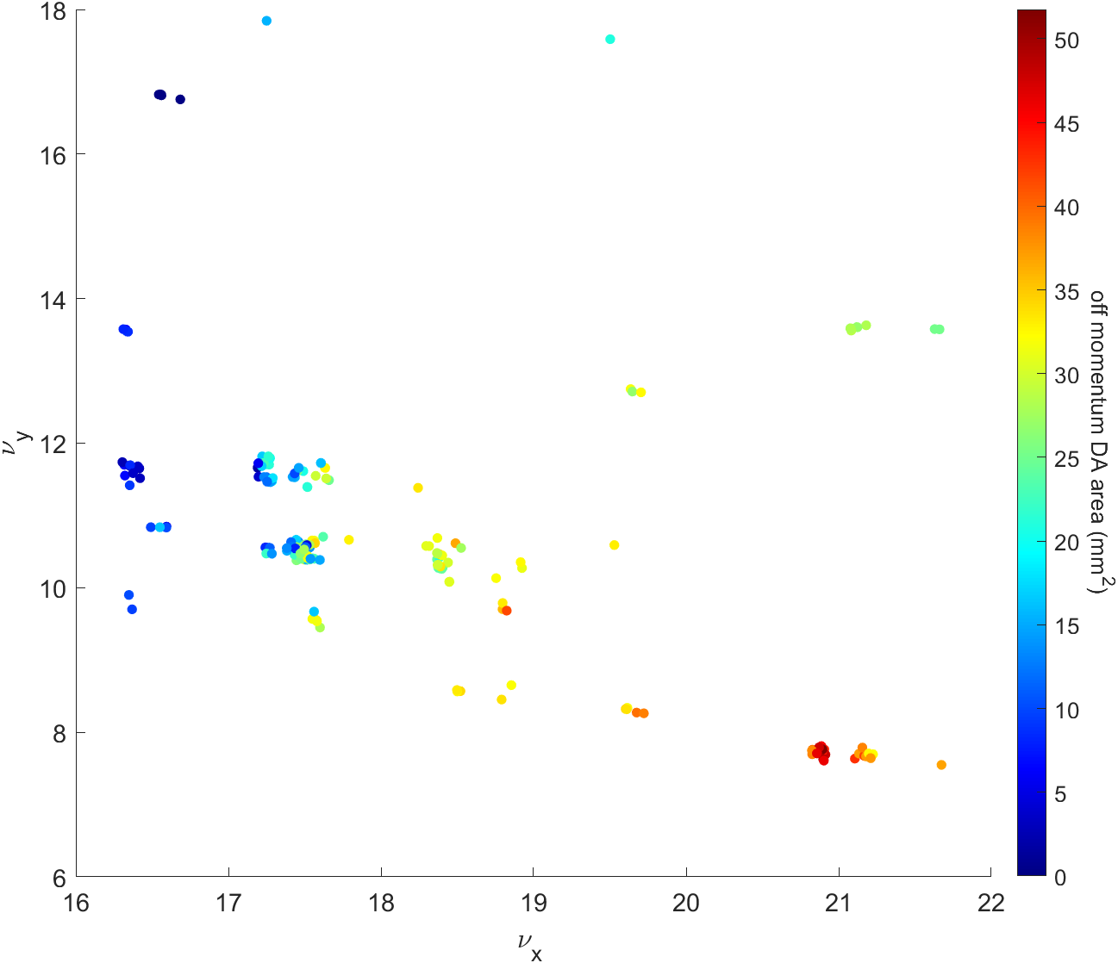
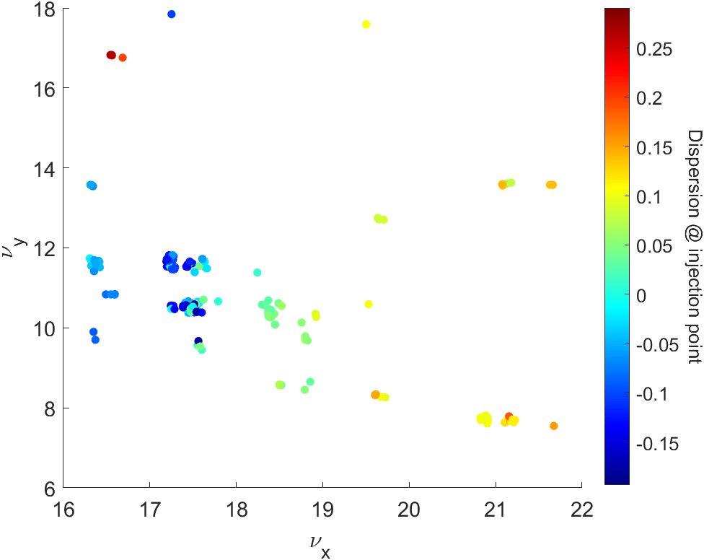
Beam physics group meeting
Booster MOGA simulation result(20th generation)

Slide 19
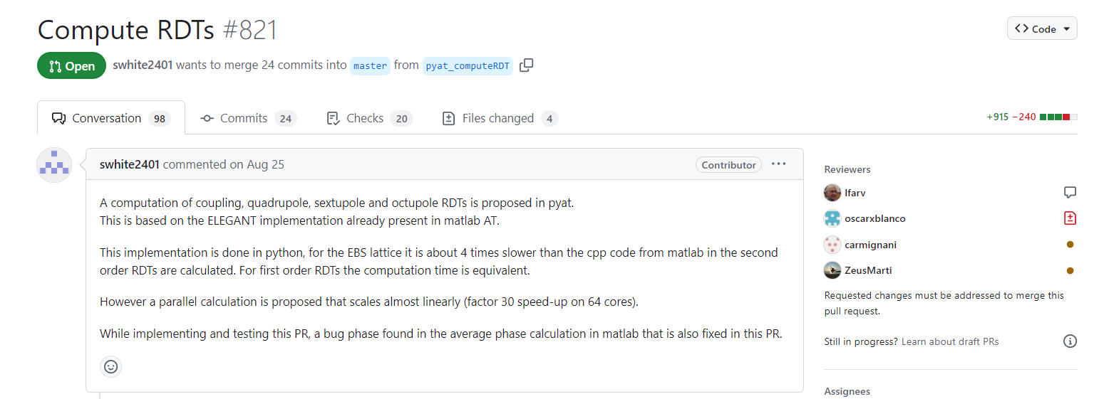
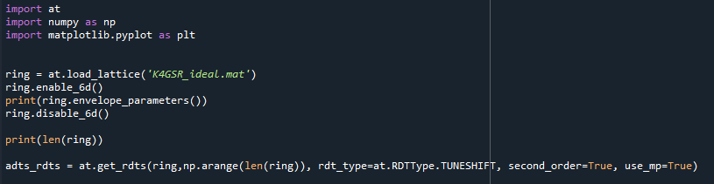
RDT value comparison
Compute RDT function in Python

Slide 20
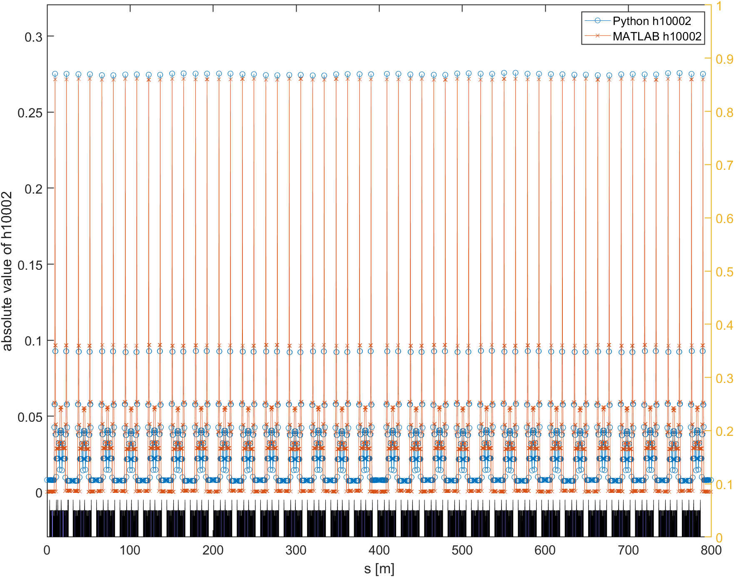
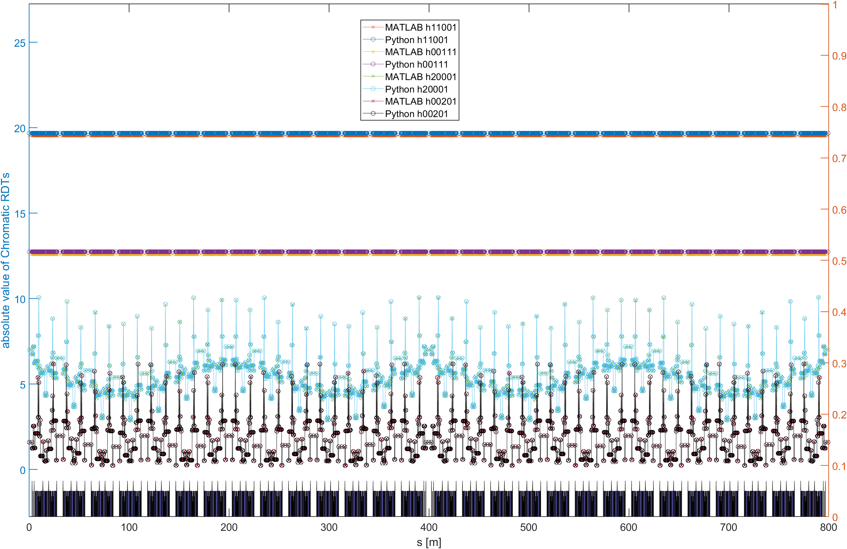
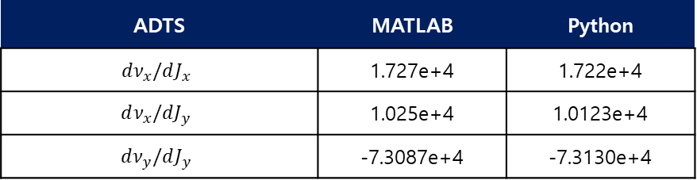
RDT value comparison
Comparison Compute RDT function between MATLAB and Python
ADTS | MATLAB | Python
$$dν_{x}/dJ_{x}$$ | 1.727e+4 | 1.722e+4
$$dν_{x}/dJ_{y}$$ | 1.025e+4 | 1.0123e+4
$$dν_{y}/dJ_{y}$$ | -7.3087e+4 | -7.3130e+4

