Slide 1
Deflecting cavity status & experimental plan at eLABs
Geunwoo Kim
24. 10. 11.

Slide 2
Contents
1. Transverse deflecting cavity (TCAV)
2. Simulation
CST
Modeling
Field distribution for Astra
MAD-X
Preparation
Current status
3. Longitudinal phase space (LPS), briefly

Slide 3
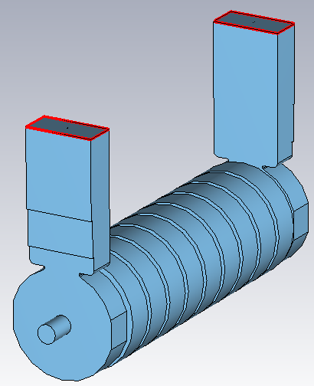
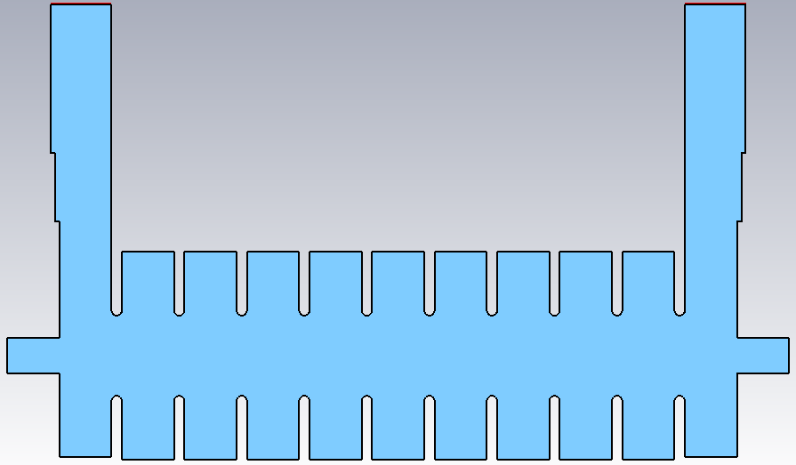
1. Transverse deflecting cavity (TCAV)
Screen
RF
deflecting
cavity
Beam
E₀
x’
Active cells
Coupler cells
TCAV kicks the beam to the transverse plane.
$V_{⊥}=−\frac{ic}{ω}\int_{0}^{L}{dz}∇_{⊥}E_{z}\left(z,\frac{z}{c}\right)$ by Panofsky-Wenzel Theorem
Gradient E_{z} is major kick component for deflecting.
TM mode is dominant than TE mode.
We can measure the longitudinal beam distribution.
<e-labs deflecting cavity shape>

Slide 4
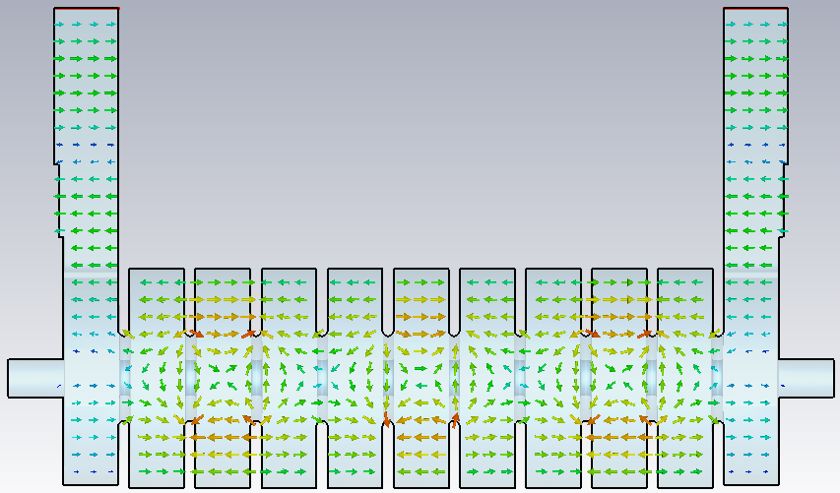
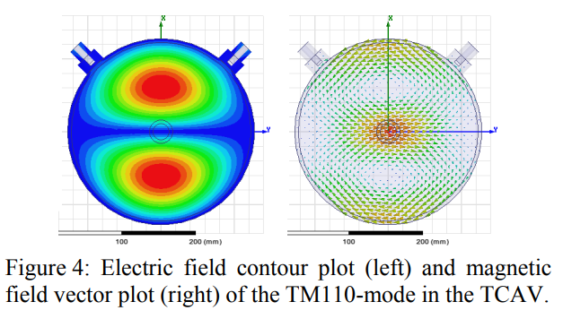
1. Transverse deflecting cavity (TCAV)
<E-field distribution>
6 cells
ΔΦ = 4π
Main feature
HEM₁₁ mode (similar to TM₁₁ mode)
: Composed of TE11 and TM11 modes
Uses both E and B fields for kicks.
Capable of achieving high shunt impedance.
$$V_{⊥}=\sqrt{2αl}\left(\frac{1−e^{−αl}}{αl}\right)\sqrt{P_{RF}r_{sh}l}=k_{D}l\sqrt{P_{RF}}.$$
∴ Therefore, achieving high transverse kick components.
z
<SCLA TCAV, TM₁₁ mode>
Compared to SCLA TCAV, r_{sh} is about a factor of 14.
 | SCLA TCAV | E-labs TCAV
Mode | TM₁₁ | HEM₁₁
Shunt Impedance(r_{sh}) | 2.1 MΩ/m | 28.7 MΩ/m
Structure | Linear and Circular | Iris-loaded

Slide 5
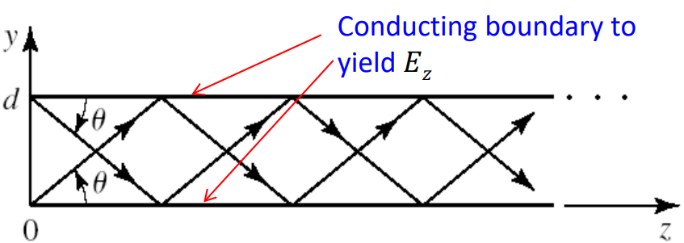
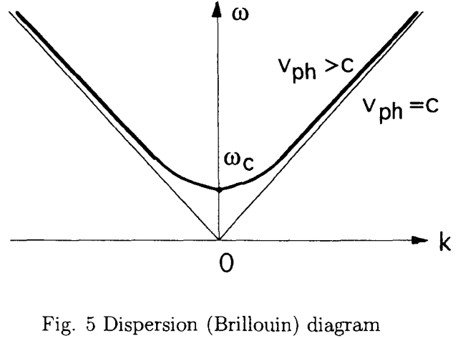
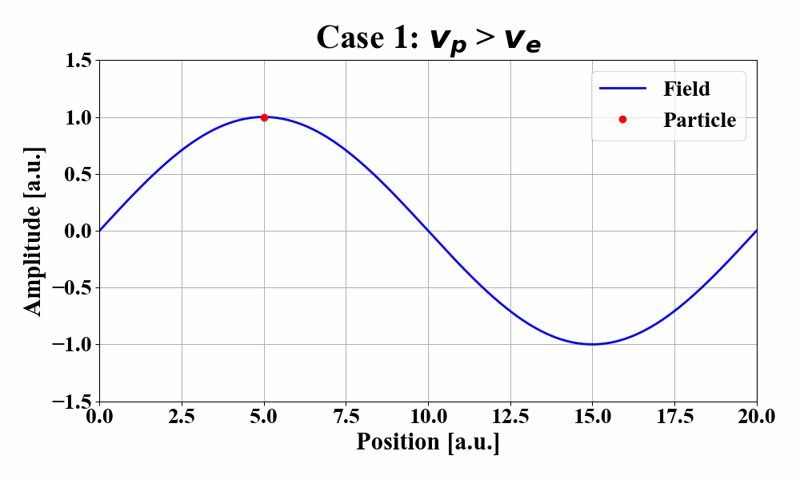
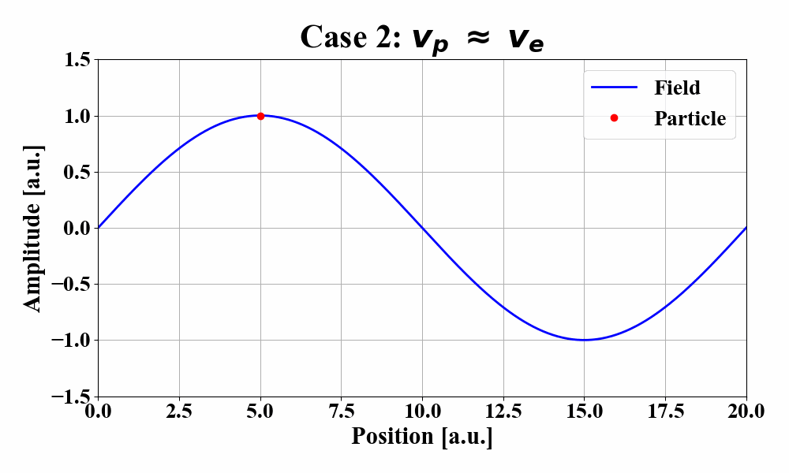
1. Transverse deflecting cavity (TCAV)
Main feature
Iris-loaded structure
Why don’t we use a uniform cavity?
Phase velocity $v_{p}$ > c in a uniform waveguide.
$$v_{p}=\frac{ω}{k}=\frac{c}{\sqrt{1−\frac{ω_{c}^{2}}{ω^{2}}}}>c for \frac{ω_{c}}{ω}>0$$
→ Particle cannot exceed the speed of light ( v_{e} ~ c, v_{e} < c).

Slide 6
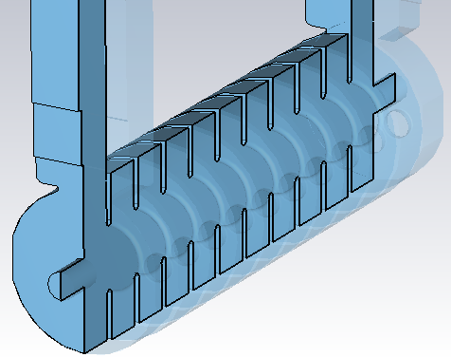
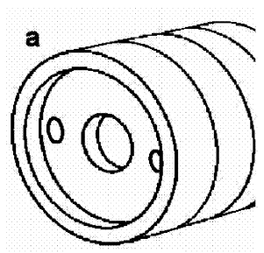
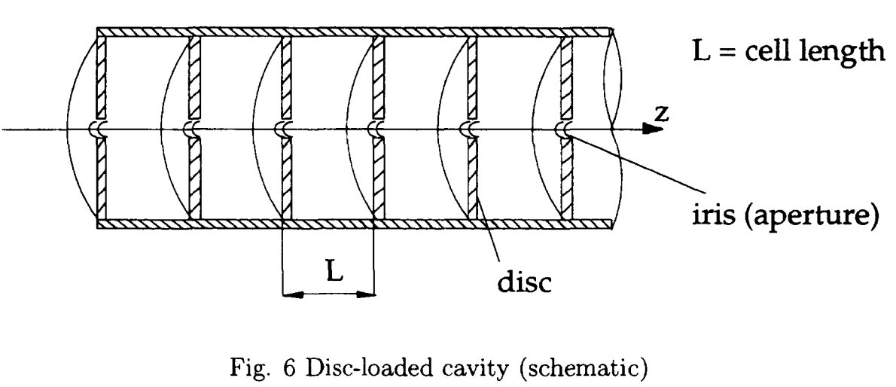
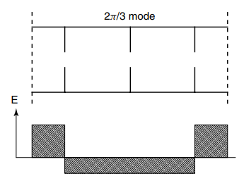
1. Transverse deflecting cavity (TCAV)
Main feature
Iris-loaded structure
Disk-loaded or “slow-wave” structure
Control $v_{p}$ is necessary to synchronize with a beam.
→ Deaccelerating $v_{p}$
2/3π mode (ΔΦ = 2π for three cells)
High efficiency (high shunt impedance)

Slide 7
1. Transverse deflecting cavity (TCAV)
The primary goal of my research
* Investigation of the longitudinal phase space (LPS) using TCAV.
Before the experiment, we need to confirm TCAV’s resolution by simulation.
1. Resolution is one of the crucial parameters. (whether it can have fs scale resolution)
2. So far, there are no measured results or simulation results.
$$σ_{z}=\sqrt{σ_{y,on}^{2}−σ_{y,off}^{2}}$$
$σ_{y,on}=\sqrt{σ_{y,off}^{2}+σ_{z}β_{d}β_{c}{\left(\frac{k_{rf}eV_{d}}{E_{0}}\sin\left(Δψ_{y}\cos{φ_{rf}}\right)\right)}^{2}}$
$$σ_{z,res}=\frac{p_{z}c}{eV_{T}ωL}\sqrt{β_{d}ε_{y}}$$
MAD-X, Astra is suitable for obtaining the beam parameter.
* 2D field distribution of TCAV should be measured using CST.
σ_{y0}: RMS beam size on the screen
β_{d}: β at TCAV entrance
β_{c}: β on screen
ΔΨ_{y}: Phase advance between TCAV and screen
Φ_{rf}: RF phase from the zero crossing
σ_{z}: RMS bunch length
k_{rf}: wavenumber of field

Slide 8
Contents
1. Transverse deflecting cavity (TCAV)
2. Simulation
CST
Modeling
Field distribution for Astra
MAD-X
Preparation
Current status
3. Longitudinal phase space (LPS), briefly

Slide 9
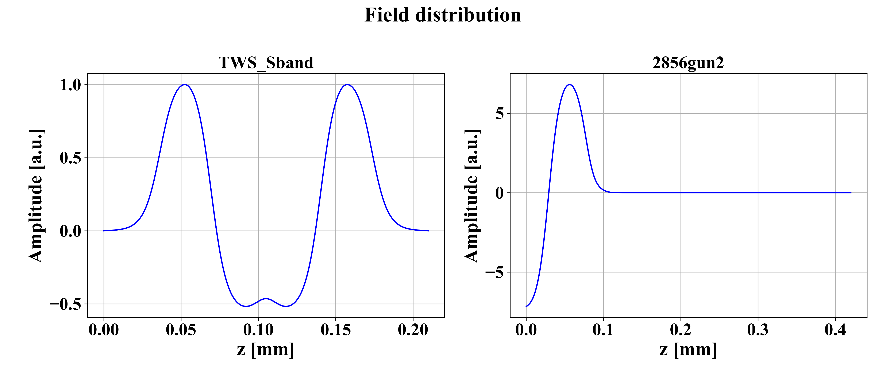
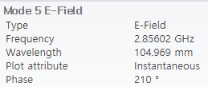
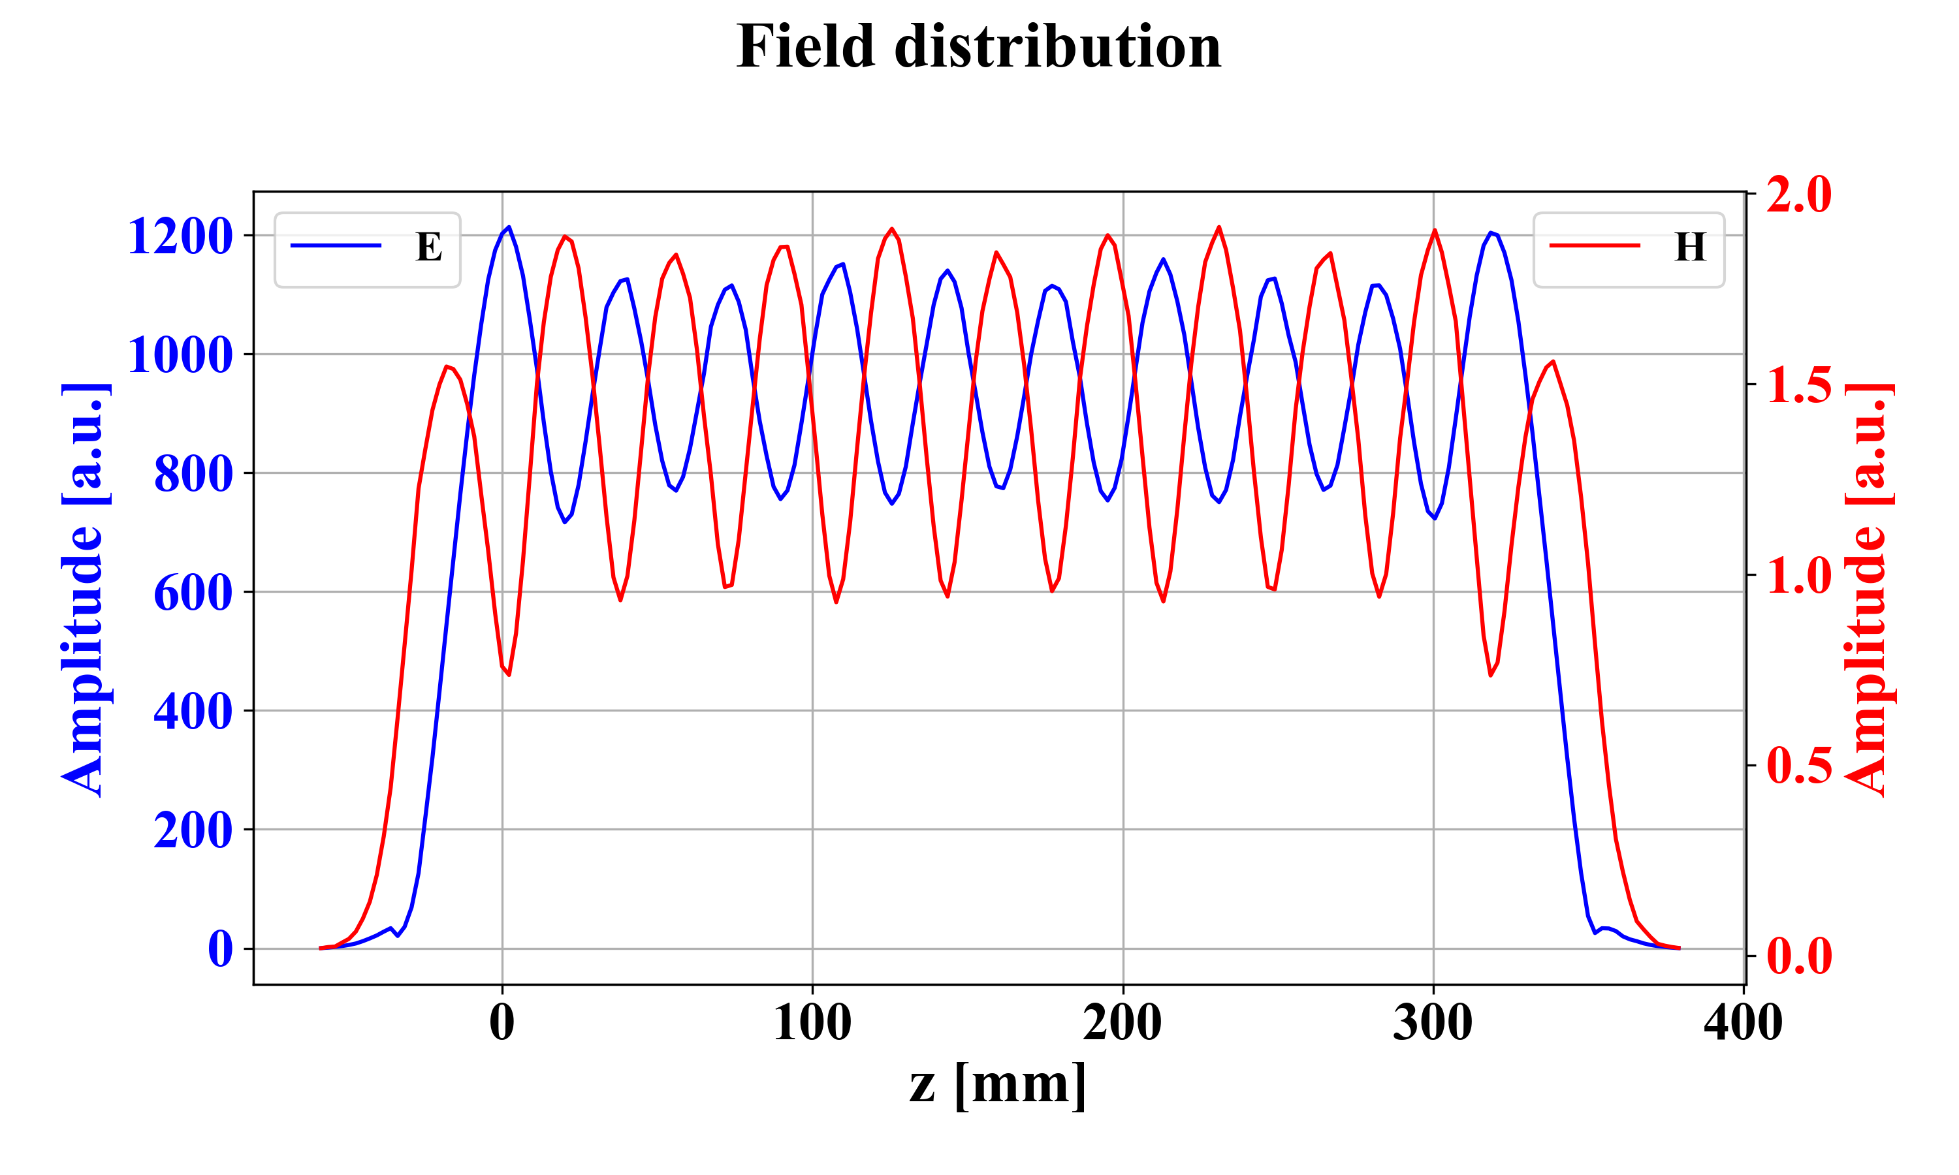
2. Simulation (CST)
Modeling & Field distribution
0. Remodeling in my own for understanding the structure
Eigenmode solver
To check whether the geometry is same or not.
HEM₁₁ mode (2.856 GHz, Mode 5)
Frequency-domain solver
< field distribution example in Astra>
d

Slide 10
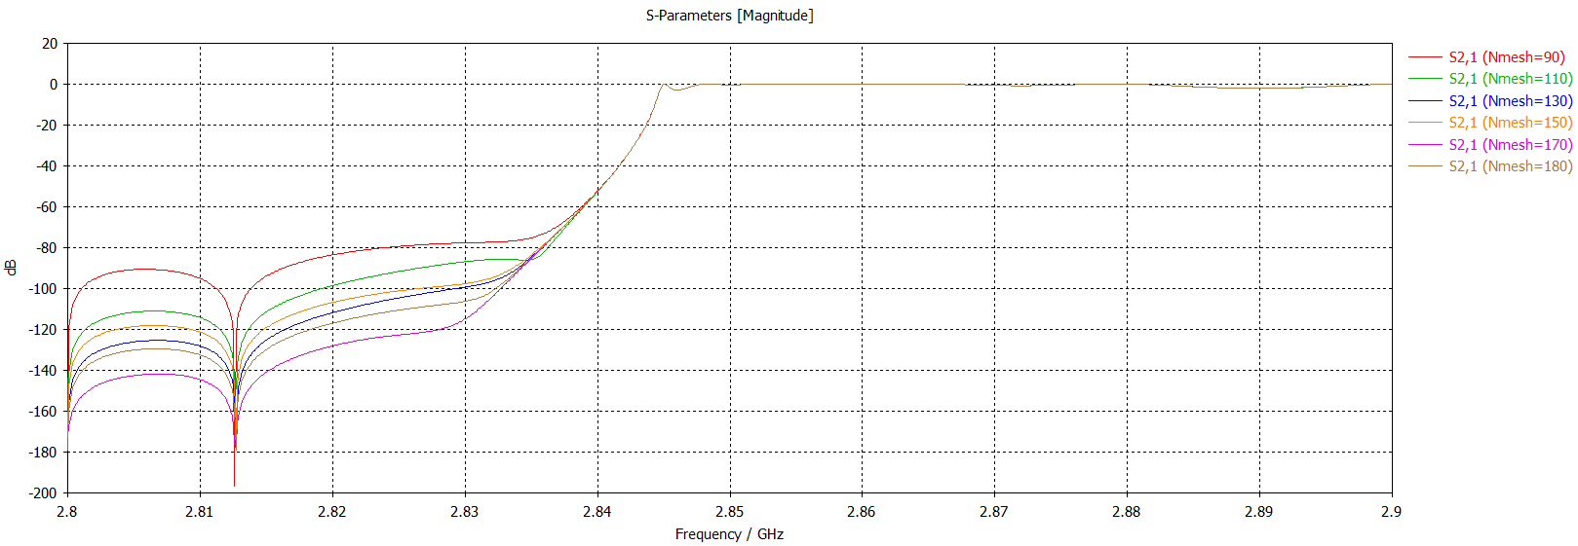
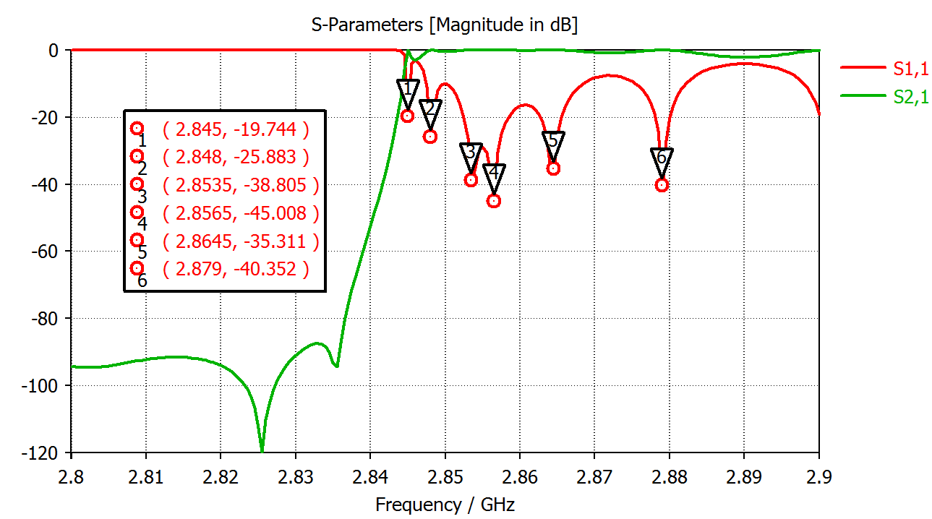
2. Simulation (CST)
Extra) Comparison simulation results with reference results.
- boundary condition: E_{t}=0
- Cell per maximum wavelength: Automatic

Slide 11
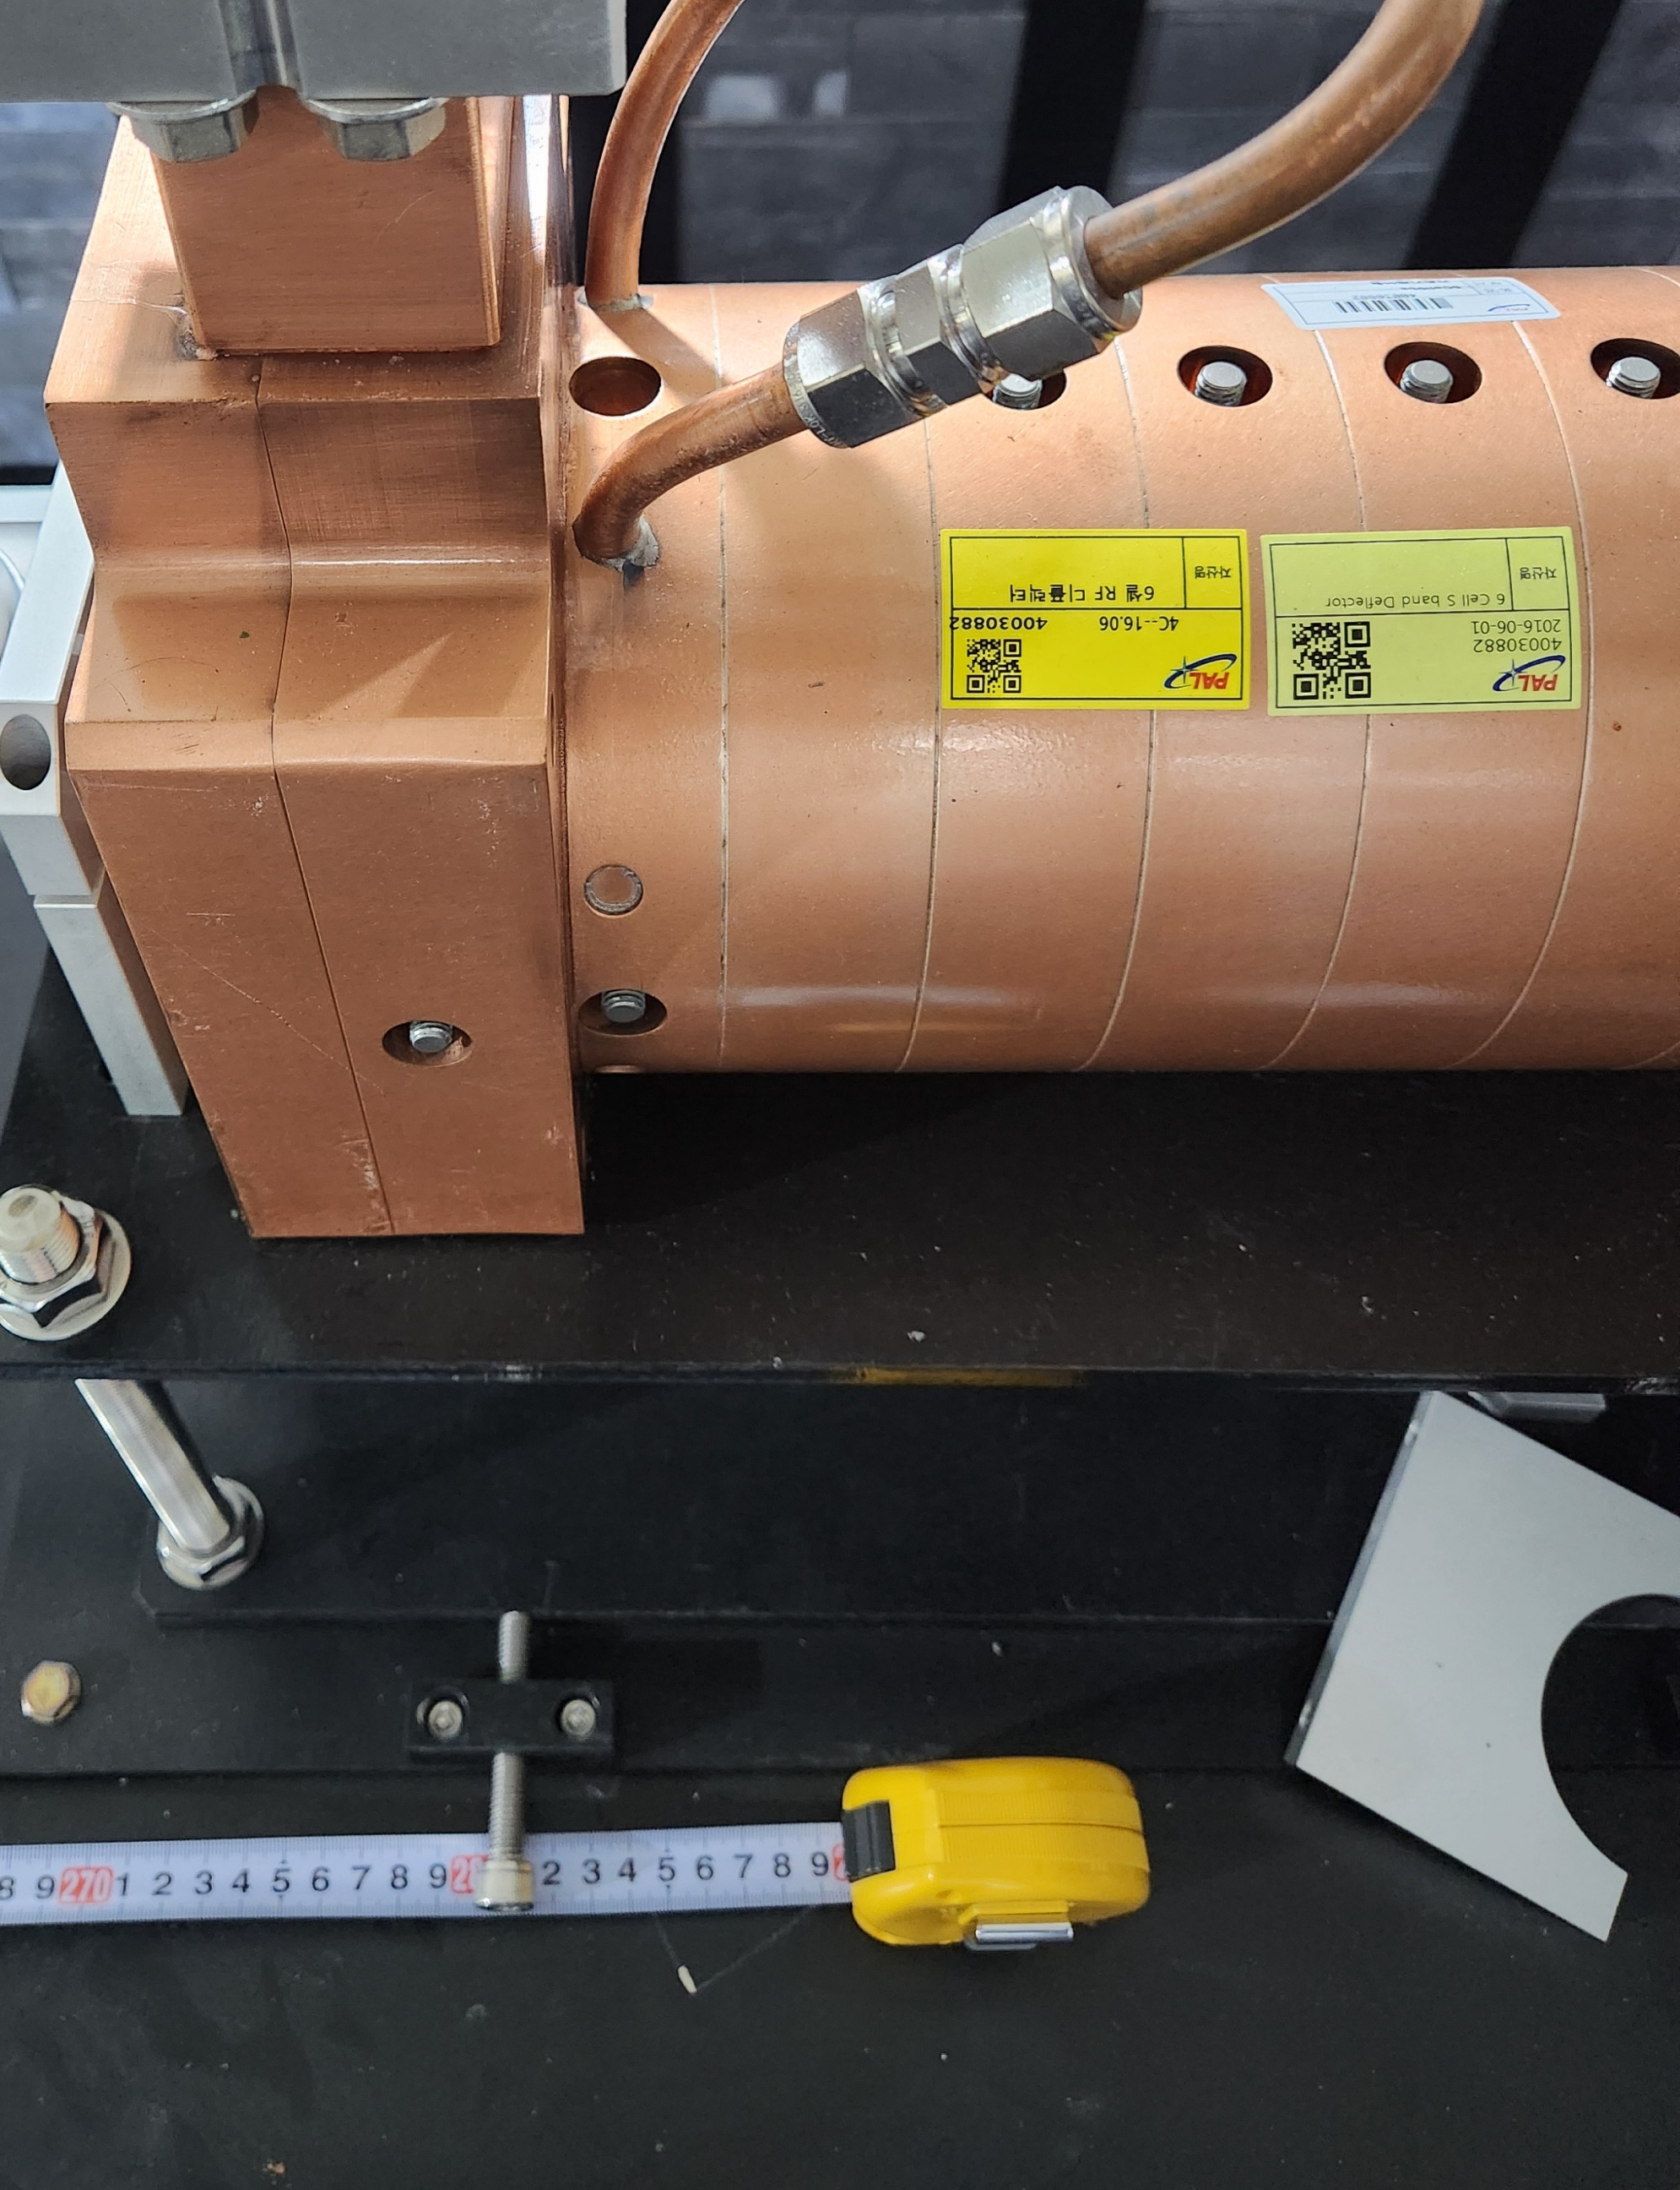
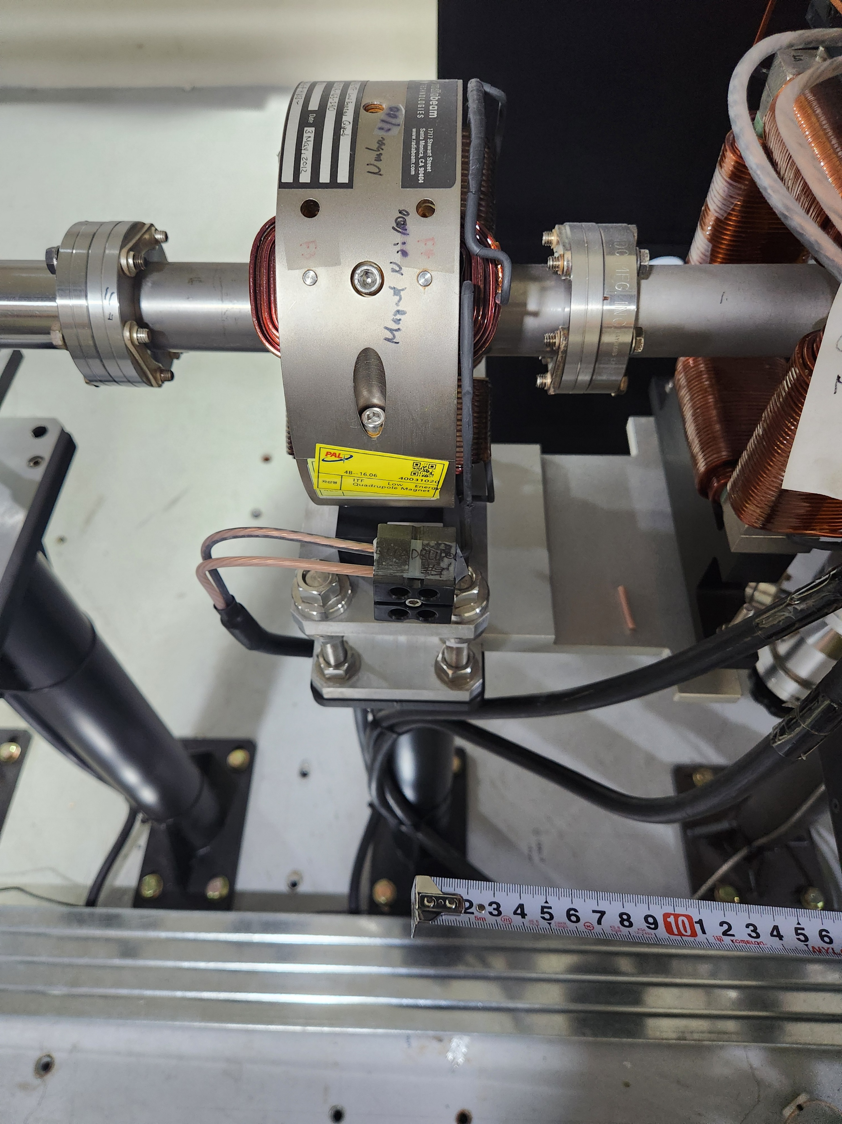
2. Simulation (MAD-X)
2.8 m
Screen
Courtesy of PhD. Sung
~ 0.465 m
<e-labs equipment layout>
Preparation
The Methodical Accelerator Design code (MAD)
e-labs layout with distance
Checking the equipment layout
Familiar with the simulations
~ 2.76 m
Of course, it is inaccurate!

Slide 12
2. Simulation (MAD-X)
2.8 m
Screen
Courtesy of PhD. Sung
~ 0.465 m
<e-labs equipment layout>
MAD-X simulation start point
Preparation
Initial condition β_{x0}, β_{y0,} α_{x0}, and α_{y0} were given right after booster cavity.
Deflecting voltage V⊥ : 2.7 MV/$\sqrt{MW}$ → 1 MV; P = 0.137 MW

Slide 13
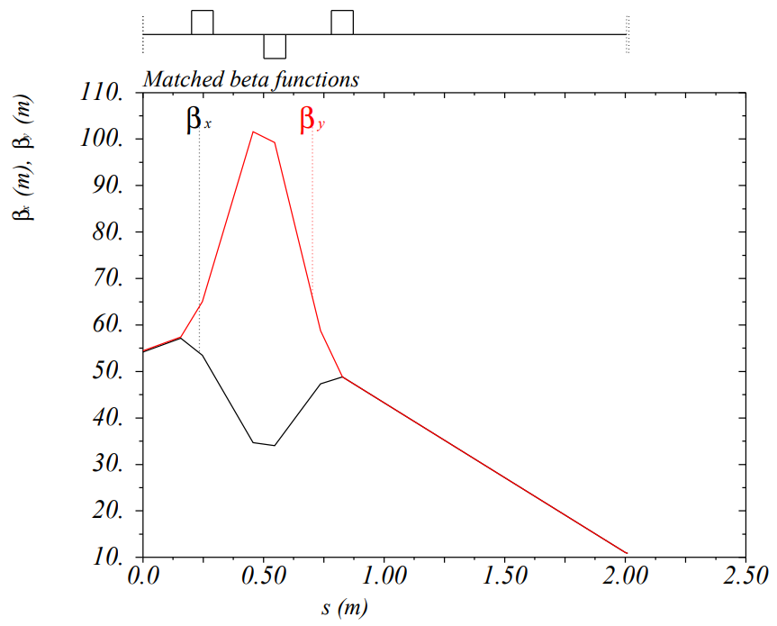
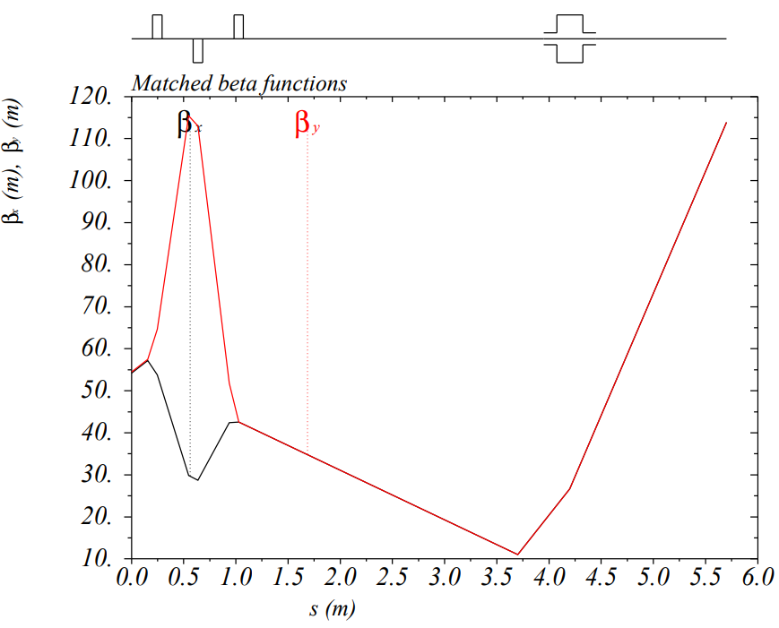
2. Simulation (MAD-X)
Current status
Study how to use MAD-X.
Insert TCAV to the beamline.
Taking β_{d}
Simulation begins at 5.0 m
TCAV
1. Space between quad
0.21 → 0.3 [m]
0.19 → 0.3 [m]
2. Adding TCAV
3. β Optimization point
s = 2 → 3.7 m
<Initial beamline>
<Revised beamline>

Slide 14
Contents
1. Transverse deflecting cavity (TCAV)
2. Simulation
CST
Modeling
Field distribution for Astra
MAD-X
Preparation
Current status
3. Longitudinal phase space (LPS), briefly

Slide 15
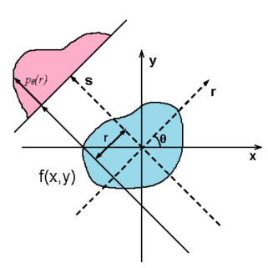
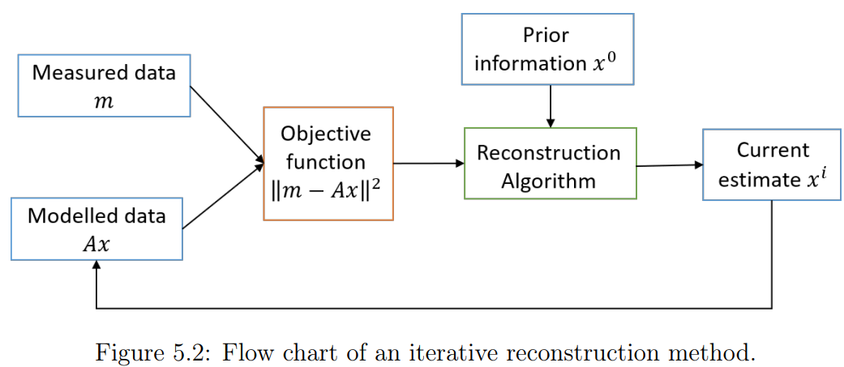
3. Longitudinal phase space (LPS)
Tomography method
Iterative Reconstruction Method

Slide 16
Summary and plans
Understanding TCAV Geometry and Operational Principles
Complete Re-modeling of TCAV
Performed using CST simulation to analyze field distribution
Comparison between reference results and my results. (Still different, but insignificant)
Inserting TCAV to the initial beamline and obtaining β by using MAD-X.
Enhanced proficiency in MAD-X, including ASTRA simulations
Focused study on Longitudinal Phase Space (LPS)
Simulations are being finalized to ensure before TCAV's deployment at PAL

