Slide 1
Photoinjector Laser Systems in Electron Accelerators
Minseo Jeong

Slide 2
Index
Introduction to photoinjector laser
Laser facilities in accelerators
-PAL eLabs
-LCLS, FACET-II, & LCLS-II
-FERMI
-SwissFEL

Slide 3
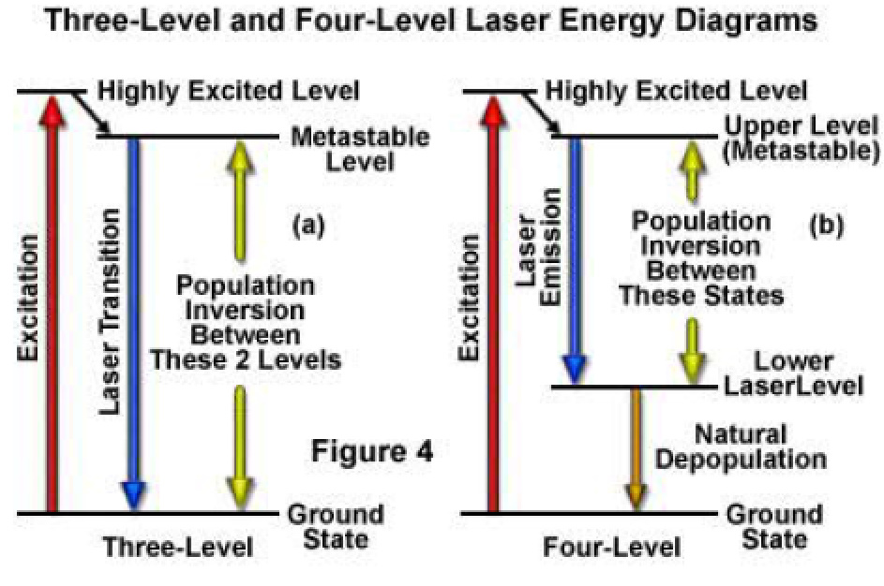
Principle of Laser
Schematic of a laser oscillator
Partially transmitting mirror
Gain Medium
Pump
Divall, Marta. “Lasers in FEL Facilities.” Proceedings of the CAS-CERN Accelerator School on Free Electron Lasers and Energy Recovery Linacs, Vol. 1, 2018, 1–20

Slide 4
Photoinjector Laser
Electron beam is generated by injecting laser to photocathode(e.g. copper) via photoelectric effect
Amplified via chirped pulse amplification(CPA)
To convert the frequency of laser from IR to UV, third harmonic generation(THG)/fourth harmonic generation(FHG) is conducted
Laser pulse was spatially/temporally shaped to optimize the electron beam

Slide 5
Photoinjector Laser
CPA
Oscillator
Stretcher
Amplifier
Compressor
THG/FHG
Pump
Laser
Photo-
cathode
Vacuum pipe
Spatial/
temporal shaping

Slide 6
Parameters for Photoinjector Laser
Wavelength
-Depends on work function of photocathode
Timing
-For synchronization of laser and RF, laser oscillator repetition rate must be subharmonic of RF
Spatial pulse shape
-Uniform pulse generates electron bunch with lower emittance than Gaussian pulse

Slide 7
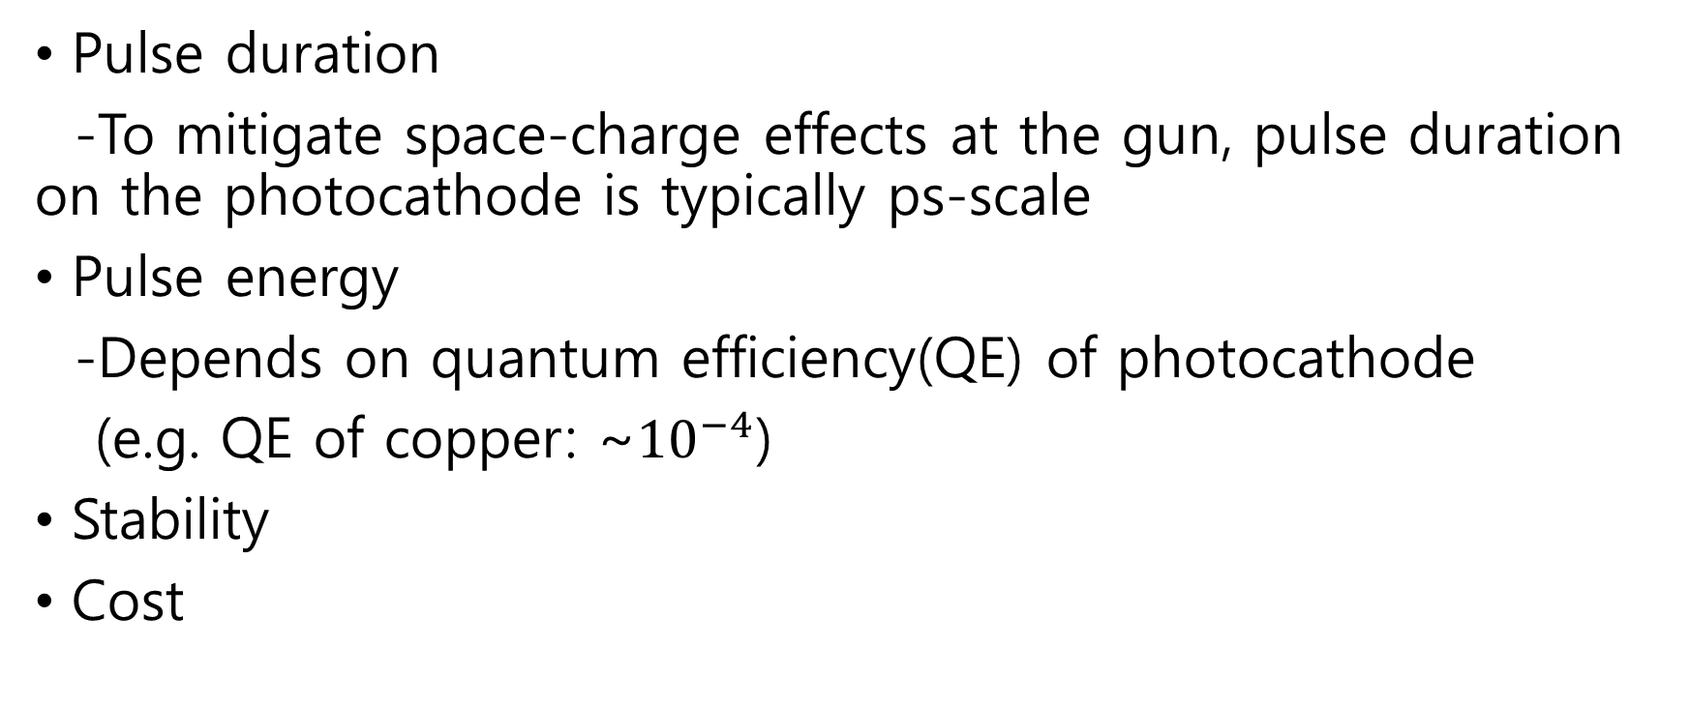
Parameters for Photoinjector Laser
Pulse duration
-To mitigate space-charge effects at the gun, pulse duration on the photocathode is typically ps-scale
Pulse energy
-Depends on quantum efficiency(QE) of photocathode
(e.g. QE of copper: ~${10}^{−4}$)
Stability
Cost

Slide 8
Materials for Photoinjector Laser
To generate picosecond pulse, Nd-doped laser(e.g. Nd-YAG, Nd-YLF) is usually used
Ti:Sapphire laser (pumped by frequency-doubled Nd:YAG laser) is typically used as photoinjector laser
-capability for sub-10 fs pulse generation, high-peak intensity, large bandwidth, stability
Recently constructed accelerators use Yb-doped(e.g. Yb-KGW) fiber laser as photoinjector laser
-high efficiency, compact, ultrashort pulse and cheaper cost than Ti:Sapphire laser

Slide 9
Index
Introduction to photoinjector laser
Laser facilities in accelerators
-PAL eLabs
-LCLS, FACET-II, & LCLS-II
-FERMI
-SwissFEL

Slide 10
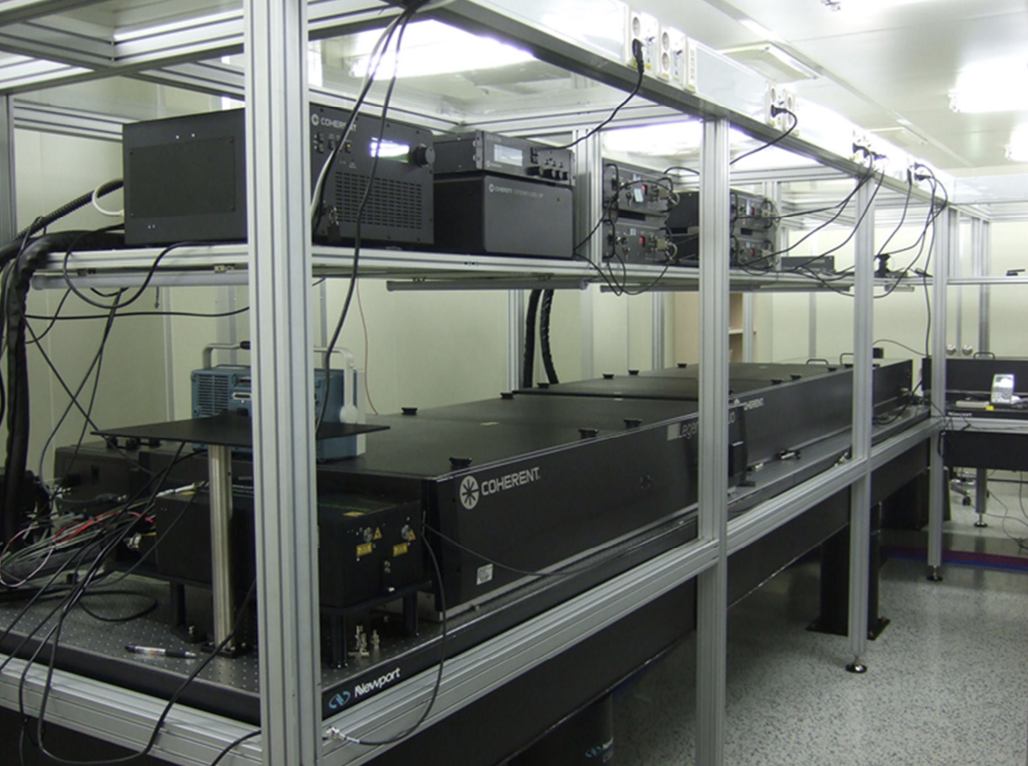
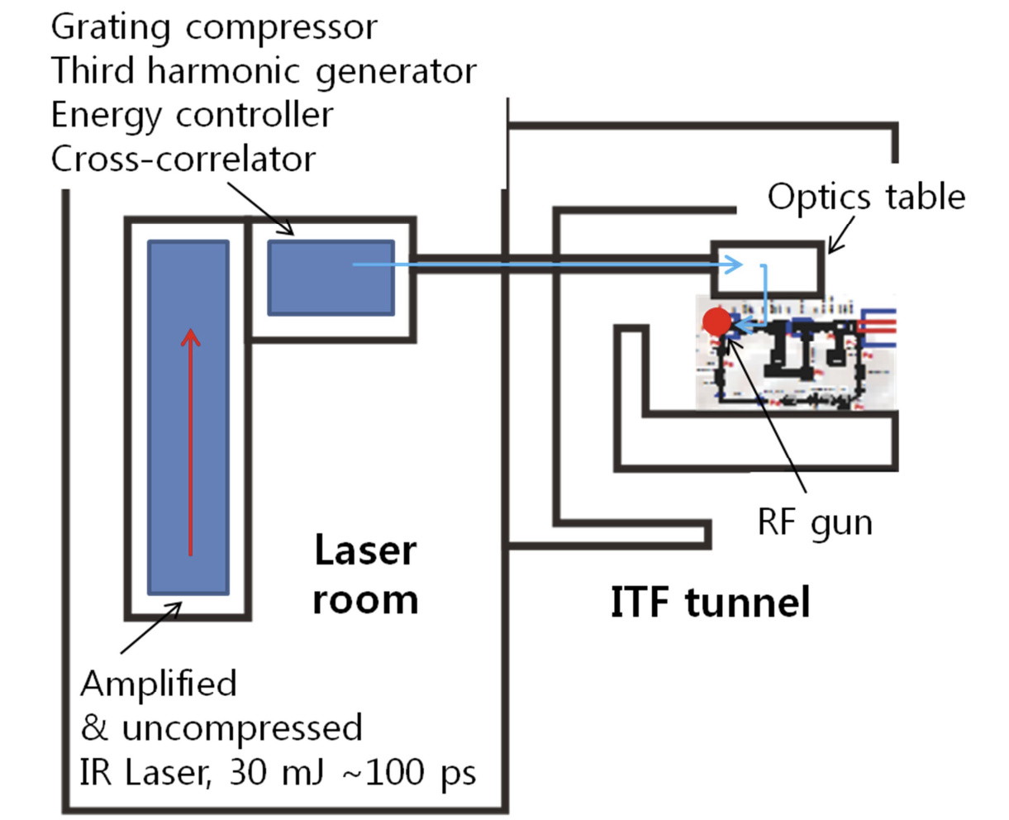
PAL-eLabs
Chae, Moonsik. “Study on electron beam optimization at PAL-XFEL injector test facility.” Ph. D.,
Pohang University of Science and Technology, 2013.

Slide 11
PAL-eLabs
Material | Ti-Sapphire laser(800nm)
Pulse energy | 10mJ(IR)
Oscillator repetition rate | 79.333MHz
Pulse repetition rate | 60Hz
Pulse duration | ~150fs
Wavelength on the photocathode | 266nm
Energy of laser pulse was amplified from 5mJ to 10mJ by regenerative amplifier
Spatial/temporal shaping of pulse was conducted

Slide 12
PAL-eLabs
Divall, Marta. “Lasers in FEL Facilities.” Proceedings of the CAS-CERN Accelerator School on Free Electron Lasers and Energy Recovery Linacs, Vol. 1, 2018, 1–20

Slide 13
LCLS
Material | Mode-locked Ti-Sapphire laser(760nm)
Pulse energy | 25mJ
Oscillator repetition rate | 117MHz
Pulse repetition rate | 120Hz
Wavelength on the photocathode | 253nm

Slide 14
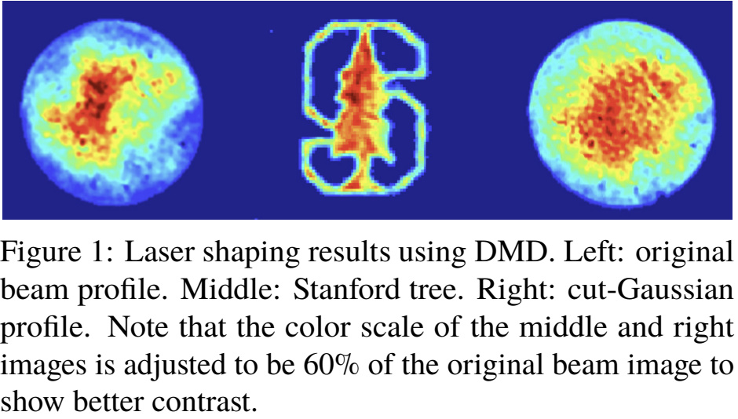
LCLS
Diode-pumped frequency-doubled Nd:YAG laser(532nm) is used to pump Ti-sapphire laser
Digital micromirror device (DMD) was used to shape the UV pulse

Slide 15
FACET-II
Material | Ti-Sapphire laser(760~800nm)
Pulse energy | 400μJ(photocathode)
Oscillator repetition rate | 76MHz
Pulse repetition rate | 30Hz
Pulse duration | ~30fs(UV)/7ps(photocathode)
Wavelength on the photocathode | 253~266nm
Frequency-doubled Nd:YAG laser(532nm) is used to pump Ti-sapphire laser
Second laser system will be installed in order to generate two electron bunches for PWFA R&D

Slide 16
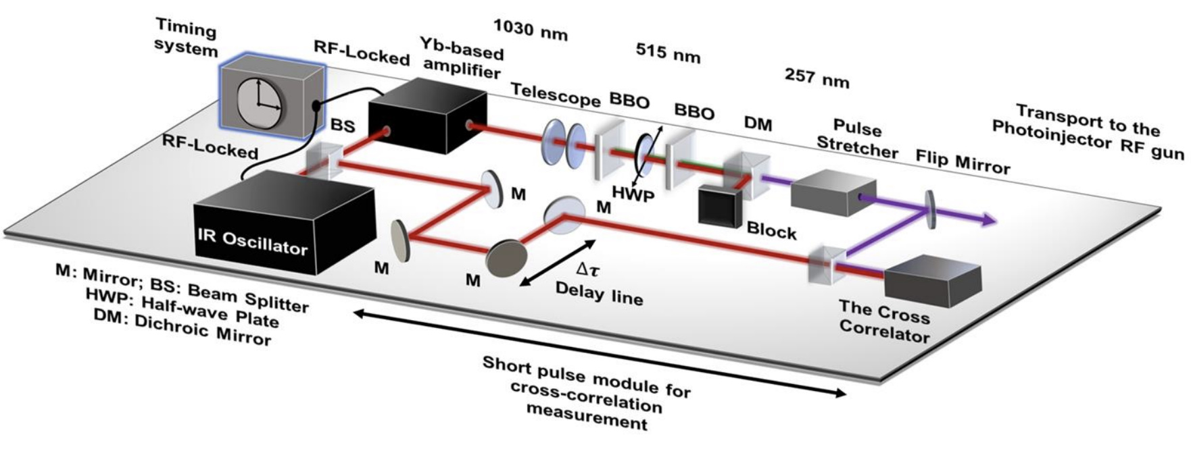
LCLS-II
Zhang, Hao. et al. “The LCLS-II Photoinjector Laser Infrastructure.” High Power Laser Science and Engineering, 2024, 1–33

Slide 17
LCLS-II
Material | Yb-doped laser(1030nm)
Pulse energy | 50μJ(IR)/300nJ(photocathode)
Oscillator repetition rate | 46.43MHz
Pulse repetition rate | 1Hz~929kHz
Pulse duration | 330fs~30ps
Wavelength on the photocathode | 257.5nm
UV conversion by BBO crystal
-conversion efficiency: 8~20%
IR pulse was fully compressed to optimize conversion efficiency

Slide 18
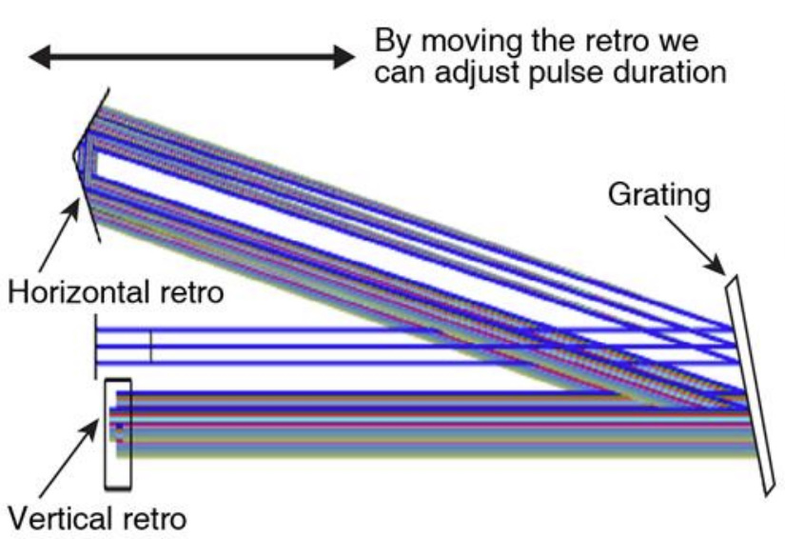

LCLS-II
Two-pass reflective grating stretcher was to increase UV pulse duration(10~30ps)
Cathode: $Cs_{2}Te$

Slide 19
LCLS-II
Due to high power and pulse repetition rate of laser, beam size in FHG crystal was enlarged by zoom telescope from 1.5mm to 2.8mm(~1MHz) to solve thermal problem
→pulse energy was decreased to ~300nJ on the photocathode
In high repetition rate conditions(>300kHz), the conversion efficiency reduced to 20% compared to maximum efficiency

Slide 20
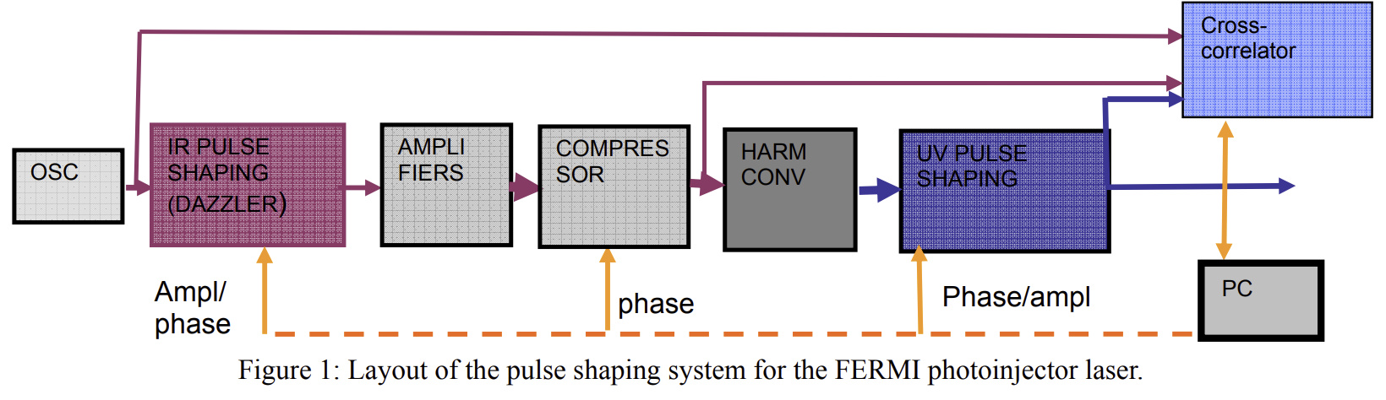
FERMI

Slide 21
FERMI
Amplification by CW diode-based pumping(stable, high cost)
~400μJ of IR beam is split away for laser heater
Material | Ti:Sapphire(centered at 783nm)
Pulse energy | 15mJ(IR)/ <0.5mJ(photocathode)
Oscillator repetition rate | 78.893MHz
Pulse repetition rate | 10Hz/50Hz
Pulse duration | 90fs(oscillator)
Wavelength on the photocathode | 261nm

Slide 22
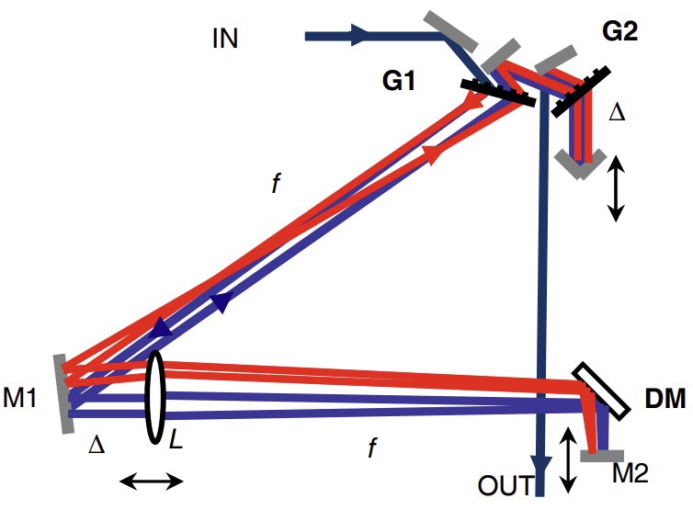
FERMI
Temporal IR pulse shaping by DAZZLER(dispersive acousto-optic filter)
-Amplitude and phase modulation
Temporal UV pulse shaping by grating-based stretcher

Slide 23
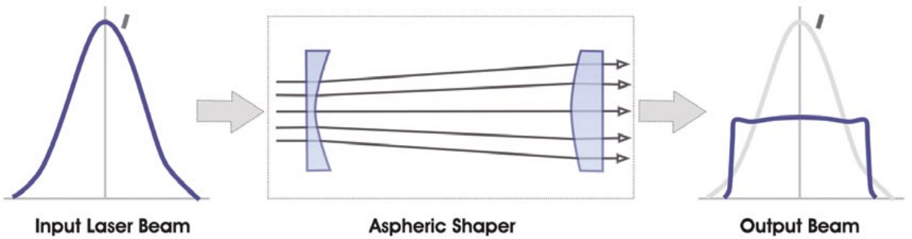
FERMI
Spatial beam shaping by aspheric shaper(Gaussian→uniform)
-low insertion loss, high damage threshold, possibility to work directly in UV

Slide 24
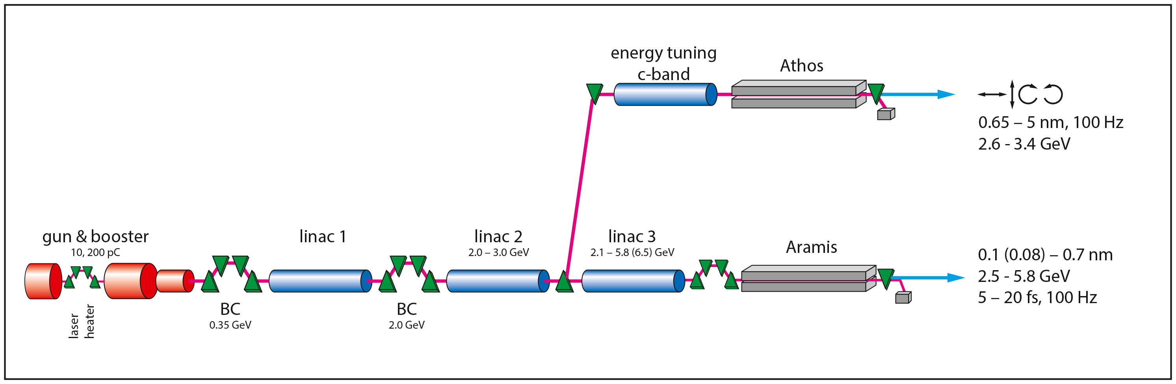
SwissFEL

Slide 25
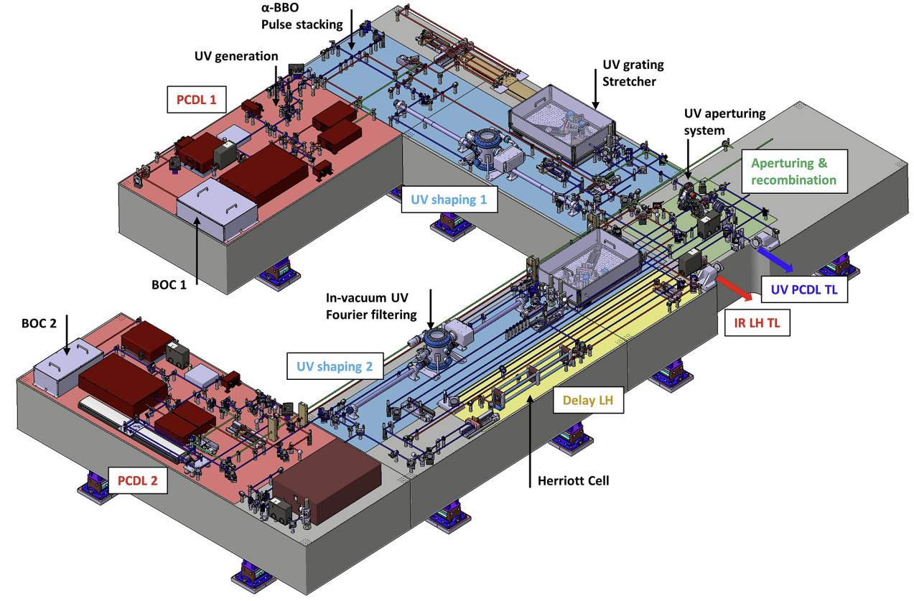
SwissFEL
Bettoni, S. et al. “Overview of SwissFEL dual-photocathode laser capabilities and perspectives for exotic FEL modes.” High Power Laser Science and Engineering, 2021, Vol. 9, 1-20.

Slide 26
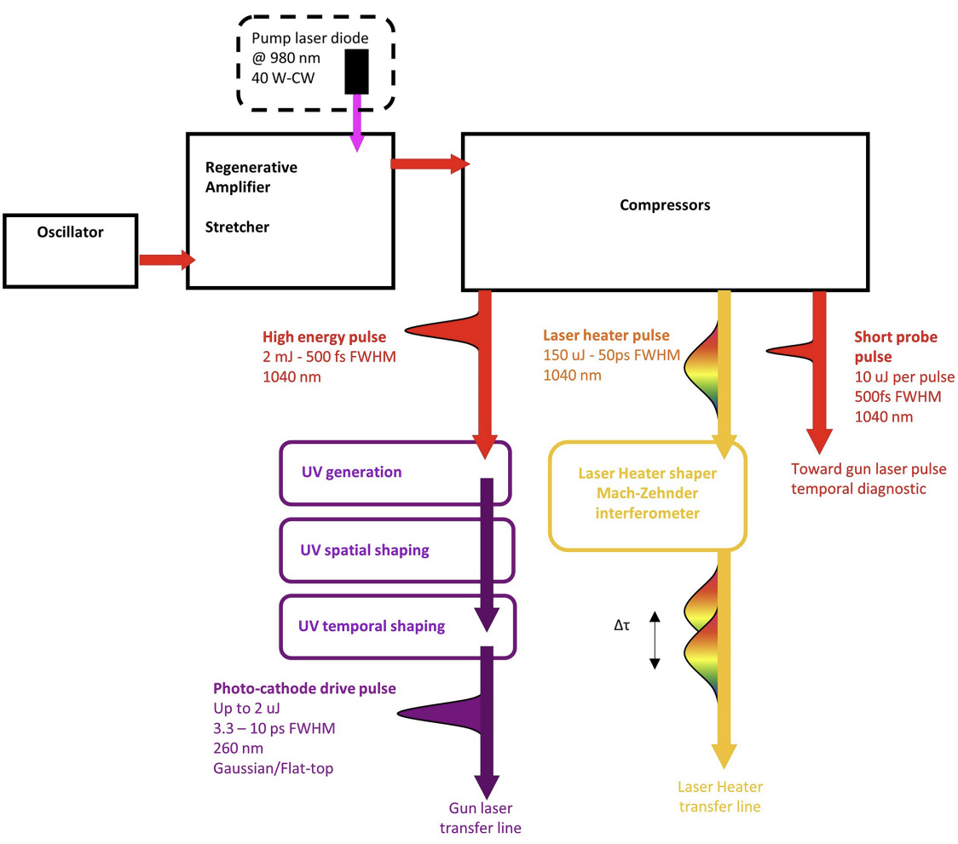
SwissFEL
Bettoni, S. et al. “Overview of SwissFEL dual-photocathode laser capabilities and perspectives for exotic FEL modes.” High Power Laser Science and Engineering, 2021, Vol. 9, 1-20.

Slide 27

SwissFEL
Material | Yb:KGW(1040nm)
Pulse energy | 2.12nJ(oscillator)/ 3.5mJ(amplifier)
Oscillator repetition rate | 71.40MHz
Pulse repetition rate | 100Hz
Pulse duration | 194fs(oscillator, FWHM)/ 500fs(compressor, FWHM)
Wavelength on the photocathode | 260nm
Amplitude stability: 0.18% rms over 12 hrs
Timing jitter: 17fs rms
$Yb:CaF_{2}$ CW diode laser(980nm) was used to pump Yb:KGW laser

Slide 28
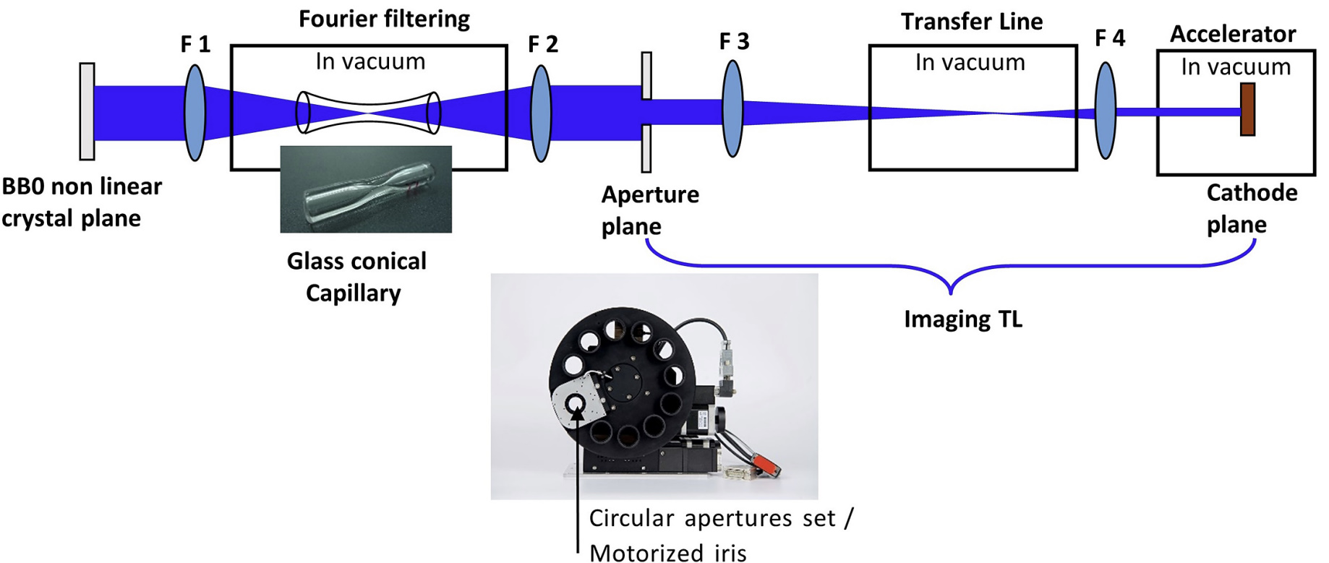
SwissFEL
UV conversion: by FHG(BBO crystal)
-UV pulse energy:560μJ
Spatial shaping by Fourier filtering(Gaussian→flattop-like)

Slide 29
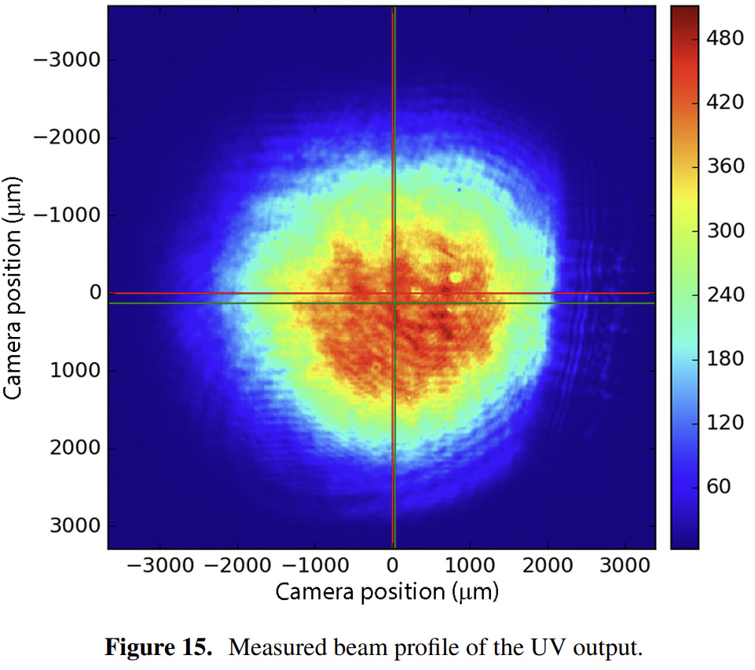
SwissFEL-Spatial Shaping

Slide 30
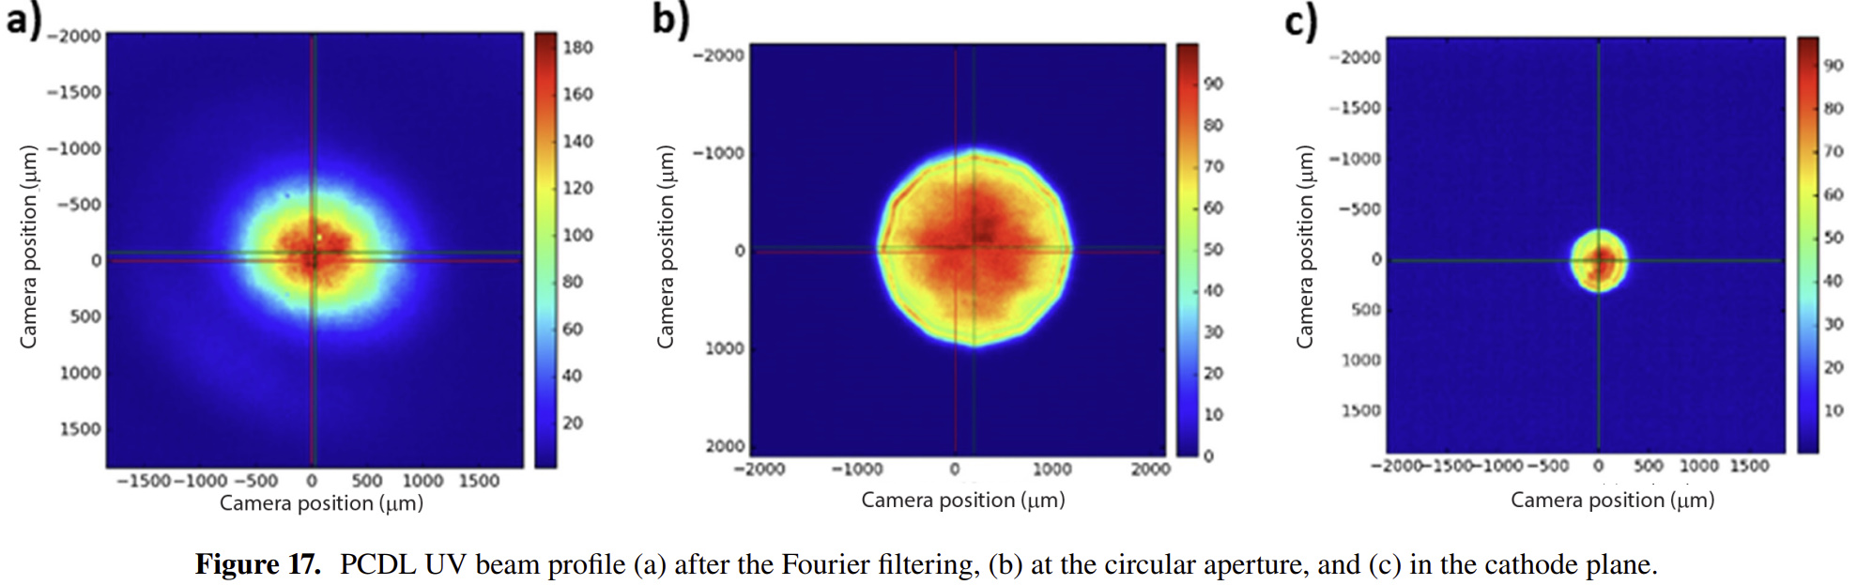
SwissFEL-Spatial Shaping

Slide 31
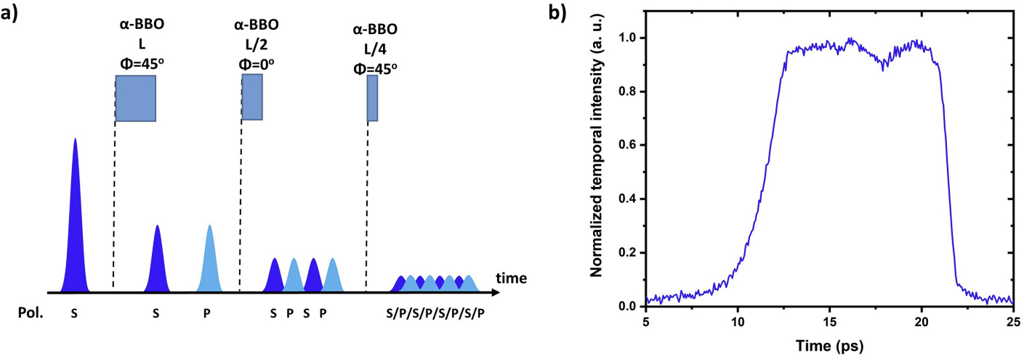

SwissFEL
Temporal pulse shaping by UV-grating based stretcher(Gaussian)/pulse-stacking(flat-top)
-3.3~10ps FWHM(Gaussian), 3.7/10ps FWHM(flat-top)
Photocathode: $Cs_{2}Te$

