Slide 1
Parameter Optimization of Passive Harmonic Cavity and Analysis of Robinson Instability based on the PLS-II Lattice
20232308 Youngmin Park
2024-09-13

Slide 2
Index
Robinson Instability
Passive Harmonic Cavity
Research Process

Slide 3
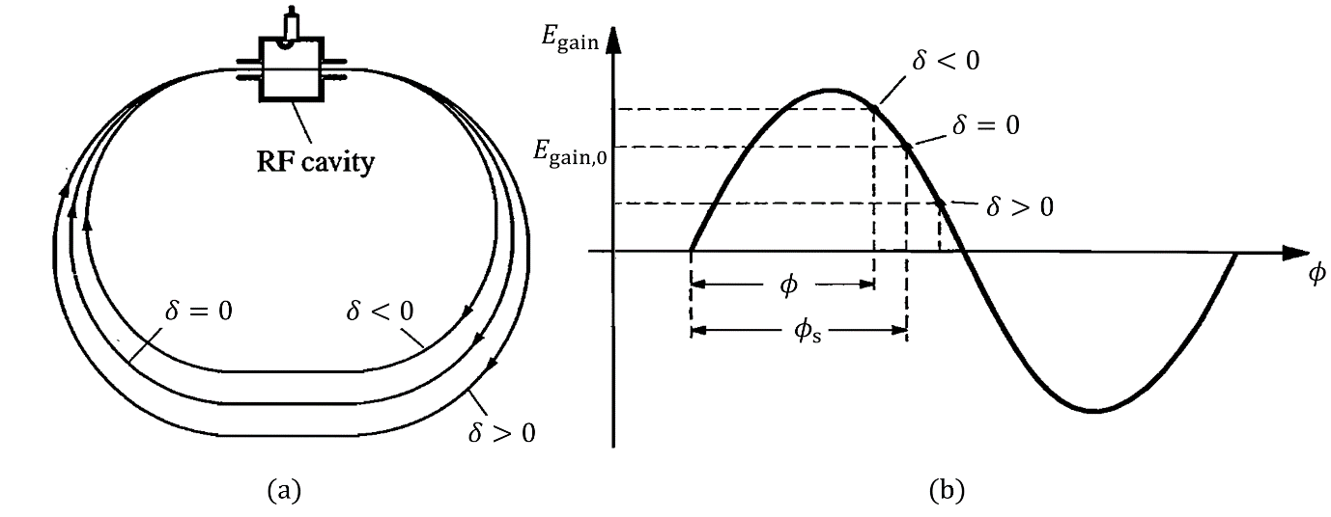
Robinson Instability
Longitudinal Dynamics
In general, in a storage ring, the beam loss energy by radiation, and this is replenished through the RF-cavity.
Above transition ($η=\frac{{ΔT}/T}{δ}>0$) Higher energy particles arrive later $→$ These experience an RF phase later
Below transition ($η=\frac{{ΔT}/T}{δ}<0$) Higher energy particles arrive earlier $→$ These experience an RF phase earlier
Most storage rings operate above transition, the synchrotron phase must be adjusted between $\frac{π}{2}$ and $π$.

Slide 4
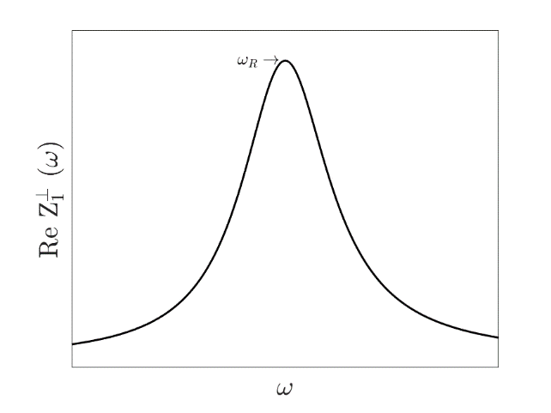
Robinson Instability
Resonator Impedance
0
$$\frac{1}{Z_{0}^{∥}}=\frac{1}{R_{s}}−\frac{1}{iωL}−iωC→Z_{0}^{∥}=\frac{R_{s}}{1+iQ\left(\frac{ω_{R}}{ω}−\frac{ω}{ω_{R}}\right)}$$
$$\left(ω_{R}=1/{\sqrt{CL}}, Q=R_{s}\sqrt{C/L}\right)$$
Particles passing through the RF cavity lose energy due to the resonator impedance.
$$W_{0}^{′}\left(z\right)=\frac{1}{2π}\int_{−∞}^{∞}{dωZ_{0}^{∥}\left(ω\right)e^{\frac{iωz}{c}}}=\left\{\begin{matrix}0 & if z>0, \\ αR_{s} & if z=0, \\ 2αR_{s}e^{\frac{αz}{c}}\left(\cos{\frac{\overline{ω}z}{c}}+\frac{α}{\overline{ω}}\sin{\frac{\overline{ω}z}{c}}\right) & if z<0.\end{matrix} \right.$$
$$\left(α=\frac{ω_{R}}{2Q}, \overline{ω}=\sqrt{ω_{R}^{2}−α^{2}}\right)$$

Slide 5
Robinson Instability
Robinson instability
$$\frac{d^{2}z_{n}}{dn^{2}}+{\left(2πν_{s}\right)}^{2}z_{n}=\frac{Nr_{0}ηC}{γ}\sum_{k=−∞}^{n}{W_{0}′(kC−nC+z_{n}−z_{k})}$$
$$n→number of revolution, z_{n}→longitudinal displacement, ν_{s}→synchrotron tune, \\ N→number of charged particle, η→slippage factor, C→Circumference$$
The beam is influenced by the cavity impedance. Under certain conditions this interaction can lead to beam instability known as Robinson instability.
Let’s assume that $z_{n}$ oscillated with respect to frequency $Ω.$
The frequency shift can be represented by the following equation.
$$z_{n}→e^{−inΩT_{0}}$$
$$Ω^{2}−ω_{s}^{2}=−i\frac{Nr_{0}η}{γT_{0}^{2}}\sum_{p=−∞}^{∞}{\left[pω_{0}Z_{0}^{∥}\left(pω_{0}\right)−\left(pω_{0}+Ω\right)Z_{0}^{∥}\left(pω_{0}+Ω\right)\right]} \\ →Ω−ω_{s}=−i\frac{Nr_{0}η}{2γT_{0}^{2}ω_{s}}\sum_{p=−∞}^{∞}{\left[pω_{0}Z_{0}^{∥}\left(pω_{0}\right)−\left(pω_{0}+ω_{s}\right)Z_{0}^{∥}\left(pω_{0}+ω_{s}\right)\right]}$$

Slide 6
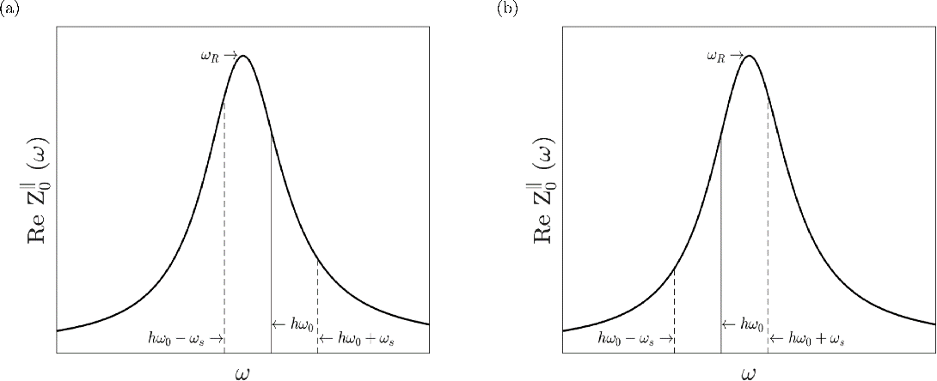
Robinson Instability
Robinson instability
$$τ^{−1}=Im\left(Ω−ω_{s}\right)=\frac{Nr_{0}η}{2γT_{0}^{2}ω_{s}}\left[\sum_{p=−∞}^{∞}{\left(pω_{0}+ω_{s}\right)Re\left(Z_{0}^{∥}\left(pω_{0}+ω_{s}\right)\right)}\right]$$
$$\left(η>0\right)$$
$$\left(η<0\right)$$

Slide 7
Robinson Instability
Modified Robinson Instability
The modified Robinson instability equation, which includes the effects of radiation damping and does not assume $Ω≈ω_{s}$, is given by[He]:
This can be derived by considering cases with and without damping, as follows:
Without radiation damping
With radiation damping
$$Ω_{new}^{2}+i\frac{2Ω_{new}}{τ_{z}}−ω_{s}^{2}=−\frac{Nr_{0}η}{γT_{0}^{2}}\sum_{p=−∞}^{∞}{\left[pω_{0}Z_{0}^{∥}\left(pω_{0}\right)−(pω_{0}+Ω)Z_{0}^{∥}\left(pω_{0}+Ω\right)\right]}$$
$$z∝e^{−iΩt}$$
$$z∝e^{−iΩt}e^{−\frac{t}{τ_{z}}}→e^{−iΩ_{new}t}, Ω−\frac{i}{τ_{z}}=Ω_{new}$$
Tianlong He, Mode-zero Robinson instability in the presence of passive superconducting harmonic cavities, PARB 26, (2023)

Slide 8
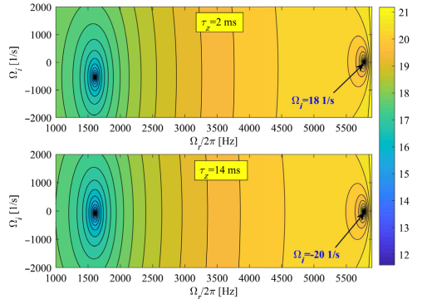
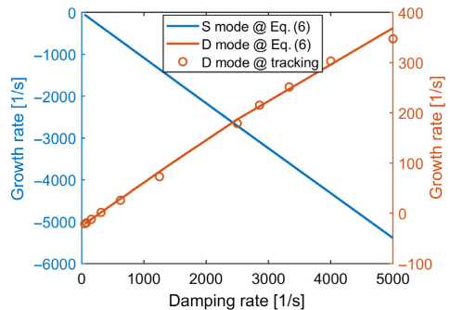
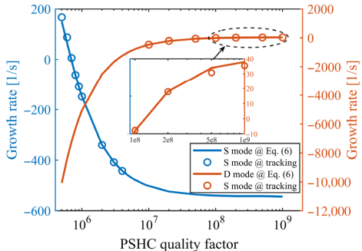
Robinson Instability
Modified Robinson Instability
$$Ω^{2}+i\frac{2Ω}{τ_{z}}−ω_{s}^{2}=−\frac{Nr_{0}η}{γT_{0}^{2}}\sum_{p=−∞}^{∞}{\left[pω_{0}Z_{0}^{∥}\left(pω_{0}\right)−(pω_{0}+Ω)Z_{0}^{∥}\left(pω_{0}+Ω\right)\right]}$$
The beam loss are driven by the two mode of Robinson instability, beam (S) mode with $Ω≈ω_{s}$ and the cavity (D) mode $Ω≈2πΔf_{r}$.
Tianlong He, Mode-zero Robinson instability in the presence of passive superconducting harmonic cavities, PARB 26, (2023)

Slide 9
Passive harmonic cavity
Harmonic Cavity
Passive harmonic cavities operate by interacting with the beam itself, while the active cavity is powered by an external generator.
$$c$$
$$c$$
$$e$$
$$e$$
Active cavities
Passive cavities
$${\tilde{V}}_{cav}={\tilde{V}}_{g}−{\tilde{V}}_{b}$$
$${\tilde{V}}_{cav}=−{\tilde{V}}_{b}$$
PHC(Passive Harmonic Cavity) vs AHC(Active Harmonic Cavity)
External generator supplies voltage, better for fine-tuning beam current changes.
Needs extra space for the generator
Cost is higher due to generator and control systems.

Slide 10
Passive harmonic cavity
Voltage of Passive Harmonic Cavity
$$Z\left(ω\right)=\frac{R_{s}}{1+iQ\left(\frac{ω_{r}}{ω}−\frac{ω}{ω_{r}}\right)}=\frac{R_{s}}{1+i\tan{ψ}}=\frac{R_{s}\left(1−i\tan{ψ}\right)}{1+\tan^{2}{ψ}}=R_{s}\cos{ψ}e^{−iψ}$$
$ψ$ is tuning angle, $\tan{ψ}=Q\left(\frac{ω_{r}}{ω}−\frac{ω}{ω_{r}}\right)$
The beam-induced voltage on a cavity is generally expressed by the following equation.
$$V\left(τ\right)=−2R_{s}FI_{avg}{\cos{ψ}}_{hω_{0}}\cos\left(hω_{0}τ+ψ_{hω_{0}}−Θ\right)$$
Super conducting passive HC, the shunt impedance is very high($\sim GΩ, NC→ \sim MΩ$):
Easier to set a specific voltage even at low currents.
The tuning angle $ψ$ is almost fixed at $\frac{π}{2}\left(lengthening\right)$ or $−\frac{π}{2}\left(shorthening\right)$
It is impossible to create a flat potential.

Slide 11
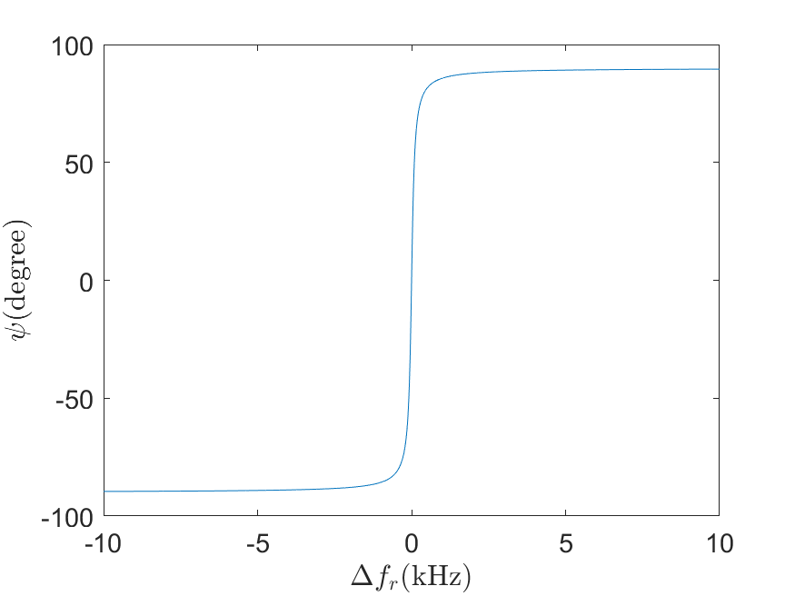
Passive harmonic cavity
Tuning angle
In the cases of an Passive Superconducting Harmonic Cavity(PSHC), the relationship between the tuning angle and detuning is described as follows.
Parameter | Value
$$Q$$ | $${10}^{8}$$
$$hω_{1}$$ | 1.5 GHz

Slide 12
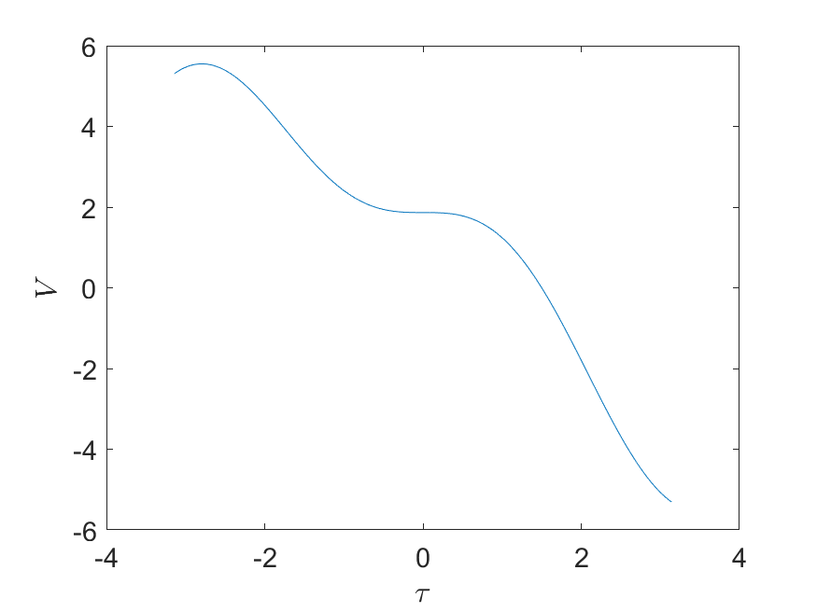
Passive harmonic cavity
Double rf-system with Passive 3rd Harmonic Cavity
$$V\left(τ\right)=V_{1}\sin\left(hω_{0}τ+φ_{1}\right)+V_{2}\sin\left(3hω_{0}τ+φ_{2}\right)−U_{0}/e$$
$$V\left(τ\right)=V_{1}\sin\left(hω_{0}τ+φ_{1}\right)−2R_{s}I_{avg}F\cos{ψ}\cos\left(3hω_{0}τ+ψ−Θ\right)−U_{0}/e \\ =V_{1}\sin\left(hω_{0}τ+φ_{1}\right)−2R_{s}I_{avg}F\cos{ψ}\sin\left(3hω_{0}τ+ψ−Θ+\frac{π}{2}\right)−U_{0}/e$$
$$V_{2}=−2R_{s}I_{avg}F\cos{ψ}, φ_{2}=ψ−Θ+\frac{π}{2}$$
$$V_{1}$$ | 4.50 MV
$$φ_{0s}=\sin^{−1}\left(\frac{U_{0}}{eV}\right)$$ | $$155.52°$$
$$φ_{1s}=\sin^{−1}\left(\frac{m^{2}}{m^{2}−1}\sin{φ_{s0}}\right)$$ | $$152.21°$$
$$φ_{2s}=\tan^{−1}\left(−\frac{m\sin{φ_{s0}}}{\sqrt{{\left(m^{2}−1\right)}^{2}−m^{4}\sin^{2}{φ_{s0}}}}\right)$$ | $$170.03°$$
$$r=\frac{1}{m}\sqrt{1−\frac{m^{2}}{m^{2}−1}\sin^{2}{φ_{s0}}}$$ | $$0.2994$$
$$\left|V_{2}\right|=rV_{1}$$ | $$1.35 MV$$
$$ψ≈80.03°$$

Slide 13
Passive harmonic cavity
Hamiltonian and Vlasov equation
$$\frac{dτ}{dt}=−ηδ, \frac{dδ}{dt}=\frac{eV\left(τ\right)}{E_{0}T_{0}}=\frac{e\left(V_{1}\sin\left(hω_{0}τ+φ_{1}\right)+V_{2}\sin\left(3hω_{0}τ+φ_{2}\right)−U_{0}/e\right)}{T_{0}}$$
$$ℋ\left(τ,δ\right)=−\frac{η}{2}δ^{2}+\frac{eV_{1}}{E_{0}T_{0}}\left[\int_{0}^{τ}{\left(\sin\left(hω_{0}τ+φ_{1}\right)−r\sin\left(3hω_{0}τ+φ_{2}\right)−U_{0}/e\right)dτ}\right]$$
The distribution function $ψ\left(τ,δ\right)$ is expressed as follows by the Vlasov equation.
$$ψ\left(τ,δ\right)→function of ℋ\left(τ,δ\right)→ψ_{0}e^{−\frac{δ^{2}}{2σ_{δ}^{2}}+\frac{eV_{1}}{2πE_{0}ησ_{δ}^{2}}\left[\int_{0}^{τ}{\left(\sin\left(hω_{0}τ+φ_{1}\right)−r\sin\left(3hω_{0}τ+φ_{2}\right)−U_{0}/e\right)dτ}\right]}$$
$$ρ\left(τ\right)→ρ_{0}e^{\frac{eV_{1}}{2πE_{0}ησ_{δ}^{2}}\left[\int_{0}^{τ}{\left(\sin\left(hω_{0}τ+φ_{1}\right)−r\sin\left(3hω_{0}τ+φ_{2}\right)−U_{0}/e\right)dτ}\right]}$$
$$σ_{t}^{2}=\left\langle τ^{2}\right\rangle =\frac{\int_{−∞}^{∞}{τ^{2}\exp\left[\frac{eV_{1}}{2πE_{0}ησ_{δ}^{2}}\left\{\int_{0}^{τ}{\left(\sin\left(hω_{0}τ+φ_{1}\right)−r\sin\left(3hω_{0}τ+φ_{2}\right)−U_{0}/e\right)dτ}\right\}\right]}}{\int_{−∞}^{∞}{\exp\left[\frac{eV_{1}}{2πE_{0}ησ_{δ}^{2}}\left\{\int_{0}^{τ}{\left(\sin\left(hω_{0}τ+φ_{1}\right)−r\sin\left(3hω_{0}τ+φ_{2}\right)−U_{0}/e\right)dτ}\right\}\right]}}$$

Slide 14
Research Process
Near flat potential condition
$$V\left(τ\right)=V_{1}\sin\left(hω_{0}τ+φ_{1}\right)+V_{2}\sin\left(3hω_{0}τ+φ_{2}\right)−{U_{0}}/e$$
$$V\left(0\right)=0, V^{′}\left(0\right)=α_{1}, V^{′′}\left(0\right)=α_{2}$$
Introducing $ξ=−\frac{3V_{2}\cos\left(φ_{2}\right)}{V_{1}\cos\left(φ_{1}\right)}$, the ratio of the harmonic “force” to the main cavity one.
Now $α_{1},α_{2}$ can be expressed as below.
PSHC case$\left(ψ≈\frac{π}{2}, φ_{2}≈π\right)$:
$$\sin\left(φ_{1}\right)=\frac{U_{0}}{eV_{1}}−ξ\frac{\cos\left(φ_{1}\right)}{3\cot\left(φ_{2}\right)}$$
$$V_{2}=−ξ\frac{V_{1}\cos\left(φ_{1}\right)}{3\cos\left(φ_{2}\right)}$$
$$α_{1}=ξV_{1}hω_{0}\cos\left(φ_{1}\right)\left(1−\frac{1}{ξ}\right)$$
$$α_{2}=−V_{1}{\left(hω_{0}\right)}^{2}\left[\sin\left(φ_{1}\right)−ξ\frac{3\cos\left(φ_{1}\right)}{\cot\left(φ_{2}\right)}\right]$$
$$α_{2}=−V_{1}{\left(hω_{0}\right)}^{2}\sin\left(φ_{1}\right)=−\frac{U_{0}{\left(hω_{0}\right)}^{2}}{e}$$
Alexis Gamelin, “Beam Dynamics Using Superconducting Passive Harmonic Cavities with High Current per Bunch”, FLS2023, Switzerland(2023).

Slide 15
Research Process
Near flat potential condition
$$ξ=−\frac{3V_{2}\cos\left(φ_{2}\right)}{V_{1}\cos\left(φ_{1}\right)}=\frac{6R_{s}I_{avg}F\cos{ψ}\cos\left(ψ+\frac{π}{2}\right)}{V_{1}\cos\left(φ_{1}\right)}$$
Remain task:
Compare Multi-particle tracking simulation and calculated bunch length $σ_{t}$.
Complete numerical simulation of the D-mode instability
Need more quantitative analysis of the D-mode instability.

