Slide 1
CAPhE Lab Meeting
K. M. Nam
Science and Technology, Pohang 37673, Korea
2024/09/06

Slide 2
Progress
1. Fresh student beam physics teaching
2. Ion instability study
3. Application for the postdoctoral research position at KBSI
4. Mathematical calculation for Filamentation
5. Future plan : To complete the draft

Slide 3
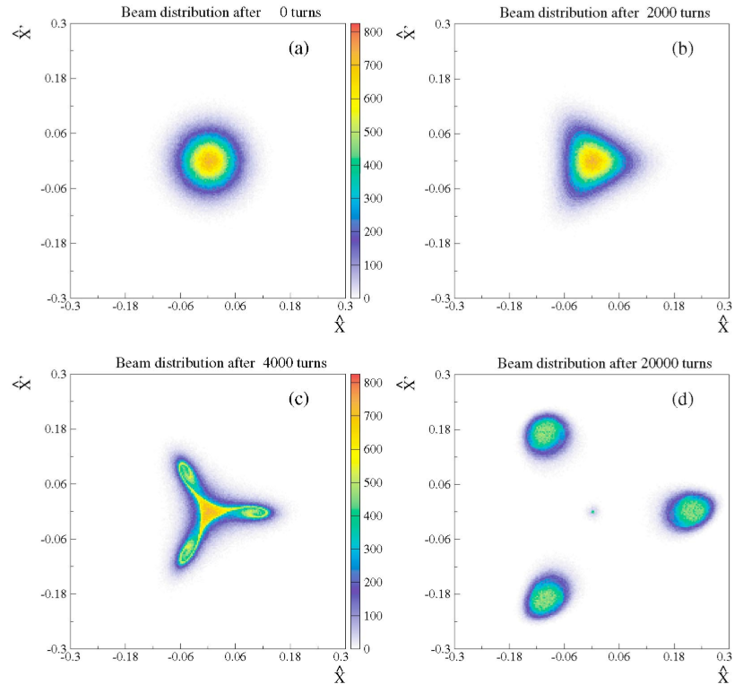
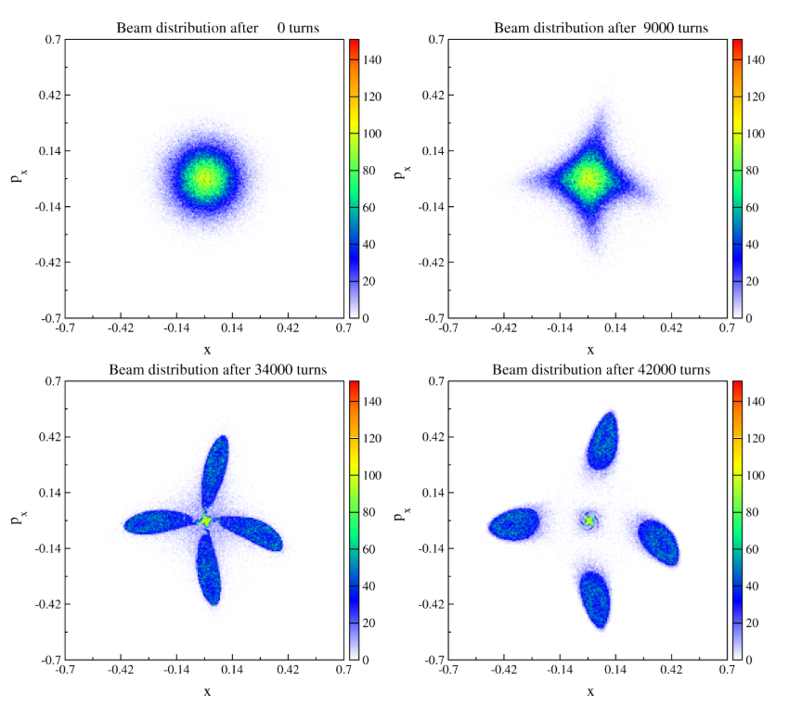
Research Interest
Markus Ries et al., Synchrotron SOLEIL 2016
Nonlinear Dynamics
(Ex. Distortion)
Resonant Dynamics
(Ex. Divergence)
Separation for Multi Mode Operation (BESSY II)
0 turn
2000 turn
0 turn
9000 turn
Theory of Resonant Islands, Amplitude-Dependent Tune Shift, Phase-Dependent Tune Shift
Application : Bunch Separation, Extraction, Etc.
4000 turn
20000 turn
34000 turn
42000 turn
3rd order Splitting (SPS)
4th order Splitting (SPS)
R. Cappi et al., PRST-AB (2004)
M. Giovannozzi et al., PRL (2002)
Notes:
Several accelerator facilities have utilized this property.
BESSY II successfully separated bunches into resonant islands to create multiple photon beams.SPEAR3 also conducted similar bunch storage experiments.
At CERN, this method is used to split electron beams into resonant islands by reducing the boundary size of the primary orbit.Despite these experimental successes, theoretical support is still lacking.

Slide 4
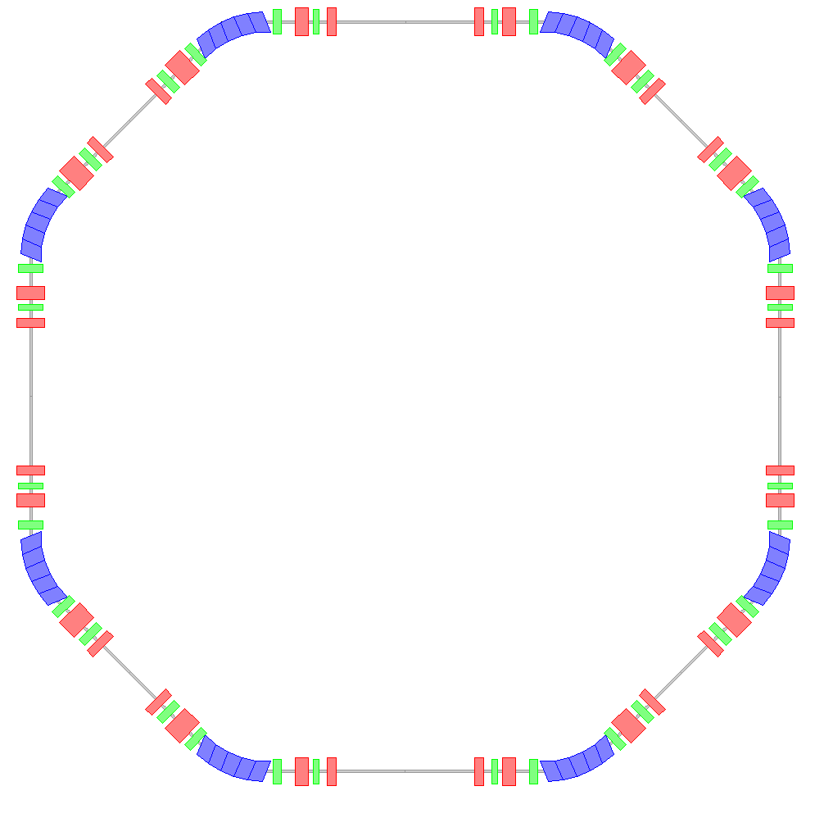
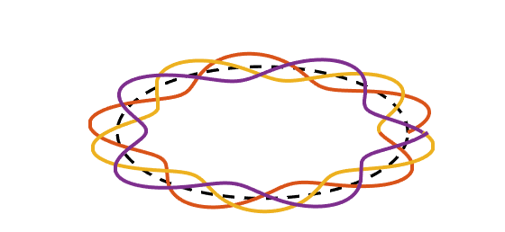
Storage Ring and Tune
Schematic layout of a storage ring
Motion of Stable Electron in a storage ring
Dipole
Quadrupole
Sextupole
$$y$$
$$s$$
$$x$$
1 cycle
1 cycle
2 cycle
0.4117 cycle
2 cycle
4 cycle
3 cycle
3 cycle
4 cycle
A storage ring circulates electrons in a circular orbit using various magnets.
Electrons oscillate around this orbit as they circulate and the number of oscillations per turn is called the tune and denoted as $ν_{x}$.
Tune is mainly determined by the dipole and quadrupole; initial electron conditions do not affect tune.
In general, tune is set to avoid rational numbers.
$$ν_{x}=4.4117$$
$$ν_{x}=4.0$$
Notes:
A storage ring circulates electrons in a circular orbit using various magnets.
Electrons oscillate around this orbit, and the number of oscillations per turn is called the tune.
In this figure, the electron oscillates one, two, three, four, and a little more, so the tune is 4.4117.
Generally, the tune is set to avoid rational numbers.

Slide 5
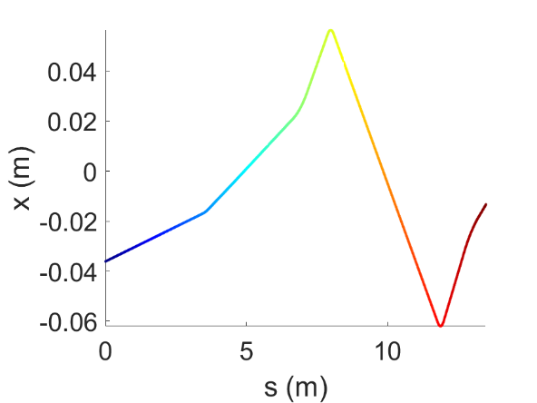
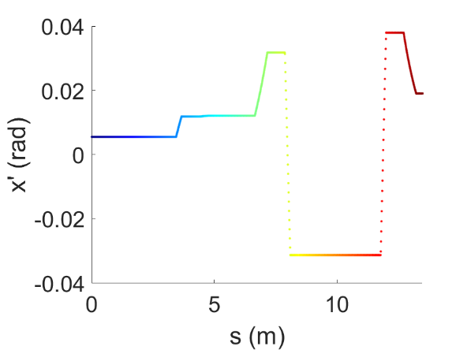
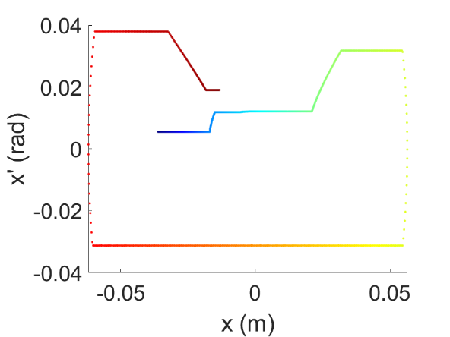
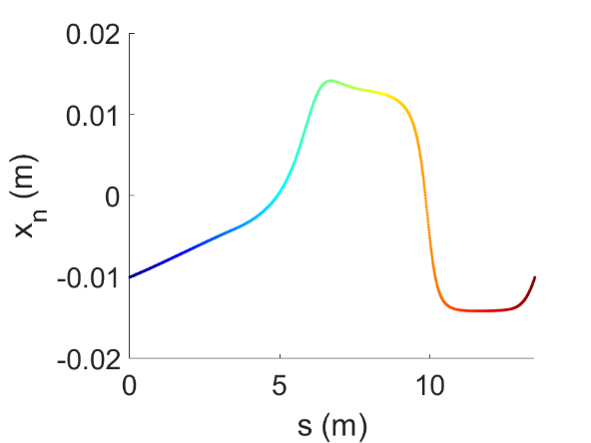
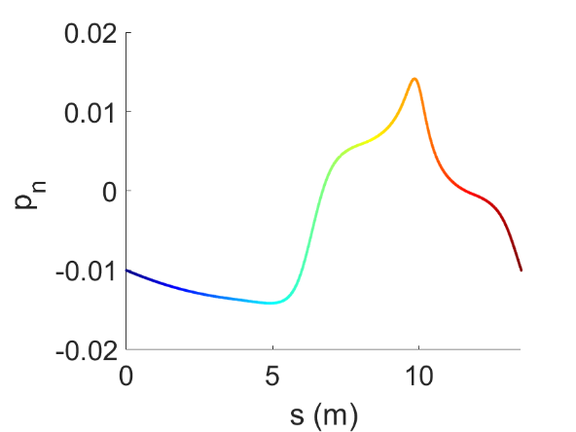
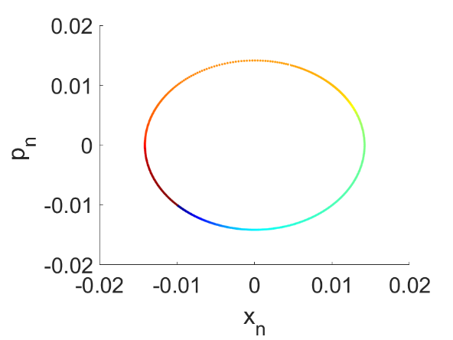
Tune (Mathematics)
When sextupoles are absent, the tune is defined as follows:
$$ν_{x}=\frac{1}{2π}\int{\frac{1}{β\left(τ\right)}dτ}.$$

Slide 6
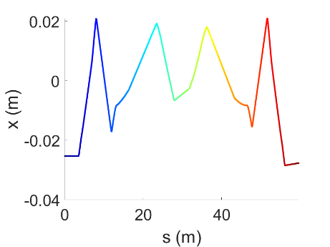
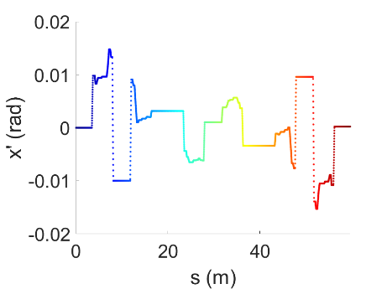
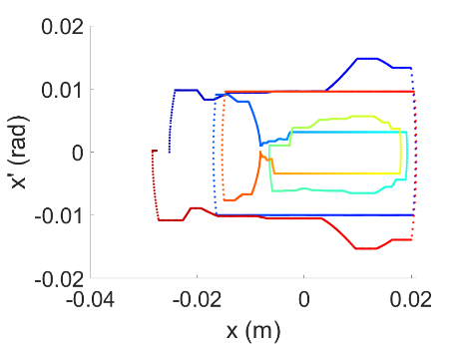
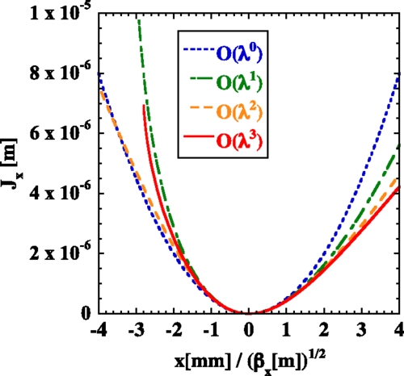
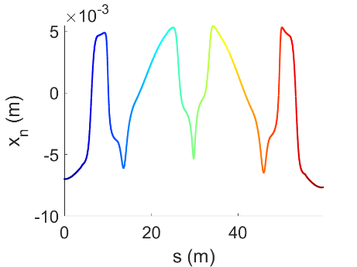
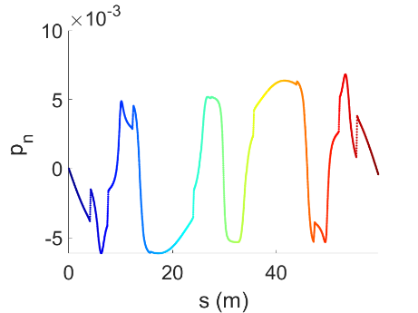
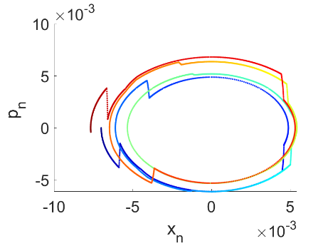
Tune Shift
In the presence of a nonlinear spring, the frequency changes in proportion to the energy, as shown, compared to when there is no nonlinear spring.
$ν_{0}=$initial tune, $α_{0}=$Effective Nonlinear Spring Constant
$J_{0}=$Initial Oscillation Amplitude
$$ν_{x}=ν_{0}+α_{0}J_{0}$$
$$U∝x^{3}$$
$$U∝x^{2}$$
$$U∝−x^{3}$$

Slide 7
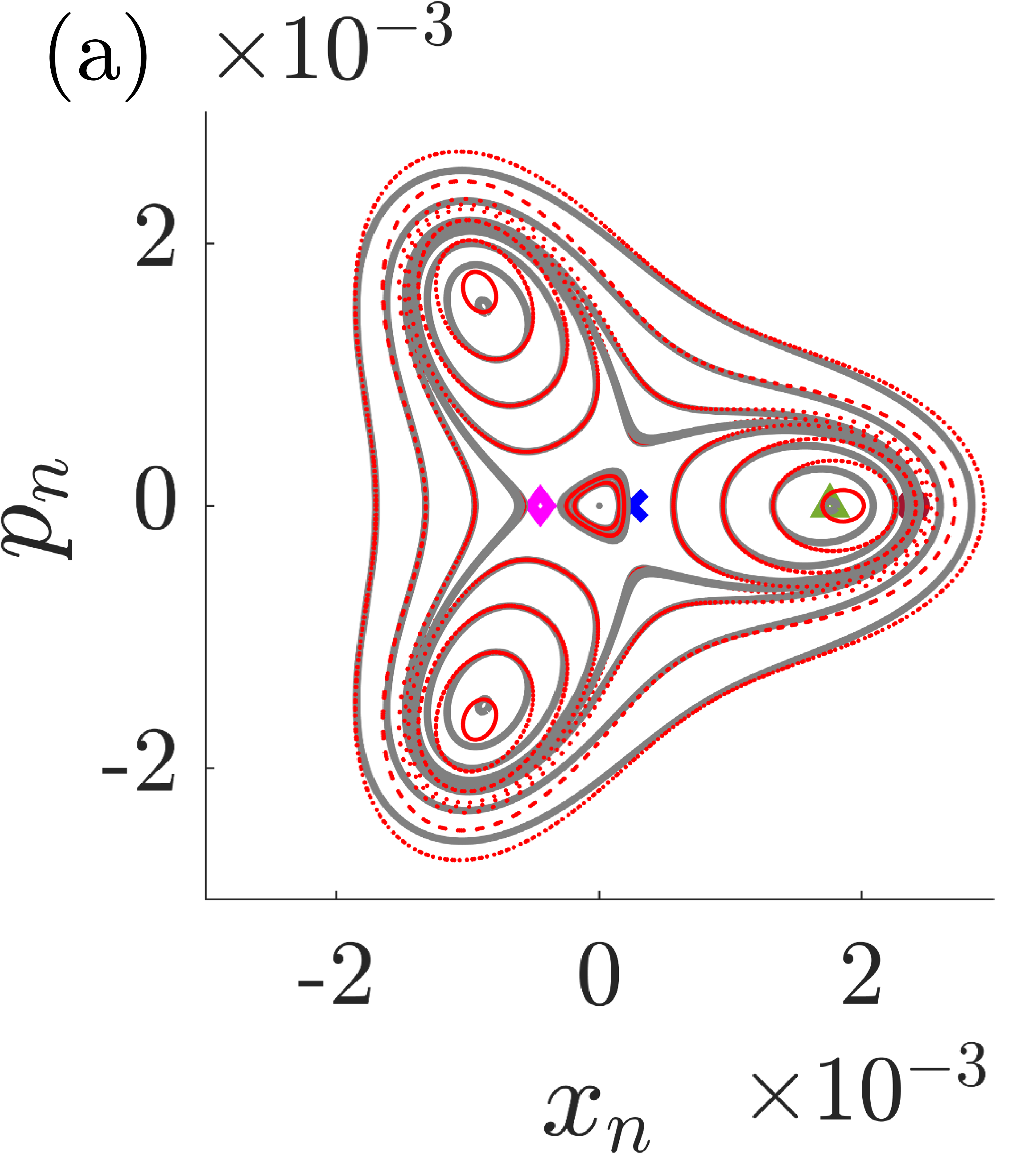
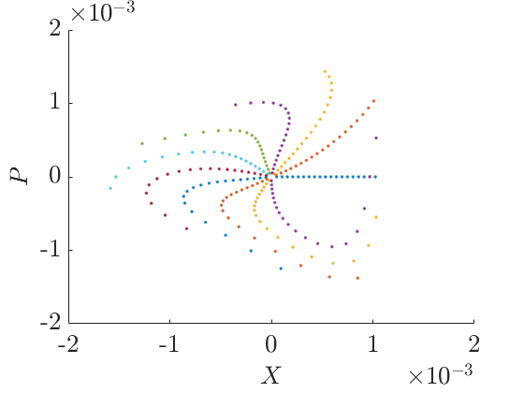
Problem (Resonance)
$ν_{0}=$initial tune, $α_{0}=$Nonlinear Spring Constant
$J_{0}=$Initial Oscillation Amplitude
$$ν_{x}=ν_{0}+α_{0}J_{0}$$
$$ΔJ_{0}≪J_{0}$$
$$U∝x^{3}$$
$$J$$
$$U∝x^{2}$$
$$×{10}^{−4}$$
$$U∝−x^{3}$$
$$J$$
$$ΔJ_{0}≅J_{0}$$

Slide 8
Problem (Resonance)
$$ν_{x}=ν_{0}+α_{0}J_{0}$$
$$U∝x^{3}<0$$
$$U∝x^{3}$$
$$U∝x^{2}$$
$$U∝x^{2}$$
$$×{10}^{−4}$$
$$U∝x^{3}>0$$
$$U∝x^{3}$$
$$U∝x^{2}$$
$$U∝x^{2}$$

Slide 9
Problem (Resonance)
$$ν_{x}−ν_{0}∝J+ΔJ or ΔJ?$$
$$J$$
$$ΔJ$$
$$U∝x^{3}$$
$$U∝x^{3}$$
$$U∝x^{2}$$
$$U∝x^{2}$$
$$×{10}^{−4}$$
New Equilibrium
New tune analysis is suggested.
Dynamics for Resonance Islands is analyzed

Slide 10
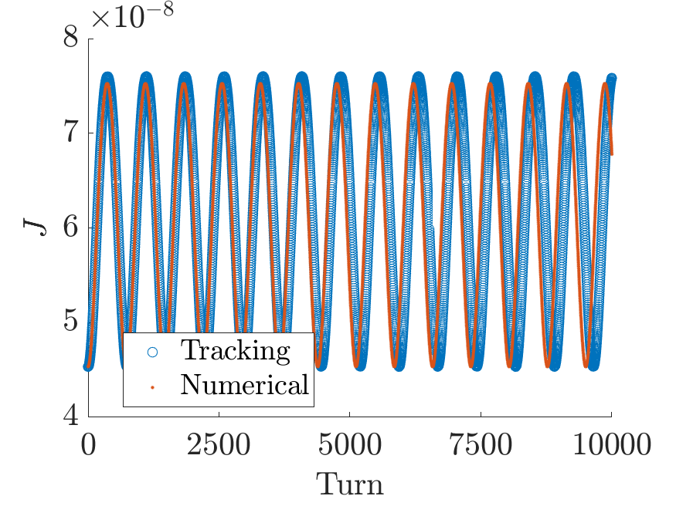
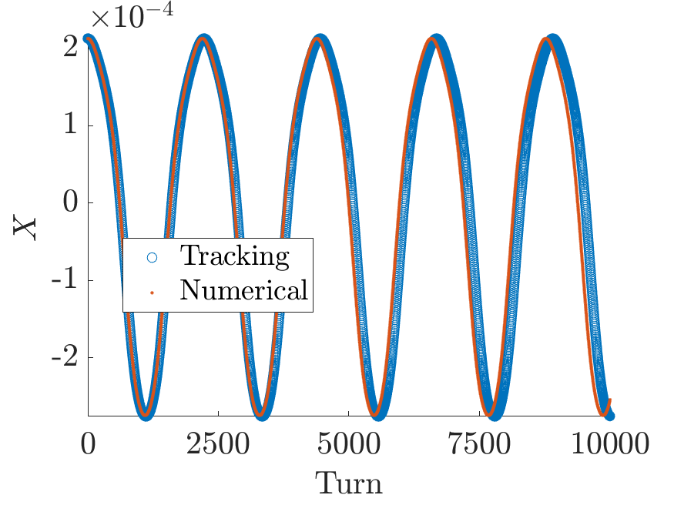
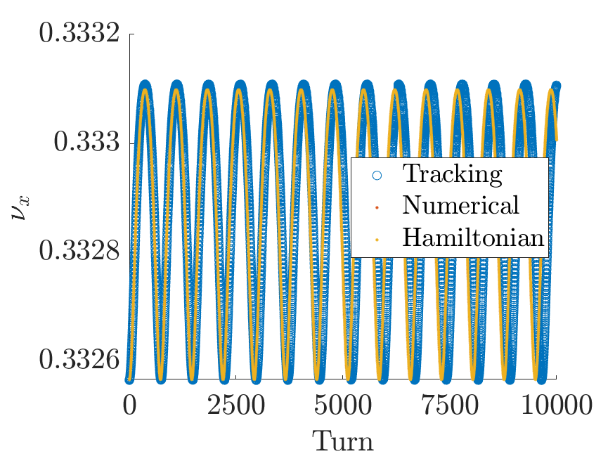
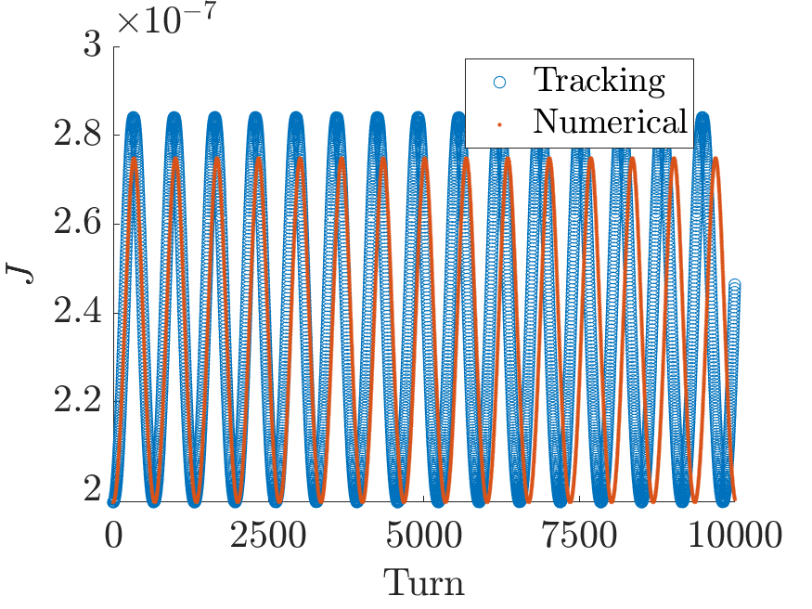
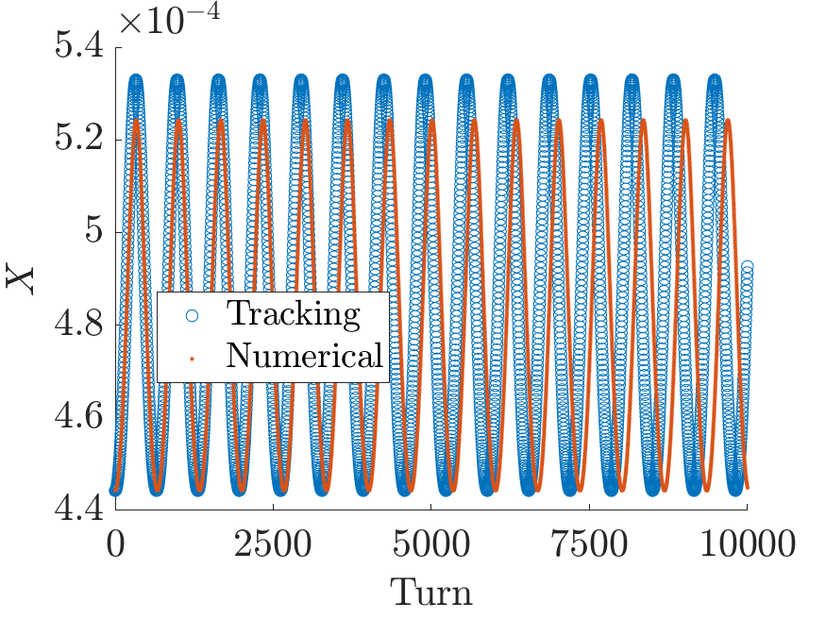
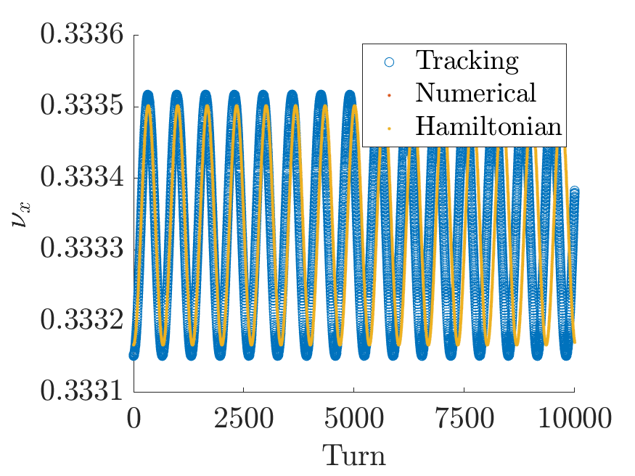
Result in Paper
Blue dots are tracking results and orange line is theoretical prediction
In Paper : Phase Dependent, Turn by Turn action, tune

