Slide 1


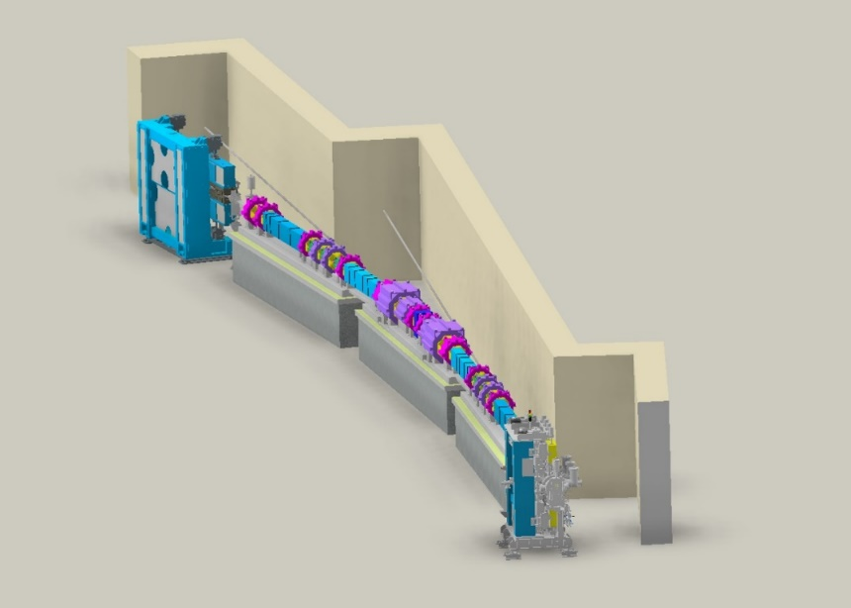

Beam physics group meeting
Booster MOGA simulation
Junha Kim
Aug 8th, 2024

Slide 2
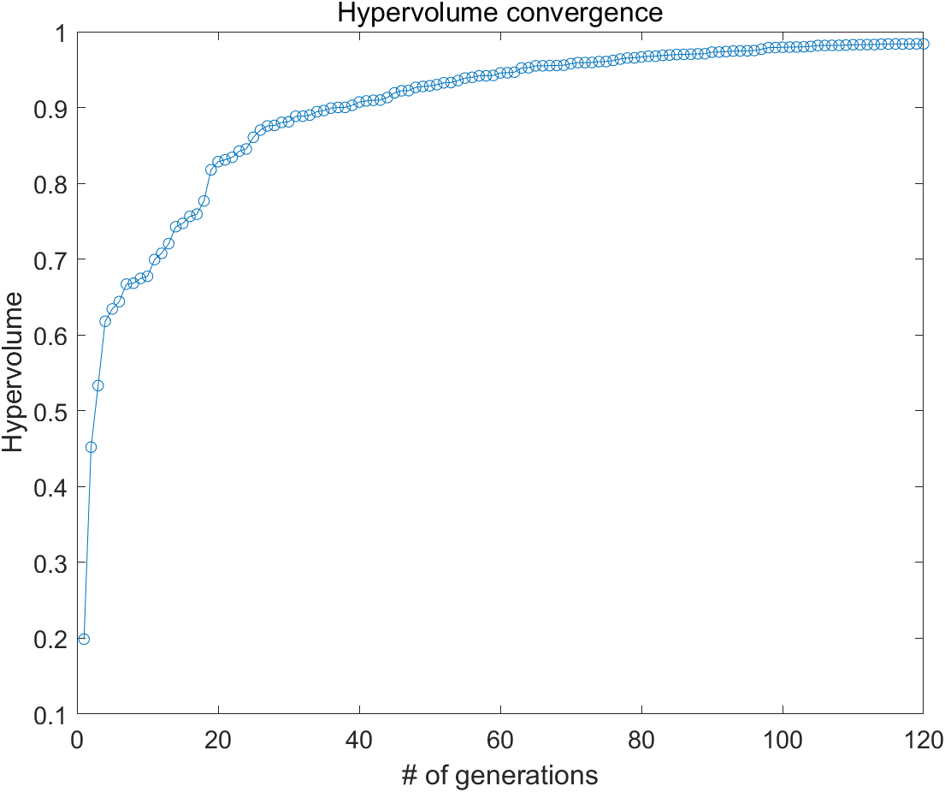
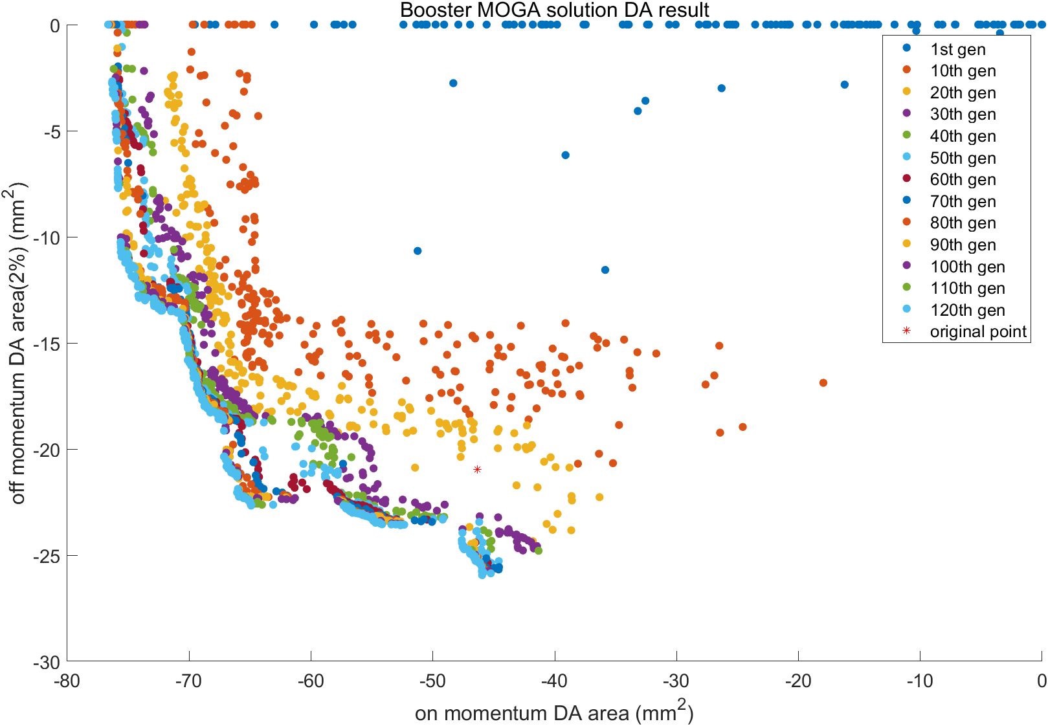
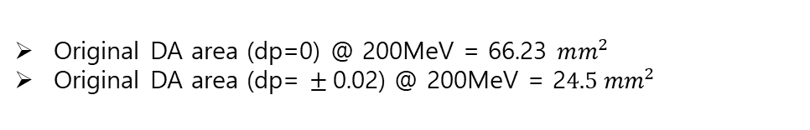
Beam physics group meeting
Booster MOGA simulation result
Lattice : gen_Booster_v4_cand1_20240411
The population size = 256
Used CPU number = 256
Total generations = 120
Number of variables = 5
(Quad in straight section + Quad in unit cells+Bending)
-30% original strength < x < 120% original strength
Number of objectives = 2
(On momentum DA area, Off momentum DA area(2%))
Original DA area (dp=0) @ 200MeV = 66.23 $mm^{2}$
Original DA area (dp= $±$0.02) @ 200MeV = 2$4.5 mm^{2}$

Slide 3
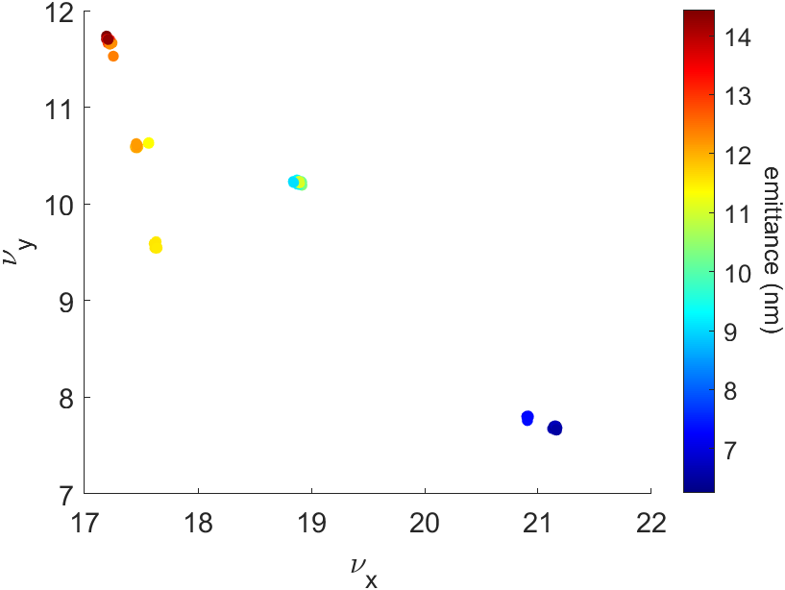
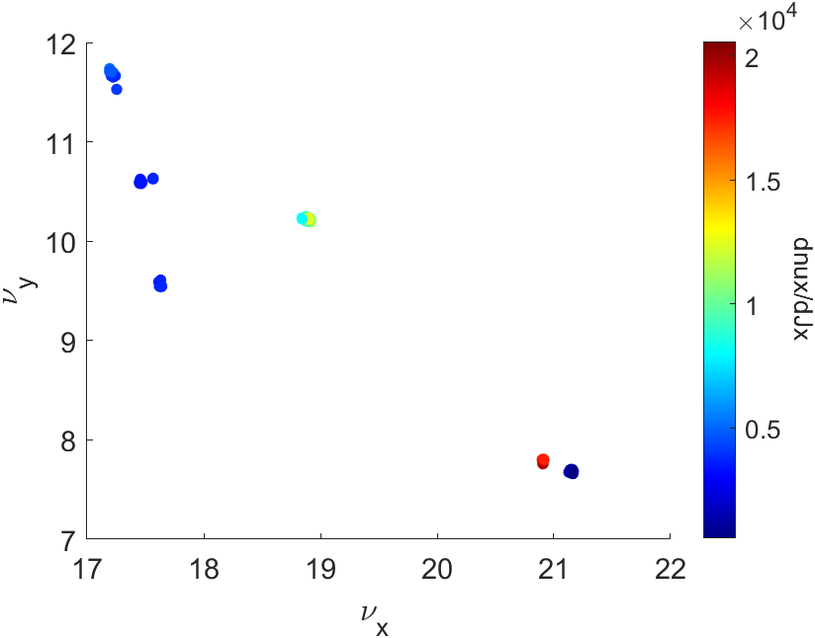
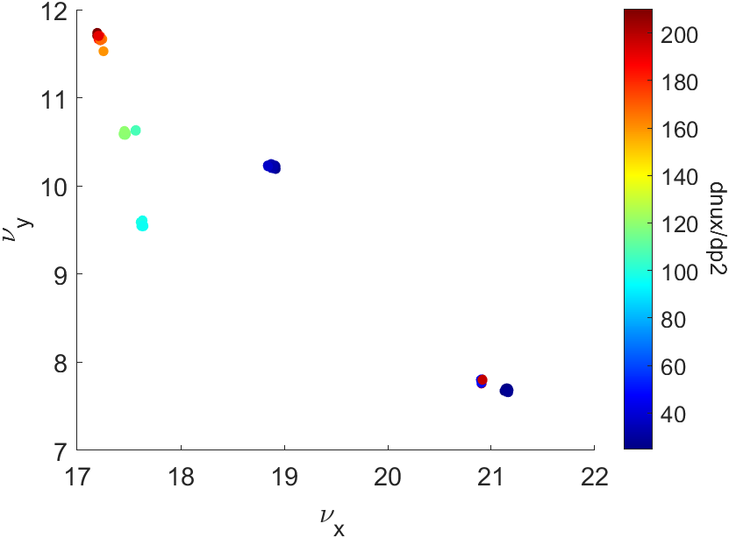
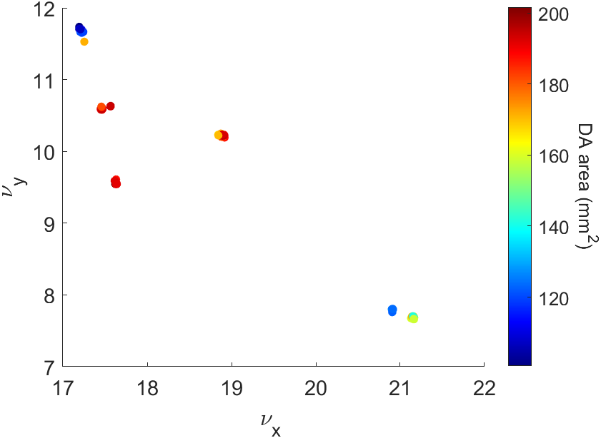
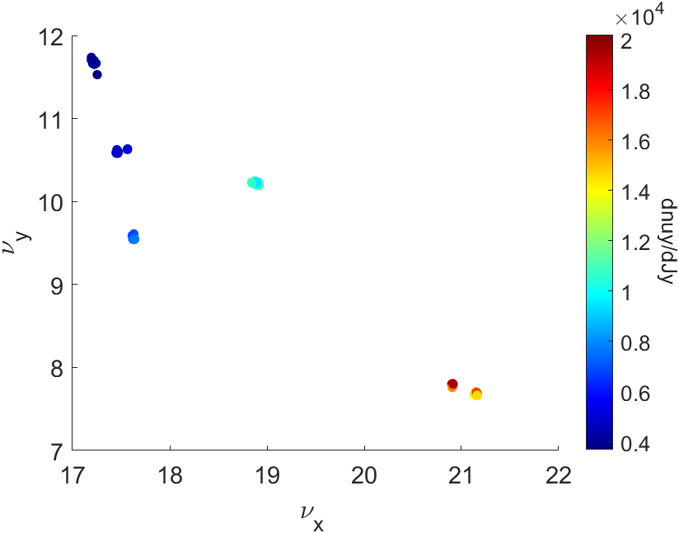
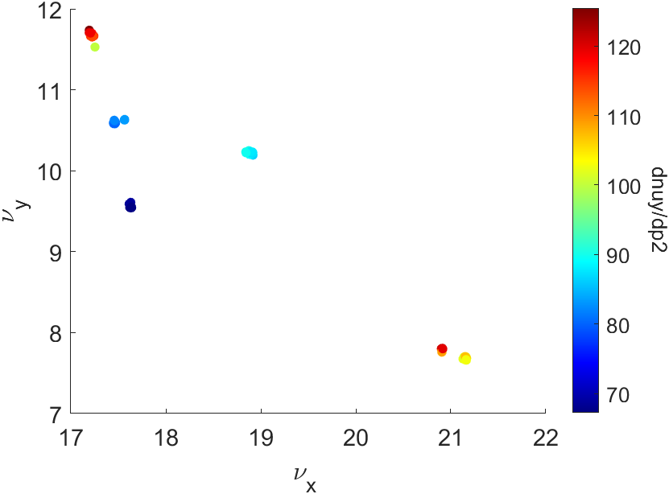
Beam physics group meeting
Booster MOGA simulation result(Final generation)

Slide 4
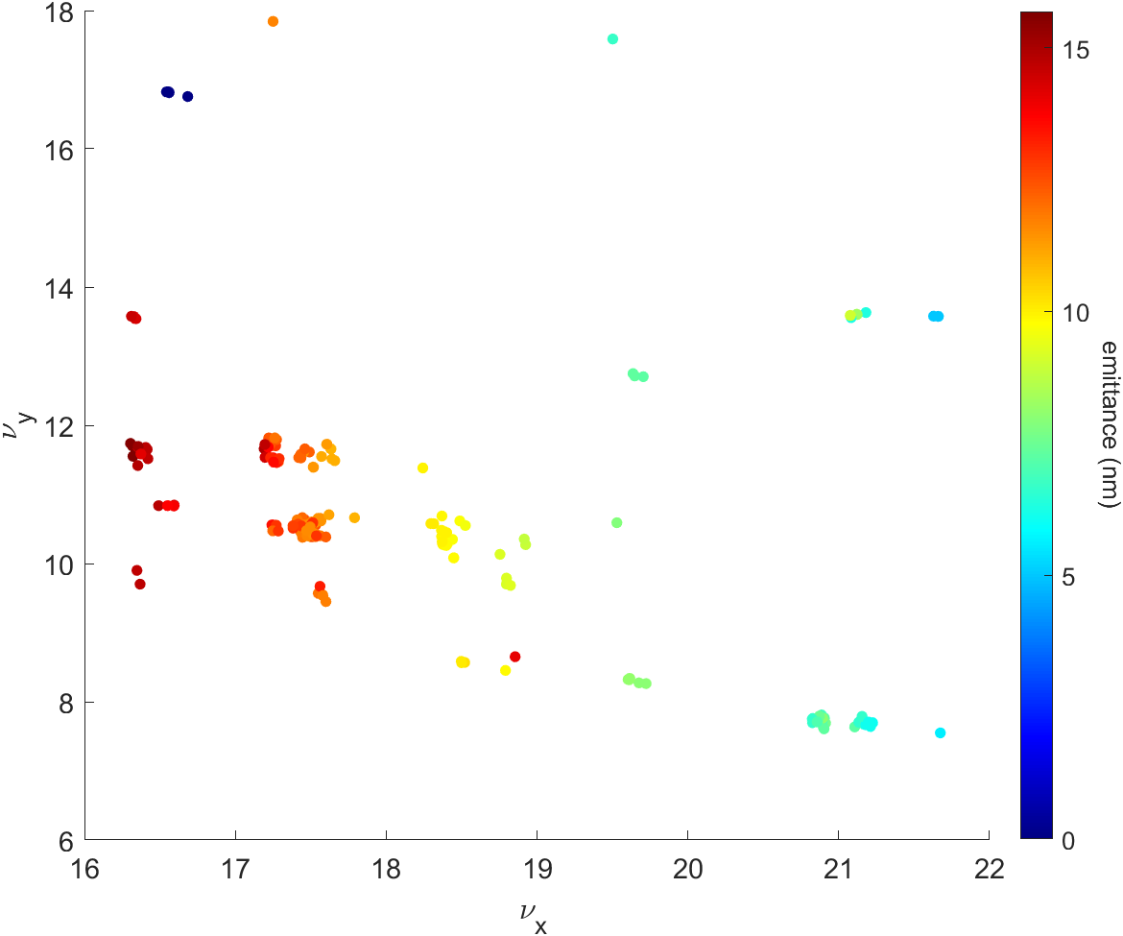
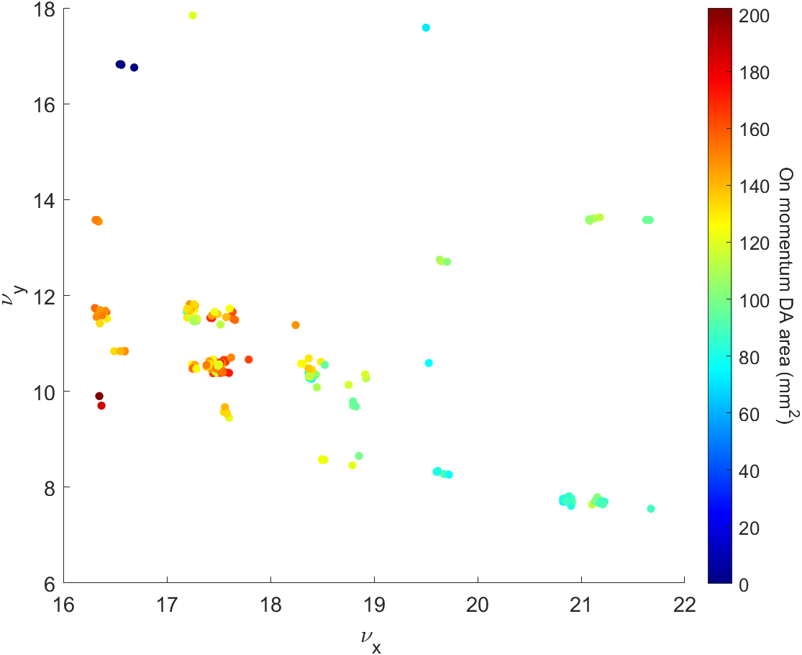
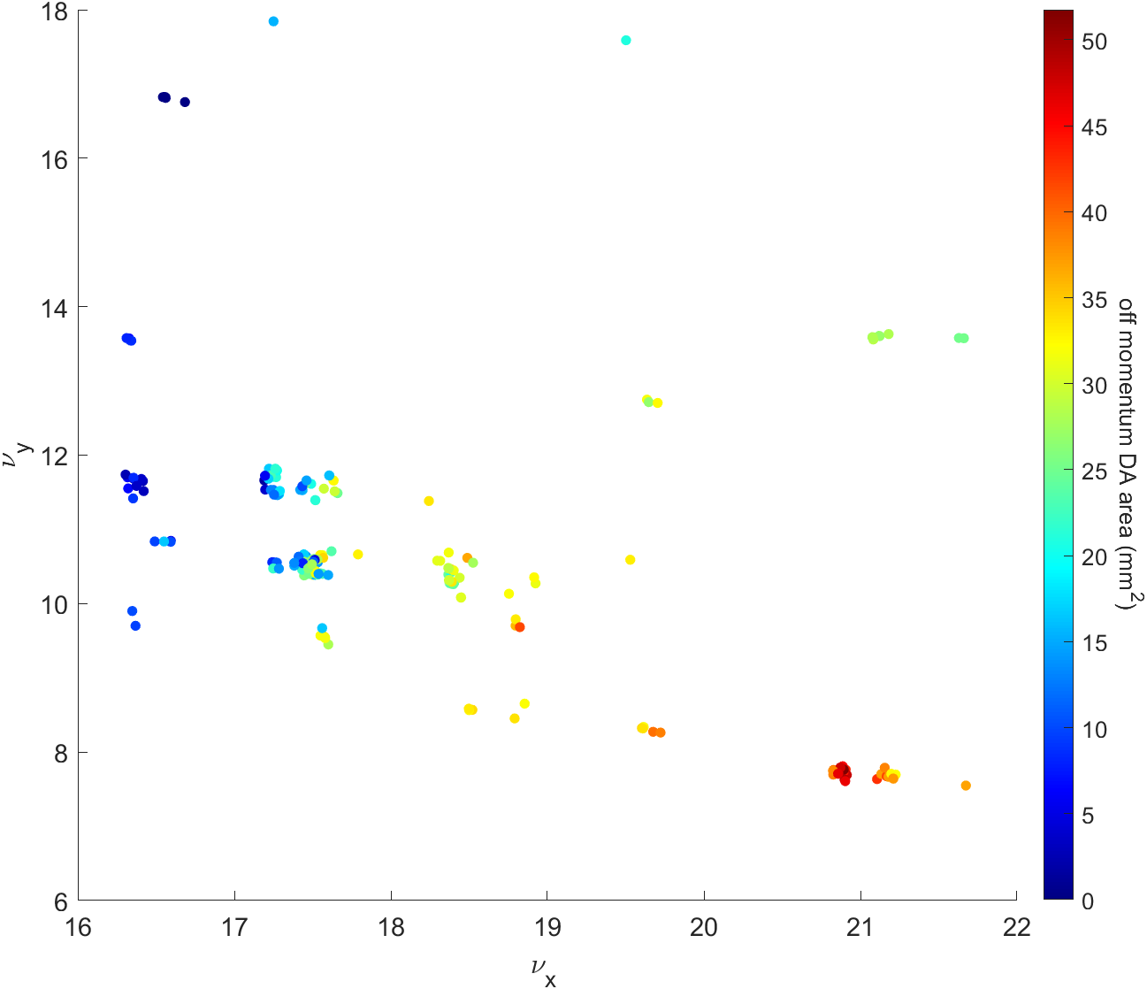
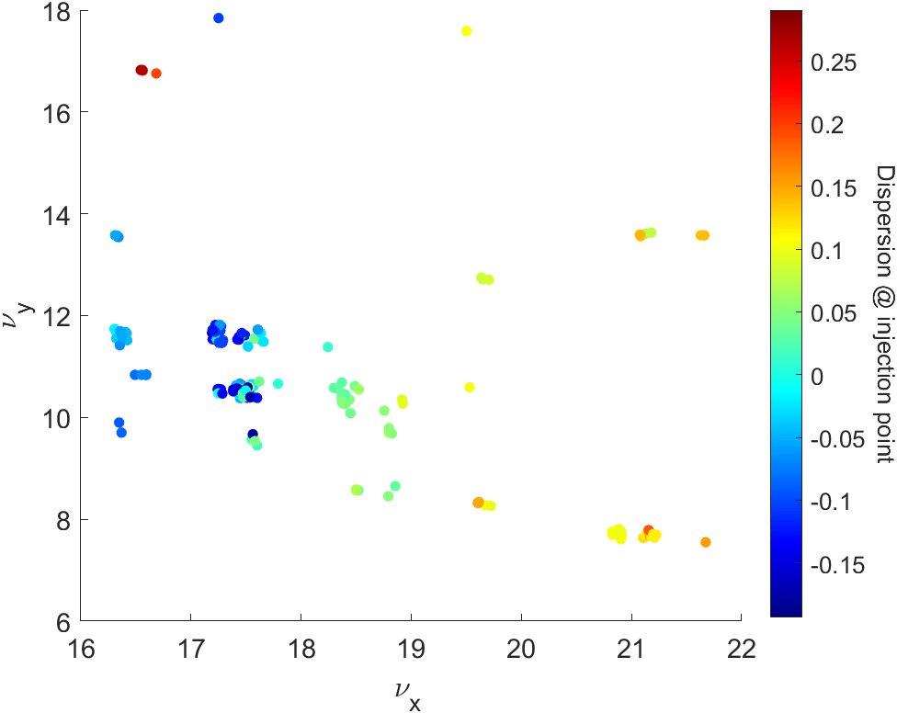
Beam physics group meeting
Booster MOGA simulation result(20th generation)

Slide 5
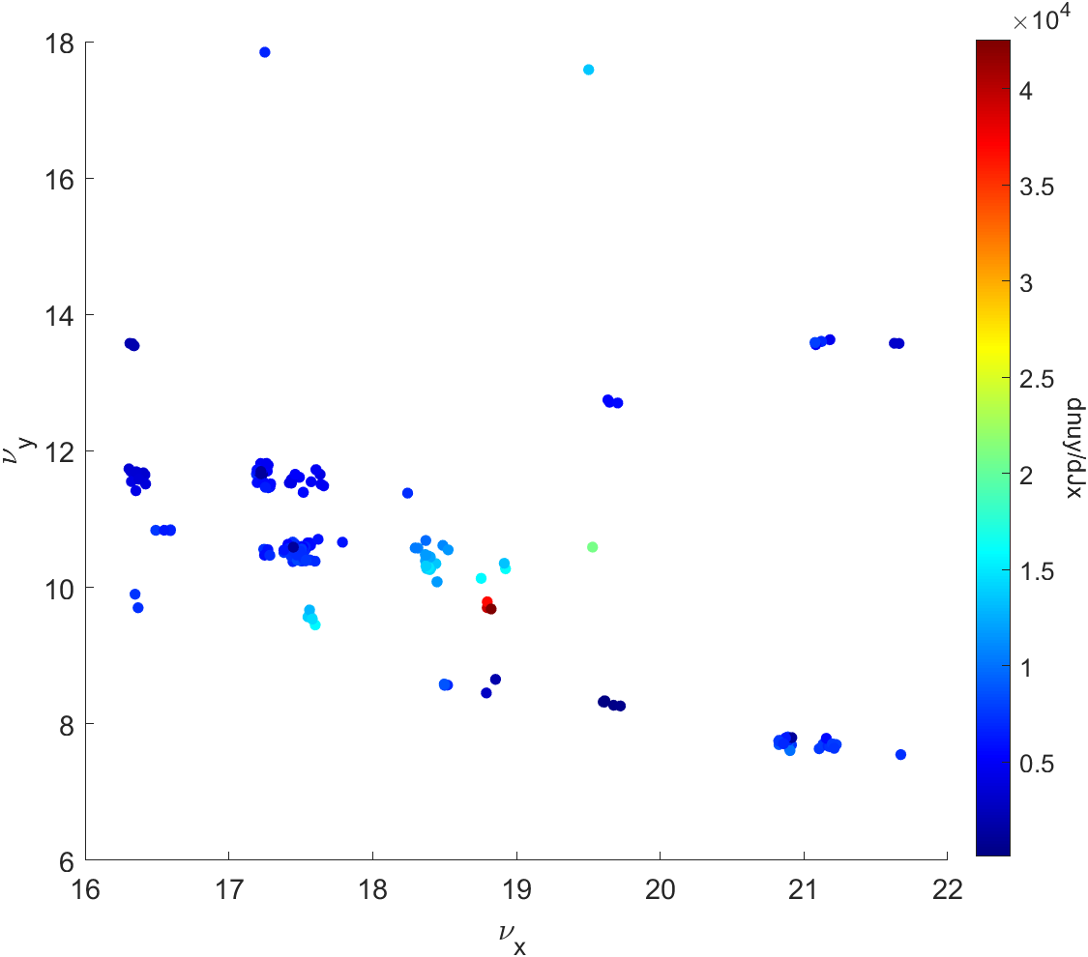
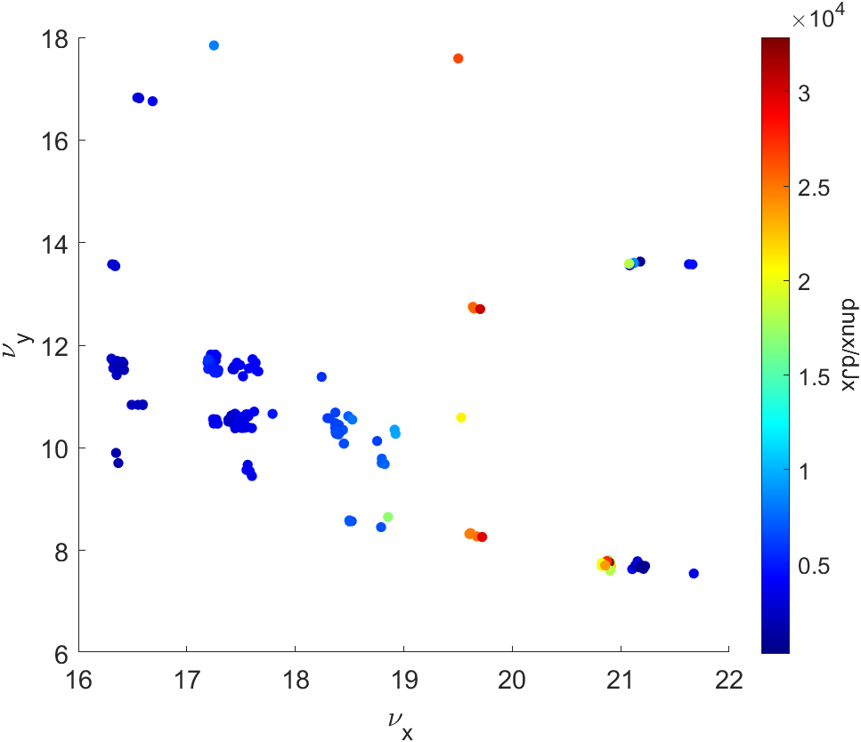
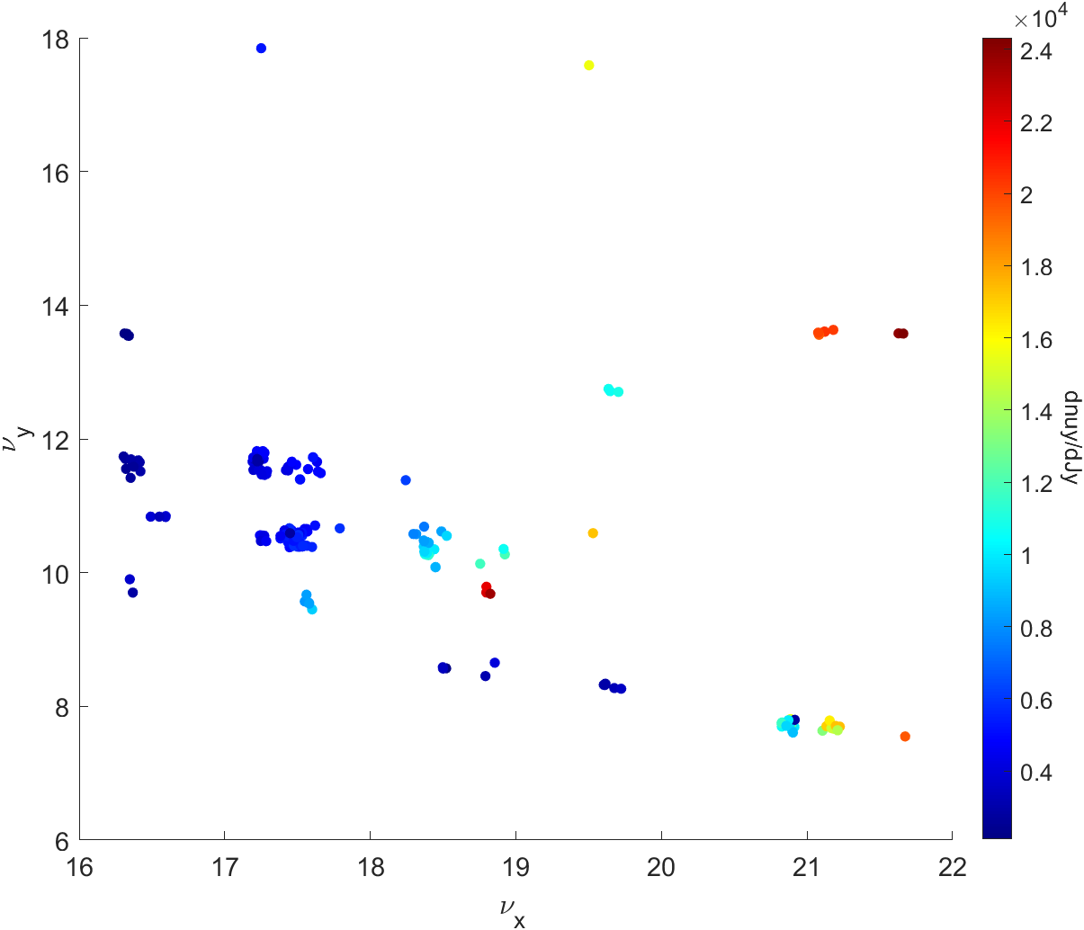
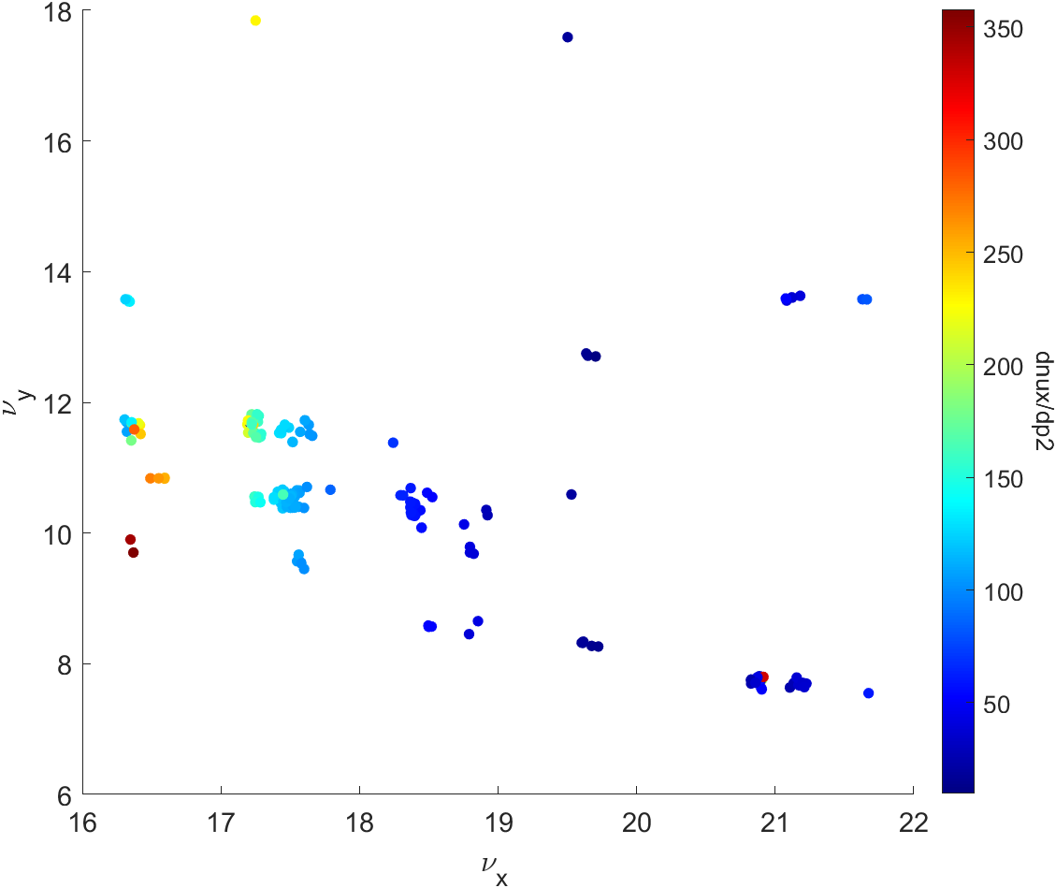
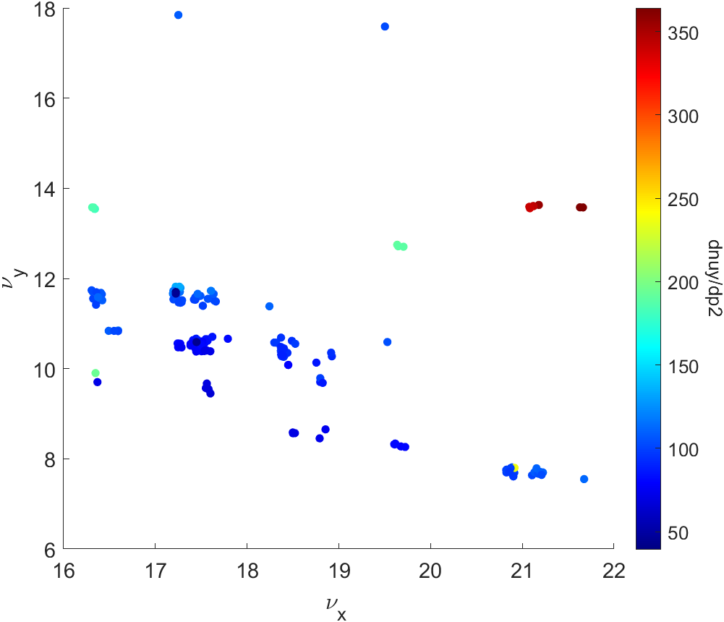
Beam physics group meeting
Booster MOGA simulation result(20th generation)

Slide 6
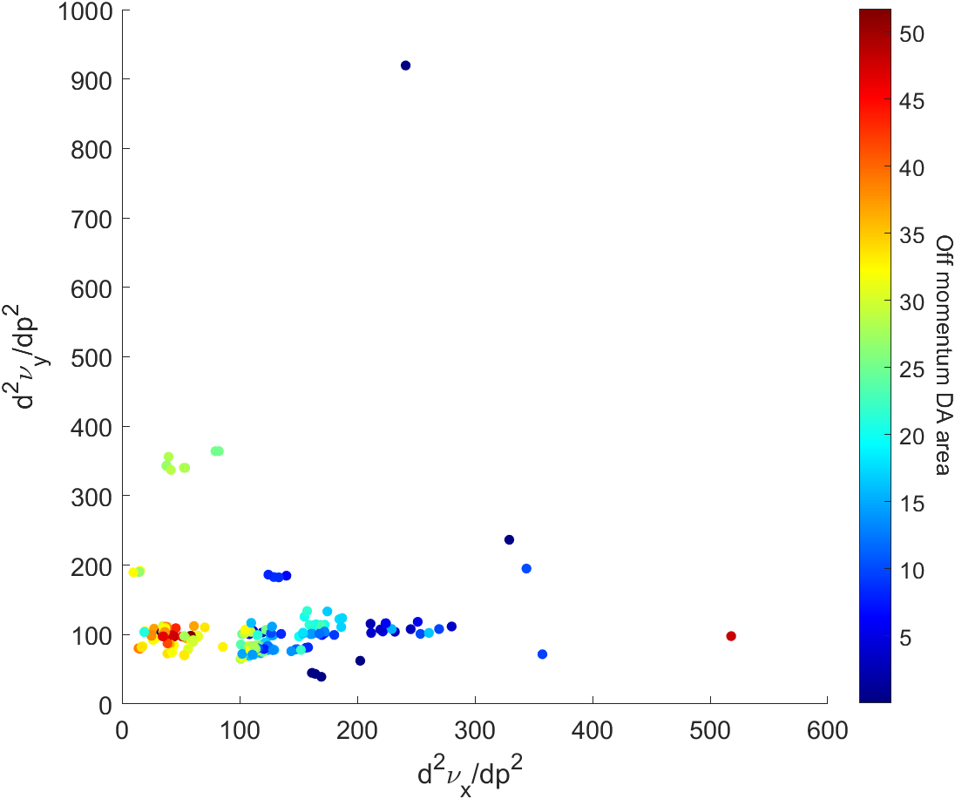
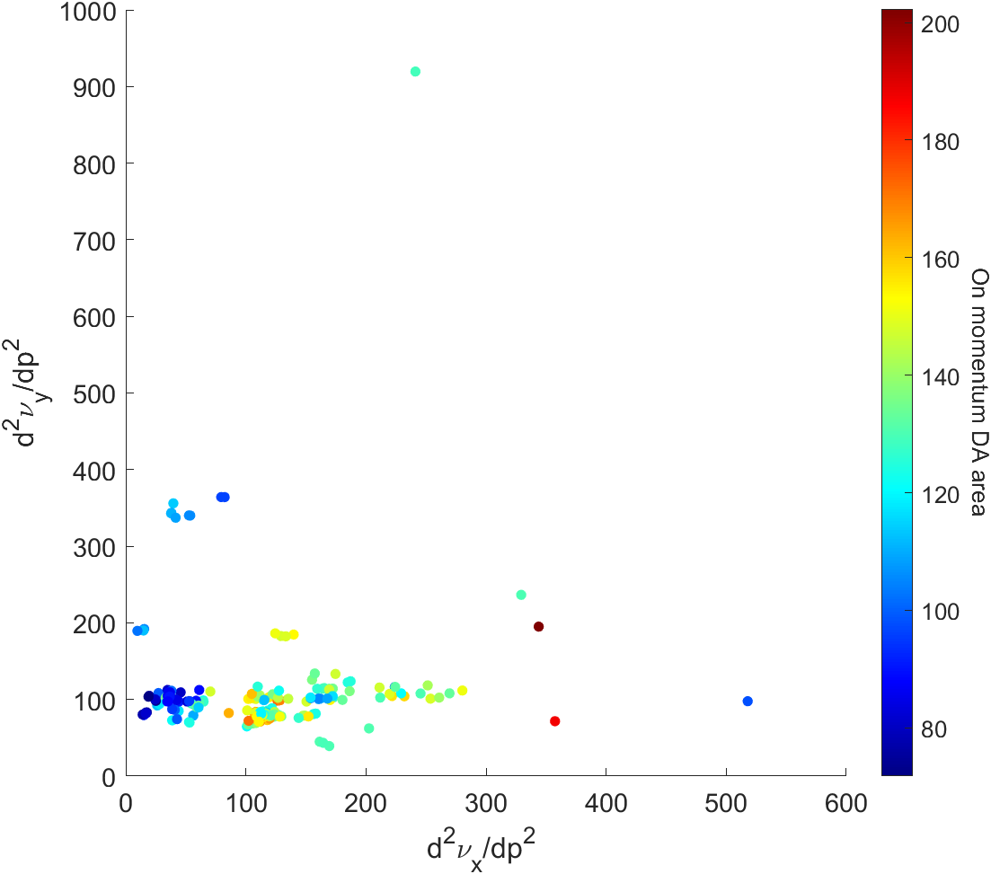
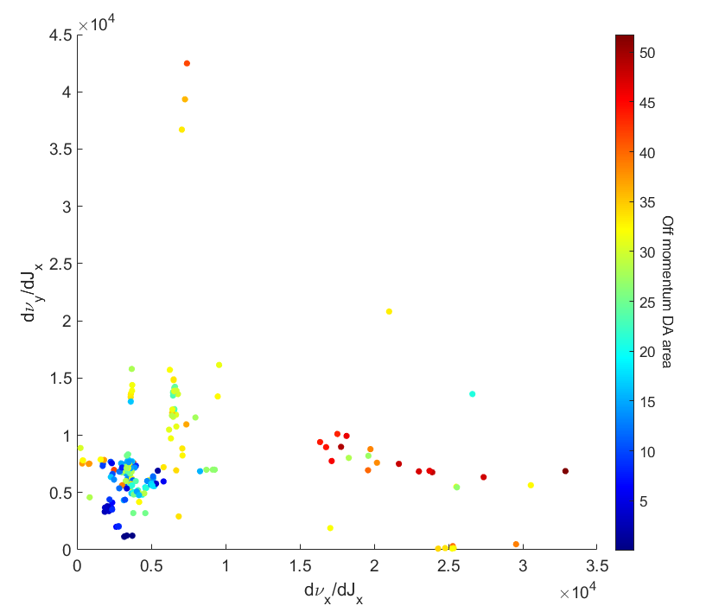
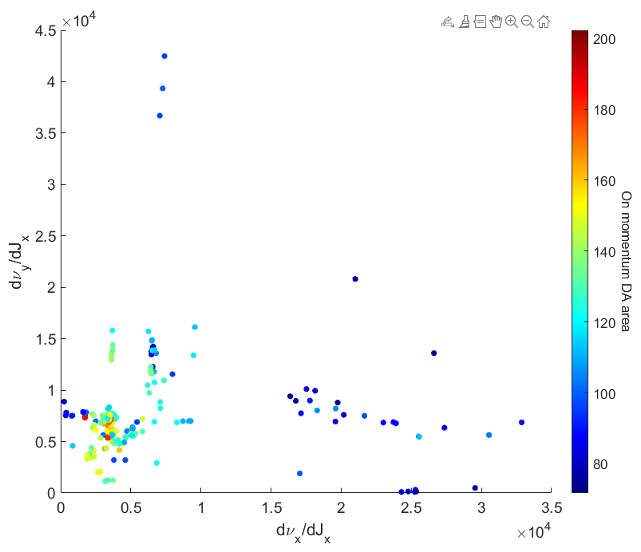
Beam physics group meeting
Booster MOGA simulation result(20th generation)

Slide 7
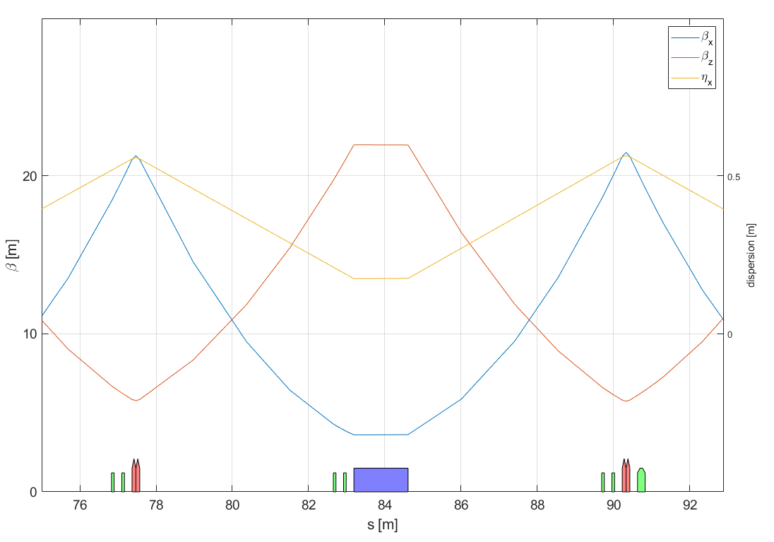
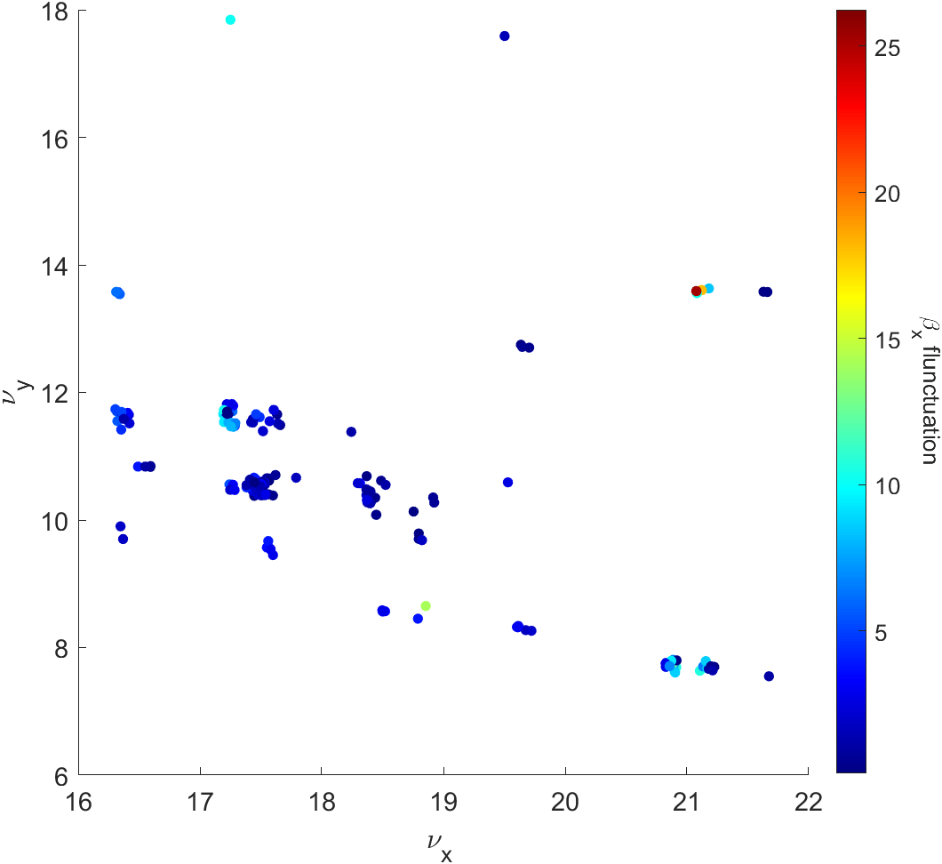
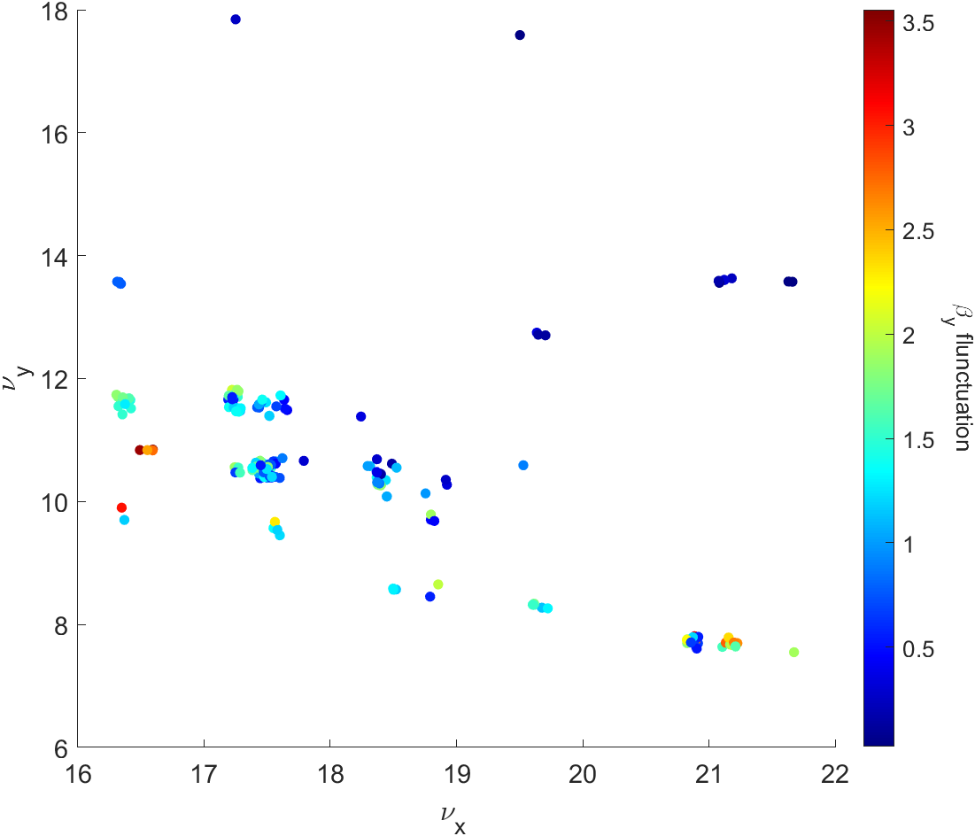
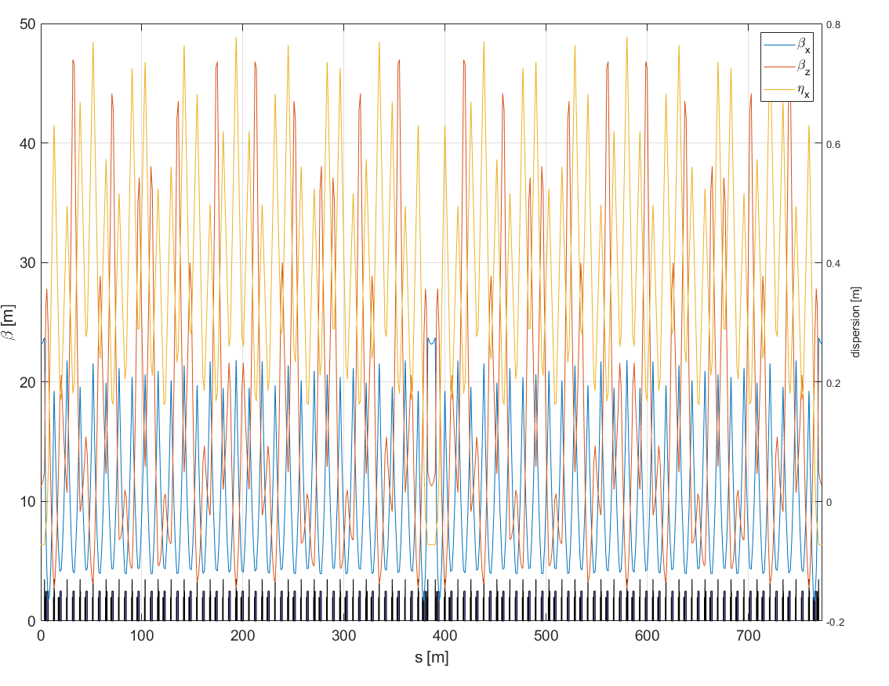
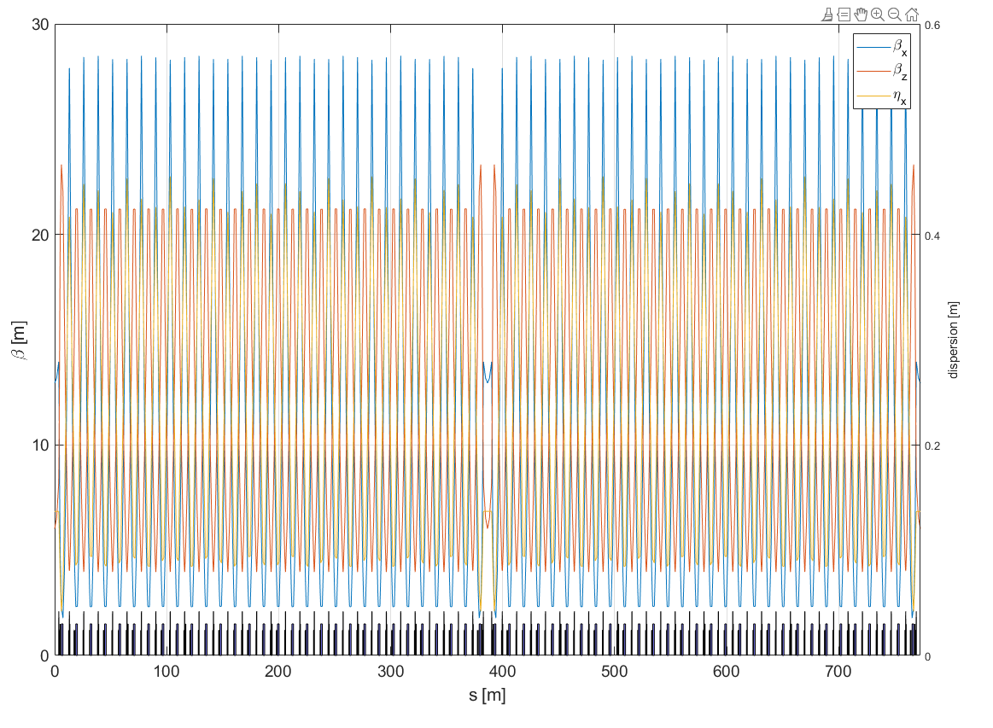

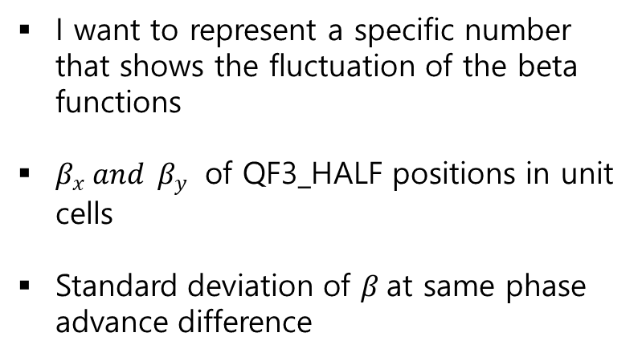

I want to represent a specific number that shows the fluctuation of the beta functions
$β_{x} and β_{y}$ of QF3_HALF positions in unit cells
Standard deviation of $β$at same phase advance difference
Max fluctuation of $β_{y}$
Min fluctuation of $β_{y}$

Slide 8
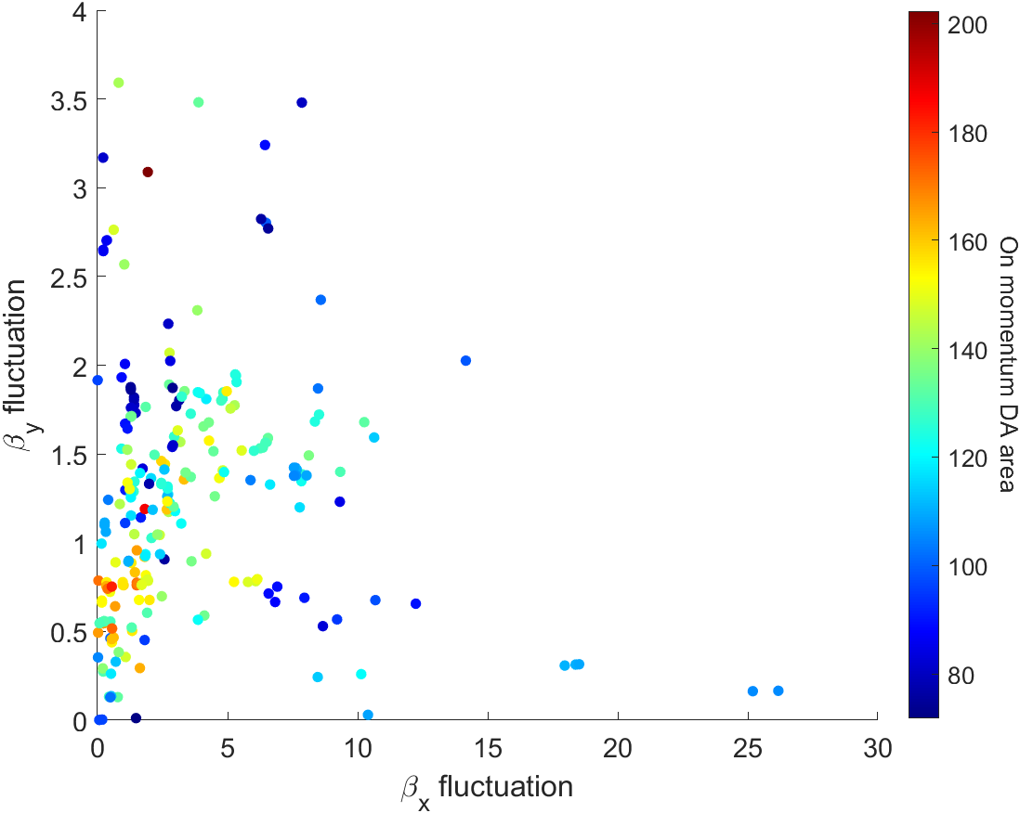
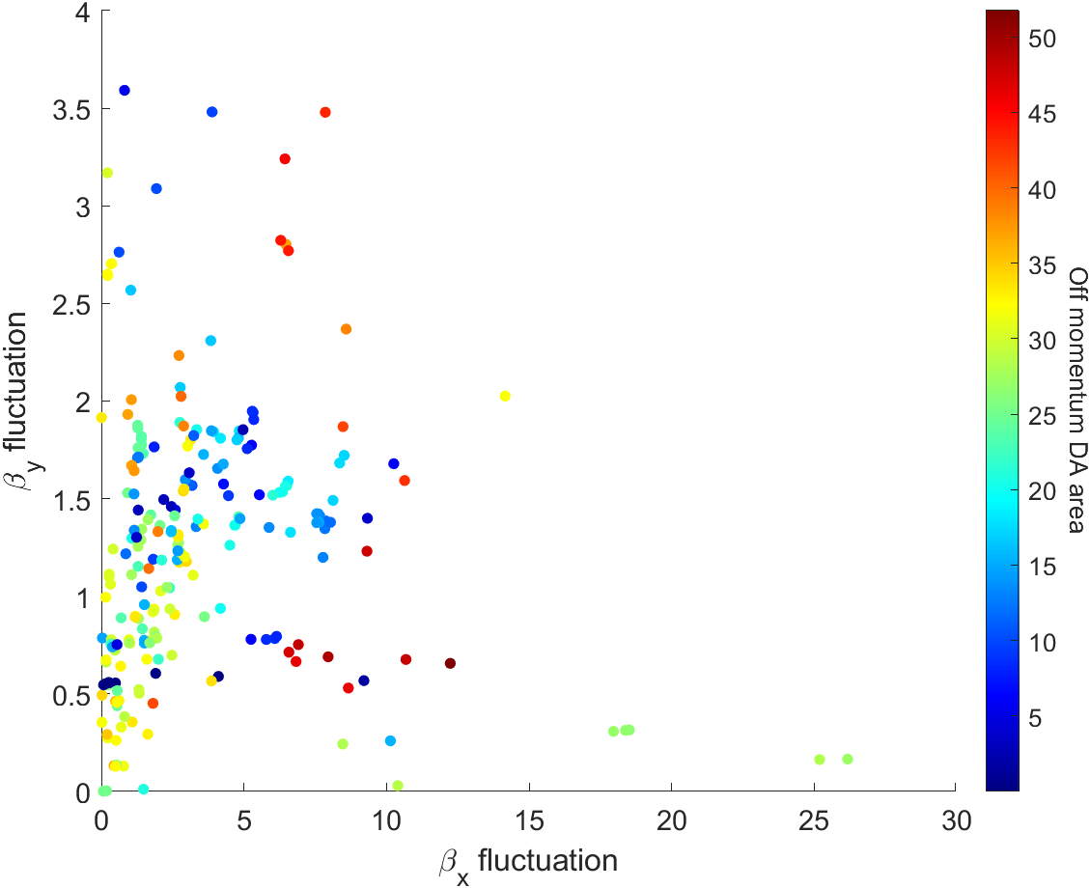
Beam physics group meeting
Booster MOGA simulation result(20th generation)

Slide 9
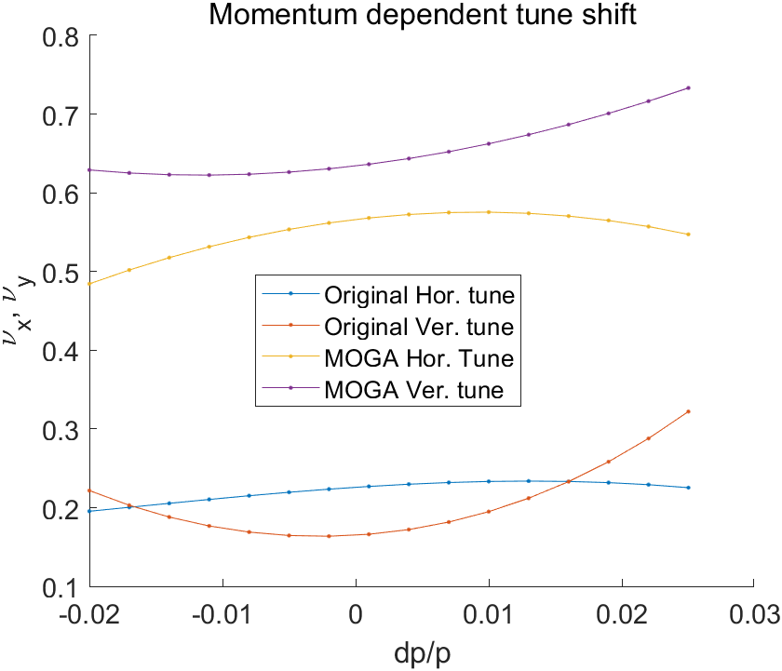
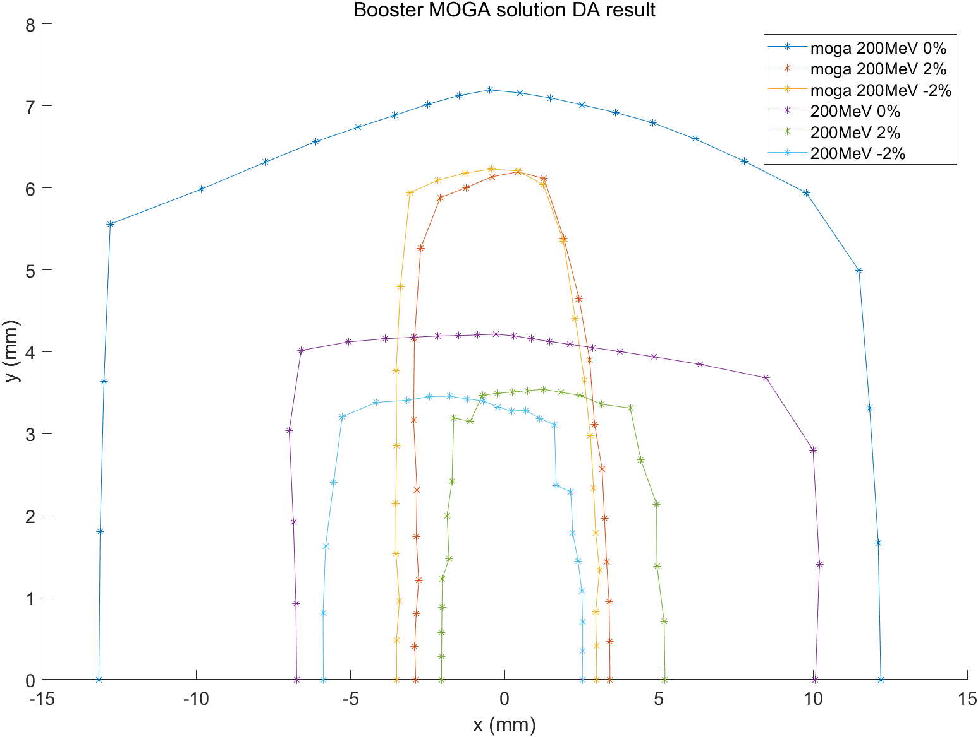
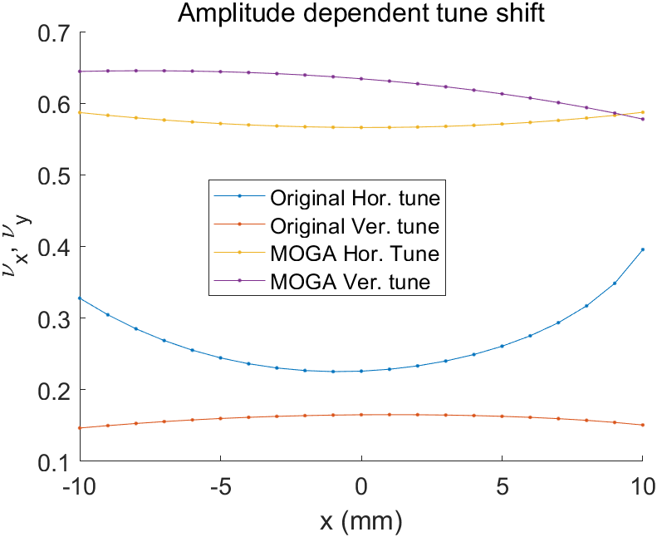
Beam physics group meeting
Booster MOGA simulation result #1

Slide 10
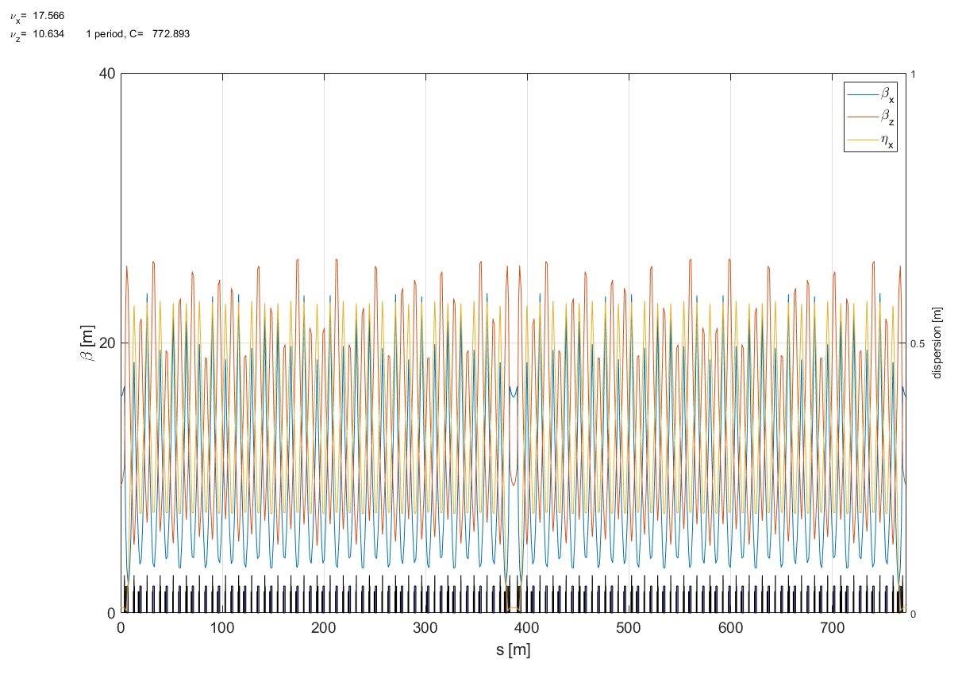
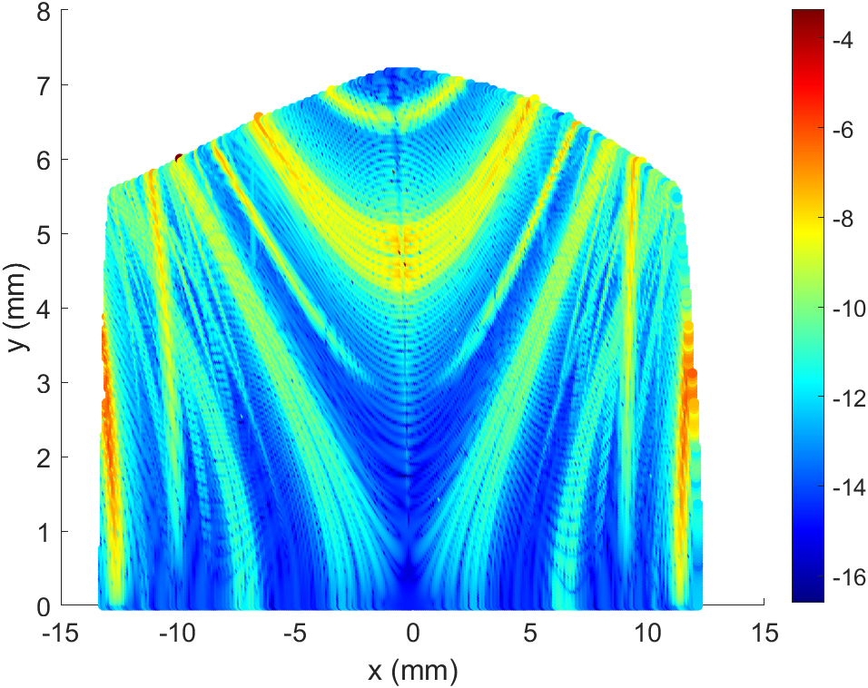
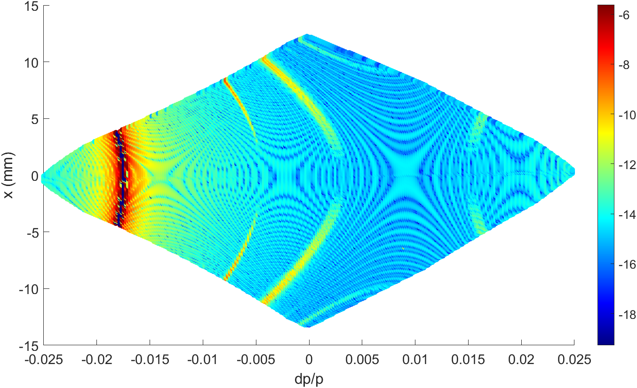
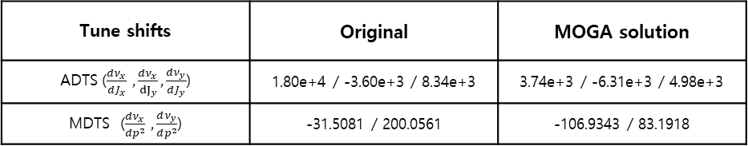
Beam physics group meeting
Booster MOGA simulation result #1
FMA x-y offset
Hor. Tune = 17.566
Ver. Tune = 10.634
Hor. Emitt = 11.3nm @ 4GeV
Twiss function at Injection point
Hor. Beta = 15. 972
Ver. Beta = 9.407
Dispersion = 0.009
Nat. Chrom = (-21.8294, -15.2947)
FMA dp-x offset
Tune shifts | Original | MOGA solution
ADTS ($\frac{dν_{x}}{dJ_{x}} ,\frac{dν_{x}}{{dJ}_{y}},\frac{dν_{y}}{dJ_{y}}$) | 1.80e+4 / -3.60e+3 / 8.34e+3 | 3.74e+3 / -6.31e+3 / 4.98e+3
MDTS ($\frac{dν_{x}}{dp^{2}} ,\frac{dν_{y}}{dp^{2}}$) | -31.5081 / 200.0561 | -106.9343 / 83.1918

Slide 11
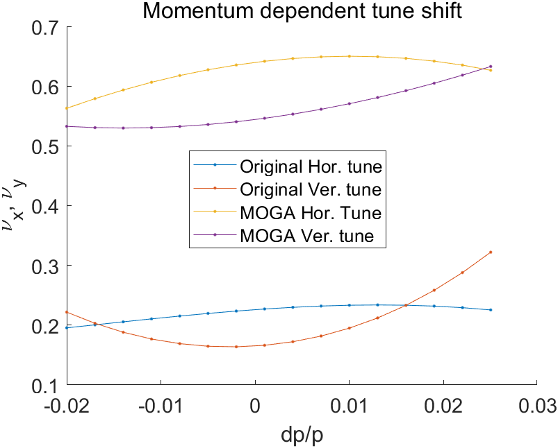
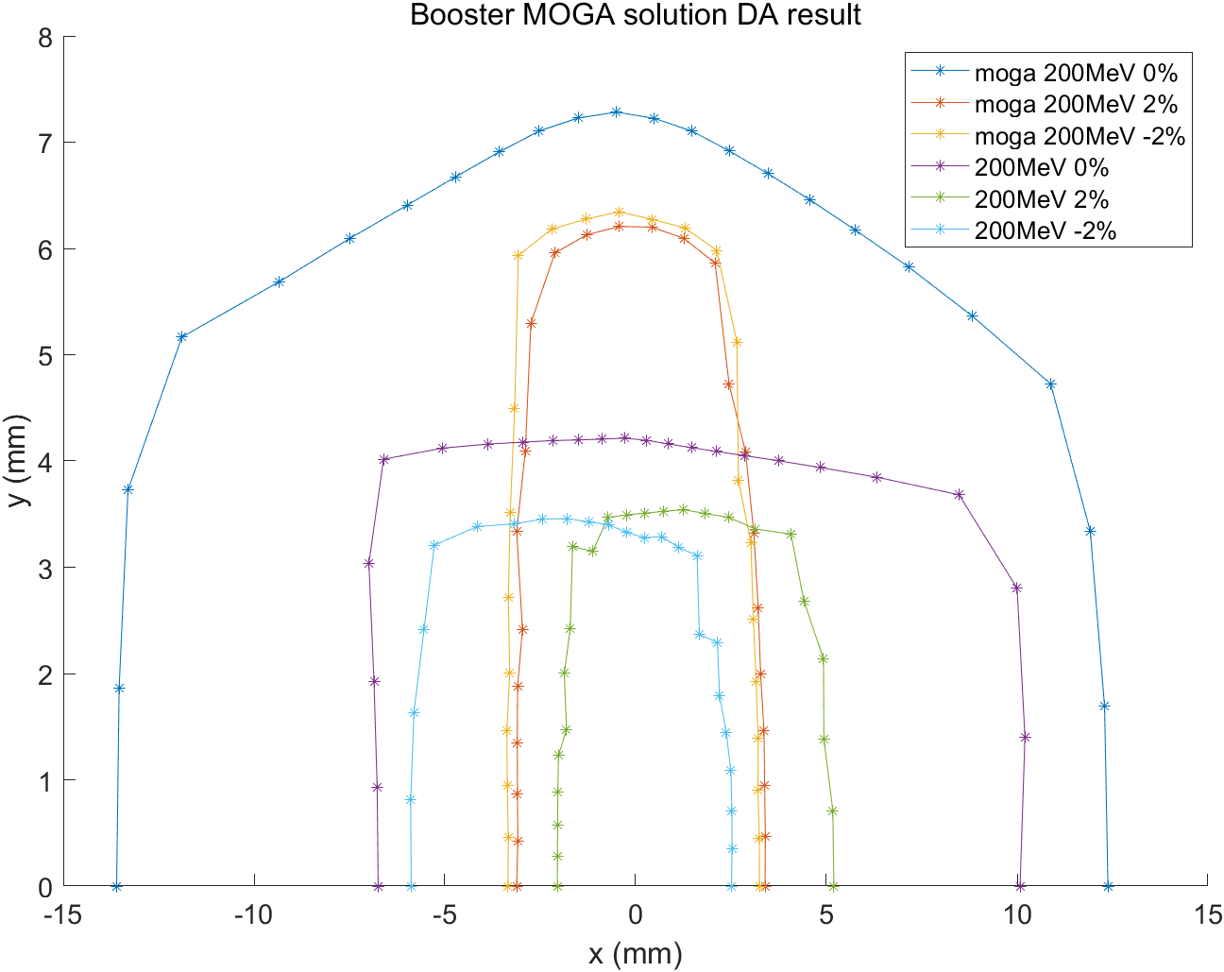
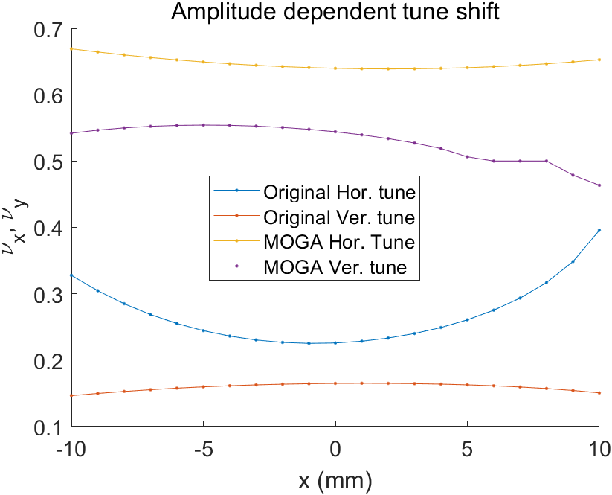
Beam physics group meeting
Booster MOGA simulation result #2

Slide 12
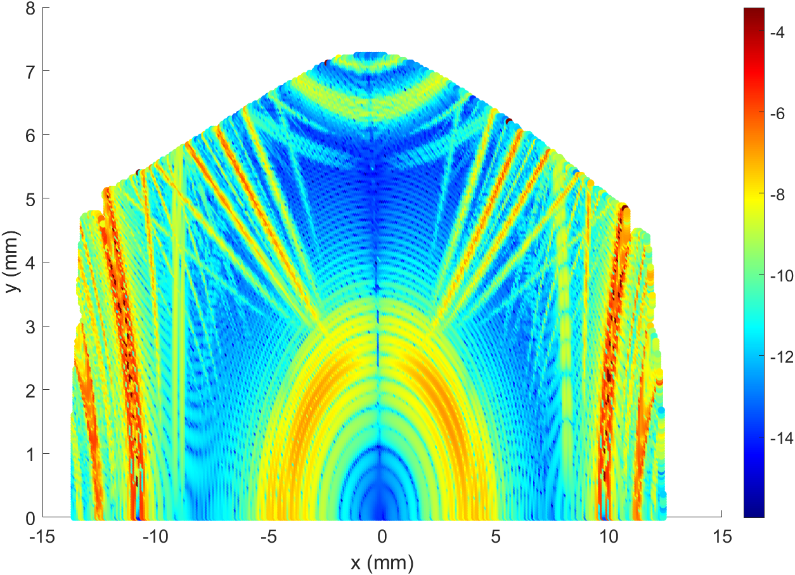
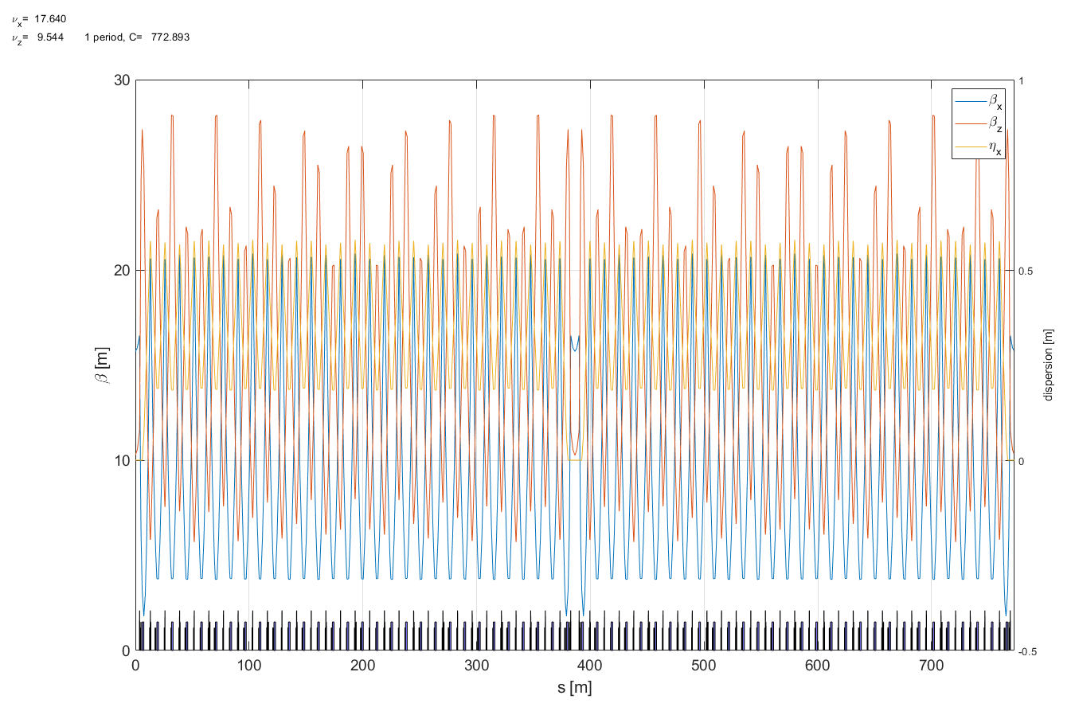
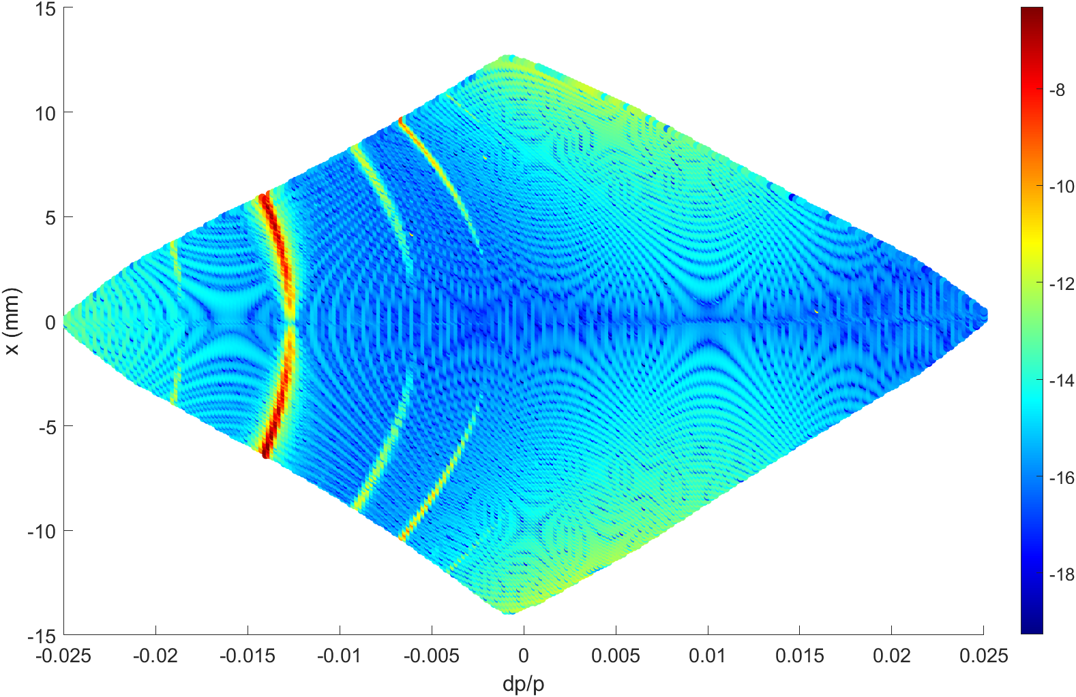
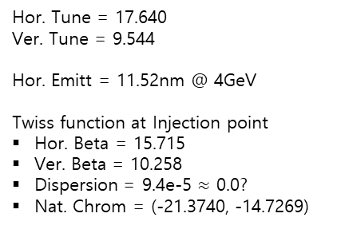
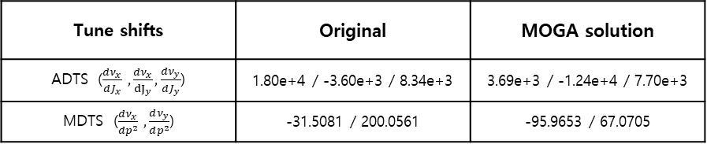
Beam physics group meeting
Booster MOGA simulation result #2
FMA x-y offset
Hor. Tune = 17.640
Ver. Tune = 9.544
Hor. Emitt = 11.52nm @ 4GeV
Twiss function at Injection point
Hor. Beta = 15.715
Ver. Beta = 10.258
Dispersion = 9.4e-5 $≈$ 0.0?
Nat. Chrom = (-21.3740, -14.7269)
FMA dp-x offset
Tune shifts | Original | MOGA solution
ADTS ($\frac{dν_{x}}{dJ_{x}} ,\frac{dν_{x}}{{dJ}_{y}},\frac{dν_{y}}{dJ_{y}}$) | 1.80e+4 / -3.60e+3 / 8.34e+3 | 3.69e+3 / -1.24e+4 / 7.70e+3
MDTS ($\frac{dν_{x}}{dp^{2}} ,\frac{dν_{y}}{dp^{2}}$) | -31.5081 / 200.0561 | -95.9653 / 67.0705

Slide 13
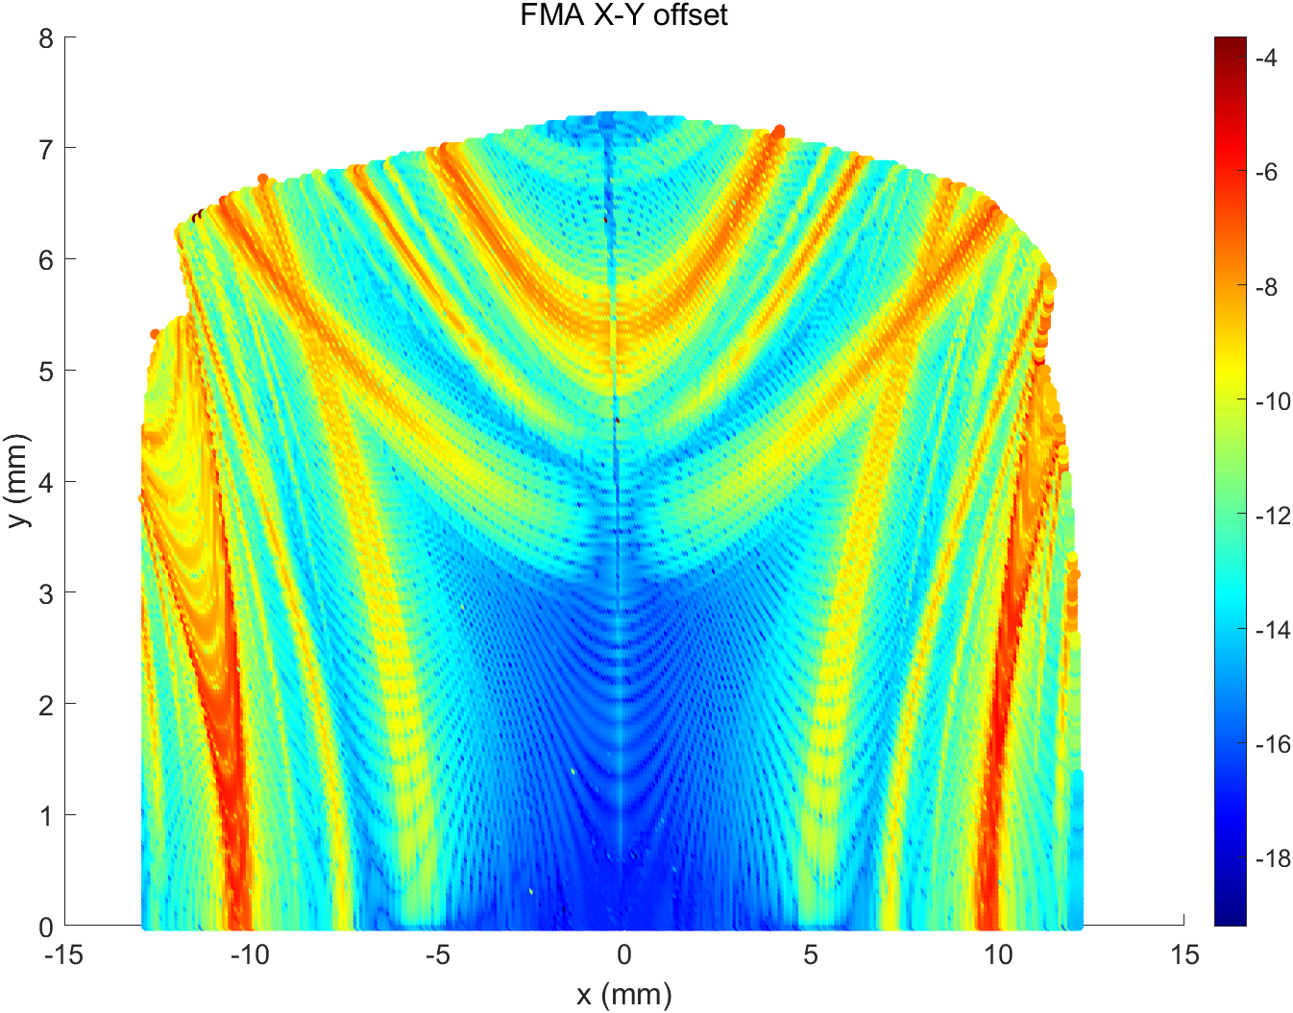
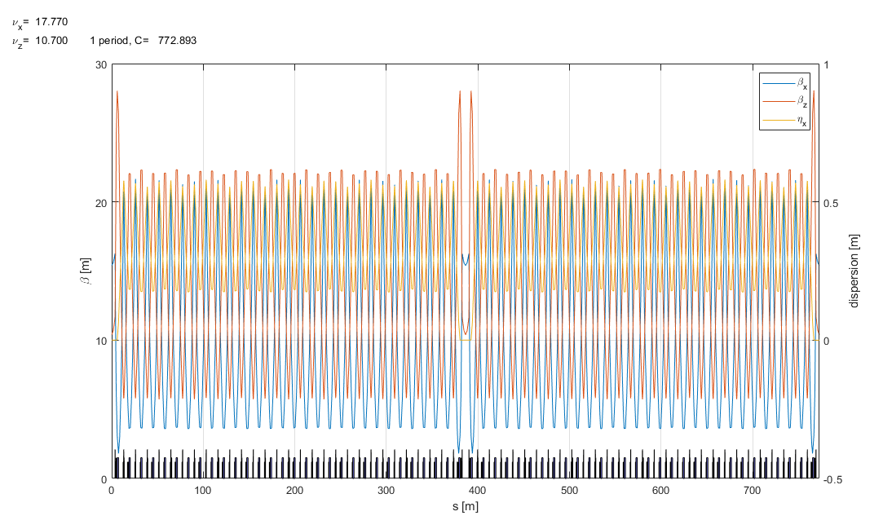
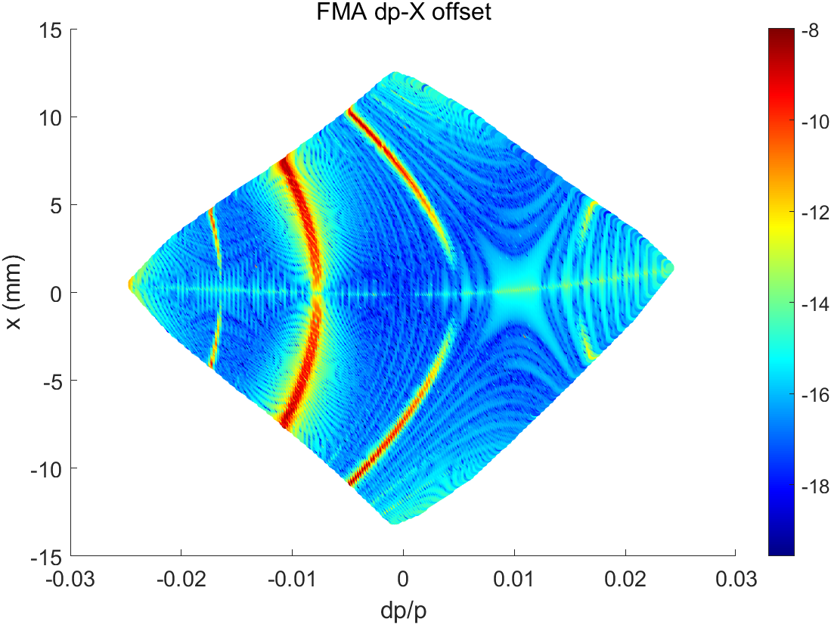
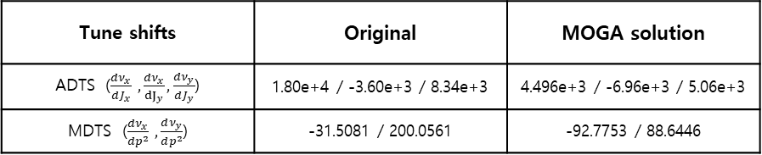
Beam physics group meeting
Booster MOGA simulation result #3 from Dr.Kim
Hor. Tune = 17.770
Ver. Tune = 10.700
Hor. Emitt = 10.89nm @ 4GeV
Twiss function at Injection point
Hor. Beta = 15. 403
Ver. Beta = 10.397
Dispersion = 0.0
Nat. Chrom = (-22.2238, -15.3008)
Tune shifts | Original | MOGA solution
ADTS ($\frac{dν_{x}}{dJ_{x}} ,\frac{dν_{x}}{{dJ}_{y}},\frac{dν_{y}}{dJ_{y}}$) | 1.80e+4 / -3.60e+3 / 8.34e+3 | 4.496e+3 / -6.96e+3 / 5.06e+3
MDTS ($\frac{dν_{x}}{dp^{2}} ,\frac{dν_{y}}{dp^{2}}$) | -31.5081 / 200.0561 | -92.7753 / 88.6446

Slide 14



Slide 15



Beam physics group meeting
Booster MOGA simulation result #3 from Dr.Kim

Slide 16

Booster ring parameter
 | Original | #1 | #2 | #3
Nat. emittance @ 4 GeV | 7.8396 nm | 11.34 nm | 11.52 nm | 10.89nm
Tune | 19.226, 13.165 | 17.560, 10.634 | 17.640, 9.544 | 17.77, 10.70
Momentum compaction | 9.3258e-04 | 1.31059e-03 | 1.32076e-03 | 1.26e-3
Jx | 1.4629 | 1.5704 | 1.5452 | 1.5565
Natural Chromaticity | -27.1, -18.2 | -21.8294, -15.2947 | -21.3740, -14.7269 | -22.2172, -15.2962
Energy spread @ 4 GeV | 1.06e-03 | 1.10190e-03 | 1.09194e-03 | 1.1e-3
Bunch length @ 4 GeV | 11.1 mm | 13.7 mm | 13.7 mm | 13.4 mm
Energy loss per turn @ 4 GeV | 1.6709 MeV | 1.6714 MeV | 1.6714 MeV | 1.6714 MeV
ADTS ($\frac{dν_{x}}{dJ_{x}} ,\frac{dν_{x}}{{dJ}_{y}},\frac{dν_{y}}{dJ_{y}})$ | 1.80e+4 / -3.60e+3 / 8.34e+3 | 3.74e+3 / -6.31e+3 / 4.98e+3 | 3.69e+3 / -1.24e+4 / 7.70e+3 | 4.496e+3 / -6.96e+3 / 5.06e+3
2nd order MDTS ($\frac{dν_{x}}{dp^{2}} ,\frac{dν_{y}}{dp^{2}})$ | -31.5081 / 200.0561 | -106.9343 / 83.1918 | -95.9653 / 67.0705 | -92.7753 / 88.6446
Beta-functions at injection point ($β_{x}$ , $β_{y}$, $η_{x}$ ) | 14.664, 2.9816, 0.0810 | 15. 972, 9.407, 0.009 | 15.715, 10.258, 0.0 | 15. 403, 10.397, 0.0
DA aperture(on momentum , off momentum) | 67.2 $mm^{2}$, 24.6 $mm^{2}$ | 155.18 $mm^{2}$, 40 $mm^{2}$ | 161.16 $mm^{2}$, 35 $mm^{2}$ | 166.43 $mm^{2}$, 33.6$mm^{2}$

Slide 17
Booster ring magnet parameter
 | Original | MOGA #1 | MOGA #2 | #3
BD1 (rad, 1/m^2) | 0.087616, -0.123230 | 0.0876 -0.1081 | 0.0876 -0.1023 | 0.0876 -0.1091
BD2 (rad, 1/m^2) | 0.105941, -0.149000 | 0.1059 -0.1307 | 0.1059 -0.1237 | 0.1059 -0.1319
QF1 , QD1 , QF2 , QF3 (1/m^2) | 1.828057 , -1.289608 , 1.412497 , 1.298000 | 1.6533 -1.0325 1.3828 1.1977 | 1.6963 -1.0574 1.3822 1.1909 | 1.6788 -0.9960 1.3892 1.2076
SF (=SFRT) , SD (=SDRT) (1/m^3) | 6.70 , -18.4 | 6.70 , -18.4 | 6.70 , -18.4 | 5.878,-13.4766

Slide 18

4GSR weekly meeting
Thank you!

Slide 19



