Slide 1
Introduction of BPM research
&
Deflecting cavity verification
Geunwoo Kim
2024. 08. 14.

Slide 2
Contents
Beam position monitor (BPM) research
  BPM signal & position definition (RAON)
  BPM offline calibration
RF deflecting cavity simulation (CST)

Slide 3

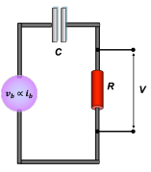
Beam position monitor, BPM
I_{image}(t)
E
I_{beam}(t)
Beam
Non-destructive diagnostics device
Enable real time beam position measurement
  +) Time of flight, phase, etc.
<Equivalent circuit>

Slide 4
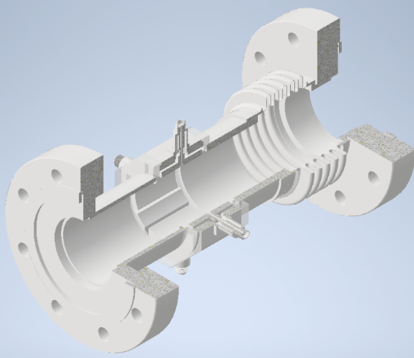
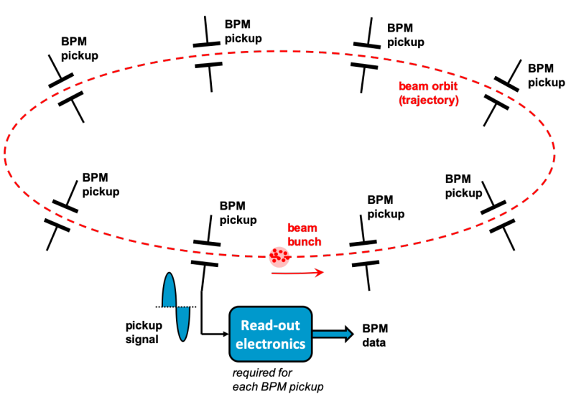
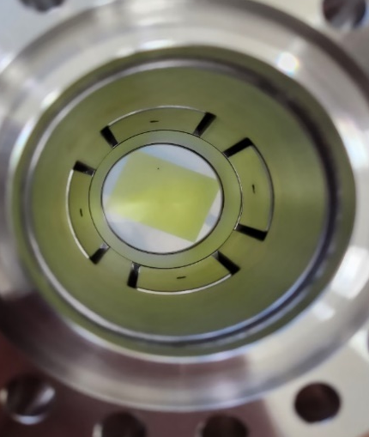
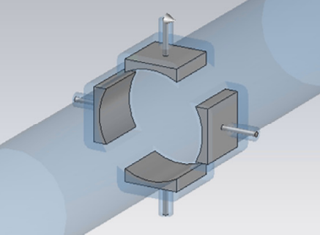
Beam position monitor, BPM
Four electrodes
③ Estimation of beam position
① Measurement
② Signal processing

Slide 5
BPM signal processing procedure
Top
Analog
Front-end
stage
ADC
Broadband
V_{right,} V_{left}
V_{top}, V_{bottom}
X_{bpm}, Y_{bpm}
Left
Right
Signal strength
definitions
Position
Calculation
definitions
Bottom
Narrowband
BPM
Data selection for calibration
BPM signal & position definition (RAON)
X_{wire} = K*X_{bpm} + offset
Position calibration
BPM offline calibration research

Slide 6
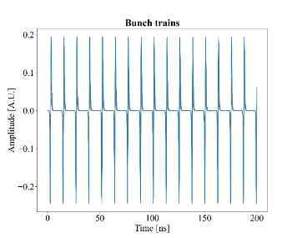
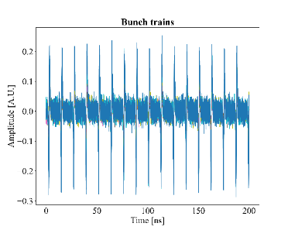
Filtering process
A
Analog
Front-end
stage
ADC
Broadband
X_{bpm}, Y_{bpm}
Data: CST simulation
Signal strength
definitions
Position
Calculation
definitions
Narrowband
V_{right,} V_{left}
V_{top}, V_{bottom}
BPM
Broadband processing
ADC
Full range signal
(No filtering)
Signal strength
definitions
Position
calculation
definitions
Noise 10%
Discussions
Narrowband processing
Broad vs Narrow
Signal definition
Position calculation
  Calibration factor
  Error/Accuracy
ADC
BPF
Signal strength
definitions
Position
Calculation
definitions
1st freq.: 81.3 MHz
2nd freq.: 162.6 MHz
Noise 10%

Slide 7
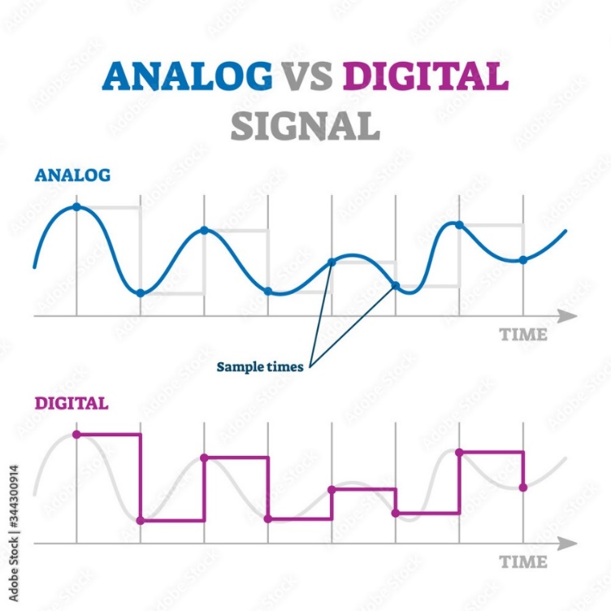
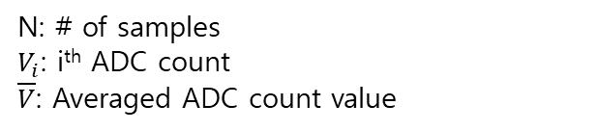
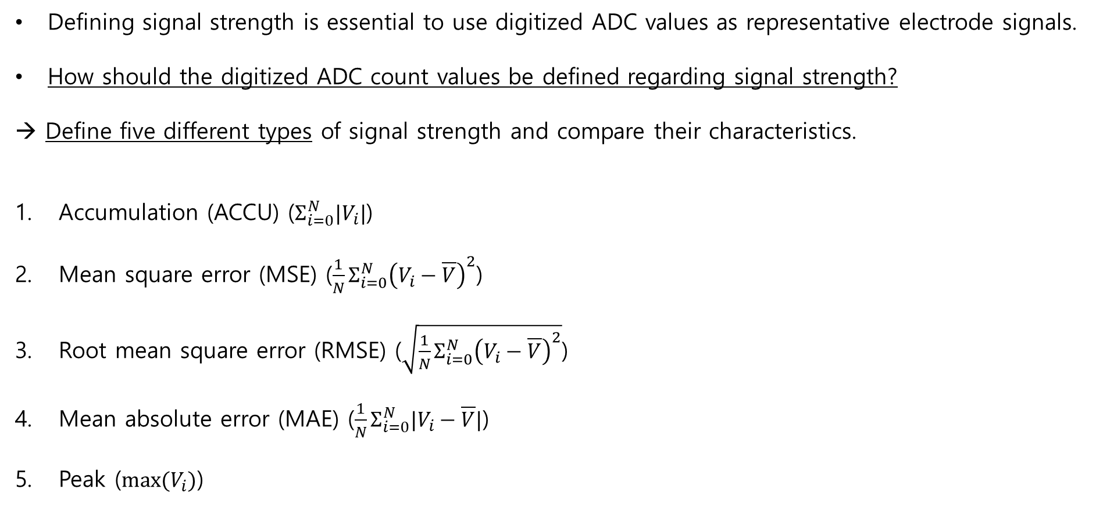
BPM pickup signal strength definitions
Defining signal strength is essential to use digitized ADC values as representative electrode signals.
How should the digitized ADC count values be defined regarding signal strength?
→ Define five different types of signal strength and compare their characteristics.
Accumulation (ACCU) ($Σ_{i=0}^{N}|V_{i}|$)
Mean square error (MSE) ($\frac{1}{N}Σ_{i=0}^{N}{\left(V_{i}−\overline{V}\right)}^{2}$)
Root mean square error (RMSE) ($\sqrt{\frac{1}{N}Σ_{i=0}^{N}{\left(V_{i}−\overline{V}\right)}^{2}}$)
Mean absolute error (MAE) ($\frac{1}{N}Σ_{i=0}^{N}|V_{i}−\overline{V}|$)
Peak ($max⁡(V_{i})$)
N: # of samples
$V_{i}$: i^{th} ADC count
$\overline{V}$: Averaged ADC count value
C
Analog
Front-end
stage
ADC
Broadband
V_{right,} V_{left}
V_{top}, V_{bottom}
Signal strength
definition
Position
Calculation
definition
BPM
A
Narrowband
B
D

Slide 8
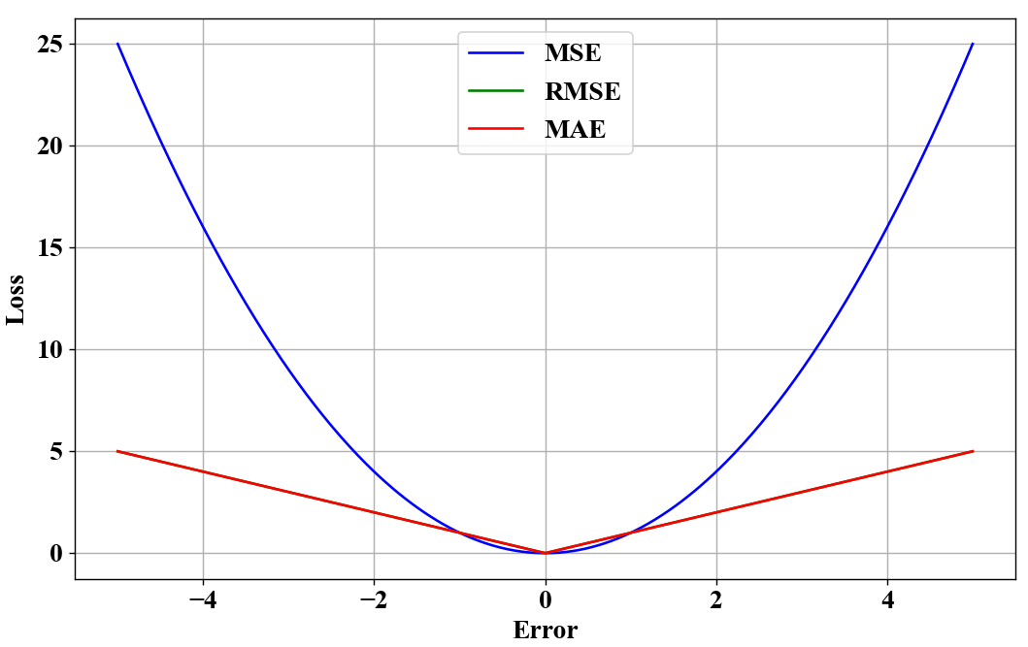
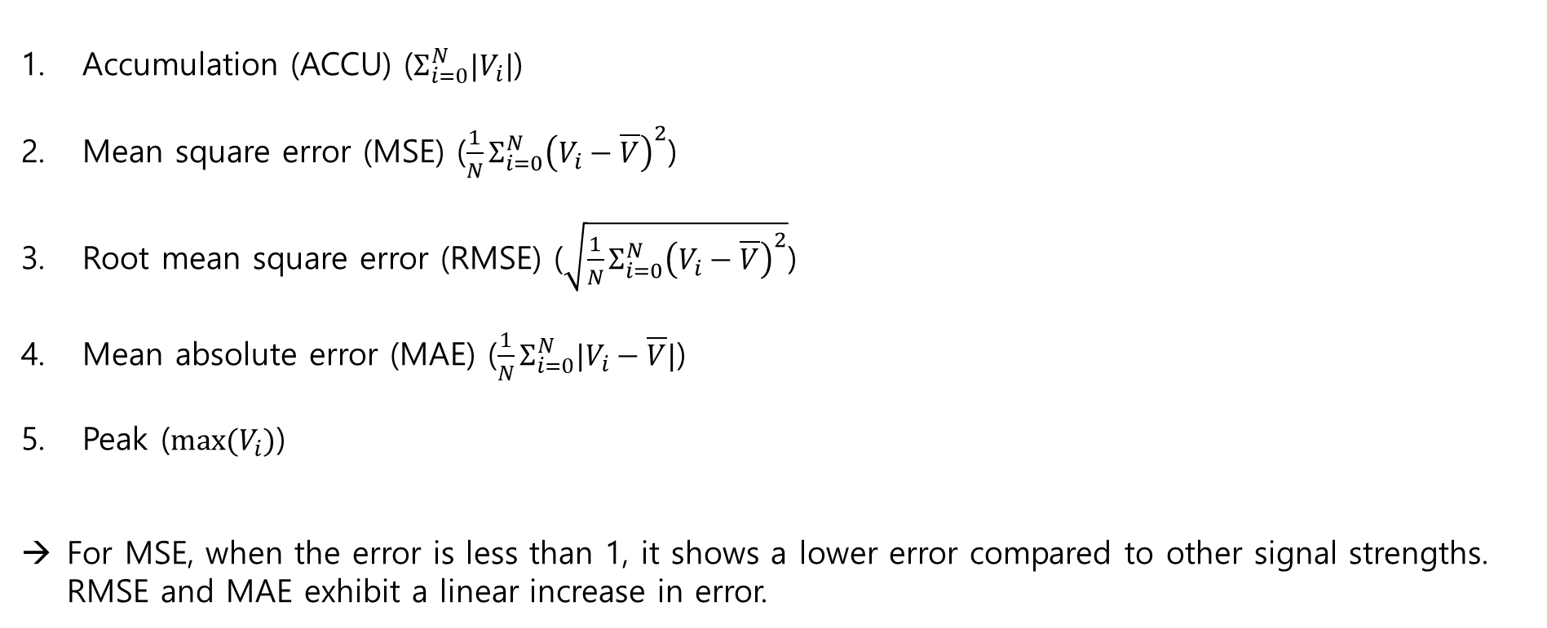
Characteristics of each signal strength definition
Accumulation (ACCU) ($Σ_{i=0}^{N}|V_{i}|$)
Mean square error (MSE) ($\frac{1}{N}Σ_{i=0}^{N}{\left(V_{i}−\overline{V}\right)}^{2}$)
Root mean square error (RMSE) ($\sqrt{\frac{1}{N}Σ_{i=0}^{N}{\left(V_{i}−\overline{V}\right)}^{2}}$)
Mean absolute error (MAE) ($\frac{1}{N}Σ_{i=0}^{N}|V_{i}−\overline{V}|$)
Peak ($max⁡(V_{i})$)
For MSE, when the error is less than 1, it shows a lower error compared to other signal strengths.
RMSE and MAE exhibit a linear increase in error.
|Error| ≤ 1
ADC
Broadband
V_{right,} V_{left}
V_{top}, V_{bottom}
X_{bpm}, Y_{bpm}
Signal strength
definition
Position
Calculation
definition
Narrowband

Slide 9

BPM position calculation definitions
Difference-over-sum (DOS)
  Delta-over-sigma, $x=\frac{V_{right}−V_{left}}{V_{right}+V_{left}}≡\frac{Δ}{Σ}$
  Log, $x=Log\left(V_{right}/V_{left}\right)=Log(V_{right})−Log\left(V_{left}\right)$
  Arctan, $x=arctan(\frac{V_{right}}{V_{left}})$
Position calibration method: linear fitting $y=Kx+δ$ x: a certain DOS value
              K: calibration coefficient
              δ: offset
Signal
Strength
definitions
V_{right}
Position
Calculation
definitions
A
B
V_{left}
Coefficient K ∝ Signal noise
∴ Lower K is better
Signal strength definitions
ACCU
RMSE
MAE
MSE
PEAK
Using 5 types of signal strength and 3 position calculation formulas, compare and analyze the correction coefficient K and error values.
Δ/Σ
Log
Atan
Position calculation fomulas

Slide 10
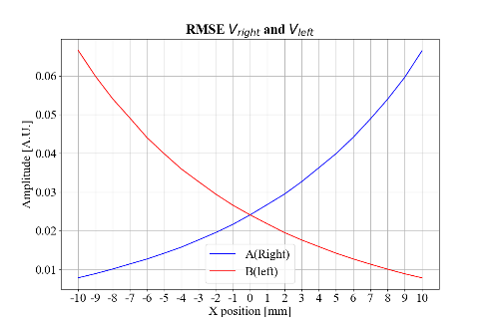
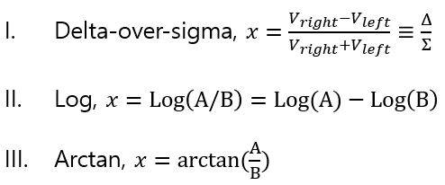
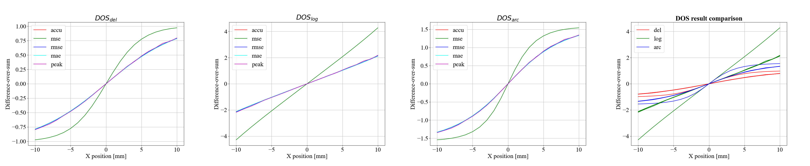
Broadband processing
Difference-over-sum
Calibration range

Slide 11
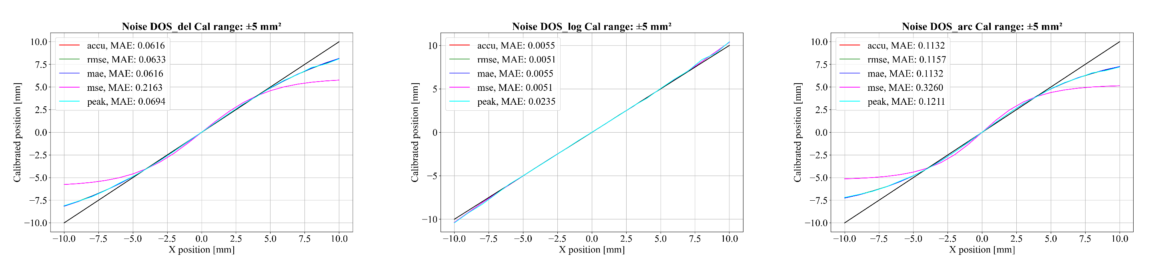
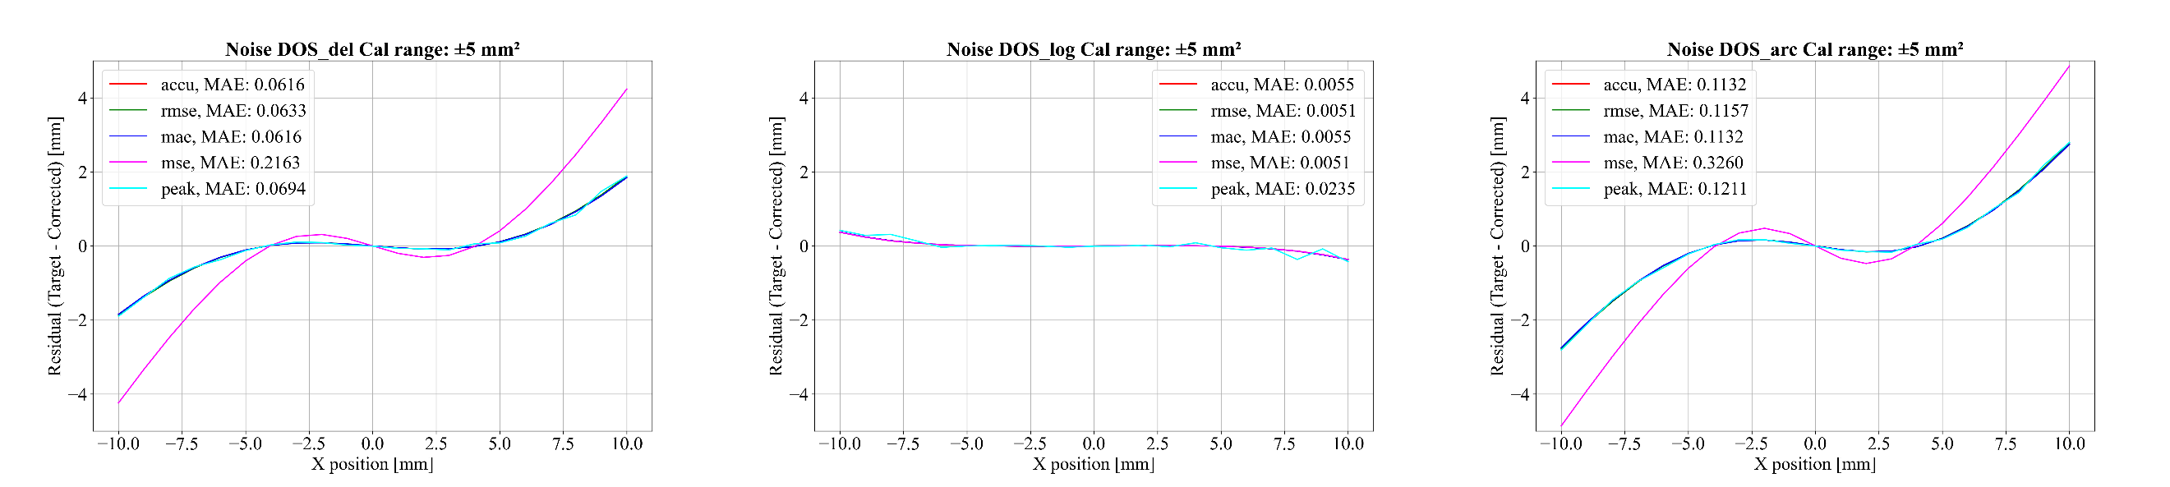
Broadband processing
Linear fitting $y=Kx+δ$ (Calibration range ± 5 mm²)
Y=X graph and calibration results plot
<Residual>
Target - corrected

Slide 12
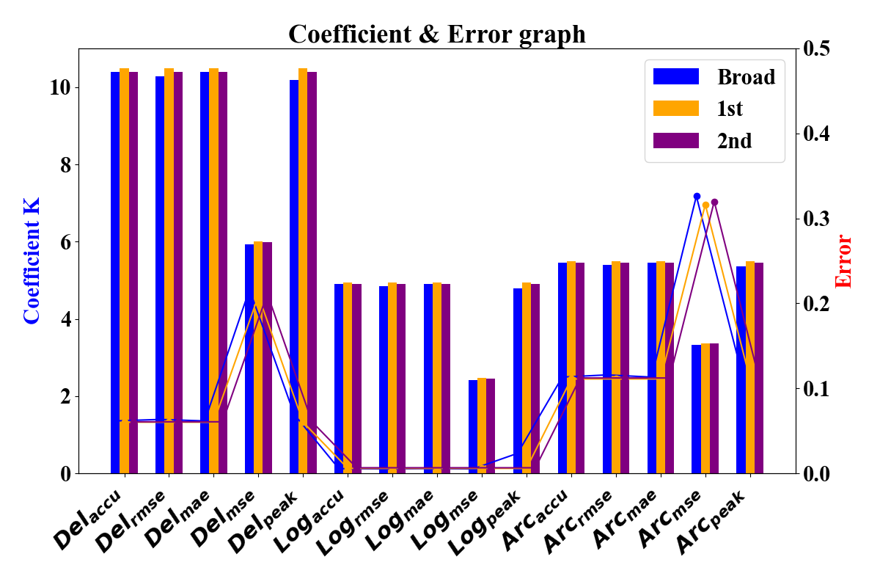
Comparison of 15 different calibration results
Signal strength definitions
ACCU
RMSE
MAE
MSE
PEAK
Δ/Σ
Log
Atan
Position calculation fomulas
Data selection for calibration
ADC
Broadband
Axis data was selected
Signal strength
definition
Position
Calculation
definition
Position calibration
Narrowband
Broad vs Narrow: With simulation + noise data, there is no significant impact on the calibration coefficients and errors between them.
Signal strength: Unless defined as in the case of MSE, similar results are observed.
Position calculation: It has been confirmed that it primarily influences the calibration coefficients and errors.
Log_{MSE} is the most suitable for position correction among the 15 methods.

Slide 13
BPM signal processing procedure
Top
Analog
Front-end
stage
ADC
Broadband
V_{right,} V_{left}
V_{top}, V_{bottom}
X_{bpm}, Y_{bpm}
Left
Right
Signal strength
definitions
Position
Calculation
definitions
Bottom
Narrowband
BPM
Data selection for calibration
BPM signal & position definition (RAON)
X_{wire} = K*X_{bpm} + offset
Position calibration
BPM offline calibration research

Slide 14
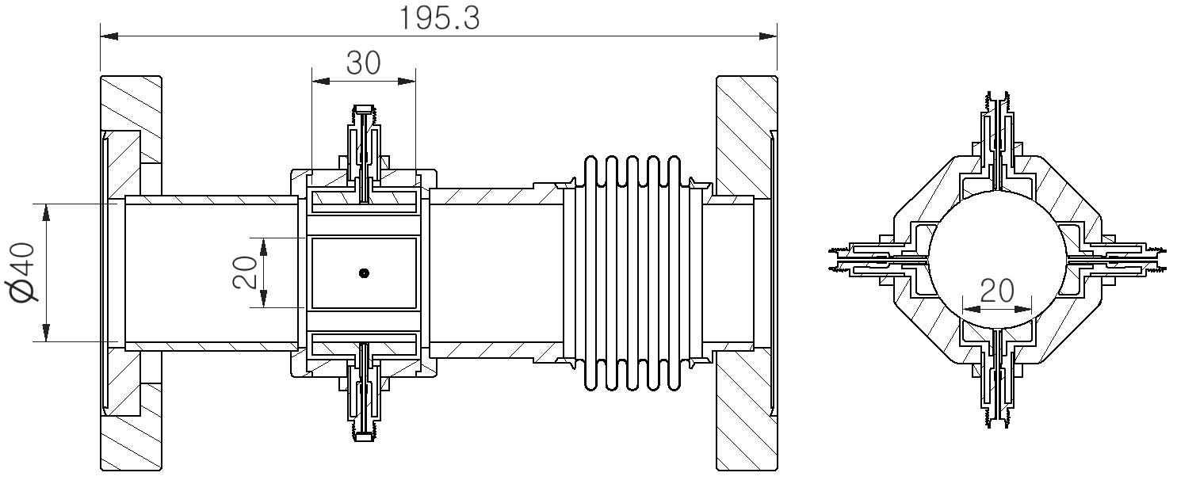
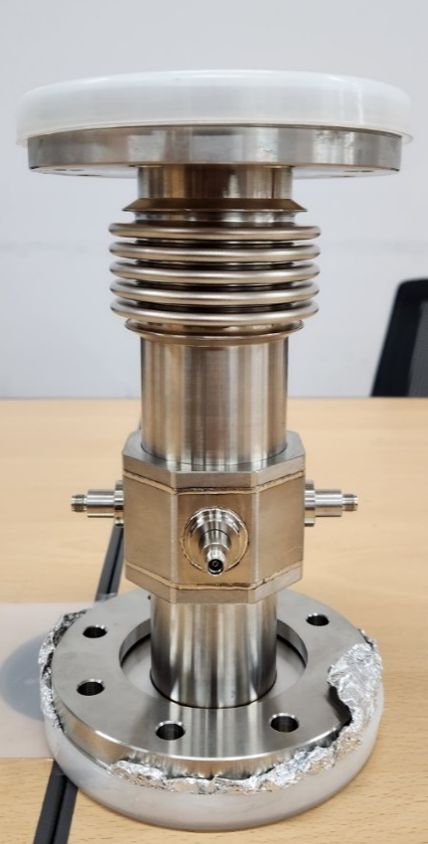
Used BPM for offline calibration
Rectangular shape electrode (similar with stripline BPM, but not stripline BPM)
The BPM was designed as part of a plan to measure various particles.
  200 keV/u, 65 MHz
  1.5 MeV/u, 200 MHz
  10 MeV/u, 352 MHz
→ In research, we performed a BPM offline calibration targeting 10 MeV/u, 352 MHz.

Slide 15
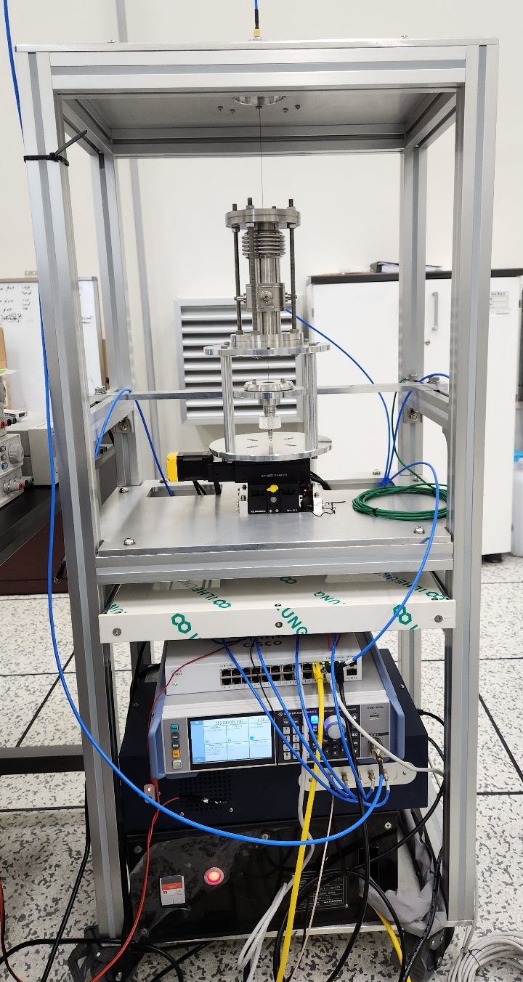
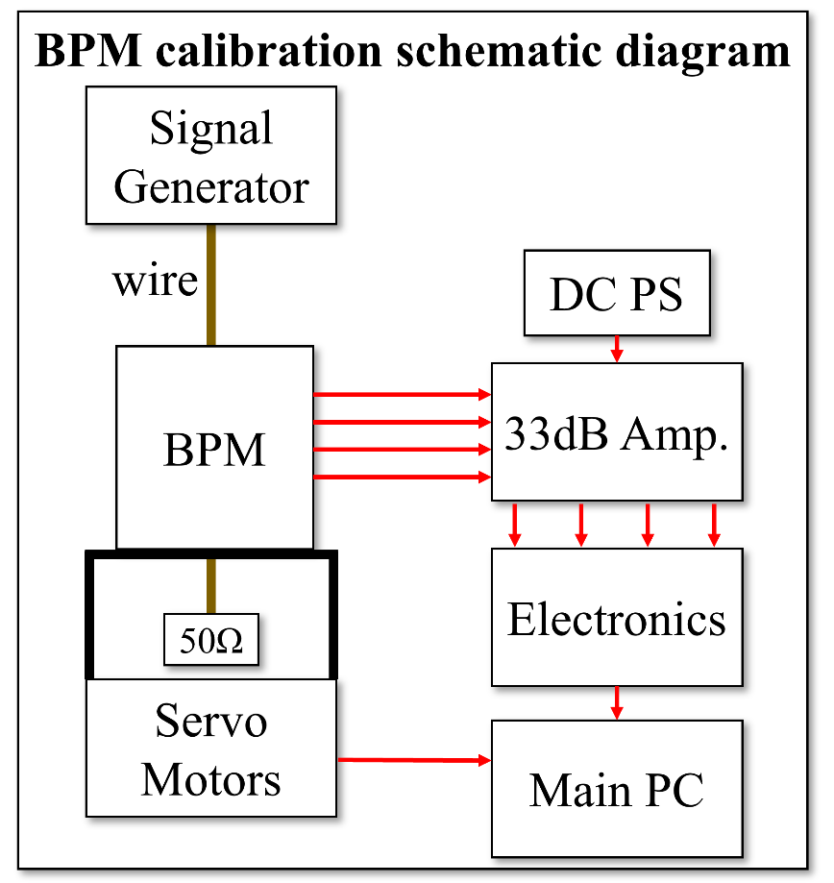
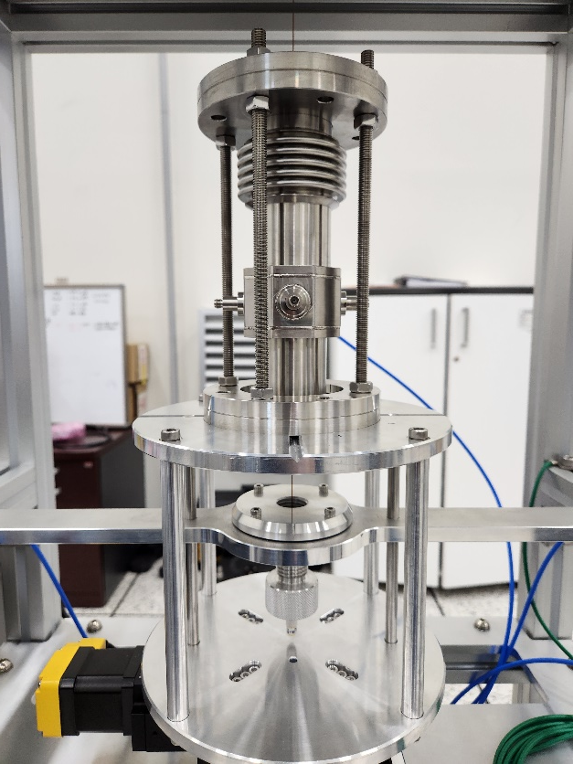
BPM offline calibration
Does not use actual beam signals for calibration
Utilizes RF signals applied to wire to simulate the beam.
The BPM is calibrated using this simulated beam method.

Slide 16
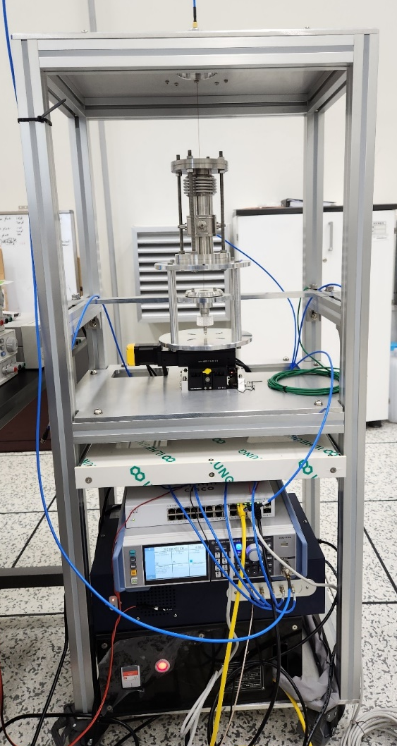
Why need a BPM test bench?
Data selection for calibration
Use of multiple BPMs
Custom-developed BPM for their specific needs
Manufacturing tolerances
Offset Identification.
Ensuring proper calibration characteristics (calibration coefficient, etc.).
X_{wire} = K*X_{bpm} + offset
Position calibration

Slide 17
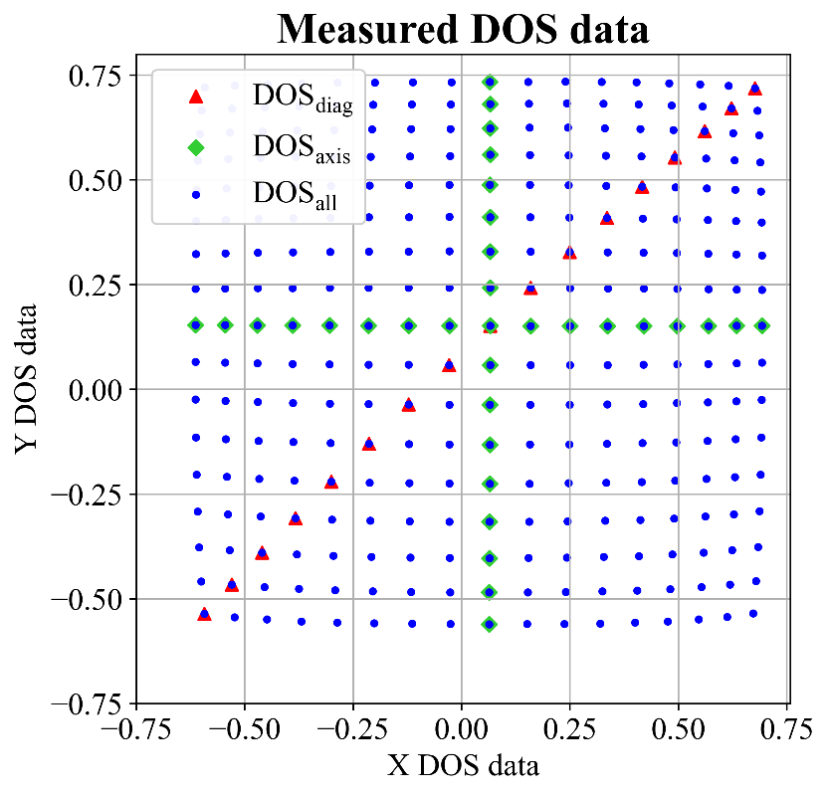
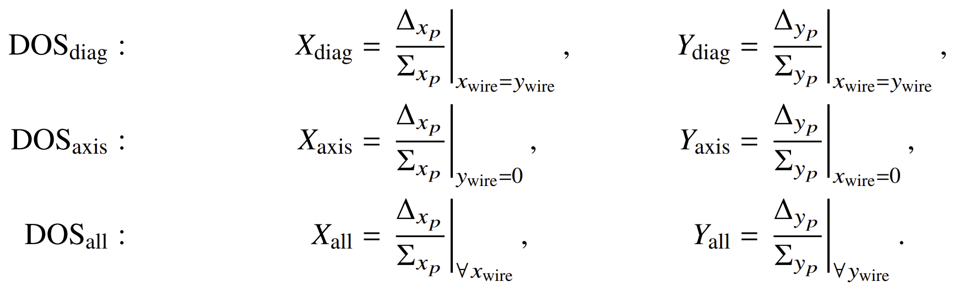

BPM offline calibration procedure
Data selection for calibration
Difference-over-sum (DOS)
  Delta-over-sigma, $x=\frac{V_{right}−V_{left}}{V_{right}+V_{left}}≡\frac{Δ}{Σ}$
  Log, $x=Log\left(V_{right}/V_{left}\right)=Log(V_{right})−Log\left(V_{left}\right)$
  Arctan, $x=arctan(\frac{V_{right}}{V_{left}})$
X_{wire} = K*X_{bpm} + offset
Position calibration

Slide 18
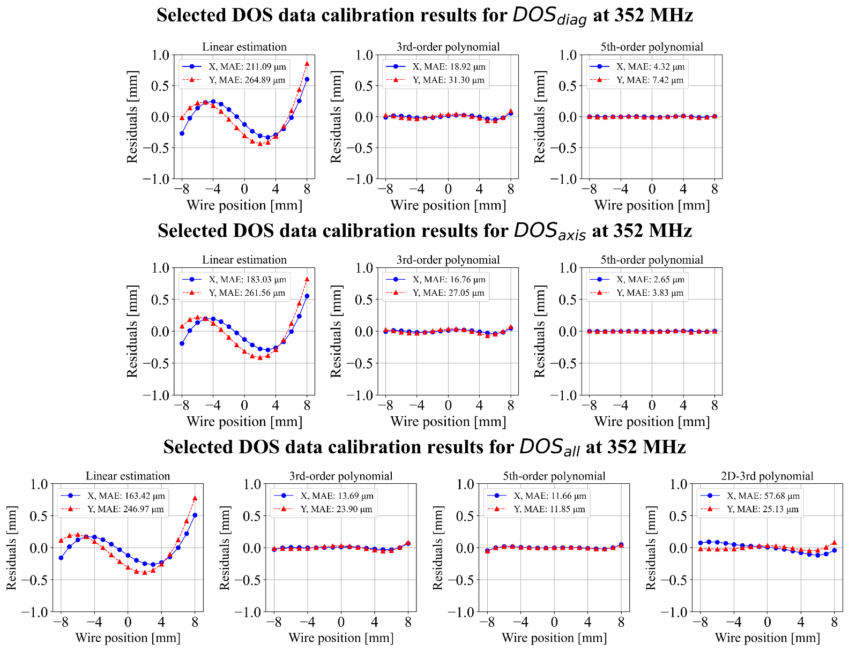

BPM offline calibration results
Calibration using selected DOS data on the ±(8,8) mm² range
  1, 3, 5th, and 2D-3rd polynomial fit correction
  1D polynomial: $\sum_{i=0}^{n}{K_{i}X_{0}^{i}+δ_{x}}$
  2D polynomial: $\sum_{j,k=0}^{m}{K_{jk}X_{0}^{j}Y_{0}^{k}+δ_{x}}$

Slide 19
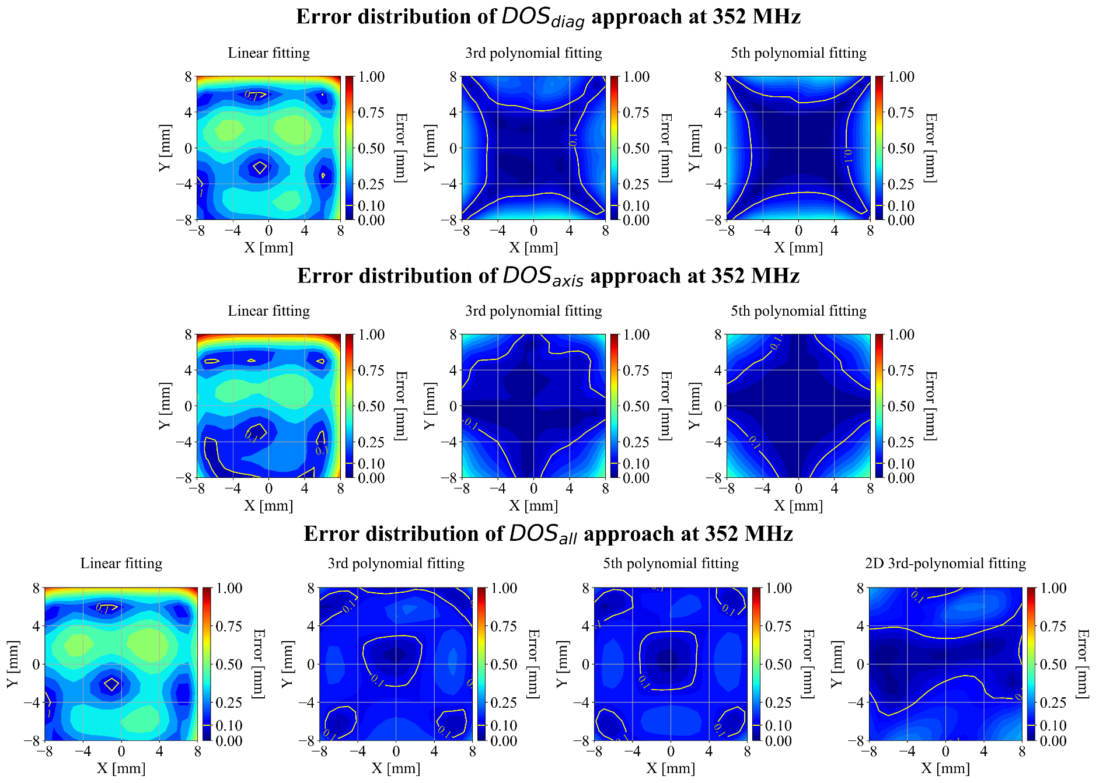
BPM offline calibration results
2D colormap

Slide 20
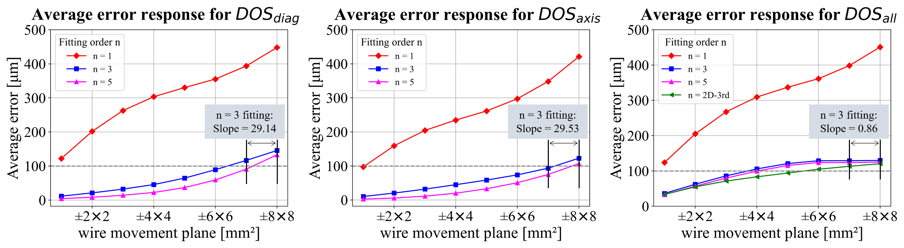
BPM offline calibration results
3rd fit correction ≤ 100 μm accuracy
DOS_{equal}: ~ ±(6,6) mm²
DOS_{axis} : ~ ±(7,7) mm²
DOS_{all} : ~ ±(3,3) mm²
2D-3rd: ±(5,5) mm²
3rd fit correction @ ±(8,8) mm², 100K samples
X STD ≤ 10 μm
Y STD < 35 μm
Whole range ≤ 100 μm STD

Slide 21
Contents
Beam position monitor (BPM) research
  BPM signal & position definition (RAON)
  BPM offline calibration
RF deflecting cavity simulation (CST)

Slide 22
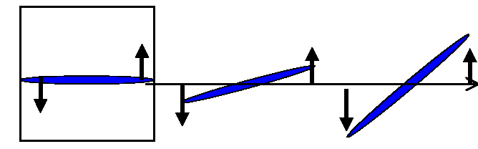
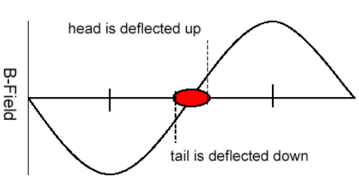
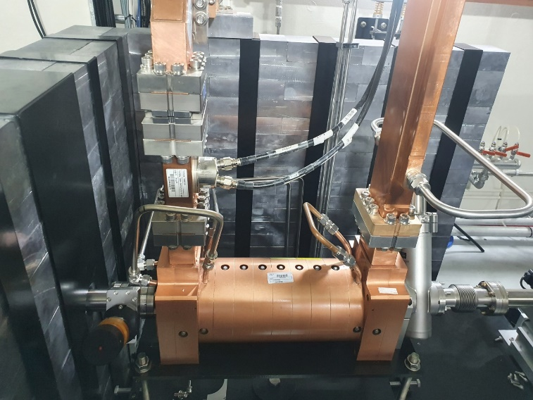
RF deflecting cavity simulation (CST)
RF
deflecting
cavity
Beam
eV_{t}
E₀
x’
E₀
Drift space
Temporal beam diagnostics for e-labs
Measurement of the longitudinal bunch length of the electron beam.
E-labs deflector

Slide 23
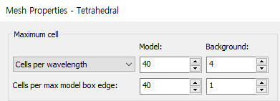
RF deflecting cavity simulation (CST)
Eigenmode solver: frequency mismatching → solved
Frequency solver: S11, S21 curve mismatchings → still progressing
Common: change mesh properties (model mesh 24 → 40)

Slide 24
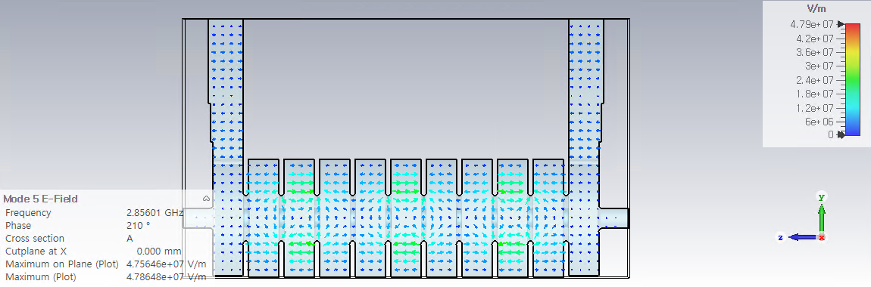
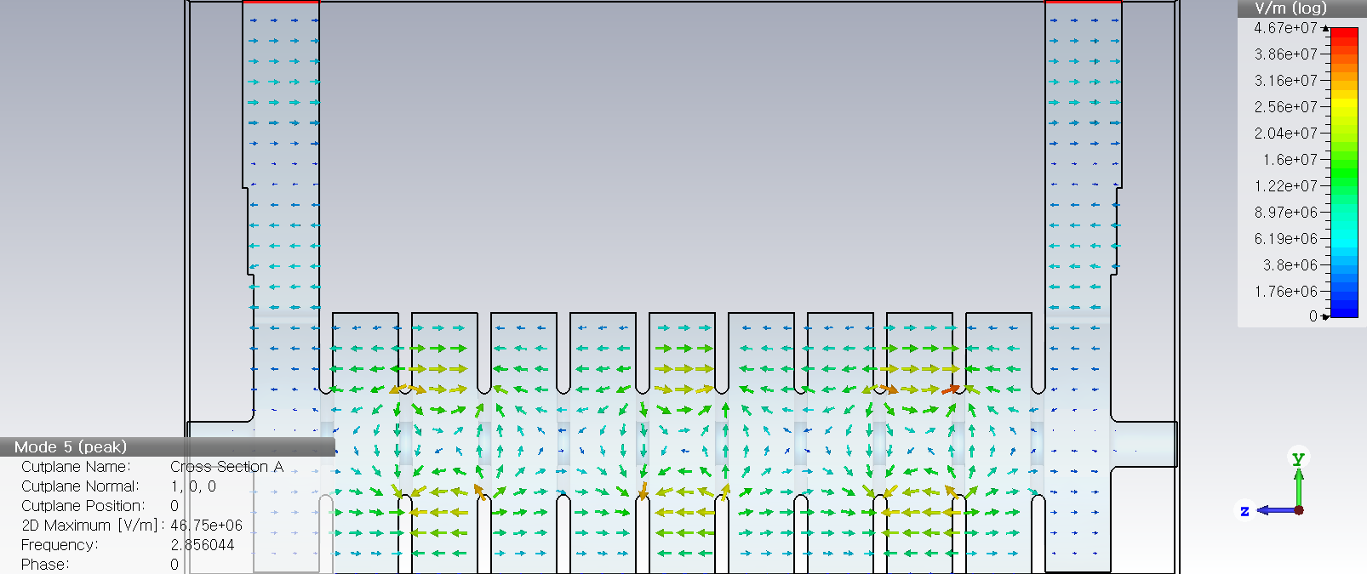
Eigenmode solver: frequency mismatching
<Simulation>
<Reference>
 | Previous sim. | Current sim. | Reference
Frequency [GHz] | 2.86519 | 2.85601 | 2.85604
Phase [deg] | 0 | 210 | 210
Max E(Plane) [V/m] | 4.45e7 | 4.76e7 | 4.67e7
Mesh parameters | 20 | 40 | ?? (maybe auto)
∴ Mesh was not enough to measure freq. properly.

Slide 25
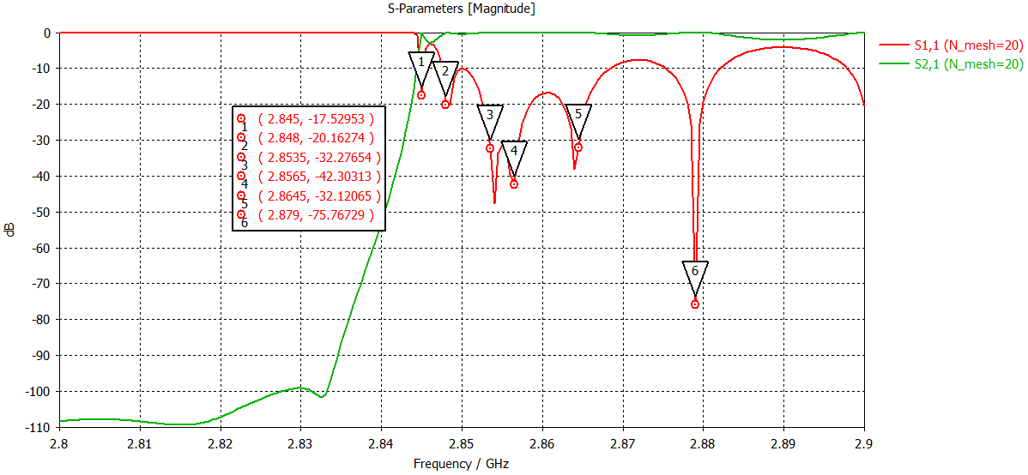
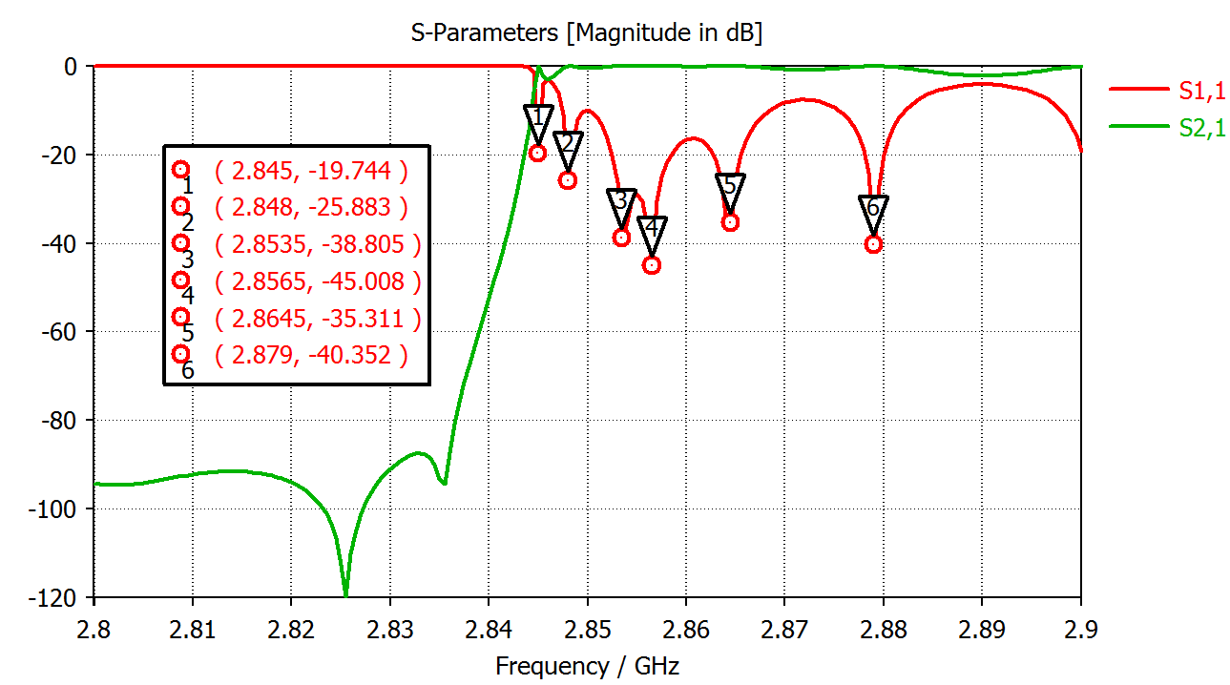
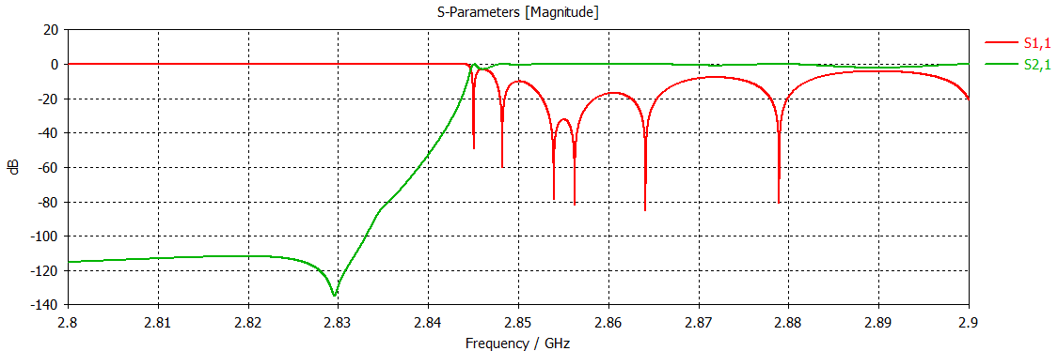
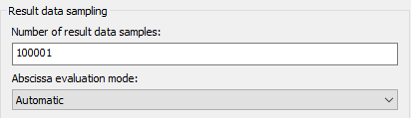
frequencymode solver
<Previous sim.>
<Reference>
<Current sim.>
Change the # of data samples (1,001 → 100,001)
Need more mesh values?

Slide 26
Next plans
Environment setting at POSTECH (CST server, PC, …)
CST simulation
  Change Mesh properties (matching results of freq & time solver)
  RF deflecting cavity theory study w/ formulas

