Slide 1


Research plan for graduation:
Design and experimental validation of hard X-ray ionization profile monitor for Korea-4GSR
Aug. 7. 2024
Woojin Song

Slide 2
Contents
Previous Research
Ionization Profile Monitor
Research Plan
Summary

Slide 3
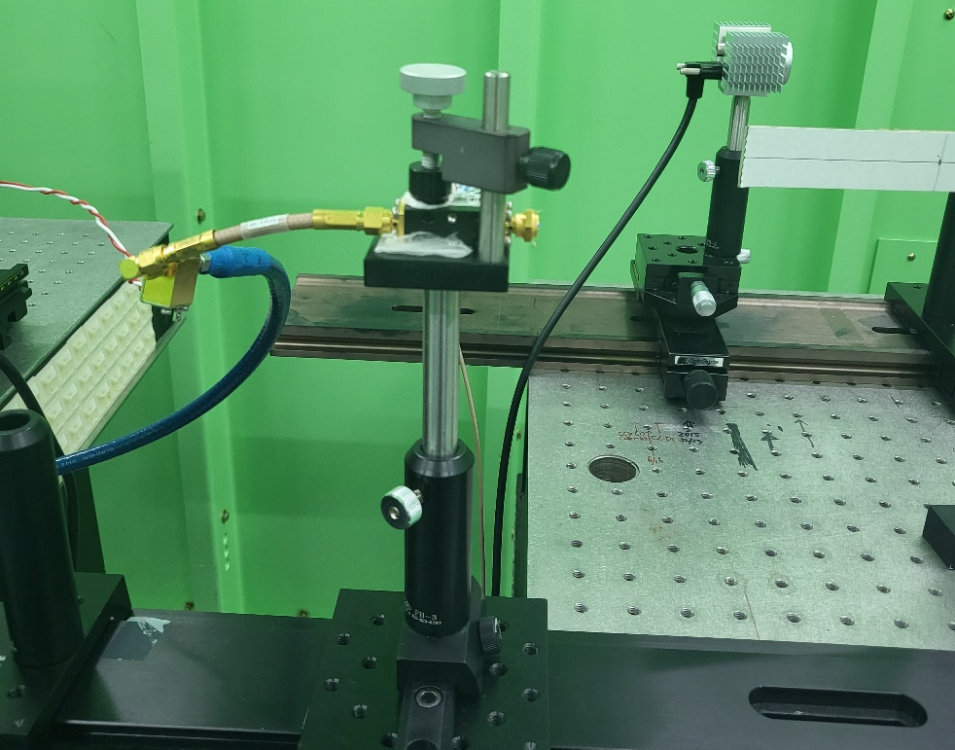
Online bunch length monitor using a fast photodiode
Previous Research
Sync. Radiation
20 ps RMS bunch length
470 buckets
Amp
MSM Photodiode
+ Bias Tee
2 ns
Camshaft
Bunch
Cable
Bunch Train,
330 bunches total
Bunch Length
Bunch Length + Fill-Pattern
Fill-Pattern
Streak Camera
High temporal resolution
(< RMS 1 ps)
Slow acquisition rate
Incompatible for turn-by-turn
measurements
Fast Photodiode
Intermediate resolution (~2 ps)
Bunch length and fill-pattern
real time measurement
BPM pick-up / FCT
Fill-pattern monitoring
Limited bandwidth
Moderate accuracy
Non-linear behavior causes
intolerable error
G. Hahn, W. Song et al,. IEEE Transactions on Instrumentation Measurement 73 (2024): 3334346

Slide 4
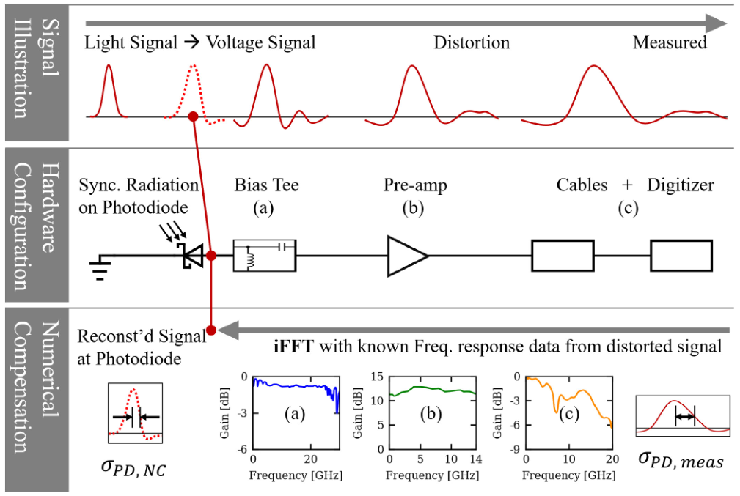
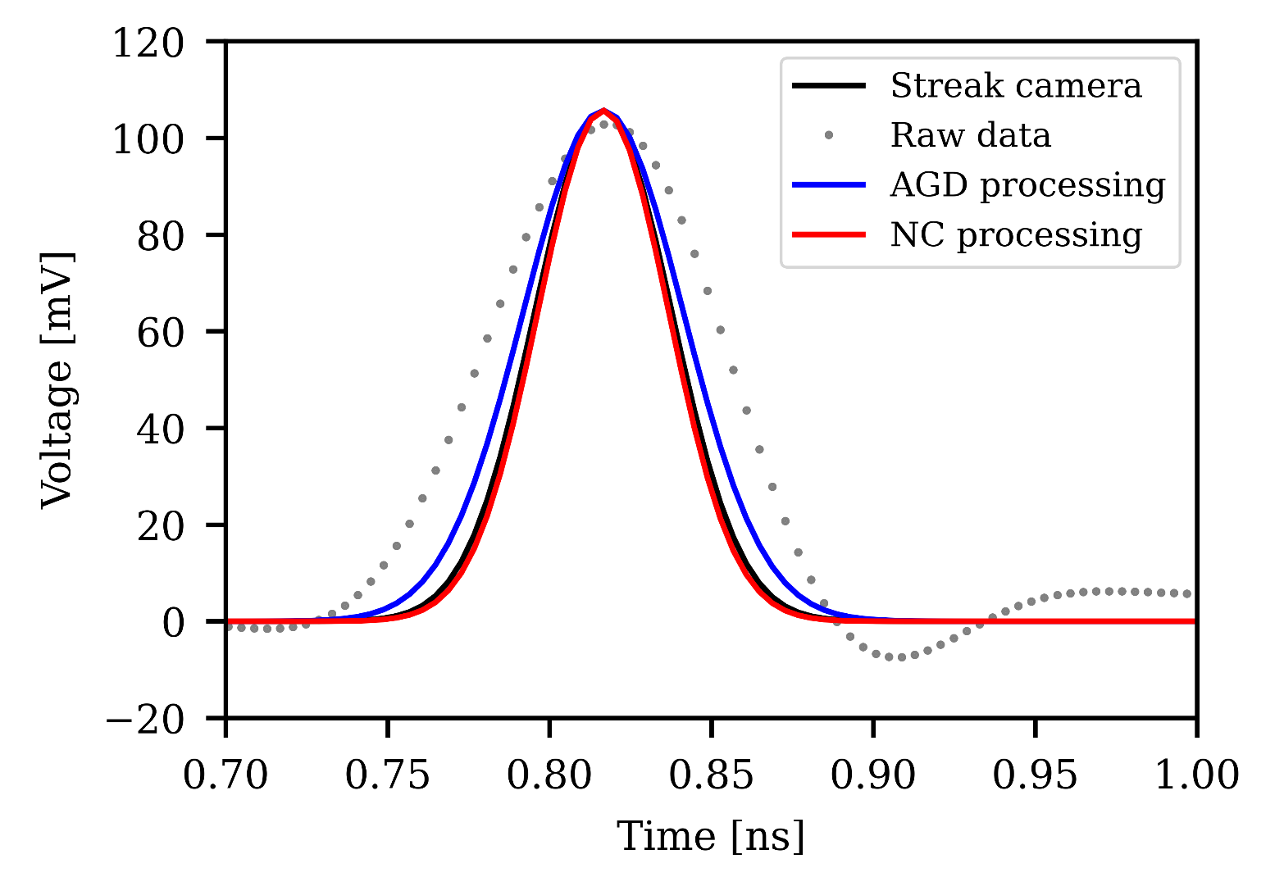
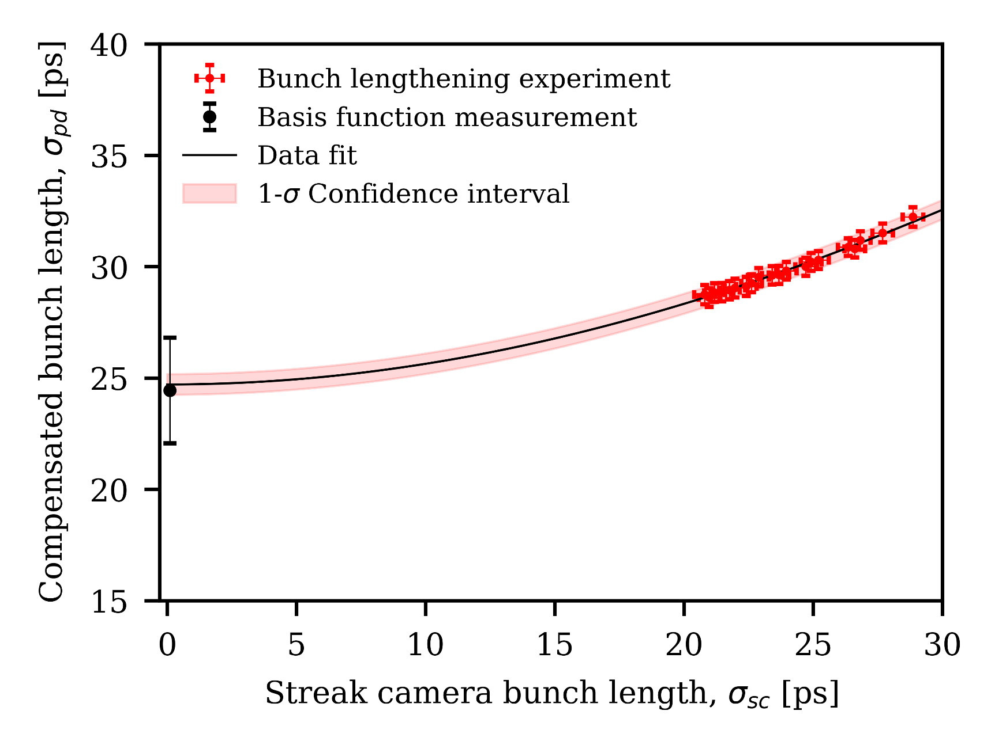

Online bunch length monitor using a fast photodiode
Previous Research
Experimentally demonstrated a compact monitor that enables
filling pattern and bunch length monitoring using VL at the PLS-II.
Numerical compensation method to restore the original signal was shown.
→ Achieved better resolution (bunch length ~ 1.2 ps, current ~ 9 μA) then conventional method
G. Hahn, W. Song et al,. IEEE Transactions on Instrumentation Measurement 73 (2024): 3334346

Slide 5
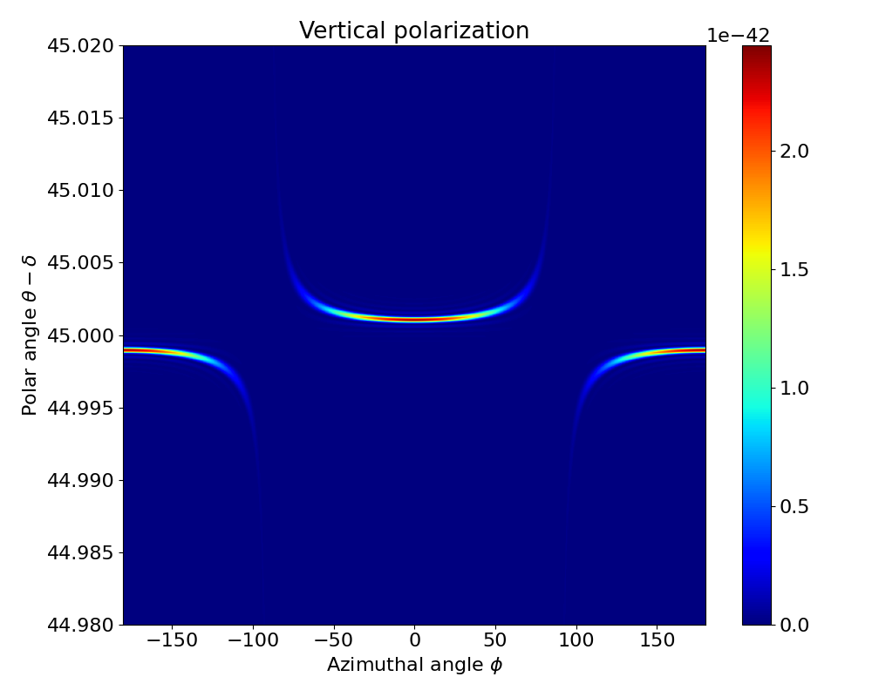
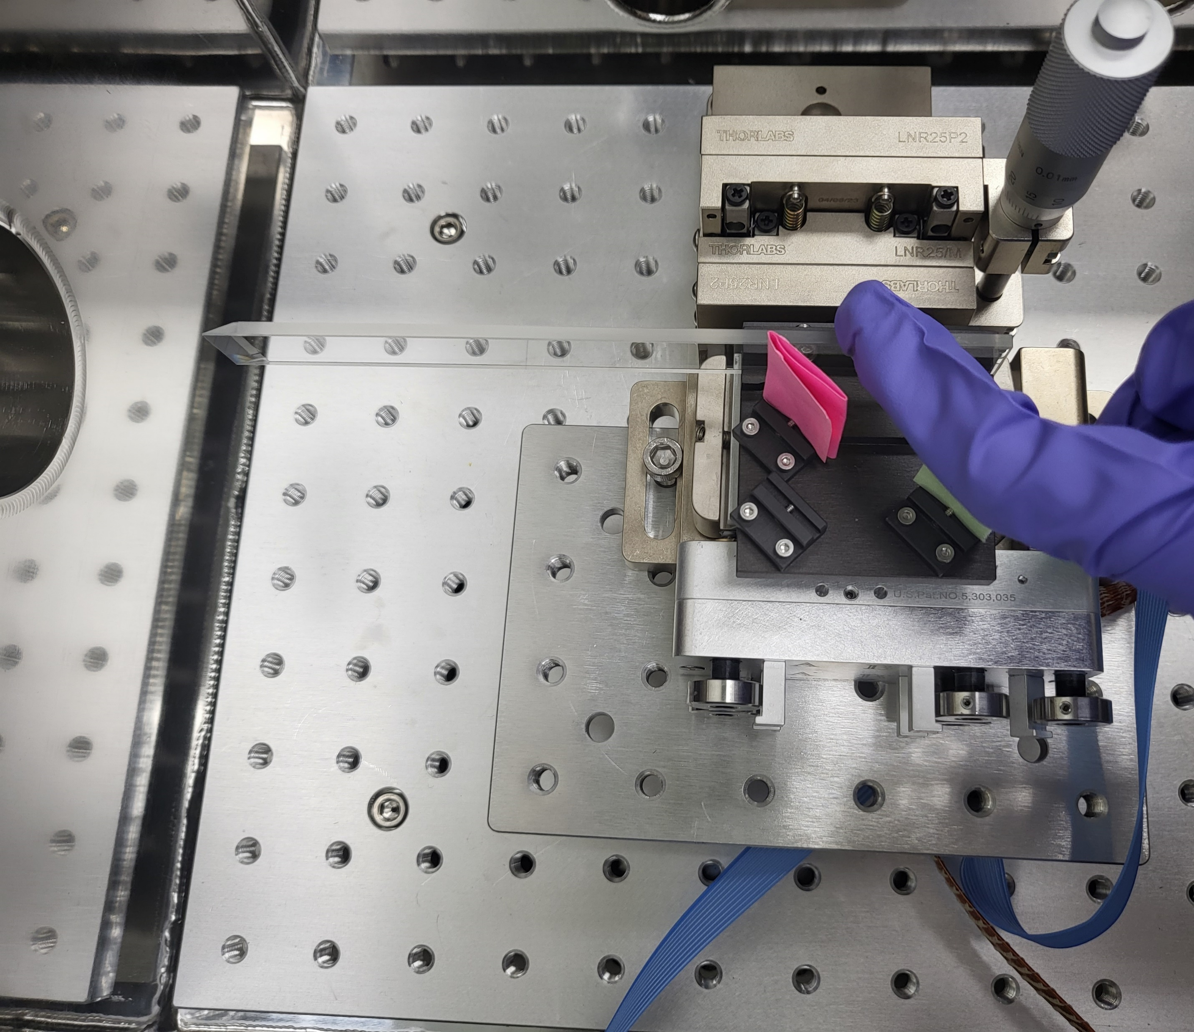


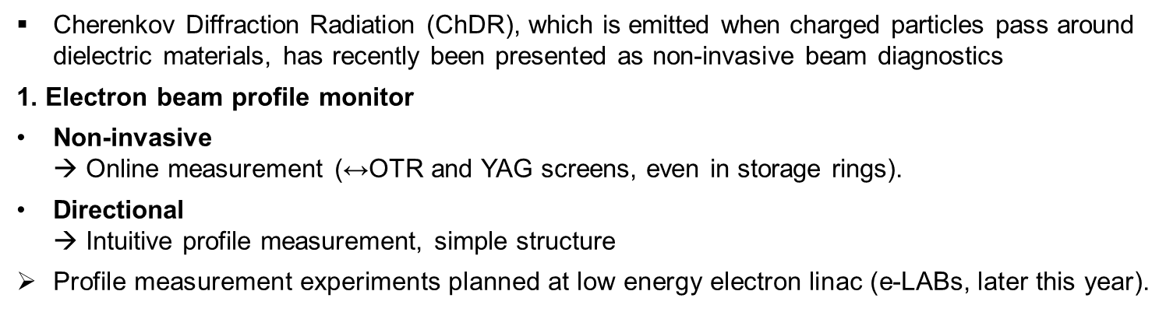
Cherenkov diffraction radiation (ChDR) based beam diagnostics
Previous Research
Cherenkov Diffraction Radiation (ChDR), which is emitted when charged particles pass around dielectric materials, has recently been presented as non-invasive beam diagnostics
1. Electron beam profile monitor
Non-invasive
→ Online measurement ($\text{↔}$OTR and YAG screens, even in storage rings).
Directional
→ Intuitive profile measurement, simple structure
Profile measurement experiments planned at low energy electron linac (e-LABs, later this year).
ChDR
E = 100 MeV, λ = 600 nm, h = 1 mm
$$ϕ$$
e-
Radiator
$$θ$$
Charged particle
ChDR
W. Song et al,. Proc. IPAC’23

Slide 6
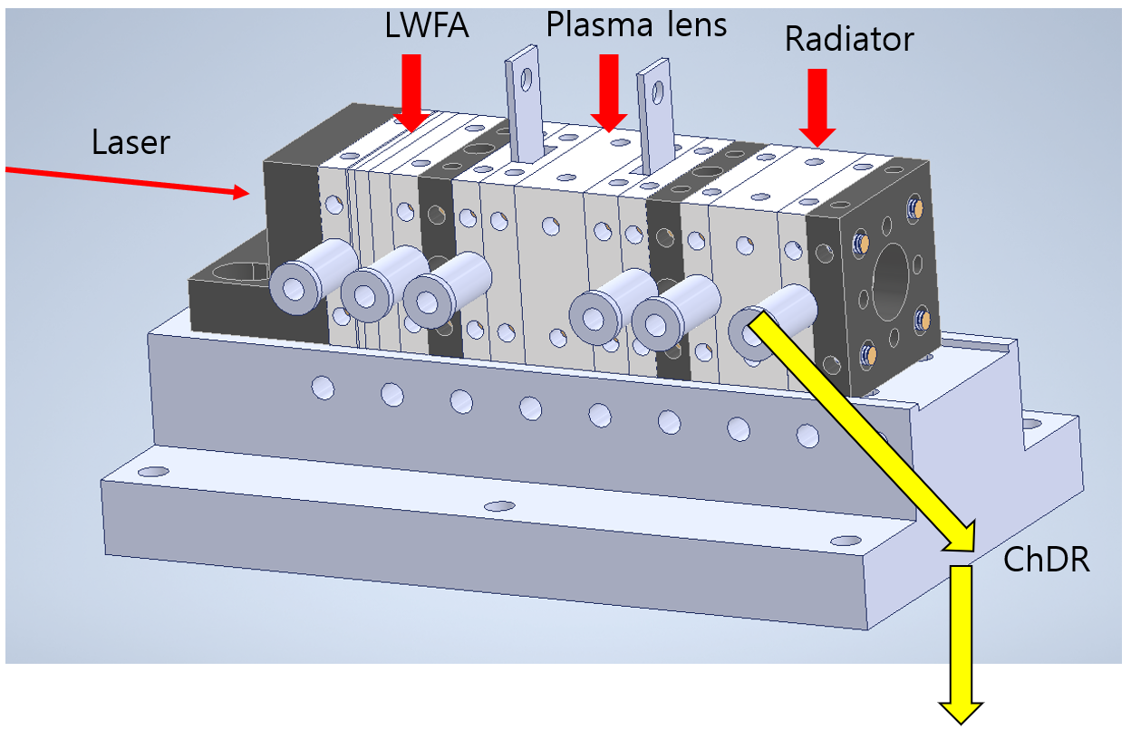
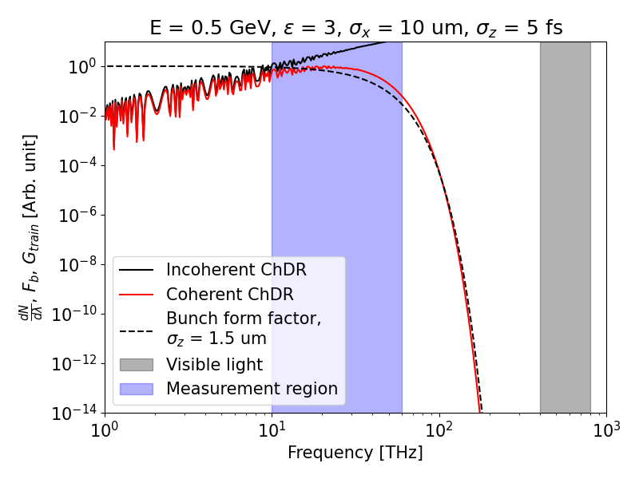
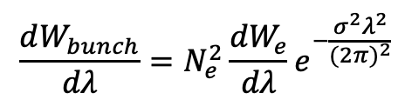
Cherenkov diffraction radiation (ChDR) based beam diagnostics
Previous Research
2. Sub-picosecond bunch length measurement
Broad spectrum, High intensity (↔ Coherent Transition Radiation)
→ Non-invasive bunch length measurement using coherent ChDR spectrum
An experiment to measure electron length after acceleration in
a laser wakefield accelerator is planned.
(LWFA experiment using IBS 150 TW Laser)
What we already know
(Incoh. or Single particle ChDR)
$$\frac{dW_{bunch}}{dλ}=N_{e}^{2}\frac{dW_{e}}{dλ}e^{−\frac{σ^{2}λ^{2}}{{(2π)}^{2}}}$$
What we meas.
(Coh. ChDR)
What we want know
(Bunch length)
Spectrometer

Slide 7
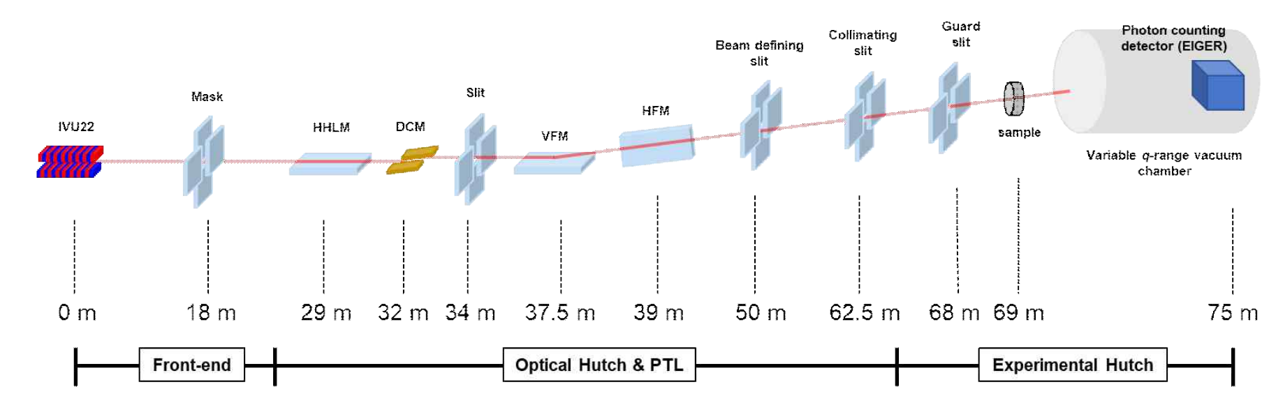
Photon Beam Diagnostics (1/3)
Previous Research
Ionization Profile Monitor
ID beamline main component layout
HHLM: High heat load mirror,
DCM: Double crystal
monochromator,
V/HFM: Vertical/Horizontal
focusing mirror
In the beamline, the photon beam is delivered through various optics to the experimental end station.
The arrival position of the photon beam changes due to variations in the source position, drift (thermal, mechanical) of the optics, and vibration.
Therefore, a photon beam diagnostic is used to provide beam position and profile information for alignment to the beamline users.
4GSR Technical design report – BioPharma-BioSAXS beamline layout

Slide 8
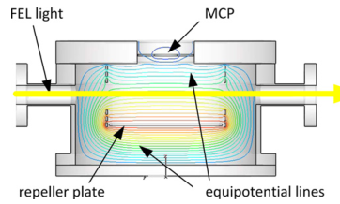
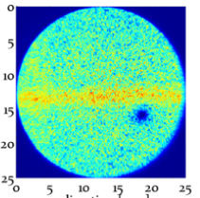
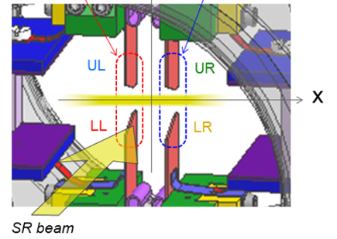
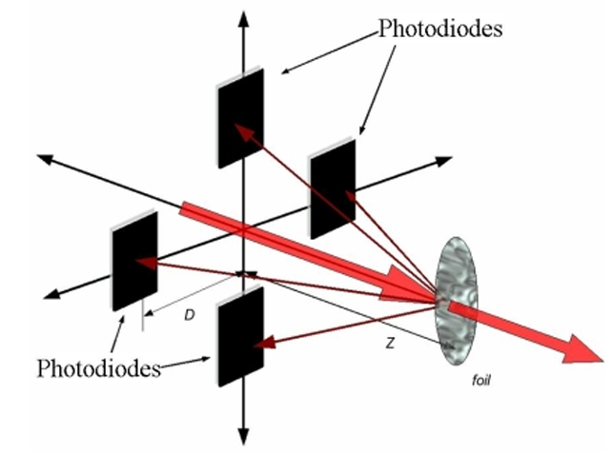
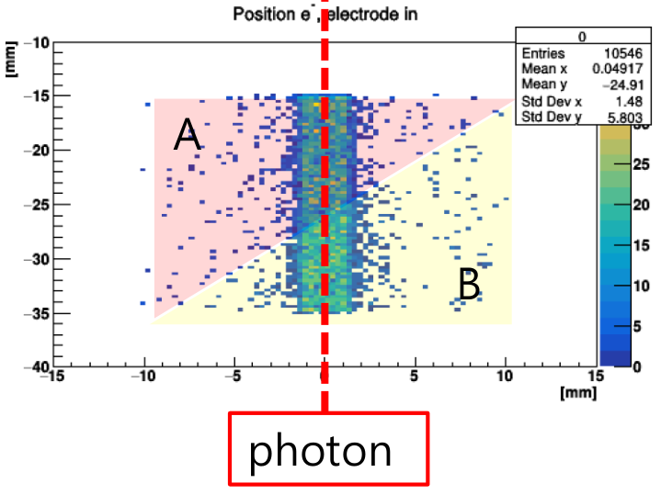
Photon Beam Diagnostics (2/3)
Previous Research
Ionization Profile Monitor
Gas
Photon beam diagnostic target and method
Position monitoring
  - Non-destructive : Gas type (MCP-screen, Wedge blades)
  - Semi-destructive : 4-blade type, Quadrant type
Profile monitoring
  - Non-destructive : Gas type (MCP-screen)
  - Destructive : YAG:Ce screen
J. Miebner, NIMA
MCP-screen
(Optical readout)
The position and profile of the photon beam can be
measured non-destructively using a gas-filled chamber.
P. Ilinski
Blades
Quadrant
Wedge blades
(Electrical readout)
H. Aoyagi, PRAB
S.R. Marques, EPAC08

Slide 9
Photon Beam Diagnostics(3/3)
Previous Research
Ionization Profile Monitor
Photon beam contamination
  At the ID beamline, undulator beam is contaminated with up/down-stream bending magnet radiation, correctors, and sextuple and quadrupole with offset trajectory.*
  This contamination can cause errors in the position measurement of blade-type PBPM that signal the edge of the ID beam.
BM beam
ID beam
BM beam
Blade
Bending
Magnet
BM Beamline
ID Beamline
Insertion
Device
*G. Decker, Proceedings of PAC, 1999

Slide 10
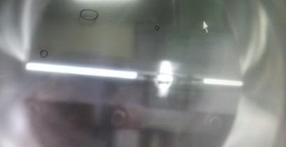
Why the Gas-type Monitor?
Previous Research
Ionization Profile Monitor
Ionization Profile Monitor (IPM) : Visualizes the tack of the photon beam.
  Direct measurement of the beam.
  Remove position measurement errors caused by contamination.
Non-destructive profile measurement by ionizing a small fraction of the beam without blocking the photon beam.
BM beam
ID beam
BM beam
From banding magnet?
J. Kim, ID 3C SAXS Mov. Mask test, 2015

Slide 11
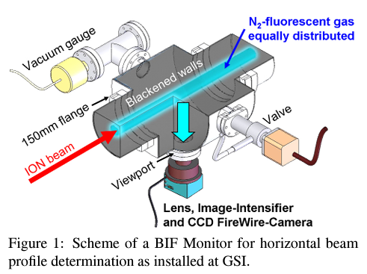
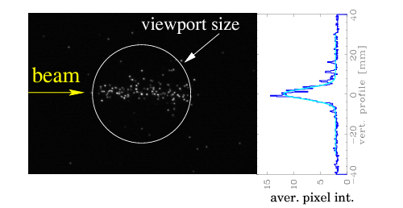
Beam Induced Fluorescence Monitor
Previous Research
Ionization Profile Monitor
Beam Induced Fluorescence monitor (BIF)
- Measure the profile of an ion beam in a synchrotron.
Direct measurement of fluorescence emitted from gas molecules due to beam-gas interaction.
→ Long integration time required due to weak signal
P. Forck, Proceedings of HB2021

Slide 12
Ionization Profile Monitor (1/2)
Previous Research
Ionization Profile Monitor
1. Photon beam ionizes gas with a photoelectric effect.
→ Ion + Electron pair generation
2. Electrode transports ions to the MCP.
3. The amplified signal produces an image on a phosphor screen.
Reason why not to use electrons*
  Pros: ~8 times higher signal strength
  Cons:
  - Secondary electrons from MCP surface
  → Background noise
  - Higher initial velocity than ions
  → Increased PSF size
Repeller electrode
Photo-electron
X-ray
-
Gas
-
+
+
Photo-ion
E field
MCP
Screen
Readout (Camera)
*J. Krider, Nuclear Instruments and Methods in Physics Research Section A 278.3 (1989): 660-663.

Slide 13
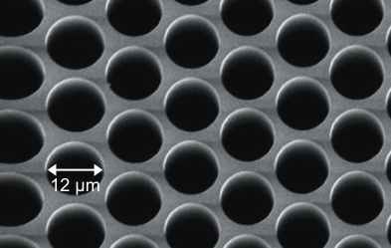
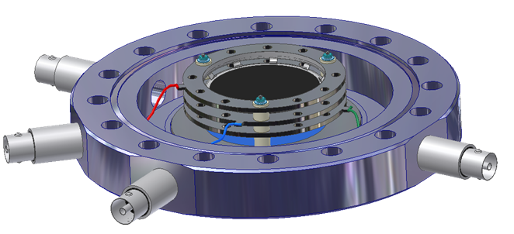
Ionization Profile Monitor (2/2)
Previous Research
Ionization Profile Monitor
Ion hits MCP channel wall and generates secondary electrons.
Electrons are again accelerated by the potential gradient and continue to multiply until they exit the channel.
Output electrons signal amplified more than 10⁴ times in MCP are converted into a visible light on the phosphor screen.
+
+
+
+
+
+
+
+
+
+
+
+
e-
Micro channel plate
Phosphor screen
Visible light
Readout (Camera)
Del Mar Photonics

Slide 14
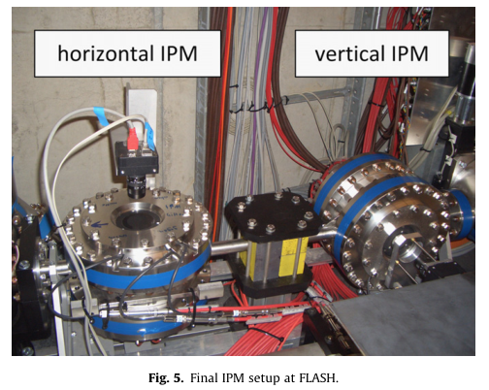
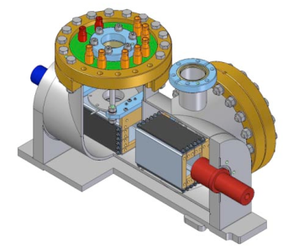
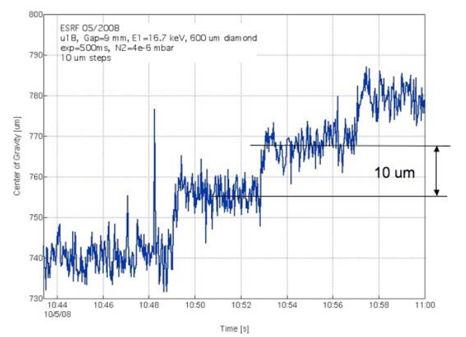
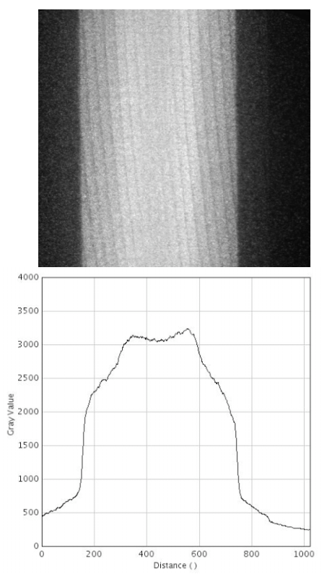
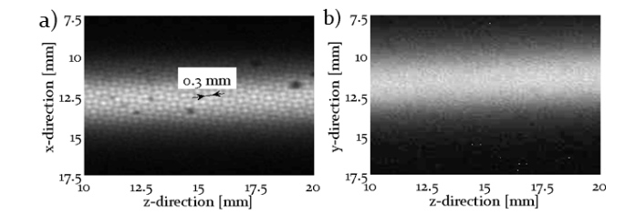
Photon Beam IPM (1/2)
Previous Research
Ionization Profile Monitor
PETRA-III (Tested at ESRF ID beamline)
FLASH
Using IPM for photon beam position measurement in PETRA-III (SR), FLASH (XFEL).
Calibration method and image analysis method for photon beam position and profile measurement is not proposed.
J. Miebner et al., Proceedings of the IPAC11
P. Ilinski, Proceedings of the BIW10

Slide 15
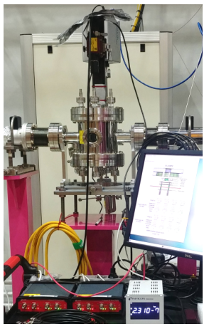
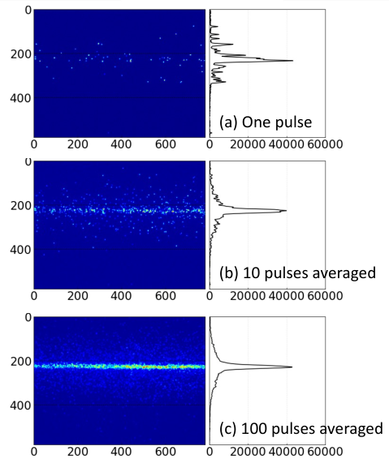
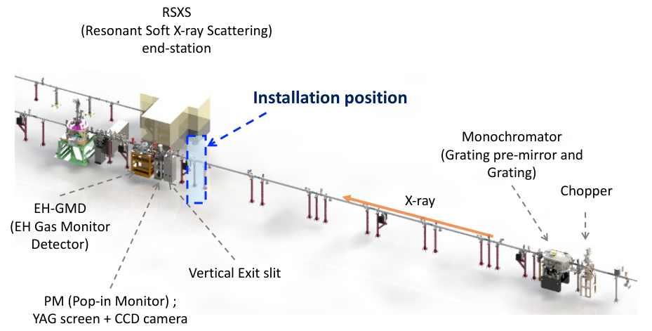
Photon Beam IPM (2/2)
Previous Research
Ionization Profile Monitor
Recently IPM for FEL beam monitoring at the PAL-XFEL soft X-ray beamline has been developed.
Position and beam size monitoring by measuring 500 eV mono/pink beam shot by shot.
Reduction of beam position measurement error by using Kr gas.
→ Likewise, no calibration method is proposed and profile monitoring is difficult due to non-linear electric field distribution.
H. Hyun et al., “X-ray ionization beam position monitor for PAL-XFEL soft X-ray”, 2024

Slide 16
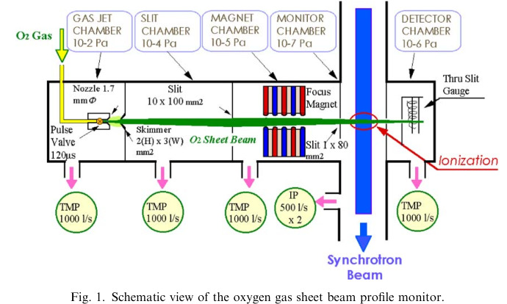
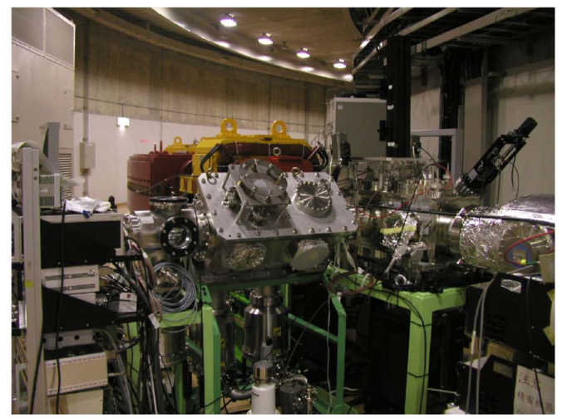
Gas Jet IPM
Previous Research
Ionization Profile Monitor
Most synchrotrons use IPM, including HIMAC, Tevatron, RHIC, LEAR, ISR, SPS, etc.
Gas jet injection to improve reaction rate and resolution.
In the case of HIMAC, high signal intensity reduces the exposure time from 10 ms to 100 ns.
→ However, complex vacuum structures are required to generate a gas jet.
Y. Hashimoto et al., Nuclear Instruments and Methods in Physics Research Section A 527.3 (2004): 289-300.

Slide 17
Summary of IPM
Previous Research
Ionization Profile Monitor
Ionization profile monitor
  The gas in the path of the beam is ionized by the photoelectric effect, and the resulting ions are used for photon beam monitoring.
  Very low density photo-ions are guided by electrodes and amplified in the MCP to measure beam position and profile with optical readout.
Limitations of Existing Methods
  Residual gas photon IPM requires long exposure time (~ 1 sec).
  Install mesh grid in photo-ion path to make field uniform → Mesh blocks ions, reducing signal
  Calibration method not suggested → Limited to profile monitoring
What we propose:
  1. Improve signal intensity in hard X-ray
    Inject gas into the chamber instead of using residual gas
    Increase signal gain by removing mesh grid
  2. Developed a precise profile measurement method
    Install shield plate - minimize non-linear field due to removal of mesh
    Isotropic field design for precise calibration
    Development of calibration method for profile reconstruction

Slide 18
Main Goal
Previous Research
Ionization Profile Monitor
Research Plan
Development of position and profile monitor
for white undulator beam at Korea-4GSR
Research plan
Factors to consider for improving resolution
1. Gas-filled detector
  Photoionization
  Vacuum system design
  Point spread function analysis
2. Electrode design
  Optimization of isotropic field
  1:1 mapping field (defocusing field)
3. Calibration
  Magnification calibration
  Image processing
4. Experimental validation
1. Read-out device resolution
2. Photo-ion broadening
3. Non-linear field (field quality)
4. Data analysis algorithms

Slide 19
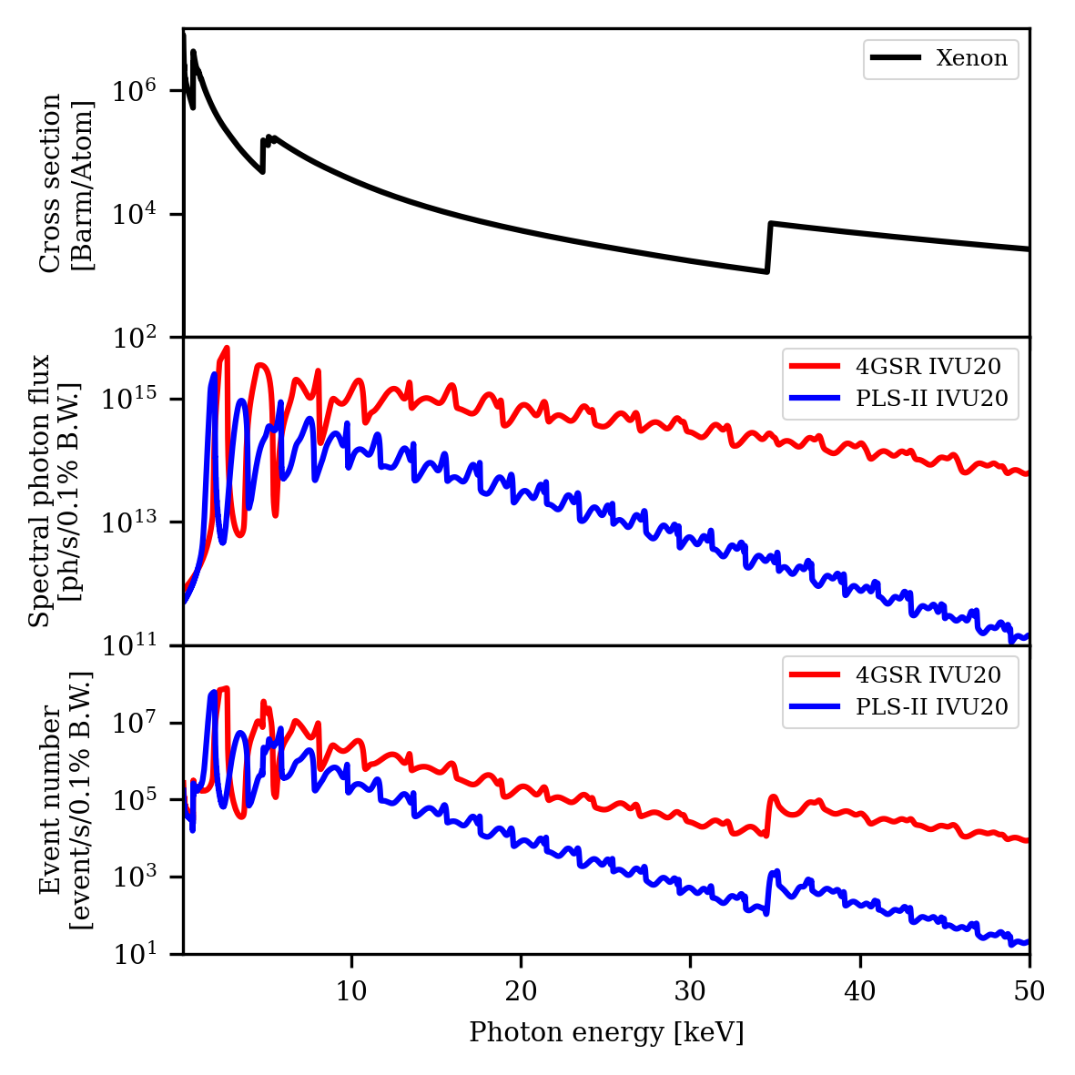
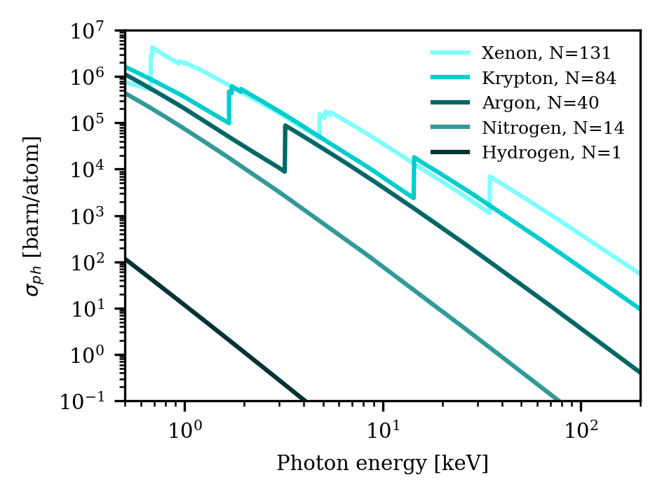
1. Gas-Filled Detector
Previous Research
Ionization Profile Monitor
Research Plan
1. Photoionization
Soft X-ray
Hard X-ray
Photoionization cross-section in the hard X-ray region of residual gas (hydrogen dominant in UHV) is significantly small.
Use of noble gases with high atomic mass to measure high energy photon.
Kr and Xe have K-absorption edges at 14 and 34 keV, respectively, so the effect on the beamline needs to be studied experimentally.
NIST X-ray form factor, attenuation, and scattering table

Slide 20
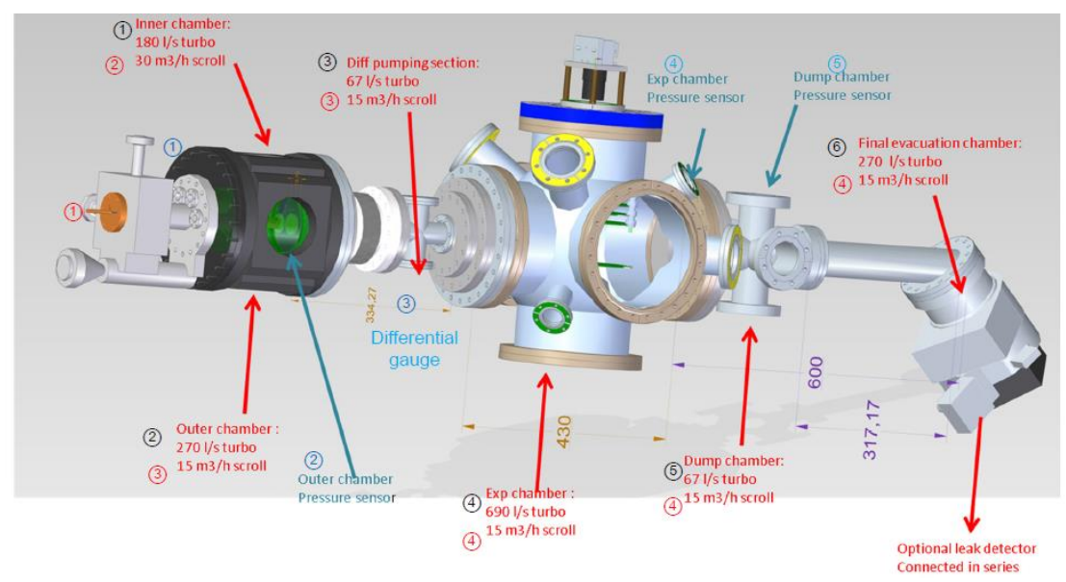
1. Gas-Filled Detector
Previous Research
Ionization Profile Monitor
Research Plan
2. Vacuum system design
Injecting gas instead of using residual gas increases chamber vacuum
→ Vacuum system with differential pumping is required to minimize change in nearby beamline vacuum degree.
V. Tzoganis, Molflow+ simulation, 2017

Slide 21
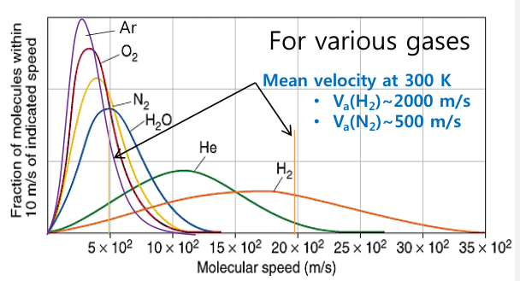
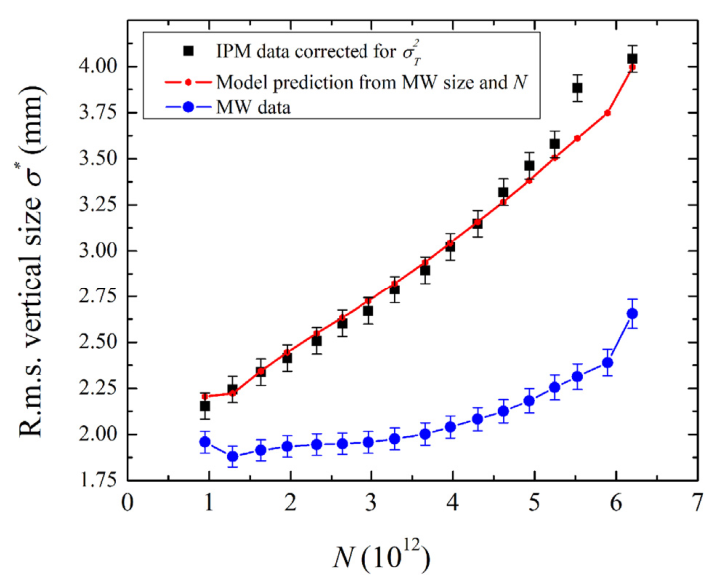
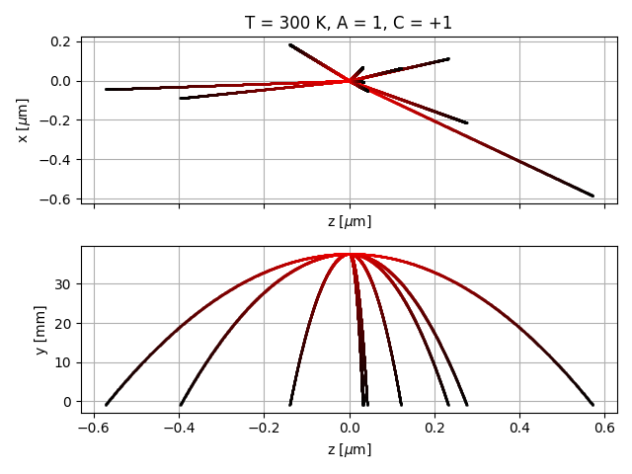
1. Gas-Filled Detector
Previous Research
Ionization Profile Monitor
Research Plan
3. Point spread function analysis
Transverse spread due to thermal energy
Broadening due to space charge
effect of non-relativistic ions
Space charge
Transverse spread occurs during the drift of photo-ions due to space charge and initial ion energy.
→ Point spread function analysis required to determine resolution of the system.

Slide 22
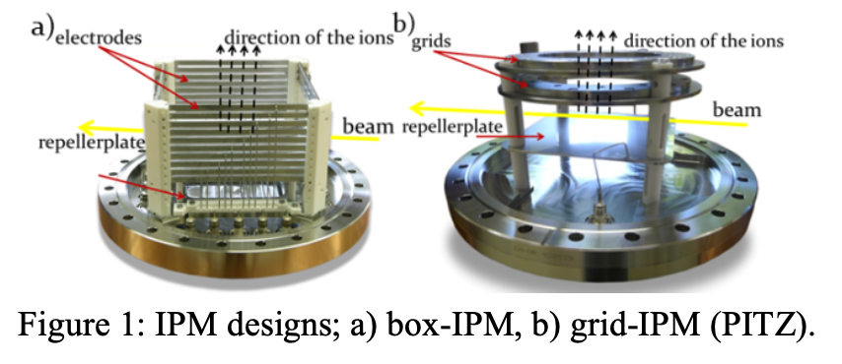
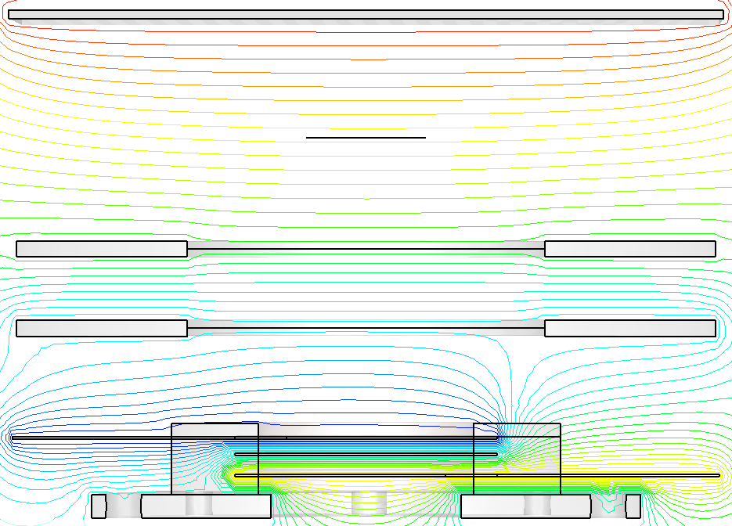
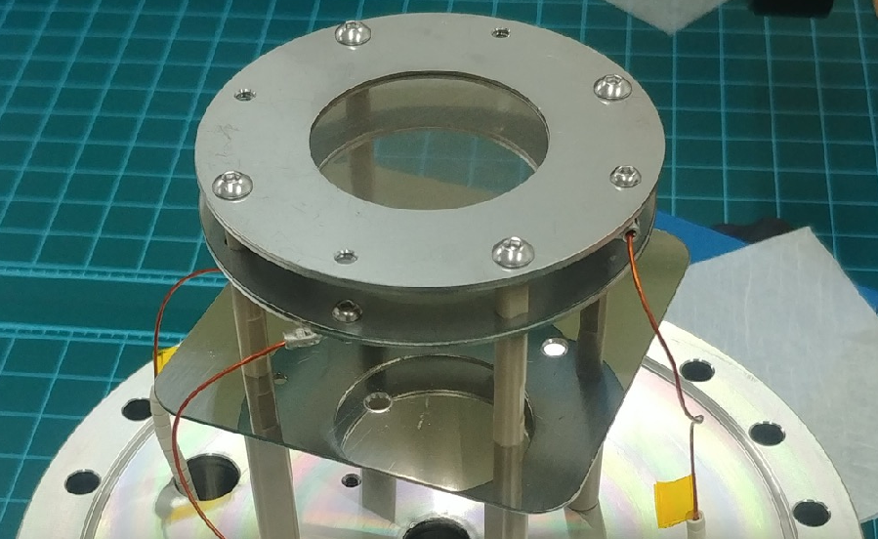
2. Electrode Design
Previous Research
Ionization Profile Monitor
Research Plan
1. Isotropic field
Beam
+
+
+
+
+
+
+
+
+
+
Mesh
Electrode
MCP
Mesh : Makes electric field uniform but reduces transmission due to mesh-ion collisions.
Estimated over 25% signal gain by removing mesh (W mesh open area: 64~81%).
Voltage applied to MCP lead bar creates anisotropic field → Linearity deteriorates

Slide 23
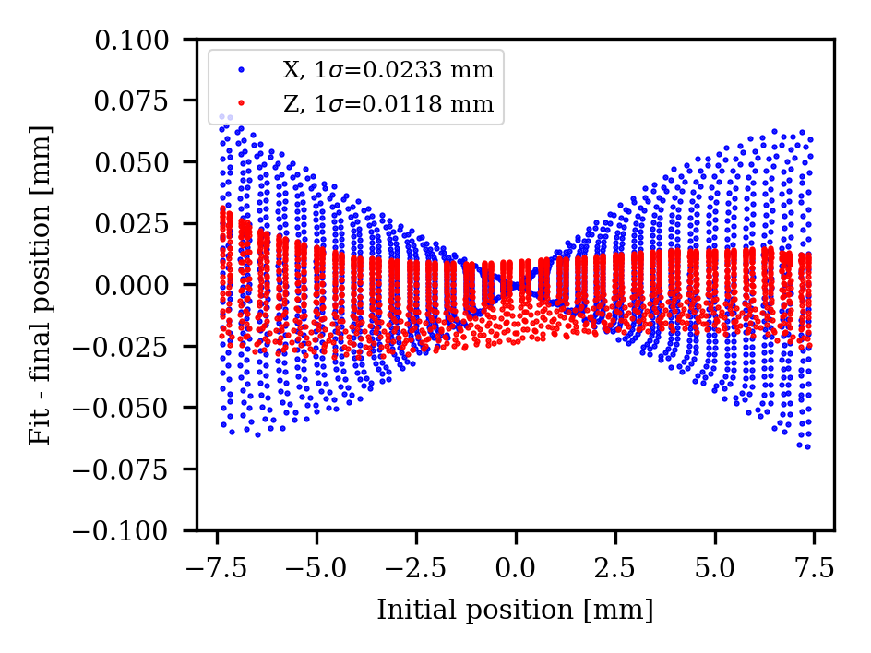
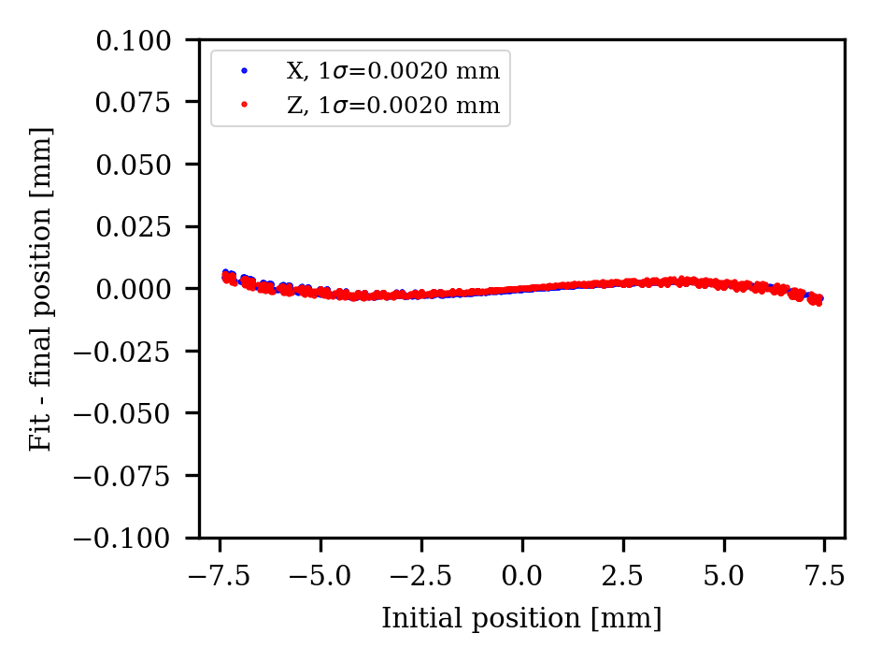
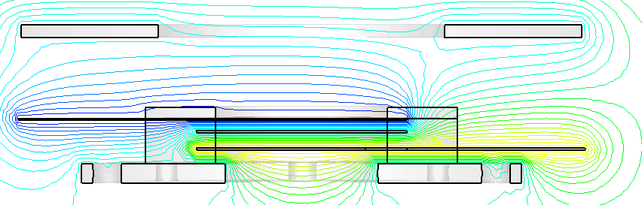
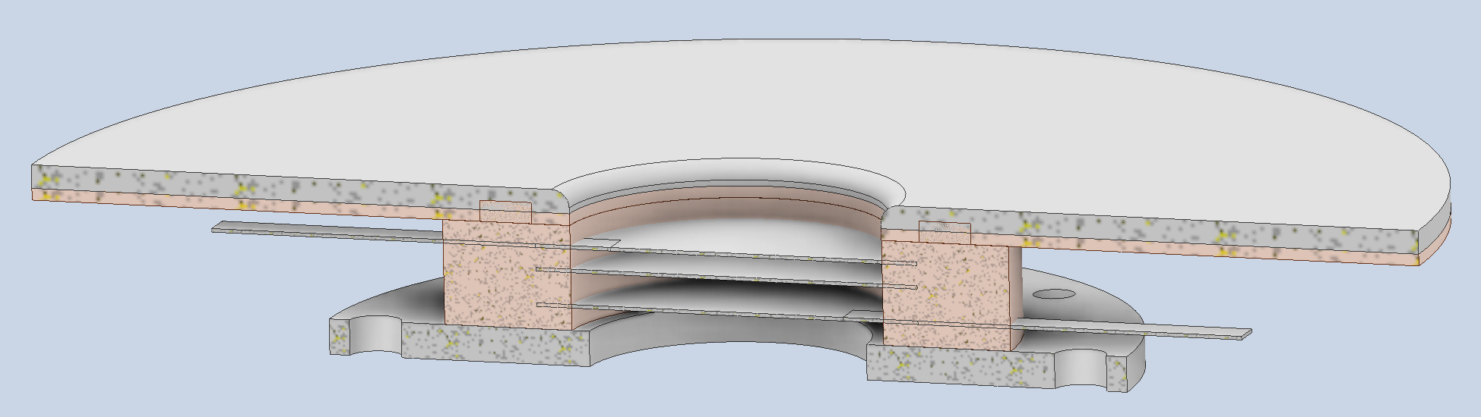
2. Electrode Design
Previous Research
Ionization Profile Monitor
Research Plan
1. Isotropic field
Install a shield plate to minimize field effects from lead potentials
Equipotential line – W/O mesh
W/O mesh
W/ shield
Electrode
-0.45 kV
-1.6 kV
+3 kV
MCP
PEEK plate (Insulator)
Shield plate
MCP

Slide 24
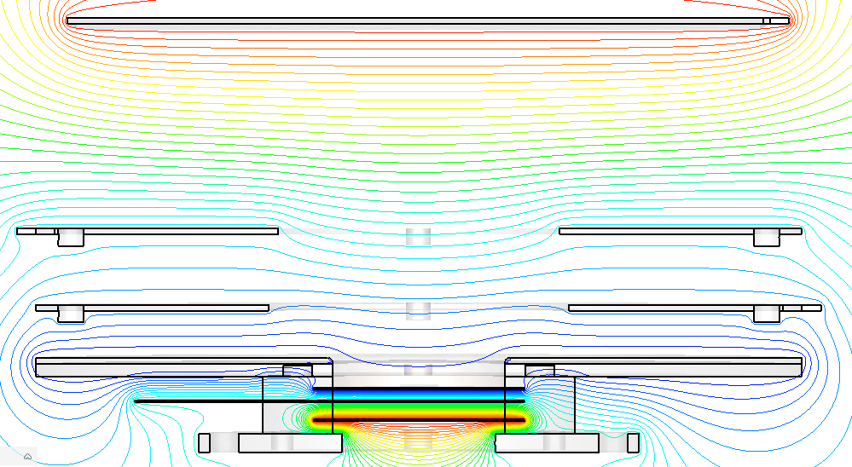
2. Electrode Design
Previous Research
Ionization Profile Monitor
Research Plan
2. 1:1 mapping field
Beam pipe
+
+
+
+
+
+
+
+
+
MCP active area (Ф 27 mm) is larger than the range the source can move (Ф 15 mm).
→ Design defocusing field for full MCP usage.
→ Achieving isotropic field simultaneously.

Slide 25
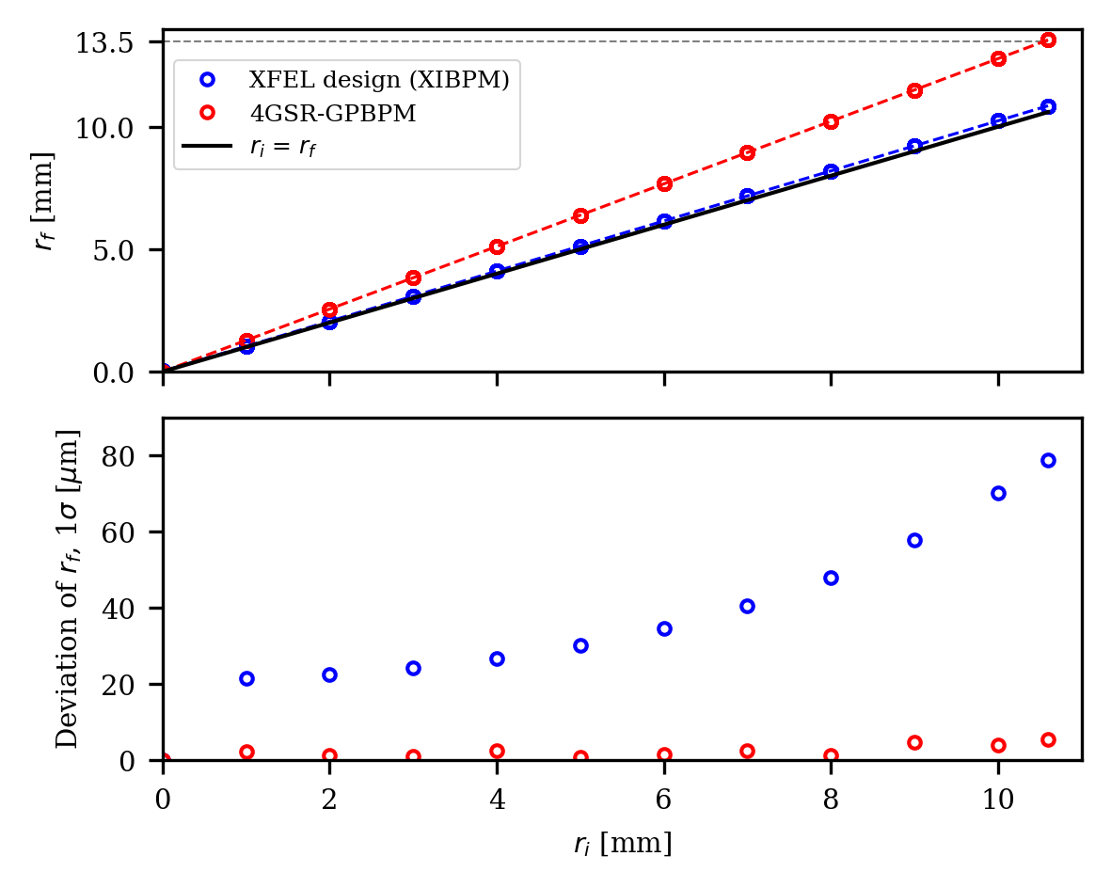
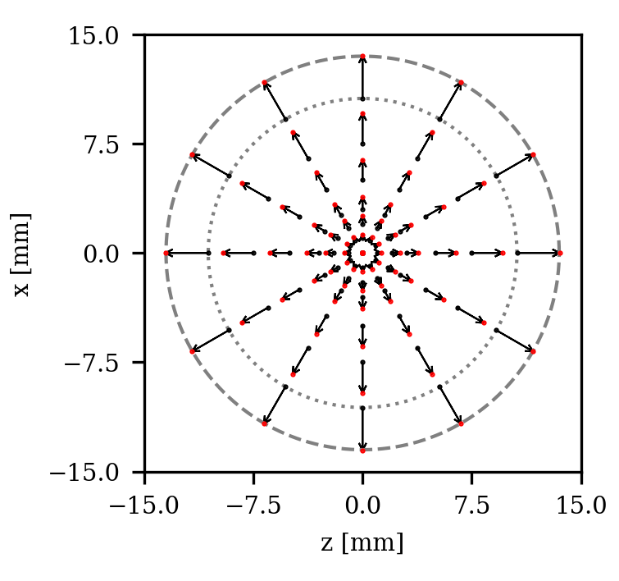


2. Electrode Design
Previous Research
Ionization Profile Monitor
Research Plan
2. 1:1 mapping field
Initial position, $r_{i}$
Final position, $r_{f}$
13.5 mm
10.6 mm
Designing an electric field optimization upgrade from an existing XFEL-XIBPM design.
  1:1 mapping field: ions generated at the edge of the expected source arrive at the edge of the MCP.
  Linearity: particles departing from the same distance spread over the same distance.
  → Distribution σ < 6 um achieved even at the edge of the MCP.
→ Linearity must be achieved to reconstruct the original image with the calibration for profile measurement.

Slide 26
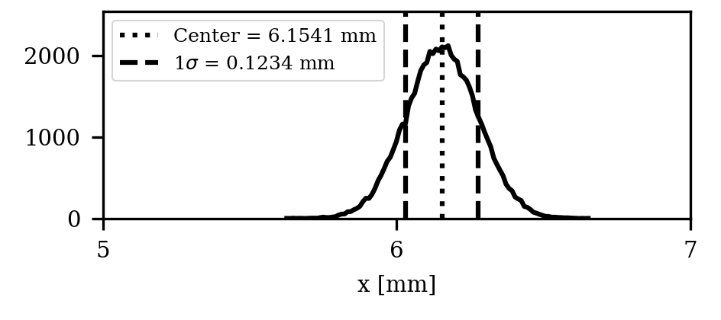
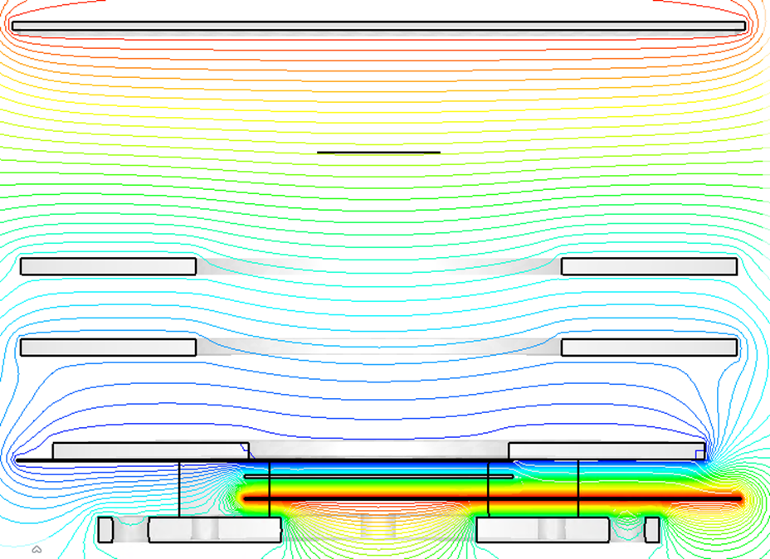
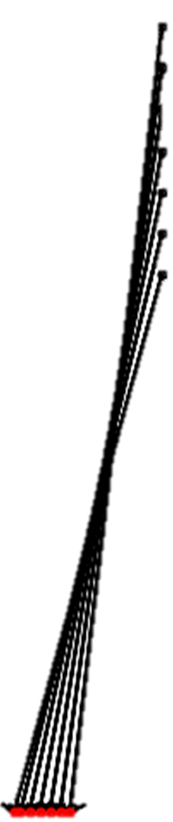



3. Calibration
Previous Research
Ionization Profile Monitor
Research Plan
1. Position calibration: Magnification correction method
Transverse space @ z=0mm
V. offset = + 5 mm
V. offset = 0 mm
V. offset = - 5 mm
Defocusing field
  Lens effect distorts 2D intensity distribution information
  Magnification depends on vertical position
Center position is also measured inaccurately
→ 2D-Profile measurements require a calibration method to correct magnification.

Slide 27











3. Calibration
Previous Research
Ionization Profile Monitor
Research Plan
1. Position calibration: Magnification correction method
Ver. monitor
$M_{h}\left(x_{r}, y_{r}\right)×x_{r}=x_{m}$
$$y_{m}$$
Real Position $x_{r}, y_{r}$
$M_{v}\left(x_{r}, y_{r}\right)×y_{r}=y_{m}$
$$y_{r}$$
Measured Position $x_{m}, y_{m}$
Expected Position (Hor. Mag. $M_{h}$)
Exp. Position (Ver. Mag. $M_{v}=M_{h}(y_{r},−x_{r})$)
Magnification correction method
2 directions (Vertical, Horizontal) monitor required.
Move beam in X, Y direction to measure calibration map (𝑀).
Calculate actual position ($x_{r}, y_{r}$) by substituting the measured beam center ($x_{m}$, $y_{m}$).
Divide the position information of the MCP image by the magnification (M) for profile reconstruction
Hor. monitor
$$x_{r}$$
$$x_{m}$$

Slide 28






3. Calibration
Previous Research
Ionization Profile Monitor
Research Plan
1. Position calibration: Magnification correction method
Ver. Monitor
(offset 5, -3 mm)
$x_{meas}=3.2397, y_{meas}=6.1001$
$M_{H}=ay_{r}+b$
$M_{V}=a\left(−x_{r}\right)+b$
$a=−0.00923, b=1.2766$
$x_{m}=M_{H}x_{r}$
$y_{m}=M_{V}y_{r}$
Initial peak position:
$$x_{real}=2.6058±0.0075 mm \\ y_{real}=4.6576±0.0214 mm$$
Calibrated peak position:
$$x_{cal}=2.6268±0.0111 mm \\ y_{cal}=4.6769±0.0293 mm$$
Hor. Monitor
(offset: 3, 5 mm)
Calibration method can restore initial position and original profile with magnification correction

Slide 29



3. Calibration
Previous Research
Ionization Profile Monitor
Research Plan
1. Position calibration: Magnification correction method
Position measurement error of Magnification correction method is within 40 μm (MCP resolution ~ 80 μm).
Calibration error can be further reduced by using higher order terms in the equation for magnification curve ($M_{H, V}$).
Need to verify calibration method by measuring calibration map experimentally.

Slide 30
3. Calibration
Previous Research
Ionization Profile Monitor
Research Plan
2. Image processing method
Screen-camera alignment
  Applying a correction method to find the center and beam path of a screen image.
Noise removal
  Image process algorithm for removing background noise to improve resolution

Slide 31

4 Experimental validation
Previous Research
Ionization Profile Monitor
Research Plan
2024 Photon IPM Development Schedule
Detail Items | 1 | 2 | 3 | 4 | 5 | 6 | 7 | 8 | 9 | 10 | 11 | 12
Basic study
Main component (MCP, power supply) order
Electrode design
Vacuum chamber design
Calibration method development
Fabrication and assembly
PLS-II (6C) ID Beamline installation
Calibration and test

Slide 32

4 Experimental validation
Previous Research
Ionization Profile Monitor
Research Plan
Magnification map
  Measurement position changes as a actual beam position changes
  Calculate magnification by moving the IPM chamber horizontally and vertically
  Verifying the difference depending on the calibration beam size
Experimental validation
  Photon energy
  White beam, Mono-energetic beam
  Gas species and vacuum degree
  Residual gas, Krypton, Nitrogen
  Effect on the experimental beam due to K-absortion edges
Magnification vs Cal. Beam size

Slide 33
Summary
Previous Research
Ionization Profile Monitor
Research Plan
Summary
Developing an Ionization Profile Monitor to measure the profile and position of the white undulator beam for Korea-4GSR.
Unlike blade PBPM, IPM is non-destructive and not affected by contamination.
Existing photon IPM are limited in profile measurement because there is no calibration method.
Low signal intensity is expected from residual gas, so plan to improve signal gain by injecting noble gas.
Designed a defocusing field to utilize all of the active area of the MCP.
Suggested a new calibration method and image processing method to measure accurate profiles.
The new proposed design will be experimentally validated on the PLS-II.

Slide 34
Appendix

Slide 35
Previous Research
Ionization Profile Monitor
Research Plan
Summary
Appendix

