Slide 1
CAPhE Lab Meeting
K. M. Nam
Science and Technology, Pohang 37673, Korea
2024/08/07

Slide 2
Index
Introducing Myself
Introduction
- Basic Concept, Research Interest
What I’ve done
Research Plan

Slide 3


Introducing Myself
About Myself
I am a graduate student in the Division of Advanced Nuclear Engineering, scheduled to receive my Ph.D. on August 9, 2024. From August 16, I will officially begin my postdoc at CAPhE in POSTECH, focusing on relativistic beam dynamics. I am interested in a variety of beam dynamics in storage rings.
During my early years, I didn't have any senior students, so I navigated my lab life alone. I am very pleased to greet and meet the various members of CAPhE. I hope to maintain good relationships and conduct excellent research together moving forward
Name | Ki Moon Nam | E-Mail | ngw5756756@postech.ac.kr
Birth | 1992-11-26 | Address | PAL-ISSC 402
Tel | 010-9660-6360

Slide 4
Career
B.S.
2012.3 ~ 2017. 2
Pohang University of Science and Technology (POSTECH), Department of Physics
M.S.
2017.3 ~ 2019. 2
Pohang University of Science and Technology (POSTECH), Division of Advanced Nuclear Engineering
Major in Theoretical Accelerator Physics and Industrial Accelerator Design
Thesis : A Simulation Study of a ERL based EUV-FEL for Lithography
Advisor : Prof Gunsu Yun and Dr. Yong Woon Parc
Ph. D.
2019. 3 ~ 2024. 8
Pohang University of Science and Technology (POSTECH), Division of Advanced Nuclear Engineering
Major in Theoretical Accelerator Physics and Beam Dynamics
Thesis : Revised Hamiltonian near Third-integer Resonance and its dynamics in Electron Storage Ring
Advisor : Prof Gunsu Yun and Dr. Yong Woon Parc
Future
2024. 8 ~
Postdoc at CAPhE, Postech.
Advisor : Prof. Moses Chung

Slide 5
Introduction

Slide 6
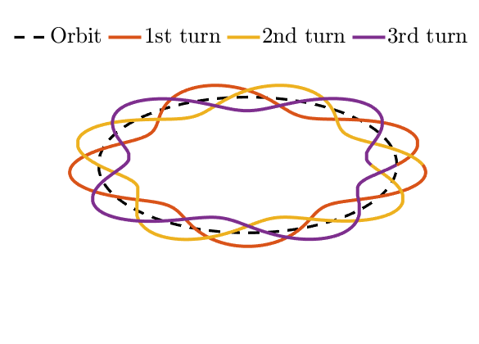
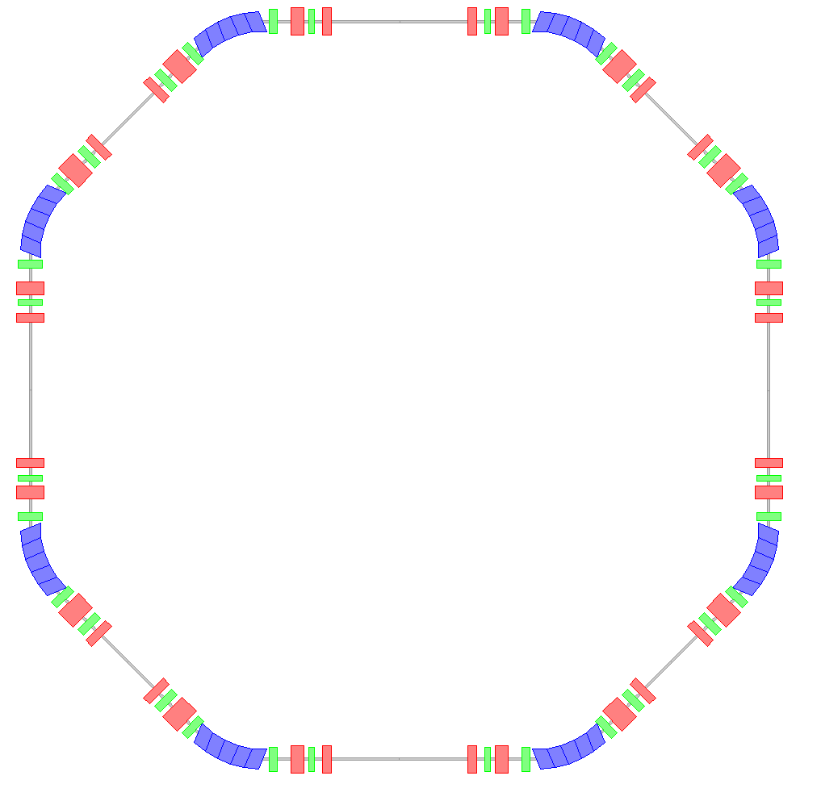
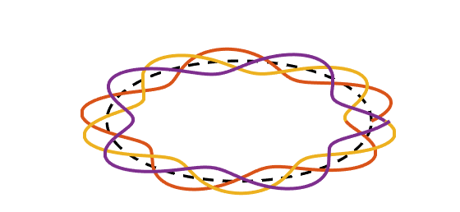
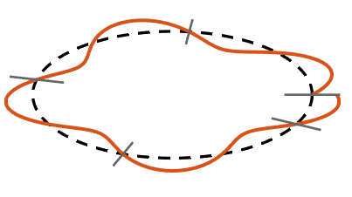
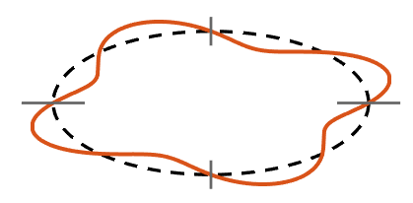




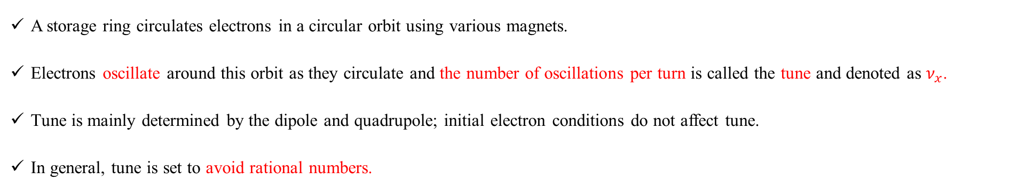

Storage Ring and Tune
Schematic layout of a storage ring
Motion of Stable Electron in a storage ring
Dipole
Quadrupole
Sextupole
$$y$$
$$s$$
$$x$$
1 cycle
1 cycle
2 cycle
0.4117 cycle
2 cycle
4 cycle
3 cycle
3 cycle
4 cycle
A storage ring circulates electrons in a circular orbit using various magnets.
Electrons oscillate around this orbit as they circulate and the number of oscillations per turn is called the tune and denoted as $ν_{x}$.
Tune is mainly determined by the dipole and quadrupole; initial electron conditions do not affect tune.
In general, tune is set to avoid rational numbers.
$$ν_{x}=4.4117$$
$$ν_{x}=4.0$$
Notes:
A storage ring circulates electrons in a circular orbit using various magnets.
Electrons oscillate around this orbit, and the number of oscillations per turn is called the tune.
In this figure, the electron oscillates one, two, three, four, and a little more, so the tune is 4.4117.
Generally, the tune is set to avoid rational numbers.

Slide 7











Tune and Resonance
Schematic layout of a storage ring
Motion of Stable Electron in a storage ring
Dipole
Quadrupole
Sextupole
$$y$$
$$s$$
$$x$$
$$ΣF_{external}=0$$
1 cycle
$$ν_{x}=4.4117$$
$$y$$
$$s$$
$$x$$
2 cycle
4 cycle
$${ΣF}_{external}≠0$$
3 cycle
$${ΣF}_{external}≠0$$
$$ν_{x}=4.0$$
$${3ν}_{x}=13.0$$
Third Integer Resonance
When external forces with position-dependent properties are present, they affect the system.
If the tune is an integer multiple of a resonance, these external forces accumulate continuously and it makes electrons diverge.
Notes:
When external forces with position-dependent properties are present, they affect the system.
As shown in this figure, if the electron's tune is an integer, it experiences external forces every turn, eventually causing divergence.
If the tune's times 3 is integer, the electron experiences the same force every 3 turns.
If the sum of these forces over 3 turns is not zero, the electron diverges.

Slide 8
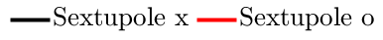
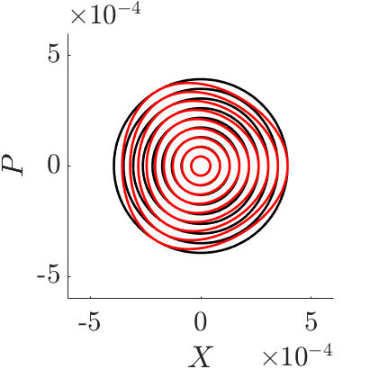
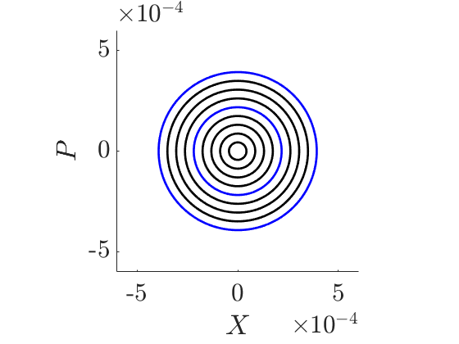
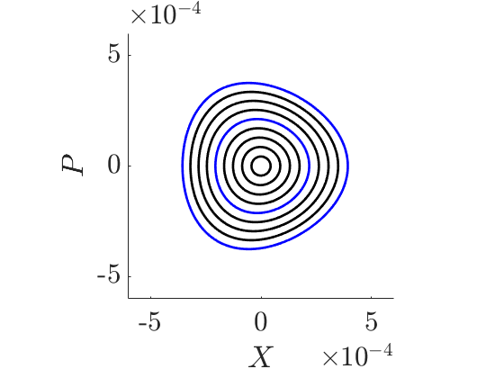
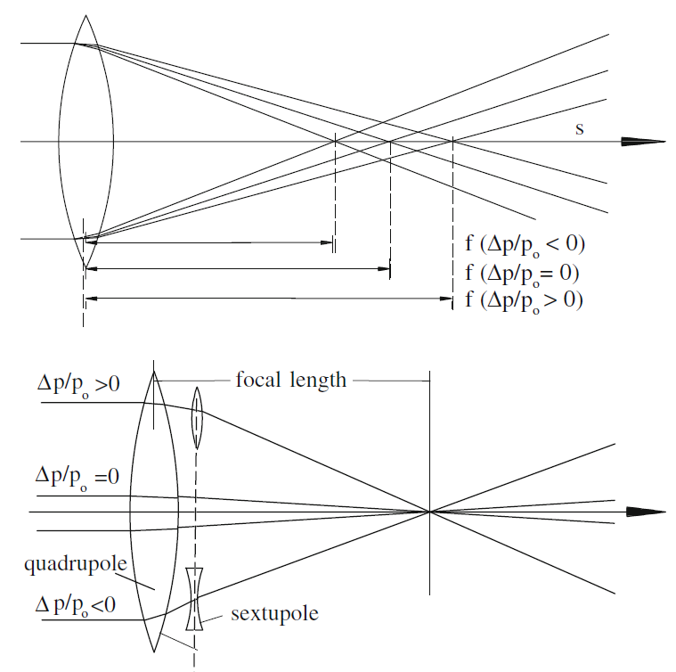




Source of External Force
Ideal (No Electron Energy Deviation)
Practical (Chromatic effect and correction)
Sextupole o
Stable
Stable
Nonlinear Phase Space Distortion Due to Sextupole magnet
$$e^{−}$$
$$e^{−}$$
$$e^{−}$$
$$e^{−}$$
This distortion exerts an external force on electrons
Helmut Wiedemann et al., Springer (4th edition), 2007
Notes:
Let me explain the source of these external forces.
Storage rings include sextupole magnets to correct chromatic effects.
However, sextupoles also cause some phase space distortion.
This distortion acts as the external force mentioned earlier.

Slide 9
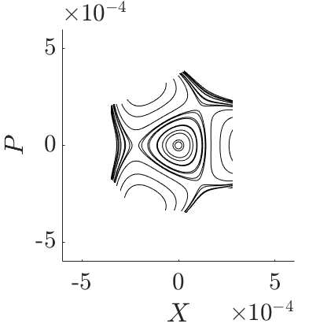
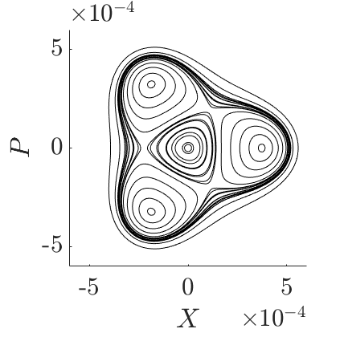
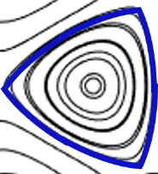
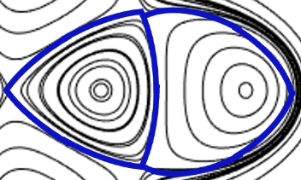



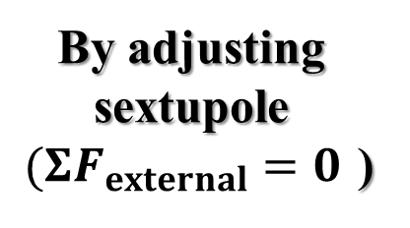



Phase Space (Near Resonance)
Third Integer Resonance
By adjusting sextupole
$(ΣF_{external}=0$)
Resonant
Islands
$$\left(ΣF_{external}=0\right)$$
Loss
Loss
$$\left(ΣF_{external}≠0\right)$$
Primary Orbit
$$\left(ΣF_{external}=0\right)$$
Loss
Loss
Boundary
Loss
Loss
Boundary
Boundary
Loss
$$e^{−}$$
$$e^{−}$$
$$e^{−}$$
Notes:
When the tune's integer multiple is close to a rational number, sextupoles distort the phase space as shown.
In the stable primary orbit region (sum of F_external = 0), the electron remains stable.In other regions, the electron diverges unless sextupoles are adjusted to make the sum of F_external zero in specific phase space regions.
This adjustment creates resonant islands, which are stable and spatially separated from the primary orbit.

Slide 10
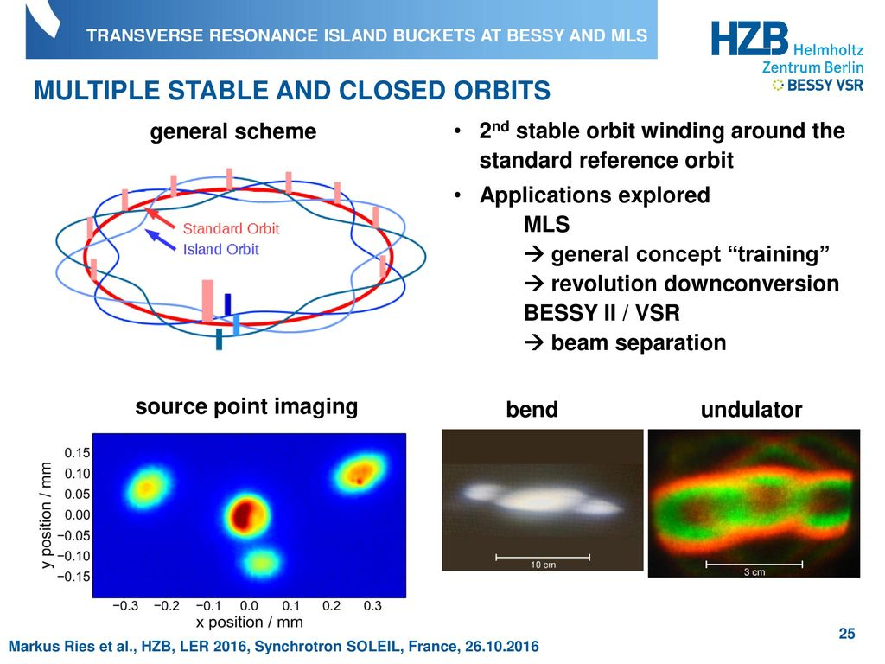
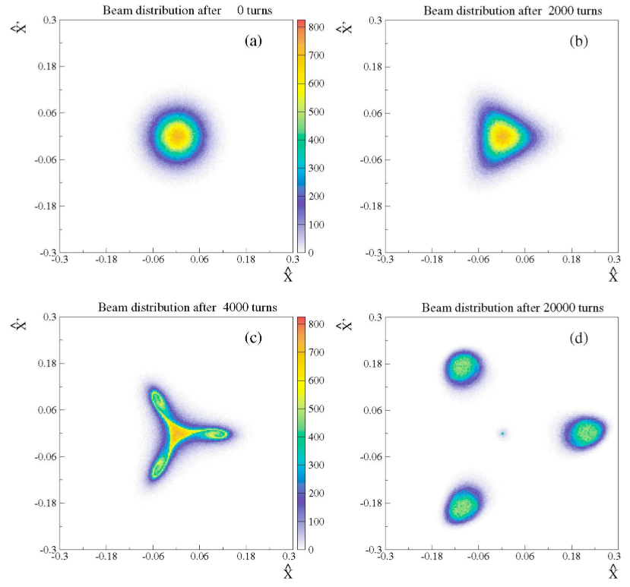
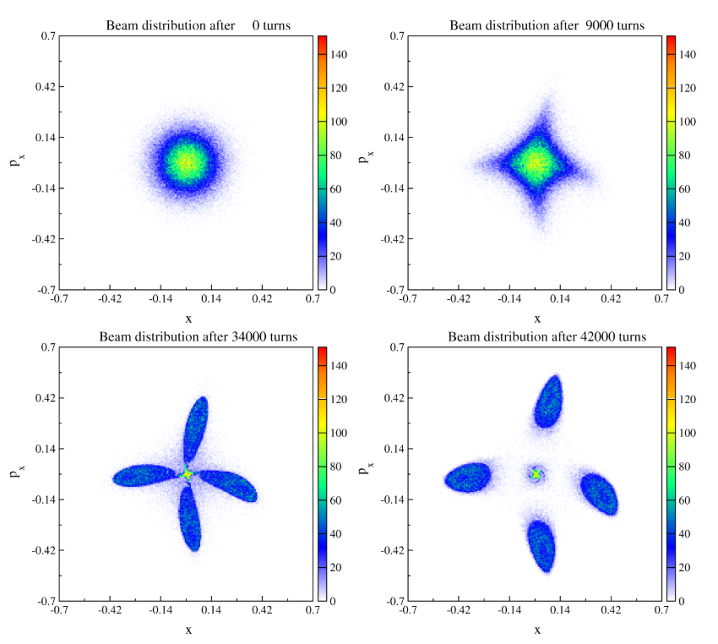
Research Interest
Markus Ries et al., Synchrotron SOLEIL 2016
Nonlinear Dynamics
(Ex. Distortion)
Resonant Dynamics
(Ex. Divergence)
Separation for Multi Mode Operation (BESSY II)
0 turn
2000 turn
0 turn
9000 turn
Theory of Resonant Islands, Amplitude-Dependent Tune Shift, Phase-Dependent Tune Shift and Devil’s Staircase
Application : Bunch Separation, Extraction, Etc.
4000 turn
20000 turn
34000 turn
42000 turn
3rd order Splitting (SPS)
4th order Splitting (SPS)
R. Cappi et al., PRST-AB (2004)
M. Giovannozzi et al., PRL (2002)
Notes:
Several accelerator facilities have utilized this property.
BESSY II successfully separated bunches into resonant islands to create multiple photon beams.SPEAR3 also conducted similar bunch storage experiments.
At CERN, this method is used to split electron beams into resonant islands by reducing the boundary size of the primary orbit.Despite these experimental successes, theoretical support is still lacking.

Slide 11
What I’ve done

Slide 12
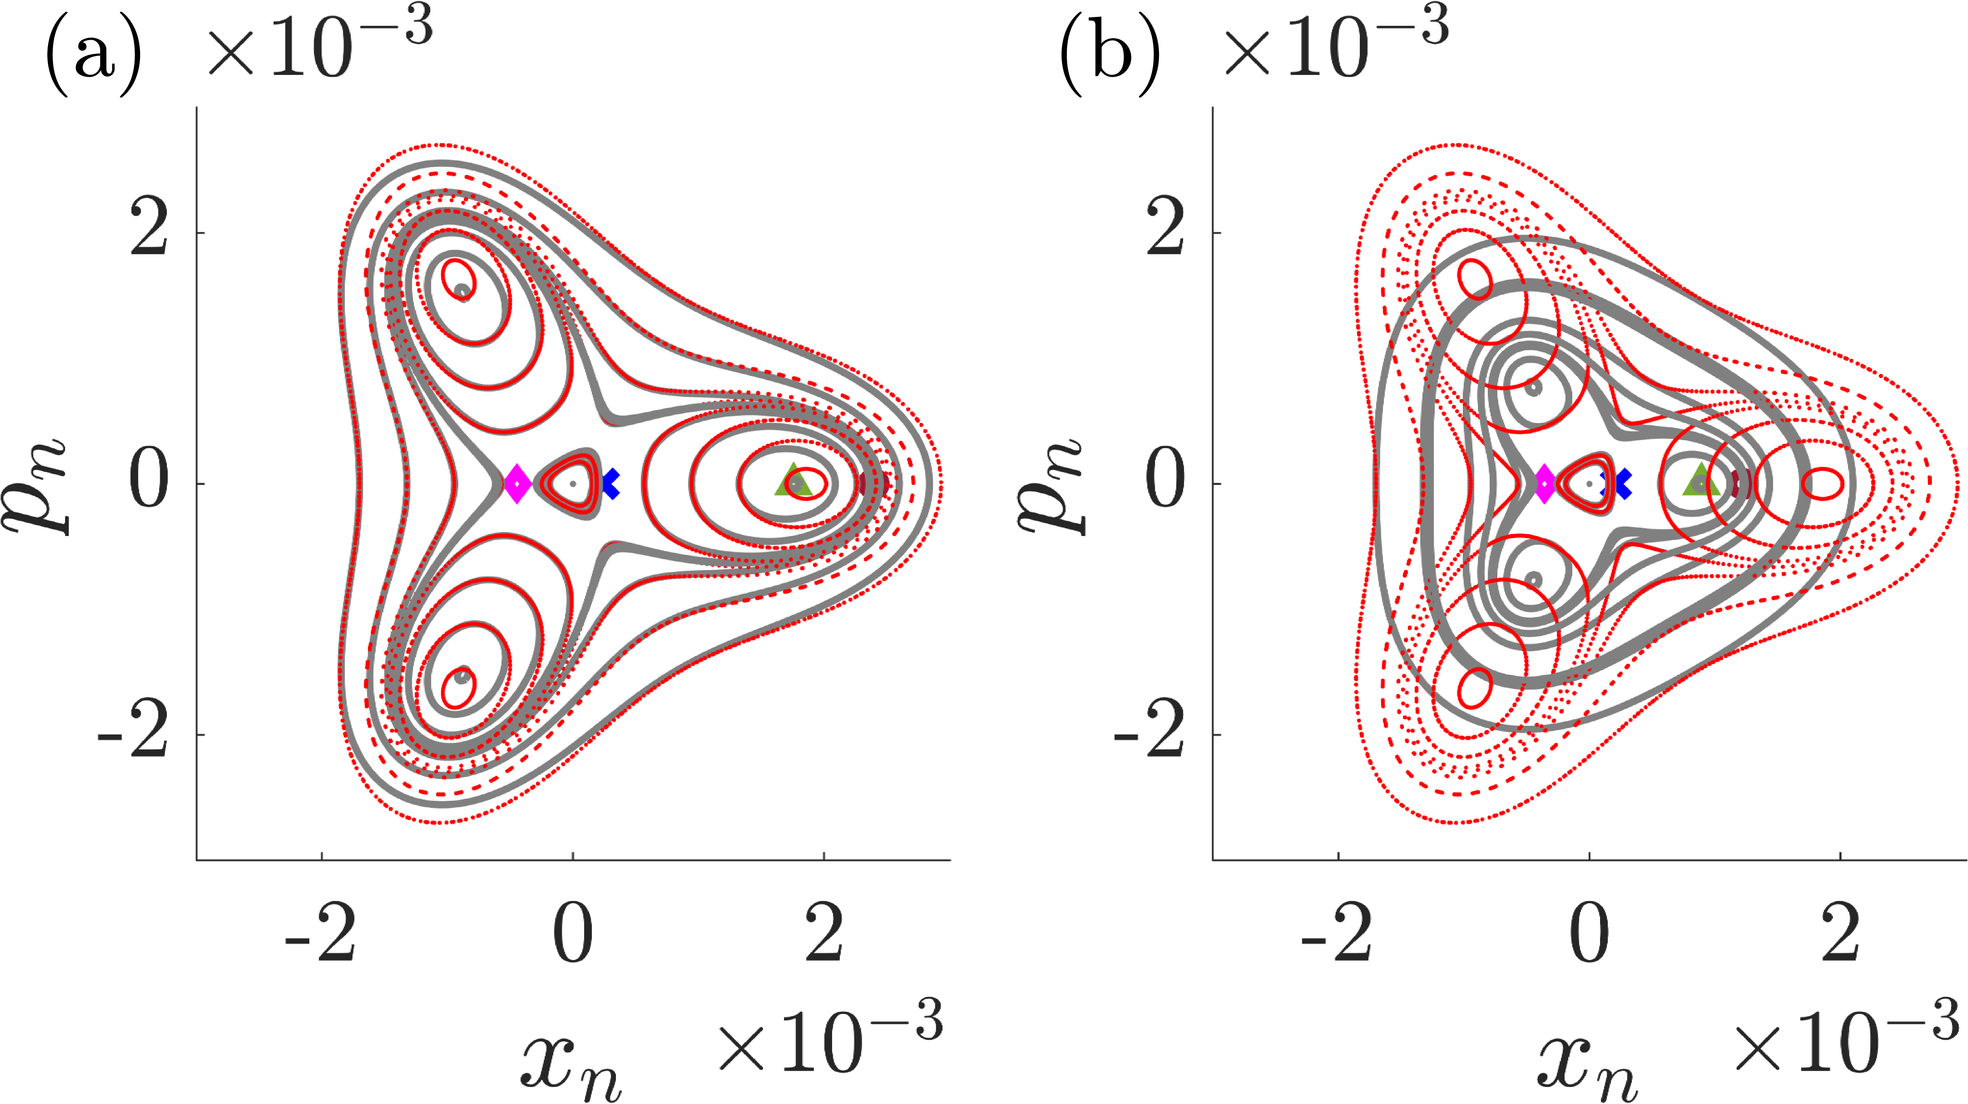


Result (New Parameter)
KM Nam et al., PRAB (2024)
KM Nam et al., PRAB (2024)
(a)
Theory
Tracking
(b)
Theory
Tracking
$H_{con}=H_{near}+\frac{1}{2}α_{Far}{\left(x_{n}^{2}+p_{n}^{2}\right)}^{2}$
$H_{rev}=H_{near}+\frac{1}{2}α_{−1}{\left(x_{n}^{2}+p_{n}^{2}\right)}^{2}$
$H_{con}$ shows bad match, so I suggested the revised one.
Contours with $H_{rev}$ shows better performance than those of $H_{con}$.

Slide 13
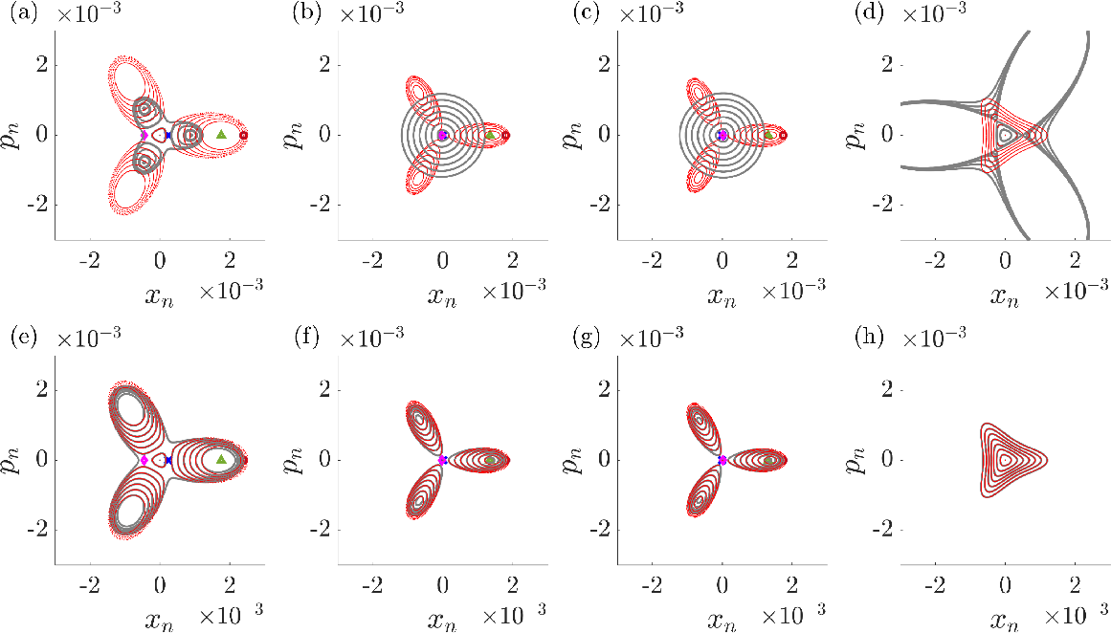






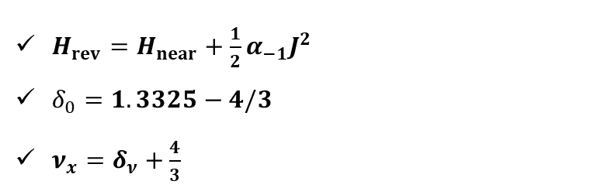



Result (New Parameter, Varying tune)
KM Nam et al., PRAB (2024)
Theory
Tracking
$H_{con}=H_{near}+\frac{1}{2}α_{far}J^{2}$
$δ_{0}=1.3325−\frac{4}{3}$
$ν_{x}=δ_{ν}+\frac{4}{3}$
$δ_{ν}=δ_{0}$
$δ_{ν}=\frac{δ_{0}}{20}$
$δ_{ν}=−\frac{δ_{0}}{20}$
$δ_{ν}=−δ_{0}$
Theory
Tracking
$H_{rev}=H_{near}+\frac{1}{2}α_{−1}J^{2}$
$δ_{0}=1.3325−4/3$
$ν_{x}=δ_{ν}+\frac{4}{3}$
$δ_{ν}=δ_{0}$
$δ_{ν}=\frac{δ_{0}}{20}$
$δ_{ν}=−\frac{δ_{0}}{20}$
$δ_{ν}=−δ_{0}$
While varying tune, contours with $H_{rev}$ shows better performance than those of$H_{con}$.

Slide 14
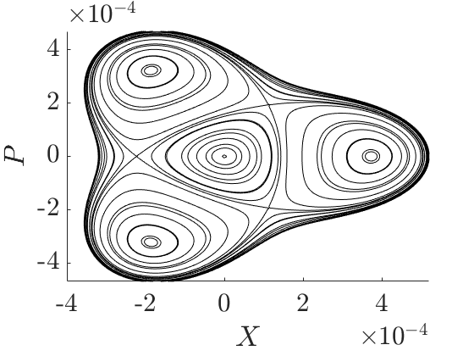
Phase Space Manipulation
Dipole
Quadrupole
Sextupole
Previously, phase space was predicted from lattice information.
This approach outlines constructing lattices to achieve desired phase spaces.
$^{∗}$Developing a 50 MeV LPA-based Injector at ATHENA for a Compact Storage Ring (unpublished)

Slide 15
Phase Space Manipulation
Dipole
Quadrupole
Sextupole
?
Previously, phase space was predicted from lattice information.
This approach outlines constructing lattices to achieve desired phase spaces.
$^{∗}$Developing a 50 MeV LPA-based Injector at ATHENA for a Compact Storage Ring (unpublished)

Slide 16
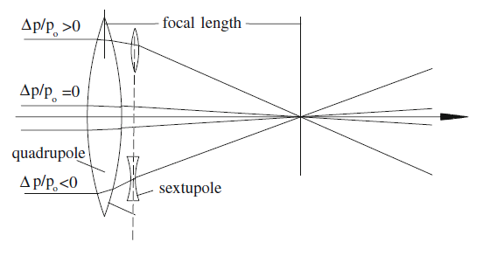
Phase Space Manipulation
Dipole
Quadrupole
Sextupole
!
but
Previously, phase space was predicted from lattice information.
This approach outlines constructing lattices to achieve desired phase spaces.
Chromaticity should be also considered simultaneously
$^{∗}$Developing a 50 MeV LPA-based Injector at ATHENA for a Compact Storage Ring (unpublished)

Slide 17
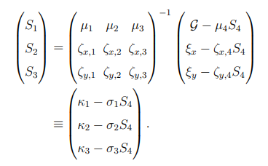
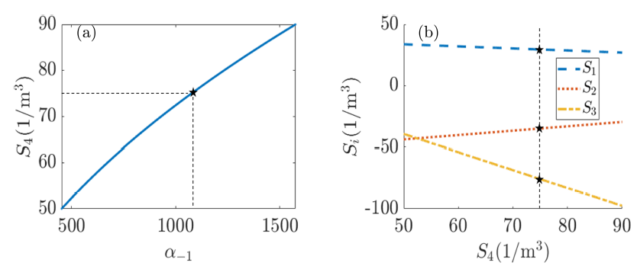

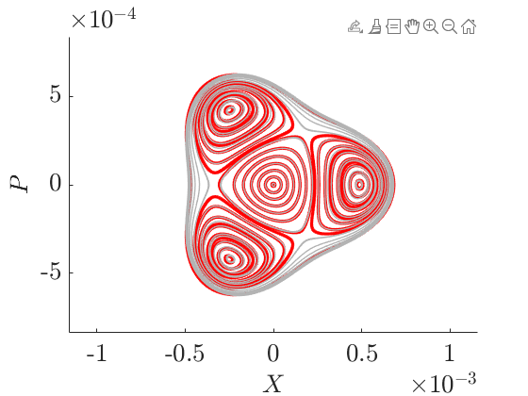

Phase Space Manipulation
Dipole
Quadrupole
Sextupole
$$\left(α_{−1}, g_{3,0,l_{3ν_{x}}},ξ_{x,y}\right)$$
!
but
Previously, phase space was predicted from lattice information.
This approach outlines constructing lattices to achieve desired phase spaces.
Chromaticity should be also considered simultaneously
$^{∗}$Developing a 50 MeV LPA-based Injector at ATHENA for a Compact Storage Ring (unpublished)

Slide 18
Research Plan
(Future Paper)

Slide 19
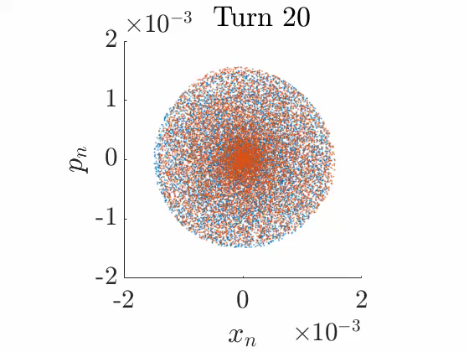
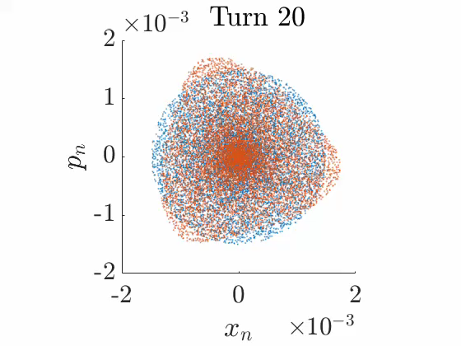
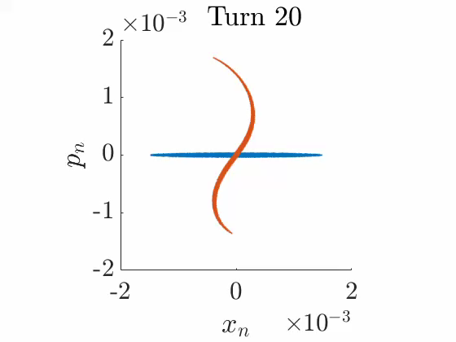
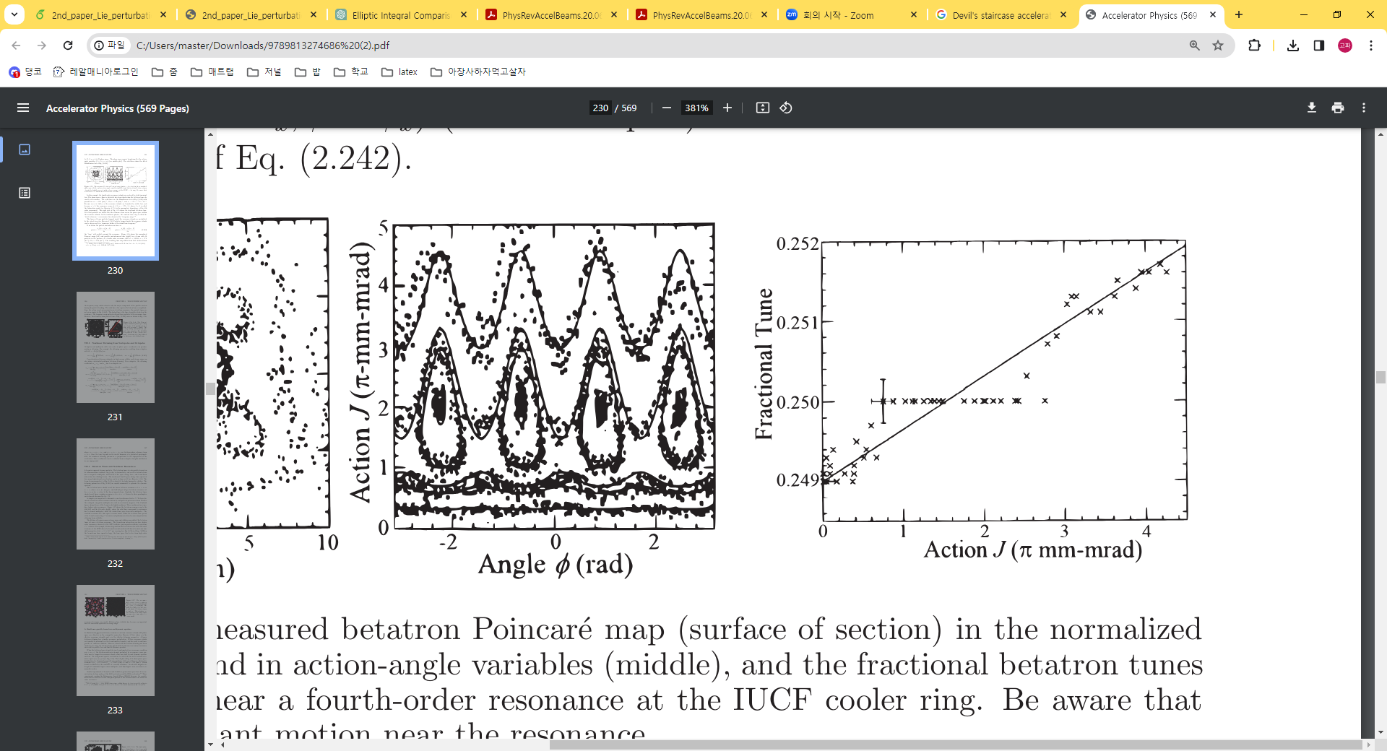
Outline
Filamentation
Nonlinear Filamentation
Nonlinear Filamentation
0.335
0.334
Conventional Hamiltonian cannot predict the motion of electron confined in closed region.
In conventional models, the action should not change.
If the action is the same, do particles with the same action have the same tune?
Devil’s Staircase phenomenon -> Need for theoretical calculations on dynamics.
0.333
0.332
Devil’s Staircase (flat tune region)

Slide 20
Outline
Filamentation
Nonlinear Filamentation
Nonlinear Filamentation
0.335
0.334
Conventional Hamiltonian cannot predict the motion of electron confined in closed region.
In conventional models, the action should not change.
If the action is the same, do particles with the same action have the same tune?
Devil’s Staircase phenomenon -> Need for theoretical calculations on dynamics.
0.333
0.332
Devil’s Staircase (flat tune region)

Slide 21


Outline
Predicted Result $\left(H_{con}\right)$
Predicted Result $\left(H_{rev}\right)$
Nonlinear Filamentation
0.335
0.334
Conventional Hamiltonian cannot predict the motion of electron confined in closed region.
In conventional models, the action should not change.
If the action is the same, do particles with the same action have the same tune?
Devil’s Staircase phenomenon -> Need for theoretical calculations on dynamics.
0.333
0.332
Devil’s Staircase (flat tune region)

Slide 22
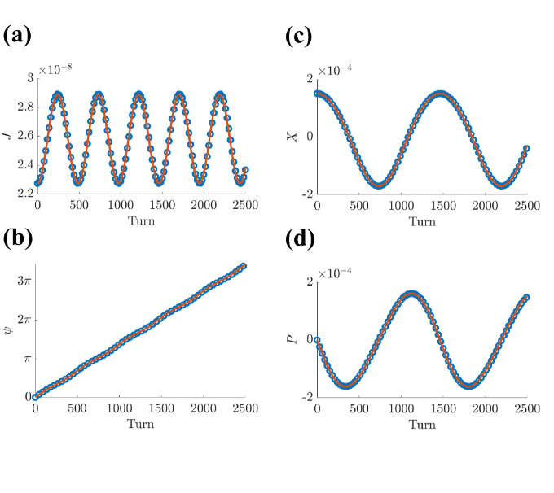
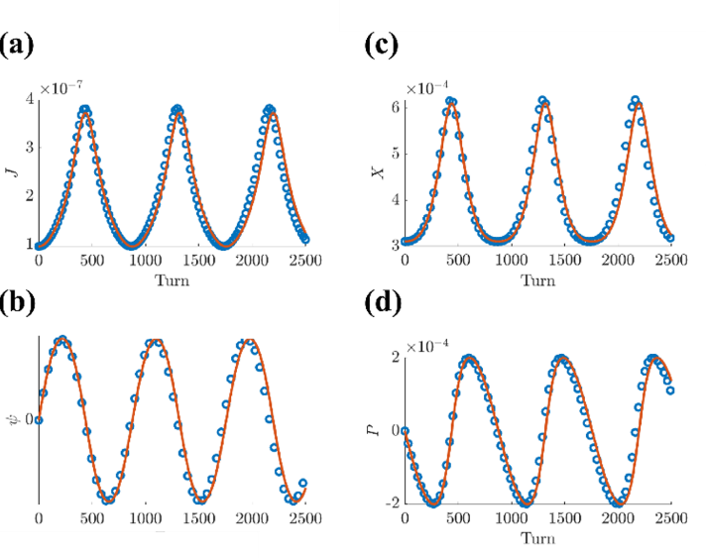
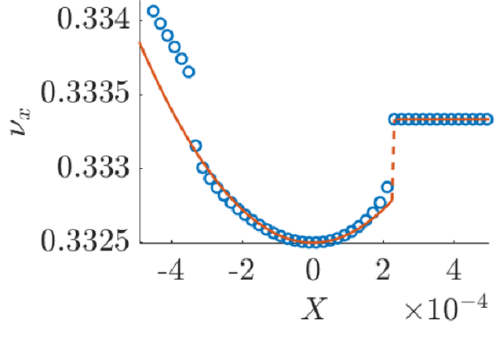
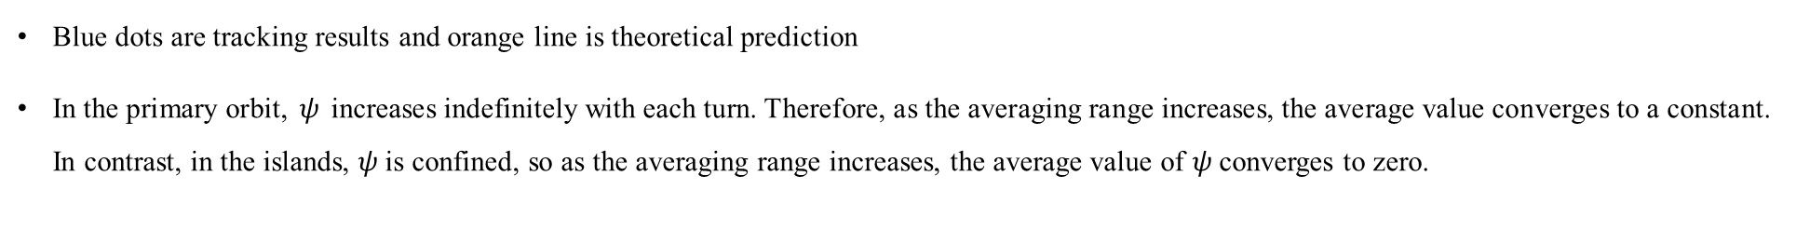
Vs Tracking Data
Primary Orbit
Islands
Devil’s Staircase
Blue dots are tracking results and orange line is theoretical prediction
In the primary orbit, $ψ$ increases indefinitely with each turn. Therefore, as the averaging range increases, the average value converges to a constant. In contrast, in the islands, $ψ$is confined, so as the averaging range increases, the average value of $ψ$converges to zero.

Slide 23
Thanks you

Slide 24
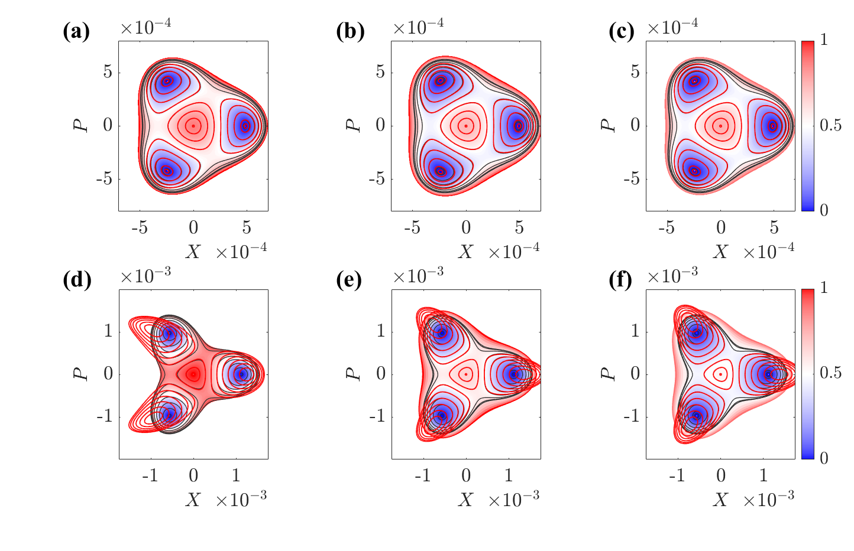
Contour (Lie transform)
(a-c) : Weak high order effect (sextupole) Family
(d-f) : Strong High Order Effect Family
The larger the high order effect, the better the effect of using Lie perturbation..

Slide 25
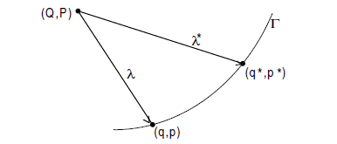

Lie Transform (APPENDIX행)
Consider the Generating function
$F\left(q,p^{∗}\right)=qp^{∗}+εF^{(1)}\left(q,p^{∗}\right)+ε^{2}F^{\left(2\right)}\left(q,p^{∗}\right)+⋯$
$p=p^{∗},q^{∗}=q \left(ε=0\right)$
When we consider $p^{∗}$,
$$p^{∗}=p−ε\frac{∂F^{\left(1\right)}\left(q,p^{∗}\right)}{∂q} −ε^{2}\frac{∂F^{\left(2\right)}\left(q,p^{∗}\right)}{∂q}+⋯ \\ =p−ε\frac{∂F^{\left(1\right)}\left(q,\left(p−ε\frac{∂F^{\left(1\right)}\left(q,p^{∗}\right)}{∂q} −ε^{2}\frac{∂F^{\left(2\right)}\left(q,p^{∗}\right)}{∂q}+⋯ \right)\right)}{∂q} −ε^{2}\frac{∂F^{\left(2\right)}\left(q,\left(p−ε\frac{∂F^{\left(1\right)}\left(q,p^{∗}\right)}{∂q} −ε^{2}\frac{∂F^{\left(2\right)}\left(q,p^{∗}\right)}{∂q}+⋯ \right)\right)}{∂q}+⋯ \\ =p−ε\frac{∂F^{\left(1\right)}\left(q,\left(p−ε\frac{∂F^{\left(1\right)}\left(q,p^{∗}\left(q,p^{∗}\left(q,p^{∗}\left(q,p^{∗}…\right)\right)\right)\right)}{∂q} −ε^{2}\frac{∂F^{\left(2\right)}\left(q,p^{∗}\right)}{∂q}+⋯ \right)\right)}{∂q} +⋯$$
Consider the two successive Canonical transform. If $λ≅λ^{∗}$,
we can transform $\left(q,p\right)→\left(q^{∗},p^{∗}\right)$
Lie Transform
Mello

Slide 26
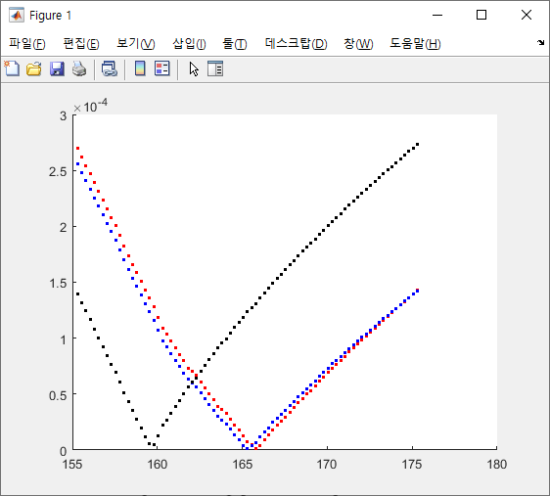
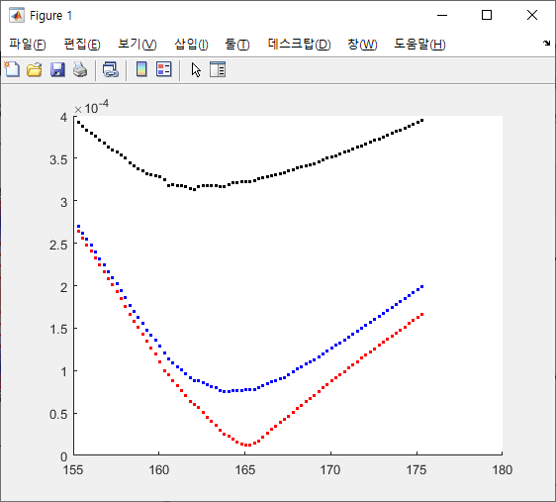

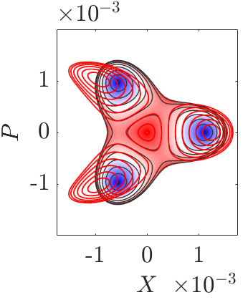
APPENDIX로 날리자
Second Order Better Matching
정량화 정의도 써야 함

Slide 27
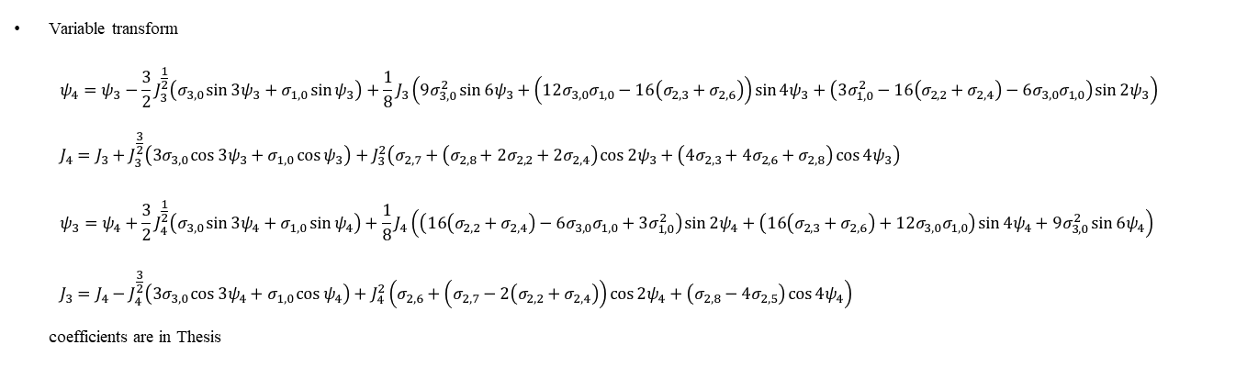
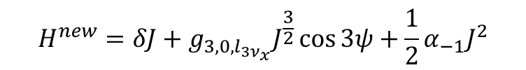
Lie Transform (Result)
Lie Transform
Mello
$$H^{new}=δJ+g_{3,0,l_{3ν_{x}}}J^{\frac{3}{2}}\cos{3ψ}+\frac{1}{2}α_{−1}J^{2}$$
Variable transform
$ψ_{4}=ψ_{3}−\frac{3}{2}J_{3}^{\frac{1}{2}}\left(σ_{3,0}\sin{3ψ_{3}}+σ_{1,0}\sin{ψ_{3}}\right)+\frac{1}{8}J_{3}\left(9σ_{3,0}^{2}\sin{6ψ_{3}}+\left(12σ_{3,0}σ_{1,0}−16\left(σ_{2,3}+σ_{2,6}\right)\right)\sin{4ψ_{3}}+\left(3σ_{1,0}^{2}−16\left(σ_{2,2}+σ_{2,4}\right)−6σ_{3,0}σ_{1,0}\right)\sin{2ψ_{3}}\right)$
$J_{4}=J_{3}+J_{3}^{\frac{3}{2}}\left(3σ_{3,0}\cos{3ψ_{3}}+σ_{1,0}\cos{ψ_{3}}\right)+J_{3}^{2}\left(σ_{2,7}+\left(σ_{2,8}+2σ_{2,2}+2σ_{2,4}\right)\cos{2ψ_{3}}+\left(4σ_{2,3}+4σ_{2,6}+σ_{2,8}\right)\cos{4ψ_{3}}\right)$
$ψ_{3}=ψ_{4}+\frac{3}{2}J_{4}^{\frac{1}{2}}\left(σ_{3,0}\sin{3ψ_{4}}+σ_{1,0}\sin{ψ_{4}}\right)+\frac{1}{8}J_{4}\left(\left(16\left(σ_{2,2}+σ_{2,4}\right)−6σ_{3,0}σ_{1,0}+3σ_{1,0}^{2}\right)\sin{2ψ_{4}}+\left(16\left(σ_{2,3}+σ_{2,6}\right)+12σ_{3,0}σ_{1,0}\right)\sin{4ψ_{4}}+9σ_{3,0}^{2}\sin{6ψ_{4}}\right)$
$J_{3}=J_{4}−J_{4}^{\frac{3}{2}}\left(3σ_{3,0}\cos{3ψ_{4}}+σ_{1,0}\cos{ψ_{4}}\right)+J_{4}^{2}\left(σ_{2,6}+\left(σ_{2,7}−2\left(σ_{2,2}+σ_{2,4}\right)\right)\cos{2ψ_{4}}+\left(σ_{2,8}−4σ_{2,5}\right)\cos{4ψ_{4}}\right)$
coefficients are in Thesis

Slide 28

Dynamics in Islands
For $Δ<0, J=J_{0}+\frac{f^{′}\left(J_{0}\right)}{4η}\left(1−cn\left(2\sqrt{η}θ;\sqrt{\frac{1}{2}−\frac{3e_{2}}{4η}}\right)\right)\begin{aligned}×{\left(2−\frac{\left(f^{′′}\left(J_{0}\right)+24\left(η−e_{2}\right)\right)}{24η}\left(1−cn\left(2\sqrt{η}θ;\sqrt{\frac{1}{2}−\frac{3e_{2}}{4η}}\right)\right)\right)}^{−1}\end{aligned}$
$g_{2}>0$, $e_{2}=±\sqrt{\frac{g_{2}}{3}}\cosh{χ}, χ=\frac{1}{3}\cosh^{−1}{\sqrt{\frac{27g_{3}^{2}}{g_{2}^{3}}}}$ and $η=\sqrt{3e_{2}^{2}−\frac{g_{2}}{4}}$
$g_{2}<0$, $e_{2}=±\sqrt{\frac{{−g}_{2}}{3}}\sinh{χ}, χ=\frac{1}{3}\cosh^{−1}{\sqrt{\frac{27g_{3}^{2}}{{−g}_{2}^{3}}}}$ and $η=\sqrt{3e_{2}^{2}−\frac{g_{2}}{4}}$

