Slide 1
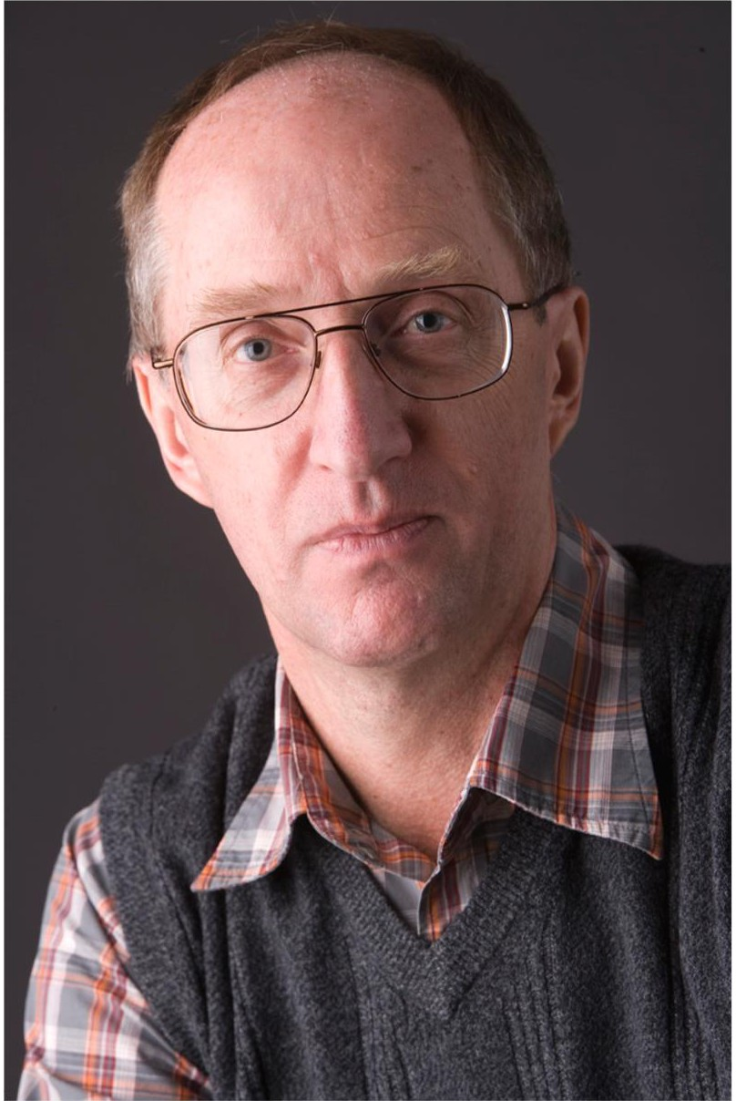
In Memoriam
Dr. Nikolai V. Mokhov
December 13, 1946 – September 5, 2026
Remembering a colleague, mentor, and friend
Fermi National Accelerator Laboratory, 1994 – 2023

Slide 2
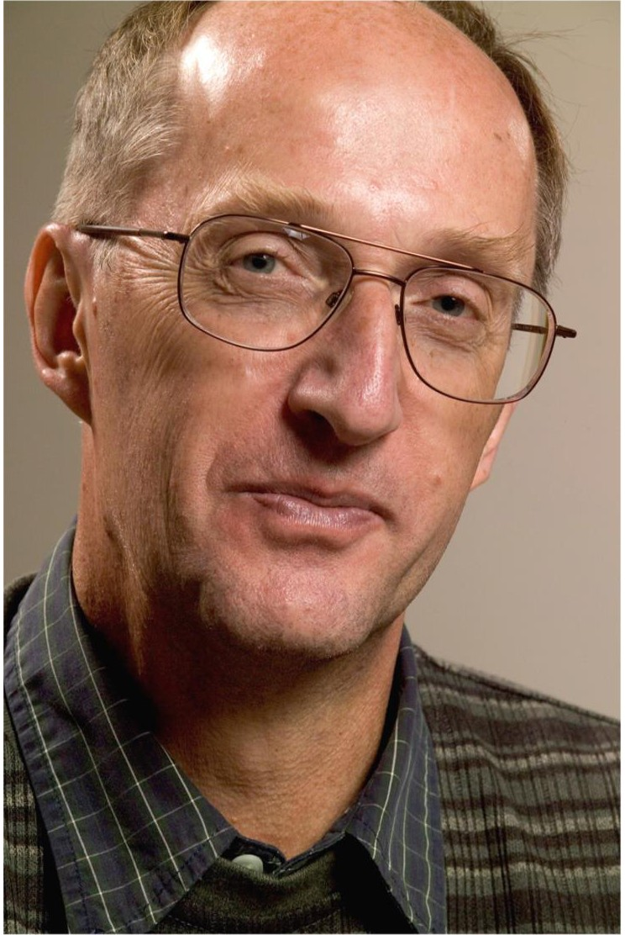
Dr. Nikolai V. Mokhov
A globally recognized physicist and pioneer in accelerator science
Nikolai passed away on Saturday, September 5, 2026,
at the age of 79.
Born on December 13, 1946, he dedicated his life to computational physics. In the early 1990s he moved with his family from Russia to the United States, worked on the Superconducting Super Collider, and then served Fermilab for nearly three decades until his retirement in 2023.
He is survived by his wife, Ljudmila, and his sons, Dmitry and Oleg.
He leaves behind a profound legacy in the global physics community and in the infrastructure of modern scientific discovery.
Nikolai in 2005

Slide 3
A Life in Physics
From Moscow and Protvino to Dallas and Batavia
1971
1976
1992
1994
MEPhI, Moscow
IHEP, Protvino
SSC Laboratory
Fermilab
MS in physics (1971); PhD in theoretical and mathematical physics (1976)
Senior Scientist and Group Leader; began developing the MARS code
Worked on the Superconducting Super Collider in Dallas, Texas
Group Leader, then Distinguished Scientist and MEDT Department Head; retired 2023

Slide 4
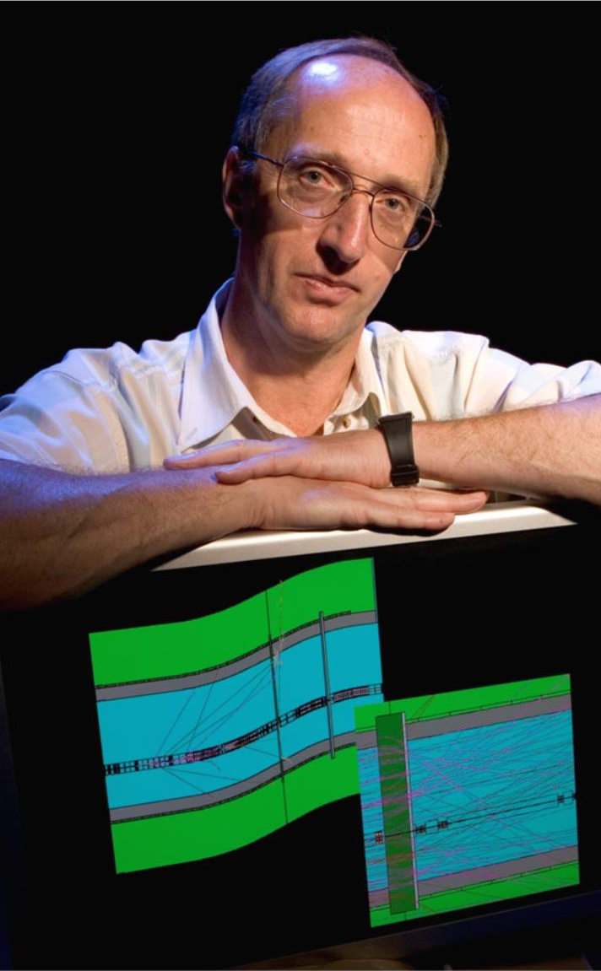
The MARS Code
Original developer of a general-purpose Monte Carlo code for radiation transport in matter
Born in Protvino in the 1970s
Groundbreaking multi-purpose code system that shaped accelerator modeling for generations
Powering the Fermilab complex
Supported the Tevatron, PIP, PIP-II, FAST/IOTA, and DUNE/LBNF
Used around the world
Applied to the SSC, LHC, ILC, and many other projects at laboratories worldwide

Slide 5
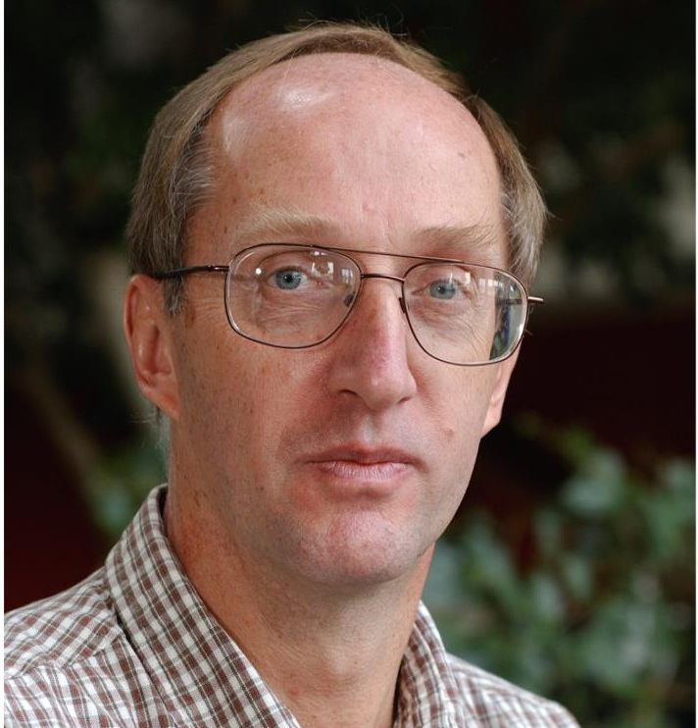
~30 years
of service at Fermilab, 1994 – 2023
MARS
his Monte Carlo code, in use for five decades
2002
Fellow of the American Physical Society
Nikolai in 2003

Slide 6
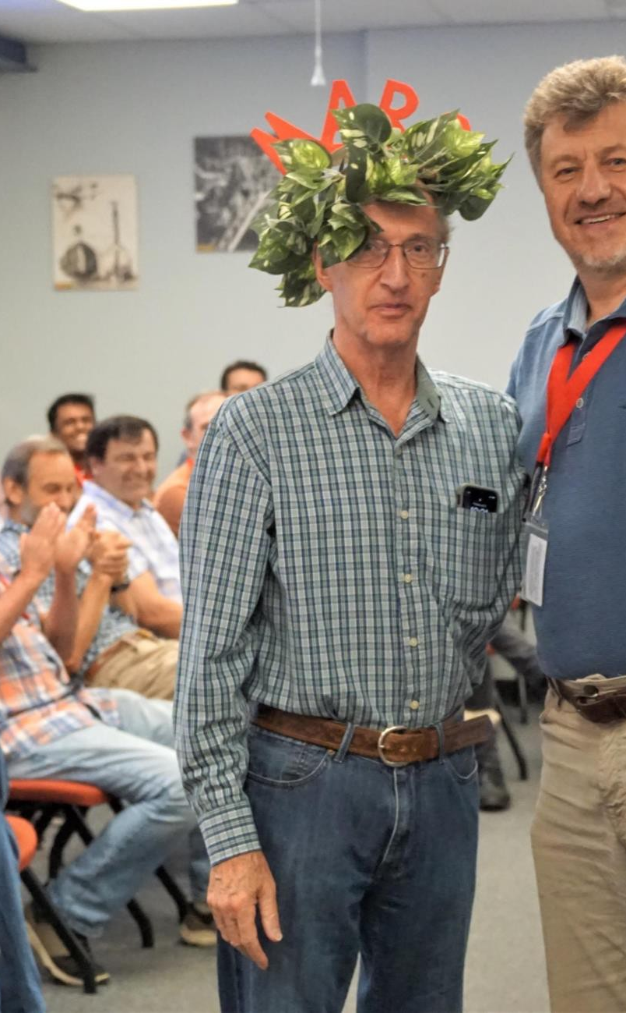
Leader and Mentor
Recognized for his work on the accelerator–detector interface
Department Head
Led the Energy Deposition Group and the Modeling, Energy Deposition and Theory (MEDT) Department
Educator
Sought-after instructor at schools on radiation problems; mentored the next generation of physicists
International collaborator
Strong proponent of global collaboration, connected with CERN, SLAC, KEK, and institutions worldwide
Retirement celebration, July 2023

Slide 7
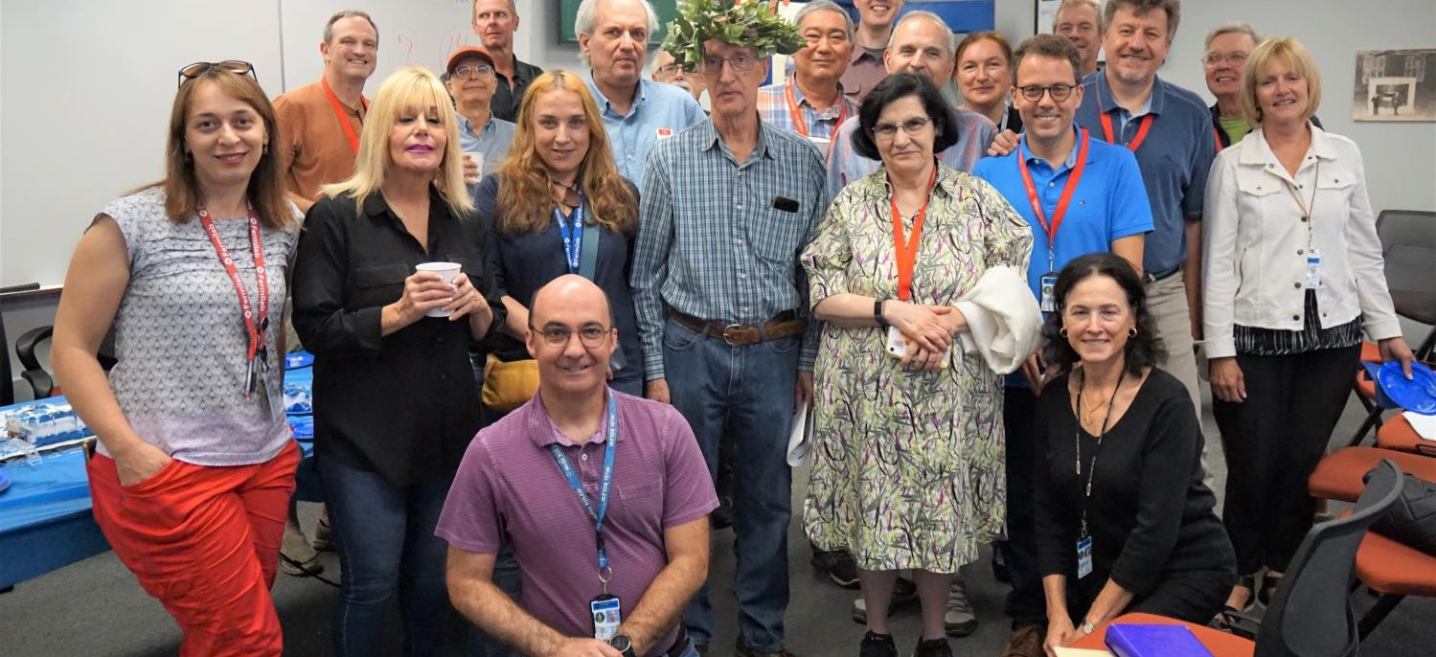
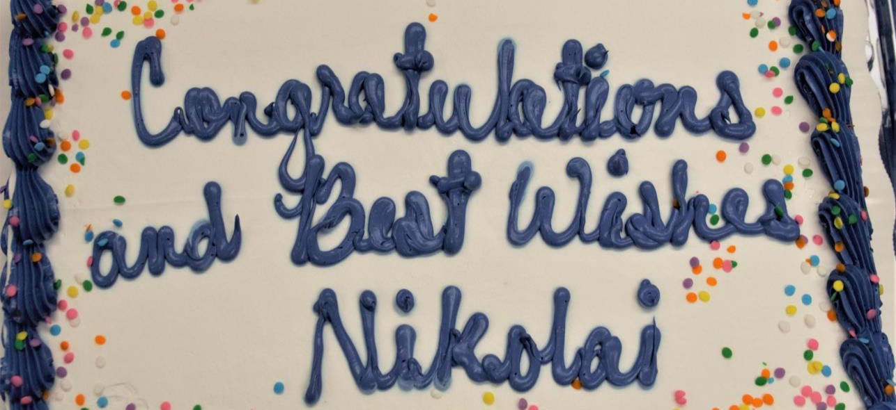
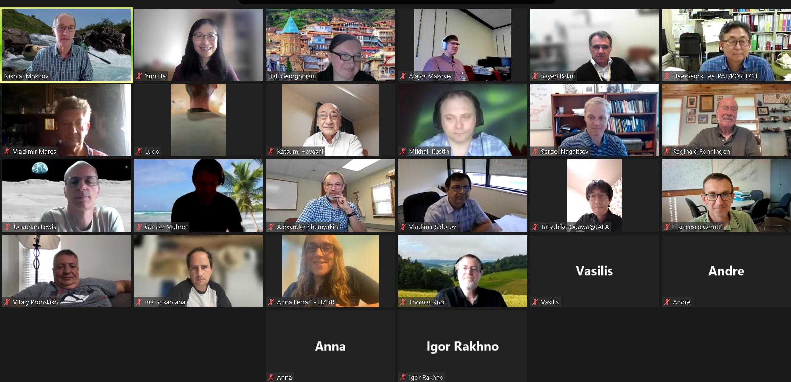
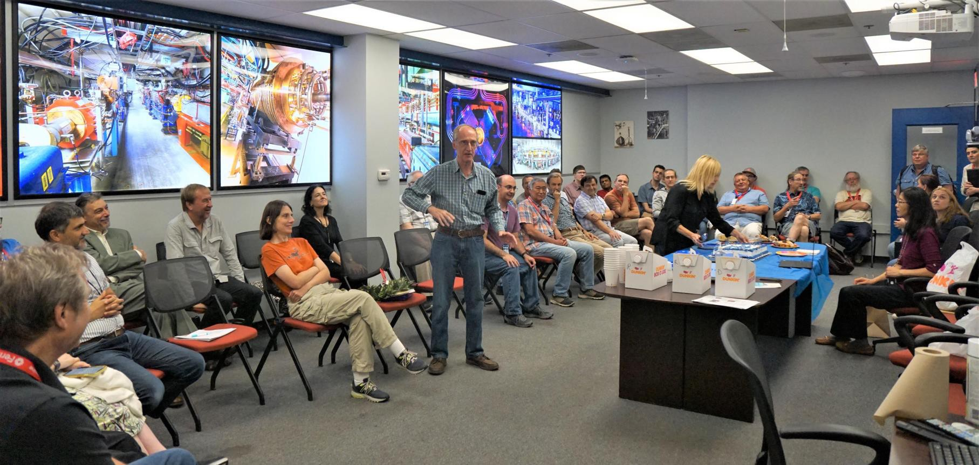
Celebrating Nikolai, July 2023
Colleagues at Fermilab and friends around the world gathered to thank him

Slide 8
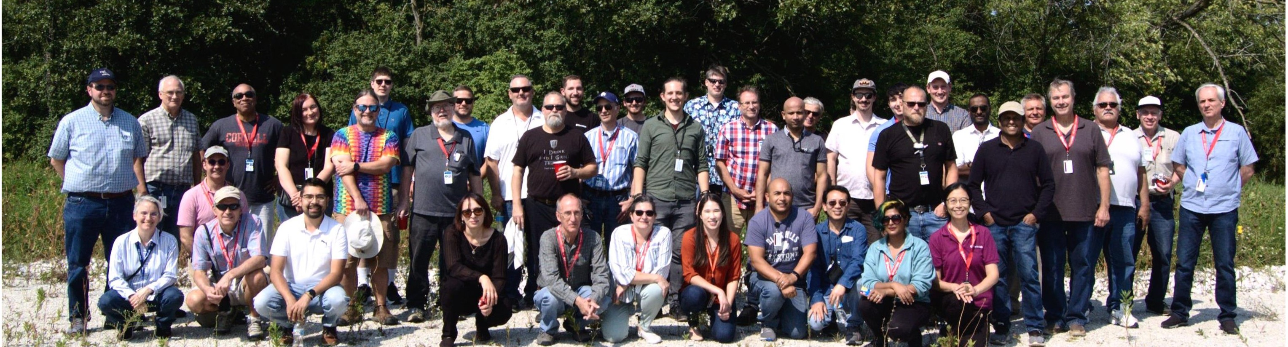
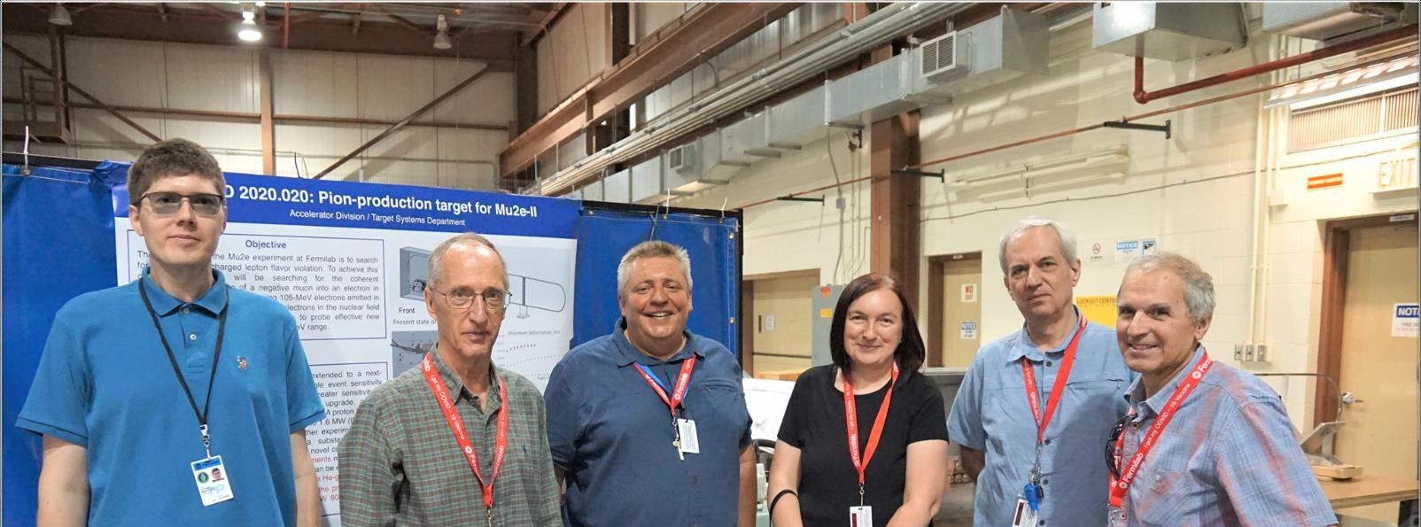
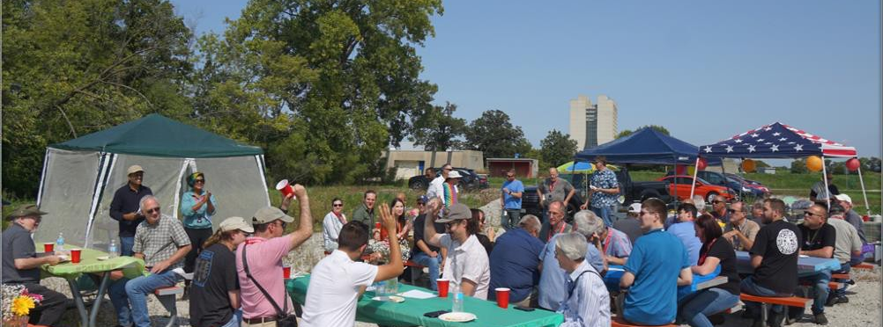
With the Target Systems Department
Target Systems Department, September 2022

Slide 9
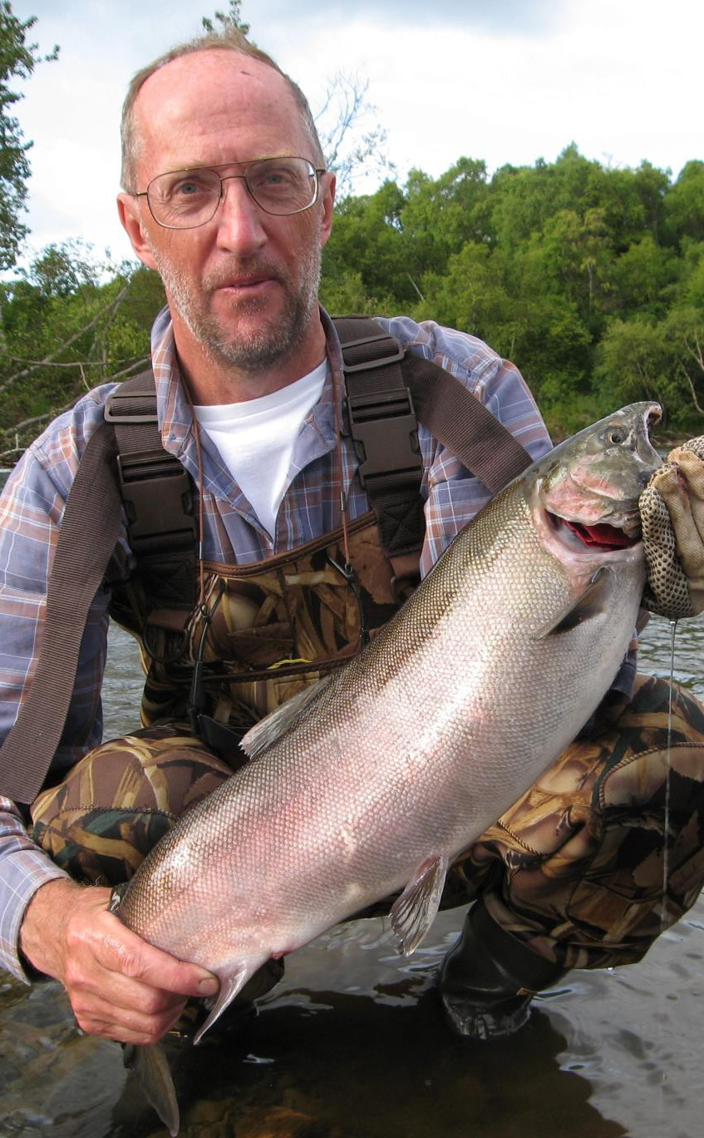

Beyond the Lab
A kind, brilliant, and vision-driven scientist
Survived by his wife, Ljudmila, and his sons, Dmitry and Oleg
An avid fisherman and outdoorsman: his retirement plans included 100 miles of white-water rafting and fishing, from snow-caps to the ocean
Remembered by family, friends, and hundreds of colleagues around the world

Slide 10
In the Words of His Colleagues
Notes from Nikolai's 2023 retirement album
Bob Zwaska
Kris Anderson
Yun He
“I am forever grateful to have worked with you and witnessed your wisdom and dedication.”
“Your expertise and great personality made these challenging assignments rewarding and enjoyable.”
“Your genuine humility shines through in the thoughtful notes expressing appreciation for every small help.”
Yosuke Iwamoto
Jonathan Williams
Kavin Ammigan
“My deep respect for your achievements and your great contribution to accelerator shielding research.”
“One of your papers was my first real introduction to targets, so thank you for the excellent primer.”
“Thank you for all the guidance and advice you provided to me over the last several years.”

Slide 11
Condolences from the SATIF SOC Members
Nikolai has been an important mentor, colleague, and friend to me and the community loses one of the fathers of particle transport simulations. I will always remember Nikolai for his passion for physics and collaboration, his enthusiastic and rich presentations, and for his warm and welcoming personality. I am deeply saddened by the loss.
— Stefan Roesler
My condolences to you and the team at Fermilab on the loss of Nikolai.
— Tom Ginter
I was sorry to learn of Nikolai's passing. Nikolai's scientific contributions and his support of the international accelerator community were truly exceptional.
— Sayed Rokni
I'm deeply touched. I hope Nikolai can also be remembered with a paper on the CERN Courier, in view of his direct and crucial contribution to the LHC design.
— Francesco Cerutti

Slide 12
Condolences from the SATIF SOC Members
This is very sad news for me as well. I had the privilege of collaborating with Nikolai on many research and development activities, including calculations and experiments related to radiation shielding and irradiation damage. I learned a great deal from him over the years and am deeply grateful for his guidance and support. My thoughts are with his family, friends, and colleagues during this difficult time.
— Yosuke Iwamoto
This is very sad and regrettable news for me as well. I would like to offer my prayers for his soul. I had known him for 30 years. To me, he was both a mentor and a colleague with whom I planned experiments. Please convey my heartfelt condolences to his family.
— Hiroshi Nakashima
Please let me express my condolences. I am very sorry for your loss. Unlike everybody else on the SATIF SOC, I never had the pleasure to talk to Nikolai. But of course I know of his work, and I also know that he and his team did a lot of great work for ESS about 10 years ago. It is obvious that he had a huge impact on the field, and that he will be remembered for what he did, but also for who he was. His passing is not only a loss to his family and his friends, but for the whole community.
— Günter Muhrer
This is deeply saddening news. I express my deepest condolences on his passing. I had many memorable experience working with Nikolai and he helped me and my colleagues a lot. I still remember his online retirement event.
— Hee-Seock Lee

Slide 13
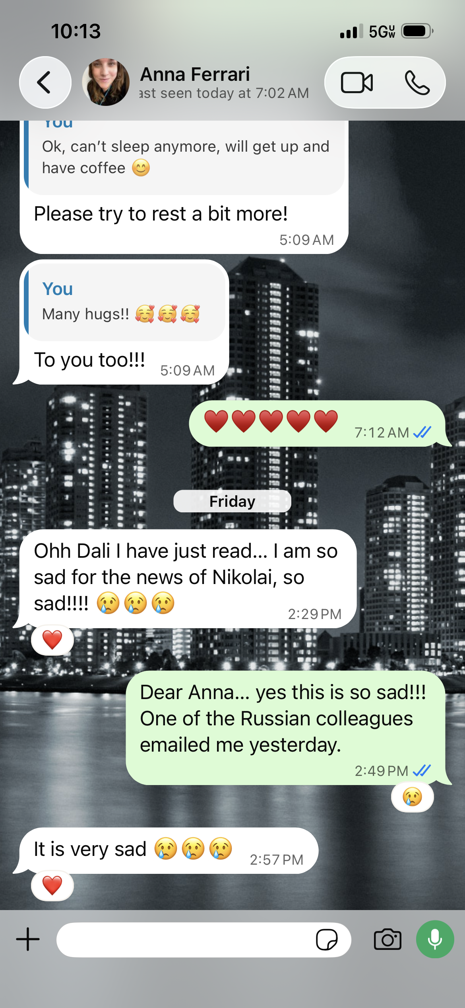
Condolences from the SATIF SOC Members
I, too, was saddened to hear the news. It was a valuable experience for me to interact with Nikolai on various levels, including through SATIF. Please convey my heartfelt condolences to his family.
— Hideo Hirayama
I am deeply saddened by the news. I met Nikolai a while ago and throughout the years could witness his outstanding scientific skills combined with his kindness. I concur that he has been a champion of international collaboration. Please convey my condolences to his family. R.I.P.
— Pedro Vaz
I want also to take this occasion to add my words of condolences for Nikolai: he was a giant, I had (and still have) a deep respect and special affection for him, he was for me a model in the way of thinking the radiation physics (since my first meeting with him in 2010 at CERN), and the news of his lost brought me great sadness.
— Anna Ferrari

Slide 14
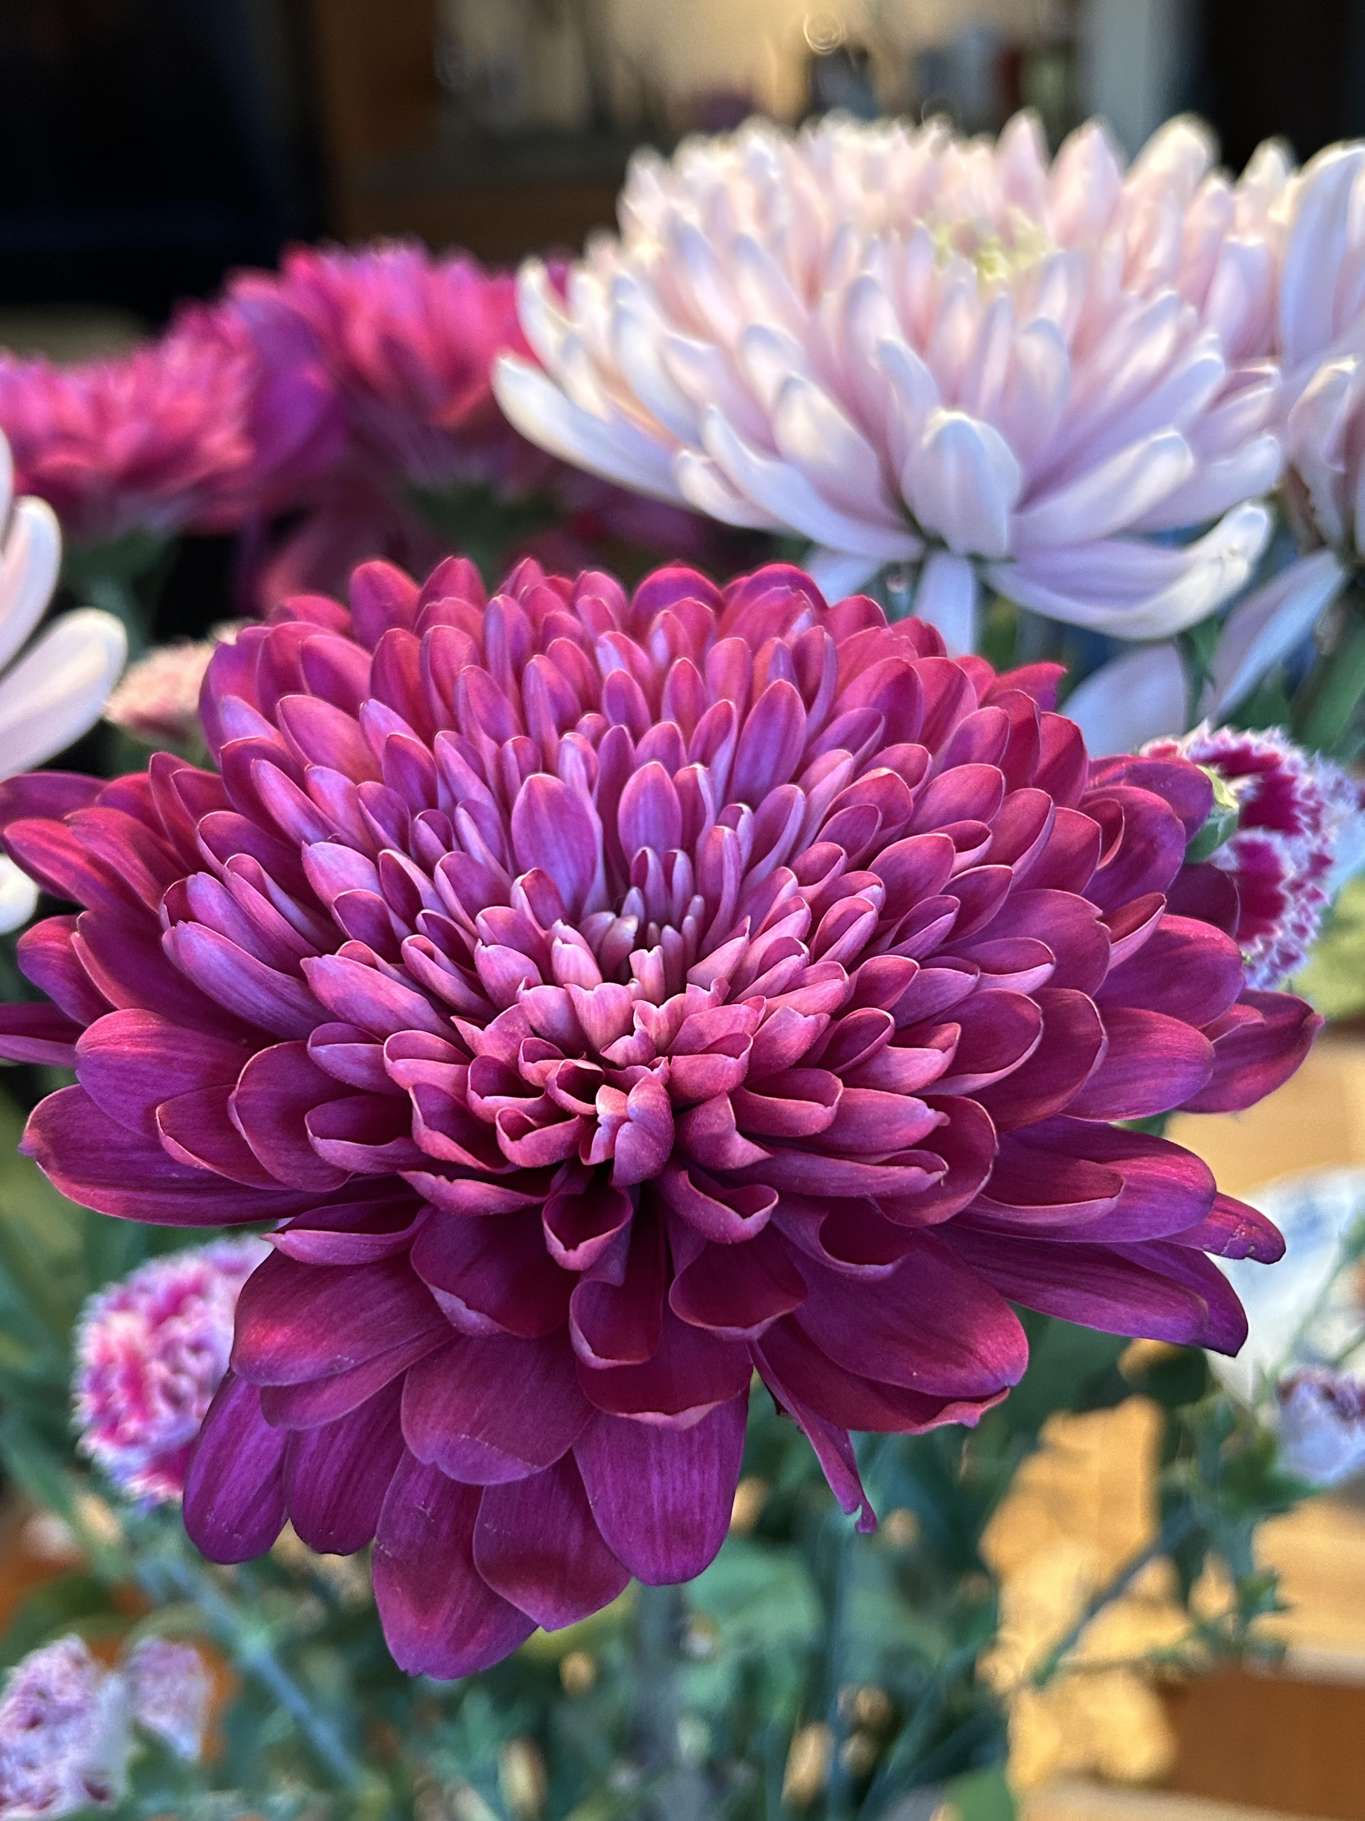
Nikolai V. Mokhov
1946 – 2026 · Forever in our memory

