Slide 1
RP studies and operational experience from the decommissioning of the CNGS target area
A. Devienne, C. Ahdida, E. Nowak, C. Saury, S. Boucly, D. Estellon, M. Tirronen, R. Charousset, F. Aberle and P. Bertreix
SATIF-17 (20-22 October 2026)
EDMS 3536520

Slide 2
Content
Introduction
Characterization
Benchmark
Feedback
Conclusion

Slide 3
Introduction
CNGS & Target Area Decommissioning

Slide 4

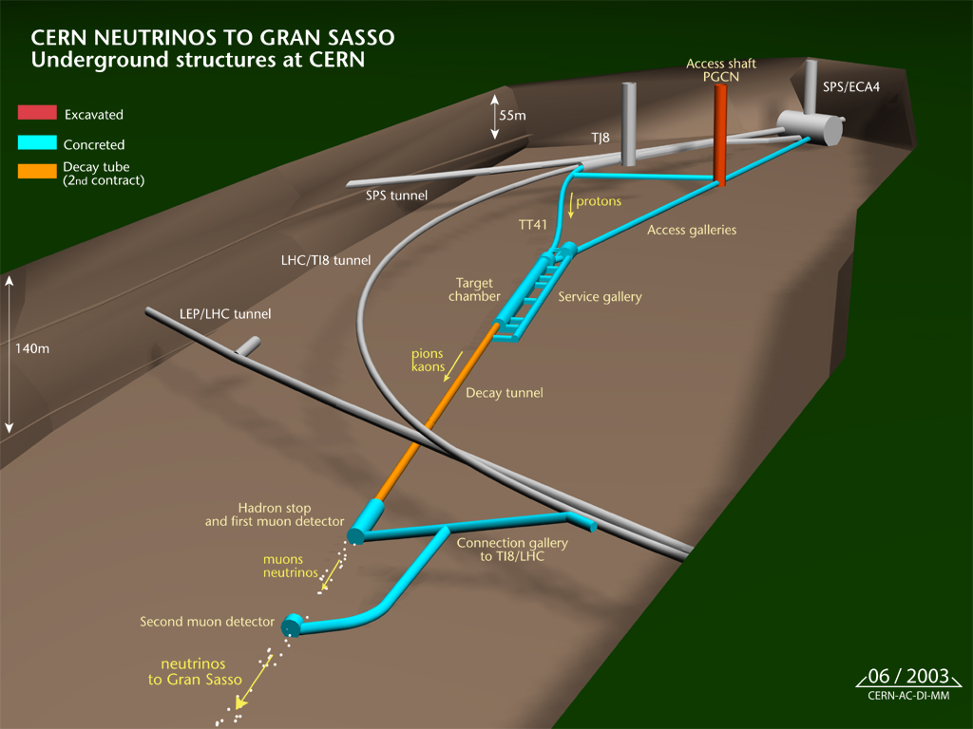
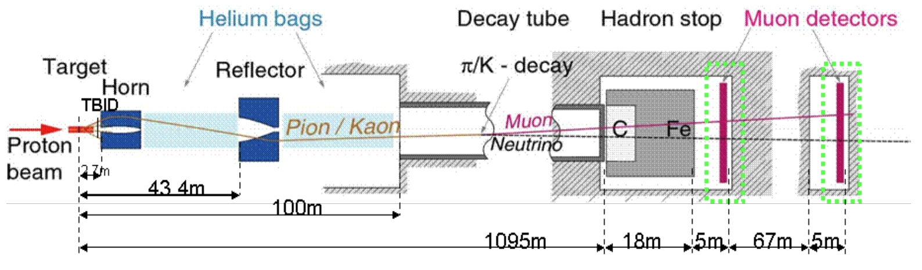

Introduction
The CNGS experiment (2006-2012) aimed at detecting muon-to-tau neutrino oscillations with an intense muon-neutrino beam generated at CERN directed over 732 km towards the Gran Sasso National Laboratory in Italy.
Target Area (TCC4)
Beam p+
400 GeV/c
$$ν_{μ}$$
Beam line description
Year | Mode | Protons on target (pot/year)
2006 | Commissioning | 0.08E+19
2007 | Commissioning | 0.08E+19
2008 | Physics | 1.78E+19
2009 | Physics | 3.52E+19
2010 | Physics | 4.04E+19
2011 | Physics | 4.84E+19
2012 | Physics | 3.90E+19
TOTAL |  | 1.82E+20
732 km
Gran Sasso (Italy)
Detectors: OPERA & ICARUS
Beam intensities

Slide 5

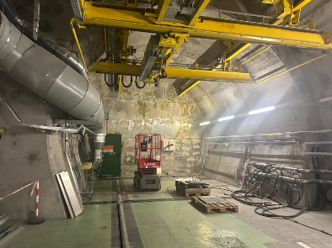
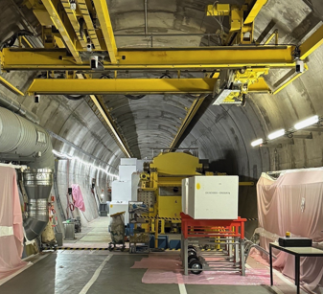
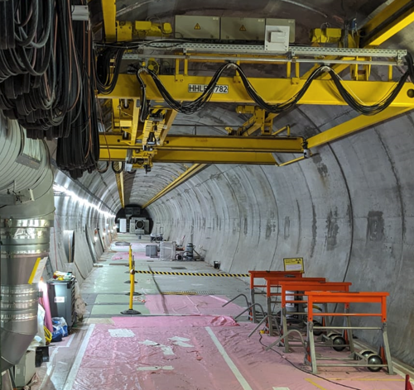
Introduction
Motivations of CNGS Target Area Decommissioning (2025-2026, 12 MCHF):
  Extension of the AWAKE experiment after LS3
  Re-use of standard shielding blocks for other CERN facilities (400 m³)
  Minimize CERN on-site radioactive storage (VLLW 81 m³, LILW 102 m³)
November 2025
January 2026
October 2026

Slide 6
Characterization
Studies & validation

Slide 7

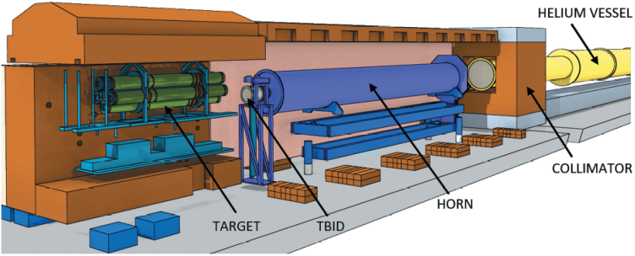
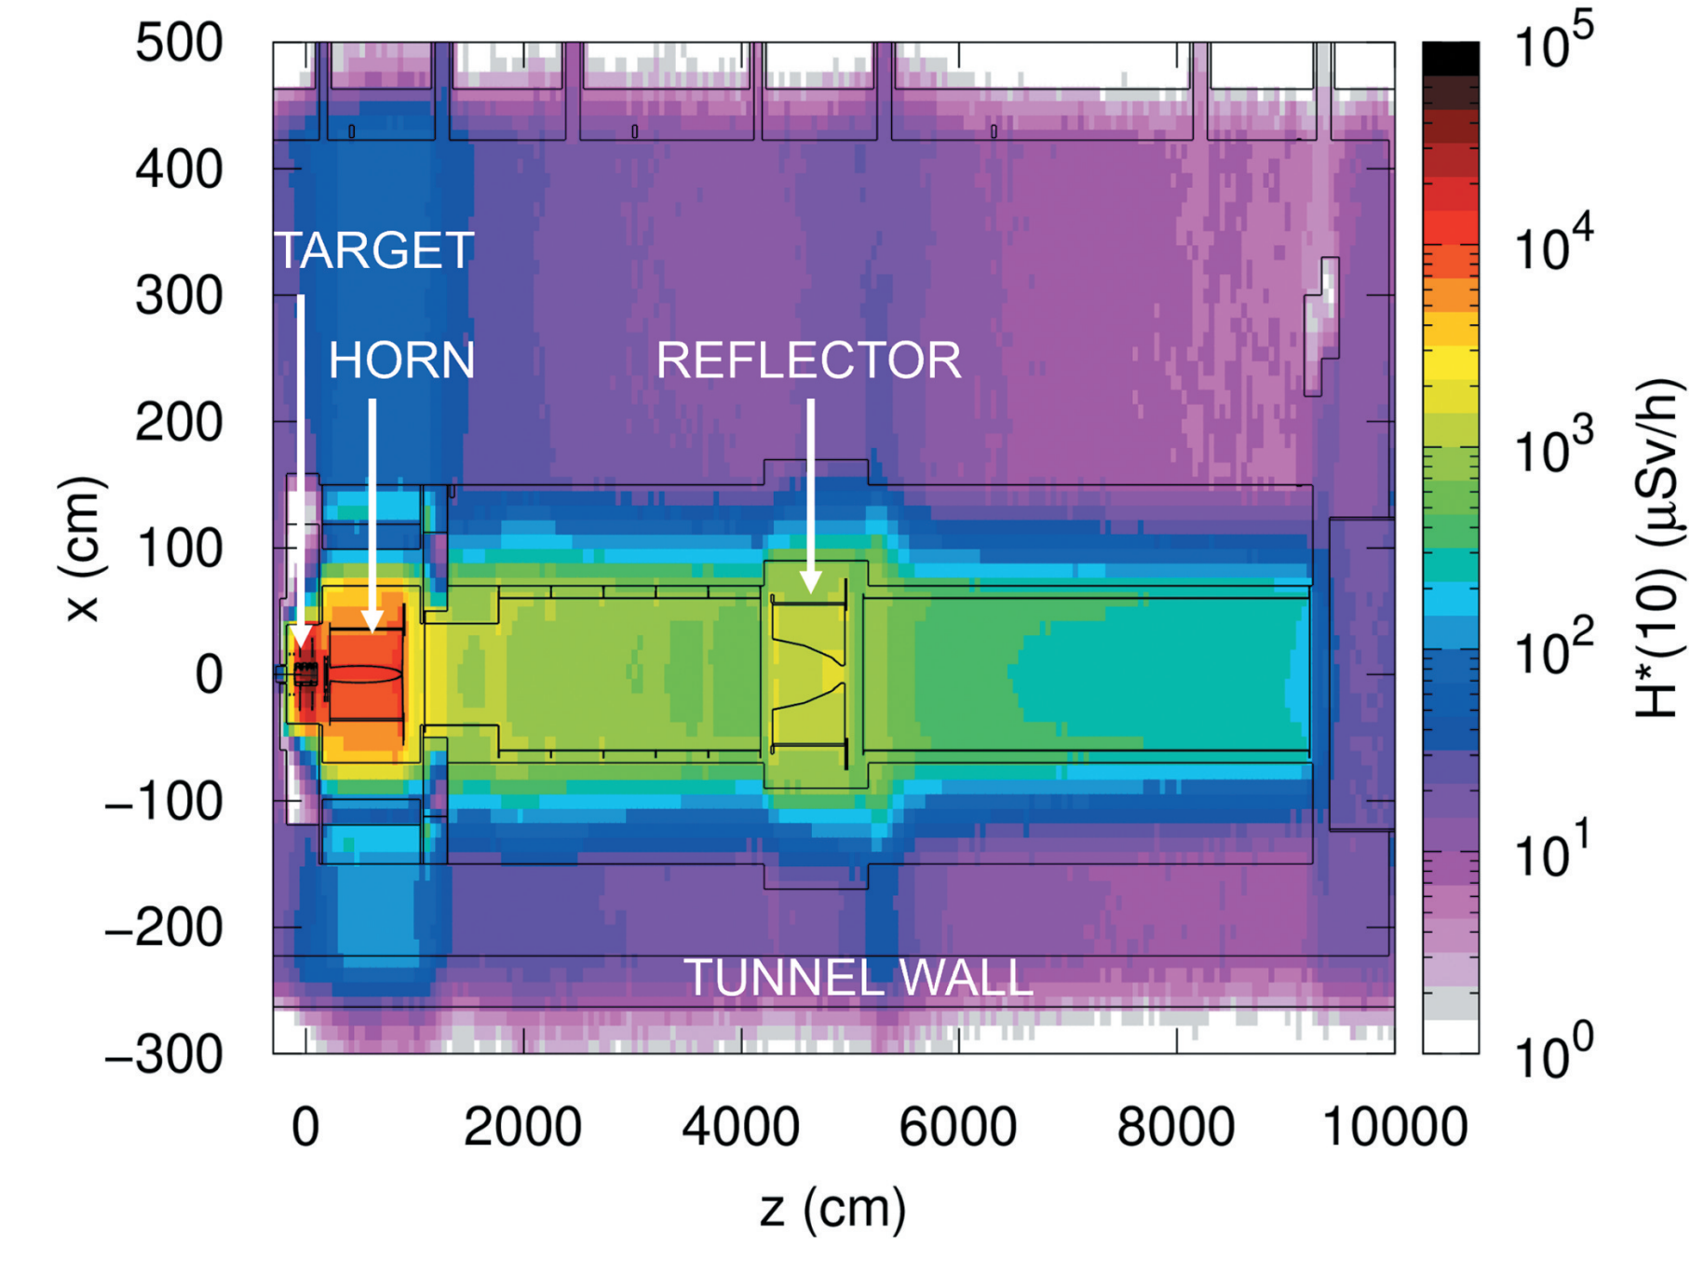
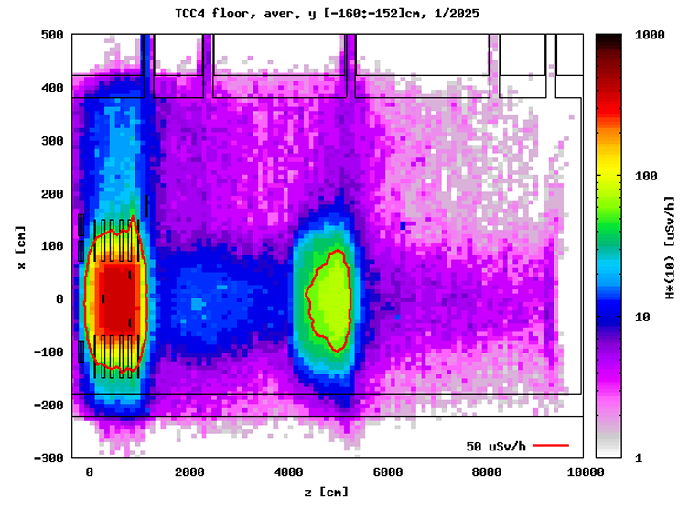
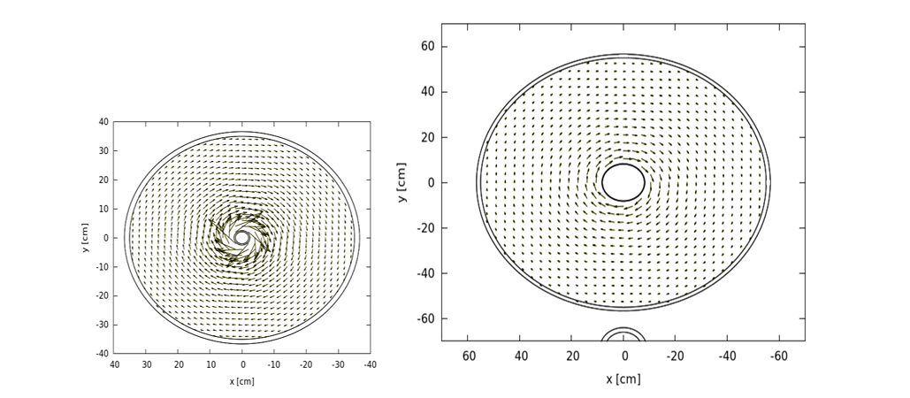
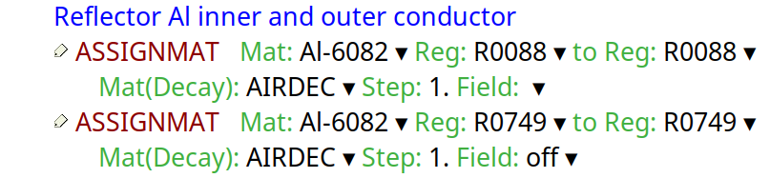

Characterization – studies
FLUKA v4.0-x
FLUKA Model
Scoring residual dose rate and activities
Detailed CSG model with CNGS beam line components, supports, shielding and concrete tunnel floor/walls
Residual dose rate in the empty tunnel (April 2026)
(using ASSIGNMAT card to assign a different material at decay)
Residual dose rate after 11 years of cooling (December 2023) with all components
User routine (magfld.f) generating a toroidal magnetic field $B_{φ}\left(r\right)=\frac{μ_{0}I}{2πr} \text{in the Horn (I=150 kA) and }\text{in }\text{the Reflector (I=180 kA)}$
Identified past contributors to the current FLUKA model: A. Ferrari, M. Lorenzo, L. Sarchiapone, S. Roesler, H. Vincke, C. Ahdida, E. Nowak
C. Ahdida et al. (2023) 10.1080/00295639.2023.2204183

Slide 8
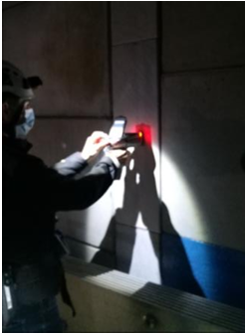
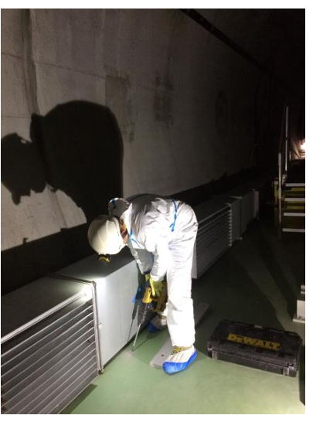
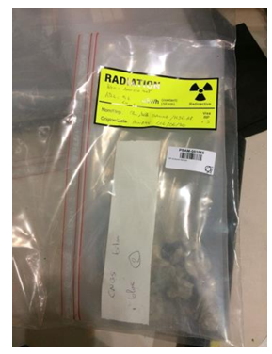
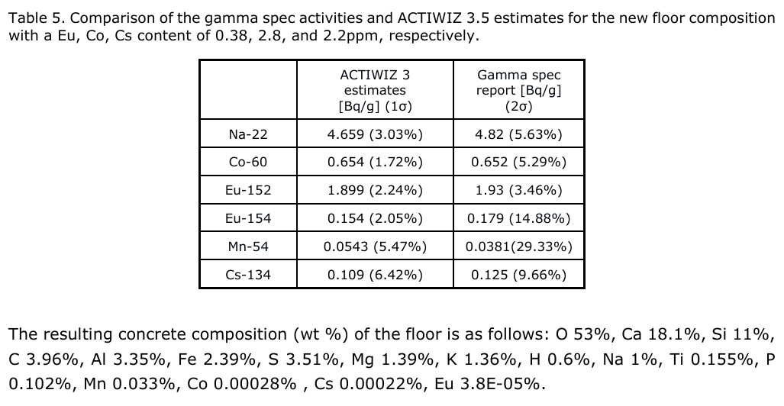
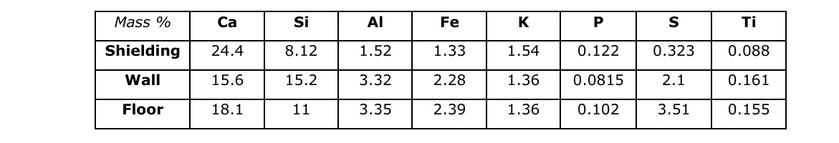
Characterization – validation
Material composition (concrete):
FLUKA + Actiwiz 3 simulations vs results from Gamma Spectrometry main radionuclides
Results of the Actiwiz and Gamma spectrometry for the concrete floor
  XRF measurements
  Sampling of concrete
  Gamma Spectrometry
Results of the XRF for the concrete composition of the shielding, tunnel walls and floor

Slide 9
Benchmark
Target, Horn & Empty tunnel

Slide 10

Benchmark – Target
Video overview of the handling, survey, cutting and packing of CNGS target station
Source: EDMS 3408902

Slide 11
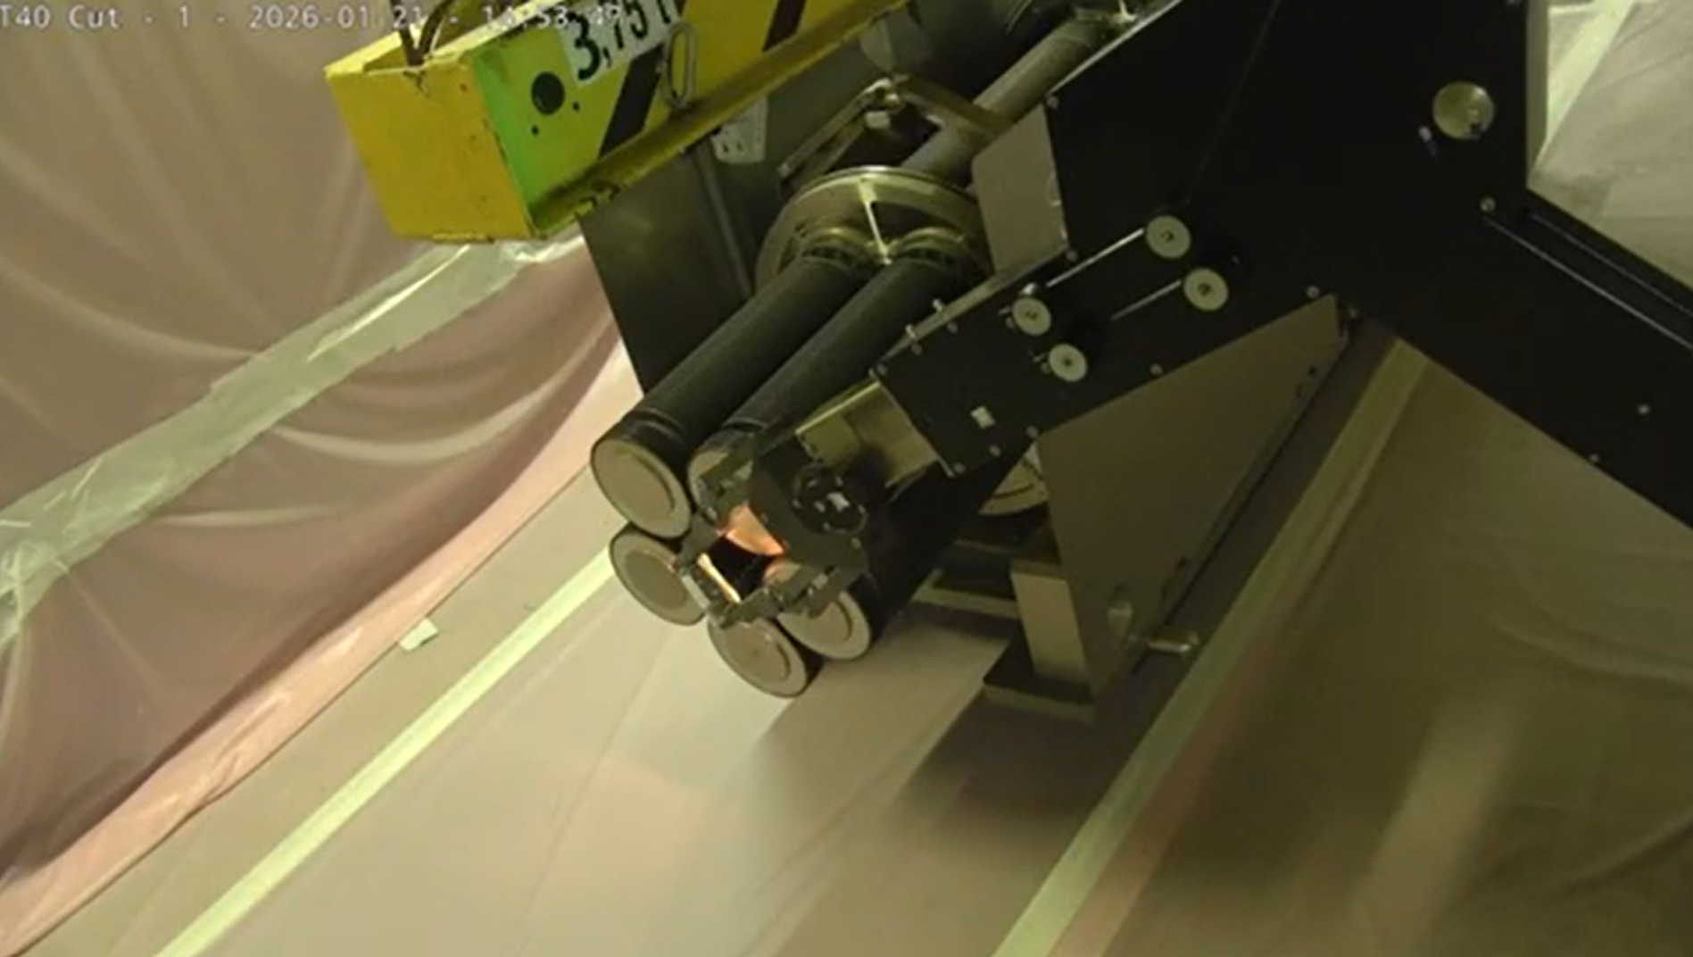
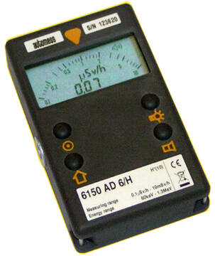
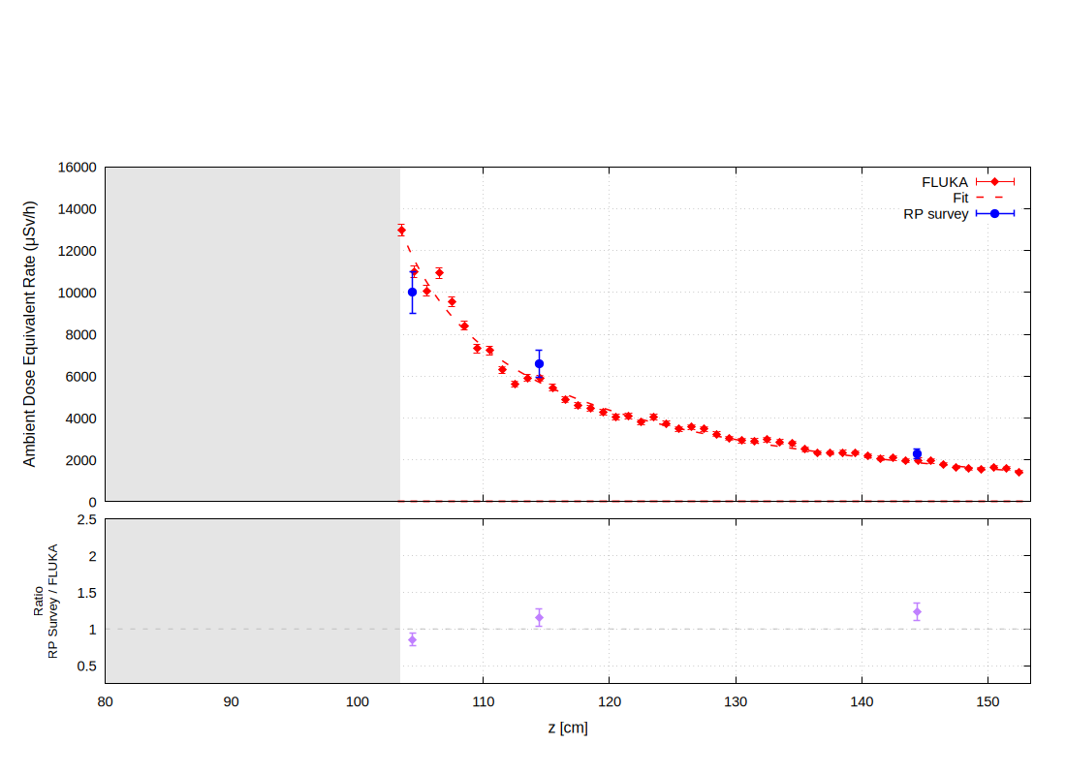
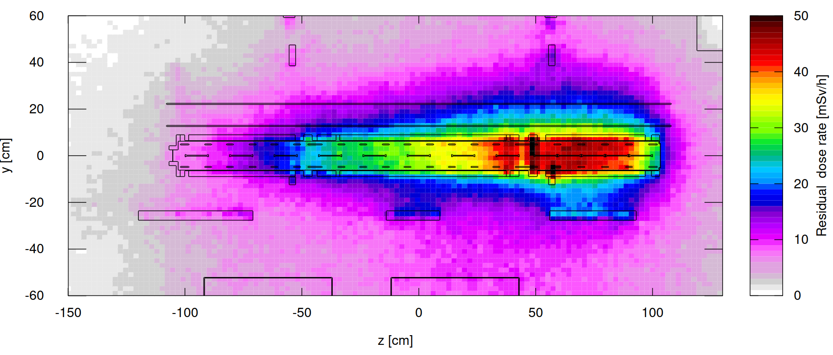
Benchmark – Target
FLUKA v4.5-x
Downstream:
  RP Survey performed with an AD-6 (Automess 6150AD) on a robot
  Ratio RP Survey / FLUKA ~1.2 (at 10 cm and 40 cm)
10 mSv/h (AD-6 & AD-t)
Residual dose rate at different distances from the downstream face. Averaged on X=[-5;5], Y[15;20]
Contact
Side view of the residual dose rate at the target location.
Averaged on X=[-5;5]
Target
10 cm
Beam
40 cm
Side view
Cool-down time for benchmark: January 2026

Slide 12
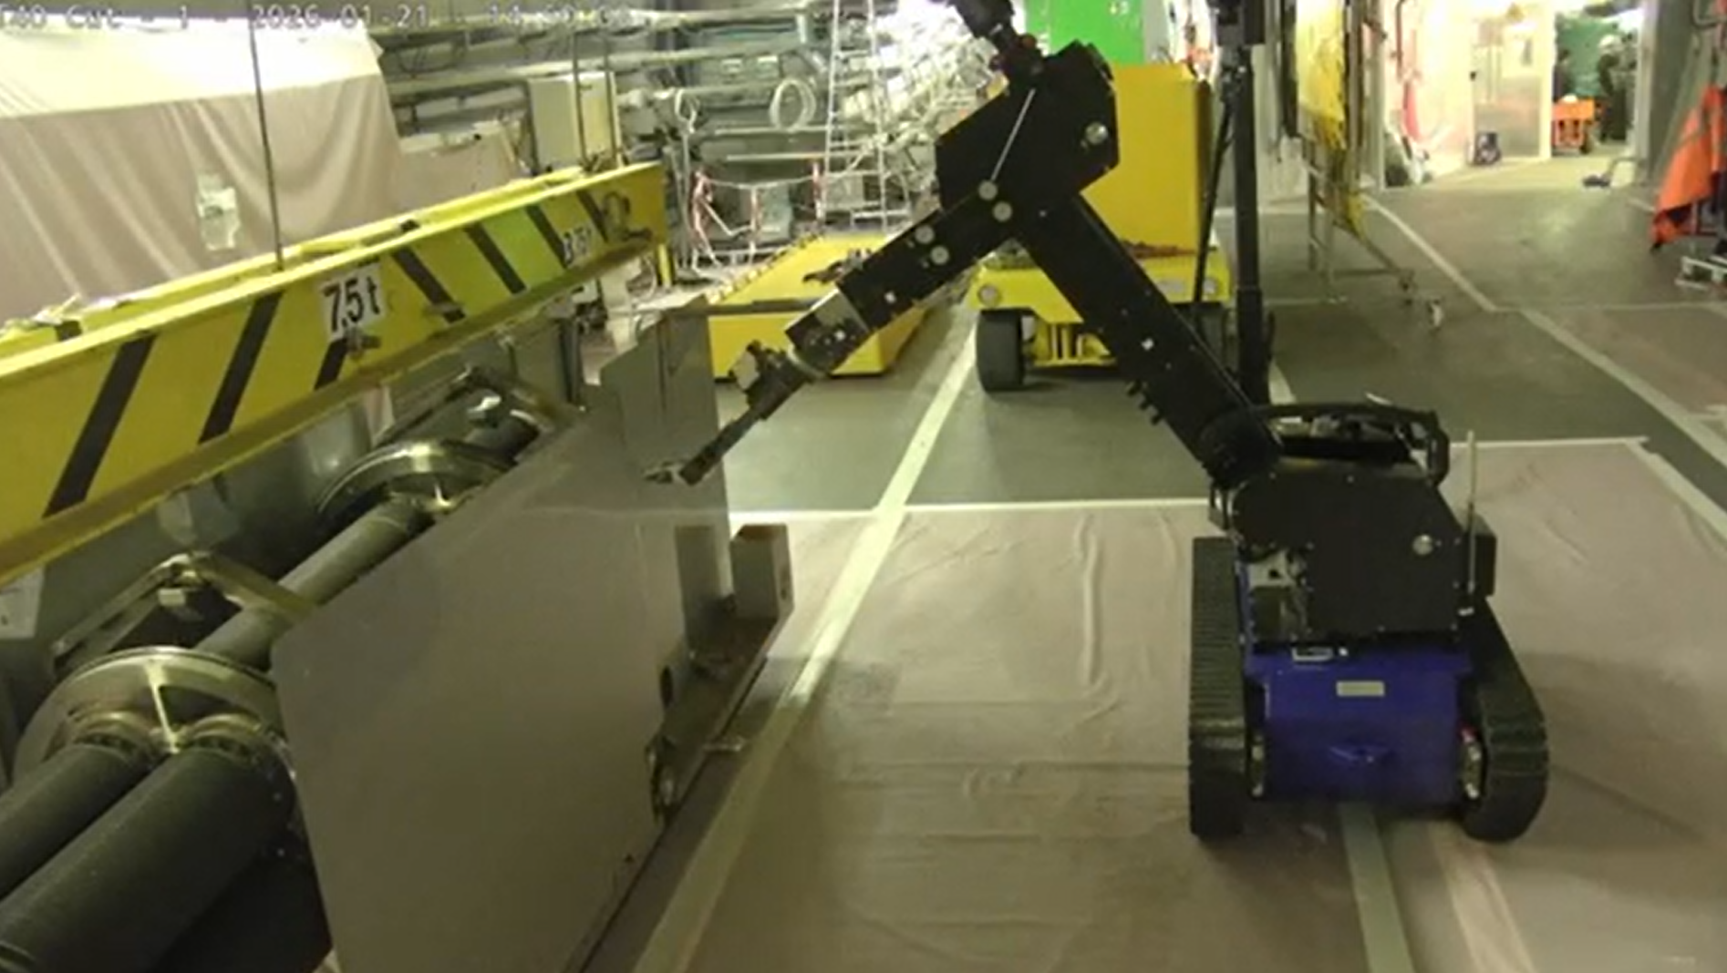
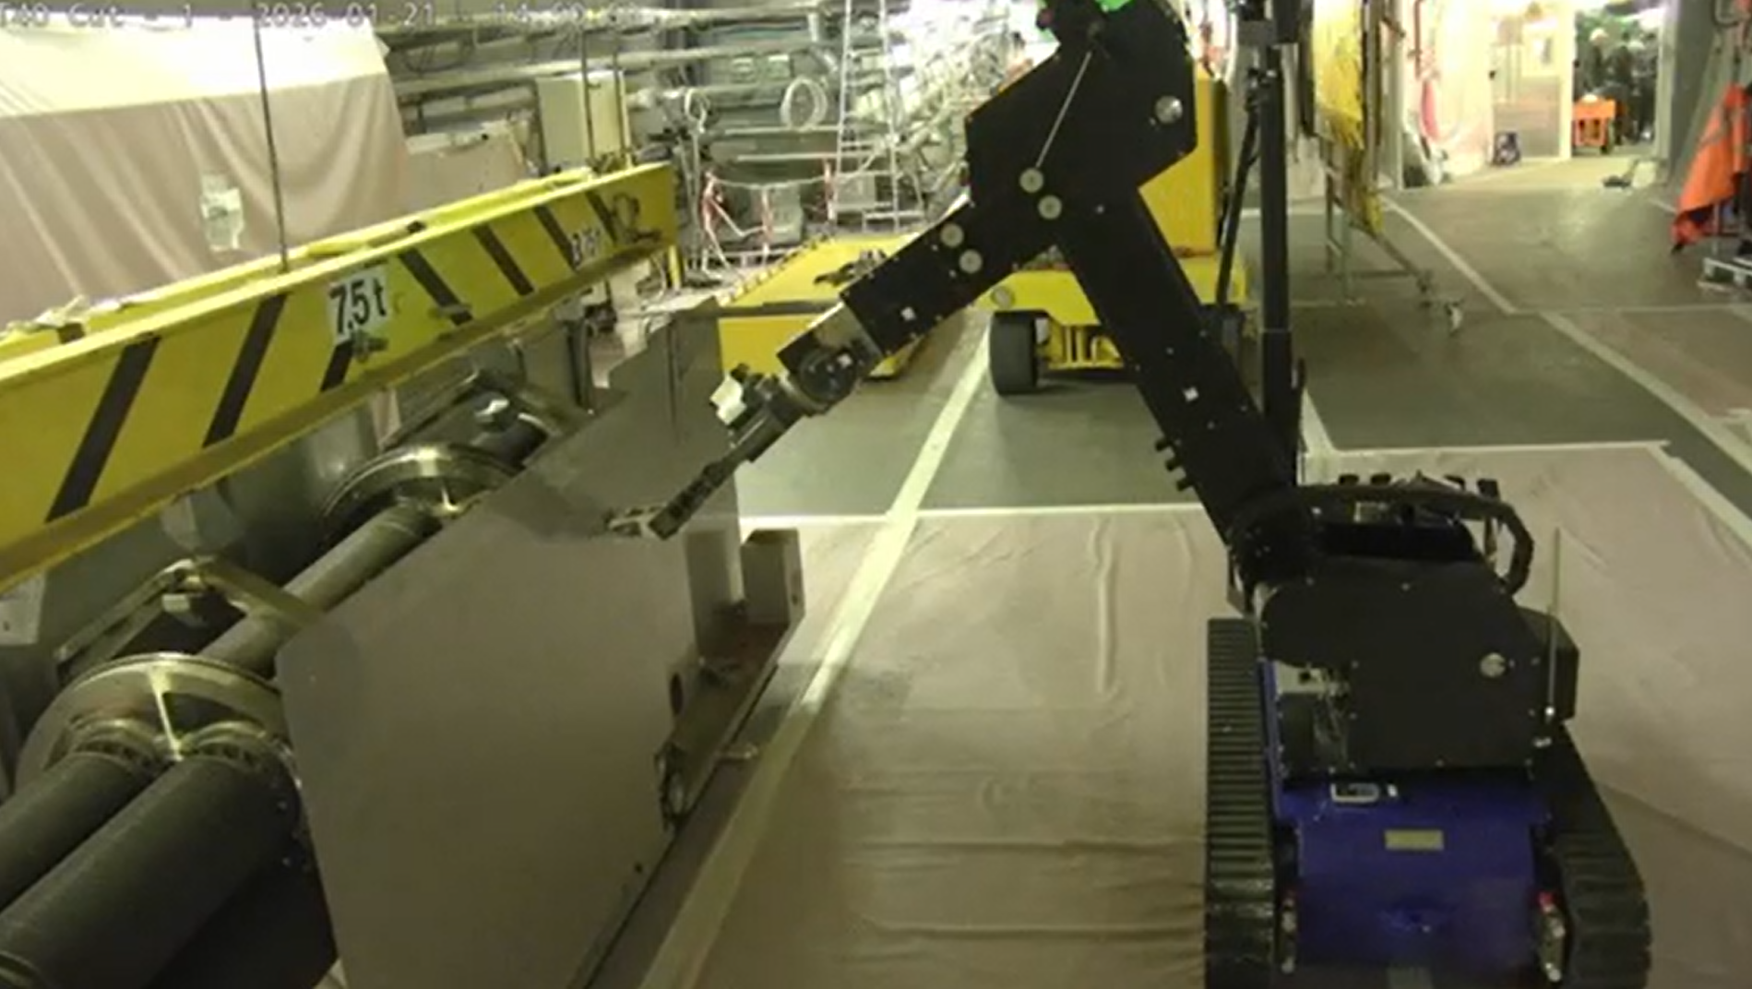
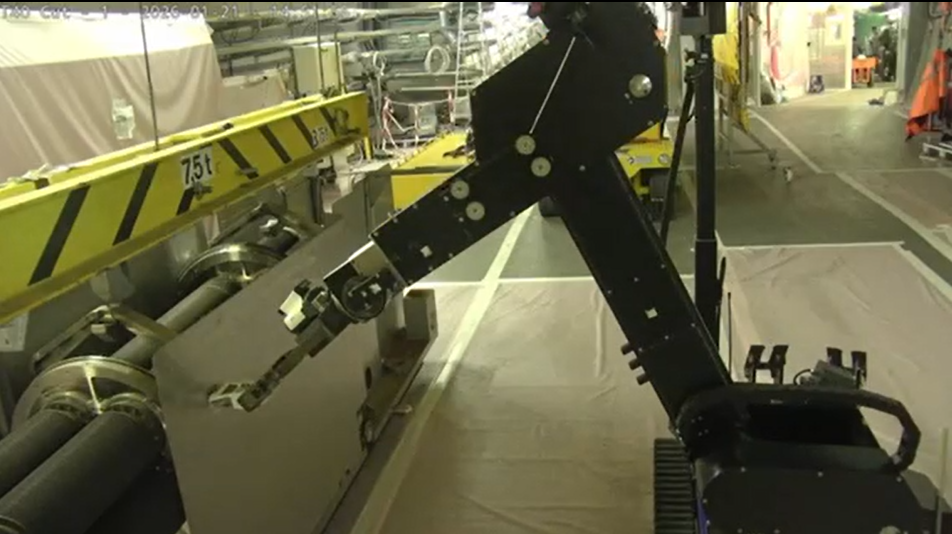
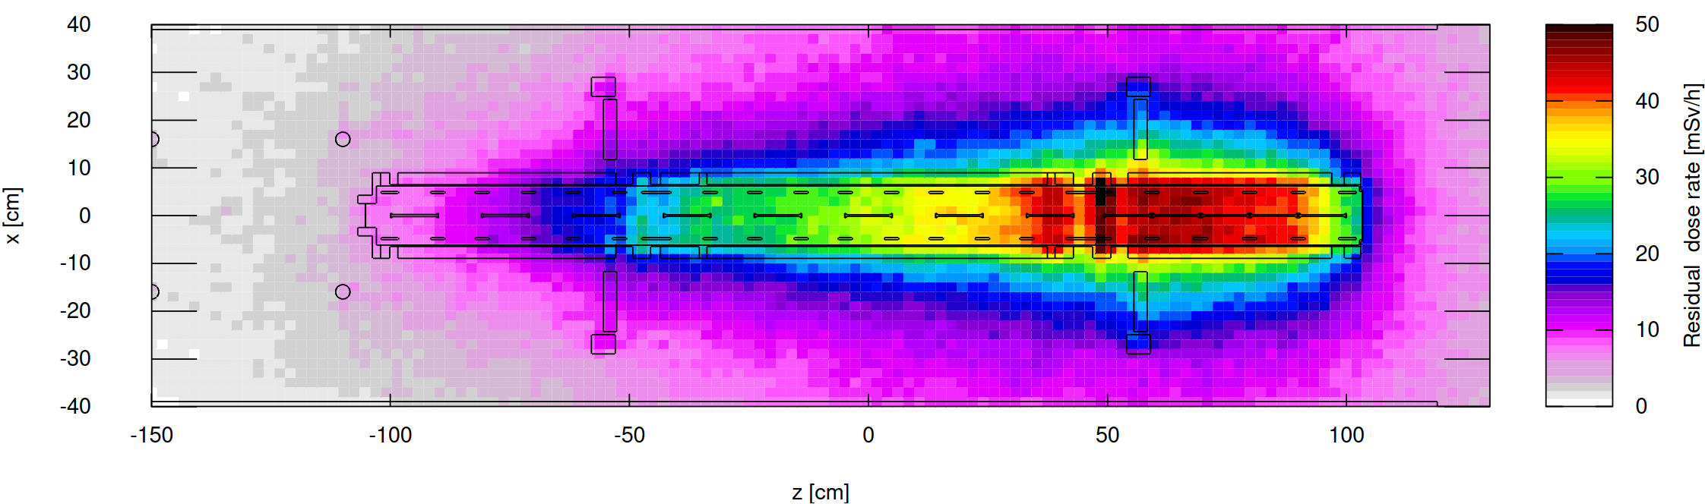
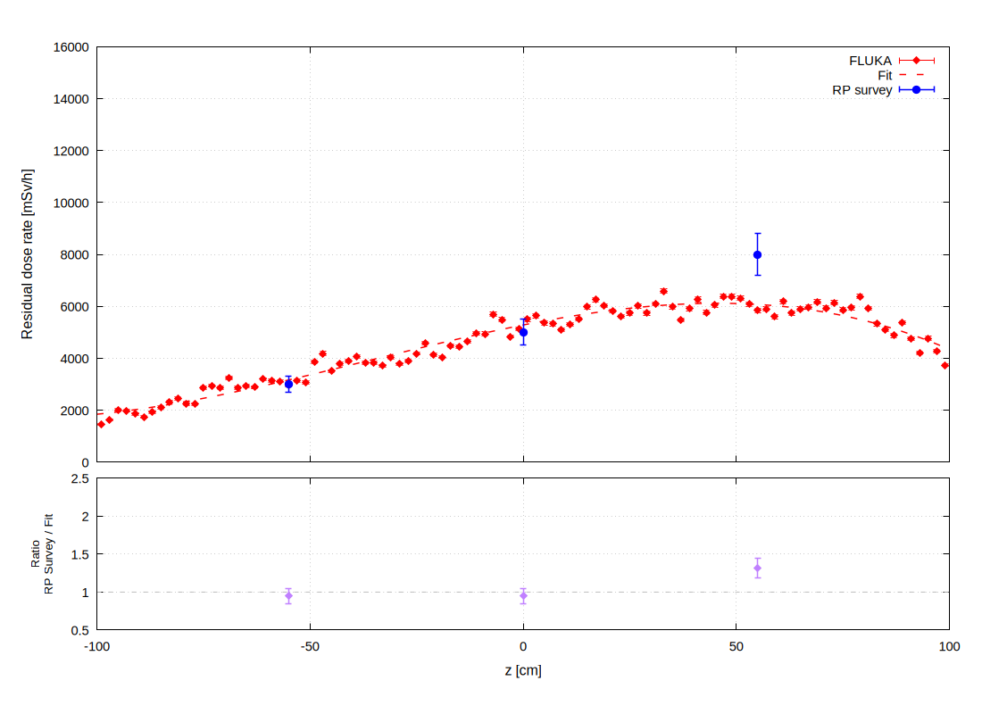
Benchmark – Target
(lateral upstream)
(lateral middle)
(lateral downstream)
Lateral:
Measurement at 10 cm laterally from the target station on the TCC4 corridor side at 3 locations (upstream, middle, downstream).
3 mSv/h (AD-6 & AD-t)
5 mSv/h (AD-6 & AD-t)
8 mSv/h (AD-6 & AD-t)
Top view of the residual dose rate at the target location. Averaged on Y=[-5;5]
Residual dose rate lateral target (@5cm).
Averaged on Y=[-10;10], X=[32;38]
upstream
downstream
Beam
middle
downstream
middle
upstream
Top view
Cool-down time for benchmark: January 2026
Residual dose rate from center along beam axis.
Averaged on X=[30;40], Y[20;30]

Slide 13
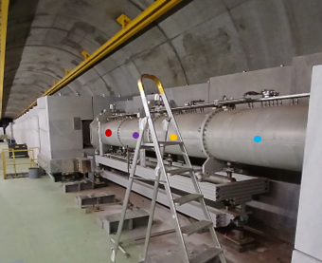
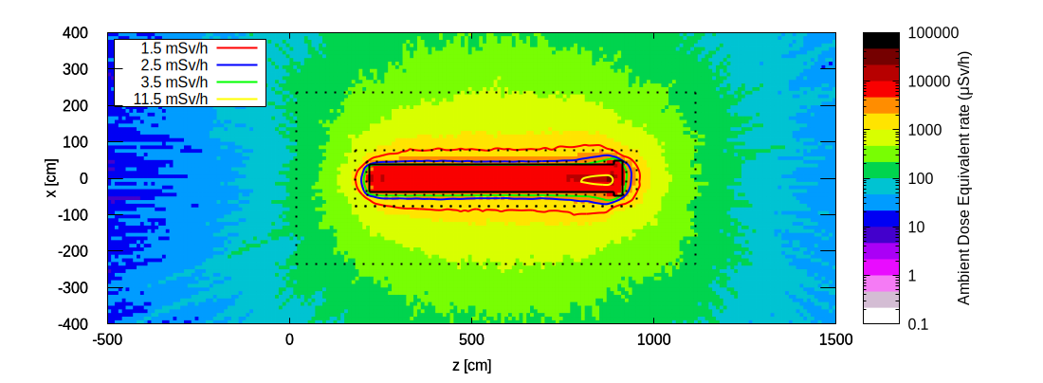
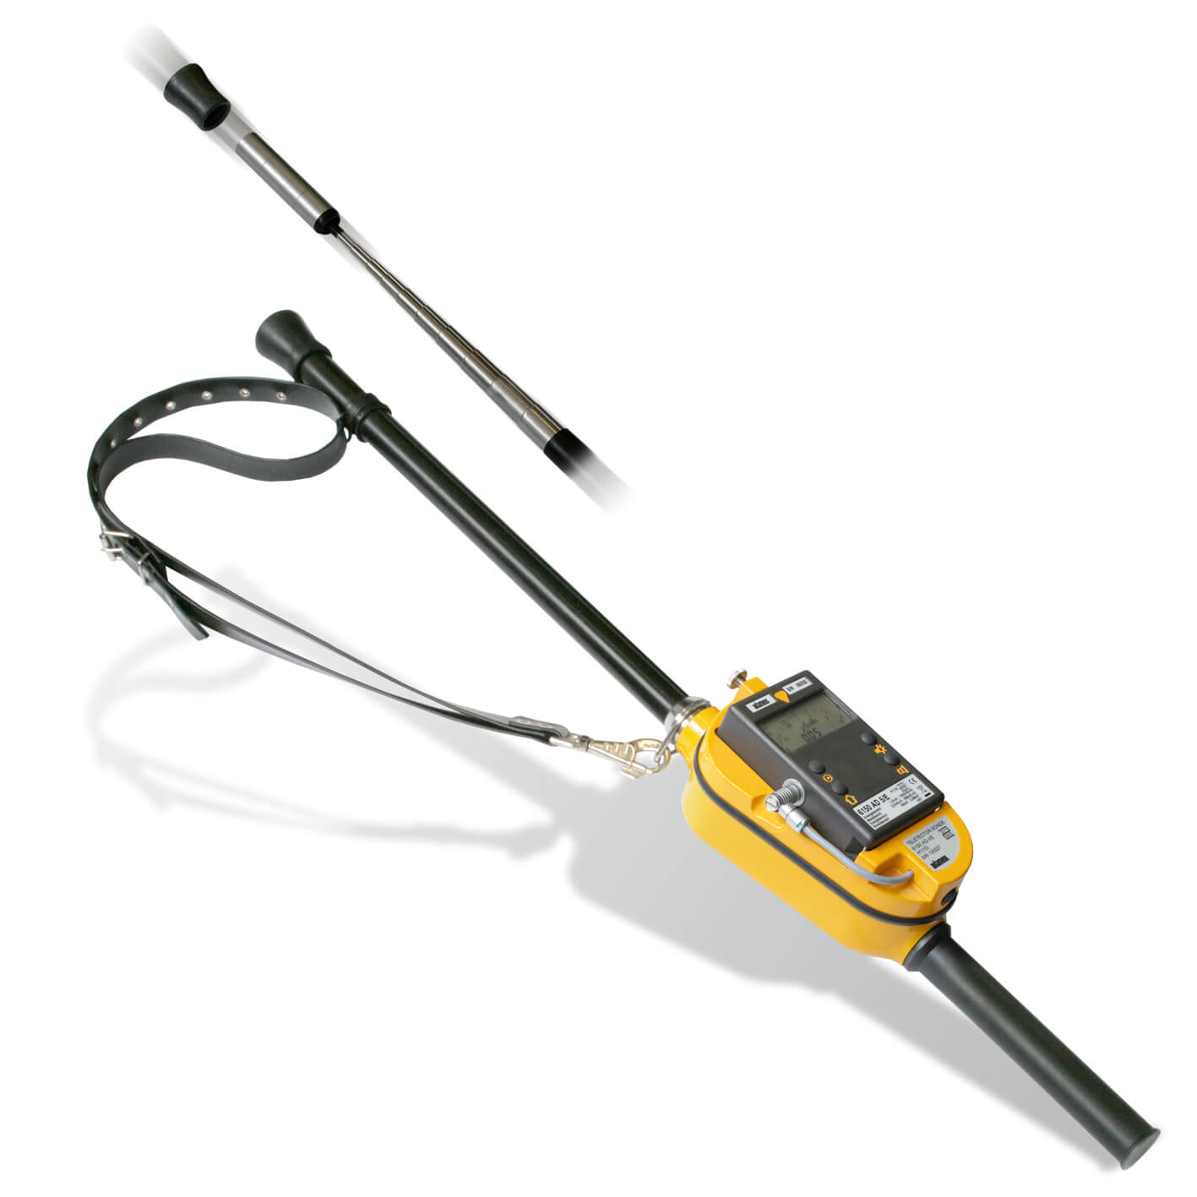
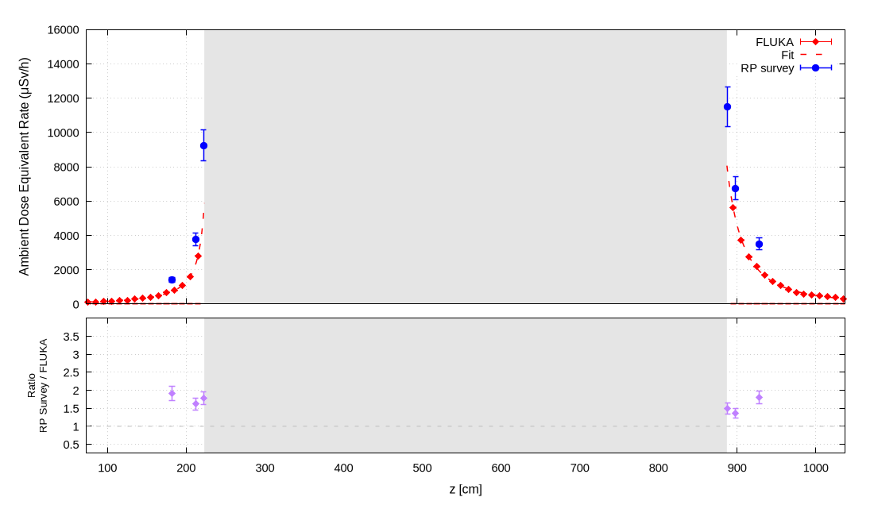
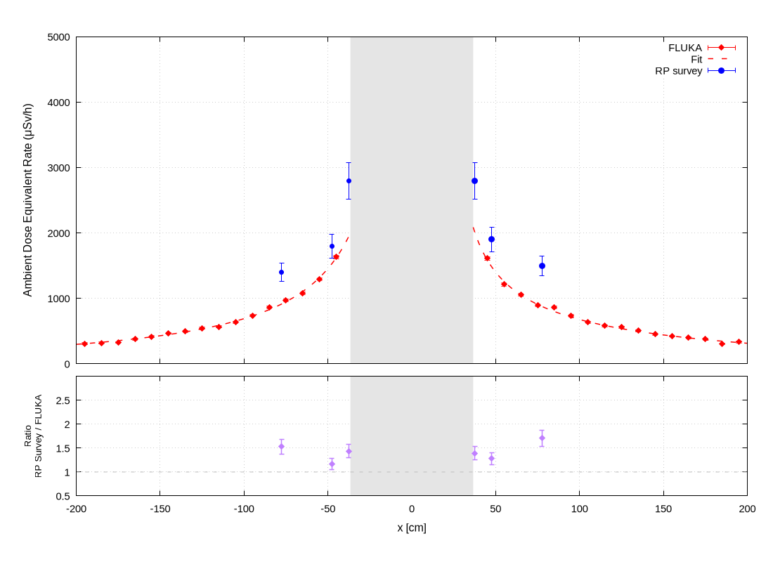
Benchmark – Horn
Cool-down time for benchmark: July 2026
RP Survey:
  Using an AD-t (Automess 6112AD)
  Upstream, downstream and laterally (both corridor and wall sides) at 3 distances (“contact”, 10cm, 40cm)
Ratio RP Survey / FLUKA:
  Up to a factor of 2
11.5 mSv/h
(AD-6 & AD-t)
Top view
Wall
40-cm
Horn
Residual dose rate upstream and downstream of the Horn. Averaged on X=[-5;5], Y[-5;5]
corridor
Horn
Possible causes (under investigation):
  Simplified geometry / materials
  Distances during survey
Implications:
  Extra dose at removal (+0.5 p.mSv)
  Additional shielding for on-road transport
Wall side
Corridor side
Upstream
Downstream
Residual dose rate laterally of the Horn. Averaged on Y[-5;5]

Slide 14
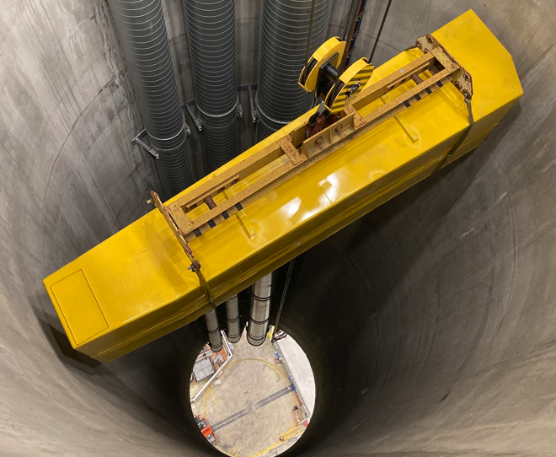
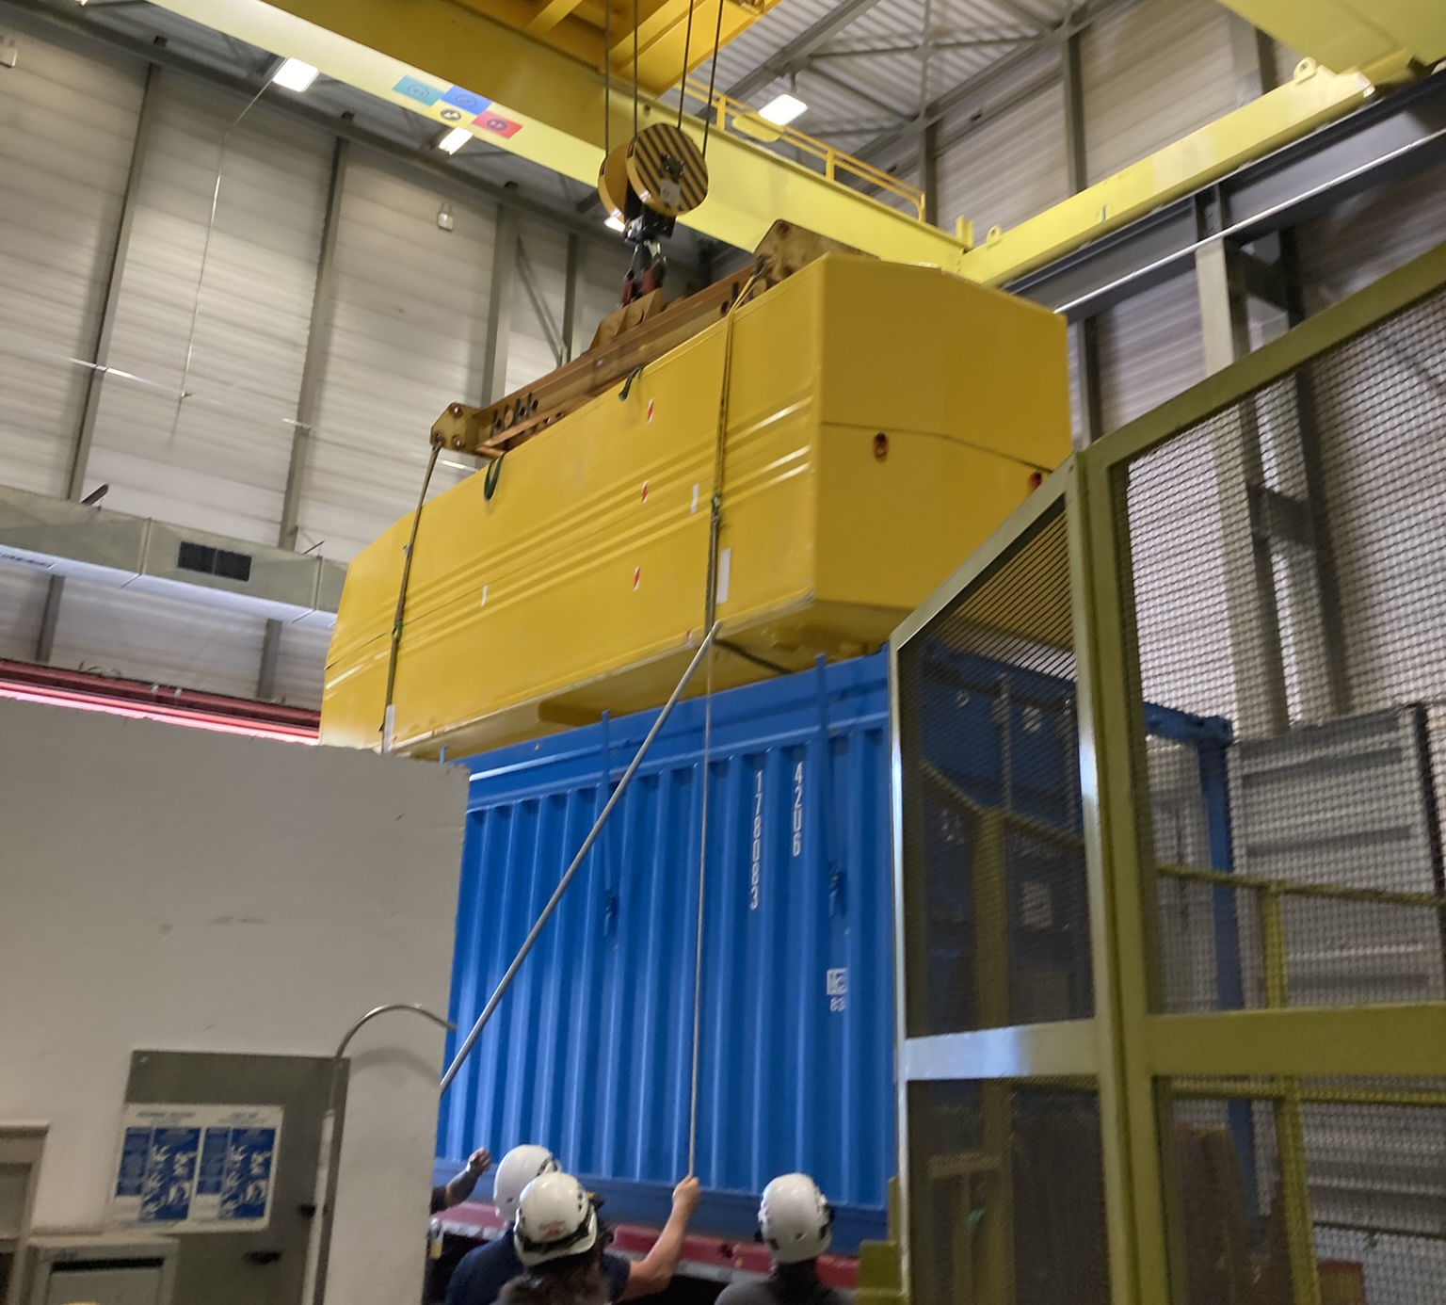
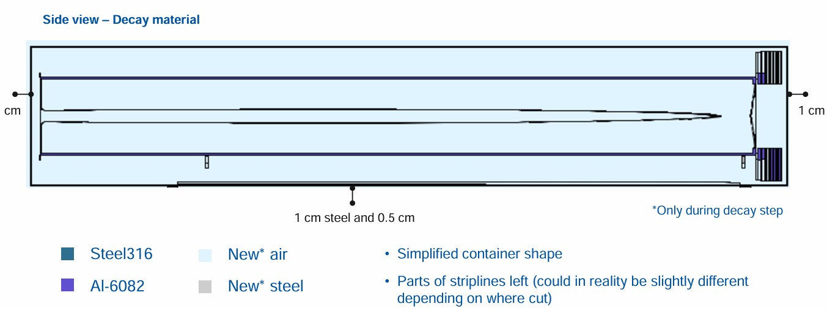
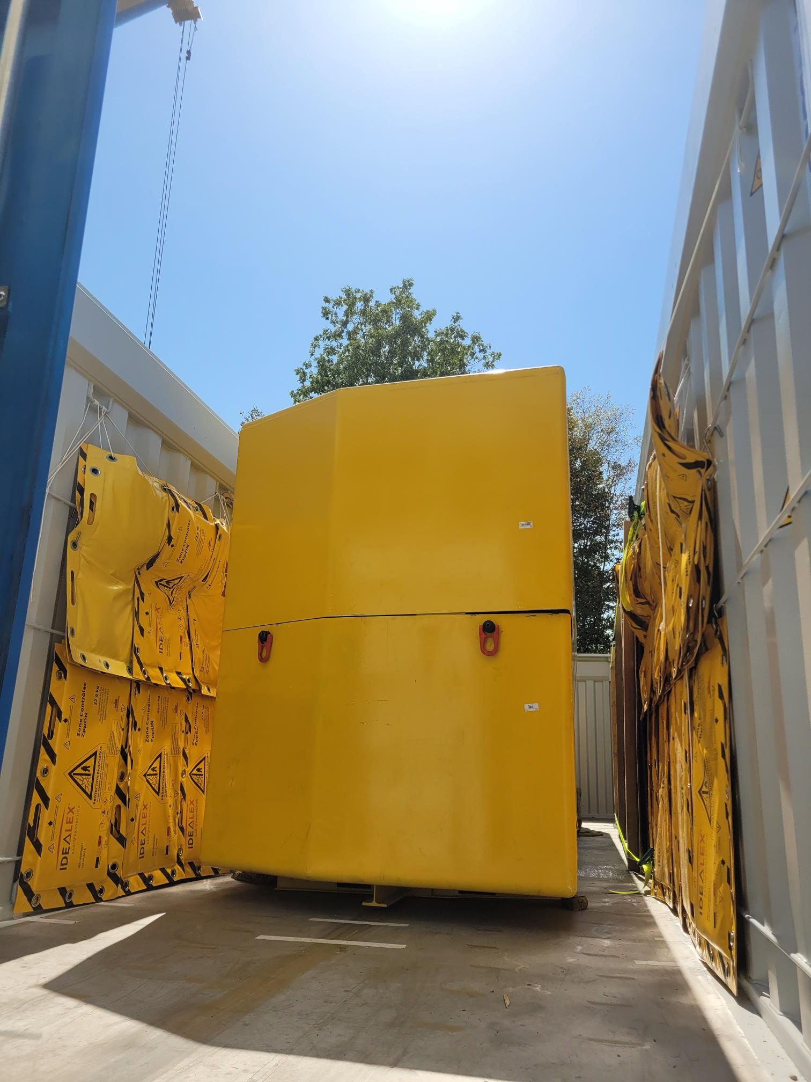
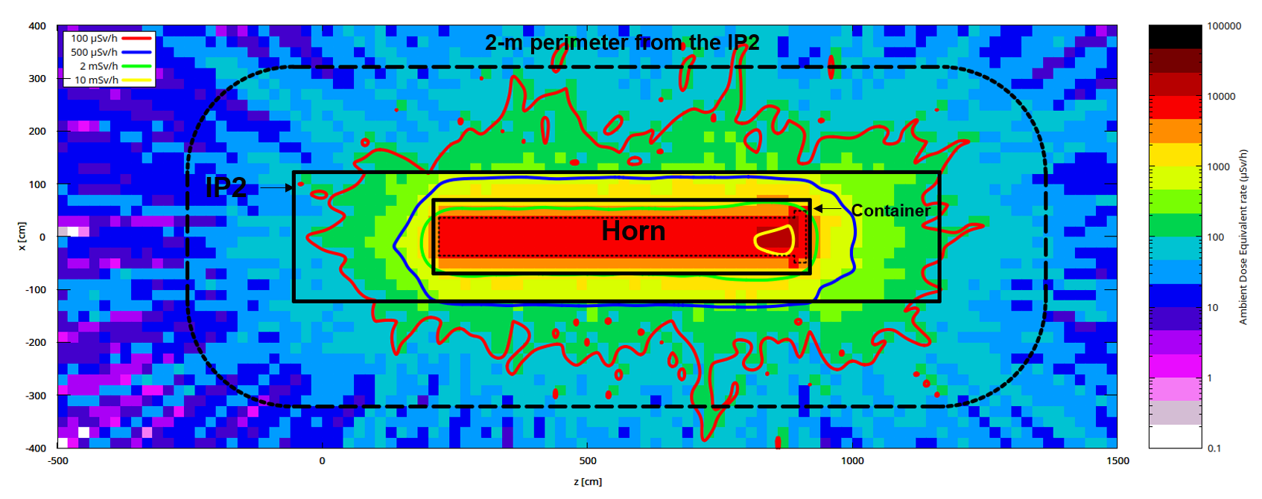
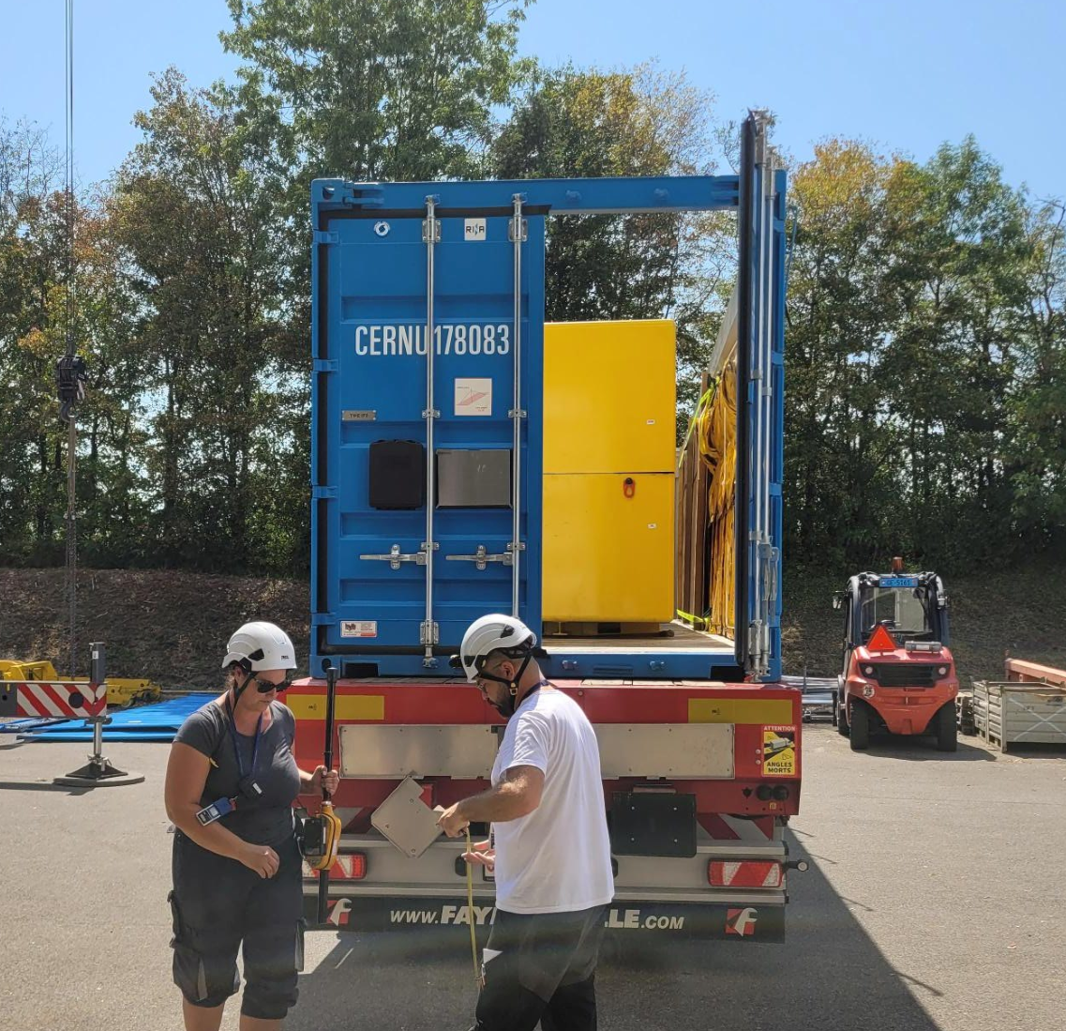
Benchmark – Horn
Horn container and Truck in FLUKA for on road transport
  Residual dose rate around truck containing the horn in its container with an additional 12 mm Pb-equivalent layer
  Bin size Z=20cm, X=20 cm, averaged in Y=[-10;10] - Scaled with RP survey (factor 2)
  Top view at beam level

Slide 15
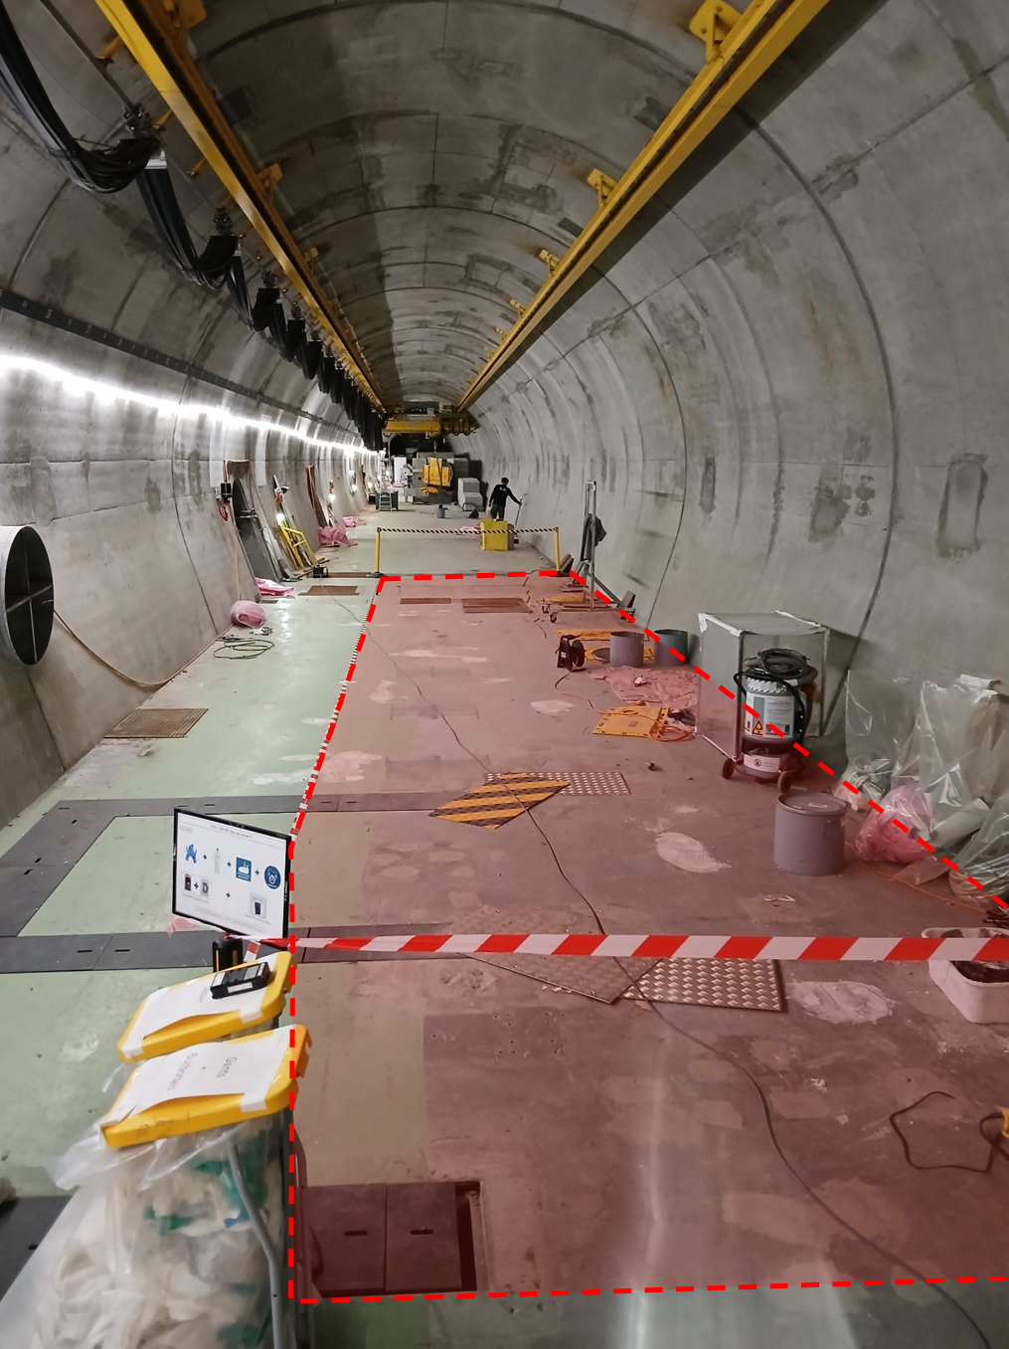
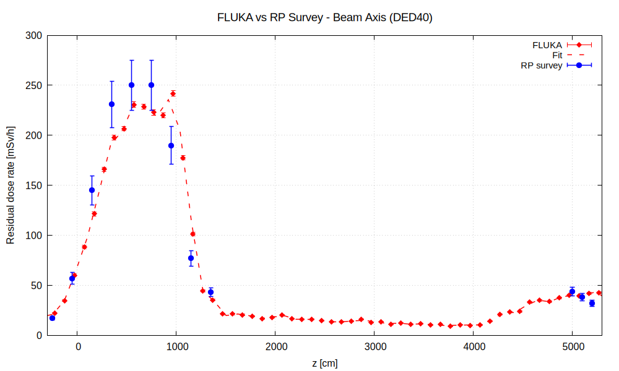
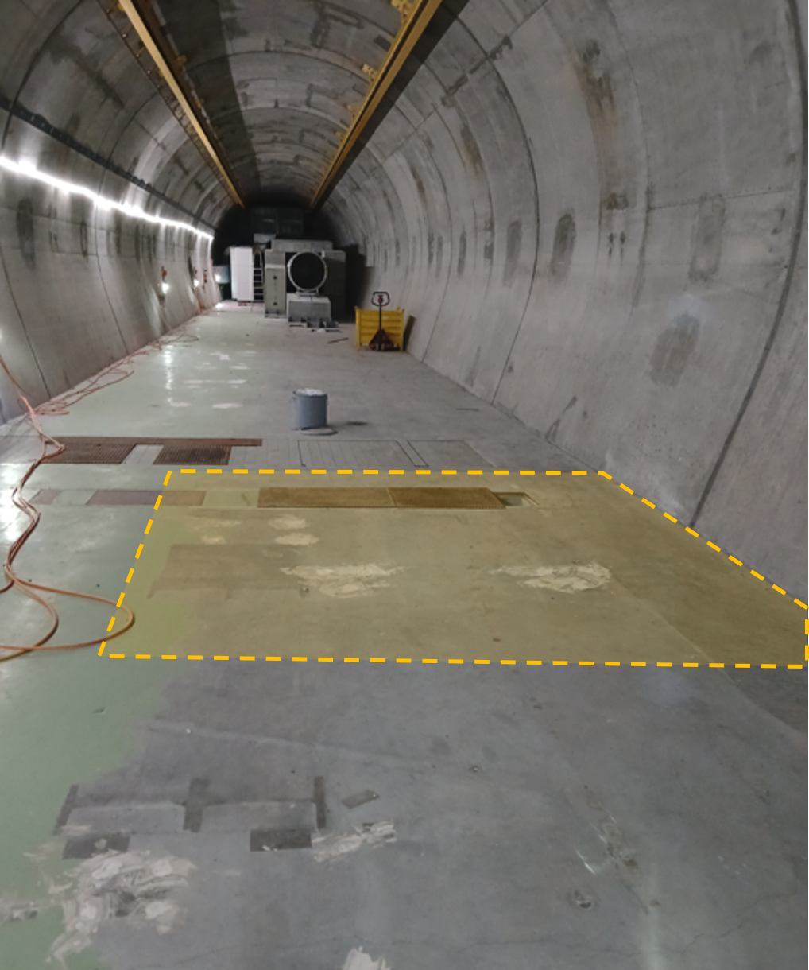
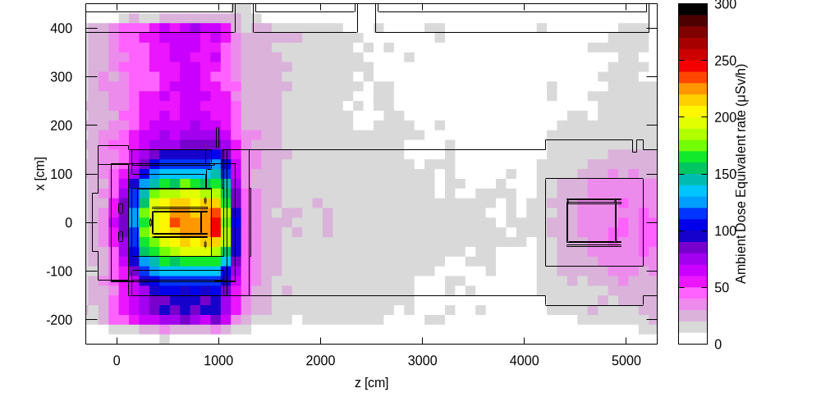
Benchmark – Empty Tunnel
Residual dose rate along the beam axis at 40 cm from the floor.
Averaged on X=[-10;10], Y[-140;-100]
RP Survey (09/2026):
  Measurement with 3 AD-6 (Automess 6150AD) mounted on mechanical arm with 3 distances (“contact”, 40cm, 100cm)
  Identification of areas >50 µSv/h at 40 cm
Good agreement with FLUKA simulation (activities still ongoing)
Top view
Horn
Reflector
Empty tunnel floor below the target & horn
Empty tunnel floor below the reflector
Cool-down time for benchmark: September 2026

Slide 16

Feedback
Planning & Contamination

Slide 17
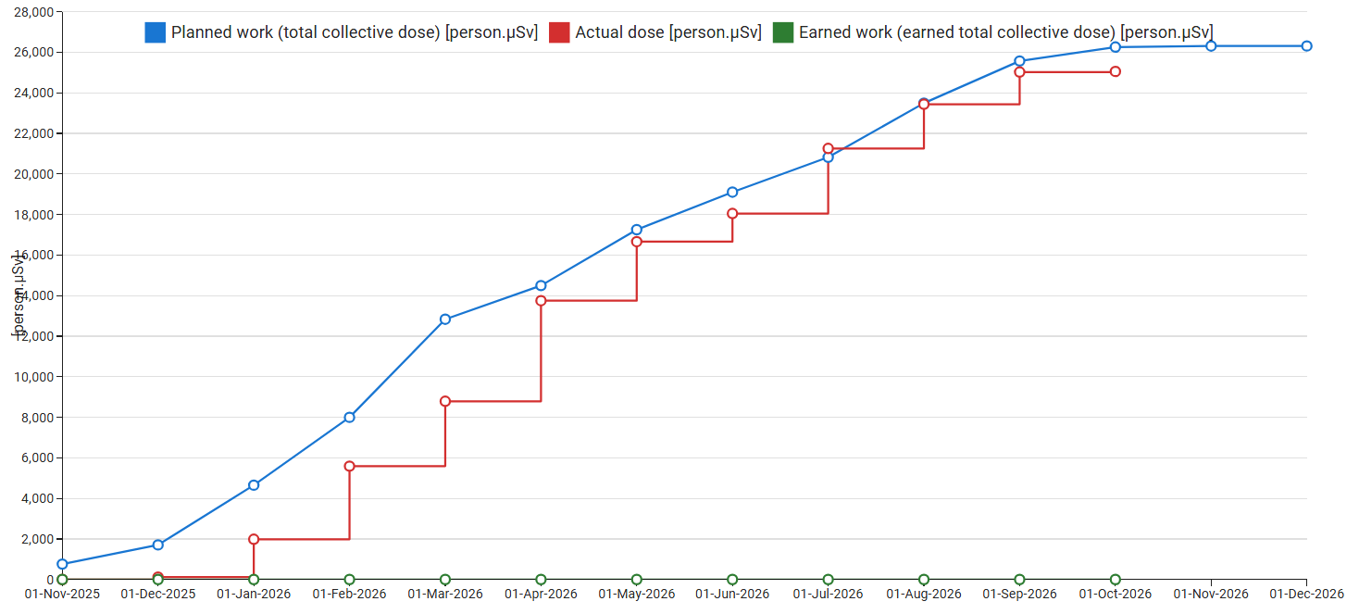
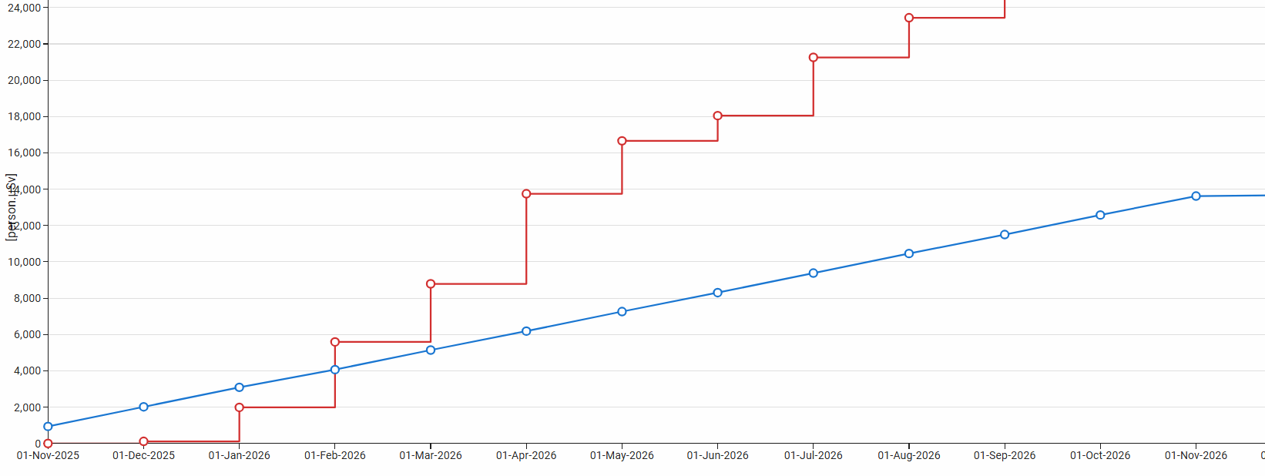
Feedback – Work and Dose Planning
Strategy:
  No safety factor used for dose estimates → early detection in case of deviation
  Safety margin of 20% in the planning → currently with +1 month behind schedule after 10 months.
  Presentation to an ALARA committee as per CERN procedure (>5 p.mSv or >1mSv) → ensure optimization measures.
Lessons learnt:
  Collective dose estimate went from 14 p.mSv (initial) to 26 p.mSv (current) → major review in July 2026
  Safety factors could have been used in critical activities for which hard limits apply (ex: on-road transport or max individual dose)
  Foresee slots in the planning for backup options (ex: removal of the Horn)
Estimated collective dose
WDP (updated in July 2026)
Actual collective dose
Major revision of dose estimates
WDP (done in October 2025)

Slide 18
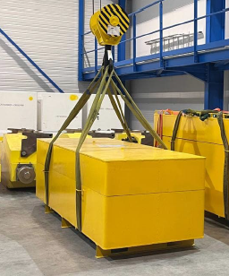
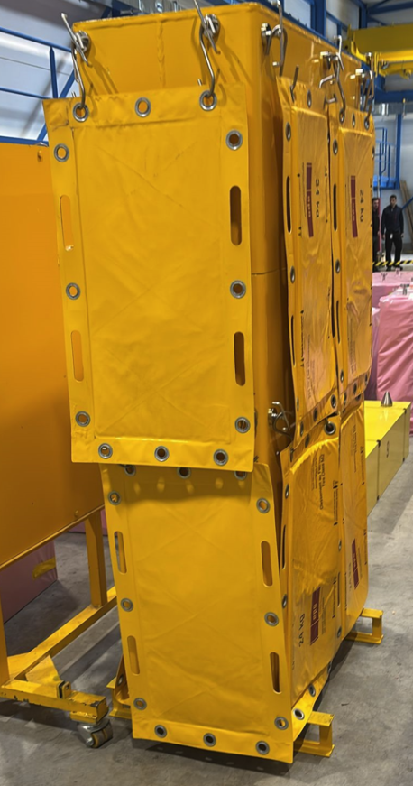
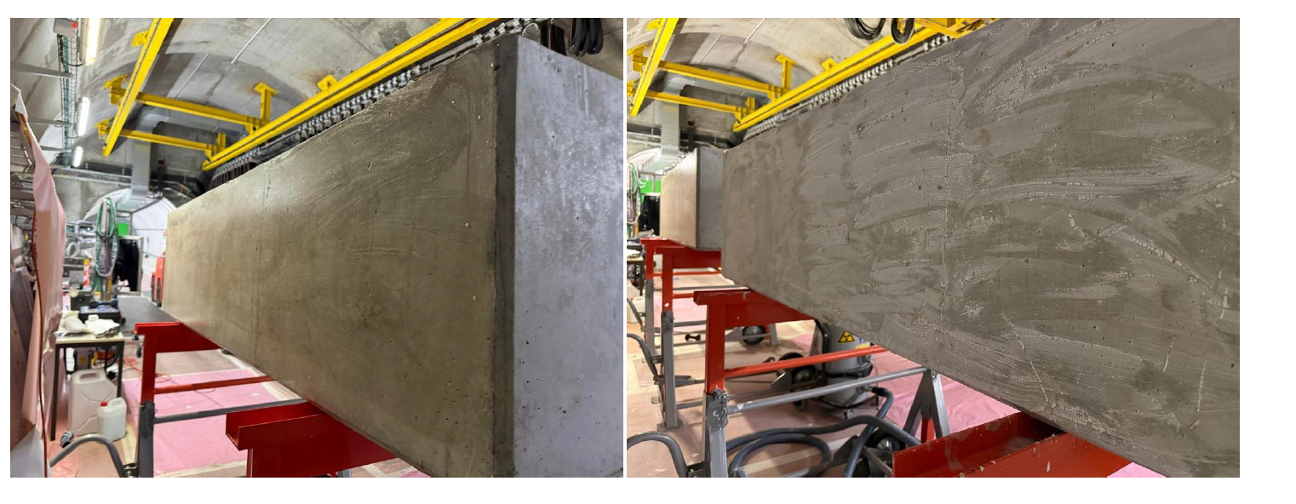
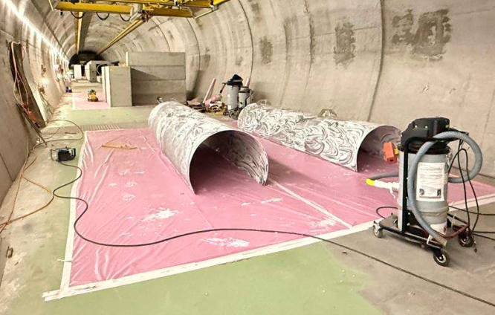
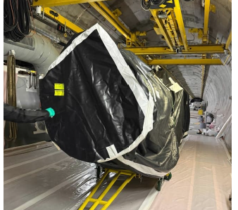
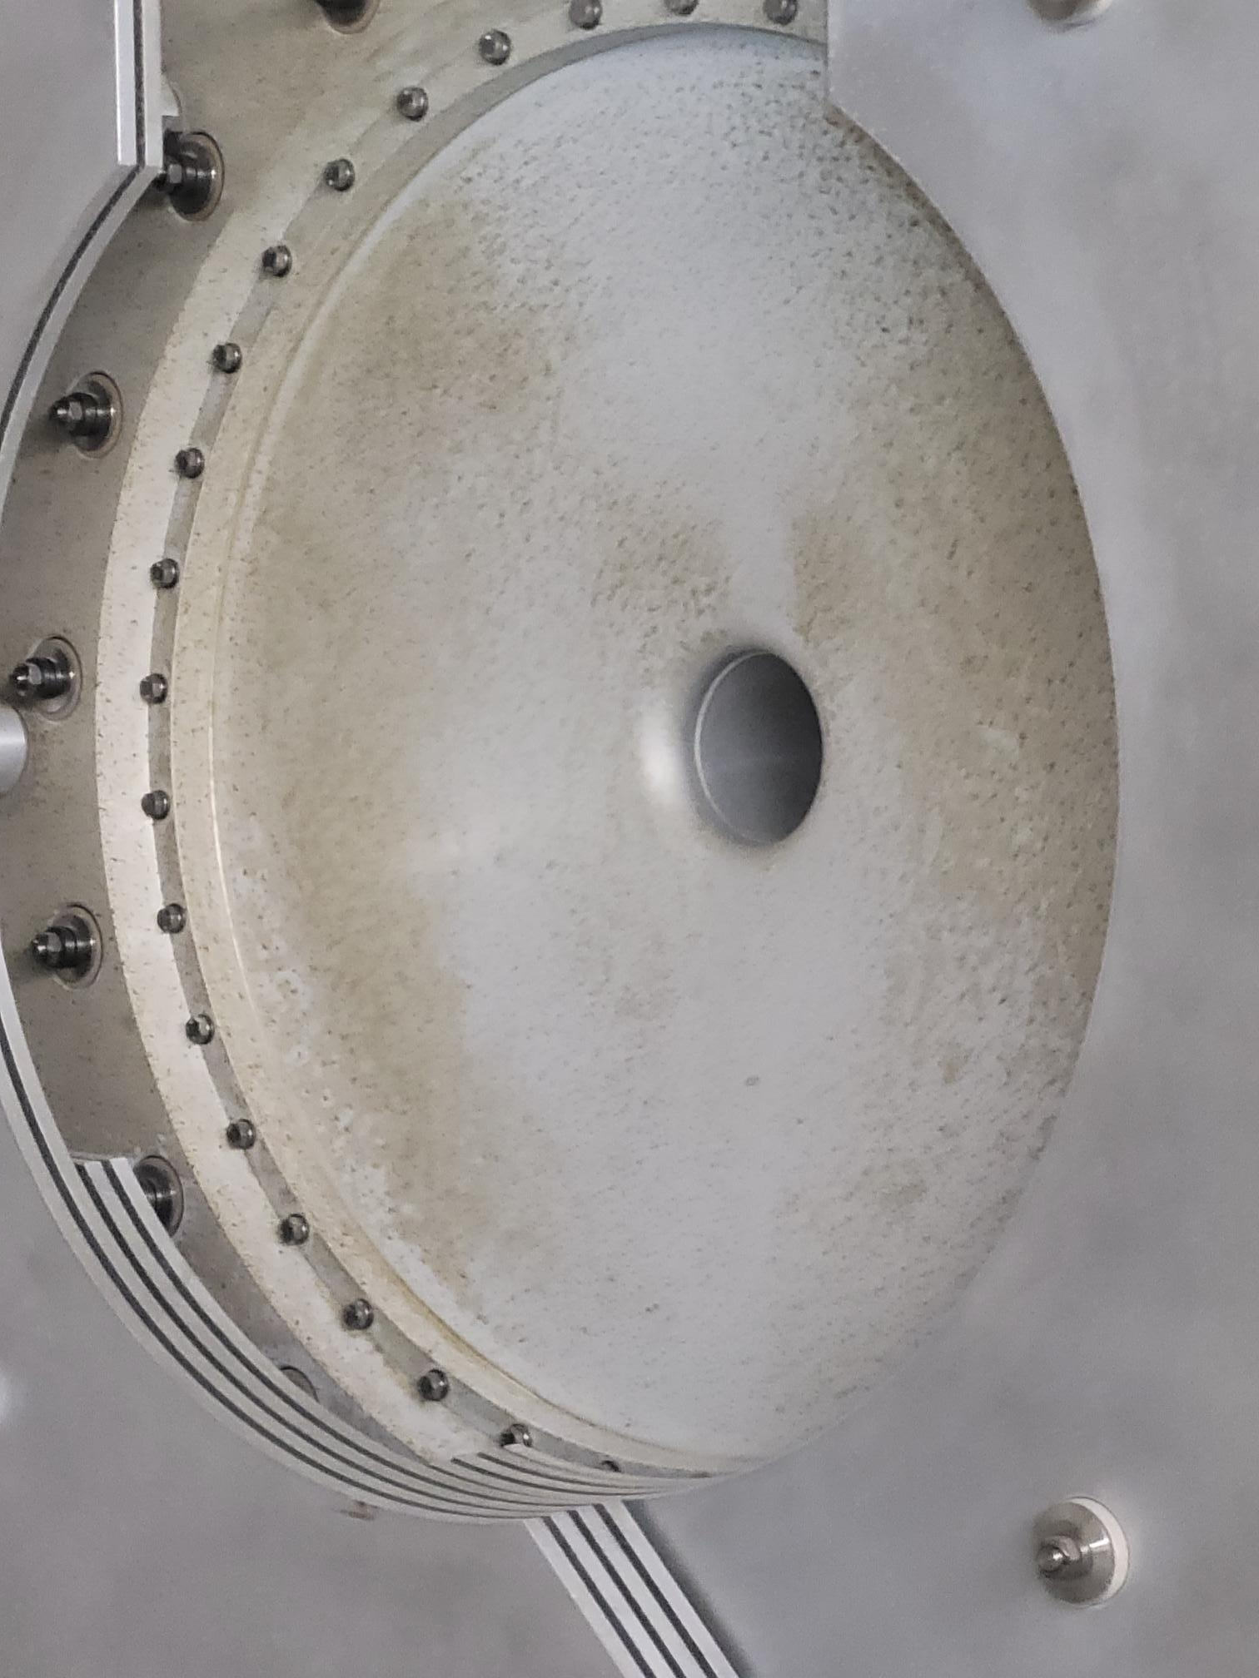
Feedback – Contamination
Items contaminated:
  136 (currently) → Marble, Concrete, Iron shielding and Aluminium beam line components facing the beam. Mainly associated with degradation of the material (rust, dust, sweat).
Limits applied:
  > 1 Bq/cm2 (unidentified β/γ) or > 0.1 Bq/cm2 (unidentified α).
  For identified radionuclides > 1 CS (values derived from Swiss legislation)
  If after cleaning or decontamination still above the limits → packaged or contamination fixed.
Main actions:
  The most radioactive items were wrapped or placed in dedicated containers.
  The Helium Tanks (Aluminium) were cut and decontaminated (ASPIGEL).
  Contamination fixed on concrete blocks < 600 µSv/h at contact (CONTAFIX),
Target
TBID
Fix contamination (spray) vs. decontamination (gel) on concrete
Helium Tank
(decontaminated)
Reflector (wrapped)

Slide 19
Conclusion

Slide 20

Conclusion
The CNGS Target Area is being decommissioned (2025-2026) for the extension of the AWAKE experiment.
Characterization studies were done in preparation of the activity. Current collective dose estimate is 26 p.mSv (14 p.mSv initially).
Benchmark results on residual dose rates show an agreement between RP survey and FLUKA generally within a factor of 2 (mainly underestimation).
Operational activities carried out by a specialized nuclear dismantling contractor: a lot of lessons learnt!
After the decommissioning of the Target Area, it will only remain from CNGS the 1-km decay tube and the hadron stop chamber (200 m³ of iron…)

