Slide 1
Assessing neutron dose variability across Monte Carlo codes in a proton therapy scenario
Maite Romero-Expósito^{a,b}, Luka Pasariček^{c}, Nicolas Arbor^{d}, Hrvoje Brkić^{f,g},
Anna Cimmino^{e}, Dávid Horváth^{e}, Villads Lundsteen Jacobsen^{h,i}, Benoit Lefebvre^{e}, Liliana Stolarczyk^{i}, Marija Majer^{c}, Roberto Versaci^{e}, Marijke De Saint-Hubert^{j}
Physica Medica 141 (2026), 105686 · DOI: 10.1016/j.ejmp.2025.105686

Slide 2
Eurados
European Radiation Dosimetry Group
85 Institutions
650 Scientists
9 active Working Groups
Members of 3 working groups participated in this work:
WG6 – Computational dosimetry
WG9 – Radiation dosimetry in radiotherapy
WG11 – High energy radiation fields
Notes:
Core Objectives: Advance the scientific understanding of ionising radiation dosimetry, improve dosimetric instrumentation and methods, and harmonize EU practices with international standards

Slide 3
Introduction
Proton radiation therapy is more accessible than before
More therapy centers
More diverse type of tumor treated
Increasing number of pregnant patients
Important to limit the dose outside the target volume
Dominated by the dose from neutrons
Neutron in the MeV range generated by nuclear interactions
Thermalized by the surrounding matter to approx. 0.025 eV
Notes:
Types: From brain and pediatric to breast, neck, lung, gastrointestal
Comprehensize dismetric evaluation for safety and effectiveness of the treatment is needed

Slide 4
Introduction
Monte Carlo simulation is essential in particle therapy
Design and commissioning facilities
Shielding design
Modelling of the treatment head
Validation of treatment planning systems
The issue:
MC codes rely on nuclear models completely or at higher energies
Previous monoenergetic studies showed differences up to 90% in neutron fluence

Slide 5
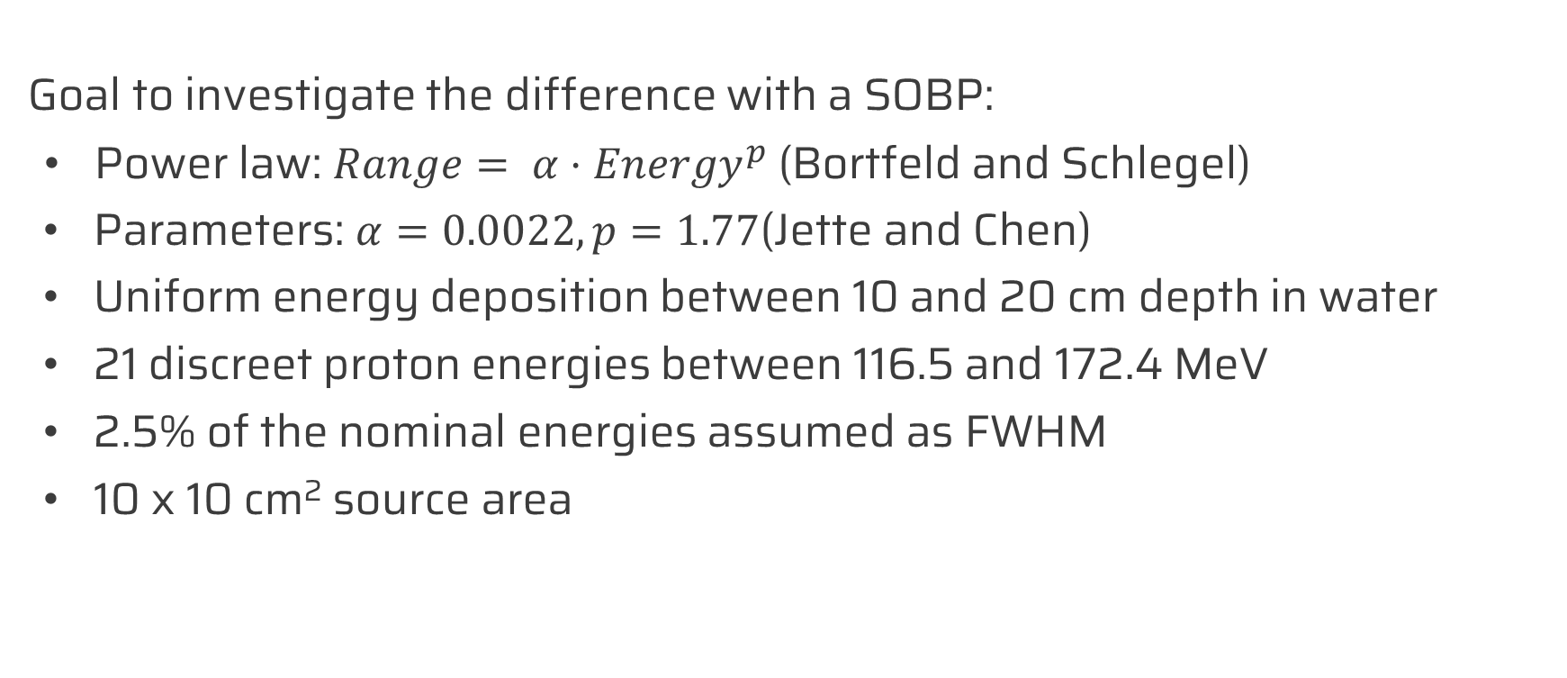
Beam
Goal to investigate the difference with a SOBP:
Power law: $Range= {α⋅Energy}^{p}$ (Bortfeld and Schlegel)
Parameters: $α=0.0022, p=1.77$(Jette and Chen)
Uniform energy deposition between 10 and 20 cm depth in water
21 discreet proton energies between 116.5 and 172.4 MeV
2.5% of the nominal energies assumed as FWHM
10 x 10 cm² source area
Notes:
SOBP: More relevant to proton therapy than monoenergetic.

Slide 6
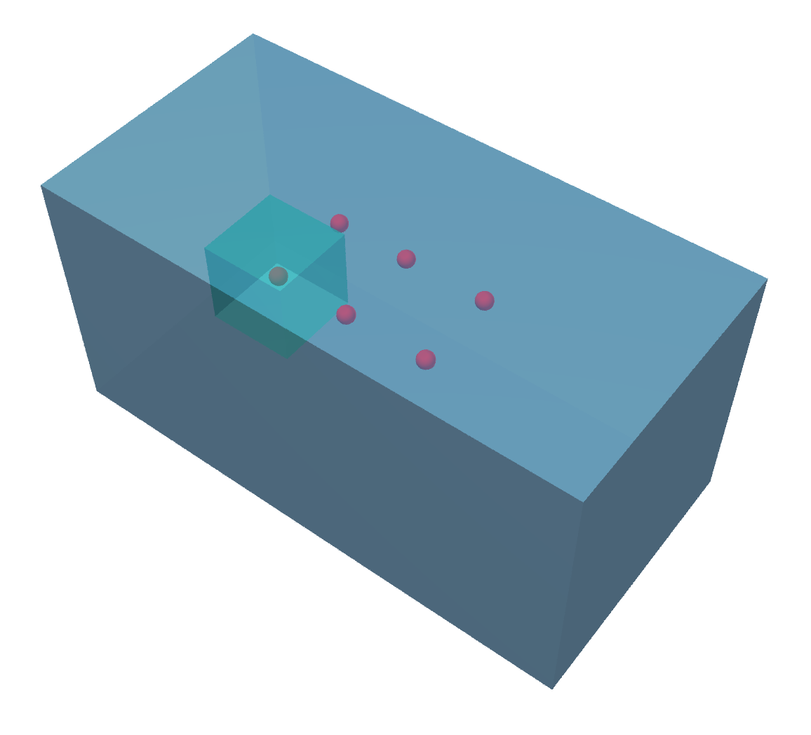
Geometry
60 x 30 x 30 cm3
water phantom
10 x 10 x 10 cm3
target volume
Deposited dose scoring:
  2 x 2 cm in 0.1 cm steps along the beam axis
  Normalized to the averaged value between 14 and 16 cm
Neutron fluence scoring:
  Scoring spheres, 1.0 cm diameter
F
LAT3
LAT4
IF
LAT1
LAT2
Beam

Slide 7
Monte Carlo codes
The codes used and nuclear models and cross-section libraries selected as default (based on developer recommendation).
 |  | Cross-section |  | Nuclear model
Code | Version | Proton | Neutron | Proton | Neutron
PHITS | 3.341 | --- | JENDL-4.0 | LIE | LIE
MCNP | 6.2 and 6.3 | ENDF* | ENDF* | CEM | CEM
FLUKA | 4-4.0 | --- | JEFF-3.3 | FLK | FLK
GATE (GEANT-4) | 9.3 | TENDL-2019 (ENDF/B-VII.1) | JEFF-3.3 | BIC | BIC
TOPAS (GEANT-4) | 3.8 p1 | TENDL-2019 (ENDF/B-VII.1) | JEFF-3.3 | BIC | BIC
* ENDF/B-VII.0 or ENDF/B-VIII.0
Notes:
INC: Intranuclear cascade
LIE: INC model of Liege
CEM: Cascade-Exciton model
FLK: Fluka – PEANUT: Glabuber – Gribov cascade and high energy collisions, (Generalized) INC, Preequilibrium emission, Evaporation/Fragmentation/Fission, final deexcitation.
BIC: Binary INC
BEC: Bertini INC
ELF: Emission of Light Fragment
JAM: Jet AA Microscopic transport model

Slide 8
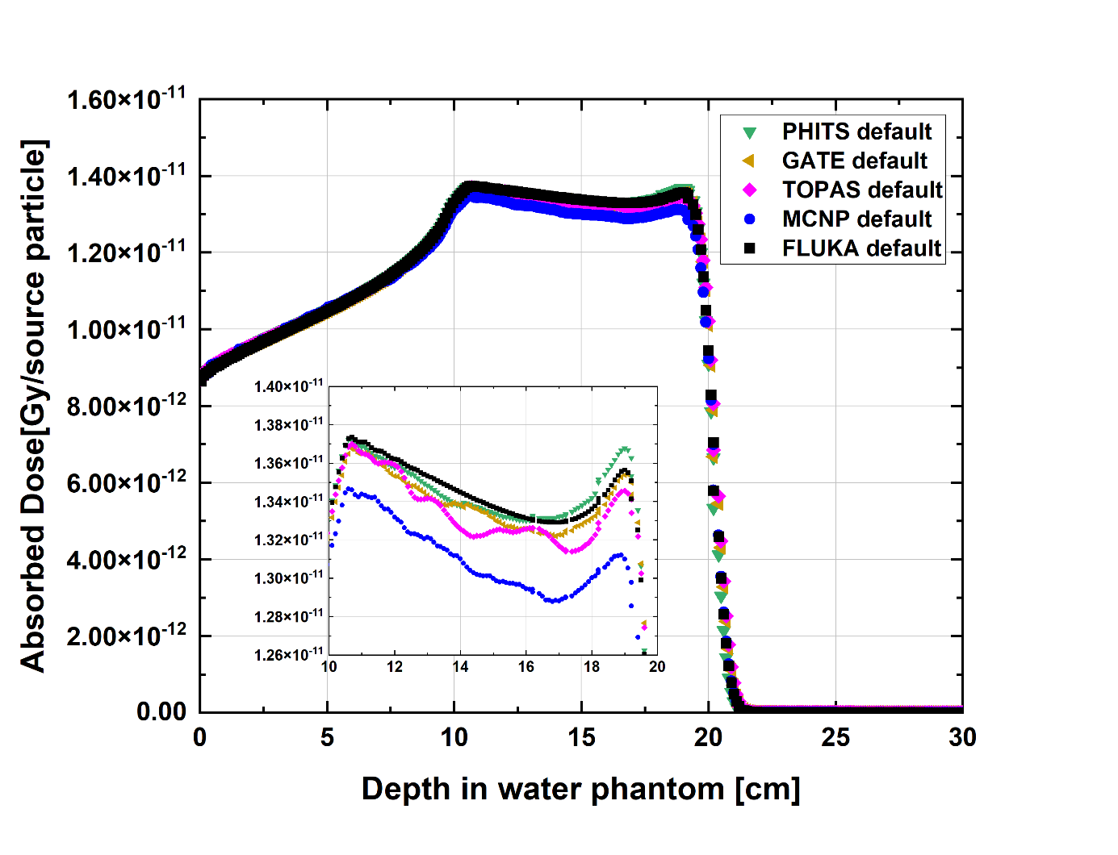
SOBP parameter comparison
Quantity | Min | Max | CV [%]
R90 [cm] | 19.54 | 19.66 | 0.3
Modulation width [cm] | 10.47 | 10.54 | 0.2
Distal fall-off [cm] | 1.07 | 1.20 | 4.8
Entrance dose [%] | 62.91 | 64.82 | 0.9
Dose at isocenter [10⁻¹¹ Gy/primary] | 1.30 | 1.34 | 1.2
Notes:
CV: Coefficient of Variation

Slide 9
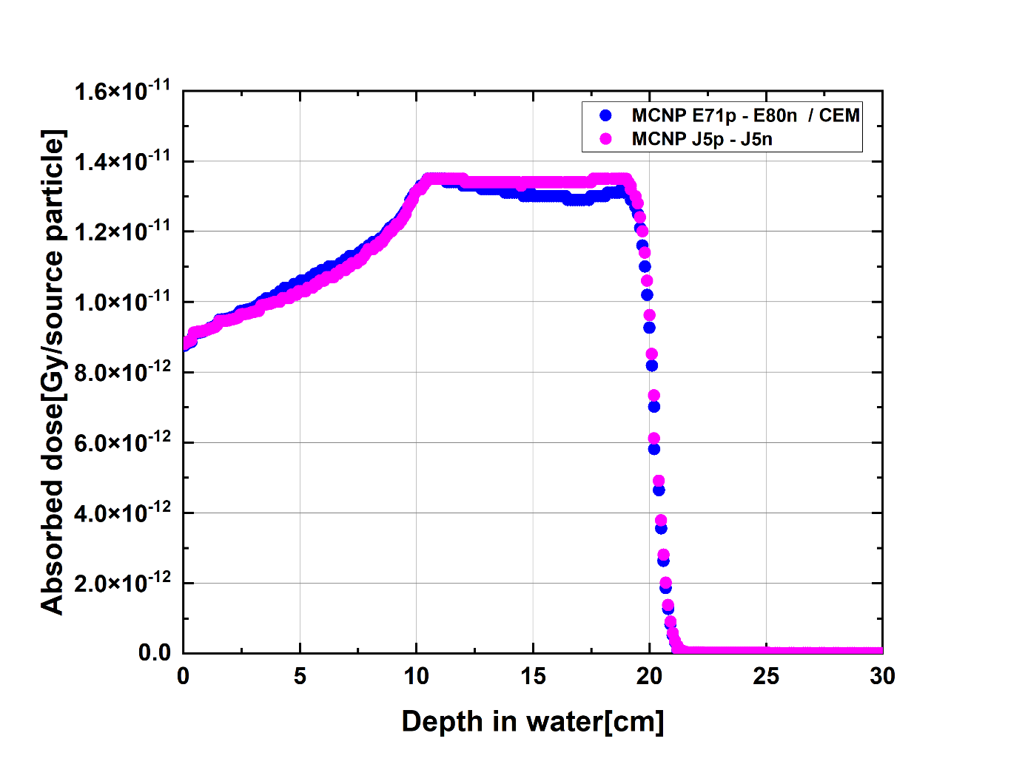
SOBP parameter comparison
With other cross section libraries and nuclear models:
No significant change
Except MCNP and PHITS with JENDL-5:
  MCNP 5% higher absorbed dose
  PHITS: 5% less absorbed dose
  Both: flatter plateau

Slide 10
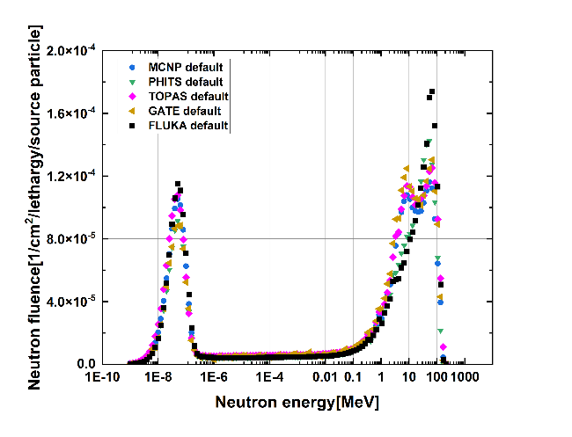
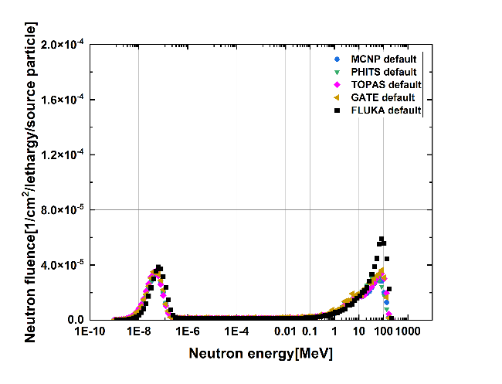
Neutron fluence spectra
In field (IF)
Forward (F)
Notes:
In Field:
Two high energy peak for MCNP, TOPAS and GATE but only one for FLUKA and PHITS.

Slide 11
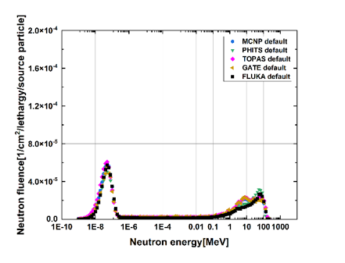
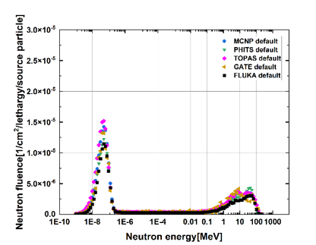
Neutron fluence spectra
Lateral (LAT) 1
Lateral (LAT) 2
Notes:
In Field:
Two high energy peak for MCNP, TOPAS and GATE is getting less pronounced,
Now PHITS gives highest peak in the high energy range, instead of FLUKA.

Slide 12
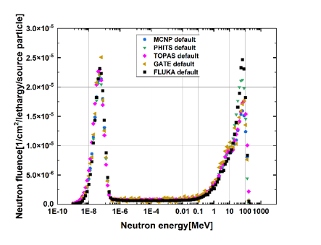
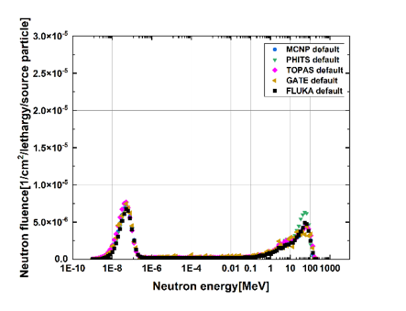
Neutron fluence spectra
Lateral (LAT) 3
Lateral (LAT) 4
Notes:
In Field:
Two high energy peak for MCNP, TOPAS and GATE are now barely detectable
FLUKA is the highest in LAT3, but PHITS in LAT4

Slide 13
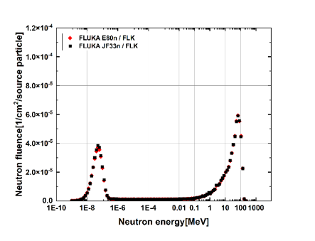
Other cross sections and models
FLUKA:
No option to change the nuclear models the proton cross sections
Effect of ENDF/B-VIII.0 neutron cross section library is negligible
Forward (F)
Notes:
Note the height of the peaks 4.0 and 6.0 [1/cm^2/prim]

Slide 14
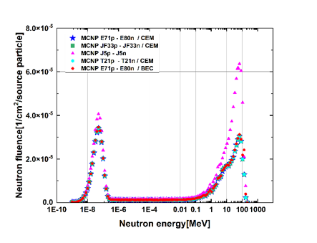
Other cross sections and models
MCNP:
Negligible difference between when changing from CEM to BEC
Similarly, when changing to JEFF-3.3 or TENDL 2021 libraries.
Using only JENDL-5:
  130% higher high energy peak
  34% higher thermal peak
  Comparable values to FLUKA
Forward (F)
Notes:
CEM: Cascade-Exciton model
BEC: Bertini INC

Slide 15
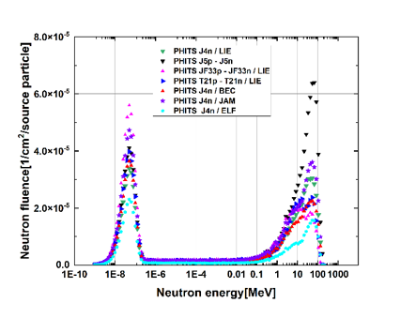
Other cross sections and models
PHITS:
Big differences when changing the nuclear model from LIE to BEC, JAM and ELF
Or, enabling proton cross section libraries: JEFF-3.3, TENDL 2021, JENDL-5.
  More 100% higher high energy peak with JENDL-5, similar values to FLUKA
Forward (F)
Notes:
LIE: INC model of Liege
BEC: Bertini INC
ELF: Emission of Light Fragment
JAM: Jet AA Microscopic transport model

Slide 16
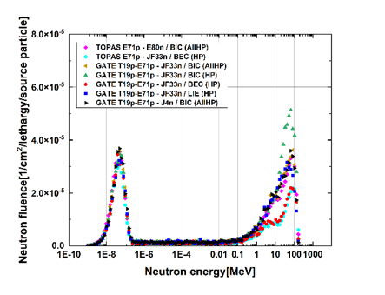
Other cross sections and models
GATE and TOPAS:
High variation for BIC, BEC and LIE (HP) nuclear models
AllHP models (where proton cross section libraries are used) give results like other codes
Negligible effect of changing the neutron cross section library
Forward (F)
Notes:
LIE: INC model of Liege
BEC: Bertini INC
BIC: Binary INC

Slide 17
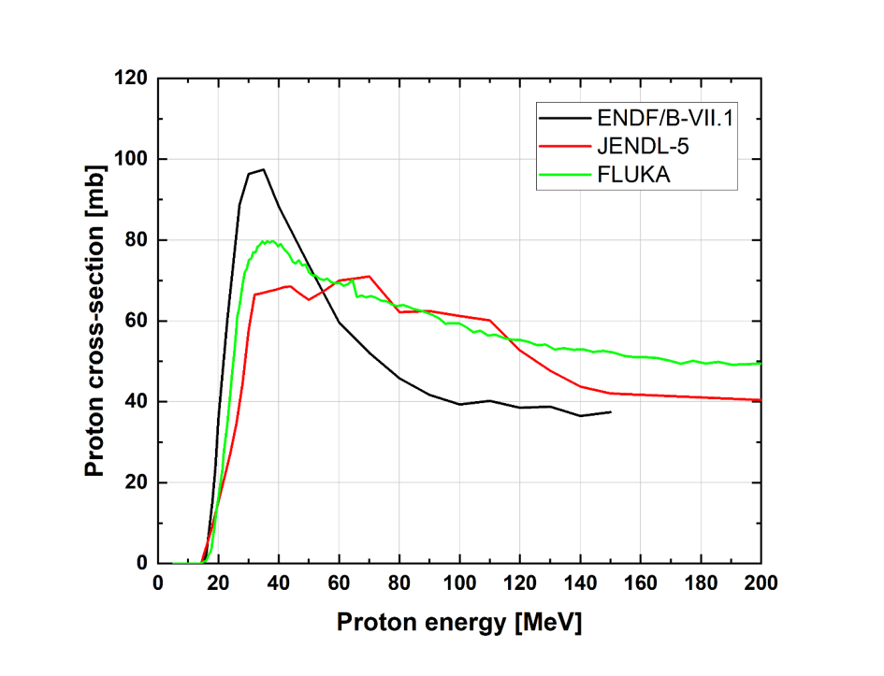
FLUKA proton cross section
¹⁶O (p,x) ¹⁵O nuclear reaction
Extracted with developer only tool
FLUKA and JENDL-5:
Lower peak but more gradual decrease
Higher cross sections at higher proton energies
Notes:
ENDF/B-VIII.0 and TENDL 2021 equivalent to ENDF/B-VII.1

Slide 18
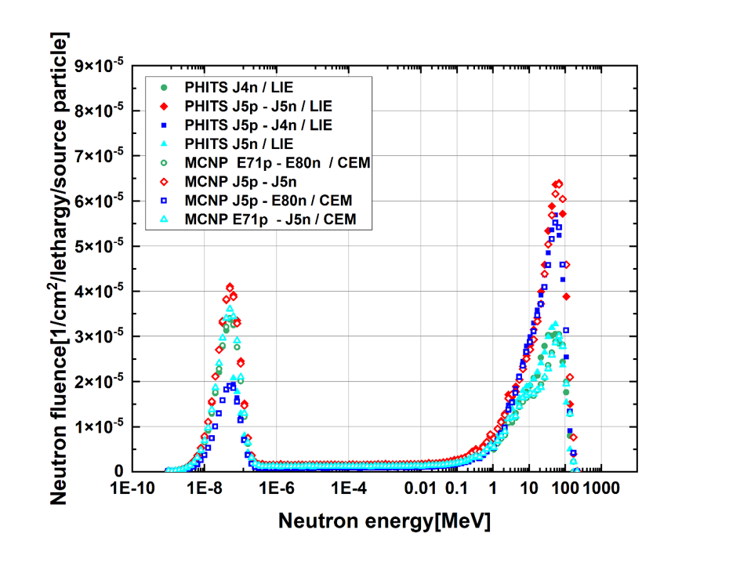
Impact of JENDL-5
Forward (F)
MCNP and PHITS:
Only JENDL-5 neutron cross section – No significant change
~100% increase in the high energy peak with JENDL-5 proton cross section
Notes:
JENDL-5 used only for proton, only for neutron, for both, or not used at all.

Slide 19
Main conclusions
Good agreement among the codes for the in-field dose
The used models and proton cross section libraries have significant impact on the neutron spectra
Neutron cross section libraries have much less influence on the results

Slide 20
Continuation
Currently ongoing effort for:
Trying to simulate dose from “protons” and “neutrons”
Scoring particle LET
Some codes have more limited features in these regards

Slide 21
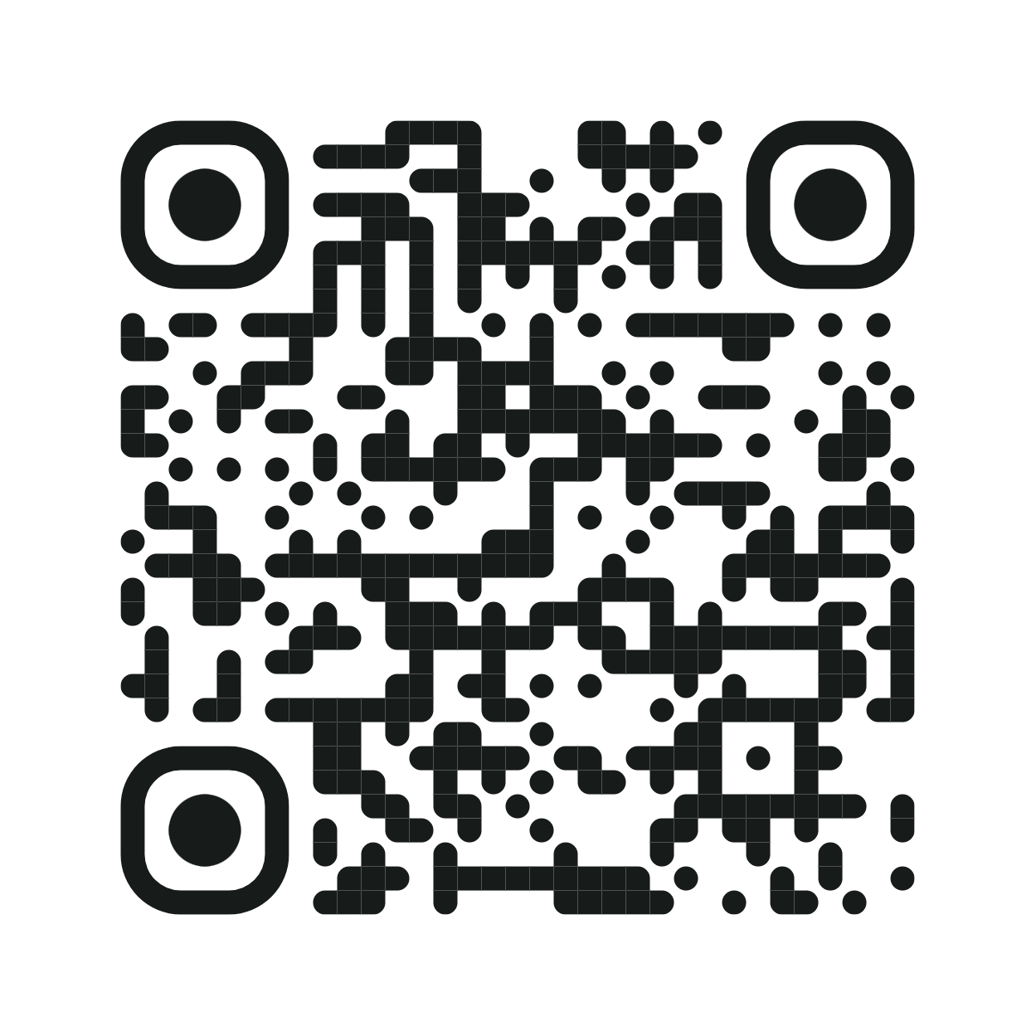
Thank you for your attention!
Any question?
Physica Medica 141 (2026), 105686
DOI: 10.1016/j.ejmp.2025.105686

