Slide 1
Multiphysics, seven incident particles nuclear data libraries generation: TENDL-2025
Jean-Christophe Sublet¹, Arjan Koning² and Dimitri Rochman³
¹UKAEA, ²IAEA, ³NAGRA

Slide 2
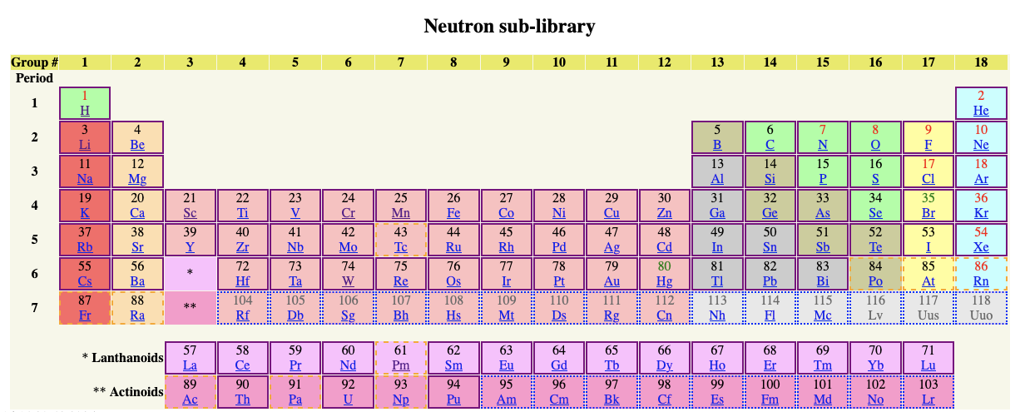
The making of TENDL-2025 – repeatability and innovation
7 incident particles: alpha, gamma, deuteron, proton, helium, triton and neutron induced libraries
2850 targets Z=3-115, Lithium to Moscovium, including as target some 519 m (1st), 29 n (2nd) isomeric states (T_{½} > 1s)
TENDL describes all open reaction channels, product yields, emitted spectra and short-lived daughter radionuclides (T_{½} > 0.1s) up to 200 MeV, with covariance derived from reference input parameters variation allowing S/UQ & P
13th version, since 2007
@ NRG (Holland)
@ PSI (Switzerland)
@ ICL (UK) 02/2026

Slide 3
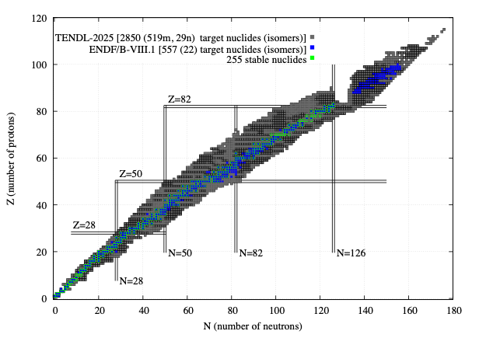
Nuclear landscape: Isotopic targets: 2850
7 incident particles
neutron*
gamma
proton
deuteron
triton
alpha
helion
*complete for transport, activation-transmutation- material sciences in term of MF’s, targets and daughters
816 in EAF-2010
795 in JENDL-5
~580 in ENDF/B, JEFF, CENDL
1036 for T_{1/2} > 1 hr + inclusive
of all “special” from the above legacy libraries

Slide 4
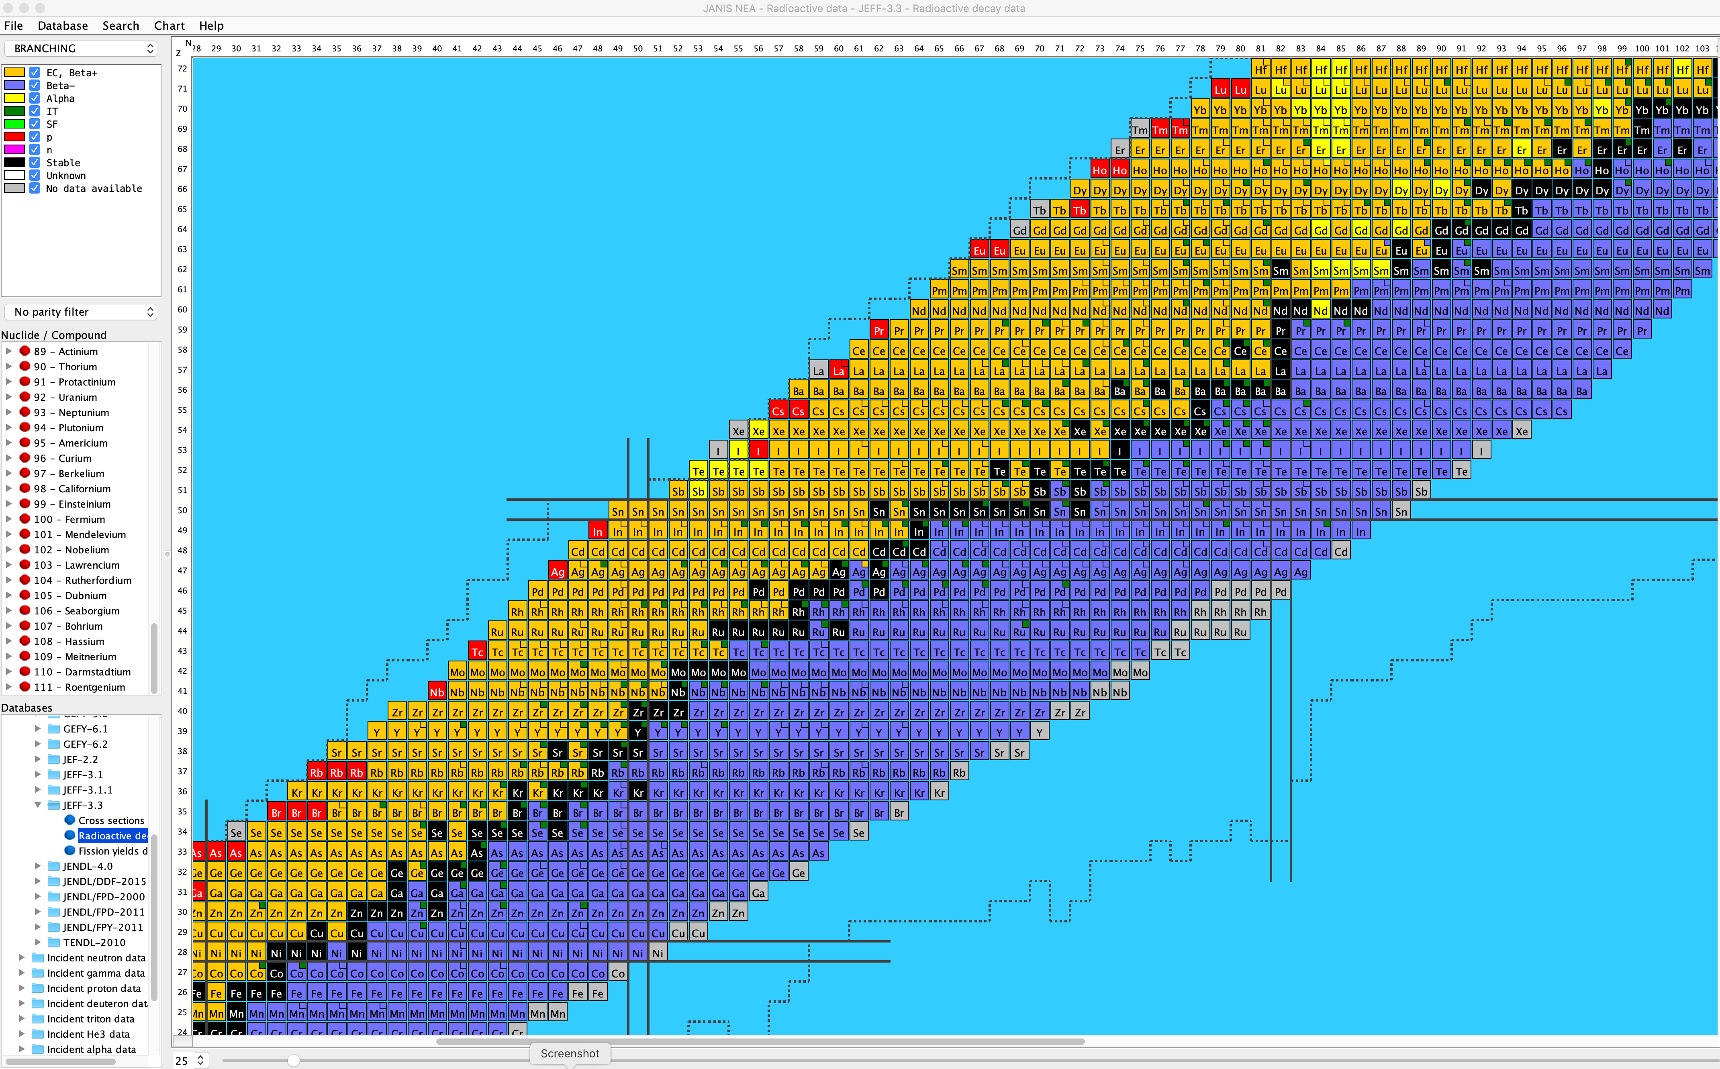
Nuclear landscape: Isotopic residuals & decays
Radioactive decay products: 4035 “reaction daughters” or “residuals”
Ground and isomeric daughters: T_{½} > 0.1s
Decay data files are not a part of TENDL
but
MF-8 contains the metastable Elevel from RIPL-4

Slide 5
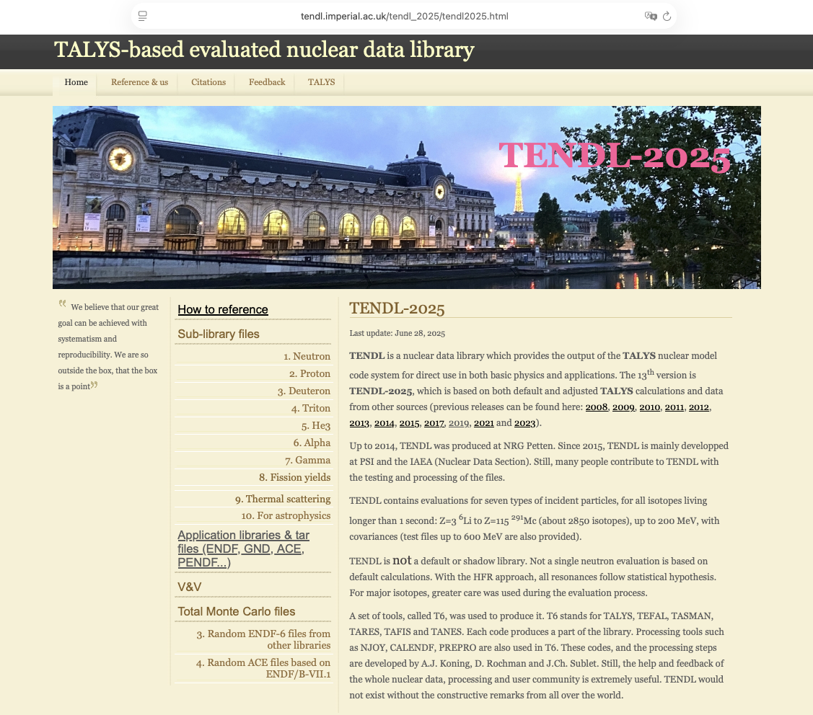
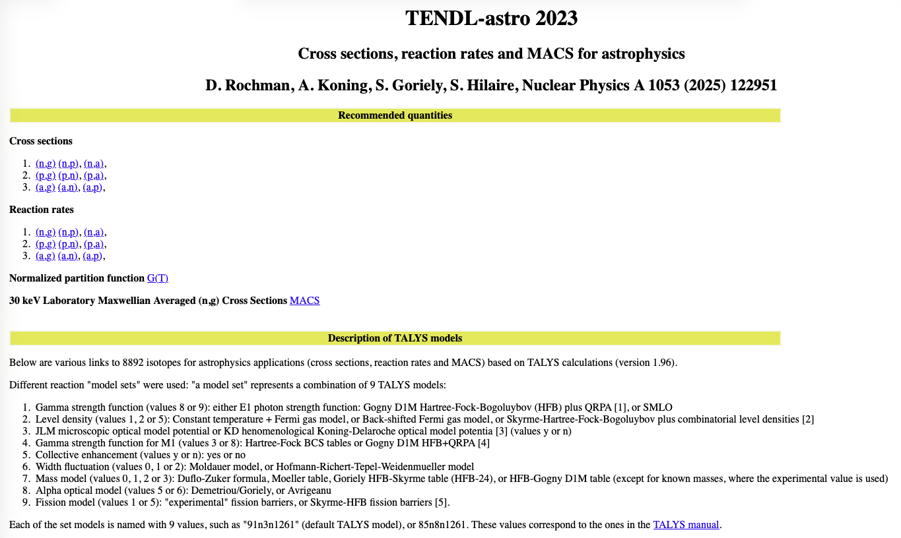
Product https://tendl.imperial.ac.uk/tendl_2025/tendl2025.html
ENDF-6: explicit s30
GNDS-2.1
Tabular forms
Applications forms
…
Astrophysics forms

Slide 6
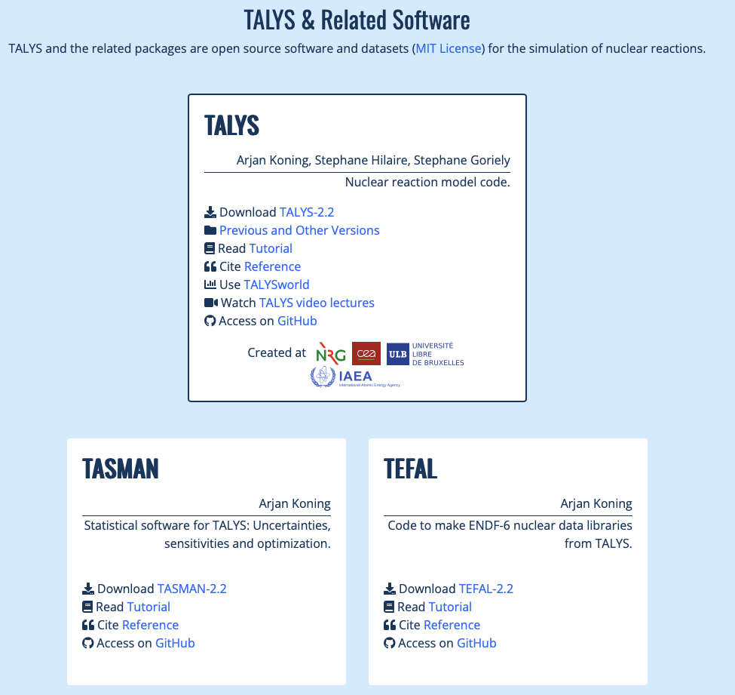
How? TALYS 2.2 from https://nds.iaea.org/talys/
Input
Physical parameters
Reaction
models
Multiple
emission
Output
projectile n
element Fe
mass 56
energy 14.0
Nuclear Structure (RIPL-3)
Masses
Discrete levels
Level densities
Resonance parameters
Photon strength functions
Optical model parameters
Fission barrier parameters
Optical model (ECIS)
Local/global OMP
Phenomenological
Semi-microscopic (JLM)
Multiple emission
Hauser-Feshbach
Multiple preeq. exciton
Fission competition
γ-ray cascade
Exclusive channels
Recoils
Fission fragment de-excitation
Direct reaction
Spherical OMP
DWBA
Coupled-channels
Rotational
Vibrational
Giant resonances
Weak-coupling
Output files per reaction channel
Cross sections
Total
Exclusive: (n,γ), (n,f), (n,n’), (n,2n), (n,p) etc.
Per level
Residual production
Particle production
γ-ray production
Emission spectra
Single-differential
Double differential
Recoils
Angular distributions
Elastic
Per level
Particle multiplicities
Fission yields, neutron observables
Astrophysical reaction rates, MACS
…
+ some 400 keywords
Other
Fission fragment distributions
‘Best’ nuclear model parameters optimised to experimental reaction data
Compound reactions
Hauser-Feshbach
Width fluctuations
Blatt-Biedenharn ang. dis.
Particle, photon and fission transmission coeff.
γ-ray emission
Phenomenological parameters
Microscopic tables
Pre-equilibrium reactions
Exciton model
Particle hole level density
Kalbach systematics
Angular distribution
Cluster emission
γ-ray emission

Slide 7
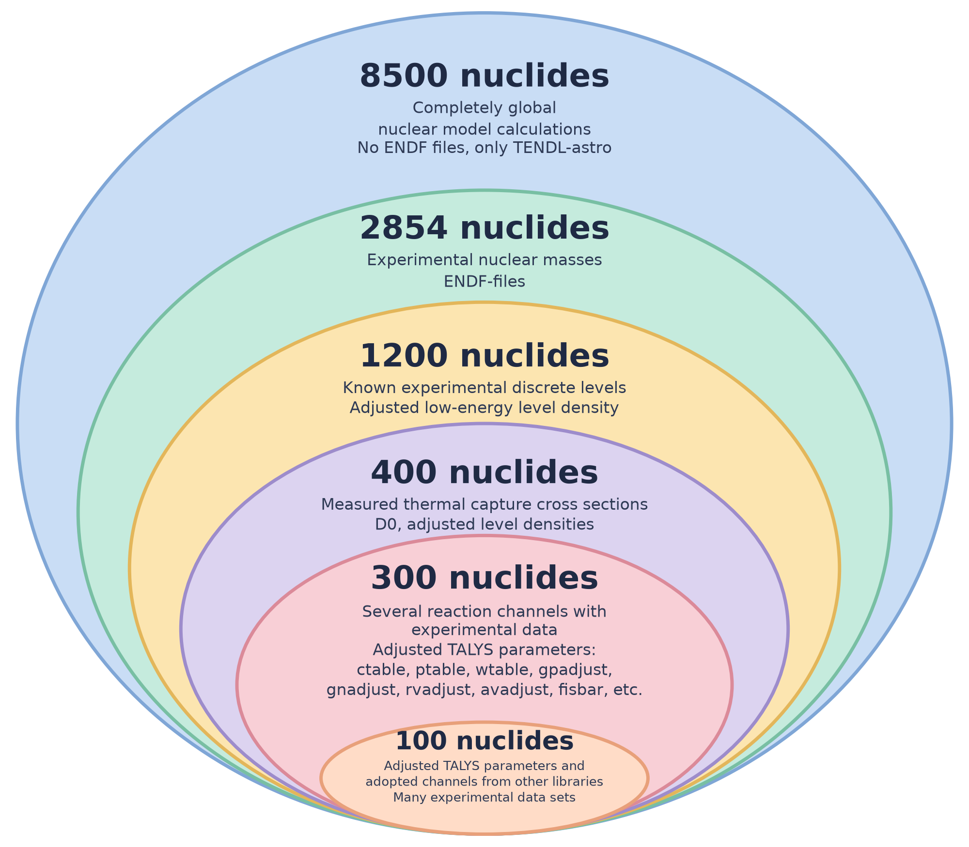
TENDL Nuclear Data Library: progressively more experimental information is added in
Astrophysics
TENDL’s
Terra cognita
Legacy GP’s

Slide 8

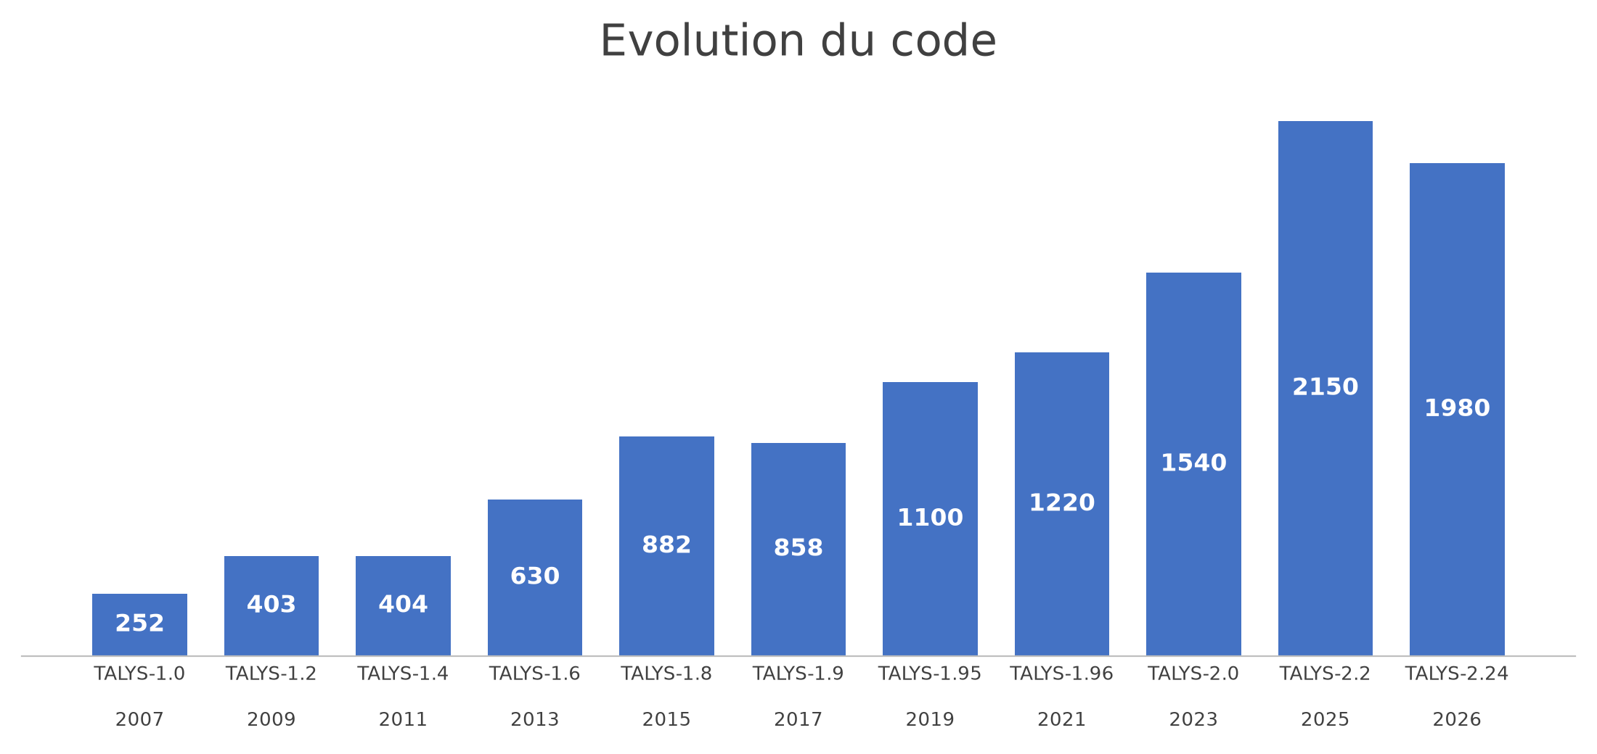
TALYS time steps evolution
Astro
Density D1M & BSk14 p-h(J,π)
+ GEF
FF decay
function forces γ D1M & RMF
+ resonance
Density p-h BSk14

Slide 9

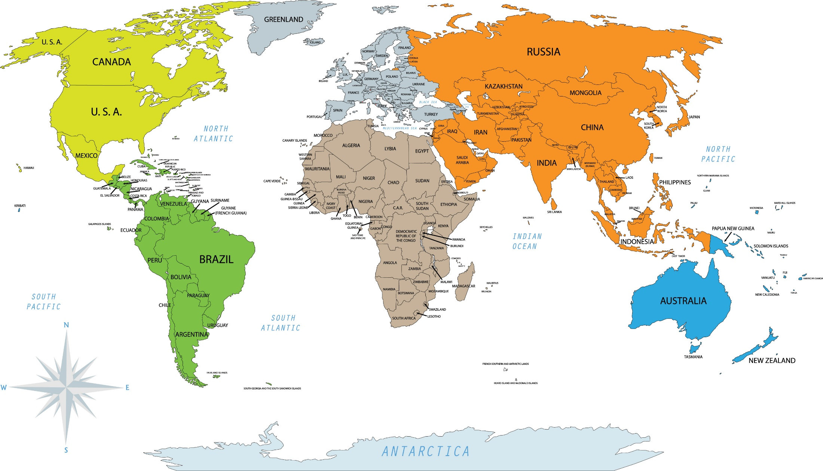
TALYS around the World
Around 9054 citations (web of sciences)
313
829
1997
347
3139
891
925
Germany
France
Belgium
848
320
207
290
330

Slide 10
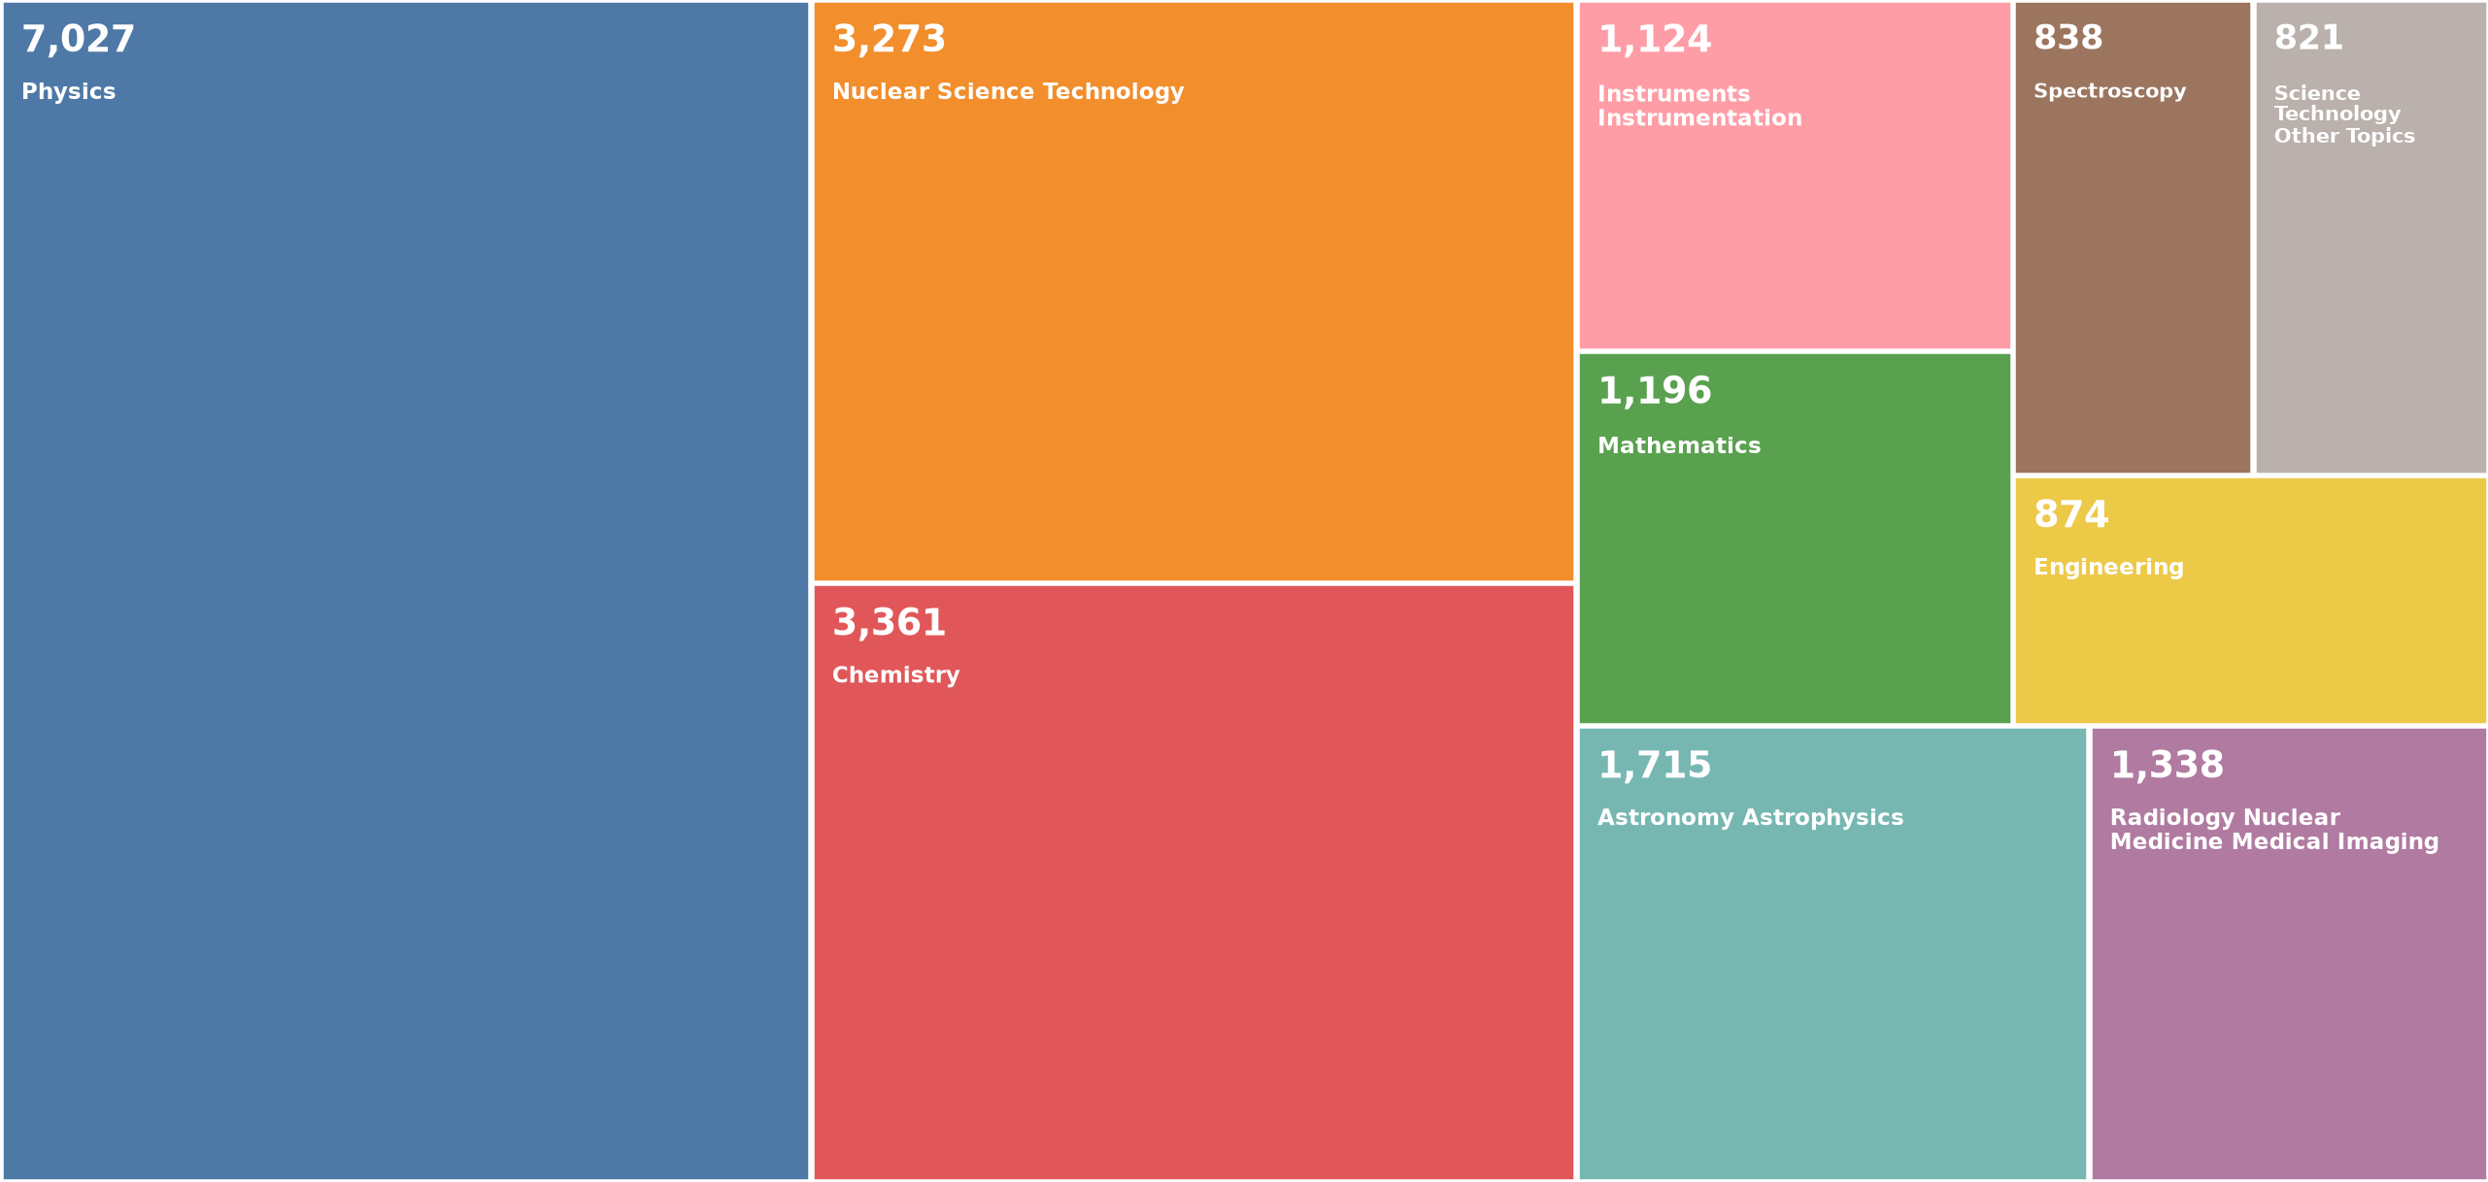
TALYS citations by research areas
Around 9054 citations (web of sciences) – area boxes overlap – top 10 only

Slide 11
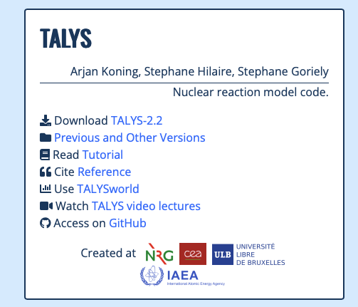
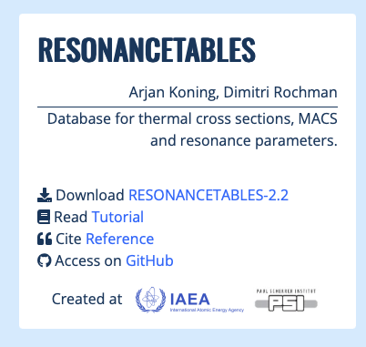
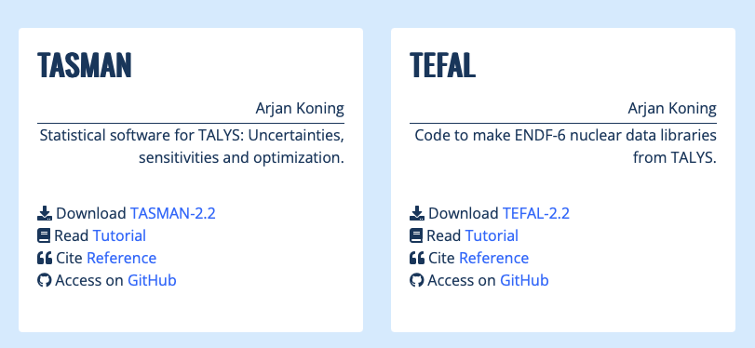
The framework T3: TALYS, TEFAL, TASMAM + resbase
https://nds.iaea.org/talys/
and GitHub

Slide 12
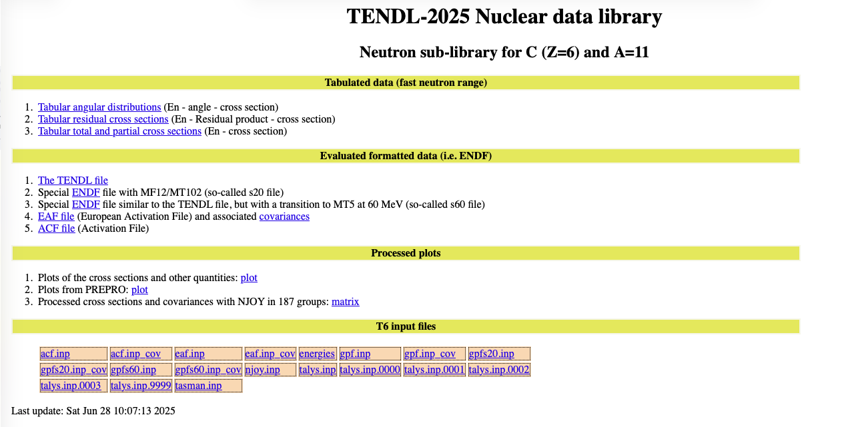
Portal https://tendl.imperial.ac.uk/tendl_2025/tendl2025.html
Tabular forms
YANDF-0.4
Angle, xs direct and compound,…
Cov.–Var. S/UQ & P
5 “ENDF” forms
Processed data plots
Code inputs

Slide 13
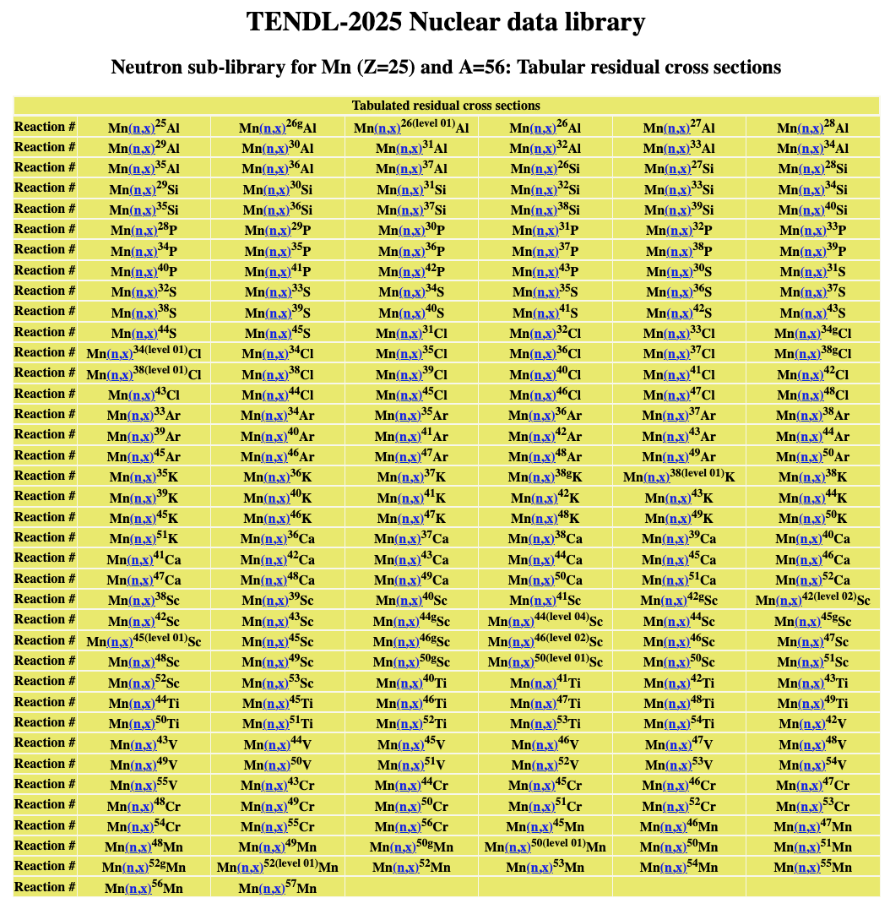
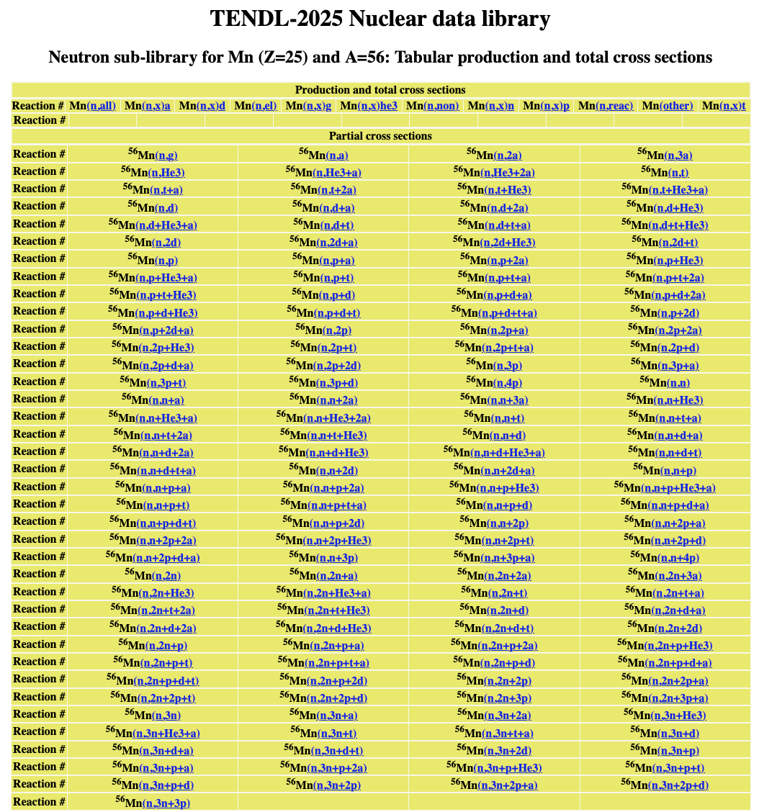
The residual products in detail
Emitted particles and/or residual products

Slide 14
YANDF-0.4
# header:
# title: Li7(n,g_1) angular distribution at 1.000000E+00 MeV
# source: TALYS-2.24
# user: Unknown User
# date: 2026-10-10
# format: YANDF-0.4
# target:
# Z: 3
# A: 7
# nuclide: Li7
# reaction:
# type: (n,g_1)
# ENDF_MF: 4
# ENDF_MT: 102
# E-incident [MeV]: 1.000000E+00
# level:
# number: 1
# energy [MeV]: 9.808000E-01
# spin: 1.000000E+00
# parity: 1
# quantity:
# type: angular distribution
# datablock:
# columns: 4
# entries: 91
## Angle xs Direct Compound
## [deg] [mb/sr] [mb/sr] [mb/sr]
0.000000E+00 2.039746E-05 0.000000E+00 2.039746E-05
2.000000E+00 2.039588E-05 0.000000E+00 2.039588E-05
4.000000E+00 2.039113E-05 0.000000E+00 2.039113E-05
TALYS 2.24 output file: nnang.L01
‘#’ for direct use in various software, e.g. Gnuplot
Without ‘#’: YAML 2 spaces indentation per level
Parsing to JSON should be easy
Only 5 main attributes for nuclear reactions
TALYS: 2 main attributes: ‘parameters’ and ‘observables’
EXFOR: all specific metadata after the data block
TALYS-2.24 /Work

Slide 15
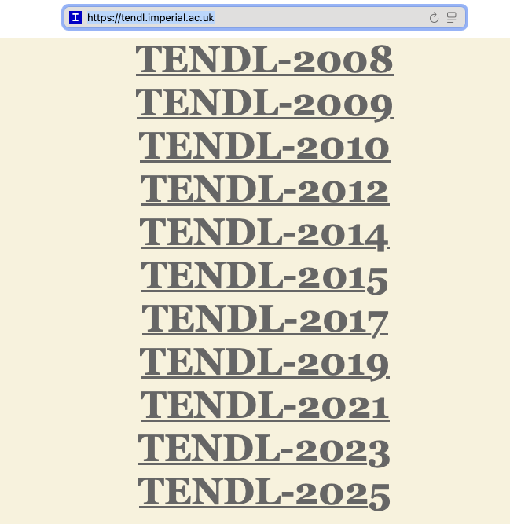
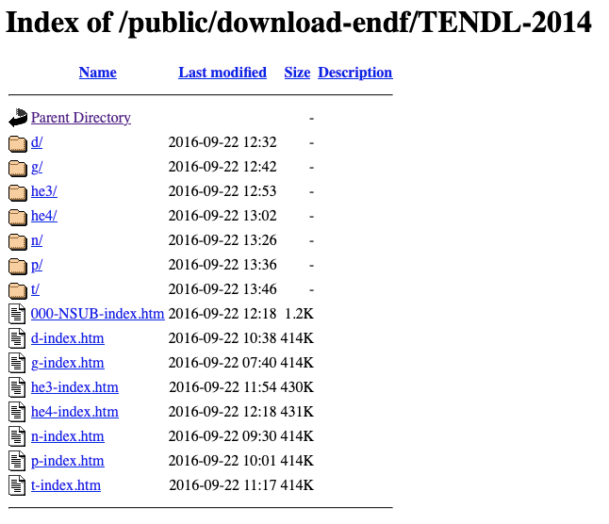
Where? https://tendl.imperial.ac.uk
Up to 2014, limited forms
Now live: 09/02/2026
All TENDL’s in the same place

Slide 16
How? TALYS-2.2 coded input parameters & GOF
Reaction | Nuclides | IP | IP | IP | IP | IP | IP
(n,γ) | 278 | wtable
(n,f) | 34 | vfiscor | betafiscor | ctable(1) | ptable(1) | ctable(2) | ptable(2)
(n,n’;2n;p) | 210 | rv(p) | gph(0) | gph(n) | ctable(n) | ctable(p)
(n,⍺) | 157 | rv(⍺) | Cstrip(⍺) | gph(0) | ctable(⍺)
(p,n) | 142 | rv(p) | rwd(p) | rv(n) | gph(0) | gph(n) | ctable(n)
(γ,n) | 77 | wtable | ftable | etable
(⍺,n) | 93 | rv(⍺) | rwd(⍺) | rv(n) | gph(0) | ctable(⍺)
(d,n) | 40 | rv(p) | rwd(p) | rv(n) | gph(0) | gph(n) | ctable(n)
Optimized parameters
Weight allocation on exp.
GOF value
How good is
the fit?

Slide 17
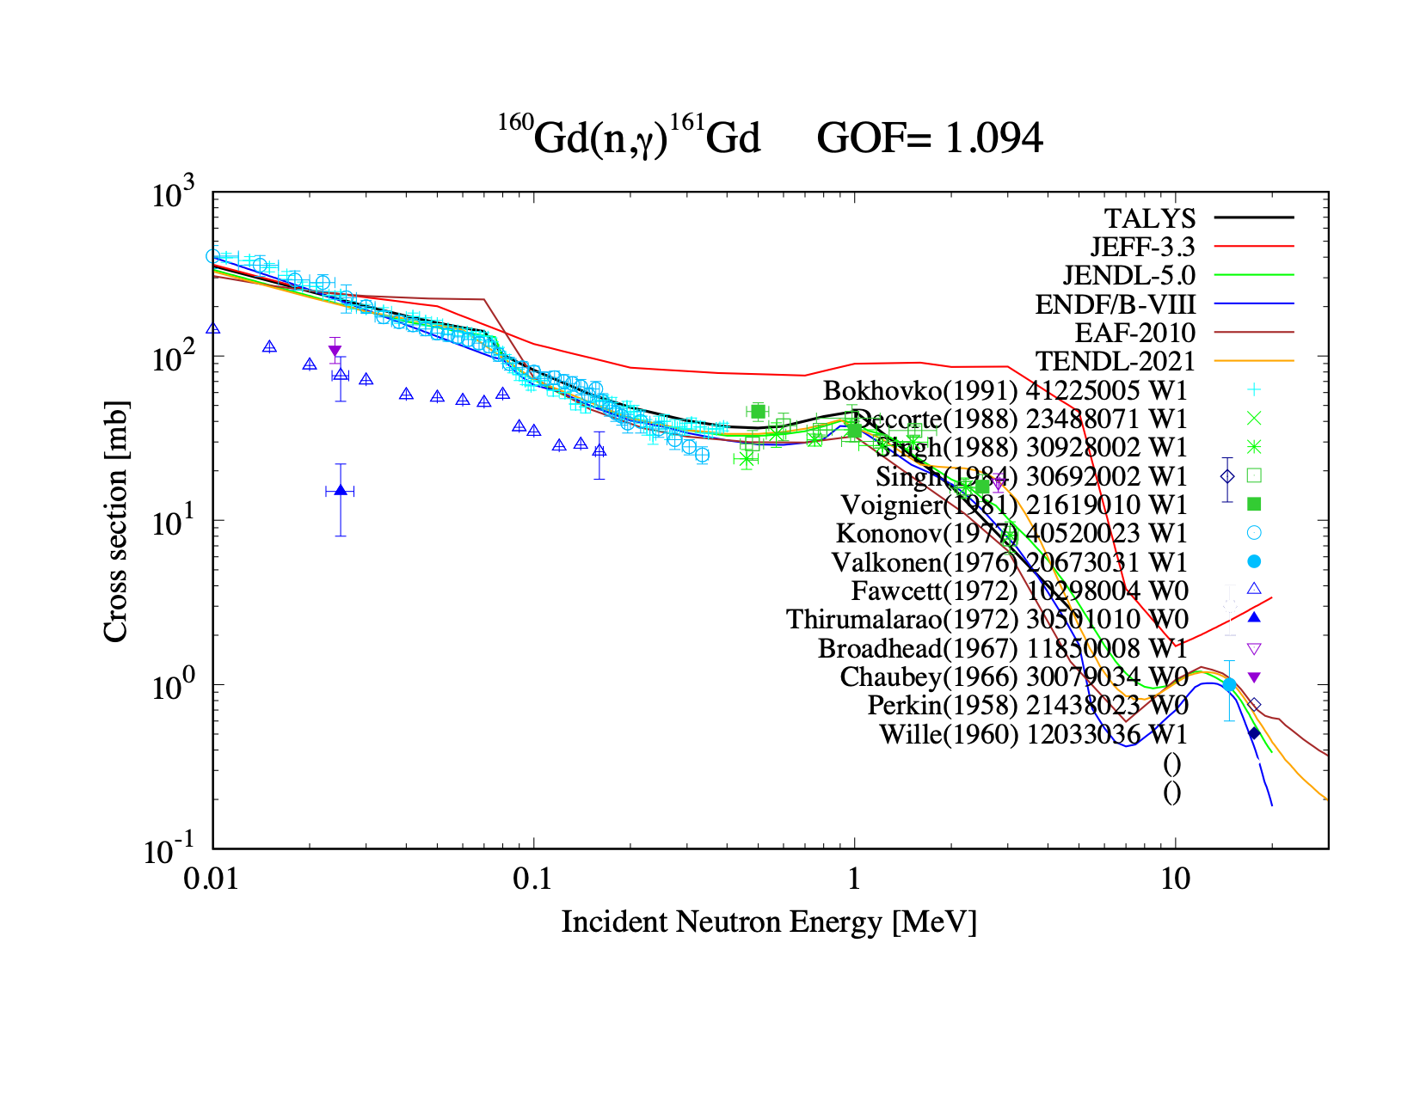
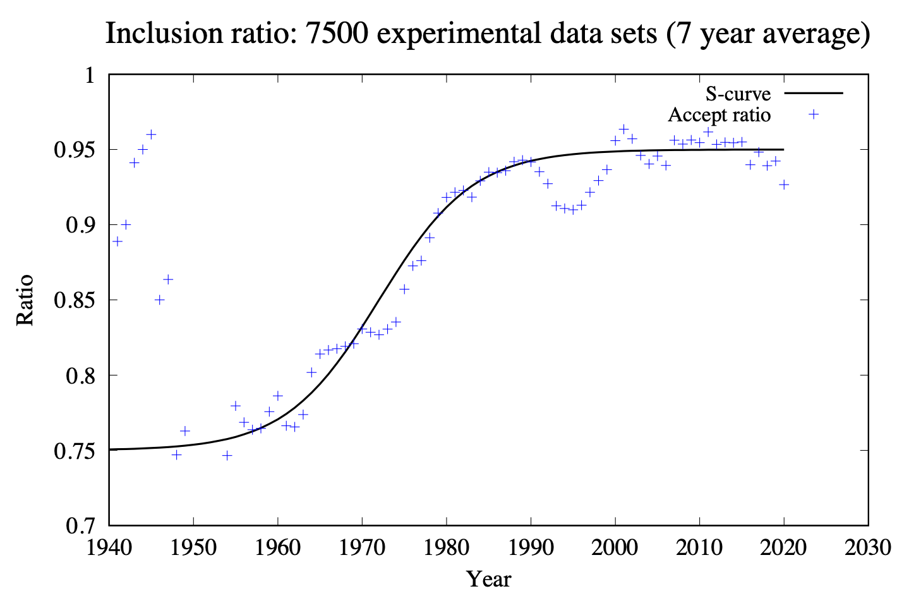
How? TALYS-2.2 coded input parameters & GOF
Outlier assignment (W0) and optimised TALYS model parameters per nuclide and reaction channel
7500 experiments, age weighted,
subjective, but..
Exp. data removed

Slide 18
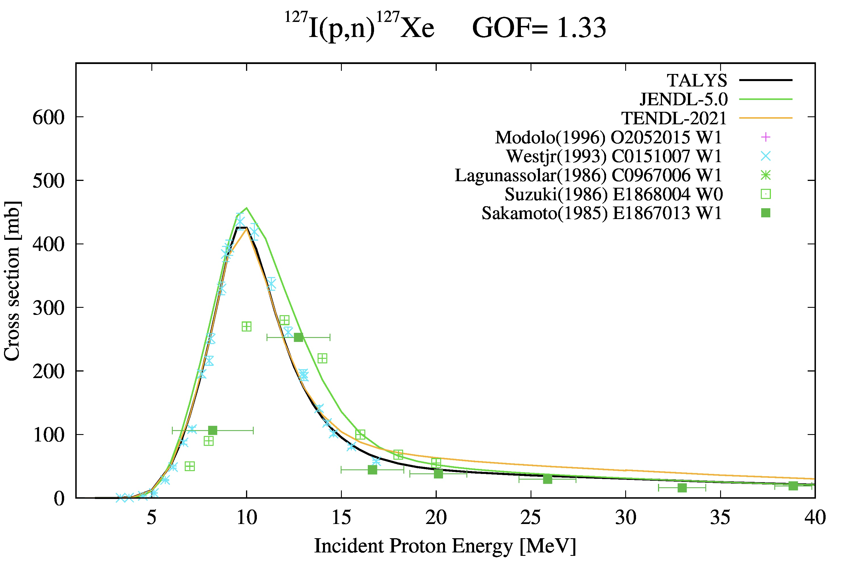
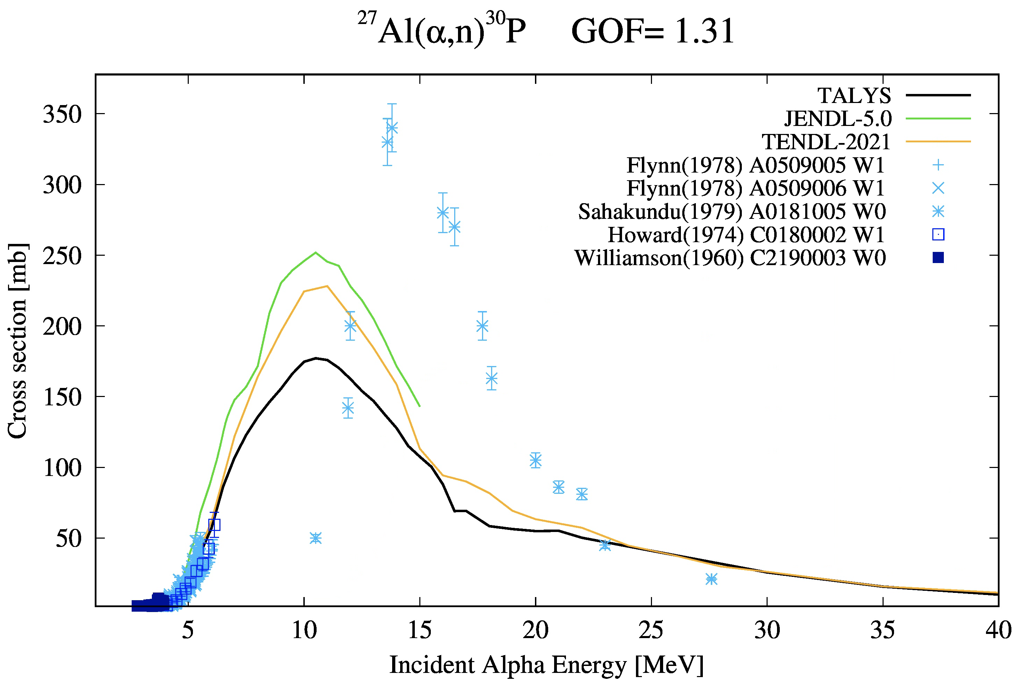
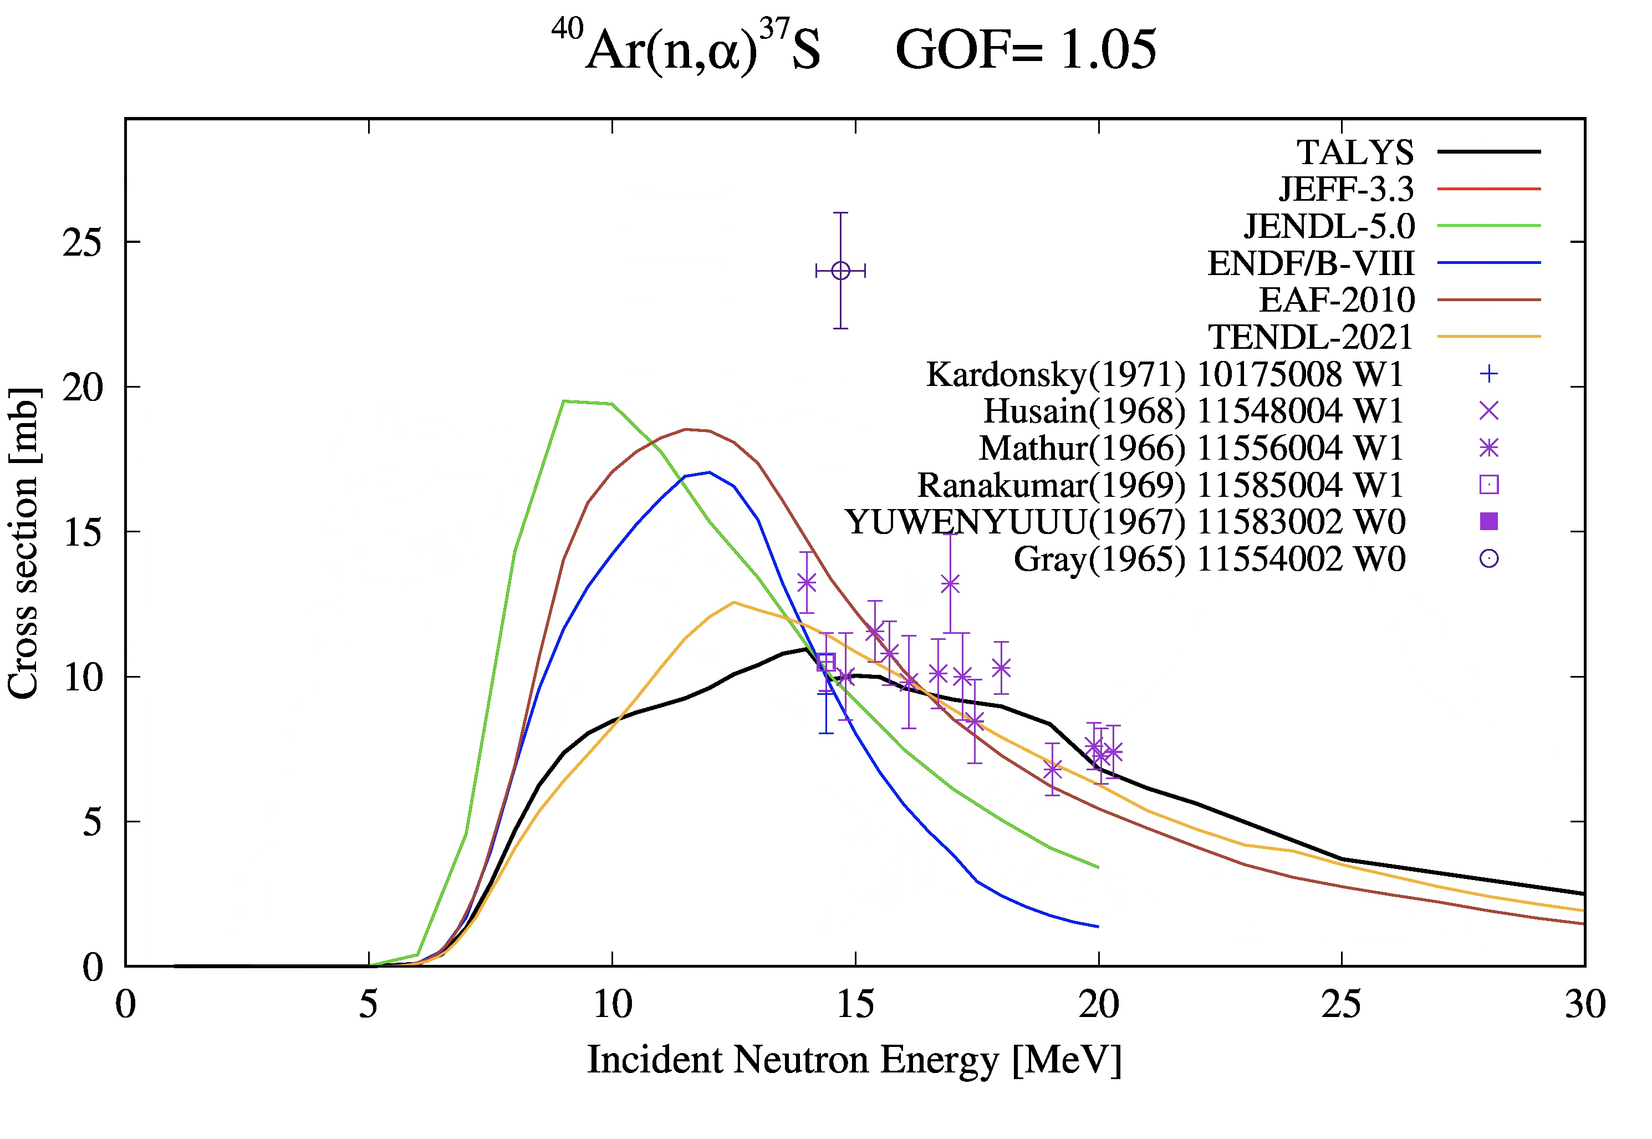
How? Scouting the experimental nuclear lanscapes
(α,n), (n,α) and (p,n) films
Exp. data removed

Slide 19
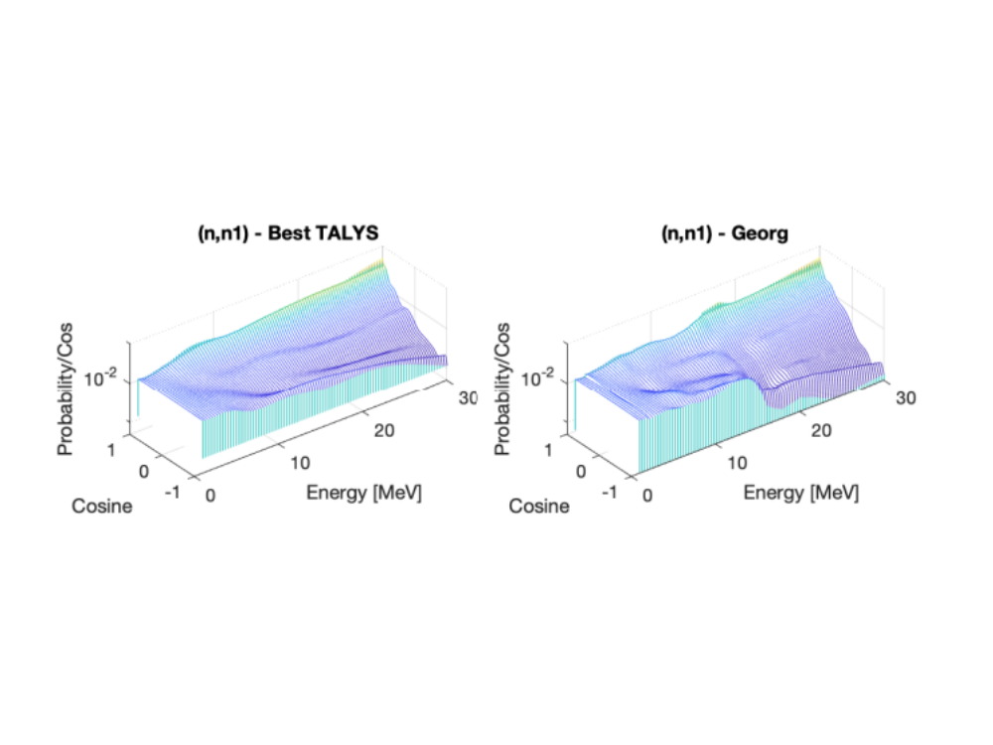

Technology: TALYS default or optimized parameters
to xs, 0.0253 eV
to MACS, 30 Kev
to Maxw., SPA
to xs, < 1 MeV
to angles
…
Adjusted TALYS input parameters 2631 1451
# 2631 1451
# General 2631 1451
# 2631 1451
ldmodel 2 2631 1451
# 2631 1451
# (n,tot), (n,el), (n,inl) 2631 1451
# 2631 1451
awdadjust n 1. awdadjust-n.table 2631 1451
# 2631 1451
# (n,p), (n,2n), (n,np) 2631 1451
# 2631 1451
rvadjust p 0.99 2631 1451
avadjust p 0.99 2631 1451
gnadjust 26 57 0.90 2631 1451
gpadjust 26 57 0.90 2631 1451
aadjust 25 56 1.12 2631 1451
pshiftadjust 26 56 -0.2 2631 1451
pshiftadjust 25 56 0.1 2631 1451
# 2631 1451
# (n,a) 2631 1451
# 2631 1451
cknock a 1.1 2631 1451
cstrip a 1.1 2631 1451
# 2631 1451
# (n,g) 2631 1451
ldmodelCN 1 2631 1451
# 2631 1451
# Other: Isomers, (n,d), (n,t), (n,h) etc. 2631 1451
# 2631 1451
***************************** T A L Y S **************************2631 1451

Slide 20
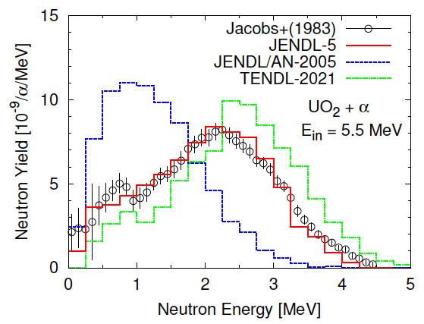

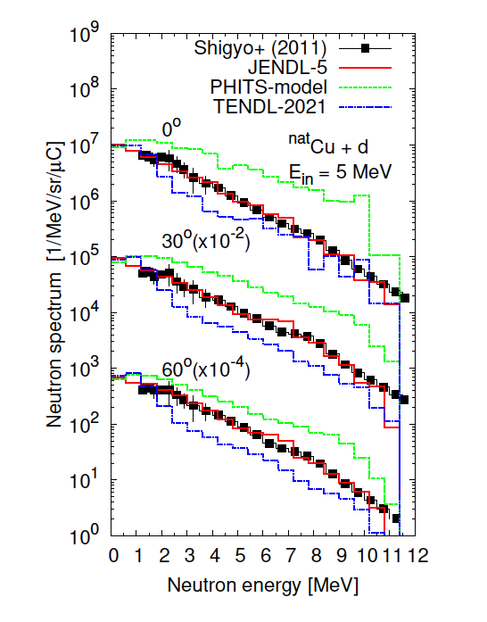
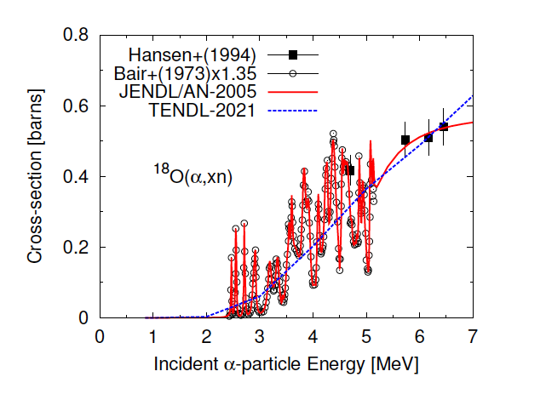
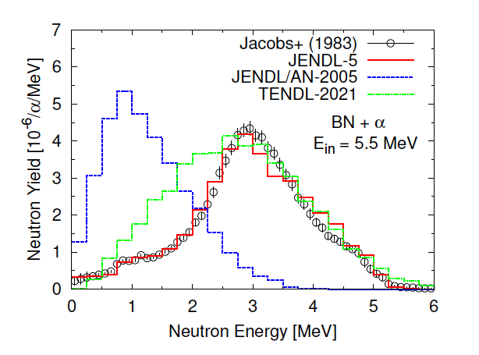
Verification & Validation - deuteron and alpha induced libraries
5 MeV deuteron on thick Copper
5.5 MeV alpha on UO₂ and Boron nitride
Better than JENDL/AN-2005 but then a-JENDL-5 arrived !!

Slide 21

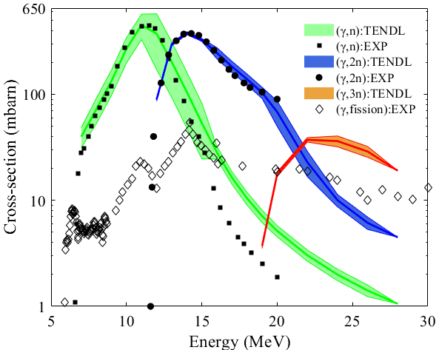
Verification & Validation processes - gamma induced libraries
Gamma on ²³²Th
variance
TALYS-2.2 blind simulation,
no exp. fitting !!
Caveat: γ-fission in MF-10

Slide 22
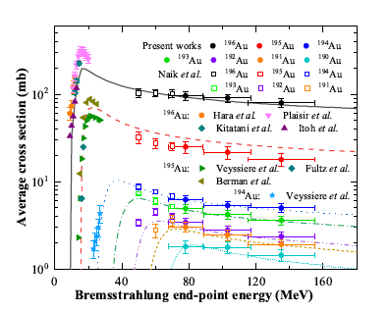
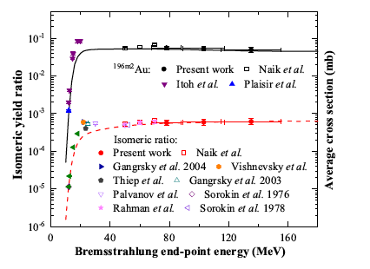
Laser-driven Ultra-Bright Ultra-Fast Bremsstrahlung g-Ray
¹⁹⁷Au(γ, xn; x=1~7) ¹⁹⁷Au(γ, n)^{196m2}Au
Isomeric ratio
2n
3n
7n
TALYS-2.2

Slide 23
Conclusions
Nuclear model codes & libraries will always require an improvement of
  Optical model and direct reactions
  Level densities
  Photon strength functions
  Fission events
  Pre-equilibrium mechanism
  Compound nucleus model
  Always need: curated experimental data EXFOR
  Continuous Integration – Verification and Validation processes
Future (the day after tomorrow with AI):
  A modular nuclear model code made by “united” scientific communities
  Nuclear model code simulators using Data Learning, Artificial Intelligence agents
  Direct feeding of probability tables “event generator style” to simulation code
  Autotalys with the help of ChatGPT/Codex & Anthropic/Claude
Next chapter: the making of TENDL-2027

