Slide 1
AI-Agent-Assisted Shielding Calculations:
Implementation of PHITS Workflows and Prospects for Multi-Code Monte Carlo Simulations
T. Sato¹⁾, S. Hashimoto¹⁾, T. Ogawa¹⁾, T. Furuta¹⁾, Y. Hirata¹⁾, S. Ohnishi¹⁾, Y. Sakaki³⁾, N. Shigyo⁴⁾
Japan Atomic Energy Agency, Tokai, Japan
High Energy Accelerator Research Organization, Tsukuba, Japan
Kyushu University, Fukuoka, Japan
Table of Contents
Recent Trends in PHITS
Introduction of AI-agent Workflow to PHITS
Prospect for Multi-Code Shielding Calculation
Summary
SATIF-17, IBS, South Korea, 2026/10/20-22

Slide 2
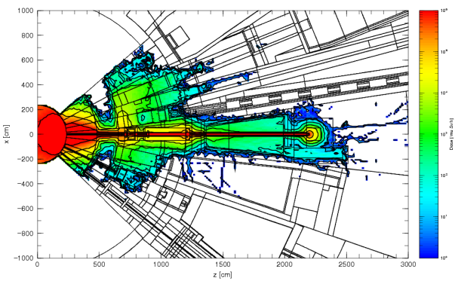
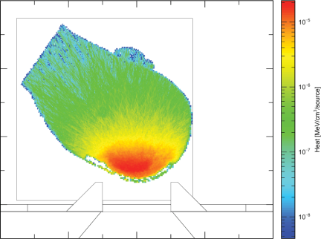
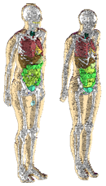
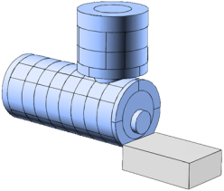
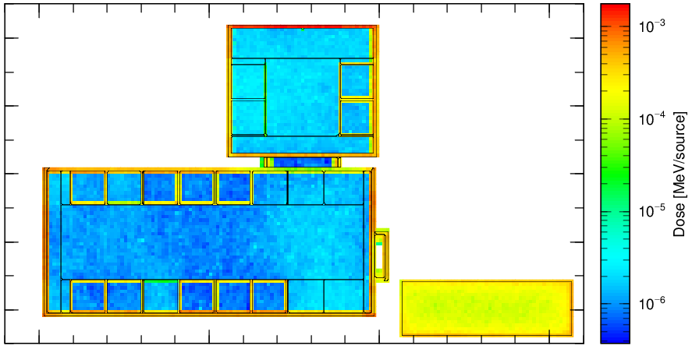


Basic Features of PHITS
Particle and Heavy Ion Transport code System
Capability
Transport and collision of nearly all particles over wide energy range using Monte Carlo method
neutron, proton, ions, electron, photon etc
10⁻⁴ eV to 1 TeV/n
All-in-one-Package
All contents of PHITS (source files, executables, data libraries, graphic utilities, etc.) are fully integrated in one package
Available in free of charge by submitting application form via PHITS website or OECD/NEA databank
Applications
Accelerator Design
Radiation Therapy & Protection
Space & Geoscience
https://phits.jaea.go.jp/
Notes:
But before that, I would like to explain the basic features of PHITS. PHITS represents particle and heavy ion transport code system, and it can analyze the transport and collision of nearly all particles over wide energy ranges up to 1 T e V, using Monte Carlo method. It is all in one package type code, that means all contents of PHITS such as source files, binary, data libraries, graphic utility are fully integrated in one package, and it is available in free of charge by submitting application form via PHITS website. It has been used for various applications such as accelerator design, radiation therapy and protection, and space and geosciences.

Slide 3
Recent Update History
2024 Apr.
2025 Apr.
2026 Apr.
2026 Sep.
Register PHITS 3.34 to OECD/NEA Data bank
Register PHITS 3.35 to OECD/NEA Data bank
Register PHITS 3.36 to OECD/NEA Data bank
Register PHITS 3.37 to OECD/NEA Data bank
New versions have been released in April every year
Version 3.37 was released in this September, as an exception to the usual once-a-year release, because it introduced the AI-agent workflow!
Notes:
This slide shows the recent update history. In general, new versions have been released in April every year, but Version 3.37 was released in this September, as an exception to the usual once-a-year release, because it introduced the AI-agent workflow. I will talk about the details of this workflow later.

Slide 4
Table of Contents
Recent Trends in PHITS
Introduction of AI-agent Workflow to PHITS
Prospect for Multi-Code Shielding Calculation
Summary
Notes:
Next, I would like to introduce the AI-agent workflow, which was recently implemented in PHITS.

Slide 5
History of AI Use in PHITS development
Converted the entire source code from Fortran77 to Fortran90 (~Later 2024)
Introduced AI agents for the development of PHITS (~Early 2026)
Released AI Phi-chan (May 2026)
Introduced AI-agent workflow in the PHITS package (Sep 2026)
Generated a Python script for the conversion using ChatGPT
Needed to revise the code manually when the script did not work well (Not an easy task)
It accelerated the PHITS development dramatically (No need to write Fortran code anymore)
Providing PHITS manual, sample input files, and lecture notes to Gemini Notebook
Encouraged users to consult it before sending questions to the PHITS office and forum
It can also generate and revise PHITS input files, but cannot execute PHITS → Significant Human-AI interaction is occasionally required
It can not only generate and revise PHITS input files but also execute and compile PHITS, and even analyze the results → Fully automatic calculation becomes feasible!
The key challenge was how to teach AI to use PHITS
Notes:
But before that, I will briefly introduce the history of AI use in PHITS development.
At first, we converted the entire source code from Fortran 77 to Fortran90 in later 2024. For this purpose, we generated a python script for the conversion using ChatGPT, but we needed to revise the code manually when the script did not work well, so it’s not an easy task.
Then, we introduced AI agents for the development of PHITS in early 2026. In fact, it really accelerated the development dramatically and we do not need to write Fortran code anymore.
Then, we released AI Phi-chan by providing PHITS manual, sample input files and lecture notes to Gemini Notebook and encouraged users to consult it before sending questions to PHITS office and forum. It can also generate and revise PHITS input file, but cannot detect errors, so significant human-AI interaction is occasionally required.
To avoid the interaction, we introduced AI-agent workflow in the PHITs package in this September. It can not only generate and revise PHITS input files but also execute and compile PHITS, and even analyze the results. So, fully automatic calculation becomes feasible with this workflow.
The key challenge of the last two time was how to teach AI to use PHITS.

Slide 6
How to Master a New Language?
Common to AI and humans
A dictionary (= manual for PHITS) alone is not a realistic way to learn
Textbooks (= lecture materials for PHITS) are essential, but not enough on their own
Many example sentences (= sample input files for PHITS) are also needed
Unique to AI
AI reads huge amounts of text well, but struggles with images (opposite to humans)
Converted the manual and lecture materials to text
Built a searchable catalog of sample input files by purpose and keyword
Notes:
For this challenge, at first, we considered how to mater a new language.
I think a dictionary, that is the manual for PHITS, alone is not a realistic way to learn, textbooks, that is lecture materials for PHITS, are essential but not enough on their own, so many practical experiences, that is sample input files for PHITS.
These are common to AI and humans, but one thing unique to AI is that AI reads huge amounts of text well, but struggles with images, opposite to humans.
Therefore, we converted the manual and lecture materials to text, and built a searchable catalog of sample input by purpose and keyword

Slide 7
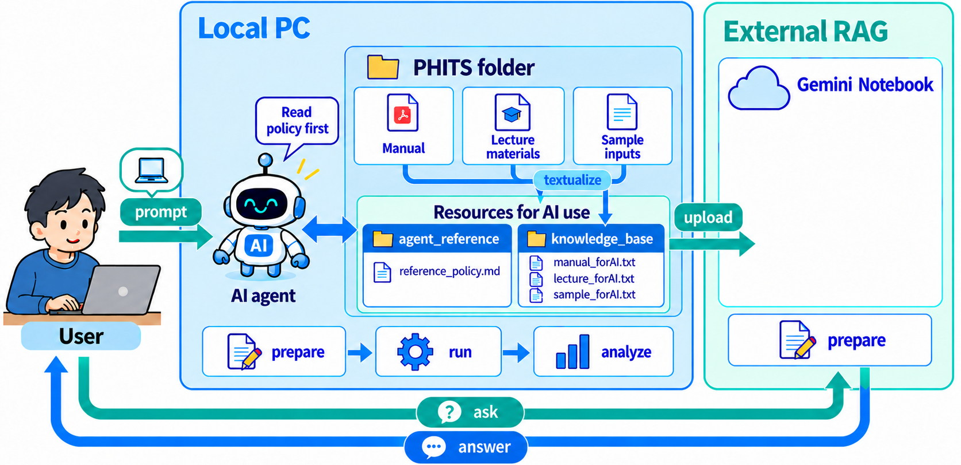



Overview of PHITS AI Workflow
“knowledge_base” is upload to external RAG service (Gemini Notebook etc.), named it AI Phi-chan
“agent_reference” is used by AI agents together with reference_policy.md
→ Rules for preparing input files, running PHITS, and analyzing the results (e.g., checking geometry)
Notes:
This slide shows the overview of PHITS AI workflow.
As I said before, manual, lecture materials, sample inputs were textualized into knowledge-base folder, and this knowledge base was uploaded to External RAG service, Gemini Notebook, and named it AI Phi-Chan. PHITS users can ask questions and get answer from it.
We also created agent_reference folder, which is used by AI agents together with AGENTS.md and reference_policy.md, which give the rules for preparing input files and executing/compiling PHITS. For example, it explicitly suggest checking geometry after making any changes on it.

Slide 8
Demonstration Tasks
Reproducibility Check (how stable AI answers to the same prompt)
Five independent tasks: cosmic-ray detector response calculation, shielding optimization, “melt the snowman” exercise, multi-detector correlation analysis, DNA damage yield estimation
Single prompt: All instructions in a single prompt
Ten AI environments: Various combinations of AI agent (Codex, Claude Code, GitHub Copilot), LLM (GPT5.5 & 5.6, Opus 4.8 & 5, Sonnet 5), and OS (Windows, Mac, Ubuntu)
Complexity Check (how far AI can handle complex tasks)
Six prompts in sequence: Find appropriate sample input for proton therapy dosimetry → calculate depth-dose distribution → design ridge filter → implement ICRP voxel phantom → optimize irradiation condition → calculate organ-at-risk doses
Single AI environment: Windows, Codex, GPT5.5
Notes:
For this AI-agent workflow, we performed reproducibility check, how stable AI answers to the same prompt, by providing five independent tasks in single prompt to ten AI environments. In addition, we performed complexity check, how far AI can handle complex tasks by providing six prompts in sequence to single AI environment.
In this presentation, I will introduce the results of shielding optimization and proton therapy dosimetry.

Slide 9
Reproducibility Check: Shielding Optimization
Prompt
Please calculate the optimum polyethylene shielding thickness for a neutron source, referring to recommendation/h10multiplier. Set up a 10 MBq Cf-252 source at the center and surround it with a spherical polyethylene shield. Variance reduction is not required. Calculate the ambient dose equivalent rate, H*(10), on the outer surface of the polyethylene sphere. Find the radius of the polyethylene sphere required to reduce H*(10) to 5 μSv/h or less. Adjust the polyethylene thickness in 1 cm increments. The statistical uncertainty of the calculated H*(10) value should be within 5%.
Notes:
For the shielding optimization, we provided the following prompt.
Please calculate the optimum polyethylene shielding thickness for a neutron source, referring to recommendation/h10multiplier folder. Set up a 10 MBq Cf-252 source at the center and surrounding it with a spherical polyethylene shield. Variance reduction is not required. Calculate the ambient dose equivalent rate, H*(10), on the outer surface of the polyethylene sphere. Find the radius of the polyethylene sphere required to reduce H*(10) to 5 μSv/h or less. Adjust the polyethylene thickness in 1 cm increments. The statistical uncertainty of the calculated H*(10) value should be within 5%.

Slide 10
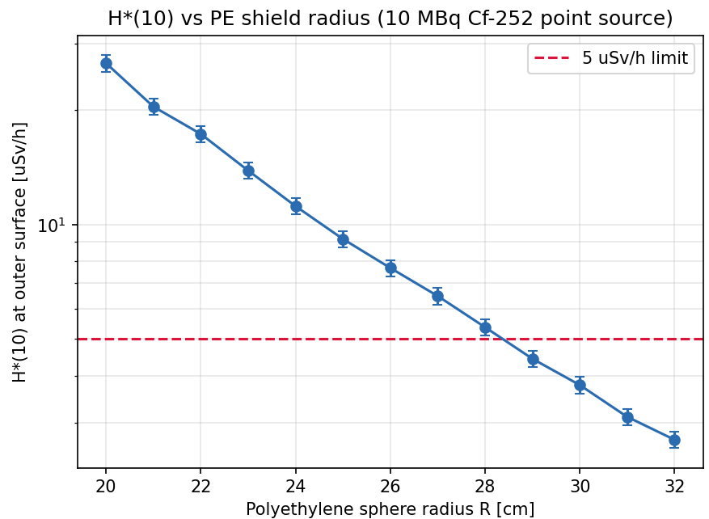
Answers from 10 AI environments
Optimal thickness & Computational Time
Example result
AI agent (LLM) | Opt. (cm) | AI time (sec) | Total time (sec)
Codex (GPT-5.5) | 26 | 212 | 2248
Codex (GPT-5.5) | 29 | 555 | 1114
Codex (GPT-5.6) | 26 | 231 | 540
Claude Code (Opus 4.8) | 29 | 403 | 1657
Claude Code (Opus 5) | 29 | 852 | 2991
Claude Code (Sonnet 5) | 29 | 967 | 1110
Claude Code (Opus 5) | 29 | 661 | 2997
Claude Code (Sonnet 5) | 29 | 586 | 720
Claude Code (Sonnet 5) | 30 | 705 | 995
GitHub Copilot (Sonnet 5) | 29 | 1023 | 9422
H*(10) vs. thickness (plotted by AI)
Expected optimal thickness: 29 cm (7/10)
Some runs answered 26 cm by calculating neutron dose only or 30 cm by adding a 1 cm central air gap
→ human or other AI check is needed!
AI time: AI thinking time
Total time: from prompt to finished calculation
Notes:
This table summarizes the optimum thickness and computational time of 10 AI environments. The expected optimal thickness is 29 cm, and 7 of 10 AI environments could properly answer. Some AI automatically created this kind of picture for making us better understand. However, some runs answered 26 cm by calculating neutron dose only, or 30 cm by adding a 1 cm central air gap, which was not intended in the prompt. Therefore, human or other AI check is needed

Slide 11
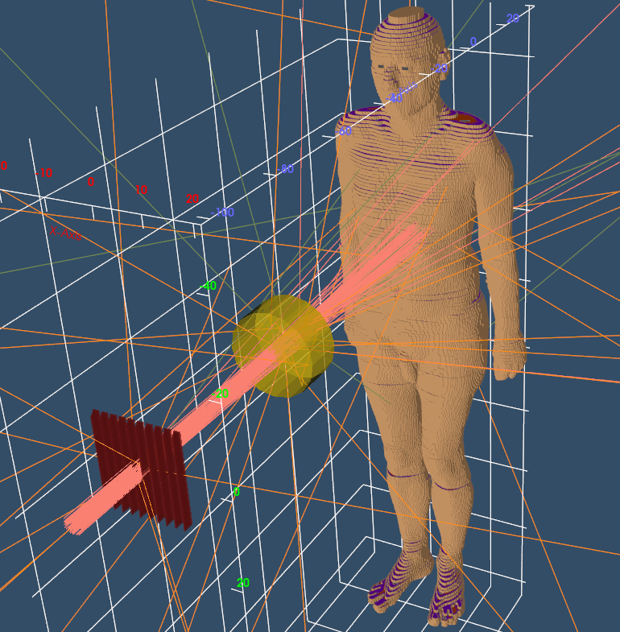
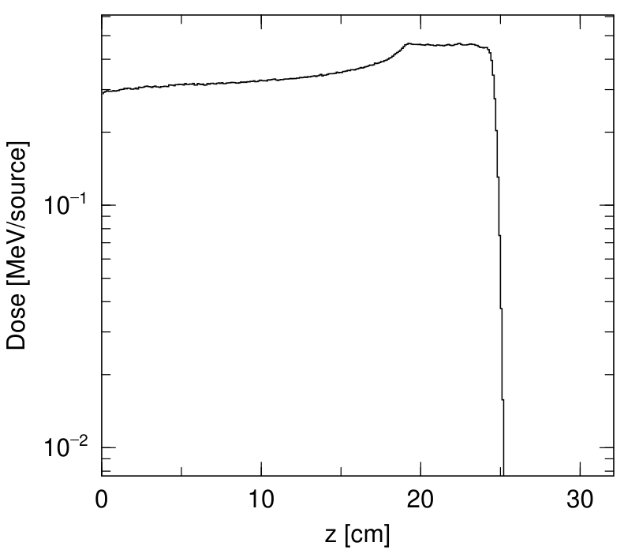
Complex Sequential Tasks
Prompt at each step
Find the best sample for proton therapy dosimetry
Calculate depth-dose curve for a 200 MeV proton beam
Design a ridge filter for a 5 cm SOBP
Irradiate the ICRP phantom by the SOBP beam
Optimize irradiation condition for stomach cancer
Calculate the absorbed doses in OAR (organ-at-risk)
Range shifter
Organ doses (10 Gy to stomach contents)
Ridge filter
Organ name | Dose (Gy)
Stomach wall | 7.25
Pancreas | 1.85
Small intestine | 0.727
Liver | 0.562
PHIG-3D view of [t-4dtrack] output
Even for a very complex task, AI can complete it if we break the task down and write the prompts step by step
Simulated SOBP depth-dose curve
Notes:
For complex sequential tasks, at first, we asked AI to find the best sample for proton therapy dosimetry and calculate depth-dose curve for a 200 MeV proton beam. Then, we asked to design a ridge filter for a 5 cm SOBP, like this, and irradiate the ICRP phantom by the SOBP beam. Then, we asked to optimize irradiation condition for stomach cancer like this and calculate the absorbed doses in OAR. Even for a very complex task like this, AI can complete it if we break the task down and write the prompts step by step

Slide 12
How to write a good prompt for PHITS simulation?
You should include (at least) the following information
Purpose of the calculation;
Name of the sample directory or input file to be used as a reference;
Components to be modified and those to be kept fixed, such as the geometry, source, tally, and calculation parameters;
Evaluation and optimization criteria, including the physical quantities to be evaluated and the required level of statistical uncertainty.
Check the results yourself or Ask another AI to verify them
Notes:
Based on these experience, I would like to share my conclusion how to write a good prompt for PHITS simulation.
You should include at lest the following information: First the purpose of the calculation, second, Name of the sample directory or input file to be used as a reference;
third, components to be modified and those to be kept fixed, such as the geometry, source, tally, and calculation parameters, and fourth, evaluation and optimization criteria, including the physical quantities to be evaluated and the required level of statistical uncertainty.
But the most important point is to check the results yourself or ask another AI to verify them. Actually, it is ideal to check by human, but recently, I realize that it is almost impossible because AI easily runs hundreds of simulations. Therefore, ask another AI is more realistic way for verification.

Slide 13
Table of Contents
Recent Trends in PHITS
Introduction of AI-agent Workflow to PHITS
Prospect for Multi-Code Shielding Calculation
Summary
Notes:
Next, I would like to introduce the AI-agent workflow, which was recently implemented in PHITS.

Slide 14
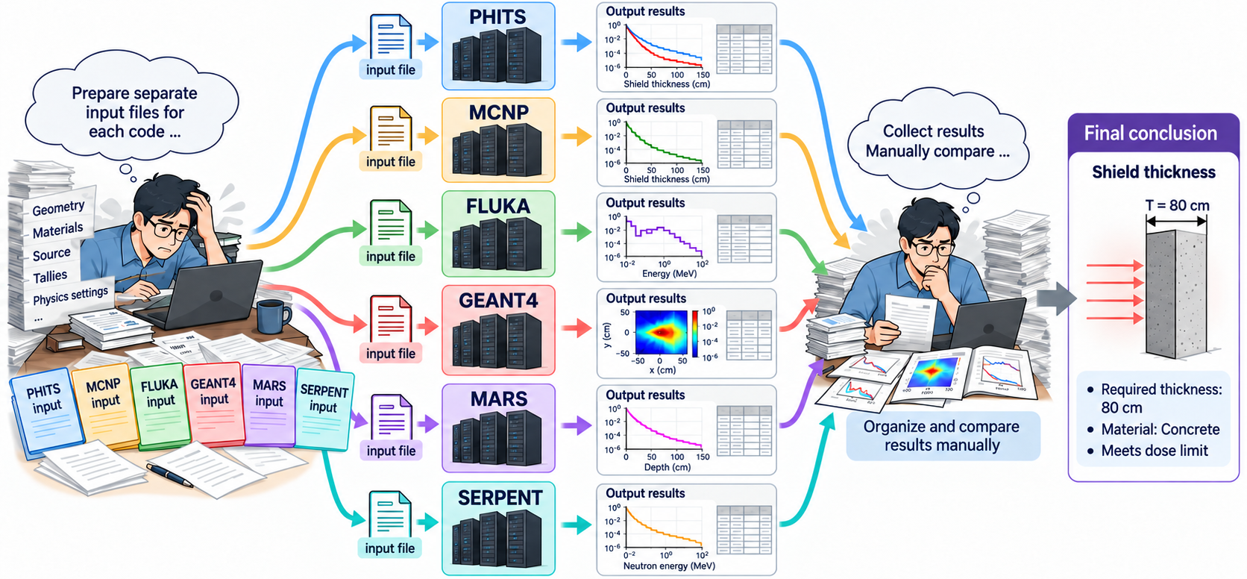
Using multiple codes is ideal for shielding calculation…
But difficult in practice!!
You must learn how to use each code, prepare the input files, and analyze the output files yourself

Slide 15
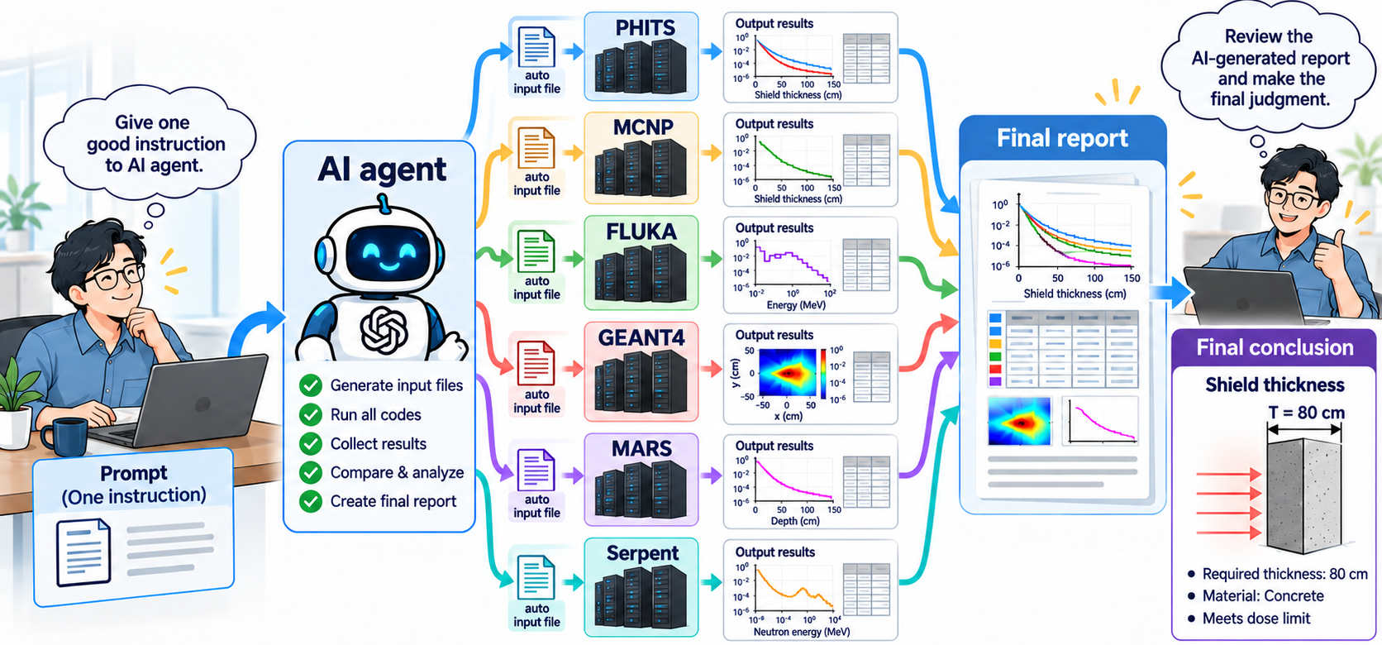
If all codes implemented their own AI-agent workflow…
It would be much easier!!
All you have to do is give a good prompt to AI agent
Prepare an input file for one code and ask AI agent to run with other codes

Slide 16
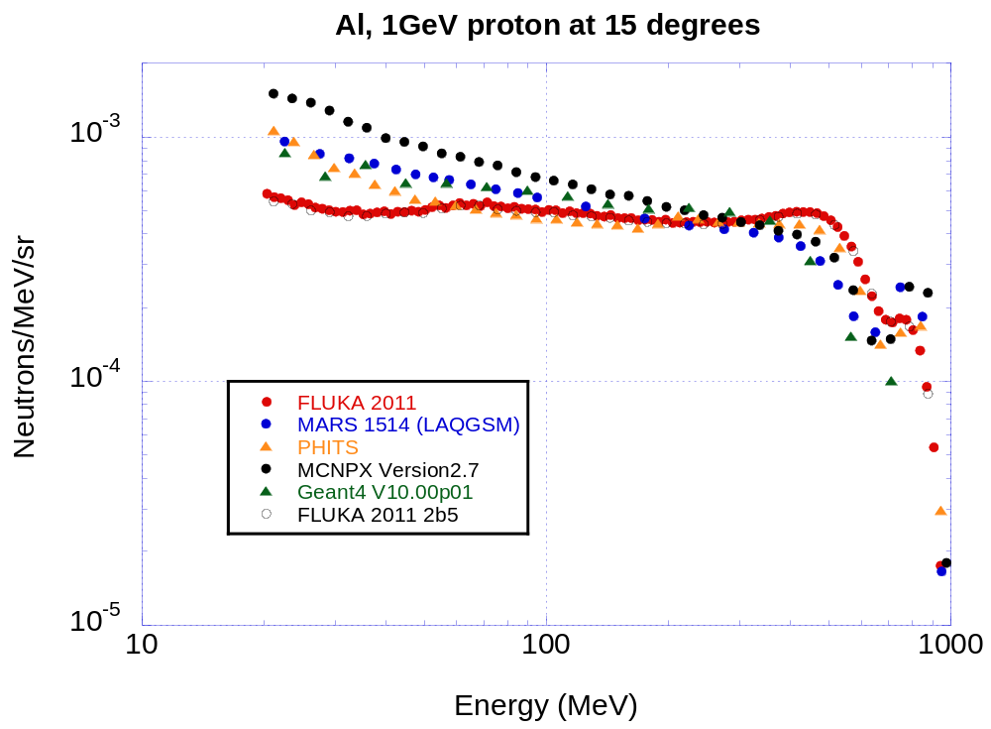
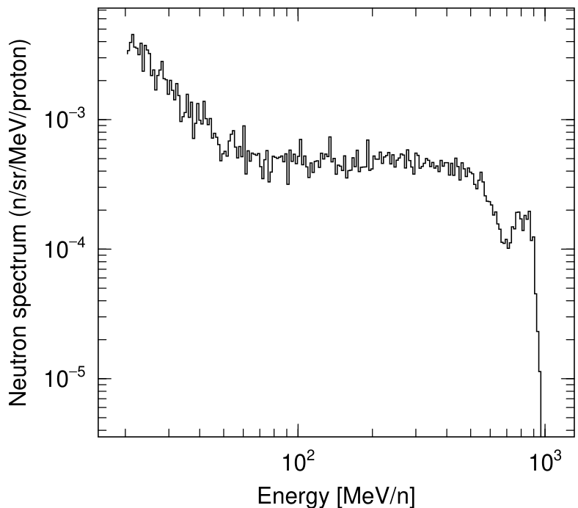
SATIF benchmark would be also easier…
SATIF-12 benchmark problem given by Prof. Hirayama
Hirayama and Sanami, SATIF12
Latest PHITS using AI-agent
Neutron spectra at 15 degree generated from Al target irradiated by 1 GeV proton
All I did was copy & paste the benchmark problem into AI-agent
Key is to define the problem without any ambiguity!
Notes:
This graph shows the SATIF-12 neutron spectrum at 15 degrees for a 1 GeV proton beam on an Al target, reported by Hirayama and Sanami, while this graph shows the corresponding result calculated with the latest PHITS using an AI agent. All I did was copy and paste the benchmark problem into the AI agent, so the key is to define the problem without any ambiguity, as I said several times in this presentation.

Slide 17
Table of Contents
Recent Trends in PHITS
Introduction of AI-agent Workflow to PHITS
Prospect for Multi-Code Shielding Calculation
Summary
Notes:
Next, I would like to introduce the AI-agent workflow, which was recently implemented in PHITS.

Slide 18
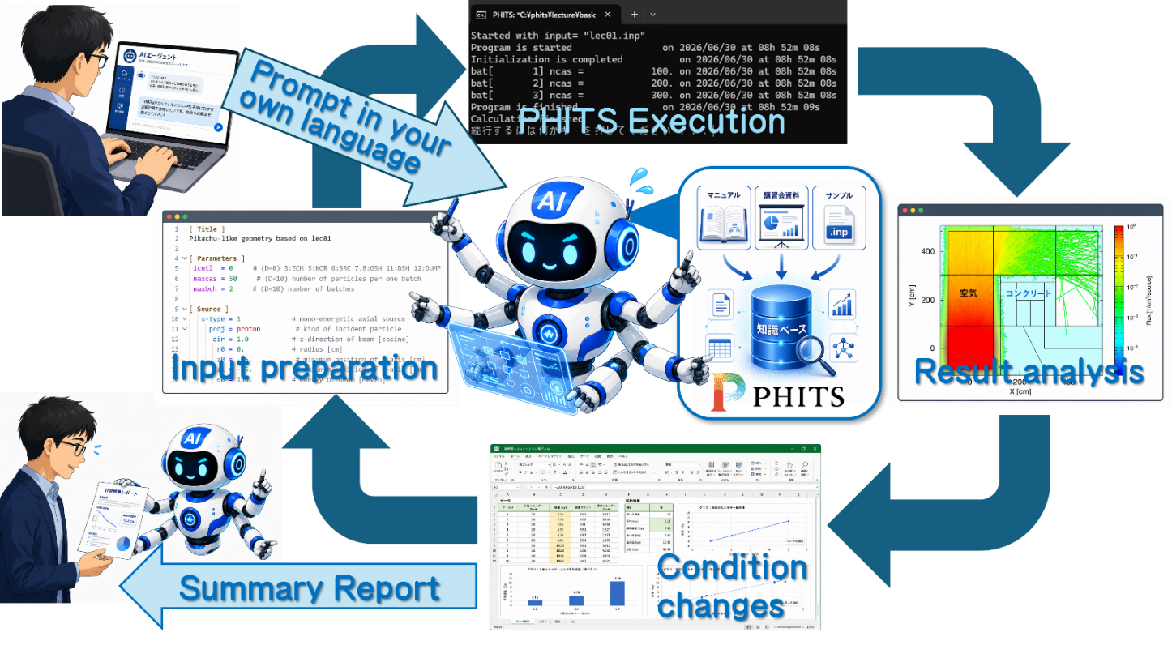
Summary
AI agents enable iterative PHITS workflow—from input preparation and execution to result analysis and condition changes—through prompts in your own language*
AI agents may make multi-code shielding calculations the standard approach in the future
*T. Sato et al., Toward AI-Agent-Driven Particle Transport Simulations: Implementation of AI-Assisted Workflows for PHITS, J. Nucl. Sci. Technol. (2026) https://doi.org/10.1080/00223131.2026.2742550

