Slide 1
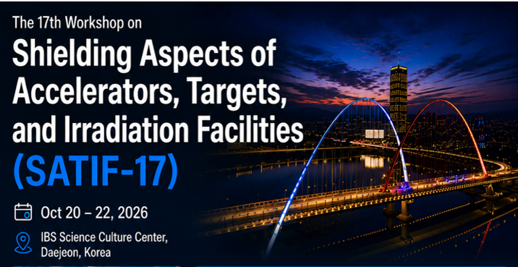
Residual Dose Rates Measured vs Calculated during the Replacement of SNS Inner Reflector Plug 2
October 21, 2026, Daejeon, South Korea
Irina Popova
F.X. Gallmeier, C. Elam
Notes:
Accessing Title Slide Options
The standard ORNL presentation template includes five branded title slide layouts:
Title | Standard. The preferred layout for lab-wide and general presentations. Features a default aerial photograph of the lab.
Title | Custom Image. Allows replacement of the default background with a custom full-slide image (16:9 or 4:3 landscape format).
Title | Custom Portrait Image. Supports inclusion of a custom 4:3 portrait image positioned next to the introductory text.
Title | Custom Landscape Image. Supports inclusion of a custom 16:9 landscape image positioned next to the introductory text.
Title | Text Only. Offers additional space for longer titles and multiple presenters.
Additional Lab-approved title slides specific to directorates and user facilities are available in PowerPoint under the following folders: Custom Title Slides and User Facility Templates, located in Presentation Templates.
Custom Title Slide Guidelines
Image Rights. Any custom images, graphics, or photography must be owned by ORNL or used with documented permission from the original creator or source.
Appropriate Image Use. Select images that work well with the layout. Ensure the focal point of the image is not obscured by the title text and white overlay box.
Relevance and Impact. Visuals are a key element of effective communication. Whenever possible, use imagery that enhances the message of your presentation and reflects ORNL’s mission and values.
Quality and Clarity. Use high-resolution images for clarity on large screens. Avoid overly complex or dark images that may conflict with the title text.
Text-Only Option. If no appropriate or approved imagery is available, or if imagery is not permitted for the subject matter, the Title | Text Only layout provides a clean, professional alternative.
Learn more about ORNL presentations
https://ornl.sharepoint.com/sites/Branding/SitePages/Presentations.aspx

Slide 2

Outline
Introduction — SNS facility and IRP role in the target monolith
Replacement Operation — IRP2 removal stages, segmentation, timeline
Instruments - measurements
Methods and assumptions — Three-step workflow: transport, transmutation, dose rate estimation
Comparisons — Example dose rate maps and comparison to measured values
Conclusions

Slide 3
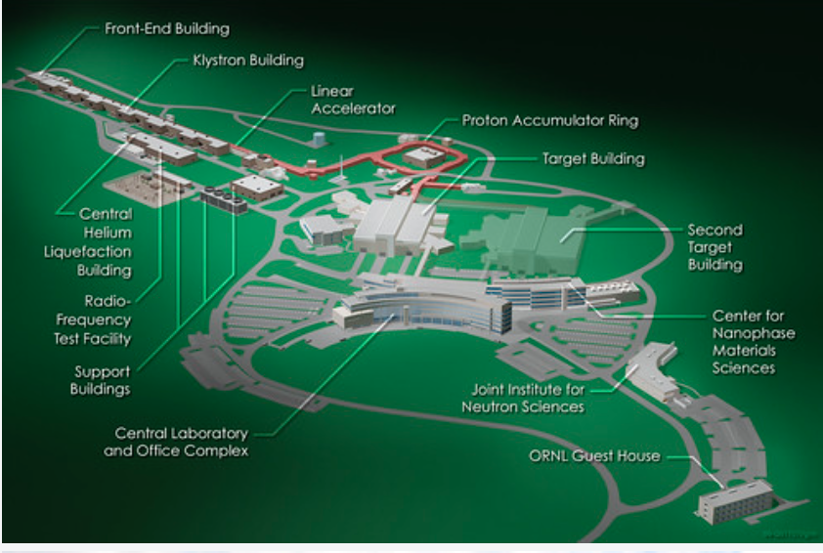
Introduction: The Spallation Neutron Source
The Spallation Neutron Source (SNS) is presently the most intense accelerator-based neutron source.
Sub-microsecond 60 Hz proton pulses at 1.3GeV from the accelerator complex impinge on a liquid-mercury target, generating pulses of neutrons that feed 20 operating instruments.
Inner Reflector Plug (IRP): beryllium reflector + moderator vessels surround the target
IRP accumulates high activation dose over operational lifetime → periodic replacement required

Slide 4
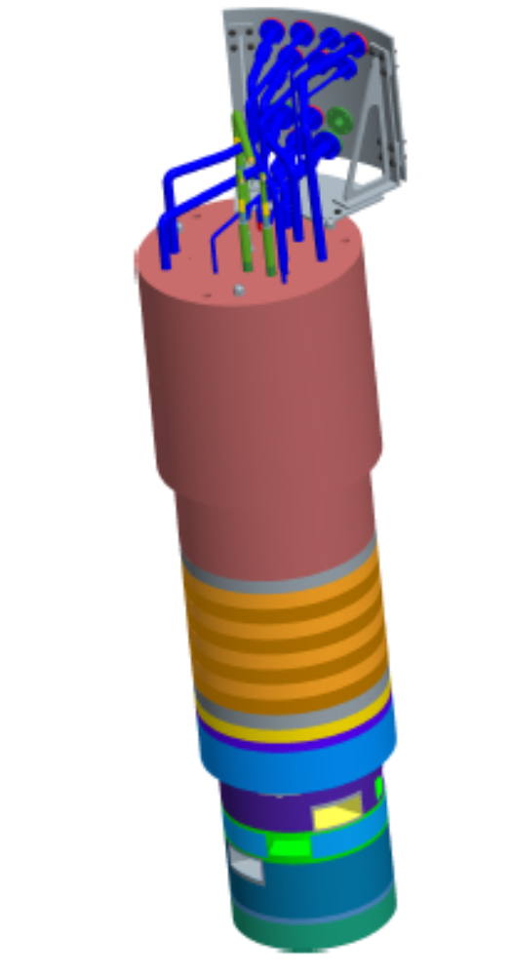
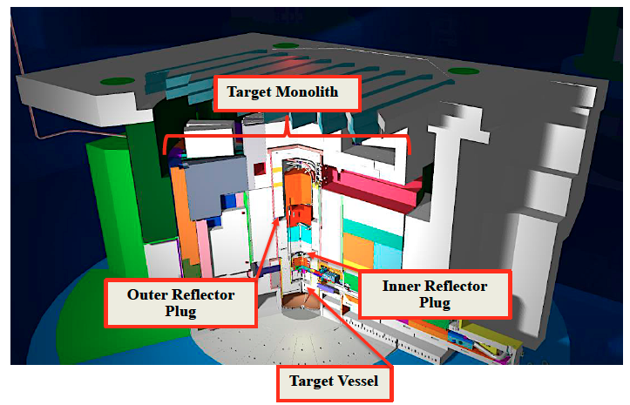
Replacement Operation
IRP2 replacement with IRP3: December 2025 maintenance outage
Critical operation demanding significant planning for a variety of activities
Target monolith is located inside the target building
Monolith outer radius ~5.10 m, houses steel shielding and Outer Reflector Plug (ORP);
IRP2 is inserted into shaft has radius ~1.30 m, height ~3.40m
IRP is split into three axial segments during the replacement: lower, middle, upper
Upper Segment
Middle Segment
Lower Segment

Slide 5
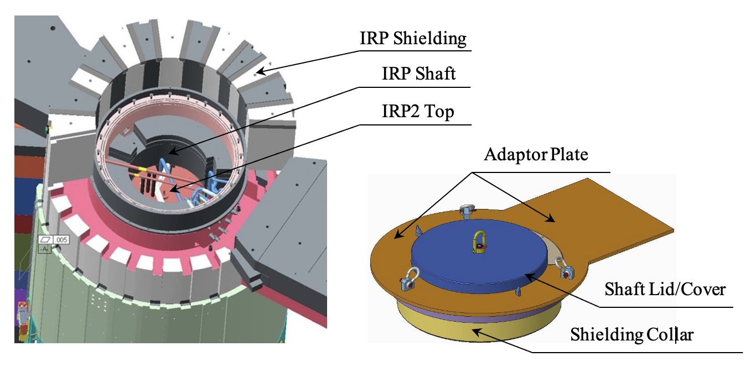
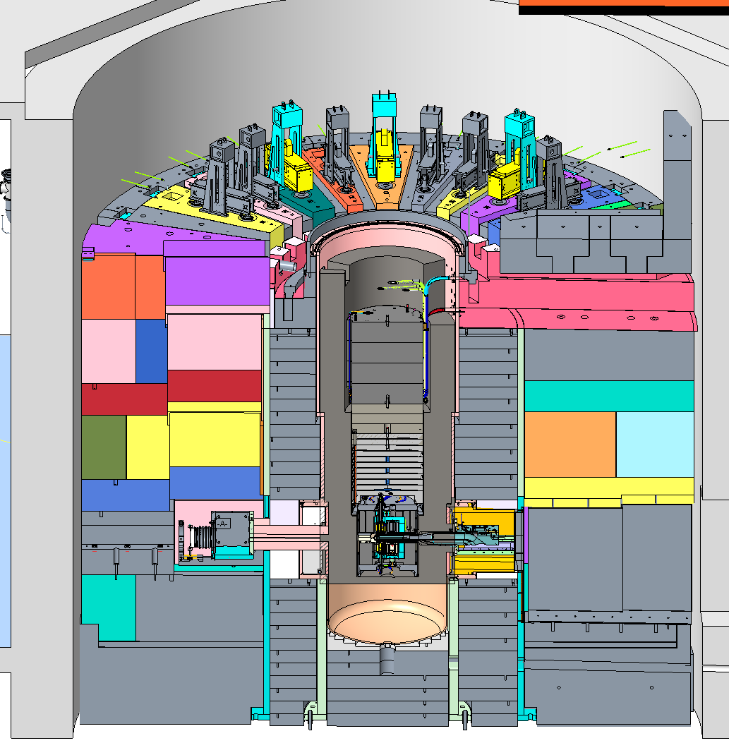
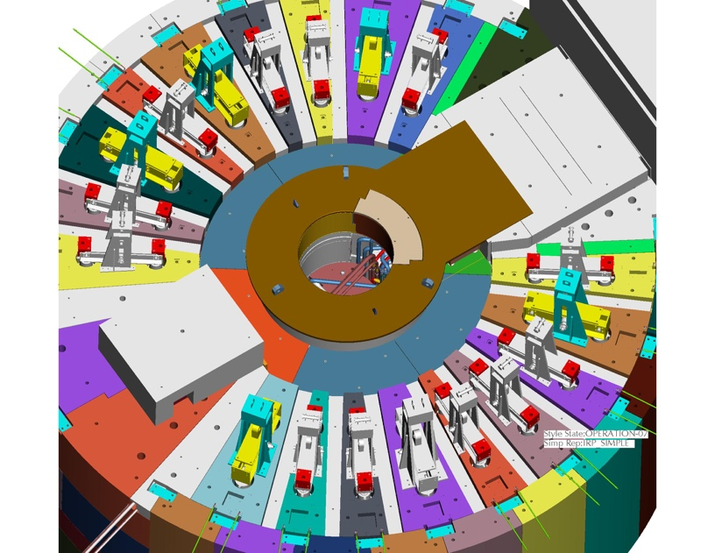

Replacement Operation
Shielding removed from the shaft to open IRP2
Adaptor plate installed on the top of the shaft
Adaptor Plate
Dose Evaluation to support radiological planning
Dose rate analyses required at each stage: worker dose compliance (10 CFR 835), remote handling equipment qualification, cask shielding verification.
IRP Shaft

Slide 6
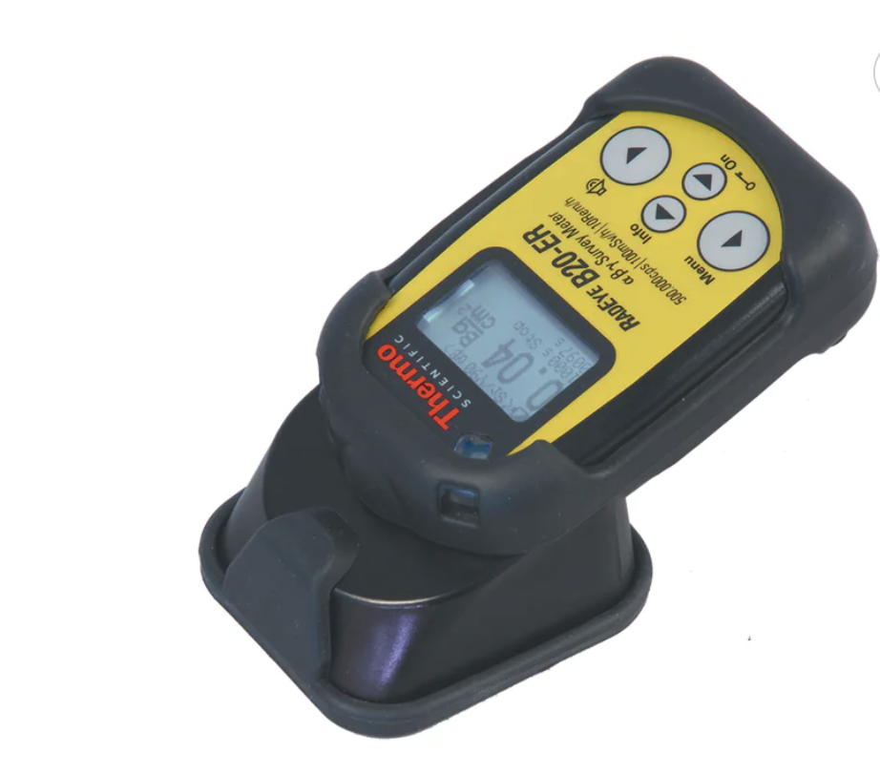
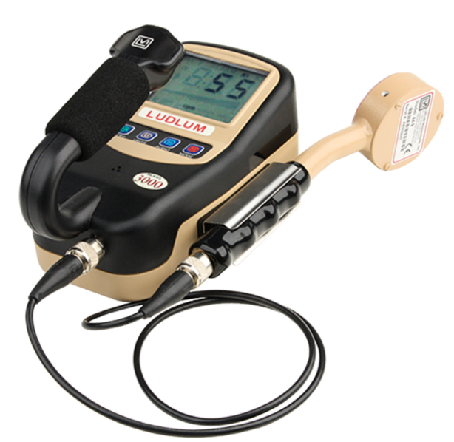
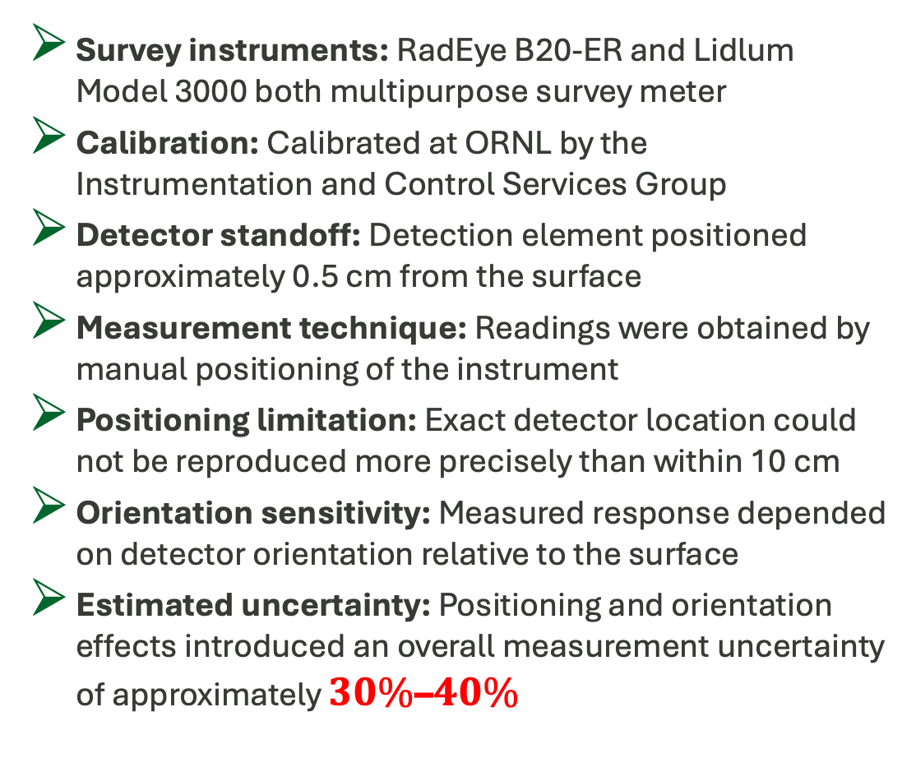
Instruments
Survey instruments: RadEye B20-ER and Lidlum Model 3000 both multipurpose survey meter
Calibration: Calibrated at ORNL by the Instrumentation and Control Services Group
Detector standoff: Detection element positioned approximately 0.5 cm from the surface
Measurement technique: Readings were obtained by manual positioning of the instrument
Positioning limitation: Exact detector location could not be reproduced more precisely than within 10 cm
Orientation sensitivity: Measured response depended on detector orientation relative to the surface
Estimated uncertainty: Positioning and orientation effects introduced an overall measurement uncertainty of approximately $30\%\text{–}40\%$

Slide 7
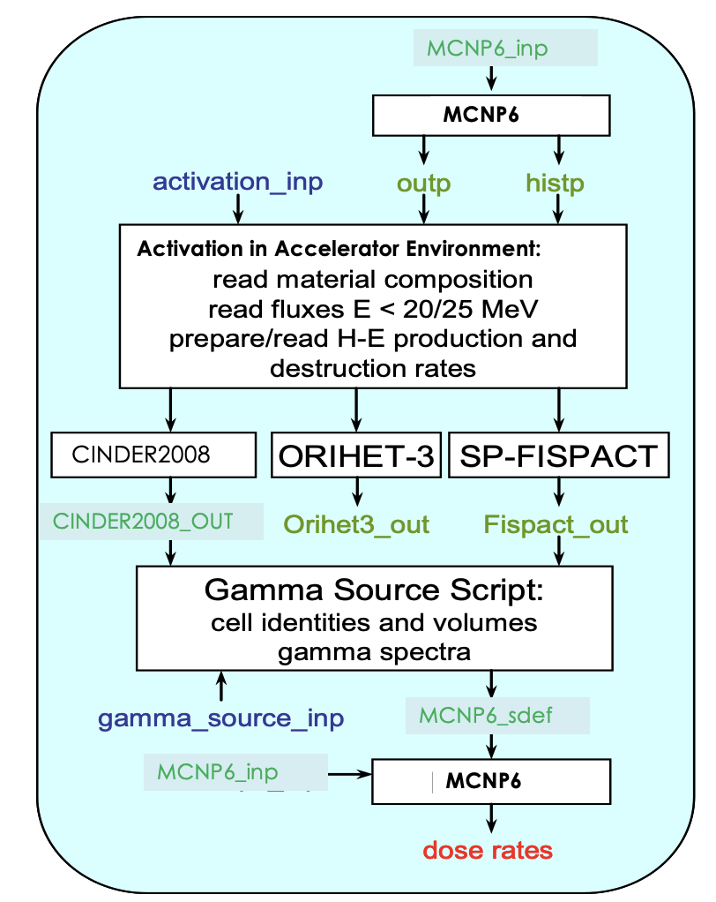
Methods and Assumptions
Step 1
Full three-dimensional radiation Monte Carlo transport calculations analyses performed with MCNP6 obtain neutron fluxes below 20MeV and reaction rates above 20 MeV
Step 2
The decay gamma sources in the activated material are calculated using AARE (Activation in Accelerator Radiation Environments) script
Step 3
Then decay gammas spectra in the multi-group structure and gamma power are extracted for each cell and are fed back to MCNP6 input file

Slide 8
Methods and Assumptions
① Challenges
② Assumptions
Overall activation includes life-time monolith activation and IRP2 activation
Cooling media for IRP1 - regular water
Cooling media for IRP2 - regular water
During IRP2 operation an upgrade of SNS facility took place – Proton Power Upgrade – 1GeV to 1.3 GeV
Complex geometry
Same target model is used in all analyses
Operation scenario is taken from SNS log-books
Analyses for the target monolith cells assume operation time since facility start-up in April 2006
The last day of beam on target of November 25, 2025

Slide 9
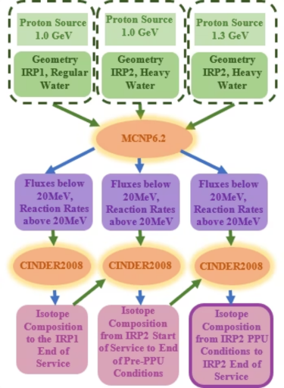
Methods and Assumptions
MCNP6.2 → AARE → CINDER2008 Coupling
Transmutation analyses for the target monolith are performed to the end of IRP1 operation cycle
Results are stored in a binary file (alldnz) containing the atom densities of all nuclides present initially or produced in the time intervals of the calculation for each cell
Transmutation analyses are performed using the results from the transport analyses for IRP2 for timeline of operation at 1GeV
alldnz files for previous analyses for target monolith(IRP1) copied into each of new cell with name dnz and input file for each monolith cell changed to used monolith isotope inventory by the beginning of the IRP2 services
Auxiliary perl code is written to copy alldnz files to dnz files and to modify input file for more than >600 activation cells

Slide 10
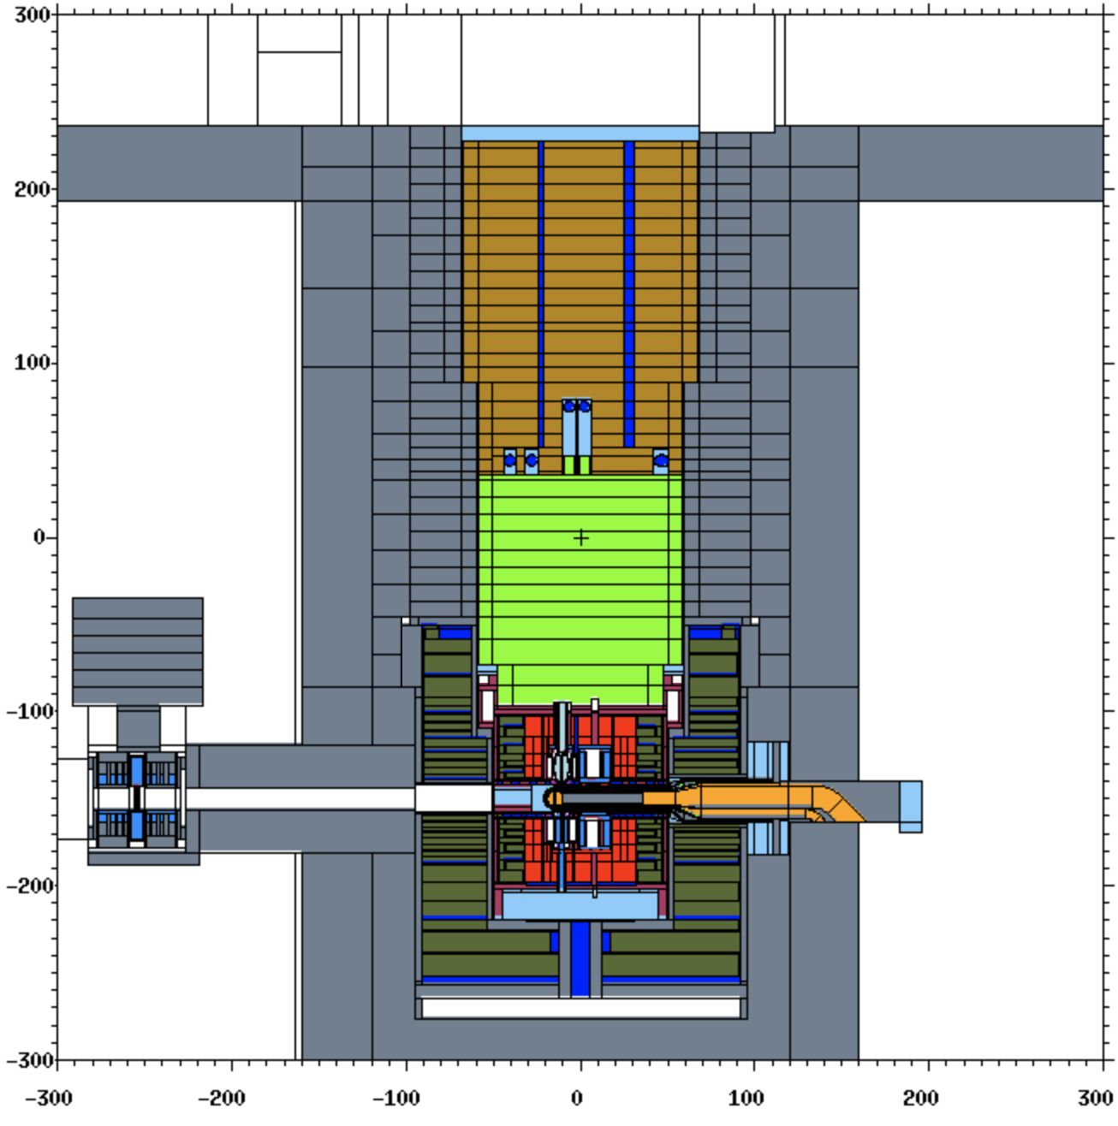
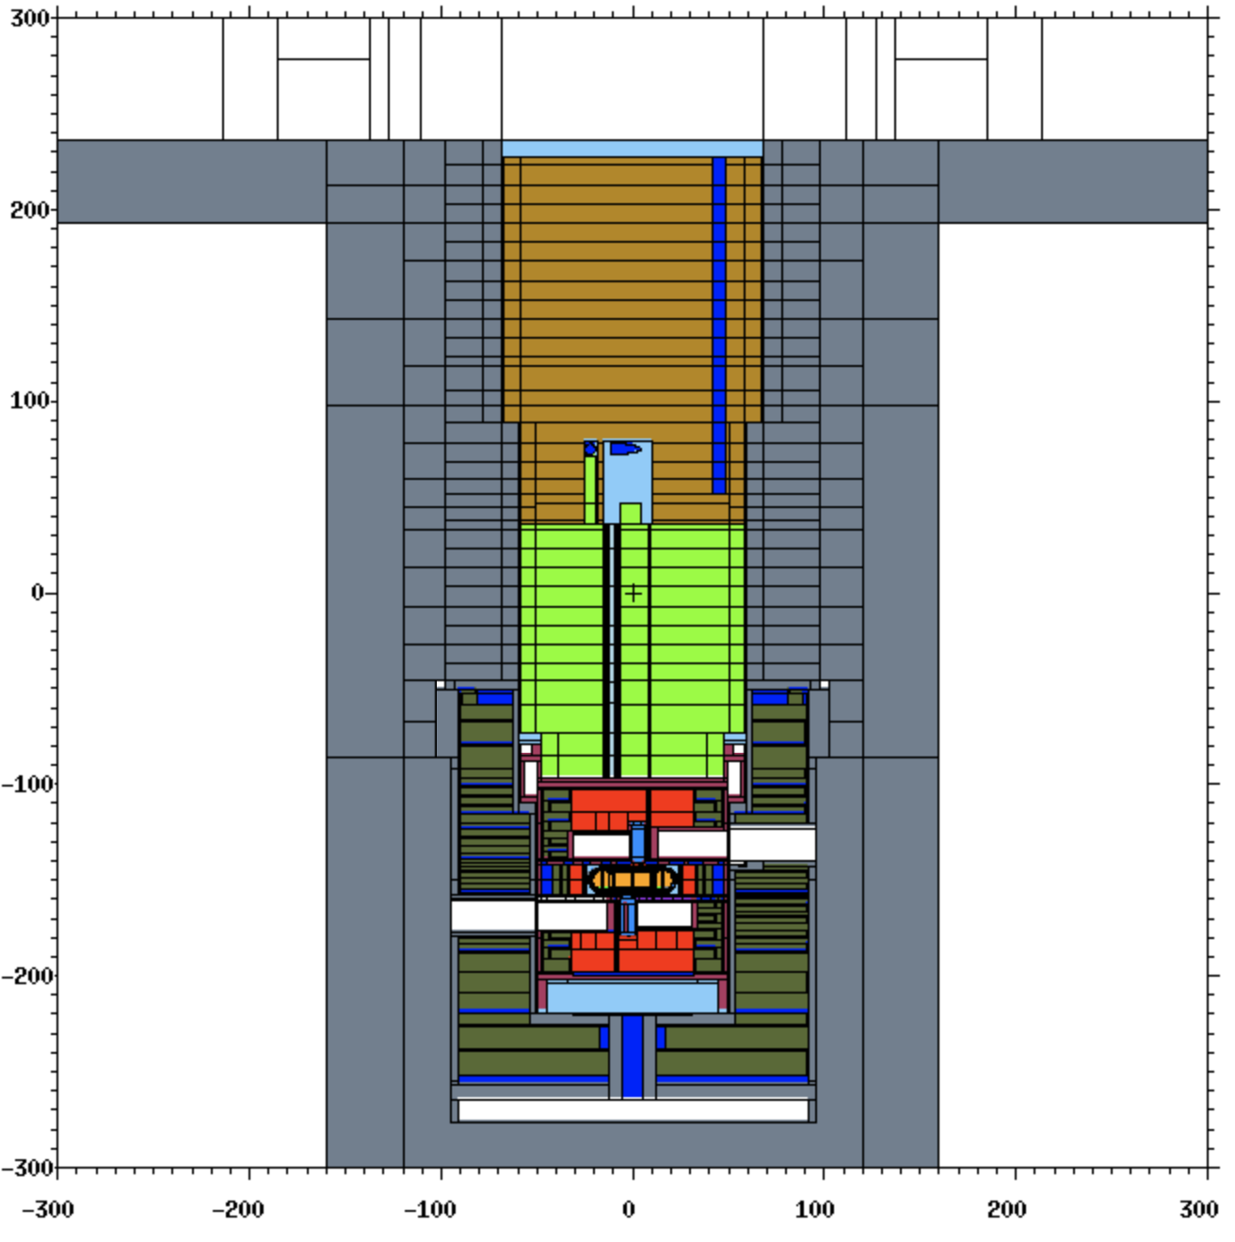
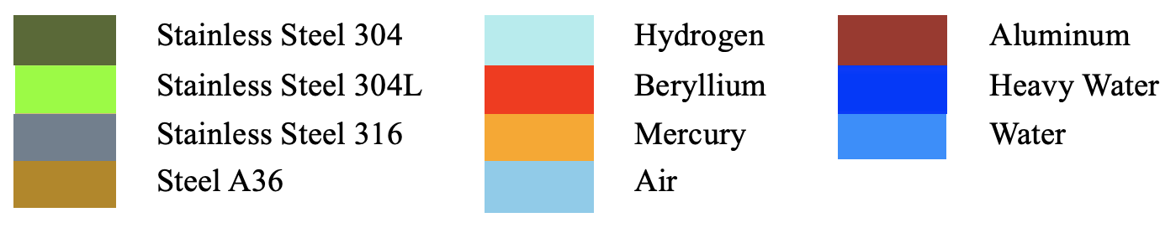
Geometry
Monolith Upper Part
IRP top
IRP middle
Monolith Shielding
IRP
Proton Beam
ORP
Target Vessel

Slide 11
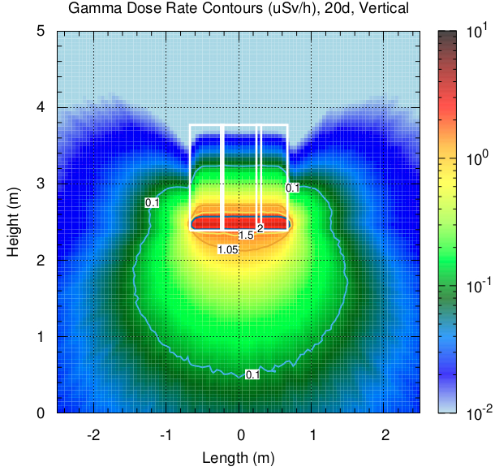
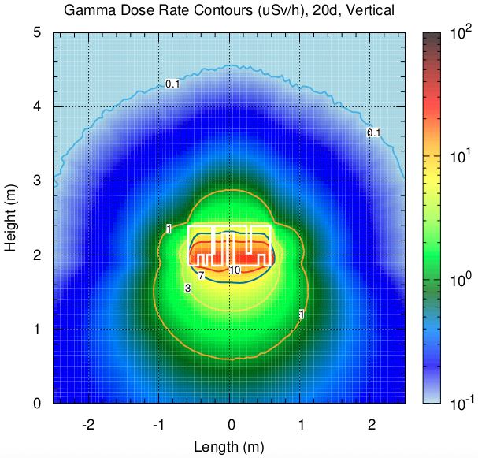
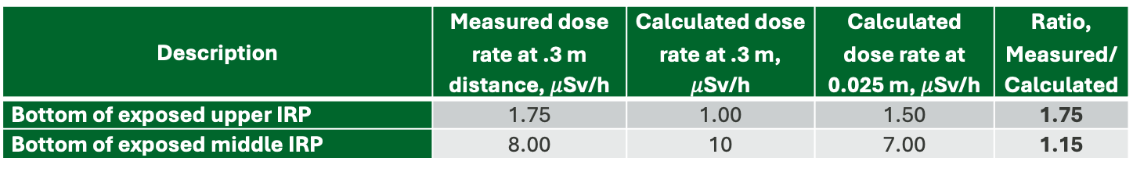
Comparison
Extraction of Top and Middle Section
Upper Segment
Middle Segment
Each segment was lifted into the container
The container was then moved away from the IRP shaft.
Dose rates were measured at the bottom of the exposed upper and middle IRP-2 segments
Description | Measured dose rate at .3 m distance, $μ$Sv/h | Calculated dose rate at .3 m, $μ$Sv/h | Calculated dose rate at 0.025 m, $μ$Sv/h | Ratio, Measured/ Calculated
Bottom of exposed upper IRP | 1.75 | 1.00 | 1.50 | 1.75
Bottom of exposed middle IRP | 8.00 | 10 | 7.00 | 1.15

Slide 12
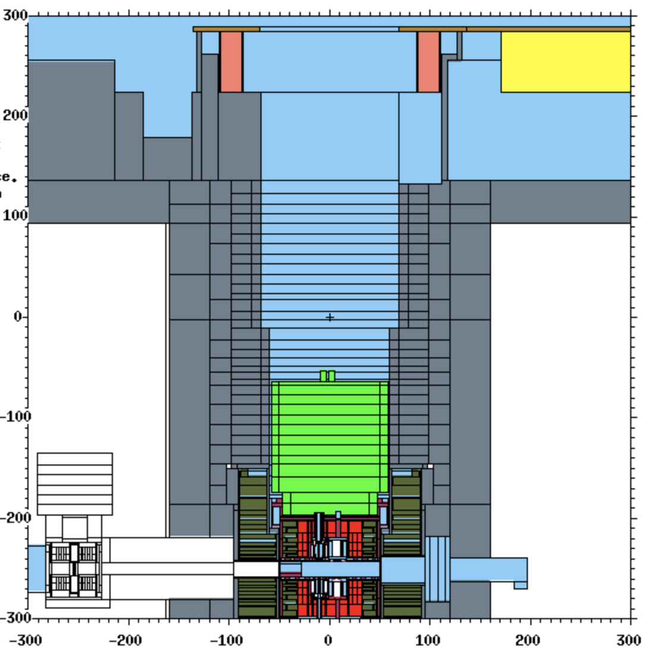
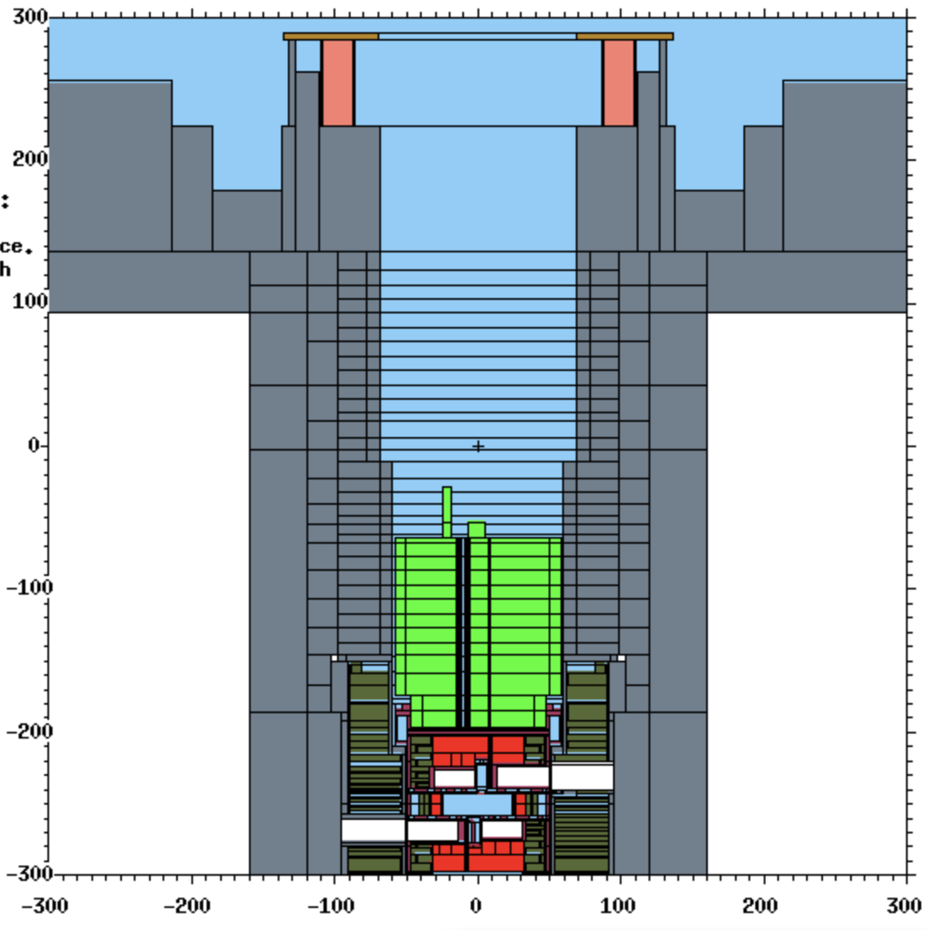
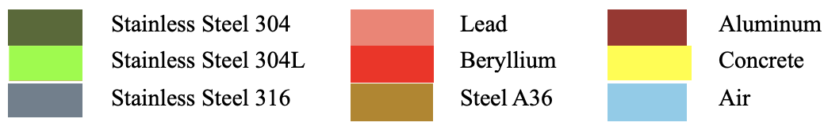
Comparison
Open Shaft with Lower Segment in the Shaft
Adapter Plate
Shaft Edge
Lead Shielding Collar
Shaft
L-Blocks
Lower Segment

Slide 13
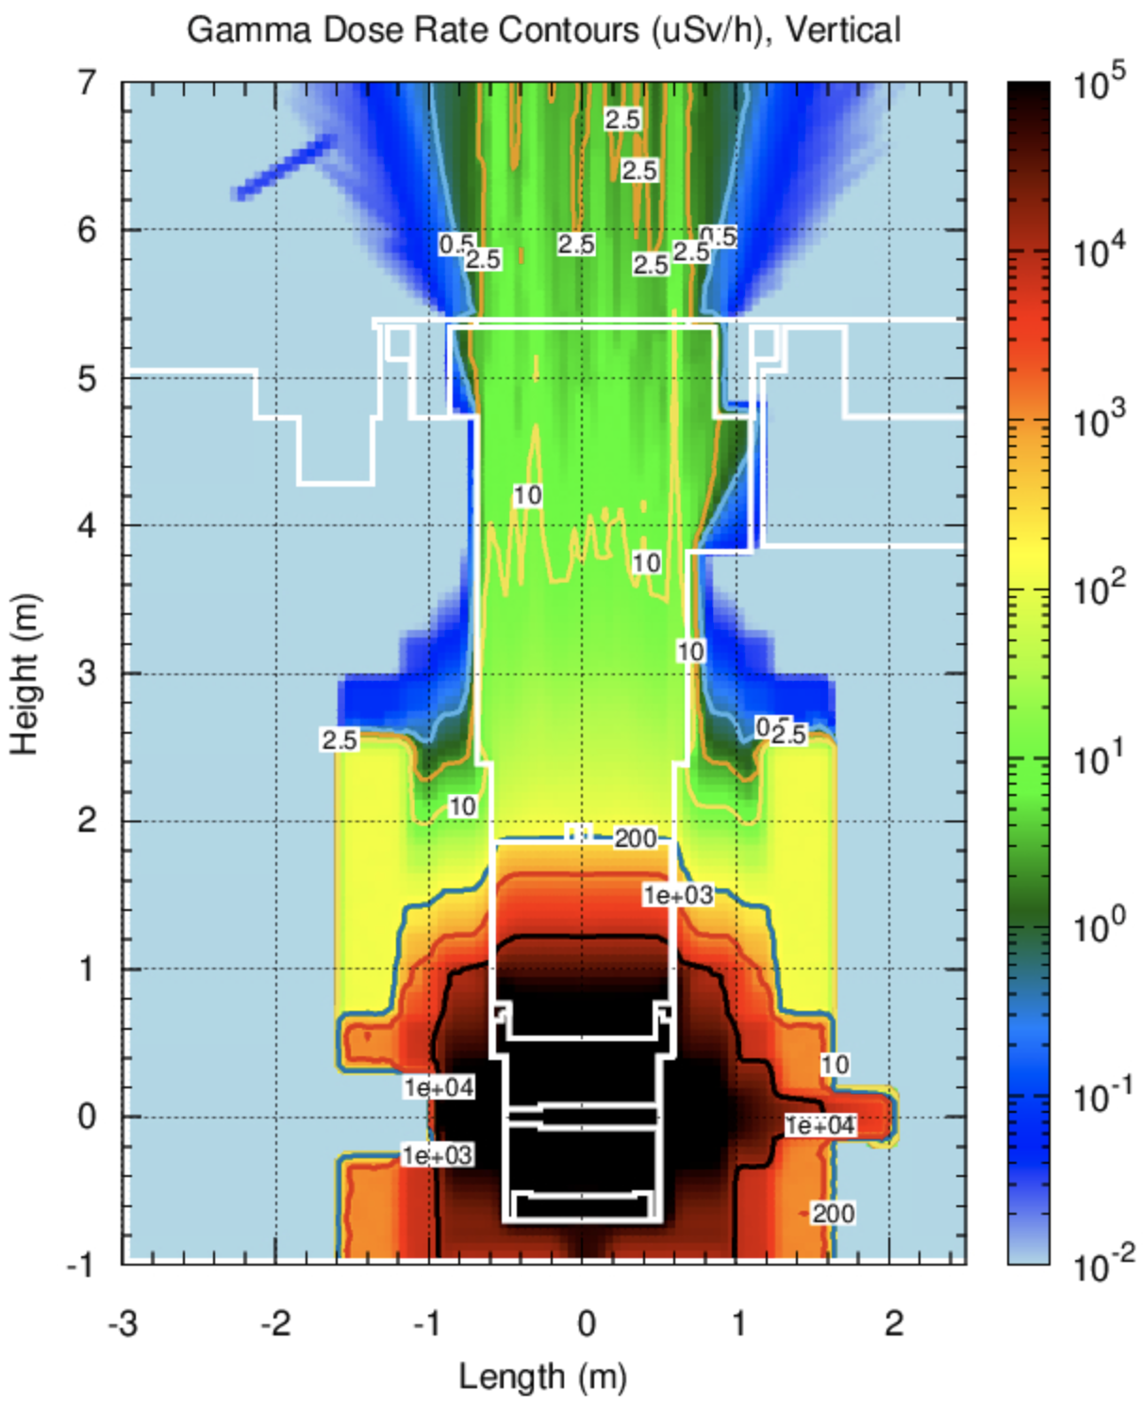
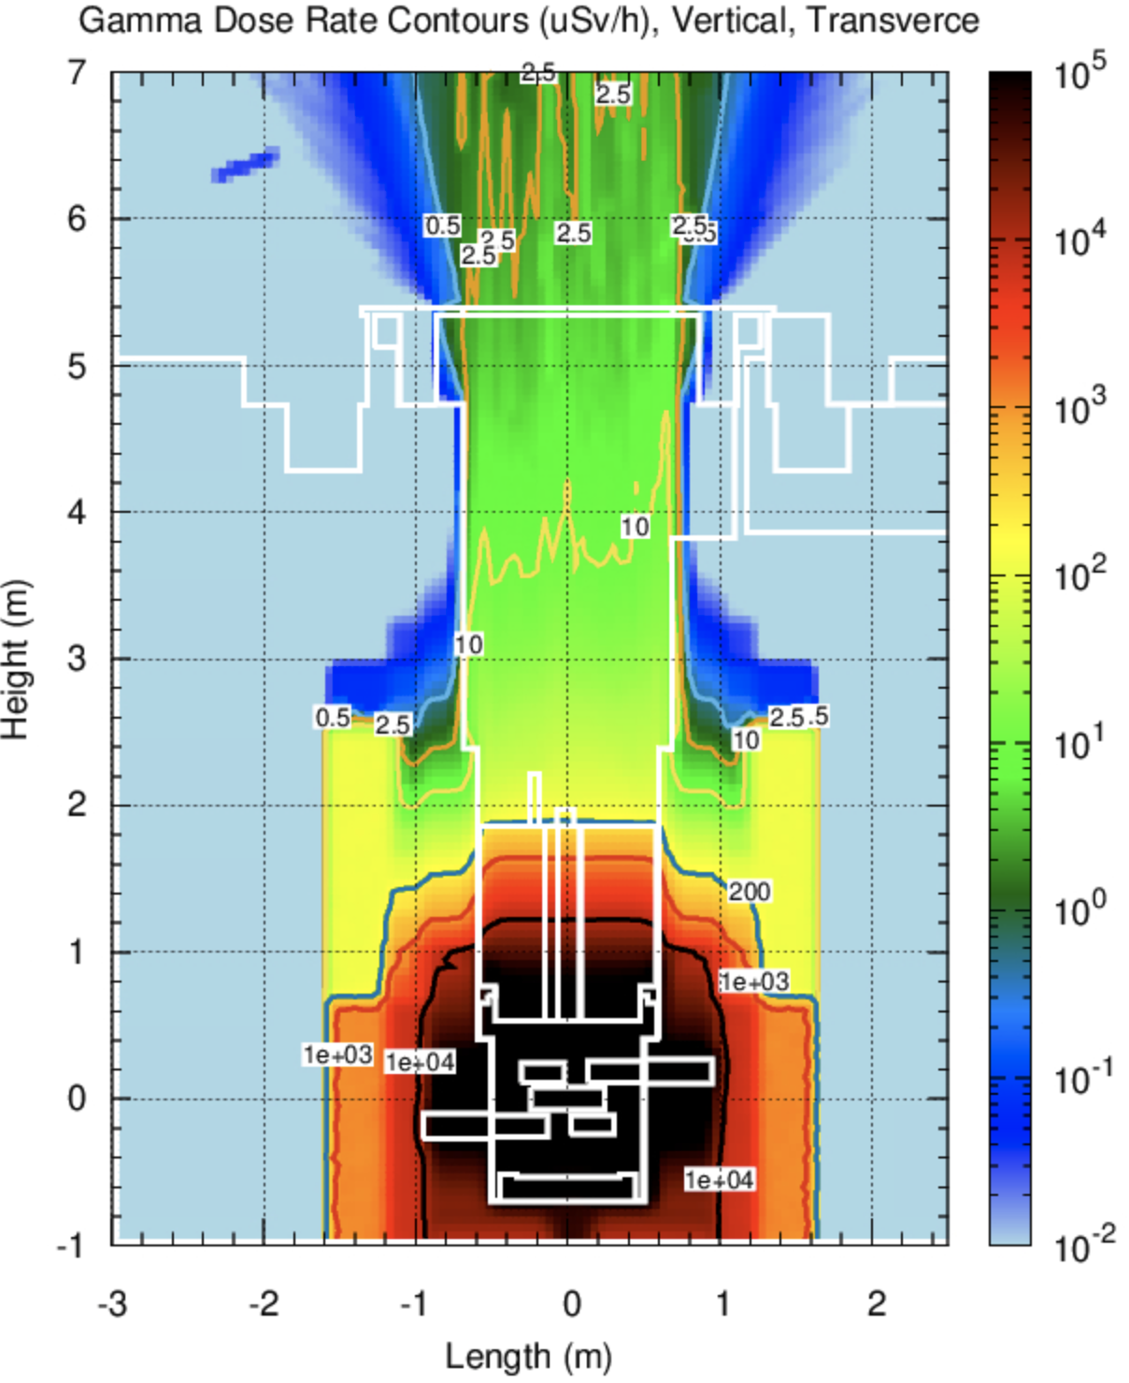
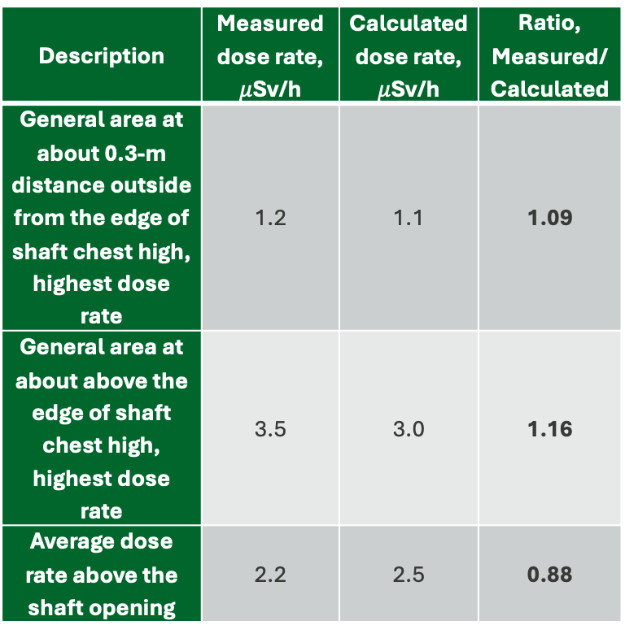
Comparison
Open Shaft with Lower Segment in the Shaft
Description | Measured dose rate, $μ$Sv/h | Calculated dose rate, $μ$Sv/h | Ratio, Measured/ Calculated
General area at about 0.3-m distance outside from the edge of shaft chest high, highest dose rate | 1.2 | 1.1 | 1.09
General area at about above the edge of shaft chest high, highest dose rate | 3.5 | 3.0 | 1.16
Average dose rate above the shaft opening | 2.2 | 2.5 | 0.88

Slide 14
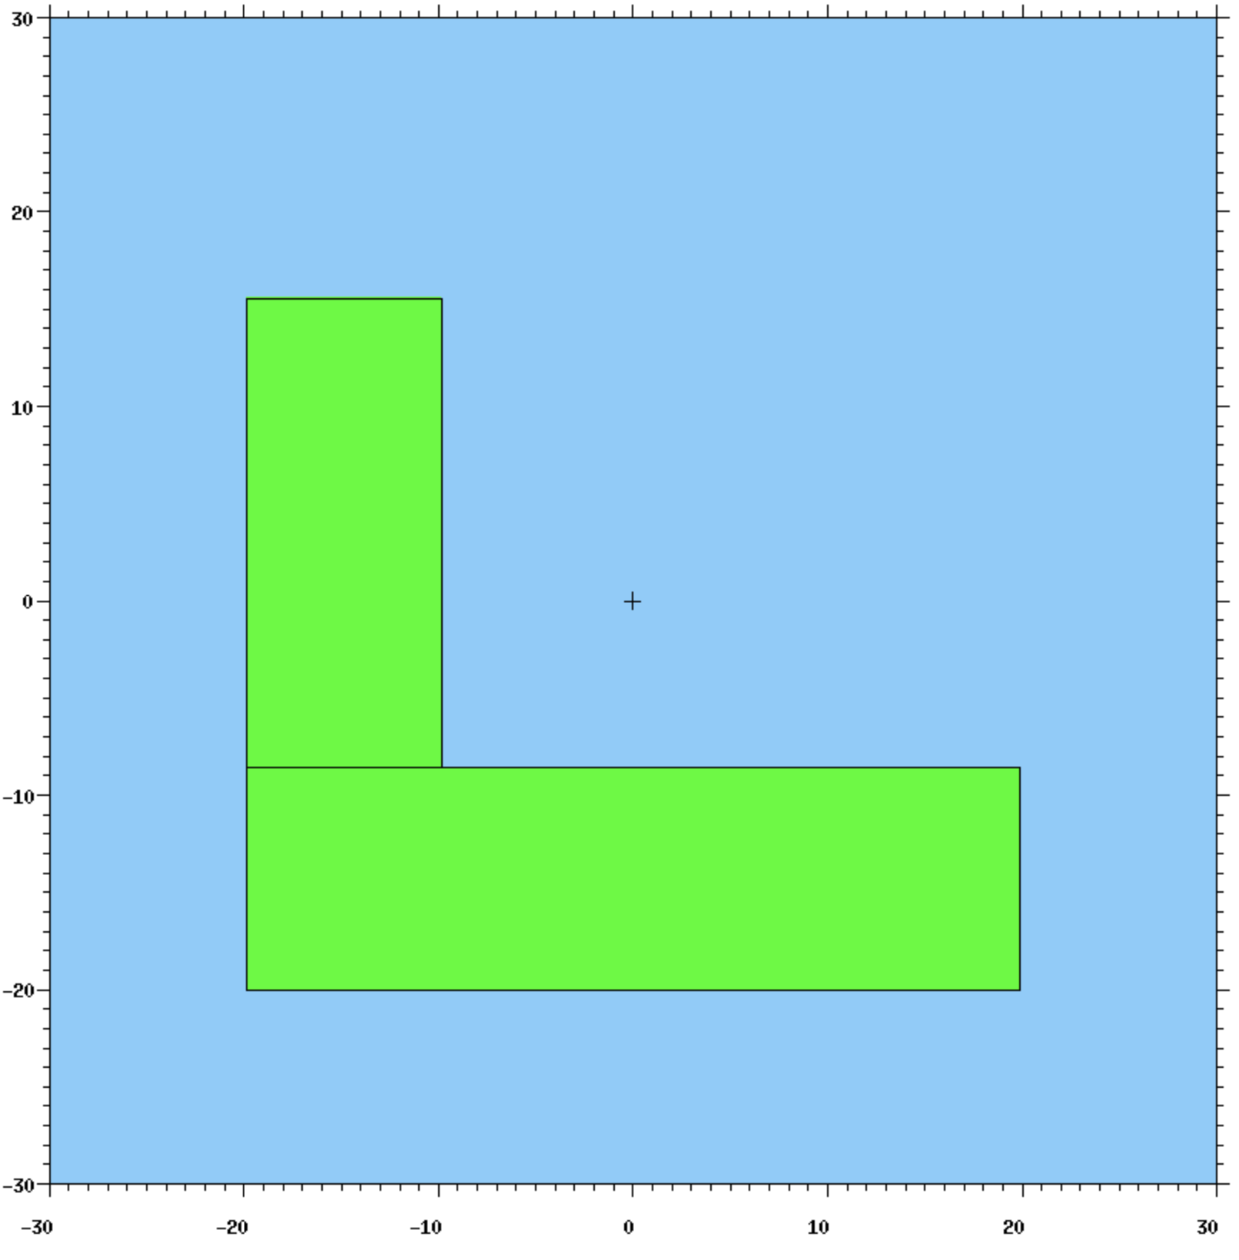
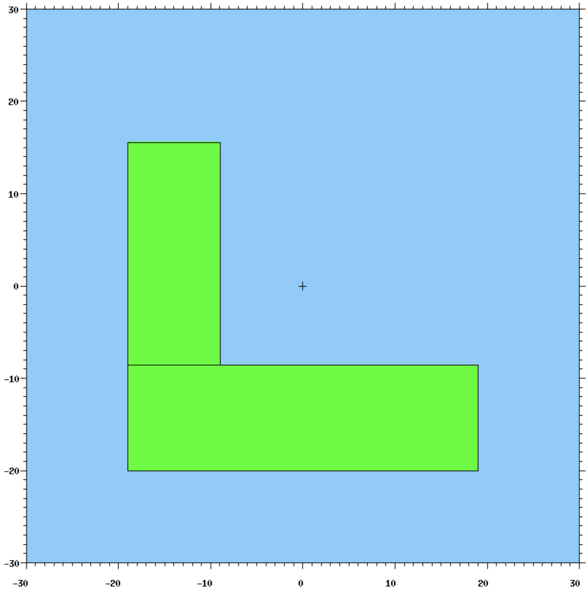
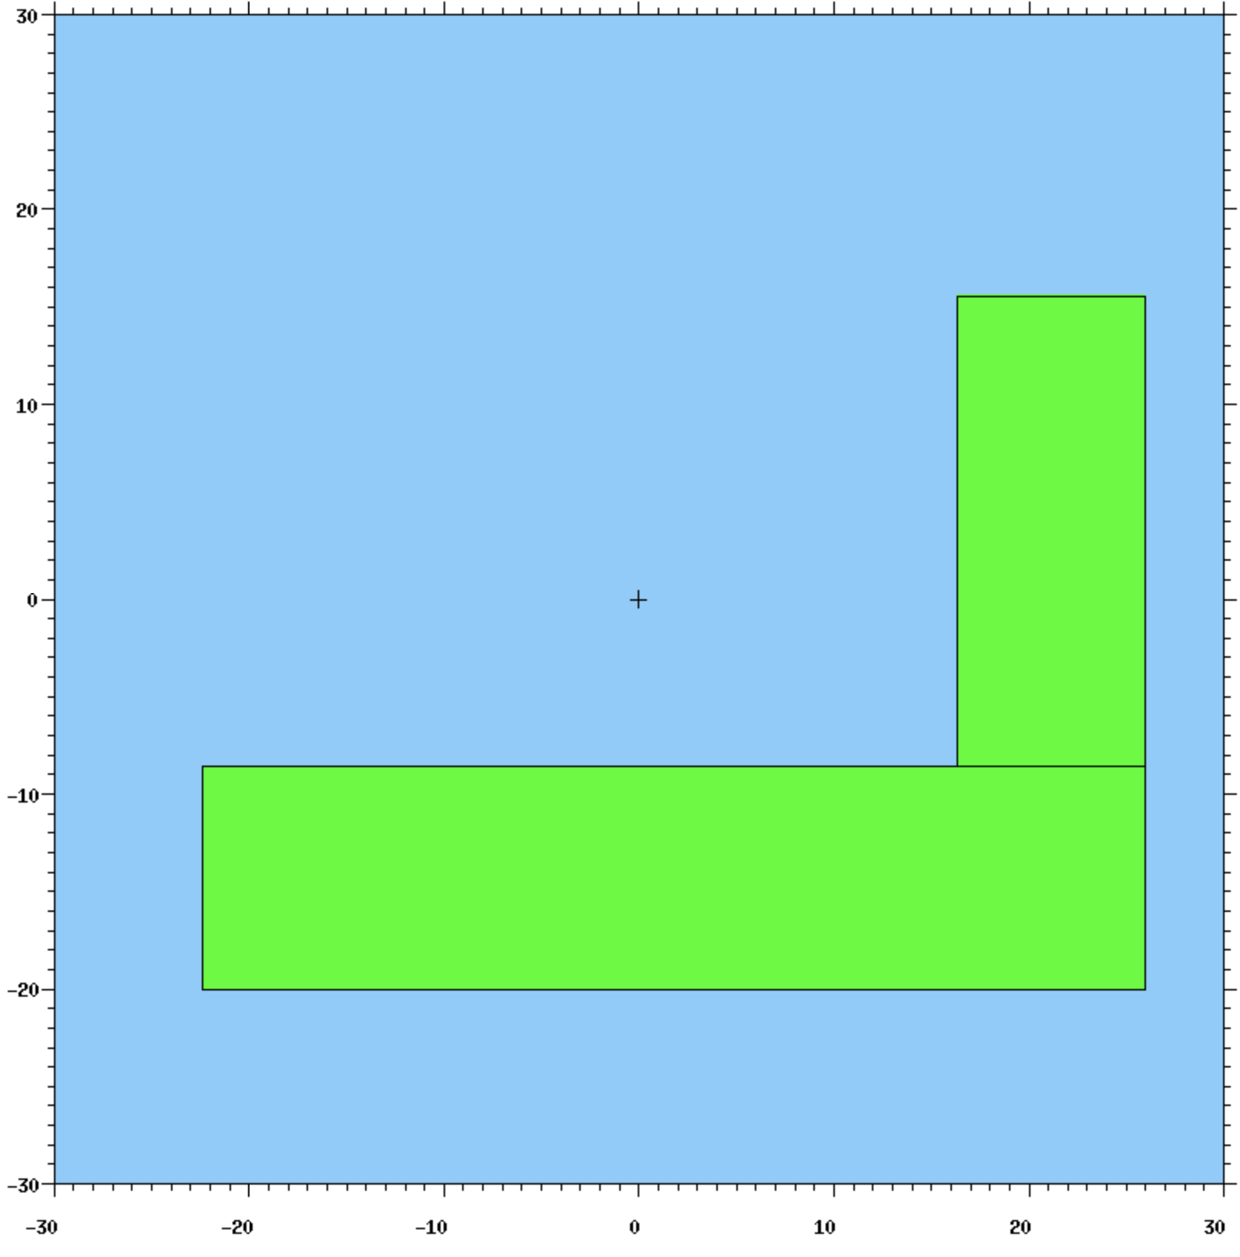
Comparison
L-Blocks
Three L-blocks were positioned on top of the lower-segment shield block
Providing mechanical stability and to protecting the piping
The blocks were individually extracted
Residual dose rate was measured separately for each block
L-Blocks

Slide 15
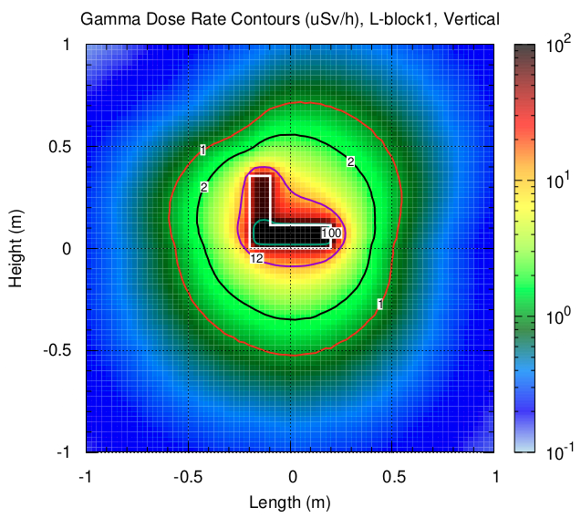
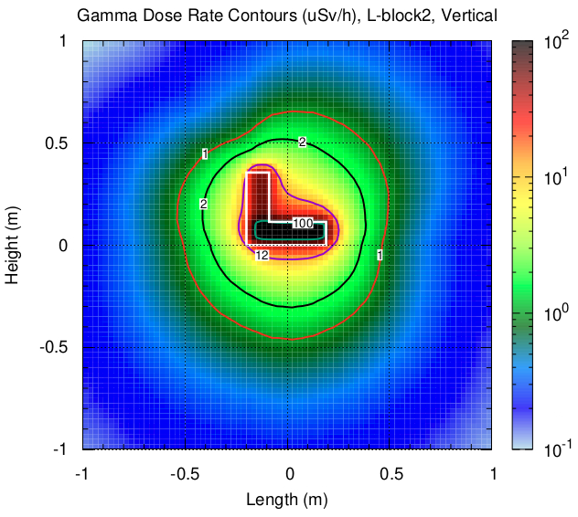
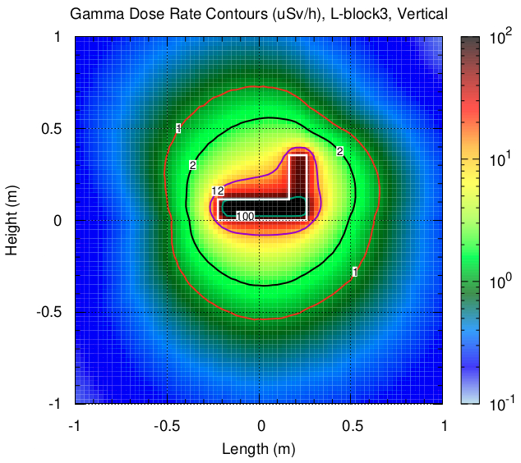
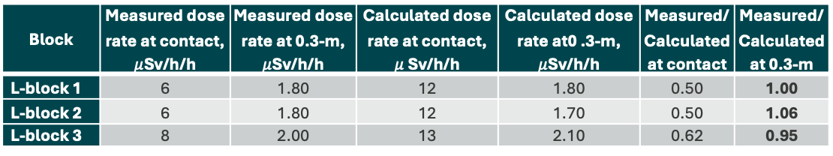
Comparison
L-Blocks
Block | Measured dose rate at contact, $μ$Sv/h/h | Measured dose rate at 0.3-m, $μ$Sv/h/h | Calculated dose rate at contact, $μ$Sv/h/h | Calculated dose rate at0 .3-m, $μ$Sv/h/h | Measured/Calculated at contact | Measured/Calculated at 0.3-m
L-block 1 | 6 | 1.80 | 12 | 1.80 | 0.50 | 1.00
L-block 2 | 6 | 1.80 | 12 | 1.70 | 0.50 | 1.06
L-block 3 | 8 | 2.00 | 13 | 2.10 | 0.62 | 0.95

Slide 16
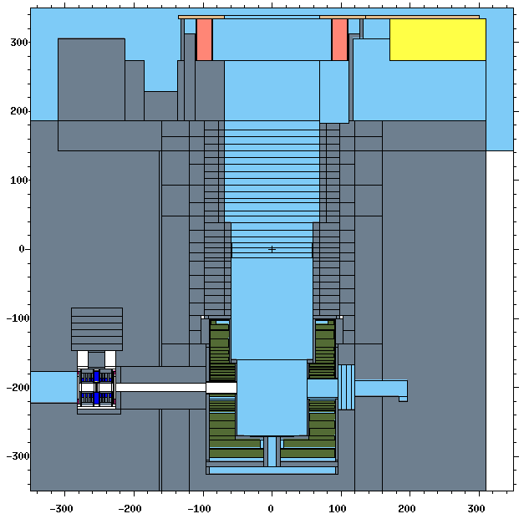
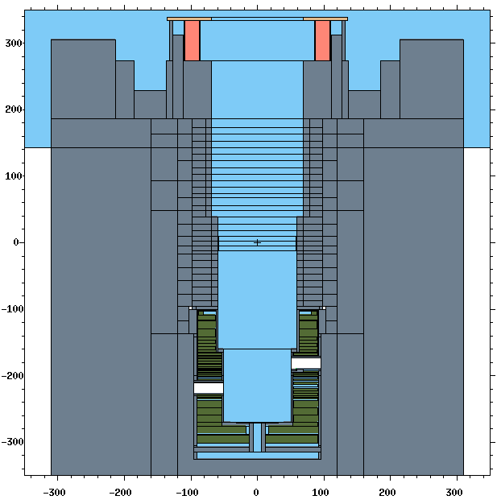
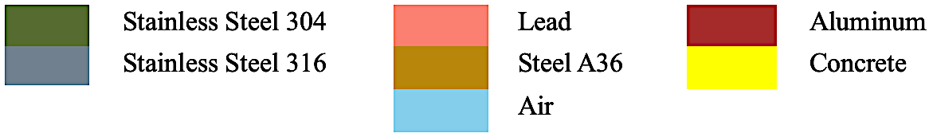
Comparison
Empty Shaft
Adapter Plate
Shaft Edge
Lead Shielding Collar
Shaft
Beam Centerline

Slide 17
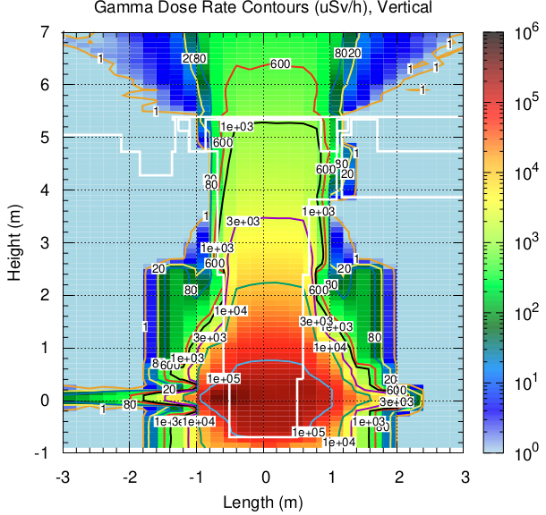
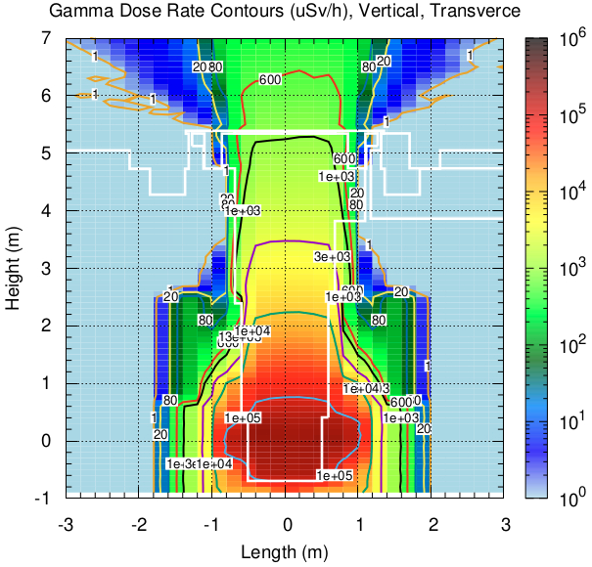
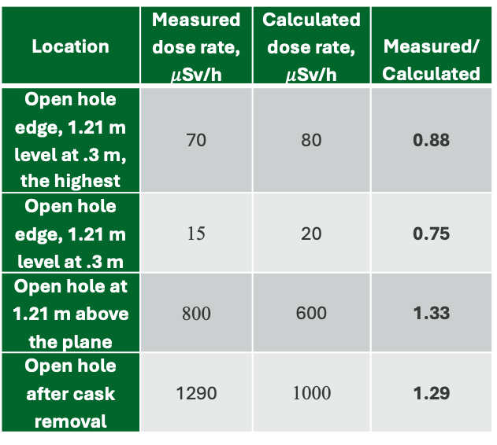
Comparison
Empty Shaft
Location | Measured dose rate, $μ$Sv/h | Calculated dose rate, $μ$Sv/h | Measured/Calculated
Open hole edge, 1.21 m level at .3 m, the highest | 70 | 80 | 0.88
Open hole edge, 1.21 m level at .3 m | 15 | 20 | 0.75
Open hole at 1.21 m above the plane | 800 | 600 | 1.33
Open hole after cask removal | 1290 | 1000 | 1.29

Slide 18
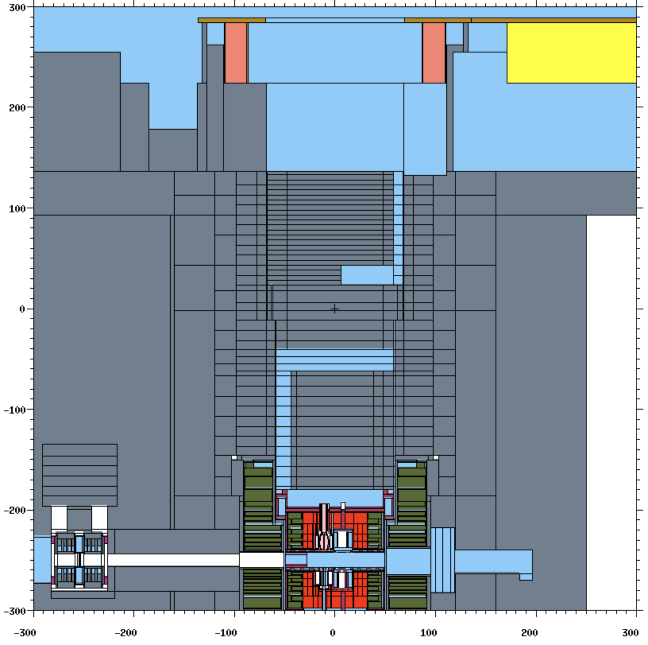
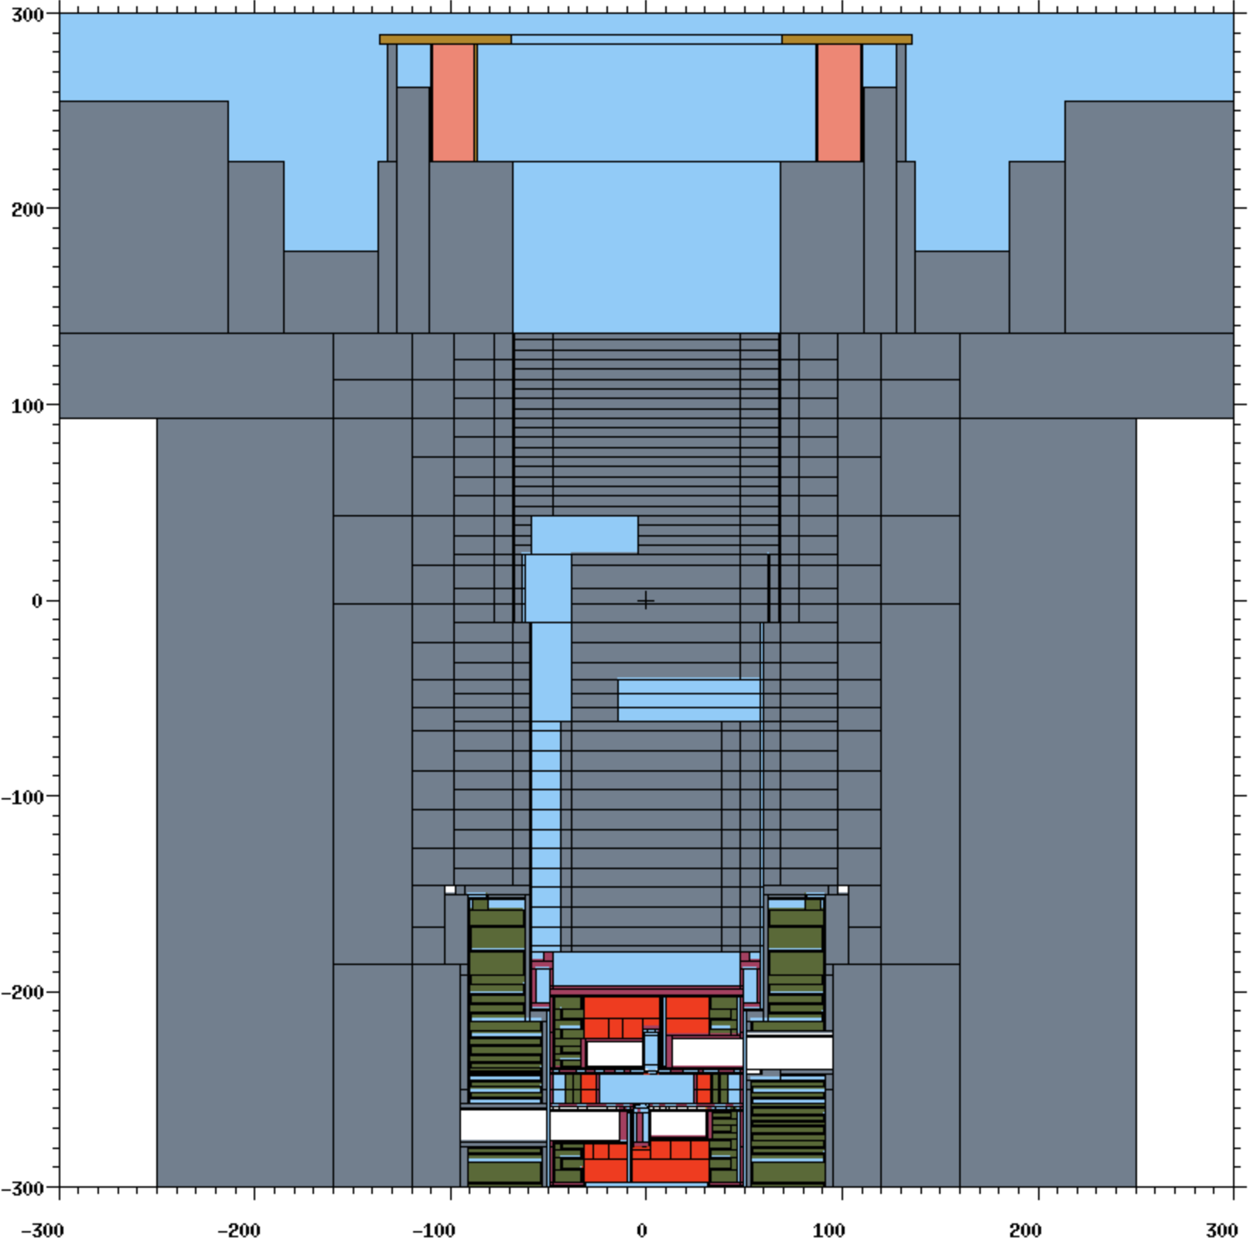
Comparison
IRP-3 installed
New IRP-3 was installed in the shaft
The shielding geometry above the plug in IRP-3 differs slightly from that of IRP-2
Adapter Plate
Shaft Edge
Lead Shielding Collar
IRP-3
Beam Centerline

Slide 19
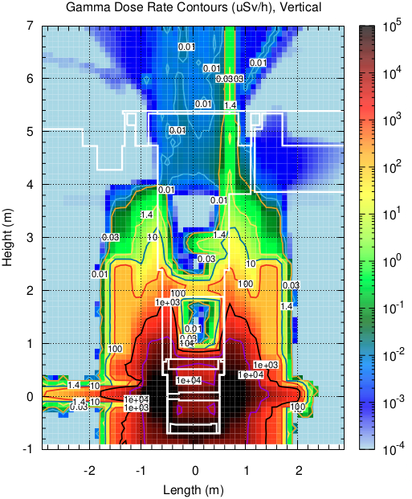
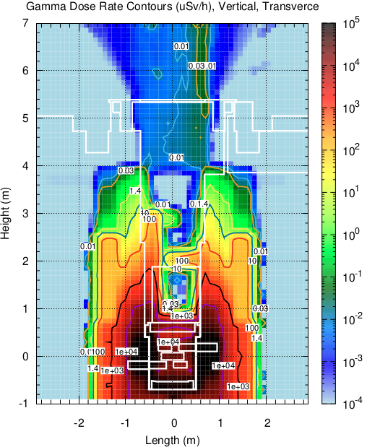
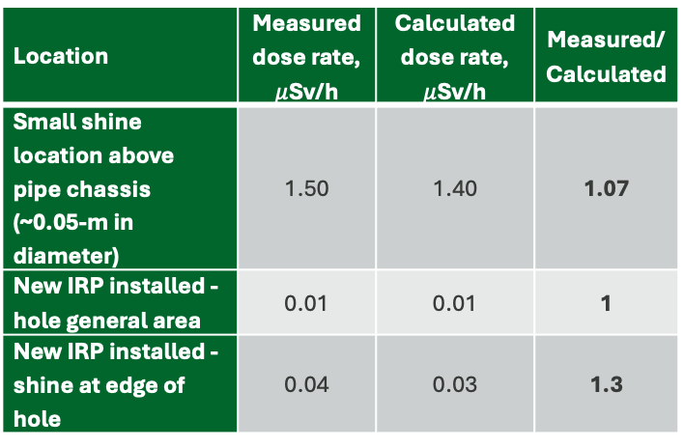
Comparison
Location | Measured dose rate, $μ$Sv/h | Calculated dose rate, $μ$Sv/h | Measured/Calculated
Small shine location above pipe chassis (~0.05-m in diameter) | 1.50 | 1.40 | 1.07
New IRP installed - hole general area | 0.01 | 0.01 | 1
New IRP installed - shine at edge of hole | 0.04 | 0.03 | 1.3

Slide 20
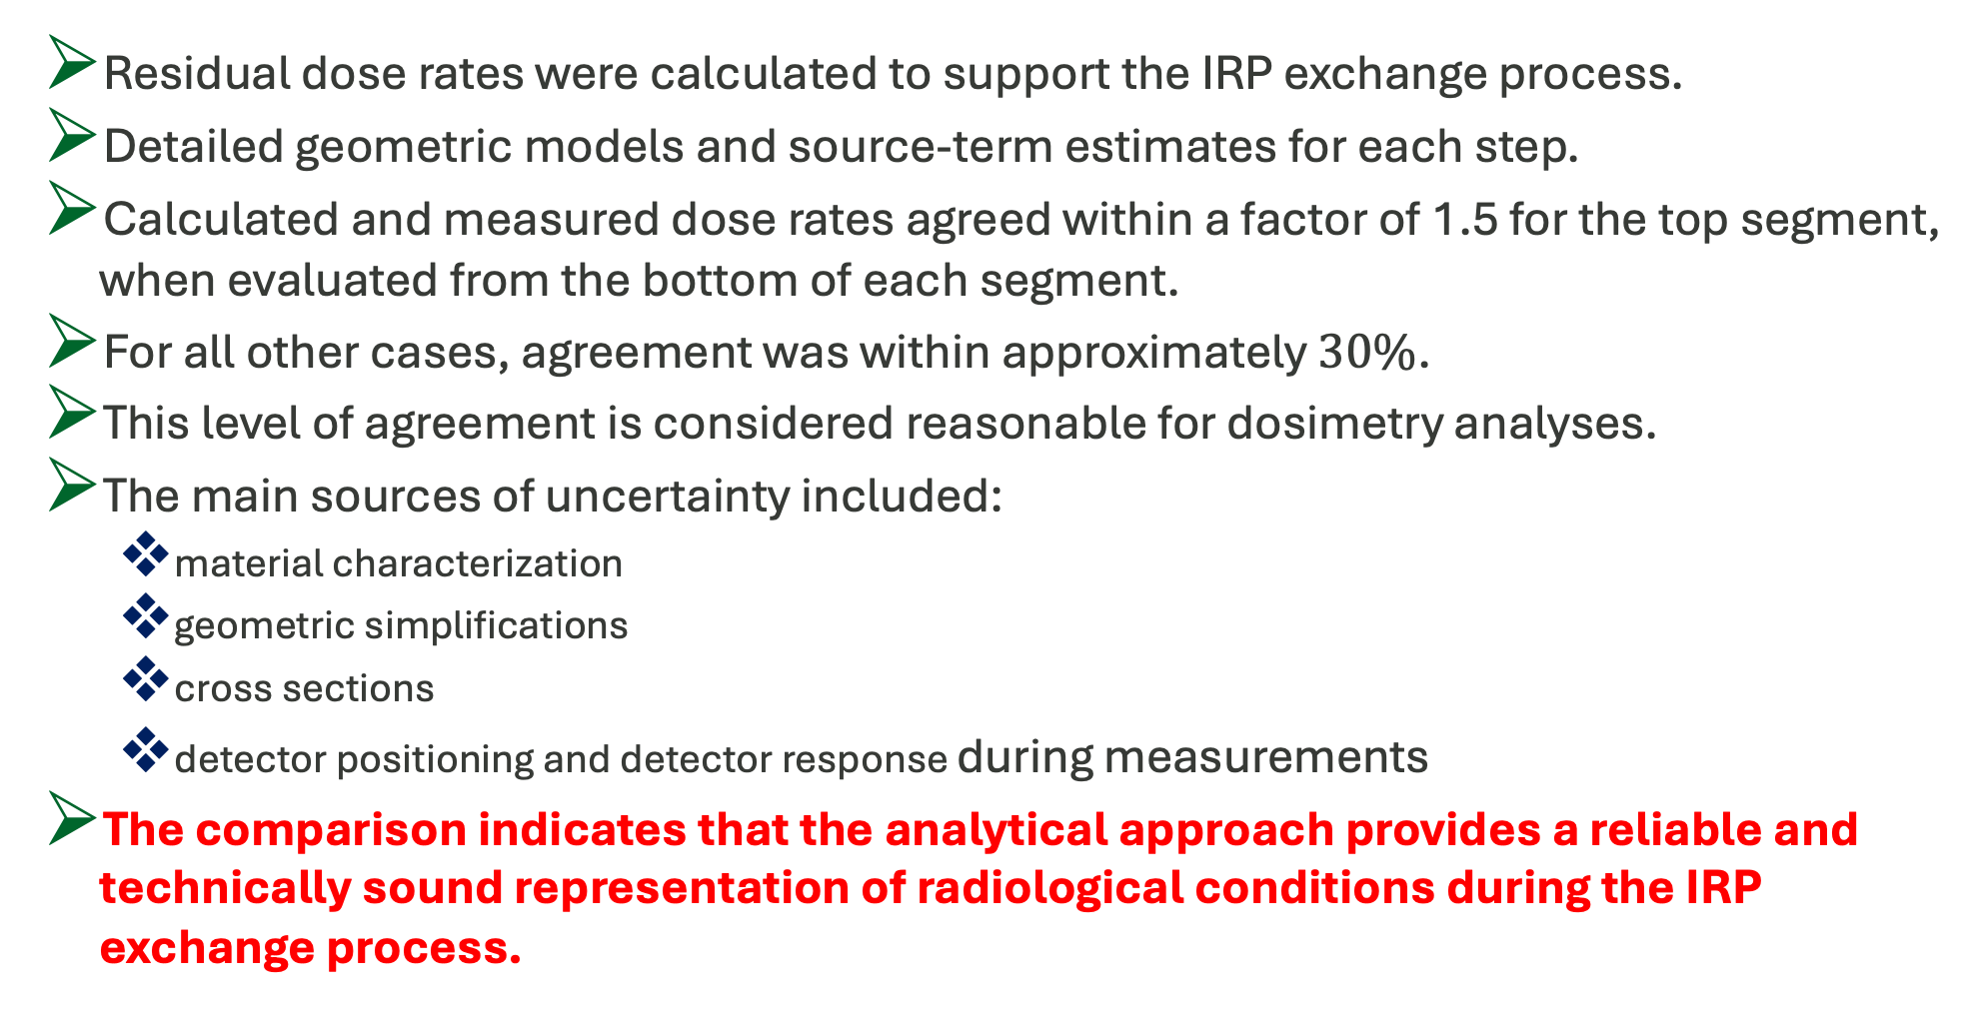
Conclusions
Residual dose rates were calculated to support the IRP exchange process.
Detailed geometric models and source-term estimates for each step.
Calculated and measured dose rates agreed within a factor of 1.5 for the top segment, when evaluated from the bottom of each segment.
For all other cases, agreement was within approximately $30\%$.
This level of agreement is considered reasonable for dosimetry analyses.
The main sources of uncertainty included:
  material characterization
  geometric simplifications
  cross sections
  detector positioning and detector response during measurements
The comparison indicates that the analytical approach provides a reliable and technically sound representation of radiological conditions during the IRP exchange process.

