Slide 1
ISOLDE Beam Dump Replacement: FLUKA residual dose rate calculations for radiological planning
IBS Science Culture Center, Daejeon, Korea
21st October 2026
Victor Garcia BALCAZA and Fabio POZZI, on behalf of the IBDRS team
17th Workshop on Shielding Aspects of Accelerators, Targets, and Irradiation Facilities (SATIF-17)
Notes:
Good afternoon. I'm Victor Garcia Balcaza, and today I'm going to present the results of the working dose planning for the dismantling of the ISOLDE beam dumps, as part of the IBDRS project.

Slide 2
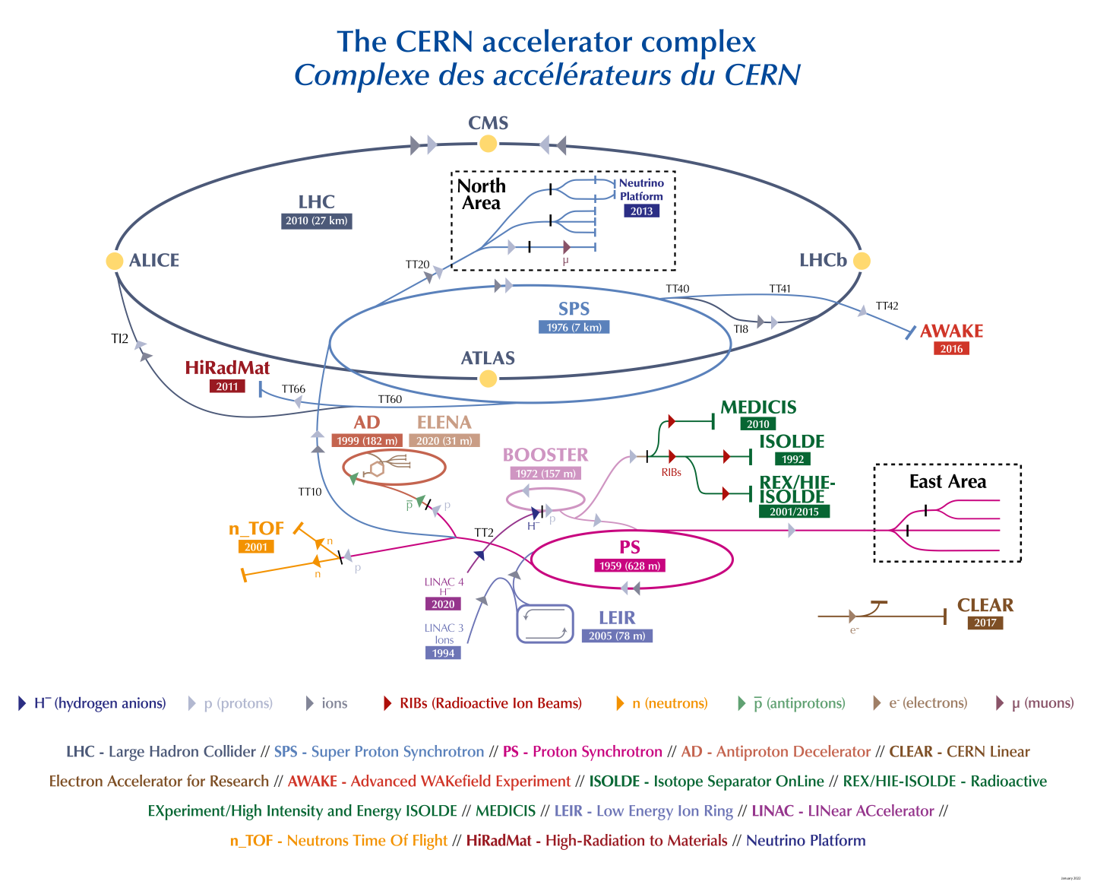

CERN’s accelerator complex – ISOLDE
Isotope mass Separator On-Line DEvice
Proton beam: 1.4 GeV / 2 µA = 2.8 kW
Fixed-target facility (e.g. UCx)
Production of Radioactive Ion Beams
Applications:
  Nuclear and atomic physics
  Solid state physics
  Materials science
  Life sciences
2 GeV p+
160 MeV H-
Notes:
First, ISOLDE is a CERN facility that uses the proton beam from the Proton Synchrotron Booster to impact thick targets, such as uranium carbide, to produce radioactive ion beams.
These ion beams are then used for different scientific applications. One example is MEDICIS, which produces radioisotopes for medical applications.
***
- Operational since 1992
- ~60% of CERN protons in accelerators are sent to ISOLDE
- Production of more than 1000 radioisotopes

Slide 3
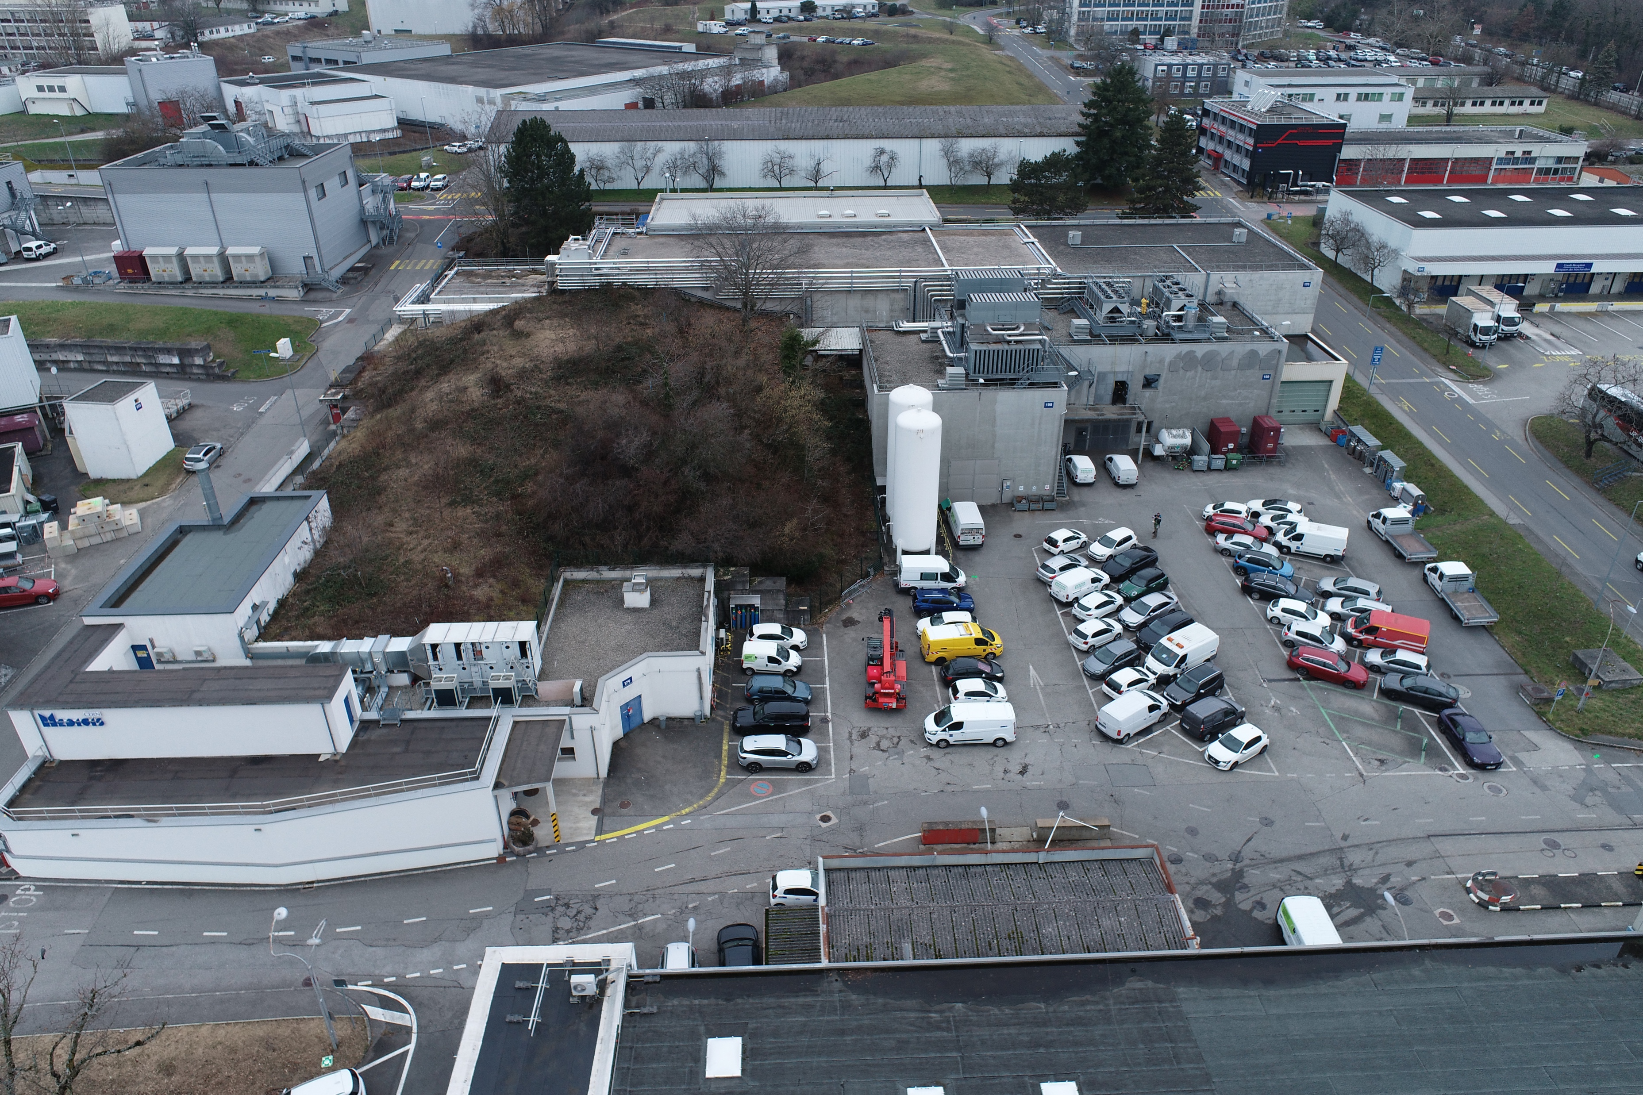
ISOLDE complex
Experimental hall
Soil shielding
(covering target area)
ISOLDE/MEDICIS laboratories
Notes:
Here we have an aerial view of the ISOLDE facility.
In red, we can see the experimental hall, here the different laboratories, including MEDICIS, and this whole area covered by soil above the target area.

Slide 4
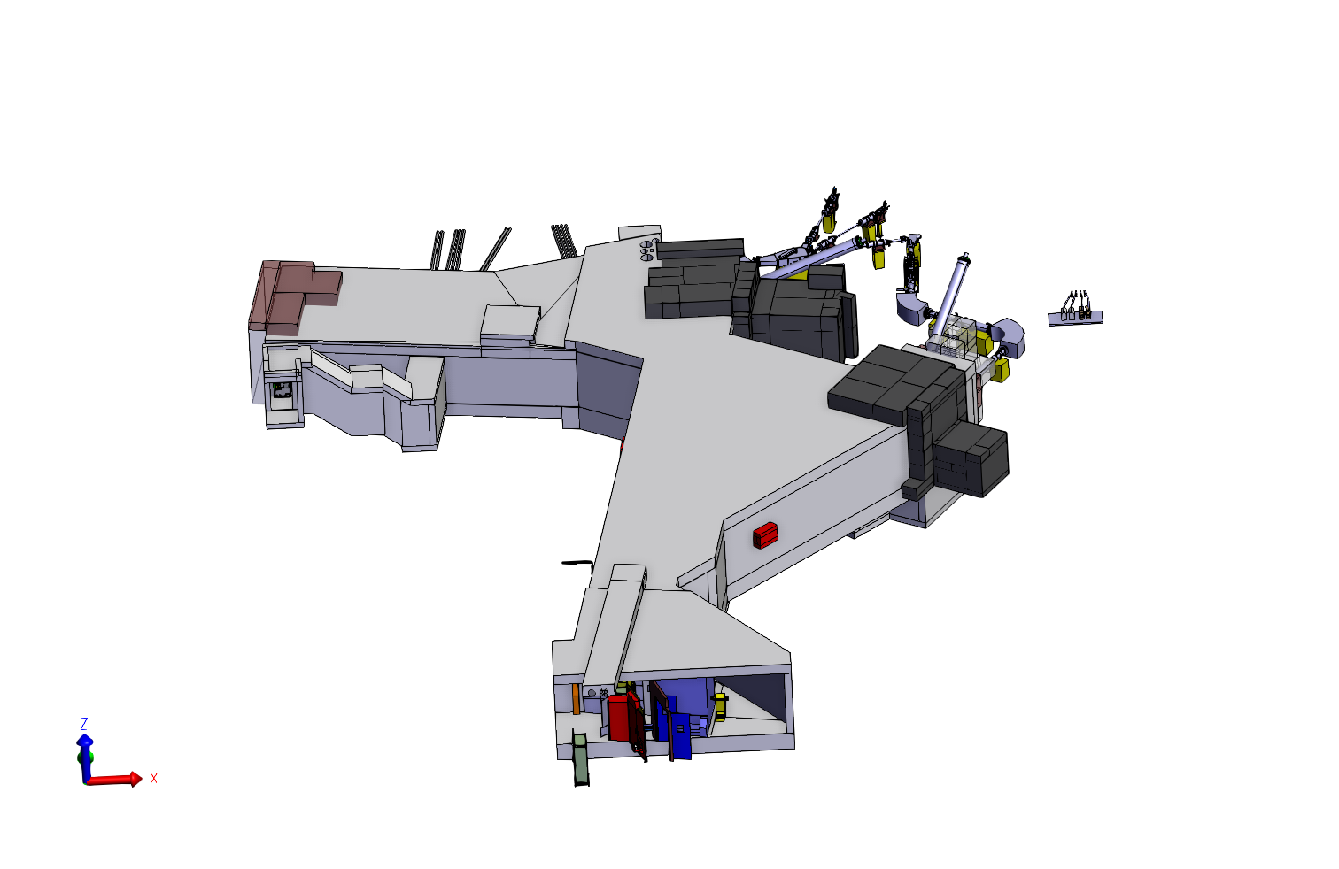
ISOLDE target area
Soil shielding
(covering target area)
Notes:
Beneath the soil, we find the target area.

Slide 5
ISOLDE target area
Target GPS
p 1.4 GeV / 2 μA
Beam dumps
Target HRS
Notes:
The proton beam can be directed towards two target stations, HRS and GPS, each with its own beam dump and concrete shielding blocks, shown here in black.

Slide 6
IBDRS project
ISOLDE Beam Dump Replacement & Sustainability
Changing operation conditions:
 | Present operation | Future operation
Proton energy | 1.4 GeV | 2 GeV
Current | Up to 2 µA | Up to 6 µA
Beam power | 2.8 kW | 12 kW
Dismantling of beam dumps:
Removal, transport, storage and disposal of:
  Soil
  Concrete and iron shielding
  Beam dumps: HRS and GPS
Design and installation of new beam dumps and shielding
Beam dumps deterioration:
Signs of corrosion and condensation
Notes:
The project we are focusing on is IBDRS, which stands for ISOLDE Beam Dump Replacement and Sustainability.
Why do we need to replace the beam dumps?
First, during CERN's Long Shutdown 3, the energy and intensity of the proton beam will be increased, so we need beam dumps suitable for the new operating conditions.
Second, after 30 years of operation, the beam dumps have deteriorated, with signs of corrosion and condensation.
The project therefore involves dismantling the existing beam dumps, removing and temporarily storing the overlying soil, dismantling the concrete shielding, and installing new beam dumps.
In this presentation, I'll focus specifically on the dismantling of the existing beam dumps and their concrete shielding.
---------------
Current beam dumps show signs of corrosion / condensation (integrity)
Improve neutron shielding around the facility (e.g. skyshine)
Take decomissioning into account (ALARA from the design)

Slide 7
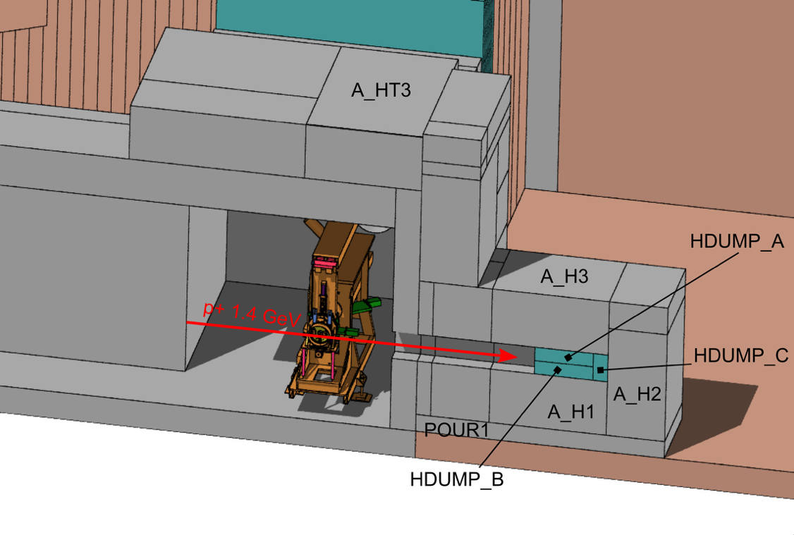
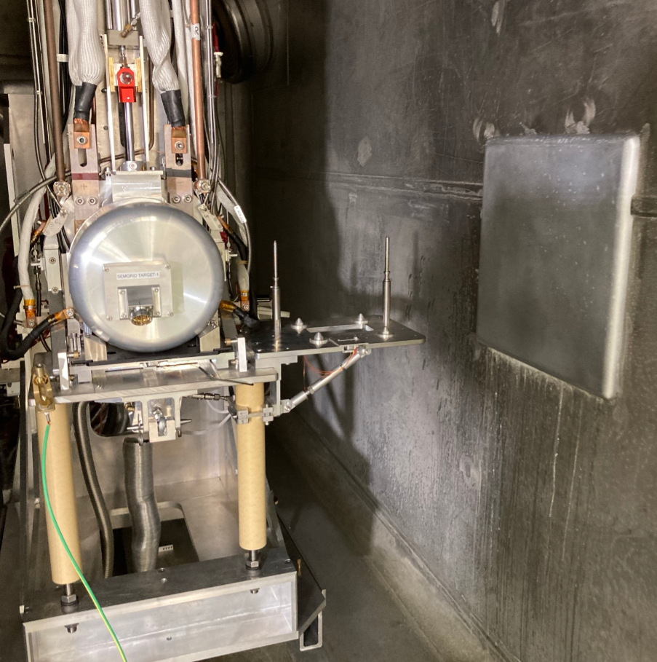
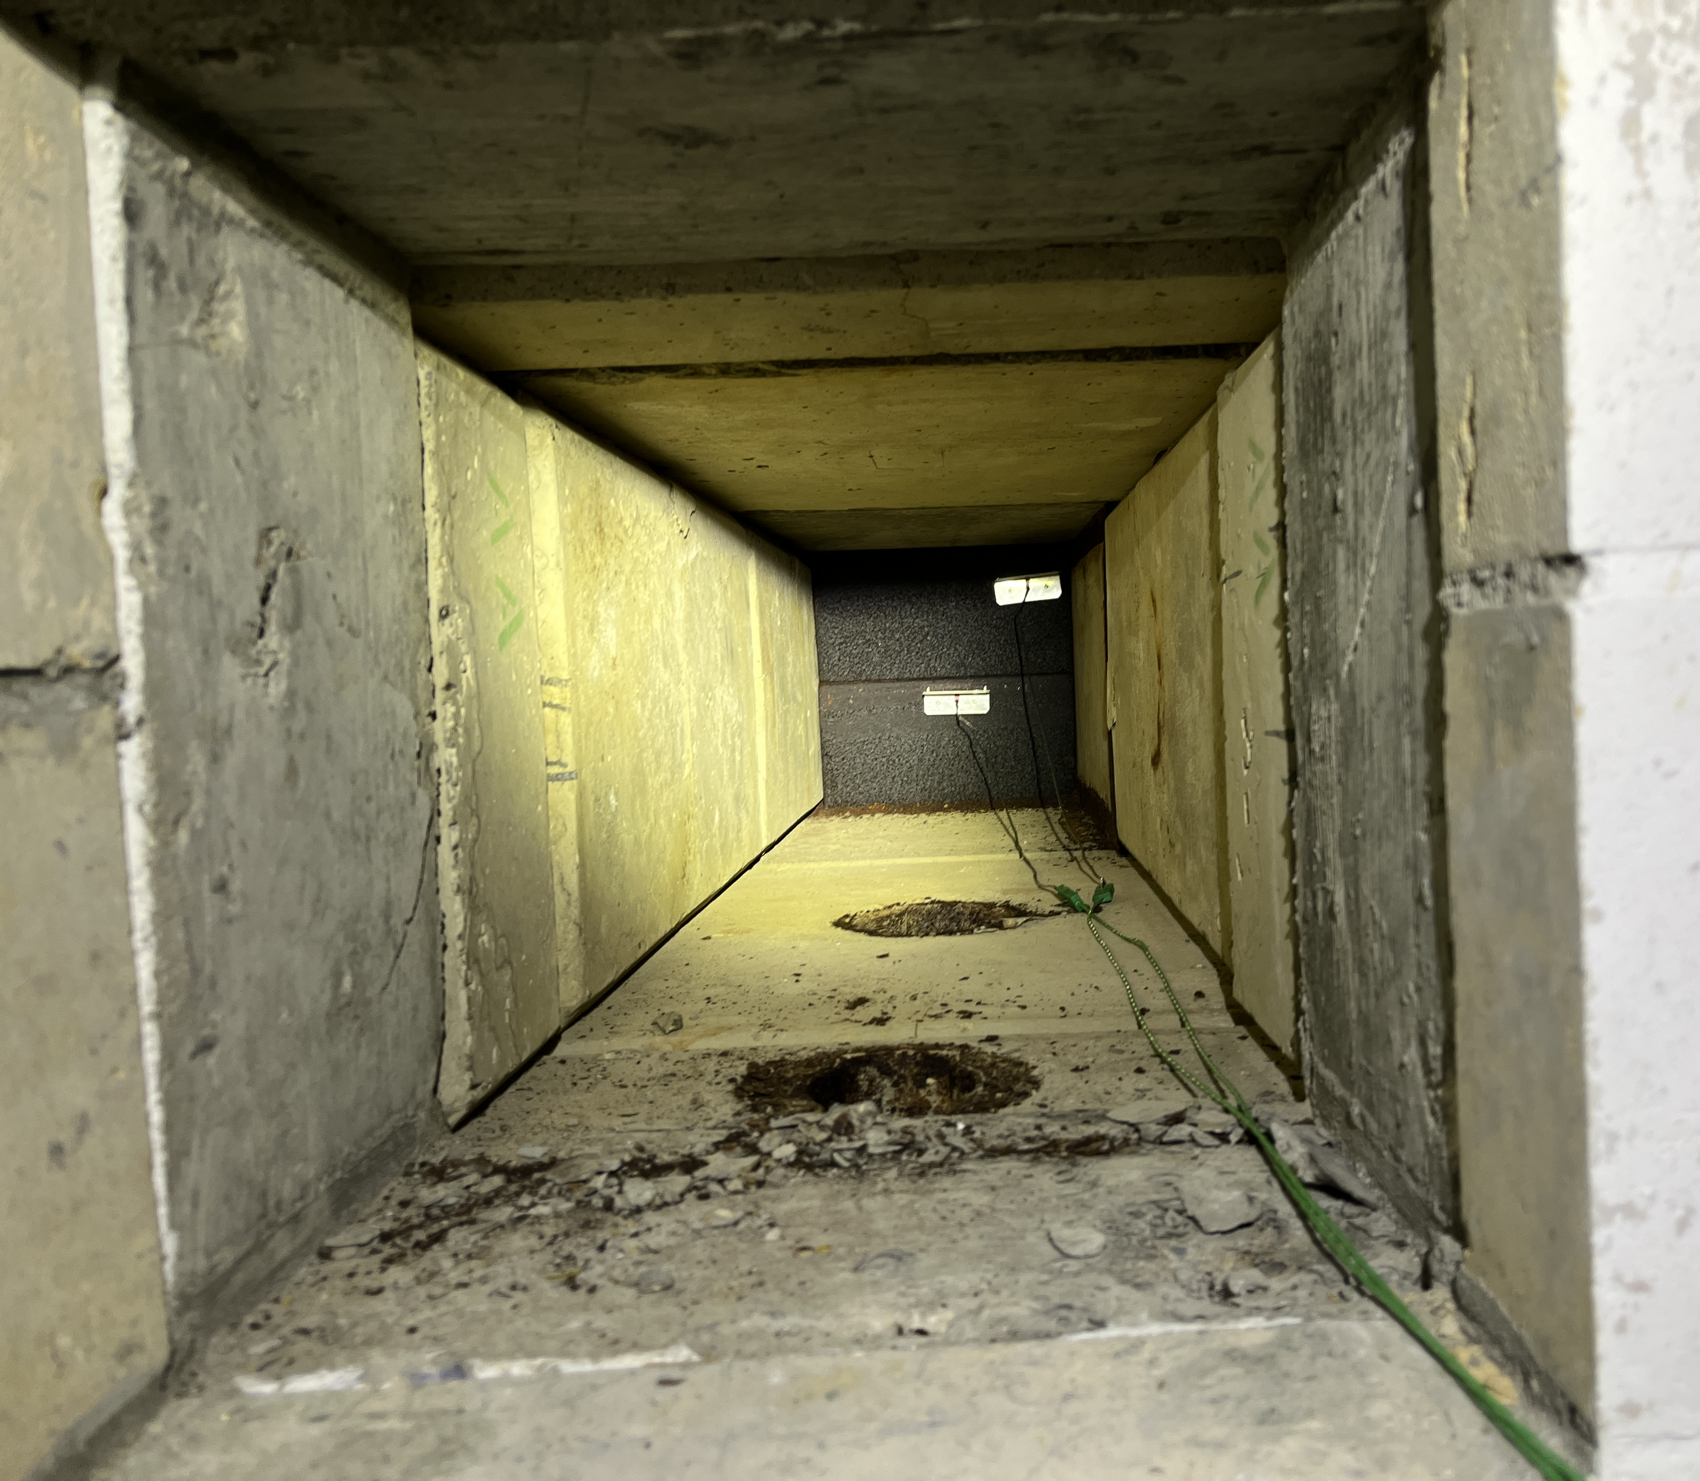

IBDRS radiological planning
Measurements not always possible (limited access)
Beam dump entrance niche
40x40 cm²
Target unit
ALARA
Estimate individual and collective doses
Beam line
2 m
Inside beam dump entrance niche
Residual dose rate calculations
Benchmarking: pre and post dismantling
FLUKA Version 4-5.0 https://fluka.cern
Notes:
Throughout this project, we need to comply with the ALARA principle and keep both individual and collective doses as low as reasonably achievable.
To estimate occupational doses, we can perform radiation measurements. However, the access to beam dump area is very restricted as it is buried under soil, we could only access the beam dump entrance.
In this photo we see the HRS target, if we enter through this window, we are inside the beam dump entrance.
An alternative to estimate residual dose rates at other locations and throughout the different stages of dismantling, we therefore used FLUKA simulations.
----------
How should the worksite be organised to minimise the risk of contaminating personnel and equipment?
What is the most appropriate methodology for characterising the soil in-situ?
What are the estimated individual and collective doses associated with the dismantling (ALARA approach)?

Slide 8
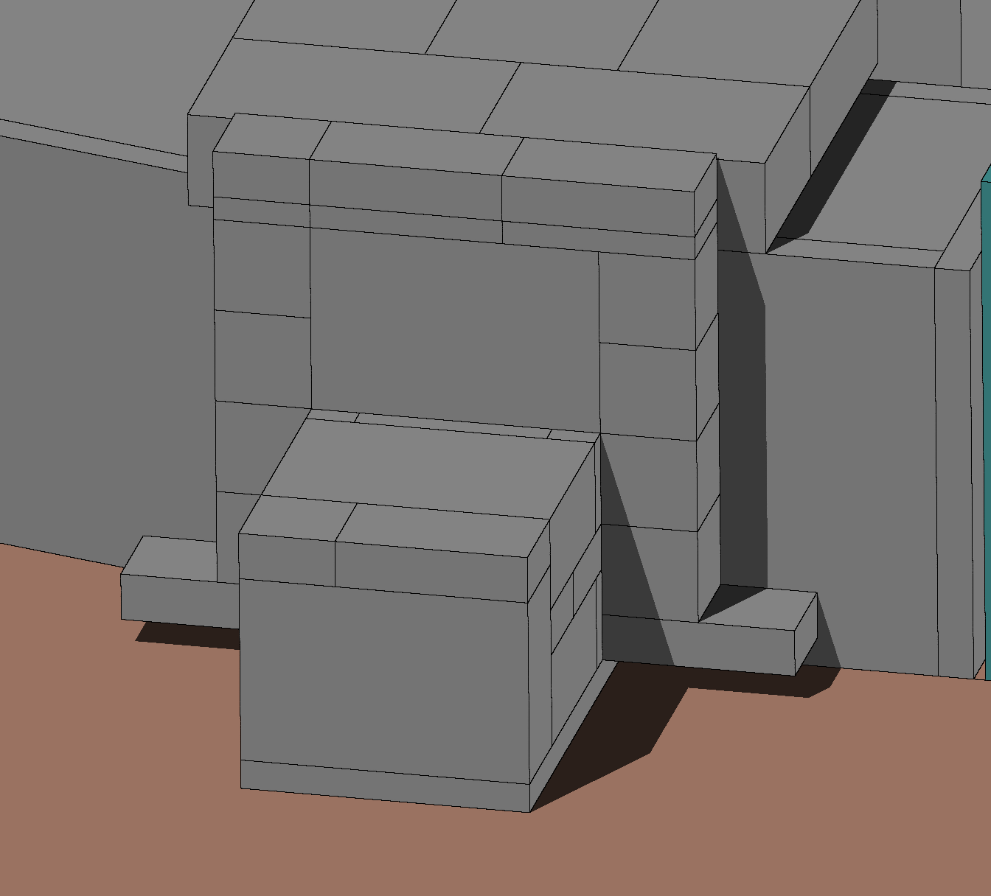
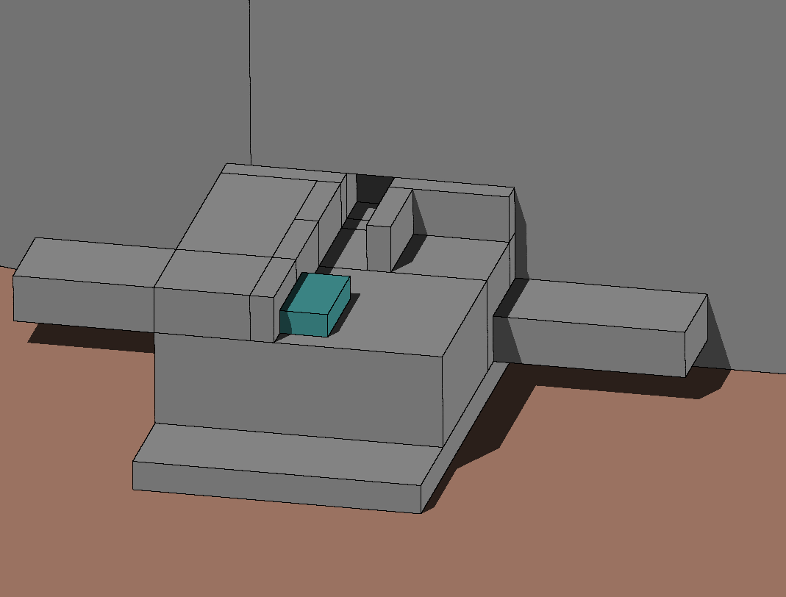
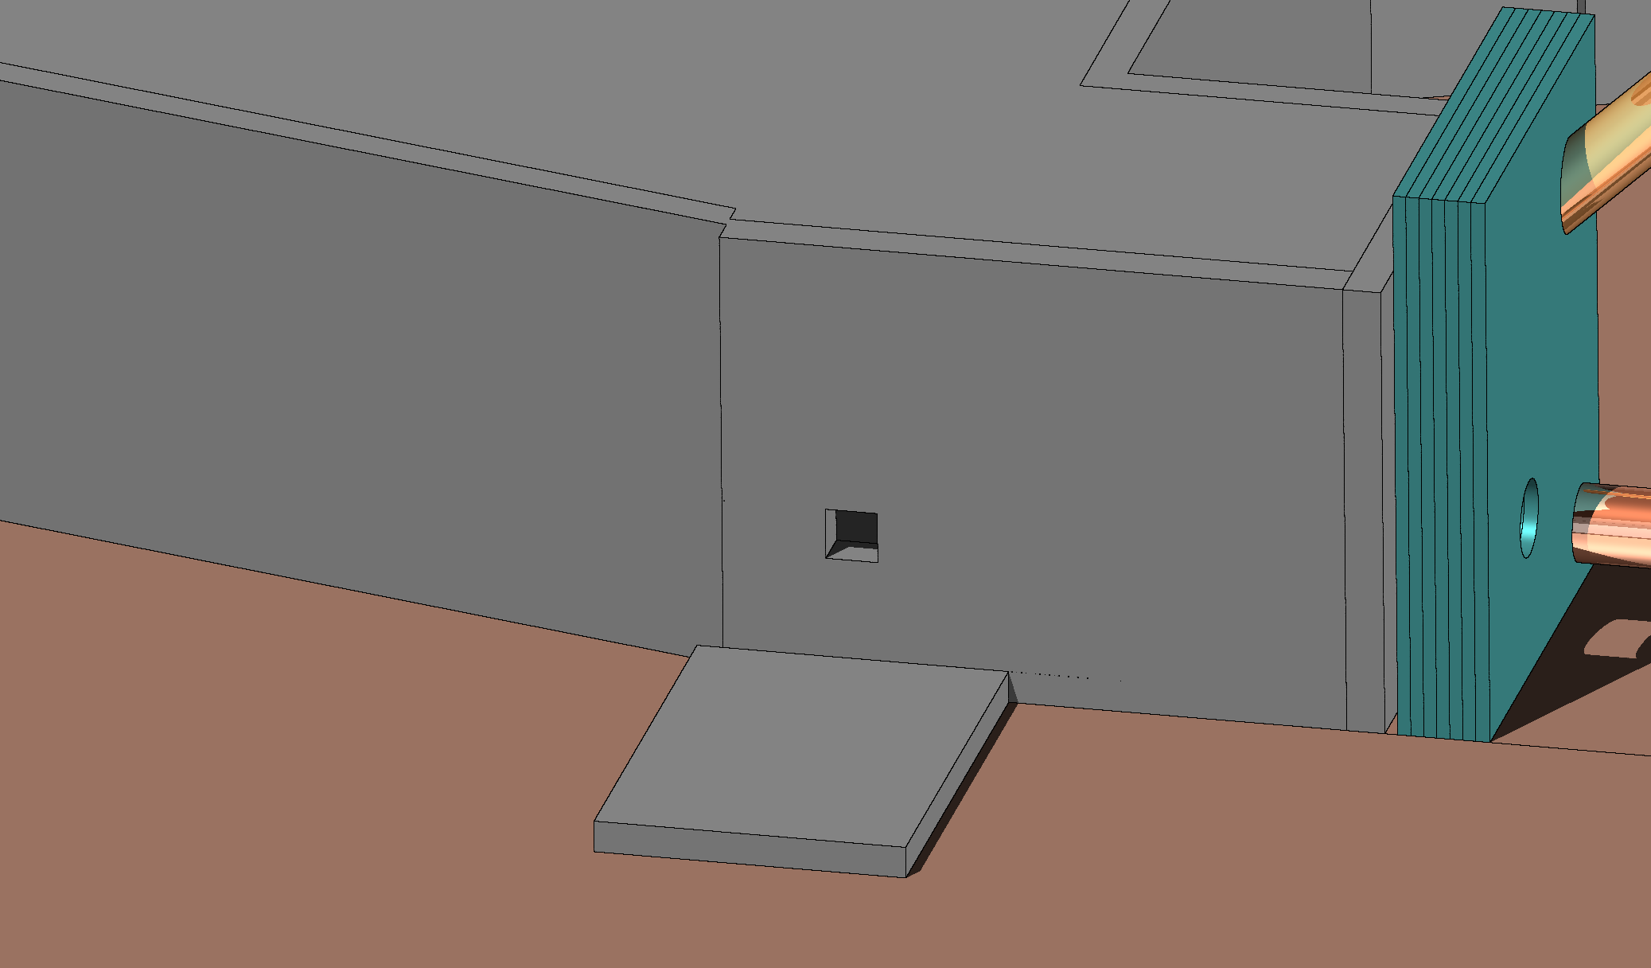
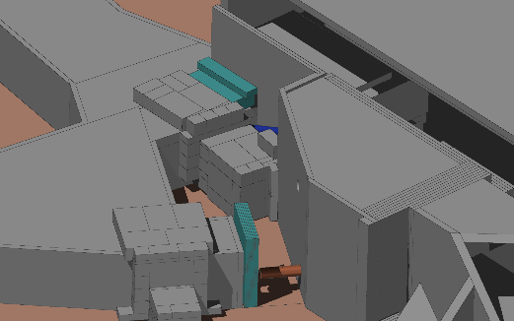
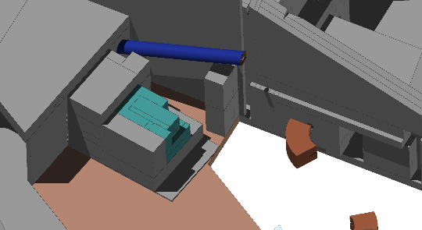
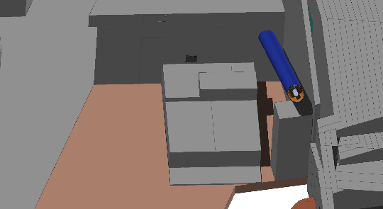
FLUKA modelling
HRS
9 dismantling configurations — removal of concrete blocks and iron beam dump
Irradiation profile
5×10¹⁹ POT/year
  200 days irradiation
  165 days no beam
30 years of operation
H1
H5
H9
Cool-down times
1, 2, 4, 6 months and 1 year
GPS
15 dismantling configurations — removal of soil, concrete blocks and iron beam dump
G3
G10
G14
Output
H*(10) residual dose rate 3D maps
Notes:
We simulated 30 years of ISOLDE operation and considered different cooling times to study how the residual dose rates evolve during the dismantling process.
For the working dose planning, we used a cooling time of two months. This tend to be a conservative assumption, since approximately four months passed between the beam stop and the completion of the soil removal.
For the HRS beam dump, we defined nine configurations, starting with all the concrete shielding blocks in place and ending with their complete removal. We modelled intermediate stages, including the configuration where the beam dump is fully exposed, shown here in green.
We followed the same approach for GPS, with 15 configurations. In this case, we modelled the soil removal in several stages, and the beam dump geometry was also more complex.

Slide 9
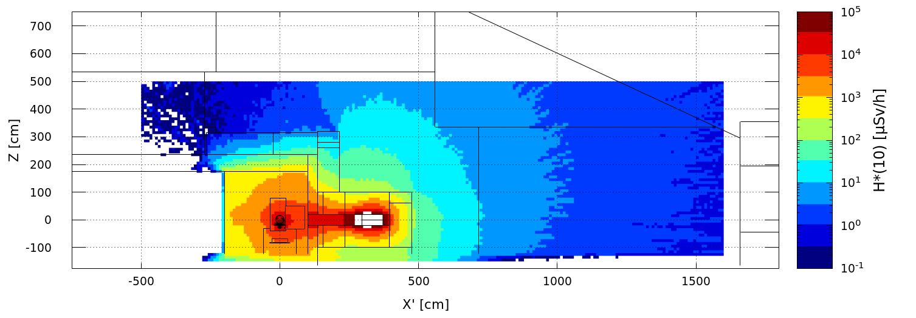
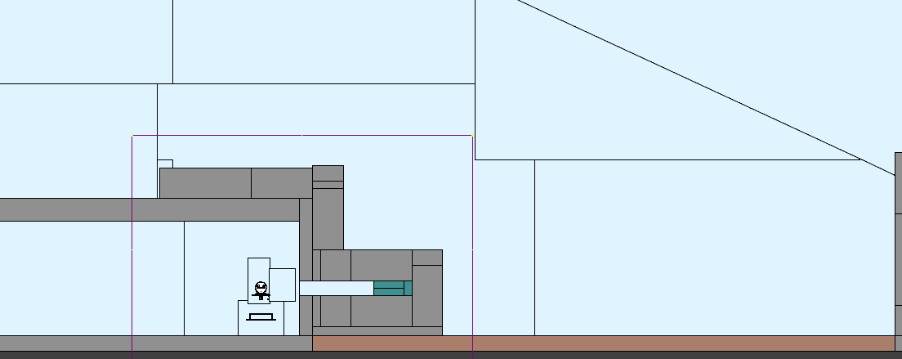

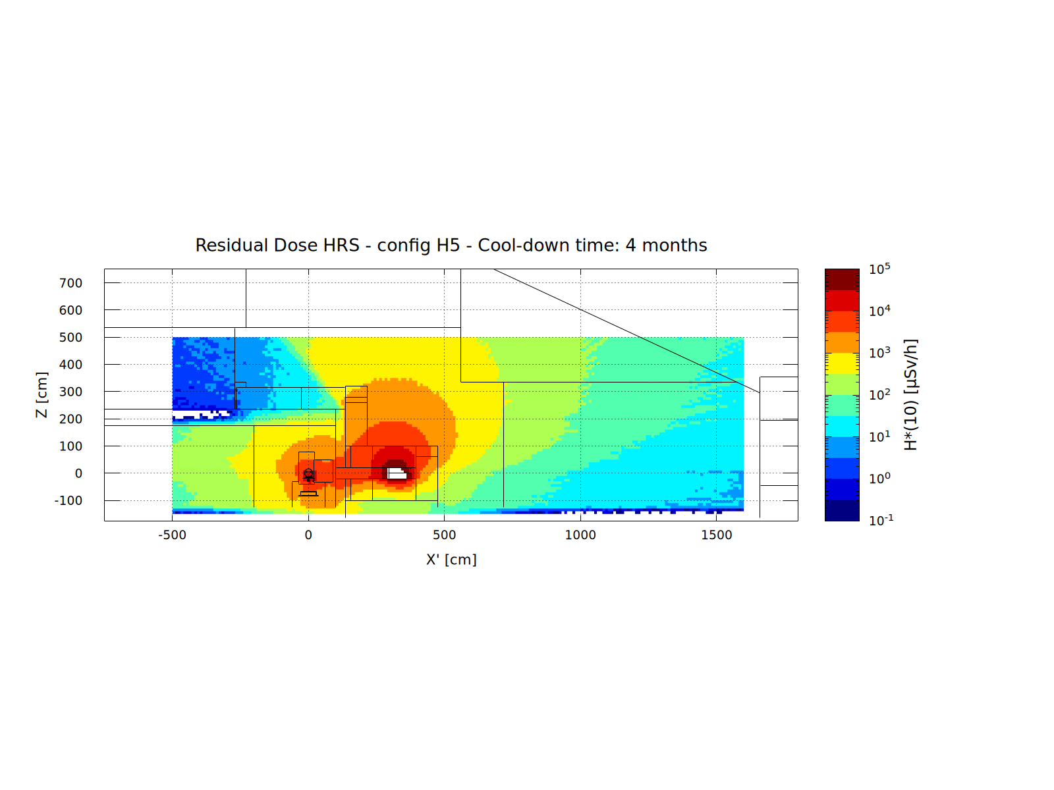
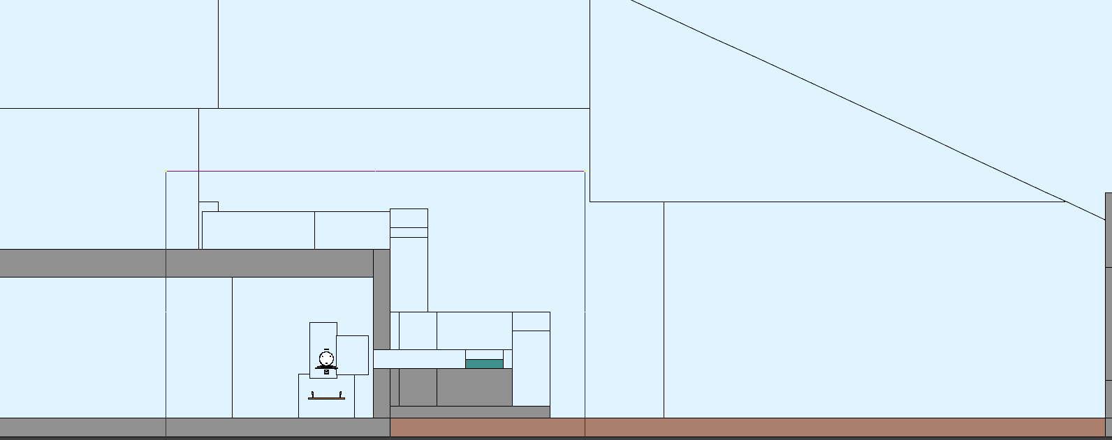
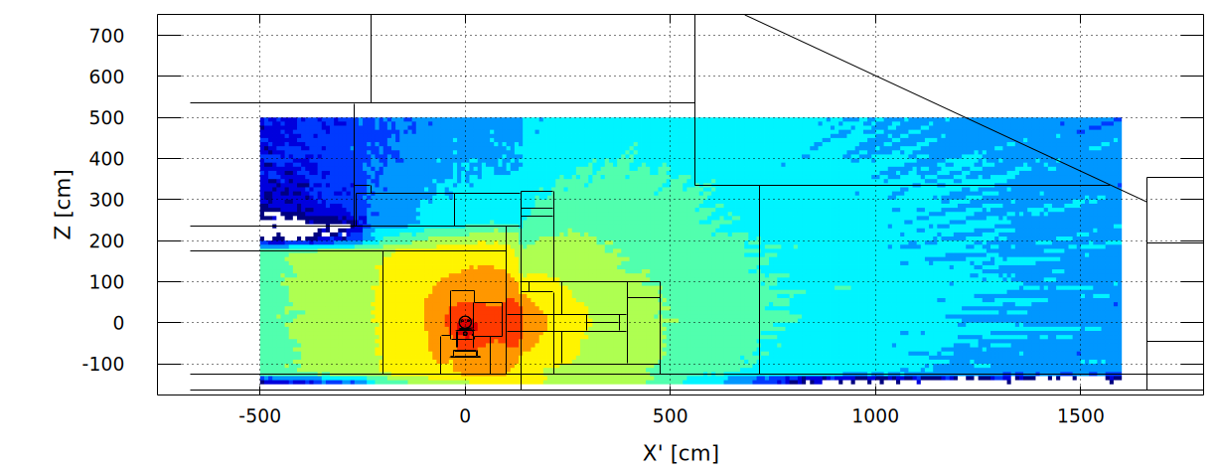
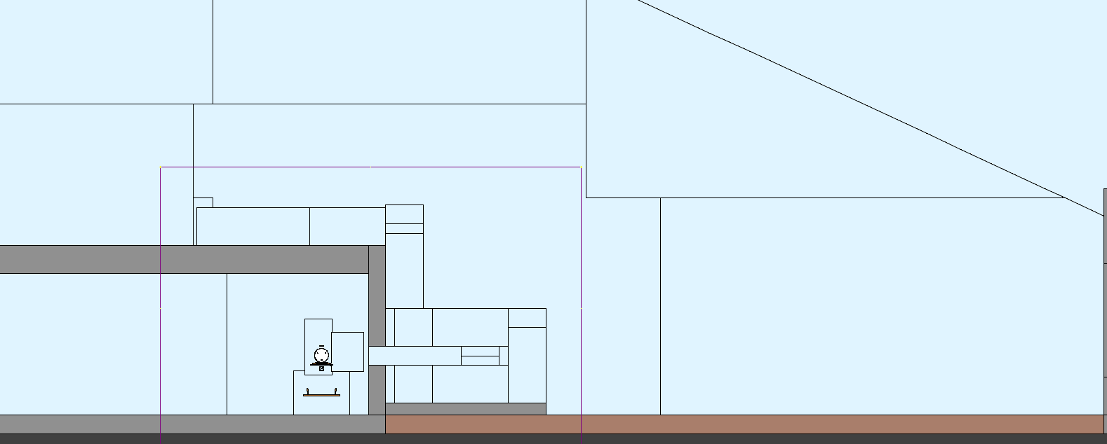
HRS: residual dose rate
4 months cool-down time
All uncertainties below 15 %
~12 µSv/h (at 3.5 m from the beam dump)
H1
H1
Soil removed
H1
Beam line
~1 mSv/h (at 3.5 m from the beam dump)
H5
Iron beam dump exposed
H5
H5
Beam line
~940 mSv/h (in contact with the beam dump)
~5 mSv/h (in the beam window)
H9
H9
Shielding removed
H9
Beam line
Notes:
Combining all these configurations with four cooling times produced an enormous number of residual dose rate maps. I'll show just a few representative examples.
Here we see the HRS beam dump in the initial configuration, with all the shielding blocks in place. In this cross-section view along the beam line, we can see the shielding blocks and on this one, the dose rates at the block surfaces and in the surrounding area. At a height of 3.5 metres above the shielding, the residual dose rate is around 12 microsieverts per hour.
It is interesting to compare it with other configurations. This H5, we have the beam dump in green almost fully exposed. The dose rates are much higher: at the same location, the value increases from 12 microsieverts per hour to around 1 millisievert per hour.
At the face of the beam dump, the most irradiated block, the residual dose rate reaches almost one sievert per hour, even after four months of cooling.
Finally, we have the last configuration, and the plots also show how the residual dose rates decrease as the irradiated shielding blocks are removed.

Slide 10
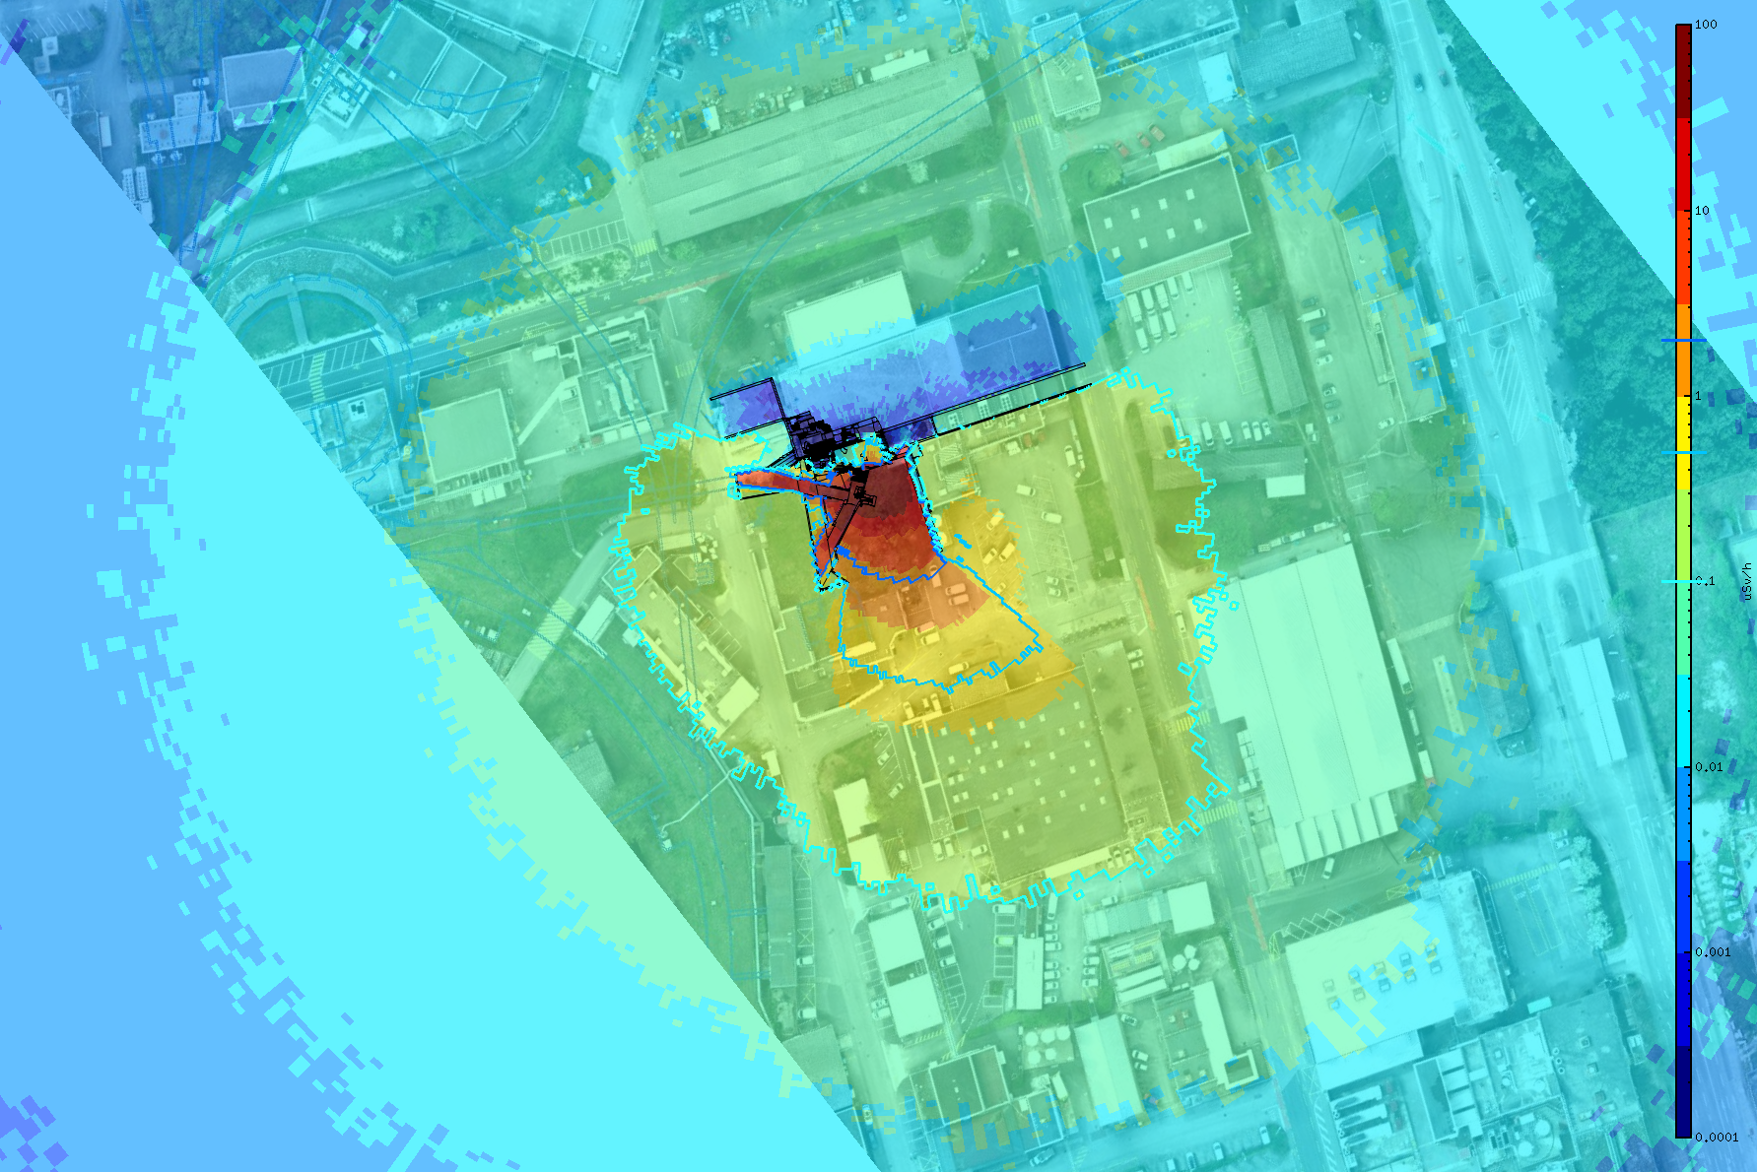
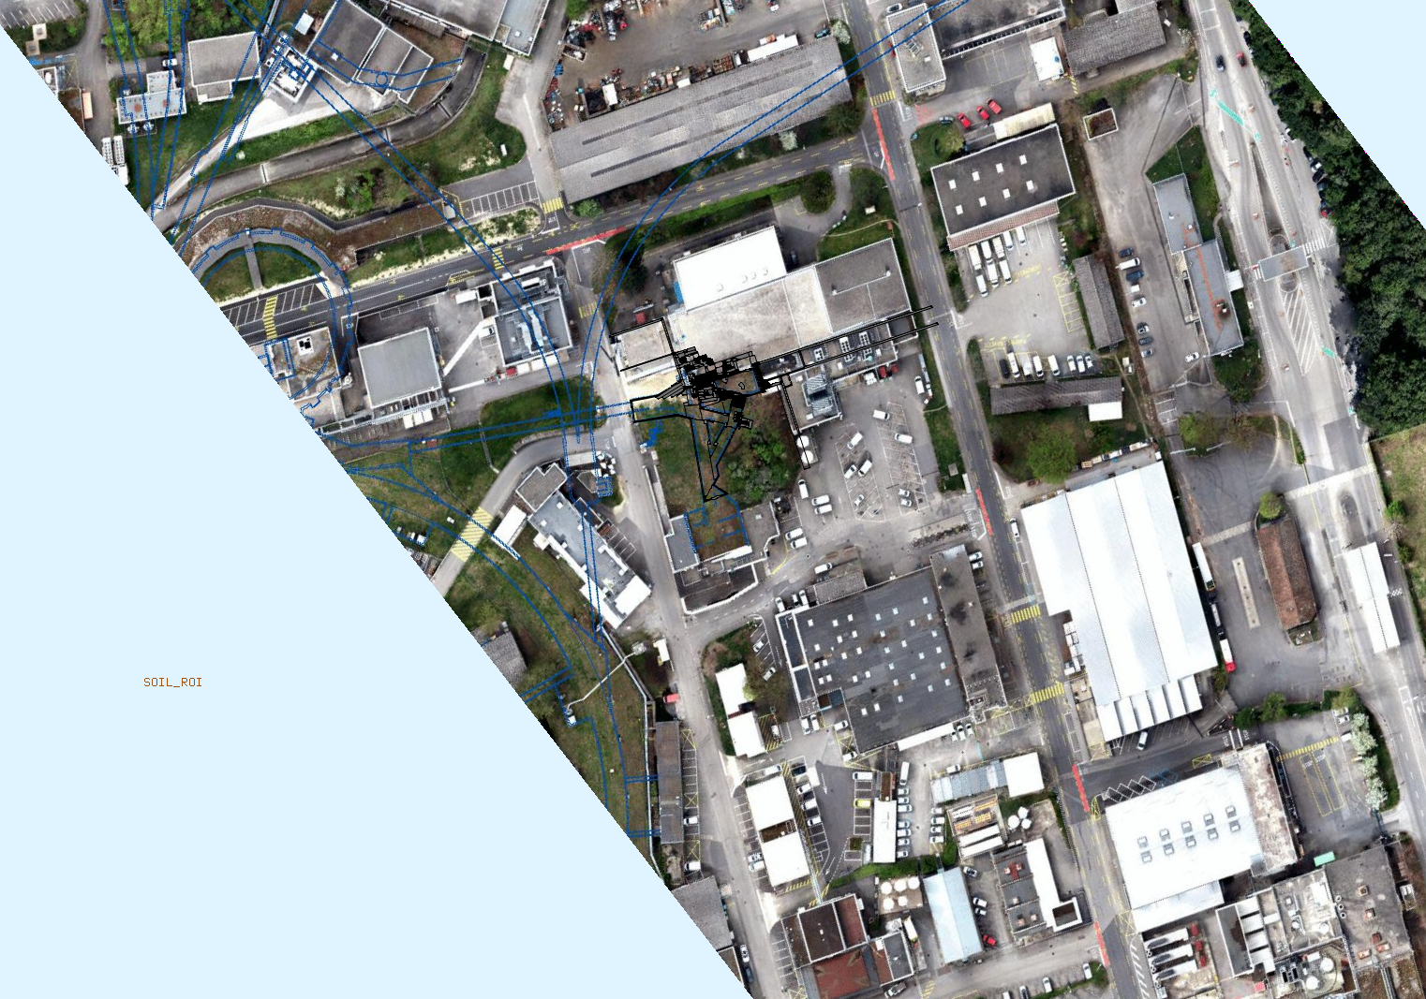
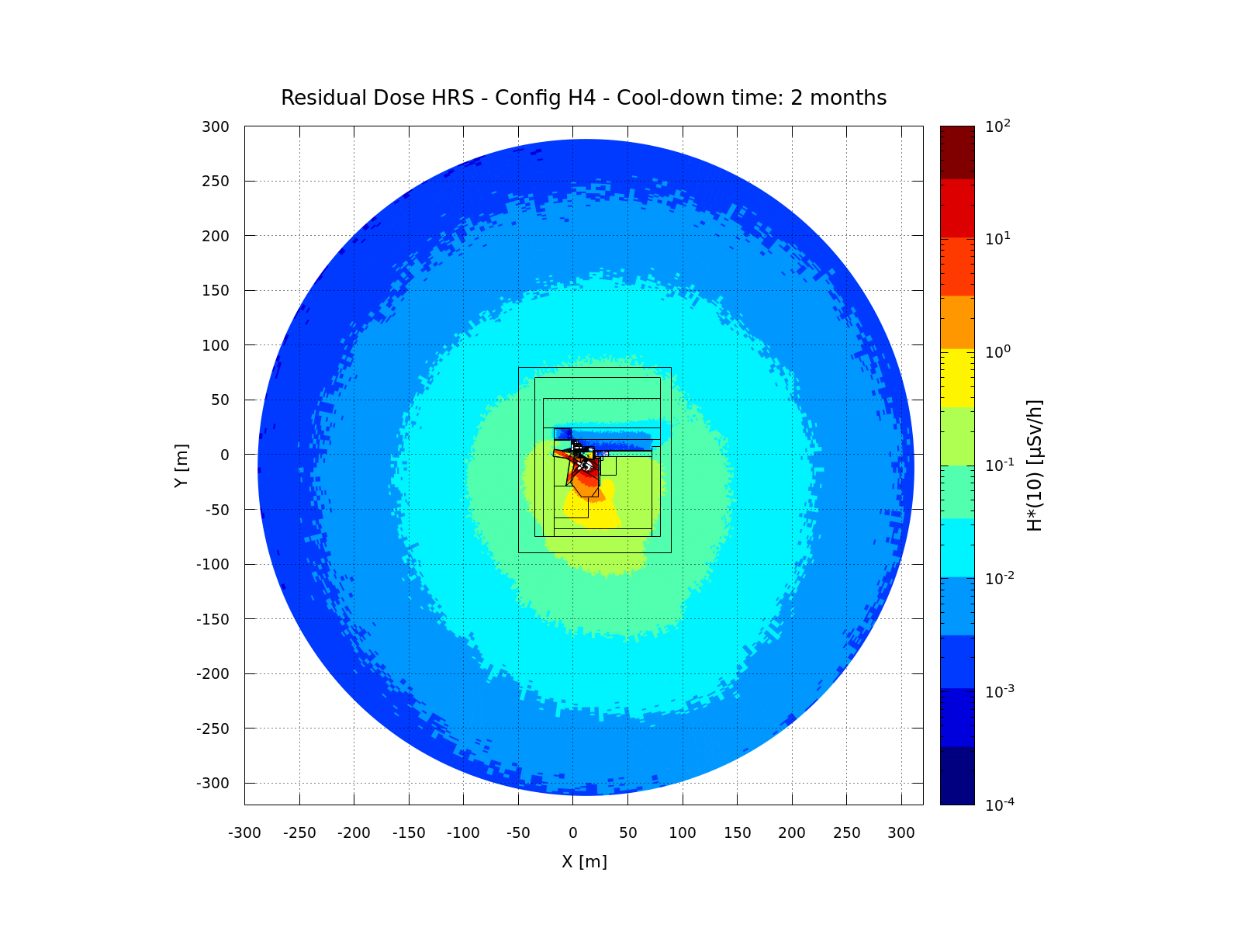
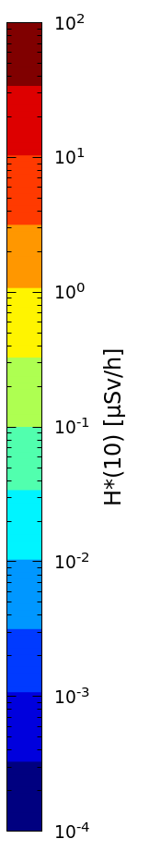
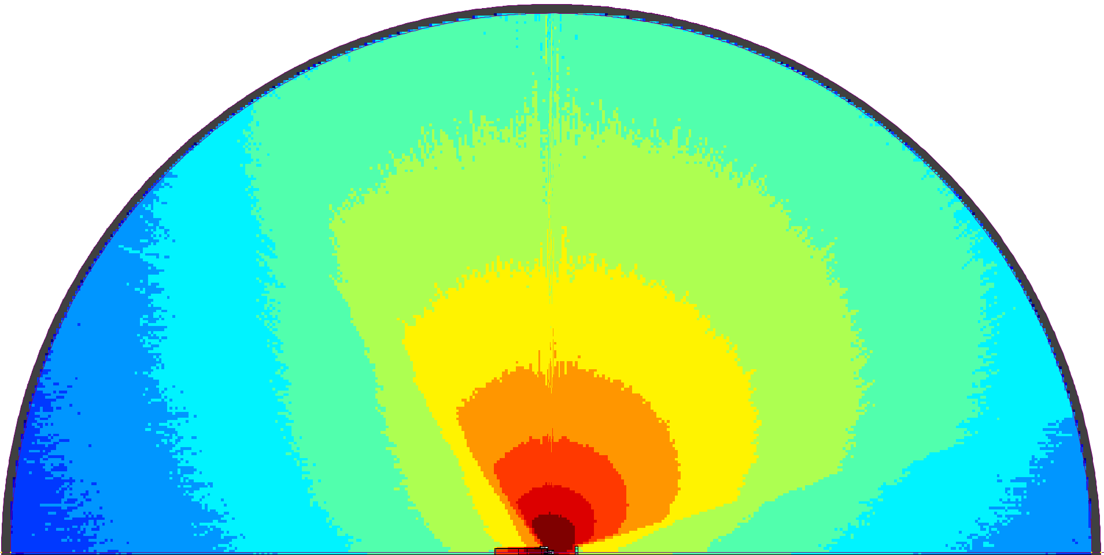
HRS: skyshine assessment
H5
H5
Rte. Einstein
Rte. Einstein
Rte. de Meyrin
(< 0.03 µSv/h)
Rte. de Meyrin
2 months
cool-down time
Rte. Rutherford
Rte. Rutherford
2.5 µSv/h
300 m
B 365
B 365
~110m
0.5 µSv/h
0.1 µSv/h
Z (height)
X
ISOLDE
Rte. Demócrite
Rte. Demócrite
H*(10) at beam level height
Notes:
For configuration H5, which showed the highest dose rates, we also performed a skyshine assessment to account for photons scattered in the atmosphere.
We calculated a 3D dose rate map with a 300 meters radius hemisphere.
More interesting, using FLAIR, we could then overlay the results onto a map of CERN to assess the impact on the surrounding roads and buildings, which gives us relevant information.
Along both roads near ISOLDE, residual dose rates exceed 0.1 microsieverts per hour over distances of approximately 110 metres.
Along Route de Meyrin, outside the CERN site, the dose rates remain below 0.03 microsieverts per hour.
This assessment is conservative: considering the most irradiated configuration and the beam dump exposed for 2 months of cooling. Nevertheless, it provides useful information for the radiation protection planning during the dismantling.

Slide 11
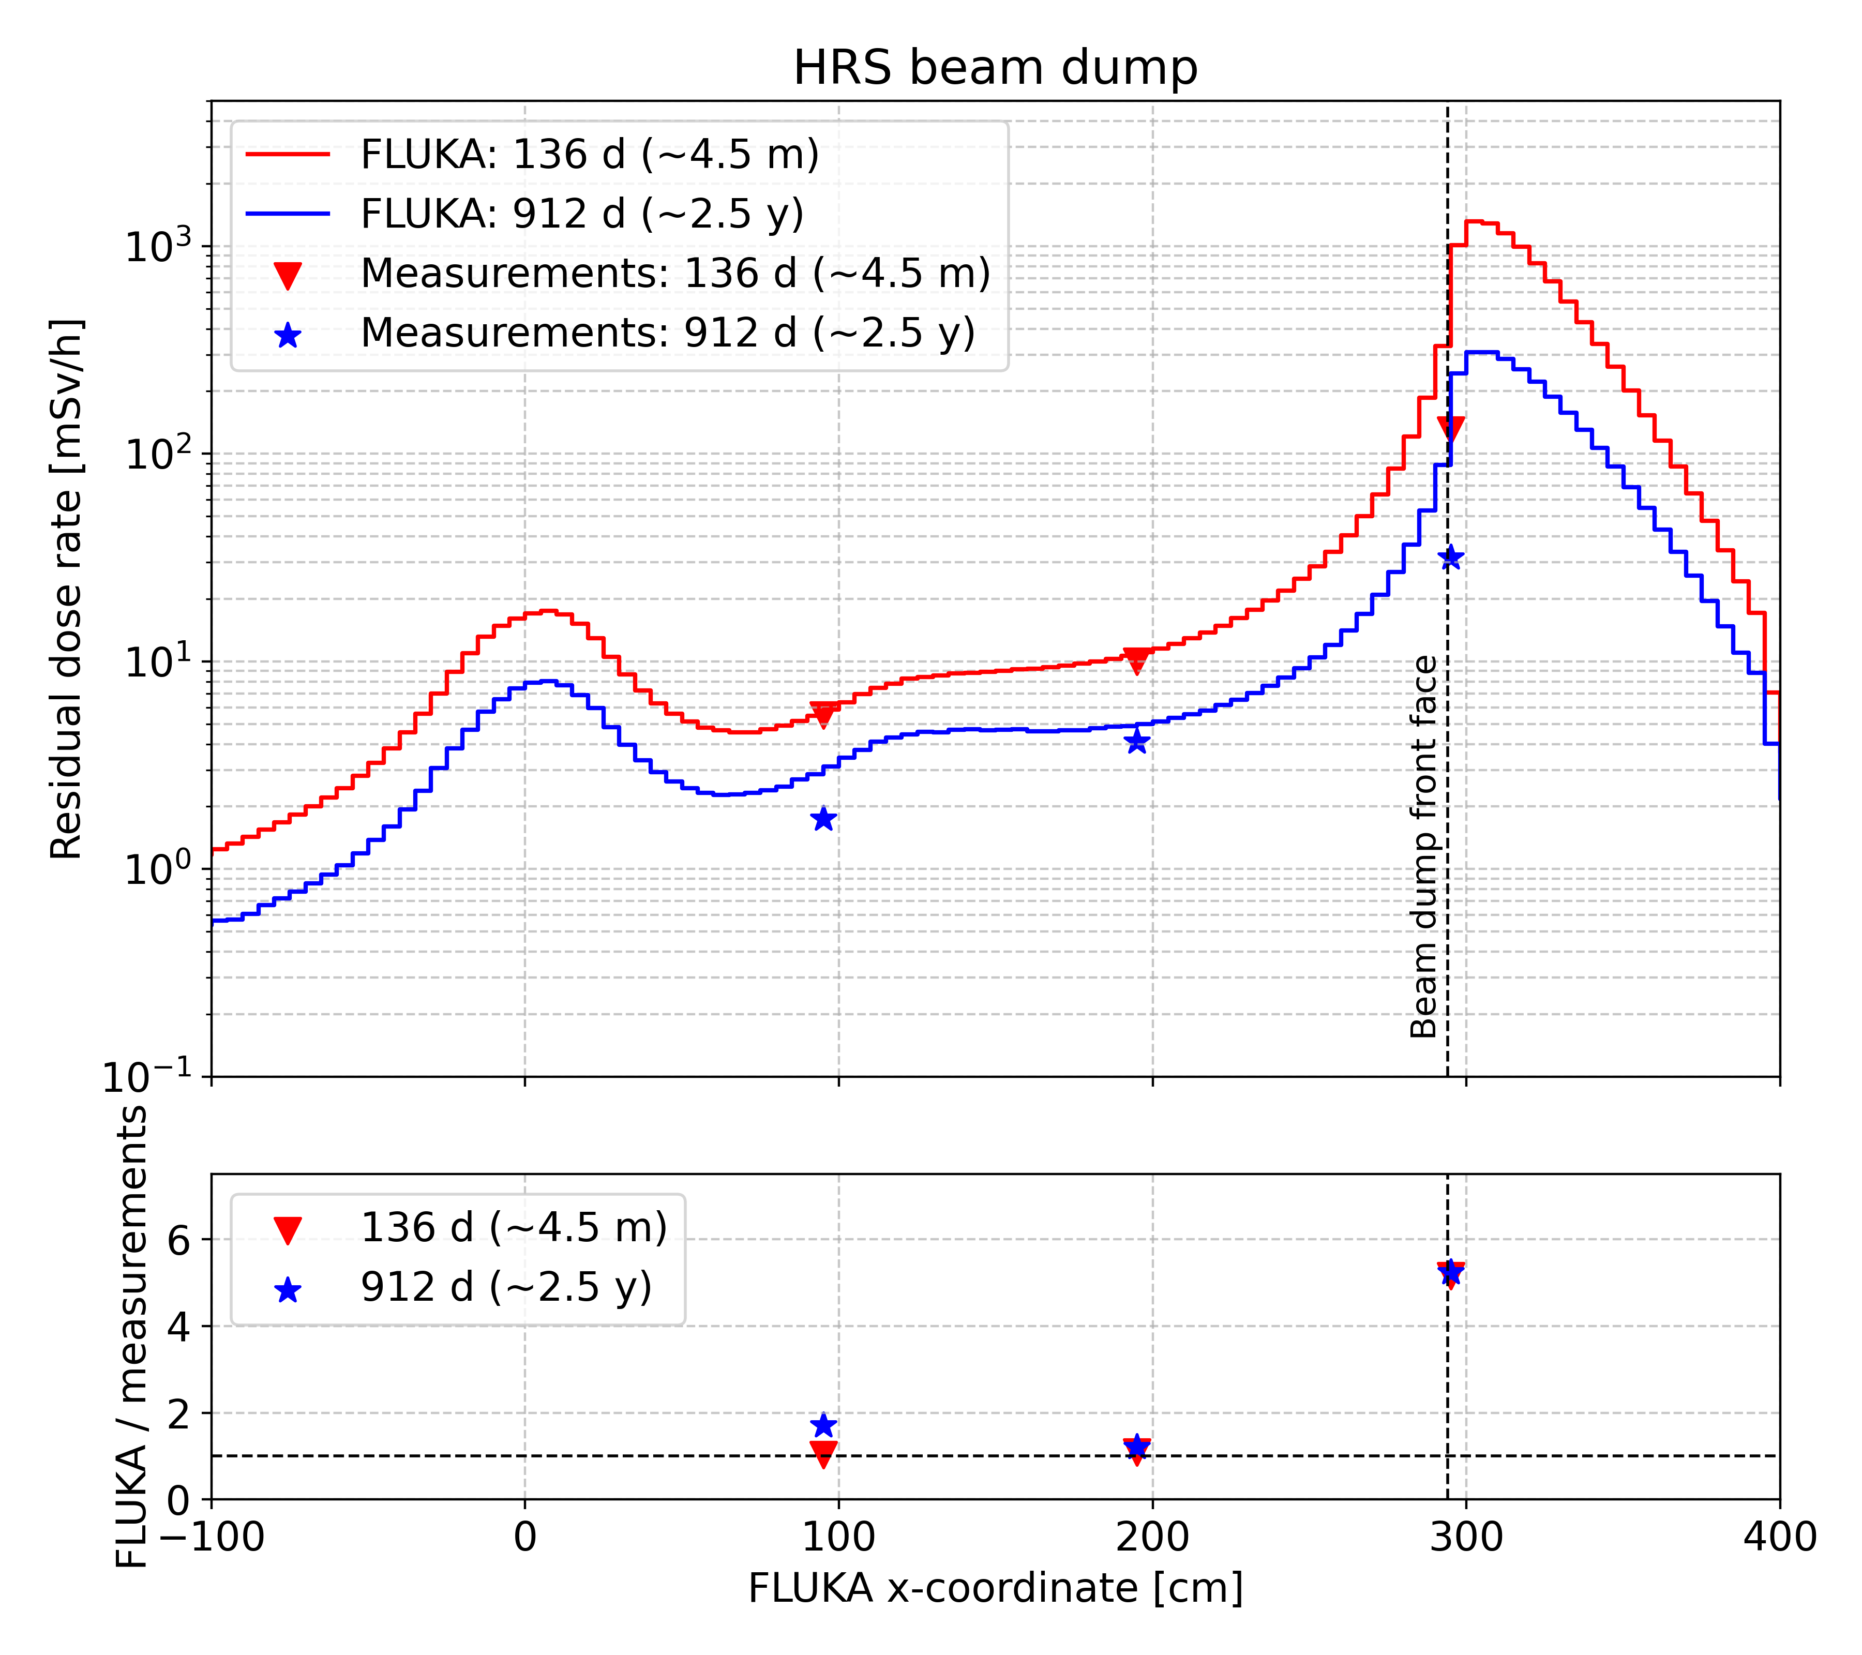
Benchmarking FLUKA against survey measurements
All FLUKA uncertainties below 5 %
Survey H0
 | Cool-down time | Year
Measurement 1 | 136 days (~ 4.5 months) | 2024
Measurement 2 | 912 days (~ 2.5 years) | 2021
10 mSv/h at 1 m
5.5 mSv/h at 2 m
130 mSv/h in contact
H*(10) values for Measurement 1
Notes:
An essential part of this work is benchmarking the simulations against measurements to assess their reliability.
We first compared the FLUKA results with two measurements taken during operation, before the IBDRS project began.
Due to access limitations, these measurements were only taken in the beam dump entrance for two different moments with different cooling times.
Here we have dots for the measurements and the lines for the FLUKA calculations.
The first thing to notice is the large discrepancy at the surface of the beam dump. Estimating dose rates at material frontiers using Monte Carlo code is challenging, specially if the scoring mesh does not match exactly and the dose rate values change sharply.
If we focus on the other two measurement points, we see a slight discrepancy at the first point for measurement set two.
This is mainly because the target structures were not present during the measurements but were included in the simulation, increasing the calculated dose rates.

Slide 12
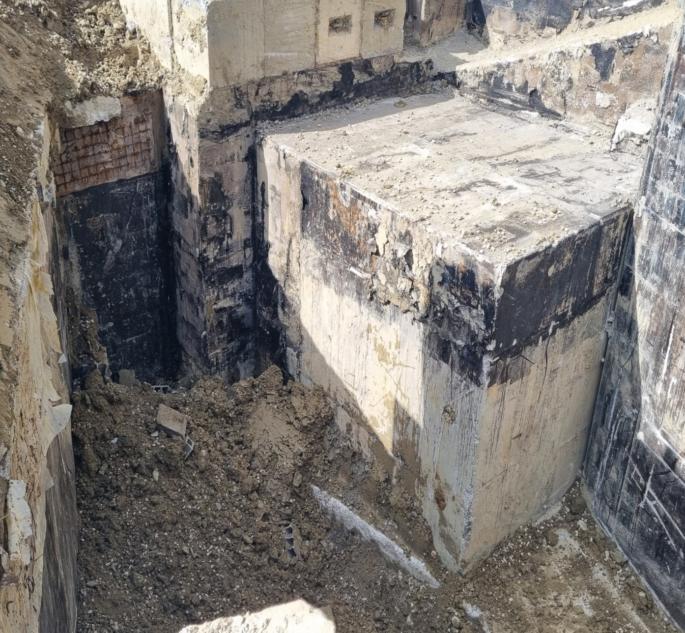

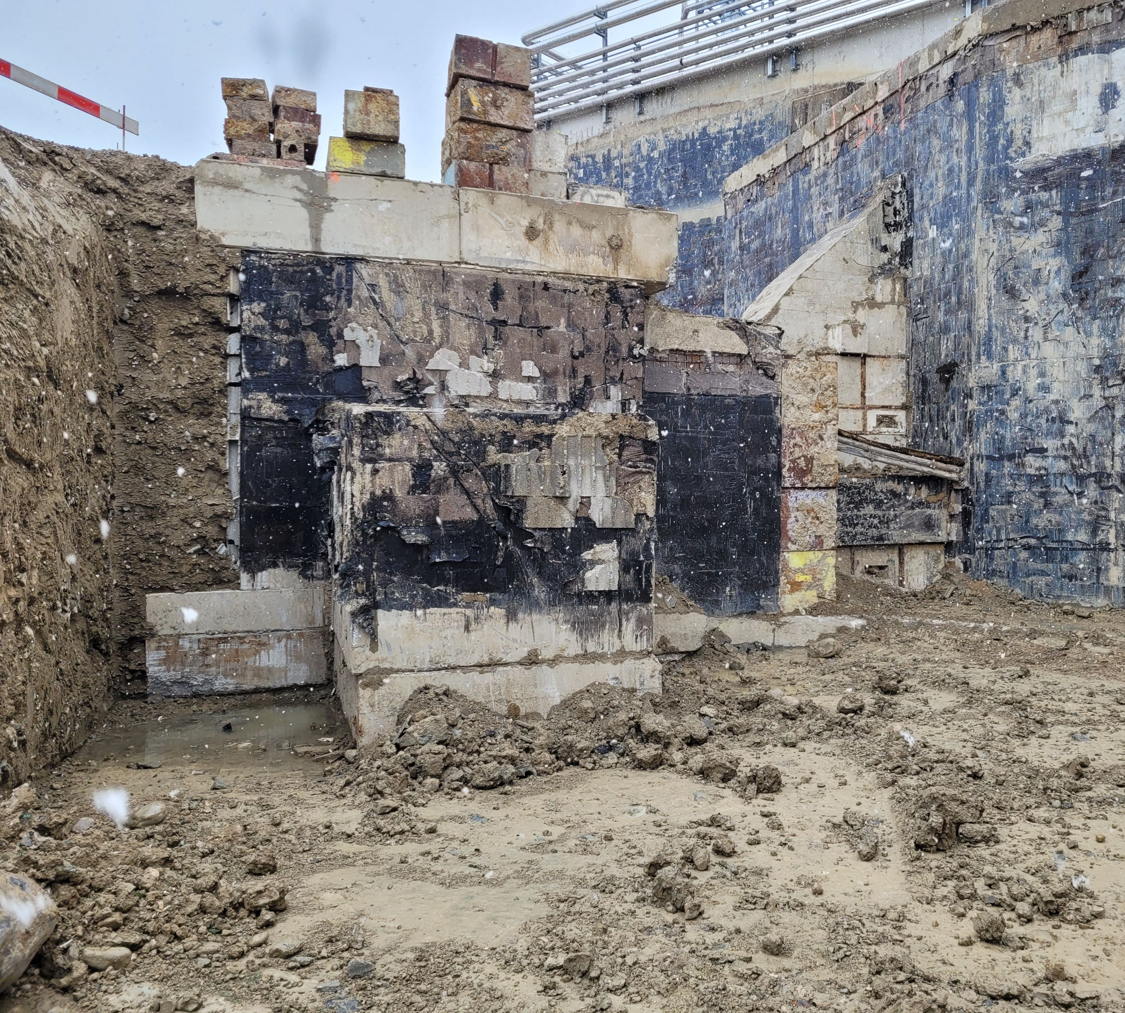
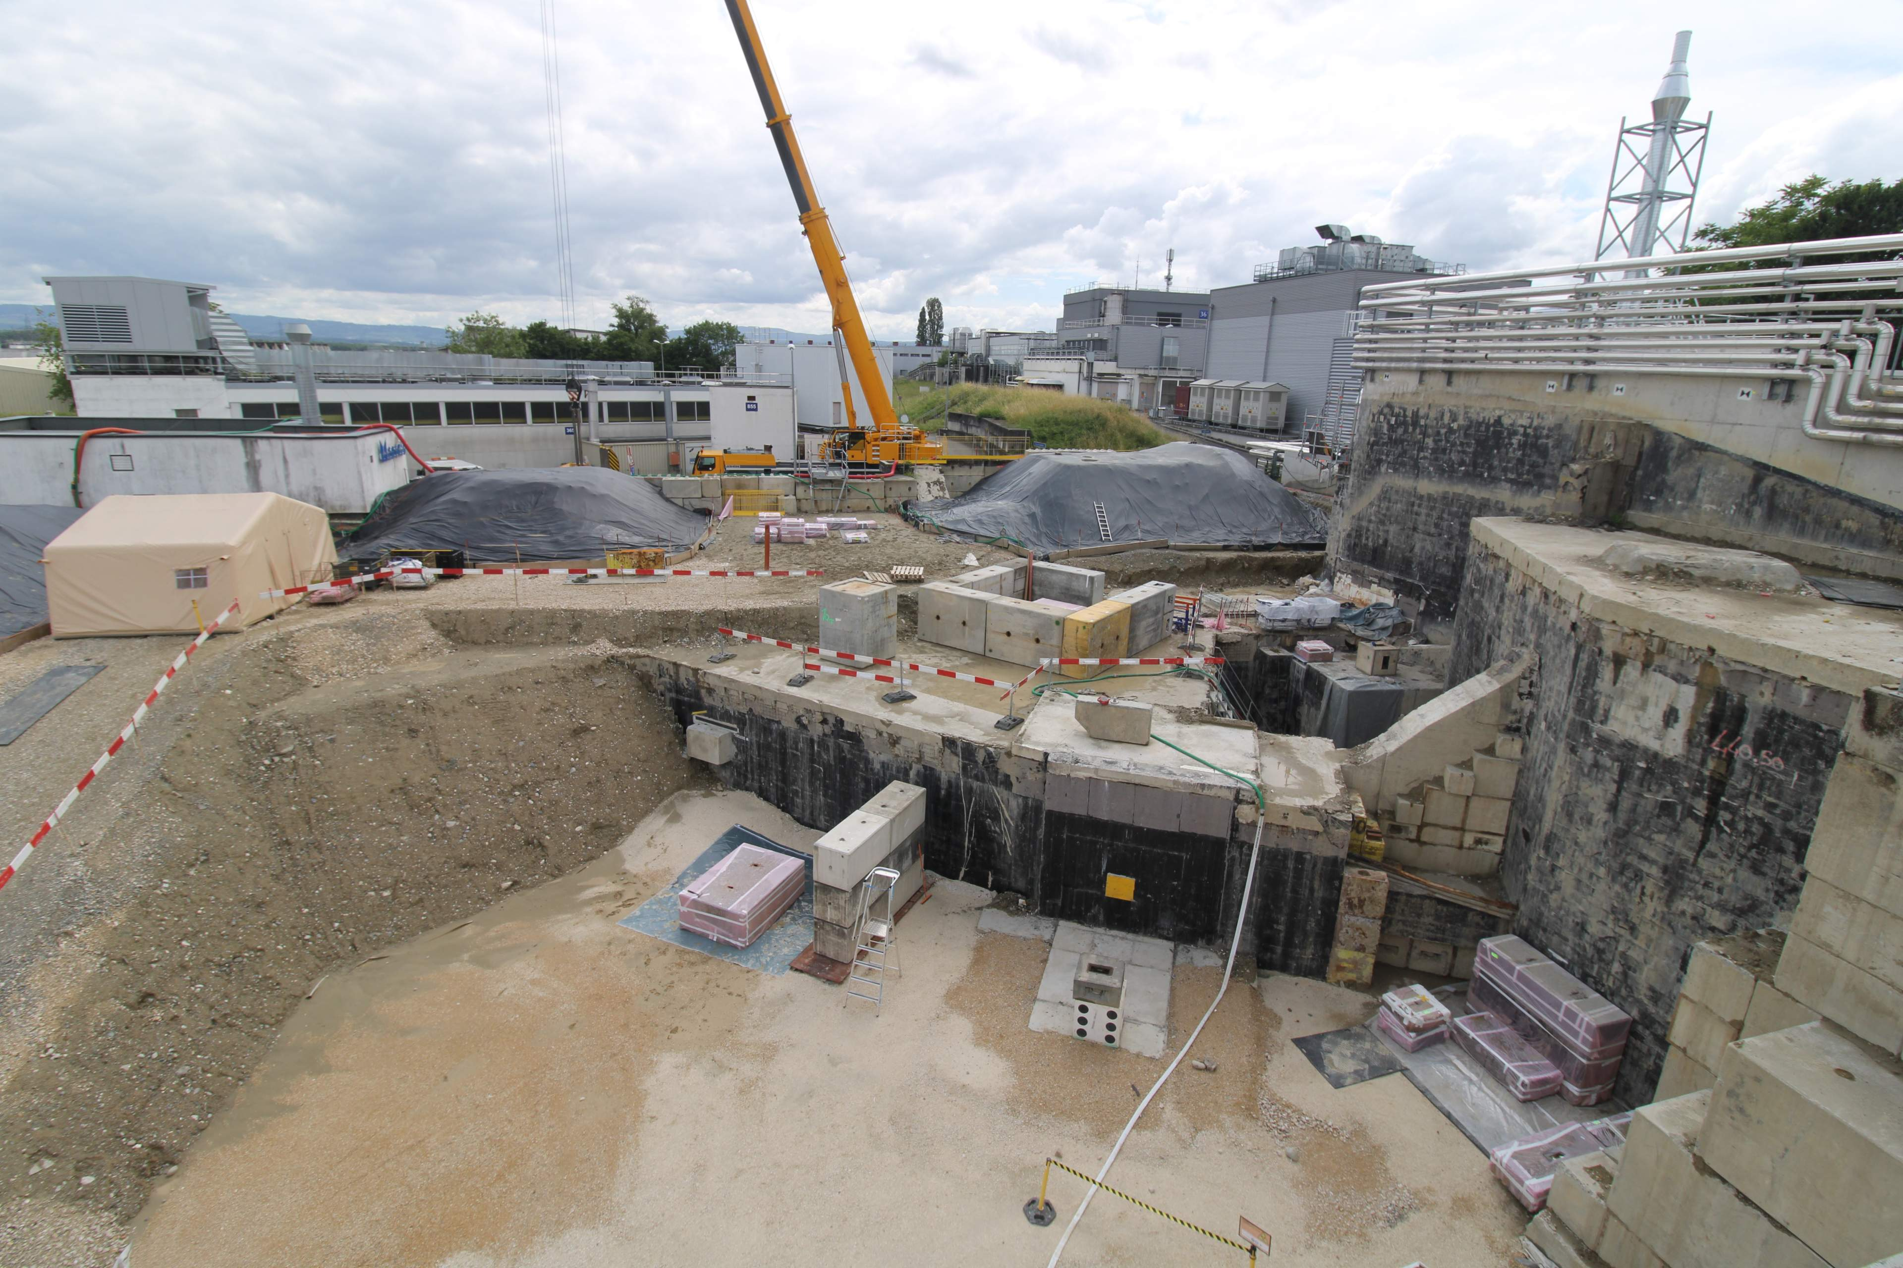
Benchmarking FLUKA against survey measurements
Survey G1
G3
ISOLDE
beam stop
08/12/2025
23/03/2026
16/04/2026
05/06/2026
Survey H1
Survey H2
H1
H9
Notes:
Once the IBDRS project had started, we were able to perform additional radiation surveys at different stages of dismantling.
These included measurements after the soil had been removed, measurements at the other target station, and measures at HRS after the beam dump and all the concrete shielding blocks had been removed.

Slide 13
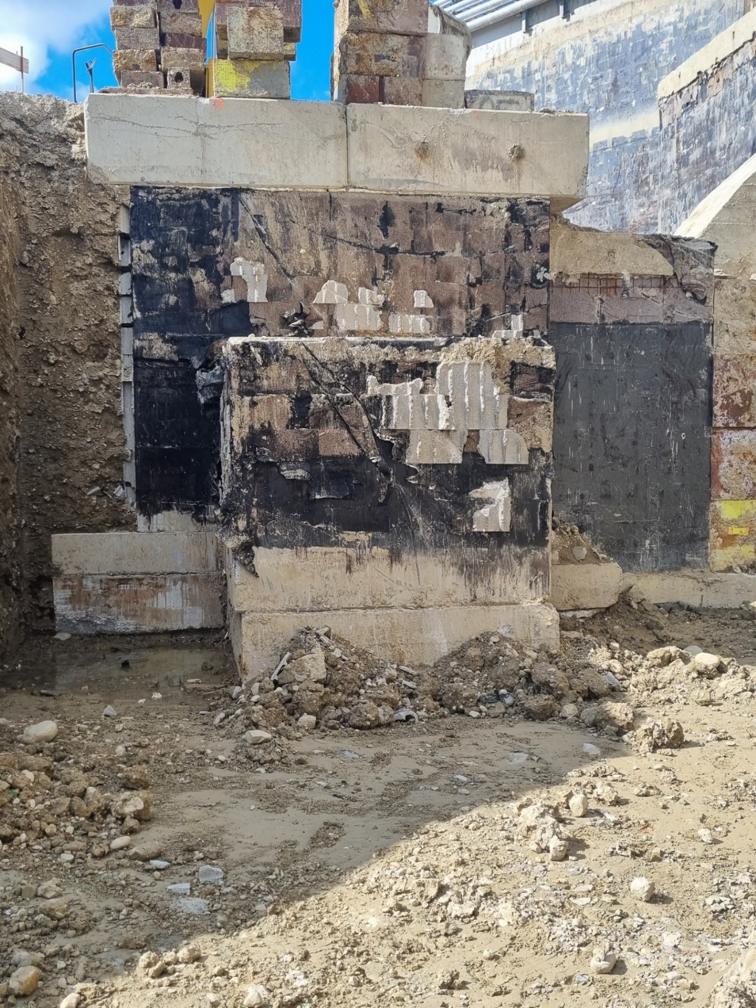
Benchmarking FLUKA against survey measurements
*Ratios are calculated as: FLUKA / measurement
**Distances from indicated wall
All FLUKA uncertainties below 5 %
Survey H1
Faraday cage
Distance | 40 cm
FLUKA | 21 µSv/h
Measurement | 20 µSv/h
Ratio | 1.05
Beam dump left 2
Distance** | 40 cm
FLUKA | 56 µSv/h
Measurement | 40 µSv/h
Ratio* | 1.40
Beam dump left 1
Distance | 40 cm
FLUKA | 52 µSv/h
Measurement | 45 µSv/h
Ratio | 1.15
Beam dump right 2
Distance | 40 cm
FLUKA | 63 µSv/h
Measurement | 50 µSv/h
Ratio | 1.26
All measurements done at beam level height: 125 cm
Beam dump rear
Distance | 40 cm
FLUKA | 59 µSv/h
Measurement | 35 µSv/h
Ratio | 1.69
Beam dump right 1
Distance | 40 cm
FLUKA | 60 µSv/h
Measurement | 50 µSv/h
Ratio | 1.20
Beam dump rear
Distance | 8 m
FLUKA | 1 µSv/h
Measurement | 0.4 µSv/h
Ratio | 2.50
Notes:
Going to the first survey example. In this photo we can see HRS beam dump after the removal of all the surrounding soil.
Let's consider a measurement taken at beam height, 40 centimetres from this left wall of the shielding. FLUKA predicts 52 microsieverts per hour, compared with the measured value of 45 microsieverts per hour. This gives a simulation-to-measurement ratio of 1.15, showing very good agreement.
We performed the same comparison at a larger set of measurement points, all at beam height and at different distances from the concrete shielding blocks.
Most ratios range from approximately 1 to 1.7, indicating a slight overprediction by FLUKA.
There is one point with a much higher ratio, but it is located eight metres from the shielding, where the measured dose rate is very low, just 0.4 microsieverts per hour.
We obtained similar results for the GPS target station in the survey taken after the soil removal.
Although I won't show them here due to time constraints.

Slide 14
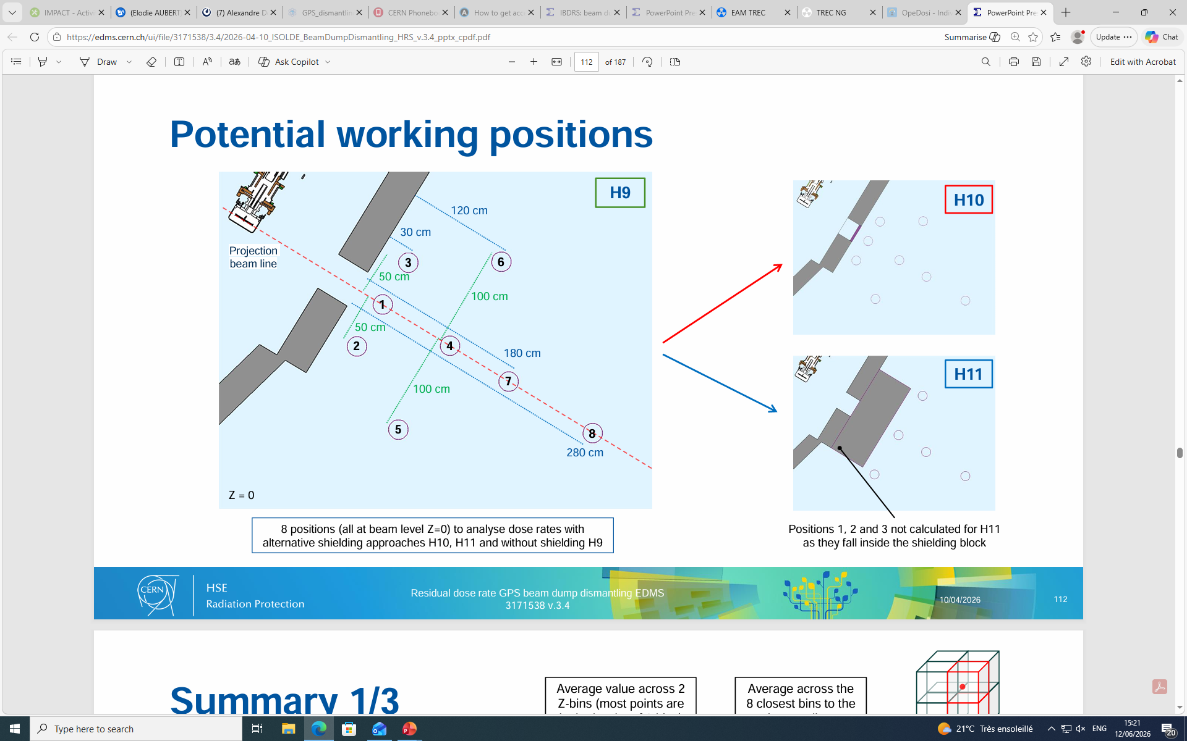
Benchmarking FLUKA against survey measurements
*Ratios are calculated as: FLUKA / measurement
All FLUKA uncertainties below 5 %
H9
Survey H2
Position ID | FLUKA [µSv/h] | Measurement [µSv/h] | Ratio*
1 | 1777 | 1350 | 1.32
2 | 950 | 810 | 1.17
3 | 938 | 770 | 1.22
4 | 438 | 350 | 1.25
5 | 245 | 197 | 1.24
6 | 246 | 200 | 1.23
7 | 274 | 208 | 1.32
8 | 154 | 115 | 1.34
260 cm
All measurements done at beam level height: 125 cm
Notes:
I find more interesting showing the final survey at HRS, it was performed after the complete removal of both the beam dump and the concrete shielding blocks.
We took measurements along the beam line at different distances from the beam entrance, as well as on both sides, always at beam height.
Comparing the in-situ measurements with the FLUKA results, we again observe very good agreement, with a slight overprediction of FLUKA.

Slide 15
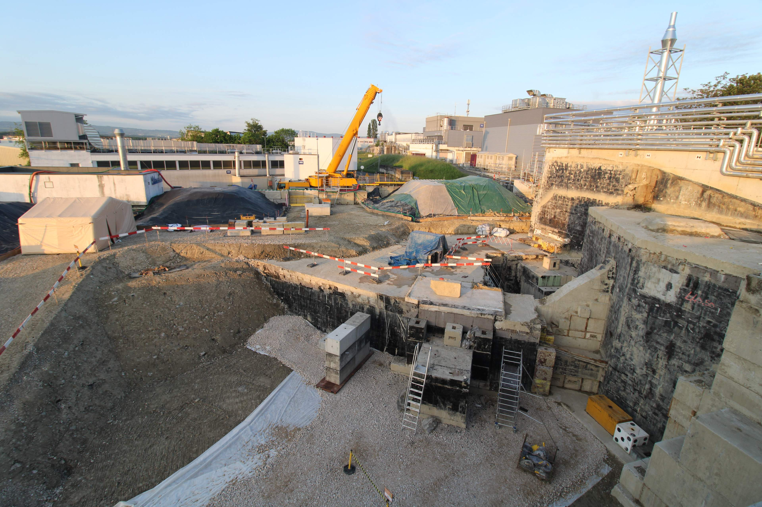
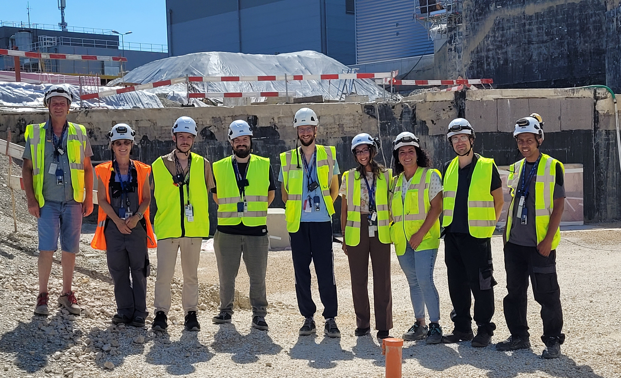
Conclusions
30/04/2026
25/09/2026
IBDRS project:
Working dose planning
Measurements
Challenges
Calculate residual dose rates
Benchmarking
Assess individual and collective dose
ALARA
IBDRS RP team
Minimise radiation exposure
Notes:
To conclude, we needed a working dose plan for the dismantling of the ISOLDE beam dumps.
As measurements were limited by accessibility to the area, we used FLUKA to estimate residual dose rates at different locations and throughout the dismantling process.
Whenever measurements were possible, we benchmarked the simulations against the experimental results, finding very good agreement overall.
These estimations were essential to assess individual and collective doses and to plan the work following the ALARA principle.
They helped us go safely from this initial situation to the final dismantled configuration.
Finally, I'd like to thank the entire IBDRS radiation protection team for their contribution. And to all of you for your attention.

Slide 16
Back-up slides

Slide 17
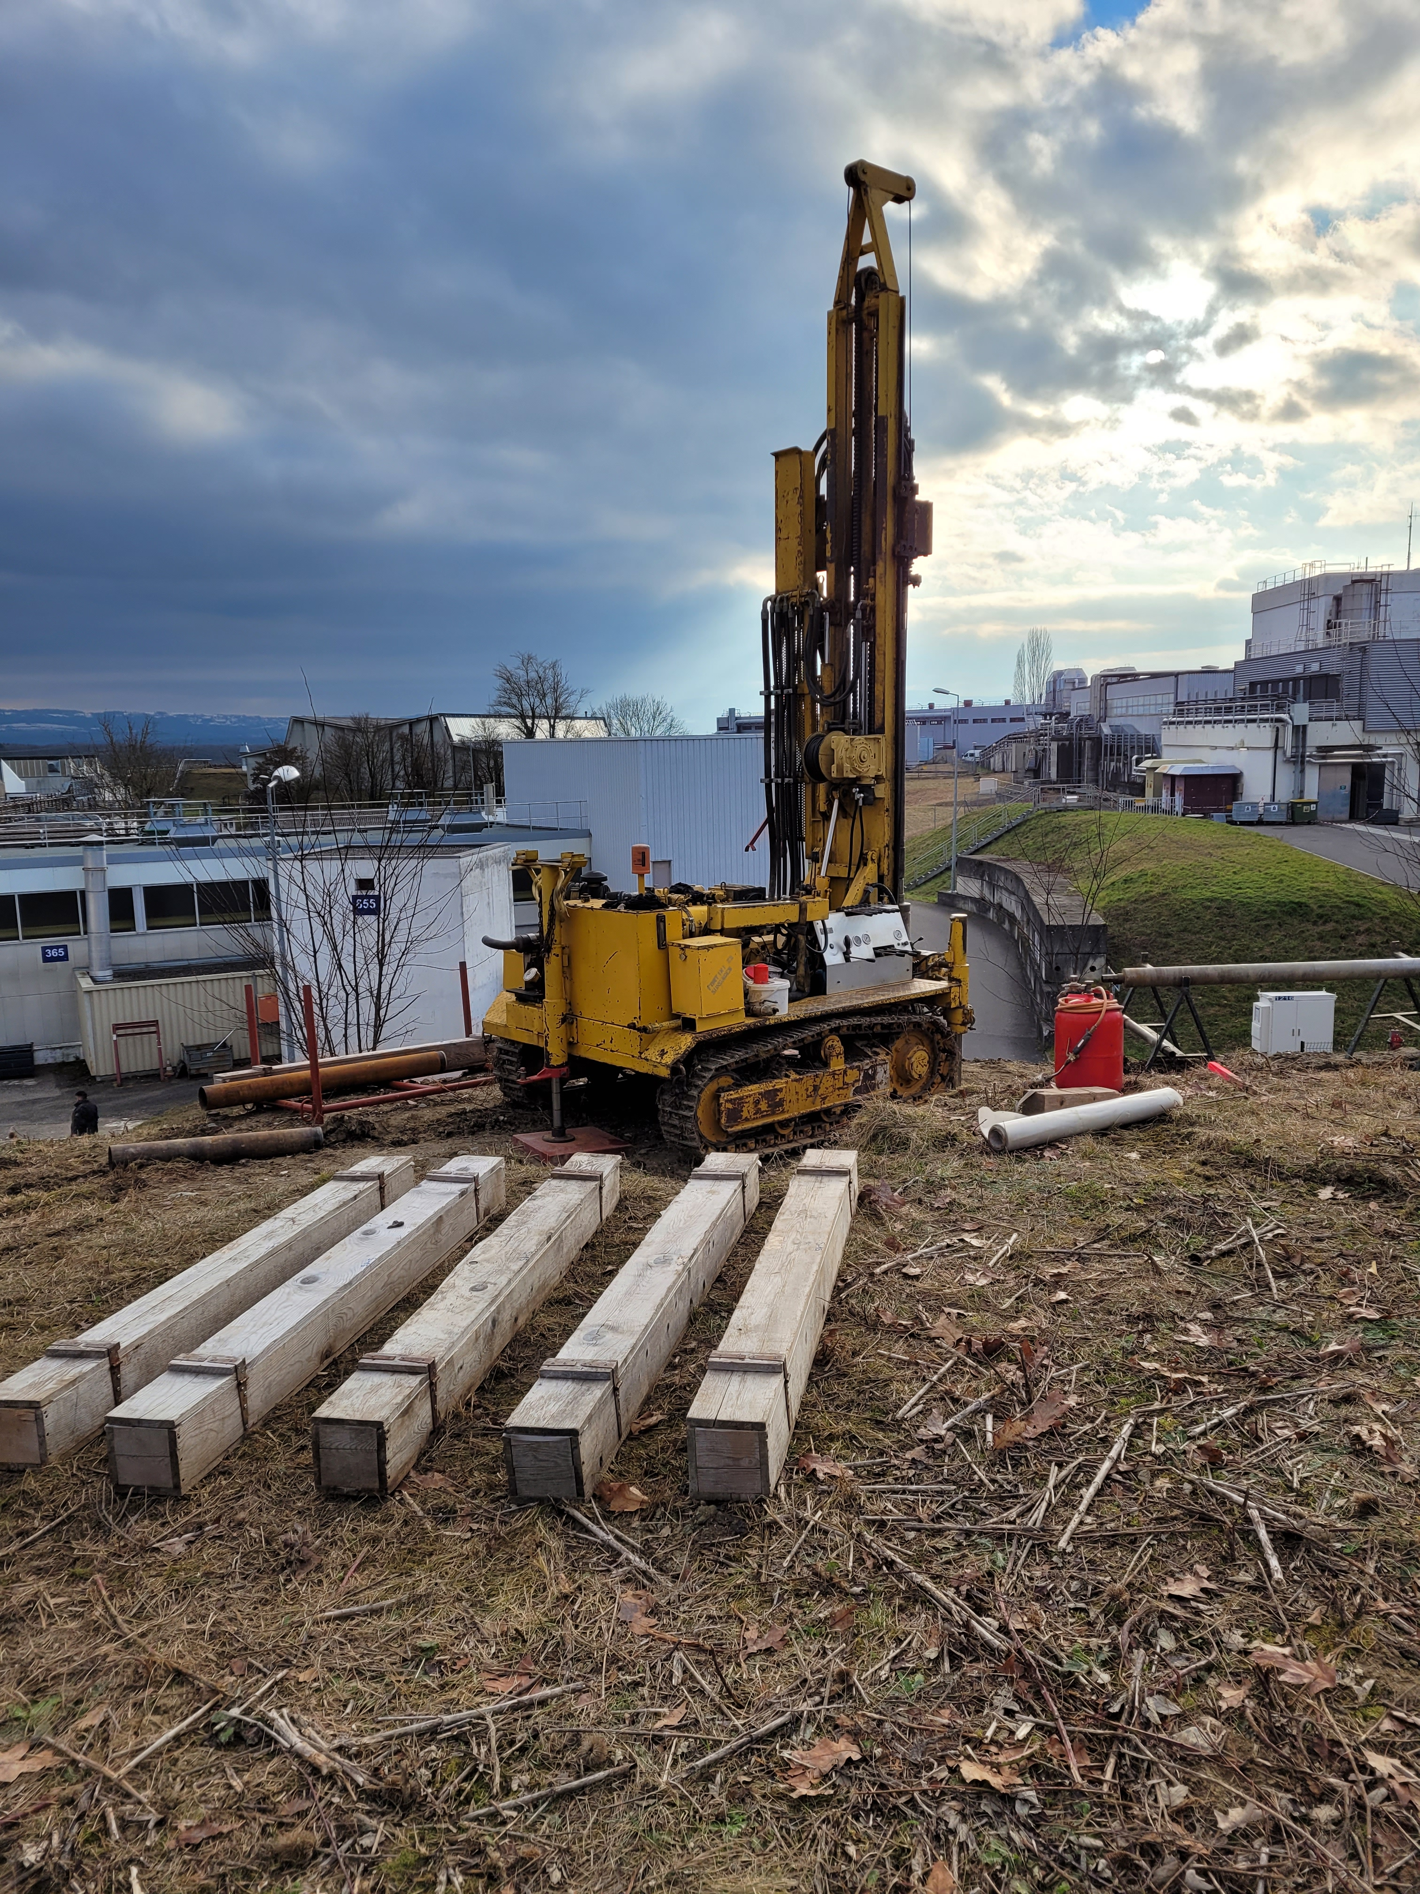
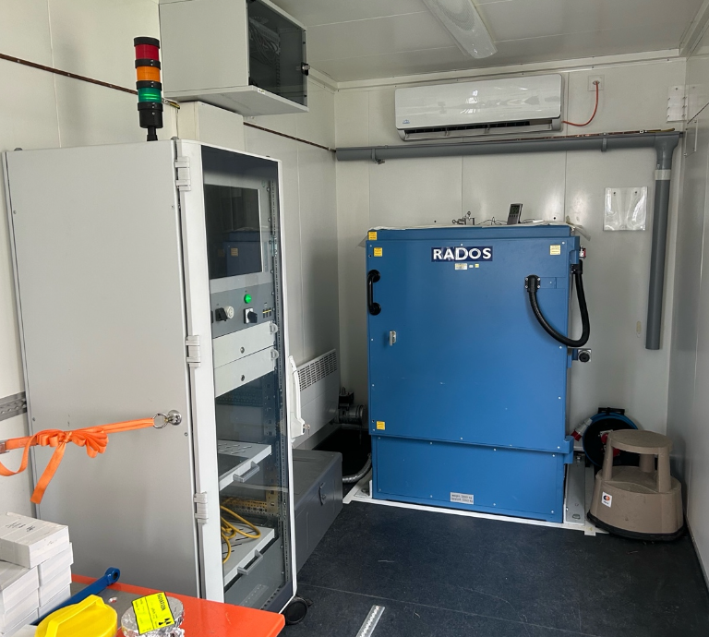
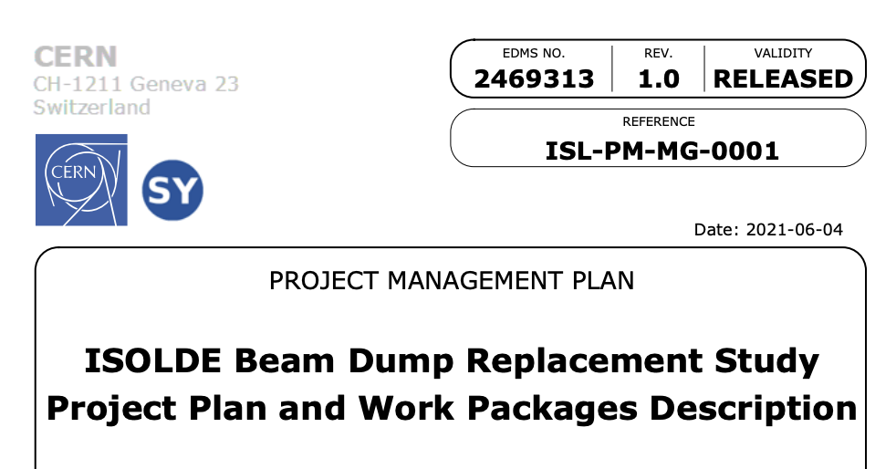
IBDRS project
Soil core drilling
Characterisation of RADOS for soil measurements
Simulations of soil activation levels (FLUKA)
Study of shielded
containers for transport (FLUKA)
2021
2024
2025
Project approved (June 2024)
Radionuclide inventory and dose rate (FLUKA)
Launch of the study phase
Dose rate measurements in proximity of the beam dumps and comparison with FLUKA

Slide 18
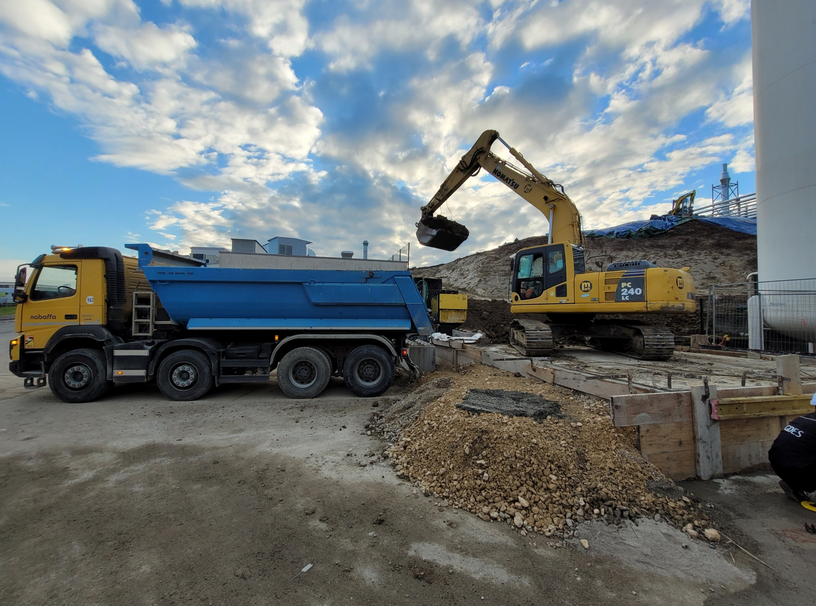
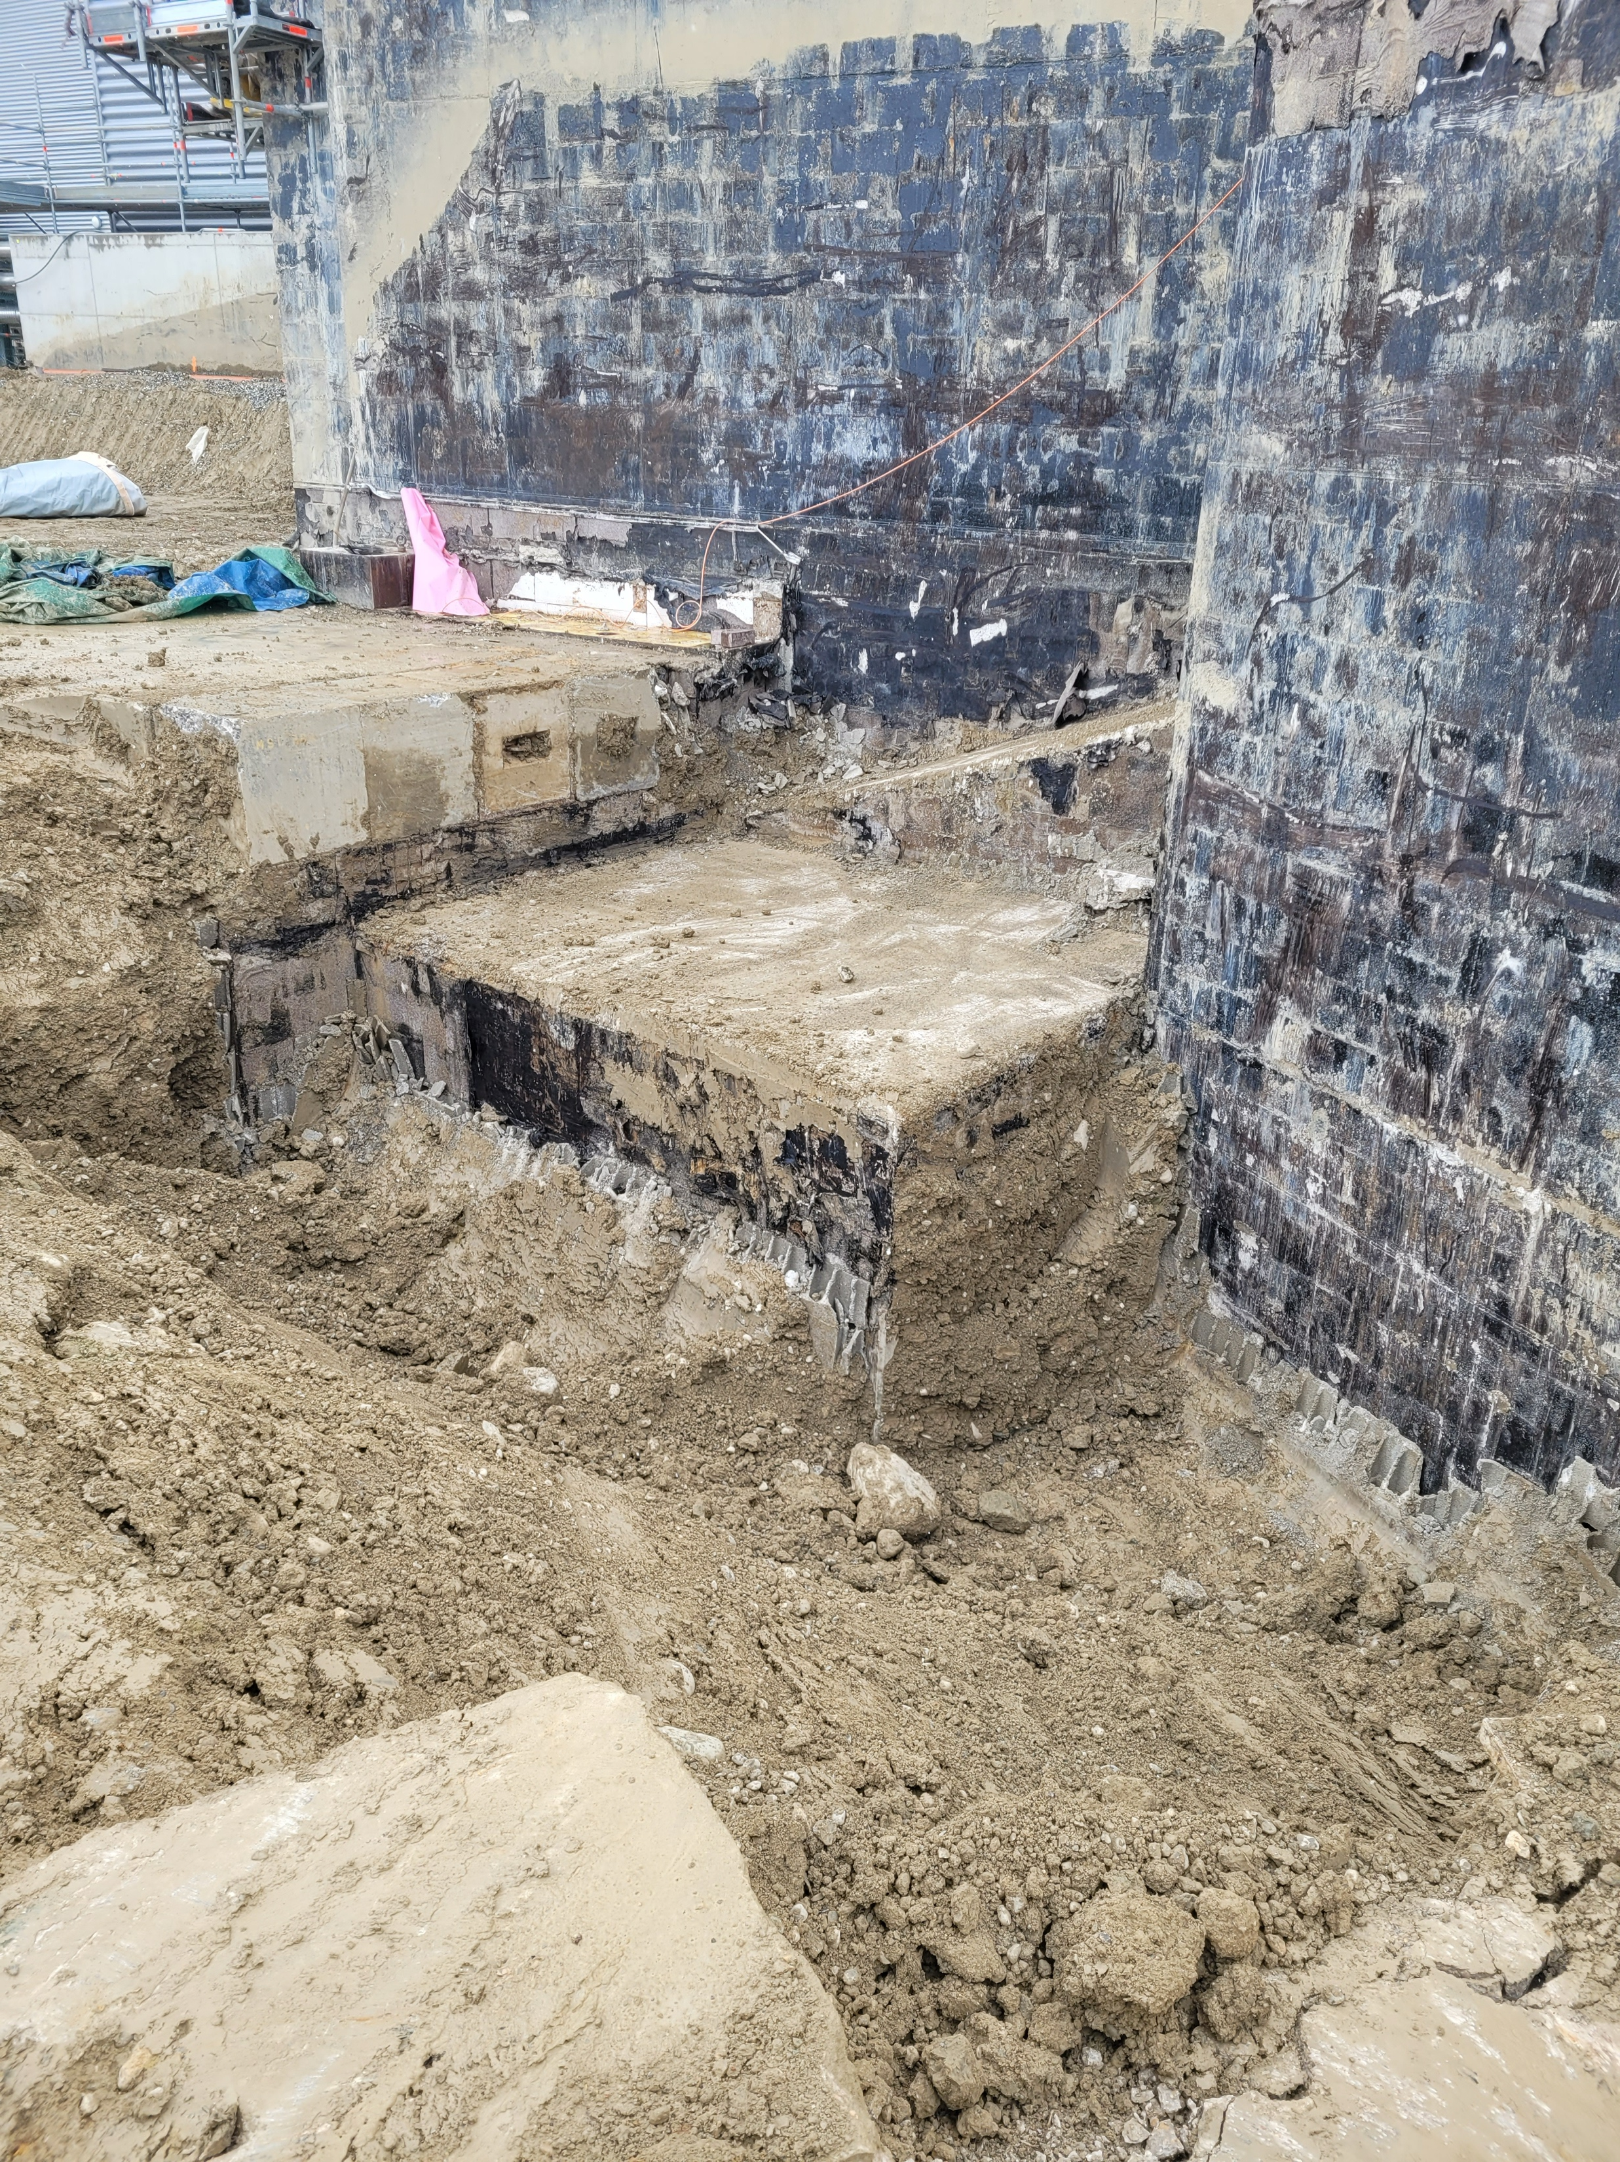
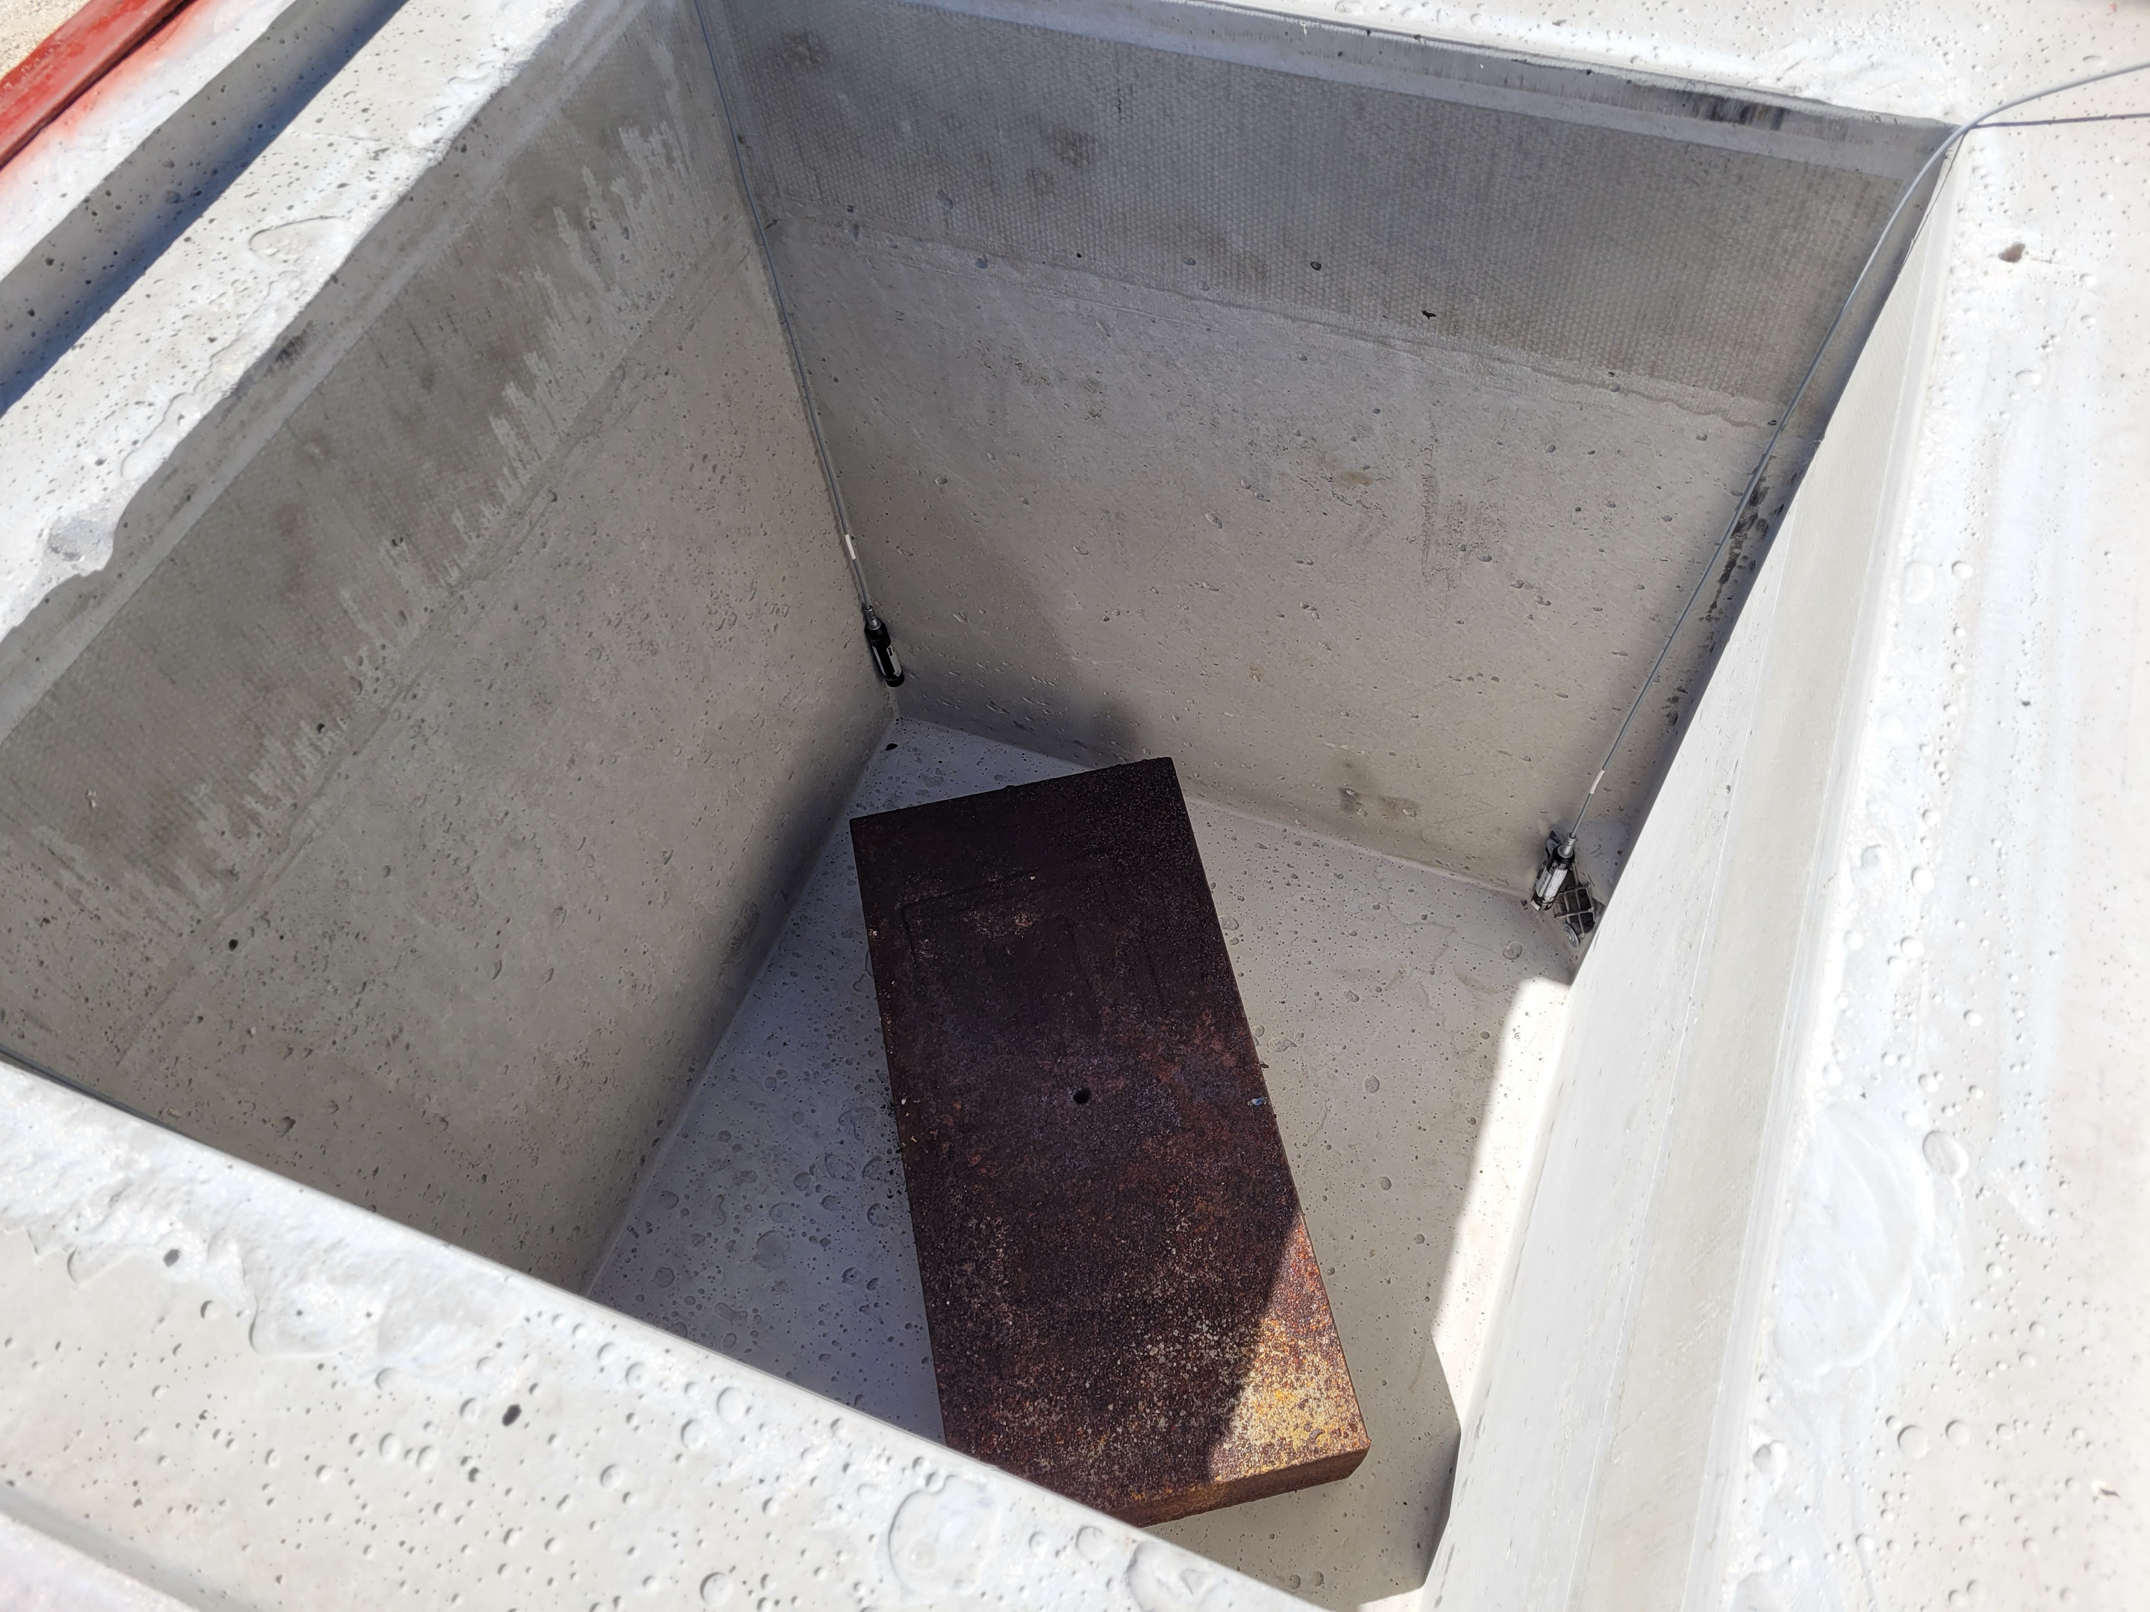
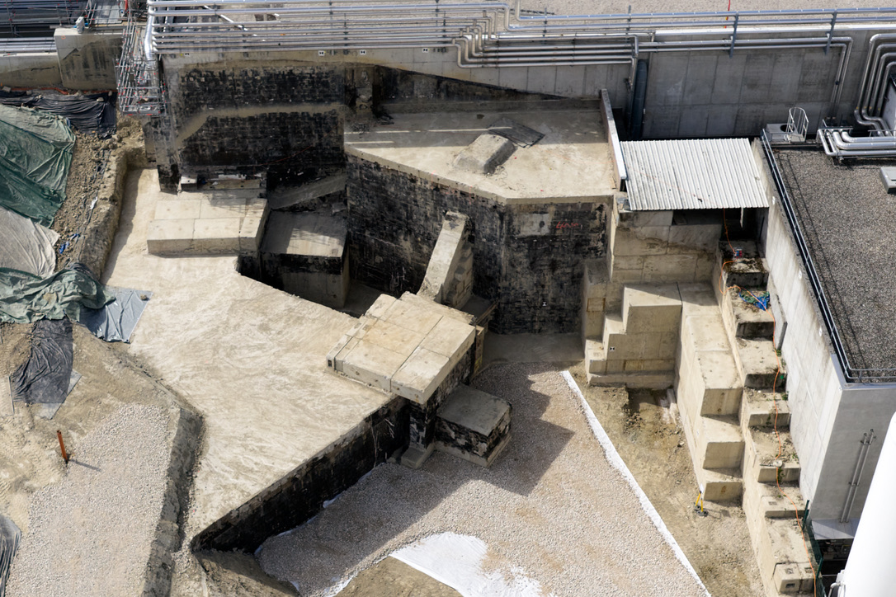
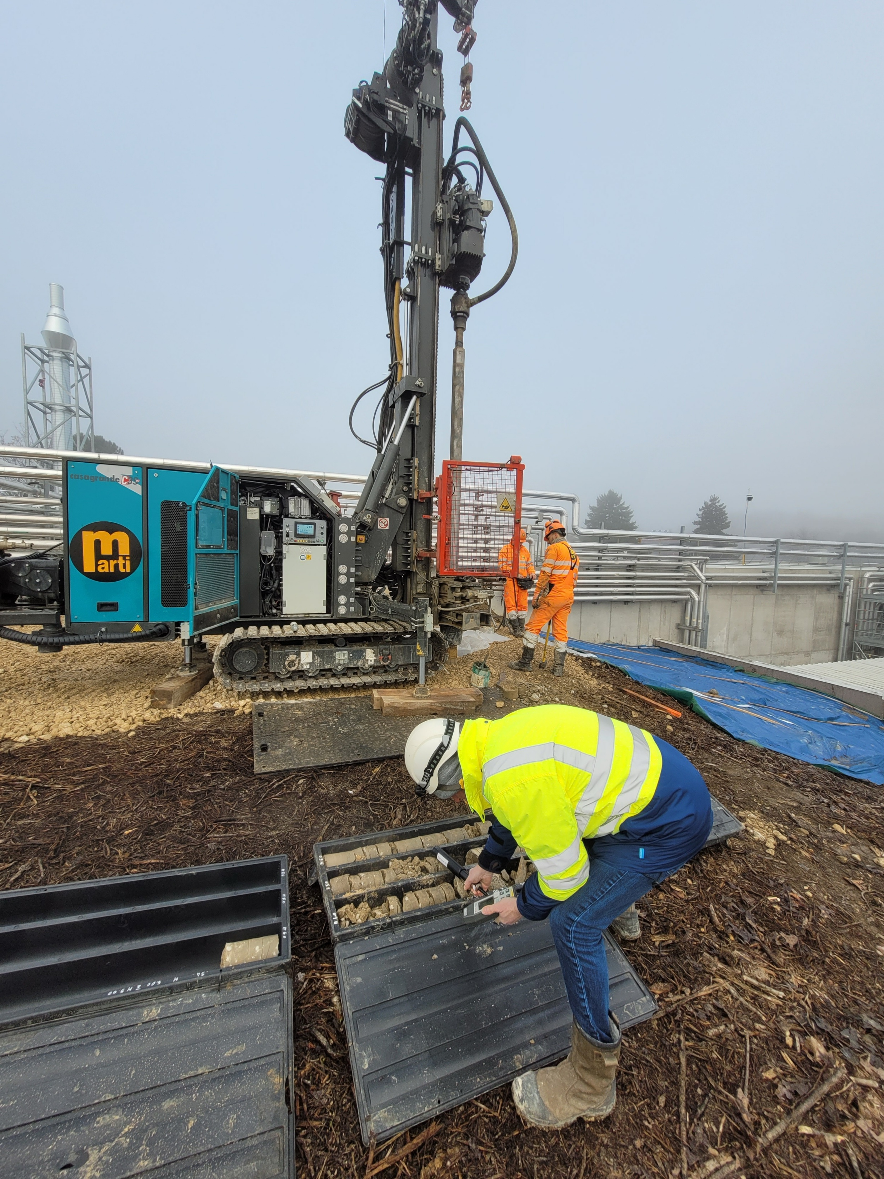
IBDRS project
Excavation and transport of non-radioactive soil
Excavation of radioactive soil
HRS beam dump safely removed and stored
GPS beam dump removal completed
01/2026
02/2026
03/2026
04/2026
05/2026
06/2026
07/2026
Core drilling
Soil excavation completed
HRS beam dump removal completed

Slide 19
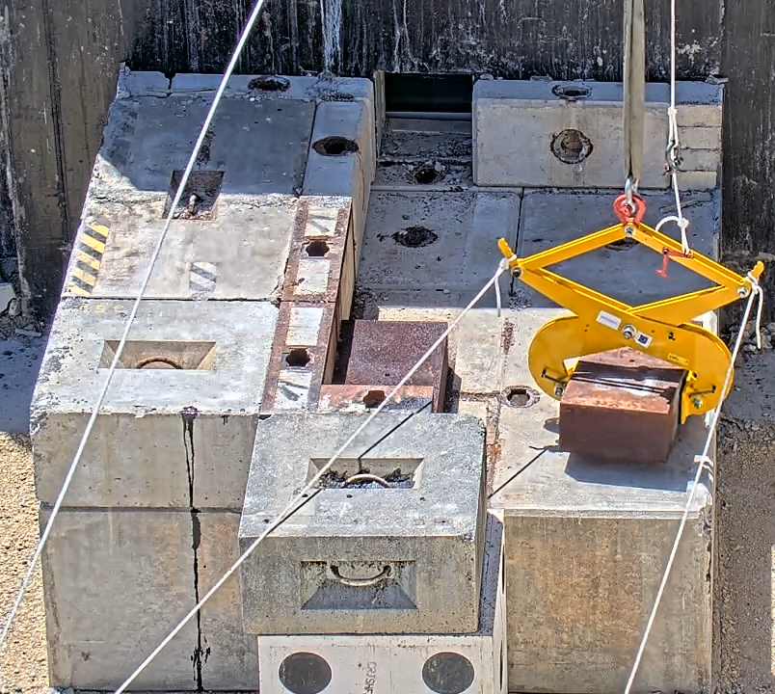
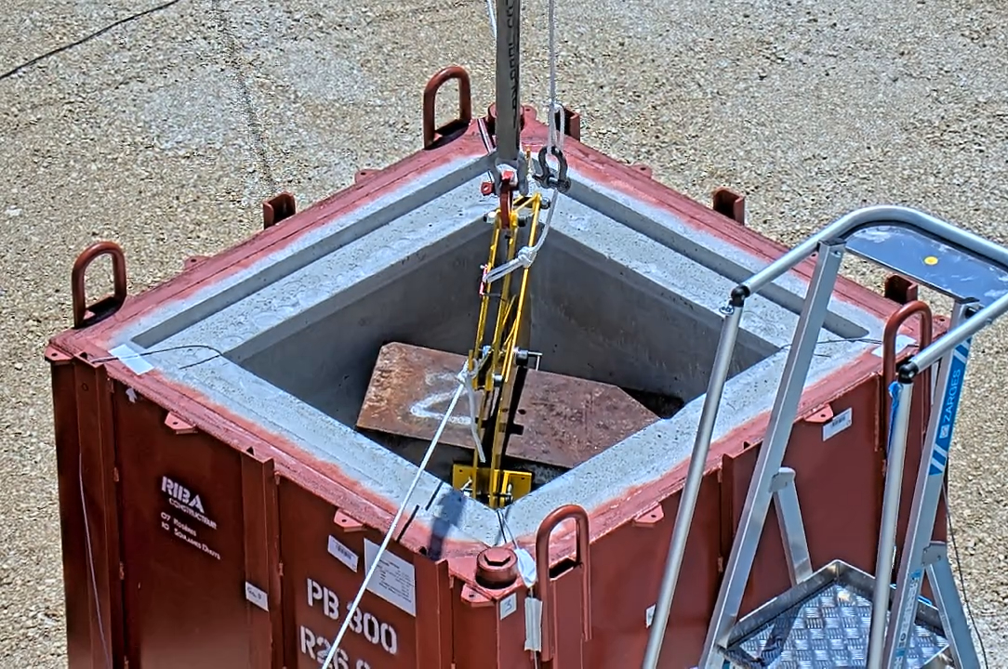
IBDRS project: HRS dismantling
05/2026
06/2026
~900 mSv/h in contact
Soil excavation completed
HRS beam dump and
shielding completed
Notes:
After the soil was removed, the HRS beam dump and shielding was dismantled block by block with a crane, taking special attention to the storage of the most activated blocks, the iron beam dumps.
The HRS beam dump and shielding were then dismantled block by block with a crane. The most activated components, including the iron beam dumps, were handled with special care and stored in dedicated containers, as shown in the photo.

Slide 20
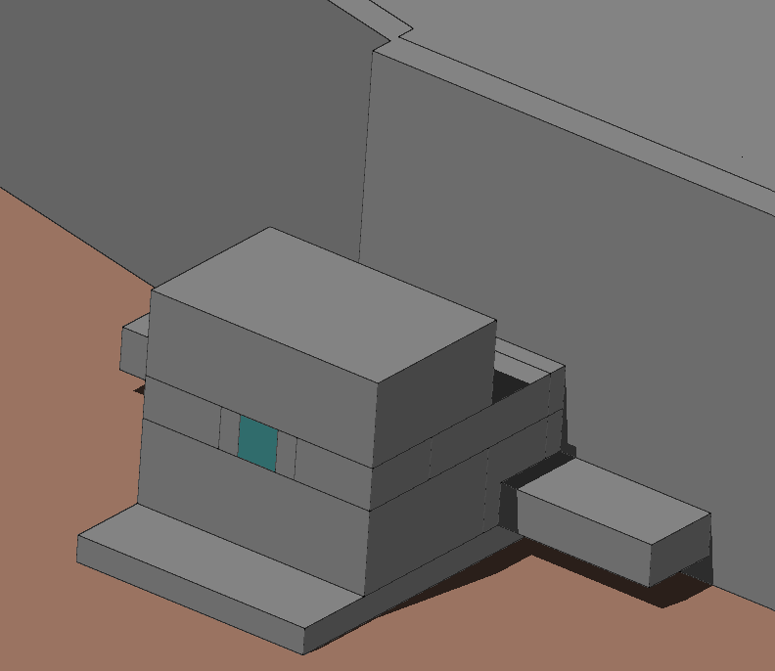


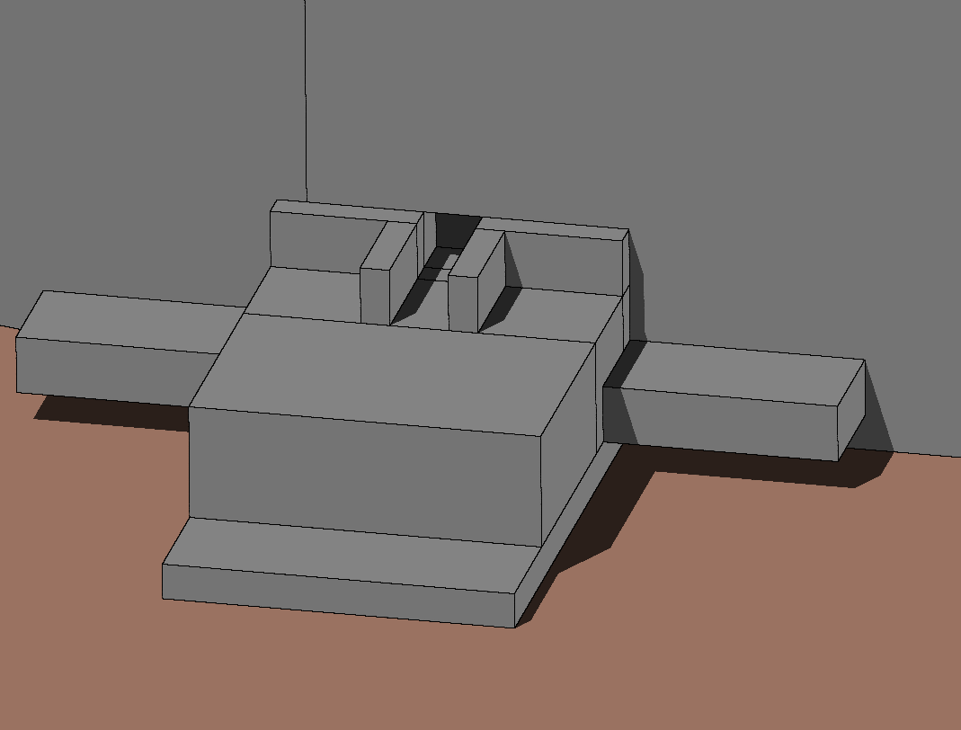
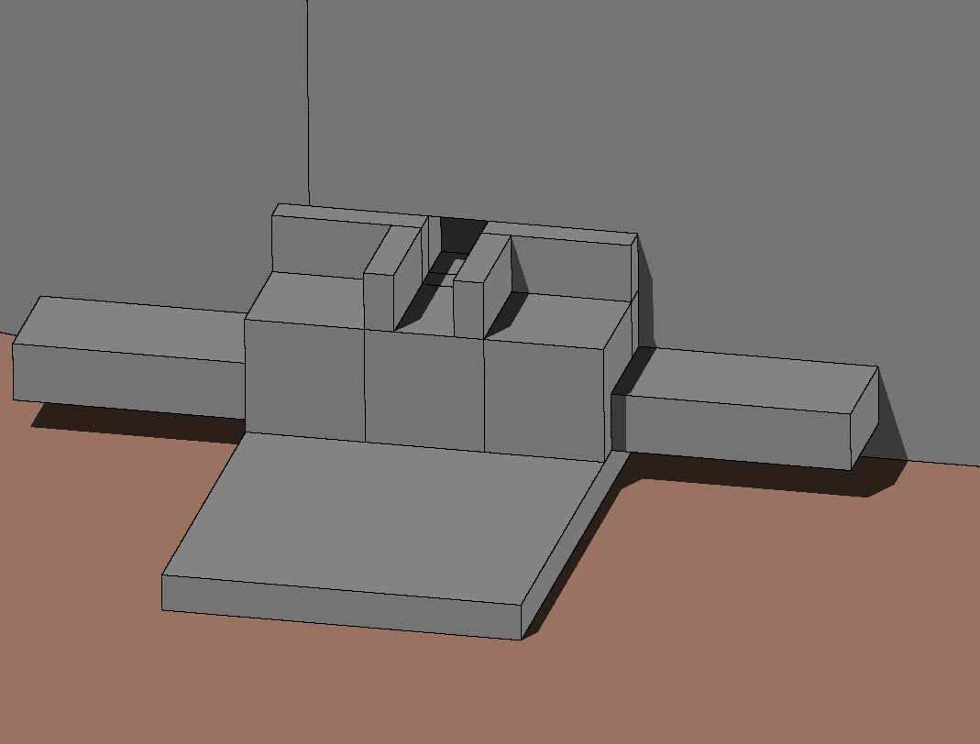
FLUKA modelling: HRS
H1
H2
H3
H4
H5
+ ine
H6
H7
H8
H9

Slide 21
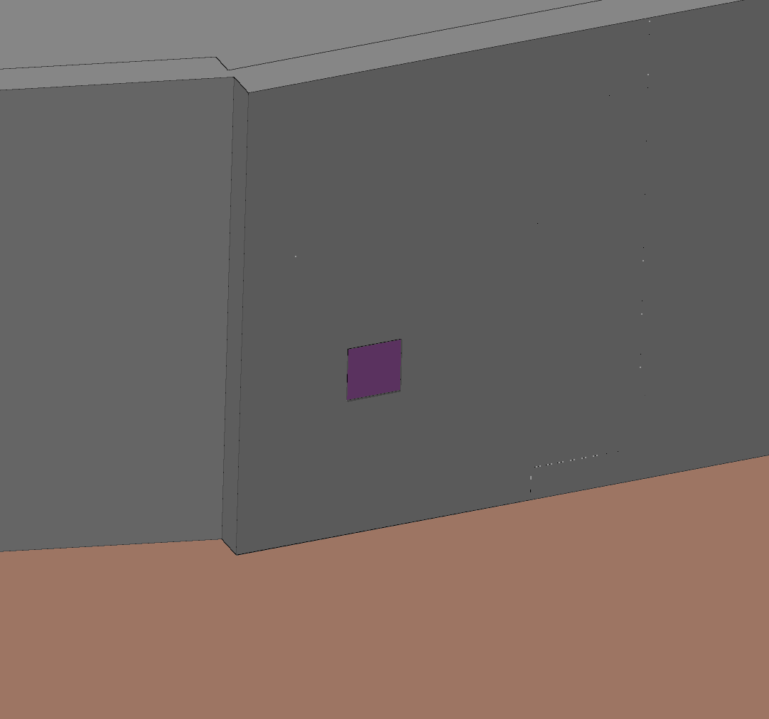
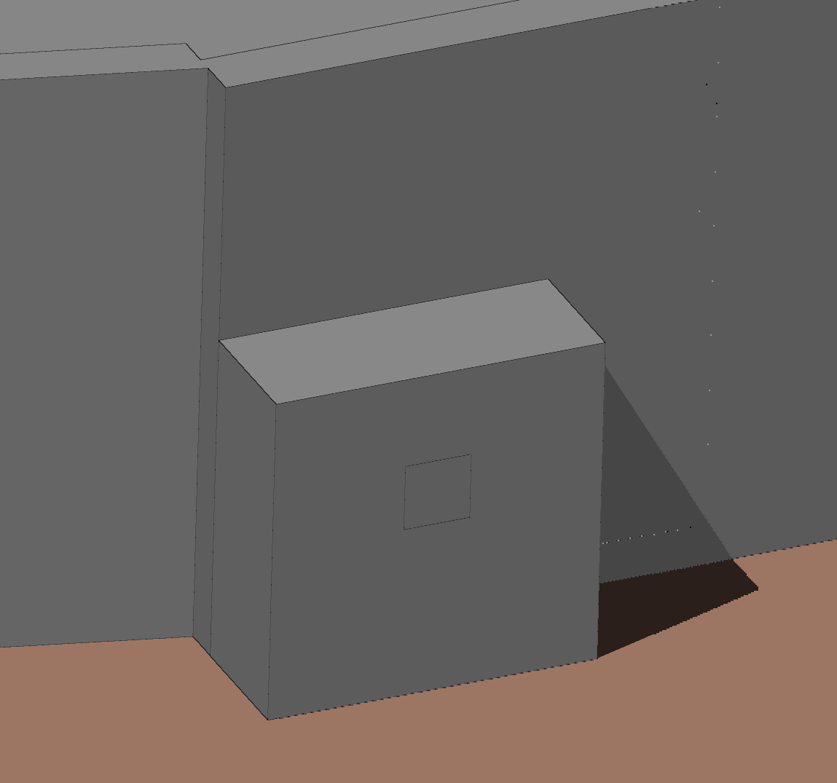
FLUKA modelling: HRS
H10: Lead block in beam window
H9
H11: Thick concrete block downstream beam window

Slide 22
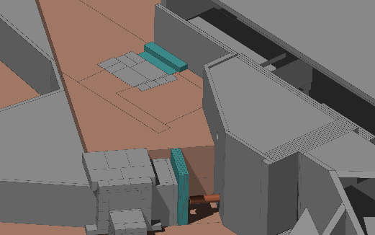
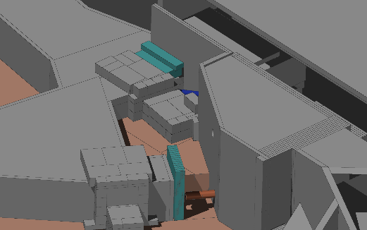
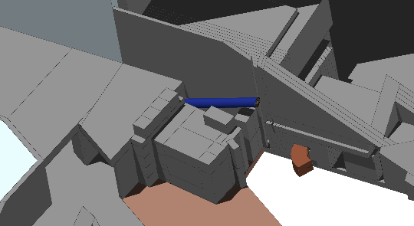
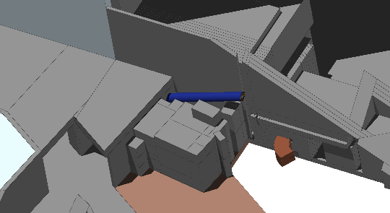

FLUKA modelling: GPS
G1
G2
G3
G4
G5
G6

Slide 23





FLUKA modelling: GPS
G7
G8
G9
G10
G11
G12

Slide 24


FLUKA modelling: GPS
G13
G14
G15

Slide 25



HRS: residual dose rate
Projection line
Cool-down times comparison

Slide 26

HRS: residual dose rate
Cool-down times comparison
Projection line

Slide 27




HRS: residual dose rate
Projection line
Configurations comparison
H9: Concrete removed
H4: Concrete removed
H1
H6: Beam dump removed
H4
H6
H9

Slide 28


HRS: residual dose rate
H5
Uncertainty analysis
271 cycles (12 hours per cycle) = 82,951,978 primaries

Slide 29
Benchmarking FLUKA against survey measurements
Survey H1
H1

Slide 30

Benchmarking FLUKA against survey measurements
*Ratios are calculated as: FLUKA / measurement
**Distances from indicated wall
Beam dump left 4
Distance | 40 cm
FLUKA | 62 µSv/h
Measurement | 50 µSv/h
Ratio | 1.24
Survey G1
Beam dump roof
Distance | Centred
*Height | Roof + 40 cm
FLUKA | 2 µSv/h
Measurement | 1 µSv/h
Ratio | 2.00
Beam dump rear
Distance | 40 cm
FLUKA | 0.66 µSv/h
Measurement | 0.9-1 µSv/h
Ratio | 0.69
Beam dump left 1
Distance | 40 cm
FLUKA | 97 µSv/h
Measurement | 80 µSv/h
Ratio | 1.22
Beam dump left 2
Distance | 40 cm
FLUKA | 68 µSv/h
Measurement | 57-65 µSv/h
Ratio | 1.11
Beam dump left 3
Distance | 40 cm
FLUKA | 11 µSv/h
Measurement | 5 µSv/h
Ratio | 2.20
All* measurements done at beam level height: 125 cm

