Slide 1
Tritium Production and Release in Particle Accelerator Environments
From Calculations to Experiments
21 October 2026
Dali Georgobiani
Fermi National Accelerator Laboratory
17th Workshop on Shielding Aspects of Accelerators, Targets, and Irradiation Facilities (SATIF-17)
IBS Science Culture Center, Daejeon, Korea
October 20 – 22, 2026

Slide 2
Outline
Introduction
Planned tritium diffusion experiment
Radiation transport model setup
Residual dose and tritium production calculations
with FLUKA.CERN and PHITS
Tritium diffusion estimates
Summary

Slide 3
Collaborators
Local “Tritium Team” members (FNAL):
Will Asztalos (IIT/FNAL), Alajos Makovec, Nisarg Patel,
Quinn Peterson, Don Athula Wickremasinghe
  Athula proposed the tritium diffusion experiment!
Colleagues from other facilities:
FRIB: Tom Ginter, Juan Zamora
ORNL: Yong Joong Lee, Vitaly Pronskikh
  We plan to carry out similar experiments at FRIB and ORNL and possibly other facilities

Slide 4
Tritium Diffusion Experiment Concept
Target module: target surrounded by material samples
  Common materials used in accelerator environments
Irradiate the target at MTA (MeV Test Area) at FNAL
→ Tritium produced in the samples by secondaries
After the beam is off, remove the samples from the module and submerge them in water so that tritium would be diffused from a sample into water
Collect tritiated water and send it to the local LSC experts
to measure tritium content
→ Can estimate diffusion coefficients in various materials

Slide 5
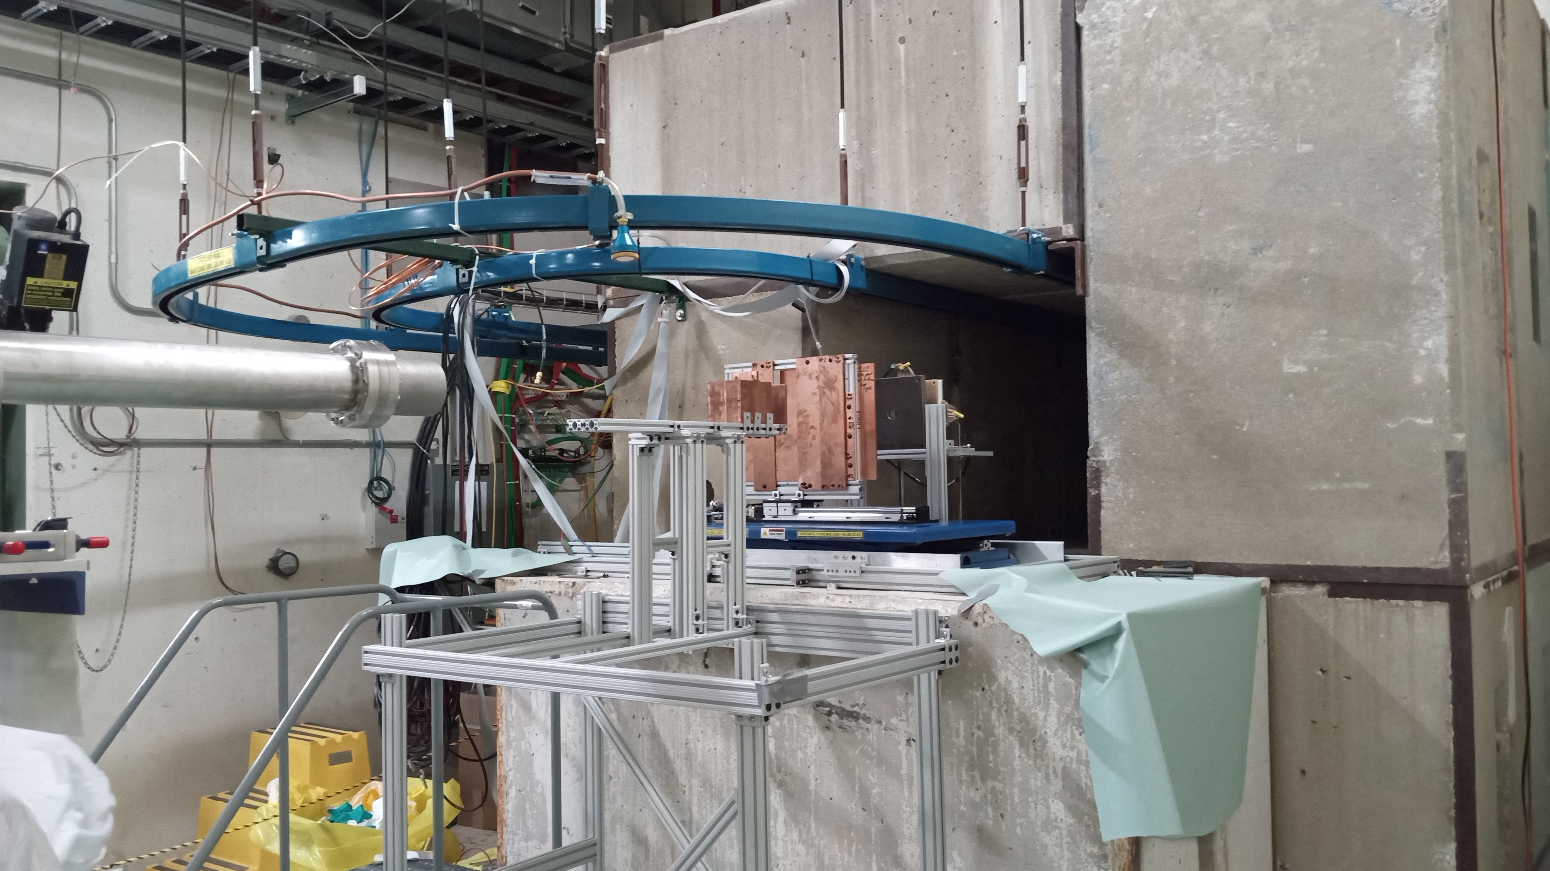
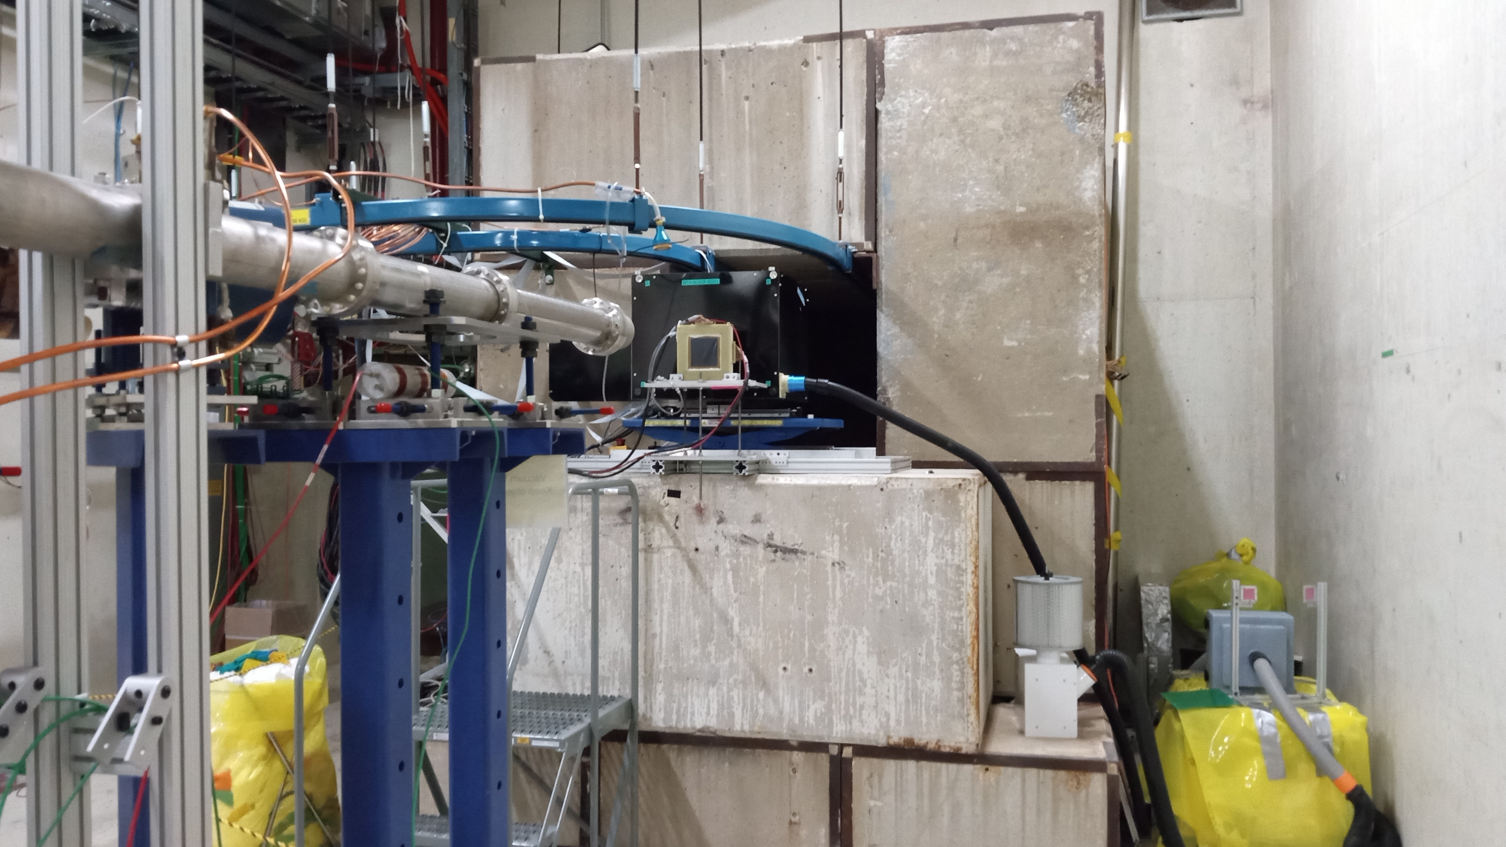
Facility at Fermilab
MTA (MeV Test Area): beamline enclosure
hosting ITA (Irradiation Test Area), a high
energy beam facility devoted to studying
the effects of radiation on components
and materials.
The ITA provides experimental space
and infrastructure at the end of the
400 MeV (up to 7.5e11 pps approved)
MTA beamline in which users can place
components and materials to study
the effects of radiation for future
experiments and fabrication.
Photos courtesy of Matt Strait (FNAL)

Slide 6
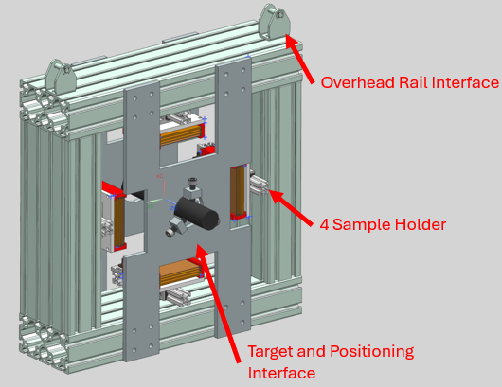
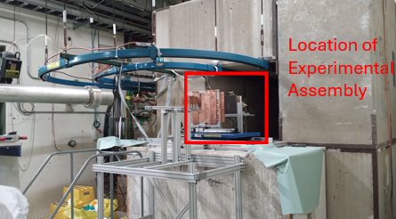
Experimental Setup: Irradiation in ITA
Courtesy of Quinn Peterson
Target module details
  Graphite target (6 cm Ø, 40 cm long; density 1.8 g/cc)
  16 samples: Cu, SS316, Al6061, A36; 10 × 10 cm, 1–4 mm thick
  4 sample holders, 13.5 cm from target, one material per side
Experimental assembly
  560 × 560 × 160 mm frame on lift table, interfaces with ITA
  Beam alignment with film + alignment group: ±0.5–1 mm
  3D-printed holders on rails; latch allows remote removal
Requirements
  Uniform water layer on all sample surfaces, constant temperature
  ≥ 10 mL of water, kept small to maximize tritium concentration

Slide 7
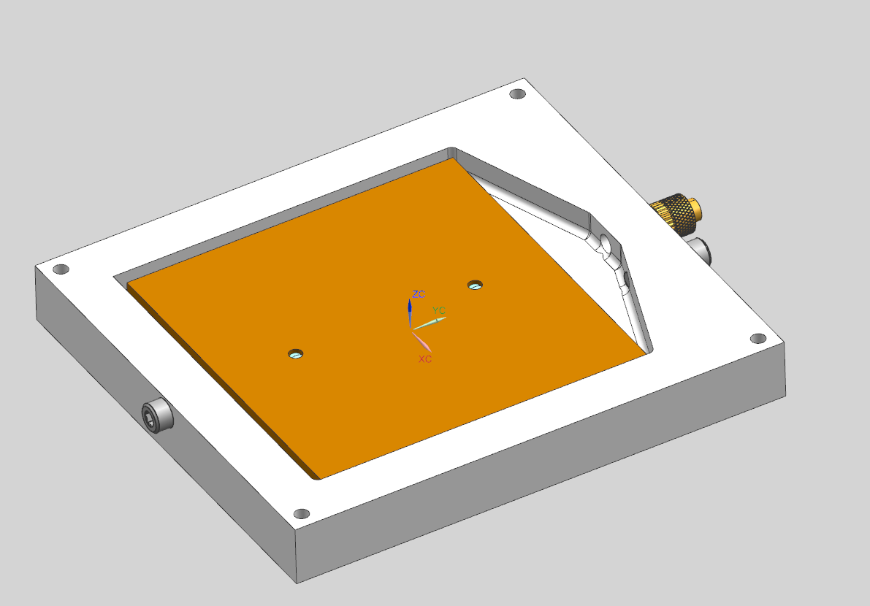
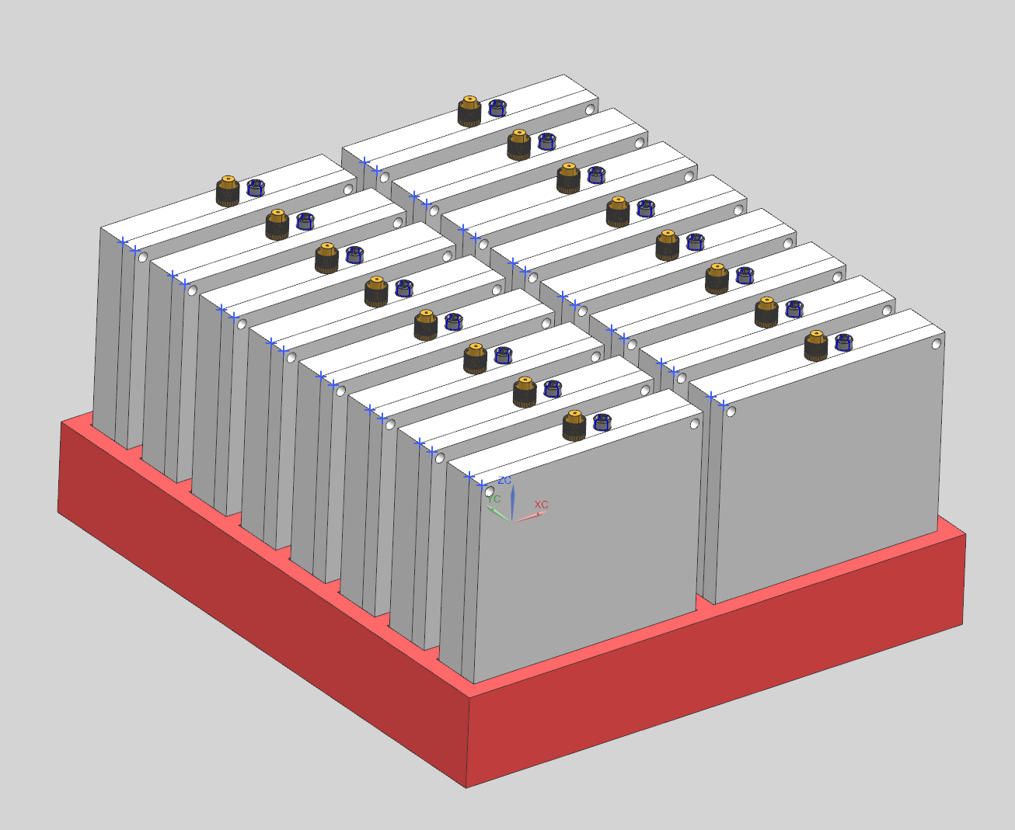
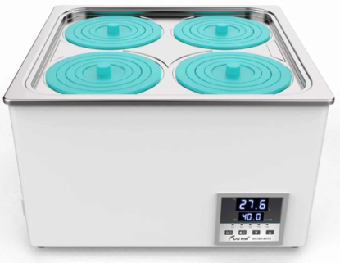
Sample Retrieval and Diffusion Procedure
Courtesy of Quinn Peterson
Dose constraints from radiation analysis
  ITA limit: 10 mrem/h at 30 cm (50 mrem/h with approval)
  1 h after beam off: module ~500 mrem/h, single sample <10 mrem/h
Retrieval (no room for extra shielding in ITA)
  Sample holders pulled out with long-arm tooling
  Assembly pushed ~3 m into ITA cave on overhead rail to cool down
Diffusion
  One SS316 container per sample, all surfaces in water
  Water injected by syringe (Luer lock) for precise volume
  16 containers in indexed array in temperature-controlled tank
SS316 diffusion container
Container array
Temperature-controlled tank
Irradiate in ITA
Remove samples
Fill containers
Diffuse at constant T
LSC measurement

Slide 8
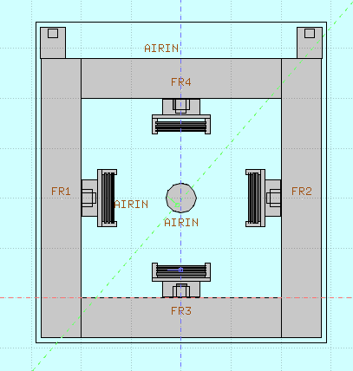
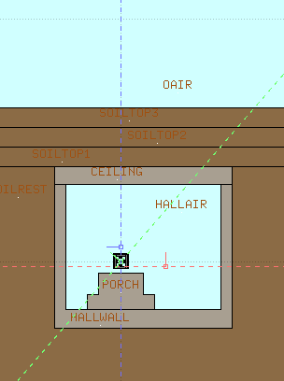
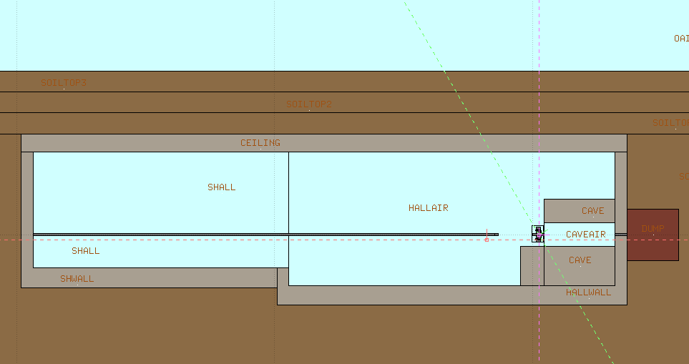
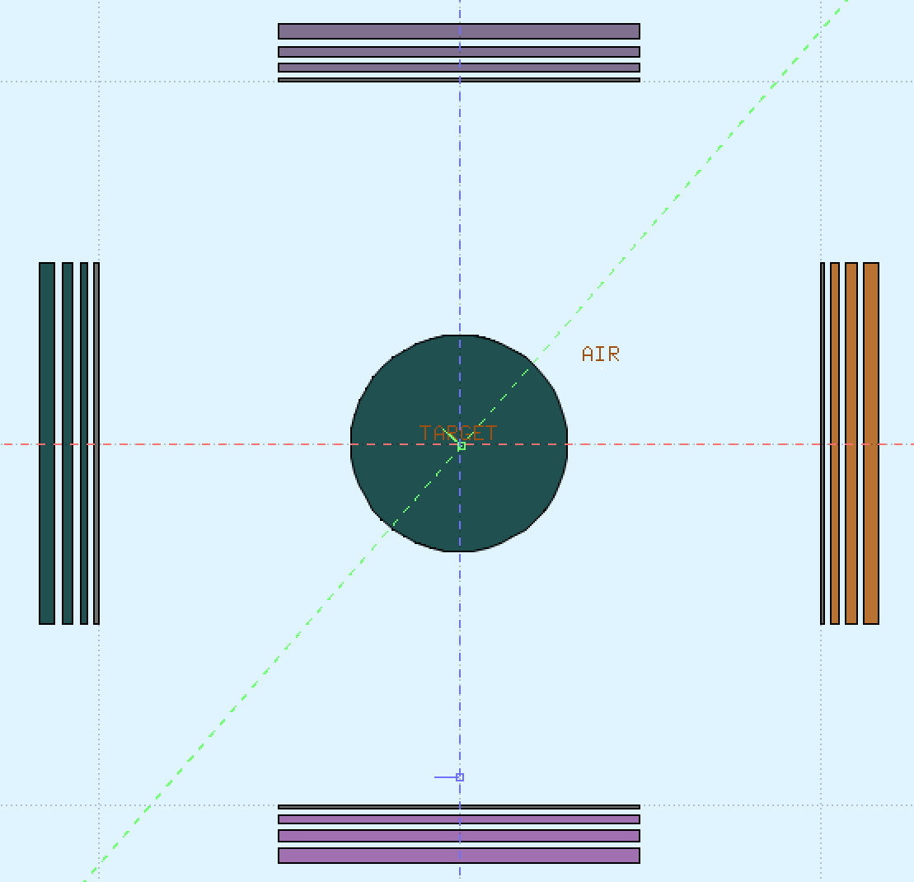
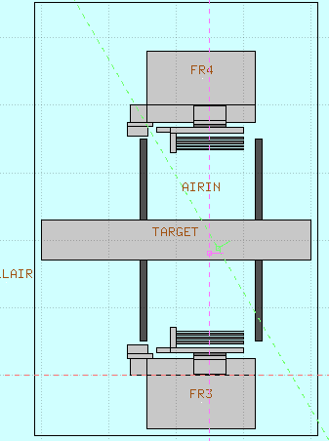
FLUKA Model Details
Target module is placed in the
beamline in the MTA enclosure
Calculations are performed with FLUKA.CERN and PHITS
Module containing target & samples
SS316
MTA enclosure model
13.5 cm
Cu
Graphite
13.5 cm
Al6061
A36

Slide 9
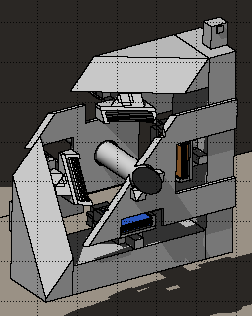
Radiation Analysis Input & Output
  Beam parameters
    400 MeV protons, 7.5e11 pps, 𝜎_{x} = 𝜎_{y} = 1 cm
  Addressing a possible rad safety issue
    To avoid contamination with irradiated powder,
    graphite target will be wrapped in 3MTM Aluminum
    Foil Tape 425 (included in the FLUKA model)
  Calculate tritium production and material activation
    Optimize for maximum tritium production and minimum activation
    Samples: minimize volume, maximize surface area (to facilitate diffusion)

Slide 10
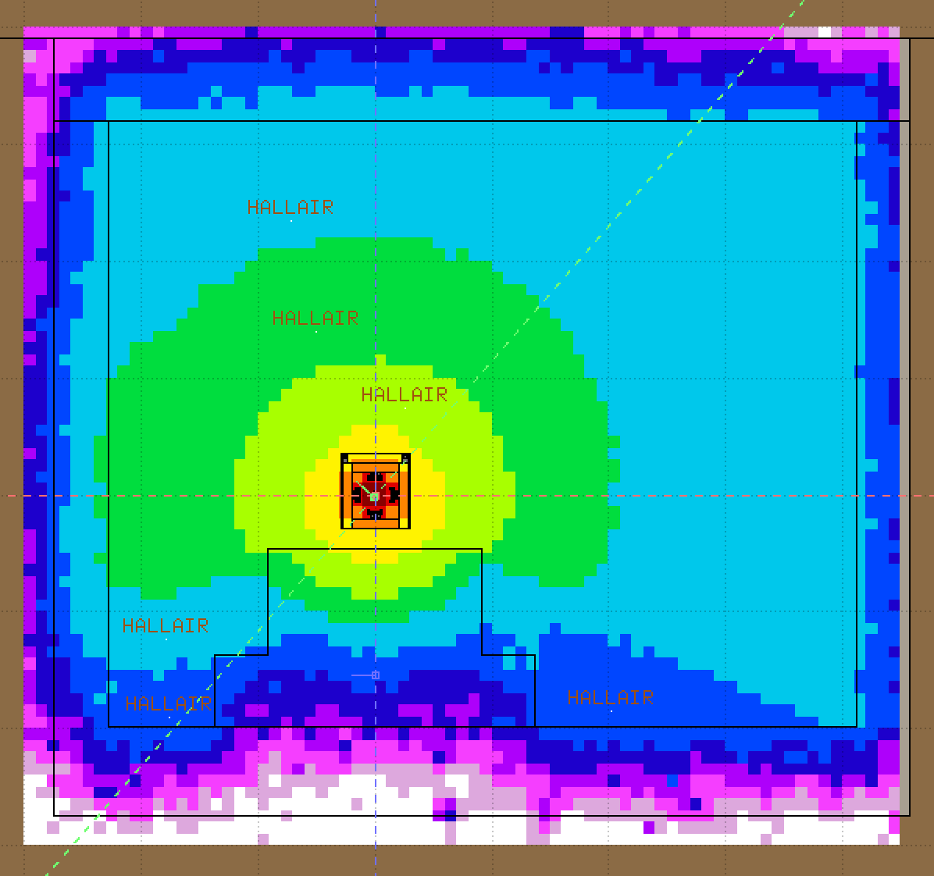
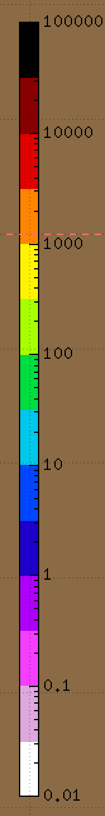
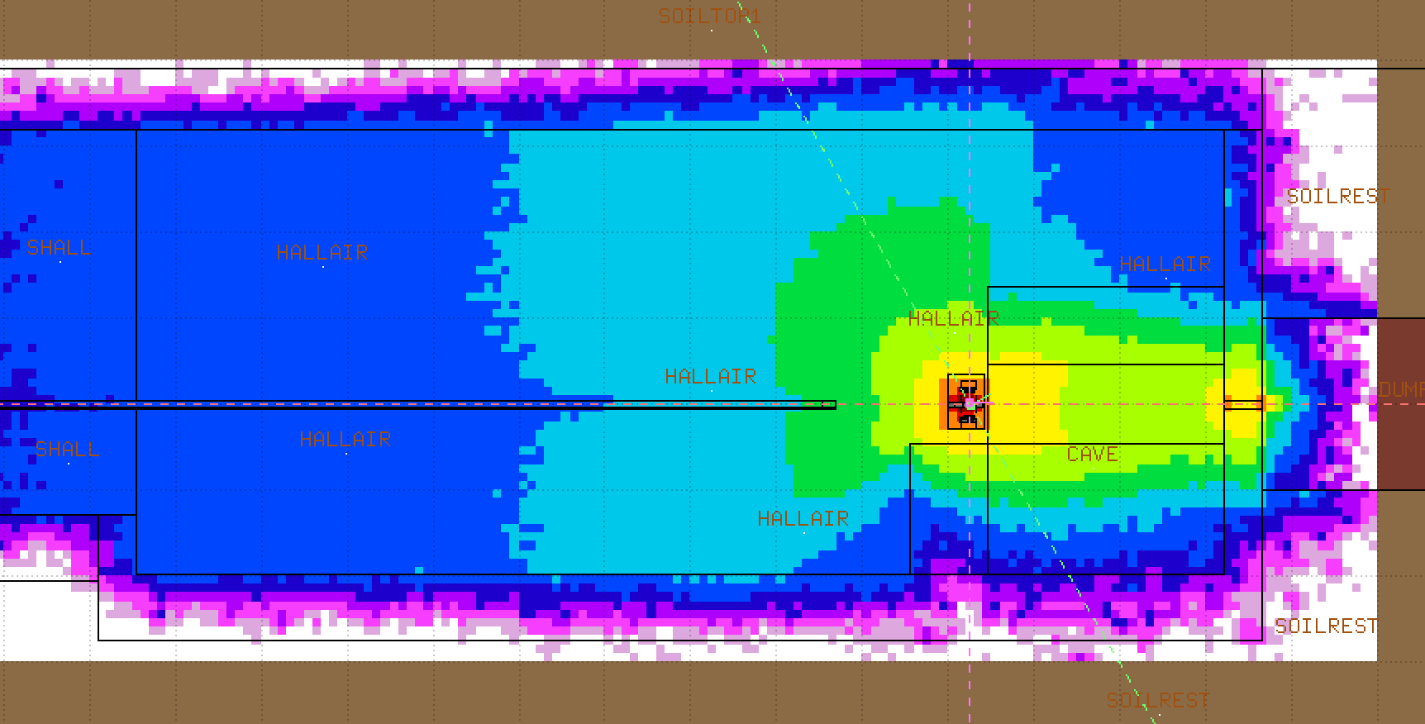
Residual Dose Maps
Cross section
-230 to 400 cm
Irradiation 1 week, cooling 1 hour
Mesh parameters are:
x = -300 to 450 cm; y = -300 to 400 cm; z = -2000 to 500 cm
dx = dy = dz = 10 cm
-500 cm
-100 cm to 80 cm
Vertical view
Numbers in mrem/h

Slide 11
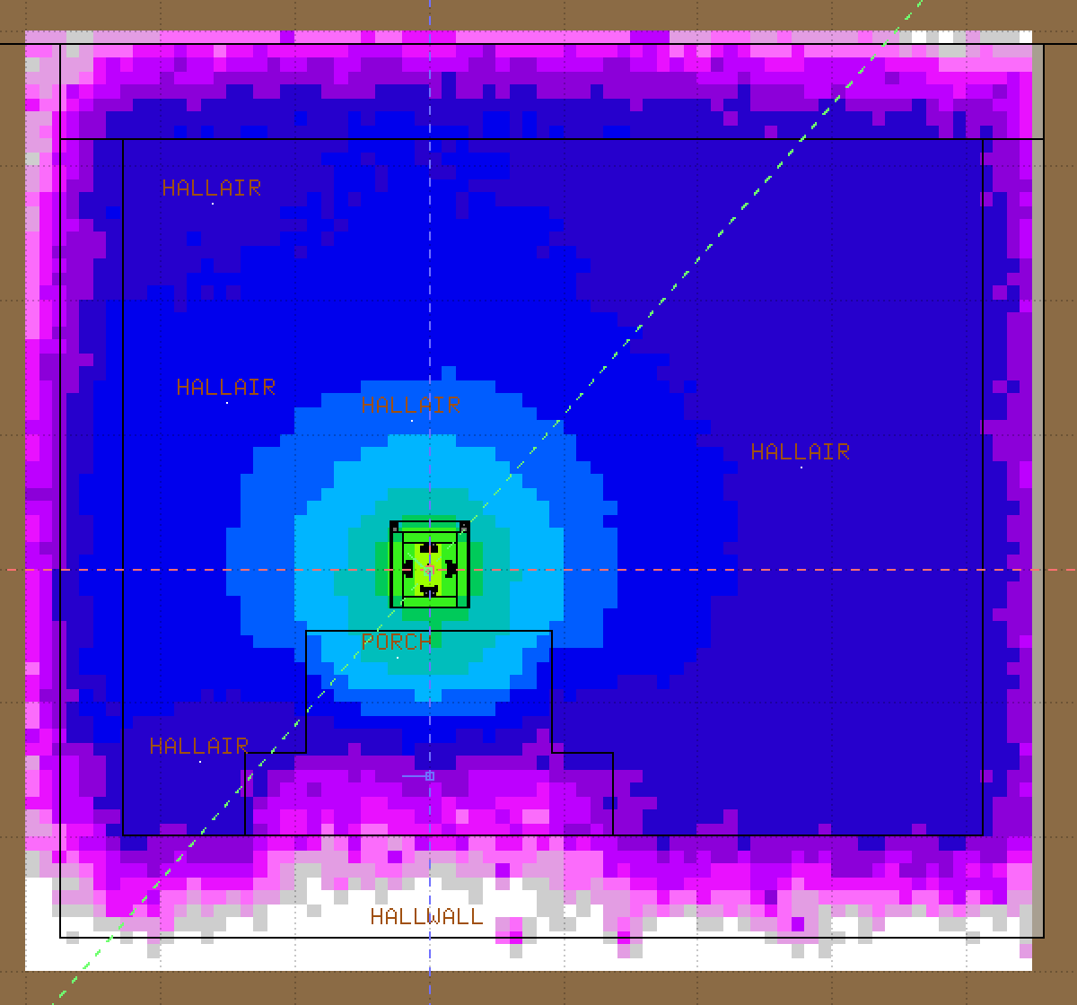
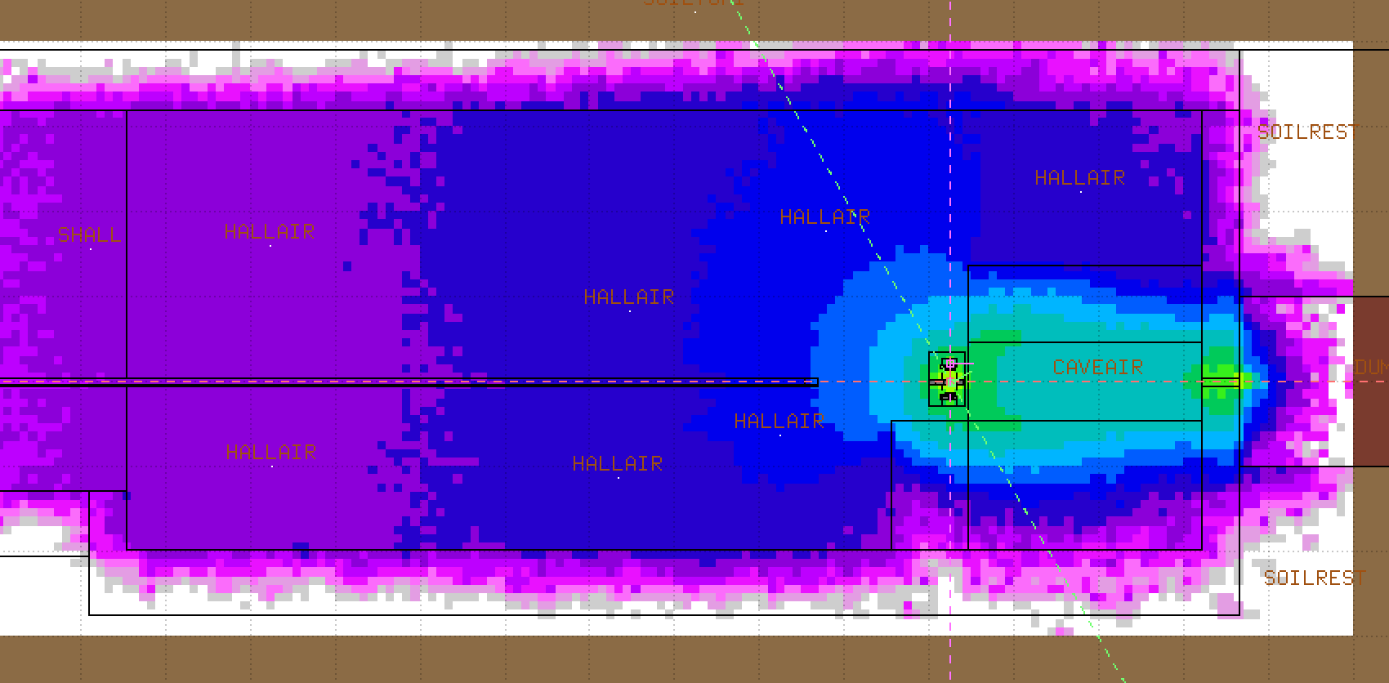
Residual Dose Maps
Cross section
Irradiation 1 week, cooling 1 day
-140 to 140 cm
Mesh parameters are:
x = -300 to 450 cm; y = -300 to 400 cm; z = -2000 to 500 cm
dx = dy = dz = 10 cm
-100 cm
Vertical view
Numbers in mrem/h

Slide 12
Residual Dose Summary for the Target Module
Residual doses at 30 cm from the module, mrem/h
Cooling | Upstream | Downstream | −x side | +x side | Bottom | Top | Max along | Max across
1 h | 358 | 529 | 381 | 368 | 411 | 268 | 529 | 411
4 h | 113 | 268 | 156 | 157 | 284 | 107 | 268 | 284
1 day | 47.4 | 109 | 63.9 | 63.7 | 114 | 44.0 | 109 | 114
2 days | 19.5 | 41.7 | 24.5 | 24.4 | 40.1 | 17.1 | 41.7 | 40.1
3 days | 10.1 | 19.1 | 11.3 | 11.3 | 15.5 | 8.1 | 19.1 | 15.5
4 days | 6.8 | 11.4 | 7.0 | 7.0 | 7.3 | 5.5 | 11.4 | 7.3
5 days | 5.6 | 8.6 | 5.7 | 5.6 | 5.2 | 4.5 | 8.6 | 5.7
6 days | 5.1 | 7.5 | 5.1 | 5.1 | 4.4 | 4.0 | 7.5 | 5.1
1 week | 4.7 | 6.9 | 4.8 | 4.8 | 3.9 | 3.8 | 6.9 | 4.8
Cause at each cooling time: at 1 h the dose is mostly C-11 (20-minute half-life) in the graphite. From about 4 h to 1 day it is mostly Na-24 (15 h) in the aluminum structure. By 1 week what’s left is mostly Be-7 in the graphite (about 7 mrem/h), which decays slowly with a 53-day half-life.
For handling: after 1 day one would still see about 100 mrem/h at 30 cm, close to the beam axis downstream or under the module. It falls to about 5–7 mrem/h after a week, and much of the drop happens between days 1 and 3 as the Na-24 decays.

Slide 13
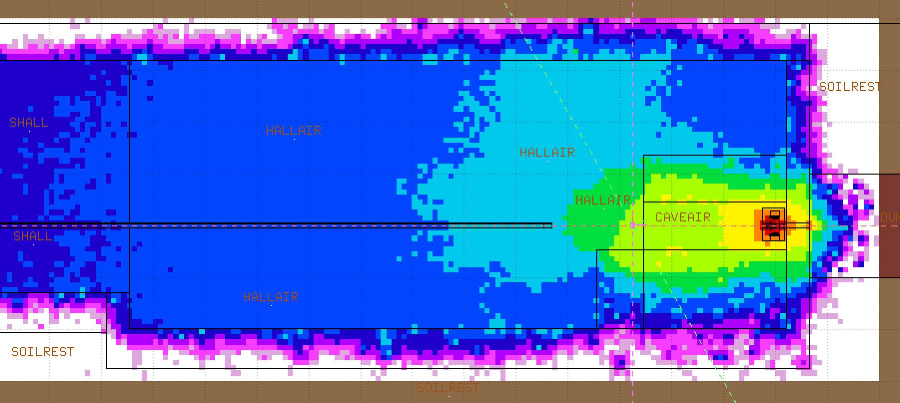
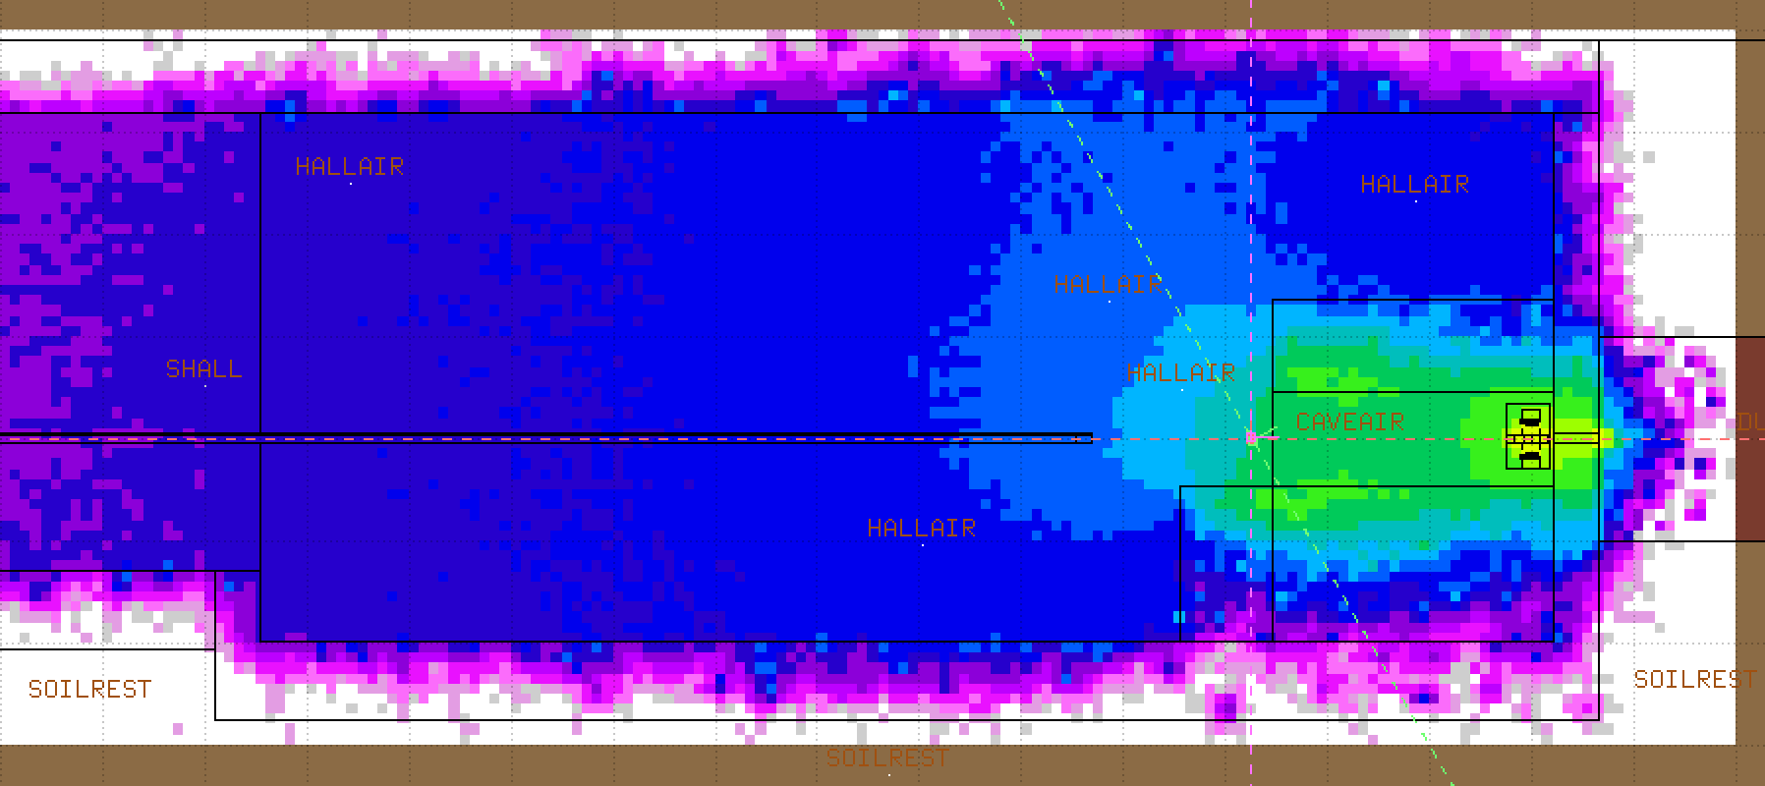
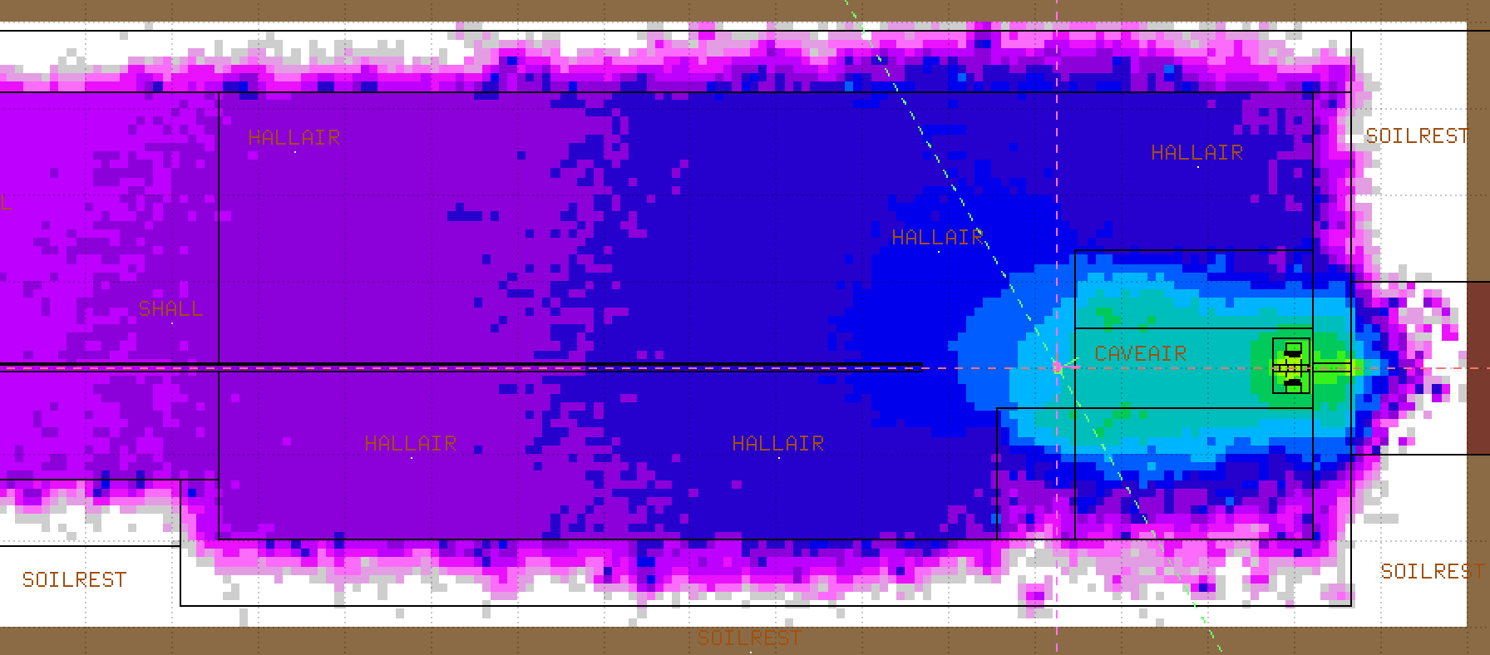
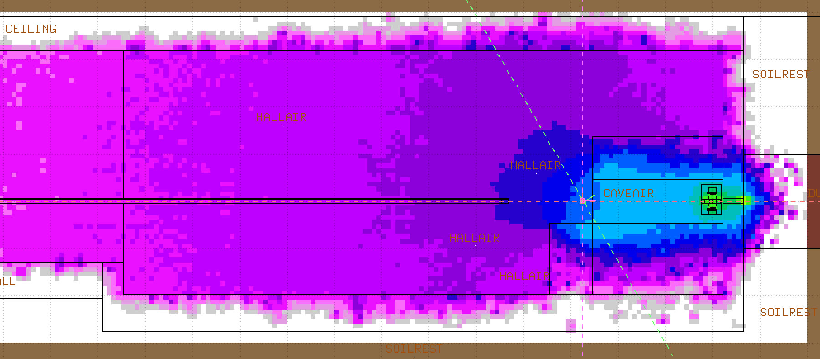
Residual Dose Maps: Target Module in Cave
Activated target module moved into the cave by 275 cm from its original location.
Irradiation time 1 week; cooling times 1 hour, 4 hours, 1 day, 2 days
1 h
4 h
1 d
2 d

Slide 14
Residual Dose Summary: Target Module in Cave
At (0, 0, 0), mrem/h
Cooling | Module | Hall/cave | Sum
1 h | 12 | 87 | 101
4 h | 3.3 | 72 | 77
1 day | 1.4 | 29 | 31
2 days | 0.61 | 9.9 | 10.7
3 days | 0.34 | 3.7 | 4.1
4 days | 0.25 | 1.6 | 1.9
5 days | 0.21 | 0.93 | 1.1
6 days | 0.20 | 0.68 | 0.83
1 week | 0.19 | 0.57 | 0.72
Target module moved into cave by 275 cm. These are residual doses
at its original location before moving. Activated concrete walls dominate the doses. Doses are around 10 mrem/h after 2 days of cooling.

Slide 15
Residual Doses for Samples Only
Aiming for ~10 mrem/h or less
Residual dose of the samples on their own, 30 cm from the outer face (mrem/h)
Material / Thickness | 1 mm | 2 mm | 3 mm | 4 mm | Sum of 4
1 h after beam-off
Cu | 1.25 | 2.05 | 2.58 | 2.78 | 8.7
A36 | 1.50 | 2.16 | 2.92 | 3.31 | 9.9
SS316LN | 1.21 | 2.84 | 3.12 | 3.09 | 10.3
Al6061 | 0.78 | 1.10 | 1.09 | 2.01 | 5.0
4 h after beam-off
Cu | 0.70 | 1.24 | 1.56 | 1.67 | 5.2
A36 | 1.03 | 1.60 | 2.08 | 2.37 | 7.1
SS316LN | 0.84 | 2.03 | 2.40 | 2.26 | 7.5
Al6061 | 0.65 | 0.92 | 0.92 | 1.67 | 4.2
Residual dose rates in individual samples even after 1 hour of cooling are very low,
always below 10 mrem/h. Max number is around 10 mrem/h for 4 stainless steel samples.

Slide 16
Target Module Optimization Examples
Graphite vs aluminum rod
  Aluminum foil tape to avoid contaminated graphite powder
Graphite target
  Material impurities
  Power deposition and temperature assessment
  DPA calculations
  Be-7 production and plating
Aluminum vs stainless for the support components

Slide 17
Tritium Production in Samples
Comparison of FLUKA & PHITS
results led to several % difference
Tritium atoms produced per proton (×10⁻⁶)
Material | 1 mm | 2 mm | 3 mm | 4 mm | Total | Rel. error
Cu | 5.9 | 9.6 | 11.9 | 13.8 | 41.2 | ±5%
A36 | 4.8 | 8.8 | 8.9 | 10.1 | 32.6 | ±6%
SS316LN | 4.5 | 7.3 | 8.9 | 10.4 | 31.1 | ±6%
Al6061 | 2.1 | 3.3 | 4.7 | 7.6 | 17.7 | ±8%
Tritium activity in the samples at the end of the 1-week irradiation (×10⁵ pCi)
Material | 1 mm | 2 mm | 3 mm | 4 mm | Total | Rel. error
Cu | 1.29 | 2.10 | 2.60 | 3.01 | 9.0 | ±5%
A36 | 1.05 | 1.92 | 1.94 | 2.21 | 7.1 | ±6%
SS316LN | 0.98 | 1.59 | 1.94 | 2.27 | 6.8 | ±6%
Al6061 | 0.46 | 0.72 | 1.03 | 1.66 | 3.9 | ±8%
Local LSC experts: Good to have 1e2 – 1e4 pCi/ml in water
Once the beam is off and the samples are immersed in water, these amounts of tritium will be
slowly diffused into water over the time, depending on the diffusion coefficients for each material.

Slide 18
Tritium Diffusion Estimates
Diffusion coefficient: D = D₀*exp(-E_{a}/RT)
    In structural metals (like stainless), D = 2e-12 cm²/s (increases with T)
    Drops by 2-3 orders of magnitude due to surface oxide barriers
    For Cu, D = 6e-10 cm²/s
    → At room T, tritium diffuses ~300 times faster in Cu vs stainless steel
    Caveat: Diffusion coefficients greatly vary across the literature!

Slide 19
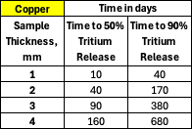
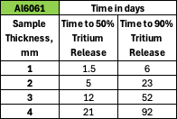
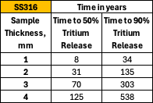
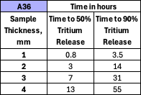
Diffusion Timescales
D_{T} = 6e-10 cm²/s
D_{T} = 4e-9 cm²/s
Both copper and aluminum alloy release tritium within days
Stainless steel has a very low
diffusion coefficient, and it takes years to release tritium
D_{T} = 2e-12 cm²/s
D_{T} = 2e-7 cm²/s
On the other hand, A36 steel releases most of tritium in a few hours

Slide 20
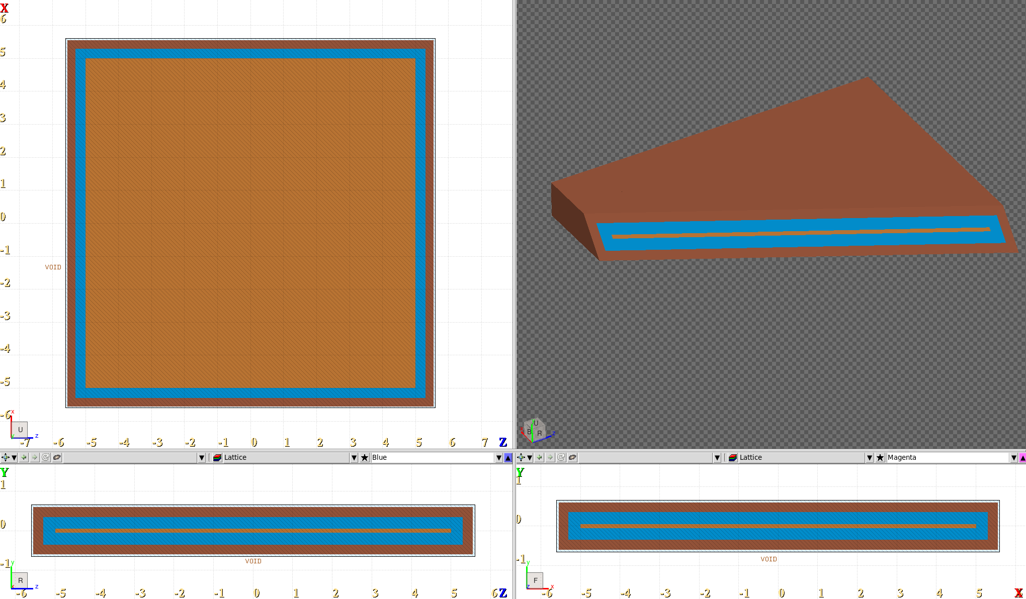
Diffusion Model Builds on Radiation Analysis
Courtesy of Alajos Makovec
Input data taken from radiation analysis results
  Geometry: FLUKA Cartesian mesh, one material per bin
  (Cu, water, SS316 holder, air)
  Tritium in Cu: 1.3e-5 ³H/primary (between 3 mm and 4 mm plate), 7.5e11 pps, 4 h → C₀ = 1.4e10 atoms/cm³
3D finite-volume diffusion solver
  Bulk diffusion + interface transfer (Cu–water, SS–water, SS–air)
  Tracks water flushes, air loss, decay; checks mass balance
Output: tritium in water (pCi/ml) vs time, 20°C & 50°C
FLUKA mesh geometry used for testing: Cu in water, inside SS316 holder
Radiation analysis: ³H production
Diffusion simulation
Flush-sample analysis
LSC measurements

Slide 21
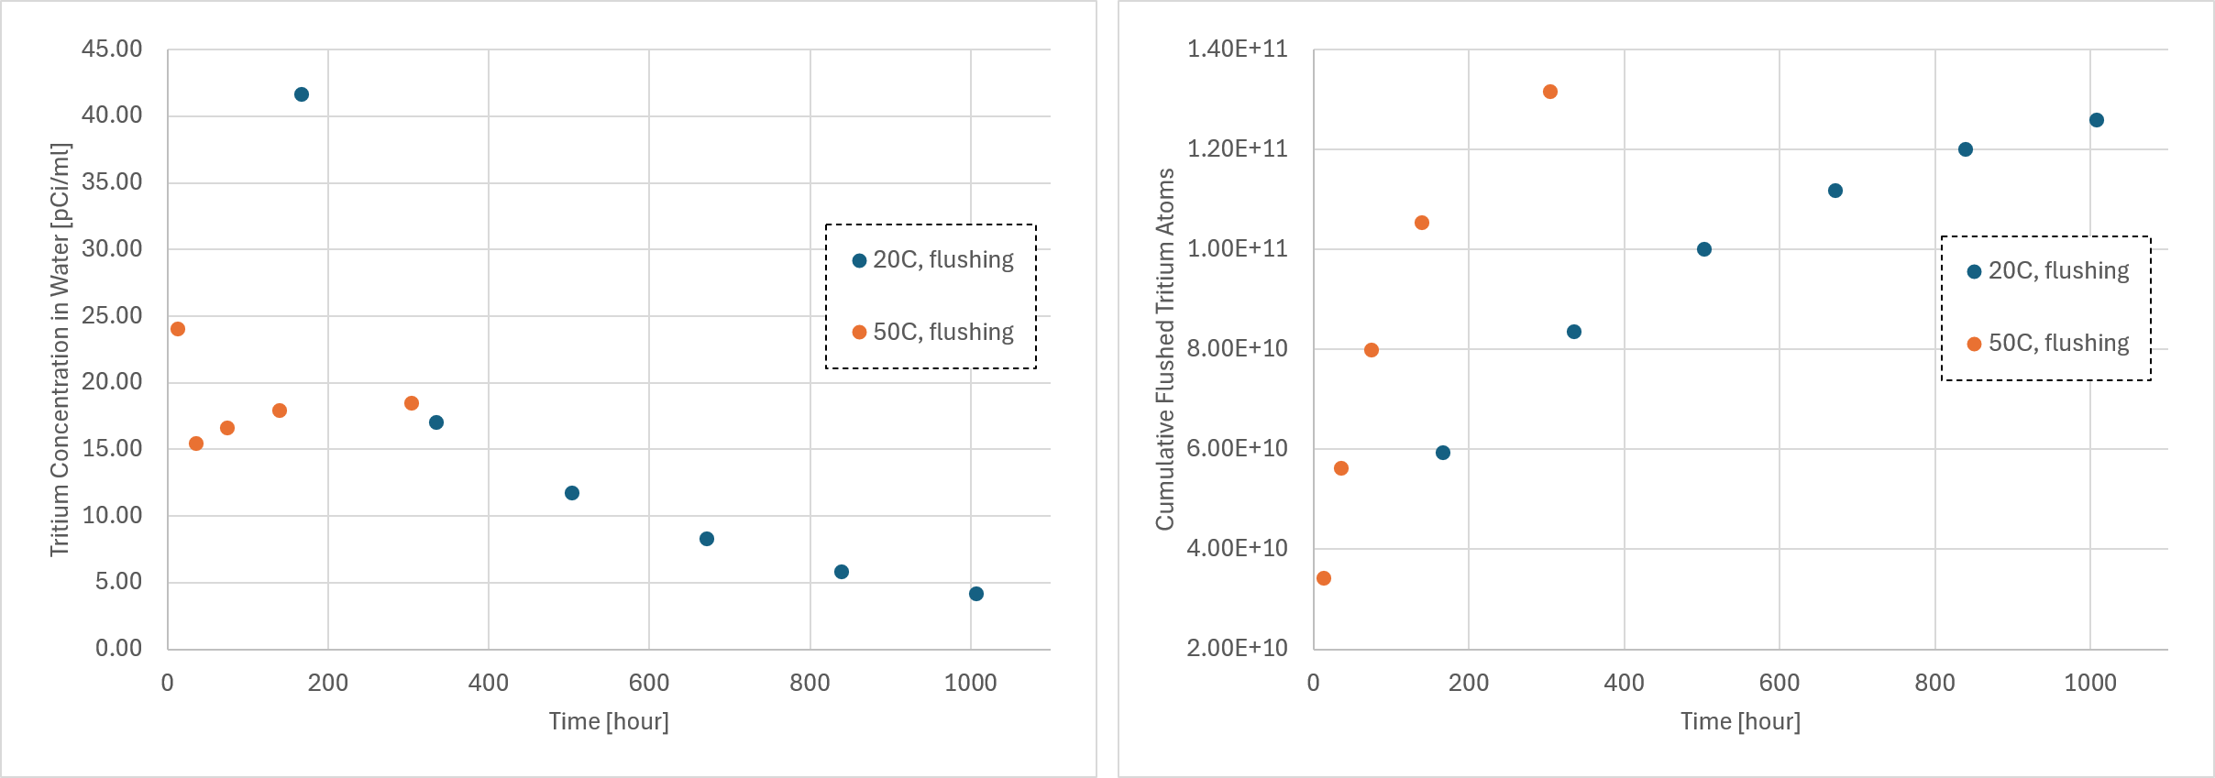
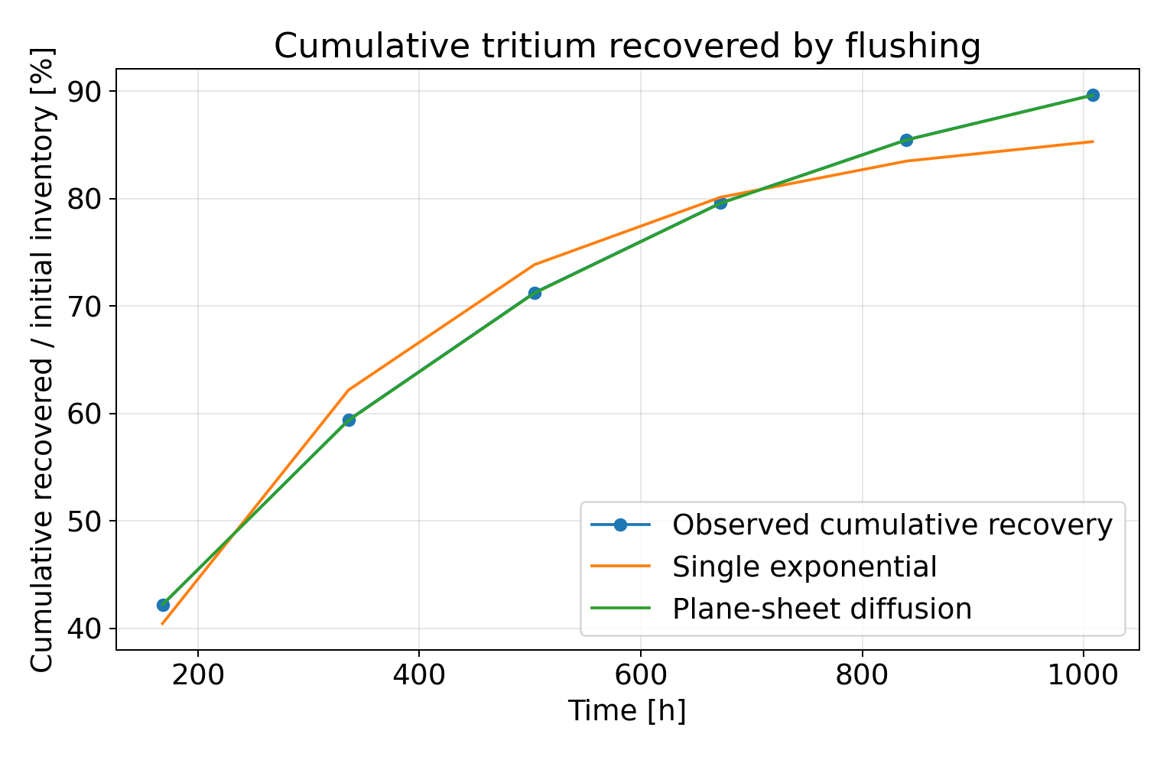
Diffusion Model: Release and Flush Analysis
Courtesy of Alajos Makovec
Simulated Cu sample with periodic water flushes
  D_{Cu} = 5.8e-10 cm²/s (20°C), consistent with our estimate (6e-10)
  Predicted water activity: ~5–40 pCi/ml per flush sample
  50°C (D ×4): more released in < 2 weeks than at 20°C in ~6 weeks
Flush analysis, validated on simulation
  Plane-sheet diffusion fit recovers D_{eff} = 5.84e-10 (20°C)
  and 2.37e-9 cm²/s (50°C); R² > 0.997
  50% / 90% release: 234 h / 1009 h (20°C), 58 h / 249 h (50°C)
1–4 mm samples, as in radiation analysis
  Release time:
    ∝ L² if bulk diffusion;
    ∝ L if interface-limited
Simulated flush samples: 20°C vs 50°C
Analysis of 20°C simulation: model fits

Slide 22
Summary
This work addresses radiation transport simulations coupled with planned experimental measurements. The Monte Carlo codes CERN-FLUKA and PHITS are being used to model and optimize an experimental configuration in which selected materials are exposed to secondary particles produced by the interaction of a proton beam with a graphite target.
After irradiation, the materials will be immersed in water for a defined period, and the resulting tritium concentration in the water will be measured. The measurements will provide experimental estimates of tritium release from irradiated materials and enable evaluation and improvement of models describing tritium transport in these materials.
The combined computational and experimental approach will contribute to improved tritium management and safety assessments in particle accelerator facilities.

Slide 23
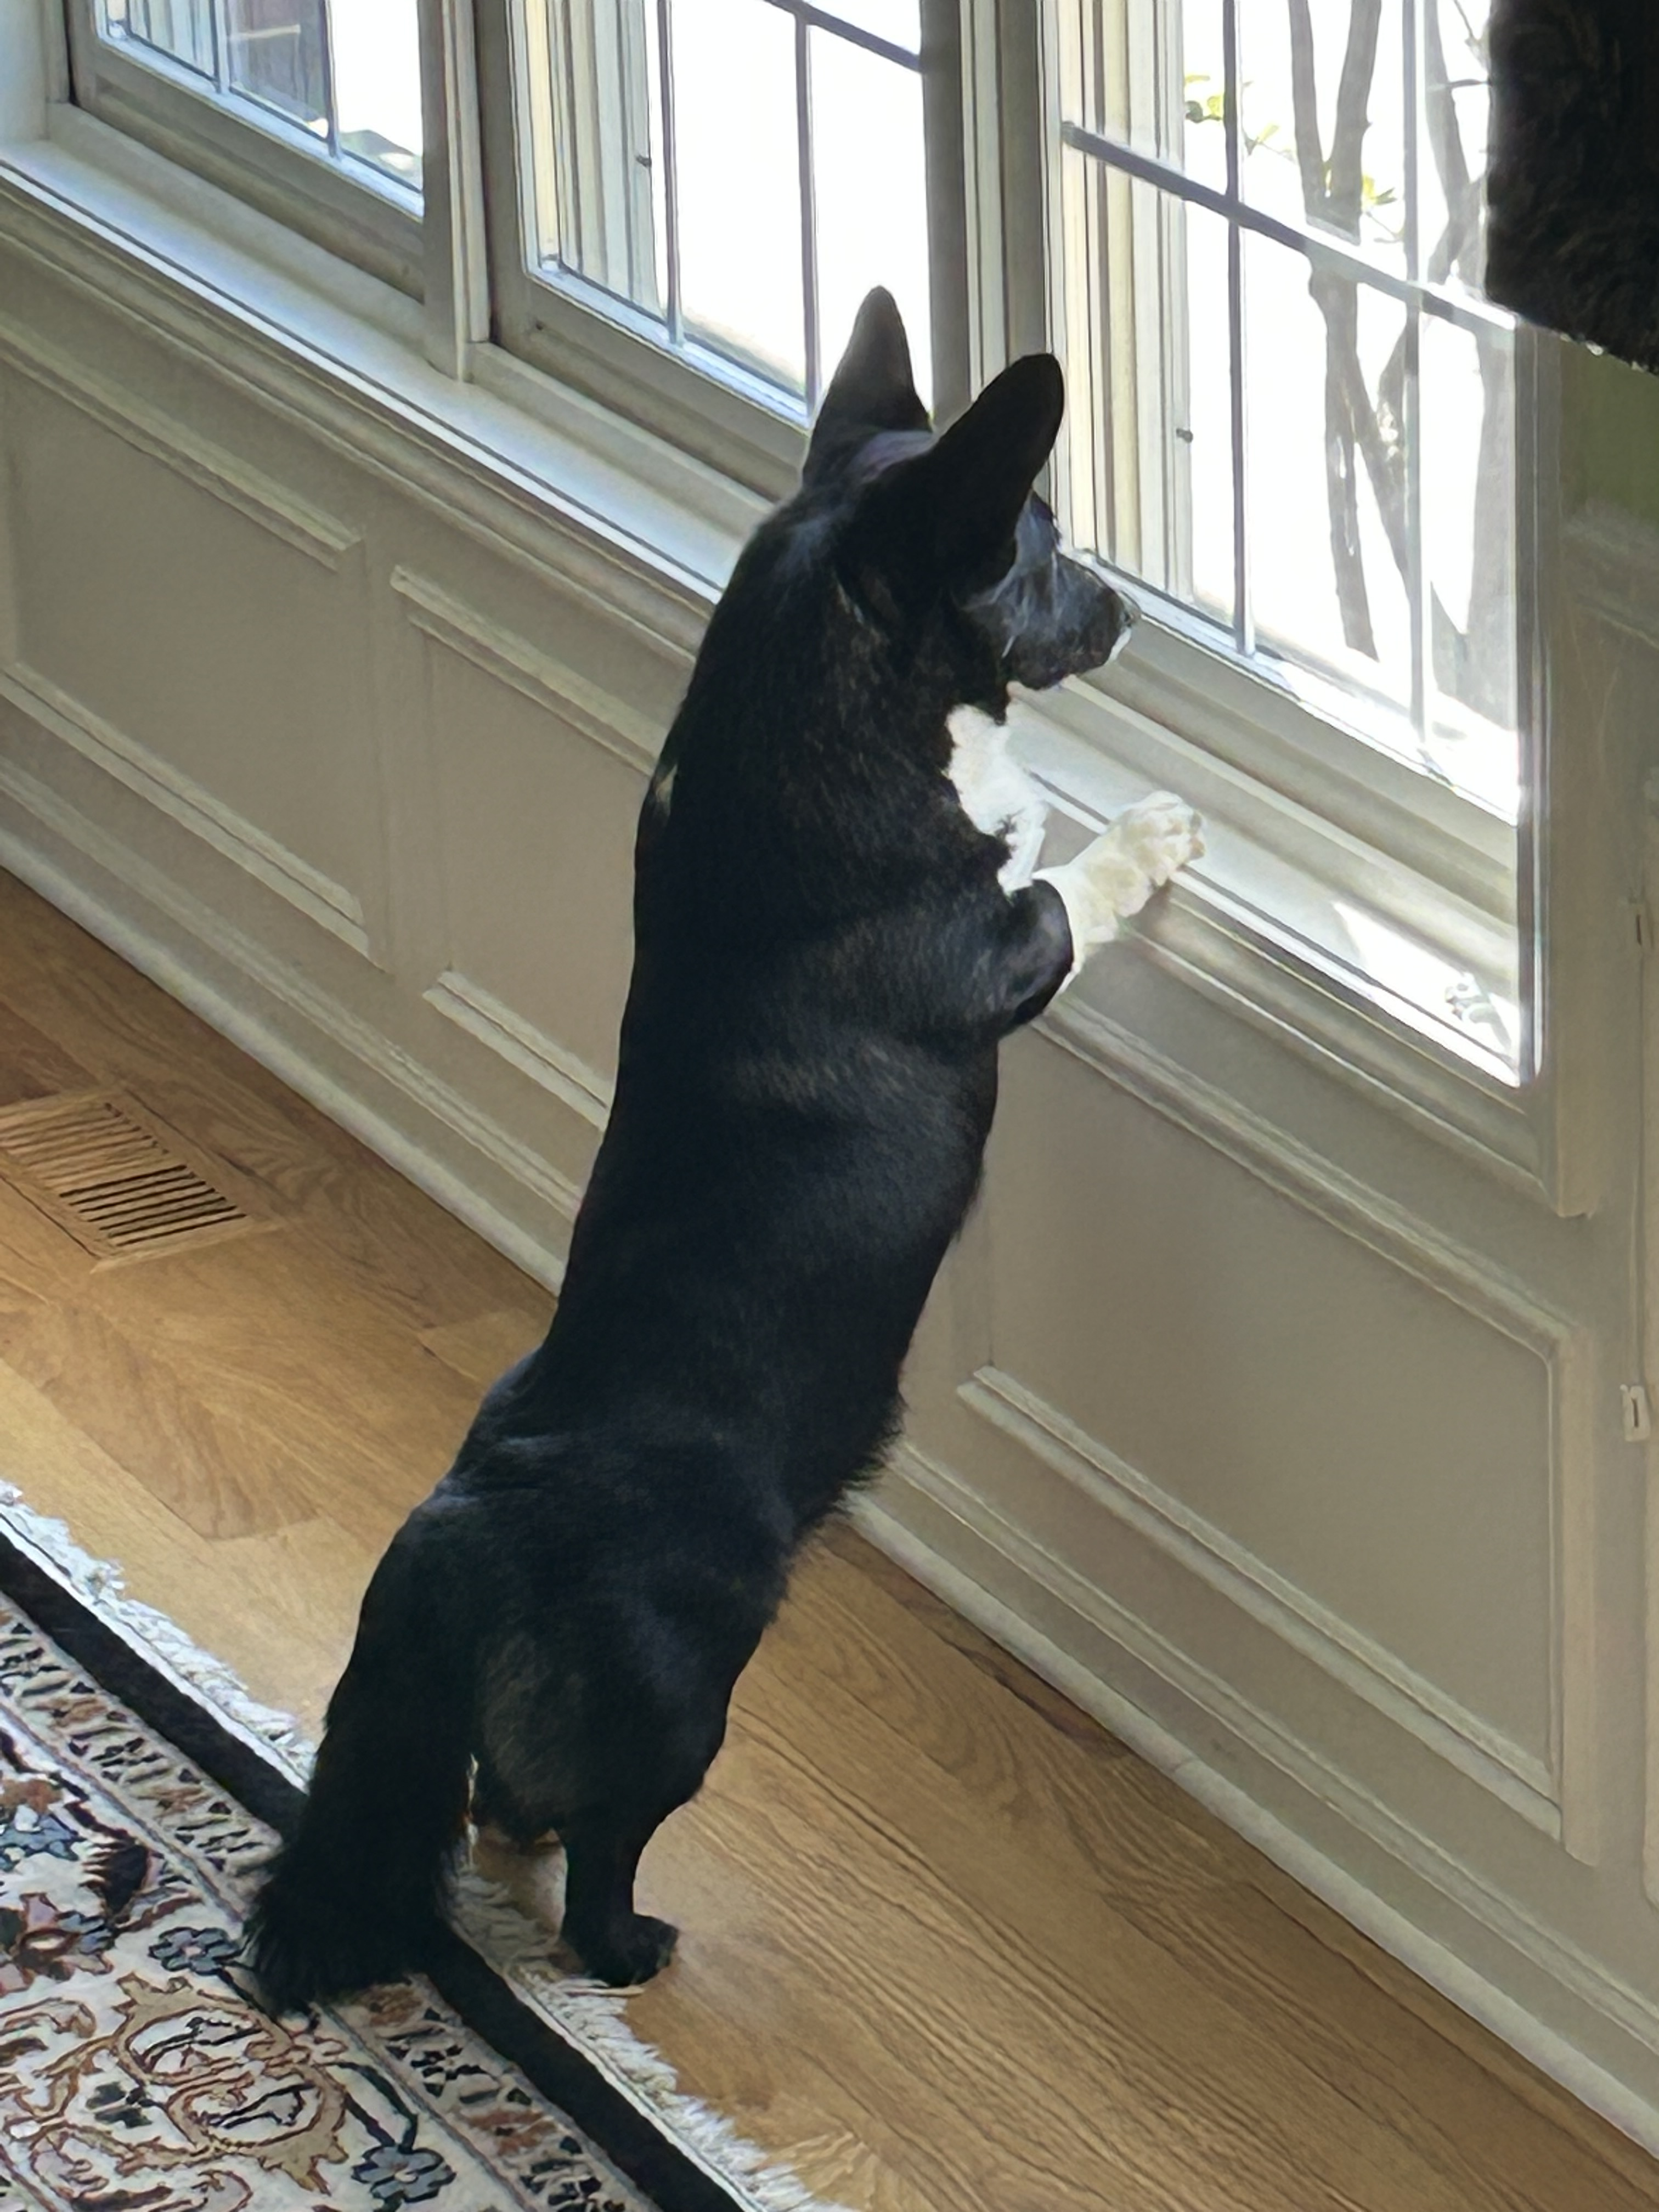
Thank You!
Questions?
Comments?

Slide 24
Backup Slides

Slide 25
Target Module Optimization (Target Cylinder)
Comparison of residual dose rates for Al6061 vs graphite target cylinder
(residual dose rates in mrem/h, at 30 cm from target)
Graphite could produce irradiated powder:
graphite rod will be wrapped in 3MTM Aluminum Foil Tape 425
(included in the FLUKA model)
Target | 1 h | 4 h | 1 day | 3 days | 1 week | 1 month
1-day irradiation
Aluminum | 1,580 | 1,190 | 436 | 51 | 4.3 | 2.3
Graphite | 678 | 2.7 | 1.2 | 1.16 | 1.1 | 0.8
1-week irradiation
Aluminum | 2,220 | 1,750 | 674 | 98 | 24.5 | 15.9
Graphite | 685 | 9.6 | 8.0 | 7.8 | 7.4 | 5.5

Slide 26
Target Module Optimization
Graphite impurity effects on the residual doses
  Purified graphite (thermally or halogen-purified): impurities add at most about 1%, so they don’t need to be modeled.
  Unpurified graphite: a few percent difference; at most about 9% around 4 hours, falling to about 4% at 1 week.
  Iron and nickel are the elements that matter most.
Residual dose increase over pure graphite, 1-week irradiation (target alone, 30 cm)
Graphite | 1 h | 4 h | 1 day | 3 days | 1 week
A. Unpurified (ash ~800 ppm) | 0.2% | 8.8% | 7.5% | 5.6% | 3.9%
B. Thermally purified | 0.0% | 1.2% | 0.9% | 0.6% | 0.4%
C. Nuclear grade (ash < 10 ppm) | 0.0% | 0.1% | 0.1% | 0.1% | 0.0%
Pure graphite, mrem/h | 714 | 10.8 | 9.1 | 8.9 | 8.4

Slide 27
Power Deposition into Target Module
Power deposited during the irradiation (7.5×10¹¹ p/s, 400 MeV, 48 W beam)
Component | Power, W | Rel. error
Graphite target | 24.1 | 0.1%
Tape (Al foil + acrylic adhesive) | 0.042 | 0.3%
Samples Cu (4) | 0.062 | 1.5%
Samples A36 (4) | 0.059 | 1.4%
Samples SS316LN (4) | 0.059 | 1.1%
Samples Al6061 (4) | 0.026 | 1.3%
All 16 samples | 0.21
Aluminium structure | 1.27 | 0.3%
Whole module | 25.6
Beam power: 48 W (7.5e11 p/s × 400 MeV).
Graphite target absorbs half the beam power; most of the rest leaves
the module in the forward direction. Individual samples get 3–19 mW.

Slide 28
Component Heating, DPA
Target temperature might reach 77 °C in the worst case.
Graphite oxidation in air begins around 400–450 °C; tape adhesive: 3M 425 is rated −54 °C to 149 °C.
→ Temperature not an issue.
Radiation dose into tape adhesive: ~1.5 MGy in a week. Inspect after irradiation.
Sample heating: negligible. At most 19 mW per sample; the samples stay at room temperature.
Aluminum structure: no concern. 1.3 W spread over the frame, plates and holders is negligible.
Displacement damage in graphite is negligible.
Displacements per atom in the graphite after the 1-week run (×10⁻⁶ dpa)
Region | DPA-SCO | DPA-NRT
Peak (beam axis, first 5–10 cm) | 8 | 14
Beam core (r < 3 mm) | 6 | 9
Whole-rod average | 1.7 | 2.6
DPA orders of magnitude below the damage levels at which graphite would noticeably change
its dimensions or thermal conductivity.

Slide 29
Be-7 Production
Be-7 production (1-week irradiation at 7.5×10¹¹ p/s; activity at the end of the irradiation)
Where | Be-7 per proton | Bq | pCi | Share
Graphite target | 4.2×10⁻² | 2.7×10⁹ | 7.4×10¹⁰ | 85%
Hall and cave concrete | 7.3×10⁻³ | 4.8×10⁸ | 1.3×10¹⁰ | 15%
Air (cave + hall + inside the module) | 9.0×10⁻⁵ | 5.9×10⁶ | 1.6×10⁸ | 0.2%
Aluminium structure | 6.8×10⁻⁵ | 4.5×10⁶ | 1.2×10⁸ | 0.14%
Tape (adhesive + foil) | 1.7×10⁻⁵ | 1.1×10⁶ | 3.0×10⁷ | 0.03%
All 16 samples | 2.6×10⁻⁶ (±20%) | 1.7×10⁵ | 4.6×10⁶ | 0.01%
Total | 4.9×10⁻² | 3.2×10⁹ | 8.7×10¹⁰
Be-7 has a 53-day half-life, so these activities change little over the cooling times we’ve been using. The Be-7 in the graphite is also what keeps the rod at about 7 mrem/h at 30 cm after a week.

Slide 30
Be-7 Production
Be-7 made in the air: about 6e6 Bq (0.2% of the total). This is the plate-out source.
Not accounting for ventilation → all of it ends up on surfaces.
Be-7 recoiling out of the graphite: none reaches the outside. Recoils stop in the tape
(thicker than the recoil range of 30 µm) → Wrapping the rod contains its Be-7.
Recoils from exposed surfaces (outer foil, plates, samples): Negligible.
→ Almost all Be-7 stays locked inside the graphite and the concrete. What can plate out
is the 6e6 Bq made in the air, about 0.2% of the total, mostly in the cave.
The samples hold about 1.7e5 Bq of Be-7 in all, roughly 1e4 Bq each. That is comparable to their tritium (about 1e5 Bq total), so it’s worth keeping in mind for the water-leaching measurements.
At room temperature Be-7 stays fixed inside the metal and doesn’t diffuse like tritium, so only Be-7 near the sample surfaces could get into the water. The 478 keV gammas also make it easy to identify if it does show up.

