Slide 1
Radiological commissioning of the LCLS-II continuous-wave superconducting linac
Models, shielding validation and radiation monitor performance, from a few watts to 19 kW
Thomas Frosio, J. Allan, J. Bauer, J. Blaha, H. Brogonia, Q. Ding, A. S. Fisher, A. Rosenstrom, M. Santana-Leitner, S. Rokni
Radiation Protection Department, SLAC National Accelerator Laboratory, Menlo Park, CA, USA
SATIF-17, Daejeon, 20-22 October 2026

Slide 2
Outline
LCLS-II overview 3
Model development 4-7
Field emission 4
Beam line description 5
Undulator synchrotron radiation 6
Diamond and fiber detectors 7
Safety systems 8-13
Shielding 8
Beam Containment System 9
Beam Containment System devices 10-13
CIVIDEC diamond detectors 10
Cherenkov fiber detectors 11
Average Current Monitor 12
Residual Dose rate Monitor 13
Benchmarks 14-16
Beam to dump 14
FLUKA against measurement 15
Conclusions 16
T. Frosio | SATIF-17 - IBS Daejeon, October 2026
2

Slide 3
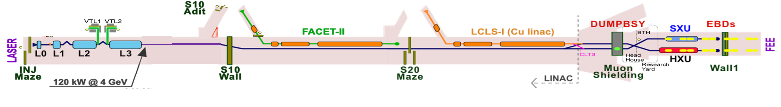
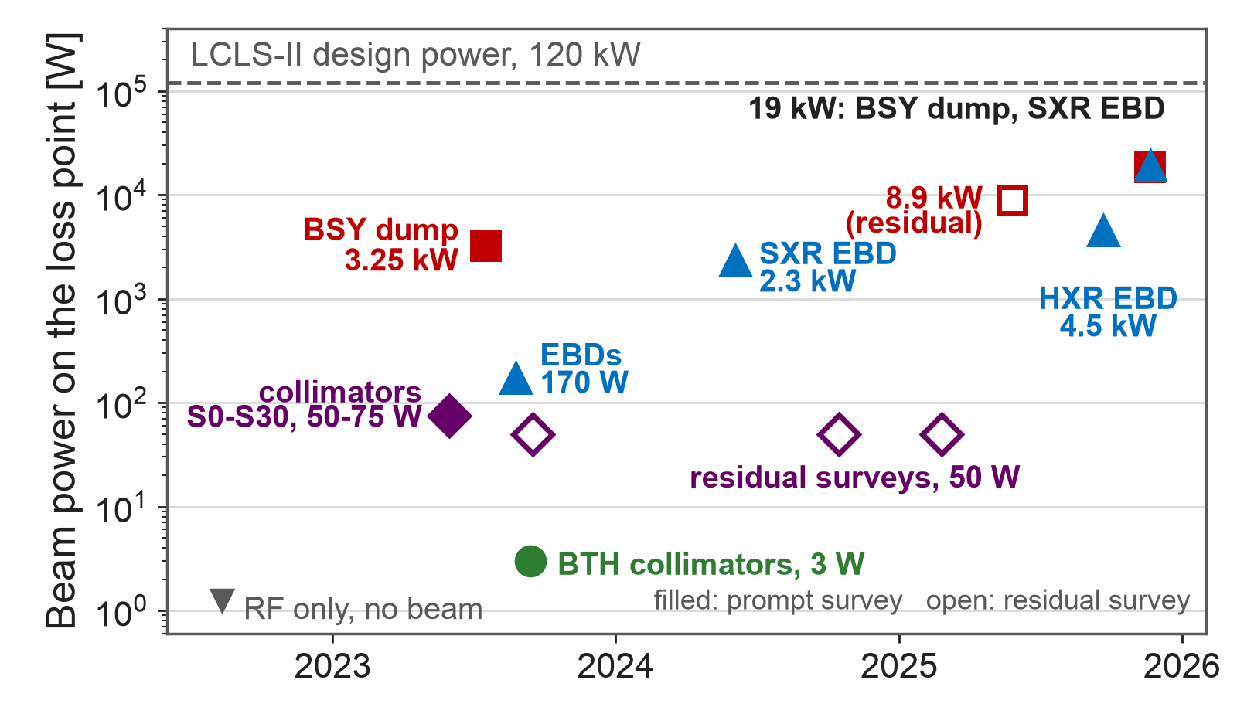
LCLS-II overview - machine and commissioning
Gun: normal conducting, 185.7 MHz, 0.75 MeV
35 cryomodules, 280 cavities, about 16 MV/m
4 GeV continuous wave, up to 929 kHz
120 kW design, 1.2 MW maximum credible beam
Sectors 0-7 accelerate; bypass line to Sector 30
3 dumps: BSY dump, SXR and HXR dumps
Penetrations every 6 m to the klystron gallery
Ramp-up, from RF only in 2022 to 19 kW in November 2025, gated by RP commissioning surveys
T. Frosio | SATIF-17 - IBS Daejeon, October 2026
3

Slide 4
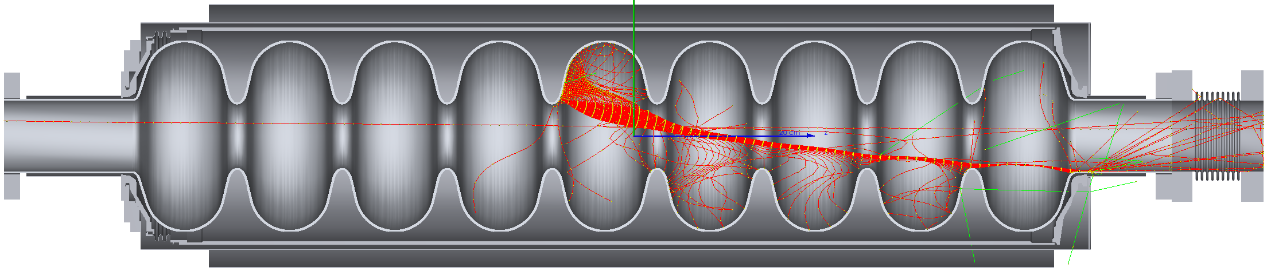
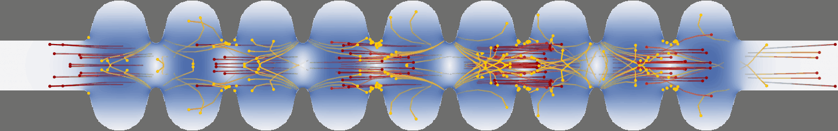
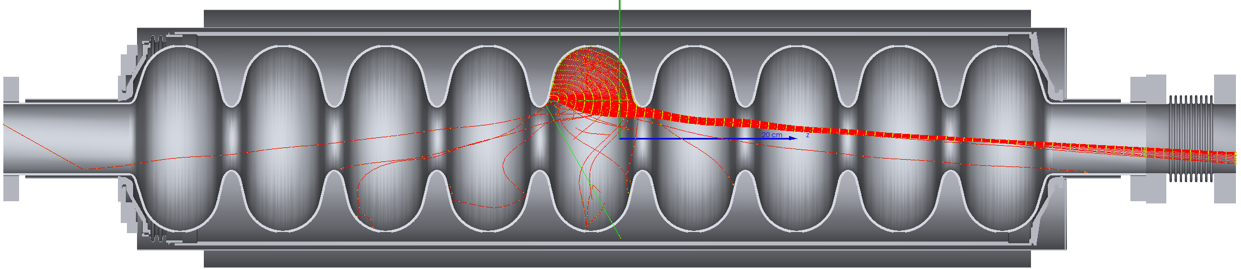
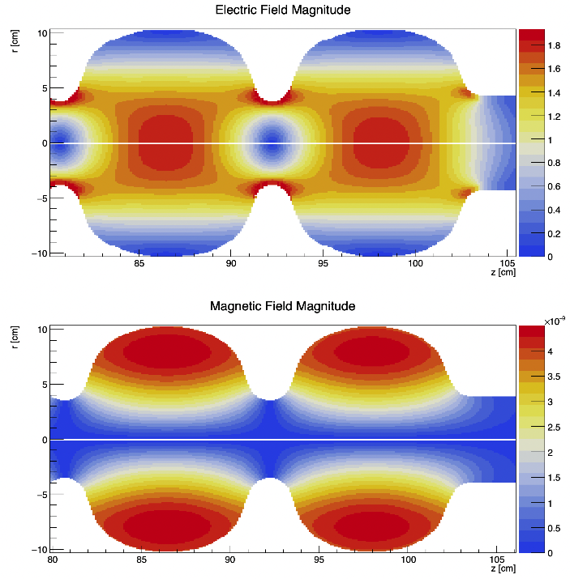
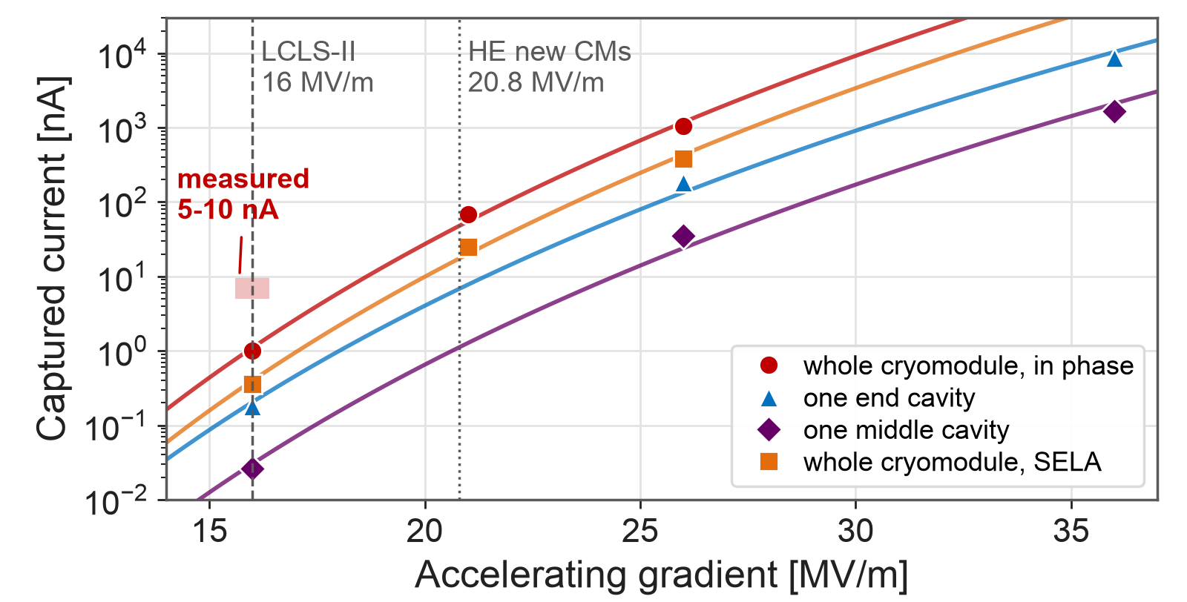
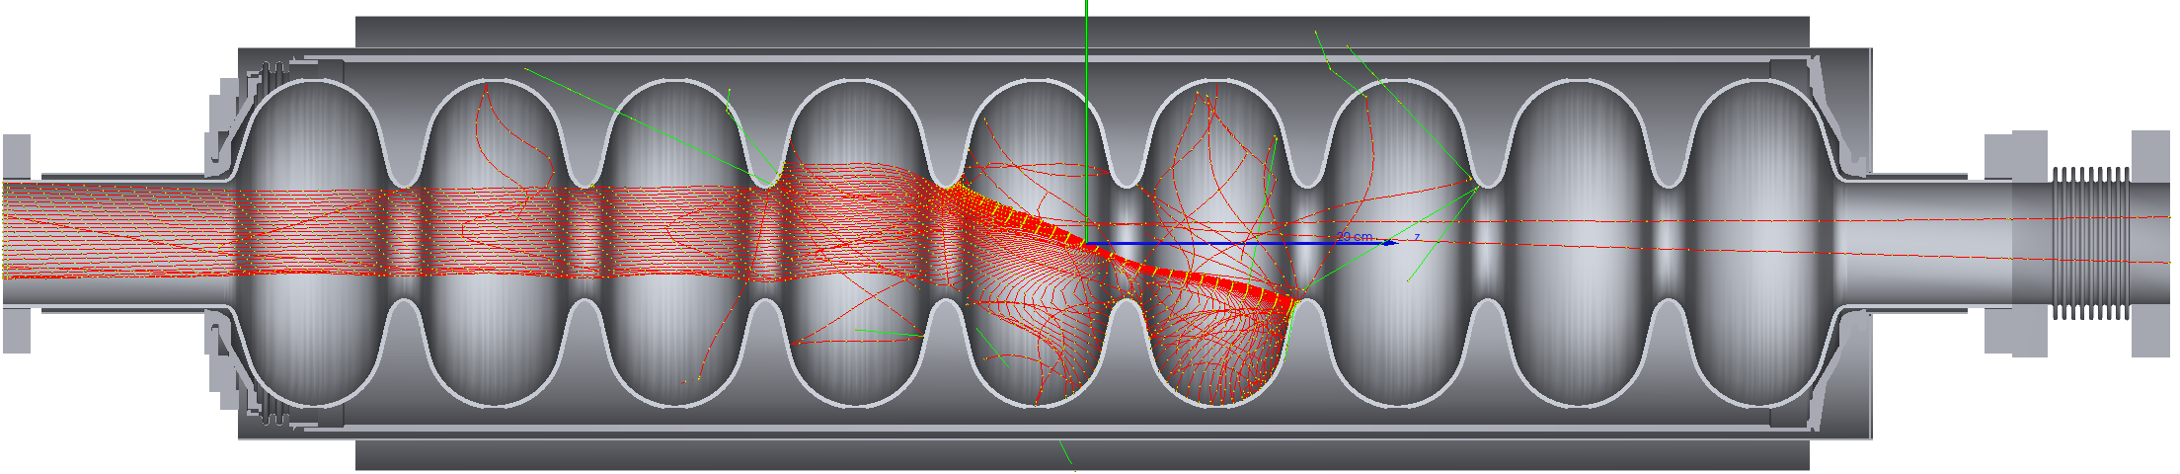
Field emission - FLUKA cryomodule source
emitted at the irises
Simulations allow
Scaling captured current for different operating modes
captured and accelerated
Understanding what can happen inside cavities
  e.g. field emitter location impacts transmitted current fraction
  e.g. guess field emitter locations
FLUKA source: emitters on the cavity walls
Fowler-Nordheim current at the local field
Tracked in the 1.3 GHz map of every cavity
Cavities in phase, or unsynchronized (SELA)
SELA, 1 nA per CM: 10 vs 15 µSv/h measured
In phase: 50 mSv/h measured, 5 times the 1 nA case
PhD (S. Adadi): field enhancement per cavity
Validated in SELA mode (10 vs 15 µSv/h), the source shows the cryomodules went from 1 to 5-10 nA in 2 years
T. Frosio | SATIF-17 - IBS Daejeon, October 2026
4

Slide 5
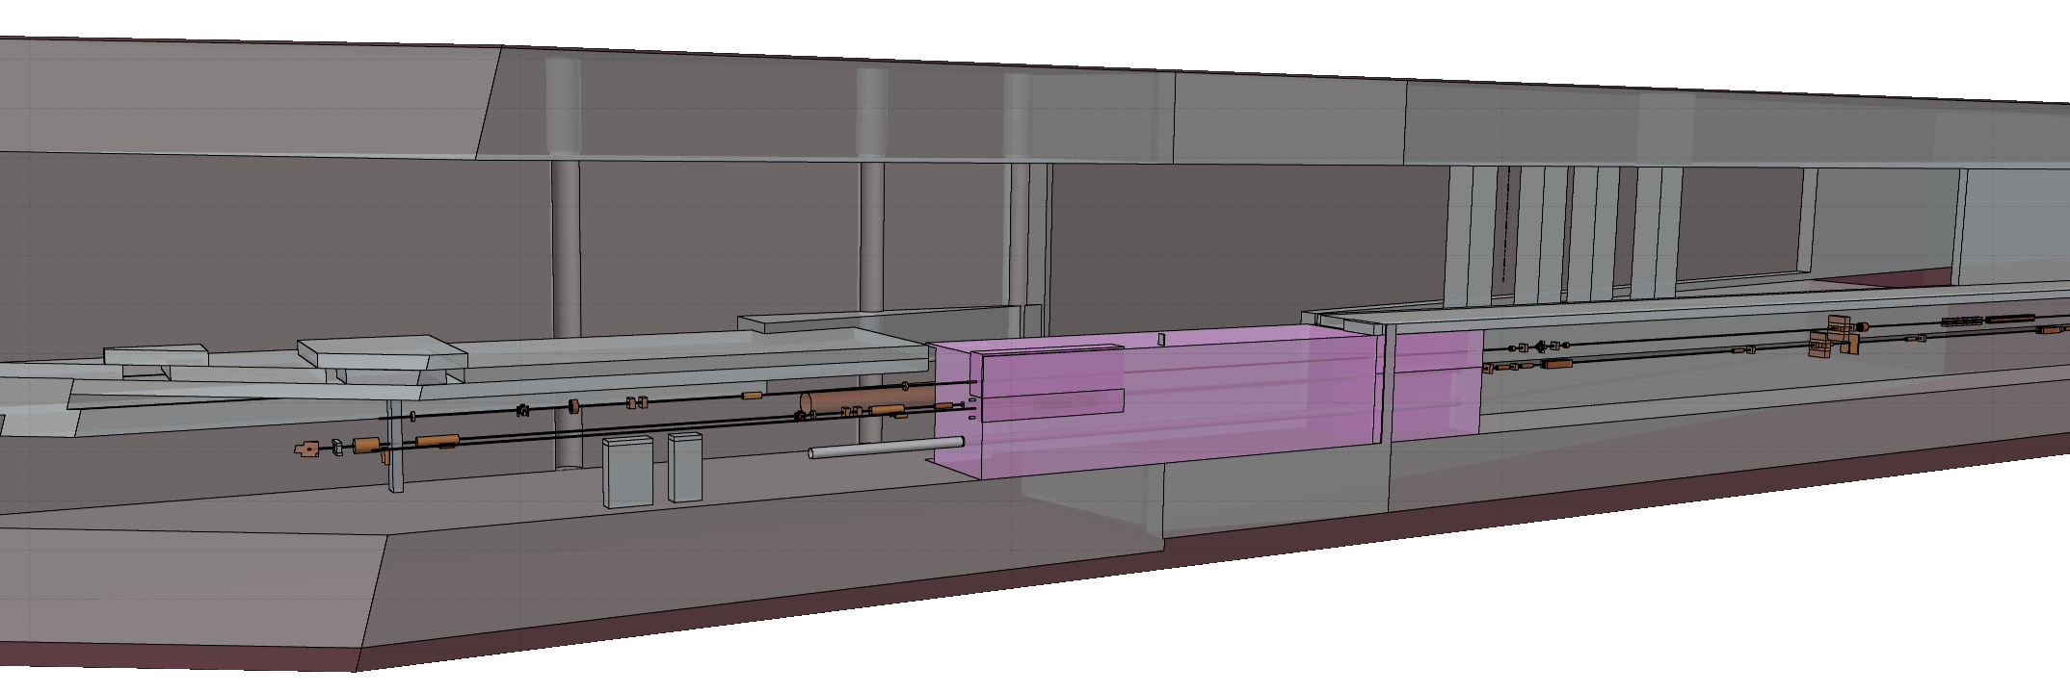
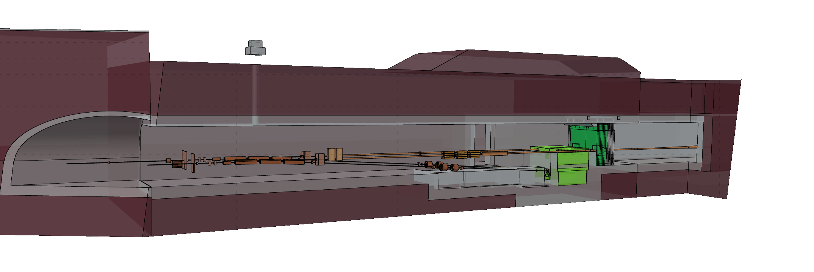
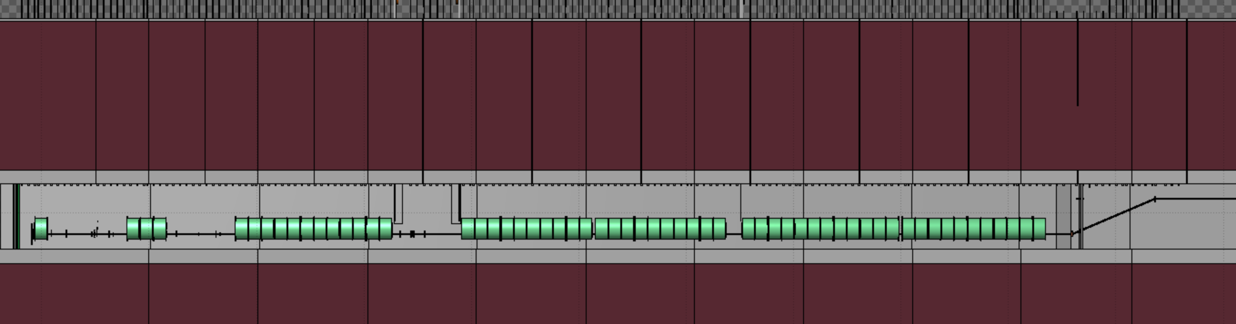
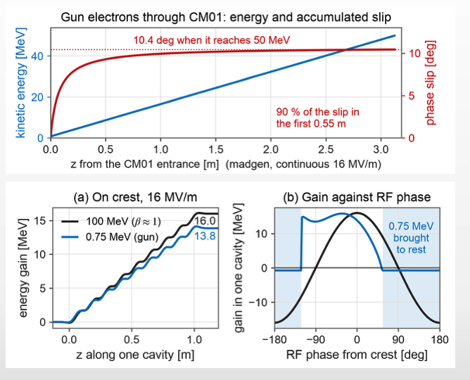
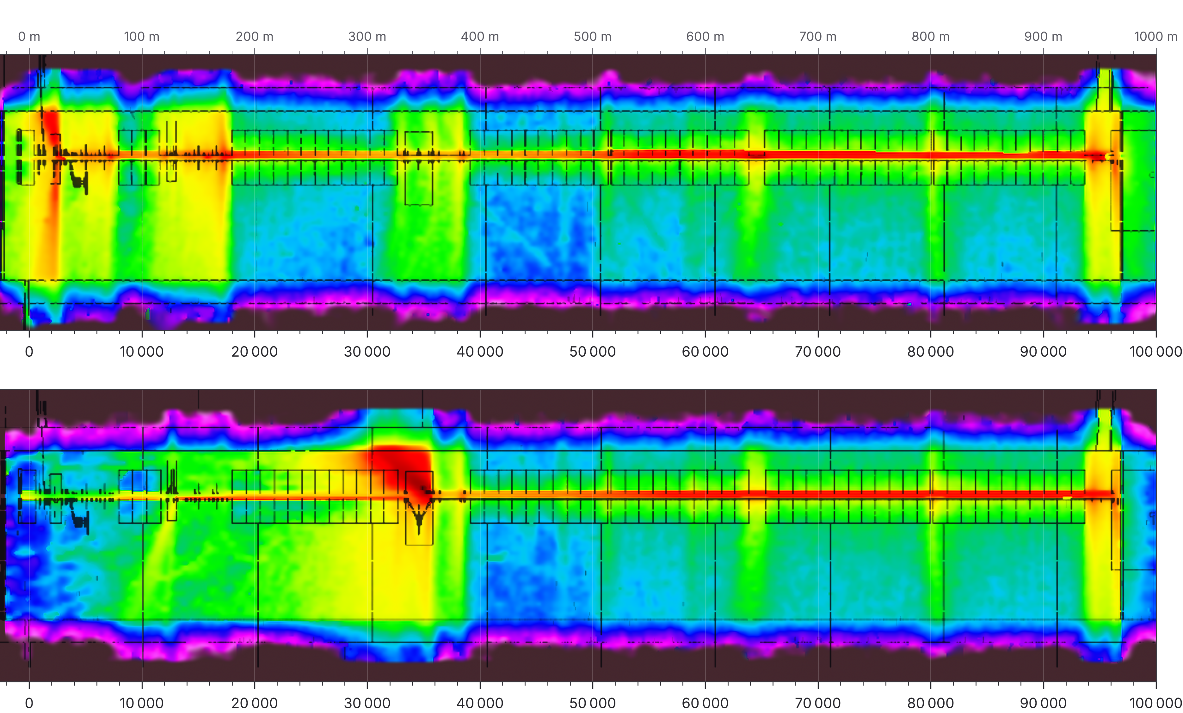
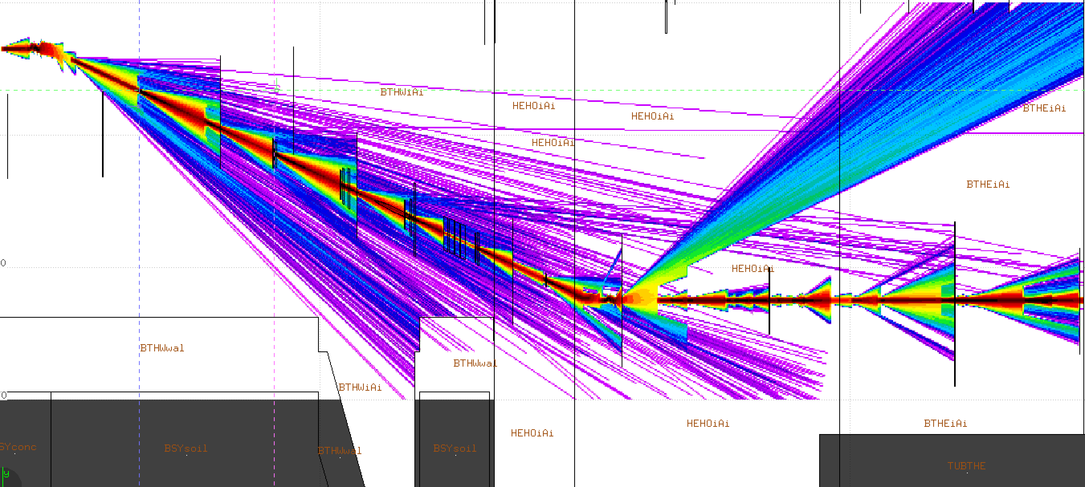
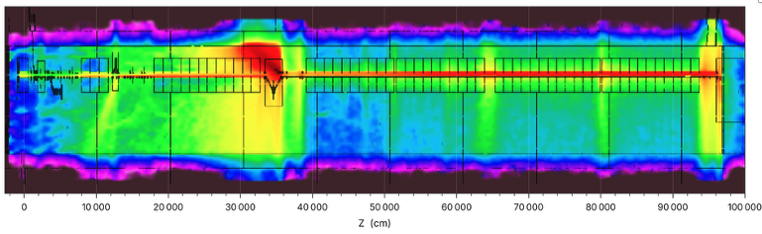
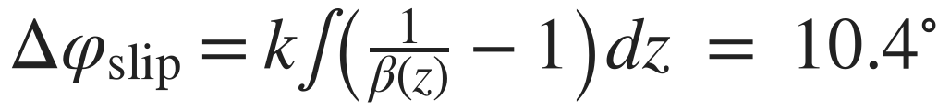
Beam line model - MAD tapes to FLUKA
MAD survey tapes in, FLUKA geometry out
3.9 km beamline, 2,524 beam line elements
Includes cryomodules and gun’s physics
Includes penetrations, shielding and tunnel
Uses: ray-tracing, beam loss showers, dark current transmission
Gun electrons (0.75 MeV, 91 % of c) fall behind the RF until about 50 MeV; integrates this slip and corrects every later cryomodule:
FLUKA models of 3.9 km of SLAC beam lines, generated from the MAD tapes
T. Frosio | SATIF-17 - IBS Daejeon, October 2026
5

Slide 6
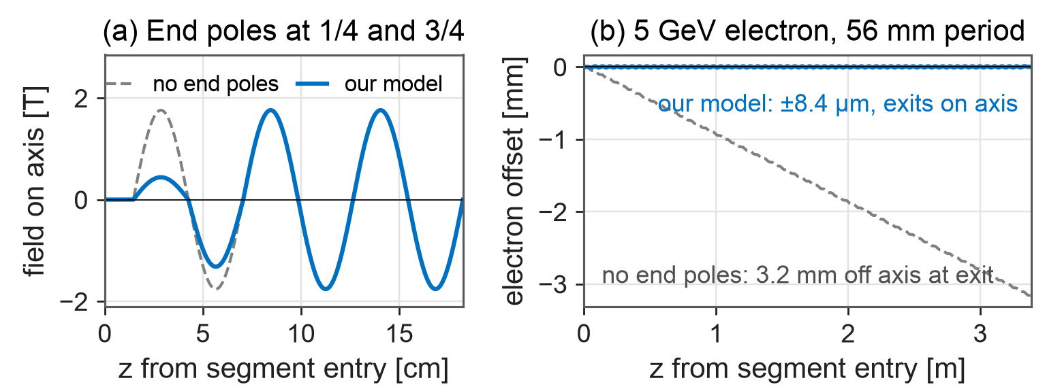
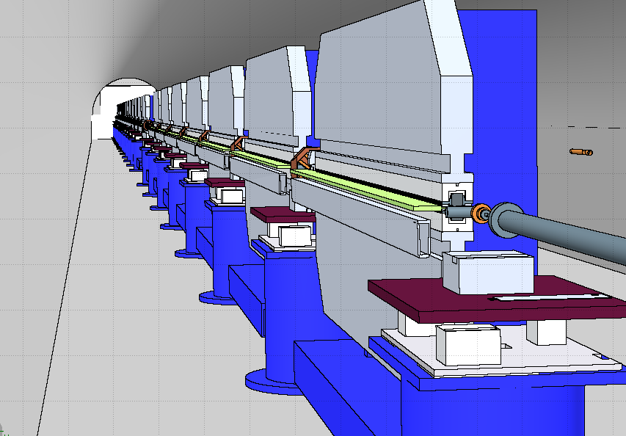
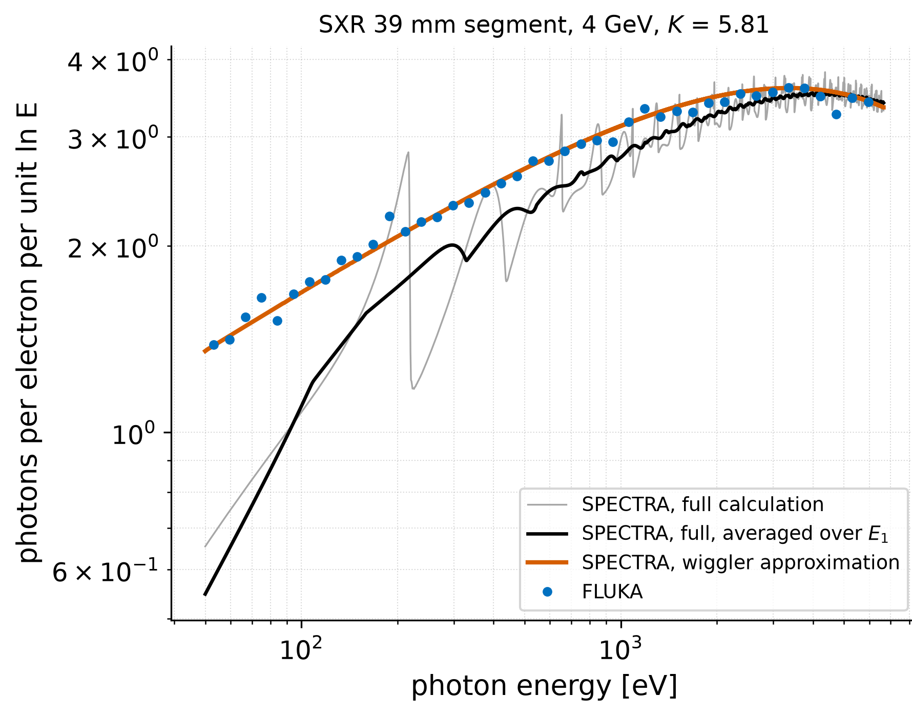
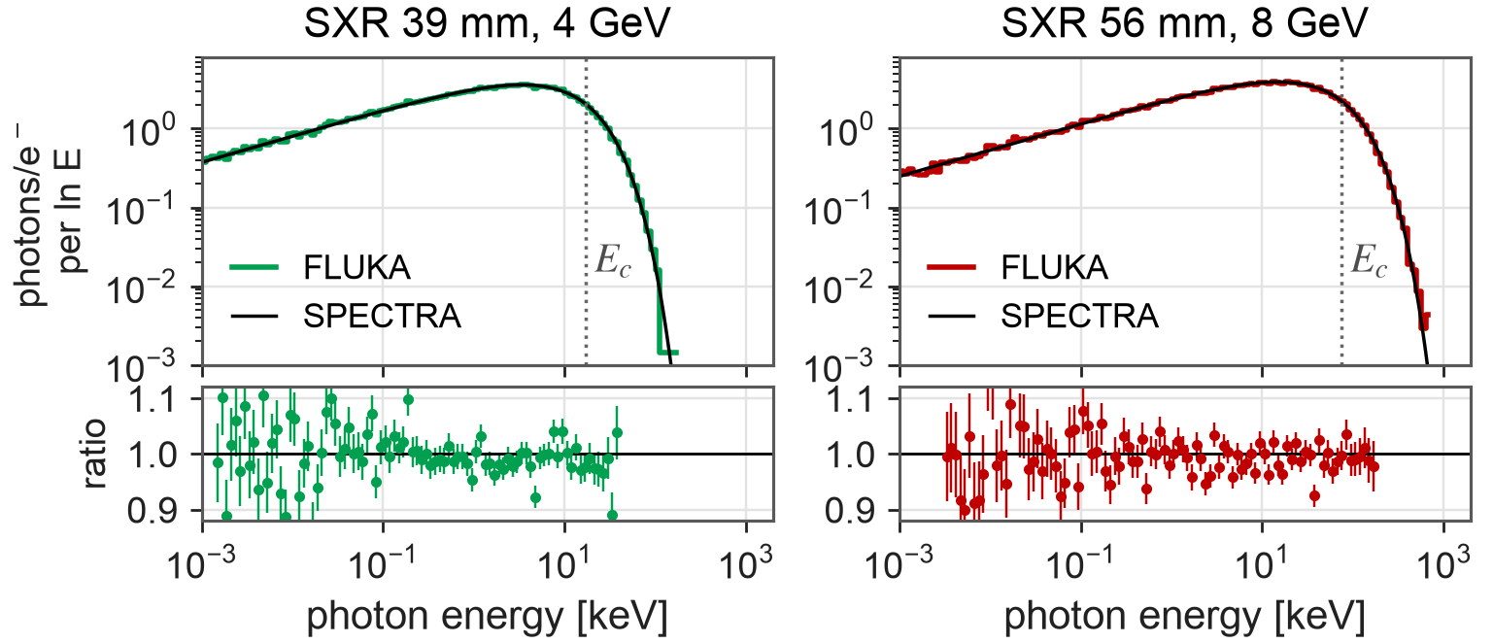
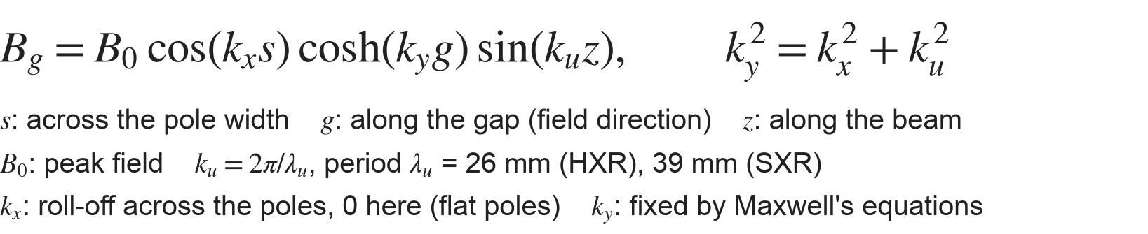
Undulator synchrotron radiation - FLUKA
Soft-X-ray vertical undulatory
FLUKA 2025.1 (SYNCRAD): photons one by one in the local field
End poles at 1/4 and 3/4 of the peak field: the electron leaves each segment on the axis, as in the real magnets
Undulator field (magfld routine), Maxwell-consistent in 3-D:
Against SPECTRA without interference: energy within 0.8 %, photons within 0.7 %
Spectrum code cannot give absorption in the chamber (81 % of the 9.6 W radiated at 4 GeV)
Maxwell-consistent undulator field in FLUKA, within 1 % of SPECTRA
T. Frosio | SATIF-17 - IBS Daejeon, October 2026
6

Slide 7
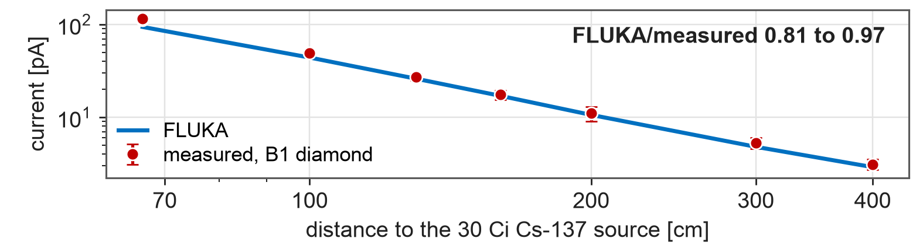
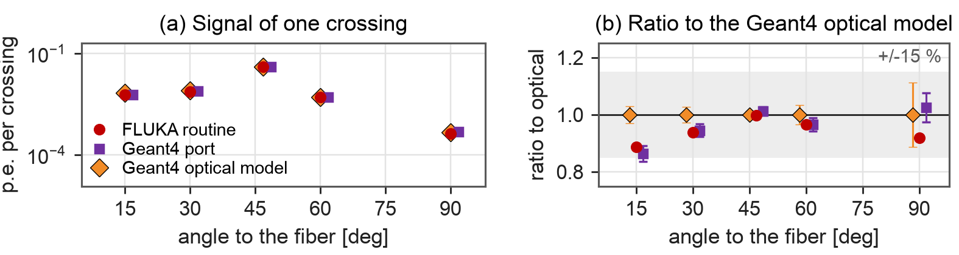
Diamond and fiber detectors - response physics
Diamond - Point Beam Loss Monitor (PBLM)
Cherenkov fiber - Long Beam Loss Monitor (LBLM)
Charge per particle in 500 µm of diamond (CIVIDEC), folded with the fluscw routine:
Charged shower particles crossing silica core emit at 46.7 deg to their path
Fiber keeps only light within 8.7 deg of its axis, best when crossing at 38-55 deg. Model counts shower's crossings and angles
Geant4 optical model tracks every photon; FLUKA and Geant4 routines compute the light analytically
Comparison: per crossing, the routines follow photon tracking within 11-14 %
Test 12-14 GeV on a thick target: within 5-10 %; Cs-137 source: linear over two decades (below)
Beyond 10 m from a thin target the model is 2x high
Diamond: fluence folded with the charge per particle. Fiber: the fast routines follow the Geant4 optical model within 14 %
T. Frosio | SATIF-17 - IBS Daejeon, October 2026
7

Slide 8
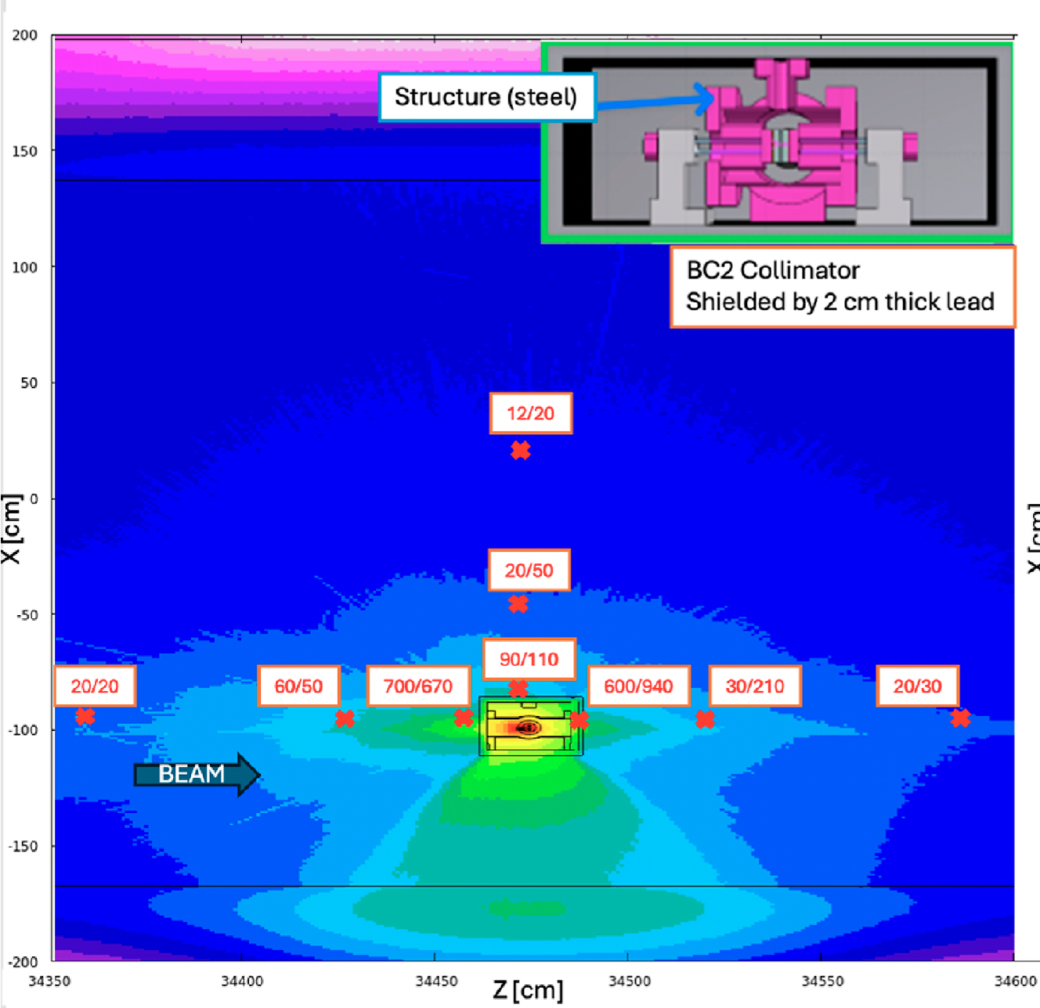
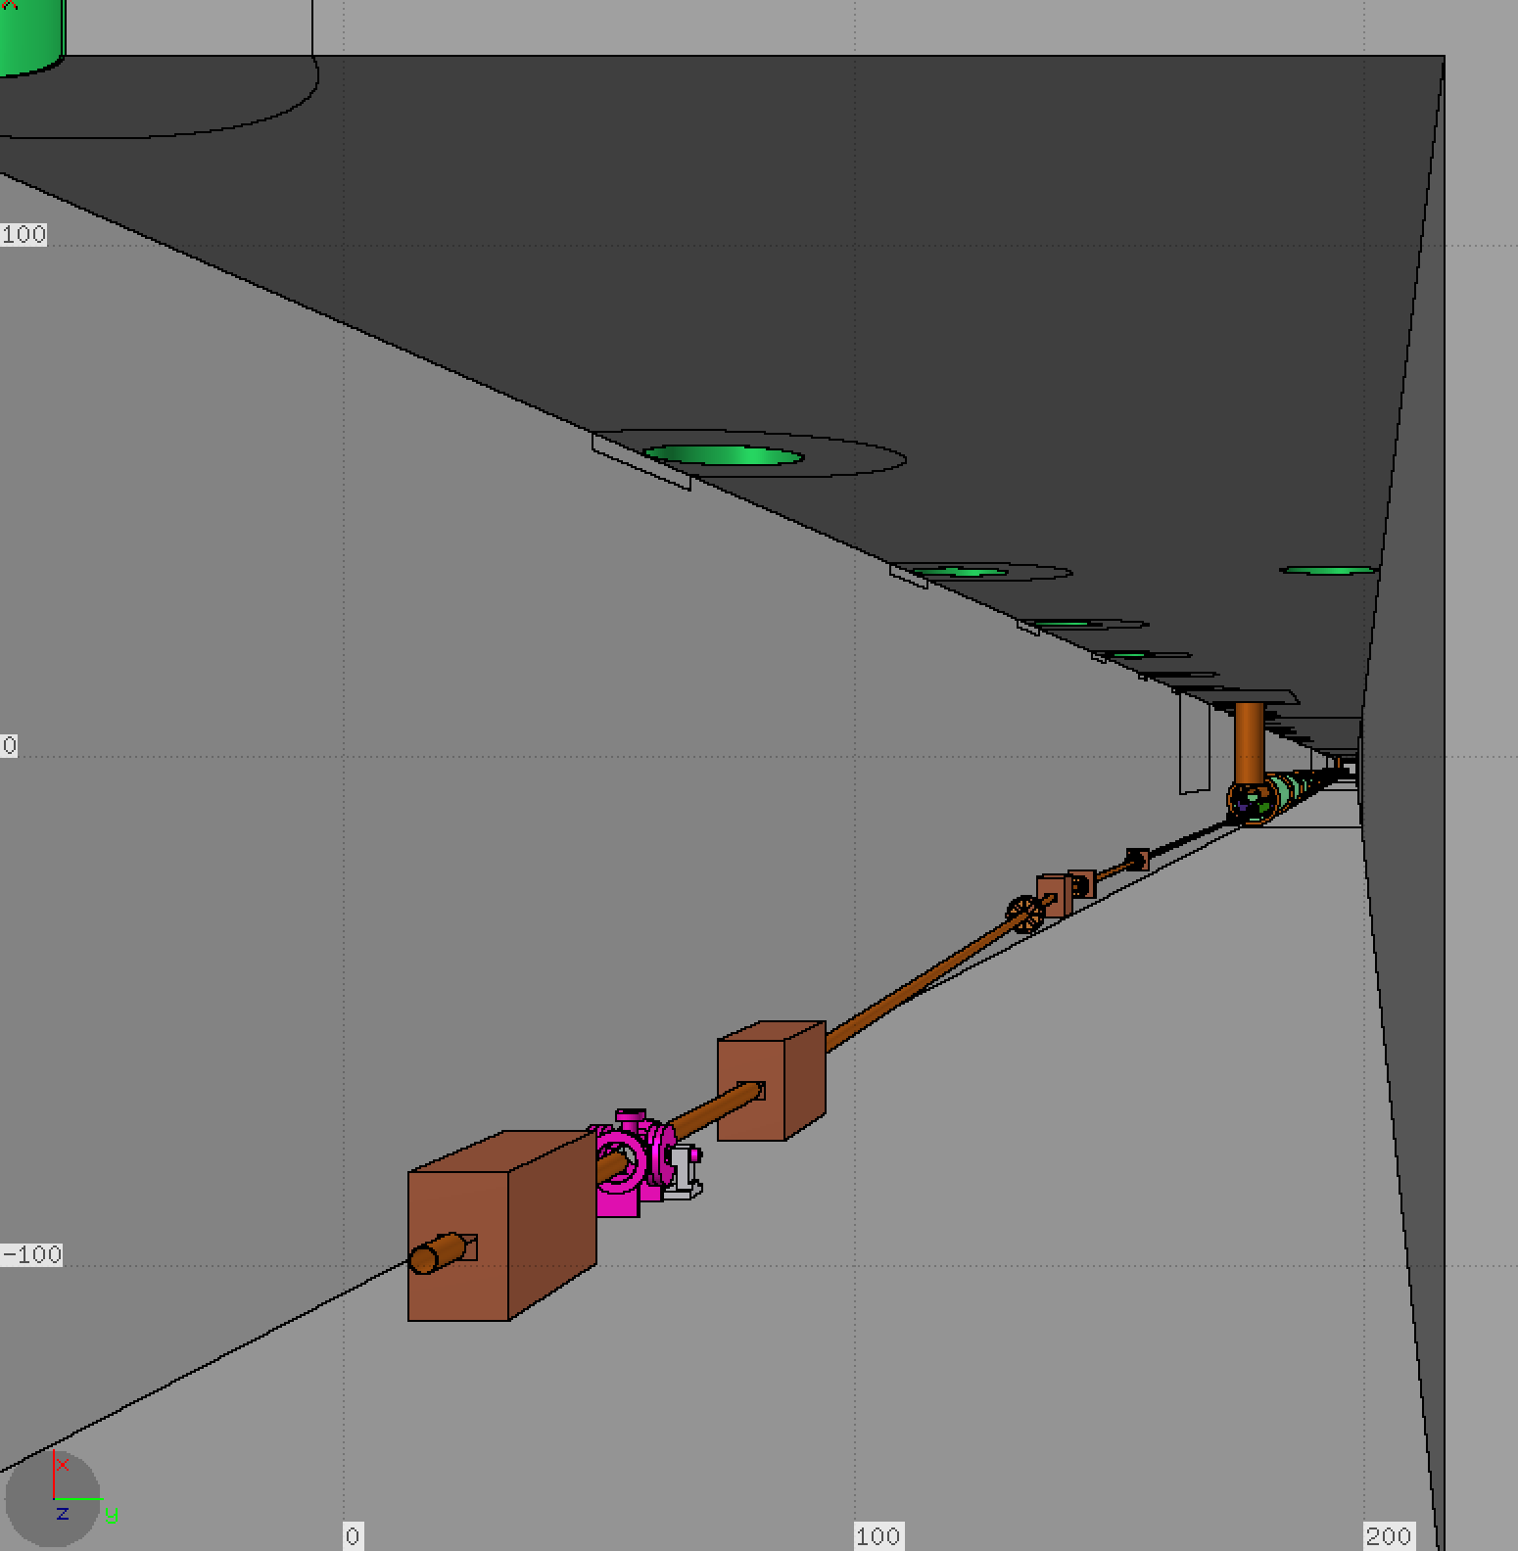
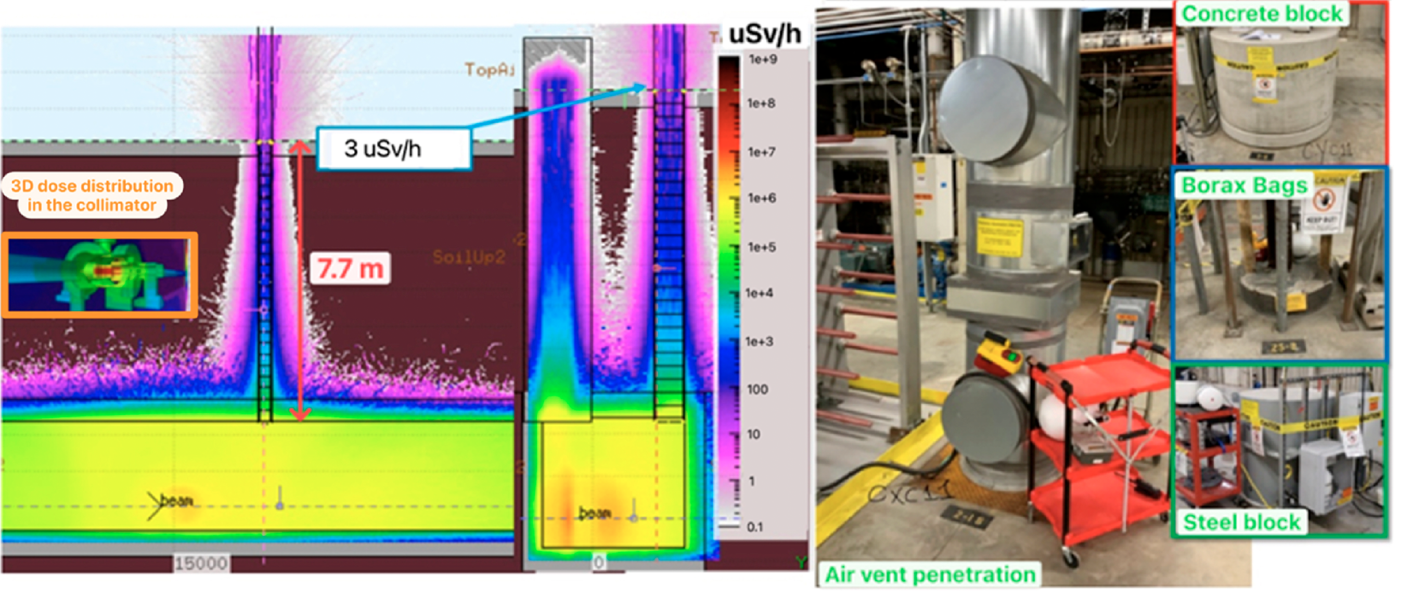
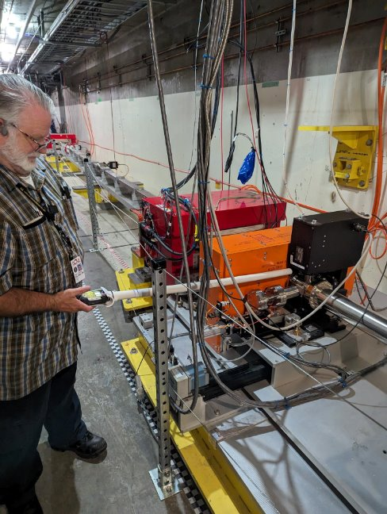
Shielding - prompt outside, residual inside
Prompt dose outside - goal below 5 µSv/h
Residual dose inside
Penetrations every 6 m (concrete, borax bags, steel): only the air vents above a struck collimator rose above background
50 W at 200 MeV on collimator CXC11: the vent above it read 3.1, FLUKA 3 µSv/h (below)
Collimators after ~3 h at < 50 W: up to 900 µSv/h at contact, 25-30 % less one hour later (2 h apparent half-life)
Gun dark current on the PC0H00 collimator after CM01: 2 mSv/h, lead added; cryomodule surfaces at most 6 µSv/h
P2-18: FLUKA 3 / measured 3.1 µSv/h
Tungsten collimator: FLUKA / measurement: factor 2
Prompt dose outside below 5 µSv/h up to 19 kW; inside, the collimators cool with a 2 h apparent half-life
T. Frosio | SATIF-17 - IBS Daejeon, October 2026
8

Slide 9
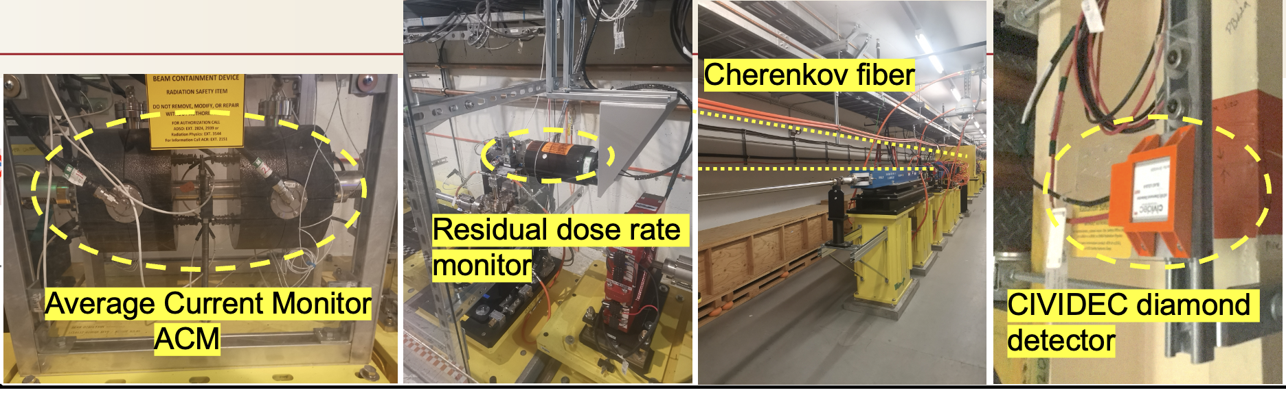
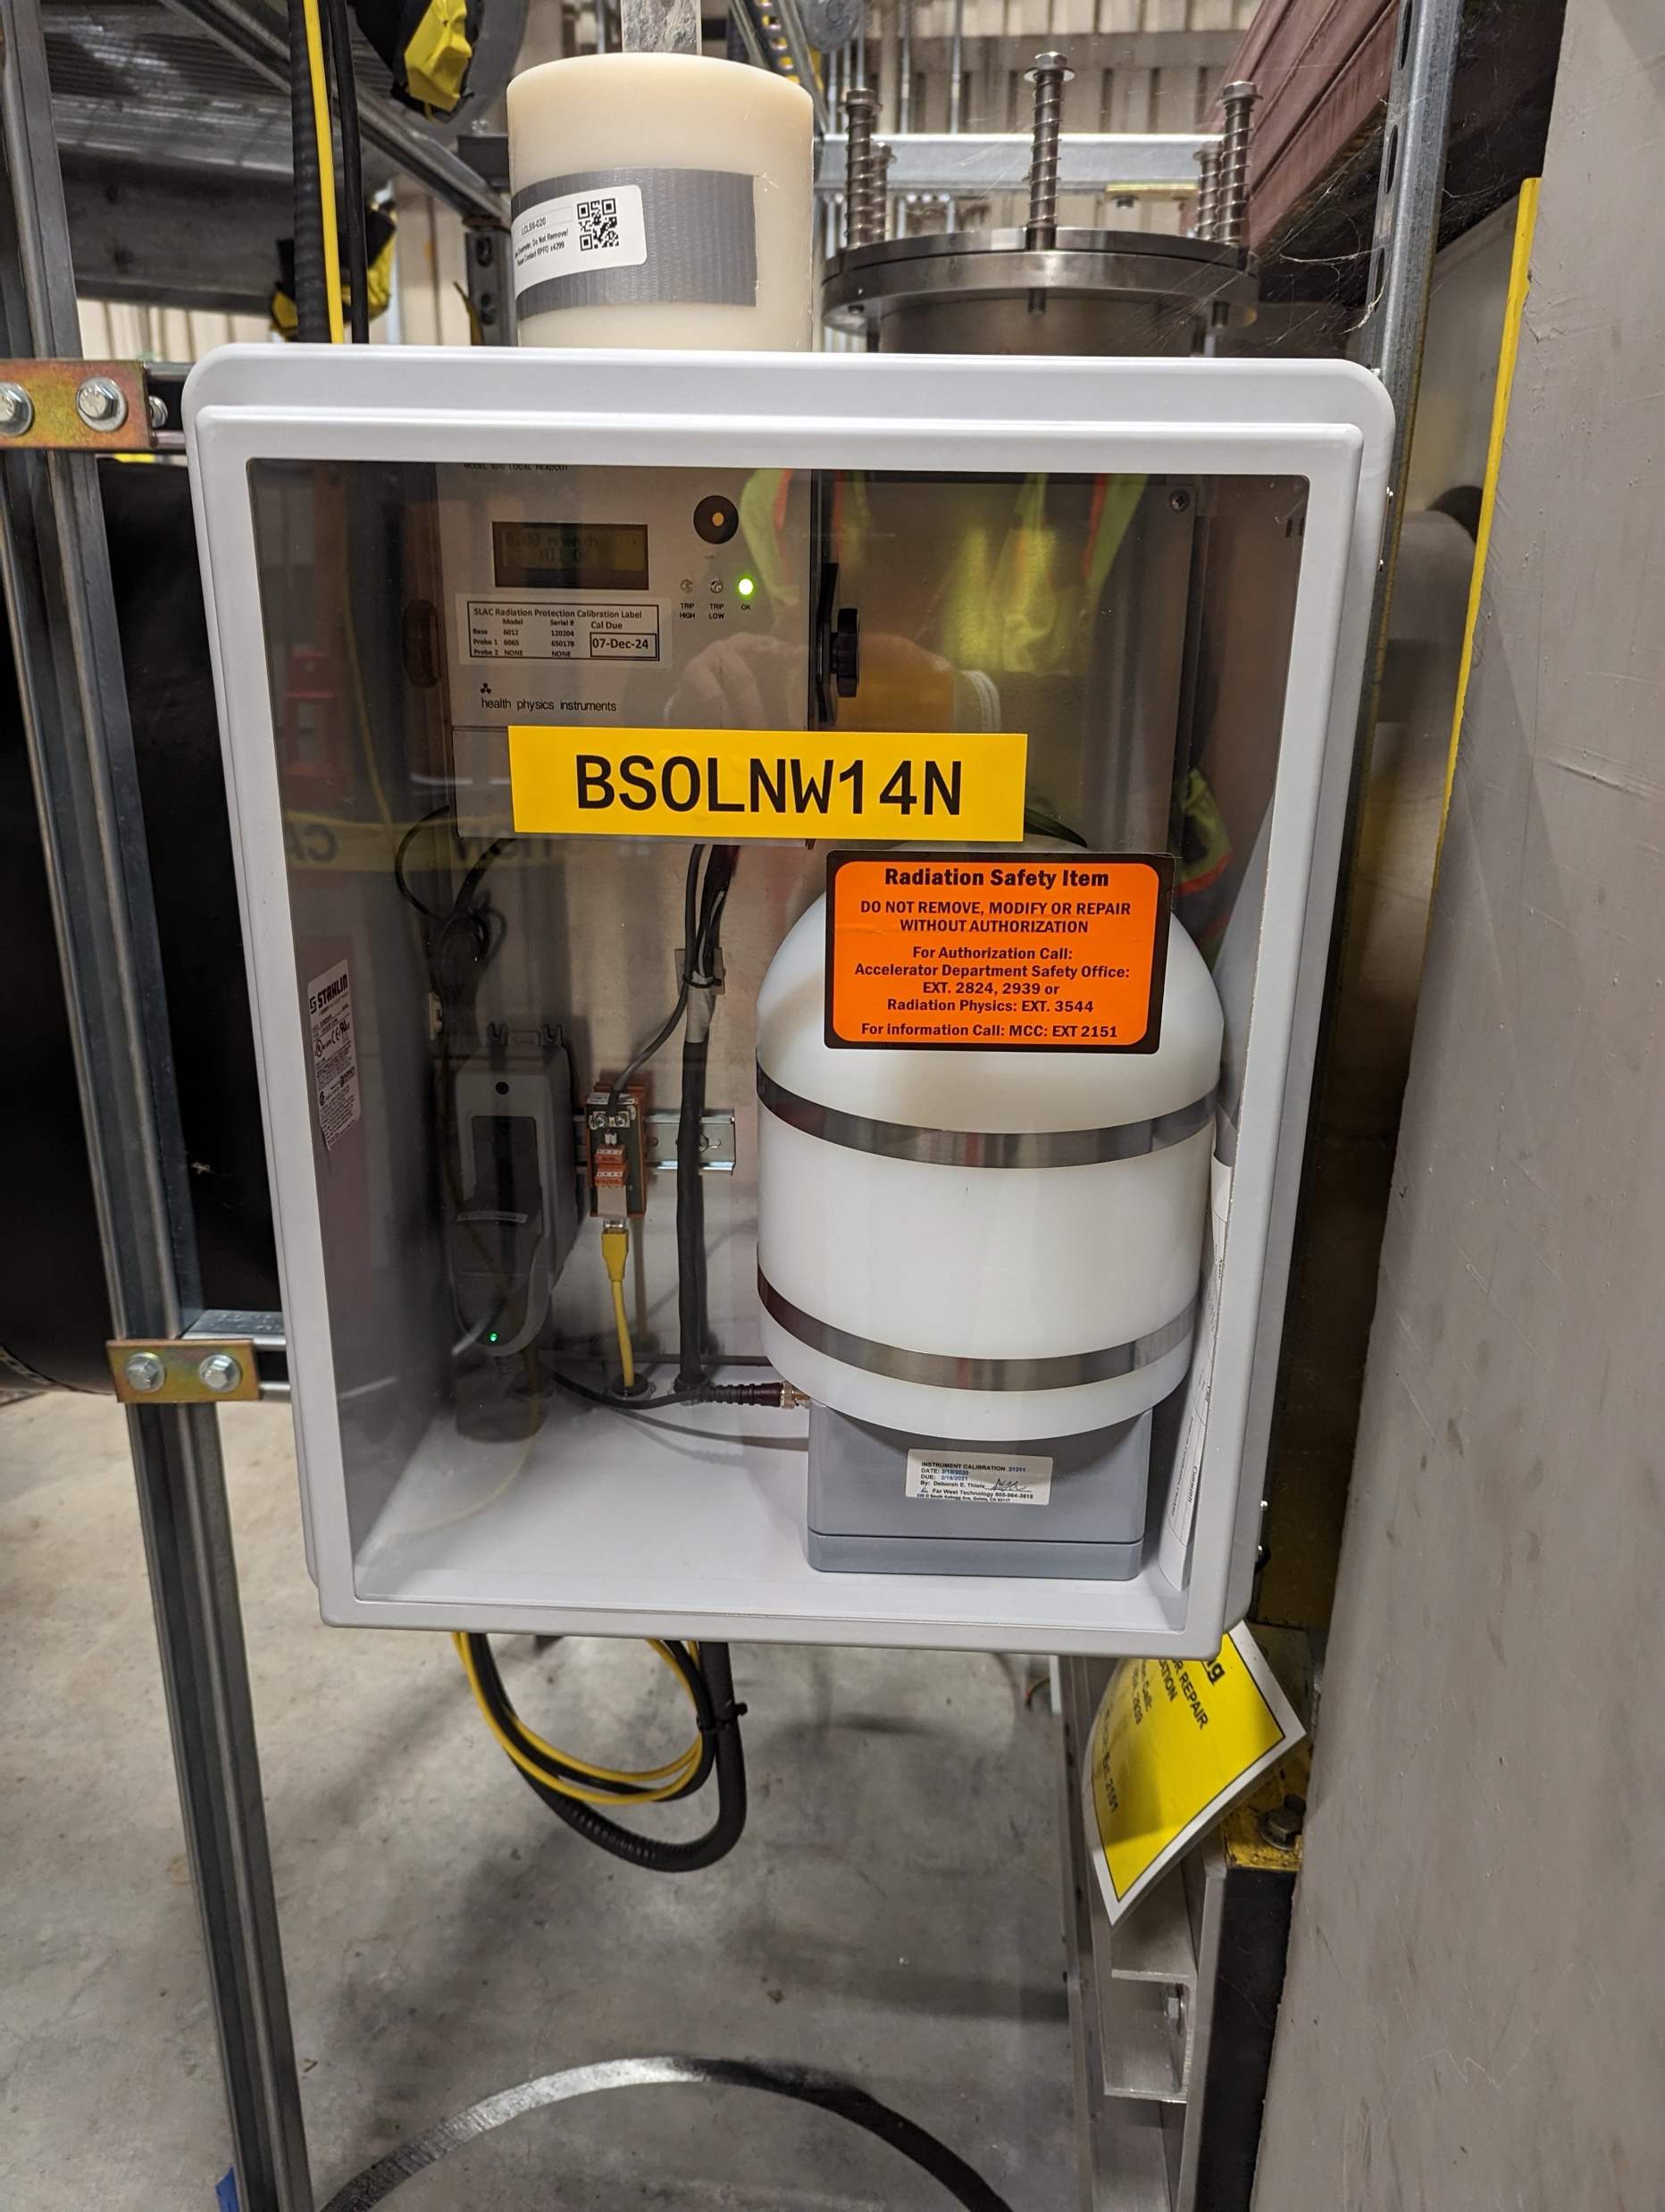
Beam Containment System - devices and limits
2 ACMs (one pair) cap current and power
Limit beam power (32 kW Nov 2025)
49 LBLMs span the entire linac (~200 m each) with overlaps
72 PBLMs: used for containment or machine protection
10 RDMs for residual dose monitoring
64 photon and neutron BSOICs trip at 50 µSv/h net
BSOIC
Credited ACMs set the envelope; diamonds, fibers and BSOICs detect abnormal events
9
T. Frosio | SATIF-17 - IBS Daejeon, October 2026

Slide 10
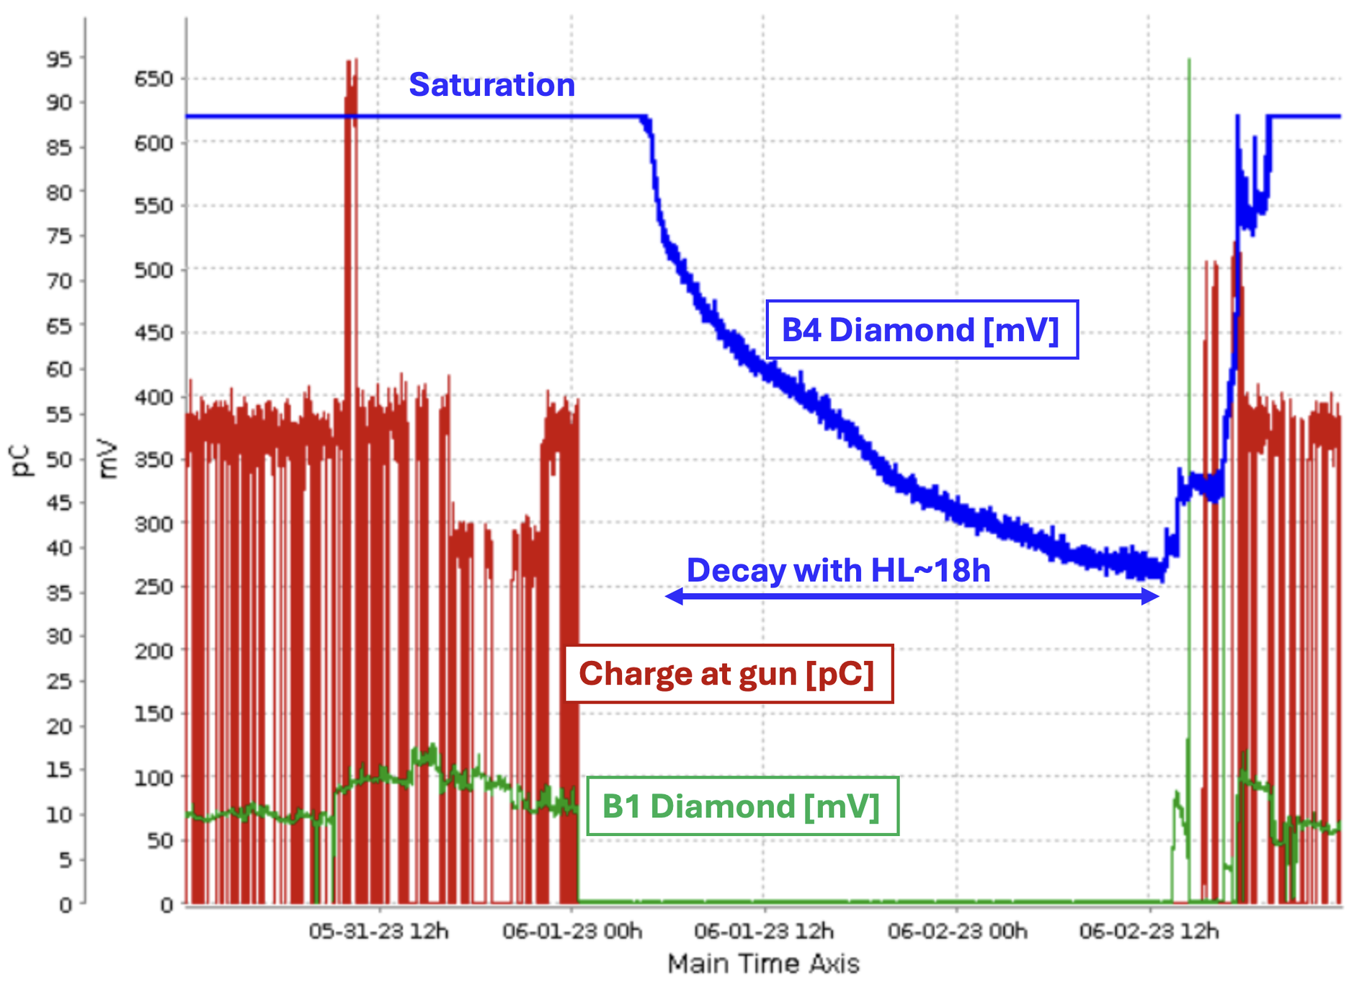
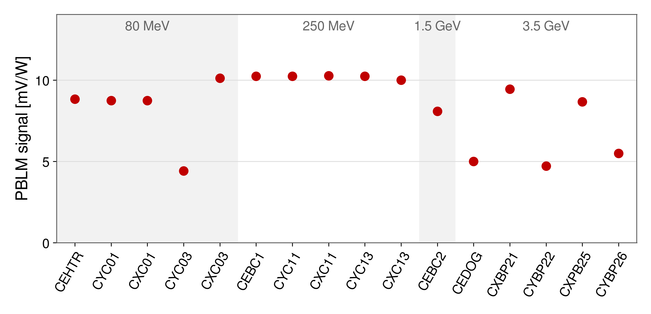
Diamond PBLMs - commissioning, archive and use
Commissioning: 50-75 W parked on 16 collimators, 80 MeV to 3.5 GeV: 4.4-10.2 mV/W, linear
Dynamic range: digitizer saturates near 625 mV, so a saturated diamond only bounds the loss (BP21 at 70-75 W)
Each diamond sees its own collimator: its signal rises when that collimator closes on the beam
In operation the B1 diamonds watch the collimators for beam containment and machine protection
Polycrystalline B4: charge trapping, then an 18 h decay that hides the real cool-down (right); single-crystal B1 since 2024
Single-crystal diamonds give a prompt, linear signal at their own collimator, up to the digitizer ceiling
T. Frosio | SATIF-17 - IBS Daejeon, October 2026
10

Slide 11
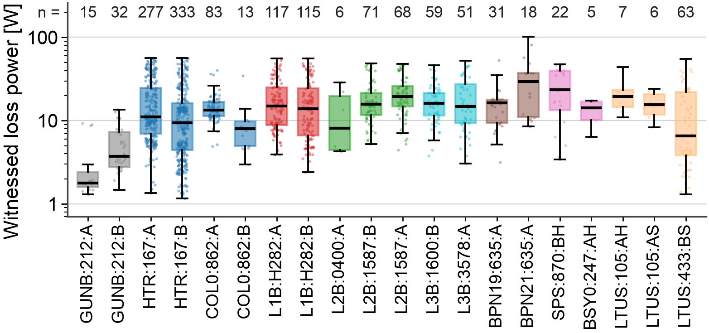
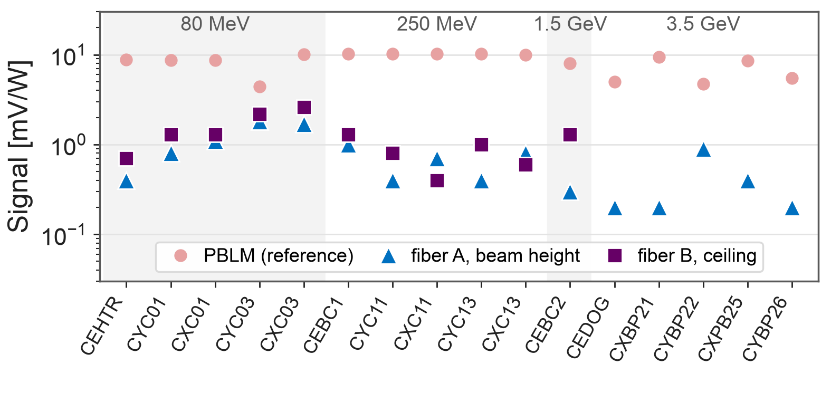
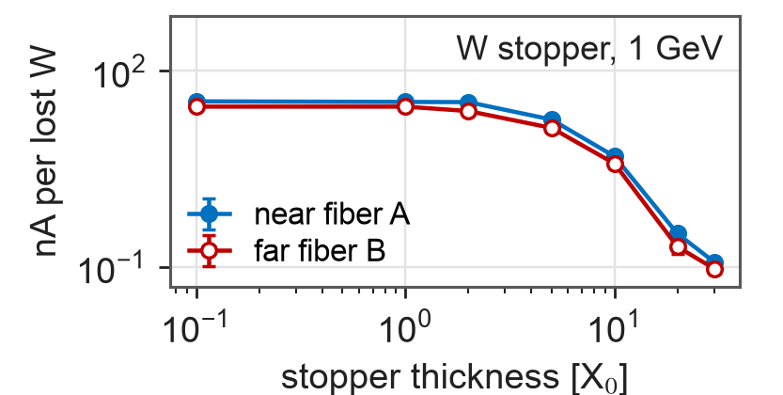
Cherenkov fiber LBLMs - results and limits
49 fibers, 6.3 km of silica: fiber A at beam height, 90 cm from the beam, B on the ceiling 3 m away
Per lost watt on 16 parked collimators: 0.2-2.6 mV/W, a spread of 13 against 2.3 for the diamonds
Target thickness: up to x100 less signal when X0 increases
Beam energy: x3.7 from 0.1 to 8 GeV on a thick target, as more particles escape
Loss location vs fiber: absorption in fiber / fiber overlap can reduce further / split the signal between two fibers
Archived fiber responses from 2023 to 2025 show those orders of magnitude
A fiber locates a loss in its span; its signal per watt depends on the loss, so each fiber needs one calibration
T. Frosio | SATIF-17 - IBS Daejeon, October 2026
11

Slide 12
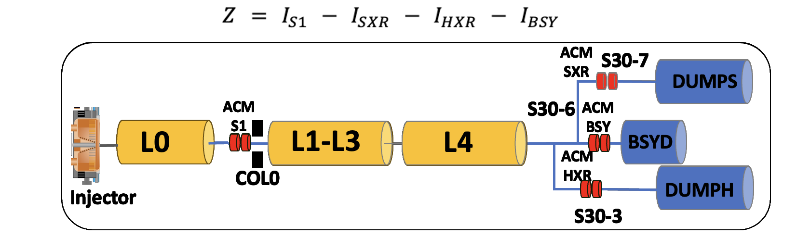
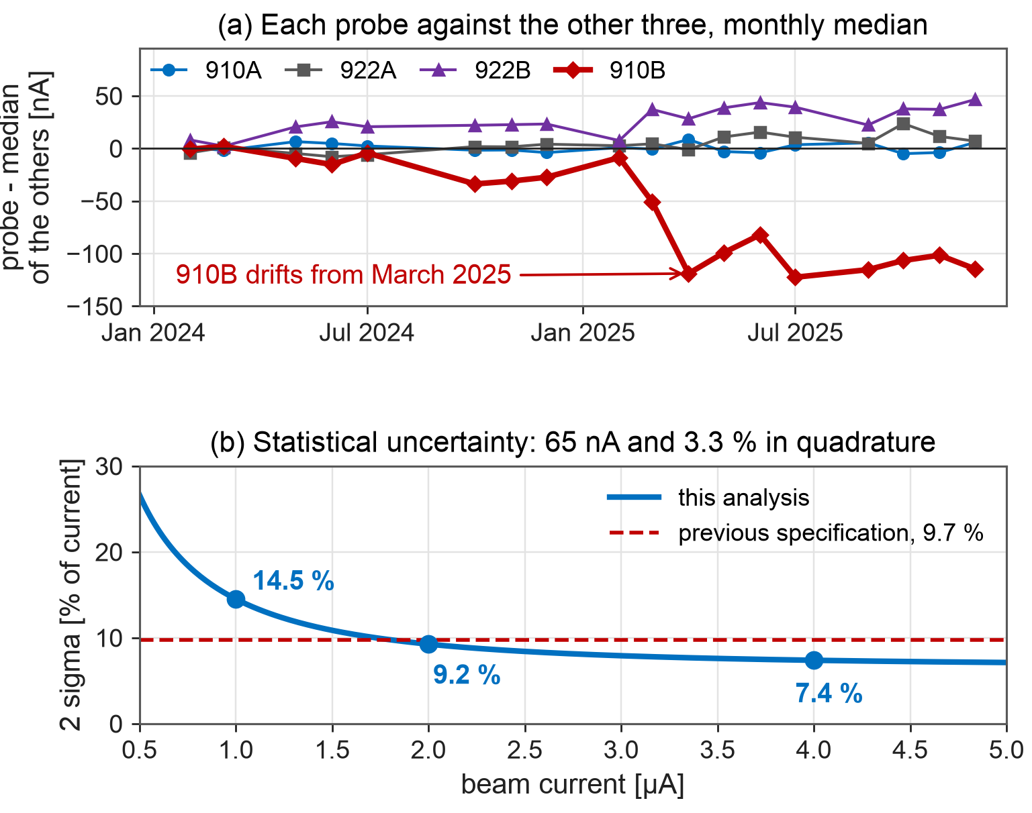
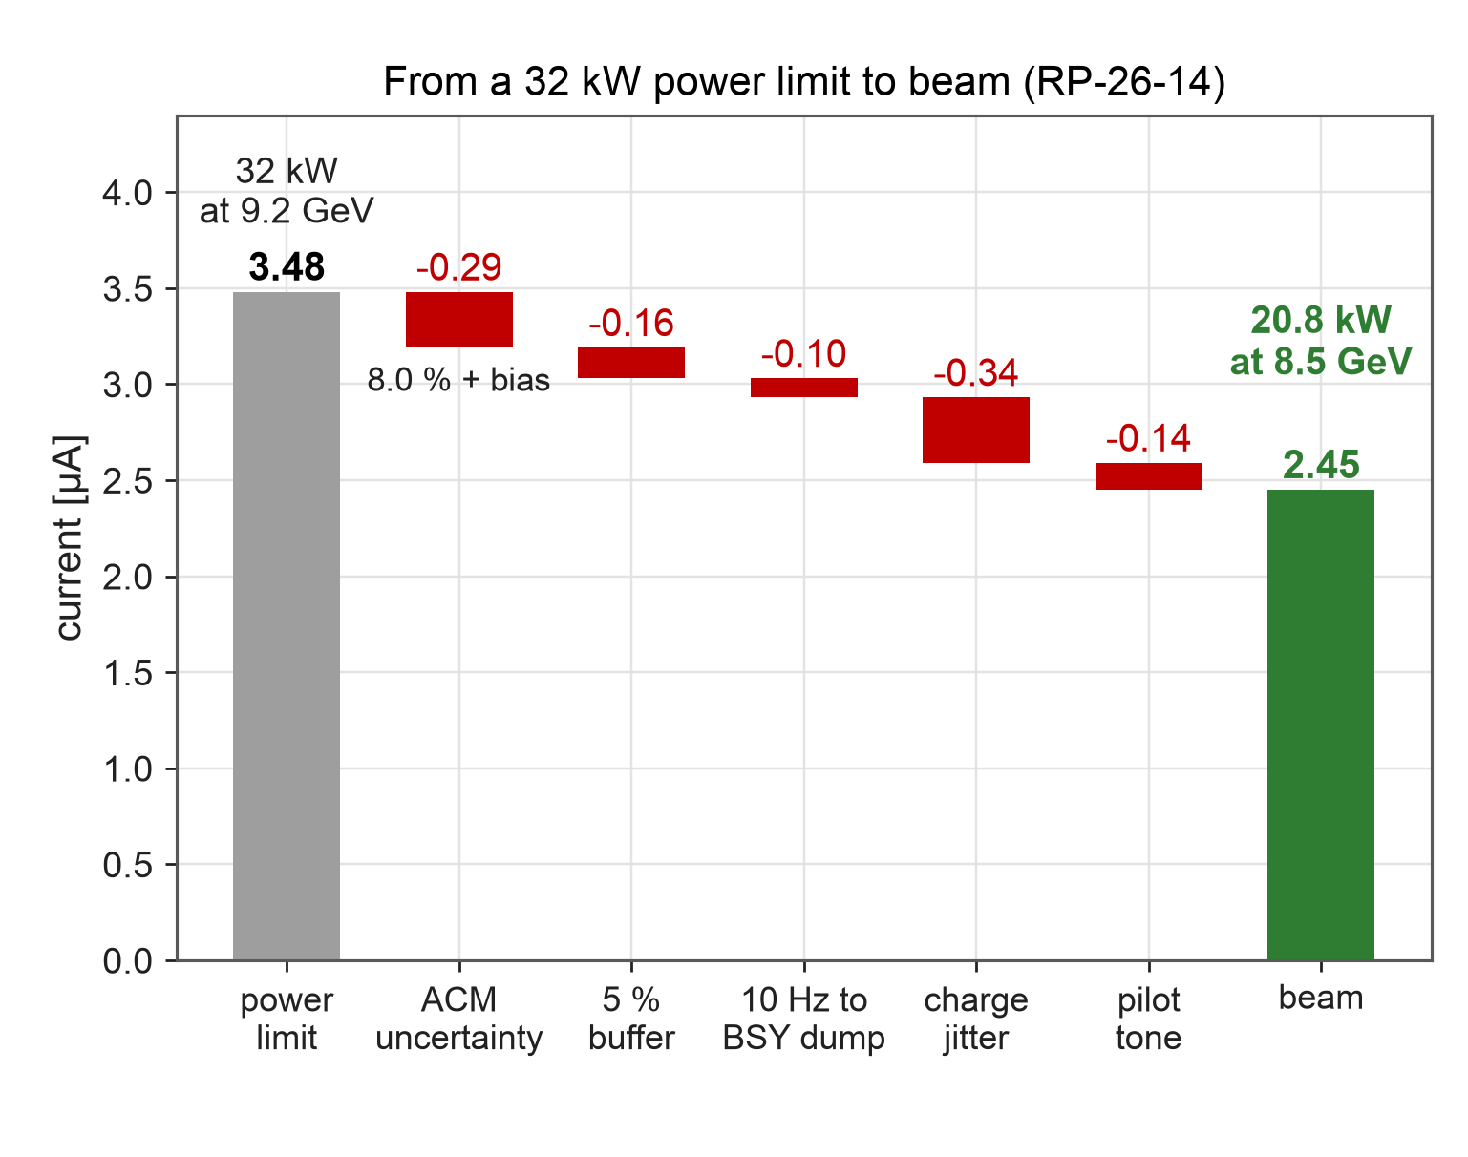
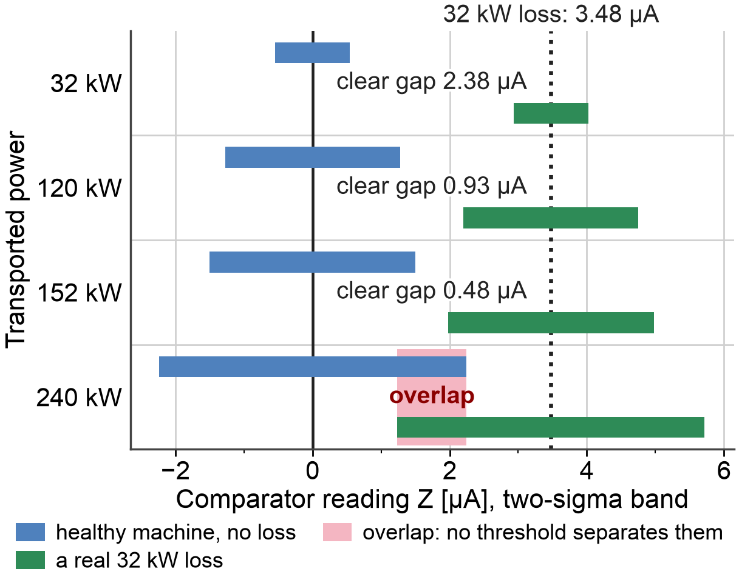
ACMs - uncertainty, available power, comparator
Average Current Monitors (ACMs): four probes at two stations see the same beam; over 24 months each is compared with the median of the other three
Median estimators: 65 nA and 3.3 % in quadrature, 9.2 % at 2 µA, 7.4 % at 4 µA (2 sigma)
Found: probe 910B drifting since March 2025 (84 nA bias), 922A dropping out in up to 3.5 % of beam-on hours
Cost: the trip threshold has to be below the limit by this uncertainty
A 32 kW limit leaves 20.8 kW of beam at 8.5 GeV, 65 %
Comparator: lost current Z = I(sector 1) - I(SXR) - I(HXR) - I(BSY); its noise grows with the power
A 32 kW loss (3.48 µA) trips clear of the uncertainty up to ~180 kW
Two years of archive set the ACM uncertainty; it costs part of every power limit and sets the comparator’s capability
T. Frosio | SATIF-17 - IBS Daejeon, October 2026
12

Slide 13
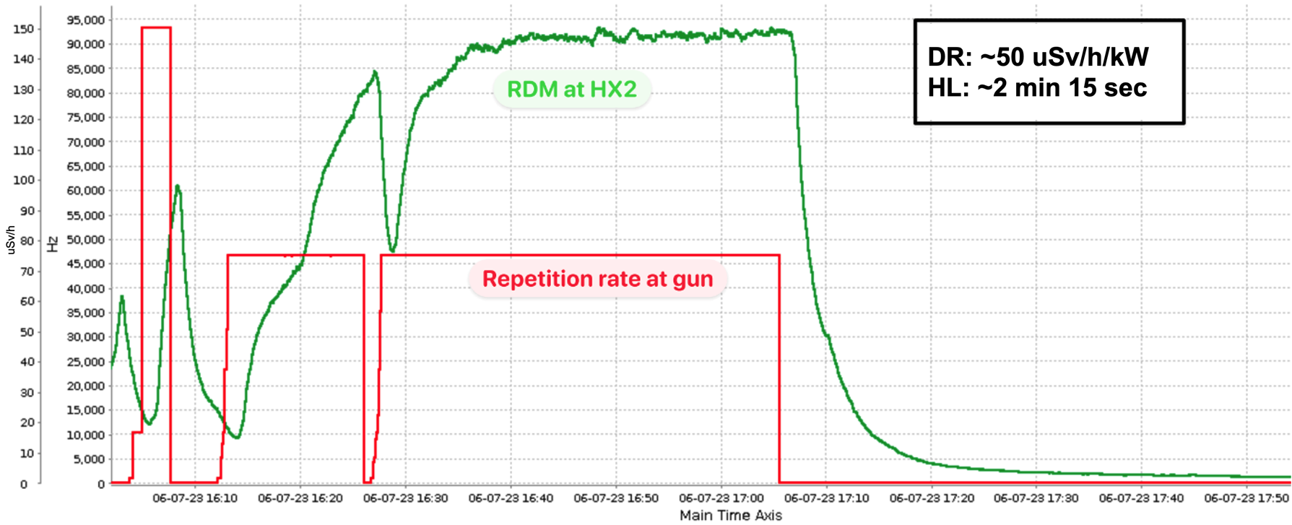
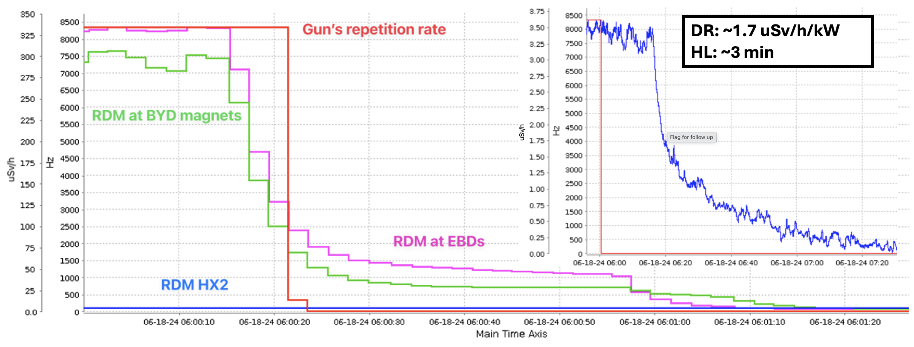
RDMs - O-15 in the dump water as a power meter
10 RDMs in the tunnel; one more in the HX-2 building, between the water tanks that cool the BSY dump and the electron beam dumps
Photonuclear reactions in a dump activate its cooling water, most likely into O-15 (about 2 min half-life), seen after the water transit time:
Dump
photonuclear O-15
Pipe to HX-2
3 or 15 min
Water tanks
RDM in HX-2
Reading
follows beam power
BSY dump
The reading rises after the transit, about 3 min from the BSY dump and 15 min from the electron dumps, and decays with measured half-lives of 2 min 15 s and about 3 min
50 µSv/h per kW for the BSY dump, 1.7 for the electron dumps, whose water travels 1 km instead of 40 m and decays on the way
Use: a real-time, non-invasive reading of the power on each dump; the tunnel RDMs read residual dose within 20 % of the survey meters
Electron dumps
Activated cooling water is a delayed but accurate power meter for each dump
T. Frosio | SATIF-17 - IBS Daejeon, October 2026
13

Slide 14
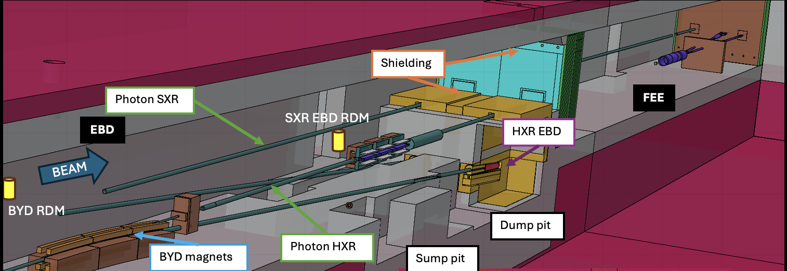
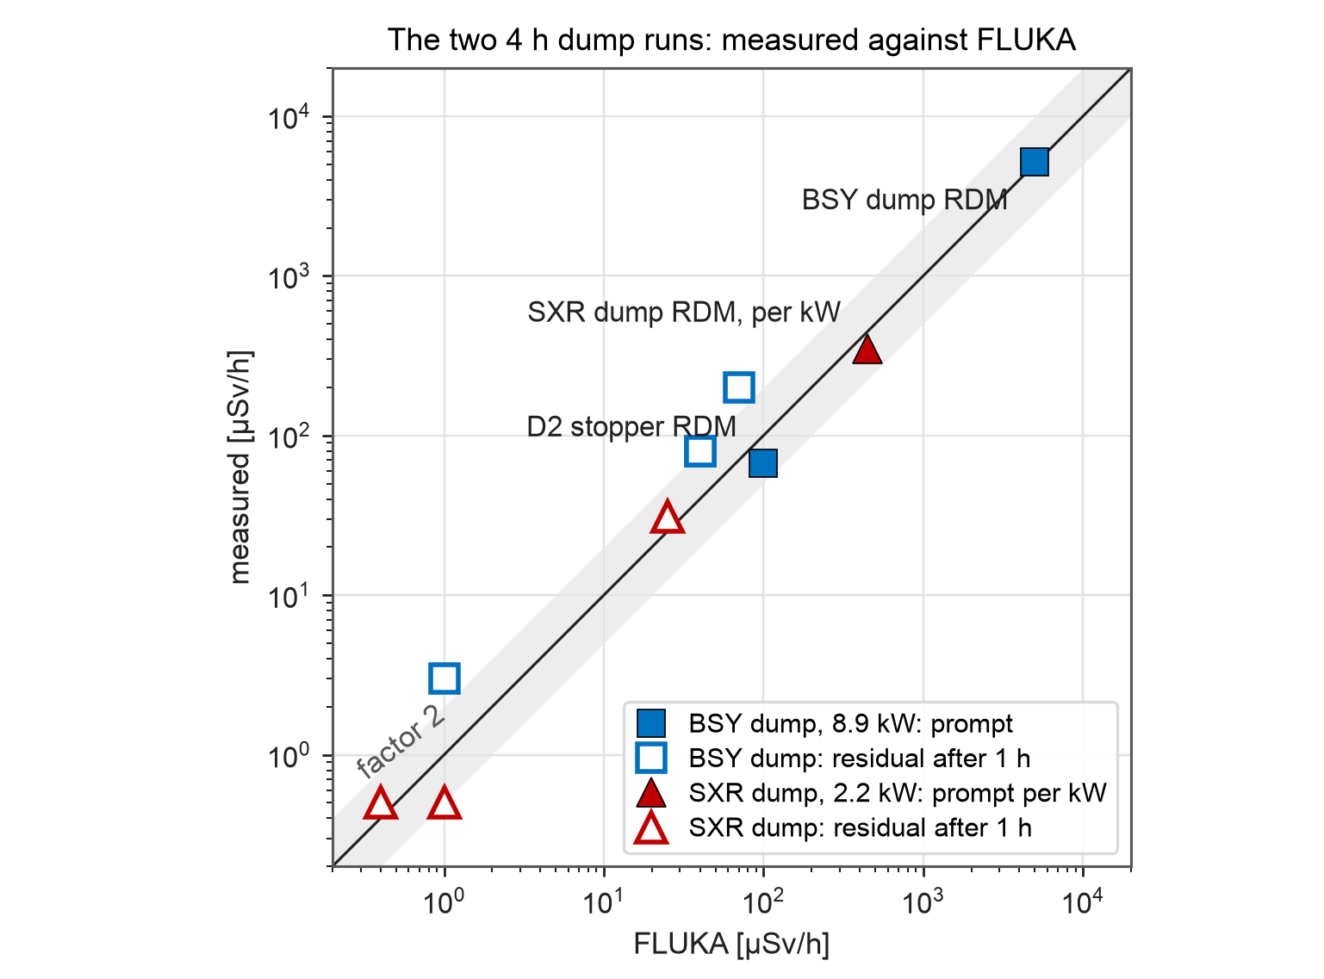
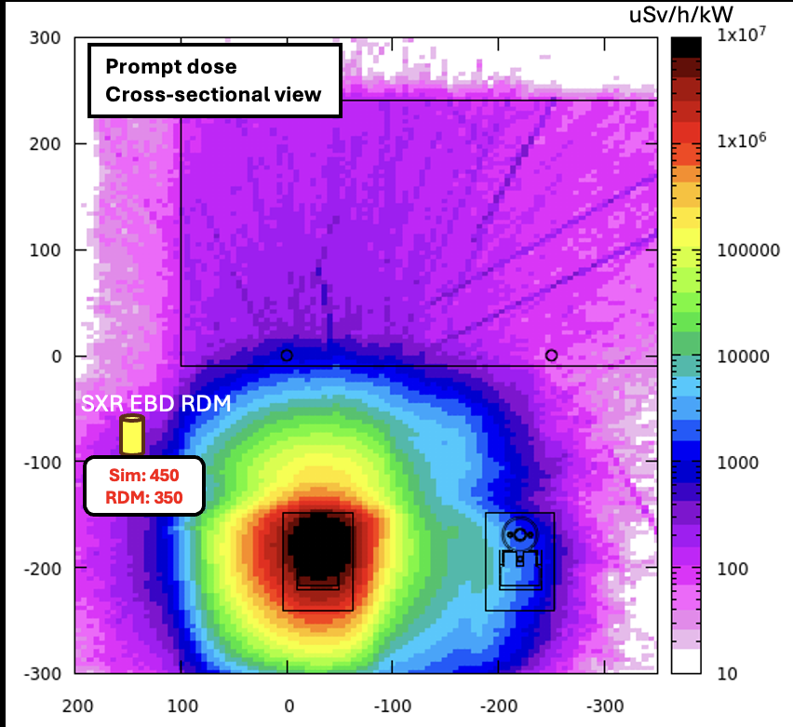
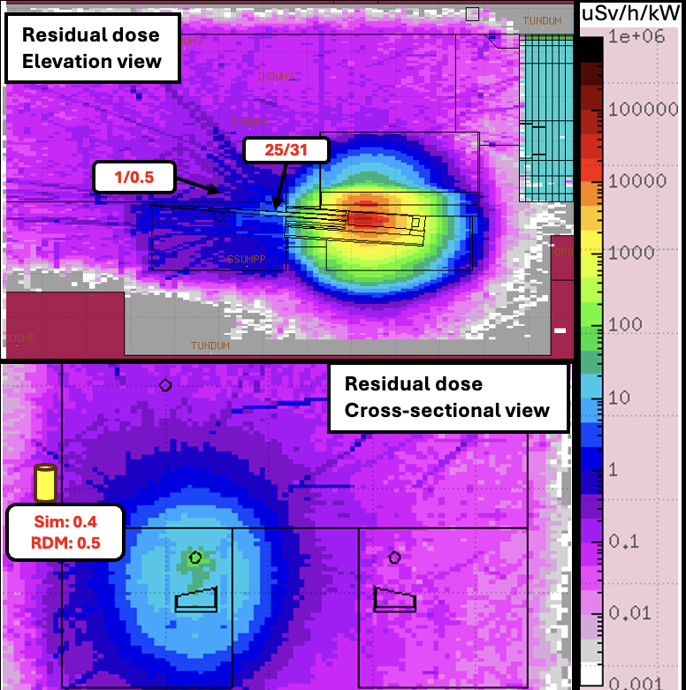
Dump benchmarks - prompt and residual
Two runs: 8.9 kW at 3.8 GeV on the BSY dump, inside its 17 m iron muon shield; 2.2 kW at 3.5 GeV on the SXR electron beam dump
Prompt, at the dump RDMs: FLUKA within 30 %, 5000 against 5200 µSv/h (BSY) and 450 against 350 µSv/h per kW (SXR)
SXR residual: within a factor of two everywhere; 3 µSv/h or less in accessible area, 31.5 µSv/h inside the dump shielding
BSY residual: 200 measured against 70 µSv/h on the shield sides after 1 h, 170 measured after 2 h: apparent half-life 4.3 h, twice the collimators'
Why FLUKA is low: earlier runs had activated the dump, the iron is stacked with gaps, and this steep dose gradient in the shielding
FLUKA gives the prompt dose at both dumps within 30 %; the BSY dump residual is 2-3 times low, from irradiation history
T. Frosio | SATIF-17 - IBS Daejeon, October 2026
14

Slide 15
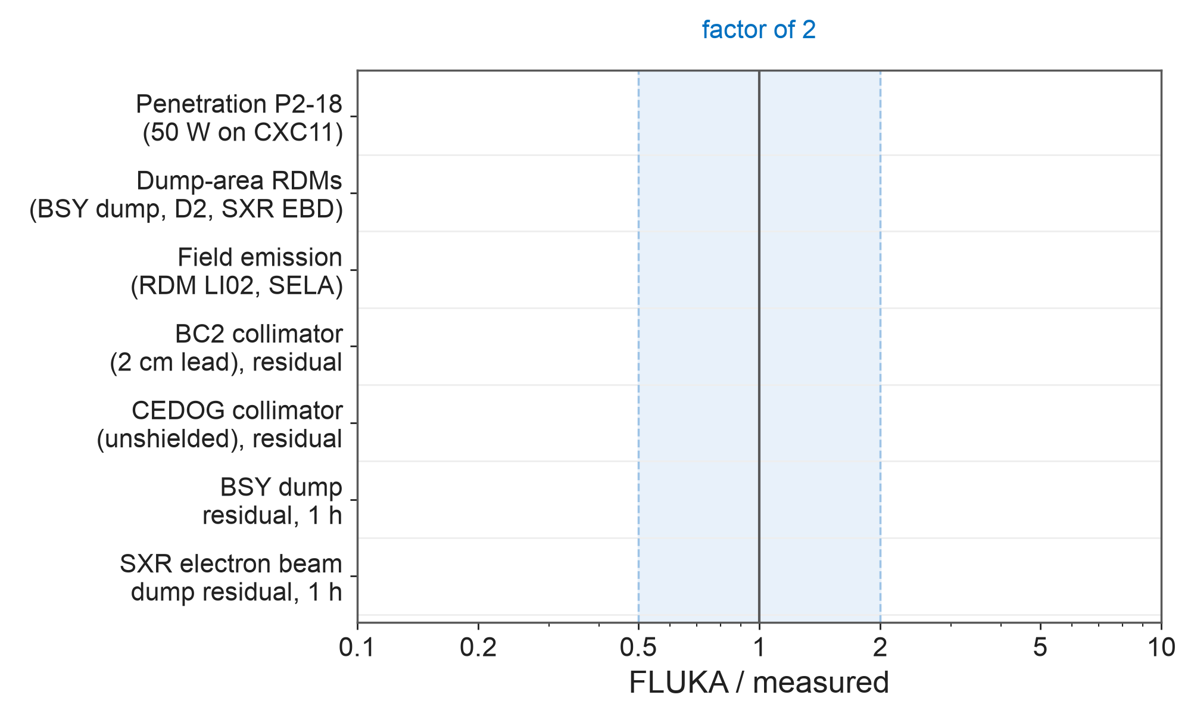
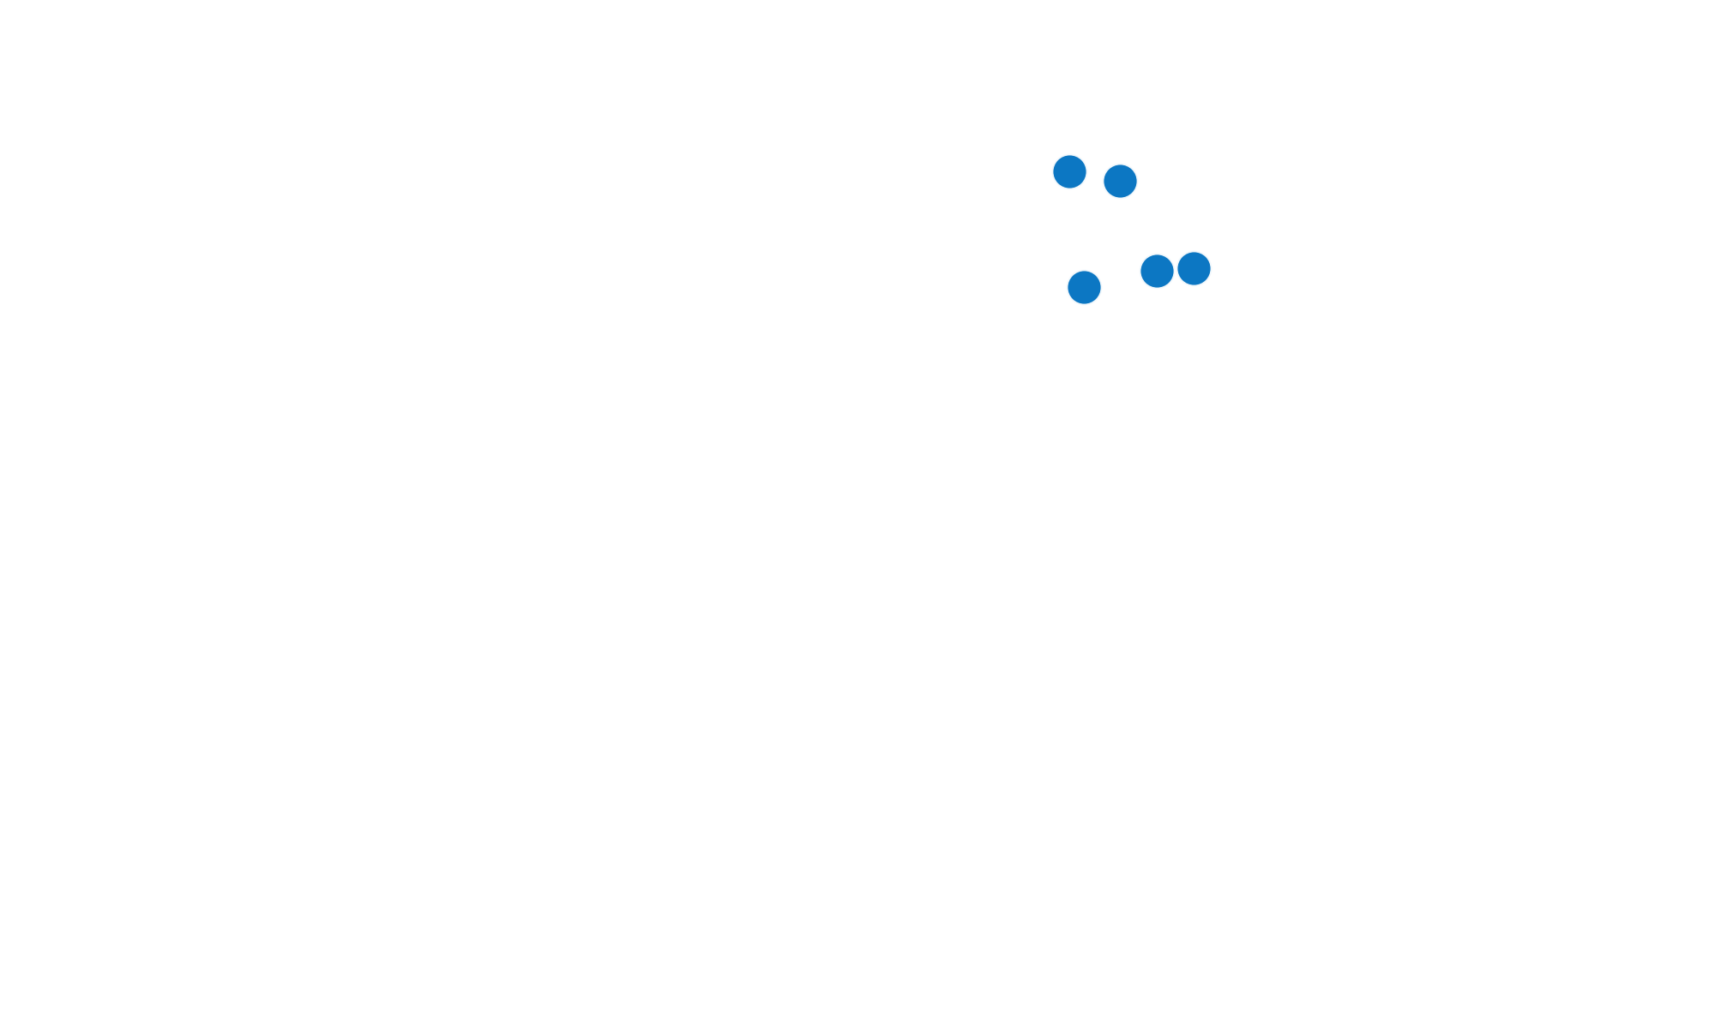

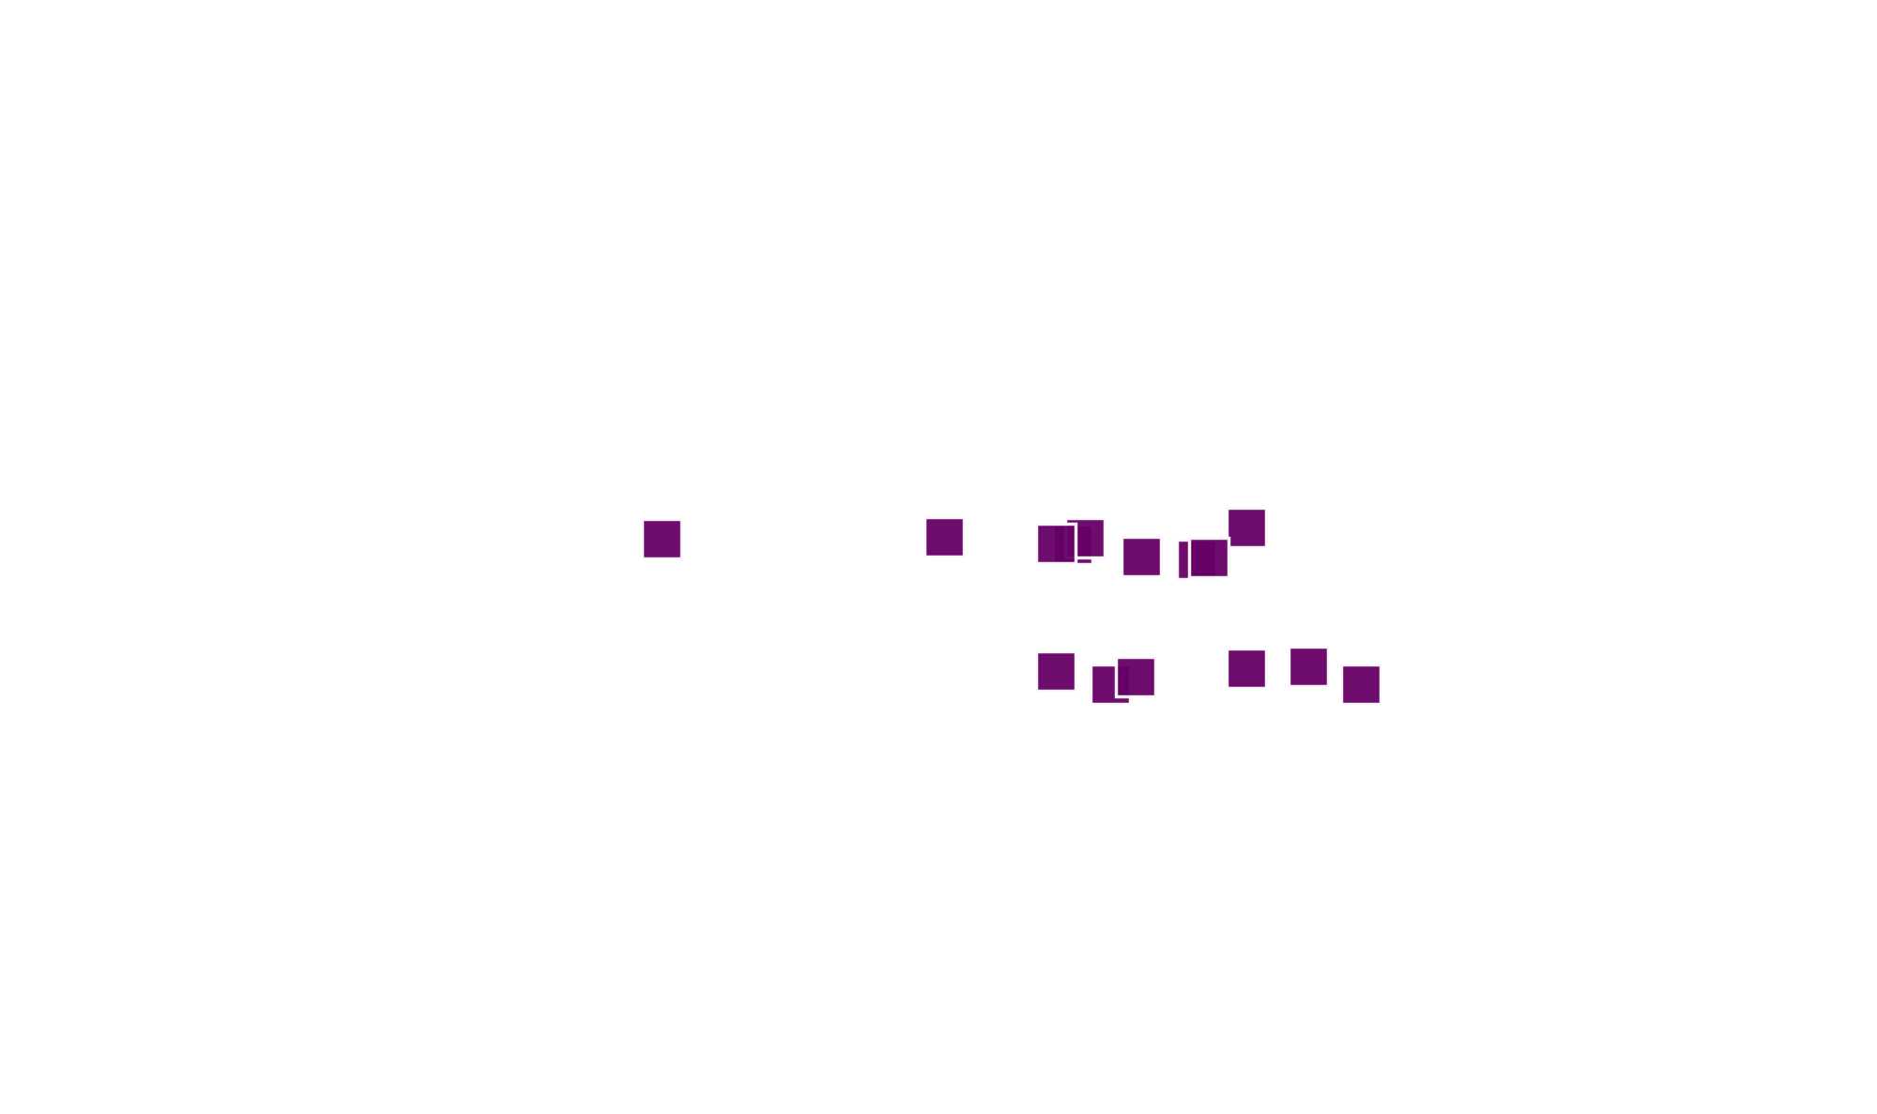
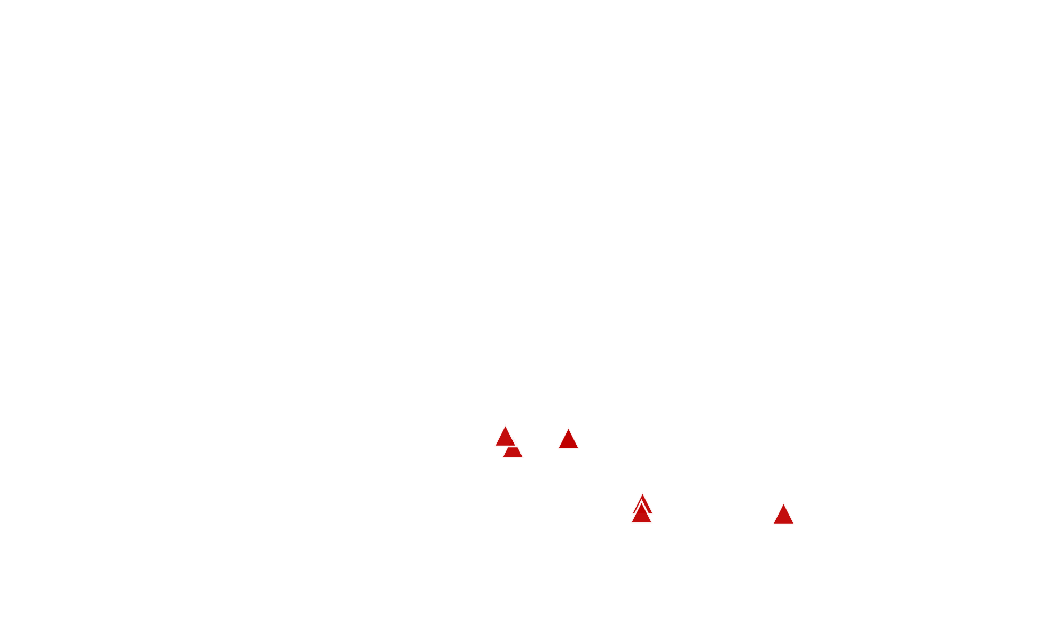
Benchmarks - FLUKA / measured, all cases
Prompt, at a penetration and the dump RDMs: 0.9-1.5
Field emission, LI02 RDM with 1 nA per cryomodule: 0.67
Collimator residual, 20 W for 3 h: BC2 within 30 % at most points, CEDOG within 2; one BC2 point off by 7
Dump residual: SXR within 2; BSY 2-3 low, from irradiation history and stacked iron
Next: FLUKA reliable for design (HE upgrade)
Prompt dose within 0.9-1.5 and residual mostly within a factor of two, from 20 W on a collimator to 9 kW on a dump
T. Frosio | SATIF-17 - IBS Daejeon, October 2026
15

Slide 16
Conclusions
FLUKA: cryomodule field-emission source, beam lines from the MAD tapes, undulator photons within 1 % of SPECTRA; prompt dose within 0.67-1.5, residual mostly within a factor of two
Shielding: every prompt reading outside the enclosure stayed below 5 µSv/h, from a few watts to 19 kW
Diamonds and RDMs: single-crystal diamonds are linear up to the digitizer ceiling; the activated cooling water (O-15) is a good proxy for the power sent to each dump
Fibers: they locate a loss, but the signal per watt vary significantly depending on other parameters (target thickness x100, location of the loss..etc)
ACMs: the archive gives 7.4-9.2 % uncertainty (2 sigma) and identified discrepancies between probes; uncertainty and margins leave 65-80 % of a power limit as beam; the comparator is suitable to catch beam losses up to a certain operational power
For LCLS-II-HE: characterize each new cryomodule, re-measure the ACM uncertainty at higher power, calibrate the fibers, confirm measured dose rates below threshold limits during the ramp-up
T. Frosio | SATIF-17 - IBS Daejeon, October 2026
16

Slide 17
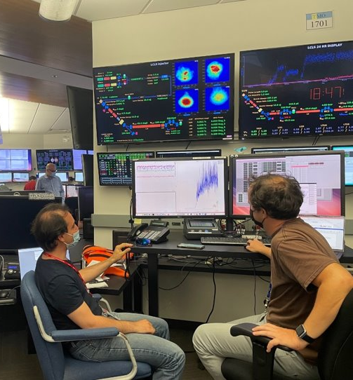
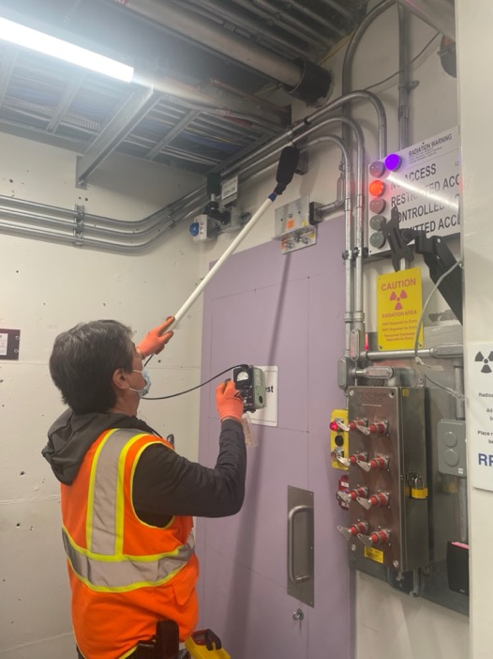











Injector West maze in S0
Monitoring from ACR
Linac South penetration in S11-S30
BTH service buildings
PPS ADIT in S10
PPS doors in BSY
EBD-FEE rack room
Questions?
HX-2 Housing outside BSY
BTH PPS door
North penetration S0-S30
PS0 in S30
penetrations in B136
VTL penetrations

