Slide 1
Swap Out Safety Analysis Methods for the ALS-U Project
SATIF-17, 2026
IBS Science Culture Center, Daejeon, Korea
Stefania Trovati, Maria Aladic, Patrycja Dyrcz, Stanimir Kisyov
October 20th, 2026

Slide 2
Outline
ALS and ALS-U Project Overview
Swap Out Incident
ALS-U Swap Out Safety Approach
Risk Analysis
Radiation Monitors and Shielding
Radiation Safety Analysis Approach
Beamline Selection
Raytracing
Radiation Dose Calculations
Results
Summary

Slide 3
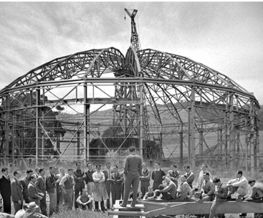
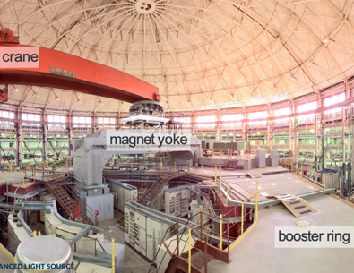
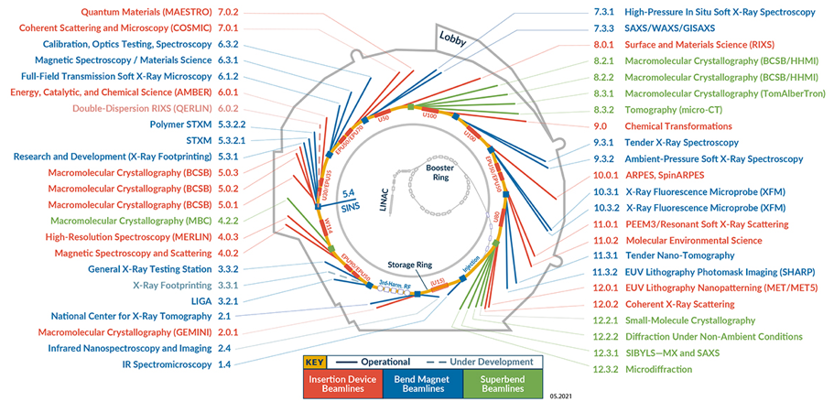
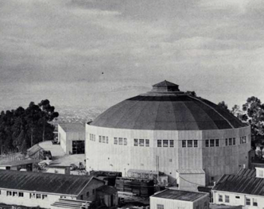
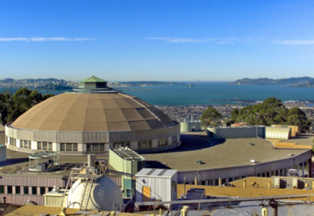
The Advanced Light Source (ALS)
Built between 1987-1993, it incorporates the dome of the Lawrence’s 184-inch cyclotron
Accelerators: Linac (50 MeV), booster and storage ring (1.9 GeV, 500 mA)
Mainly developed for soft X-ray science, it has added, over time, hard X-ray beamlines
1940

Slide 4
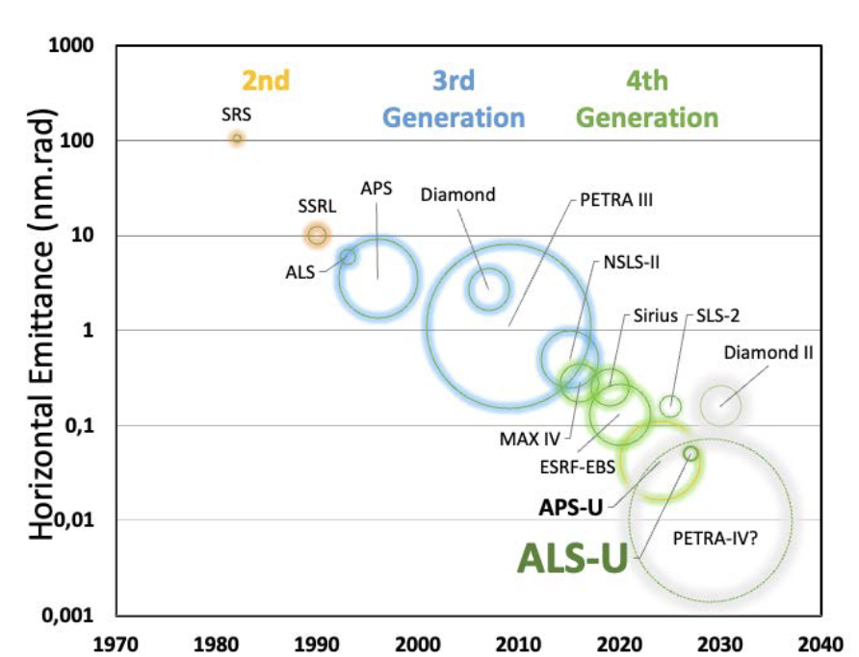

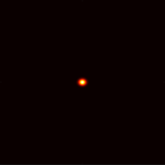
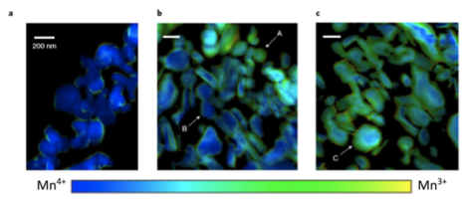
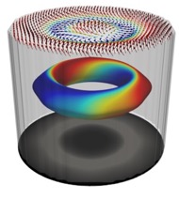
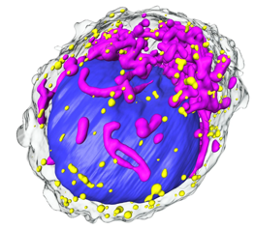
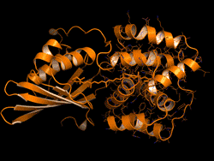
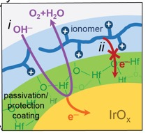
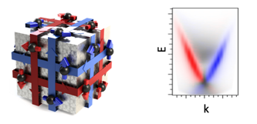
ALS → ALS-U
Main Goals
  Increase in brightness and coherent flux of soft x-rays (@1 keV) of at least 2 orders of magnitude beyond today’s ALS capabilities
  Nearly fully coherent beams in the soft x-ray range
  Infrared and hard x-ray capabilities comparable to present-day ALS
  Development of a set of experimental capabilities that will enable to resolve nanometer-scale features and interactions, for real-time observation
ALS
ALS-U
ALS-U will enable 3D ptychography (100 hour measurement down to 1 hour)
ALS-U coherence will expand the capability to study electronic properties at the quantum level with high spatial resolution
ALS-U brightness will inform on how small molecules influence functionality and enhance imaging of sub-cellular structures

Slide 5
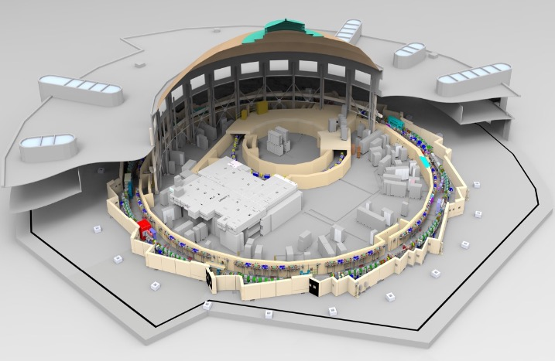
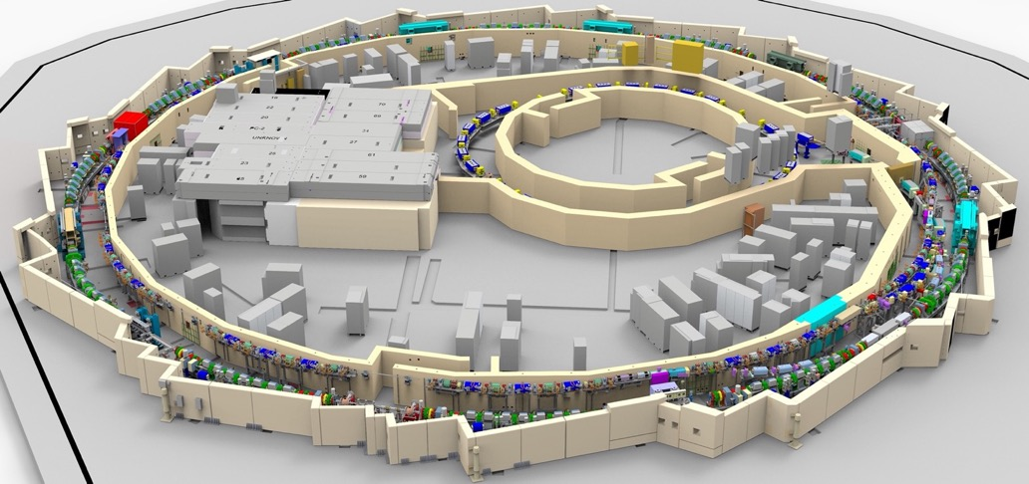
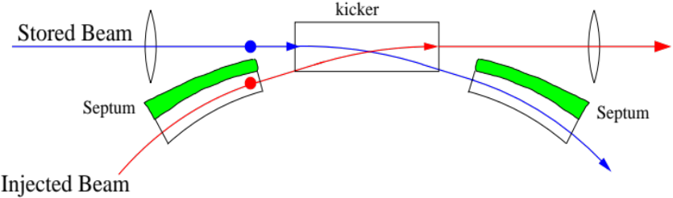
ALS-U Project
Insertion Devices
Transfer Lines
Accumulator Ring
Storage Ring
New 9-bend achromat storage ring (SR)
New 3-bend achromat accumulator ring (AR)
3 new transfer lines, of which two are used to swap 2 bunch trains out between AR and SR (ATS and STA)

Slide 6
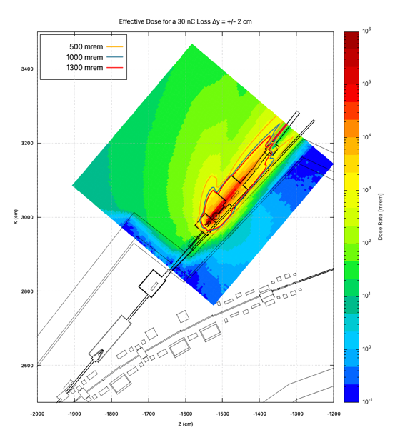
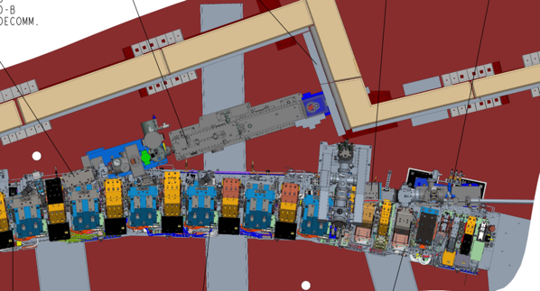
Swap-Out Incident
During swap out an errant 30 nC electron bunch train could be injected into a photon beamline
With no mitigations, it could reach the experimental floor and generate few-rems doses for a 30-nC bunch train
For a sustained swap-out incident, doses would become unacceptable!
The lack of First Optics Enclosure contributes to the high dose levels.
30 nC

Slide 7
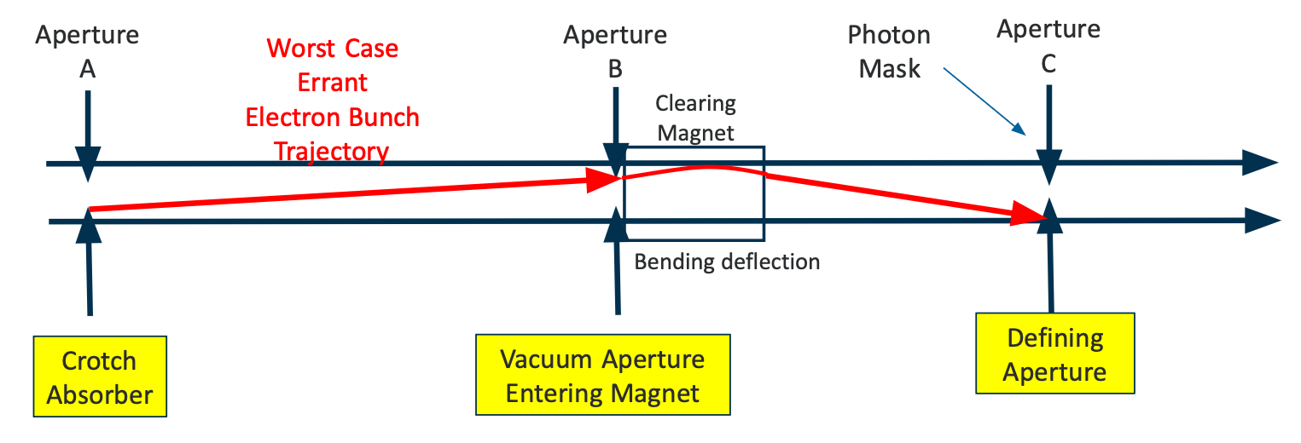
ALS-U Swap-Out Safety Approach
Diverse and redundant controls approach, that leverages the ALS top-off safety framework, are planned:
  energy matching and beam current interlocks to reduce probability of occurrence
  radiation monitor interlocks to limit the duration of an event
  shielding to reduce severity
  photon beamline apertures to prevent the electron beam from reaching the experimental floor
In addition, for swap-out:
    clearing magnets at all beamlines to prevent beam from reaching the floor
    injection sequencer software that reduces injection if injection efficiency < 90%.
EXISTING
NEW

Slide 8
Risk Analysis
Sustained unmitigated swap out event yields a high risk
Using the current ALS top-off strategy of credited apertures only to intercept the beam not viable due to the large dataset of parameters to analyze
Without clearing magnets, we could not reach low or negligible risk
The clearing magnets allow
  to force the beam loss in the tunnel
  to identify, together with apertures, where the beam will strike and therefore optimize also radiation monitor location.
 | Frequency →
Severity ↓ | I - High >1.00E-01 Events/Year | II - Medium ≥1.00E-02 & ≤1.00E-01 Events/Year | III - Low ≥1.00E-04 & <1.00E-02 Events/Year | IV - Extremely Low <1.00E-04 Events/Year
A - Considerable Impact [Death] (≥100 Rem) | Unmitigated Swap Out Scenario HIGH |  | With Stored Beam Interlock Energy Match Interlock (depending on initiating event) MEDIUM
B - Limited Impact [Severe Injury] (≥25 & <100 Rem) | With clearing magnets and apertures HIGH |  | With Stored Beam Interlock Energy Match Interlock (depending on initiating event) LOW
C - No Significant Impact [Minor Injury] (≥5 & < 25 Rem)
D - Negligible impact (<5 Rem) | With Interlocked Radiation Monitors LOW |  | With Stored Beam Interlock Energy Match Interlock and Interlocked Radiation Monitors NEGLIGIBLE

Slide 9
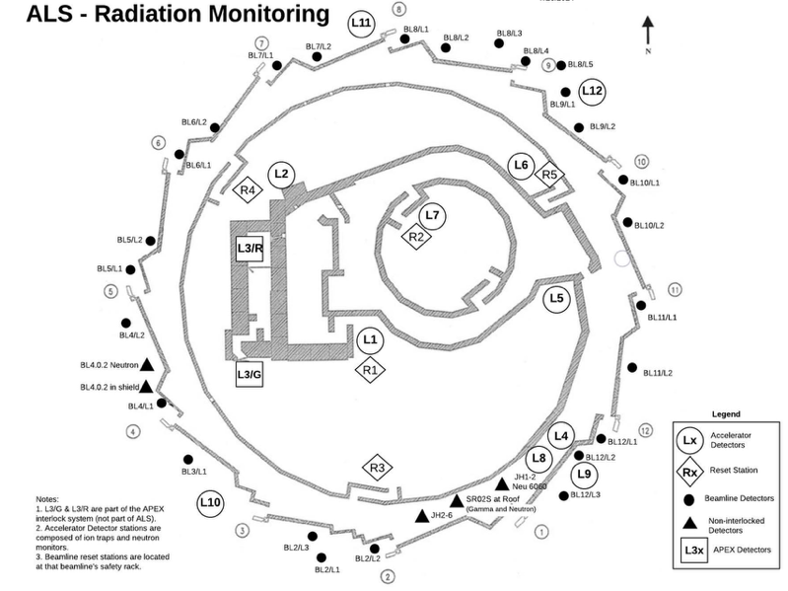
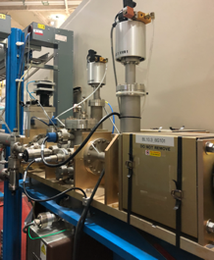
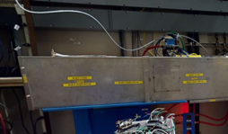
Radiation Monitors & Shielding
Beamline radiation monitors are already installed and credited for top-off. At least 1 monitor per beamline
Interlocked to PPS (Swap-Out): in case of a trip, shutters are closed and swap-out injection is inhibited
Since there are no first-optics enclosures on the experimental floor, shielding is installed directly on the beamline: lead collimators and exclusion zones are used to contain bremsstrahlung levels.
Exclusion zone
lead
collimator

Slide 10
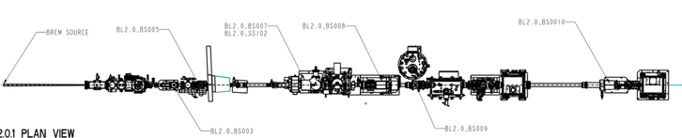
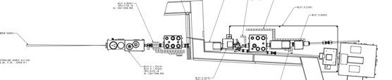
Radiation Safety Analysis Approach
43 Beamlines now and still ~30 after the upgrade
Need to reduce the number of cases to study to validate clearing magnet design before all beamlines can be studied in detail
Beamlines were divided based on their source, which also determines some of the geometrical layout in the tunnel and therefore also the type of clearing magnet:
  ID beamlines with no first optics in front-end (6)
  ID beamlines with first optics in front-end (6)
  BM beamlines with hard bend magnet as source (8)
  BM beamlines with warm bend magnet as source (9)
  Wiggler beamlines (3)
ID with FO on the exp. floor
shield wall
tunnel
exp. floor
first optics
ID with FO inside shield walls
first optics

Slide 11
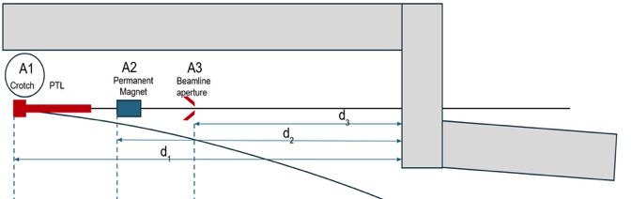
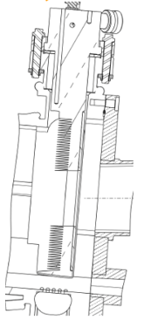
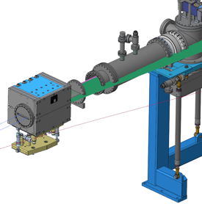
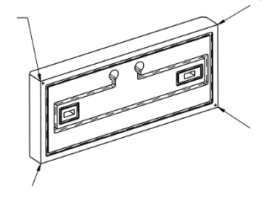
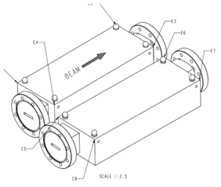
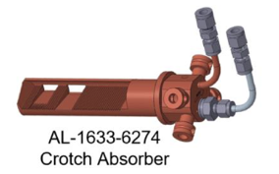
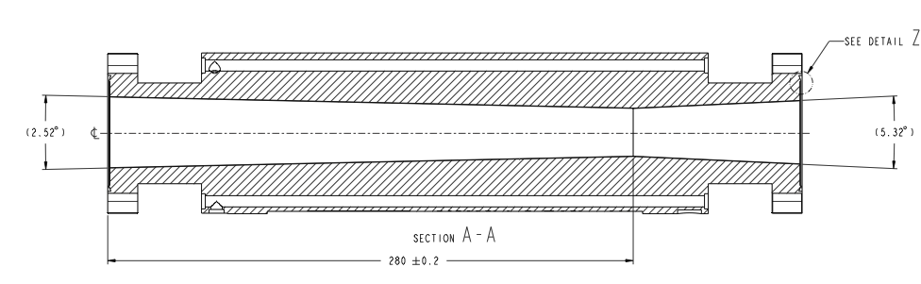
Radiation Safety Analysis Approach
Geometry layout of the Front-Ends was used to reduce the number of beamlines to analyze to worst-case types, based on
the distance of the narrowest apertures from the entrance to the experimental floor
on the aperture sizes
presence and aperture of bremsstrahlung collimators in the front-end.
A1
A3
Beamline Aperture
FRONT-END
PTL
A2
Clearing Magnet
beam
CROTCH
CROTCH
CLEARING
MAGNET
APERTURE
beam
COLLIMATORS
PTL
beam

Slide 12
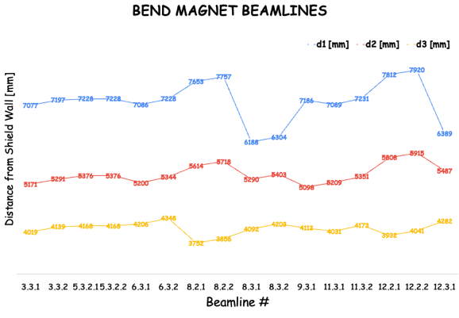
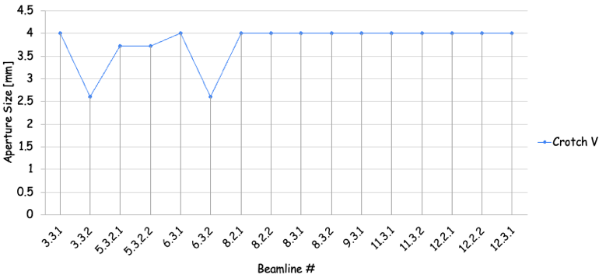
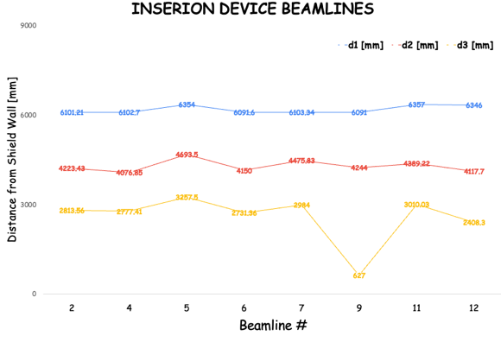
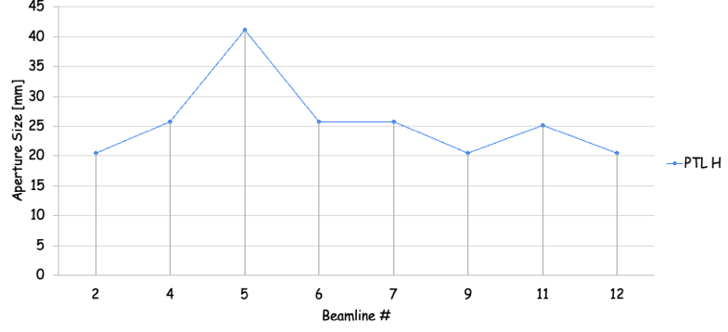
Radiation Safety Analysis Approach

Slide 13
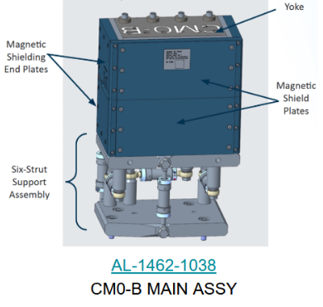
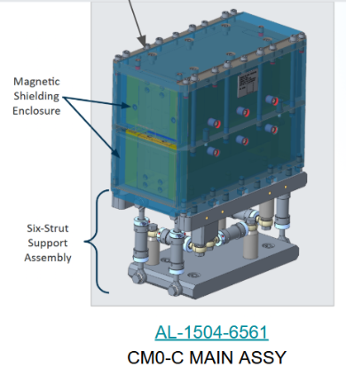
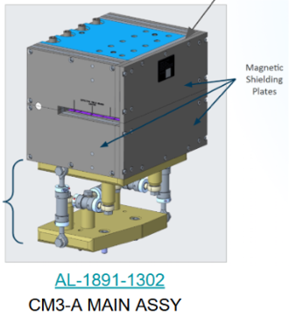
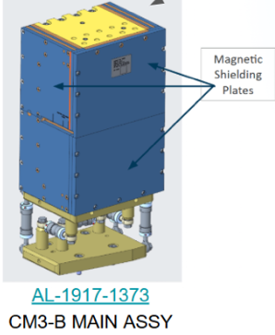
Beamline Selection
4 types of Clearing Magnets, 5 types of beamlines
CM family | CM Name | Beamline | CM B field
1 | CM0-B | 02.0 (no optics in tunnel) | 1.4 T
1 | CM0-B | 07.0 (new IDBLs, optics in tunnel) | 1.4 T
2 | CM0-C | 05.0 (wiggler) | 0.67 T
3 | CM3-A | 8.2 (hard-bend BL, optics in tunnel) | 1.25 T
4 | CM3-A | 3.3 (white light BL, worst case) | 1.25 T
5 | CM3-B | 08.3 | TBD
5 | CM3-B | 12.3 | TBD

Slide 14
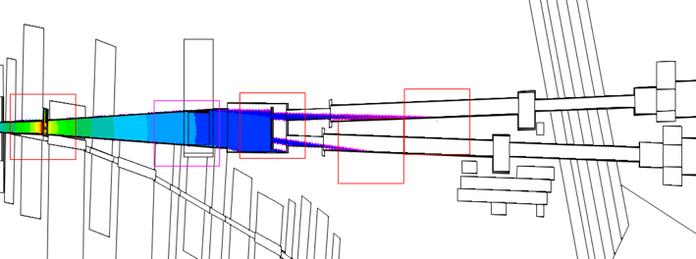
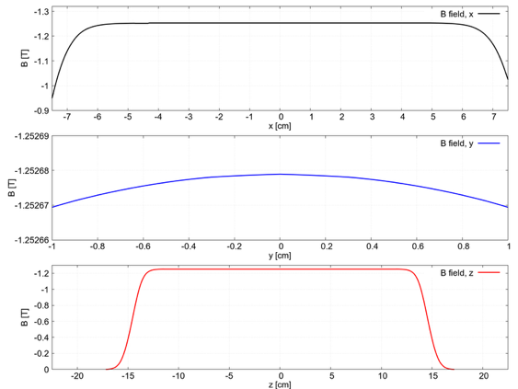
Raytracing
Ray Tracing
Ray‑tracing using FLUKA.CERN of all possible electron beam trajectories transmitted through the main aperture (crotch absorber)
  includes the effect of the clearing magnet field
  all vacuum components set to fully absorb the rays to only score primary electron trajectories
  includes aperture alignment tolerances (+/- 2 mm).
clearing
magnet
anamorphic view X/Y = 0.3
crotch
B field

Slide 15
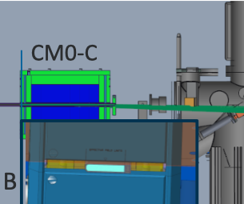
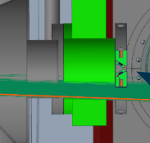
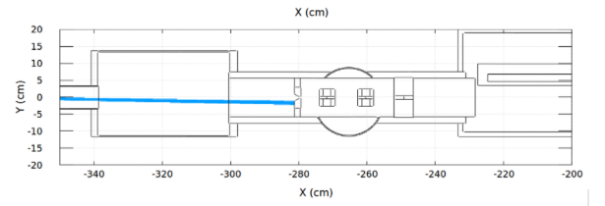
Raytracing
The Source.f routine is used to generate a source defined as all the possible beams that could go through the first aperture that separates
  ray trace source is any point in the crotch aperture emitted at 4𝝅
  beam energy sampled between 1.9 GeV and 2.1 GeV
Comparison with the methods used by the magnet group shows very good agreement.
Magnet Group “Brushes”
FLUKA Ray Traces

Slide 16
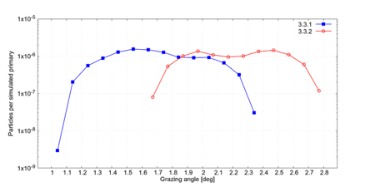
Impact Points
Impact points and impact angles are recorded as output of the ray tracing
Scoring regions size determined based on results of preliminary ray trace to decide how fine the meshing should be
Smallest incidence angles are chosen
Rule of thumb for location: upstream of clearing magnet smallest distance from the center of beamline axis, downstream of the clearing magnet smallest angle of incidence.
Incidence Angles

Slide 17
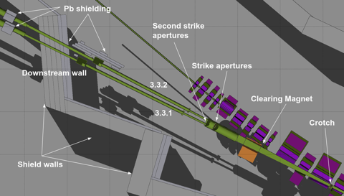
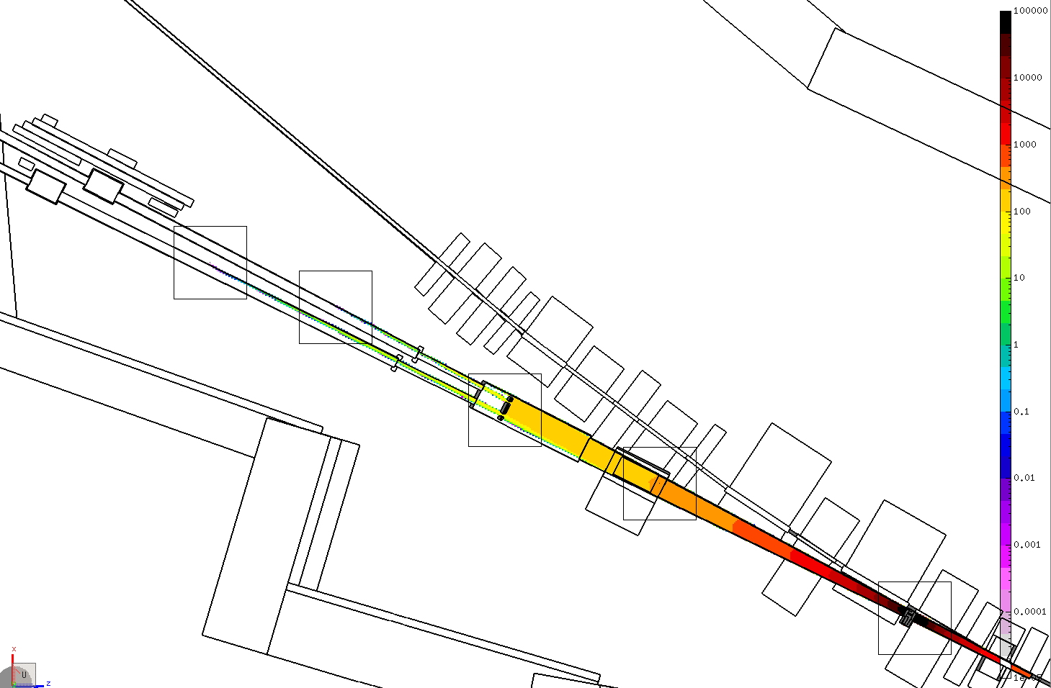
Radiation Dose Calculations
Radiation‑transport simulations to quantify dose levels outside the shield walls and verify adequacy of the existing shielding
Source located at the worst impact points, identified looking at proximity of strike to center of vacuum chamber and/or distance from shield wall:
  upstream of clearing magnet: crotch absorber for BMBL and PTL for IDBL
  entrance to clearing magnet
  beam apertures downstream of clearing magnets
  points closest to the shield walls.
Radiation monitor

Slide 18
Design Limits and Goals
  LIMITS:
  public: 100 mrem/year
  general employee: 5000 mrem/year
10 CFR 835
“Occupational Radiation Protection”
LBNL
EHS MANUAL Ch. 21 - RCM
  ADMINISTRATIVE LIMITS:
  public: 100 mrem/year
  general employee: 500 mrem/year
  design dose limit: < 0.5 mrem/h
ALS-U Shielding Policy
DESIGN GOALS:
< 0.5 mrem/h with an ALARA goal of 0.05 mrem/h for routine losses and 100 mrem/event for mis-steering events on the experimental floor
10 mrem/y to MEI

Slide 19
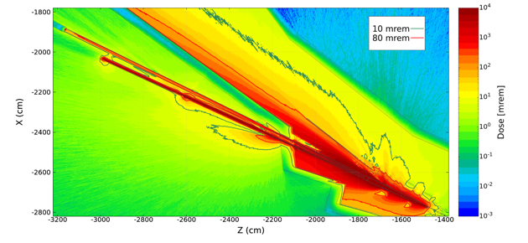
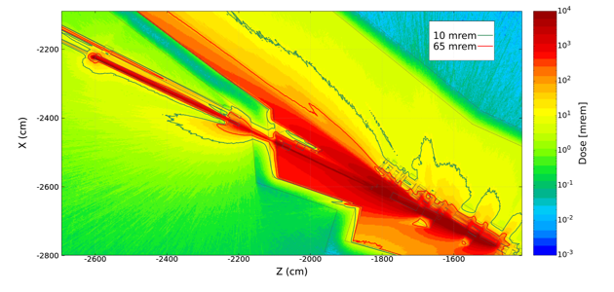
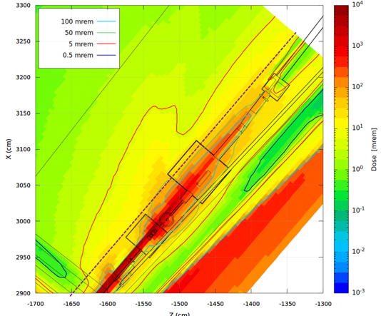

Results – Strikes Upstream of CM
3.3.X – horizontal strike at crotch
80 mrem at 30 cm for 30 nC loss
3.3.X – vertical strike at crotch
65 mrem at 30 cm for 30 nC loss
8.2.X – horizontal strike at crotch
25 mrem at 30 cm for 30 nC loss
7.0.X – vertical strike at PTL
50 mrem at 30 cm for 30 nC loss

Slide 20


Results – Strike at CM- Results
Strikes at the 3.3.X CM generates 25 mrem on the floor
Doses from strikes at 3.3.X are higher than for the other beamlines due to the lack of in vacuum bremsstrahlung collimators, present at other beamlines.

Slide 21




Results – Strike Downstream of CM
Strike at apertures downstream of the CM and in the beam pipe produce ~15 mrem on the experimental floor
The incidence angle of the beam is of 1.0° for the 3.3.1 beamline tube and 1.6° for the 3.3.2 beamline.
3.3.1 – strike at 3.3.1 aperture
15 mrem at 30 cm for 30 nC loss
3.3.2 – strike in 3.3.2 beam pipe
15 mrem at 30 cm for 30 nC loss

Slide 22


Strikes Downstream of CM - Mirror inside the FE
A strike on the mirror M1 inside the FE was also simulated to evaluate whether clearing magnets would not be needed for those configurations
First optics are typically placed just upstream of the shield walls
Strikes at the M1 results in 30 mrem at 30 cm on the experimental floor
A collimator just downstream of the M1 attenuates the dose on the floor. Without it, the dose would be 3x higher
Such collimator configuration is not available at all beamlines with M1 inside the wall, due to space constraints and doses could reach or exceed the 100 mrem limit
With the clearing magnet strikes result in much lower doses: < 10 mrem
Crediting a mirror as a safety component would also be difficult from a configuration control standpoint.
collimator

Slide 23
Dose Trend Along Beamlines
Interaction location | Single-event beam loss (30 nC)
3.3 beamline crotch | 80 mrem
3.3.2 beamline crotch (top) | 65 mrem
3.3 tube inside the clearing magnet (top) | 25 mrem
3.3.1 beamline aperture | 16 mrem
3.3.1 beamline strike aperture (top) | 15 mrem
3.3.2 beamline tube, following the 3.3.2 strike aperture | 15 mrem
upstream of or at CM
downstream of CM
7.0 PTL | 50 mrem
7.0 Clearing magnet CM | 5 mrem
7.0 Aperture AP002 | 10 mrem
upstream of or at CM
downstream of CM

Slide 24
Summary
Radiation Safety Analysis uses selection criteria to reduce the number of cases to study to allow final design and procurement of clearing magnets: worst beamline geometrical parameters and at least one beamline per each type of clearing magnet
A strike on the experimental floor would yield unacceptable doses. The use of clearing magnets is required to constrain the strike to inside the accelerator tunnel
Results show that strikes downstream of the clearing magnets yield doses which are lower than doses generated by strikes upstream, due to the forward peaked bremsstrahlung transported to the experimental floor without much absorption (in the center of the vacuum chamber) for upstream strikes
Within our safety analysis framework, clearing magnets are required to reduce risks to low or negligible and to keep doses from missteer events below our policy goal of 100 mrem/event
The results show that the clearing magnets as designed, together with the other controls, provide the required safety functions to keep doses below our limits and goals
Detailed studies for all beamlines will still be performed ahead of their post-upgrade operation.

Slide 26




ALS → ALS-U
On axis swap out injection needed to reach higher brightness and improved undulator performance
Off-axis injection + accumulation
On-axis swap-out injection
Stored Beam
Stored Beam
Fast Kicker
requires larger
dynamic
apertures
can use smaller dynamic
apertures
Injected Beam
Injected Beam
Latices with stronger focusing + higher brightness
Small (~6mm) round apertures
Delta/Apple-X undulator
higher performance polarizing undulators

