Slide 1
Evaluation of the Second Target Station Standard Heavy Neutron Beamline Shutter
October 22, 2026
SATIF-17, Daejeon, Republic of Korea
Thomas M Miller
Senior Neutronics Scientist, Second Target Station Project

Slide 2
I must recognize the other STS staff that assisted with this analysis
Kumar Mohindroo
  Building models, developing methodology, almost everything
David Hartman
  Building models
Igor Remec
  Developing methodology and sanity checks

Slide 3
Outline
Deliverables and Requirements
Assumptions and Limitations
Methodology
Models
Results
Conclusions

Slide 4
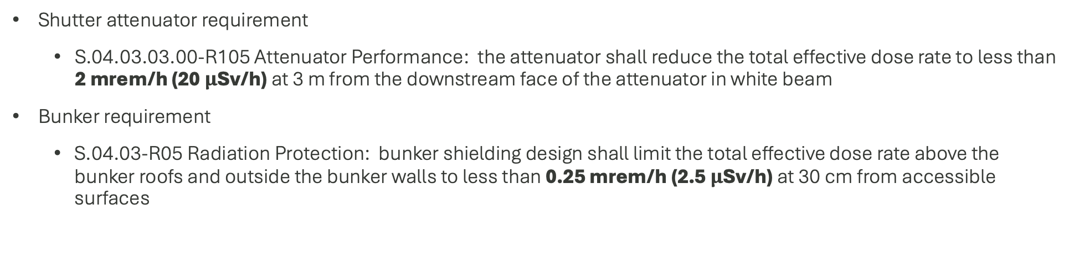
Deliverables and Requirements
Shutter attenuator requirement
  S.04.03.03.00-R105 Attenuator Performance: the attenuator shall reduce the total effective dose rate to less than 2 mrem/h (20 $μ$Sv/h) at 3 m from the downstream face of the attenuator in white beam
Bunker requirement
  S.04.03-R05 Radiation Protection: bunker shielding design shall limit the total effective dose rate above the bunker roofs and outside the bunker walls to less than 0.25 mrem/h (2.5 $μ$Sv/h) at 30 cm from accessible surfaces

Slide 5
Deliverables and Requirements
Shutter attenuator requirement
  S.04.03.03.00-R105 Attenuator Performance: the attenuator shall reduce the total effective dose rate to less than 2 mrem/h (20 $μ$Sv/h) at 3 m from the downstream face of the attenuator in white beam
Bunker requirement
  S.04.03-R05 Radiation Protection: bunker shielding design shall limit the total effective dose rate above the bunker roofs and outside the bunker walls to less than 0.25 mrem/h (2.5 $μ$Sv/h) at 30 cm from accessible surfaces
Assumptions and Limitations
Assumptions
  Power = 700 kW, proton energy = 1.3 GeV
  Evaluate ST09, forward most beamline, to establish an upper bound
  Use of reflective boundary conditions to reduce computational requirements
Limitations
  The heavy shutter has only been evaluated inside the bunker

Slide 6
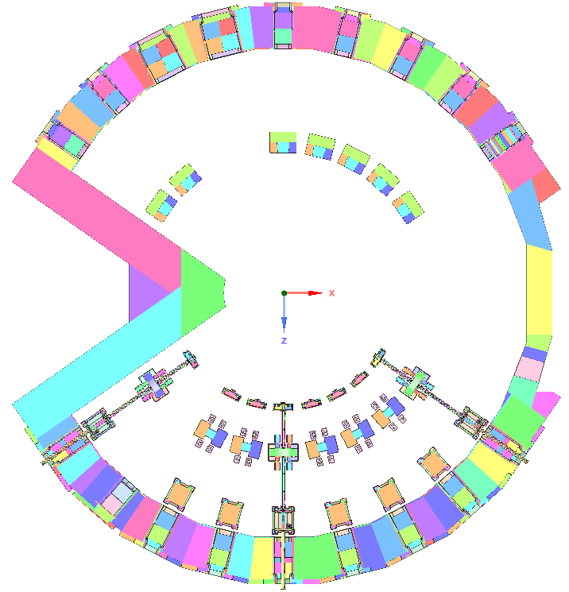
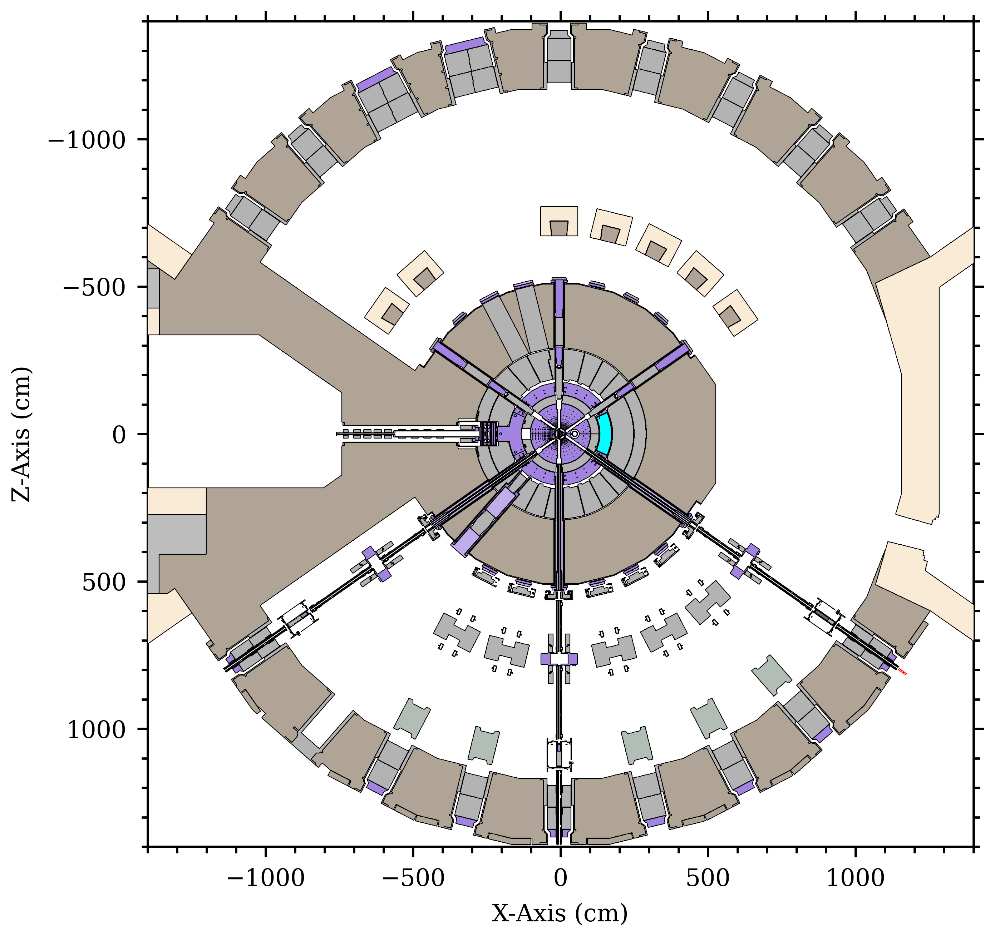
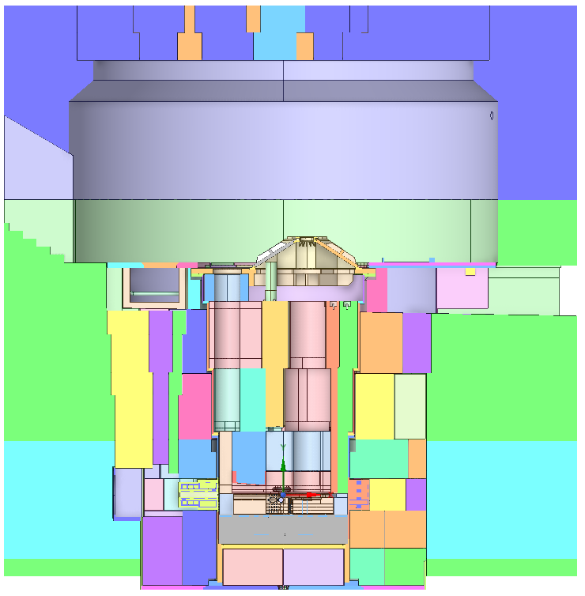
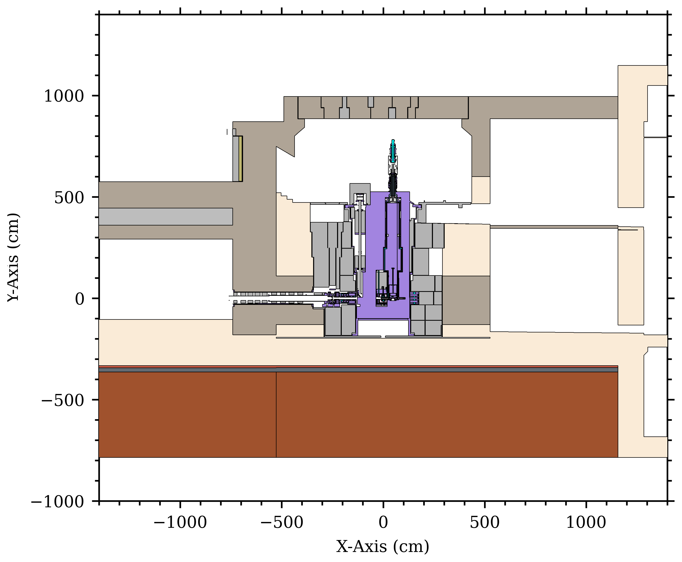
Model components converted from CAD to CSG, stored in our Git repository, and assembled via a bash script
Lower Bunker
Monolith + Core Vessel
Catalán, J. P., et al., GEOUNED: A new conversion tool from CAD to Monte Carlo geometry, Nuclear Engineering and Technology (2024).
https://doi.org/10.1016/j.net.2024.01.052.

Slide 7
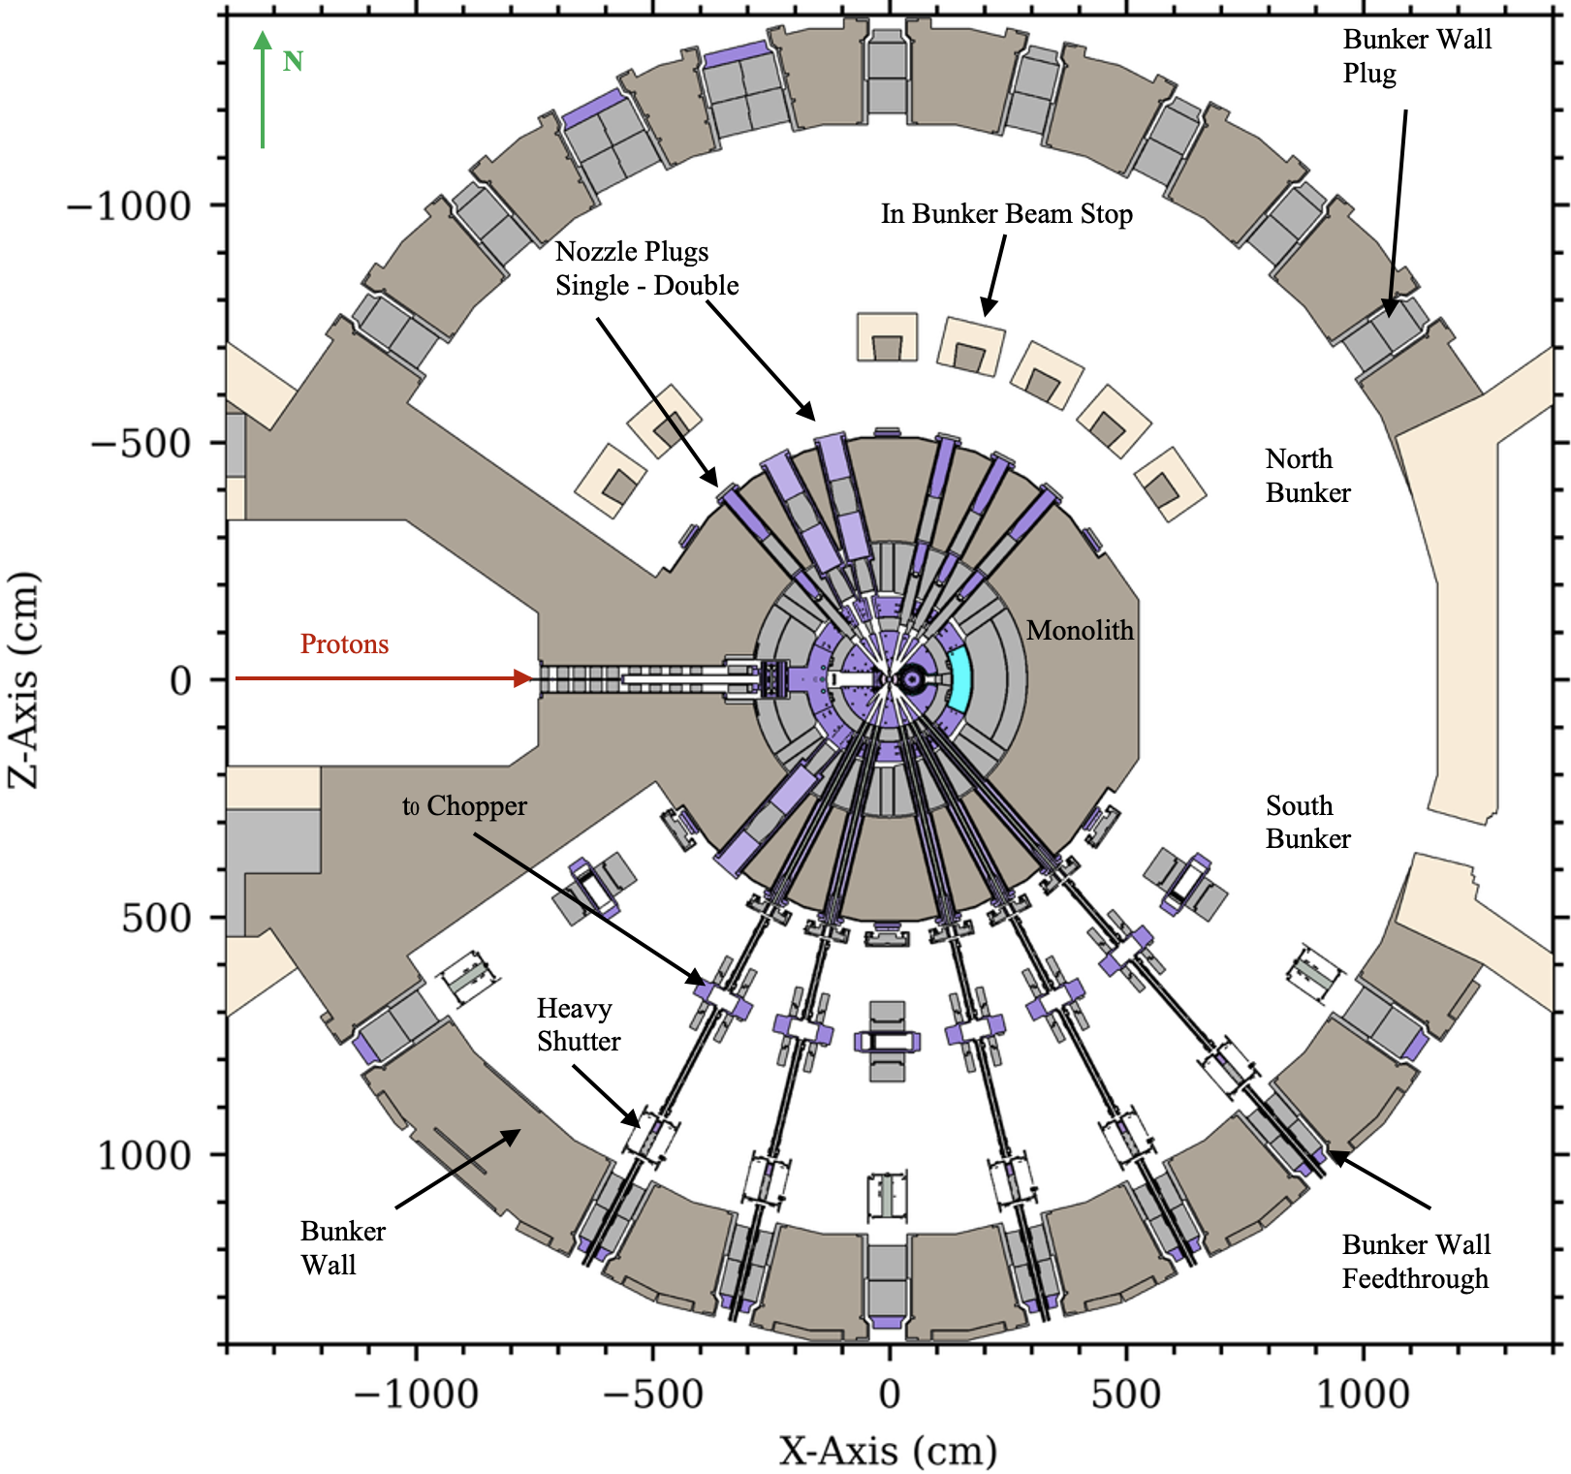
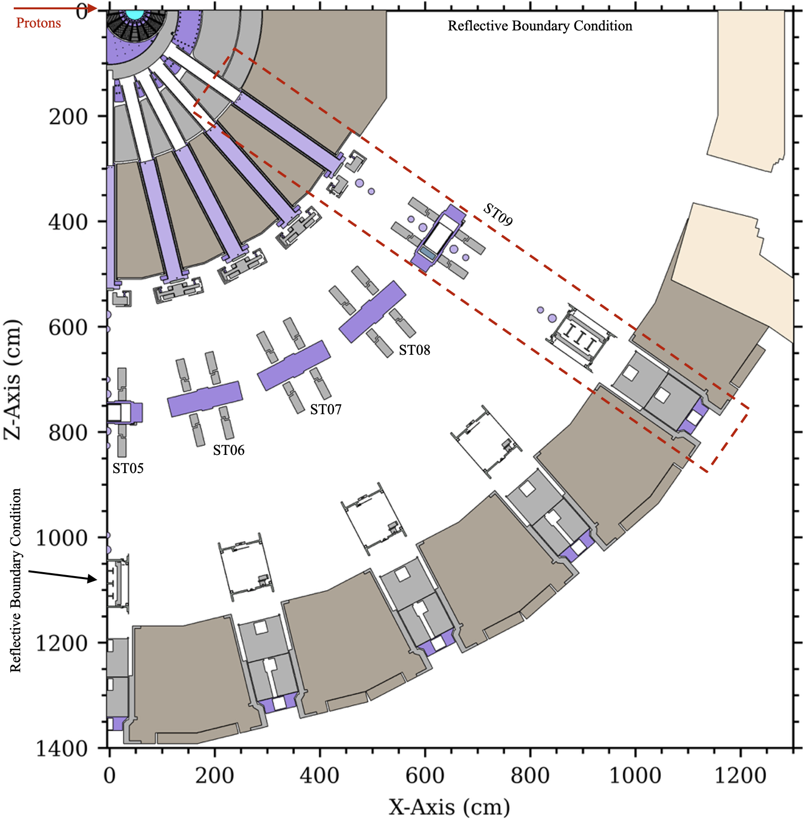
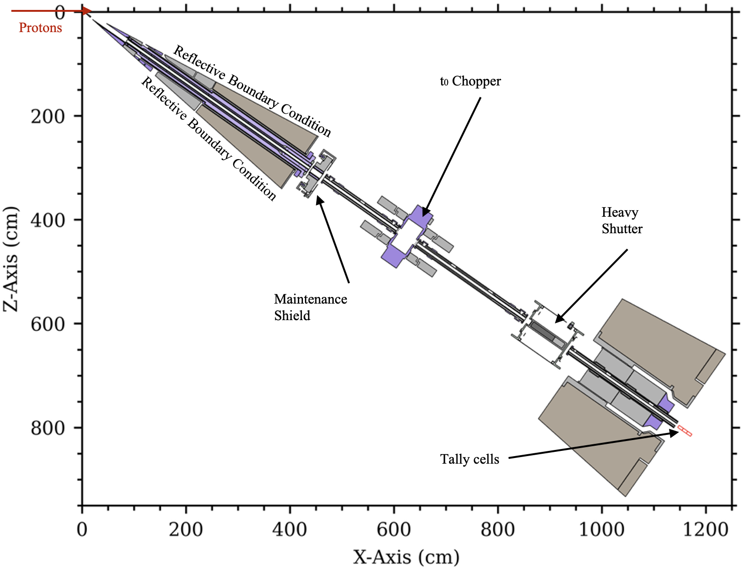
Three different versions of our MCNP model can be used with different boundary conditions to analyze a neutron beamline
Full – no BC
Quadrant – reflected BC
Wedge – reflected BC

Slide 8
Three different versions of our MCNP model can be used with different boundary conditions to analyze a neutron beamline
Full – no BC
Quadrant – reflected BC
Wedge – reflected BC
ST09 is the forward most beamline with respect to the proton beam direction,
which results in the largest population of high energy particles

Slide 9
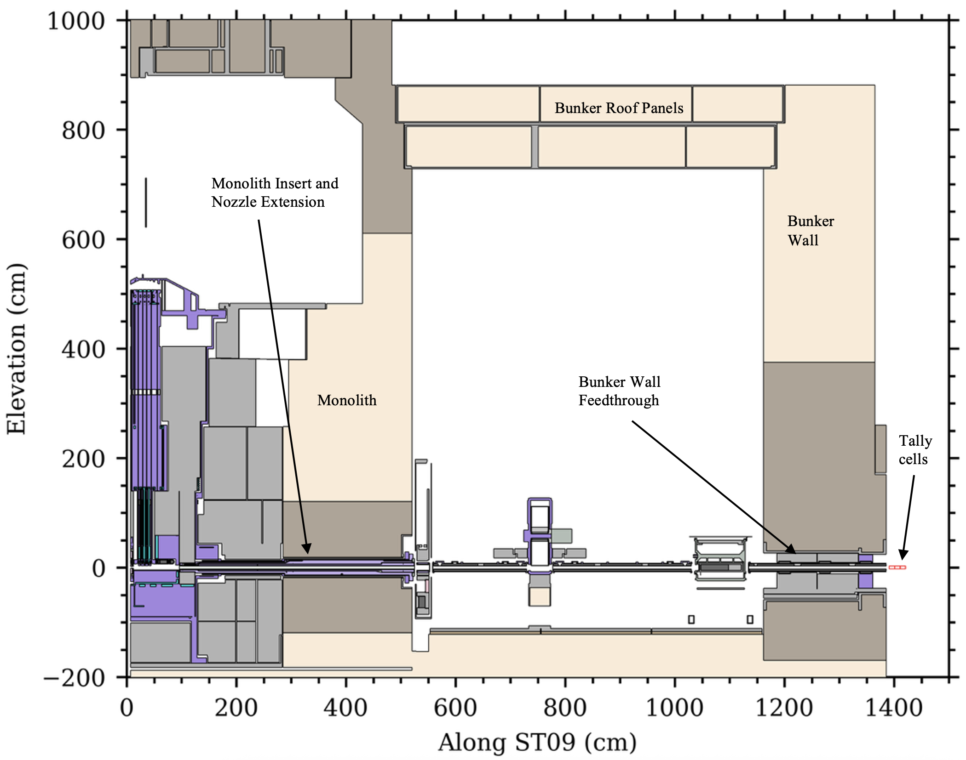
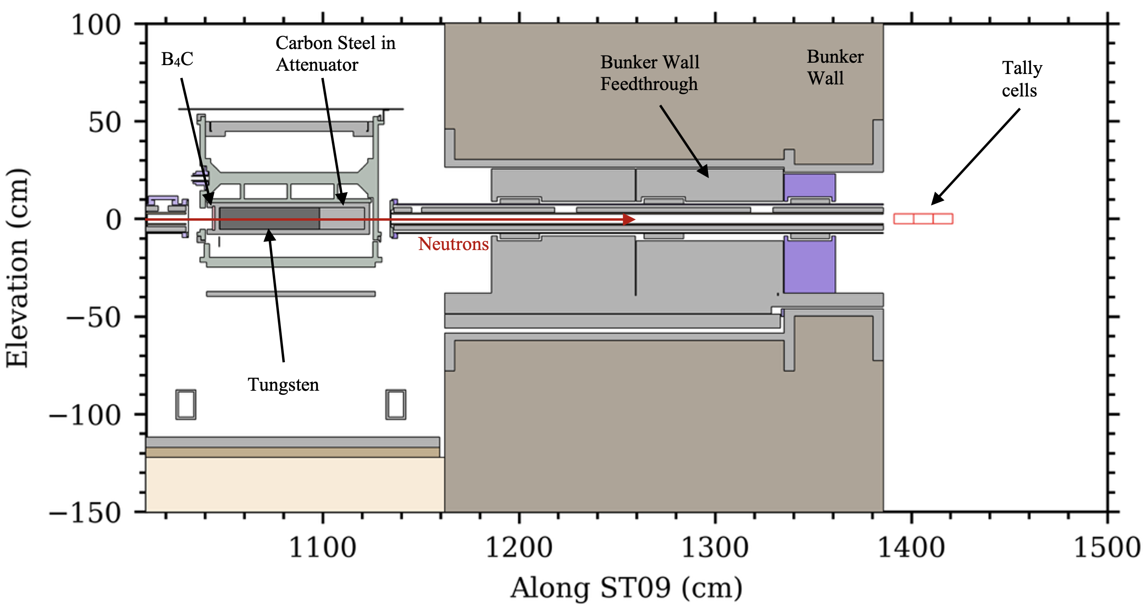
Elevation view of ST09 and a closer look at the standard heavy neutron beamline shutter

Slide 10
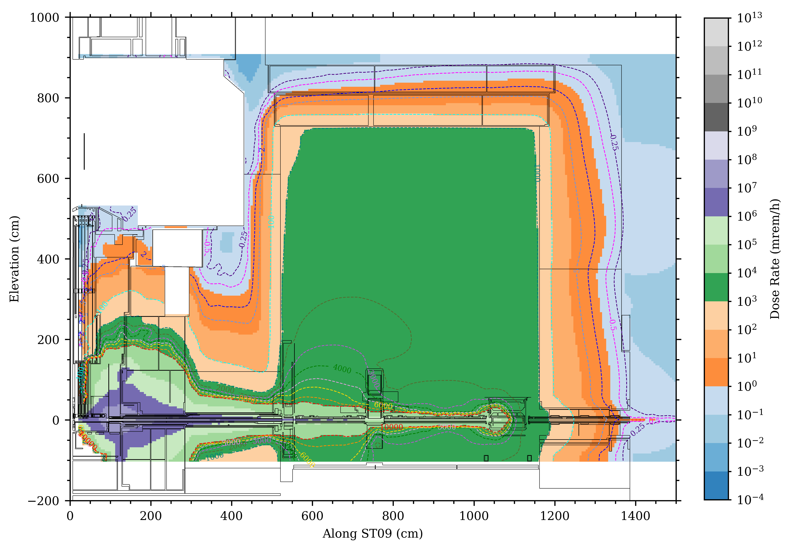
Methodology
Neutron beamline shielding source
Computational tools
  MCNP with ENDF/B-VII.1
  ADVANTG with HILO2k
Two-step methodology developed specifically for Instrument Systems analyses
  Neutron beamline shielding sources ensure streaming down the beamline is sampled (ST09 for this analysis)
  The proton source ensures leak through the bulk shielding is accounted for
  Minimize “double counting”

Slide 11
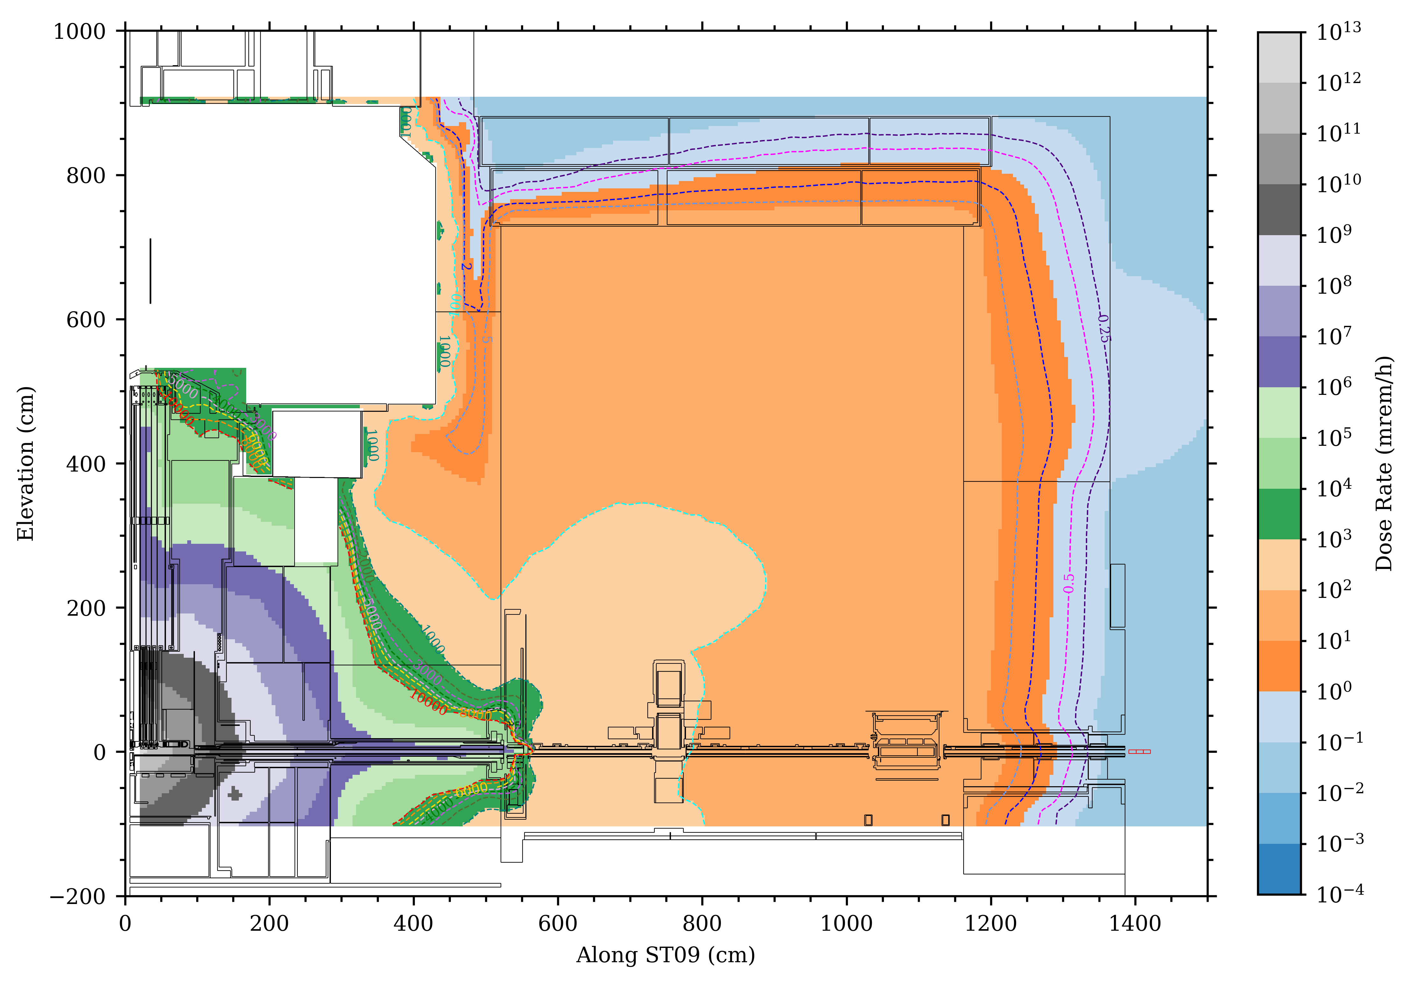
Methodology
Neutron beamline shielding source
Proton on target source
Computational tools
  MCNP with ENDF/B-VII.1
  ADVANTG with HILO2k
Two-step methodology developed specifically for Instrument Systems analyses
  Neutron beamline shielding sources ensure streaming down the beamline is sampled (ST09 for this analysis)
  The proton source ensures leak through the bulk shielding is accounted for
  Minimize “double counting”

Slide 12
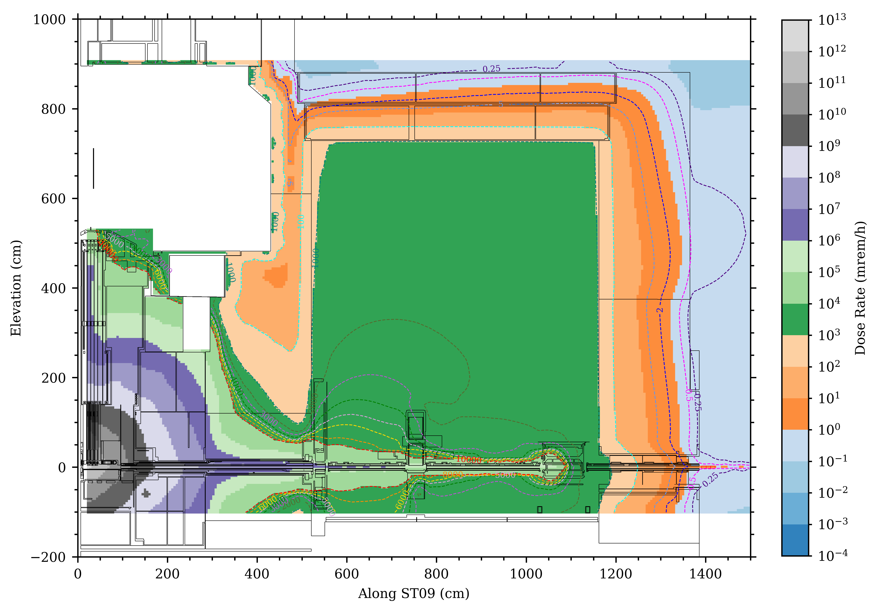
Methodology
Neutron beamline shielding source
Proton on target source
Computational tools
  MCNP with ENDF/B-VII.1
  ADVANTG with HILO2k
Two-step methodology developed specifically for Instrument Systems analyses
  Neutron beamline shielding sources ensure streaming down the beamline is sampled (ST09 for this analysis)
  The proton source ensures leak through the bulk shielding is accounted for
  Minimize “double counting”
Total = neutron source + proton source

Slide 13
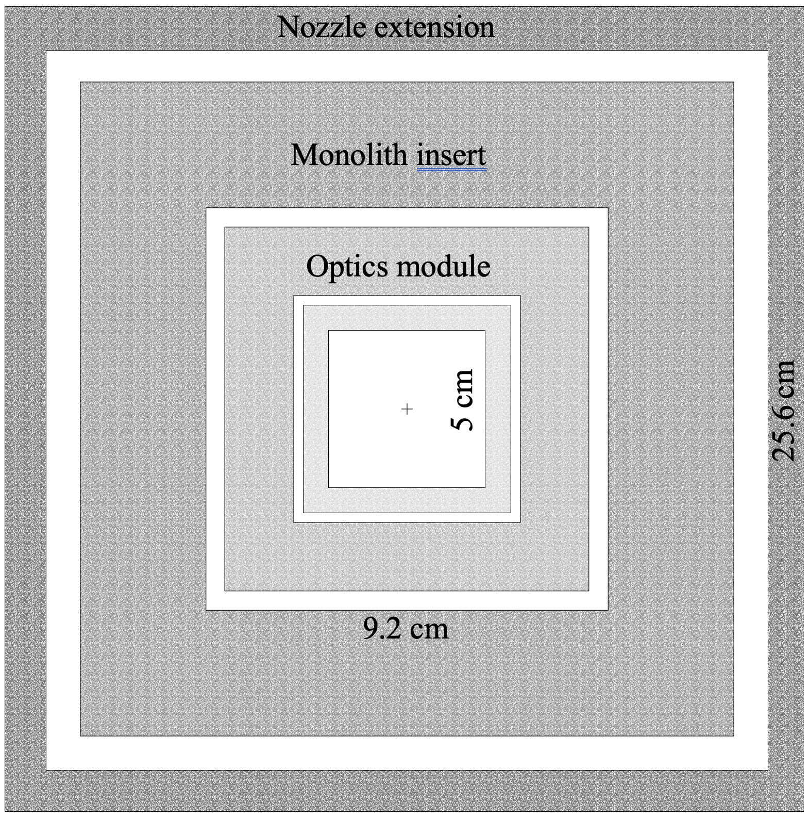
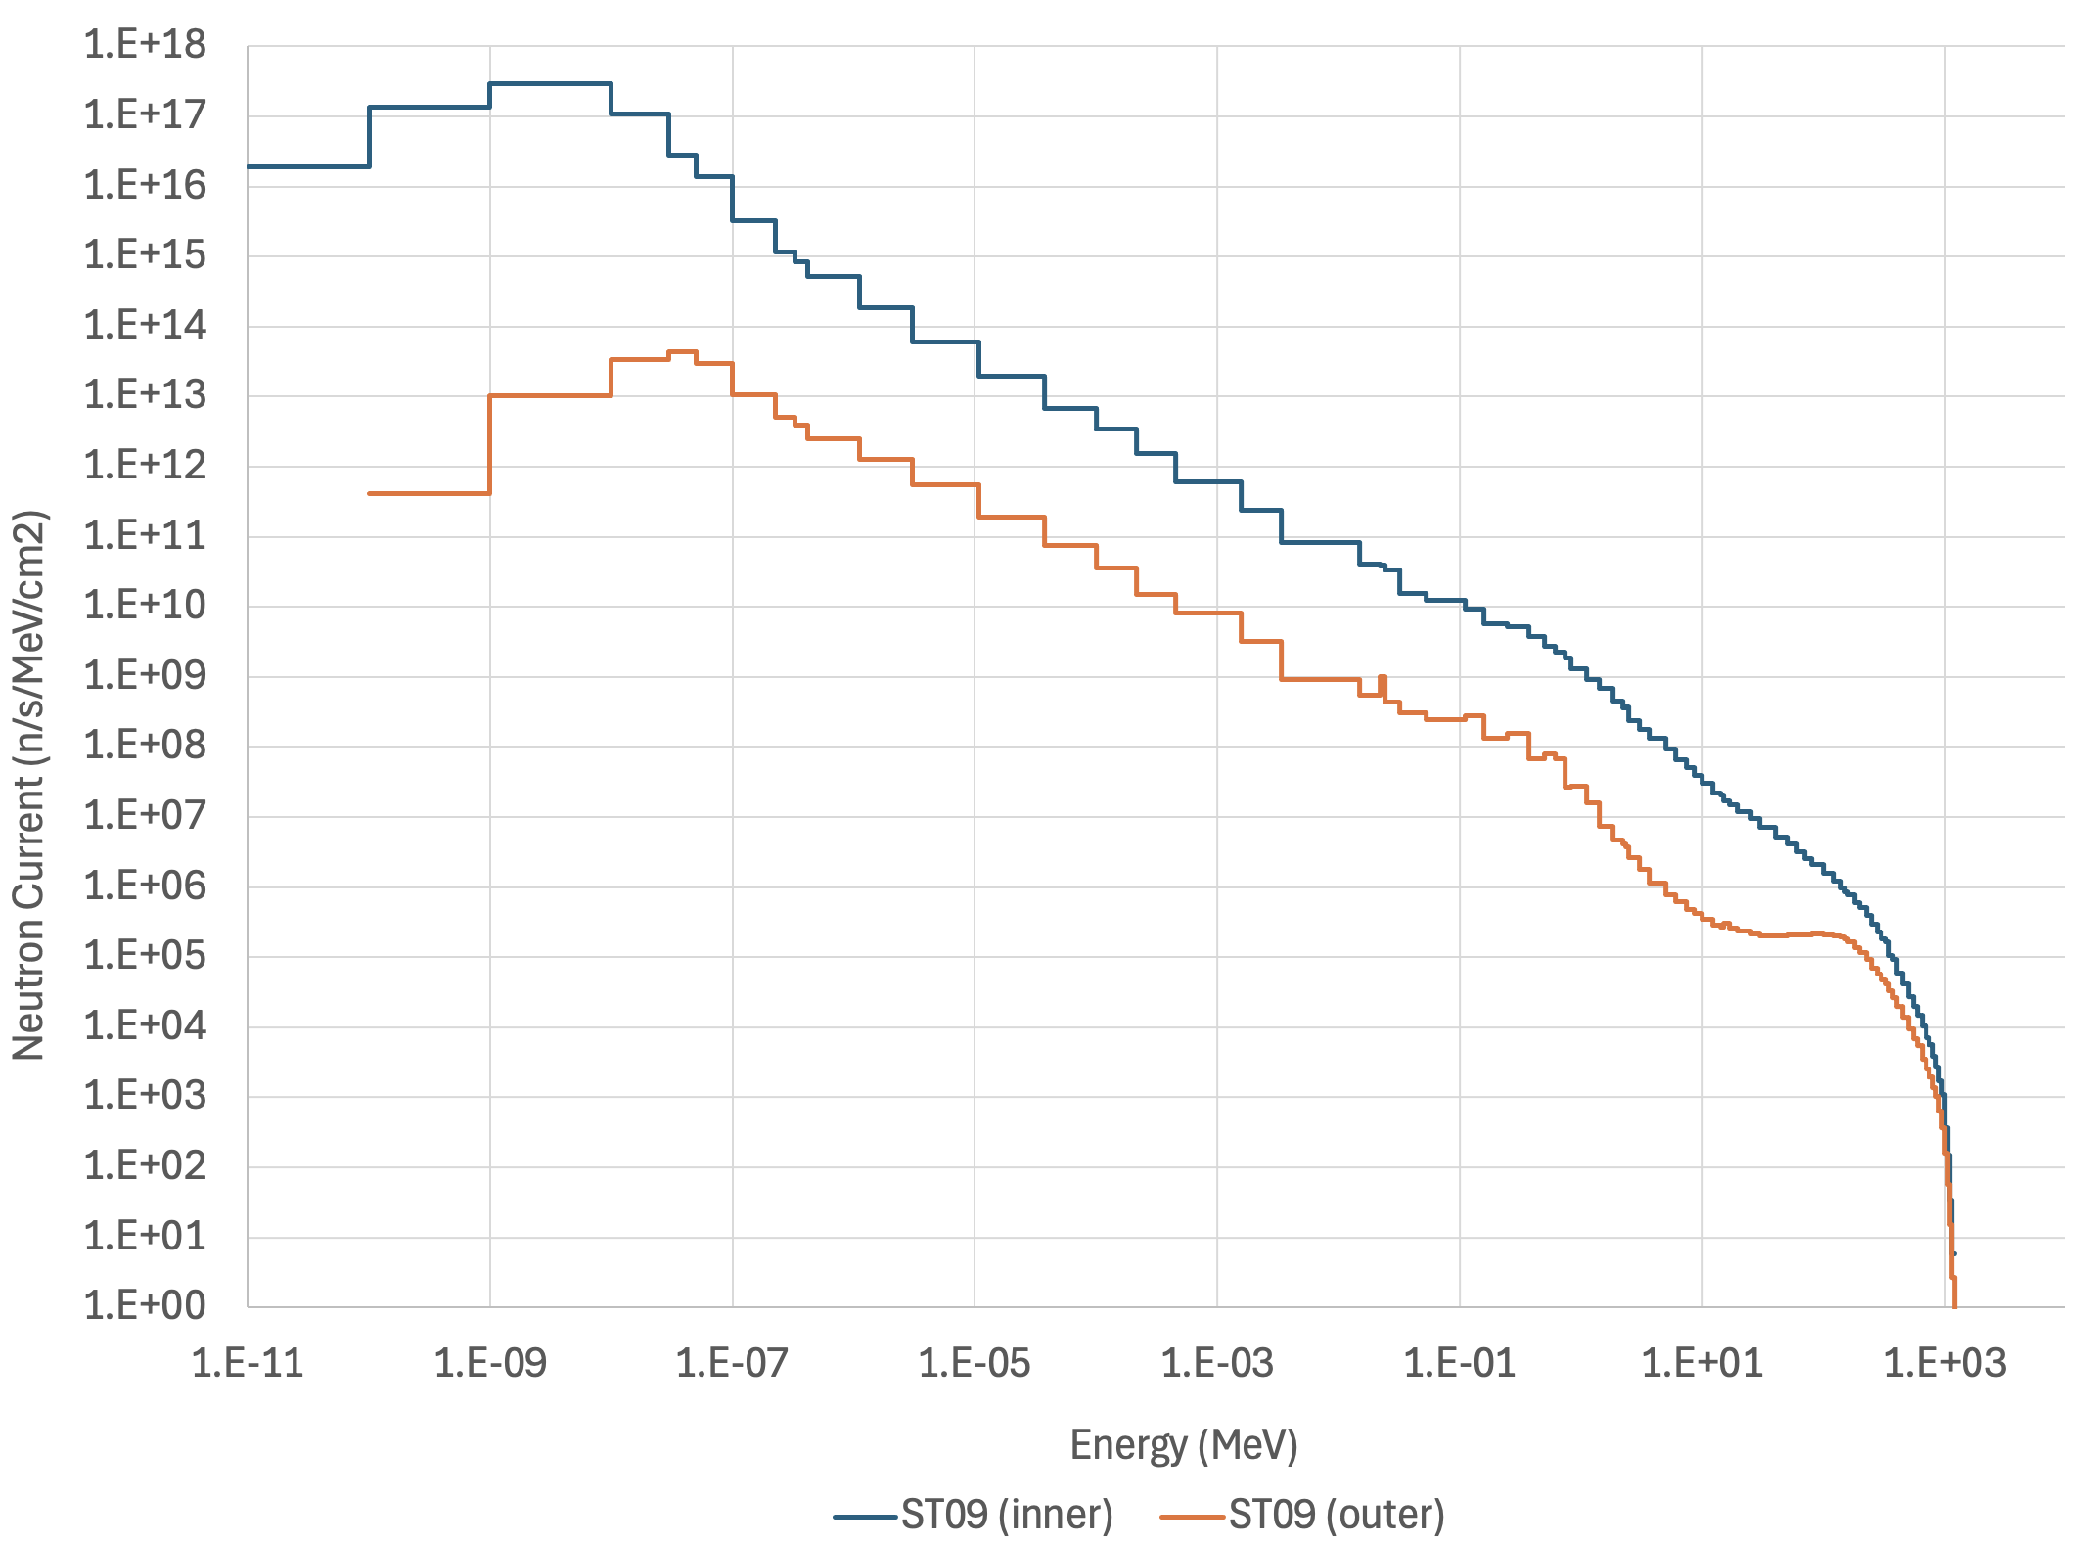
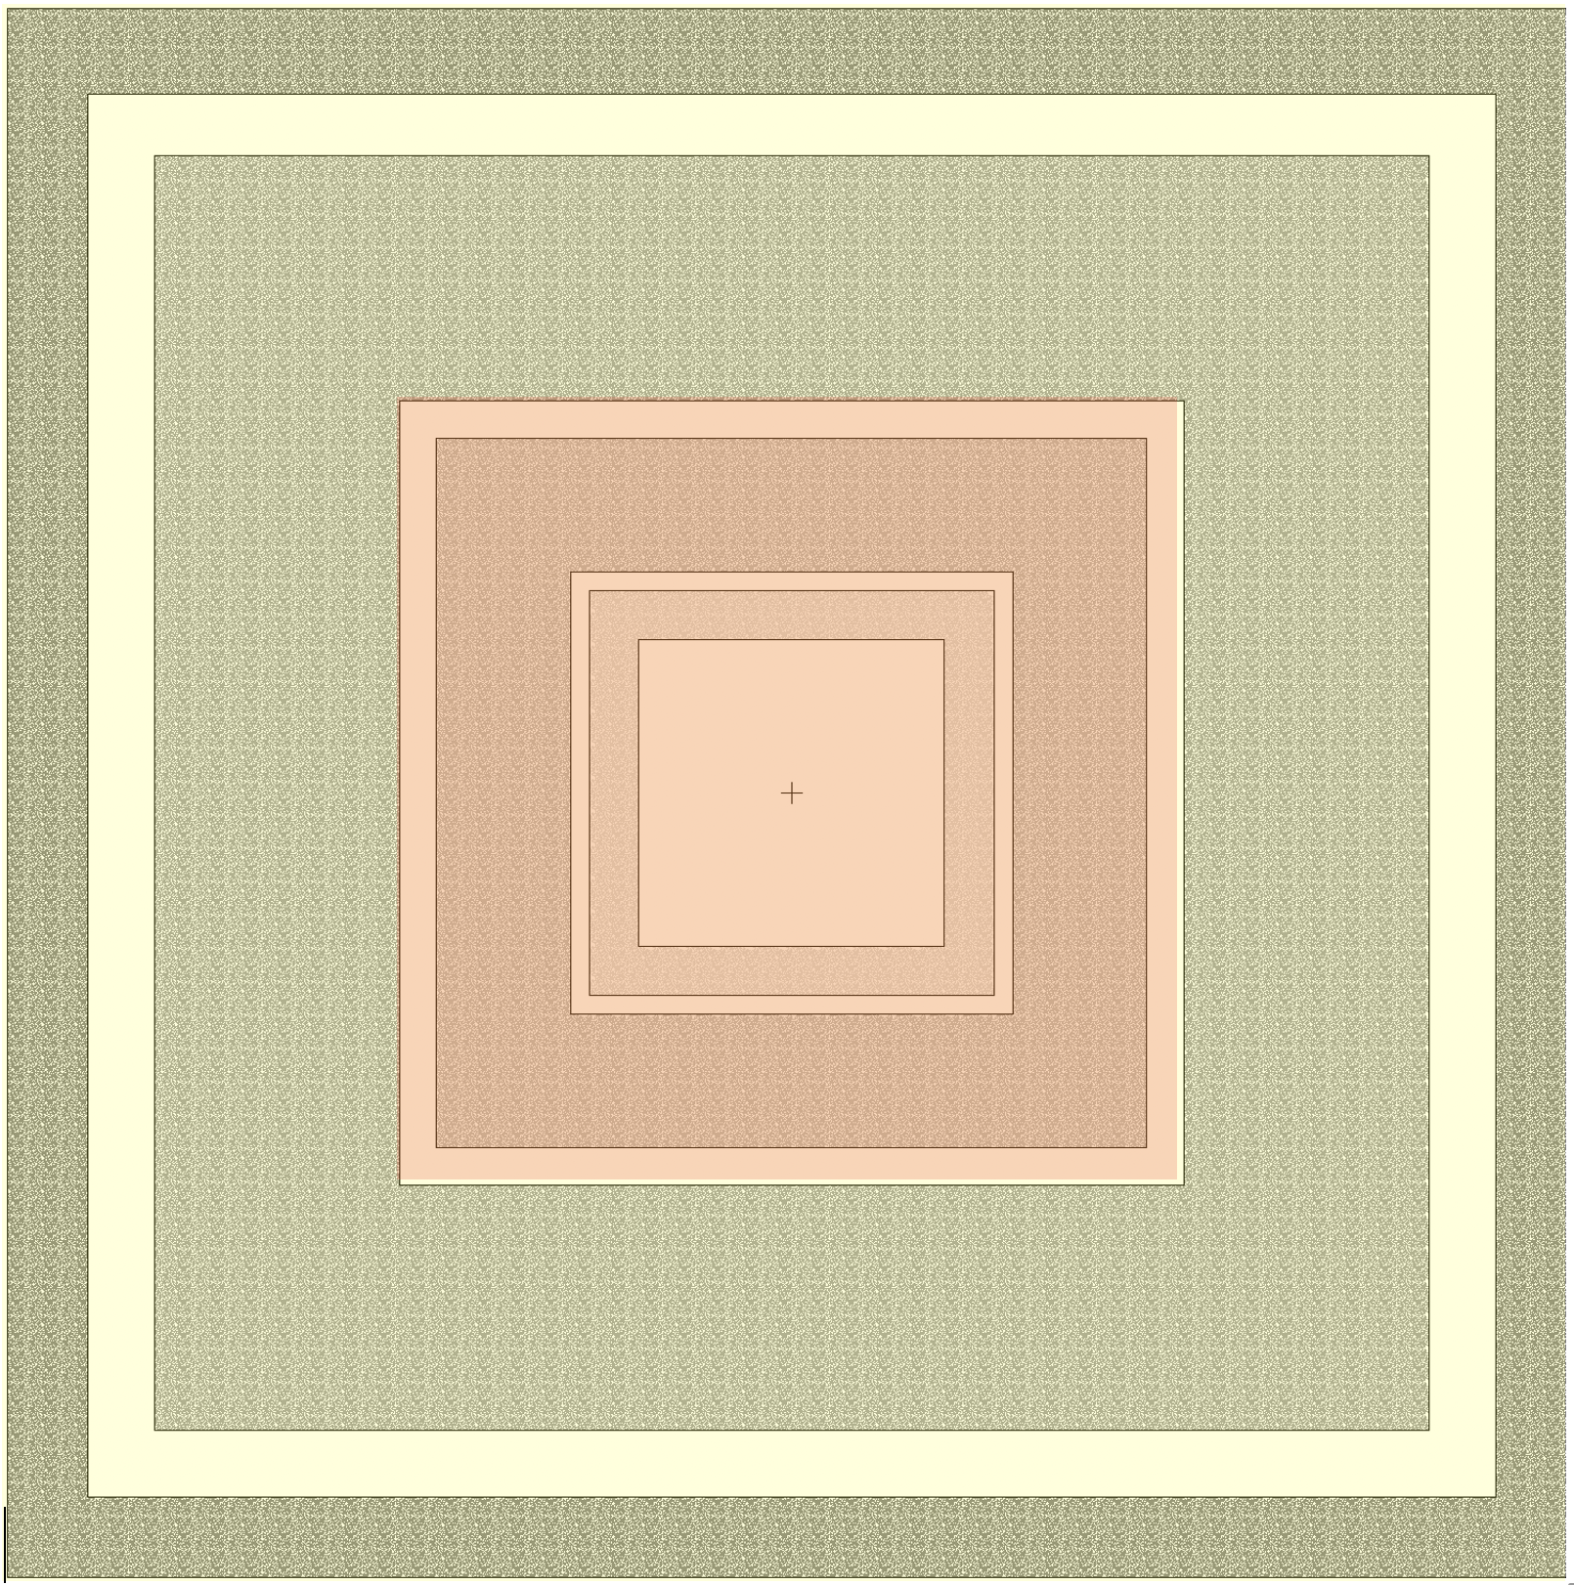
ST09 Neutron Beamline Shielding
Source Data (0-2 degrees)
ST09 inner
ST09 outer
Inner source
Outer source
Illustration of simplified neutron beamline geometry & geometric configuration of a neutron beamline shielding source

Slide 14
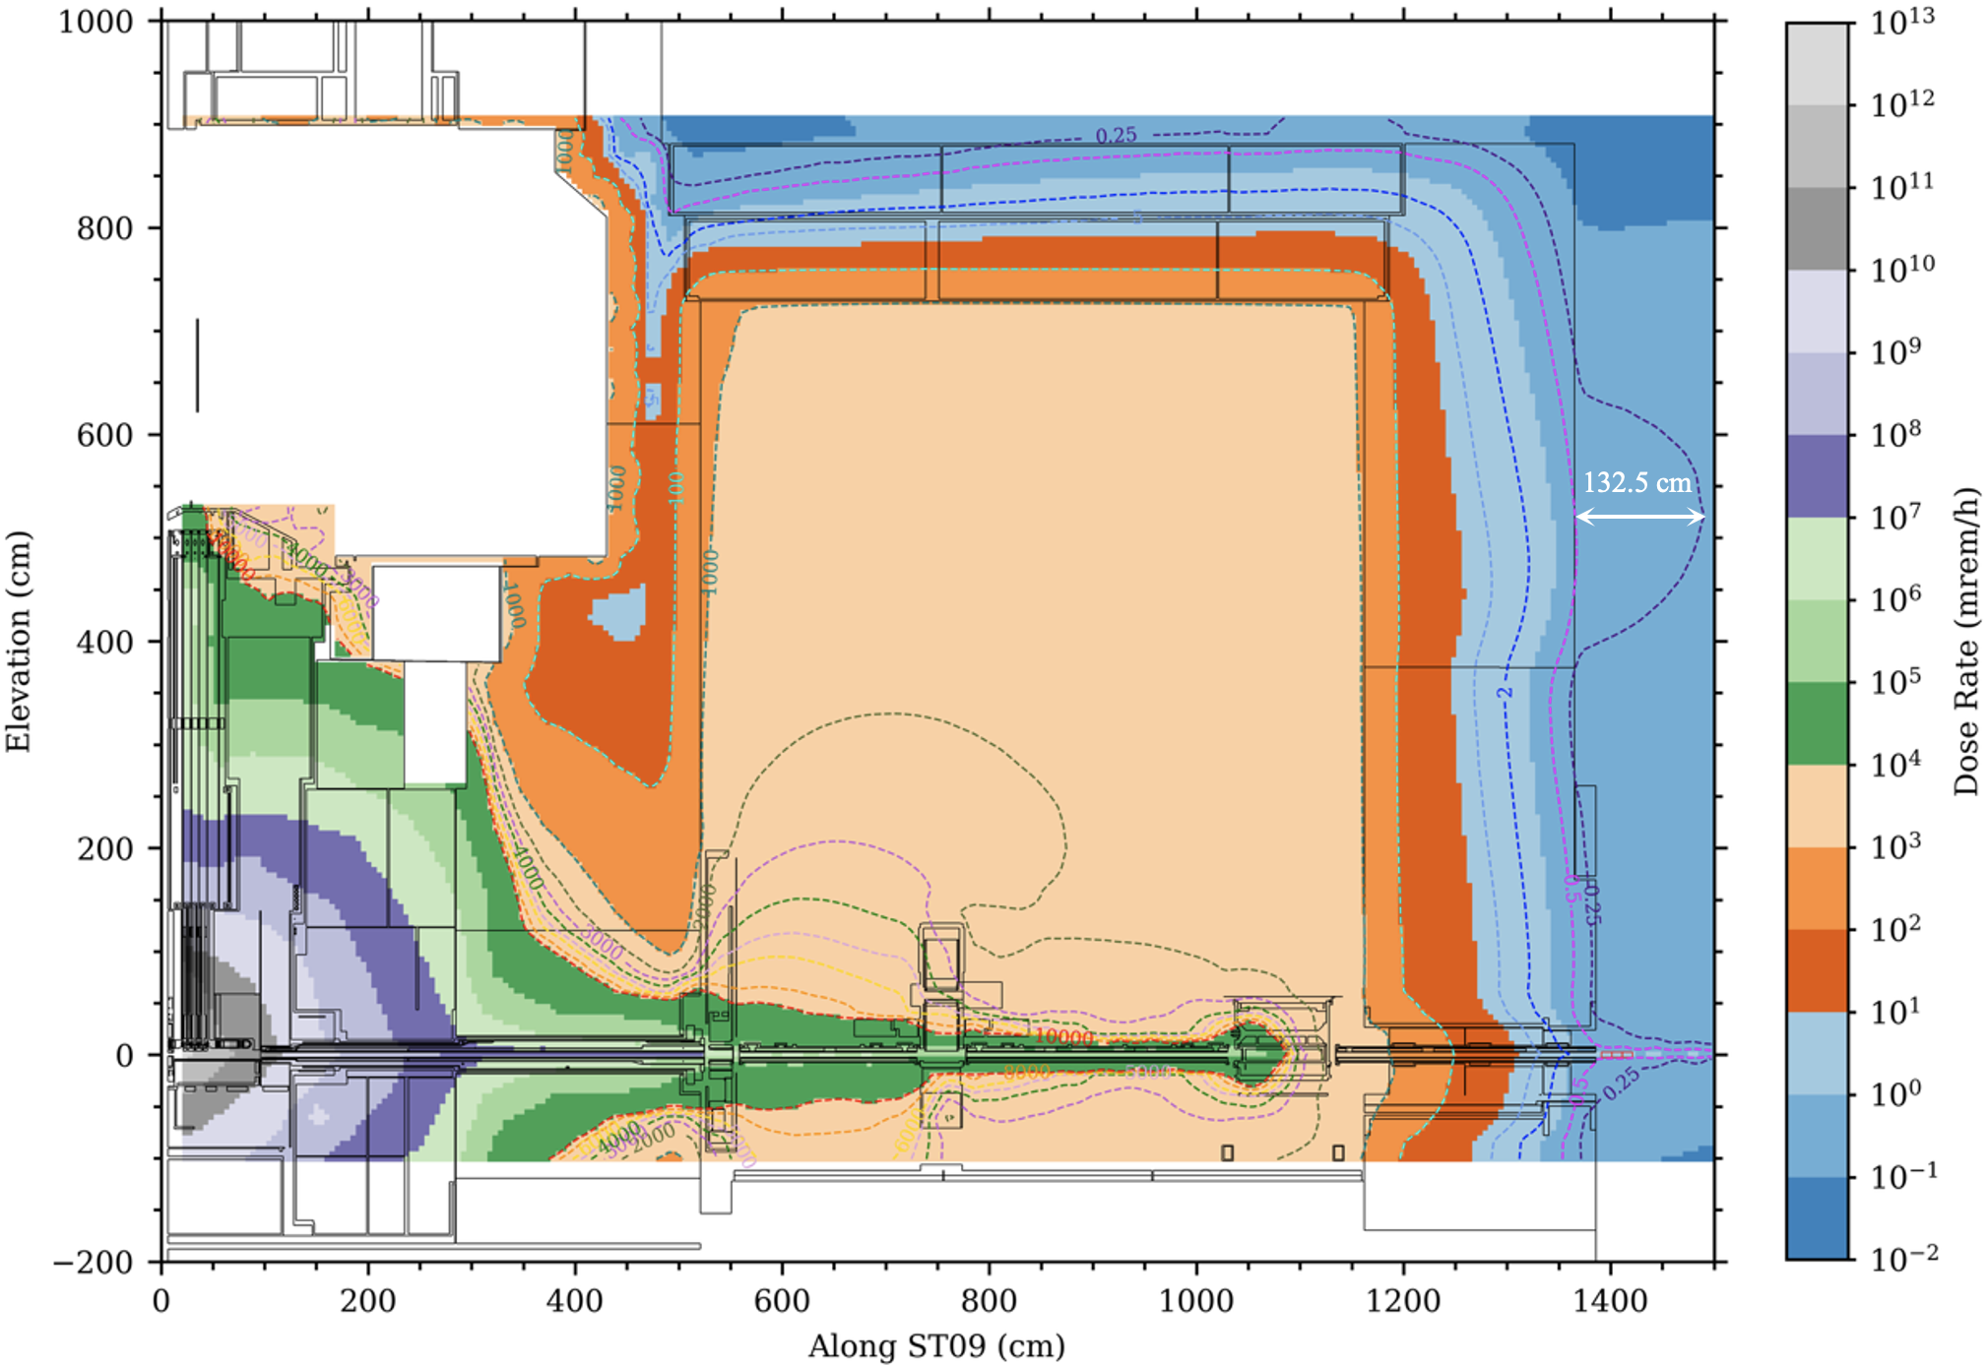
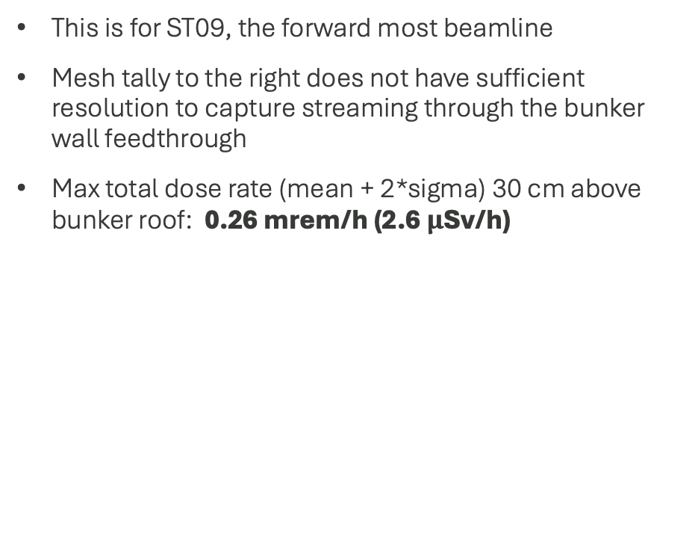
Performance of bunker roof and wall
This is for ST09, the forward most beamline
Mesh tally to the right does not have sufficient resolution to capture streaming through the bunker wall feedthrough
Max total dose rate (mean + 2*sigma) 30 cm above bunker roof: 0.26 mrem/h (2.6 $μ$Sv/h)

Slide 15
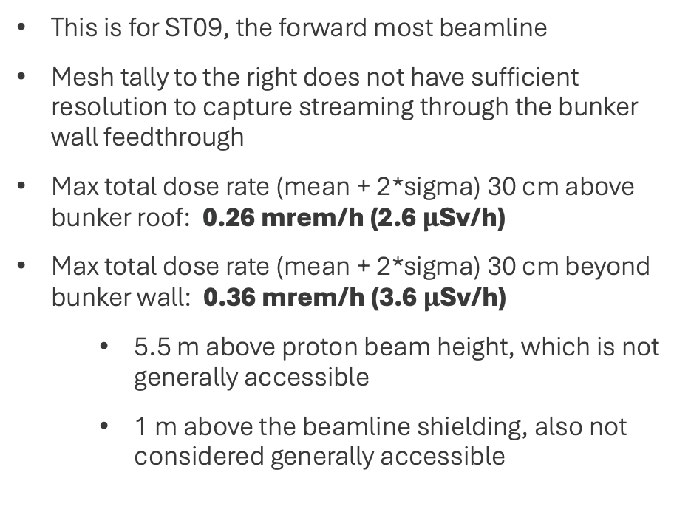
Performance of bunker roof and wall
This is for ST09, the forward most beamline
Mesh tally to the right does not have sufficient resolution to capture streaming through the bunker wall feedthrough
Max total dose rate (mean + 2*sigma) 30 cm above bunker roof: 0.26 mrem/h (2.6 $μ$Sv/h)
Max total dose rate (mean + 2*sigma) 30 cm beyond bunker wall: 0.36 mrem/h (3.6 $μ$Sv/h)
  5.5 m above proton beam height, which is not generally accessible
  1 m above the beamline shielding, also not considered generally accessible

Slide 16
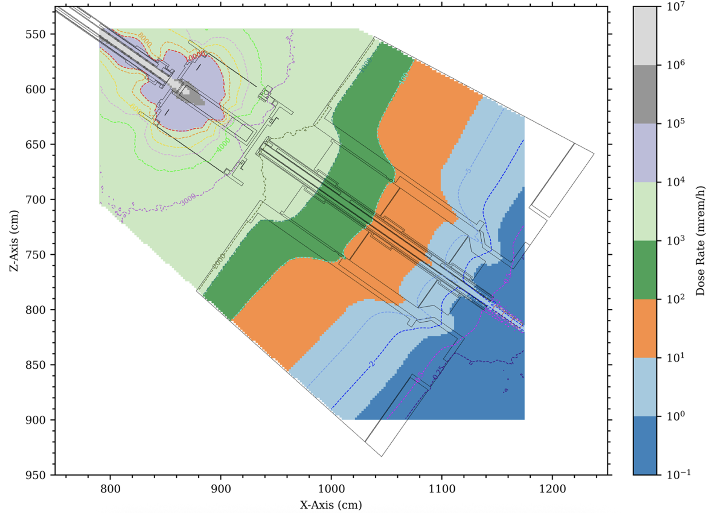
Performance of the shutter attenuator
Mesh tally to the right has much finer resolution (20 cm³ voxels)
Larger uncertainty in small mesh tally voxels pushes analysis to use cell-based tally results

Slide 17
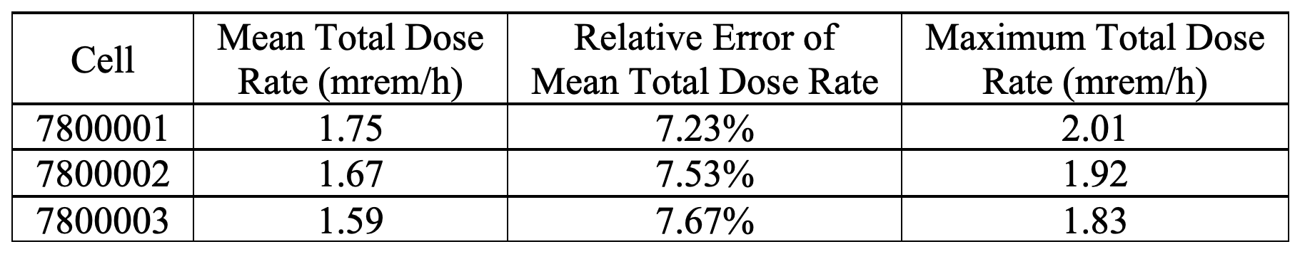
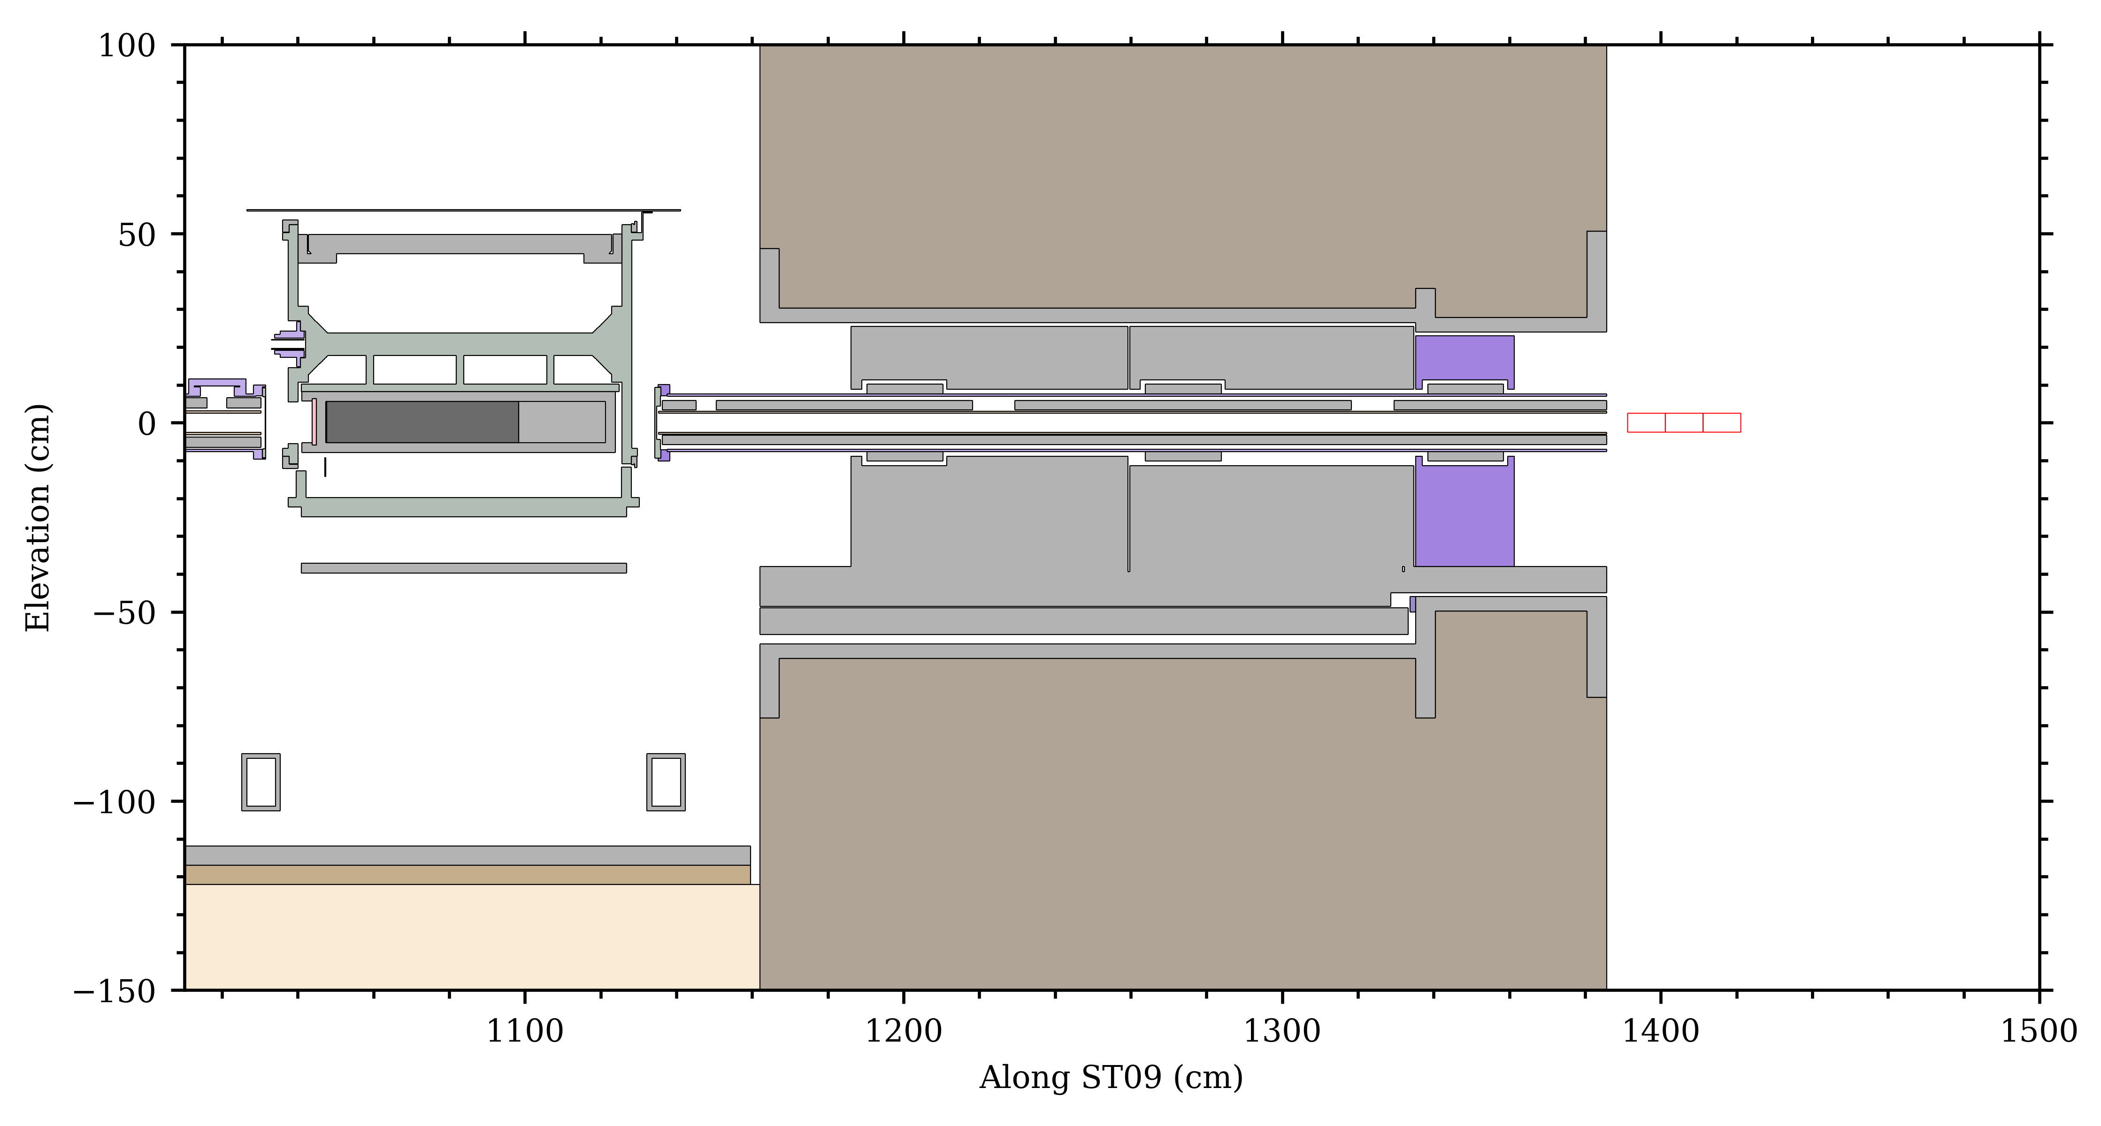
Performance of the shutter attenuator
Larger uncertainty in small mesh tally voxels pushes analysis to use cell-based tally results
  Three cells, each 5 x 5 x 10 cm (equivalent volume of 12.5 mesh tally voxels)
Max total dose rate (mean + 2*sigma) 290-300 cm beyond shutter attenuator: 1.83 mrem/h
1 2 3
Tally cells

Slide 18
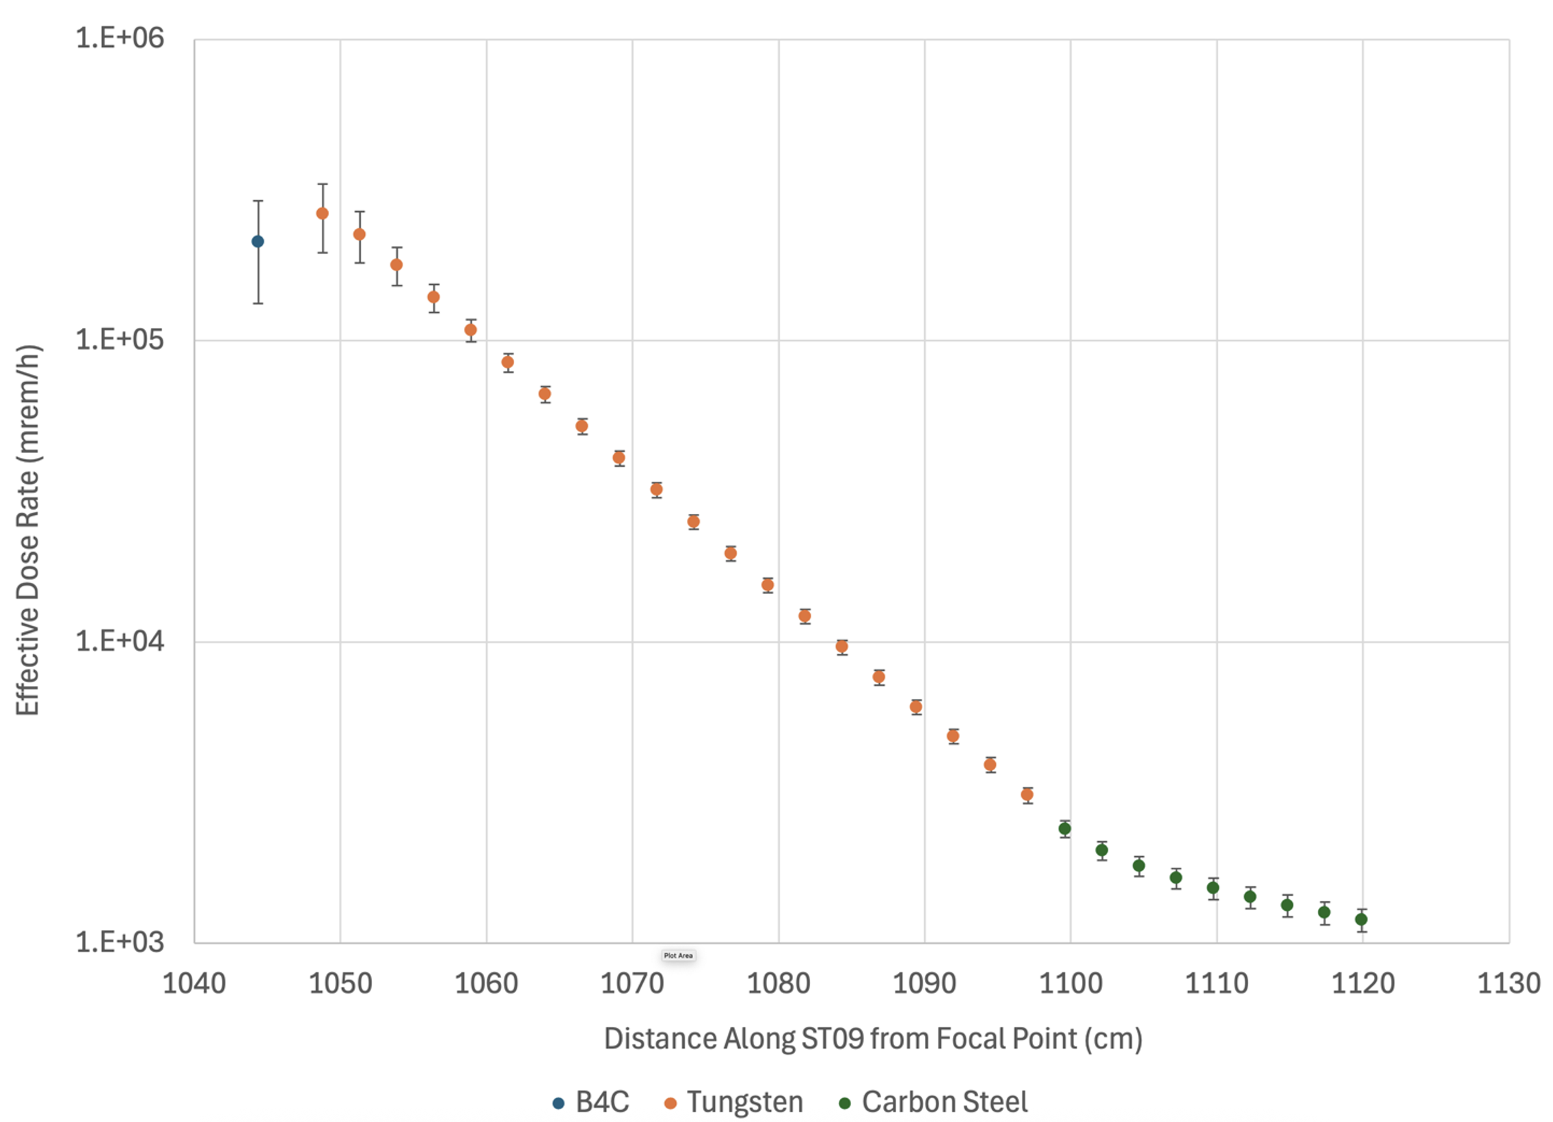
Performance of the shutter attenuator
Larger uncertainty in small mesh tally voxels pushes analysis to use cell-based tally results
  Three cells, each 5 x 5 x 10 cm (equivalent volume of ~31 mesh tally voxels)
Max total dose rate (mean + 2*sigma) 290-300 cm beyond shutter attenuator: 1.83 mrem/h
Shutter attenuator: 20 tungsten plates followed by 9 carbon steel plates (all plates 2.5 cm thick)
Attenuator dose reduction is more than 2 orders of magnitude
1 2 3
Tally cells

Slide 19
Conclusions
The heavy shutter attenuator reduces the total effective dose rate to less than 2 mrem/h, 3 m downstream of the attenuator – this meets the design requirement
The max total effective dose rate in the high bay, 30 cm above the bunker roof panels, is 0.26 mrem/h when the heavy shutter attenuator intercepts the neutron beam – this meets the design requirement
The max total effective dose rate in the instrument hall, 30 cm beyond the bunker wall, is 0.36 mrem/h when the heavy shutter attenuator intercepts the neutron beam
  This meets the design requirement because this location is not generally accessible
  Other areas that are generally accessible have max total effective dose rates less than 0.25 mrem/h – this meets the design requirement

Slide 20
Thank you!

Slide 21
Additional Slides

Slide 22
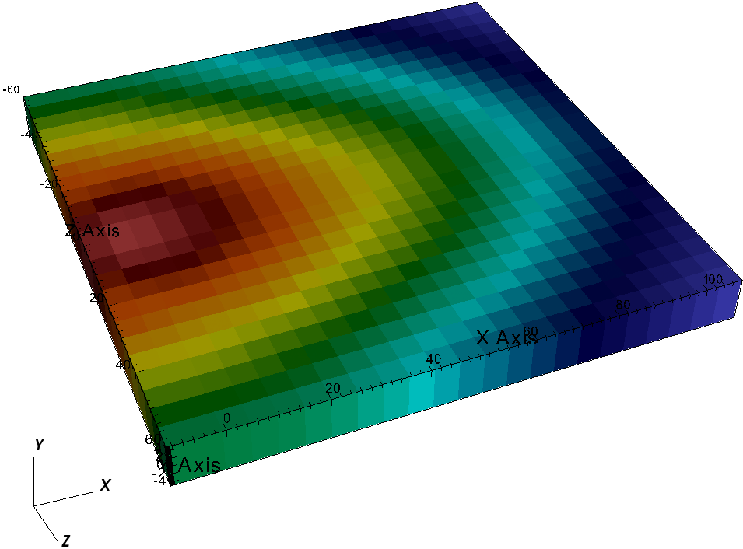
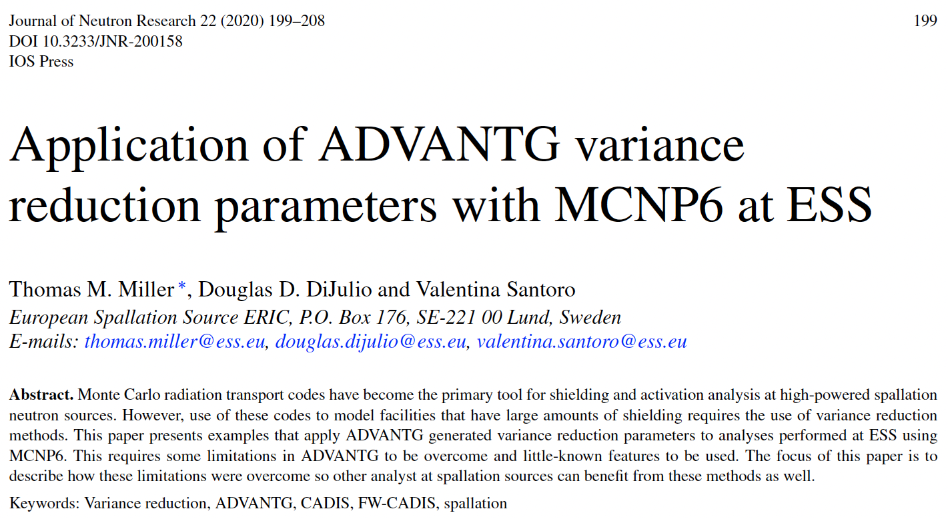
ADVANTG used to generate Monte Carlo biasing parameters
ADVANTG was developed for reactor applications, i.e. below 20 MeV
With the use of HILO2k cross sections and surrogate neutron sources, one can apply ADVANTG to spallation applications
ADVANTG generates
  Weight windows
  A consistent biased neutron source
STS surrogate neutron source (flux, not neutron production)

Slide 23
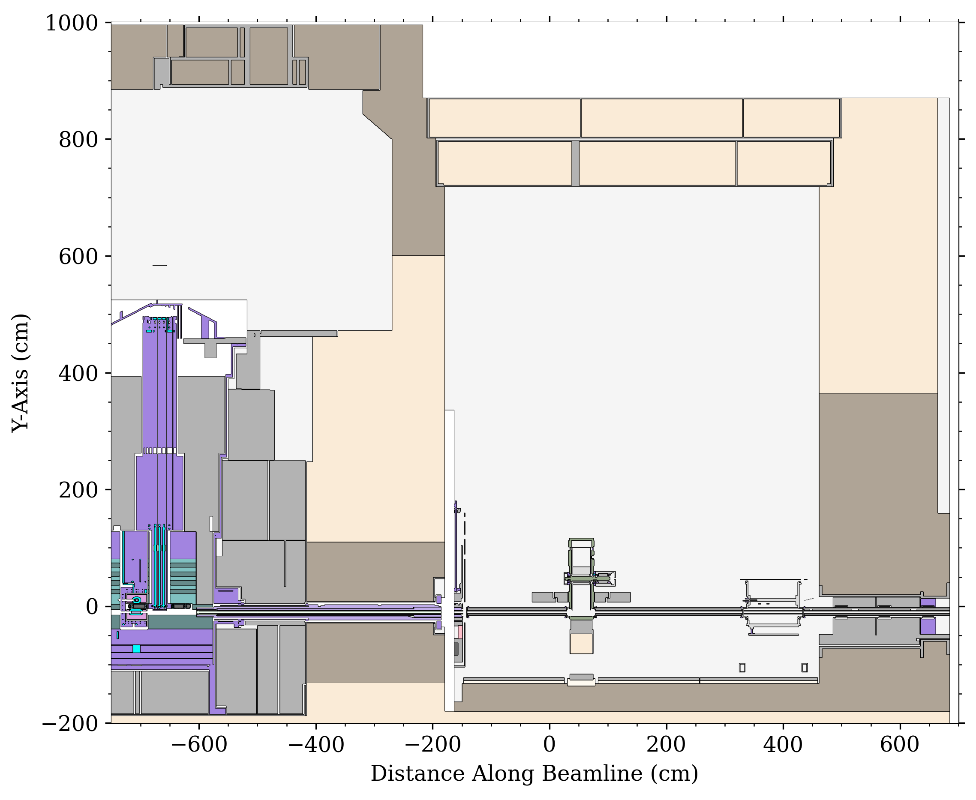
Geometry
Conversion
  Hand-built CSG
  GEOUNED (CSG)
  Attila4MC (UM)
Master MCNP model Git repository

Slide 24
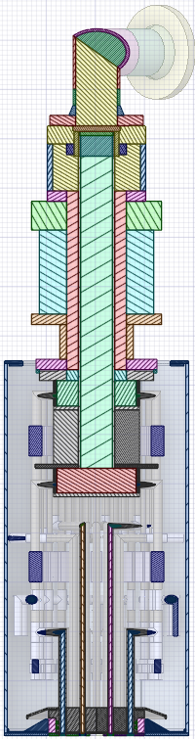
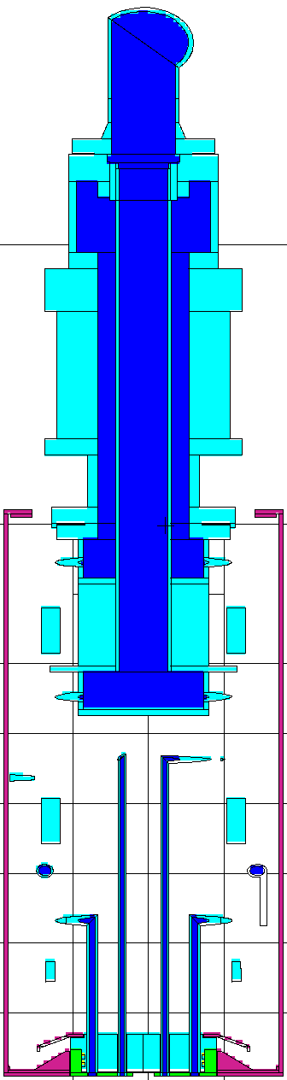
GEOUNED CAD to CSG Geometry Conversion
Today, our primary tool for building CSG geometry is GEOUNED
The conversion starts with a “clean” CAD file provided by an STS designer
GEOUNED reads that CAD file (usually stp format) and creates an MCNP CSG output
GEOUNED

Slide 25
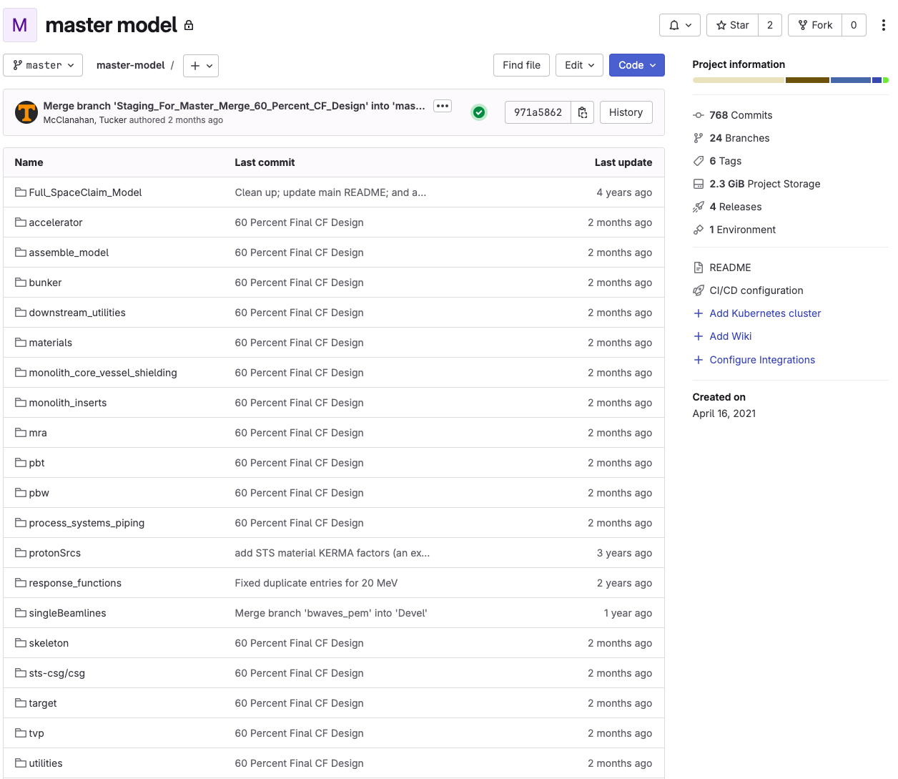
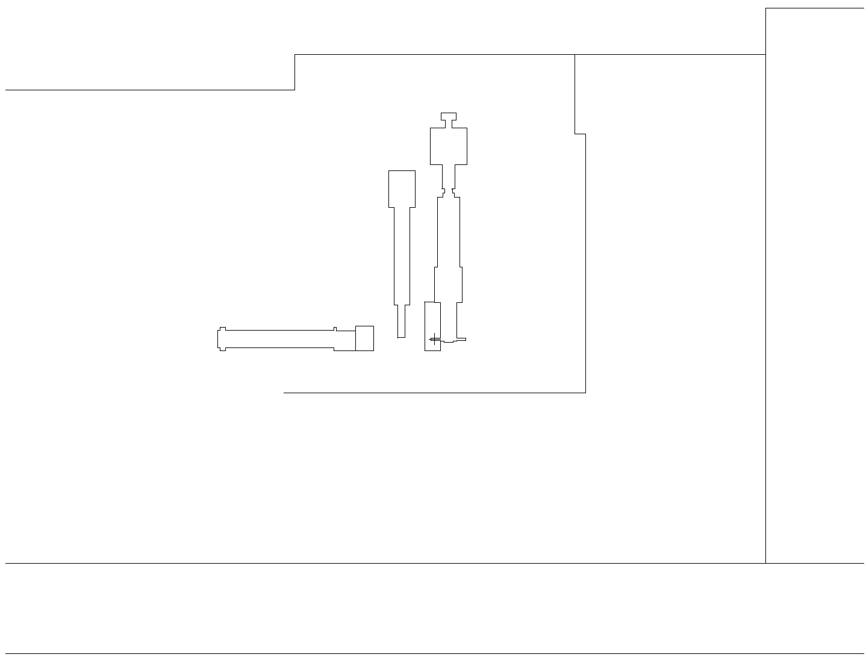
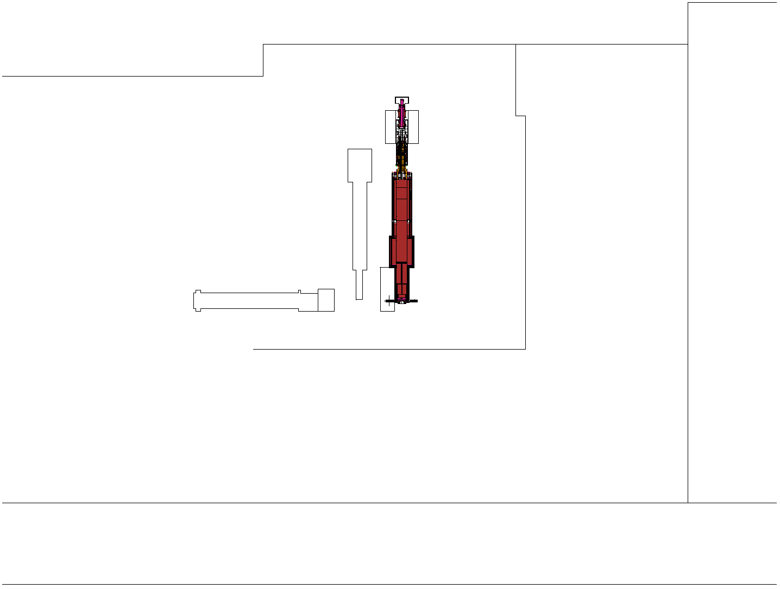
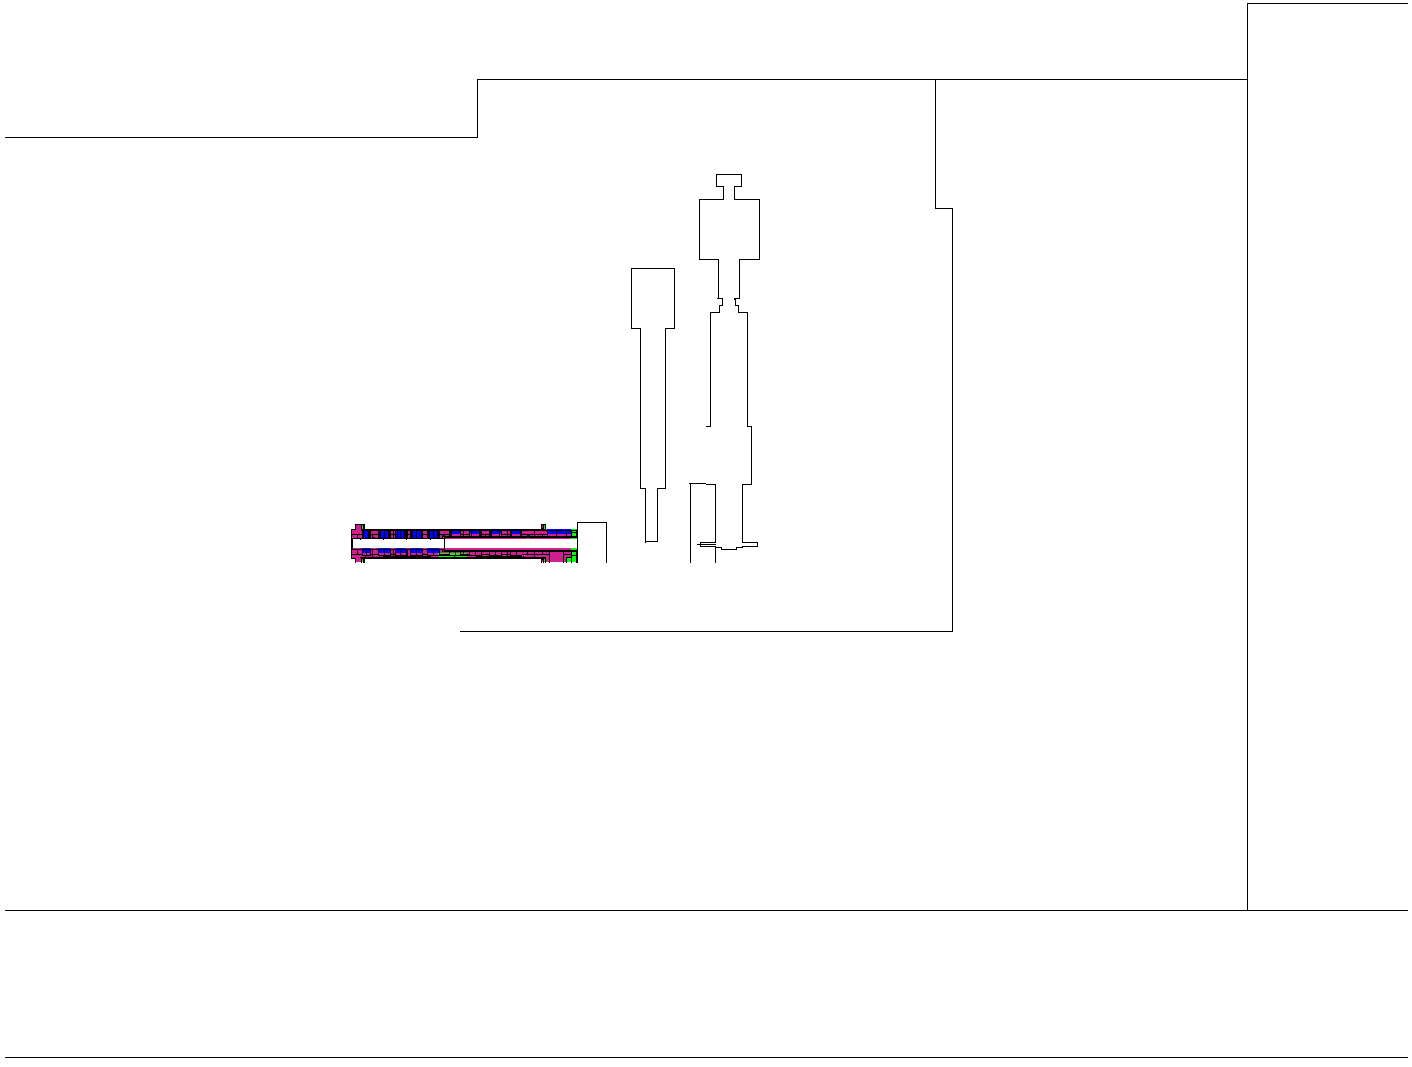
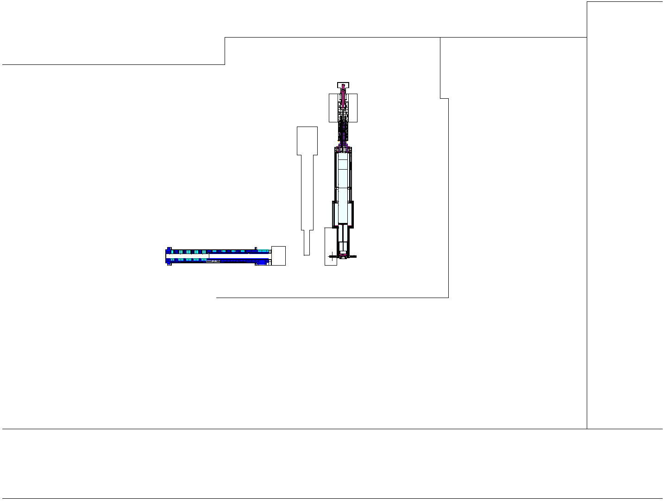
MCNP Master Model Git Repository
Modular construction of a model
Skeleton that holds all components
CSG and UM both possible
Assemble model script
Materials also included

Slide 26
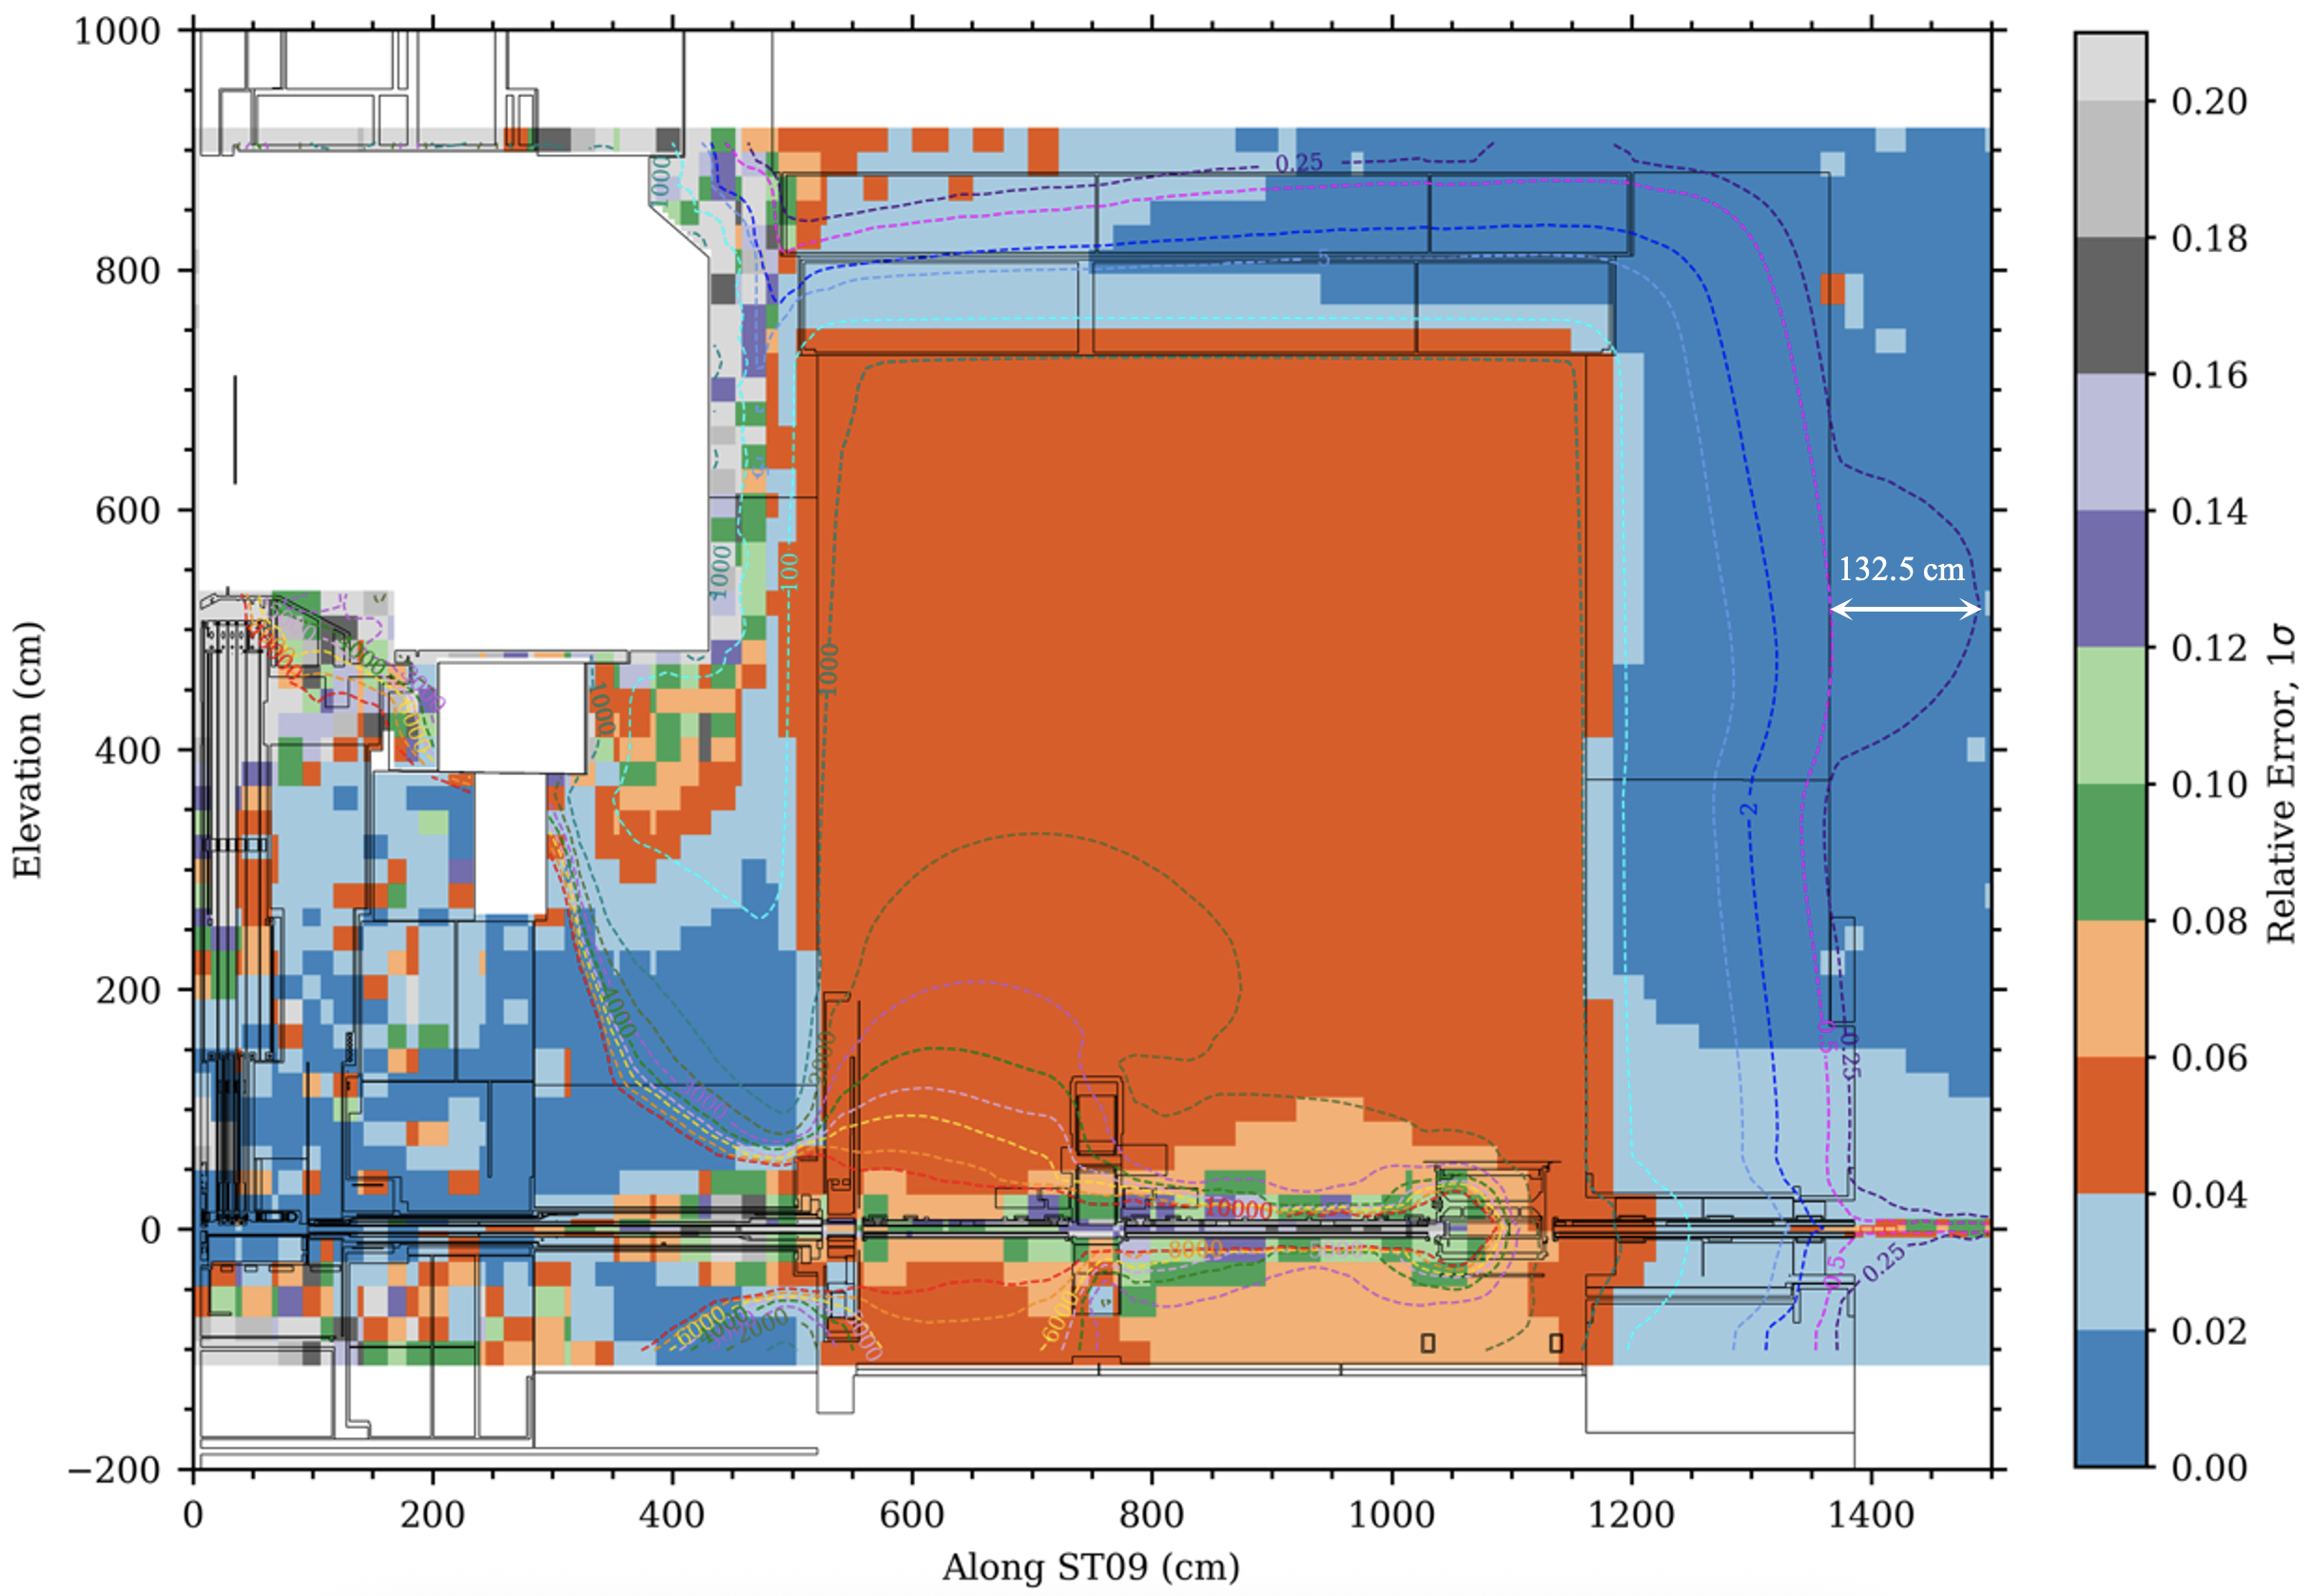
Performance of bunker roof and wall
This is for ST09, the forward most beamline
Mesh tally to the right does not have sufficient resolution to capture streaming through the bunker wall feedthrough
Max total dose rate (mean + 2*sigma) 30 cm above bunker roof: 0.26 mrem/h (2.6 $μ$Sv/h)
Max total dose rate (mean + 2*sigma) 30 cm beyond bunker wall: 0.36 mrem/h (3.6 $μ$Sv/h)
  5.5 m above proton beam height, which is not generally accessible
  1 m above the beamline shielding, also not considered generally accessible

Slide 27
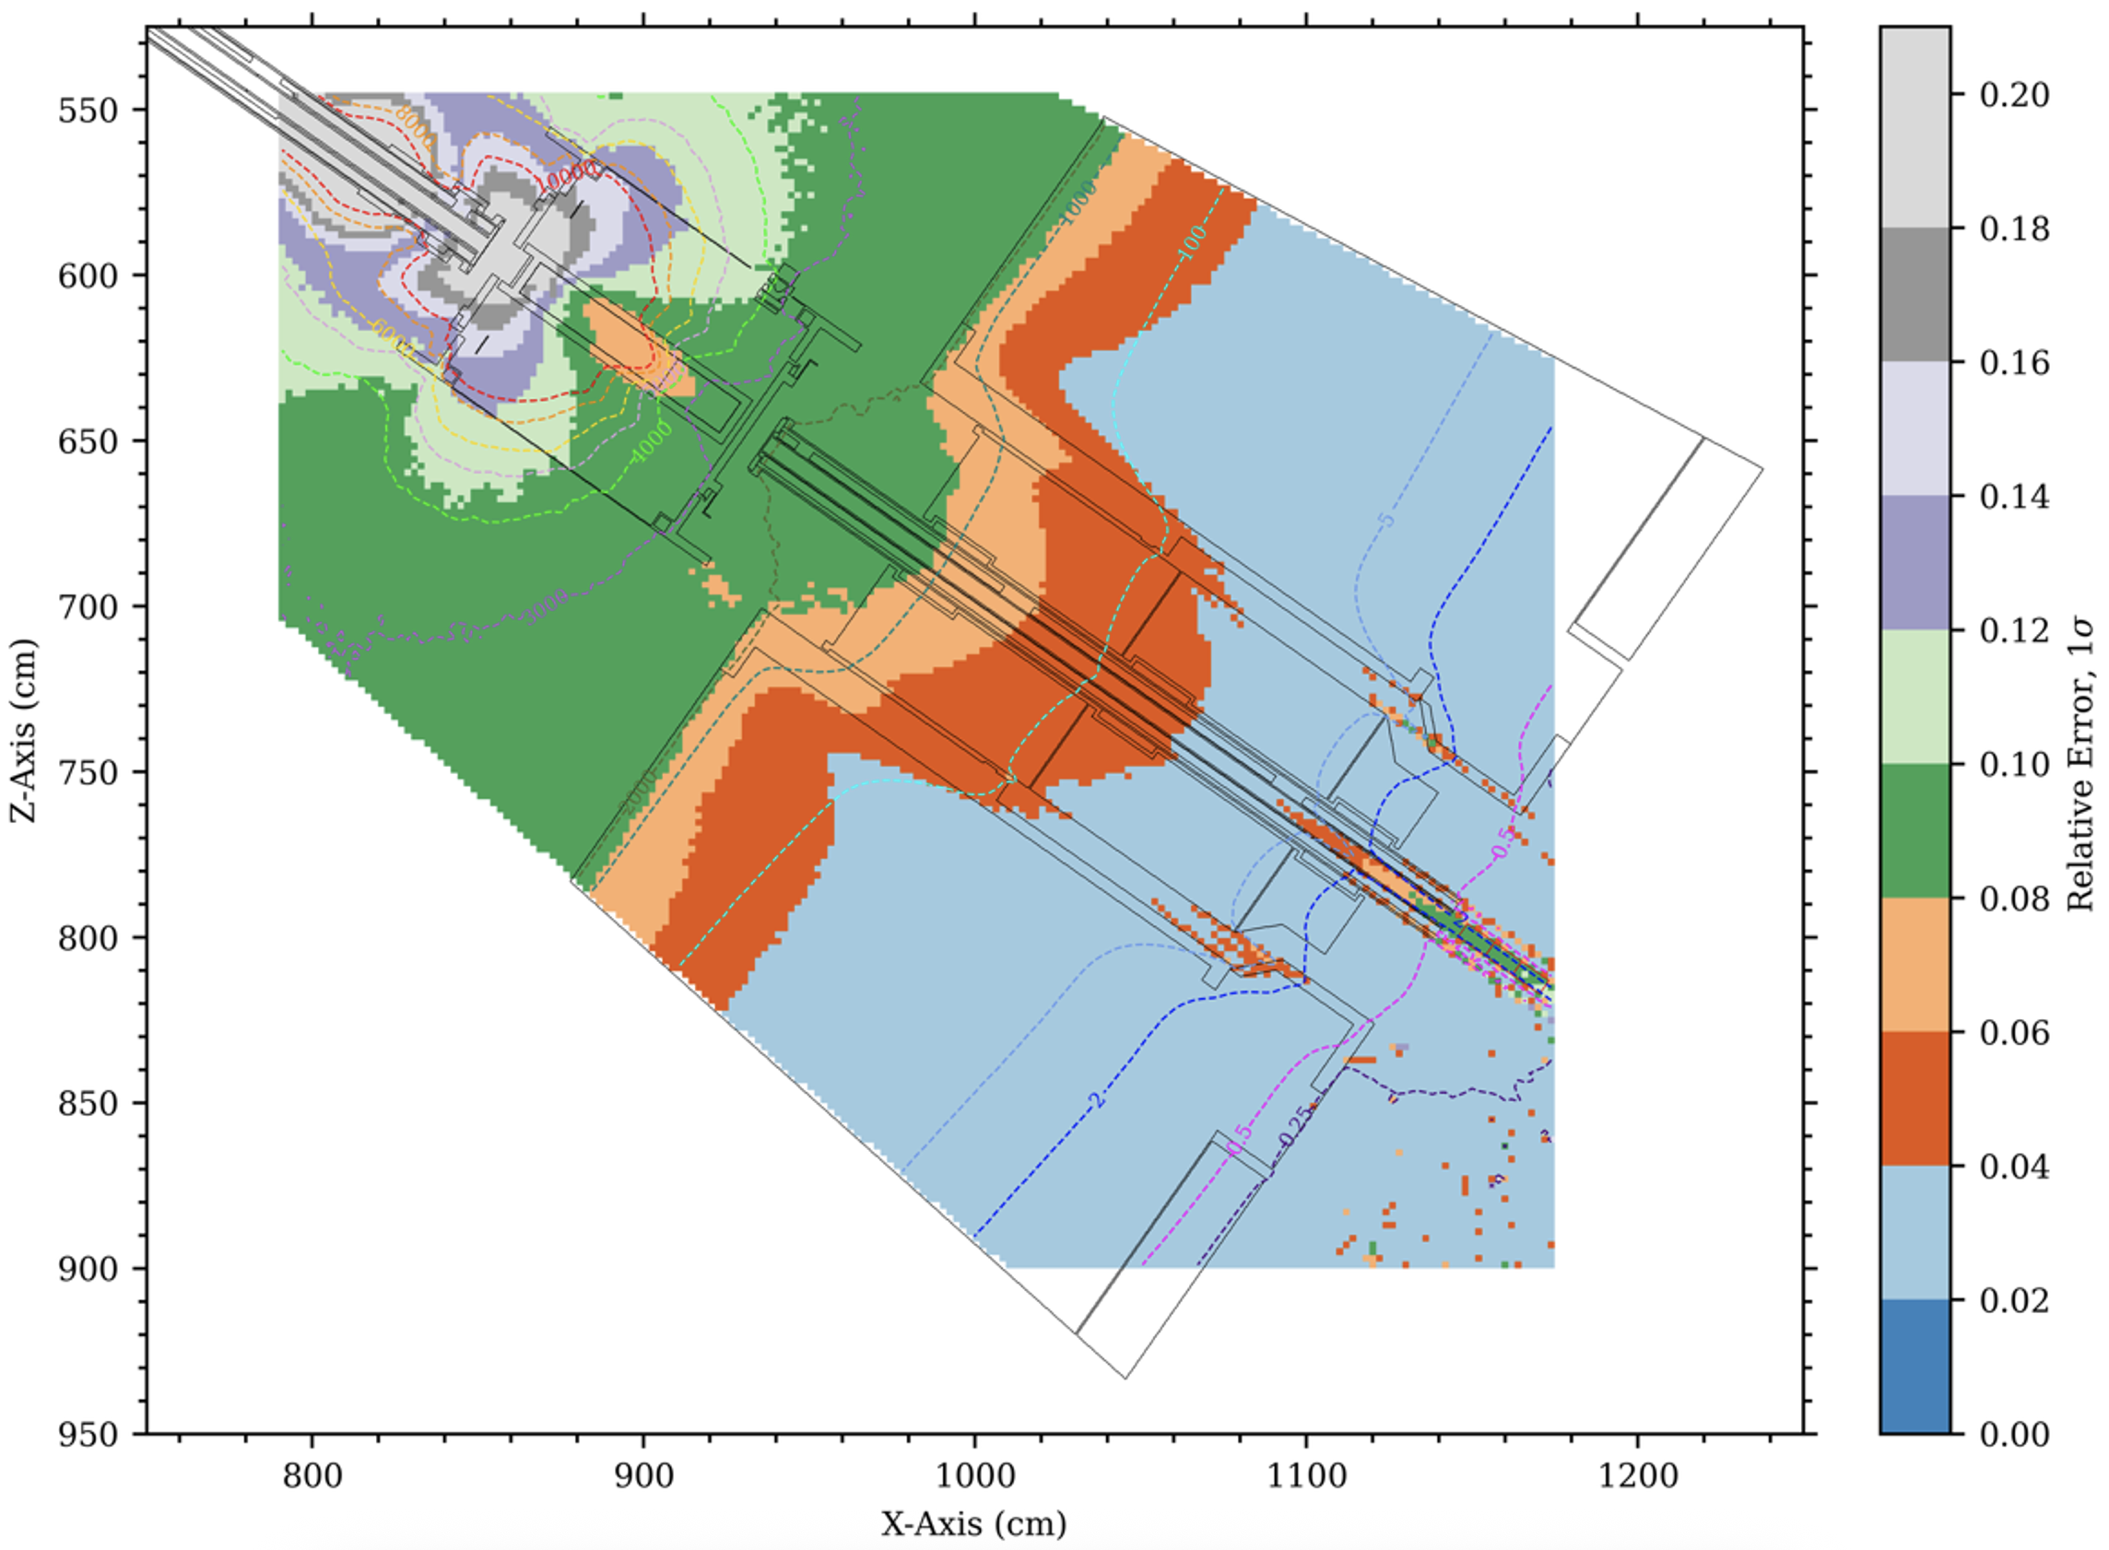
Performance of the shutter attenuator
Mesh tally to the right has much finer resolution (20 cm³ voxels)
Larger uncertainty in small mesh tally voxels pushes analysis to use cell-based tally results

Slide 28
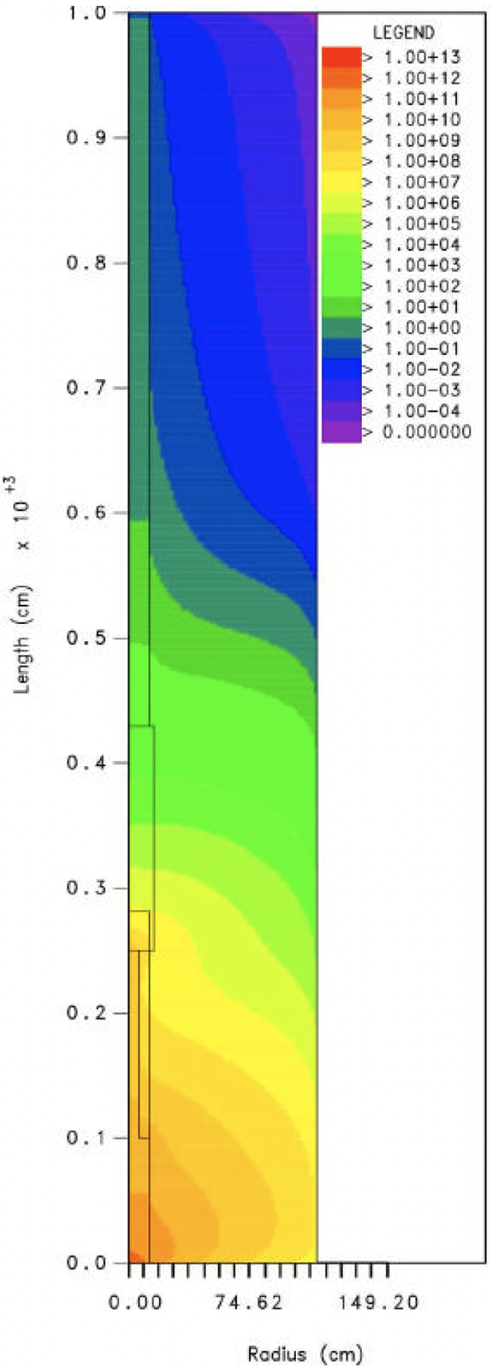
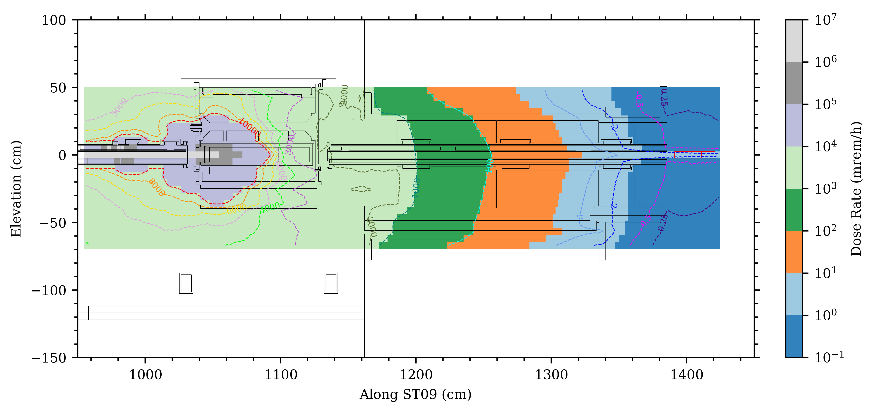
Comparison of SNS and STS shutters
Centerline of SNS shutter. Max dose rate 5.7 m from end of shutter 0.982 mrem/h
The SNS analysis was performed in 2001 with discrete ordinates (DORT) and the HILO-2k cross sections
  32 cm of tungsten followed by 147 cm of stainless steel
The SNS analysis used a factor of 2 design margin
  The design limit for both facilities is 2 mrem/h
  However, distance to SNS sample is 5.7 m, rather than 3 m
The STS analysis was performed with MCNP6.2, continuous energy ENDF/B-VII.1 cross sections, and the CEM nuclear model
  50 cm of tungsten followed by 22.5 cm of stainless steel
Centerline of STS shutter. Max dose rate 3 m from end of shutter 1.83 mrem/h.
SNS shutter
Tungsten followed by stainless steel
Neutrons
Neutrons

