Slide 1
Nuclear data sensitivity and uncertainty analysis of the TIARA Fe and Concrete shielding benchmark from the SINBAD Database
Ivo Kodeli, Enrico Sartori
SATIF-17 Meeting, Daejeon, 20-22/10 2026

Slide 2
Benchmarking activities at UKAEA
Focus on nuclear fusion: large and complex geometries, neutron & gamma source terms, higher energy neutrons than fission, material degradation studied using higher energy neutrons
Involved in fusion reactor projects such as JET, ITER, STEP, MAST-U, DEMO, IFMIF-DONES;
Licensing needs: V&V, understand and eventually reduce uncertainties
Fusion research needs (W, Cu, Fe, Li, Pb, Be, V, Mo, Cr, Y, Ti, C, Zr, Si,...)
M/C calculations using acceleration methods: MCNP, Serpent2, OpenMC, TRIPOLI, FLUKA, GEANT4
Nuclear data sensitivity and uncertainty analysis: predominantly using deterministic codes
SINBAD database serves for validation of transport codes and nuclear data,
CAD based computational workflows
Project on automation of benchmark analysis.
Activation & nuclear waste studies (Fispact II)
Open to international collaboration projects: SINBAD (NEA), Conderc, FENDL (IAEA), JADE (F4E)
2

Slide 3


SINBAD - Radiation Shielding Experiments
Preserve results from expensive experiments in an user-friendly format
Evaluate the quality, consistency and completeness of experimental information
V&V of radiation transport codes, nuclear data performance, reactor design concepts
Radiation transport and shielding encompassing:
  reactor shielding, PV dosimetry (48)
  fusion blanket neutronics (31)
  accelerator shielding (23)
Developing an approach of global method and data validation, using integral experiments
P. Miller, P. Nagel, M. Salvatores, E. Sartori, Shielding Experimental Benchmark Base at the Nuclear Energy Data Bank, Proc: 7th Int. Conf. on Rad. Shielding, Bournemouth, UK 1988 NEACRP-L-310
1992: 1st SINBAD compilation by E. Sartori (SINBAD-ASPIS-FE) launching SINBAD as a joint effort between NEA Data Bank, NEA Nuclear Science Committee (NSC) and RSICC
1992-2009 ~100 shielding benchmarks compiled in SINBAD
2011: OECD/NEA Working Party on Scientific Issues of Reactor Systems (WPRS) Expert Group on Physics of Reactor Systems (EGPRS): monitor, steer and support the continued development of SINBAD (Chair R. Grove, ORNL)
Working Party on Evaluation Cooperation (WPEC) - SG47 “Use of SINBAD for Nuclear Data Validation” 2019 – 2022 (I. Kodeli)
NEA Task Force on SINBAD development (>2022) (T. Miller, ORNL, O. Buss, NEA)
Notes:
3

Slide 4
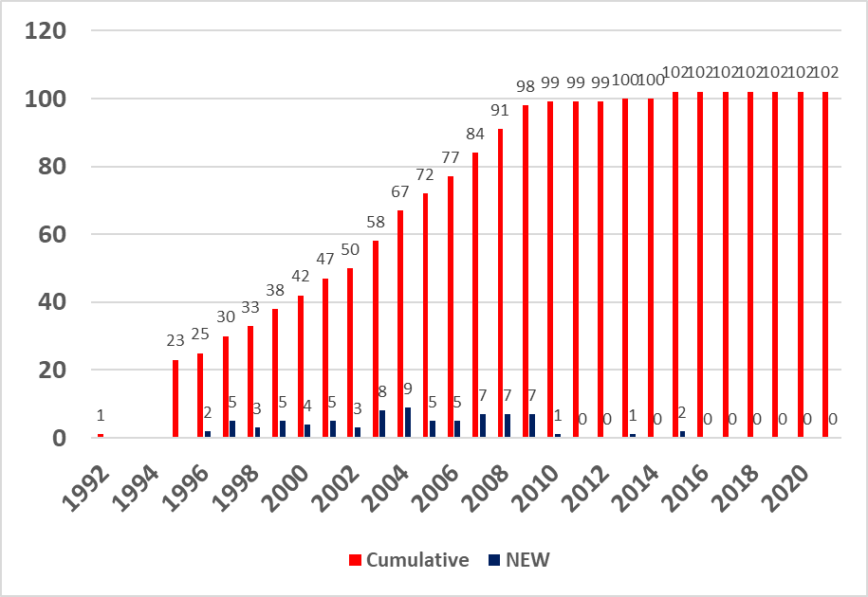
Critical remarks on SINBAD
Few new evaluations included since last 18 years; 19 recent benchmarks (> 2000), 23 older benchmarks (<1980)
Quality evaluation and independent review process is mandatory: measurement uncertainty assessment needs to be improved and studied more in detail; quality evaluation started ~2009 should be finished for the remaining benchmarks
Computer code inputs missing for some benchmarks
Format issues: differences with IRPhE/ICSBEP; new format(s) for SINBAD
Benchmark model to be provided as part of benchmark evaluation => computational model accurately describes the experimental arrangement
Preparing an “ISO” standard for benchmarks was proposed by Enrico >25 years ago. Time to do it?
4

Slide 5
WPEC Subgroup 47: Recommendations
Objective: promote & facilitate wider use of shielding benchmarks, provide feedback and recommendations for improvements from users on their needs.
New benchmarks should be evaluated in benchmark databases ASAP, not only published in journals;
Careful verification of completeness and consistency of experimental information is mandatory. Correct and complete interpretation of measured results and understanding of uncertainties & correlations.
Accelerator validation needs (MYRRHA): better information on the quality and experimental uncertainty, more (&) high-quality accelerator benchmarks needed
Quality evaluations: several SINBAD evaluations updated with reassessment of measurement uncertainty, completeness of experimental information, quality standards for modern ND V&V
Computer code input data:
  Additional inputs & feedback were provided from users,
  Variance reduction ww cards to reduce CPU time,
  Extended list of computer codes used for analysis,
Priority list for future evaluations: SINBAD renaissance in cooperation with EGPRS & SINBAD Task Force. No new benchmark evaluations since 18 years;
New SINBAD options discussed
  CAD geometry & material composition as detailed as reasonably possible;.
  Sensitivity profiles
  New formats

Slide 6
Priority List for future evaluations: ACCELERATOR Benchmarks
Neutron Penetration through Fe & Concrete for 140-350-MeV Quasi-Monoenergetic Neutrons, RCNP, Osaka University (Prof. Takashi Nakamura)
JASMIN: Japanese-US Study of Muon Interactions & Neutron Detection FERMILAB (Prof. Takashi Nakamura)
68 MeV P on thick Cu target (JAERI)
Reaction Rate in Thick Concrete Shield Irradiated by 6.2 GeV Protons (LBL-1965)
Experiment using 4 m concrete at KENS/KEK 500 MeV Proton Accelerator (KENS/KEK)
Cosmic ray induced n spectrum at Zugspitze 2660m & Chacaltaya 5240m;
CERF measurements (GSF, Neuherberg)
TOF N spectra & radioactivity induced in Li, Be, Cu, C, Al, for 25-40 MeV d (Tohoku Univ.)
Neutron spectra from 20cm Fe slab, D2O(He3,xn) reaction at 40 MeV (NPI Rez)
Residual Product Yields in Thin Targets Irradiated by 100-2600 MeV P (ITEP, Moscow)
SLAC experiment using 28.7 GeV electrons (SLAC)

Slide 7
V&V using SINBAD Fe benchmarks
Benchmark / quality | Additional information needed on
TIARA 43 MeV ⁷Li(p,n) transmission through Fe (1996) ♦♦♦ | 43 & 68 MeV protons on Li-7 target Fe (130 cm), concrete (< 200 cm), polyethylene (< 180 cm) BC501A liquid scintillator, Bonner spheres, fission counters, TLD, SSNTD Code inputs: MCNP, (PHITS, MORSE, DORT)
TIARA 43 MeV ⁷Li(p,n) transmission through Concrete (1996) ♦♦♦ | 43 & 68 MeV protons on Li-7 target Fe (130 cm), concrete (< 200 cm), polyethylene (< 180 cm) BC501A liquid scintillator, Bonner spheres, fission counters, TLD, SSNTD Code inputs: MCNP, (PHITS, MORSE, DORT)
Řež IFMIF-DONES | Not (yet) in SINBAD High uncertainty in neutron source characterisation
*** | valid for nuclear data & code benchmarking
** | suitable for education & training
* | benchmarks of historical interest

Slide 8
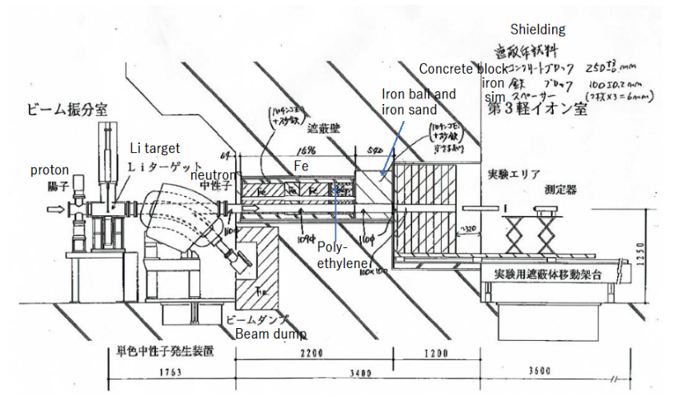
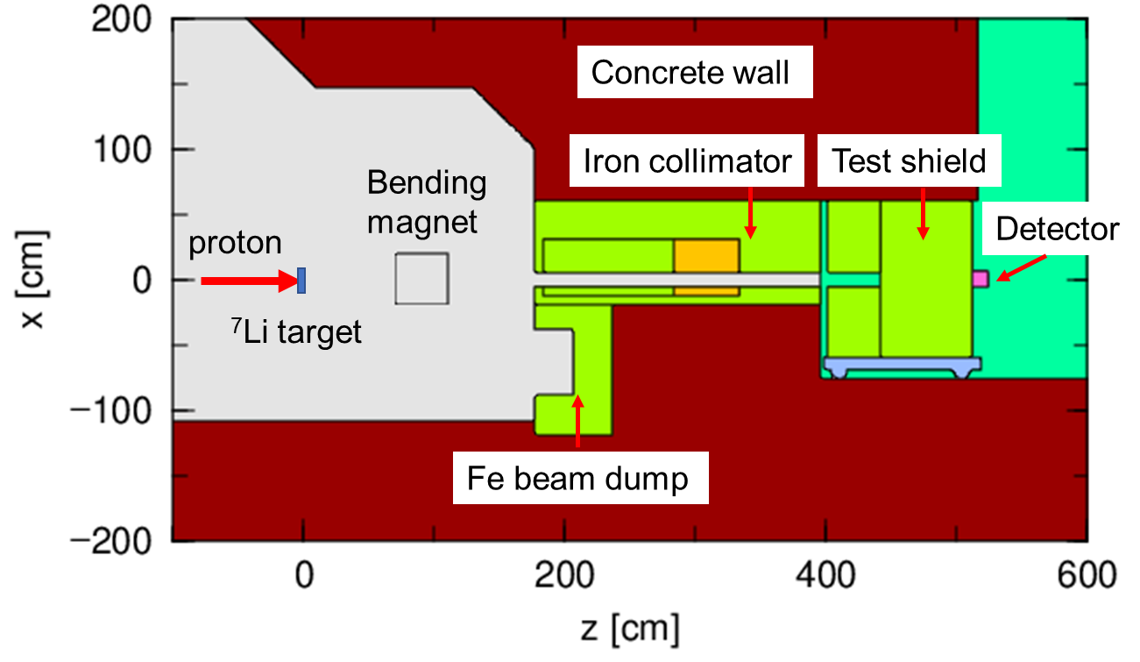
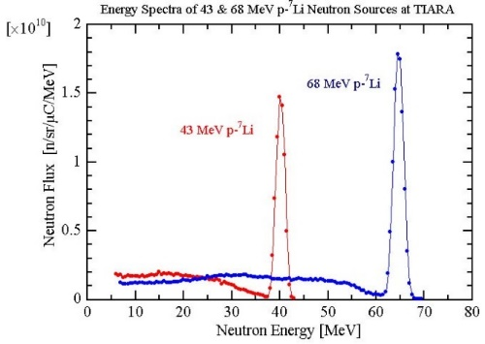
TIARA facility (1995)
Projectile: 43 & 68 MeV protons on Li-7 target
Shield: Fe (130 cm), concrete (< 200 cm), polyethylene (< 180 cm)
Measurement: neutron spectra and reaction rates by BC501A liquid scintillator, Bonner spheres, fission counters, TLD and SSNTD
Organisation: TIARA/JAERI
Code inputs: MCNP, (PHITS, MORSE, DORT)
8

Slide 9
TIARA facility (1995) NEA-1552/03
History of evaluations:
Sinbad evaluation in 2000 by I. Kodeli & N. Nakao (NEA-1552/03)
QA & Monte Carlo code MCNPX v.2.6.0 by P. Ortego (2012): experiment is adequate for ND & code benchmarking (MCNP model prepared with p-⁷Li source, including target, accelerator window, collimators, shielding block and detector; inconsistent results for n. spectra);
C. Konno, S. Kwon (2012-2019), MCNP-5, -6.1.1 & DORT, source neutron spectrum measured in the experiments used as a neutron source for the analysis
MCNP-5 analysis by B. Kos (2019) detailed model for n. spectra & r. rates (on & off-exes), measured neutron source spectrum was used as source in MCNP, variance reduction parameters;
Re-evaluation using PHITS model promised for OECD NEA TRG meetings for ICSBEP/SINBAD (Yosuke Iwamoto, 2022), PHITS inputs not (yet) in SINBAD
Open issues in the modelling:
More information needed on the surroundings, target, source, beam dump and collimator. Attempts were made to include explicit modelling of (p,n) source and collimator in the model (P. Ortego, B. Kos), however the available information on the geometry around the shielding block is not sufficient to allow meaningful results.
Geometrical details needed to model the dosimeters (Bonner spheres, fission counters, BC 501A spectrometers), surrounding concrete structure, detector stands and detectors support.
9

Slide 10
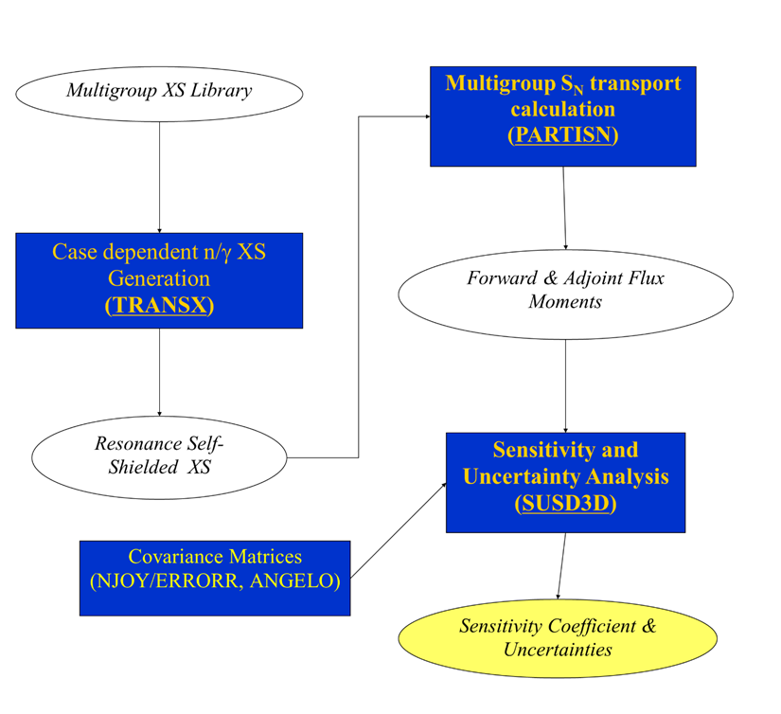
Computer codes used
- MCNP-reference solution
- DORT&TORT deterministic transport
SUSD3D/XSUN-2026
Deterministic S/U of k_{eff}, β_{eff}, shielding using TRANSX, PARTISN, (DORT/TORT, DENOVO), SUSD3D;
S/U analysis of neutron & gamma related quantities (neutron/gamma flux, reaction rates, heating, damage, etc.):
Sensitivity to n&γ source
Covariances in COVFILS, COVERX & BOXR formats
JEFF-3.3, ENDF/B-VIII.0 33 & 175g, FENDL-3.2 211/42 n/γ, (XSUN2026: ENDF/B-VIII.1, JENDL-5.0, CENDL-3.2, JEFF-4.0), IRDFF-II
ND processing difficulties: LRF=7, LCOMP=2 format (MF32) –e.g. ¹⁶O covariances; ⁶⁵Cu, new MF6/MT18 files, LB=8 (²⁷Al); NJOY2016 and PUFF4 codes used for covariance matrix processing; Covfils vs. Coverx matrix processing by NJOY2016 and SCALE/PUFF-4

Slide 11
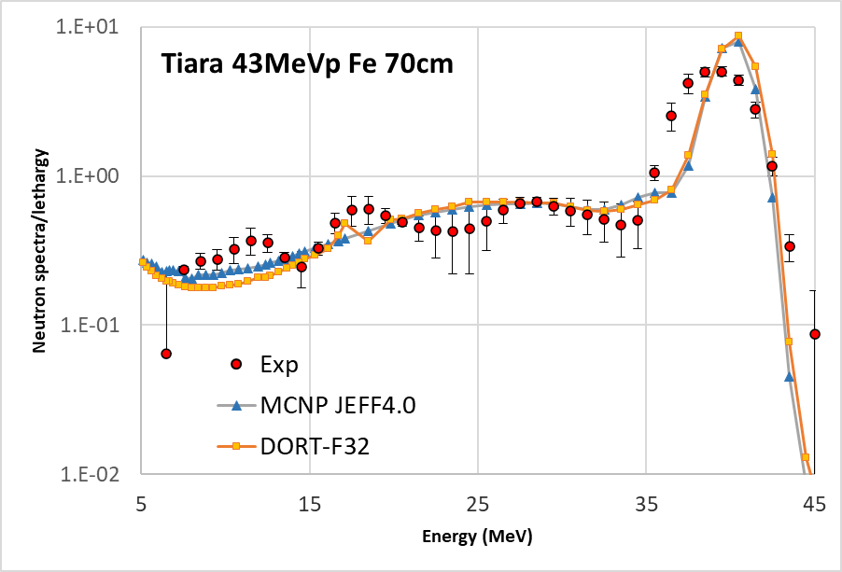
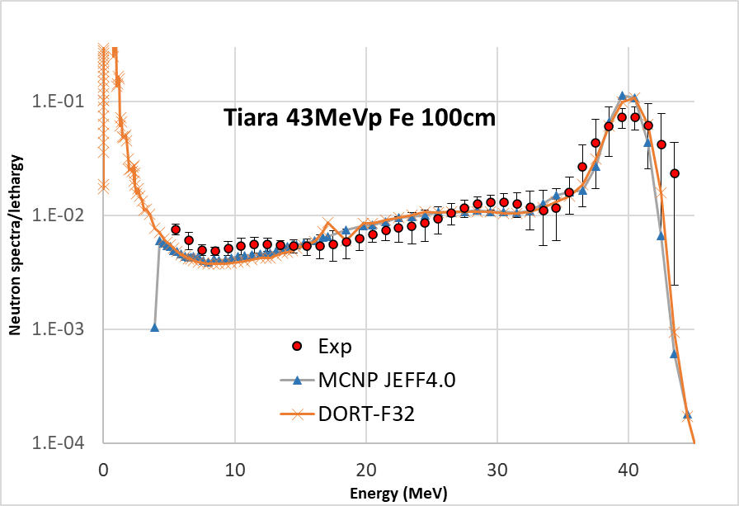
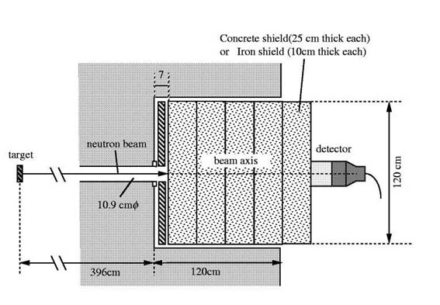
TIARA 43 MeV p-⁷Li iron
TIARA transmission of quasi-monoenergetic neutrons generated by 43 MeV p–Li7 through 10, 20, 40, 70 and 100 cm thick iron slabs of 120 cm x 120 cm rectangular surface (1996)
BC501A organic liquid scintillator
Bonner ball counter
- ²³⁸U, ²³²Th fission counters, TLD, SSNTD
NEA-1552/03

Slide 12
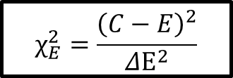
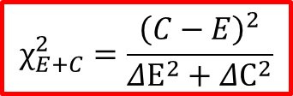
TIARA 43 MeV p-⁷Li iron
Nuclear data uncertainty in neutron flux in 70 and 100 cm thick iron block in TIARA 43 MeV p benchmark. Covariances > 20MeV only available in JEFF-4.0.
TIARA 43MeV Fe | JEFF-4.0 (%)
 | 70 cm |  |  |  | 100 cm
Neutron flux between | C/E | Δ_{XS} | Δ_{exp} | χ²_{E+C} (χ²_{E}) | C/E | Δ_{XS} | Δ_{exp} | χ²_{E+C} (χ²_{E})
35-45 MeV | 0.96 | 25.5 | 4.3 | 0.03 (1.04) | 3.26 | 52.4 | 16.9 | 16.8 (178)
25-35 MeV | 1.13 | 48.8 | 7.3 | 0.07 (2.96) | 0.97 | 19.9 | 8.8 | 0.02 (0.11)
15-25 MeV | 0.99 | 39.6 | 7.8 | 0.001 (0.03) | 1.21 | 76.6 | 7.9 | 0.07 (7.05)
10-15 MeV | 0.80 | 22.6 | 8.5 | 0.67 (5.45) | 0.86 | 49.0 | 6.3 | 0.08 (5.08)
7-10 MeV | 0.82 | 23.1 | 6.8 | 0.54 (6.79) | 0.81 | 49.3 | 6.5 | 0.15 (8.45)
5-7 MeV | 8.7 | 23.2 | 237 | 10.5 (10.6) | 0.71 | 49.6 | 9.4 | 0.33 (9.46)
$$χ_{E+C}^{2}=\frac{{\left(C−E\right)}^{2}}{{ΔE}^{2}+{ΔC}^{2}}$$
$$χ_{E}^{2}=\frac{{\left(C−E\right)}^{2}}{{ΔE}^{2}}$$

Slide 13
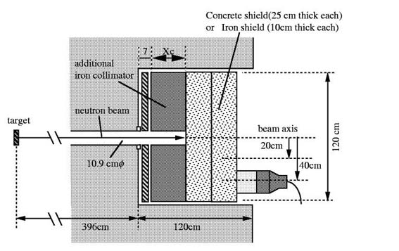
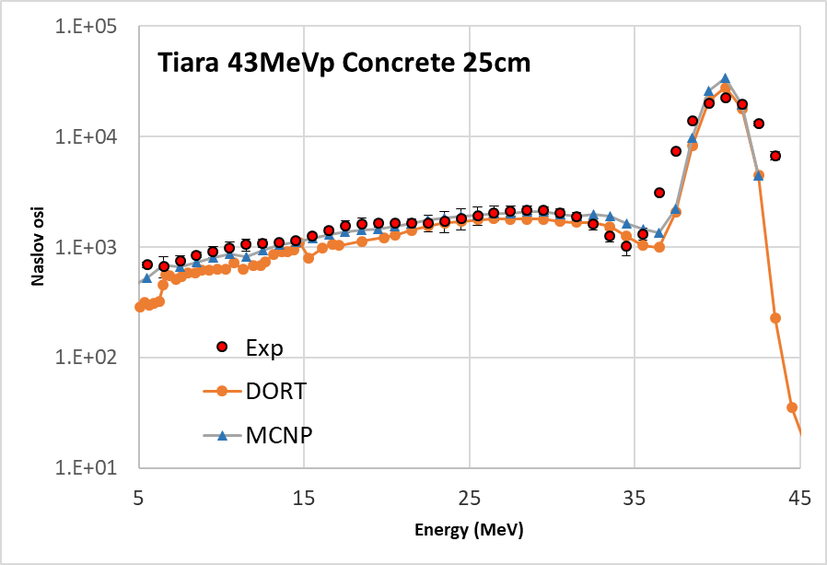
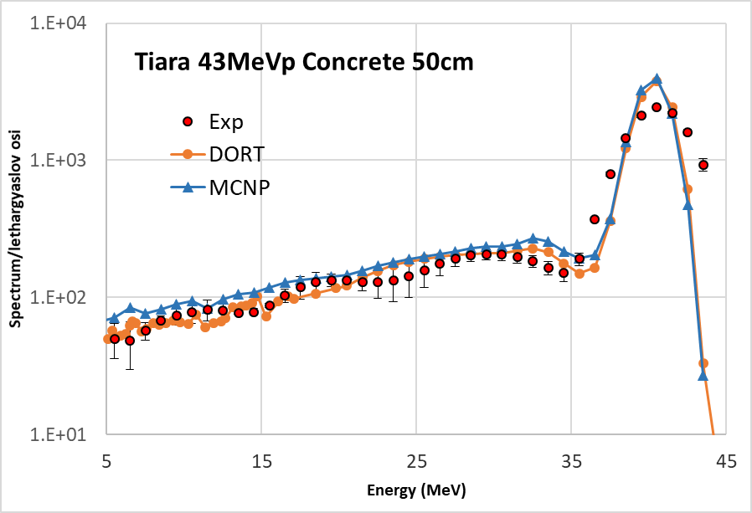
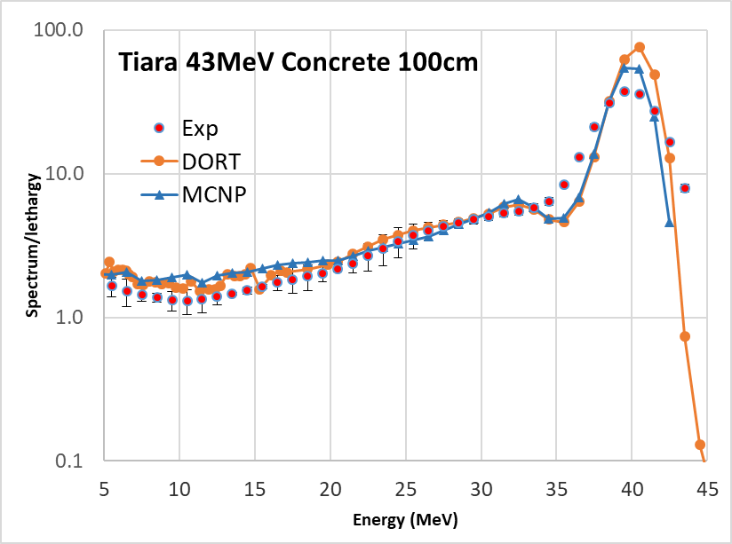
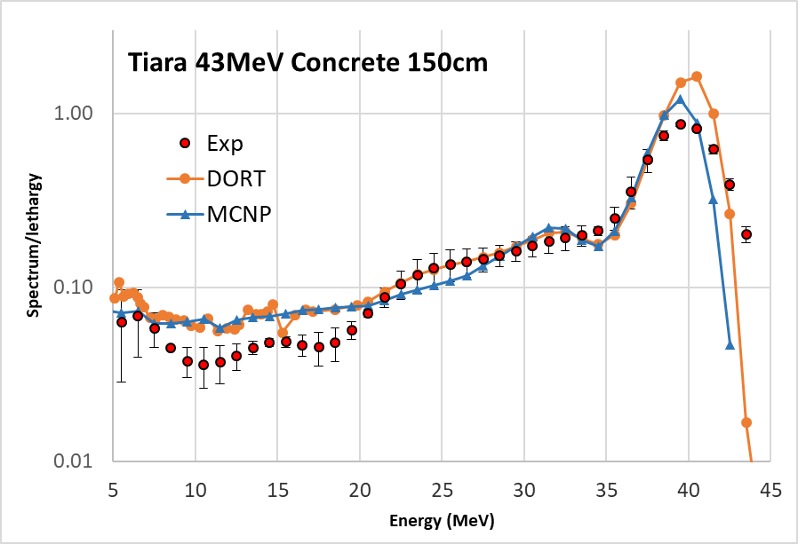
DORT 2D (rz) vs. MCNP
TIARA 43 MeV p-⁷Li concrete
FENDL-3.2

Slide 14
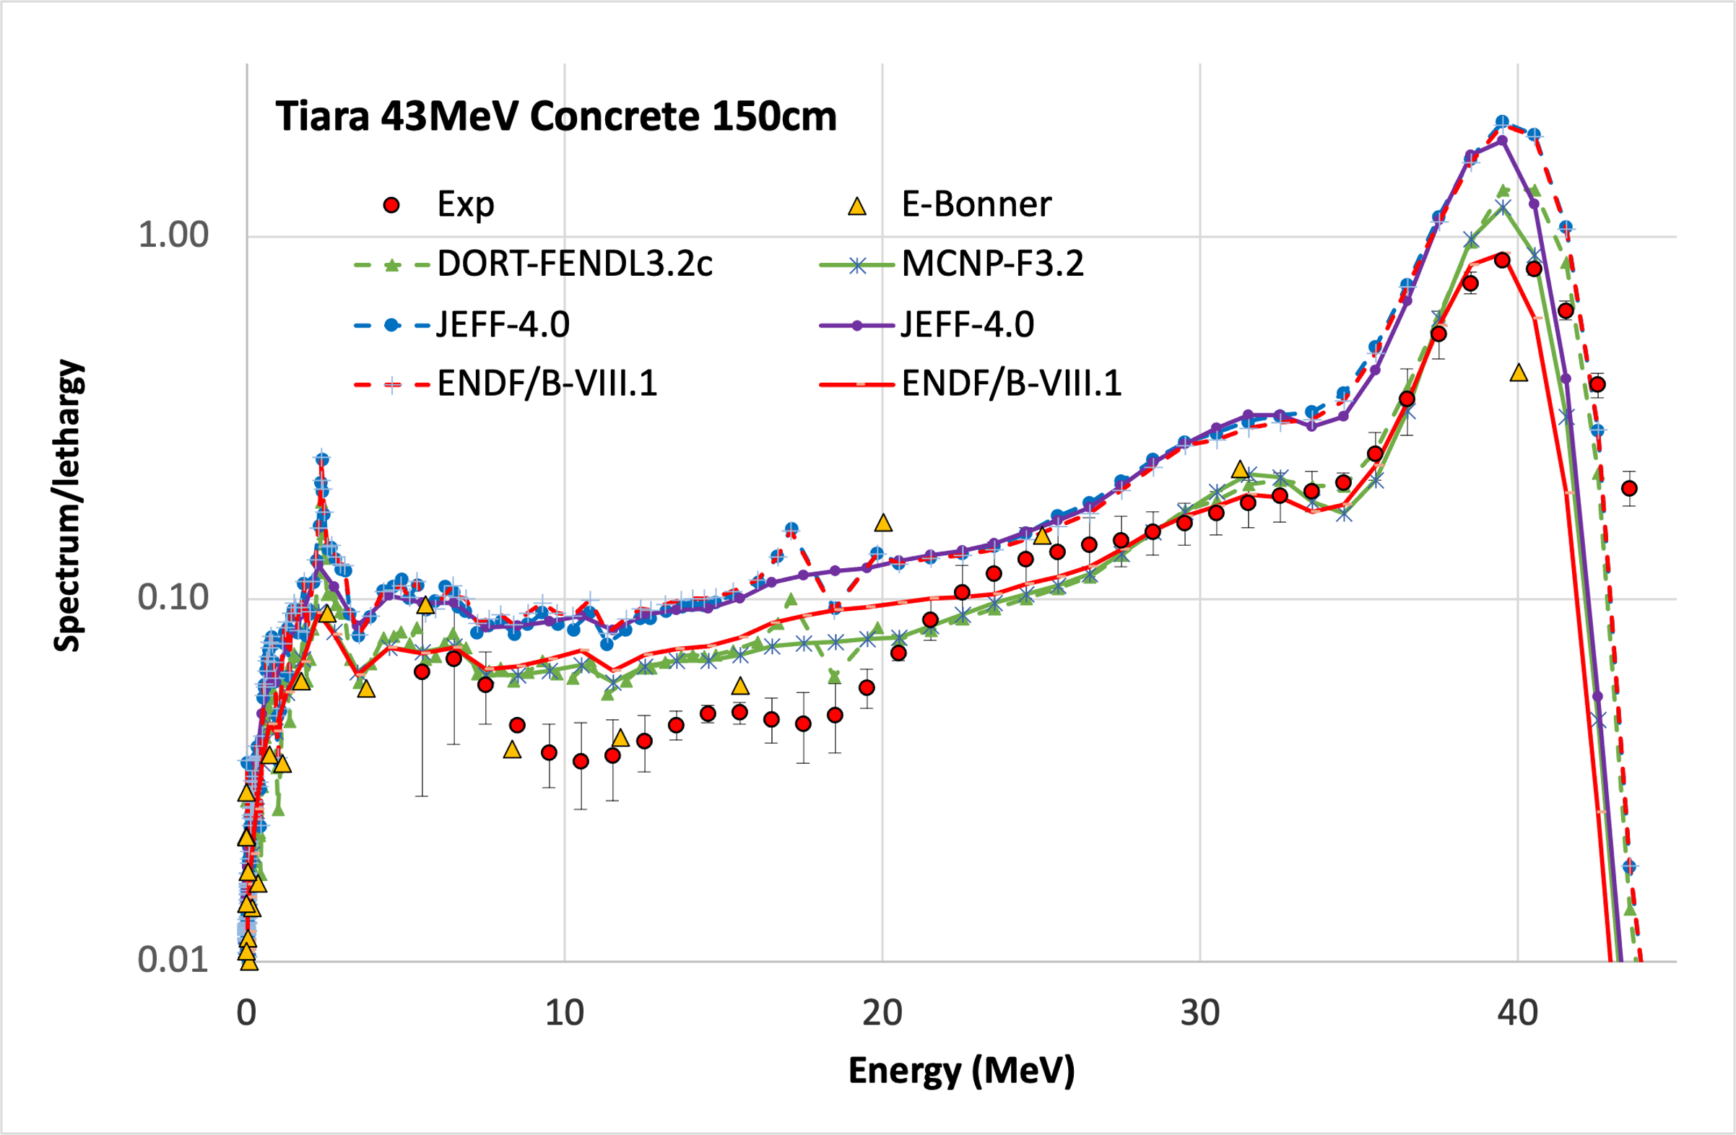
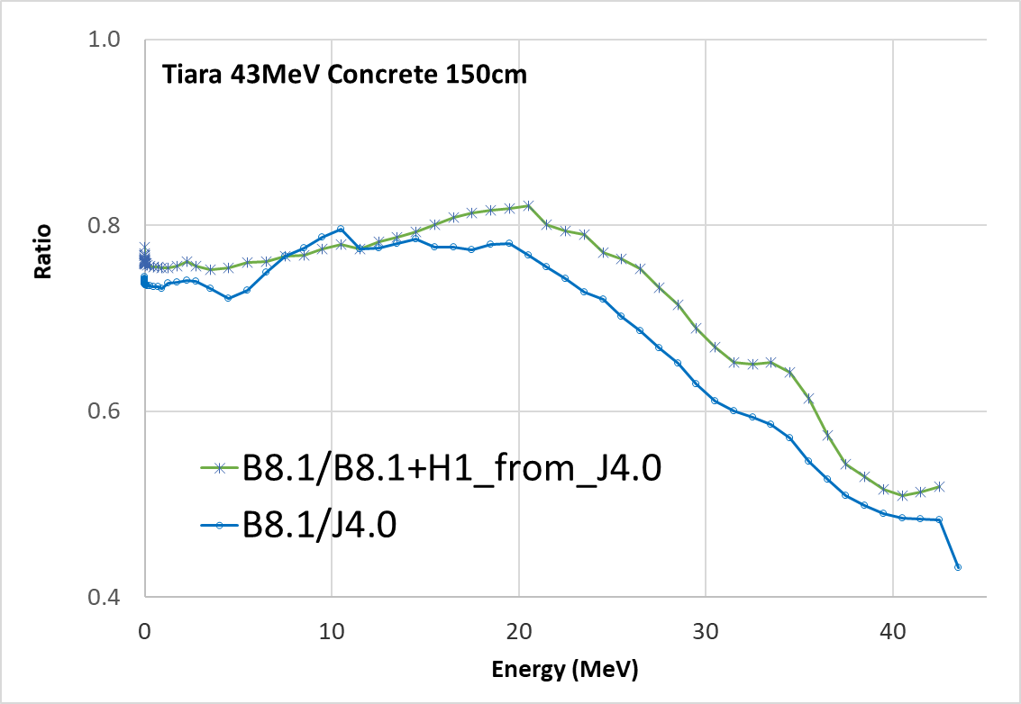
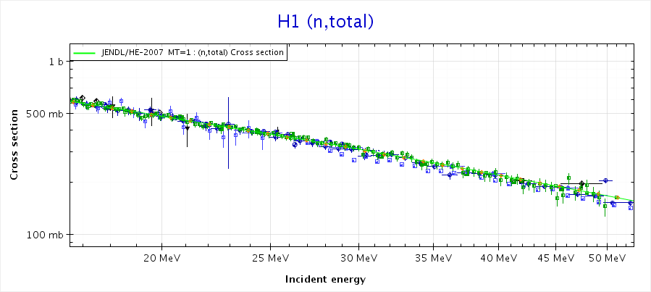
TIARA 43 MeV p-⁷Li concrete
NJOY2016 multigroup XS processing > 20MeV. No data:
- ENDF/B-VIII.1: ¹H, ²³Na, ²⁴⁻²⁶Mg, ³⁹⁻⁴¹K
JEFF-4.0: ²³Na
Nuclear models used in MCNP. FENDL3.2 was completed above 20MeV (D. Aldama)

Slide 15
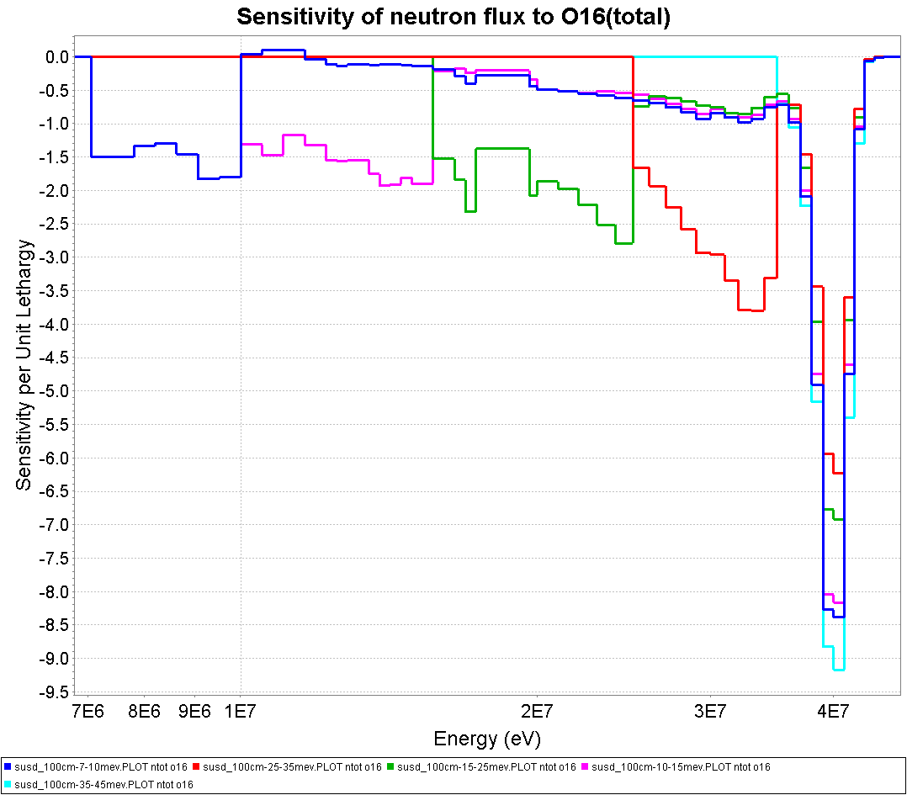
TIARA 43 MeV p-⁷Li concrete
Sensitivity of neutron spectra in the energy ranges between 7 – 10 – 15 – 25 – 35 - 45 MeV to ¹⁶O total cross section for the 100cm TIARA 43MeV concrete benchmark.

Slide 16
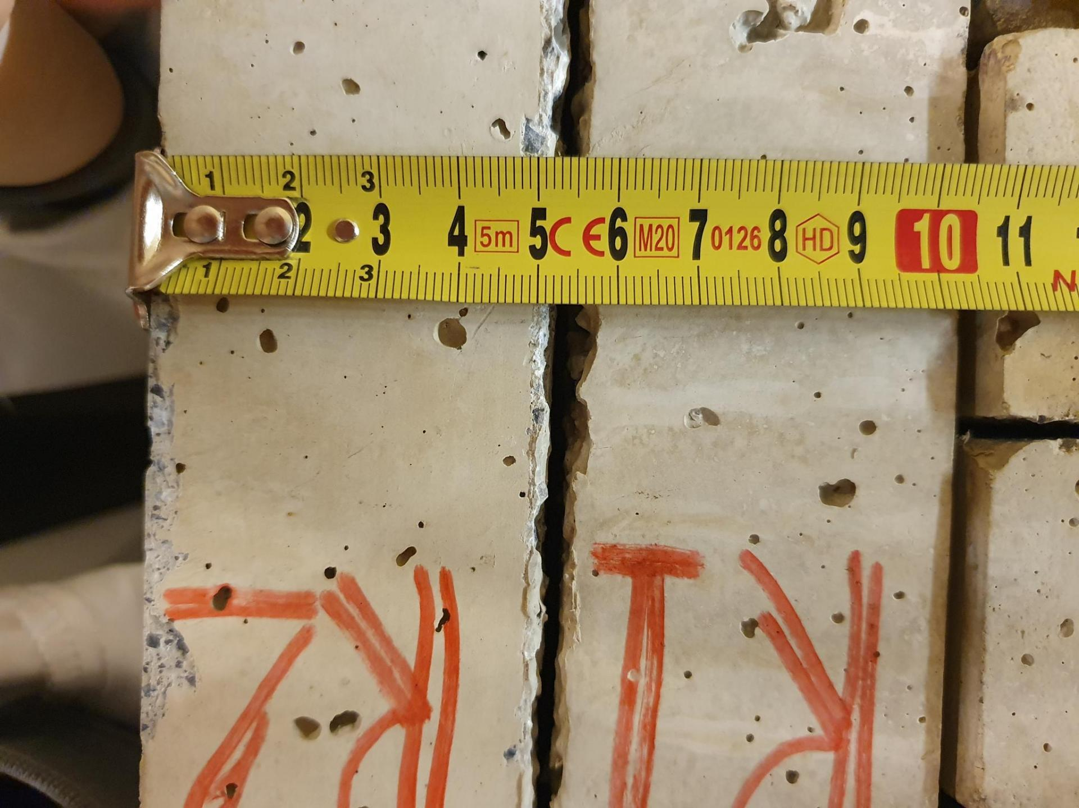
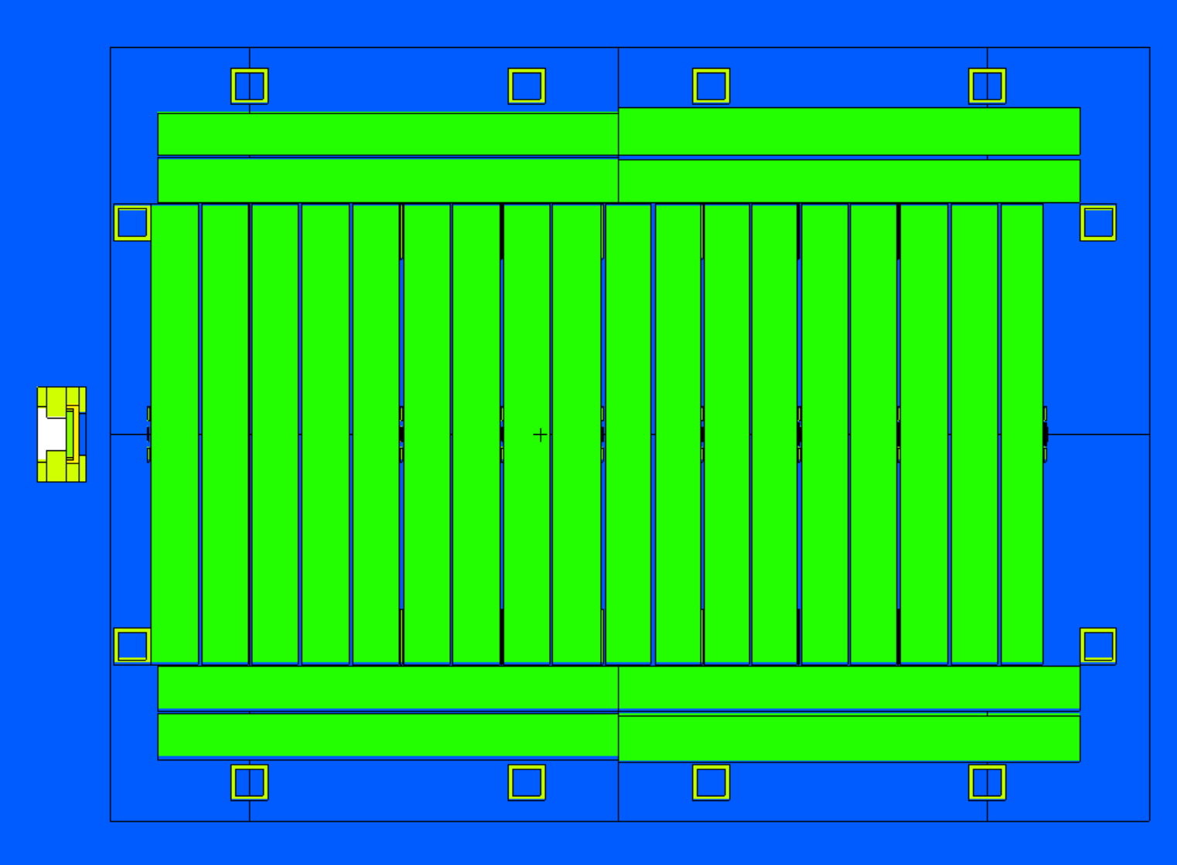
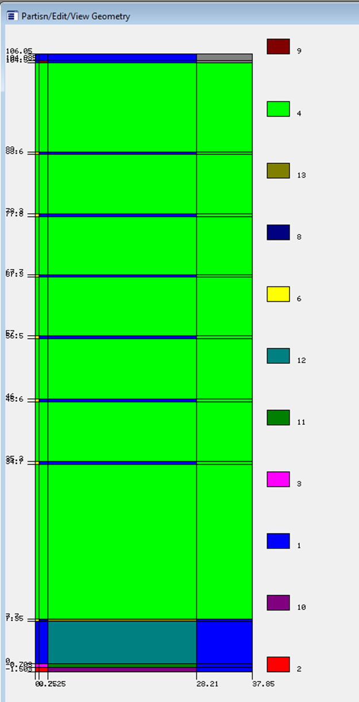
S/U analysis of the IFMIF-DONES shielding mock-up experiment
WPENS: ⁷Li(p,n)⁷Be
E_{n} up to ~35MeV
Heavy concrete 70x70x100 cm³
In, Al, Ti, Fe, Au foils
Model for DORT
Objectives:
Compare benchmarks performed at FNG Frascati and cyclotron neutron source at NPI (CAS Rez)
Help draw conclusions on this experiment activity
Conducting S&U to find out the largest contribution to uncertainty
Evaluation of the potential and readiness for SINBAD integration

Slide 17
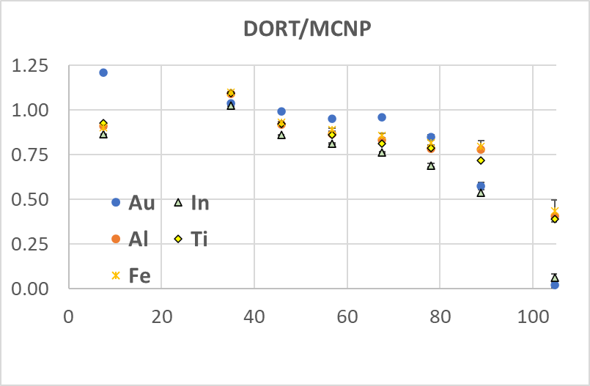
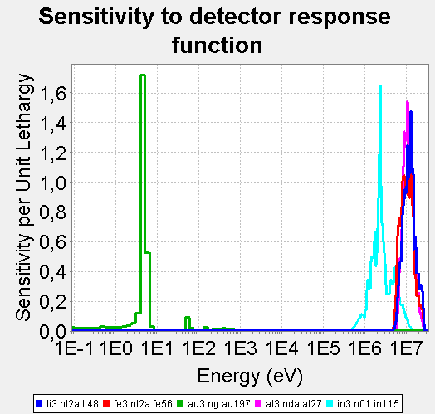
DORT vs. MCNP comparison
¹⁹⁷Au(n,g)
¹¹⁵In(n,n‘)
⁵⁶Fe(n,p)
²⁷Al(n,a)
⁴⁸Ti(n,p)

Slide 18
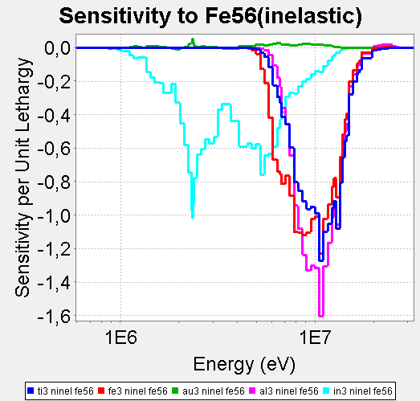
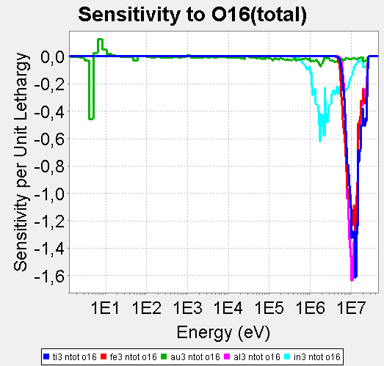
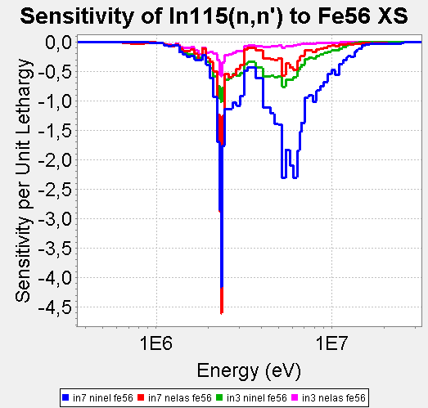
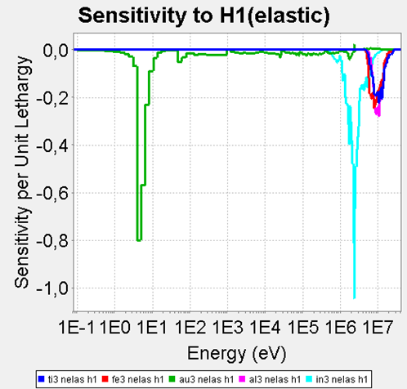
Sensitivity analysis

Slide 19
ND Sensitivity and uncertainty
Isotope | Sensitivity (%/%)
 | ¹¹⁵In(n,n’) |  |  | ²⁷Al(n,α) D3 | ⁴⁸Ti(n,p) D3 | ⁵⁶Fe(n,p) D3 | ¹⁹⁷Au(n,γ) D3
 | D3 | D6 | D7
Fe-56 | -1.19 | -2.58 | -3.05 | -1.22 | -1.20 | -1.24 | -0.51
O-16 | -0.81 | -1.76 | -2.08 | -1.13 | -1.13 | -1.07 | -0.27
H-1 | -0.50 | -0.82 | -0.91 | -0.17 | -0.17 | -0.19 | -0.68
Ca-40 | -0.11 | -0.25 | -0.29 | -0.13 | -0.12 | -0.13 | +0.06
Isotope |  |  | Uncertainty (%) (DORT/SUSD3D/FENDL-3.2)
 | ¹¹⁵In(n,n’) |  |  |  | ²⁷Al(n,α) D3 | ⁴⁸Ti(n,p) D3 | ⁵⁶Fe(n,p) D3 | ¹⁹⁷Au(n,γ) D3
 | D3 | D6 | D6 | D7
Total FENDL3.2 | 2.2 | 5.3 | 5.3 | 6.5 | 10.6 | 12.1 | 10.1 | 2.2
Total JENDL5.0 | 5.4 | 9.8 |  | 11.3 | 6.9 | 7.0 | 9.7 | 4.4
Total JEFF4.0 | 4.4 | 9.1 |  | 10.6 | 7.4 | 7.0 | 8.7 | 1.9
Fe-56 | 3.7 | 7.6 | 4.2 | 8.9 | 5.8 | 5.8 | 7.1 | 1.8
O-16 | 2.3 | 4.7 | 3.0 | 5.4 | 4.0 | 3.9 | 4.9 | 0.4
Ca-40 | 0.5 | 1.1 | 1.5 | 1.3 | 1.0 | 0.9 | 0.9 | 0.3
σ_{D} | 1.6 | 1.6 | 1.6 | 1.6 | 0.5 | 3.6 | 1.9 | 1.1

Slide 20
Conclusions
V&V of Fe and concrete nuclear data from JEFF-4.0 / ENDF/B-VIII.1 using TIARA benchmarks combined with S/U analysis;
TIARA Concrete 43 MeV Li7(p,n):
  C/E overestimated using JEFF-4.0; good agreement of ENDF/B-VIII.1 results with FENDL-3.2 (and the measurement) seems an error compensation artifact;
  MCNP nuclear model used for ENDF/B-VII.1 ¹H > 20MeV may not be optimal for ¹H;
  good agreement between MCNP and DORT for FENDL-3.2 and on-axis spectra;
WPENS heavy concrete benchmark, performed in 2024 at the Rez 35 MeV proton cyclotron was analysed by the SUSD3D sensitivity and uncertainty to assist in the interpretation of the measured foil activities. The cross sections Fe, O, H and Ca contribute mostly to ND uncertainty.
S/U results: sensitivity profiles of ²⁷Al, ⁵⁶Fe and ⁴⁸Ti reaction rates are very similar, suggesting that they are measuring similar neutron energies. The differences observed in the C/Es between ²⁷Al, ⁵⁶Fe and ⁴⁸Ti therefore cannot be mainly attributed to the transport cross sections. ¹¹⁵In and ¹⁹⁷Au activation foils provide an independent information on lower neutron flux.
Total uncertainty of the orders of tens on %, mainly ¹⁶O. Quality and completeness of covariance matrix information is questionable.
Future extensions:
  WPENS SINBAD evaluation: a code-independent geometry model description and an investigation of non-ND uncertainties, such as uncertainty in neutron source, dimensions and material composition;
  Comparison with FNG Concrete and TIARA Concrete 43MeV ⁷Li(p,n) benchmarks.
SINBAD project: renaissance still on hold?
SUSD3D/XSUN-2026 is under preparation and will be available from NEA DB.

