Slide 1

Japanese Shielding Material Standard for Facility Design
Koichi Okuno¹⁾ ,Tatsuya Osawa²⁾, Ken-ichi Kimura³⁾, Mikihiro Nakata⁴⁾, Yukio Sakamoto⁵⁾ , Erina Matsuyama⁶⁾,
Masahiro Taniguchi⁷⁾, Ken-ichi Tanaka⁸⁾, Koji Oishi⁹⁾, Satoshi Takeo¹⁰⁾, Satoshi Ishikawa¹¹⁾, Hidenori Kawano⁵⁾,
Toshihisa Tsukiyama⁵⁾, Masahiro Yoshida¹²⁾, Toshio Amano¹¹⁾,Kazuaki Kosako¹³⁾, Yoshihiro Hirao¹⁴⁾,
and Toshinobu Maenaka¹⁵⁾
1) Hazama-Ando Technical Research Institute, Tsukuba, Japan, 2) Mitsubishi Heavy Industries, Ltd., Kobe, Japan, 3) Fujita Corporation, Atsugi, Japan 4 )MHI Nuclear Development Co., Ltd., Tokaimura, Japan, 5) Atox Co., Ltd., Kashiwa, Japan, 6) Toshiba Corporation, Yokohama, Japan, 7) Taisei Corporation, Tokyo, Japan, 8) KNE Professional Engineer Office, Tokyo, Japan, 9) Japan Environment Research Co., Ltd., Tokyo, Japan, 10) Hitachi-GE Vernova Nuclear Energy, Ltd., Hitachi, Japan, 11) ITOCHU Techno-Solutions Corporation, Tokyo, Japan, 12) Nuclear Safety Technology Center, Tokyo, Japan, 13)Shimizu Corp., Tokyo, Japan, 14) National Maritime Research Institute, Tokyo, Japan, 15)Takenaka Corp., Tokyo, Japan
email : okuno.koichi@ad-hzm.co.jp

Slide 2
Introduction
• When constructing the facility, shielding calculation are performed during the design
phase.
• Concrete is widely used for shielding, but the concrete to be placed is often unspecified
in design phase.
• Concrete composition such as ANL-5800 are often used for shielding calculation even
though their basis and validity are not always clear.
• Atomic Energy Society of Japan (AESJ) developed evidence based shielding concrete
compositions using research result with the Architectural Institute of Japan, and issued
them as an AESJ academic standard.

Slide 3
Policy and Application
01
Reasonably conservative
Composition with shielding performance on the safety side
02
Eliminating Regional Characteristics
Averaging the impact of different aggregates by region
03
Standardization of
Two types concrete
Standard concrete composition for Si and Ca aggregates
04
Realistic moisture content
Residual moisture is considered according to thickness
05
Application
Accelerators below 20 MeV
(Mainly medical linacs and PET cyclotrons)

Slide 4
AESJ Standard Concrete Composition
Unit: atoms / (barn·cm)
Element | Concrete with Si aggregate | Concrete with Ca aggregate
H (Hydrogen) | 7.70 × 10⁻³ | 7.70 × 10⁻³
Si (silicon) | 1.77 × 10⁻² | 9.97 × 10⁻⁴
Fe (Iron) | 1.39 × 10⁻⁴ | 1.39 × 10⁻⁴
Ca (Calcium) | 2.79 × 10⁻³ | 1.65 × 10⁻²
C (carbon) | 0 | 5.30 × 10⁻³
O (oxygen) | 4.22 × 10⁻² | 3.31 × 10⁻²
Density (g/cm³) | 2.156 | 2.156
05

Slide 5
How to use
1) If the concrete composition is known, can use the measured composition.
Otherwise, use the AESJ standard composition.
2) Use the concrete composition with Si aggregate as default. Use the concrete composition with
Ca aggregate When clear that limestone aggregate is to be used.
3) The moisture composition of the standards corresponds to 1,500 mm of shielding concrete.
For thinner shielding concrete, apply the moisture correction formula to avoid non-conservative
results.
4) If the customer specifies concrete density, apply the density correction formula.

Slide 6
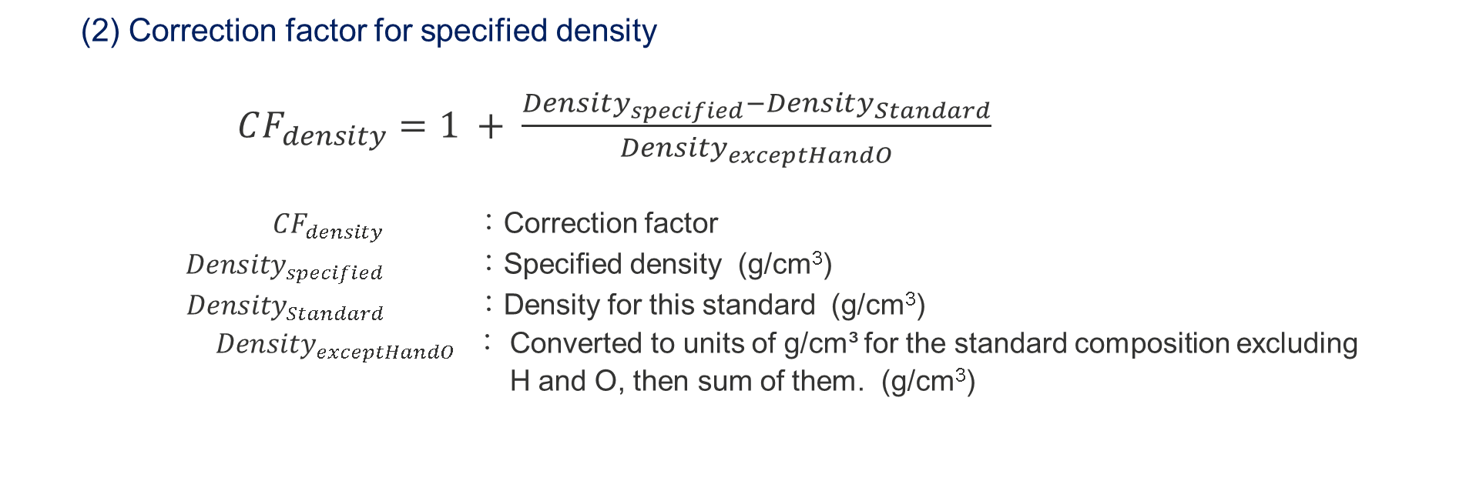
Correction formula for moisture and density in concrete
(1) Moisture content relative to the shielding thickness
H (atoms/(barn・cm)) : 1.77E-06×(T-1500) + 7.70E-03
O (atoms/(barn・cm)) : 8.83E-07×(T-1500) + 4.22E-02 (Si aggregate)
8.83E-07×(T-1500) + 3.31E-02 (Ca aggregate)
Density(g/cm³) : 2.64E-05×(T-1500) + 2.156
T : Concrete thickness (mm)
(2) Correction factor for specified density
$CF_{density}=1 + \frac{Density_{specified}−Density_{Standard}}{Density_{exceptHandO}}$
$CF_{density}$ ：Correction factor
$Density_{specified}$ ：Specified density (g/cm³)
$Density_{Standard}$ ：Density for this standard (g/cm³)
$Density_{exceptHandO}$ ： Converted to units of g/cm³ for the standard composition excluding
H and O, then sum of them. (g/cm³)

Slide 7
Elimination of Regional Characteristics
Concrete composition are different in every region. Because concrete are used local aggregate. Therefore, standard composition must remove regional variability.
Aggregates are grouped as sandstone-based (Si rich) or limestone-based (Ca rich) in
Japan.
Using concrete mix-design data of Architectural Institute of Japan (AIJ) , sandstone aggregate is represented by Si, limestone aggregate by Ca, and cement by Ca and Si.
Porosity, water absorption, and aggregate density are incorporated to define the two standard compositions.

Slide 8
Elimination of Regional Characteristics
• Regional differences are removed by simplifying the composition.
• Based on 840 AIJ mix-design examples, sandstone aggregate is represented by Si and cement by Ca and Si that
were considered porosity, water absorption, and aggregate density.
Aggregate
Actual
Simplified
S
Na
Al
12%
Si
Si
Si
12%
Si
75%
K
Si
75%
Fe
When replacing, the weight of the oxide is preserved.
Mg
1%
Si
1%
Ca
1%
Si
1%
・Fe and C were left because a
significant difference in the dose
attenuation rate.
Fe
3%
Si
3%
Cement
Actual
Simplified
Si
22%
Si
22%
Ca
65%
S
Ca
65%
Si
Mg
2%
Si
2%
Elements of Standard
・Silica aggregate Concrete:
H, O, Si, Ca, Fe
・Limestone aggregate Concrete:
H, O, Si, C, Ca, Fe
Al
5%
Fe
3%
Si
5%
Fe
3%

Slide 9
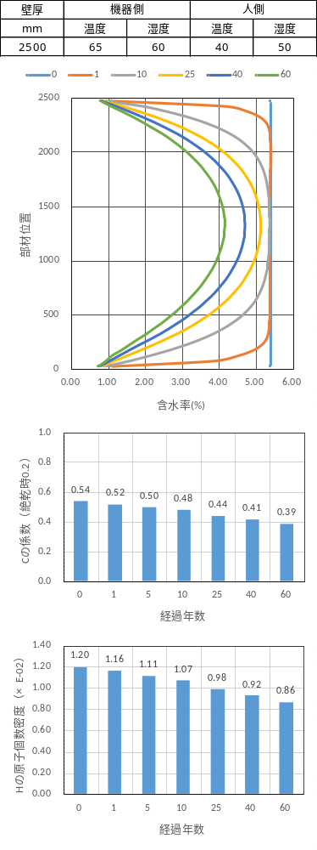
Moisture transfer for shielding concrete wall
pour
Outside
(Temperature 40℃, Humidity 50%)
10 yr
・Moisture evaporates from the
concrete surface.
・ Thick shielding concrete retains
free water internally.
・ A coupled Darcy-flow, heat-transfer, and
evaporation model was used to calculate
changes in hydrogen, oxygen, and density
25 yr
Position in wall (mm)
40 yr
60 yr
Inside
(Temperature 65℃, Humidity 60%)
Moisture content (%)
Changes in moisture content distribution with age
in a 2.5m thick concrete wall

Slide 10
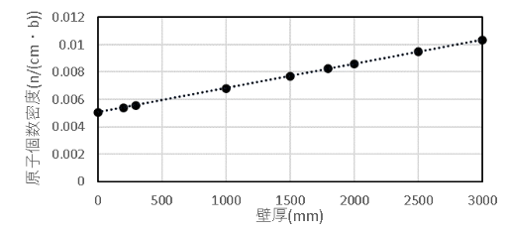
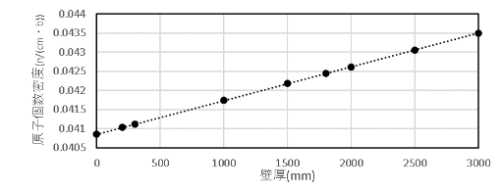
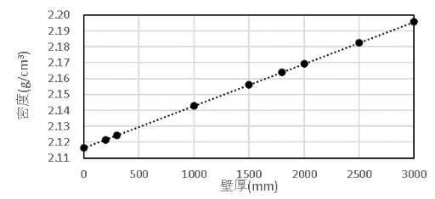
Changes in residual H, O, and density by wall thickness
H (atomic density)
O (atomic density)
Density (g/cm³)
Wall thickness (mm)
Wall thickness (mm)
Wall thickness (mm)
H
O
density
Moisture Content Relative to Shielding Thickness
H (atoms/(barn・cm)) ：1.77E-06×(T-1500)＋7.70E-03
O (atoms/(barn・cm)) : 8.83E-07× (T-1500) + 4.22E-02 (Si aggregate)
8.83E-07× (T-1500) + 3.31E-02 (Ca aggregate)
Density (g/cm³) : 2.64E-05×(T-1500)+2.156
T : Concrete thickness (mm)

Slide 11
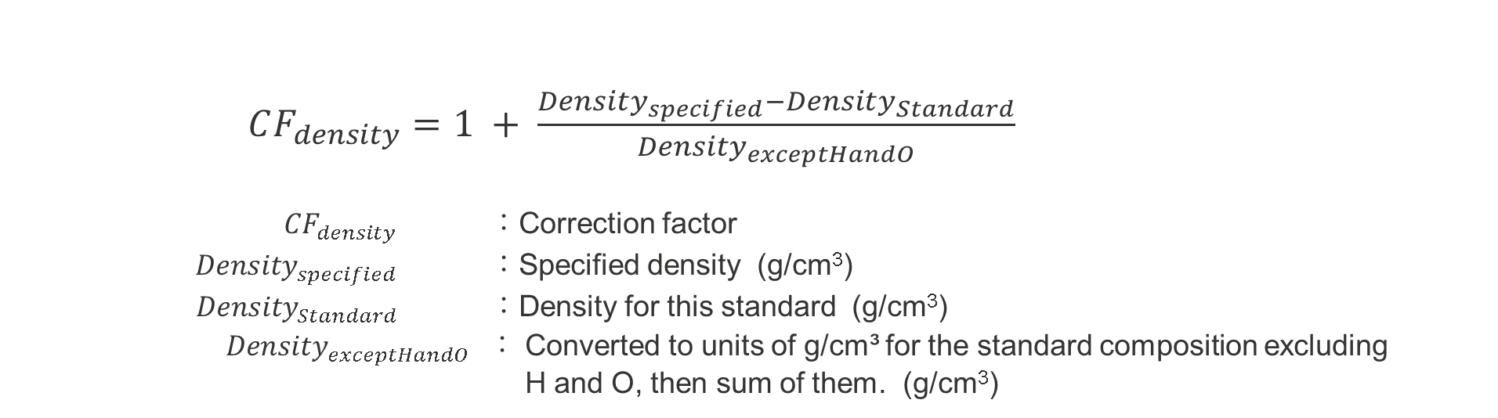
Correction factor for specified density
・In Japan, customers may specify the concrete density used in shielding calculations; 2.1 g/cm³ is common.
・Density variation is driven mainly by coarse-aggregate properties. Japanese Industrial Standards (JIS)
specifies maximum aggregate sizes of 20 or 25 mm.
・Changing the maximum size from 20 to 25 mm, changes the atomic density of individual elements by
approximately 1 to 7%.
$CF_{density}=1 + \frac{Density_{specified}−Density_{Standard}}{Density_{exceptHandO}}$
$CF_{density}$ ：Correction factor
$Density_{specified}$ ：Specified density (g/cm³)
$Density_{Standard}$ ：Density for this standard (g/cm³)
$Density_{exceptHandO}$ ： Converted to units of g/cm³ for the standard composition excluding
H and O, then sum of them. (g/cm³)

Slide 12
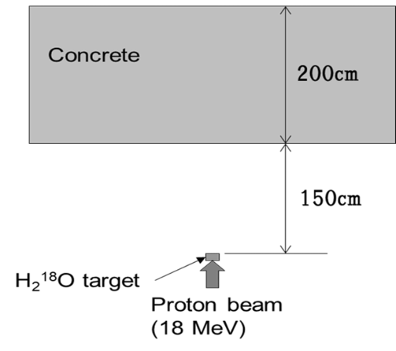
Dose Rate Calculation
Calculation model : 18 MeV Proton Accelerator (PET cyclotron)
Calculation
PHITS 3.27
Nuclear data
JENDL-5
Source
18 MeV monochromatic protons
Target
H₂¹⁸O, 4 mm
Wall model
200 cm, approximately 400×400 cm²
Tally
Neutrons and photons,
5 cm thickness each within a cylindrical region
11

Slide 13
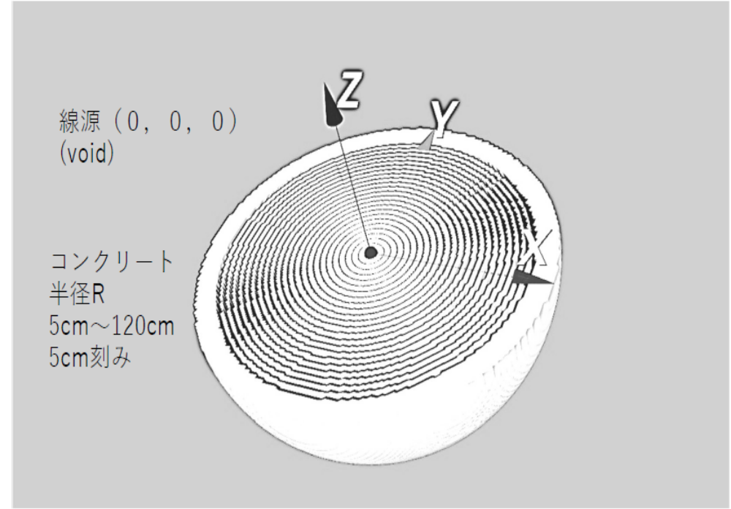
Dose Rate Calculation
Calculation model : 10 to 20 MeV Photon (Medical Liniac)
Calculation
MCNP 6.2
Library
el03 / mcplib84 / JENDL-5
Source (0, 0, 0)
(void)
Source
Continuous photons from a tungsten target
Electron energy
10, 12, 15, 17, 18, 20 MeV
Model
Homogeneous sphere with a radius of 5–120 cm
Tally
5 cm thickness each in spherical shell
Source: SATIF Manuscript .docx (Provided by User)
12

Slide 14
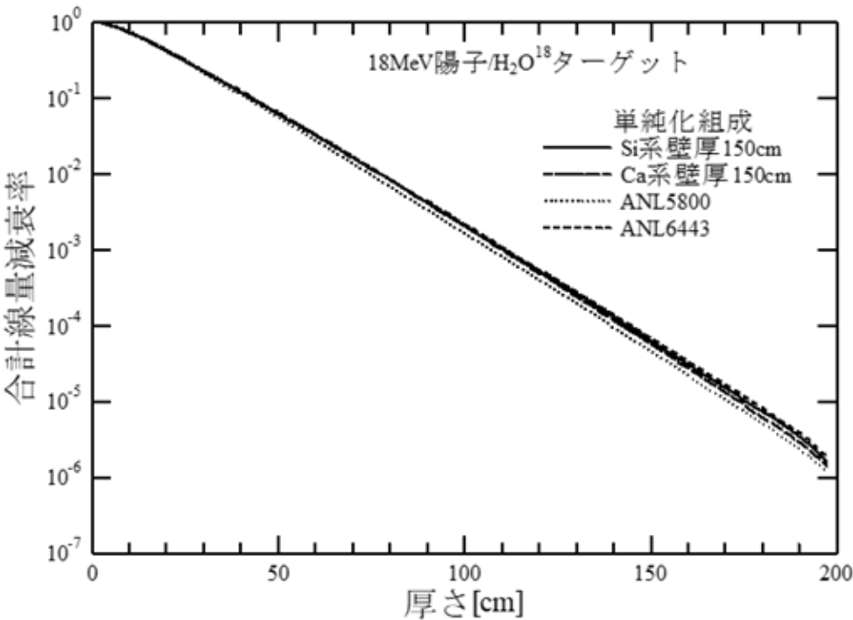
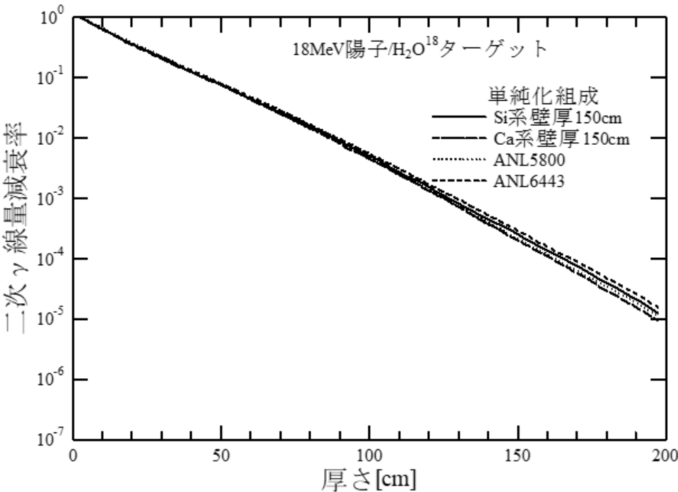

Comparison with ANL (18 MeV Proton Accelerator)
Si concrete
Si concrete
Ca concrete
Ca concrete
2nd gamma dose rate attenuation
Total dose rate attenuation
Thickness (cm)
Thickness (cm)
• No major difference was observed
• The ¹⁸O(p,n)¹⁸F spectrum extends to higher energies. ANL-5800 contains rich hydrogen, therefore neutron
above several MeV decreases by elastic scattering with H.

Slide 15
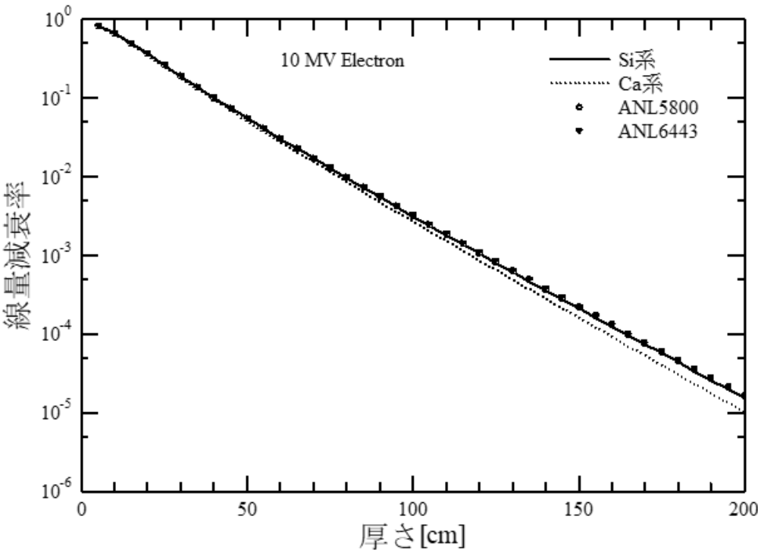
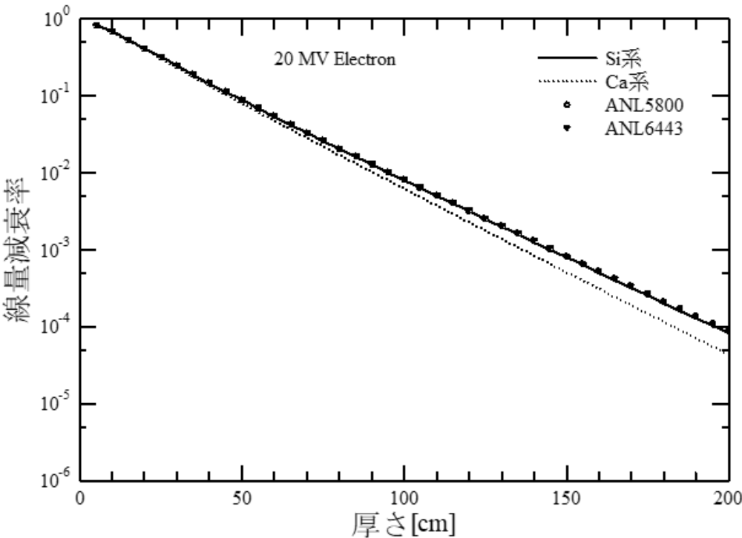
Comparison with ANL (photon below 20MeV)
10 MV electron
20 MV electron
— Si concrete
··· Ca concrete
• ANL-5800
◆ ANL-6443
— Si concrete
··· Ca concrete
• ANL-5800
◆ ANL-6443
Dose rate attenuation
Dose rate attenuation
Thickness (cm)
Thickness (cm)
• Ca concrete shows greater attenuation.
• Attenuation by electron pair production is greater in Ca than in Si as photon energy increases. it is considered
that attenuation in Ca is greater at 20 MeV than at 10 MeV.
• A photonuclear reaction occurred around 17 MeV. However, ⁴⁰Ca and ²⁸Si have similar photonuclear cross
sections, so their effect on attenuation is only a few percent.

Slide 16
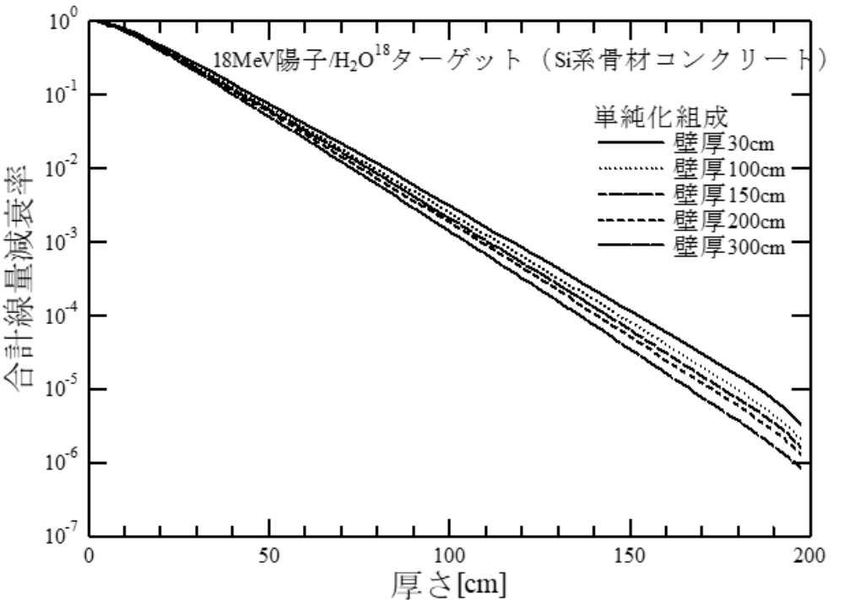
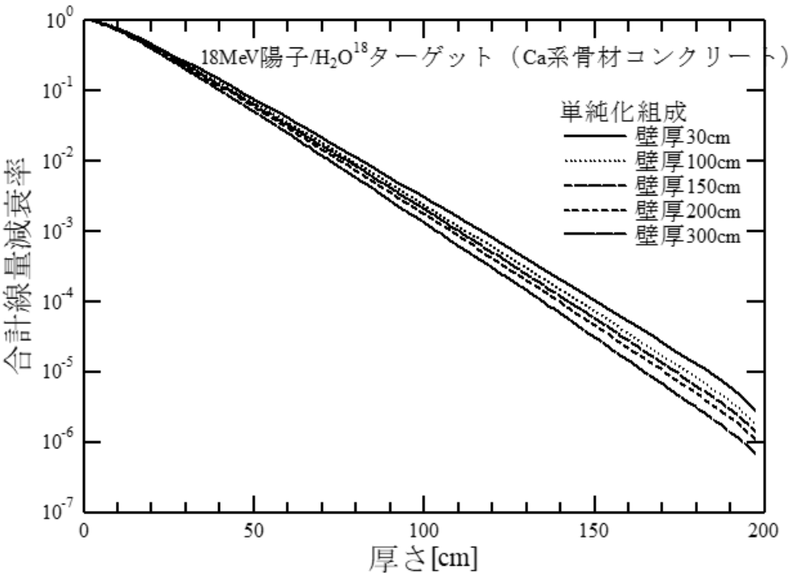
Moisture fluctuation
(18 MeV proton / H₂¹⁸O target)
Moisture affects neutrons, so, comparison was performed for the total dose of neutrons and secondary gamma rays
Si concrete
Ca concrete
— 30cm
··· 100cm
– – 150 cm
⋯ 200 cm
— 300 cm
— 30cm
··· 100cm
– – 150 cm
⋯ 200 cm
— 300 cm
Total dose attenuation
Total dose attenuation
Thickness (cm)
Thickness (cm)
The range of concrete thickness in Si concrete by moisture fluctuations is approximately -7 cm to +6 cm
The range of concrete thickness in Ca concrete by moisture fluctuations is approximately -7 cm to +7 cm
Reference value

Slide 17
Comparison with other types of concrete
unit：g/cm³
 | USA |  | KOREA |  | AESJ Standard (JAPAN)
 | ANL6443 | ANL5800 | Kori NPP unit1 | PAL | Si concrete | Ca concrete
H | 0.0115 | 0.0144 | 0.0123 | 0.013061 | 0.013 | 0.013
O | 1.1285 | 1.15 | 1.12 | 1.170479 | 1.122 | 0.88
C | 0.0023 | 0.0023 |  |  | 0 | 0.106
NA | 0.0368 | 0.0368 | 0.0382 | 0.040187
MG | 0.005 | 0.005 | 0.00565 | 0.006028
AL | 0.078 | 0.078 | 0.102 | 0.107503
SI | 0.775 | 0.775 | 0.709 | 0.740466 | 0.826 | 0.047
P
S |  |  |  | 0.003015
K | 0.0299 | 0.0299 |  | 0.045212
CA | 0.1 | 0.1 |  | 0.194911 | 0.186 | 1.098
TI
MN
FE | 0.032 | 0.032 | 0.0277 | 0.029135 | 0.013 | 0.013
Density | 2.2 | 2.22 | 2.24 | 2.350 | 2.156 | 2.156

Slide 18
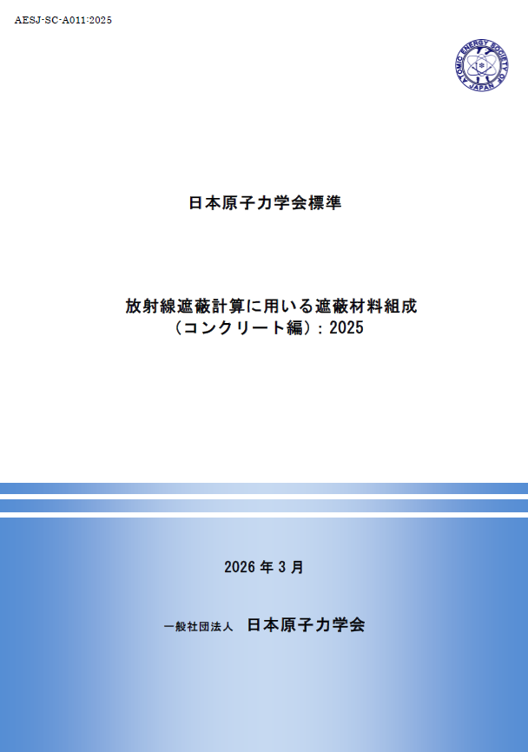
Conclusion
Concrete compositions with a clear engineering basis used for the shielding calculations will be issued as a standard of the Atomic Energy Society of Japan (AESJ).
If the aggregate of concrete has not been selected, the use of the composition of Si concrete showed reasonably conservative results compared with the ANL composition.
Developed with the cooperation of the Architectural Institute of Japan (AIJ), this work is expected to support future facility design.
For collaboration opportunities or further details,
please contact:
Koichi Okuno : okuno.koichi@ad-hzm.co.jp
Mikihiro Nakata : mikihiro.nakata.a7@nu.mhi.com
Toshio Amano : toshio.amano@ctc-g.co.jp

