Slide 1
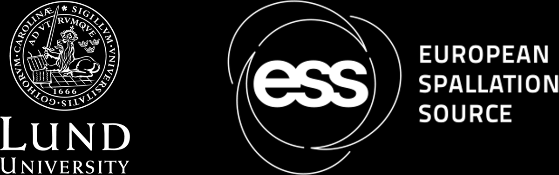
Benchmark activation experiment of various foil samples using the ESS accelerator dump line
TOMÁS DÄHN COSTANTE
SATIF-17 · DAEJEON · 20 OCTOBER 2026

Slide 2
Agenda
1
Introduction
ESS status, transition to operations and future needs
2
Methods
Foil irradiation at the PBI, gamma spectrometry and simulations
3
Results
Measured activities and C/E ratios
4
Conclusions
Agreement and proposed future work
20 October 2026 - Benchmark activation experiment of various foil samples using the ESS accelerator dump line
2

Slide 3
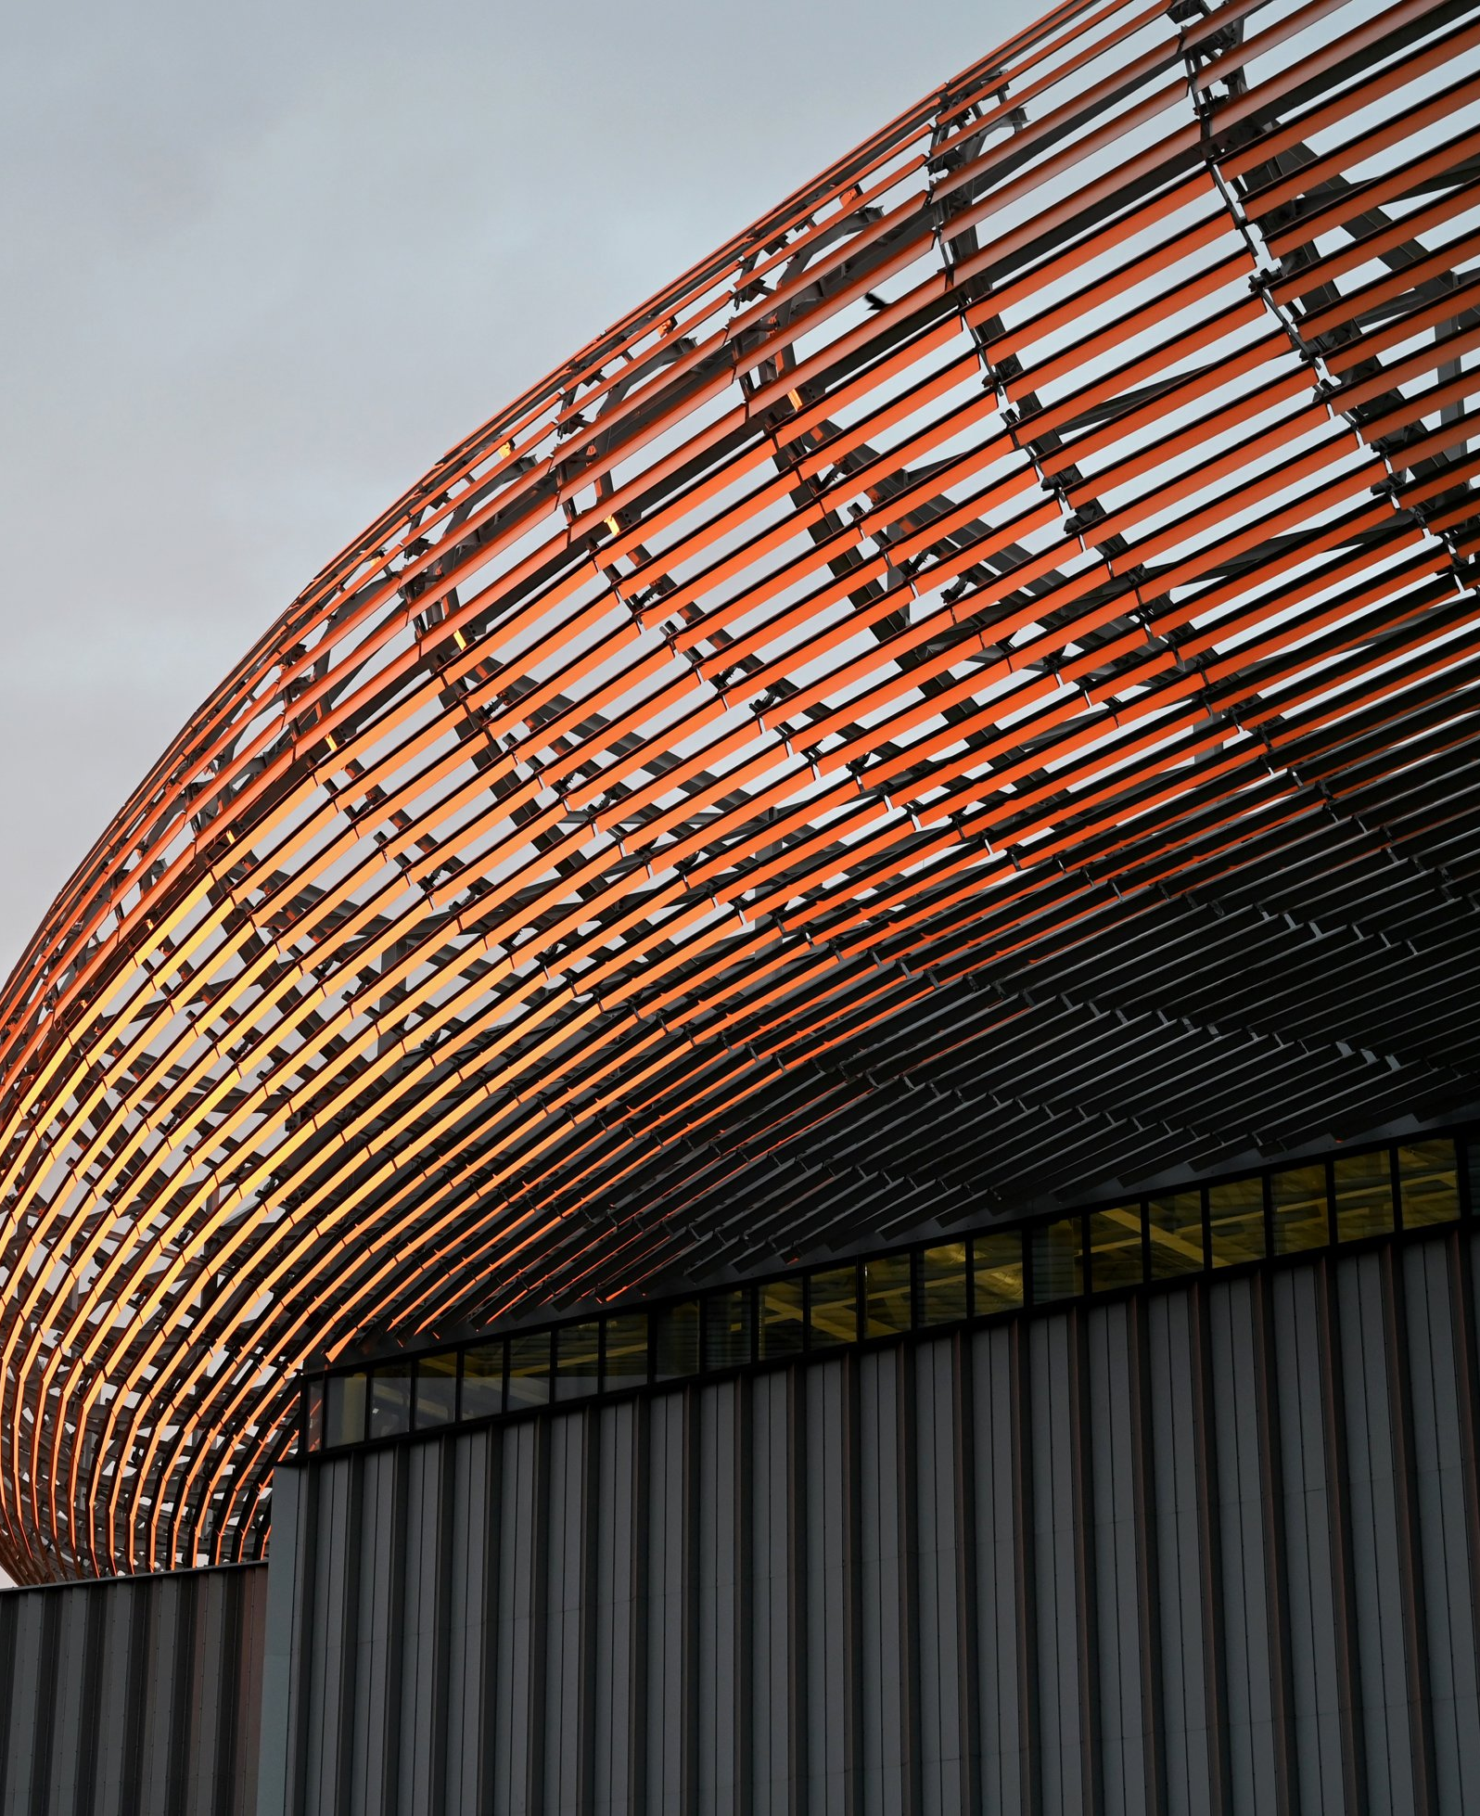
Introduction
#1
ESS status, transition to operations and future needs

Slide 4

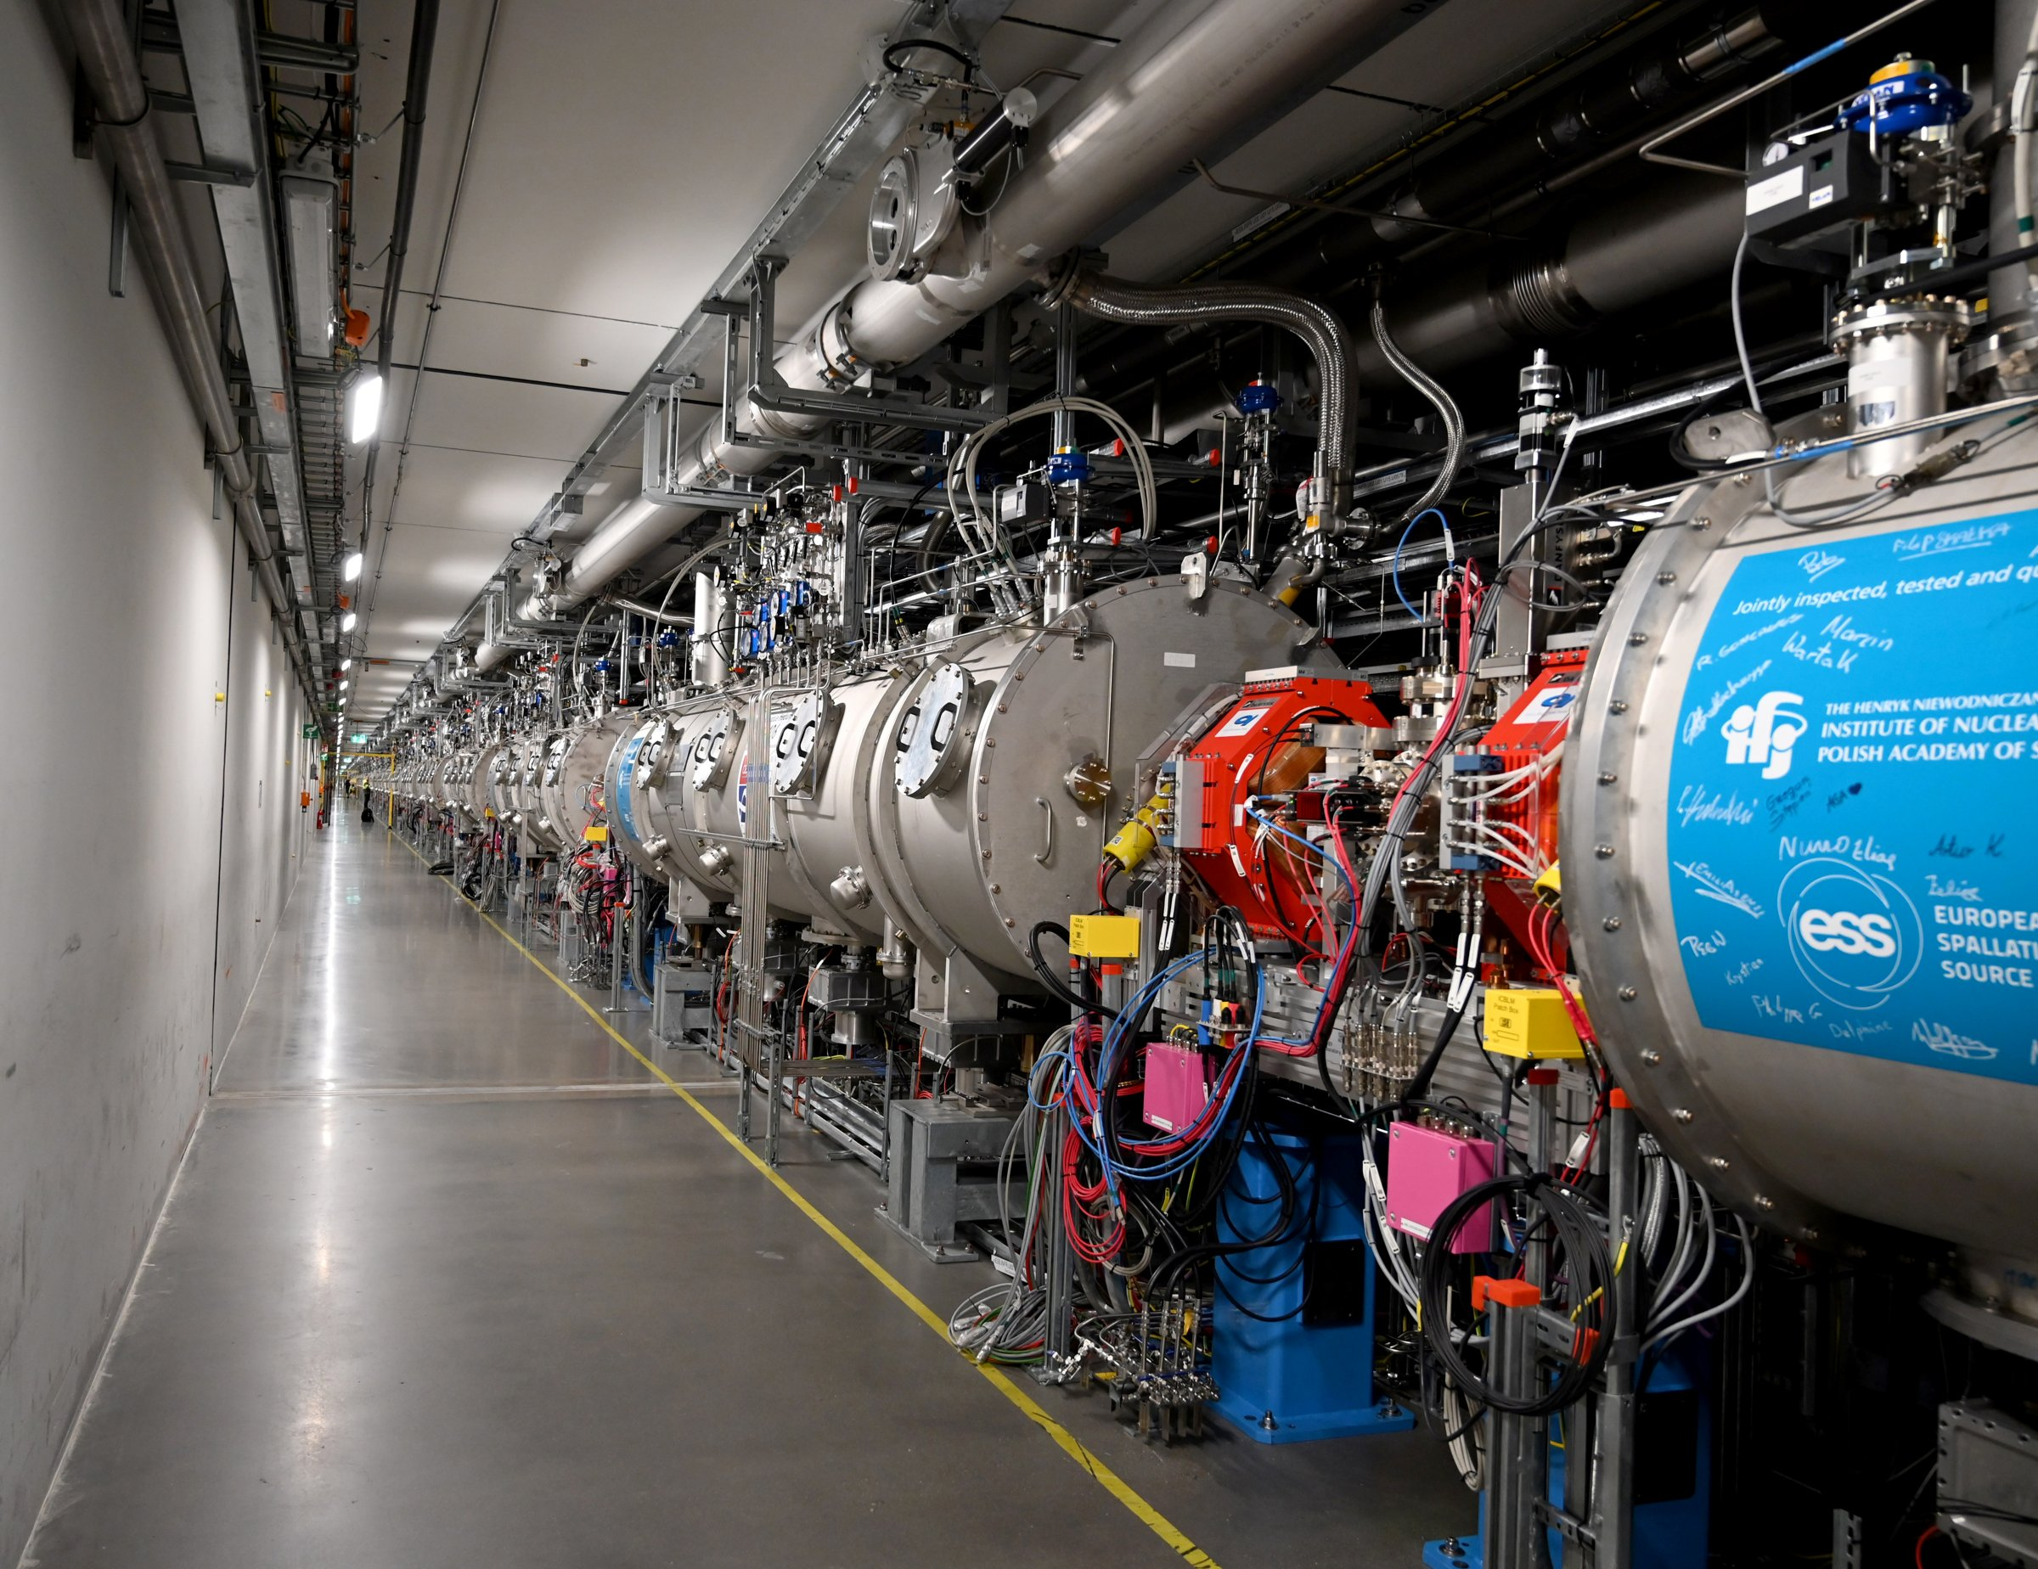
Introduction
ESS status & future needs
Accelerator commissioned
Beam on Dump milestones reached last year, tuning tests running
MRP2 installed
New Moderator Reflector Plug in place after last year's incident
Beam on Target: early 2027
Transition to operations
20 October 2026 - Benchmark activation experiment of various foil samples using the ESS accelerator dump line
4

Slide 5
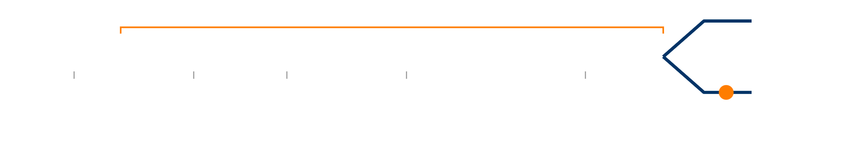

Introduction
ESS status & future needs
Uncontrolled beam losses → activation
Target
IS
RFQ
MEBT
DTL
Spoke
Medium β
High β
HEBT
3.6 MeV
90 MeV
216 MeV
571 MeV
2 GeV
Beam Dump
PBI device
Normal-conducting
Superconducting
Transport lines
1
Beam losses
2
Activation
3
Operational impact
4
Validated predictions
Protons lost on beam pipe, magnets and cavities, and beam fully stopped in the dumps.
Protons and secondary neutrons build up activation in accelerator components and surrounding equipment.
Residual dose rates for maintenance and classification of radioactive waste.
Transport and activation codes benchmarked against measurements in ESS conditions.
20 October 2026 - Benchmark activation experiment of various foil samples using the ESS accelerator dump line
5

Slide 6
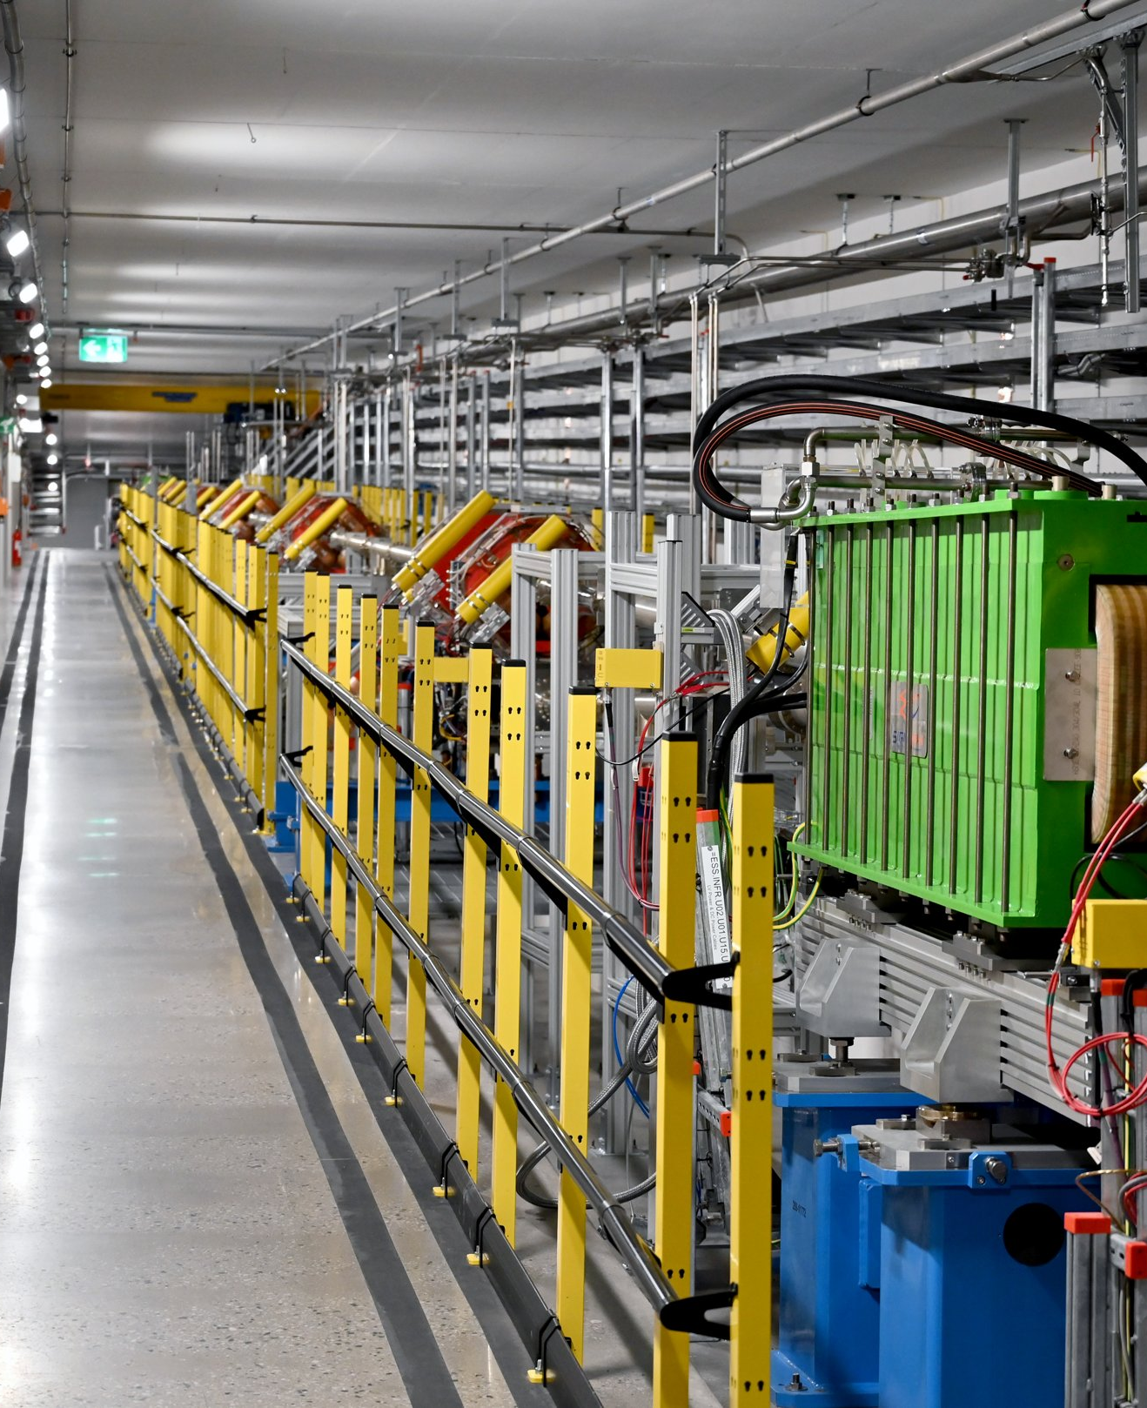
Methods
#2
Foil irradiation at the PBI, gamma spectrometry and simulations

Slide 7
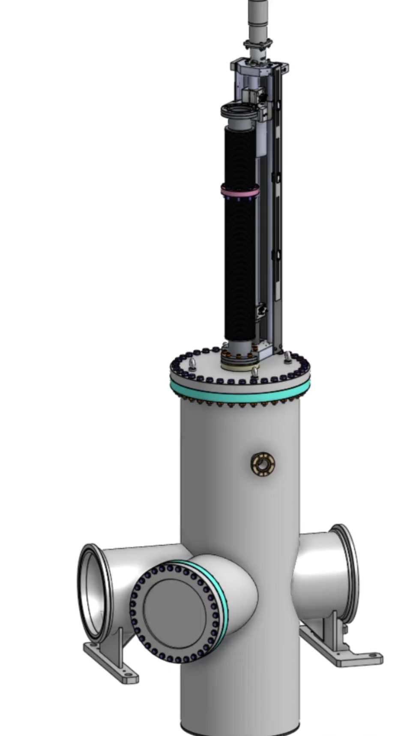
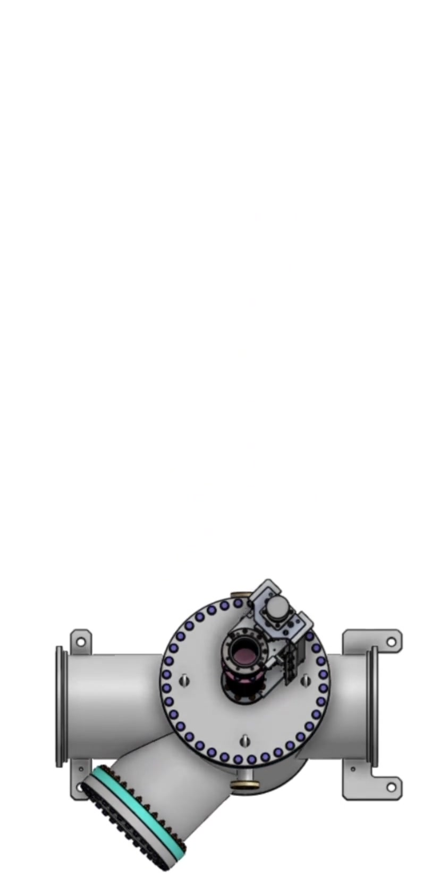
Experiment design
Irradiation over the PBI device
Proton beam imaging device
The PBI is located in the dump line, just before the beam dump
Foils on the top flange
Six pure-element foils positioned onto the flange around the actuator
Tuning test beam
Irradiated during the beam-on-dump commissioning runs
Side view
Top view
20 October 2026 - Benchmark activation experiment of various foil samples using the ESS accelerator dump line
7

Slide 8
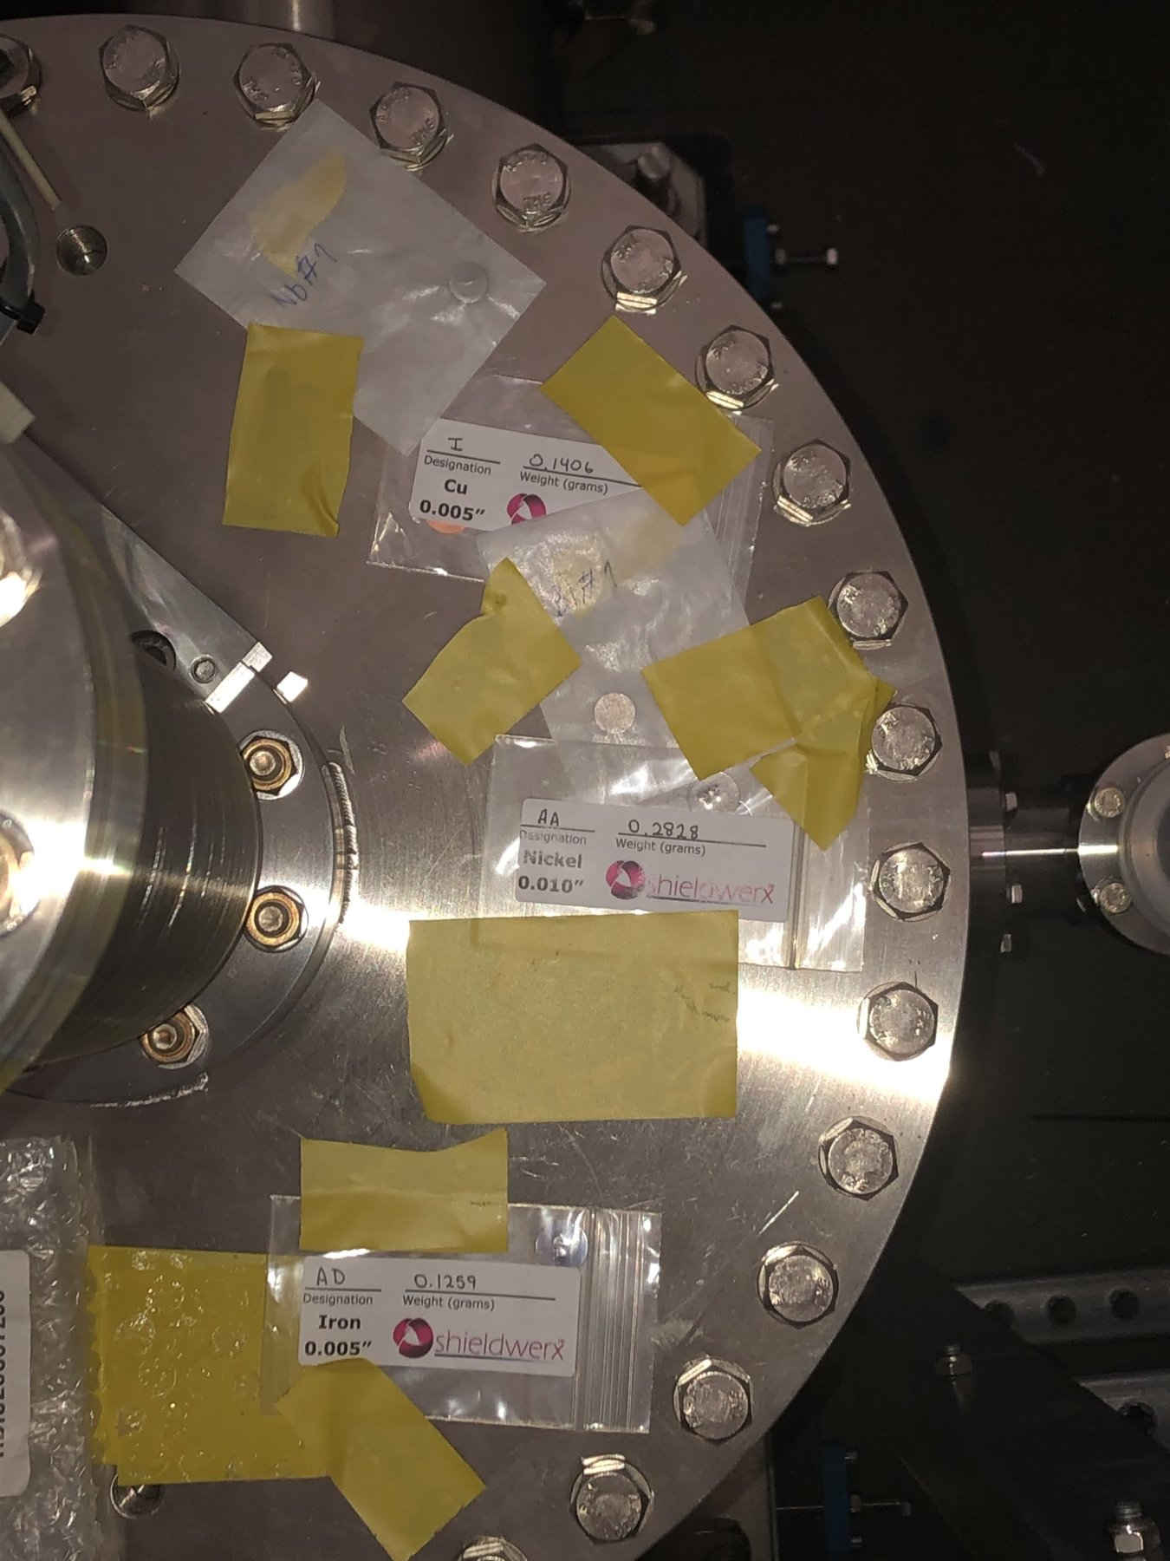
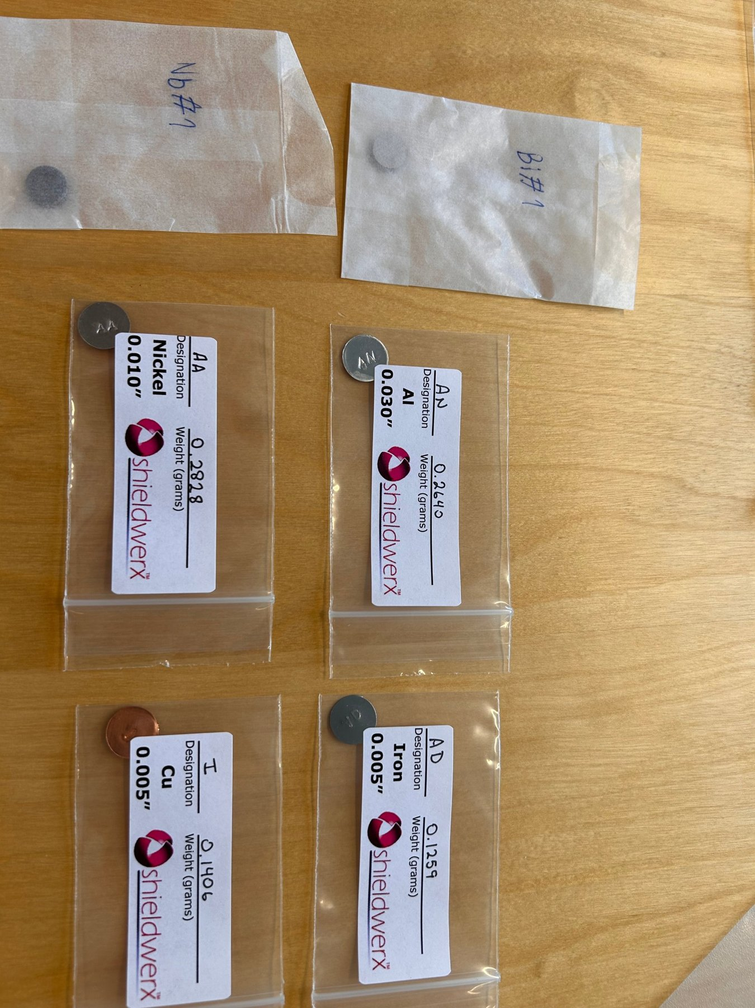
Experiment design
Foil samples
Foil | Thickness | Mass
Al | 0.762 mm | 0.264 g
Fe | 0.127 mm | 0.126 g
Ni | 0.254 mm | 0.283 g
Cu | 0.127 mm | 0.141 g
Nb | 2 mm | 2.17 g
Bi | 2 mm | 2.47 g
Discs of 12.7 mm diameter.
Positions on the PBI top flange
Samples before irradiation
20 October 2026 - Benchmark activation experiment of various foil samples using the ESS accelerator dump line
8

Slide 9
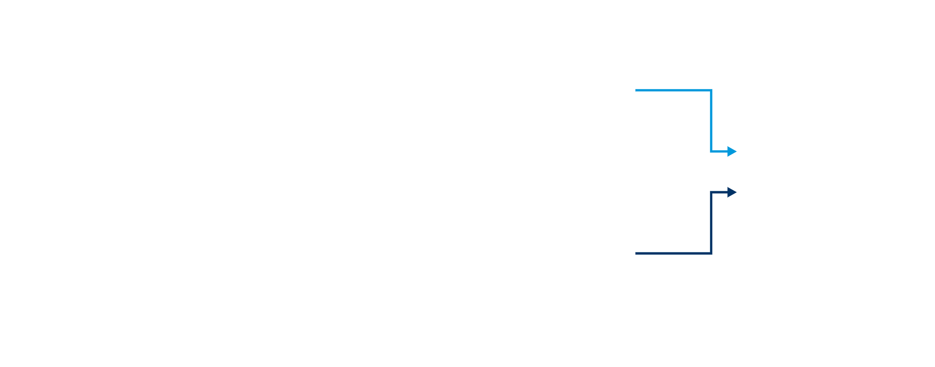

Benchmark workflow
Experimental and computational chains
Experiment
Irradiation
Gamma spectrometry
Spectrum analysis
Foils on the PBI during beam-on-dump 2 tests
E ± σ
HPGe spectra of each foil
Identification of nuclides and their activity
C / E
Calculation
Modelling
Source retrieval
Activation
per nuclide and foil
Dump line and PBI device geometry in PHITS 3.35
Beam parameters and irradiation history from PBI device measurements
Nuclide inventories in each foil using DCHAIN
C ± σ
20 October 2026 - Benchmark activation experiment of various foil samples using the ESS accelerator dump line
9

Slide 10
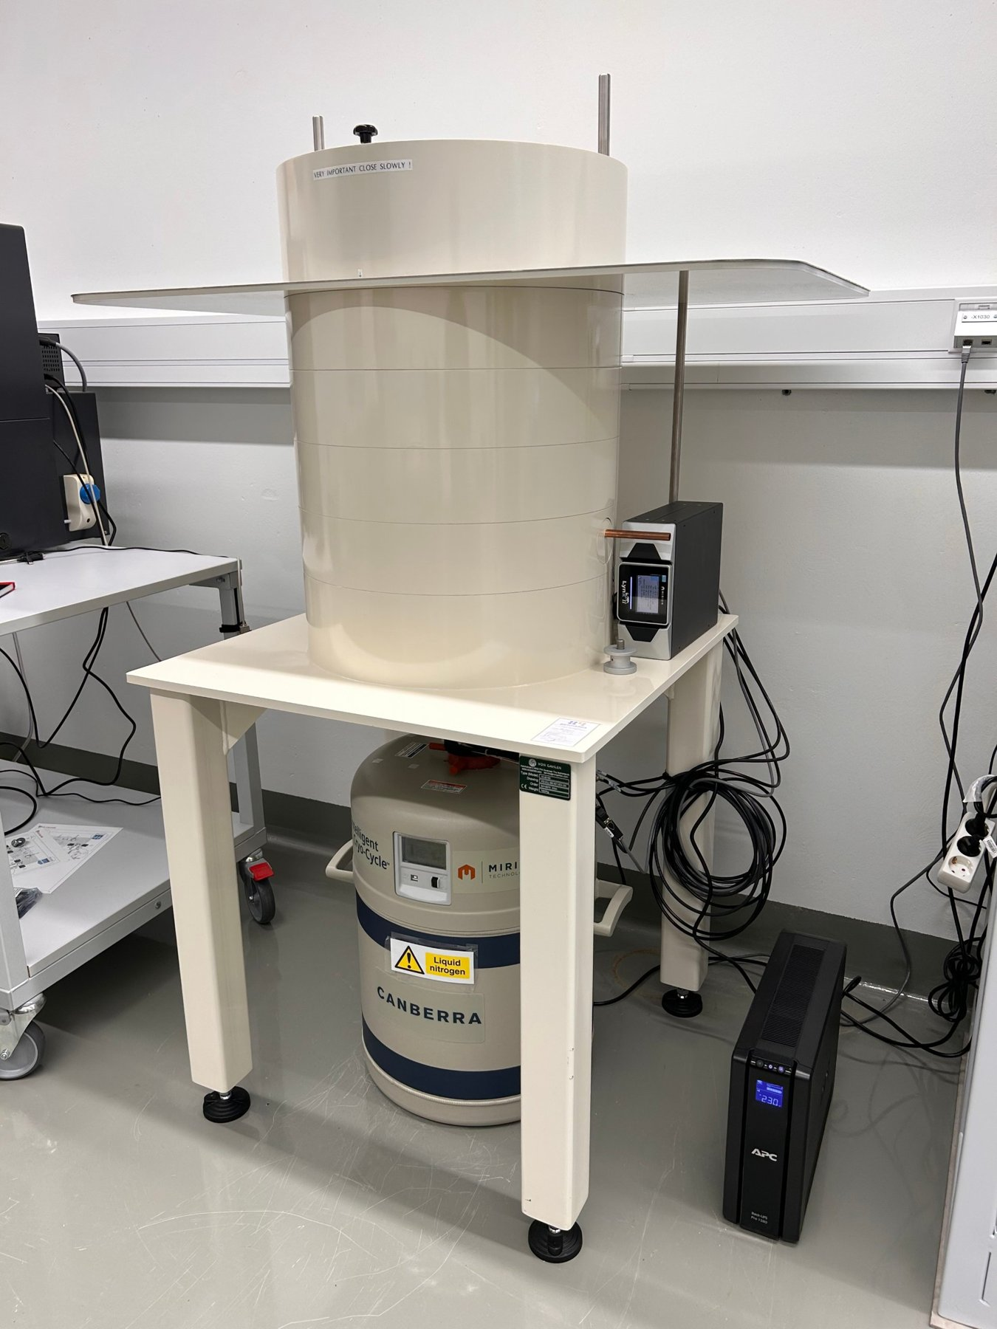
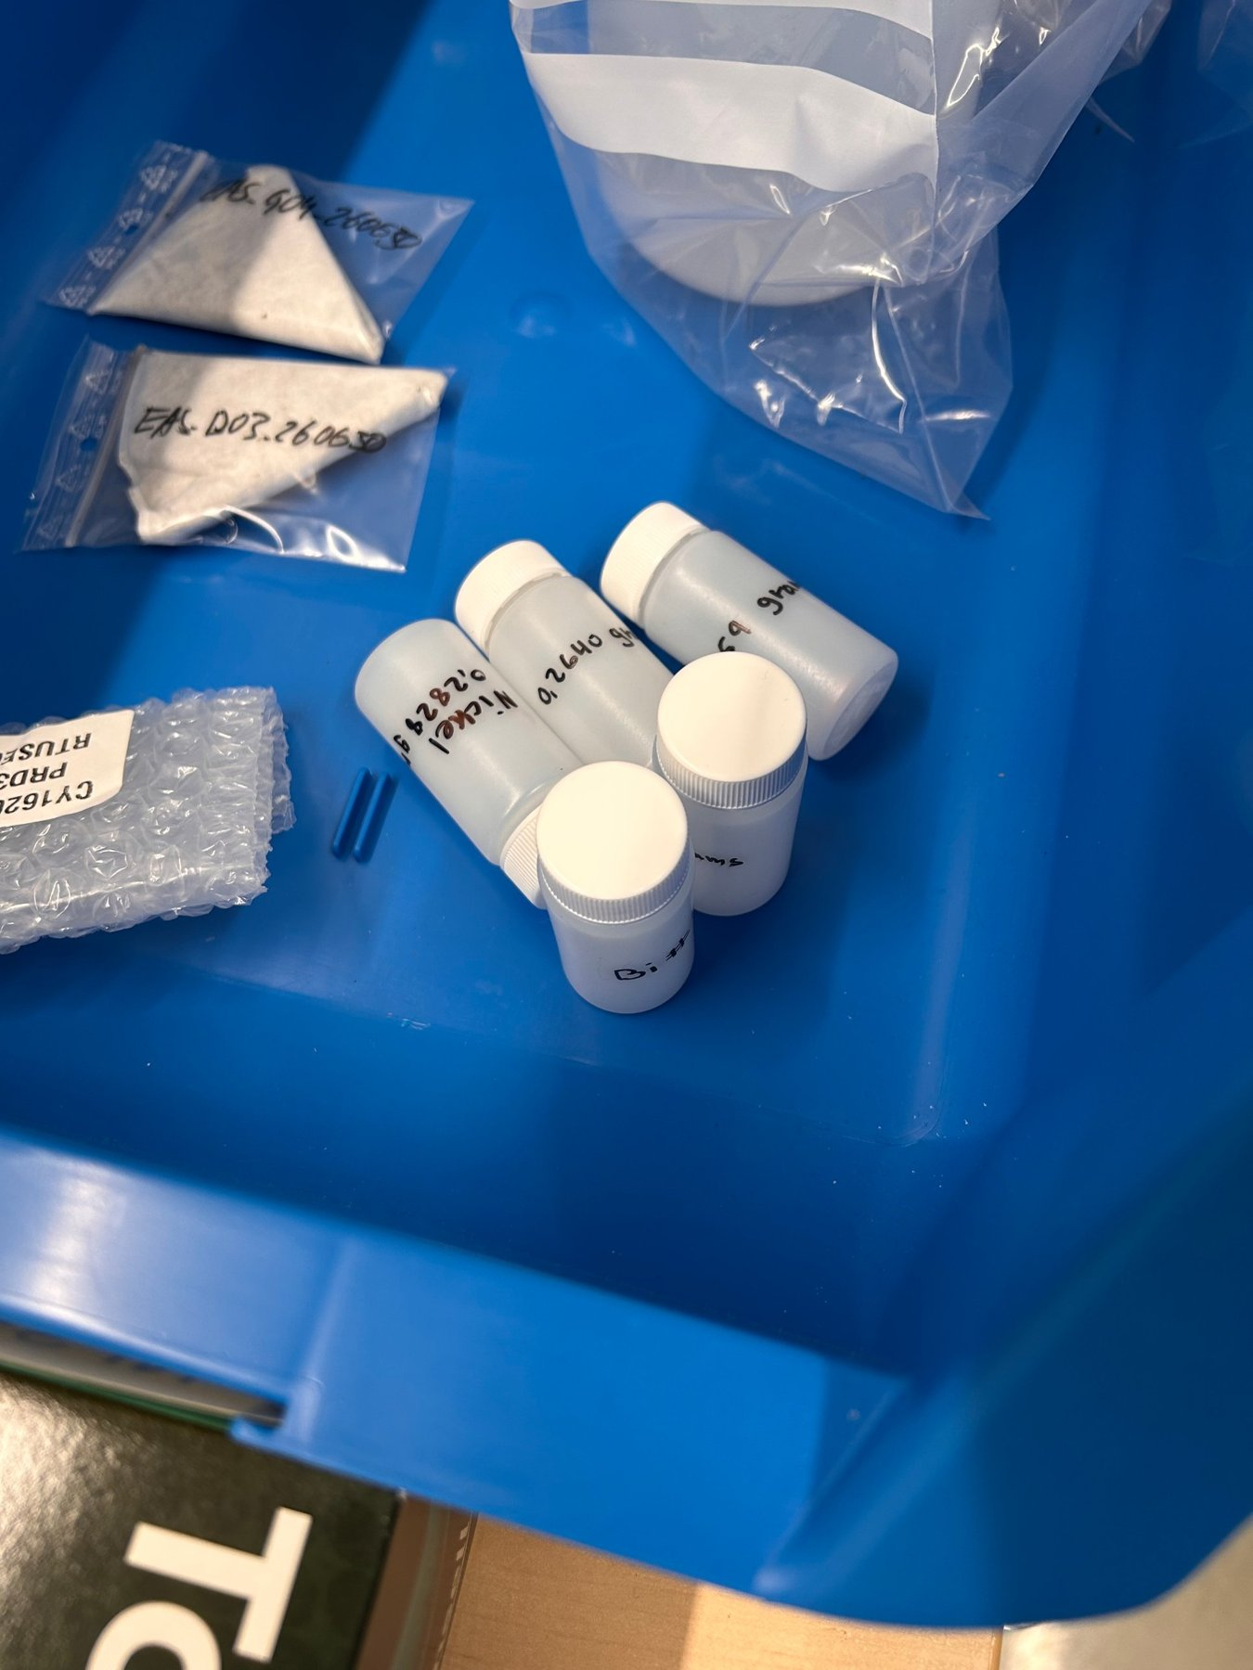
Experimental work
Gamma spectrometry
Detector
Canberra broad-energy HPGe (BE3830P) from the ESS RP Lab
Measurements
One fixed counting position per sample, 4-hour long measurements
Analysis
Acquisition, Analysis and Corrections using Genie2K
BE3830P Detector
Foils after irradiation
20 October 2026 - Benchmark activation experiment of various foil samples using the ESS accelerator dump line
10

Slide 11
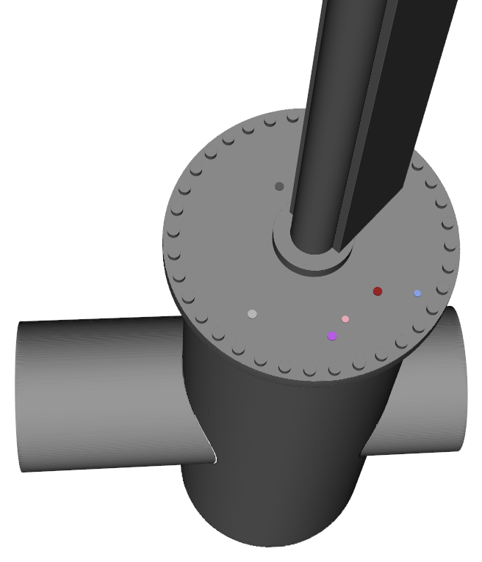
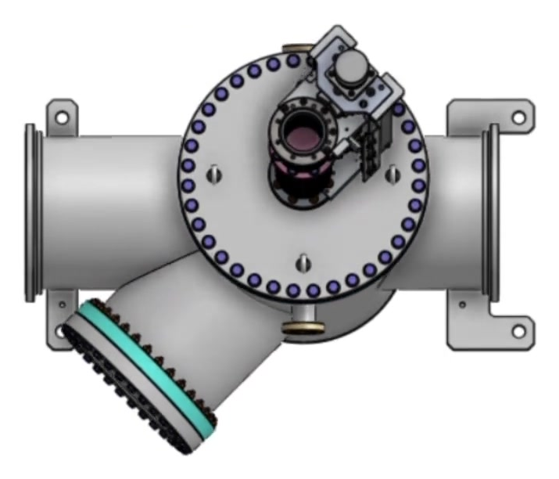

Computational work
Simulation model
Geometry
PBI vessel, top flange and the foils in PHITS 3.35
Source
Proton beam to the beam dump, with measurements from the device
Scoring
Fluence and production from models are passed to DCHAIN
Engineering CAD, top view
Transport model – PHIGS 3D
20 October 2026 - Benchmark activation experiment of various foil samples using the ESS accelerator dump line
11

Slide 12
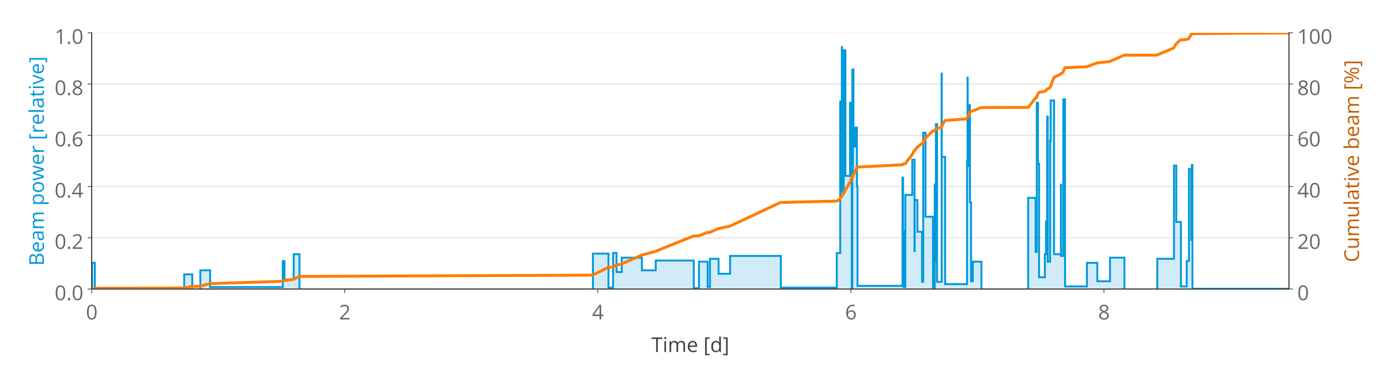
Computational work
Irradiation history
99 steps over 9.5 days
Normalization
Source definition
Time evolution & distribution captured from the PBI device
Source energy of 800 MeV,
current known for each frame
A Gaussian distribution was fitted to each period’s mean source
20 October 2026 - Benchmark activation experiment of various foil samples using the ESS accelerator dump line
12

Slide 13
Results
#3
Measured activities and calculated-over-experimental ratios

Slide 14
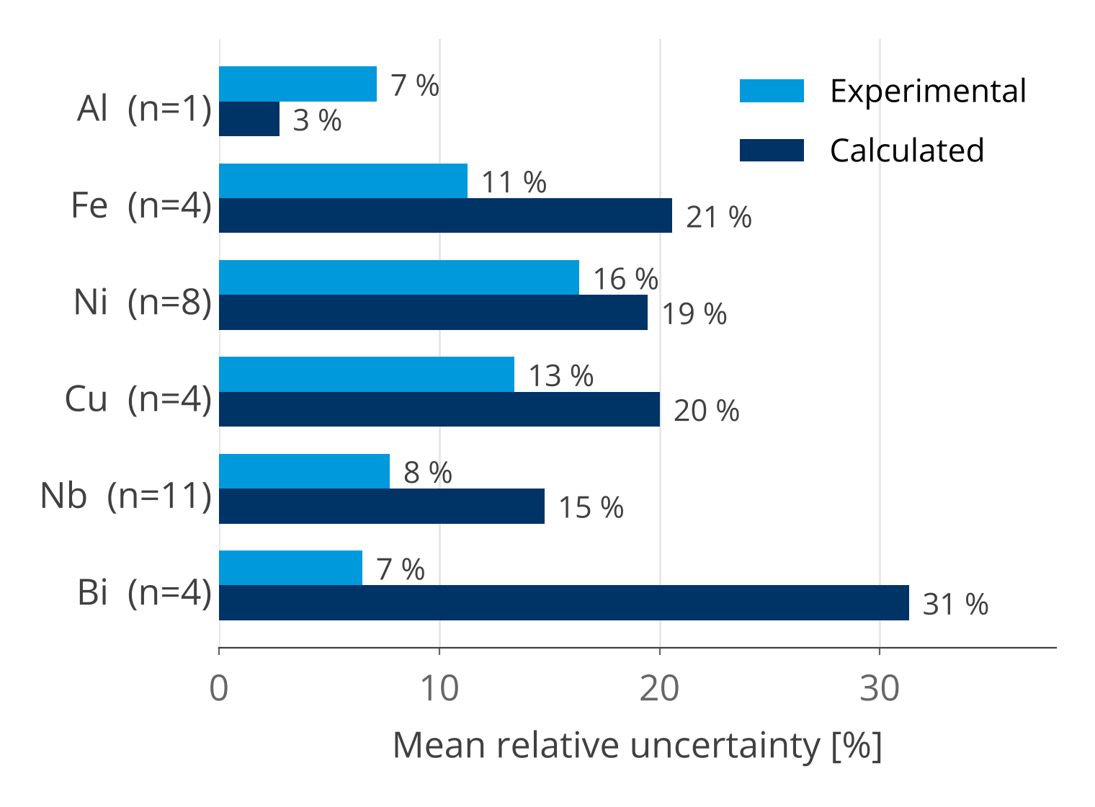
Considerations
Uncertainties
Contributor | On | Mean (range)
Gamma spectrometry | E | 11 % (2–54 %)
Simulations | C | 19 % (1–56 %)
Beam history | C | 5 %
Combined | C/E | 22 % (7–59 %)
Peaks with medium/low identification confidence: 19 % mean unc. Peaks with high identification confidence: 8.5 % mean unc.
n = nuclides measured per foil; metastable Pb isotopes excluded of the comparison due to large uncertainties in the decay chain
20 October 2026 - Benchmark activation experiment of various foil samples using the ESS accelerator dump line
13

Slide 15
Experimental results
Nuclides identified per foil
Foil | Nuclides identified | n
Al | Na-24 | 1
Fe | Sc-47, Cr-51, Mn-52, Mn-54 | 4
Ni | Cr-51, Mn-52, Mn-54, Co-56, Mn-56, Co-57, Ni-57, Co-58 | 8
Cu | Mn-52, Mn-56, Co-57, Co-58 | 4
Nb | Rb-83, Sr-83, Sr-85, Y-87, Y-87m, Y-88, Y-89, Zr-88, Zr-89, Nb-90, Nb-92m | 11
Bi | Tl-201, Tl-202, Pb-204m, Bi-205, Pb-205m, Bi-206 | 6
34
nuclides identified in six foils
76 %
with high confidence
20 October 2026 - Benchmark activation experiment of various foil samples using the ESS accelerator dump line
15

Slide 16
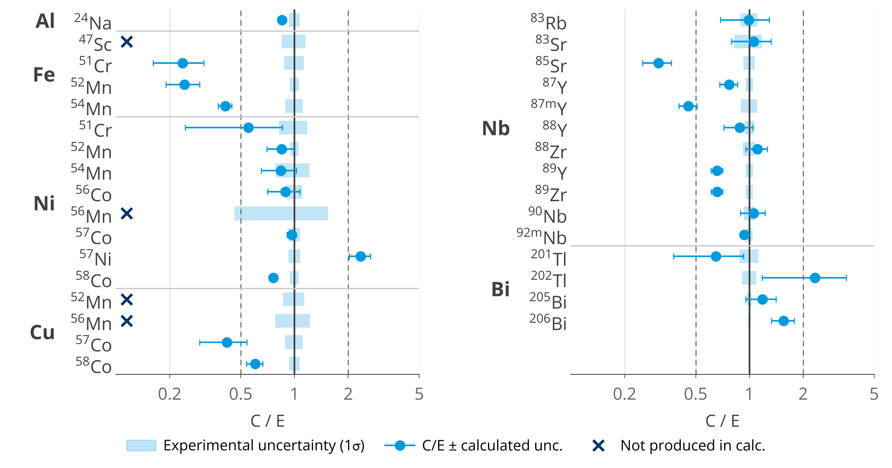
Benchmark results
Calculated over experimental activities
71%
within a factor of 2
14 / 28
compatible with C/E = 1 at 1σ
4
measured but not produced in the simulations
20 October 2026 - Benchmark activation experiment of various foil samples using the ESS accelerator dump line
16

Slide 17
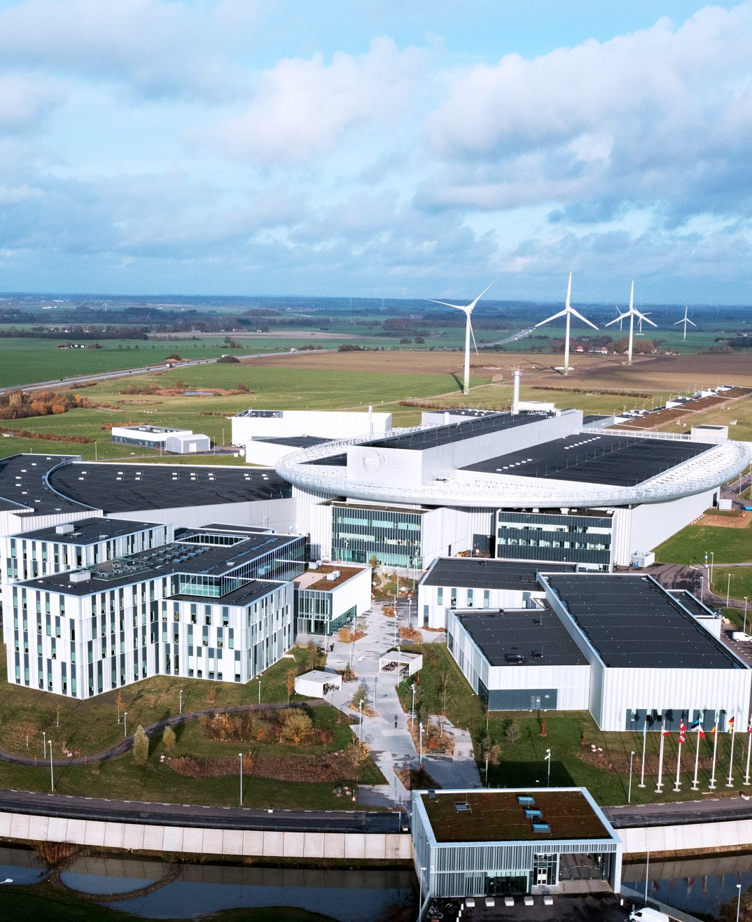
Conclusions
#4
Discussion and future work

Slide 18
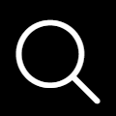
Conclusions
Discussion & future work
Satisfactory agreement
Open questions
Ongoing: neutron spectrum
20 of 28 nuclides C/E within a factor of 2. Al, Ni and Nb close to unity.
Fe and Cu products underestimated; Mn isotopes not produced or underestimated.
Characterizing the neutron spectrum at the position using foil irradiation of Au (Cd), Sc, Ti, Bi, and Nb.
20 October 2026 - Benchmark activation experiment of various foil samples using the ESS accelerator dump line
18

Slide 19
Thank you!
Authors: T. Dähn Costante, D. D. Di Julio, J. I. Márquez Damián, C. Thomas, J. Cederkäll, P. Wilke, G. Muhrer, F. Tidholm, N. Markovic, T. Chulapakorn
CONTACT INFORMATION
tomas.dahncostante@ess.eu
European Spallation Source ERIC, Partikelgatan 2, 224 84 Lund

Slide 20
Appendix
Activities and C/E: Al, Fe, Ni, Cu
Foil | Nuclide | E [unit] | C (rel.) | C/E
Al | Na-24 | 0.287 ± 0.021 | 0.244 (3 %) | 0.85 ± 0.07
Fe | Sc-47 | 0.064 ± 0.010 | not produced | —
Fe | Cr-51 | 0.74 ± 0.09 | 0.17 (31 %) | 0.24 ± 0.08
Fe | Mn-52 | 0.382 ± 0.022 | 0.093 (21 %) | 0.24 ± 0.05
Fe | Mn-54 | 0.241 ± 0.027 | 0.099 (9 %) | 0.41 ± 0.06
Ni | Cr-51 | 0.31 ± 0.06 | 0.17 (56 %) | 0.55 ± 0.32
Ni | Mn-52 | 0.281 ± 0.015 | 0.237 (17 %) | 0.85 ± 0.15
Ni | Mn-54 | 0.046 ± 0.010 | 0.039 (22 %) | 0.84 ± 0.26
Ni | Co-56* | 0.311 ± 0.033 | 0.276 (20 %) | 0.89 ± 0.20
Foil | Nuclide | E [unit] | C (rel.) | C/E
Ni | Mn-56* | 0.17 ± 0.09 | not produced | —
Ni | Co-57 | 0.808 ± 0.062 | 0.779 (6 %) | 0.96 ± 0.09
Ni | Ni-57 | 0.356 ± 0.027 | 0.836 (14 %) | 2.35 ± 0.37
Ni | Co-58 | 3.80 ± 0.21 | 2.89 (1 %) | 0.76 ± 0.04
Cu | Mn-52* | 0.023 ± 0.003 | not produced | —
Cu | Mn-56* | 0.087 ± 0.019 | not produced | —
Cu | Co-57 | 0.036 ± 0.004 | 0.015 (30 %) | 0.42 ± 0.13
Cu | Co-58 | 0.197 ± 0.013 | 0.118 (11 %) | 0.60 ± 0.08
* medium or low identification confidence. C/E in orange: outside a factor of 2.
20 October 2026 - Benchmark activation experiment of various foil samples using the ESS accelerator dump line
20

Slide 21
Appendix
Activities and C/E: Nb, Bi
Foil | Nuclide | E [unit] | C (rel.) | C/E
Nb | Rb-83* | 0.54 ± 0.06 | 0.53 (30 %) | 0.99 ± 0.32
Nb | Sr-83* | 0.82 ± 0.15 | 0.87 (25 %) | 1.06 ± 0.32
Nb | Sr-85 | 1.88 ± 0.14 | 0.58 (18 %) | 0.31 ± 0.06
Nb | Y-87 | 11.9 ± 0.6 | 9.17 (11 %) | 0.77 ± 0.09
Nb | Y-87m | 0.462 ± 0.048 | 0.211 (12 %) | 0.46 ± 0.07
Nb | Y-88 | 0.622 ± 0.038 | 0.549 (19 %) | 0.88 ± 0.17
Nb | Zr-88 | 1.41 ± 0.11 | 1.56 (14 %) | 1.11 ± 0.18
Nb | Y-89 | 18.4 ± 0.9 | 12.1 (7 %) | 0.66 ± 0.06
Nb | Zr-89 | 18.5 ± 0.9 | 12.1 (7 %) | 0.66 ± 0.06
Foil | Nuclide | E [unit] | C (rel.) | C/E
Nb | Nb-90* | 0.609 ± 0.043 | 0.643 (16 %) | 1.06 ± 0.18
Nb | Nb-92m | 26.2 ± 1.1 | 24.6 (2 %) | 0.94 ± 0.04
Bi | Tl-201 | 3.97 ± 0.47 | 2.58 (42 %) | 0.65 ± 0.29
Bi | Tl-202 | 0.416 ± 0.038 | 0.971 (50 %) | 2.33 ± 1.18
Bi | Pb-204m* | 0.187 ± 0.030 | 0.0018 (10 %) | 0.009 ± 0.002
Bi | Bi-205 | 7.90 ± 0.26 | 9.33 (19 %) | 1.18 ± 0.23
Bi | Pb-205m | 0.25 ± 0.09 | 1.26 (19 %) | 5.08 ± 2.15
Bi | Bi-206 | 12.4 ± 0.2 | 19.3 (14 %) | 1.55 ± 0.23
* medium or low identification confidence. C/E in orange: outside a factor of 2. Metastable Pb not included in the C/E figure.
20 October 2026 - Benchmark activation experiment of various foil samples using the ESS accelerator dump line
21

