Slide 1




Fundamental Diagnostics Results of KOMAC 100 MeV Linac Neutrons Using Neutron Activation System
26th International Conference on Accelerators and Beam Utilizations (ICABU2024)
14th Nov. 2024
Jeong-Jeung Dang¹
Jooyub Lee², Junsik Kim², Geehyun Kim², Kyoung-Jae Chung², and Dong-Hwan Kim³
¹KENTECH, ²Seoul National University, ³KAERI/KOMAC

Slide 2
Outline
Introduction to Development of Fusion Neutron Radiation Test Environment
01
NAS Experiment at KOMAC Neutron Beamline
02
Discussion and Summary
03

Slide 3
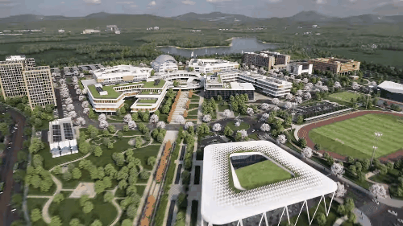
Introduction to KENTECH
Korea Institute of Energy Technology (한국에너지공과대학교)
  Opened in 2021
  Gwangju-Jeonnam Joint Innovation City, Naju-si, Jeollanam-do
  Specialized in energy engineering
    Fostering energy talents
    Leading future energy research
  Department of Energy Engineering
  Members (- ’25)
    400 undergraduate students
    600 graduate students

Slide 4
Introduction to KENTECH
Korea Institute of Energy Technology
  Five Specialized Energy Fields (Research Institutes)
    Energy AI
    Energy Materials and Devices
    Grid Modernization
    Hydrogen Energy
    Environmental and Climate Technology
  Recently, the Nuclear Energy Research Institute has been established.
    Advanced nuclear energy systems such as fusion reactor and molten salt reactor.

Slide 5

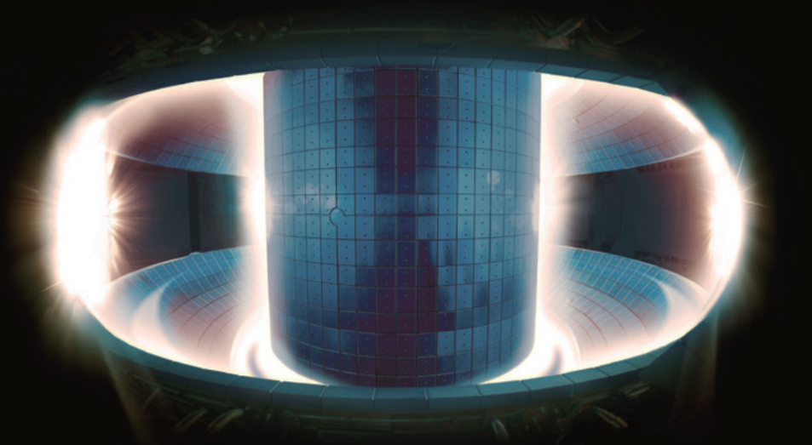
Clean Energy Resources

Slide 6
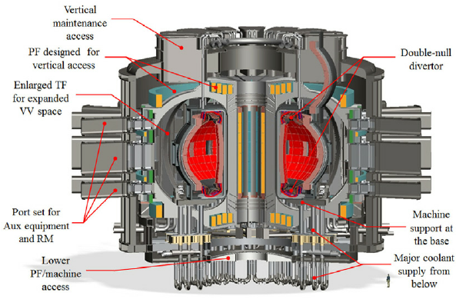



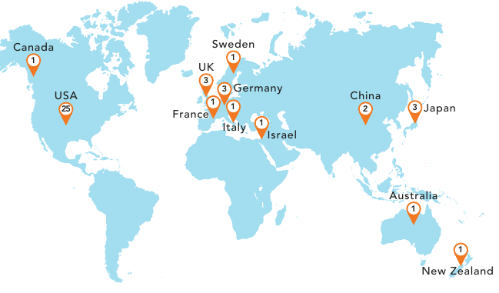

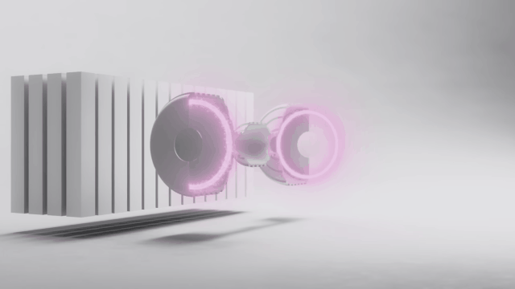
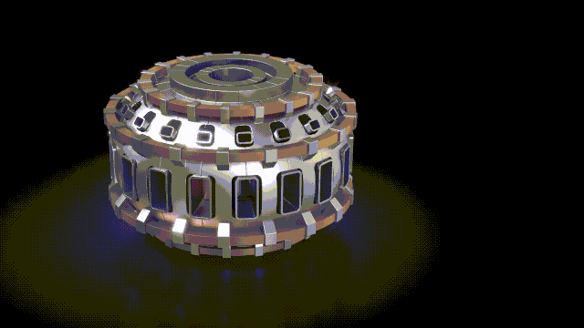
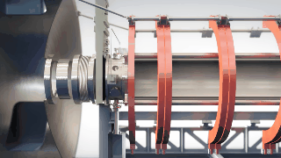
Way To Nuclear Fusion Power Plant
Government / Public Sector
K-DEMO
operation,
designing
fusion power
plant
ITER 1st
plasma
ITER fusion
experiment
Advanced
operation
of KSTAR
Beginning
of K-DEMO
designing
Beginning of
K-DEMO
construction
2024
2030
2040
2050
$ 6.2 B
US, $577M
(Sam Altman, Supplying
contract with MS)
US, > $2,000M
(Bill Gates, MIT)
US, > $1,200M
(Google, Cheveron)
$ 5.9 B
(private)
$ 0.27 B
(public)
Company / Private Sector
Source: 제4차 핵융합에너지 개발 진흥 기본계획(2022~2026), The Global Fusion Industry in 2023 (FIA)

Slide 7
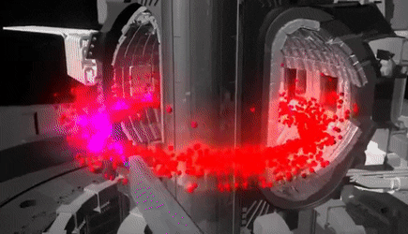
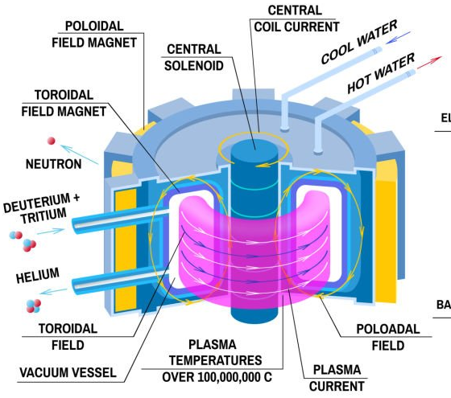

Nuclear Fusion Energy
Nuclear Fusion Energy and Tokamak
  Nuclear fusion reaction: $D+T→He\left(3.5 MeV\right)+n\left(14.1 MeV\right)$
  Fusion reactor (Tokamak)
    Confining fusion plasma using closed magnetic fields resembling a donut
    Heating plasma and sustaining its thermal energy to be favorable to fusion reaction
    Recovering produced fusion energy (neutron energy, blanket)

Slide 8
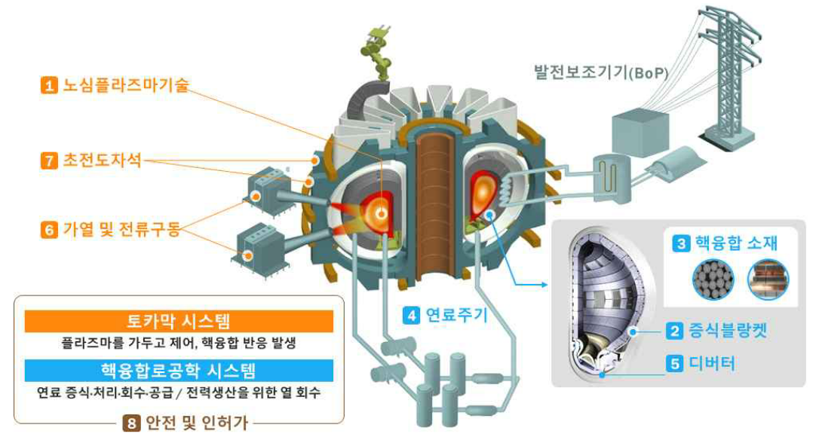
Core Technologies to Harness Fusion
Reactor core plasma technology
Superconducting magnet
Heating and
current driving
Materials for
fusion reactor
Fuel cycle
Blanket
(tritium breeding)
Divertor
Safety and license
Source: 제4차 핵융합에너지 개발 진흥 기본계획(2022~2026)

Slide 9

Control Integrated with Diagnostics
Center for Integrated Diagnostics and Control for Burning Plasma
  Advanced fusion technology center
    Reactor core plasma technology: fusion plasma control and diagnostics
  Diagnostic device technology suitable for the demonstration fusion reactor (DEMO)
  Integrated diagnosis and control method for burning plasma
  Advanced core control and stable operation

Slide 10
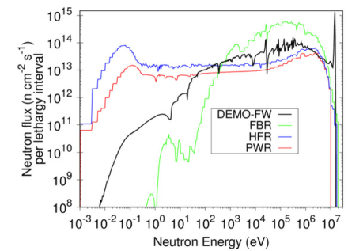
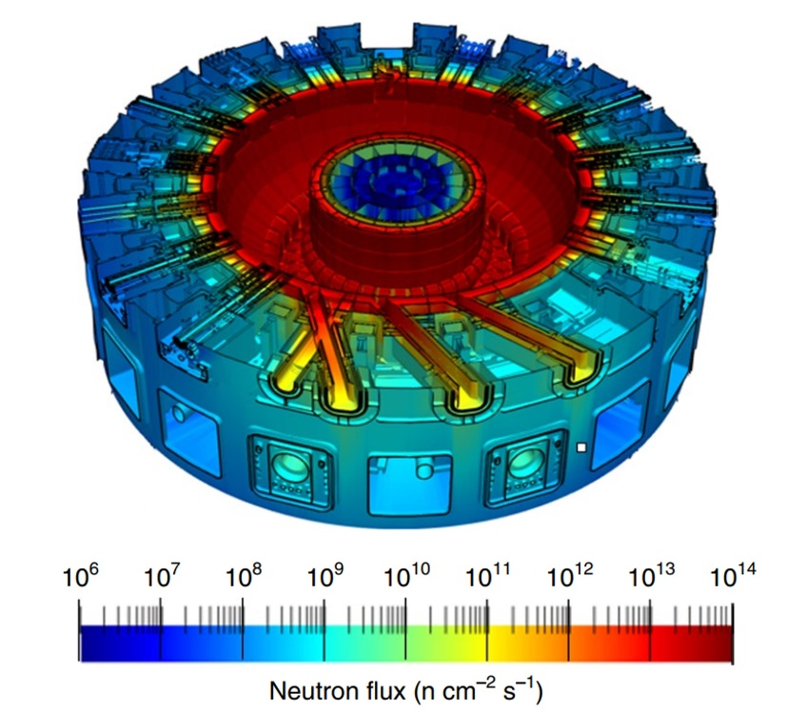
Fusion Neutron Radiation Test Technology
Development of Fusion Neutron Radiation Test Technology
  Subproject of “Center for Integrated Diagnostics and Control for Burning Plasma”
  Establishing a radiation test environment for fusion reactor researchers
    Electronics or materials exposed to high flux fusion neutrons should be tested for their radiation hardness.
    There is no high flux fusion neutron source.
Neutron flux of ITER
R. Juarez et al., Nature Energy 2021
Typical neutron spectra of reactors
Jean-Christophe Sublet et al., EPJ Web of Conferences 146, 02003 (2017)

Slide 11
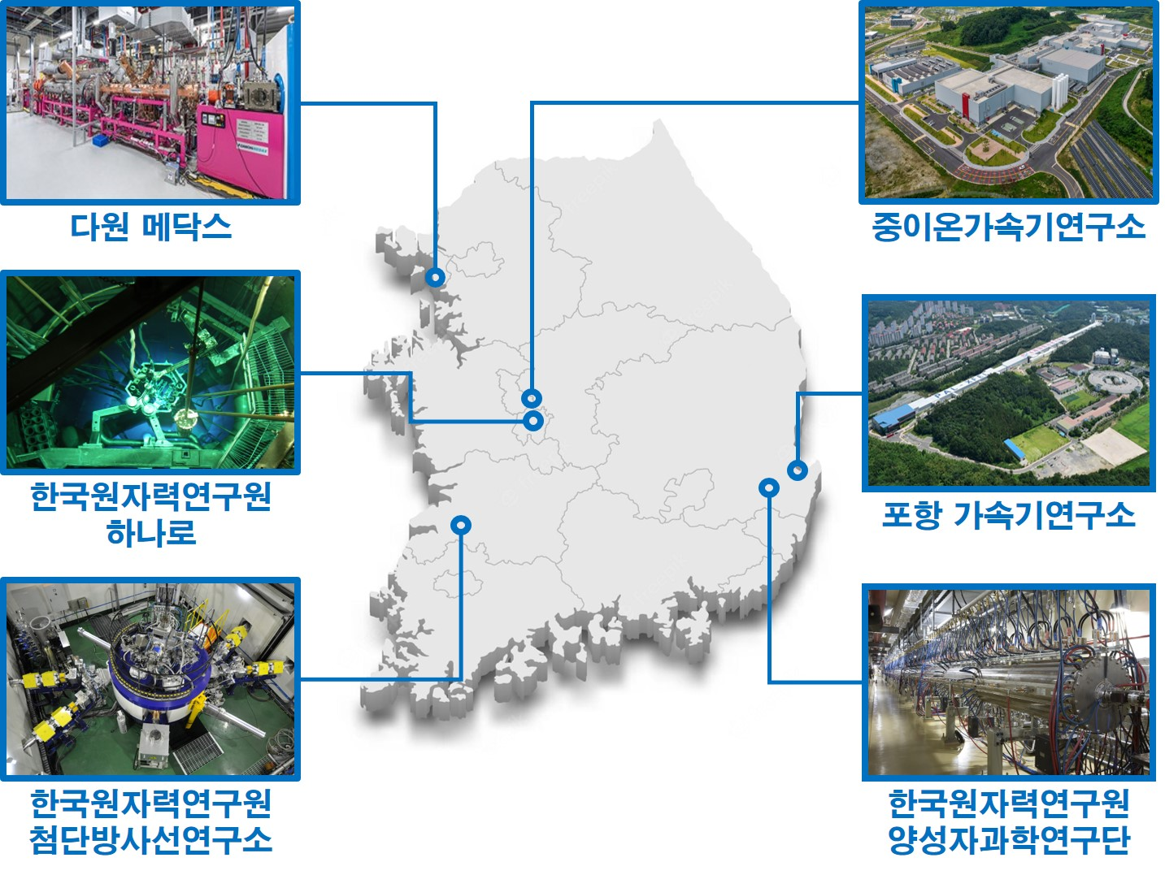
Fusion Neutron Radiation Test Technology
Development of Fusion Neutron Radiation Test Technology
  Accelerator-based neutron sources
    Wide range of neutron energy and flux
    Characterizing sources and building a database to simulate fusion neutrons for nuclear fusion relevant engineers and researchers
DEMO,
FPP
HANARO
Neutron flux
KOMAC
linac
ARTI
cyclotron
1 10 100
Neutron energy [MeV]

Slide 12
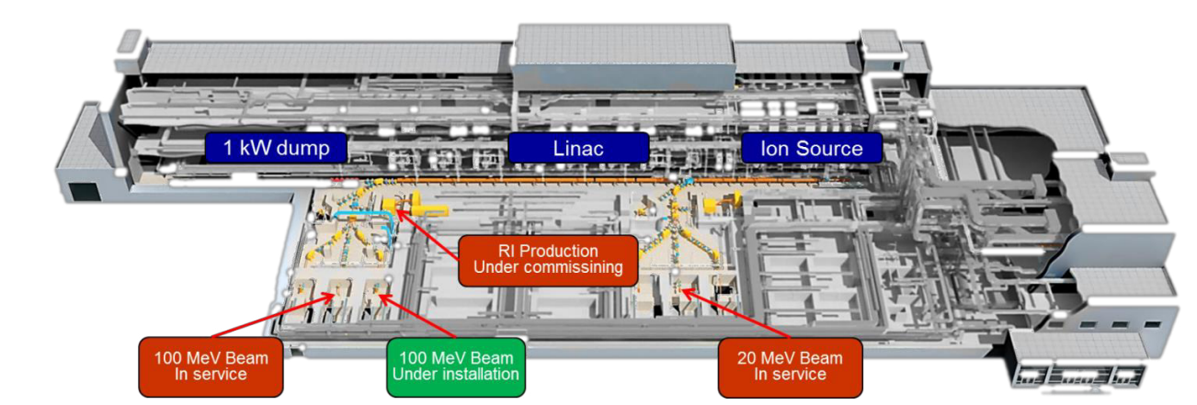
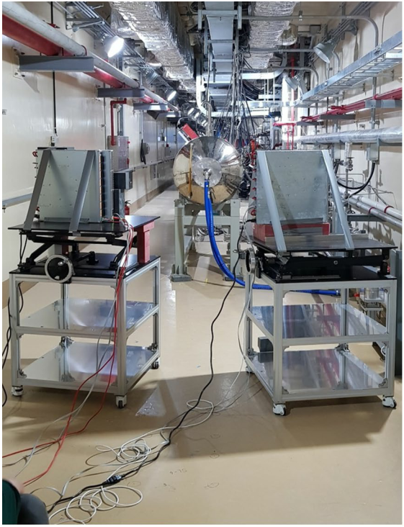
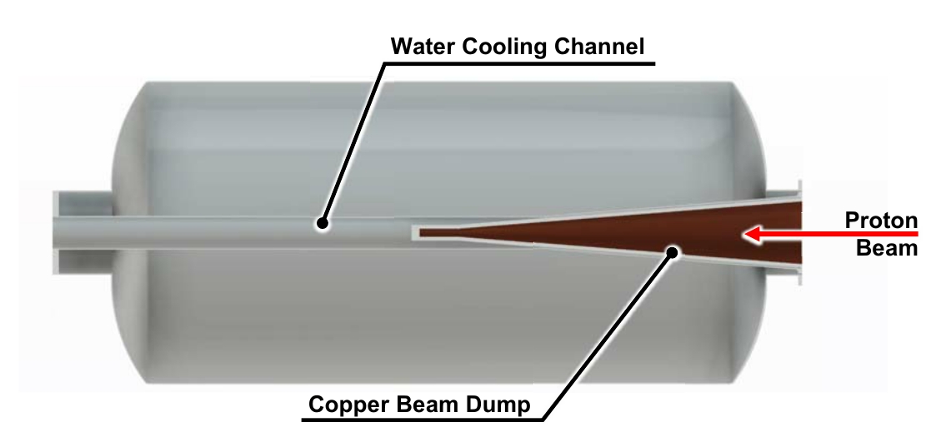
KOMAC Neutron BeamLine
100 MeV Linac Neutron Beamline
  Neutrons are produced in the beam dump at the end of the linac.
Han-Sung Kim, et al., LINAC2016, TH1A02
P. Lee, et al., Journal of Physics: Conference Series, 1350 (2019) 012066
Han‑Sung Kim, et al., JKPS, 80 (2022) 799–807

Slide 13
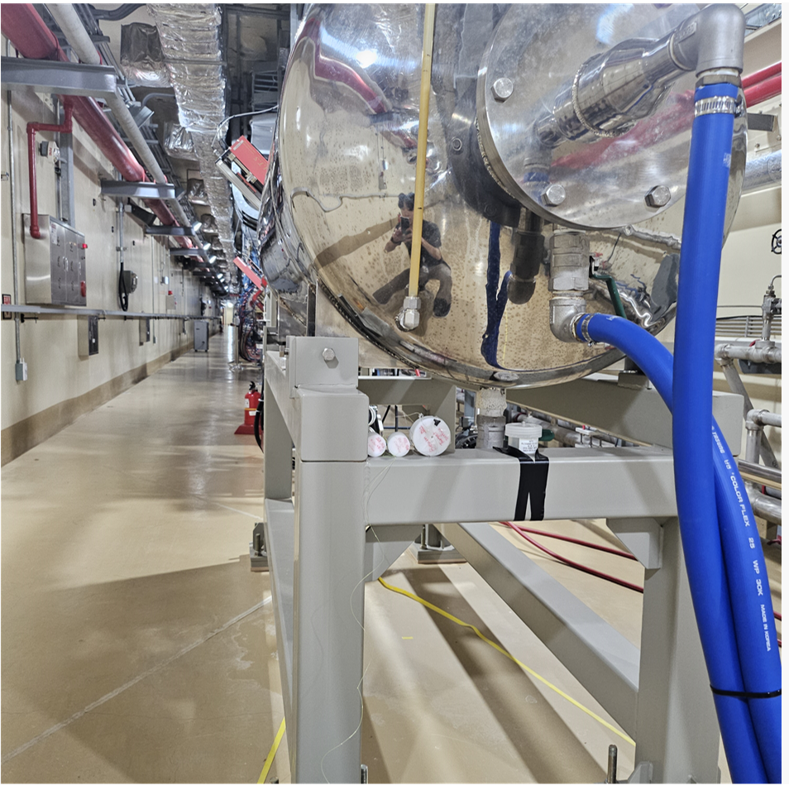
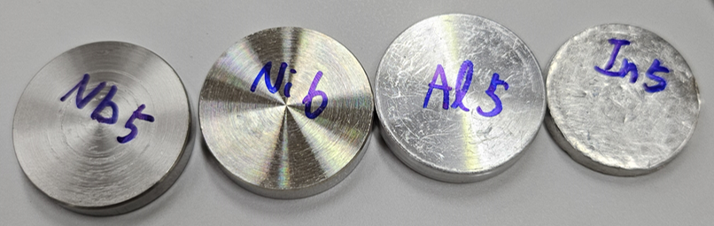
Neutron Energy Measurement by NAS
Neutron Activation System
  Neutron energy measurement by analyzing activation (gamma) of irradiated metal samples (specimens)
  Metal samples: bismuth, aluminum, nickel, indium, niobium
HPGe gamma detection system
Beam
Dump
Shield
Beam
Neutrons
Sample
Detector
Sample
P. S.,
digitizer
Neutron irradiation
Retrieving and analyzing gammas of
the samples after irradiation (activation)

Slide 14
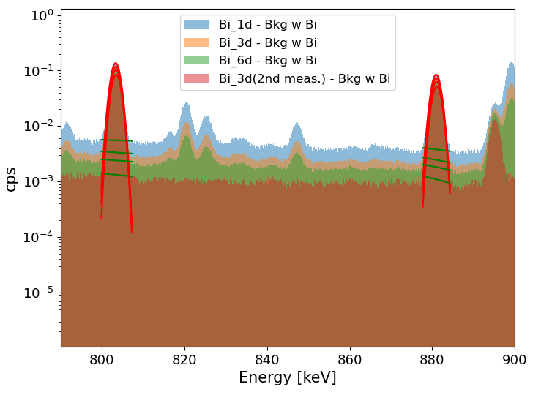
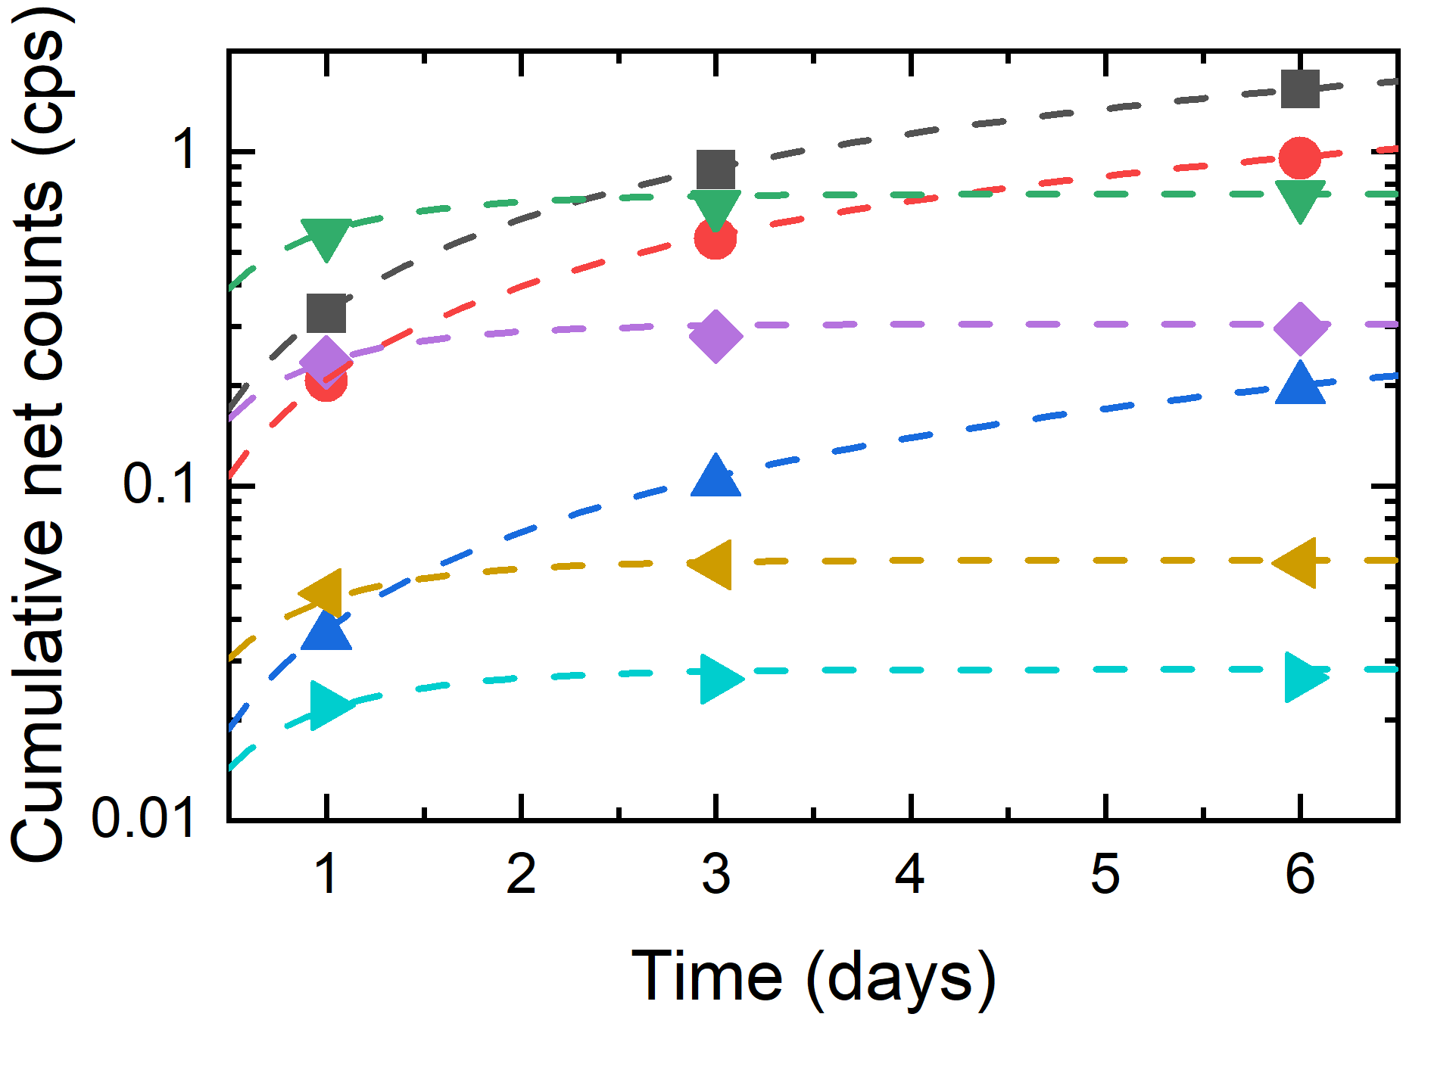
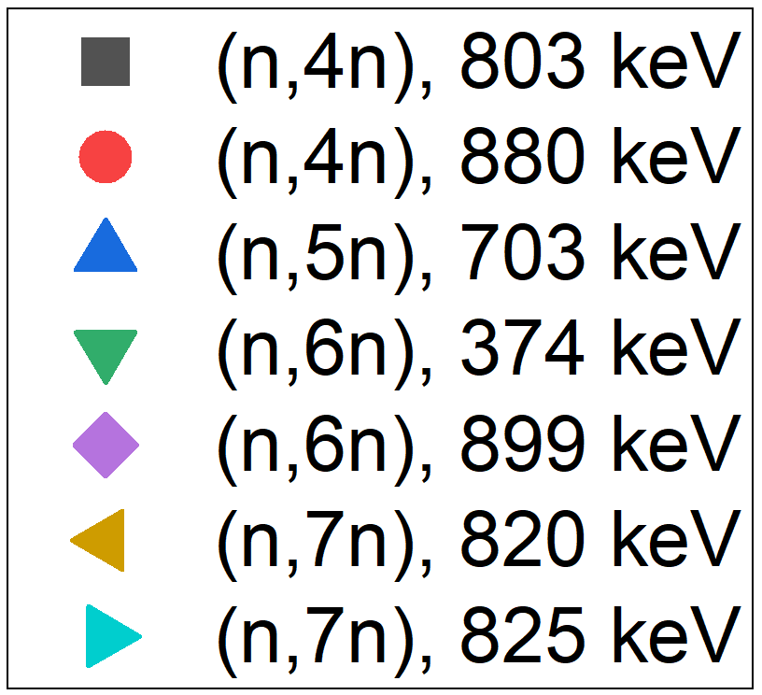
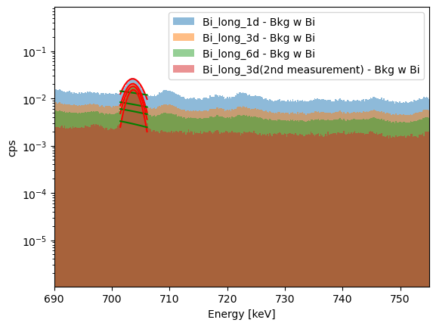
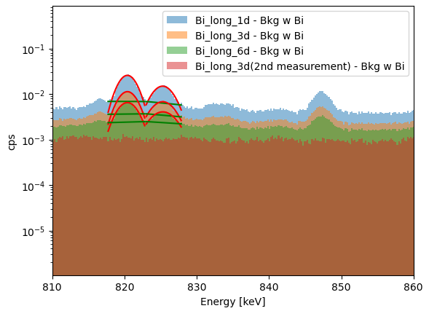
Neutron Activation of Bi Sample
Activation by (n, xn) Reaction
  Estimating of a half-life evaluated from net counts and comparing it with a theoretical half-life, to verify the validity of the analysis method and measured gamma ray data.
(n,4n) Bi206
(n,5n) Bi205
(n,7n) Bi203
Decay data (symbol) and
theoretical decay curve (dashed line)

Slide 15
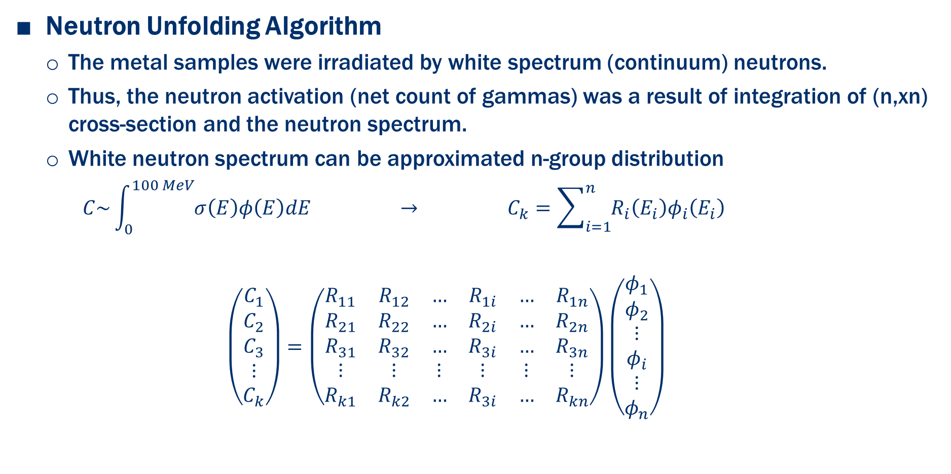
Neutron Energy Measurement by NAS
Neutron Unfolding Algorithm
  The metal samples were irradiated by white spectrum (continuum) neutrons.
  Thus, the neutron activation (net count of gammas) was a result of integration of (n,xn) cross-section and the neutron spectrum.
  White neutron spectrum can be approximated n-group distribution
      $$C\sim \int_{0}^{100 MeV}{σ\left(E\right)φ\left(E\right)dE} → C_{k}=\sum_{i=1}^{n}{R_{i}\left(E_{i}\right)φ_{i}\left(E_{i}\right)}$$
      $$\left(\begin{aligned}C_{1} \\ C_{2} \\ C_{3} \\ ⋮ \\ C_{k}\end{aligned}\right)=\left(\begin{matrix}R_{11} & R_{12} & … & R_{1i} & … & R_{1n} \\ R_{21} & R_{22} & … & R_{2i} & … & R_{2n} \\ R_{31} & R_{32} & … & R_{3i} & … & R_{3n} \\ ⋮ & ⋮ & ⋮ & ⋮ & ⋮ & ⋮ \\ R_{k1} & R_{k2} & … & R_{3i} & … & R_{kn}\end{matrix}\right)\left(\begin{aligned}φ_{1} \\ φ_{2} \\ ⋮ \\ φ_{i} \\ ⋮ \\ φ_{n}\end{aligned}\right)$$
Net count
(HPGe)
Neutron spectrum
Sample response by activation
(is under calculation using *FISPACT-II)
FISPACT: nuclide inventory code implementing
radioactivity and nuclear transformation model

Slide 16
Discussion and Summary
Fundamental Diagnostics Results of KOMAC 100 MeV Linac Neutrons Using Neutron Activation System
  Development of fusion neutron radiation test environment
  Various domestic accelerator based neutron sources to provide wide range of energy and flux of neutrons
  Neutron measurement of KOMAC neutron beamline by NAS
    Activation (gamma) was measured and under analyzation.
    Neutron unfolding is in progress. We expect to get the neutron spectrum of KOMAC neutron beamline soon.
  Characterization of other accelerator based neutrons will be conducted.

Slide 17
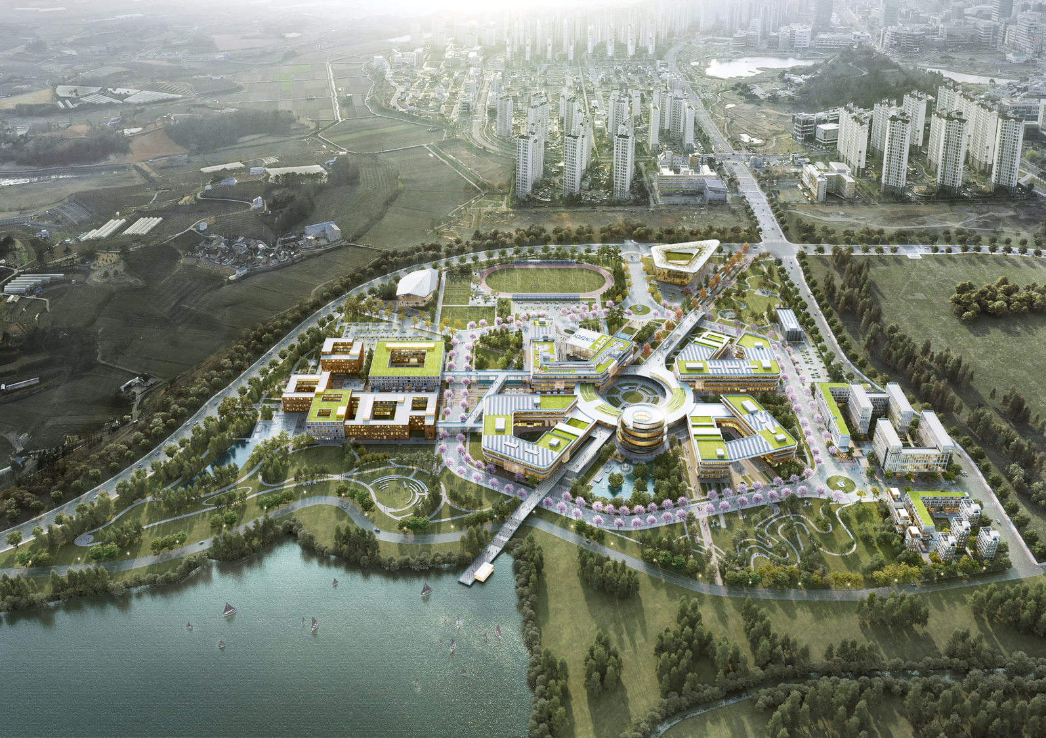

Thank you

