Slide 1
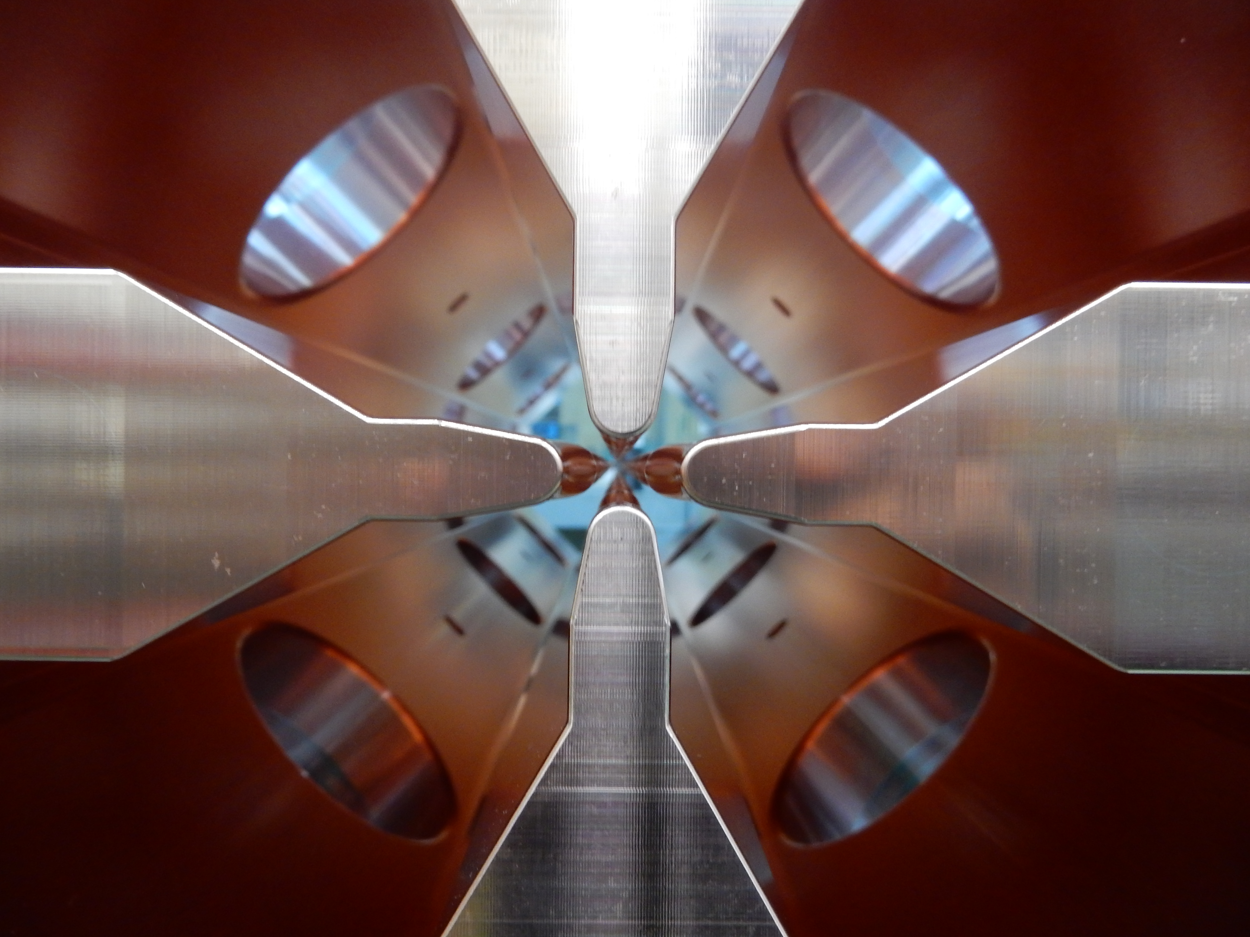
Recent Results of the
J-PARC Linac Beam Commissioning
Masashi Otani (KEK/J-PARC)
On behalf of the J-PARC linac commissioning Gr.
26th International Conference on Accelerators and Beam Utilizations (ICABU2024) Nov. 2024

Slide 2
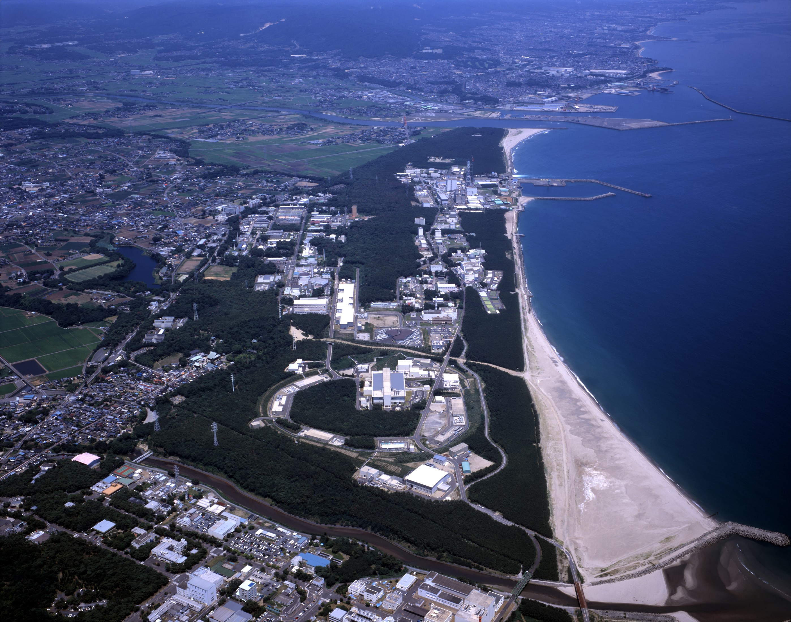
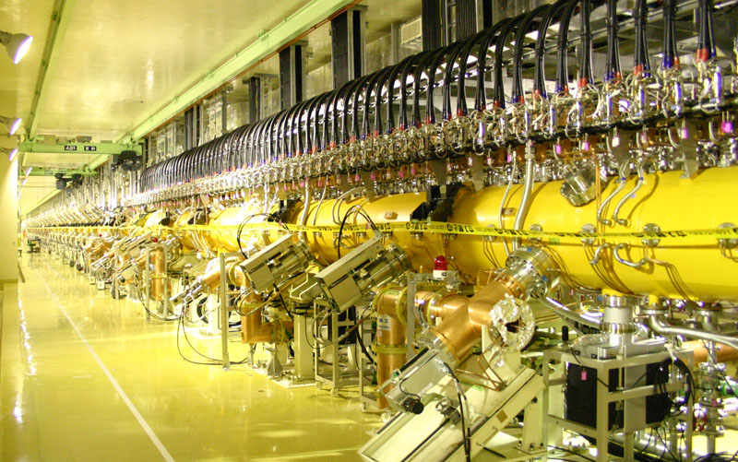
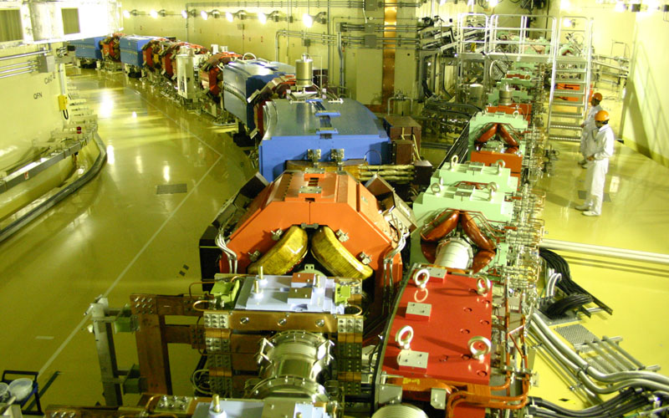
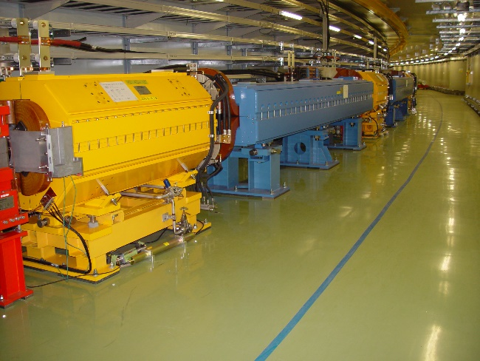

J-PARC
LINAC 400 MeV
RCS 3 GeV
MR 30 GeV
Neutrino
Material & Life science Facility
Hadron
Tokai, Ibaraki

Slide 3
Brief History
Year | Event
2002 | Linac/RCS/MR bldg. construction start
2005 | Linac/RCS bldg. is completed
2006 | Beam commissioning start (Linac)
2007 | 181 MeV / 3 GeV acceleration is achieved at linac/RCS MR bldg. is completed
2008 | 30 GeV acceleration is achieved at MR
2014 | Linac upgrade (181 → 400 MeV) is completed
2015 | 1 MW single shot mode operation is achieved
2018 | 1 MW continuous operation is succeeded
2019 | 1.5 MW single shot mode operation is demonstrated
2022 | MR: 1-year long shutdown for high repetition upgrade
2024 | Beam power of RCS was increased to 1 MW Achieved 800-kW beam operation (FX) Achieved 80-kW beam operation (SX)

Slide 4
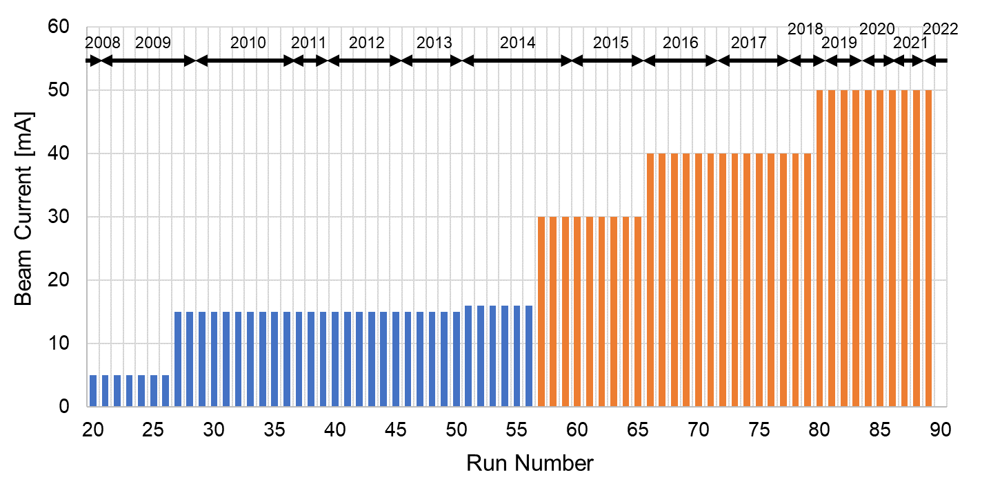
Beam Power @ Linac
After upgrade
Before upgrade
start MLF user operation
Linac upgrade
start 50 mA operation

Slide 5
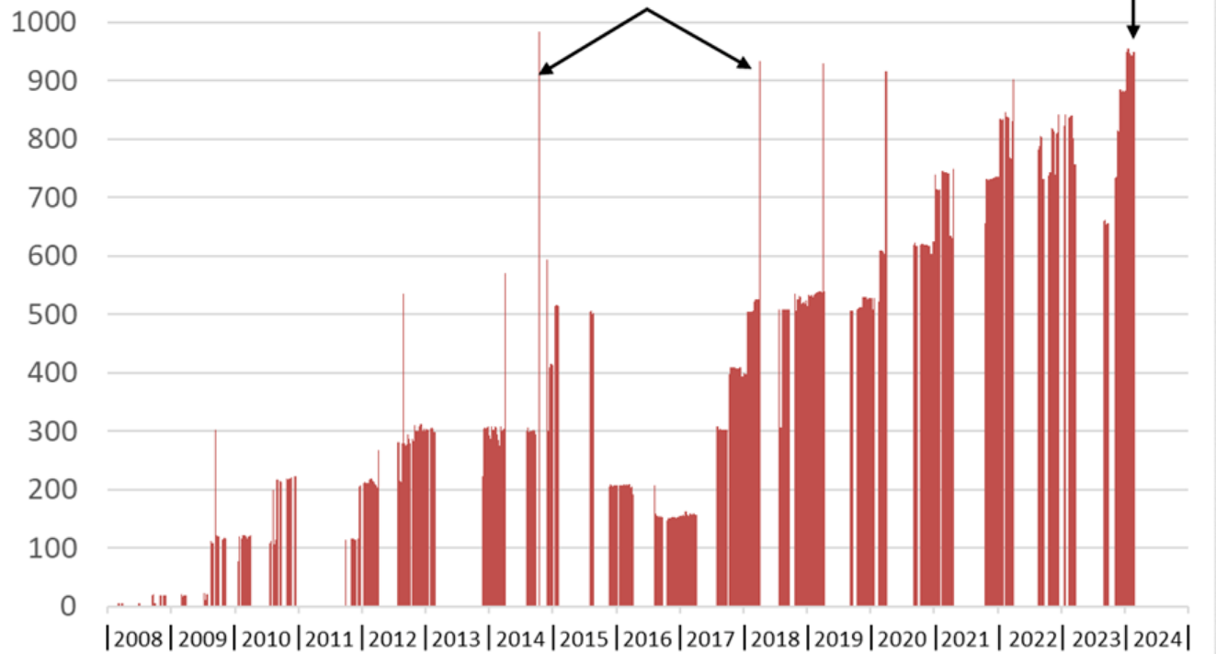
Beam Power @ RCS
User operation with 1MW
1MW (single)
1MW (continuous)

Slide 6
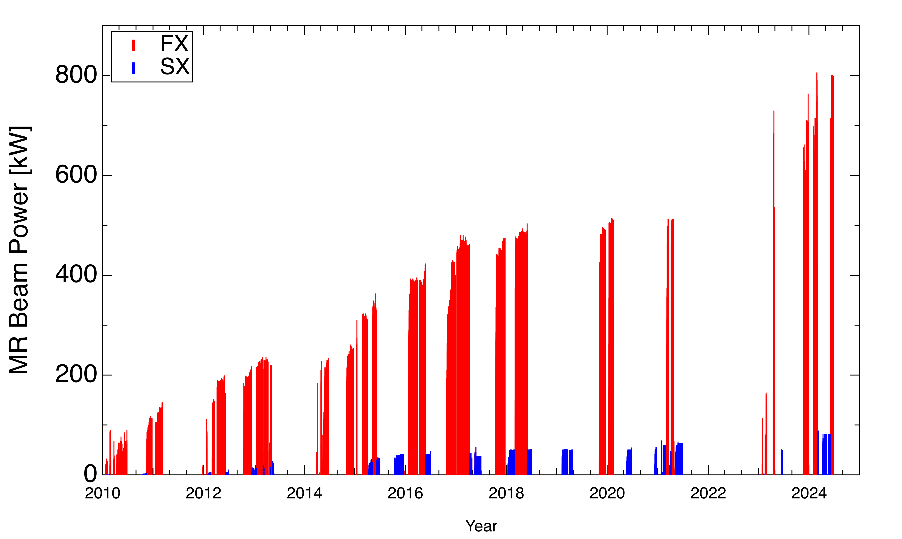
Beam Power @ MR
FX 800 kW
2.27×10¹⁴ ppp
1-year long shutdown for
high repetition rate upgrade
SX 80 kW
7.2×10¹³ ppp
Operation
cycle
3.52s 3.04s 2.56s 2.48s 1.36s
6.00s 5.52s 5.20s 4.24s
- Started beam commissioning for 1.36-s cycle in June 2022
- Achieved 760-kW beam operation in December 2023
(exceeded the original design performance of 750 kW)
- Achieved 800-kW beam operation in June 2024
- Started beam commissioning in June 2023
- Achieved 50-kW beam operation in June 2023 with 5.20-s cycle
- Achieved 80-kW beam operation in April 2024 with 4.24-s cycle
FX:
SX:

Slide 7
Short/Long Term Milestone @ LINAC
50→～60 mA to achieve both 1MW for MLF and higher rep. (→1.16s) at MR
  14% of RCS beam goes to MR at 1.16 s rep.
～80 mA and longer pulse (500→750 us) are target aligned with the J-PARC upgrade under consideration
  MLF 2nd target station

Slide 8

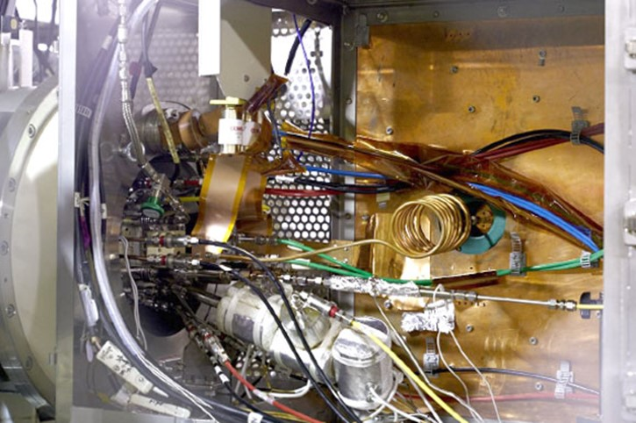
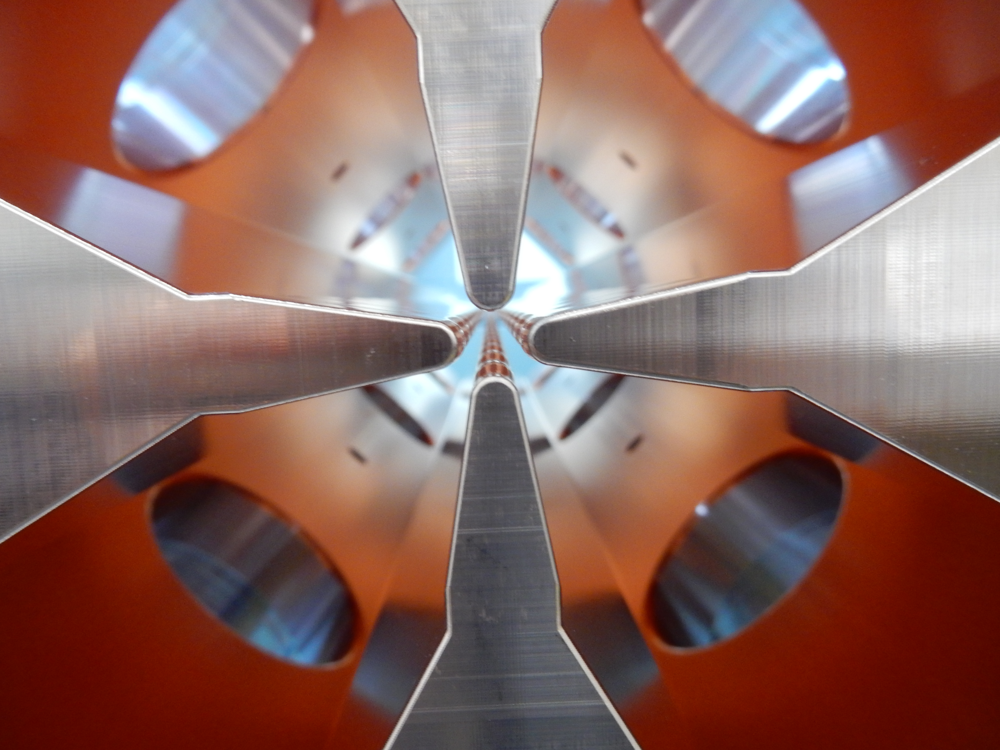
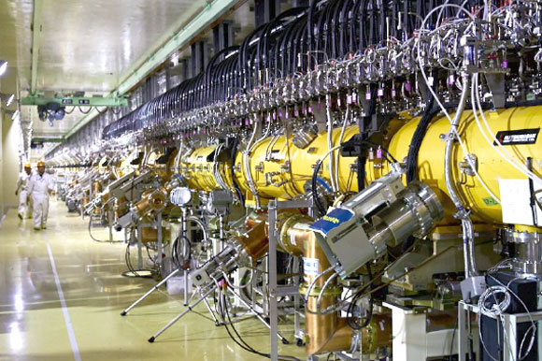
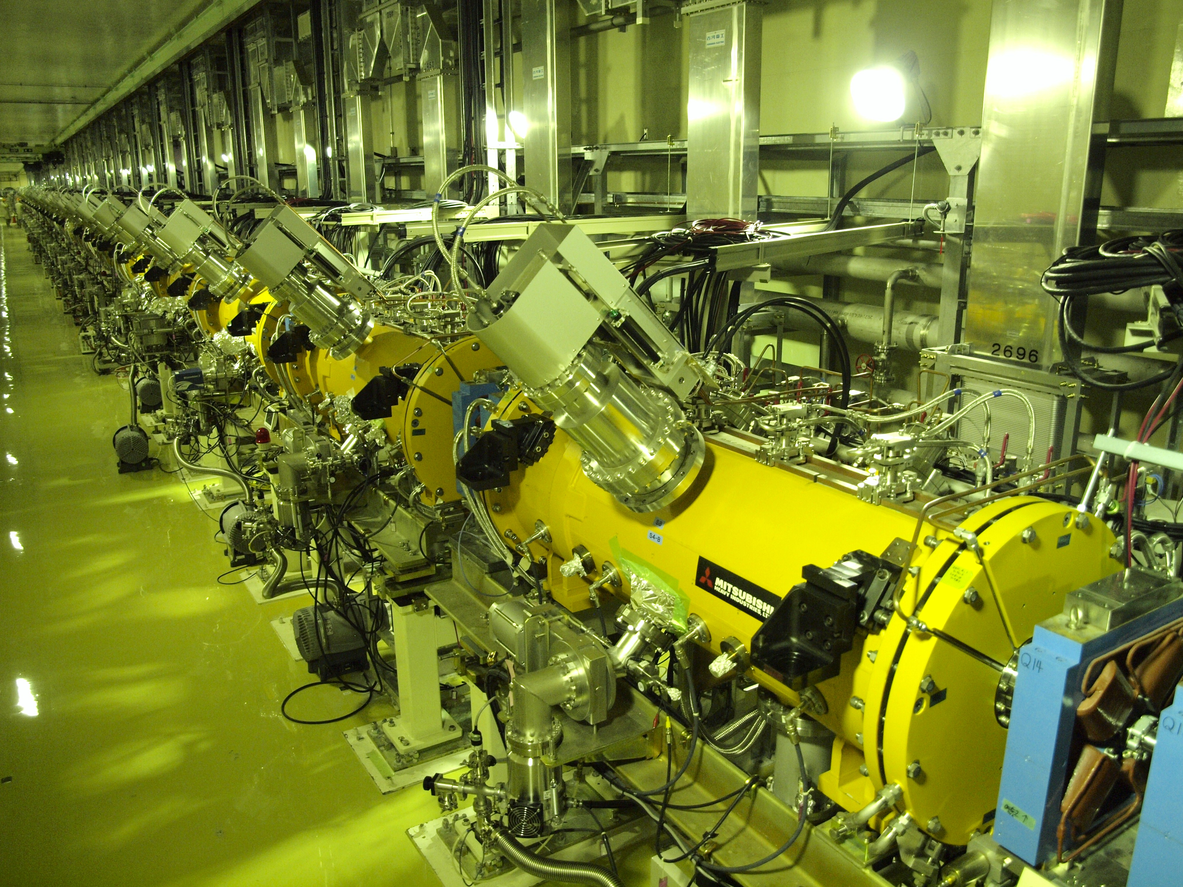
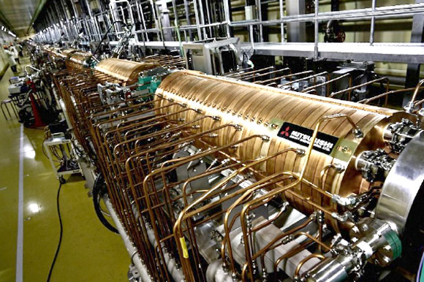
Overview of linac
LEBT
MEBT1
MEBT2
L3BT
0.05 MeV
(β=0.01)
3 MeV
(β=0.08)
50 MeV
(β=0.31)
191 MeV
(β=0.55)
400 MeV
(β=0.71)
RCS
3 meters
27 meters
91 meters
109 meters
IS
RFQ
DTL
SDTL
ACS
particle | H⁻
output energy | 400 MeV
repetition | 25 Hz
324 / 972 MHz
peak current | 50 mA
macropulse | 500 us

Slide 9
Towards Higher Currents
LEBT
MEBT1
MEBT2
L3BT
0.05 MeV
(β=0.01)
3 MeV
(β=0.08)
50 MeV
(β=0.31)
191 MeV
(β=0.55)
400 MeV
(β=0.71)
RCS
We performed beam tests at nominal current of 50 mA and 60 mA commissioning.
  Beam measurement and tuning at MEBT1
  determine beam quality for entire linac
  Understanding of the beam loss
  Loss mitigation by parameter tuning
  loss mainly due to H⁻ → H⁰
  and RF control
  Equipment design towards higher currents
  based on the measurements/simulations

Slide 10
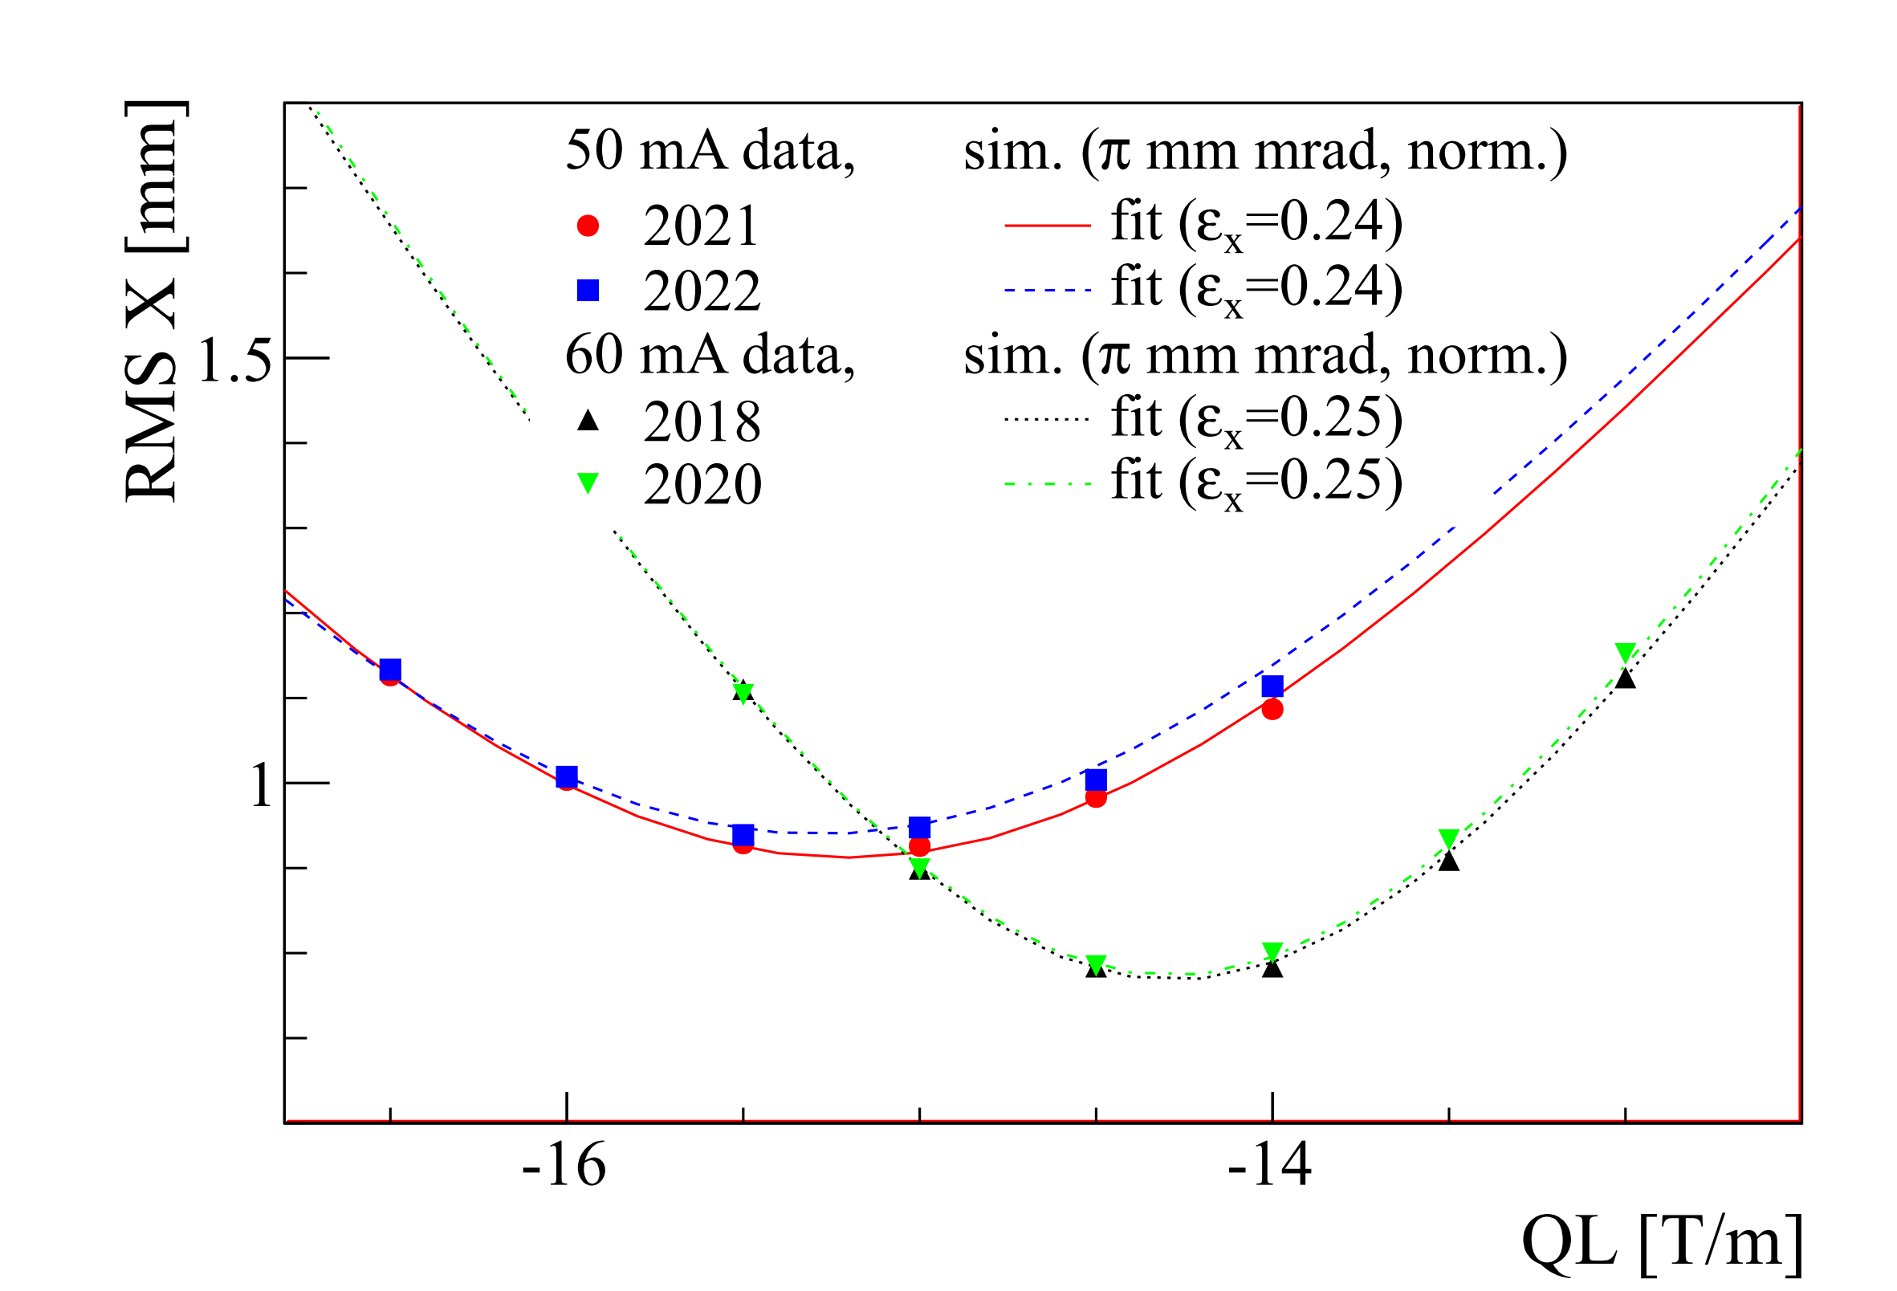
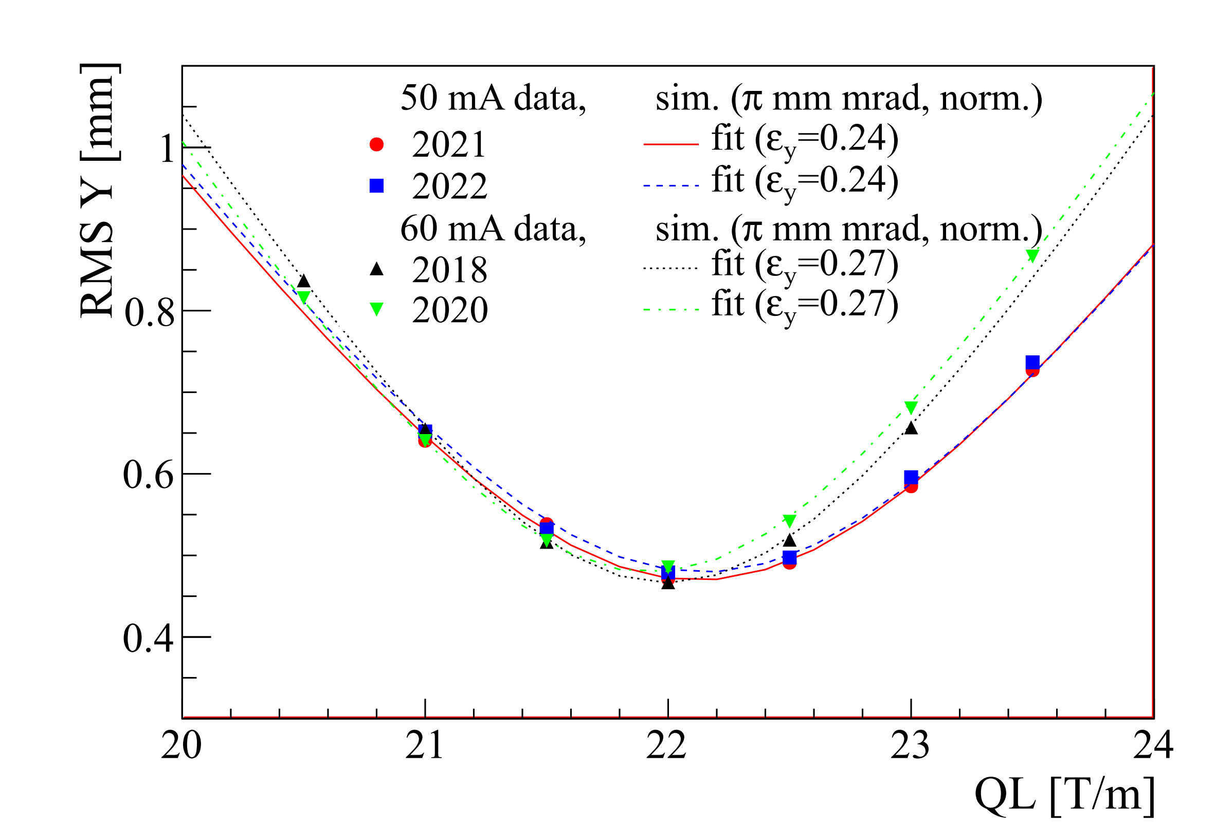
Transverse Measurement@MEBT1
3 m
Scraper
Bun-
cher
RFD
RFQ
DT
L
Q
Wire Scanner Monitor
WSM
Simulation reproduces measurement well and stable every period.

Slide 11
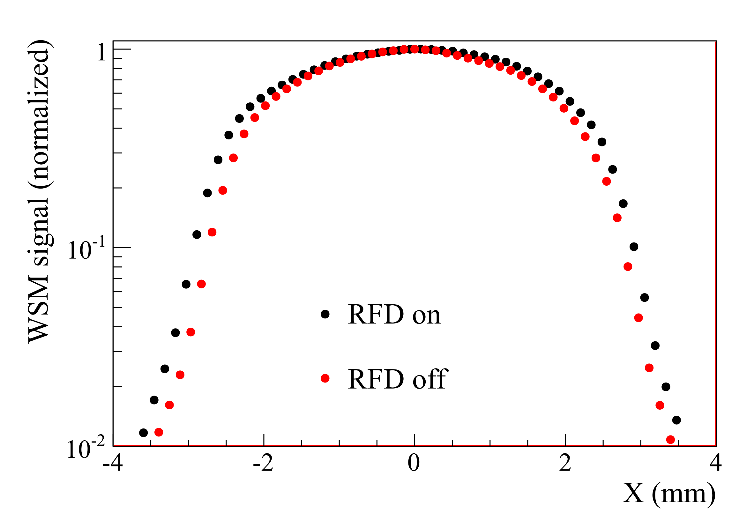
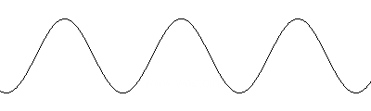
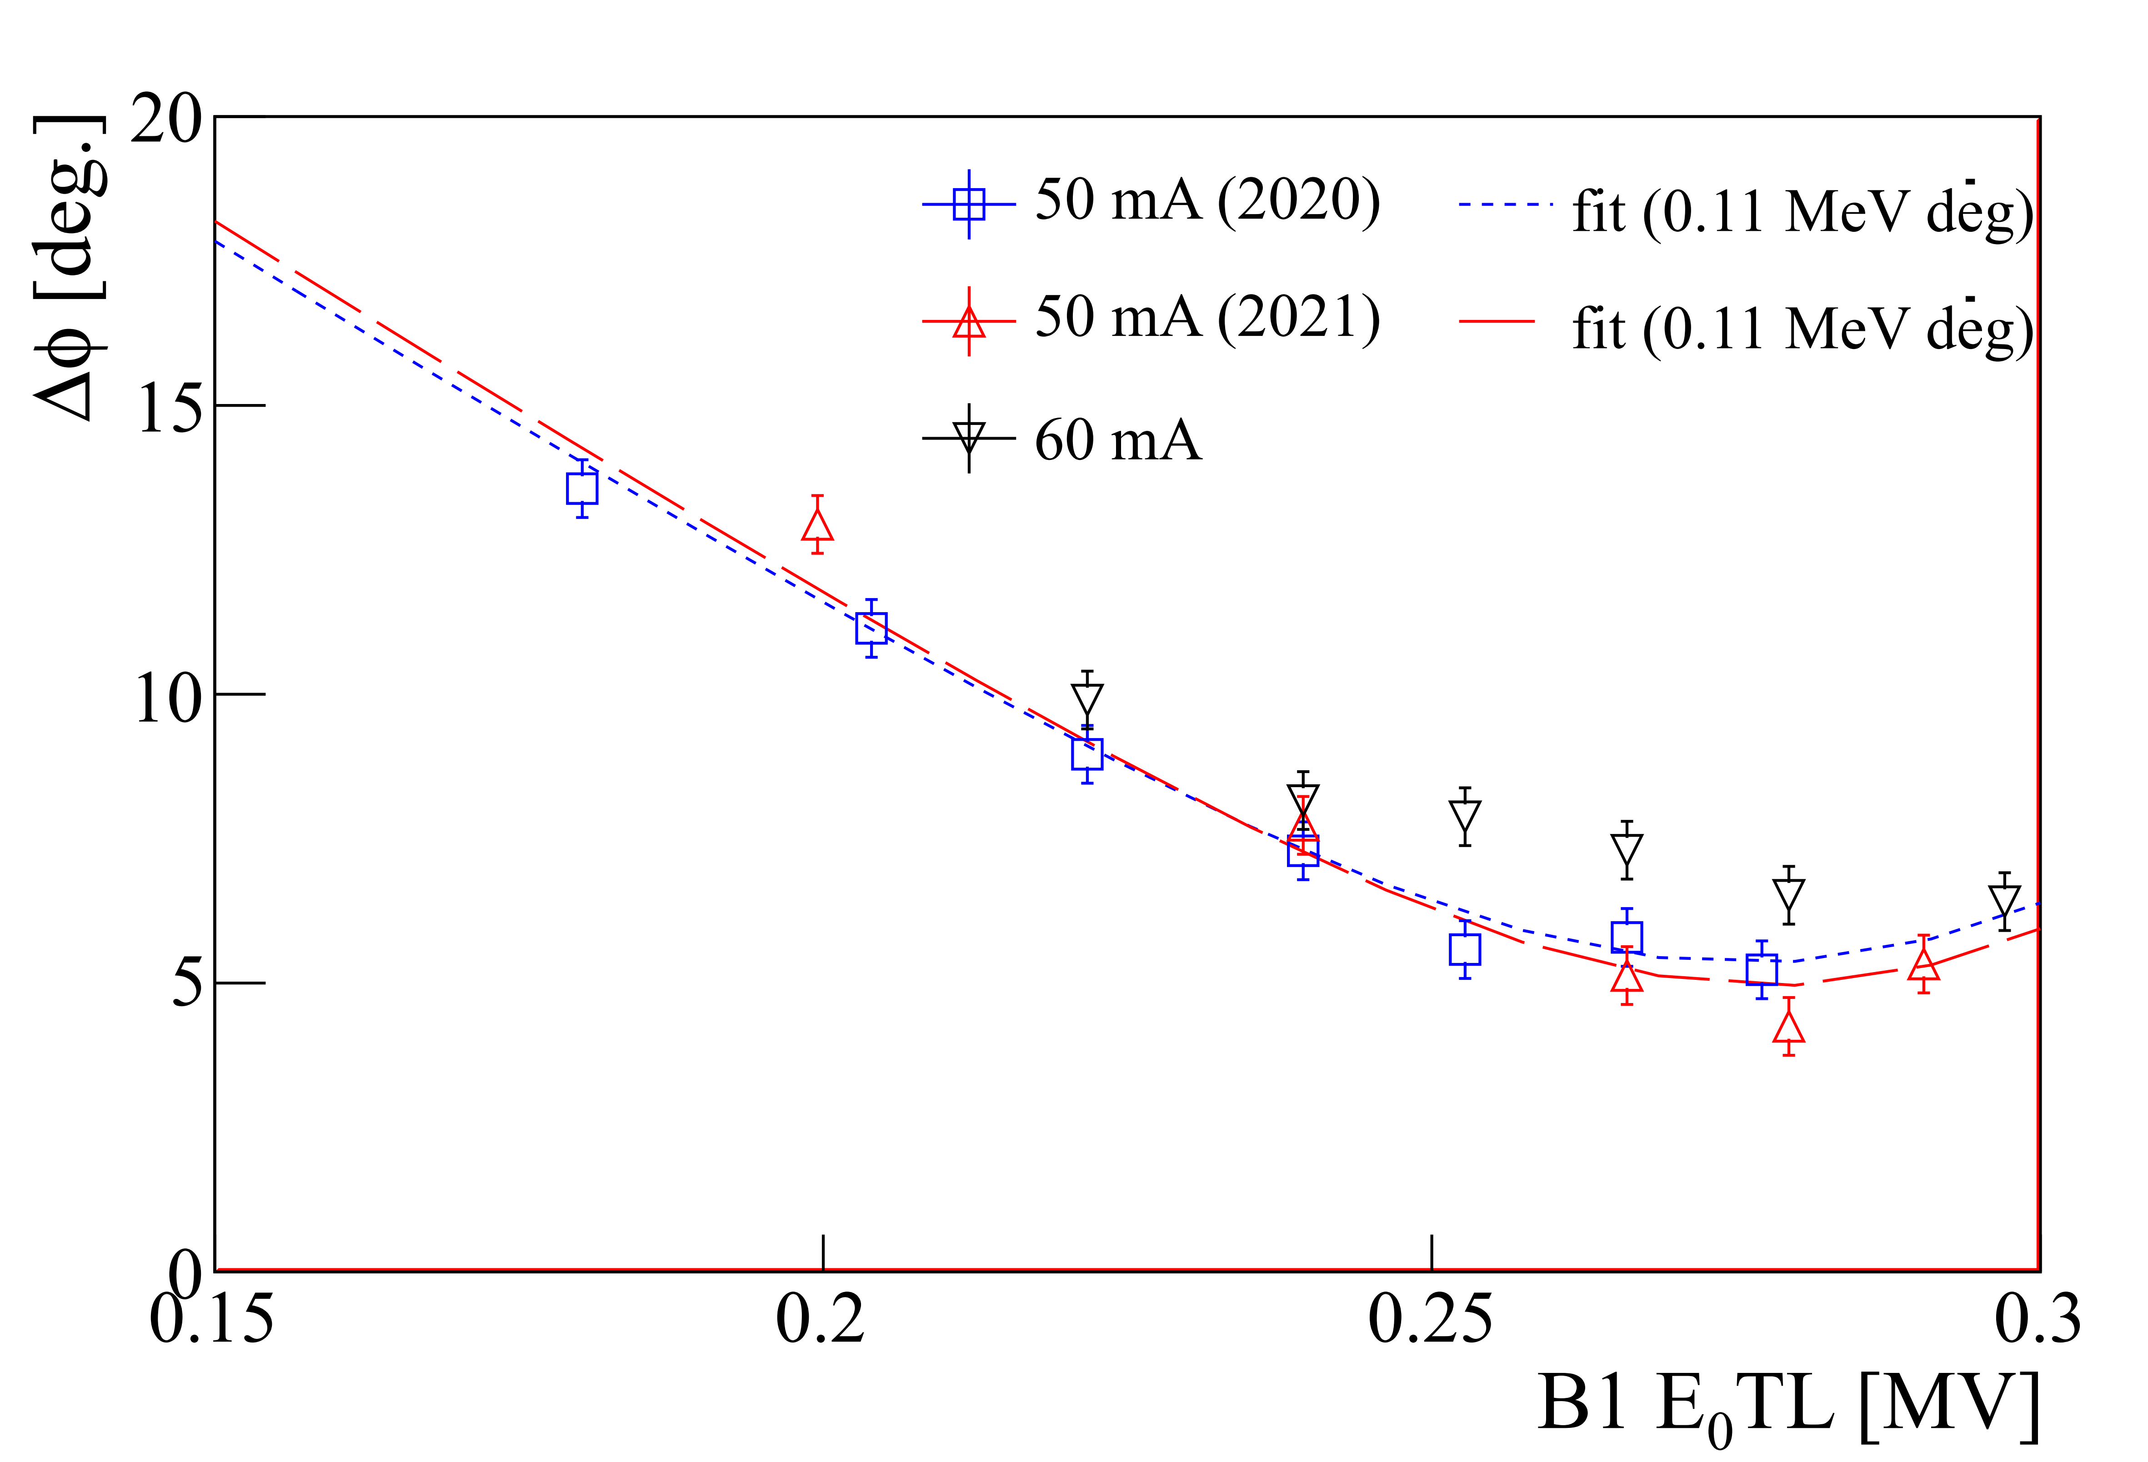




Longitudinal Measurement
New method using RFD, originally used to generate intermediate pulses [M. Otani et al, NIMA908(2018)313-317]
nominal mode
for measurement
example
$$E_{x}$$
$$x$$
$$z$$
RFD ON
$$y$$
OFF
Simulation reproduces
measurement well

Slide 12
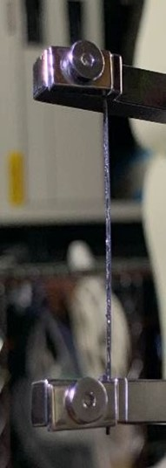
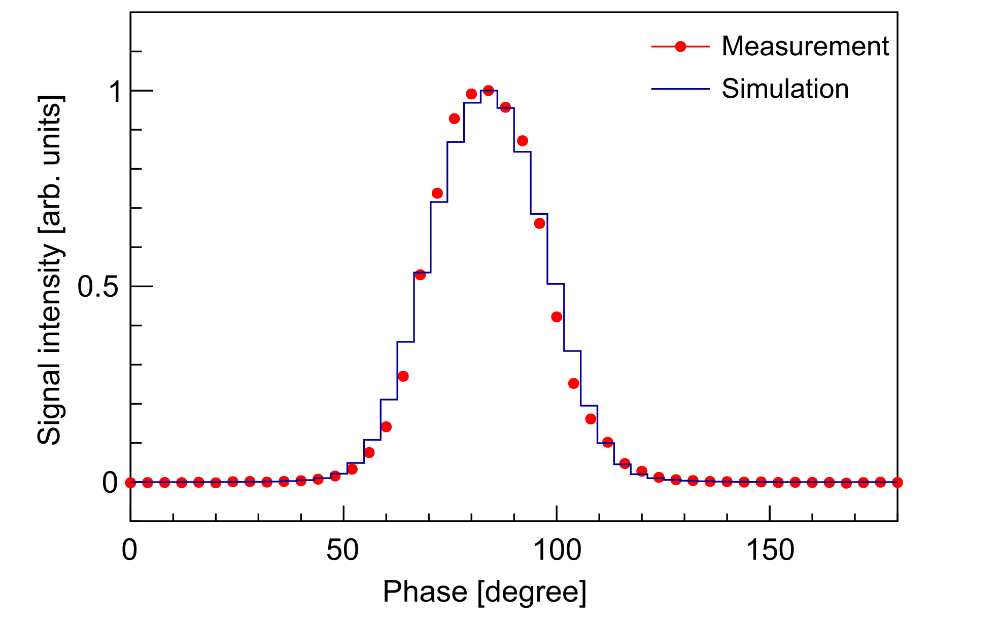
Bunch Shape Monitor
BSM with HOPG target, which reduces heat load due to the beam and thus mitigates problems caused by damage, has been developed to enable shape measurement impossible with the RFD method
[R. Kitamura et al., PRAB 26 (2023) 032802]
HOPG

Slide 13
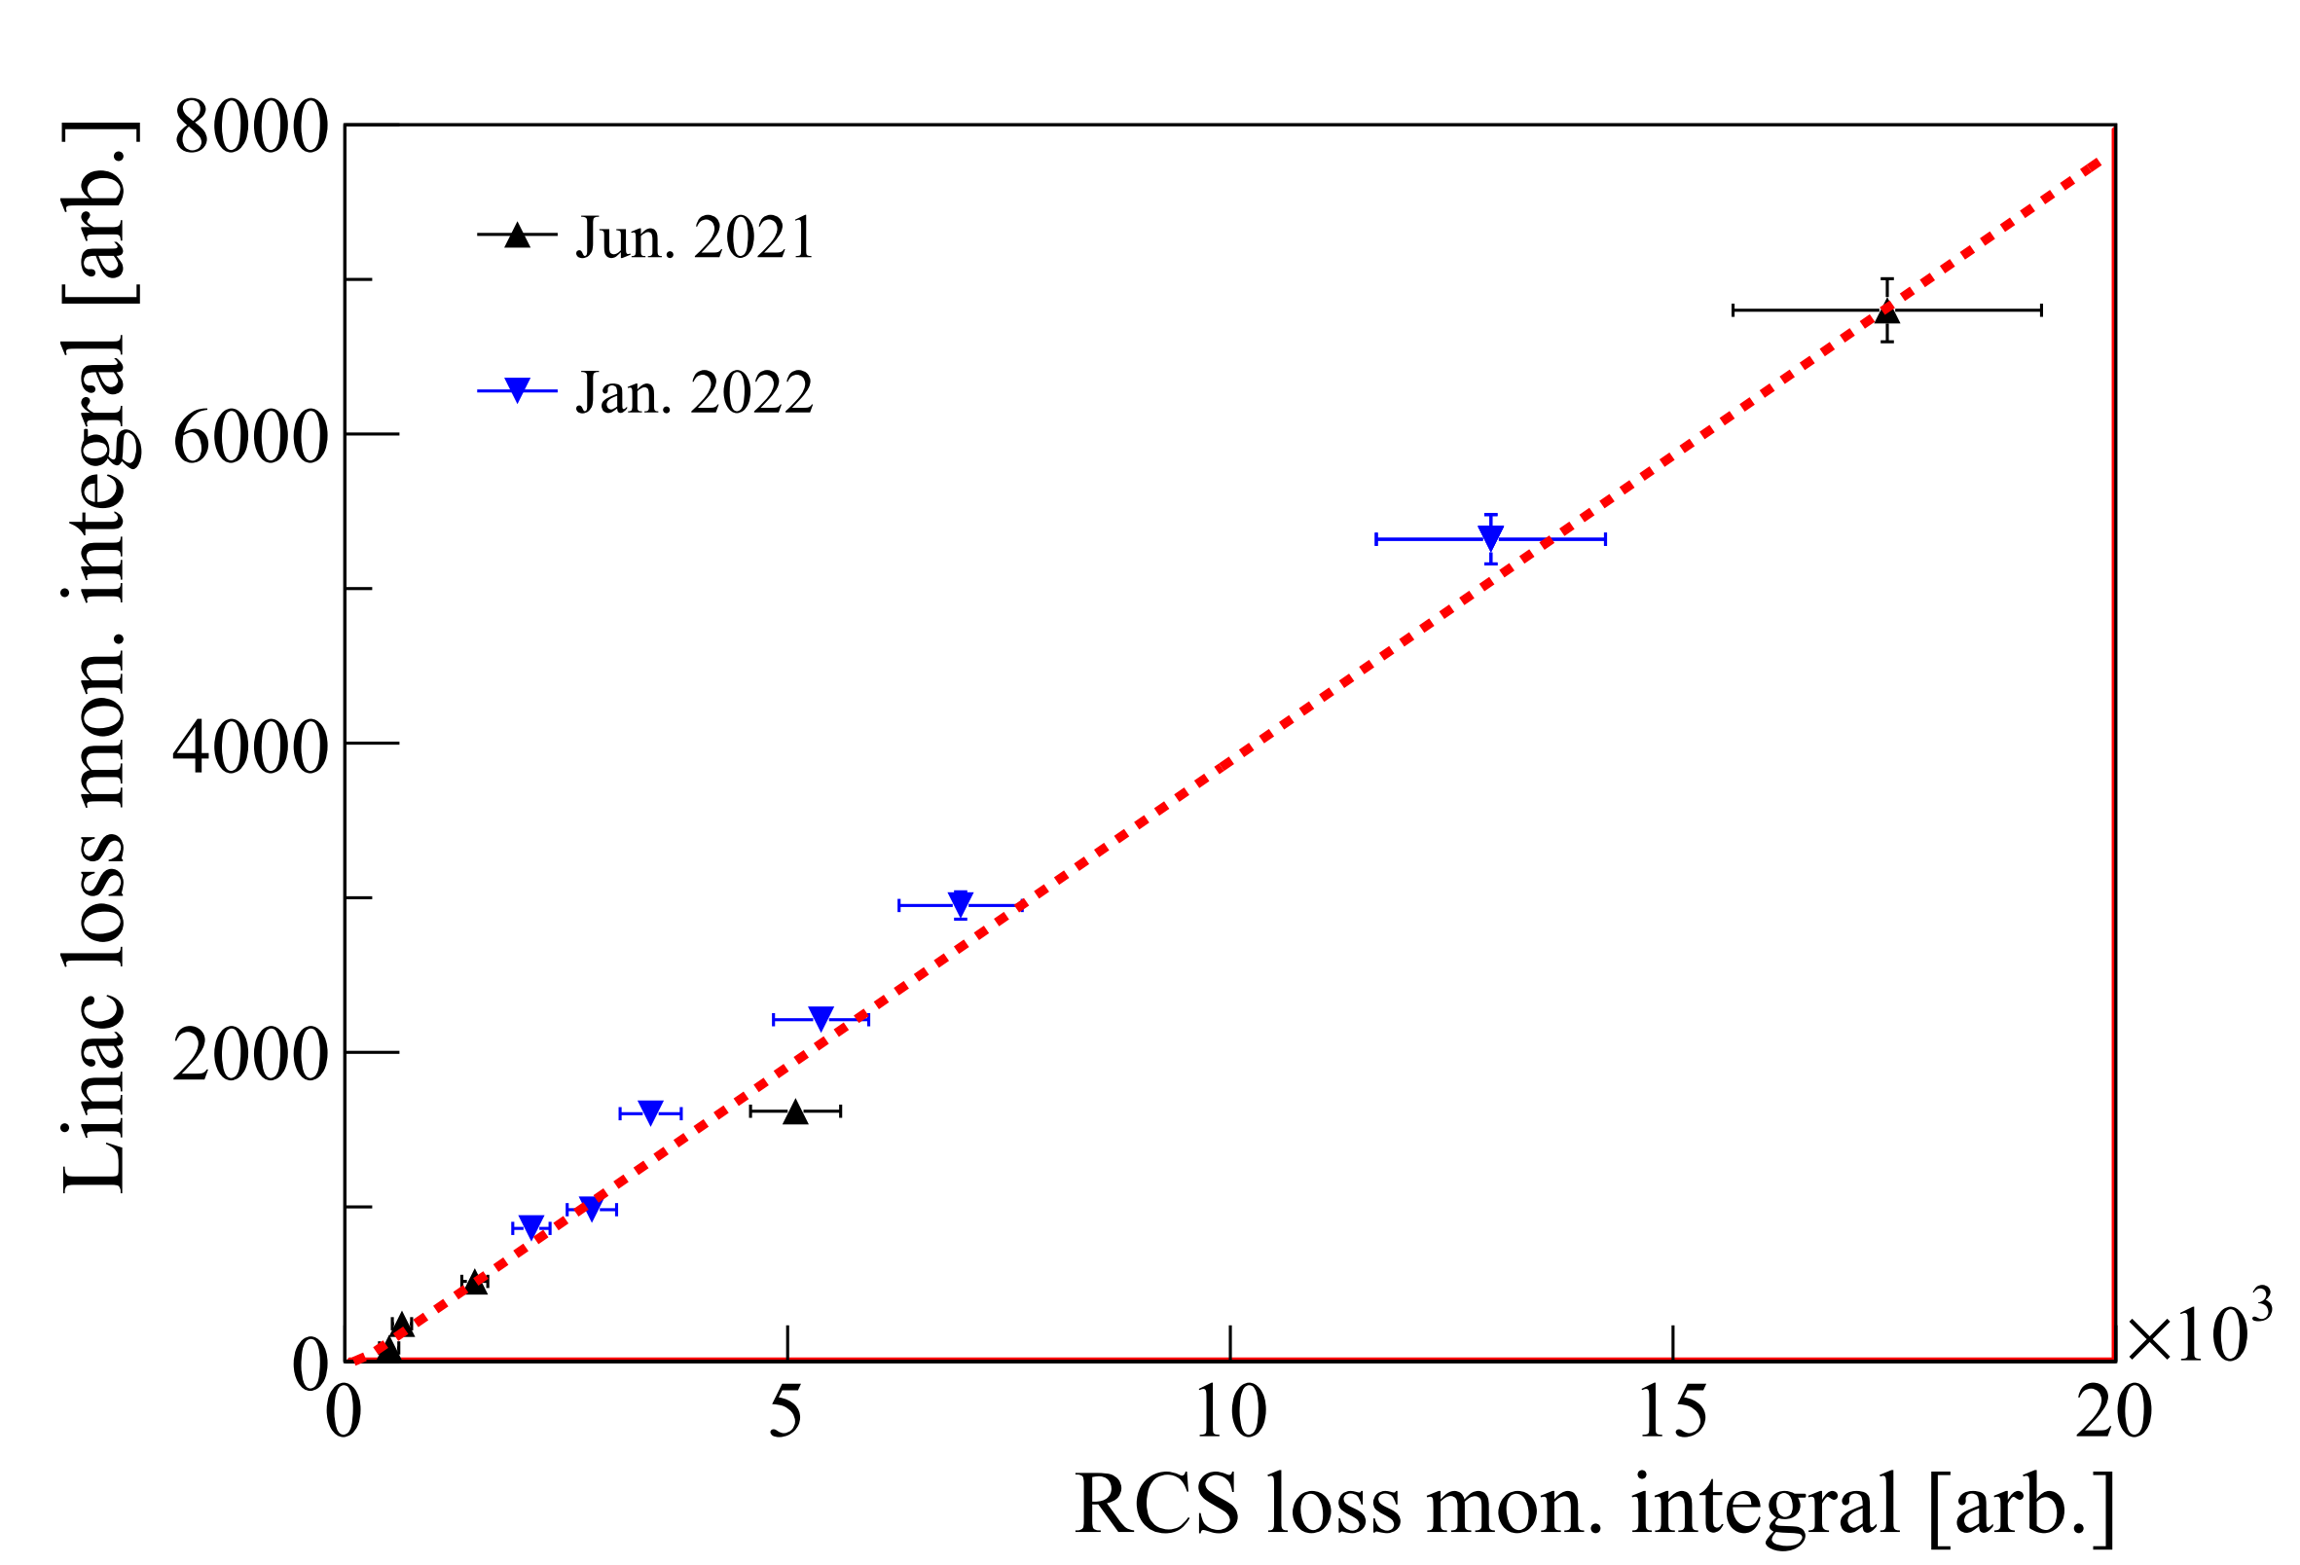
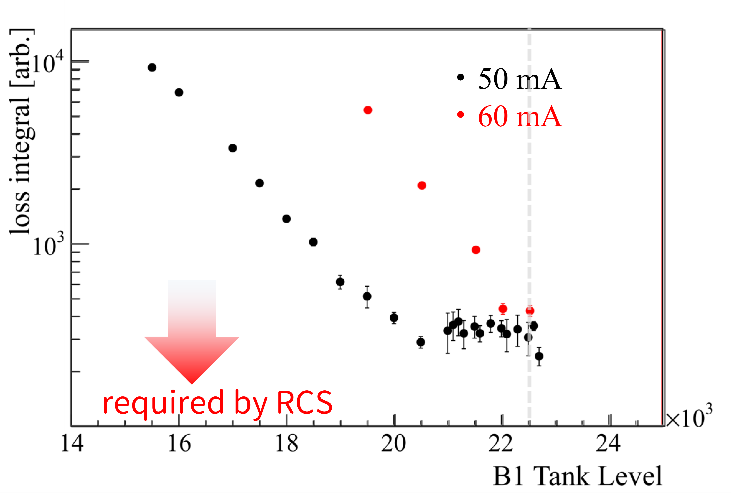
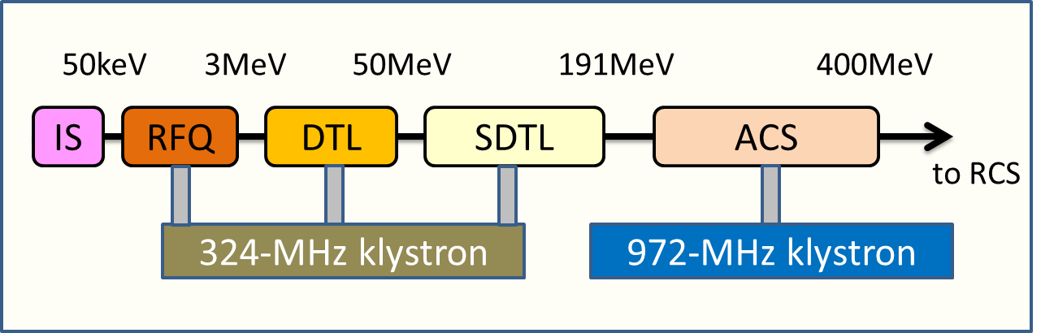
Extinction
Remnant transported downstream without sufficient kick by RFD (extinction), not entering the RF bucket in RCS, is one of the main loss at RCS.
Measurement of RCS loss using linac equip. only
Tuning of the RCS loss by buncher @ MEBT1
MEBT2
required by RCS
Establish the measurement and tuning method

Slide 14
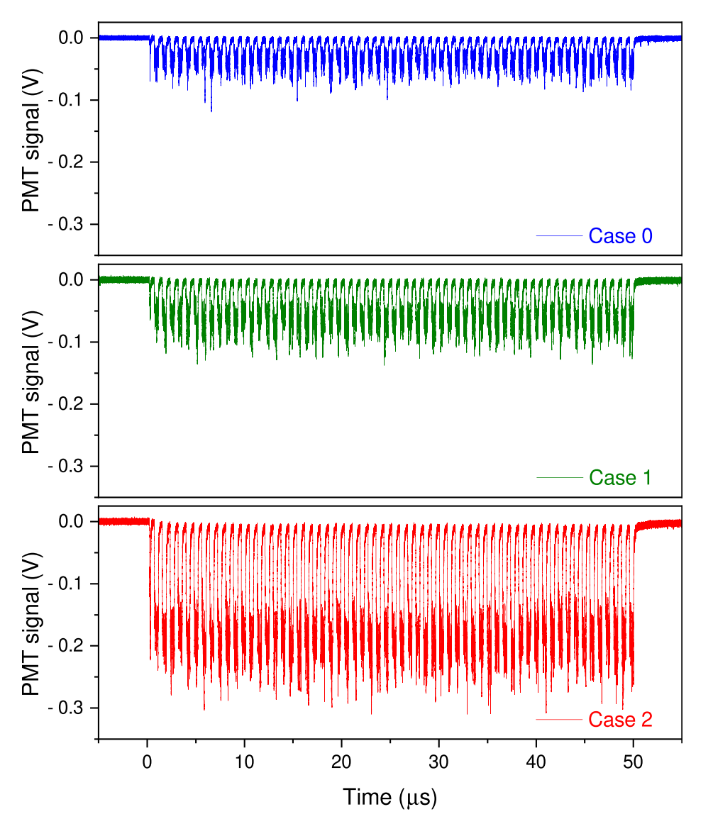
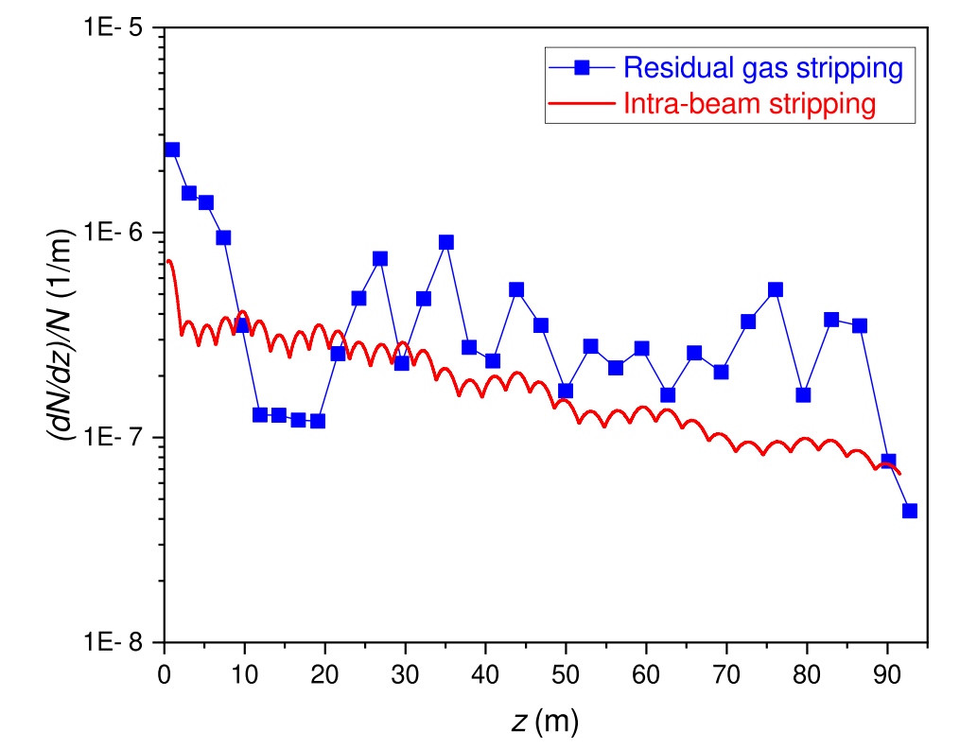

H⁰ Measurement @ SDTL
H⁰ is main loss source in linac, especially in SDTL, and should be understood.
Measurement by changing pressure of SDTL shows residual gas $≅$ Intra-Beam Stripping $≫$magnetic field stripping
[J. Tamura et al., NIMA 1049 (2023) 168033]
Residual gas
IBSt
Nominal pressure
Signal due to H0
Estimated fraction of H0
High pressure
Higher pressure
SDTL section
time [μs]

Slide 15
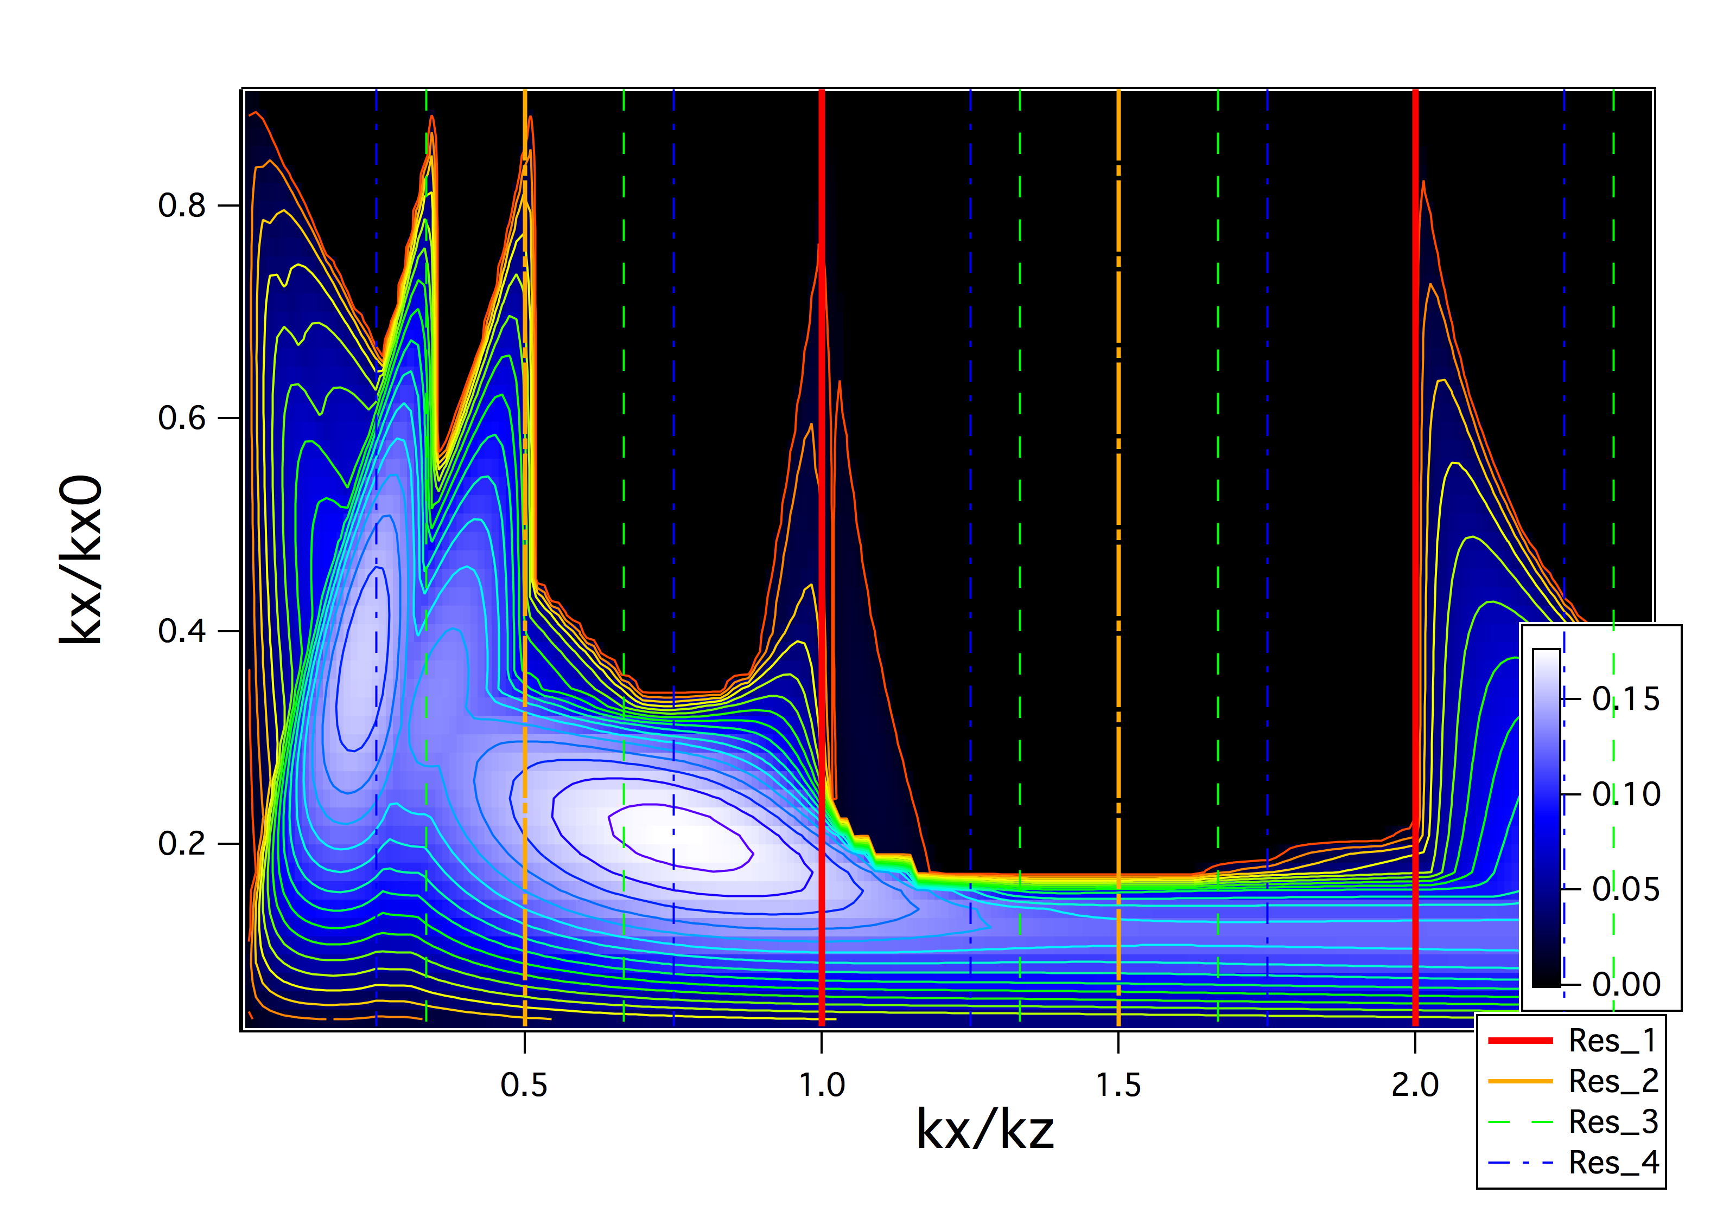
ACS tuning for Loss Mitigation
Loss is mainly due to H⁰ by Intra-Beam Stripping
Weak transverse focusing for wide envelope to mitigate IBSt
nominal design
Weak longitudinal focusing to avoid unstable, compatible with loss mitigation
Beam studies are necessary with
Weak transverse focusing (T=1→T<1) and
Weak longitudinal focusing (Tank level < 100%)

Slide 16
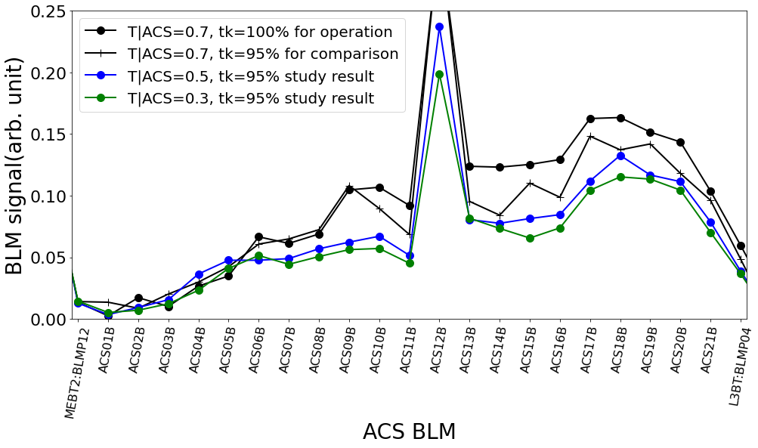
Result
demonstrated loss mitigation with weak focusing setting
stable user operation with T=0.7 since 2019
further study for T=0.5/0.3 is under way

Slide 17
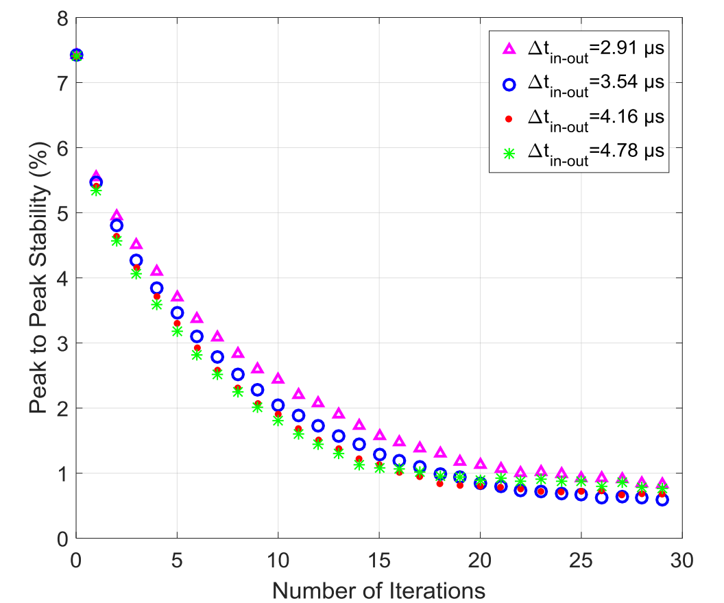
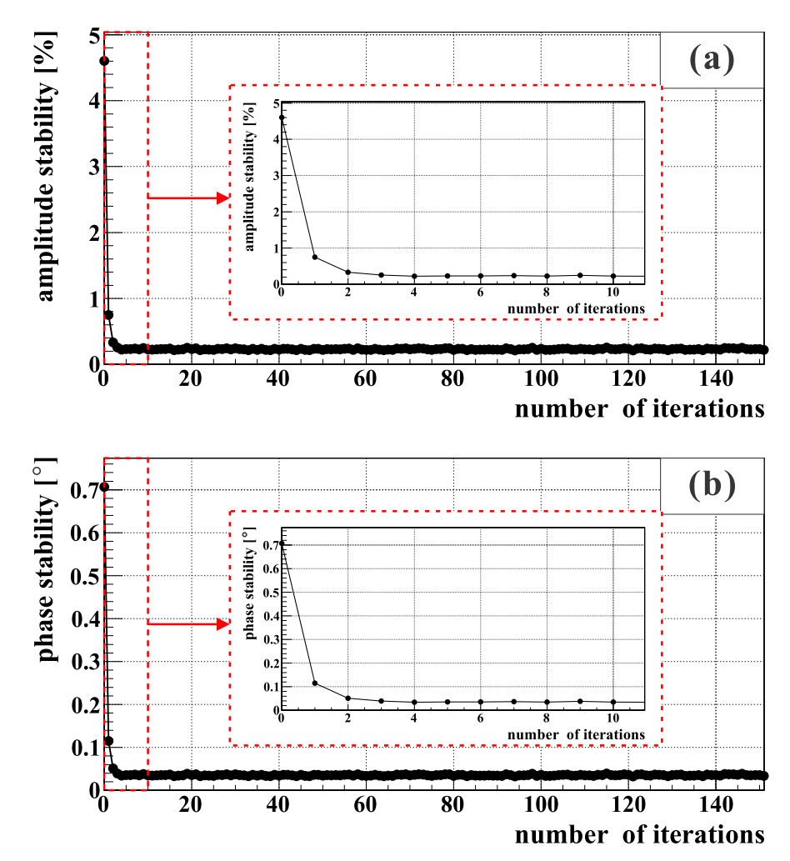
RF Control for Intermediate Pulse
Several improvements are possible with the new RF system, one of which is the adaptive Feed-Forward control.
Calibrating the system in the freq. domain in advance and isolating fluctuations caused by klystrons etc. improves the performances
NIM A945 (2019) 162612
JINST 17 (2022) T11002
pp of stability [%]
pp of stability [%]
2nd time
26th time
0.2 %
0.4 %
# of iterations
# of iterations
demonstrated more rapid and stable operation

Slide 18
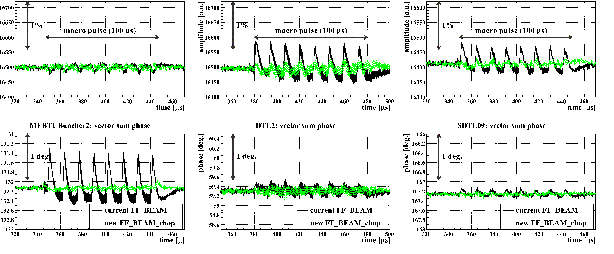
RF Control for Intermediate Pulse
New RF system can also support FF control including intermediate pulse
RF stability with thinning pattern of intermediate pulse
tank voltage
[arb. unit]
1%
MEBT1 Buncher
DTL
SDTL
1deg.
tank phase
[degree]
demonstrated better stability

Slide 19
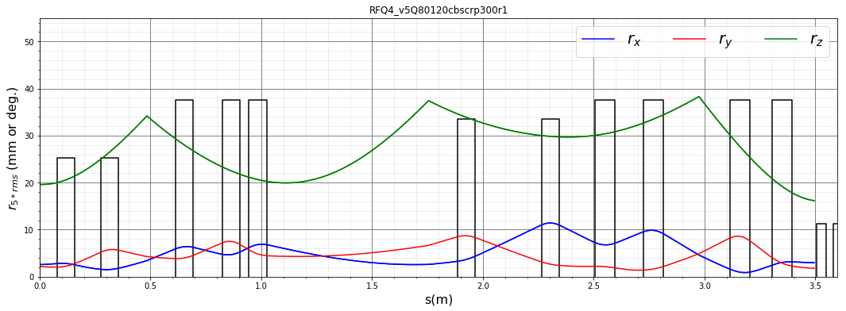
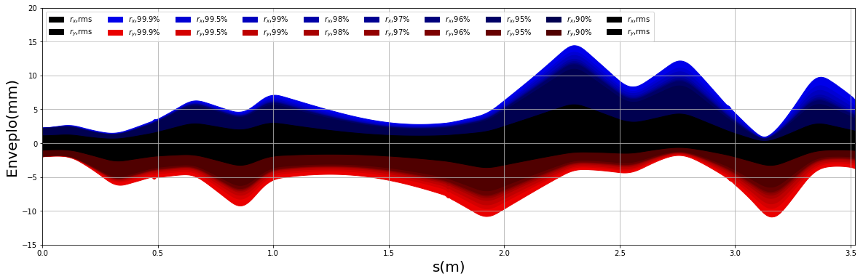
Design of new MEBT1
New design towards >60 mA has been investigated.
  more element with compact design for feasible beam control, smooth connection of focusing strength
5 x RSM (mm or deg.)
30
0
10
envelope
0
10
0
1
z (m)
2
3

Slide 20
Summary
J-PARC has successfully demonstrated operation of 1 MW in RCS and 0.75 MW in MR.
Continuous evolution requires higher peak currents in the linac, and several beam studies have been conducted.
  Established beam measurements at MEBT1 allowing trials of higher beam currents and design of new equipment.
  Origin of the main loss, H⁰, was investigated and beam tuning to mitigate it was demonstrated.

