Slide 1

Study on Electron Injection in Laser Wakefield Acceleration with Plasma Structures of Metal-Layered Target
Hyeon Woo Lee, Sang Yun Shin, Seong Hee Park*
Dept of Acceleration Science, Korea University, Sejong.

Slide 2
Contents
Introduction : LWFA & LWFA-Al3p
Aluminum Target with Thin Titanium Layer (LWFA-ATA)
Two-layered Target with Titanium and Aluminum (LWFA-TA)
Summary

Slide 3
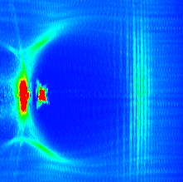
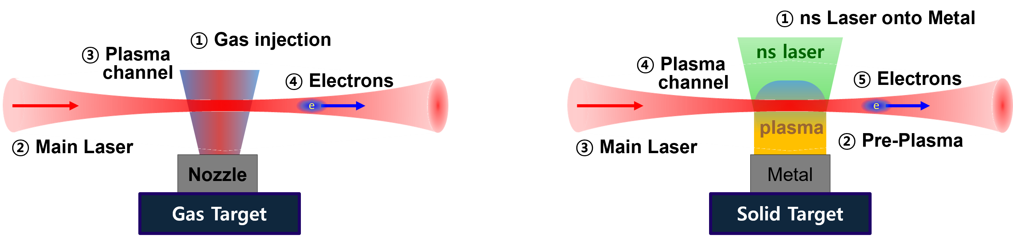
Introduction : Laser wakefield accelerator
Laser Wakefield Acceleration
  Higher accelerating gradient than RF accelerators → Compact accelerator
  Interaction between a laser and under-dense plasma → Generation of acceleration cavity by ponderomotive force
  → Electron injection and acceleration (self-injection via transverse wave-breaking, ionization injection etc.)
  ❗ ❗ Key factor : The method of electron injection and plasma generation ❗ ❗
Acceleration cavity
Injected electrons
Main Laser
Gas Target
  Easy target generation
  High and sharp acceleration gradient
Metal Target
  High repetition rate achievable through maintaining high vacuum [1]
  Tunable a plasma profile
[1] Self-guided laser wakefield acceleration using ablated plasma targets, T Matsuoka, Plasma Phys. Control. Fusion 51 (2009) 095003 (8pp)

Slide 4
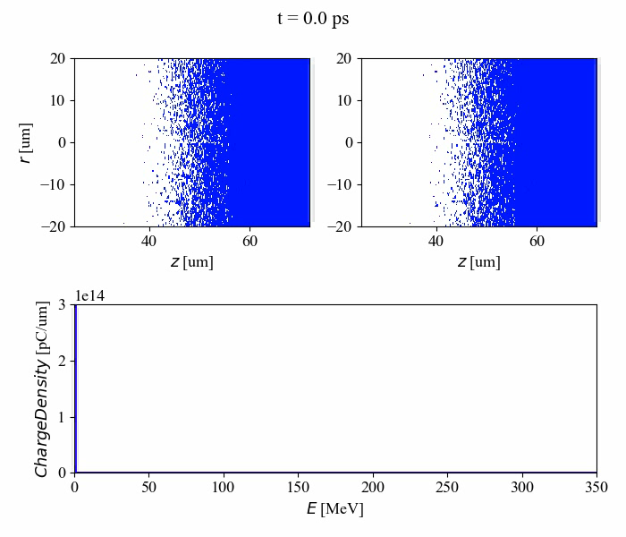
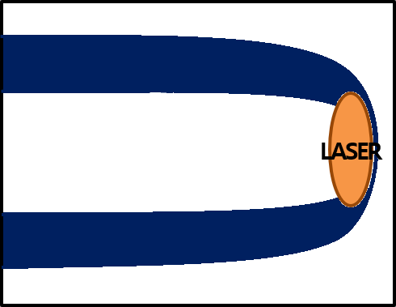
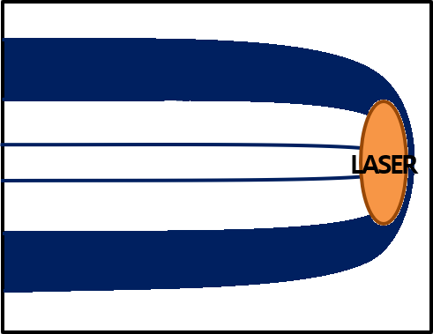
Metal Target-based LWFA : Ionization Effects
Al³⁺
Ti⁴⁺
Al⁴⁺~Al¹⁰⁺
Ti⁵⁺ ~ Ti¹¹⁺
Al¹¹⁺
Ti¹²⁺
Ti¹³⁺ ~ Ti¹⁹⁺
laser peak
Intensity [Wcm^-2]
pre-pulse
Z

Slide 5
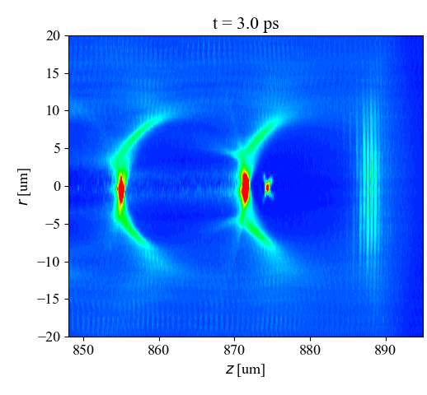
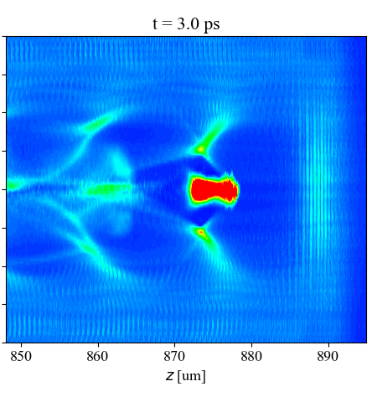
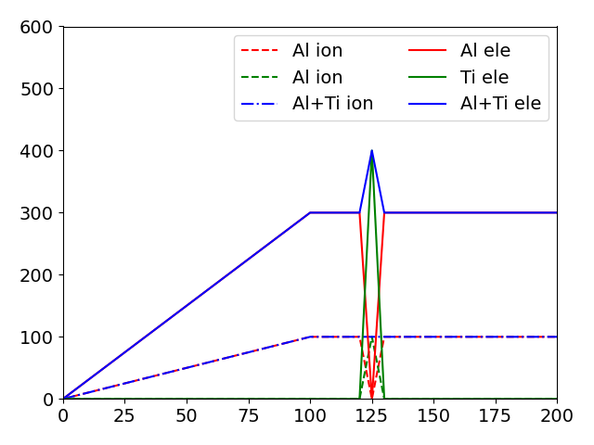
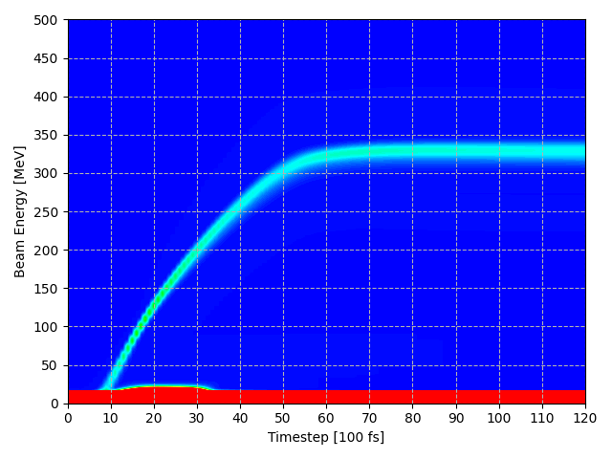
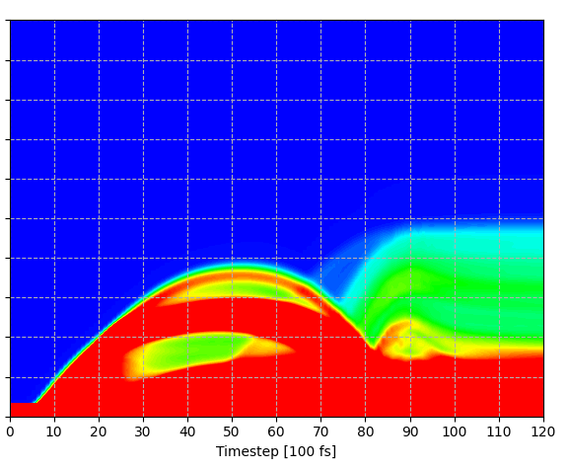
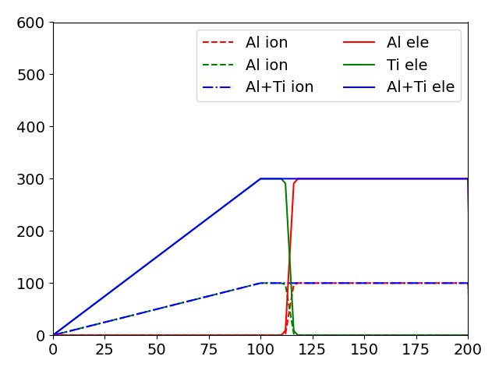
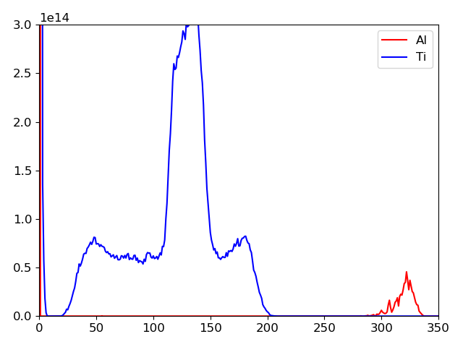






Metal Target-based LWFA : ATA vs. TA
Pre-pulse
ramp
$$n_{e}$$
Main Laser
$$n_{i}$$
Thin Ti layer
Al
Ti
Al
metalic disk target
Pre-pulse
ramp
$Ti$
$ρ=2642 pc/μm$
$∆E=22.4\%$
$$n_{e}$$
Main Laser
$$n_{i}$$
$Al$
$ρ=98 pc/μm$
$∆E=5.2\%$
Ti layer
Ti
Al
metalic disk target
Experiment setup
Density profile for simulation

Slide 6
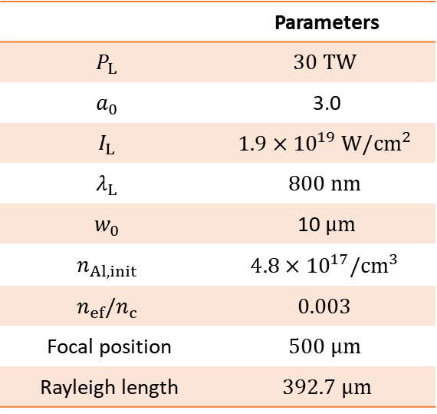
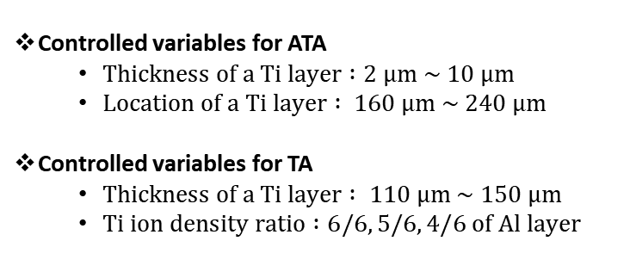
Simulation set-up
Initial input parameters
 | Parameters
$$P_{L}$$ | $$30 TW$$
$$a_{0}$$ | 3.0
$$I_{L}$$ | $$1.9×{10}^{19} W/cm^{2}$$
$$λ_{L}$$ | $$800 nm$$
$$w_{0}$$ | 10 $μm$
$$n_{Al,init}$$ | $$4.8×{10}^{17}/cm^{3}$$
$$n_{ef}/n_{c}$$ | $$0.003$$
Focal position | $$500 μm$$
Rayleigh length | $392.7 μm$
Pre-pulse
ramp
$$n_{e}$$
Main Laser
$$n_{i}$$
Thin Ti layer
Al
Ti
Al
metalic disk target
Pre-pulse
ramp
Controlled variables for ATA
  $Thickness of a Ti layer :2 μm \sim 10 μm$
  $Location of a Ti layer : 160 μm \sim 240 μm$
Controlled variables for TA
  $Thickness of a Ti layer : 110 μm \sim 150 μm$
  $Ti ion density ratio :6/6, 5/6, 4/6 of Al layer$
$$n_{e}$$
Main Laser
$$n_{i}$$
Ti layer
Ti
Al
metalic disk target
Experiment setup
Density profile for simulation

Slide 7
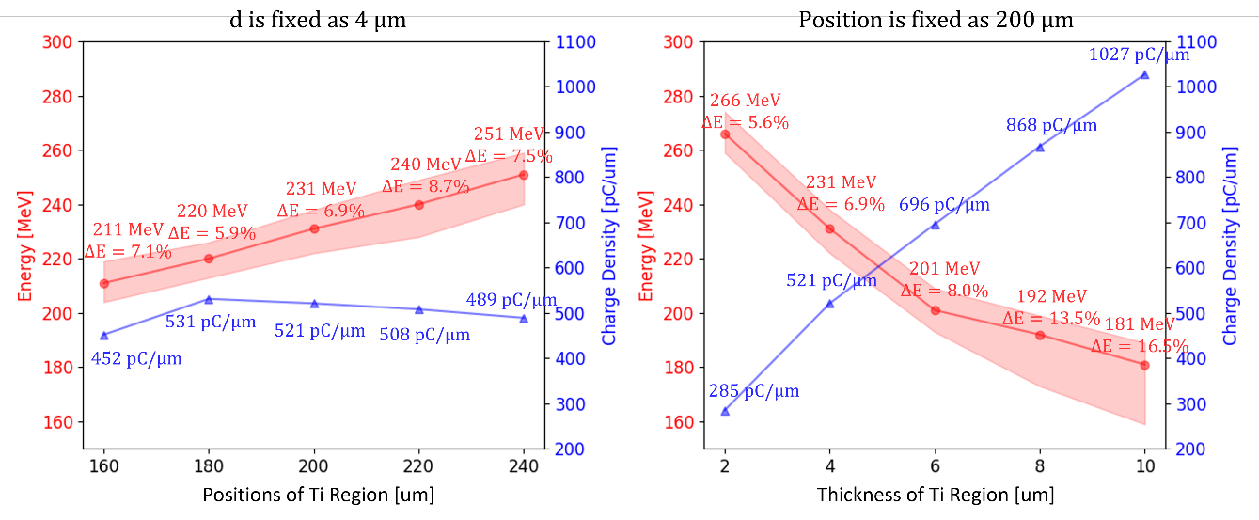
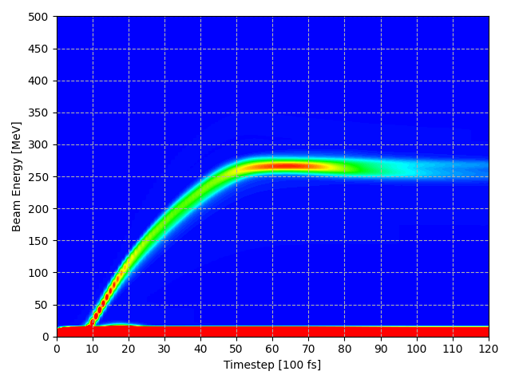
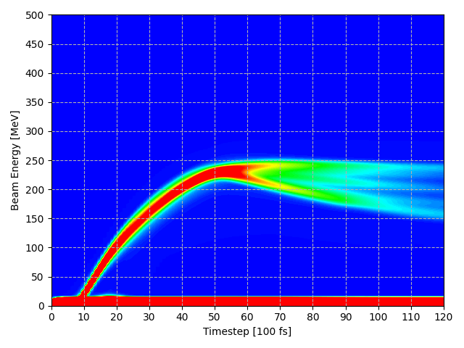
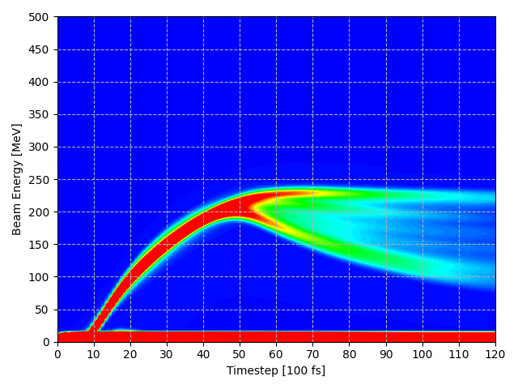
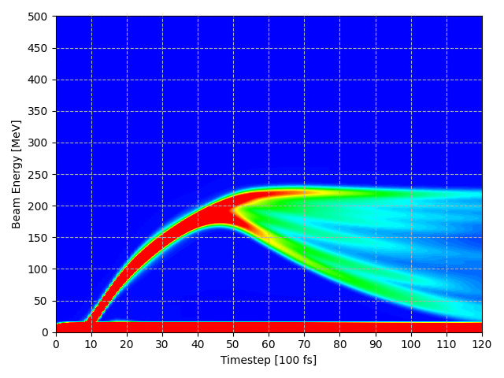
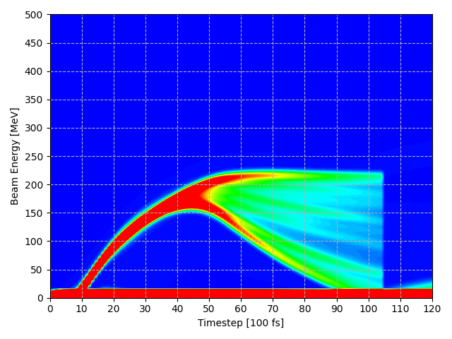
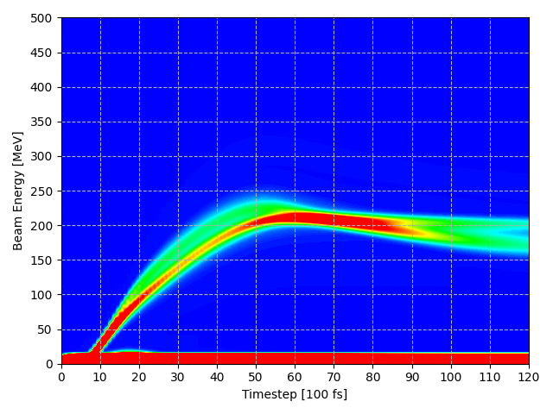
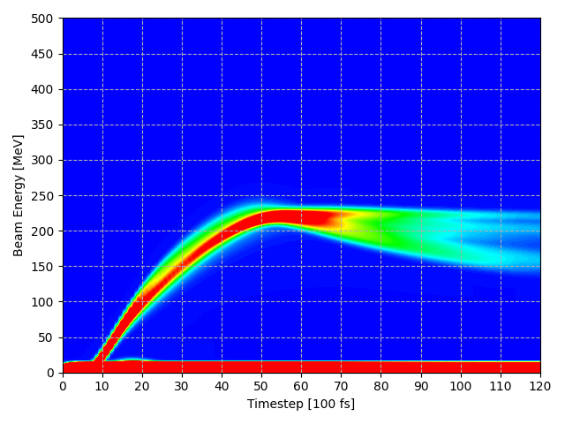
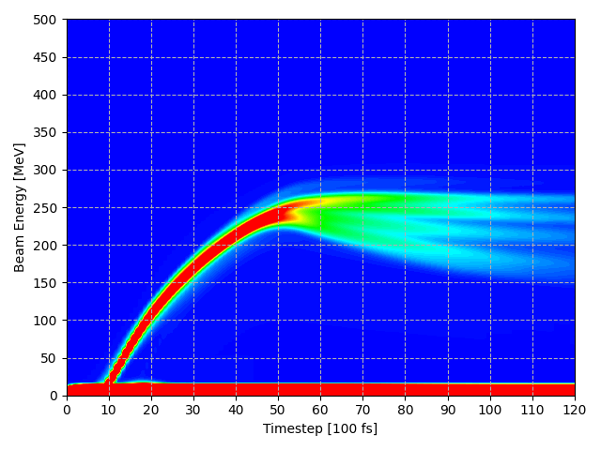
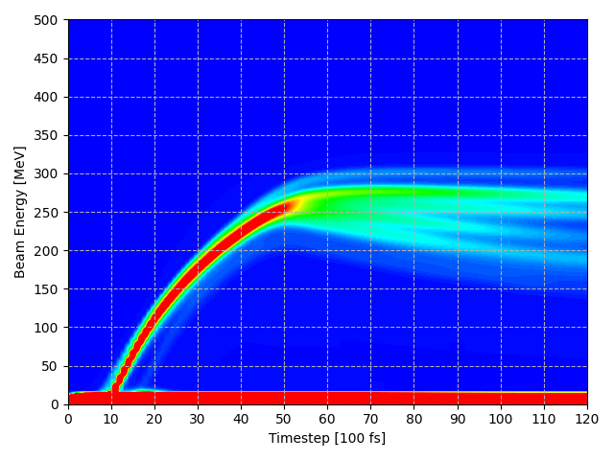




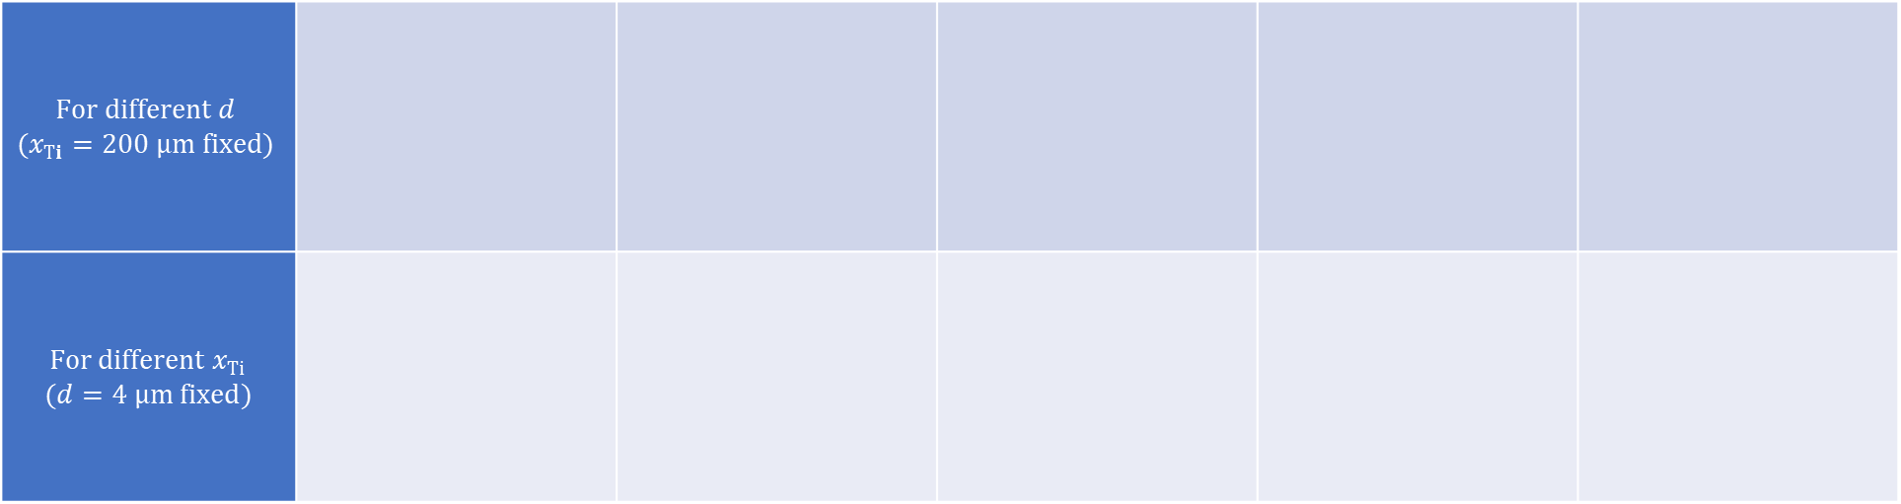








Simulation Results of ATA : Ti thickness & Location
Plasma Density Profile
Pre-pulse
$$n_{e}$$
Main Laser
$P_{L}=30TW$
$w_{0}=10 μm$
$a_{0}=3.0$
$$n_{i}$$
Thin Ti layer
0
50
100
150
200
metalic disk target
Ti
Al
Experiment setup
Density profile for simulation
$$For different d$$ $$(x_{Ti}=200 μm fixed)$$
$For different x_{Ti}$ $(d=4 μm fixed)$
$d_{Ti}=2 μm$
$d_{Ti}=4 μm$
$d_{Ti}=6 μm$
$d_{Ti}=8 μm$
$d_{Ti}=10 μm$
$x_{Ti}=160 μm$
$x_{Ti}=180 μm$
$x_{Ti}=200 μm$
$x_{Ti}=220 μm$
$x_{Ti}=240 μm$
8.8 ps
7.0 ps
6.1 ps
5.3 ps
5.0 ps

Slide 8
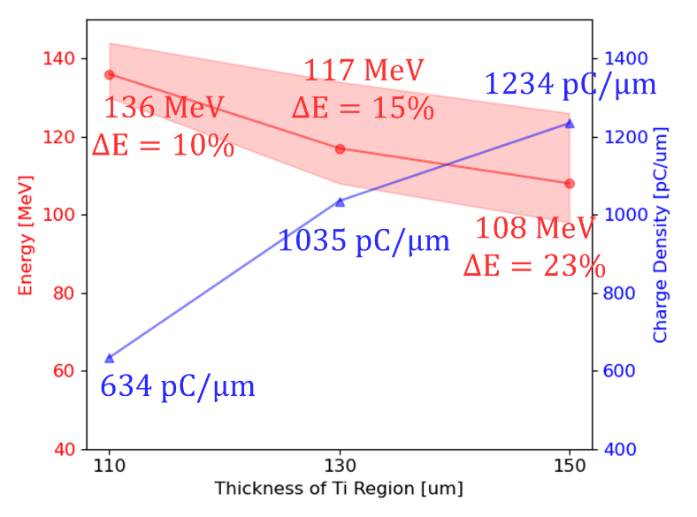
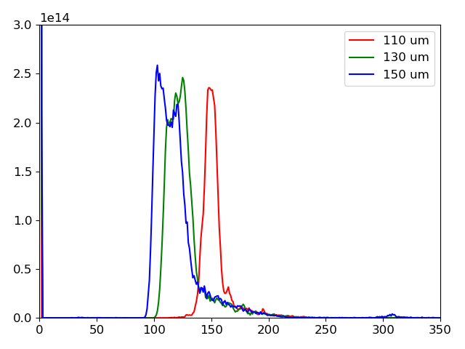
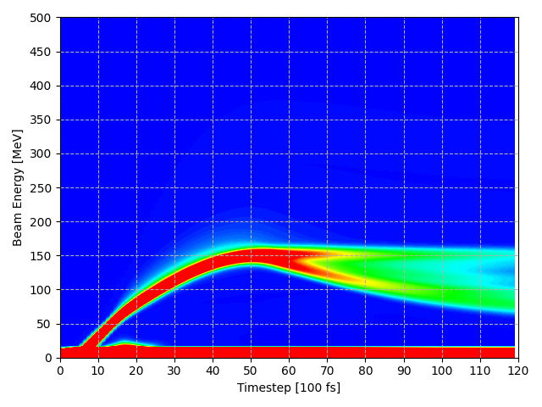
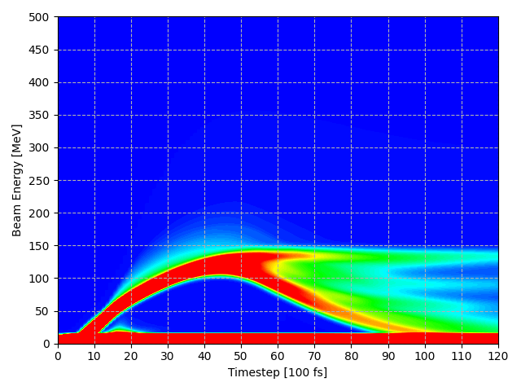
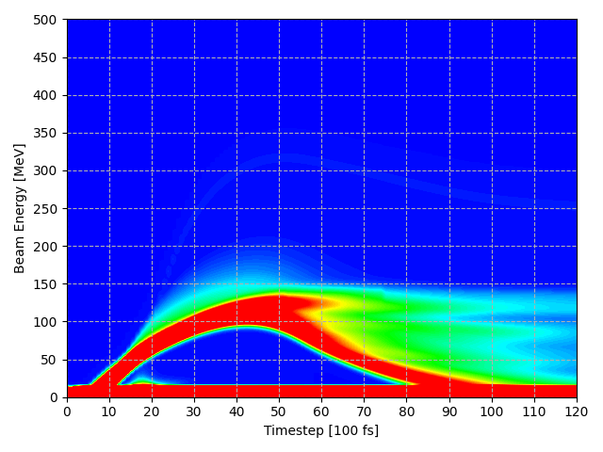





Optimization of Ti layer : Thickness
Status of Electron Beams
Energy Distribution
Plasma Density Profile
Pre-pulse
Main Laser
$$n_{e}$$
Charge Density [pC/um]
$P_{L}=30TW$
$w_{0}=10 μm$
$a_{0}=3.0$
$$n_{i}$$
Ti layer
0
50
100
150
200
metalic disk target
Ti
Al
Experiment setup
Density profile for simulation
Energy [MeV]
$TA 110 μm$
$TA 130 μm$
$TA 150 μm$

Slide 9
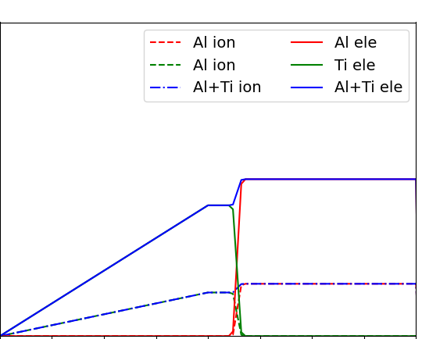
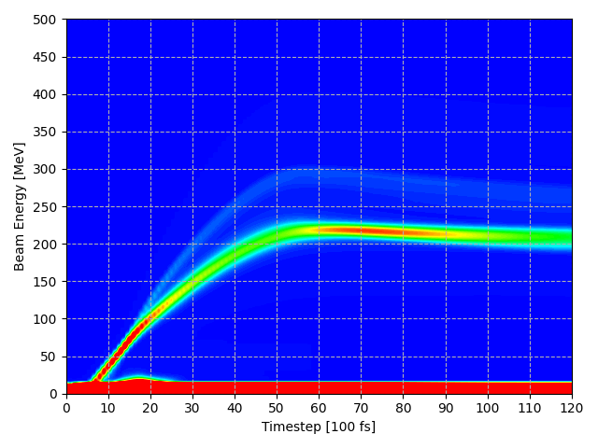
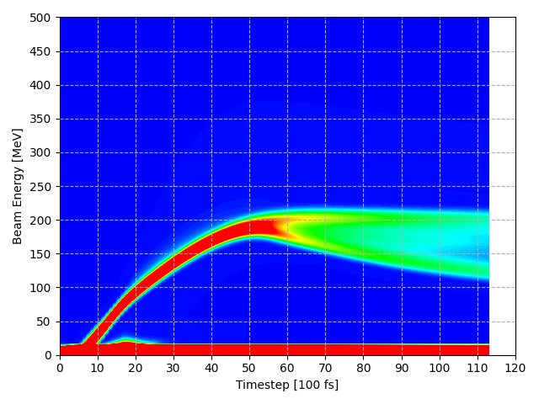
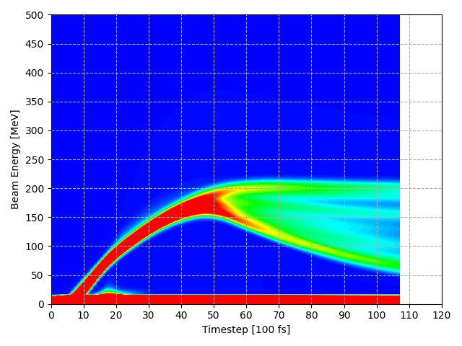
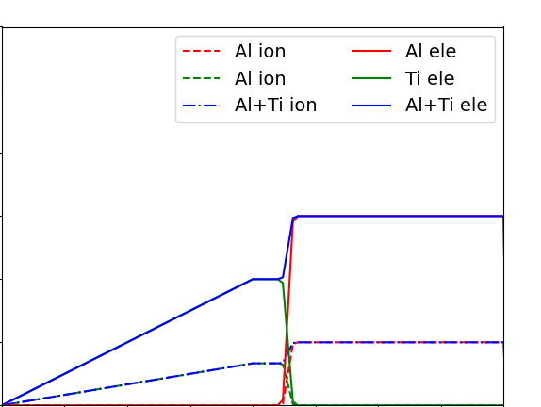
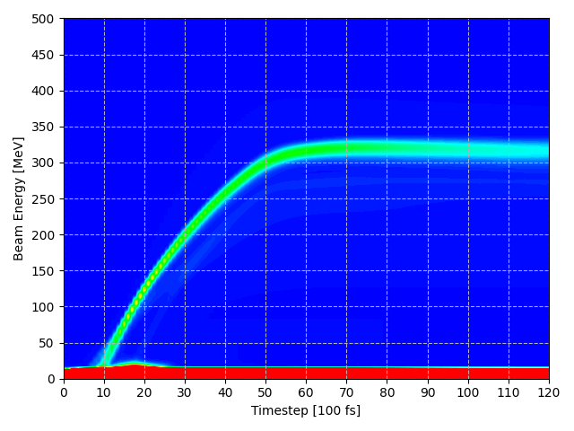
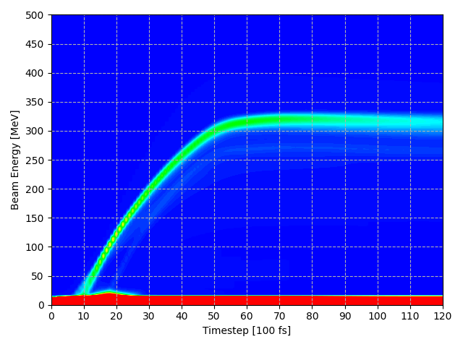
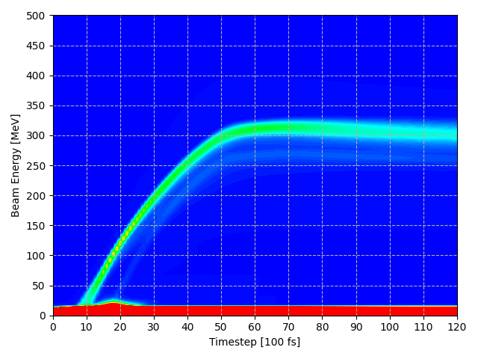


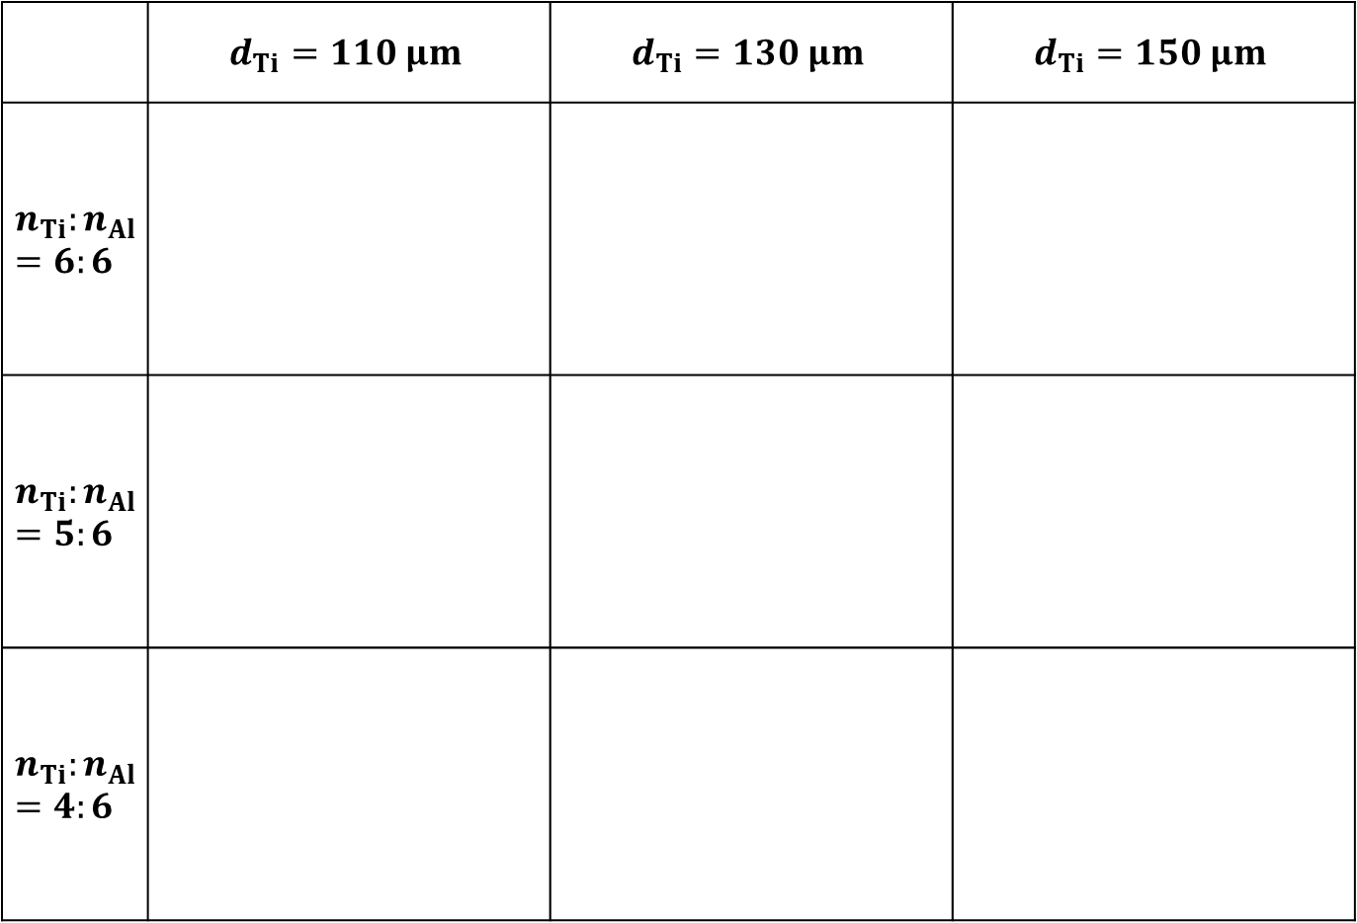










Optimization for Ti layer : Thickness & Density
 | $$d_{Ti}=110 μm$$ | $$d_{Ti}=130 μm$$ | $$d_{Ti}=150 μm$$
$$n_{Ti}:n_{Al}=6:6$$
$$n_{Ti}:n_{Al}=5:6$$
$$n_{Ti}:n_{Al}=4:6$$
Plasma Density Profile
$E_{peak}=136 MeV$
$∆E=10.3 \%$
$ρ=634 pC/μm$
$E_{peak}=117 MeV$
$∆E=15.4 \%$
$ρ=1035 pC/μm$
$E_{peak}=108 MeV$
$∆E=23.1 \%$
$ρ=1234 pC/μm$
ramp
$$d_{TI}$$
$$n_{e}$$
$$n_{i}$$
$E_{peak}=218 MeV$
$∆E=6.0 \%$
$ρ=268 pC/μm$
$E_{peak}=187 MeV$
$∆E=10.2 \%$
$ρ=559 pC/μm$
$E_{peak}=164 MeV$
$∆E=18.9 \%$
$ρ=798 pC/μm$
ramp
$$d_{TI}$$
$$n_{e}$$
$$n_{i}$$
$E_{peak}=316 MeV$
$∆E=4.7 \%$
$ρ=176 pC/μm$
$E_{peak}=311 MeV$
$∆E=4.8 \%$
$ρ=187 pC/μm$
$E_{peak}=310 MeV$
$∆E=5.5 \%$
$ρ=203 pC/μm$
$$d_{TI}$$
ramp
$$n_{e}$$
$$n_{i}$$
0
100
200

Slide 10
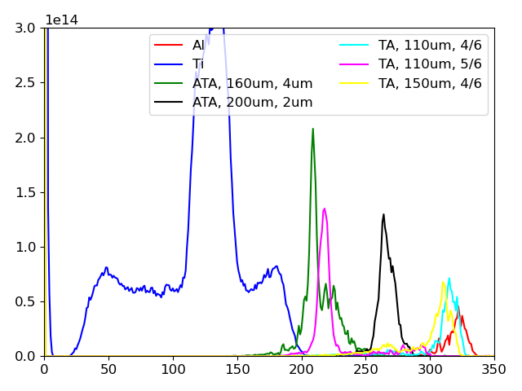

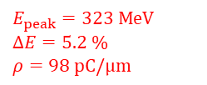



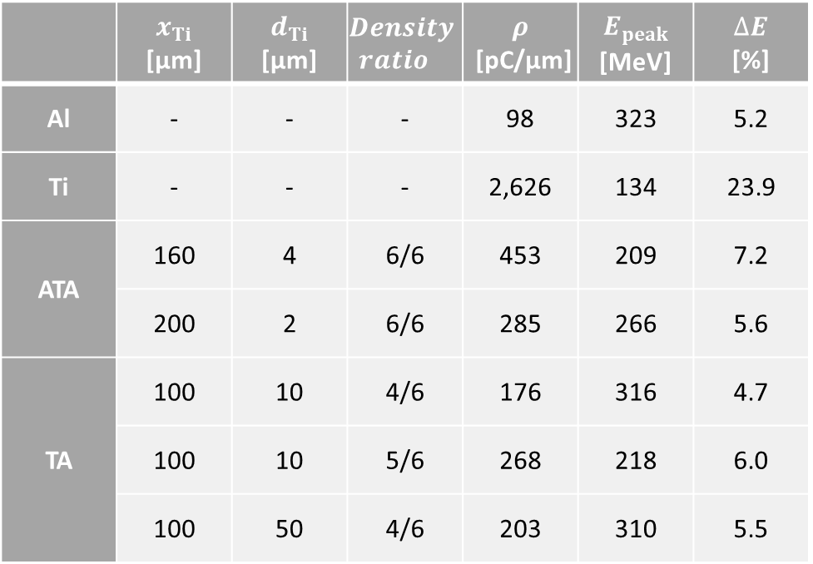


Comparison of Laser-accelerated Electron beam
Energy Distribution
 | $$x_{Ti}$$ [μm] | $$d_{Ti}$$ [μm] | $$Density$$ $$ratio$$ | $$ρ$$ [pC/μm] | $$E_{peak}$$ [MeV] | $$∆E$$ [%]
Al | - | - | - | 98 | 323 | 5.2
Ti | - | - | - | 2,626 | 134 | 23.9
ATA | 160 | 4 | 6/6 | 453 | 209 | 7.2
 | 200 | 2 | 6/6 | 285 | 266 | 5.6
TA | 100 | 10 | 4/6 | 176 | 316 | 4.7
 | 100 | 10 | 5/6 | 268 | 218 | 6.0
 | 100 | 50 | 4/6 | 203 | 310 | 5.5
$E_{peak}=134 MeV$
$∆E=23.9 \%$
$ρ=2626 pC/μm$
$E_{peak}=209 MeV$
$∆E=7.2 \%$
$ρ=453 pC/μm$
$E_{peak}=218 MeV$
$∆E=6.0 \%$
$ρ=268 pC/μm$
$E_{peak}=266 MeV$
$∆E=5.6 \%$
$ρ=285 pC/μm$
$E_{peak}=316 MeV$
$∆E=4.7 \%$
$ρ=176 pC/μm$
$E_{peak}=310 MeV$
$∆E=5.5 \%$
$ρ=203 pC/μm$
$E_{peak}=323 MeV$
$∆E=5.2 \%$
$ρ=98 pC/μm$

Slide 11
Summary
Utilize the characteristics of laser wakefield acceleration through laser-ablated Ti plasma.
In structures with a thin Ti layer, electron injection can be controlled by adjusting the position and thickness of Ti layer.
In a titanium-aluminum structure, controlling electron injection from titanium plasma through adjusting the thickness and density, enhancing charge while maintaining a similar energy distribution compared to using aluminum alone.

Slide 12
Thanks for listening

