Slide 1
Development of FEL code
to simulate the integrated undulator line
MyungHoon Cho
2024-11-14
1/21

Slide 2
Contents
Introduction to FELIS code.
Bench mark
Future development
Summary

Slide 3
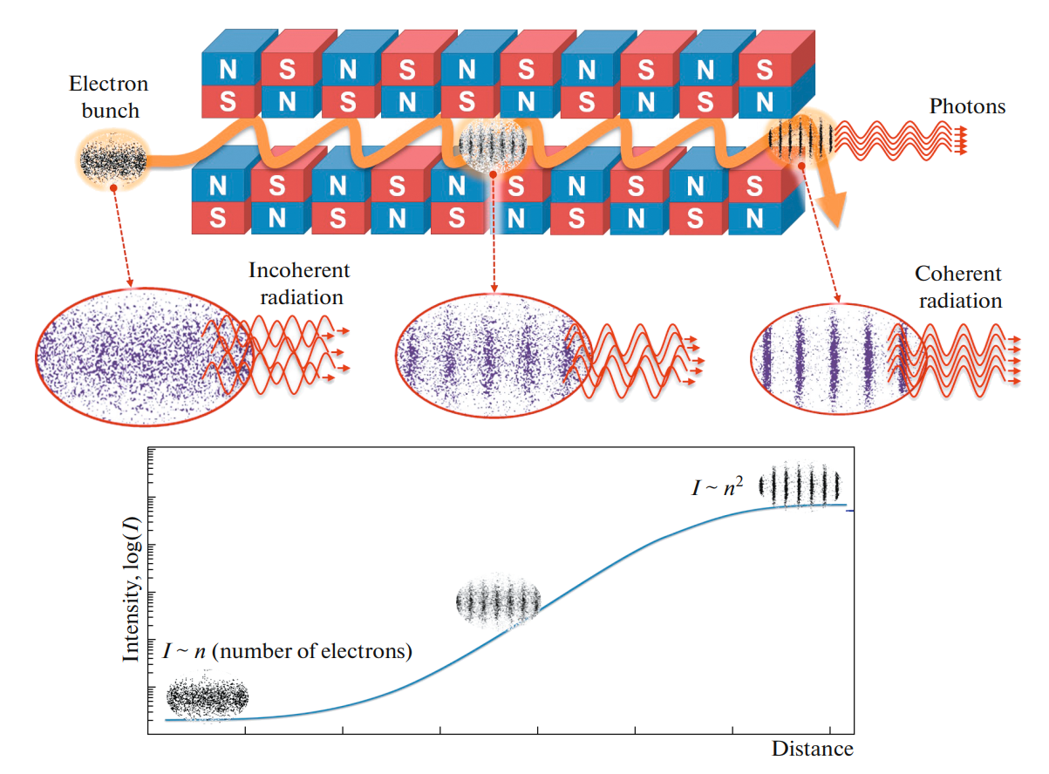
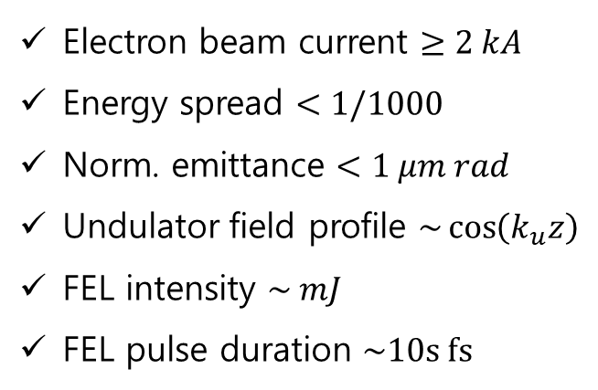
Free-Electron Laser (FEL)
- FEL is a radiation amplification by response of electrons and self-generated radiations.
- High gain FEL needs high beam current and well-defined undulator setting as well as very good electron beam quality.
Electron beam current $≥2 kA$
Energy spread $<1/1000$
Norm. emittance $<1 μm rad$
Undulator field profile $\sim \cos\left(k_{u}z\right)$
FEL intensity $\sim mJ$
FEL pulse duration $\sim 10s fs$
microbunching
field amplification

Slide 4
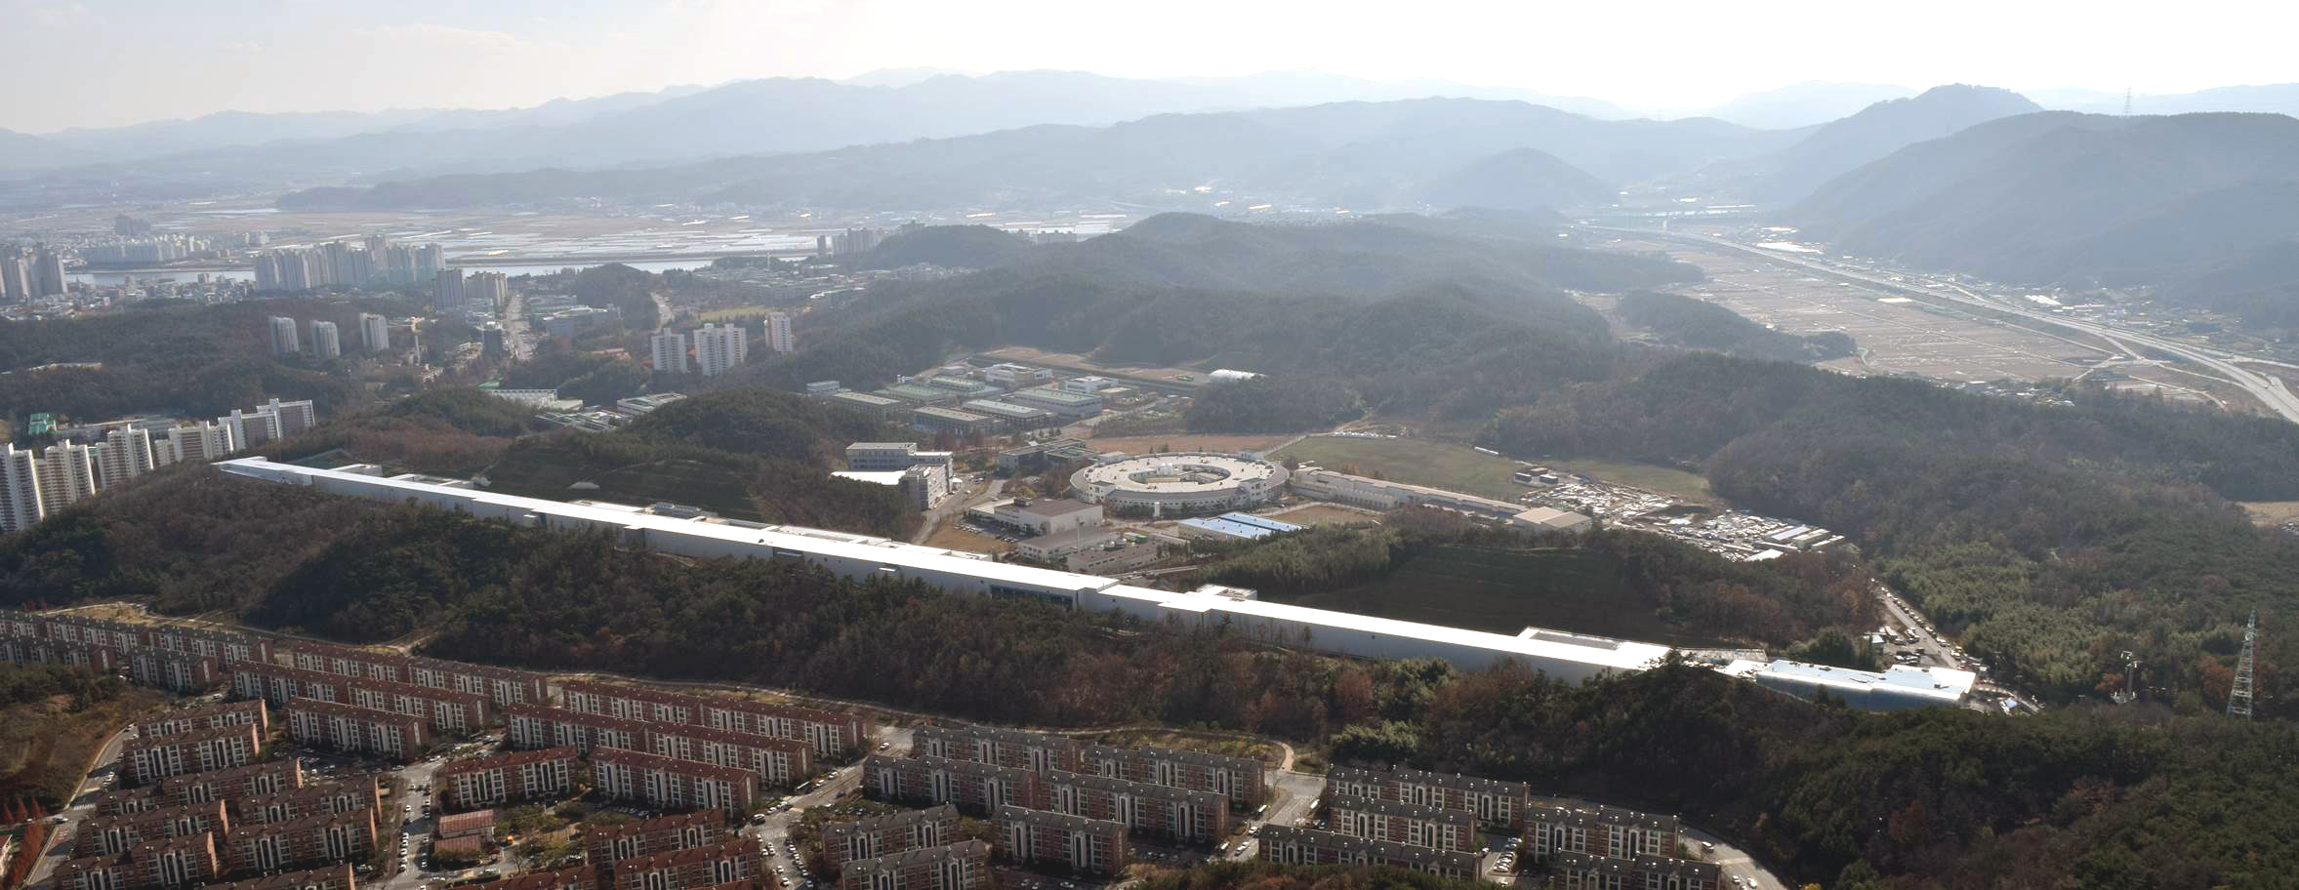
Free-Electron Laser (FEL)
 | Hard X-ray | Soft X-ray
Photon energy | 2.0 ~ 20 keV (0.6 ~ 0.06 nm) | 250 ~ 1250 eV (5 ~ 1 nm)
Beam energy | 4 ~ 11 GeV | 3 GeV
Repetition rate | 60 Hz | 60 Hz
Band width of pink beam (ΔE/E) | ~ 0.4 % | ~ 0.5 %
Photon flux (pink beam) | > 1.0 x 10¹¹ phs/pulse | > 1.0 x 10¹² phs/pulse
PLS-II
Injector
Linac
Undulator (SX)
Exp.Hall (SX)
Undulator (HX)
PAL-XFEL
Exp.Hall (HX)
Project Period: 2011 ~ 2015
11-GeV Electron Linac (Normal Conducting S-band, 60 Hz)
Total Length: 1.1 km

Slide 5
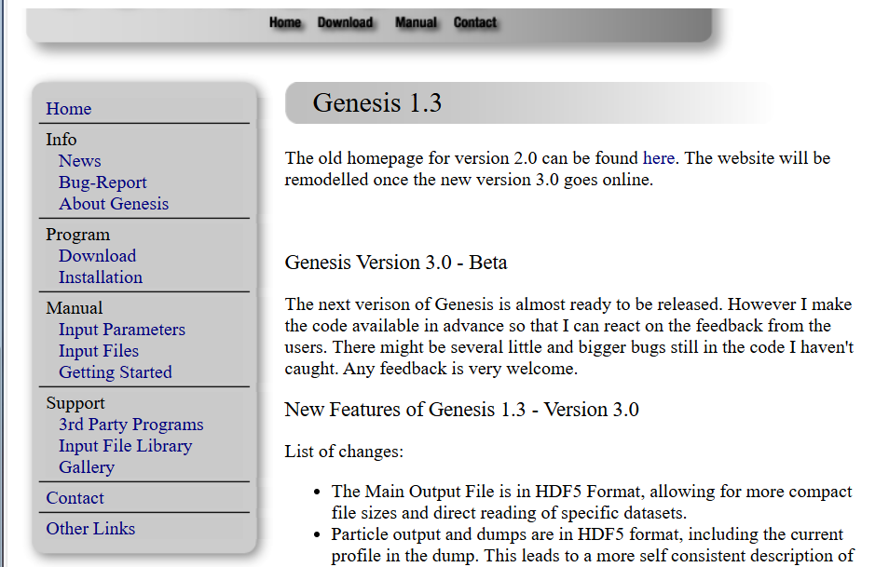
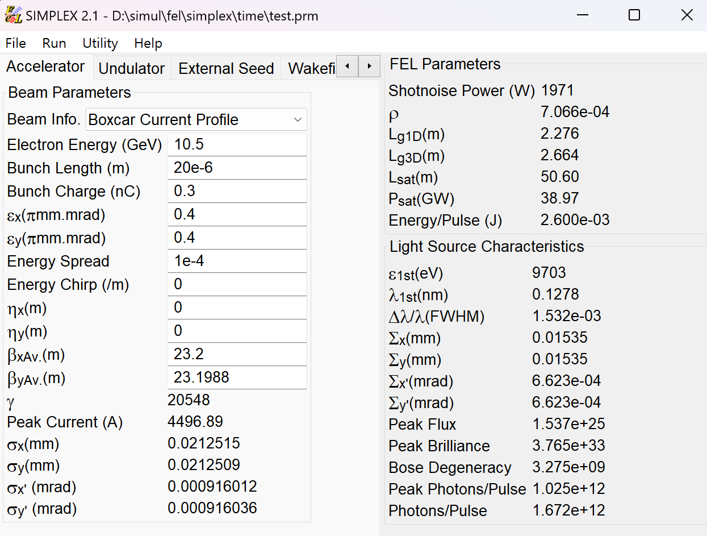
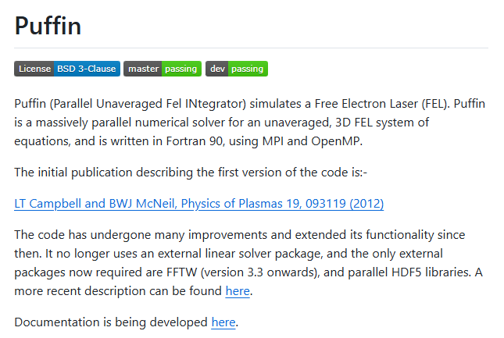
FEL codes
Averaged code
Unaveraged code
and others ….

Slide 6

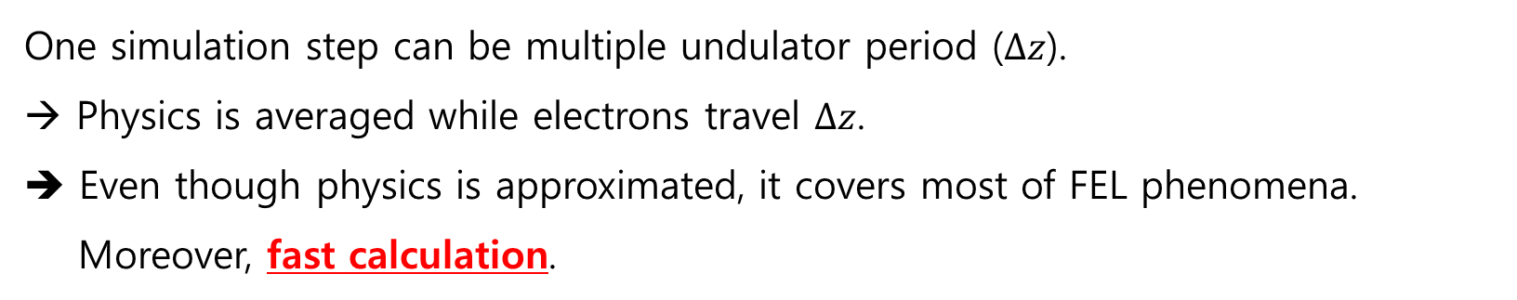
Averaged Code
Most popular FEL code is the averaged algorithm (like GENESIS 1.3), since it is fast.
$$Δz$$
One simulation step can be multiple undulator period ($Δz$).
Physics is averaged while electrons travel $Δz$.
➔ Even though physics is approximated, it covers most of FEL phenomena.
Moreover, fast calculation.

Slide 7
FEL Code calculation sequence
For realistic situation, users have to consider more information such as wakefields, tapering undulator, phase shifter, chicane, self-seeding, and so on.
- Basic components are undulators and quadrupoles which should be calculated in FEL code.
. . .
undulator
quad
field solver
for space charge, high harmonics
calculation of
Quads and K
particle push
Additional calculation :
phase shifter, chicane, self-seeding, etc
more information of initial condition

Slide 8
FELIS : the Free-Electron-Laser simulation using Integrated Slices
FELIS is the FEL code for simulating PAL-XFEL performance.
# FELIS
Electrons can cross adjacent slices.
Current density can be changed.
Space charge and wakefield can be varied.
…..
Und.
Und.
…..
Und.
Und.
# Genesis 1.3
Electrons moves in periodic boundary.
Current density is fixed.
Space charge and wakefield are fixed.
…..
Und.
Und.
…..
Und.
Und.

Slide 9
FELIS : the Free-Electron-Laser simulation using Integrated Slices
FELIS includes diverse calculation modules of chicane, phase shifter, self-seeding, and so on inspired by SIMPLEX FEL code.
Requirement
: C language, MPI library, Gnu-Scientific Library (gsl), HDF5 library (output file)
Functions
- 1D and 3D mode.
- Fundamental equations follow GENESIS 1.3 thesis.
- Field solver : Alternating-direction implicit (ADI) method
- Particle mover : 4th order Runge-Kutta method
- Shotnoise : Fawley algorithm
- Wakefield : numerical impedance calculation method
- Space charge field : Poisson solver using Green function
- chicane
- phase shifter : phase jump method
- self-seeding : Bragg forward wakefield model
S. Reiche, Ph.D thesis (1999)
Fawley, PRST-AB 5 070701 (2002)
K. Bane, PRST-AB 18 034401 (2015)
J. Qiang, Comp. Phys. Comm. 203 122 (2016)
R. Lindberg, PRST-AB 15 050706 (2012)
Github : https://github.com/scienter/fel.git

Slide 10
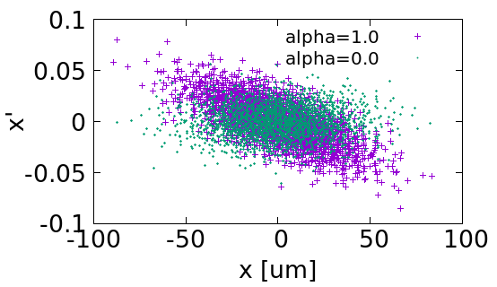
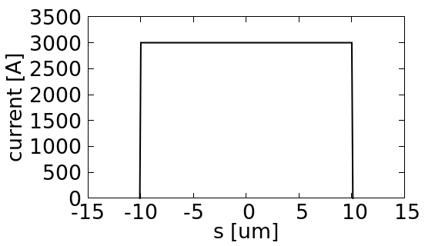
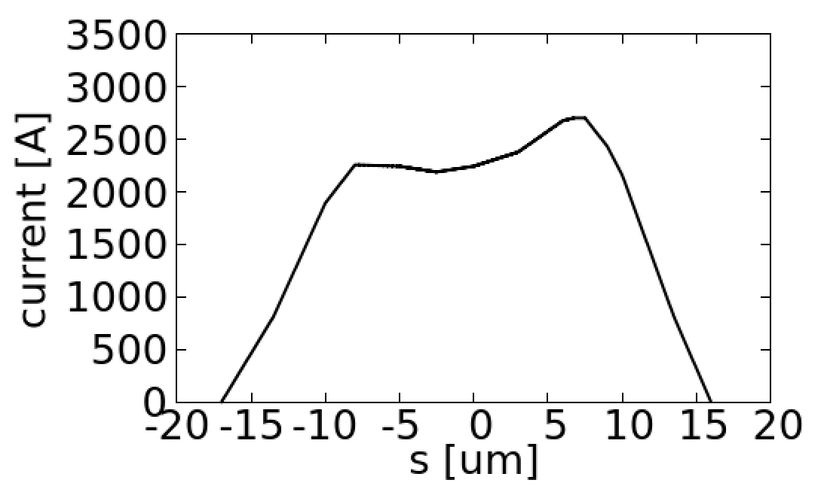
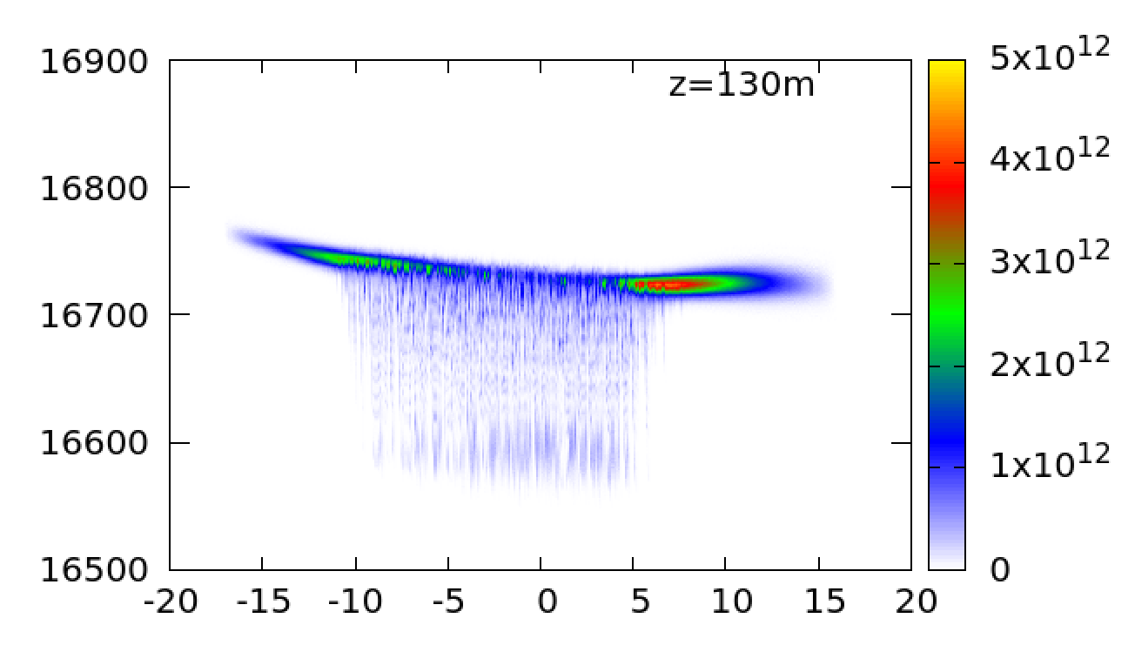
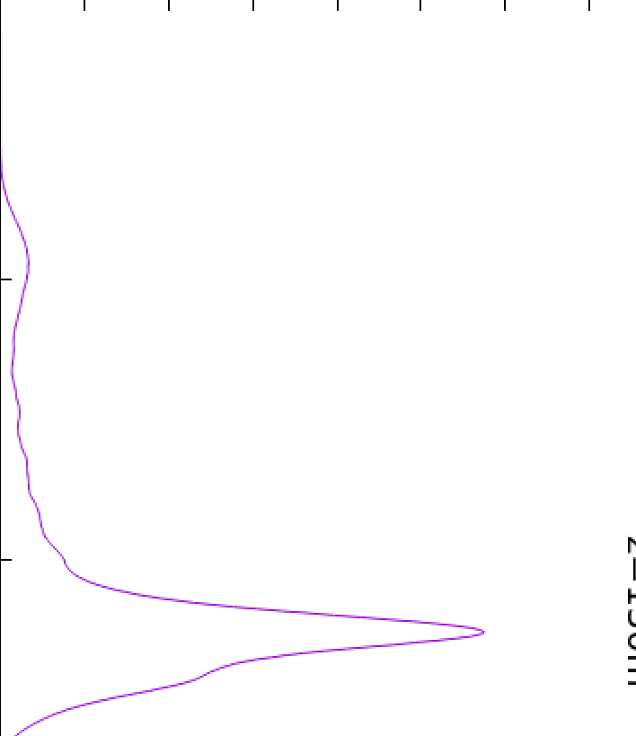


FELIS : electron beam loading
[EBeam]
beam_energy=8543 // [MeV]
energy_spread=0.017558 // [%]
peak_current=3000 // [A]
norm_emittance_x=0.4 // [mm mrad]
norm_emittance_y=0.4 // [mm mrad]
beta_x=25.6 // [m]
beta_y=13 // [m]
alpha_x=1.0
alpha_y=1.0
beamlets_in_bucket=2000
number_in_beamlet=4
Znodes=2
Z0=-10e-6
Z1=10e-6
Initial particle distribution
current distribution
Zn0=1
Zn1=1
Znodes=15
Z0=-17e-6
Z1=-13.5e-6
Z2=-10.0e-6
Z3=-8e-6
…
z_n0=0
z_n1=0.3
z_n2=0.7
z_n3=0.835
…
$$γ$$
$$z\left[μm\right]$$

Slide 11
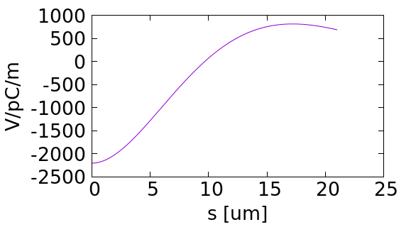
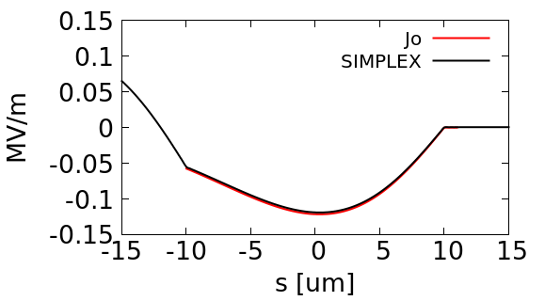
FELIS : Wakefield
FELIS implies the longitudinal wakefield automatically.
[Wakefield]
activate = ON
shape = Flat
ac_dc = AC
radius = 4.5e-3 // [m]
conductivity = 3.03e7
ctau = 2.4e-6 // relexation_time * light velocity [m]
wake function
wake field for hole bunch
FELIS

Slide 12
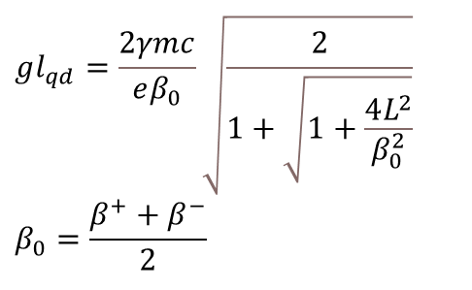
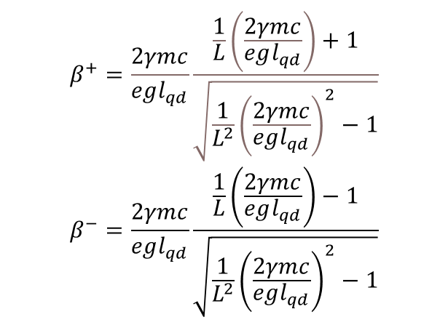
FELIS : quads and matching
Basic beam optics gives matching condition for the quad value ‘g’ with given ‘$l_{qd}$’.
[Quad]
numbers=13
unit_start = -0.0325 // [m]
unit_end = 9.9675 // [m]
quad_start = -0.0325 // [m]
quad_end = 0.0325 // [m]
g = ?? // [T/m]
[Quad]
numbers=13
unit_start = 4.9675 // [m]
unit_end = 14.9675 // [m]
quad_start = 4.9675 // [m]
quad_end = 5.0325 // [m]
g = ?? // [T/m]
$$β^{+}=\frac{2γmc}{egl_{qd}}\frac{\frac{1}{L}\left(\frac{2γmc}{egl_{qd}}\right)+1}{\sqrt{\frac{1}{L^{2}}{\left(\frac{2γmc}{egl_{qd}}\right)}^{2}−1}}$$
$$β^{−}=\frac{2γmc}{egl_{qd}}\frac{\frac{1}{L}\left(\frac{2γmc}{egl_{qd}}\right)−1}{\sqrt{\frac{1}{L^{2}}{\left(\frac{2γmc}{egl_{qd}}\right)}^{2}−1}}$$
$$gl_{qd}=\frac{2γmc}{eβ_{0}}\sqrt{\frac{2}{1+\sqrt{1+\frac{4L^{2}}{β_{0}^{2}}}}}$$
$$β_{0}=\frac{β^{+}+β^{−}}{2}$$

Slide 13
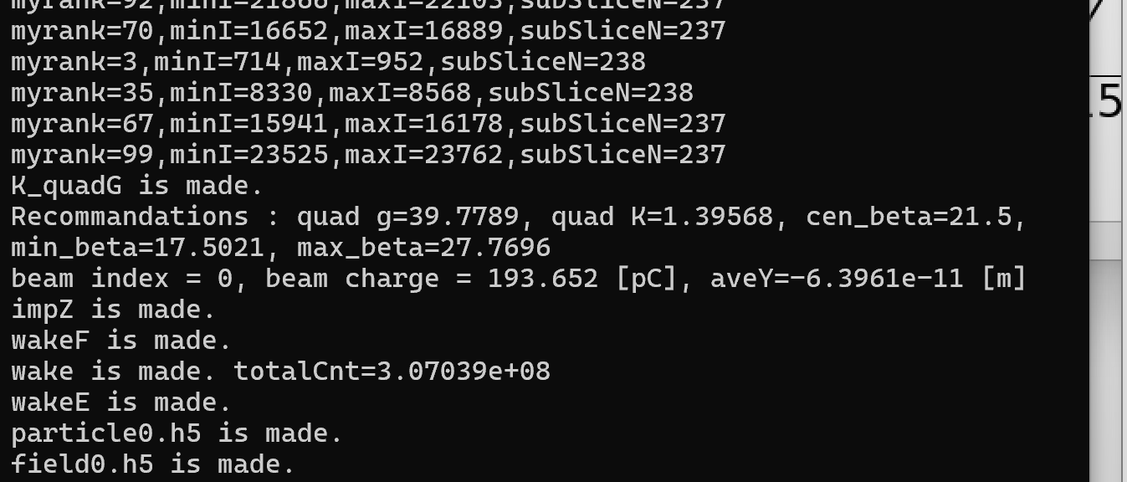
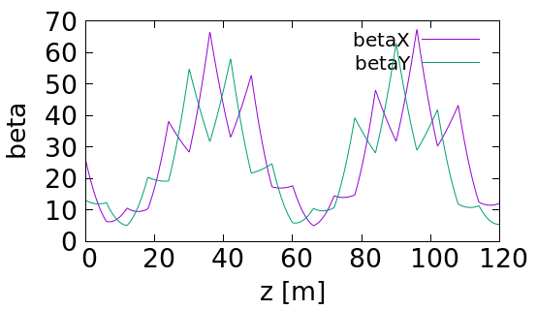
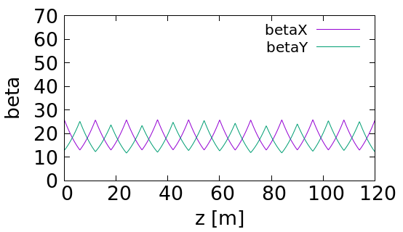
FELIS : quads and matching
FELIS will recommend ‘quad q’ value for matching.
[Quad]
numbers=13
unit_start = -0.0325 // [m]
unit_end = 9.9675 // [m]
quad_start = -0.0325 // [m]
quad_end = 0.0325 // [m]
g = 40 // [T/m]
[Quad]
numbers=13
unit_start = 4.9675 // [m]
unit_end = 14.9675 // [m]
quad_start = 4.9675 // [m]
quad_end = 5.0325 // [m]
g = -40 // [T/m]
Before matching
After matching

Slide 14
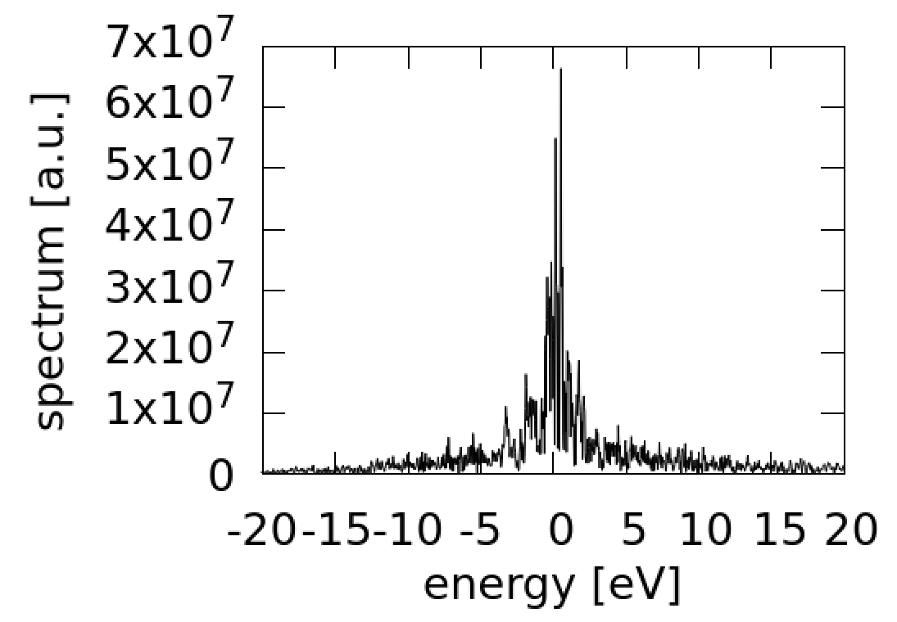
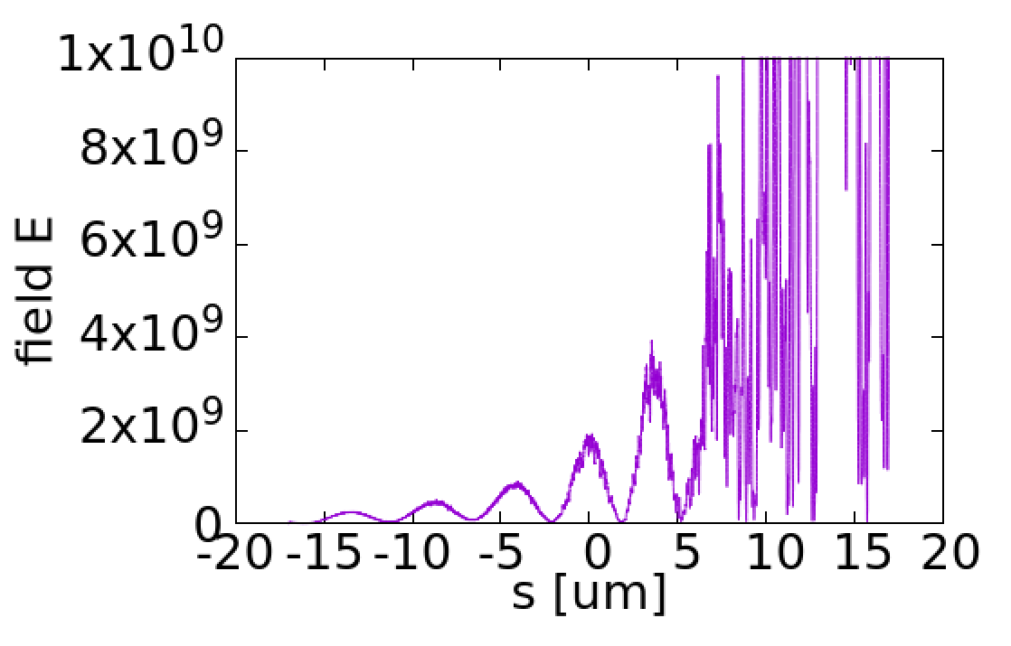
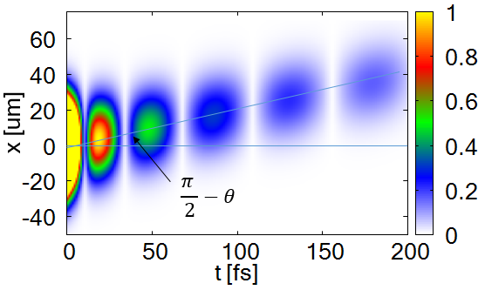
FELIS : self-seeding
Self-seeding calculation is in option.
[Chicane]
chicane_ONOFF=ON
delay_time = 50 //[fs]
position_z = 51 //[m]
dipole_length = 0.4 //[m]
dipole_distance_1 = 1.4 //[m]
dipole_distance_2 = 1.4 //[m]
selfseed_ONOFF = ON
energy_range=80 // [eV]
shift_energy = -30 // [eV]
washing_bunch = OFF
crystal_thickness = 100 // [um]
crystal_type = Diamond_220
diamond crystal
Theoretical wake
Simulated wake

Slide 15
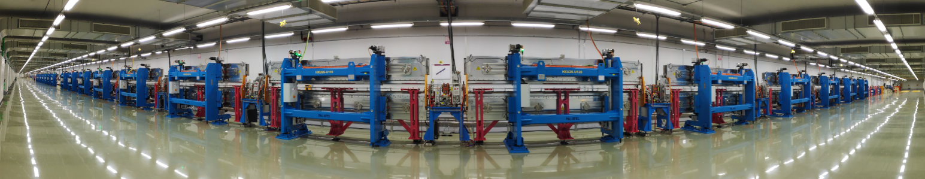
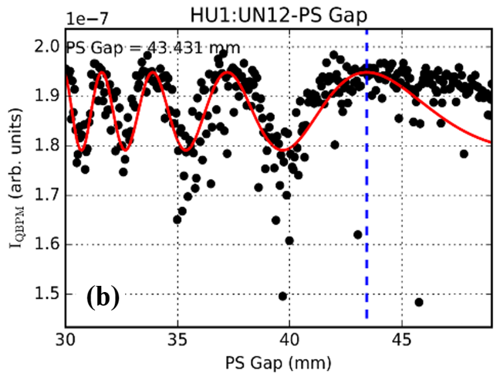
FELIS : phase shifter
Phase shifters are used for optimizing FEL intensity.
phase shifter
Self-seeding
BPM
quadrupole
sinusoidal fitting
in-phase
out-phase
saturation region

Slide 16
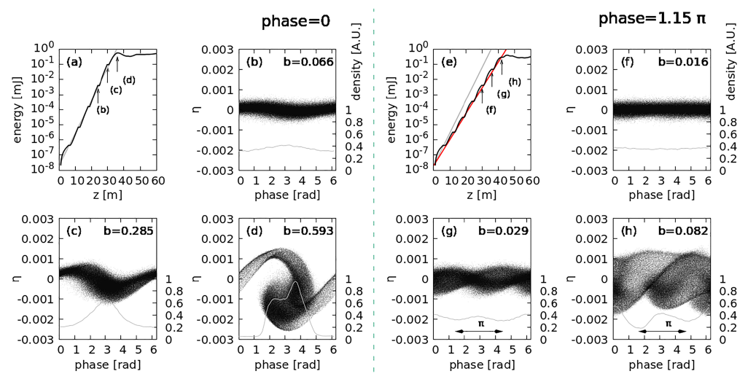
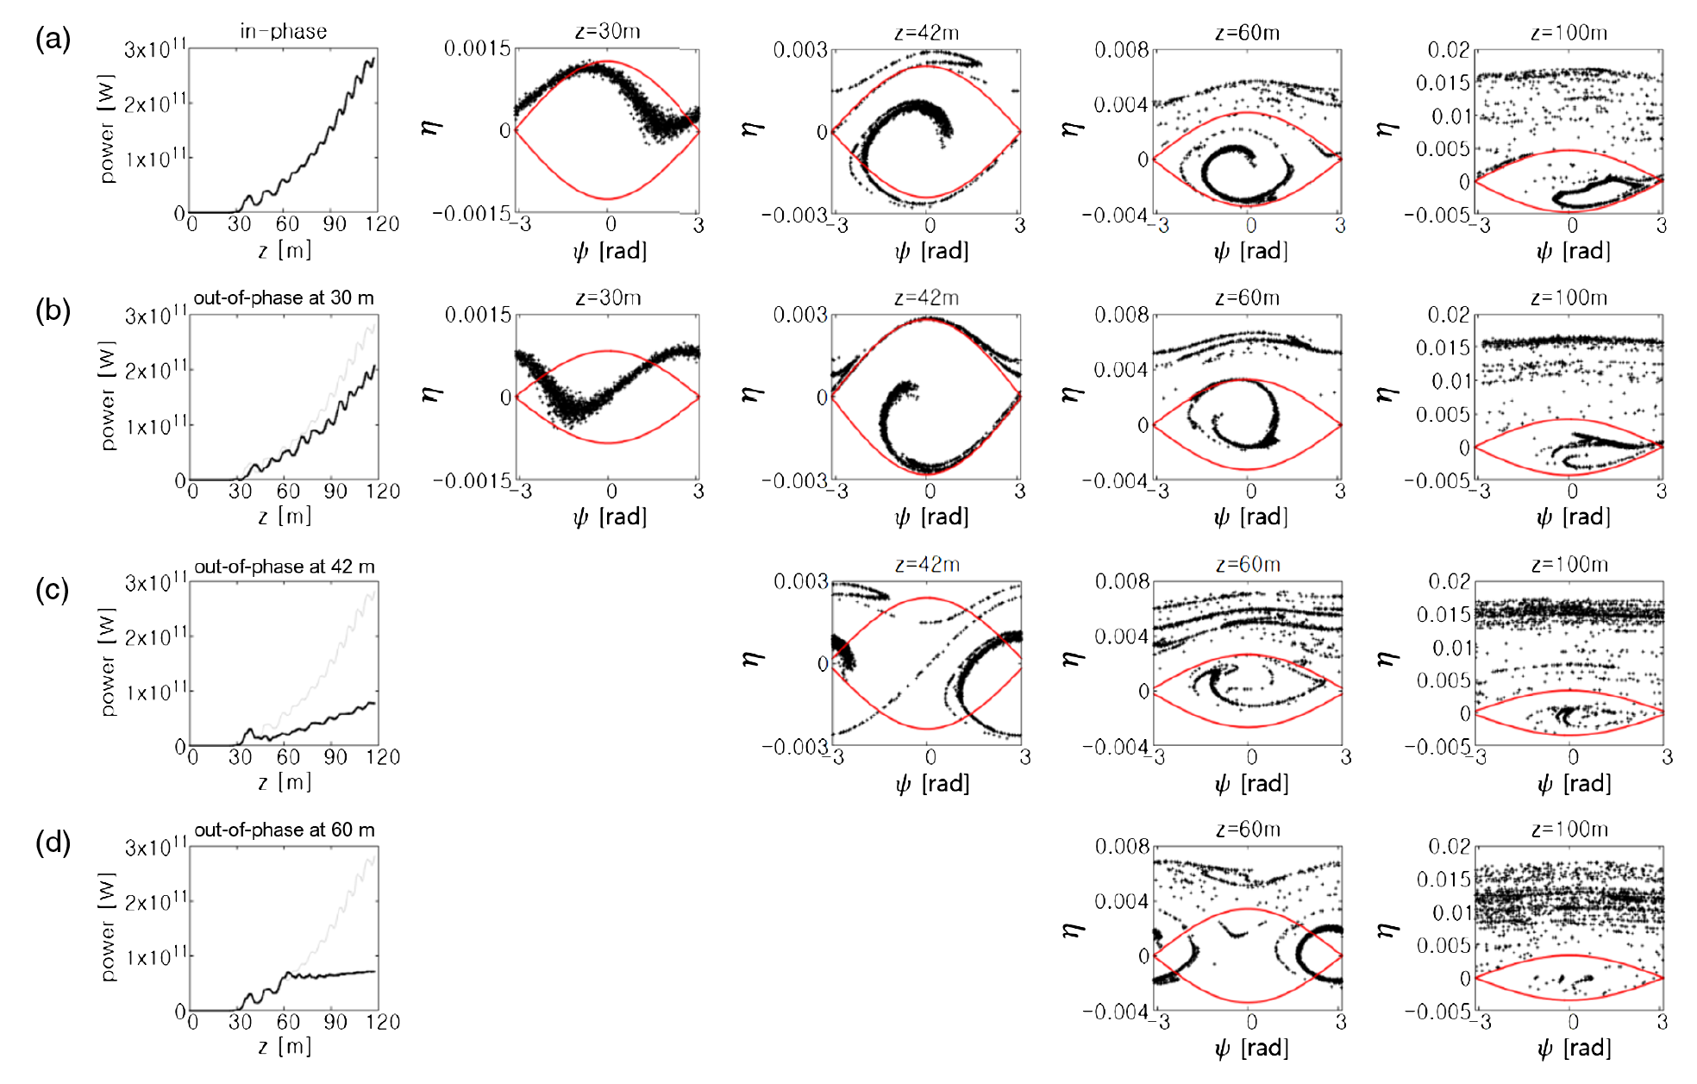
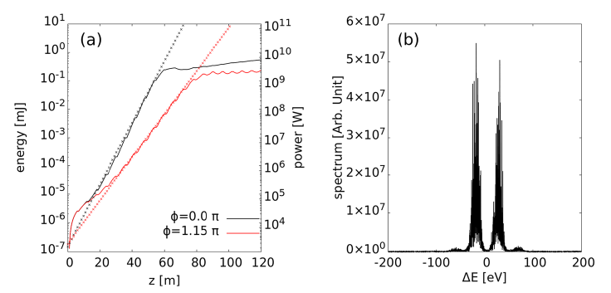
FELIS : phase shifter
Setting phase shifter will shift each electrons’ phase location.
[Phase_shifter]
number = 10
start_position = 6 //[m]
interval_length = 6 //[m]
phase = 1.15 //[pi]
two color FEL by setting suppression of FEL lasing
gain curves by setting different phase
PRAB 23 090702 (2020)
Scientific Reports 13 13786 (2023)

Slide 17
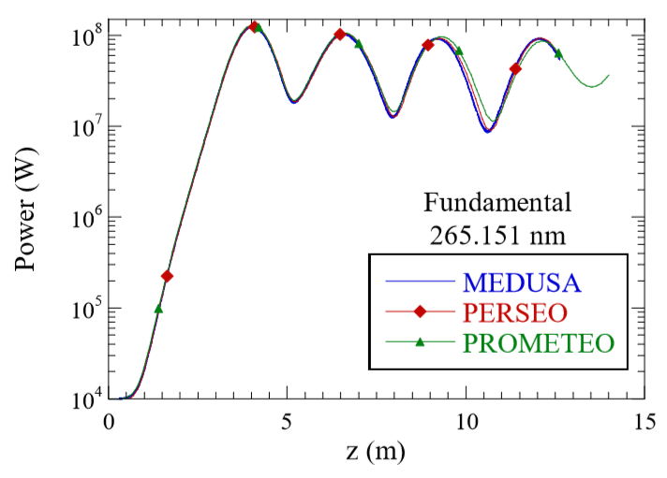
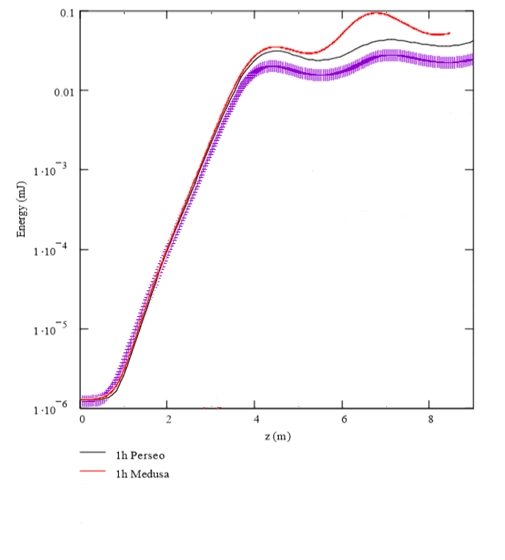
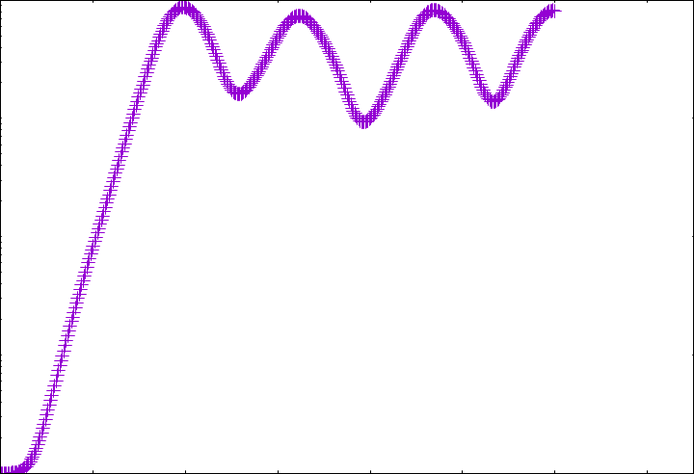
FELIS : bench mark
1D comparisons of MEDUSA, PERSEO, PROMETEO, and FELIS.
FELIS
static
time dependent
FELIS
Single flat undulator and loading seed pulse.
L.Giannessi, Nuclear Inst. Methods in Phys. Research, Sec. A: Accelerators, Spectrometers, Detectors and Associated Equipment 5 143 (2008)

Slide 18
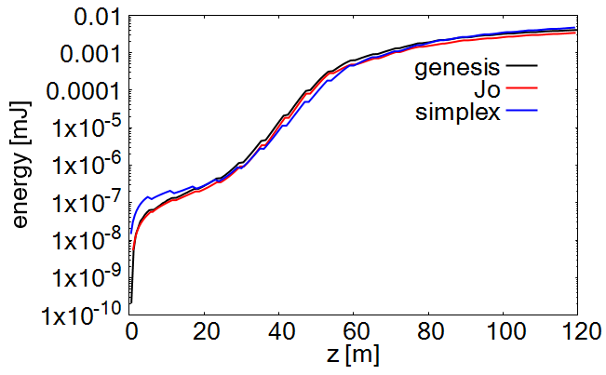
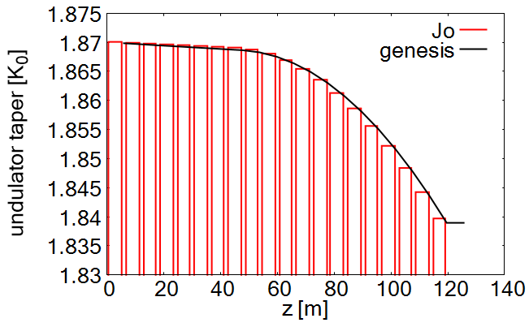
FELIS : bench mark
3D comparisons of GENESIS 1.3, SIMPLEX, and FELIS.
Undulator tapering
FELIS
FELIS
energy [J]

Slide 19
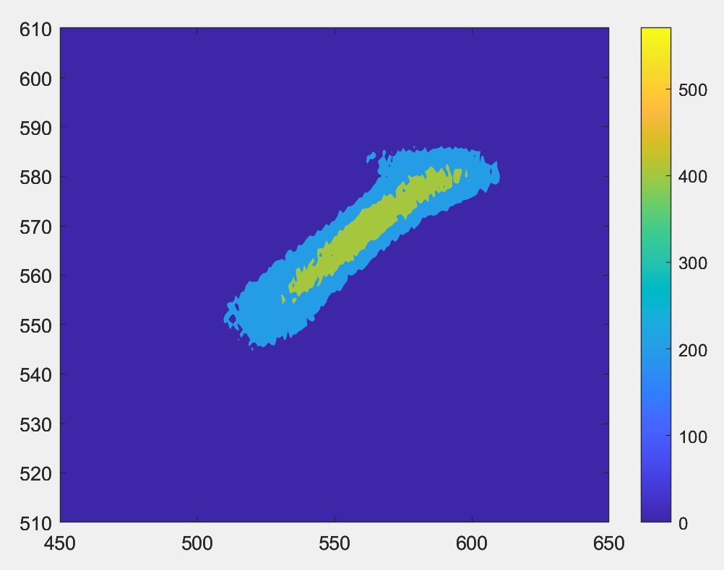
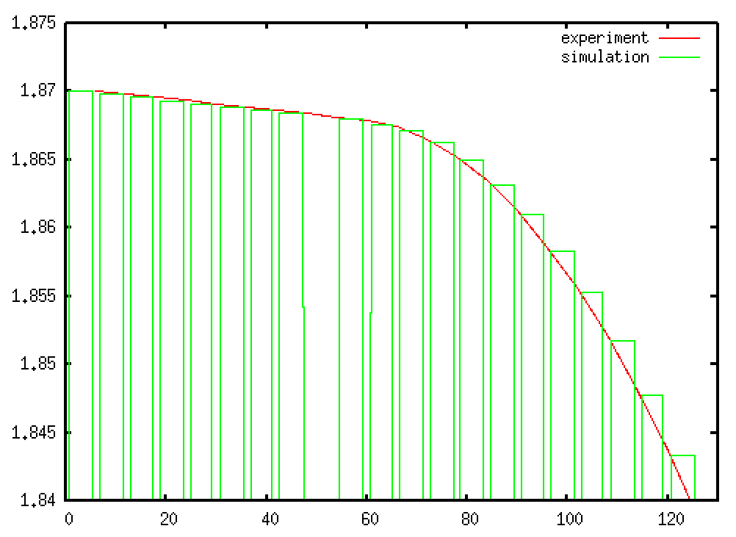
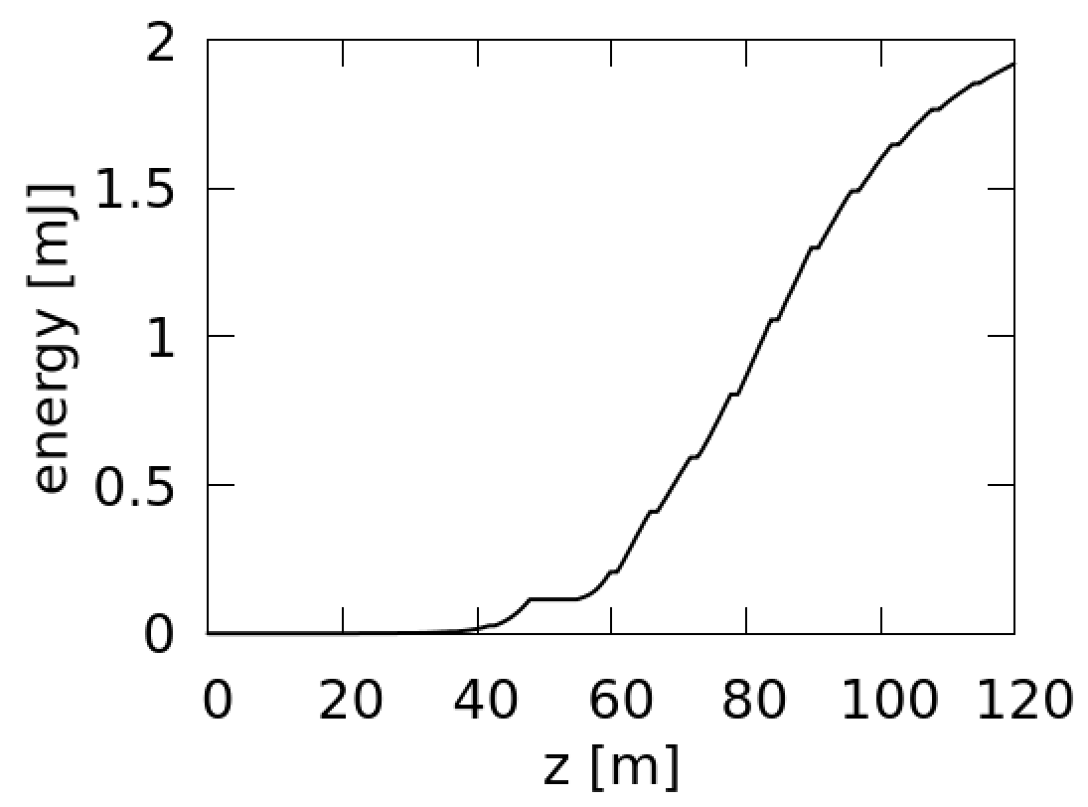
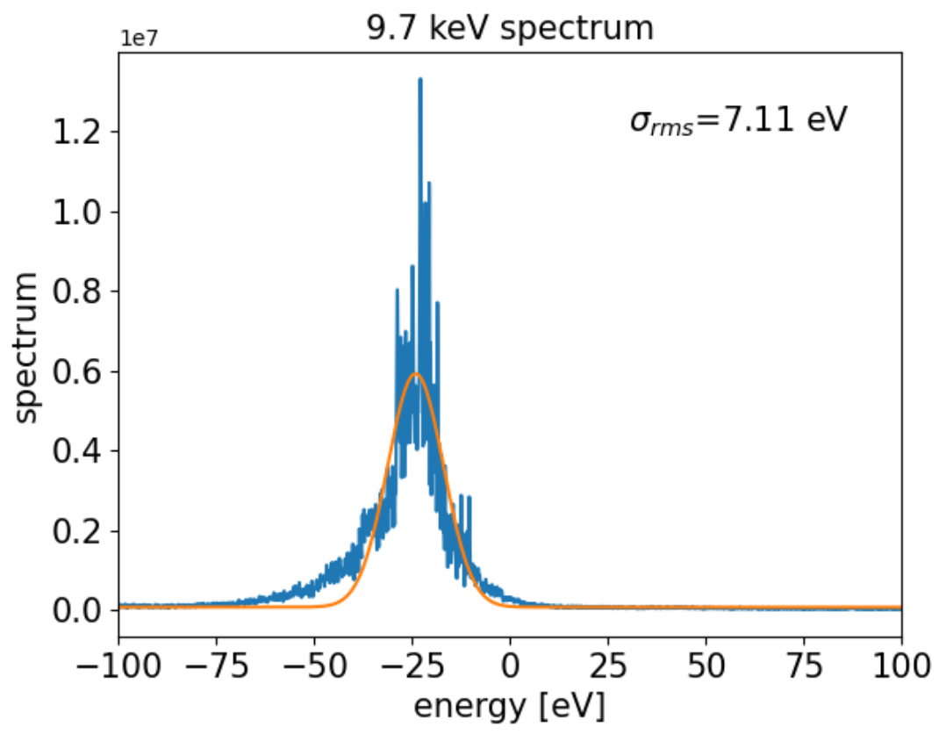
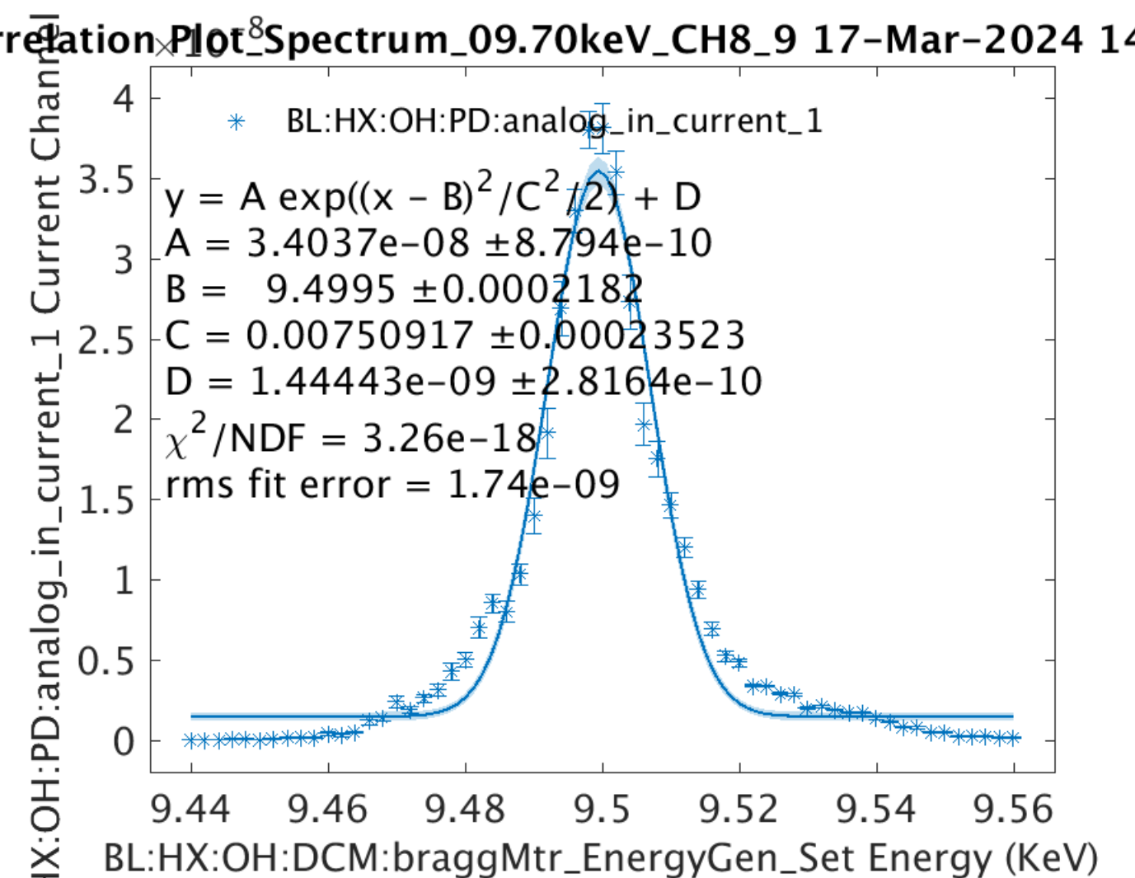

Comparing with PAL-XFEL
FEL intensity and spectrum are similar with the measurement.
Undulator tapering
experiment
time
energy
average of 10 data
$$σ_{rms}=7.51 eV$$
simulation

Slide 20
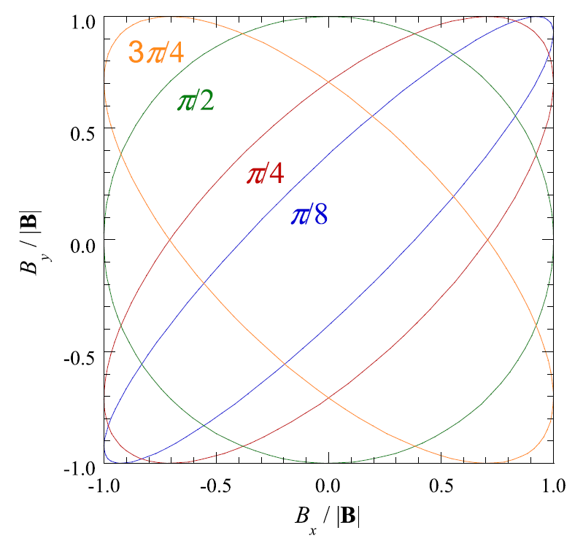
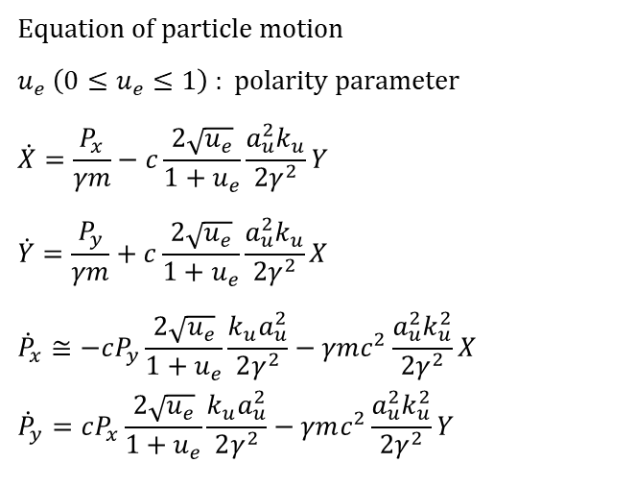
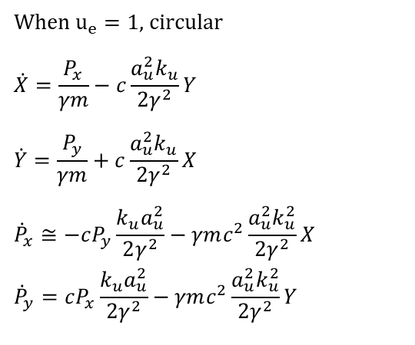
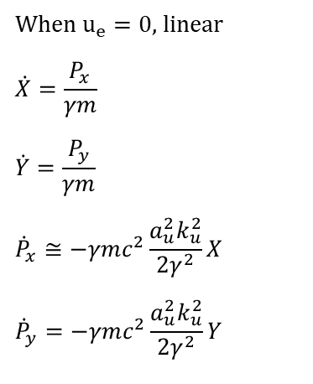
Further development
Elliptically polarized mode will be developed for future installation of the AppleX undulator.
formula in GENESIS 1.3
Equation of particle motion
$u_{e} \left(0≤u_{e}≤1\right)$ : polarity parameter
$$\dot{X}=\frac{P_{x}}{γm}−c\frac{2\sqrt{u_{e}}}{1+u_{e}}\frac{a_{u}^{2}k_{u}}{2γ^{2}}Y$$
$$\dot{Y}=\frac{P_{y}}{γm}+c\frac{2\sqrt{u_{e}}}{1+u_{e}}\frac{a_{u}^{2}k_{u}}{2γ^{2}}X$$
$${\dot{P}}_{x}≅−cP_{y}\frac{2\sqrt{u_{e}}}{1+u_{e}}\frac{k_{u}a_{u}^{2}}{2γ^{2}}−γmc^{2}\frac{a_{u}^{2}k_{u}^{2}}{2γ^{2}}X$$
$${\dot{P}}_{y}=cP_{x}\frac{2\sqrt{u_{e}}}{1+u_{e}}\frac{k_{u}a_{u}^{2}}{2γ^{2}}−γmc^{2}\frac{a_{u}^{2}k_{u}^{2}}{2γ^{2}}Y$$
When $u_{e}=0$, linear
$$\dot{X}=\frac{P_{x}}{γm}$$
$$\dot{Y}=\frac{P_{y}}{γm}$$
$${\dot{P}}_{x}≅−γmc^{2}\frac{a_{u}^{2}k_{u}^{2}}{2γ^{2}}X$$
$${\dot{P}}_{y}=−γmc^{2}\frac{a_{u}^{2}k_{u}^{2}}{2γ^{2}}Y$$
When $u_{e}=1$, circular
$$\dot{X}=\frac{P_{x}}{γm}−c\frac{a_{u}^{2}k_{u}}{2γ^{2}}Y$$
$$\dot{Y}=\frac{P_{y}}{γm}+c\frac{a_{u}^{2}k_{u}}{2γ^{2}}X$$
$${\dot{P}}_{x}≅−cP_{y}\frac{k_{u}a_{u}^{2}}{2γ^{2}}−γmc^{2}\frac{a_{u}^{2}k_{u}^{2}}{2γ^{2}}X$$
$${\dot{P}}_{y}=cP_{x}\frac{k_{u}a_{u}^{2}}{2γ^{2}}−γmc^{2}\frac{a_{u}^{2}k_{u}^{2}}{2γ^{2}}Y$$
It recovers GENESIS 1.3
Developing the elliptical wave equation is on-going.
1D model of the elliptical wave equation NJP 18 062003 (2016)

Slide 21
Summary
FELIS is the FEL code to simulate PAL-XFEL performance.
All particles are loaded at beginning, so shifting particles between adjacent slices is possible.
Inspired from GENESIS1.3 and SIMPLEX, FELIS supports diverse application modules by simply setting options.
Simulation results well describe measurements in PAL-XFEL.
Further development will be for an arbitrary elliptical polarization case.

