Slide 1
Ultrafast Ferroelectric Based Tuning for Microphonics Suppression in SRF Cavities
Chunguang Jing
Euclid Techlabs, LLC
11/14/2024, ICABU

Slide 2

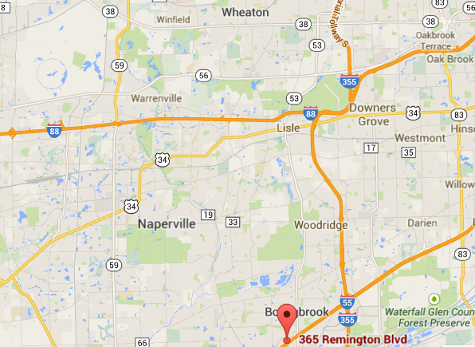
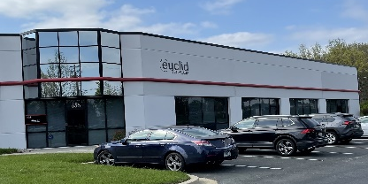
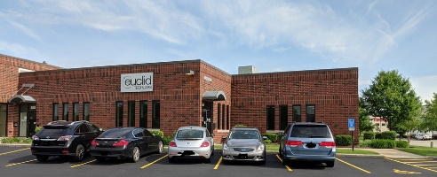
Euclid Techlabs LLC
Euclid Techlabs, LLC is a research and development company specializing in linear particle accelerators, ultrafast electron microscopy, and advanced material technologies for energy, defense, and medical applications. The company was formed in 2003. Euclid has developed expertise and products in several innovative technologies: time-resolved ultra-fast electron microscopy; ultra-compact linear accelerators; electron guns with thermionic, field emission or photo-emission cathodes; fast tuners for SRF cavities; advanced dielectric materials; HPHT and CVD diamond growth and applications; thin-film applications in accelerator technologies; and beam physics. Merging these technologies allows Euclid to create cost-effective, compact and reliable solutions, which provide potential access to a wide variety of markets.
25 employees, 12 PhD, particle physicists, material scientists, as well as electrical and mechanical engineers
2 Lab/offices: Bolingbrook, IL and Washington DC.
Tight collaborations with National Labs and Institutes: FNAL, ANL, BNL, LBL, SLAC, LANL, Jlab, NIST, NIU, IIT, etc.
DOE
BNL
30 min
flight
NIST
Fermilab
Washington
Jlab
2.5 hour
drive
ANL
Euclid Techlabs
www.euclidtechlabs.com

Slide 3
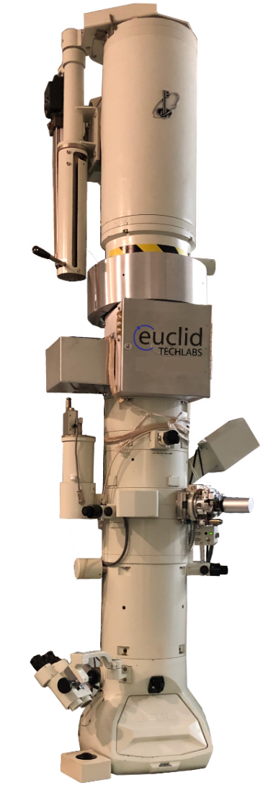
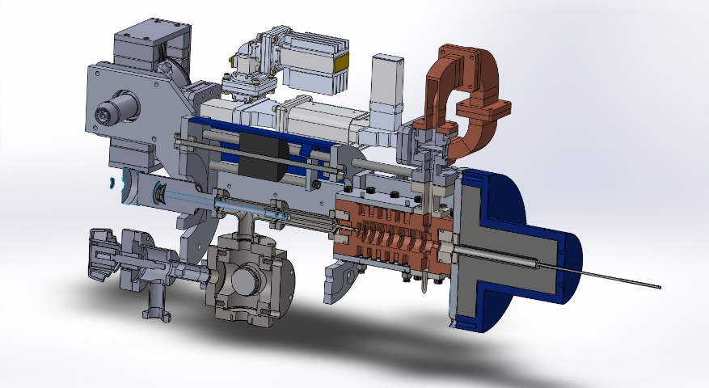

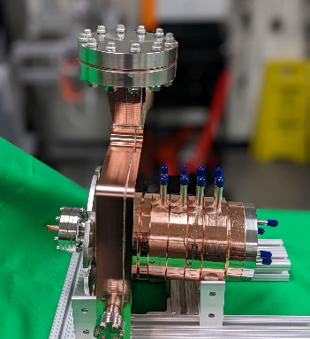
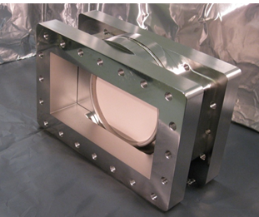
Products & Capabilities Snapshot
Products
UltraFast Pulser (UFPTM) for TEM
Compact Electronic Brachytherapy Device
Low loss ceramics (linear and non-linear)
RF photogun/thermioic RF gun
Low energy LINAC
UHV L-band RF window
BPM compact readout
Capabilities
Femtosecond Laser Ablation System
Thin Film Deposition Lab
EM Testing Lab
Radiation Shielding/Testing Lab
Experimental electron beamlines

Slide 4
Motivation – Fast Ferroelectric Tuner
A fast controllable phase shifter would allow microphonics compensation for the SRF accelerator (application of transient beamloading detuning is under consideration)
Nonlinear ferroelectric microwave components can control the tuning or the input power coupling for rf cavities. Applying a bias voltage across a nonlinear ferroelectric changes its permittivity. This effect is used to cause a phase change of a propagating rf signal or change the resonant frequency of a cavity. The key was the development of a low loss but still tunable ferroelectric material. The parameters have to be :
Dielectric constant has to be low (~ 100-150)
Loss factor has to be low ~ 10⁻³ at 1 GHz and 3×10⁻⁴ at 100 MHz
Tuning range has to be high ~ 6-8% at ~15 kV/cm
Can be done with (Ba, Sr)TiO₄+Mg based oxides
Courtesy of N.Shipman, CERN
*Ferroelectric tuning for SRF cavity was proposed by I. Ben-Zvi

Slide 5
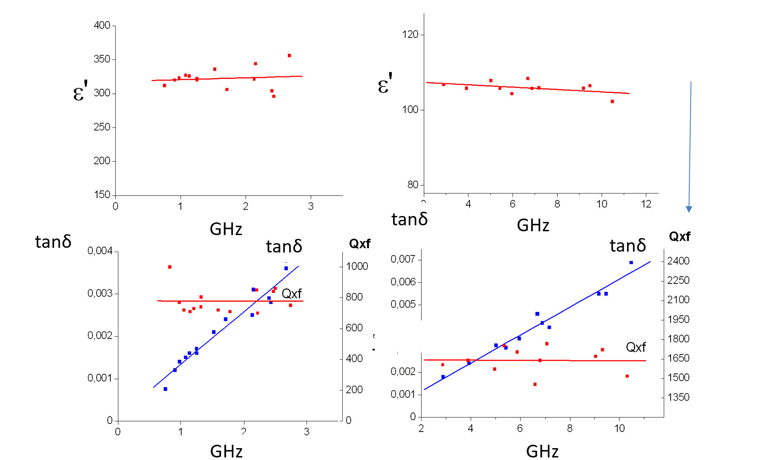
Frequency dependence of ε and tanδ for the ferroelectrics with low permittivity at ~GHz range
Q×f – FoM, GHz
Q×f=f (GHz)/tanδ
Q×f ~ const. at
50 MHz – 100 GHz
BST(M) is microwave ceramic – it means that its permittivity
does not depend on frequency.
Same time, loss factor tan δ of microwave ceramic linearly increases with frequency.
tanδ= 2.8×10⁻⁴ (80 MHz), =4.8×10⁻⁴ (400 MHz),

Slide 6
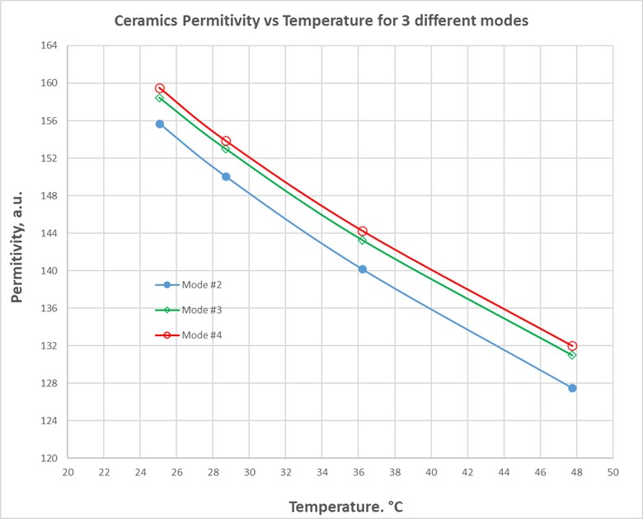
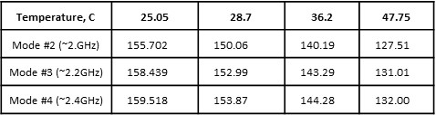

Ferroelectric ceramic properties, temperature
C, pF
BST ferroelectric
~ε
20000
BST with Mg oxide increasing content
15000
10000
(3)
(2)
(1)
5000
0
100
150
200
250
300
T, K
Temperature dependence of the BST(M) material permittivity in the 25C-50C temp. range.
Curie temperature shift from 250K to 170K with increase of Mg-based oxides in BST-Mg oxide solution.
Dielectric constant of BST based ferroelectrics strongly is dependent on temperature. With the low linear ceramic content in BST, Curie temperature is ~250K shifting to the ~170K range with linear ceramic content increase. For the BST(M) material with its dielectric constant ~150 at room temperature, Δε(T)/ε~1%/⁰K or Δε/T=1.2/⁰K. Optimal operations for BST (M) has to be in the 10⁰C-50⁰C temperature range.

Slide 7
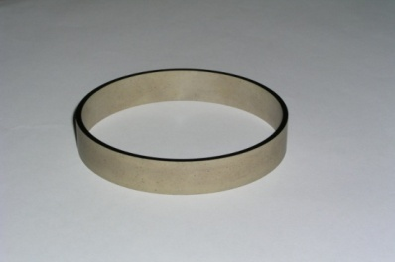
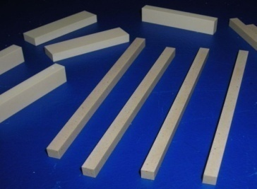
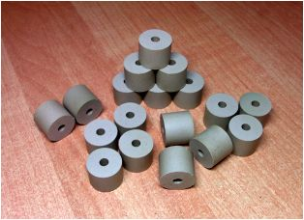
Progress on BST(M) Material Development
(Ba,Sr)TiO₄+Mg oxides in various proportions at room temperature
Q*f
tanδ=4×10⁻⁴ 400 MHz
K_{dc} =ε(V=0)/ε(V₀)
tunability
Q×f – FoM, GHz
Q×f=f (GHz)/tanδ
Q×f ~ const. at
50 MHz – 100 GHz
8% at 15kV/cm
BST(M), ε~50-150
record low values of dielectric constant and loss tangent at relatively high tunability level required for high power bulk tuner operating in air (< 30 kV/cm) and in vacuum ( up to 80 kV/cm).

Slide 8
Ferroelectric ceramic properties
Parameters | Value
dielectric constant, ε | ~150
tunability, Δε/ε | ~10% at 15kV⋅cm⁻¹ of the bias field
response time | 10 - 100 ns
tanδ at 1 GHz and 400 MHz | ~1×10⁻³ and ~4×10⁻⁴ correspondingly
breakdown limit | 200 kV/cm
thermal conductivity, K | 7.02 W/m-K
specific heat, C | 0.605 kJ/kg-K
density, ρ | 4.86 g/cm³
coefficient of thermal expansion | 10.1×10⁻⁶ K⁻¹
temperature tolerance, ∂ε⁄∂T | (1-2) K⁻¹

Slide 9
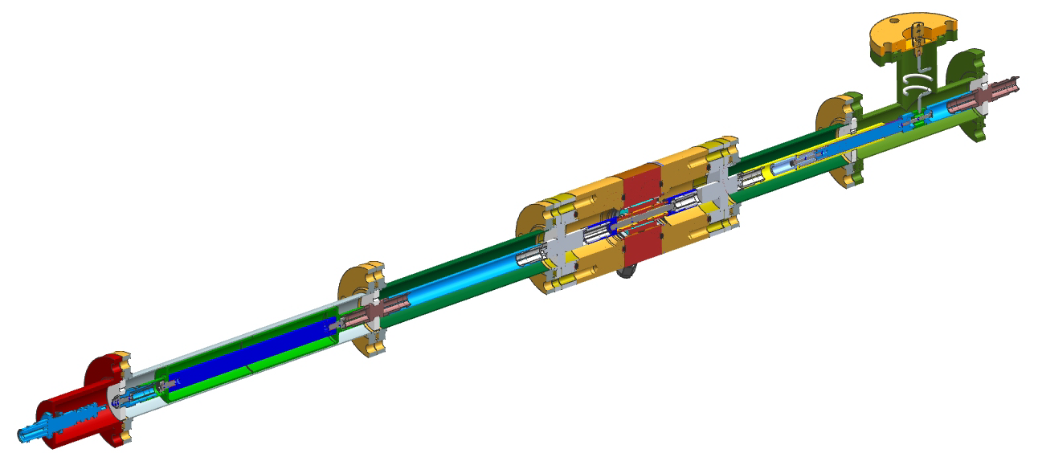
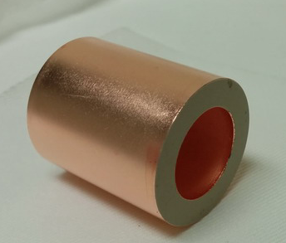
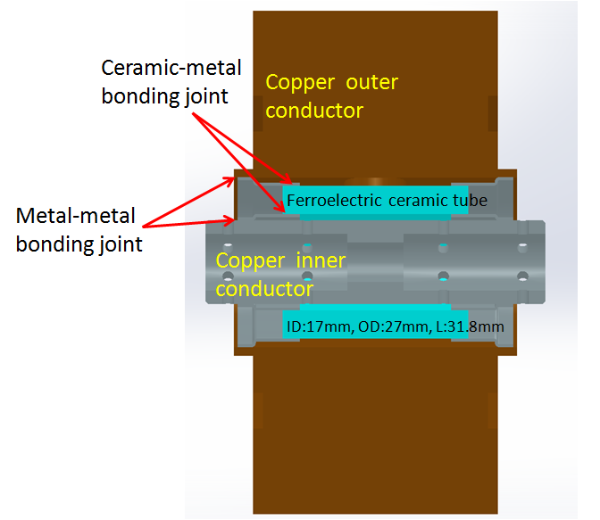
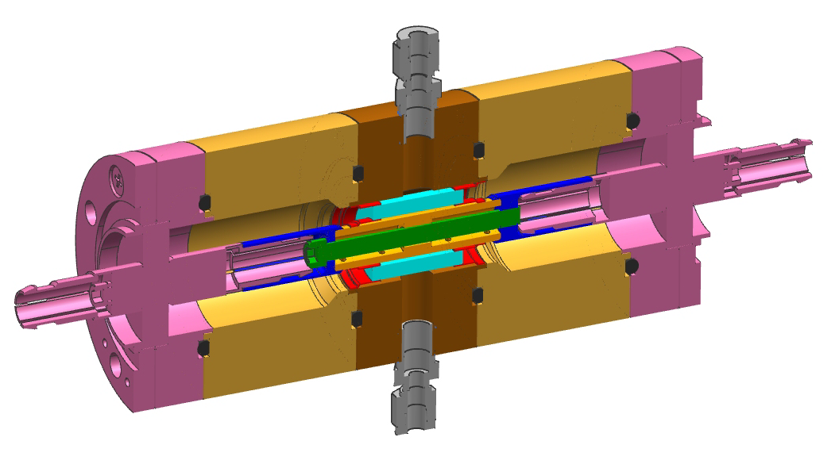
BST Based Tuner Design (assembly)
design of S. Kazakov and V. Yakovlev

Slide 10
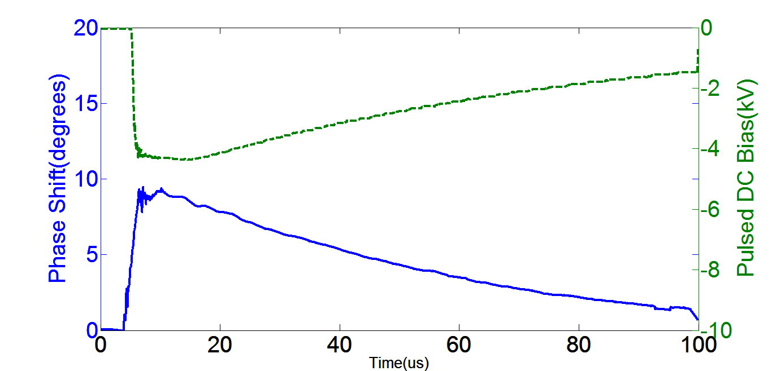
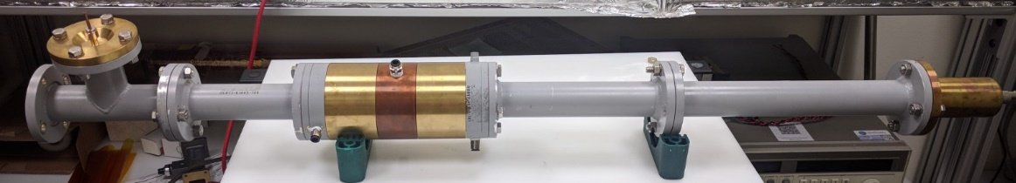
Ferroelectric Based High Power Tuner for SRF Cavities
Ferroelectric Fast Reactive Tuner (FE-FRT) for SRF accelerator operations
  Ultrafast tuner: 100 ns range
In collaboration with CERN
  Case study: LHeC application
Offers potential for significant reduction in RF power consumption
N. Shipman, et al., ERL’19, TUCOZBS02

Slide 11

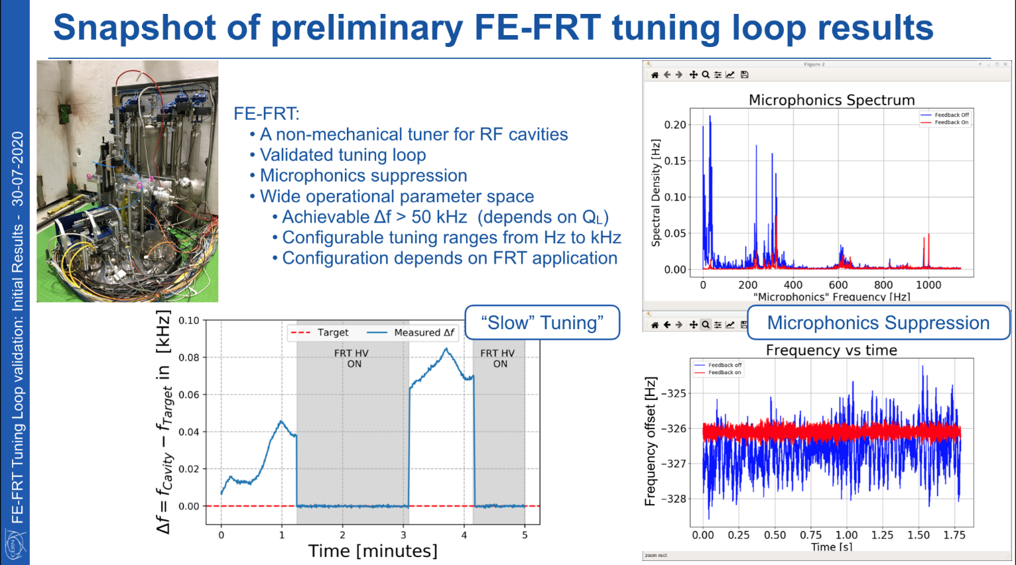
Preliminary Test Results, CERN, 2020
First Ferroelectric Fast Reactive Tuner (FE-FRT) test with a superconducting cavity
Courtesy of A.Macpherson and N.Shipman, CERN

Slide 12
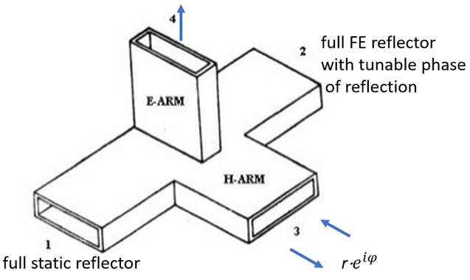
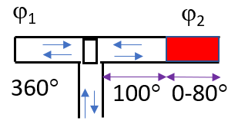
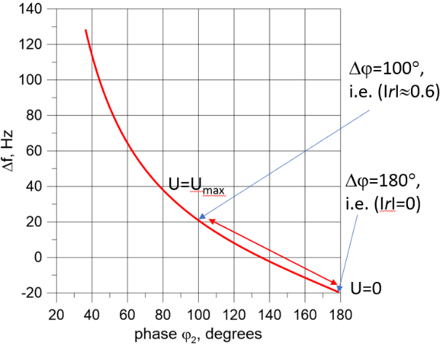
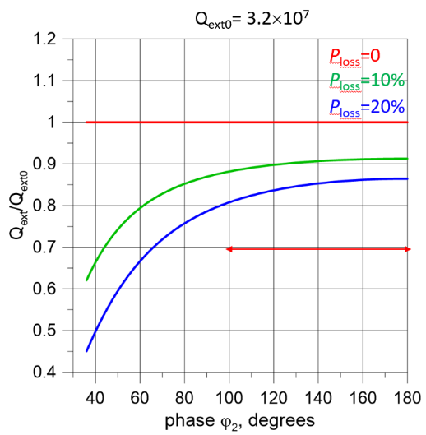
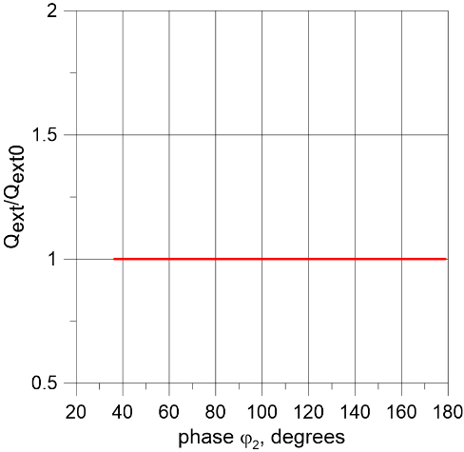


FRT for Single Port SRF Cavity
$re^{iφ}=\frac{2r_{0}}{1+r_{0}^{2}}cos⁡(φ)∙e^{iφ}$
$re^{iφ}=$ $\frac{1}{2}\left(1+e^{iφ_{2}}\right)$= $e^{iφ_{2}/2}$cos($φ_{2}/2$)

Slide 13
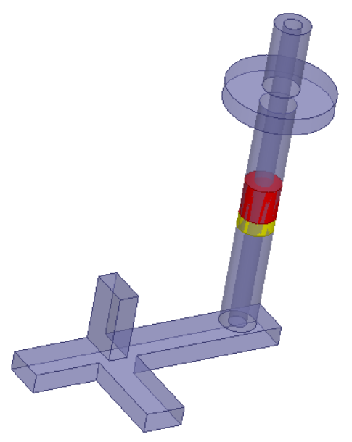
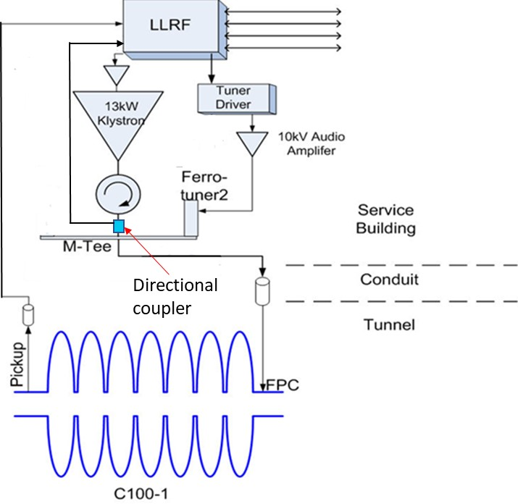
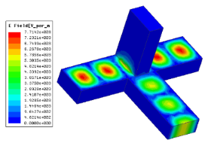
FRT for 1.5 GHz Single Port CEBAF Cavity
Ferroelectric tuning element (red) with alumina matching section (yellow)
C100 cavity, and C100 cryomodule with FPCs in CEBAF section SL25, Jlab.
Ferroelectric tuner and MT (upper corner) in the LLRF schematic of C100
Euclid Techlabs is developing the first fast ferroelectric tuner for a SRF accelerator that is currently in operation – CEBAF at JLAB. In comparison with our first tuner prototype, it requires a new configuration, with a single RF power port for both the klystron and the tuner. This is the only option for the current C100 cryomodules at CEBAF, and many other projects.

Slide 14
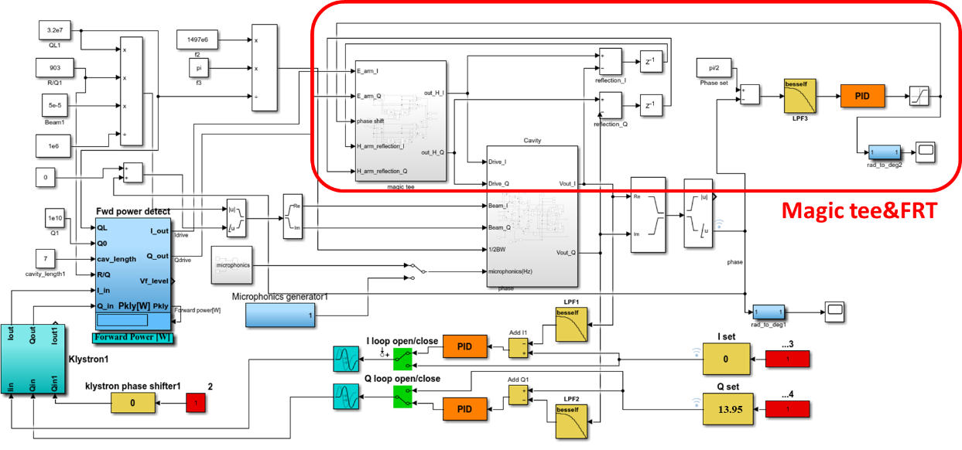
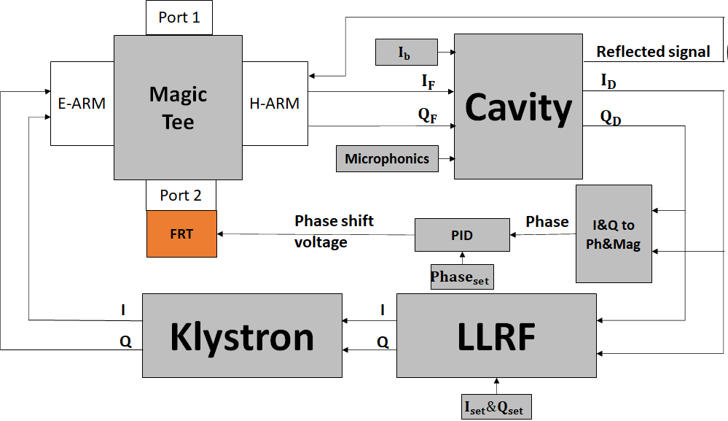
Simulink modeling of the FRT microphonics compensation via the single FPC of CEBAF Cavity (I)

Slide 15
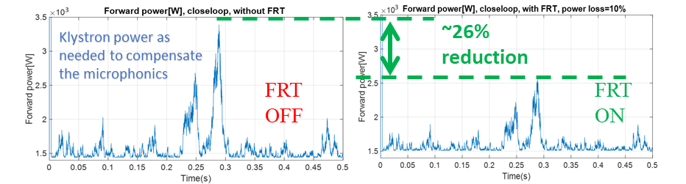
Simulink modeling of the FRT microphonics compensation via the single FPC of CEBAF Cavity (II)
Although it is non-ideal to use FRT through FPC, it is possible to maintain Qext and compensate the microphonics simultaneously.
Simulink modeling shows the klystron power demanding can be reduced by ~26% in the case of Jlab C100 cavities.
Cavity voltage
FRT with 10% loss
Cavity Phase
Emulated microphonics signal

Slide 16
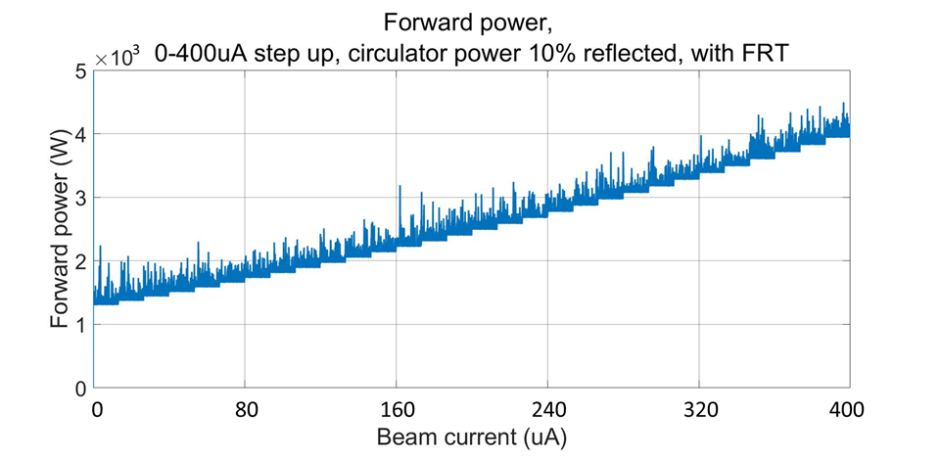
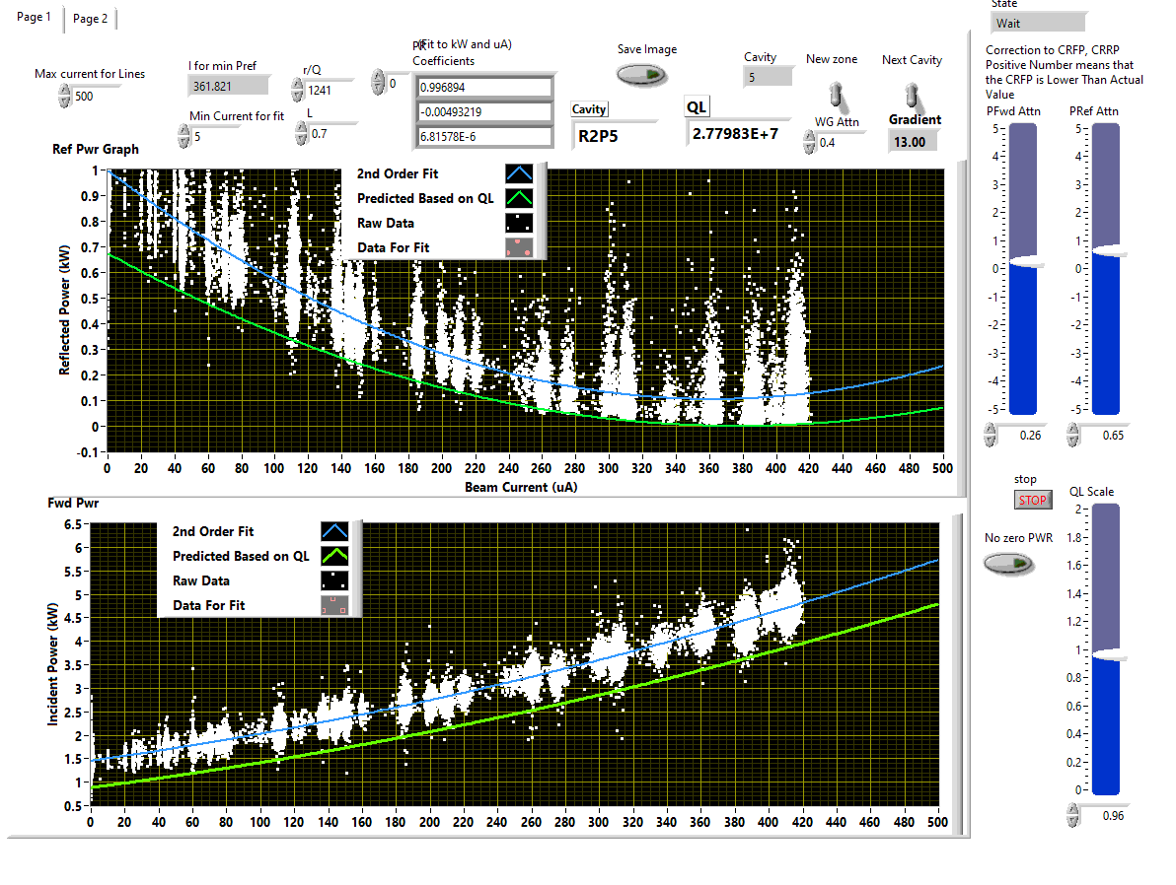
Simulink modeling of the FRT microphonics compensation via the single FPC of CEBAF Cavity (III)
The simulated RF power required for a beam current stepped from 0 to 400 µA with the FRT on, Δf= ‑30 Hz ~ +15 Hz, 4.5 kW RF power at the peak.
The real measured RF power from the JLAB C100 module in operation, where 6 kW of rf power is needed at 400 µA of current.

Slide 17
The 1.5 GHz FRT Development in 2021 (I)
Parameter | No tuner | With FRT
Frequency | 1497 MHz | 1497 MHz
C100 cavity length | 0.7 m | 0.7 m
R/Q | 901.6 Ω | 901.6 Ω
Q₀ | 1×10¹⁰ | 1×10¹⁰
Q_{ext} | 3.2×10⁷ | 3.2×10⁷
Stored energy | 21 J | 21 J
Voltage | 13.5 MV | 13.5 MV
P_{beam} | 5.4 kW | 5.4 kW
Frequency shift | 40 Hz | 40 Hz
Power in tuner | 0 | 2.7 kW
P_{loss} in ferroelectric | 0 | 150 W
P total | 11-12 kW | 6-9 kW

Slide 18
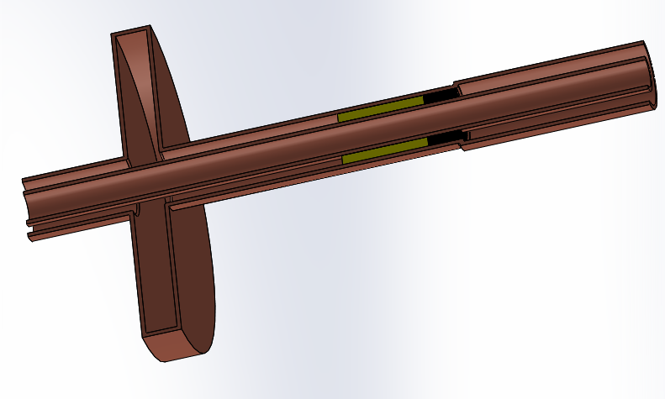
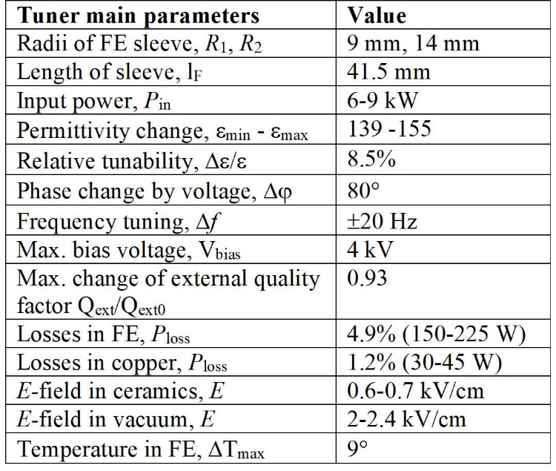
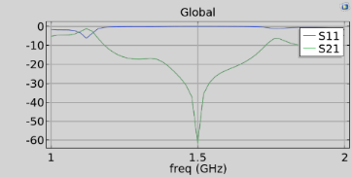
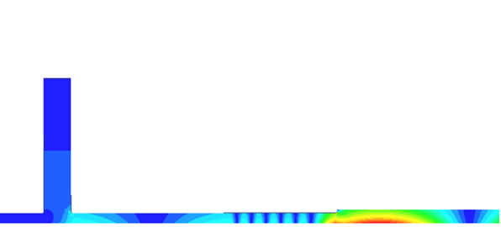
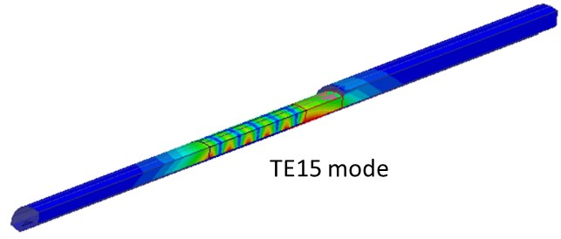
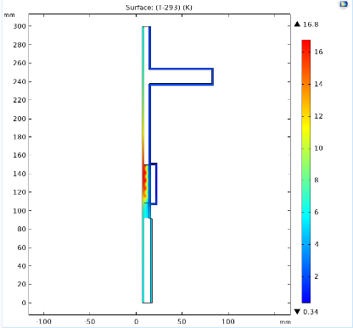
The 1.5 GHz FRT Development in 2021 (II)
HOM analysis
3 kW of CW power causes 17° temperature rise with water cooling outside and cooled air inside.
Euclid has carried out thermal and RF measurements of improved ferroelectric ceramic, completed the tuner RF and thermomechanical design, and is currently finishing the mechanical engineering design for fabrication. HOM analysis is complete too.

Slide 19
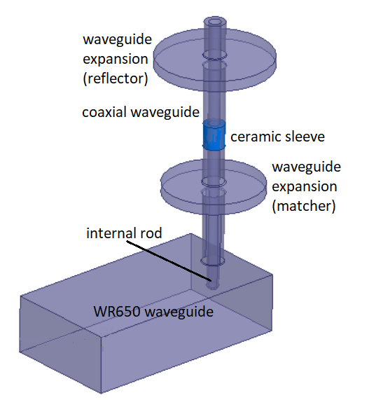
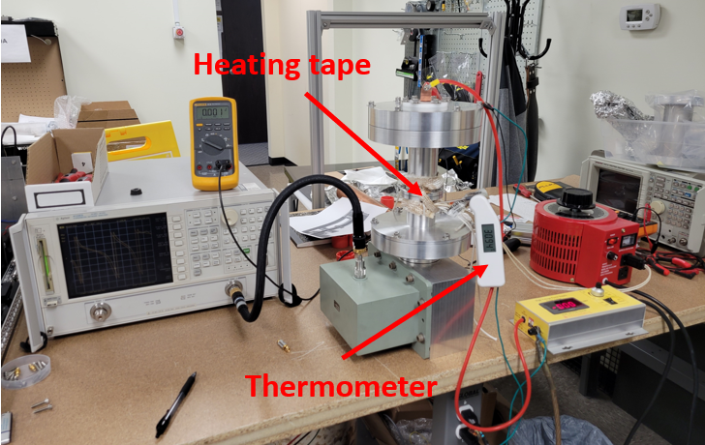
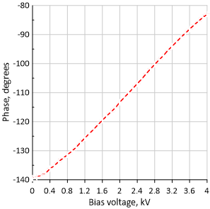
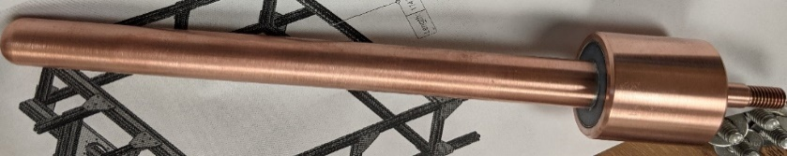
The 1.5 GHz FRT Development in 2021 (III)

Slide 20
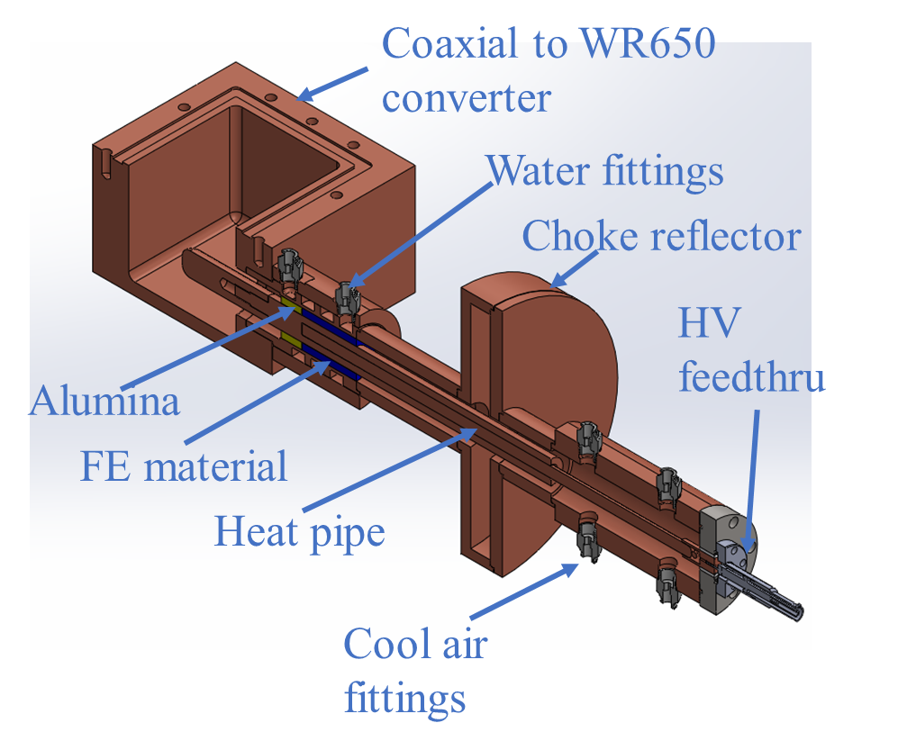
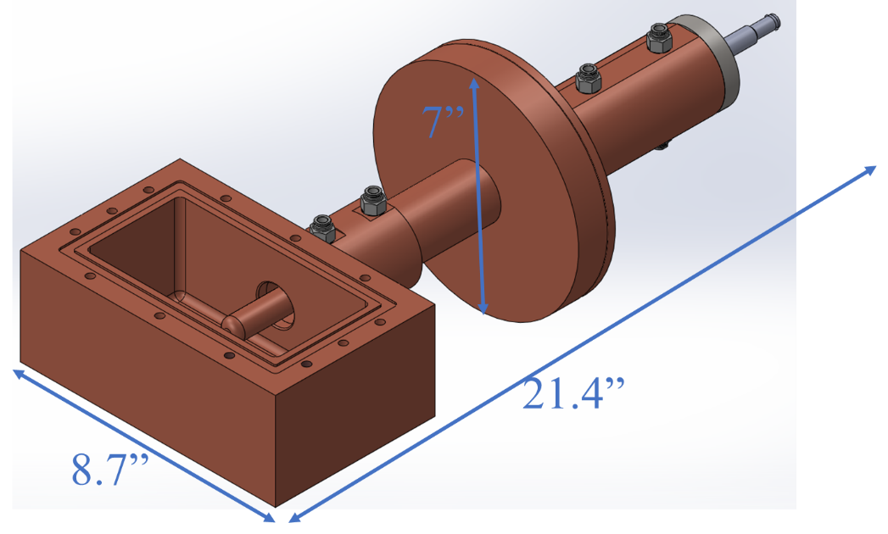
The 1.5 GHz FRT Development in 2021 (IV)

Slide 21
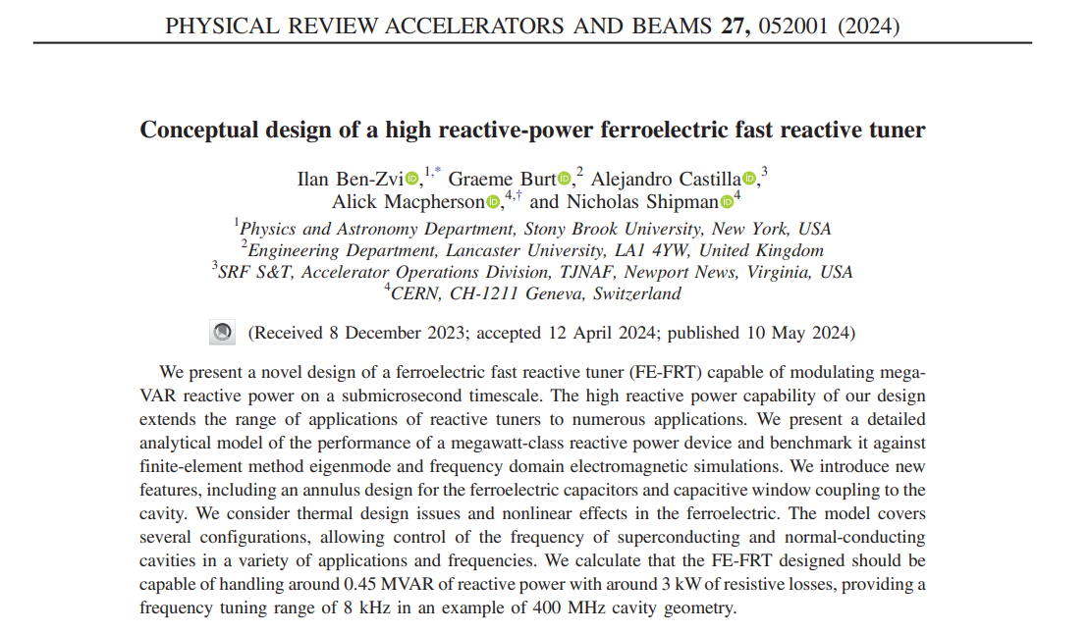
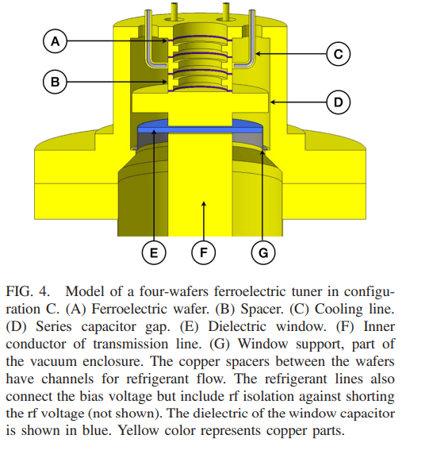
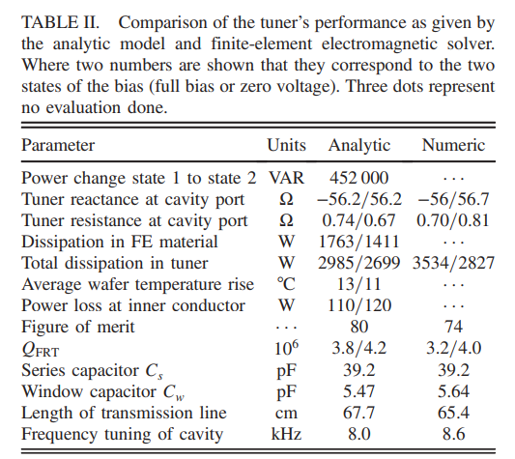
New Research Direction
MVAR level of FRT concept
I. Ben-Zvi, etc, PRAB 27, 052001 (2024)
N. Shipman, et al, CERN

Slide 22
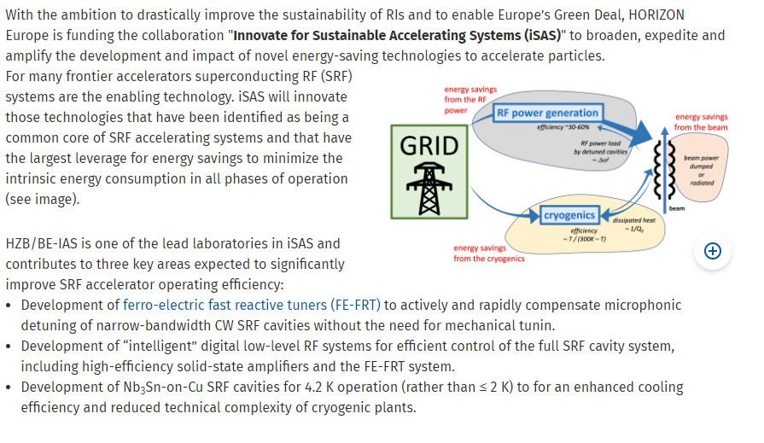
New Research Opportunities

Slide 23
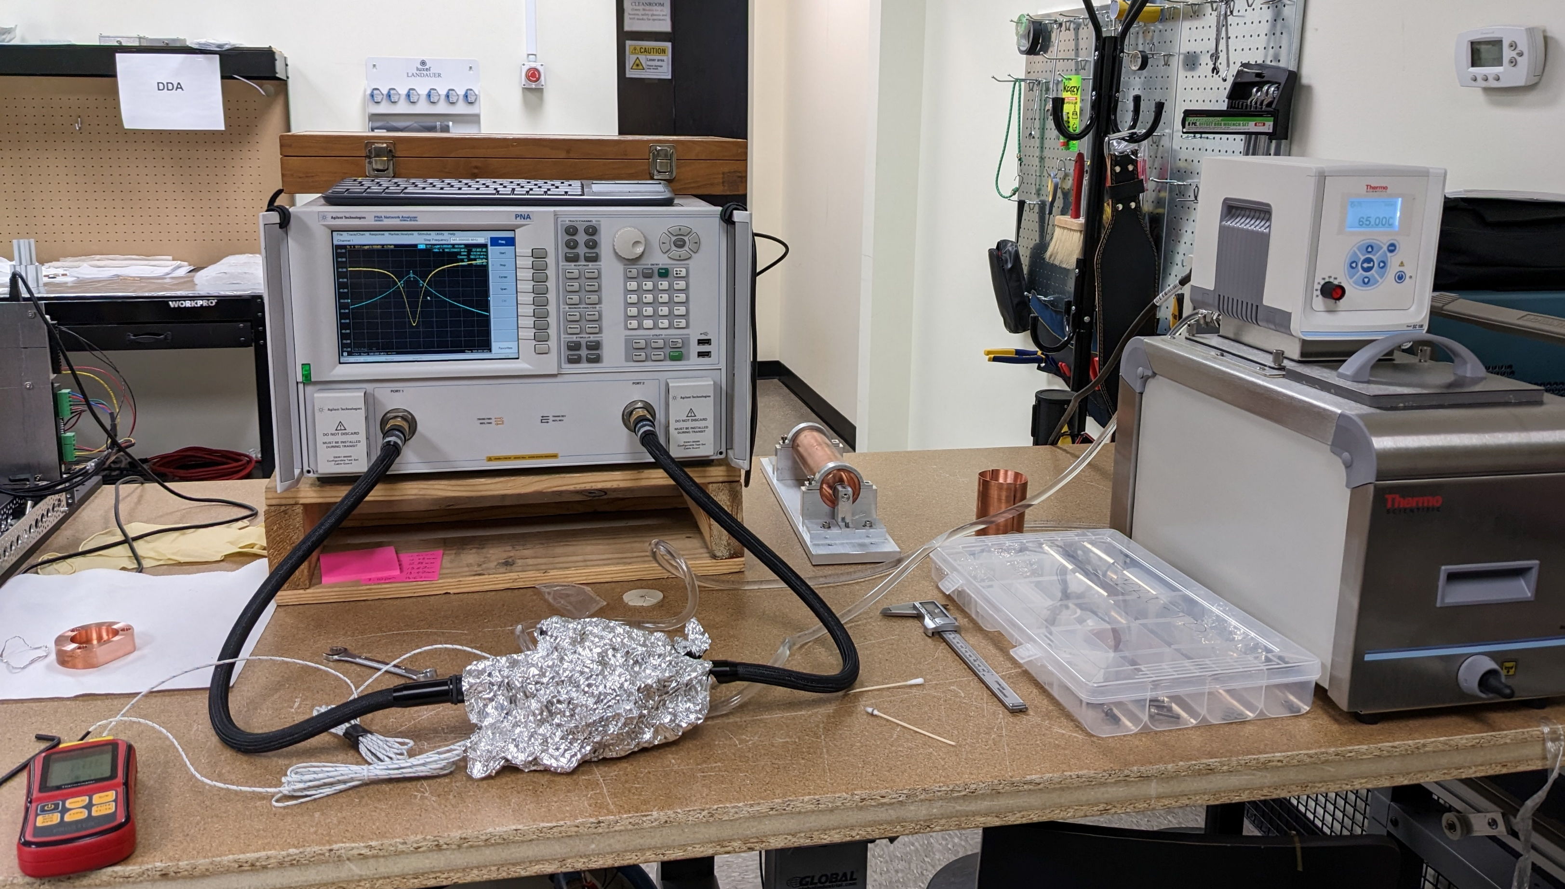


Temp dependence of 40mm disks (2023)
Dielectric constant and tanδ measurements in the temperature range
T=20⁰С-60⁰С at 400 MHz for the BST(M) ferroelectric material: tanδ=1.3×10-3 T=22⁰ С and ~ 17% improvement at T=55⁰С.

Slide 24


Temp and DC bias dependence of FE disks (2024)

Slide 25
Summary
  BST (M) ceramic was developed with dielectric constant ~150, loss factor ~ 5×10⁻⁴ at 400 MHz and tunable ~ 8% at 15 kV/cm at 10-100 ns pulse range
  The fast 400 MHz BST(M) ferroelectric tuner was designed, fabricated and cold tested at Euclid. Validation test at CERN of the 400 MHz tuner with SRF cavity demonstrated successful microphonics compensation at up to 1 kHz frequency range.
  1.5 GHz MT single port tuner configuration is currently under development for the Jlab’s C100 cavity for CEBAF.
  New FRT applications are on the horizon.

Slide 26
Acknowledgements
DOE, Office of Science Nuclear Physics, SBIR Program
Our collaborators
  JLab: R. Rimmer, T. Powers, C. Hovater, T. Plawski
  BNL, I. Ben-Zvi
  CERN: N. Shipman, A. Macpherson, F. Gerigk, E. Jensen,
  Fermilab: V. Yakovlev, S. Kazakov
  HZB: Axel Neumann, Jens Knobloch, N. Shipman

