Slide 1

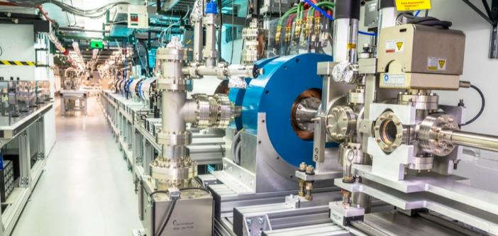
structure wakefield acceleration for Short-pulse RF research at the Argonne Wakefield Accelerator (AWA) facility
JOHN POWER
On behalf of the AWA group
Nov, 2024
https://www.anl.gov/awa

Slide 2
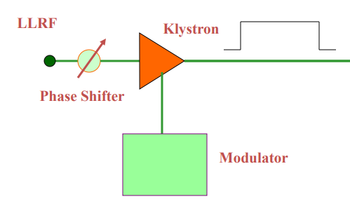
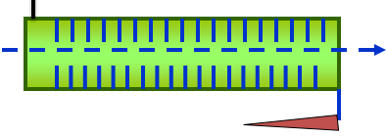
What is Short-pulse RF acceleration?
Conventional acceleration: Accelerating structure powered by an RF klystron. Pulse length: 100 ns < t_{rf} < 10 us
Advanced acceleration: Accelerating structure powered by a beam-driven SWFA. Pulse length: t_{rf} < 10 ns
Conventional acceleration
Structure Wakefield Acceleration (SWFA)
1000 ns
10 ns
Why?
Higher acceleration gradients to lead to compact accelerators
10 MW
1000 MW
Accelerator Structure
Accelerator Structure
main beam
RF Klystron Driven Structure
drive beam
Power Extraction and Transfer Structure (PETS) driven structure

Slide 3
outline
Argonne Wakefield Accelerator (AWA) Facility
Structure Wakefield Acceleration
Short-Pulse RF High Gradient Accelerators

Slide 4
Structure wakefield acceleration at The
Argonne wakefield accelerator
facility

Slide 5
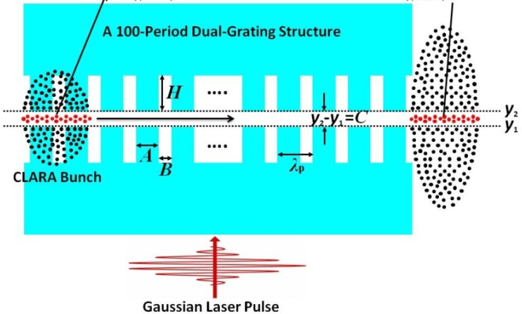
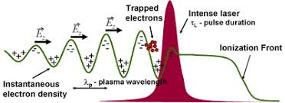

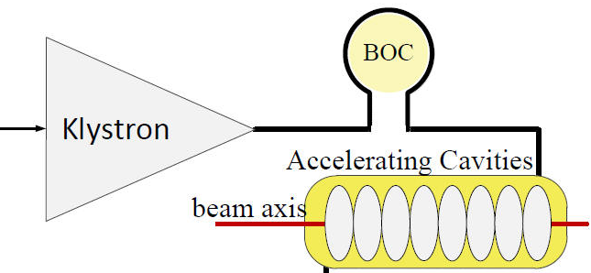
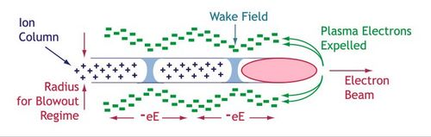
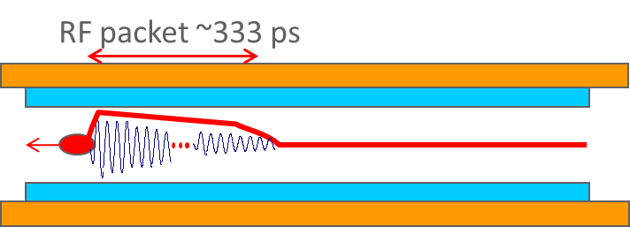
What are the Advanced acceleration concepts (AAC) in the U.S.?
AAC ~ Wakefield Acceleration: Laser Wakefield Acceleration, Plasma Wakefield Acceleration, and Structure Wakefield Acceleration (SWFA).
Beam Test Facilities: Demonstrating the viability of emerging accelerator science ultimately relies on experimental validation.
LWFA
(Laser WF Accelerator)
DLA
(Dielectric Laser Accelerator)
AWA
Laser pulse
Energy Source
PWFA
(Plasma WF Accelerator)
SWFA
(Structure WF Accelerator)
RF Driven Structure
Particle beam
Plasma
Structure
Medium

Slide 6


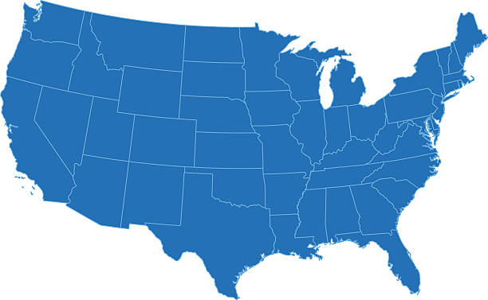


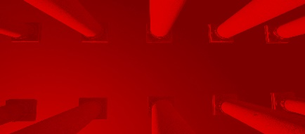






WHERE is the AAC program in the U.S.?
AAC ~ Wakefield Acceleration: Laser Wakefield Acceleration, Plasma Wakefield Acceleration, and Structure Wakefield Acceleration (SWFA).
Beam Test Facilities: Demonstrating the viability of emerging accelerator science ultimately relies on experimental validation.
FAST/IOTA
Particle Beam
FACET-II
AWA
BELLA
ELL
ATF
UT³
Laser Beam
U.S. advanced and novel accelerator beam test facilities
[C. Clarke et al 2022 JINST 17 T05009, https://iopscience.iop.org/article/10.1088/1748-0221/17/05/T05009 ]
National Laboratories
Universities

Slide 7
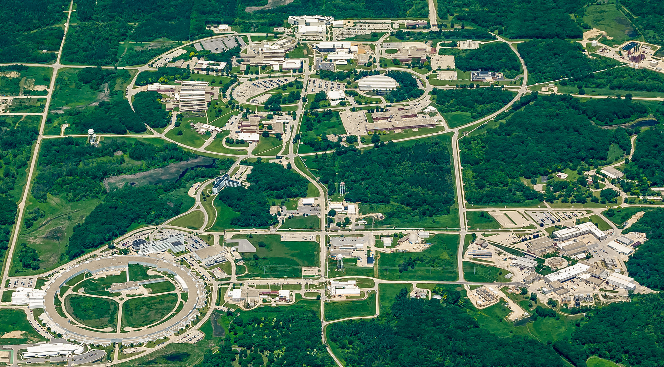
Argonne wakefield accelerator (AWA)
Argonne Campus: 15 minutes west of Chicago
ATLAS: NP national user facility
200 AREA
400 AREA
300 AREA
APS: BES national user facility
AWA: HEP test facility
Notes:
Accelerators at Argonne

Slide 8
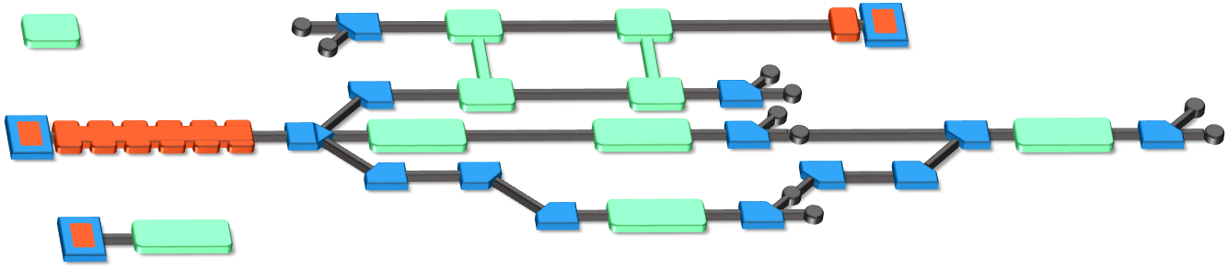
The Argonne Wakefield Accelerator (AWA) Facility
https://www.anl.gov/awa
A Beam Test Facility to enable the development of novel acceleration technology
Witness RF photoinjector (15 MeV)
Provides two-beam capability
Bright beams for low-energy experiments
Drive RF Photoinjector (65 MeV)
  single bunch: 100nC
  bunch train: 600 nC
Experimental Switchyard
Highly reconfigurable
6D phase space manipulation
Argonne Cathode Test Stand (2-4 MeV)
Cathode research and diagnostics
Physics of high-gradient breakdown
Laser
100 mJ (IR), 10 mJ (UV),
300 fs – 6 ps (UV)
temporal shaping
8/30

Slide 9
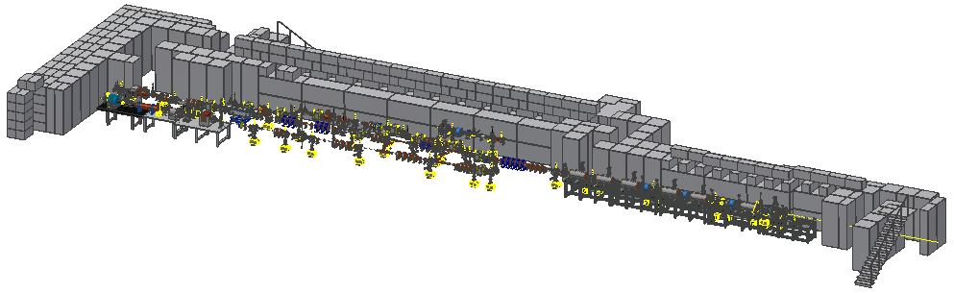
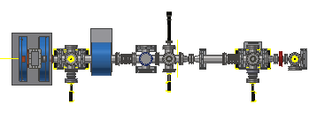

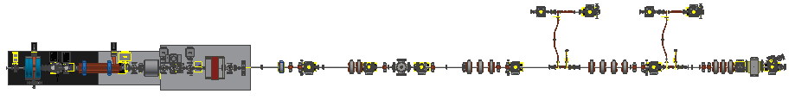
The Argonne Wakefield accelerator
5 Zones
The AWA Facility
Zones 2-5 are experimental areas
Zones 2, 4, and 5 have ~ 1 m experimental area
Zones 3A & 3B are fully re-configurable
AWA Bunker
https://www.anl.gov/awa
EXPERIMENTAL AREA
ACT
Drive
AWA Vacuum and Experimental Zones
Witness

Slide 10
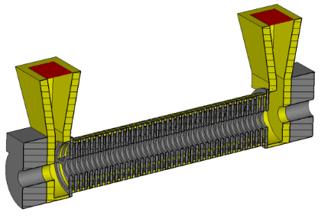
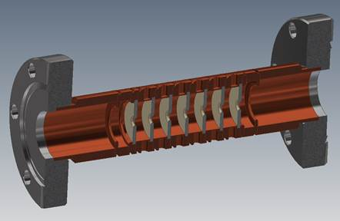
Developing Next-Generation Accelerator technology at the AWA
enabling
GV/m STRUCTURE WAKEFIELD acceleration
to produce
bright GeV-class electron beams
at the
Argonne Wakefield accelerator
BASIC RESEARCH
3 THEMES (next slide)
DEVELOPING APPLICATIONS
    NEAR-TERM (e.g. UED)
    MID-TERM (e.g. Compact XFEL)
    LONG-TERM (e.g. linear collider)

Slide 11

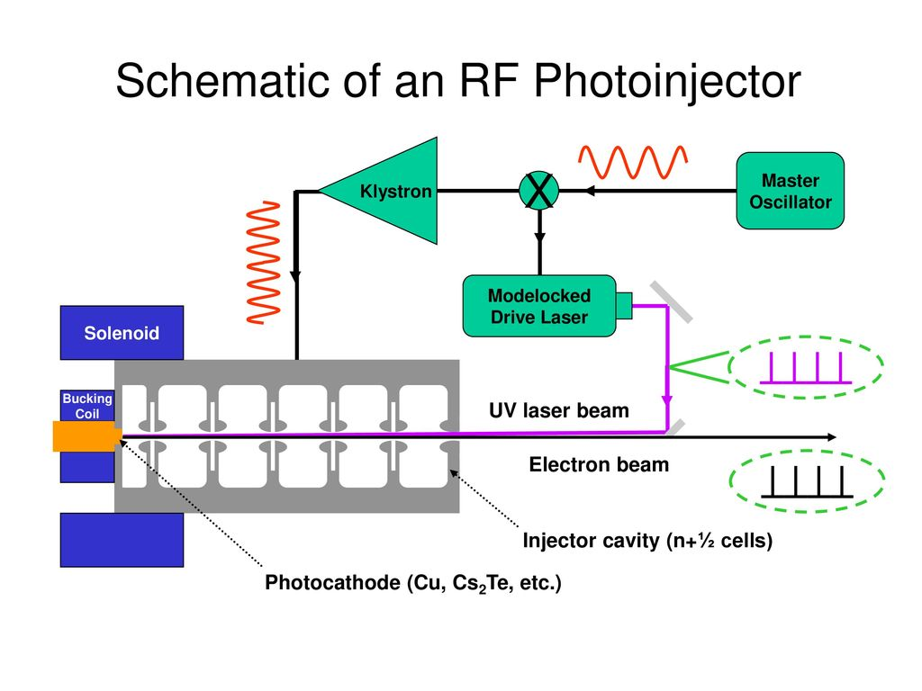
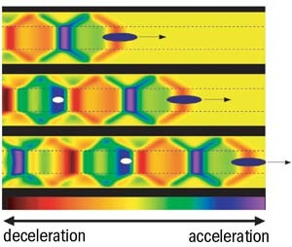
AWA facility: 3 Research themes
research themes
Applications
Beam Production
Beam Manipulation
Advanced Accelerator
e.g. SWFA
Long-term
Multi-TeV e+e- linear collider
      Higg’s Factory
    Mid-term
1 GeV Water-window FEL
5 GeV XFEL light sources
Inverse Compton sources
Near-term
*Compact accelerators for societal applications
Industrial
Security
Medical
e.g. RF Photoinjector
e.g. Double Emittance Exchange
Beam shaping & control.
Beam Diagnostics.
Electron sources
  High-brightness
  High-intensity
SWFA & PWFA
  High-Gradient
  High-Efficiency
11

Slide 12

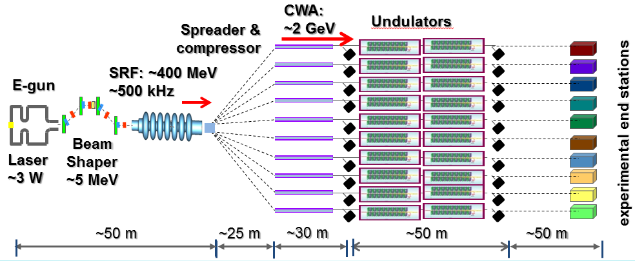
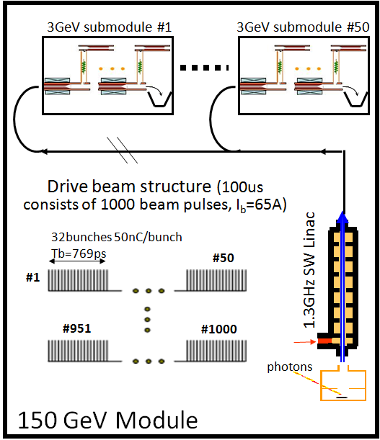
e-beam Driven Structure Wakefield Acceleration (SFWA)
Collinear Wakefield Acceleration
(CWA)
Two Beam Acceleration (TBA)
Klystron-like
PWFA-like
main beam
MB
main beam
Accelerator
drive beam
Power Extraction and Transfer Structure (PETS)
DB
drive beam
SWFA XFEL
SWFA 3 TeV linear collider
e⁻
e⁺
IP
3TeV
1
10
10
1
A. Zholents, et al, NIMA 829, 190-193 (2016)​
A. Zholents, et al, Proceedings of IPAC2018​
CLIC CDR​: https://project-clic-cdr.web.cern.ch/CDR_Volume1.pdf​
W. Gai, C. Jing, J.G. Power, JPP 78, 339-345 (2012)​

Slide 13
Two Beam Acceleration
Accelerator
main beam
drive beam
Power Extraction and Transfer Structure (PETS)
High Gradient Operation
13/30

Slide 14
Limits to high gradient operation
Structure (most studied):
X-band, NCRF, 100ns<pulse length<1000 ns, OFE Copper BDR = 1e−6 m⁻¹
RF Breakdown guidelines
E_{surf} < 250 MV/m,
Pulse heating: ΔT < 50 ⁰C,
Power: abs(Sc) < 5 MW/mm²
Stored Energy: U < 1 J
Simakov, Dolgashev, Tantawi, “Advances in high gradient normal conducting accelerator structures, NIMA, Volume 907, 2018, https://doi.org/10.1016/j.nima.2018.02.085
RF Breakdown ← main problem
Field emission/dark current (unwanted beam loading and ionizing radiation can blind beam diagnostics, etc.)
Excessive conditioning time
14/30

Slide 15
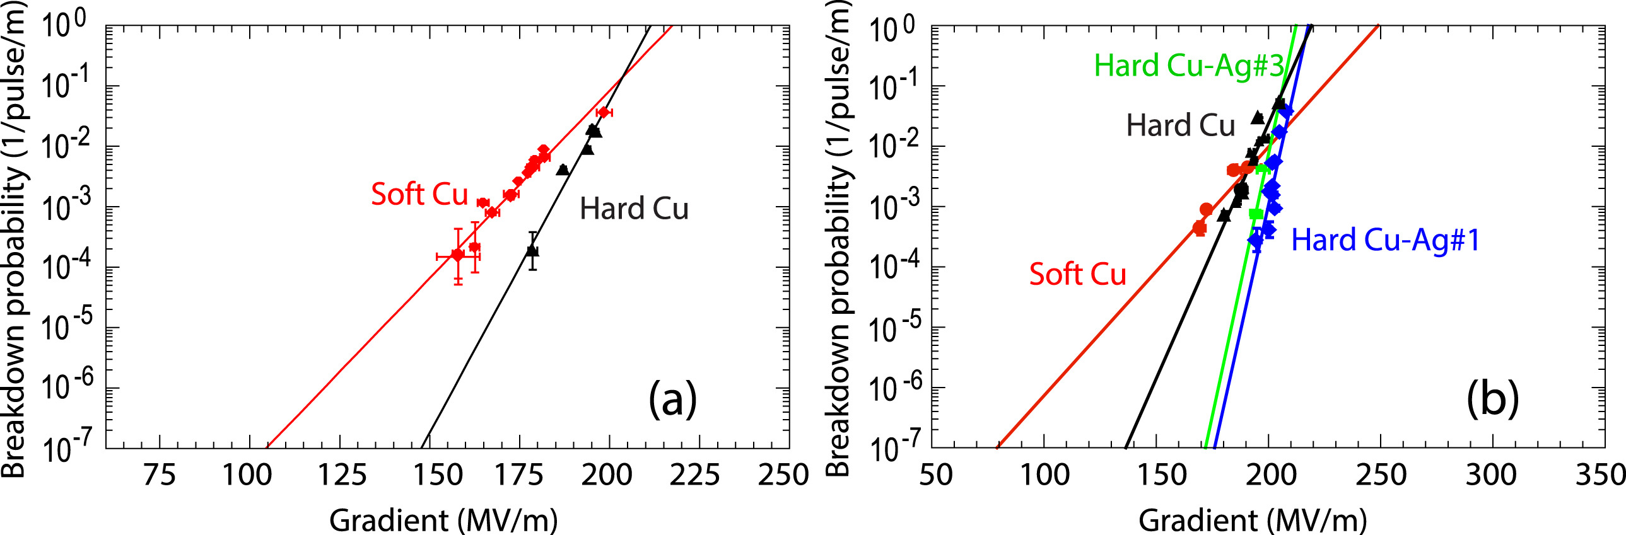
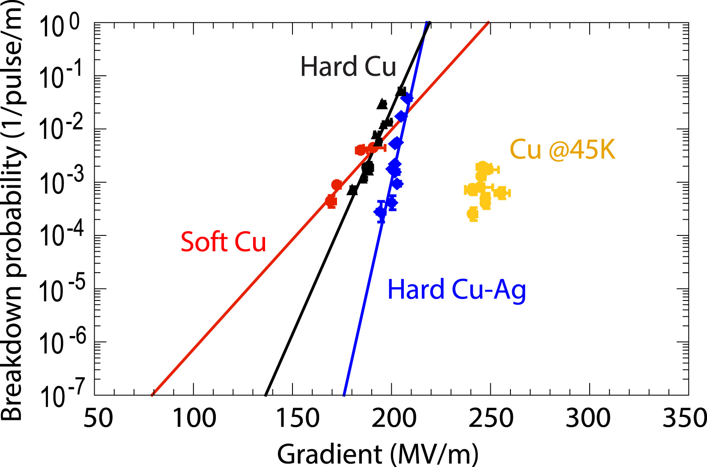
3 promising paths to higher gradients
1
Material: Hard bi-metallic alloy (SLAC: Cu:Ag 0.8% Ag)
2
Temperature: cryogenic temp (SLAC/UCLA/LANL: cold copper)
3
Short RF pulse
(ANL/Tsinghua/PSI)
15/30
Notes:
Not exhaustive list …

Slide 16
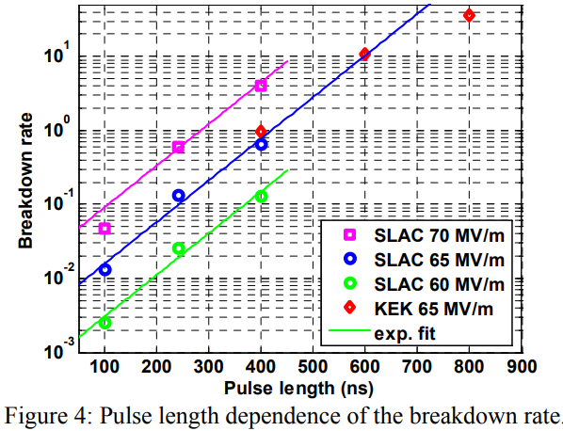
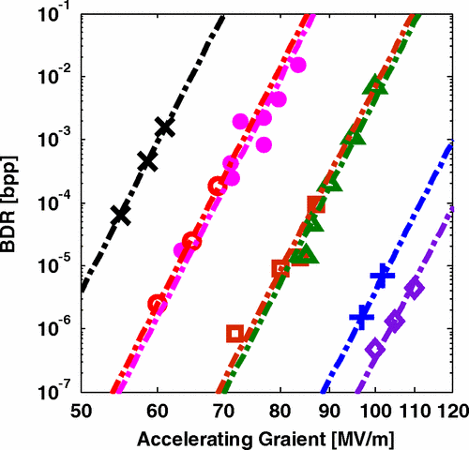
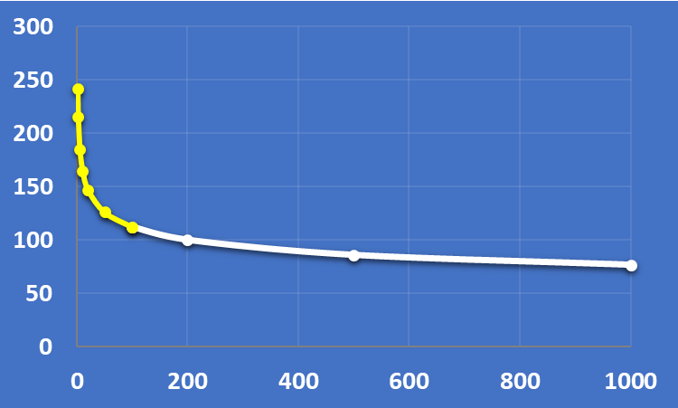
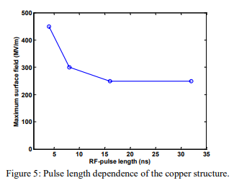


The Short Pulse RF Advantage
3
$$BDR∝E^{30}τ^{5}$$
S. Doebert et al.,PAC’05
https://accelconf.web.cern.ch/p05/PAPERS/ROAC004.PDF
A. Grudiev, S. Calatroni, and W. Wuensch
Phys. Rev. ST Accel. Beams 12,102001 (2009)
3e−7/m, 100 MV/m, 200ns
Scaling Law
0.1 μs
1 μs
long pulse regime
$$E (\frac{MV}{m})$$
RF Pulse length (ns)
Short pulse < 100 nsec
PSI: 90 nsec TW gun
Tsinghua: Short ~50 nsec
AWA/Euclid/NIU: Ultrashort ~10 nsec
klystron
CLIC 2003
TBA
New physics? Empirical scaling law, underlying mechanism may change
Challenges: Challenges to operate in the short-pulse regime: broadband couplers, efficiency, stability, etc.
H. H. Braun, et al., “High-power testing of 30 GHz accelerating Structures at CTF II”, CLIC Note 475
W. Wuensch, et al., “A demonstration of high-gradient acceleration”, PAC’03
16/30

Slide 17
RF power generation: PETS*
*this could also be klystron driven but needs to be short-pulse.
Two Beam Acceleration
Accelerator
main beam
drive beam
Power Extraction and Transfer Structure (PETS)
17/30

Slide 18
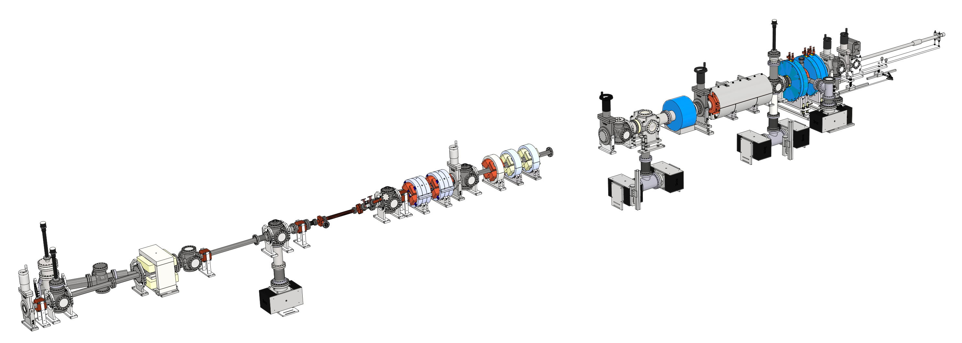
short pulse rf generation at the awa
TBA drive beam PETS
ZONE1
(Drive RF photoinjector)
Drive bunch train
-5 GW beam power
-100A, 6 nsec
……..
ZONE3a
(PETS)
…
magnets & diagnostics
1.3 GHz Drive gun (Cs₂Te photocathode)
  High charge bunch train (up to 600 nC)
  Final beam energy: ~65 MeV
…
Short RF pulse
(2 Hz)
Harmonics of 1.3 GHz
7.8 GHz
11.7 GHz
26 GHz
91 GHz
182 GHz
18/30
Notes:
X-band test has become a general capability of AWA (work underway for 26 GHz to THz)

Slide 19
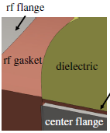
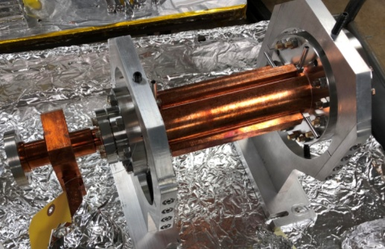
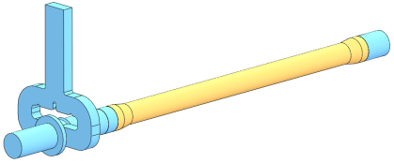

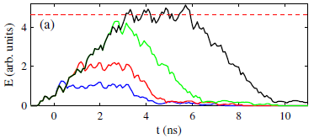
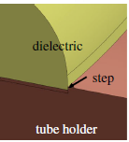
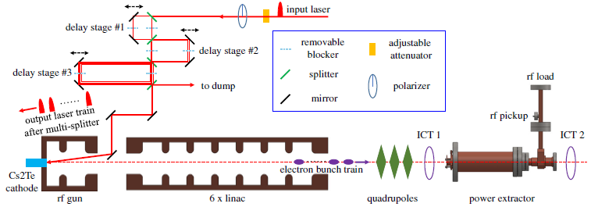
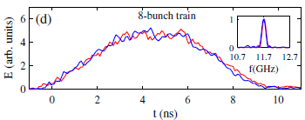
Producing Short pulse rf power (I)
---towards 1 GW by Dielectric X-band PETS
Physics design
Mechanical design
Fabrication
Dielectric X-band PETS (200 MW)
J. Shao, et al, PRAB 23, 011301 (2020)

Slide 20

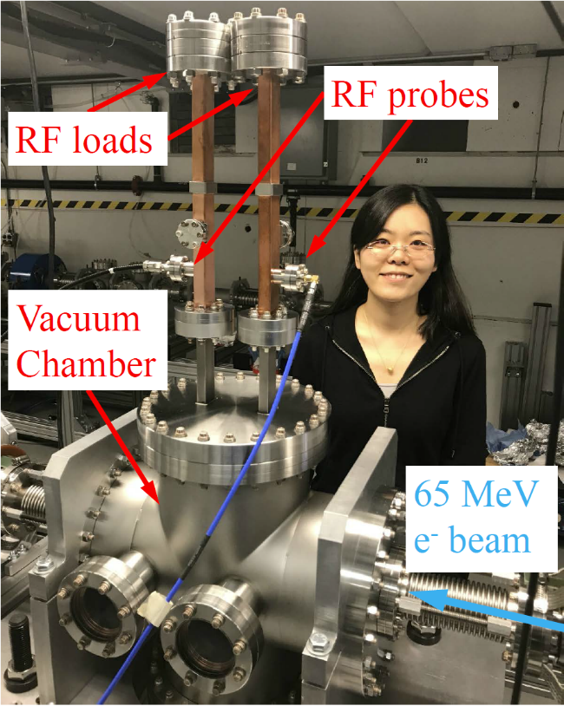
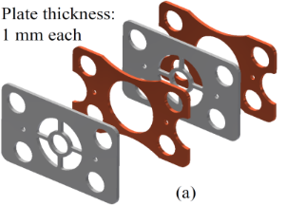
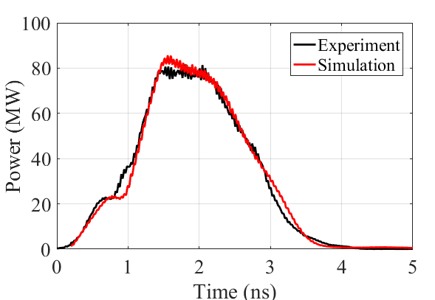
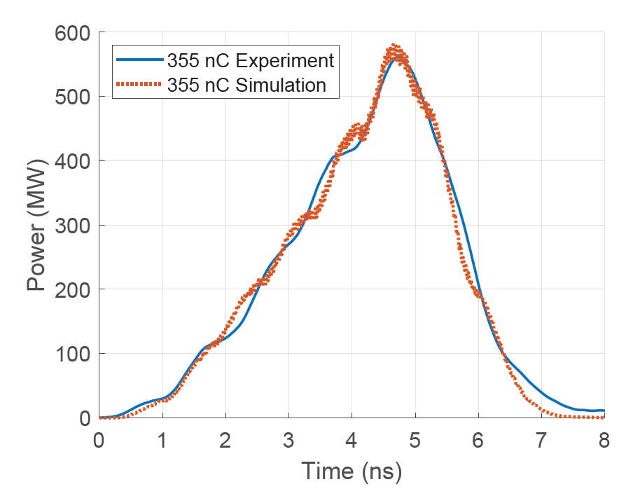
Producing Short pulse rf power (II)
---towards 1 GW by Metamaterial PETS
Forward Port
Backward Port
Beam
80 MW → 380 MW → 565MW
X. Lu, et al, PRL 122, 014801 (2019)
J. Picard et al., PRAB 25, 051301 (2022)
X. Lu, et al, APL Appl. Phys. Lett. 116, 264102 (2020)

Slide 21

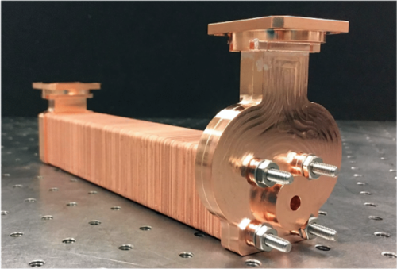
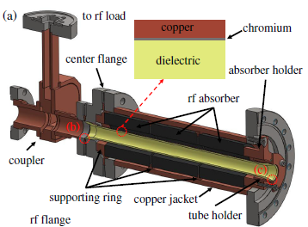
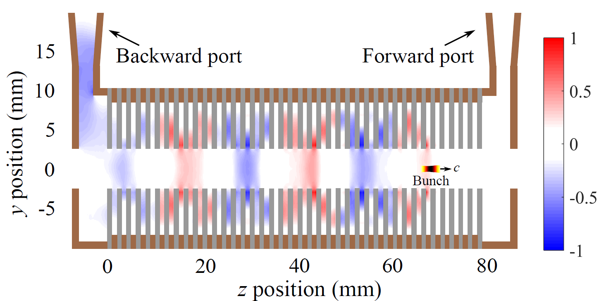
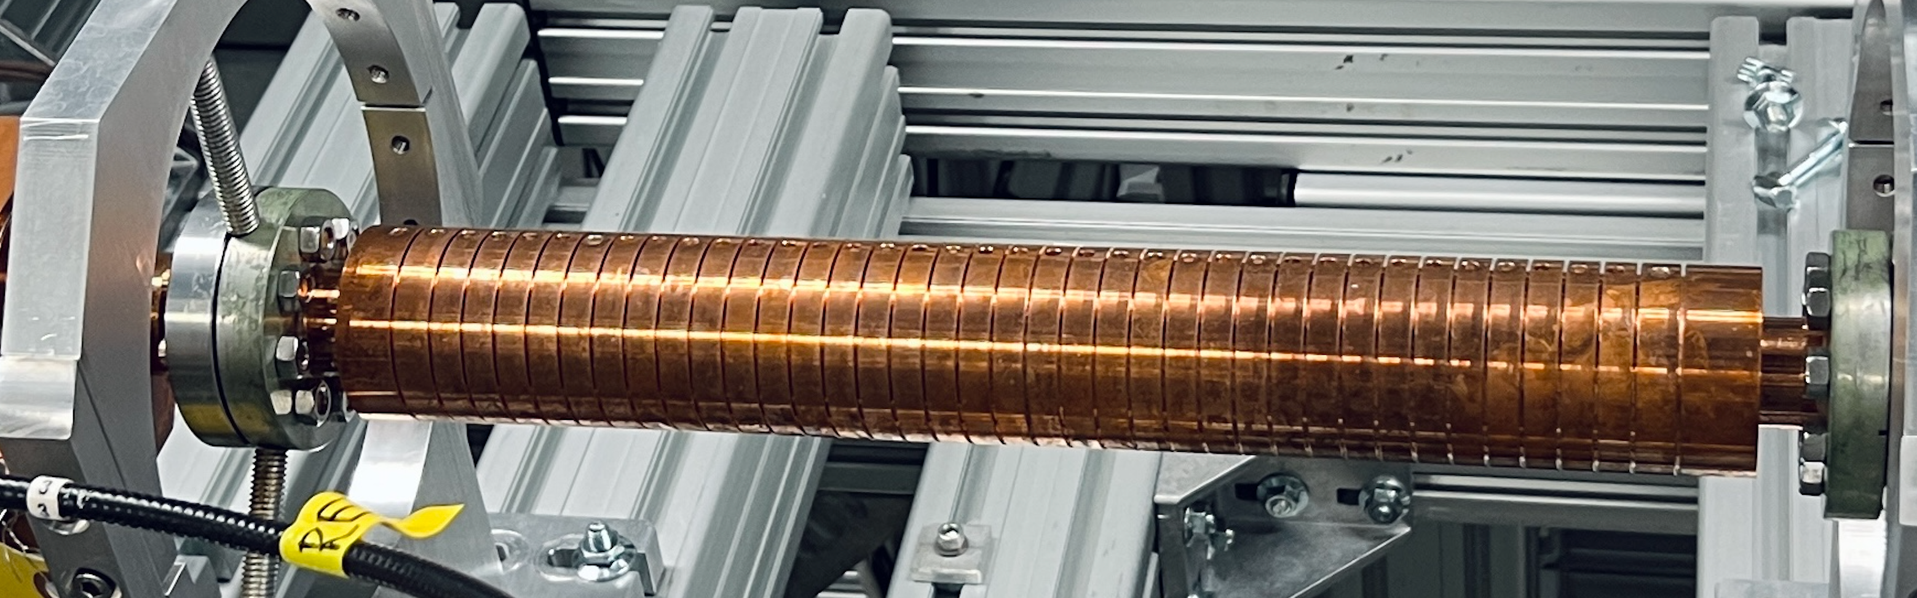
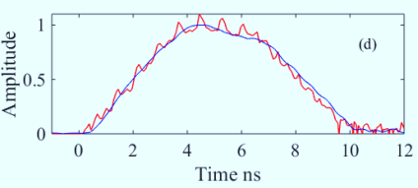
PETS results at AWA (summary)
MTM X-band PETS (565 MW)
Dielectric X-band PETS (200 MW)
DOI: 10.1103/PhysRevAccelBeams.23.011301
  Highest peak power as 565 MW from a train of eight bunches with a total charge of 355 nC
J. Picard et al., PRAB 25, 051301 (2022)
1000 MW
900 MW
800 MW
700 MW
600 MW
500 MW
400 MW
300 MW
200 MW
100 MW
0 MW
AWA energy upgrade
15 MeV → 65 MeV
X-band MTM (2021)
Metallic X-band PETS (400 MW)
X-band metallic (2020)
X-band MTM (2019)
C-band
dielectric
(2008)
X-band metallic (2018)
C-band
dielectric
(2000)
X-band dielectric (2018)
K-band dielectric (2010)
J. Shao et. al., https://accelconf.web.cern.ch/ipac2019/papers/MOPRB069.pdf
21/30
2000 2005 2010 2015 2020 2025

Slide 22
TBA: high-gradient structures: accelerator
Two Beam Acceleration
Accelerator
main beam
drive beam
Power Extraction and Transfer Structure (PETS)
22/30

Slide 23
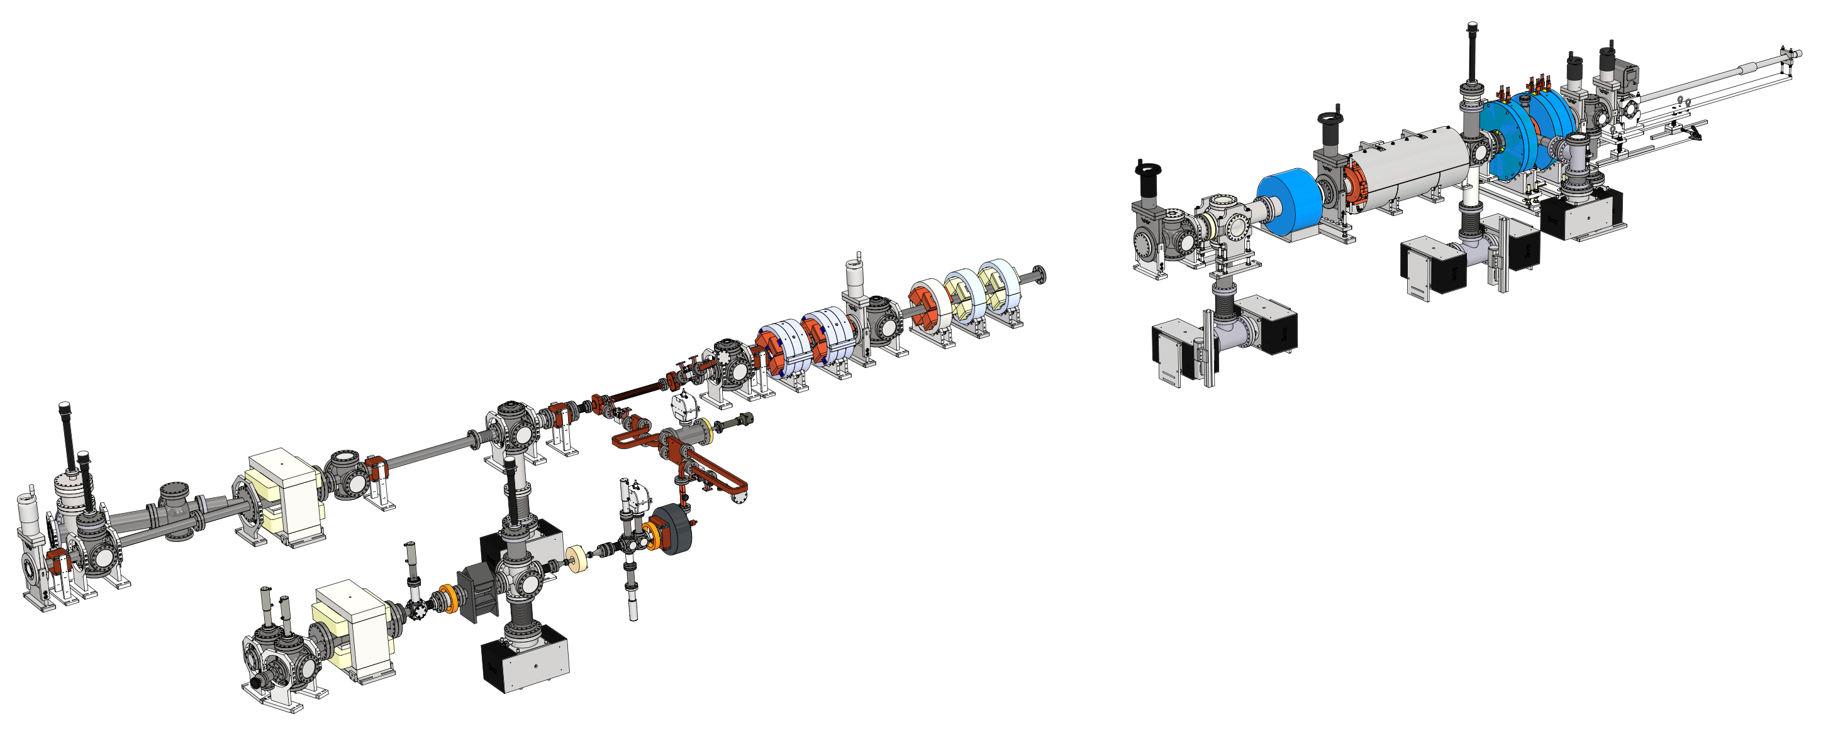
High gradient structure test stand
…
ZONE3a
(PETS)
ZONE1
(Drive RF photoinjector)
Beam on YAG1
…
Example:
X-band gun beamline
high gradient test stand
23/30

Slide 24


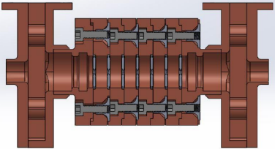
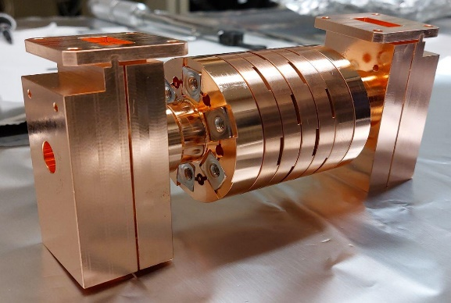
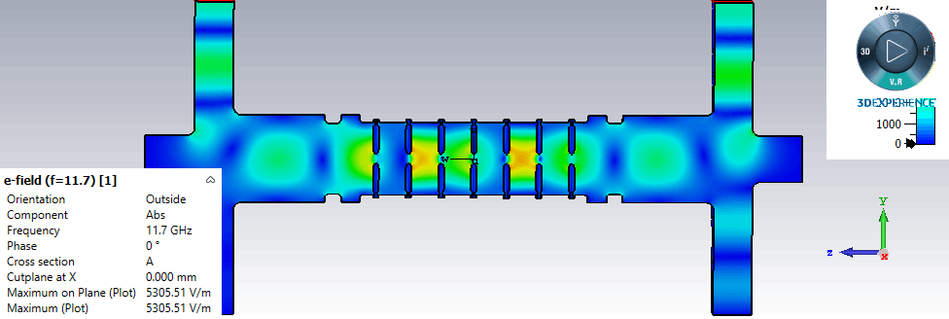
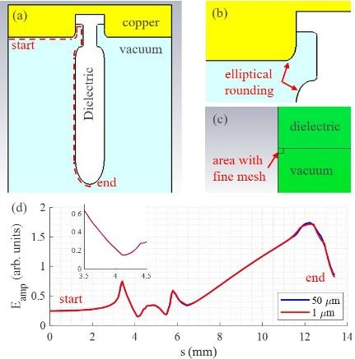
~100 MV/m Dielectric Disk Accelerator
Previous: 100 MV/m single cell DDA
Next: Multicell DDA
Clamped structure, like single cell.
Special attention to triple junction design
High-power test results
AWA drive gun limited run to 293 nC
PETS = 222 MW
Gradient ~78 MV/m (no arcing, no multipactor)
24/30

Slide 25
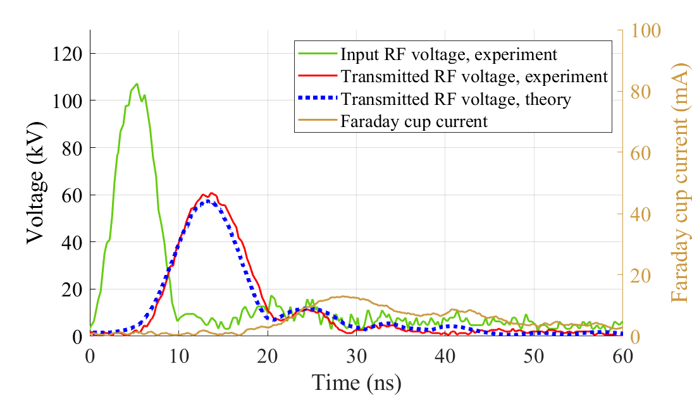

~200 MV/m Metamaterial Accelerator
Efficient structure design to explore gradient limitation
  190 MV/m peak gradient from 115 MW input RF
  11.7 GHz structure optimized for 6 ns FWHM RF pulses extracted from the drive beam
  Breakdown Insensitive Accelerating Regime (BIAR)
D. Merenich, X. Lu et al., Phys. Rev. Accel. Beams 27, 041301 (2024)
https://journals.aps.org/prab/abstract/10.1103/PhysRevAccelBeams.27.041301

Slide 26



~300 MV/m Iris loaded accelerator
11.7 GHz structure
Breakdown Insensitive Acceleration Regime
300 MV/m gradient
Drive beam
PETS
RF
400 MW RF power generated from PETS with 450 nC drive beam
300 MV/m gradient in the middle cell, 500 MV/m peak surface field

Slide 27






~400 MV/m X-band photogun
Sub-GV/m acceleration for bright beam
  388 MV/m on the photocathode
  BDR ~4e-6 (estimated)
  Ultra low dark current (<1pC per RF pulse)
Gun performance →
400 MV/m on cathode
Xgun →
G. Chen et al., (AAC 2024)
Submitted to NIMA (2024)
First photoelectron beam
W.H.Tan et. al., PRAB 2022
Phys. Rev. Accel. Beams 25, 083402, August 2022 (2022)

Slide 28










~700 MV/m beam-driven THz wakefield structure (planned)
Planned Demo Beamline
COLLABORATION
KU-PAL-NIU-ANL
- Total : 10 m
>1 GW THz power
<1 GV/m gradient
EUV/IR generation
THz PET (~4GW)
~1 m
Gun
Linac (~40 MeV)
QMs
THz Power Extraction Tube
Power Transfer
Drive beam source
(20 nC, 40 MeV)
Undulator
6~7 m
THz Gun
THz Accelerating Tube
~2 m
THz Acc (700 MV/m)
~1 m
First beam test
Korea Univ. Sejong: S.-H. Park, J. Ko, B.-H. Oh, H. Shim, M. K. Seo, K.-H. Kim
Norther Illinois Univ. : G. Ha
Argonne National Lab: J. Power, G. Chen, E. Wisniewski, S. Doran, W. Liu
Pohang Accelerator Lab. : J. H. Kim, H. Kong, H. J. Kwak, J. Kim, S.-H. Kim
Korea-4GSR, KBSI : S.H. Shin

Slide 29






HIGH GRADIENT ACCELERATING STRUCTURES
400 MV/m
350 MV/m
300 MV/m
250 MV/m
200 MV/m
150 MV/m
100 MV/m
50 MV/m
0 MV/m
X-band PC Gun (2021)
AWA energy upgrade
15 MeV → 65 MeV
X-band metallic (2021)
1.5 cell X-band Photocathode Gun
X-band MTM (2023)
C-band TBA
DLA (2008)
W-band CWA metallic (2015)
X-band metallic (2018)
X-band TBA DDA (2022)
C-band TBA
DLA (2000)
C-band CWA
PBG (2009)
K-band TBA DLA (2018)
Metamaterial Accelerator
2000 2005 2010 2015 2020 2025
Single-cell Disk Loaded Waveguide
Dielectric Loaded Accelerator (DLA)
Single-cell Dielectric
Disk Accelerator (DDA)
3-cell Disk Loaded Waveguide
29/30

Slide 30
Summary → SWFA: SHORT-PULSE REGIME
ONGOING
  Power Extraction and Transfer Structure (PETS)
  X-band RF test stand (500 MW, 2 Hz)
  200 MW dielectric PETS
  400 MW metallic PETS
  565 MW metamaterial PETS
  Accelerator
  High-gradient structures
  100 MV/m X-band dielectric disk accelerator
  200 MV/m X-band MTM accelerator
  300 MV/m X-band metallic accelerator
  400 MV/m X-band photocathode gun
    Discovery of BIAR regime
Structure Wakefield Acceleration
Accelerator
Power Extraction and Transfer Structure (PETS)
30/30

Slide 31





Summary → SWFA: SHORT-PULSE REGIME
NEXT STEPS
Near term Demonstrators
10 MeV Upgrade Xgun and Xlinac
100 MeV high-brightness Xgun photoinjector beamline
Upgrade AWA drive beam energy from 65 MeV to ~130 MeV
500 MeV demonstrator
Mid to Long Applications
1 GeV water window FEL
5 GeV XFEL
Multi-TeV linear collider
30/30

Slide 32
extras

Slide 33
applications
XFEL (X-ray Free electron laser)
  Coherent 42 keV X-rays ala MaRIE (e Matter-Radiation Interactions in Extremes” style)
  Using high energy (12 GeV) TBA X- & K-band linac
ICS (Inverse Compton Scattering)
  Incoherent X-rays (10’s of keV photon bursts for material studies)
  Using medium energy (30 MeV) TBA X-band linac
UED (Ultrafast Electron Diffraction)
  Pump-probe methos yields information on the dynamical changes of the structure of materials
  Using low energy (few MeV) TBA X-band gun

Slide 34

XFEL in biar?
Advantages:
Short pulses
Drive beam can generate RF at multiple frequencies
Automatically sync’ed
Challenges:
Still in research phase
Kickers
Waveguides
TBA---9GeV Compact FEL in BIAR regime
Fast filled accelerator
Yuliang Jiang, et al, PRAB 24, 112002 (2021)

Slide 35
WHY AAC? … Why SWFA?
SWFA 3 TeV linear collider
e⁻
e⁺
AAC Roadmap: PWFA, LWFA, SWFA
IP
AAC technology is versatile
Long-term
  1-10 TeV e+e- linear collider
  Higg’s Factory
Mid-term
  XFEL light sources
  Inverse Compton sources
Near-term
  Compact accelerators for societal applications or Stewardship (E.g. Industrial, Security, Medical applications.)
3TeV
SWFA XFEL
1
10
10
1
SWFA
  Positron acceleration
  Takes advantage of much existing technology from today’s accelerators
  Recent progress (few MV/m → 300 MV/m at X-band, exploring GV/m …)

Slide 36





Structure Wakefield Acceleration (SFWA)
Collinear Wakefield Acceleration
Main focus:
High Transformer Ratio
THz structure
Main challenges:
Temporal shaped high charge bunch
Beam Break up instability
Precise structure fabrication
Accelerator Module
0.22 m
0.5 m
corrugated metallic waveguide

Slide 37





Electron beam-driven structure wakefield acceleration (SWFA)
Two Beam Acceleration (TBA)
Main focus:
High charge bunch trains
GHz structure
Main challenges:
Broadband RF couplers
Breakdown & efficiency
Cost of maintaining two beamlines
main beam
Accelerator
Power Extraction and Transfer Structure (PETS)
drive beam
PETS
CLIC
AWA
Quartz tube
main beam
drive beam
Sicking, E., Ström, R. From precision physics to the energy frontier with the Compact Linear Collider. Nat. Phys. 16, 386–392 (2020).
https://doi.org/10.1038/s41567-020-0834-8

